Slide 1
WP12 Closing Remarks
Peter.mcintosh@stfc.ac.uk
Nicoleta.baboi@desy.de
Juliette.plouin@cea.fr
8 - 9th April 2015
WP12 2nd Annual Review Meeting, DESY

Slide 2
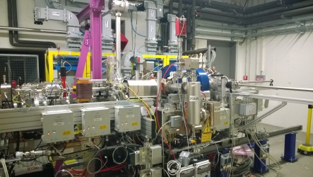
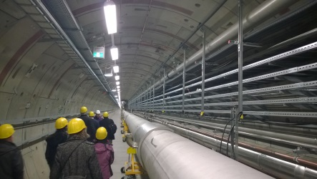
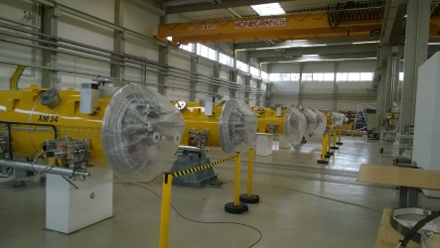
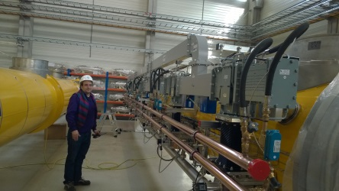
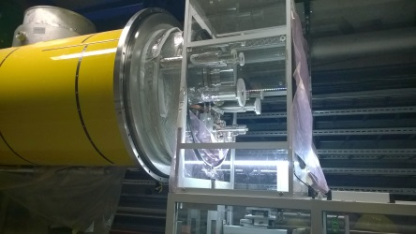

Many thanks to our DESY hosts for the excellent hospitality!
  Nicoleta, Ruth and Reinhard particularly.
  Plus all of the DESY tour guides – it’s really impressive to see the progress being made for XFEL!
Many thanks to all Task Leaders and Speakers for a series of really impressive talks!
Really enjoyed this second review
and the fact we are already
generating significant results!

Slide 3
Impressive Progress!
Task 12.2 SRF Thin Films
  First Nb3Sn samples generated at CERN, refined deposition procedure being developed.
  Plasma Enhanced ALD process with improved thermal budget demonstrated with AlN @ INP.
  QPR tested to high Hpk @ JLab, tests being confirmed at HZB, microphonics issues to be resolved, first test samples to be prepared.
  First magnetometer system tests performed @ CEA with promising results for both single and multi-layers, error sources being evaluated.
Task 12.3 High Gradient NC
  CLIC crab cavity high power tested by ULAN to almost 2 times its design gradient with very low breakdown performance.
  High efficiency benchmarked ‘kladistron’ design developed by CEA, >65% efficiency predicted, prototype being developed with Thales.
  First high-resolution, WFM electronics prototype tested by PSI achieving 14um resolution, preparing system for SwissFEL.
Task 12.4 SRF HOM Diagnostics
  HOM diagnostic resolution analysis identifying performance limits performed by UMAN/DESY, refinement underway.
  Fully integrated cascaded model developed by UROS, results look very promising.
Task 12.5 RF Photocathodes
  High QE performance Cu and Nb thin film photo-cathodes deposited and characterised at STFC.
  Improved evaporation deposition process used by NCBJ to provide photo-cathode for first SRF cavity tests at DESY.
  First SRF cavity tests at DESY showed impressive pk-field performance of 32MV/m, refinements underway.
Task 12.2 SRF Thin Films
  First Nb3Sn samples generated at CERN, refined deposition procedure being developed.
  Plasma Enhanced ALD process with improved thermal budget demonstrated with AlN @ INP.
  QPR tested to high Hpk @ JLab, tests being confirmed at HZB, microphonics issues to be resolved, first test samples to be prepared.
  First magnetometer system tests performed @ CEA with promising results for both single and multi-layers, error sources being evaluated.
Task 12.3 High Gradient NC
  CLIC crab cavity high power tested by ULAN to almost 2 times its design gradient with very low breakdown performance.
  High efficiency benchmarked ‘kladistron’ design developed by CEA, >65% efficiency predicted, prototype being developed with Thales.
  First high-resolution, WFM electronics prototype tested by PSI achieving 14um resolution, preparing system for SwissFEL.
Task 12.4 SRF HOM Diagnostics
  HOM diagnostic resolution analysis identifying performance limits performed by UMAN/DESY, refinement underway.
  Fully integrated cascaded model developed by UROS, results look very promising.
Task 12.5 RF Photocathodes
  High QE performance Cu and Nb thin film photo-cathodes deposited and characterised at STFC.
  Improved evaporation deposition process used by NCBJ to provide photo-cathode for first SRF cavity tests at DESY.
  First SRF cavity tests at DESY showed impressive pk-field performance of 32MV/m, refinements underway.
Monographs:
Task 12.3 proposed by B Wooley (ULAN)
Task 12.4 submitted by T Fligsen (UROS)

Slide 4
Really nice to see ….
Even more Phd and post-doc students providing high impact in a number of areas.
First Phd students about to qualify:
  Thomas Fligsen (UROS)
  Ben Wooley (ULAN)
Our results now generating journal publications, Accelerating News articles and Monographs:
  Keep up the excellent work!

Slide 5
Many thanks to all for a very productive and enjoyable review!
Looking forward to seeing many of you again for EUCARD-2 Annual Review in April @ ALBA.
Have a safe journey home!

Slide 6


