Slide 1


Photocathode Research using Facilities at Daresbury Laboratory:
Progress Report
Sonal Mistry
Loughborough University, STFC ASTeC

Slide 2
Overview
Motivations for Research
Research Equipment
Results & Discussion
Future Plans

Slide 3
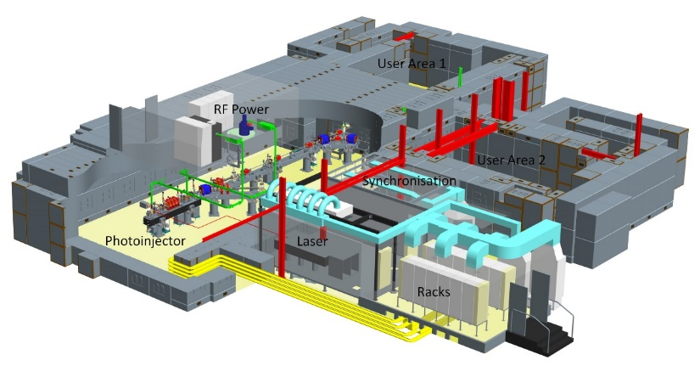
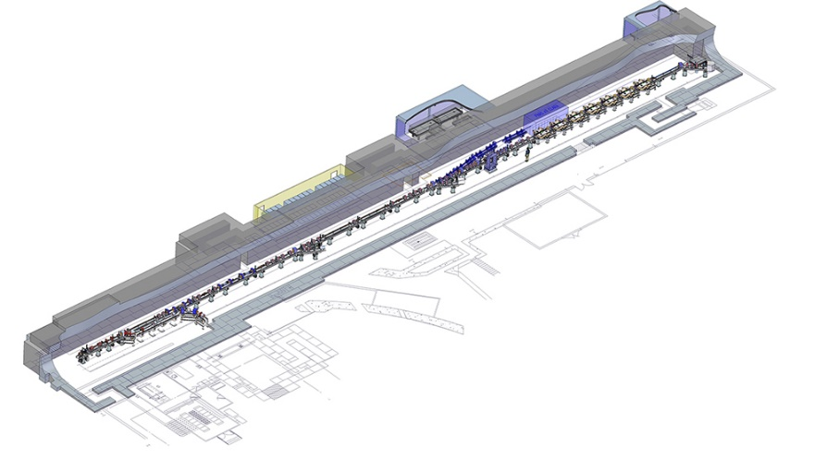
Motivations
VELA
Photoinjector consists of 2.5 cell S-band RF gun
Cu photocathode:
Quantum Efficiency = 1 x 10⁻⁵
Interest in investigating alternative metal to copper
Investigate applicability of metals to deliver ultra high brightness beams
CLARA
1.5 cell high repetition rate gun
Interchangeable photocathode

Slide 4
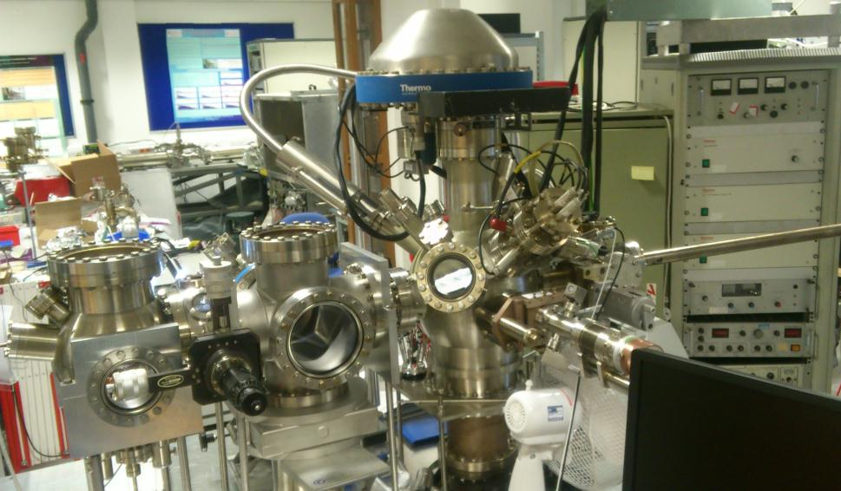
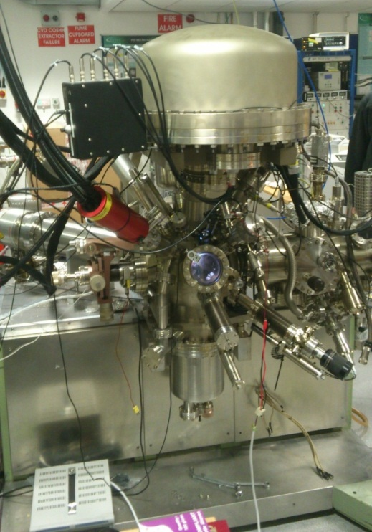
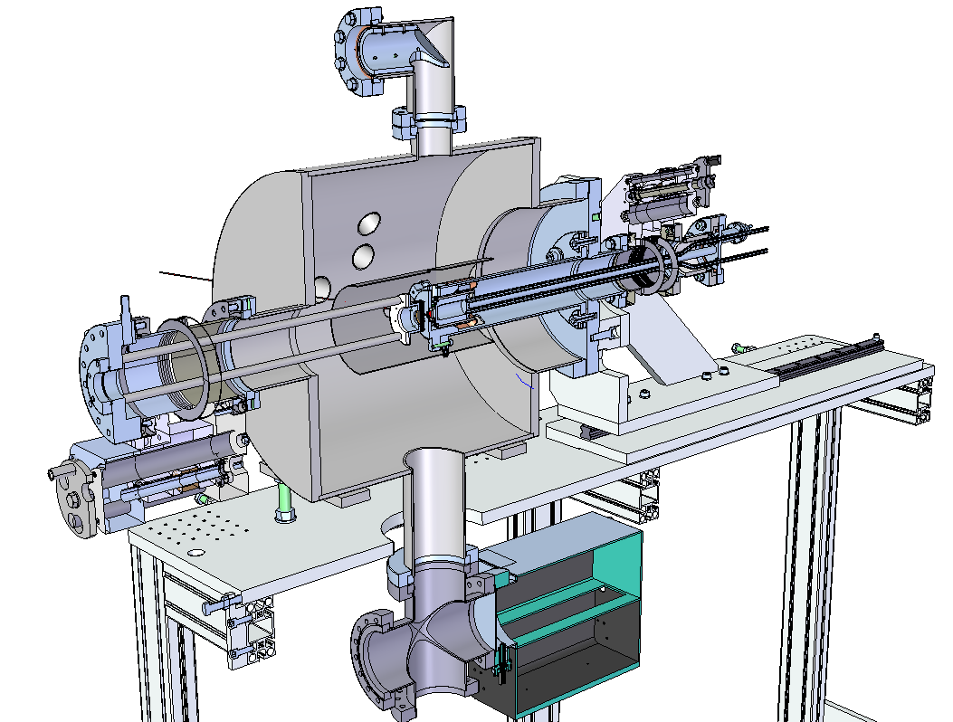
Photocathode Research Equipment
SAPI - Surface Analysis/Preparation Installation
ESCALAB-II – Surface analysis facility
TESS – Transverse Electron Energy Spread spectrometer

Slide 5
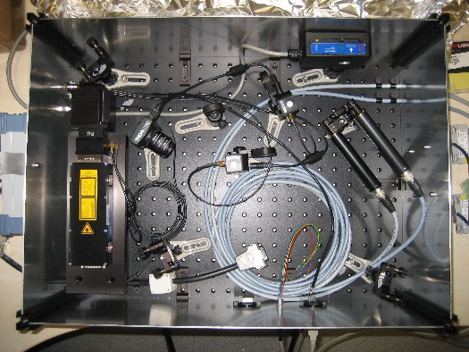
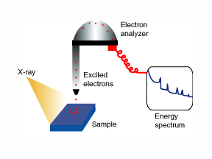

Photocathode Research Techniques
QE
hν
e⁻
Kelvin Probe
e⁻
e⁻
e⁻
e⁻
XPS
Photoelectron
Probe
X-ray
V_{s}
- - - - - - - - -
2p
+++++++++++++++
2s
1s
Sample

Slide 6
Photocathode Research Techniques
Argon Ion Sputtering
Plasma Cleaning
Annealing

Slide 7
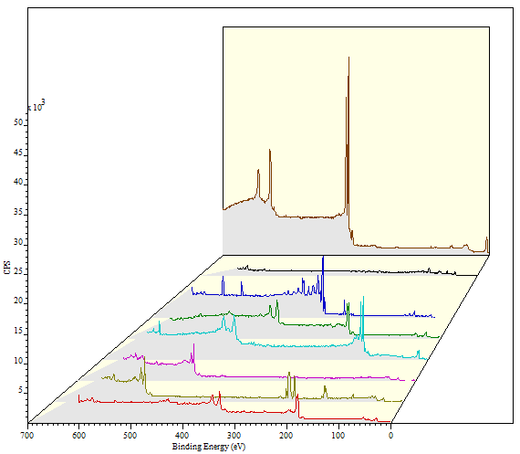
Experimental Procedure
XPS survey spectra for cleaned metal photocathodes
1st Experiment Aim:
To identify metal photocathodes with reasonable QE
A survey of a 10 bulk metals, chosen because:
Widely used in photoinjectors
Low work function
Vacuum compatibility
Silver
Aluminium
Magnesium
Niobium
Lead
Titanium
Vanadium
Zirconium
11
Notes:
Preparation procedure
Took metals and cleaned and took xps analysis

Slide 8
Results: Ar⁺ sputter
Metal | QE (%) | XPS for sample surface(%) O 1s C 1s | Work Function (eV)
Al Received Ar⁺ sputter | 9.5E-6 2.2E-5 | 36.8 38.3 13.4 17.4 | 4.0 4.9
Ag Received Ar⁺ sputter | 8.5E-6 5.1E-5 | 0 59.4 0 0 | 5.1 5.1
Cu Received Ar⁺ sputter | 5.0E-6 1.1E-5 | 32.9 66.2 0 0 | 5.4 5.3
Mg Received Ar⁺ sputter | 6.0E-6 1.7E-3 | 35.2 52.3 40.0 0 | 3.4 3.4
Mo Received Ar⁺ sputter | 1.47E-7 2.48E-6 | 24.2 64.9 7.8 17.8 | 5.1 5.2
Metal | QE (%) | XPS for sample surface (%) O 1s C 1s | Work Function (eV)
Nb Received Ar⁺ sputter | 3.9E-7 1.9E-4 | 47.8 48.6 16.2 21.0 | 5.3 4.7
Pb Received Ar⁺ sputter | 2.9E-5 2.4E-4 | 43.9 34.8 0 0 | 4.6 4.7
Ti Received Ar⁺ sputter | 0 3.3E-4 | 39.2 53.6 14.6 16.8 | 4.7 4.5
V Received Ar⁺ sputter | 1.4E-6 2.2E-5 | 45.7 45.9 25.0 0 | 5.5 5.0
Zr Received Ar⁺ sputter | 3.88E-6 2.89E-4 | 48.4 44.1 14.4 0 | 4.4 4.3
12
Notes:
Discuss results. BUT how long does it last for??

Slide 9
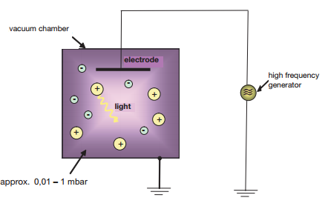
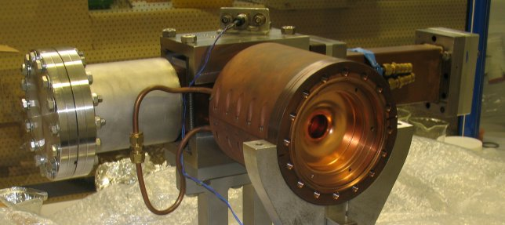
O₂ plasma cleaning and post annealing
VELA Cu photocathode prepared by:
O₂ plasma cleaning
  Removes carbon
  Leaves thin oxygen layer
Annealing
  Oxygen dissolves into bulk
Second experiment applies this cleaning procedure to the metals identified in the first experiment.

Slide 10
Results: O₂ plasma cleaning
Measurements for Ti, Zr, Mg, Cu, Nb, Pb:
O₂ Plasma Cleaned for 20 minutes
Annealed
Metal | QE (%) | XPS for sample surfaces (%) O 1s C 1s | Work Function (eV)
Ti O₂ plasma Anneal 250°C (0.5 hr) Anneal 250C (24 hr) | 0 6.32E-5 1.16E-4 | 87.1 5.1 88.3 4.5 79.9 9.0 | 5.8 4.5 4.3
Zr O₂ plasma Anneal 250°C (0.5 hr) Anneal 250°C (24 hr) | 3.82E-7 6.94E-5 1.35E-4 | 78.4 12.4 83.5 3.9 74.6 9.8 | 4.9 4.3 4.8
Mg O₂ plasma Anneal 200°C (0.5 hr) Anneal 200°C (4 hr) Anneal 200°C (24 hr) | 3.82E-7 2.40E-5 4.90E-5 7.09E-5 | 83.5 3.2 76.8 3.5 67.8 9.4 66.7 3.8 | 4.4 3.9 3.7 3.6
Metal | QE | XPS for sample surfaces (%) O 1s C 1s | Work Function (eV)
Cu O₂ plasma Anneal 250°C (0.5 hr) | 0 1.6E-4 | 80.1 3.1 76.7 6.5 | 5.7 5.7
Nb O₂ plasma Anneal 300°C (0.5 hr) | 5.21E-7 1.34E-4 | 87.5 5.7 80.2 6.3 | 5.7 4.5
Pb O₂ plasma Anneal 160°C (0.5 hr) Anneal 200°C (0.5 hr) | 3.47E-7 6.94E-6 1.67E-5 | 82.1 7.1 77.9 10.9 77.8 9.9 | 5.6 4.3 4.5
13

Slide 11
Results: O₂ plasma cleaning
x 10
2
60
Cu region as received
CuO
50
40
30
CPS
20
Satellite
Satellite
Metal | QE | XPS (%) O 1s C 1s
Cu Received O₂ plasma Anneal 250°C | 4.2E-6 0 1.6E-4 | 40.4 59.0 80.1 3.1 76.7 6.5
10
Cu 2p_{1/2}
Cu 2p_{3/2}
0
970
965
960
955
950
945
940
935
930
925
x 10
3
Binding Energy (eV)
60
Cu region oxygen plasma cleaned
CuO
50
40
30
CPS
20
Satellite
Cu 2p_{3/2}
10
Satellite
Cu 2p_{1/2}
0
970
965
960
955
950
945
940
935
930
925
x 10
4
Binding Energy (eV)
14
Cu region oxygen plasma cleaned and post annealed
Cu₂O
Cu 2p_{3/2}
12
10
8
Cu 2p_{1/2}
CPS
6
4
2
0
970
965
960
955
950
945
940
935
930
925
14
Binding Energy (eV)

Slide 12
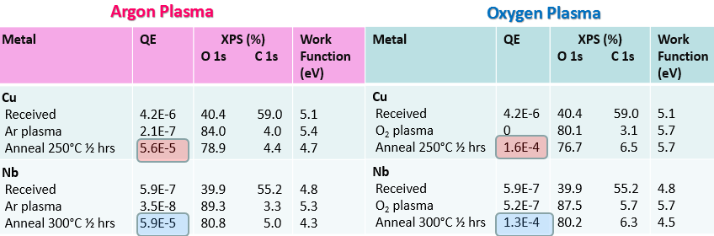
Results: Ar plasma cleaned
Argon plasma treatment is just as effective in removing C 1s from the sample surfaces
QE obtained for oxygen plasma treatment and post anneal is greater than that obtained with argon plasma treatment for all samples
15

Slide 13
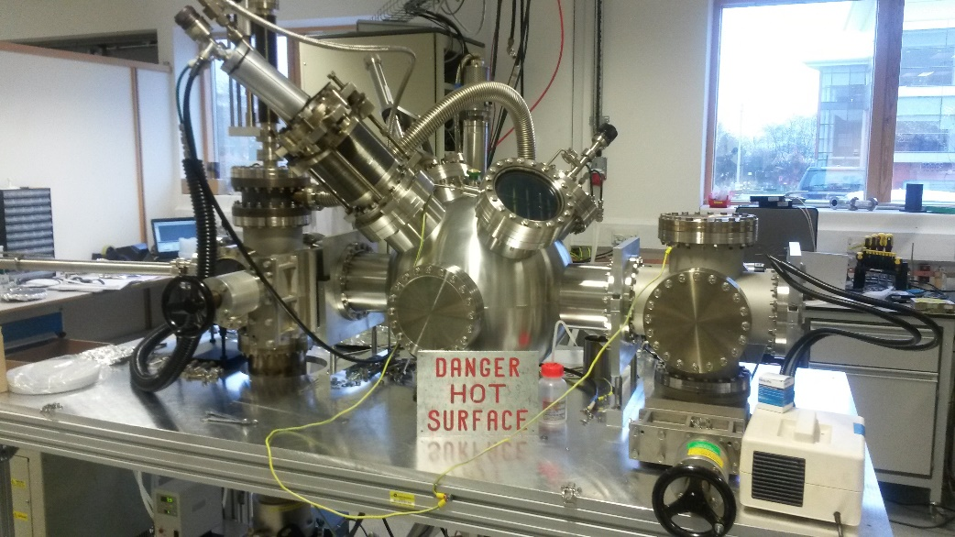
Thin Films Photocathodes
Along with polycrystalline metals, can consider also using film deposition
Metal thin film | QE (%) | XPS for sample surfaces (%) O 1s C 1s | Measured φ (eV)
Cu Received Heated 250°C Repeat | 1.47E-6 1.14E-4 1.17E-4 | 23.5 67.8 20.2 61.7 17.9 62.0 | 5.1 4.9 4.7
Nb Received Heated 250°C Heated 300°C Ar⁺ sputter | 7.75E-7 2.45E-5 5.66E-6 2.64E-4 | 63.1 25.3 61.5 4.3 55.8 15.9 9.6 0 | 4.4 4.9 5.1 4.8
Metal thin films deposited on silicon substrate by magnetron sputtering
So far only Cu and Nb thin films have been produced (µm)
Notes:
Silicon is not a proper material for RF gun, we are planning to use cu/moly

Slide 14
Cu thin film compared with bulk
XPS | Bulk (%) | Thin film(%)
O 1s | 6.1 | 17.943
C 1s | none | 62.03
Cu 2p | 93.9 | 20.027
Cu 2p_{3/2}
x 10
4
10
Cu 2p_{3/2}
CPS
Cu 2p_{1/2}
8
Cu 2p_{1/2}
Cu₂O
 | Work function (eV) | QE
Bulk | 5.234 | 1.70E-5
Thin Film | 4.68 | 1.17E-4
Thin film Cu annealed 250°C
6
Bulk Cu Ar+ sputter and post annealed 250°C
Cu
4
Thin film Cu as received
Cu 2p_{1/2}
Cu 2p_{3/2}
Satellite
Satellite
CuO
2
Bulk Cu as received
Satellite
Cu 2p_{1/2}
Satellite
Cu 2p_{3/2}
CuO
0
970
965
960
955
950
945
940
935
930
925
17
Binding Energy (eV)

Slide 15
Nb thin film compared with bulk
XPS | Bulk (%) | Thin film(%)
O 1s | 16.24 | 9.57
C 1s | 20.98 | none
Nb 3p | 62.78 | 90.43
Nb
 | Work function (eV) | QE (%)
Bulk | 4.7 | 1.9E-4
Thin Film | 4.8 | 2.64E-4
NbO and NbO₂
Thin film Nb Ar⁺ sputter
NbO and NbO₂
Thin film Nb annealed 300°C
x 10
3
Thin film Nb annealed 250°C
25
NbO
20
Bulk Nb Ar⁺ sputter
15
Nb₂O₅
CPS
Thin film Nb as received
10
Nb₂O₅
Bulk Nb as received
5
214
212
210
208
206
204
202
200
198
196
Binding Energy (eV)
18

Slide 16
Future Plans
Short Term Plan
Deposit metal thin films onto Cu/Mo substrate
Investigate single crystal cu (and others) photocathodes
Medium Term Plan
Carry out transverse longitudinal energy measurements from metal photocathodes
Long Term Plan
Modify ESCALAB-II to accept INFN style pucks
Transverse and longitudinal energy spread measurements from metal photocathodes
Investigate single crystal photocathodes (Cu and others)
Produce and investigate metal thin film photocathodes
Modify ESCALAB-II to accept DESY/INFN plug based photocathodes
Test metal photocathodes in VELA/CLARA

Slide 17
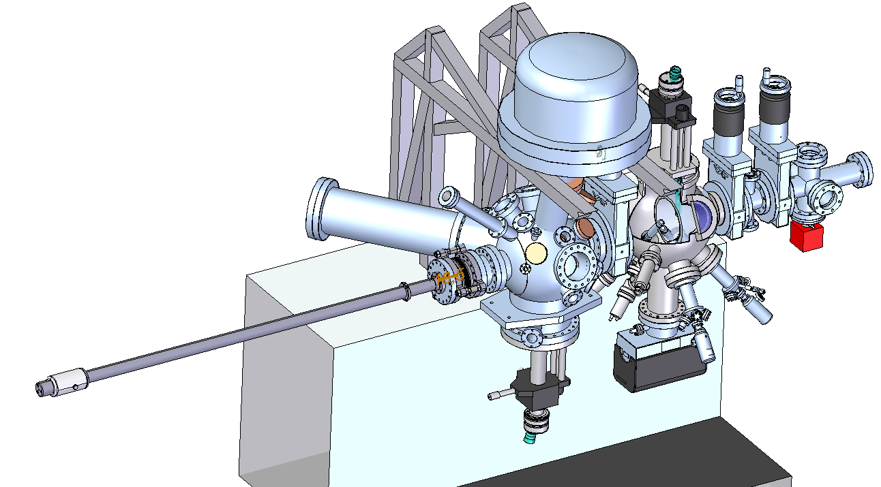
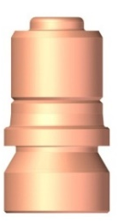
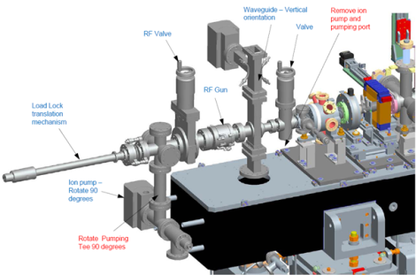
Future Plans
Short Term Plan
Deposit metal thin films onto Cu/Mo substrate
Investigate single crystal cu (and others) photocathodes
Medium Term Plan
Carry out transverse longitudinal energy measurements from metal photocathodes
Long Term Plan
Modify ESCALAB-II to accept INFN style pucks
ESCALAB upgrade later this year
DESY / INFN puck design
High repetition rate gun with photocathode transfer facility to be commissioned 2016

Slide 18
Conclusions
Short Term Plan
Deposit metal thin films onto Cu/Mo substrate
Investigate single crystal cu (and others) photocathodes
Medium Term Plan
Carry out transverse longitudinal energy measurements from metal photocathodes
Long Term Plan
Modify ESCALAB-II to accept INFN style pucks
New results for O₂ and Ar plasma cleaned photocathodes
Preliminary results for Cu and Nb thin film photocathodes
Progress with design work for ESCALAB upgrade
Commissioning of High Repetition Rate gun in February 2016
For Further Information: -
DELIVERABLE REPORT: 12.4, ‘SCIENTIFIC REPORT ON PHOTOCATHODE R&D’
MILESTONE REPORT: MS75, ‘INVESTIGATION OF QUANTUM YIELD AND ENERGY SPECTRUM OF THE ELECTRONS, EMITTED FROM THE METAL PHOTOCATHODE’

Slide 19
Acknowledgements
STFC ASTeC
Deepa Angal-Kalinin, Boris Militsyn, Lee Jones, Joe Herbert, Tim Noakes, Reza Valizadeh, Keith Middleman, Mark Surman
Daresbury Technology Department
Ryan Cash and Barry Fell
Loughborough University
Mike Cropper
Thank you for listening!

Slide 20
XPS
Photoelectron
XPS process:
Sample surface illuminated with X-Rays
X-Rays absorbed within 10 nm of sample
Core level electrons are emitted
X-ray
2p
2s
Measure E_{k} of photoelectrons
Corresponding E_{b} is deduced:
1s
E_{b} for core level electrons are unique for each chemical species
Therefore spectrum represents surface composition
E_{k} = hν – E_{b} – ɸ_{s}
Kinetic Energy
Spectrometer work function
X-Ray Energy
Binding Energy
9
Notes:
This is of high significance, because the binding energies for core level electrons are unique for each chemical species. Thus, by recording the number of photoelectrons emitted as a function of Eb, it is possible to obtain a spectrum representing surface composition.

Slide 21

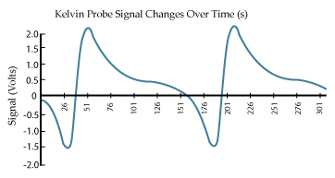
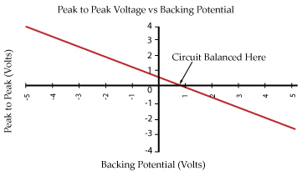

Kelvin Probe
Probe set to vibrate upon close contact with sample surface
As d varies, so does C
Result is a periodic flow of charge around the circuit, and thus a varying voltage
Output signal is periodic (V_{s})
V_{b} is set to a range of potentials and a plot of V_{ptp} verses V_{b} is made.
When V_{ptp} = 0 the V_{CPD} of the surface is equal and opposite to V_{b}.
Probe
V_{s}
- - - - - - - - -
+++++++++++++++
Sample
Peak to peak voltgae
Externally applied backing potential
eV_{CPD}= φ_{probe} - φ_{sample}
21
Notes:
Measure the local contact potential difference (CPD) between the conducting probe and the sample
The probe is brought in close to the sample surface
An electrical force is experienced between them as a result of the difference in Fermi energies.
If this force can be matched, and cancelled out with an opposing force of equal magnitude, then the difference in work functions can be obtained.

Slide 22
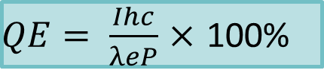
QE
QE is the average photoelectric yield per incident photon.
QE measurements comprise
  a LED source giving 265 nm (4.65 eV) light and a pico-ammeter to measure drain current.
  a UV LASER source which offers higher intensity at 266 nm
  Photodiode used to measure LED power
QE suggests how much current can be extracted from a cathode and as such is an indication of the potential beam current.
hν
e⁻
e⁻
e⁻
e⁻
e⁻
This property is unique to each photocathode material and is a function of the laser wavelength and the photocurrent produced.
11
Notes:
For a metal, providing that the incident photon has energy greater than or equal to the work function, the electrons in the conduction band will be excited above the vacuum level, and are then free to escape.
There is a high density of free electrons in the conduction band, therefore when photoelectrons are transported up to vacuum level, there is a large amount of electron-electron scattering dominates and redistributes energy distribution very quickly

