Slide 1
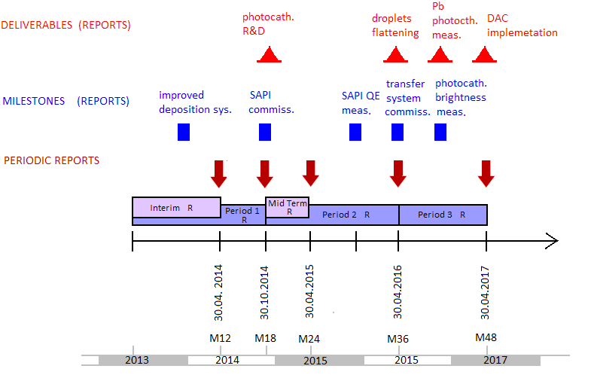
Milestones
Deliverables

