Slide 1




Resolution study of HOMBPM at FLASH
WP12 annual meeting
Presenter: L. Shi (U. Manchester / DESY)
Members: N. Baboi (DESY), R.M. Jones (U. Manchester), T. Wamsat (DESY),
B. Lorbeer (DESY), N. Eddy (FNAL), P. Zhang (CERN), S. Habib (WUT)
The work is supported partly by EuCARD² with Grant No. GA 312453

Slide 2
Outline
  HOMBPM system at FLASH
  HOM Data acquisition at FLASH
  Data analysis and results
    DLR based calibration and validation
    SVD based calibration and validation
    NNT based calibration and validation
    Theoretical resolution estimation
  Summary and Outlook.
HOM: Higher Order Mode
SVD : Singular Value Decomposition
NNT: Neural Network

Slide 3
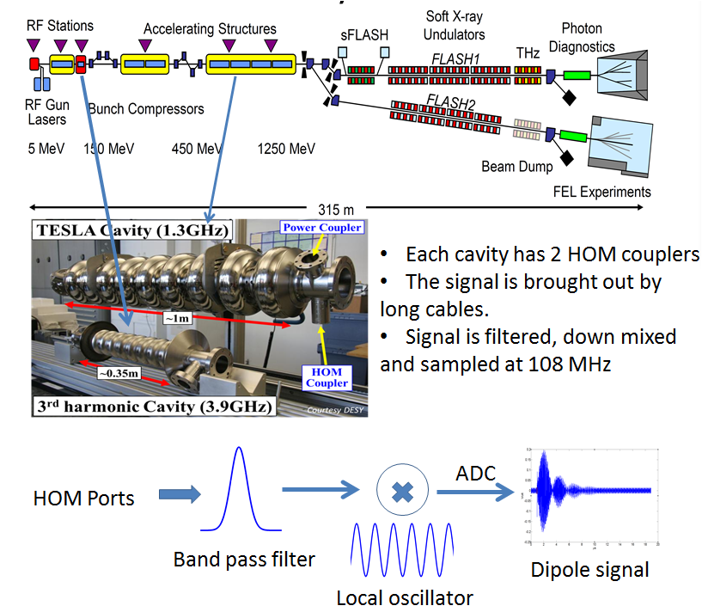
HOMBPM system at FLASH
Cavities are equipped with
HOM couplers to damp the
HOMs inside.
All HOM raw data
are accessible from DOOCS
(control system)
The HOMBPMs were
integrated into beam orbit
feedback system at FLASH.
Due to instability issues of
HOMBPMs, they were
removed latter on.

Slide 4
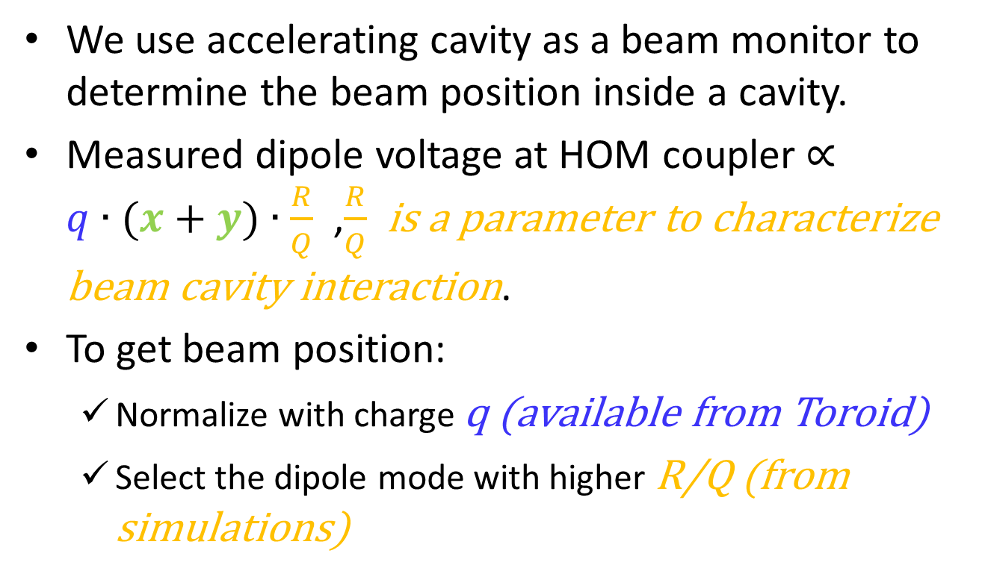
Principle of an HOMBPM
We use accelerating cavity as a beam monitor to determine the beam position inside a cavity.
Measured dipole voltage at HOM coupler $∝$ $q∙(x+y)∙\frac{R}{Q}$ ,$\frac{R}{Q}$ is a parameter to characterize beam cavity interaction.
To get beam position:
  Normalize with charge q (available from Toroid)
  Select the dipole mode with higher R/Q (from simulations)

Slide 5
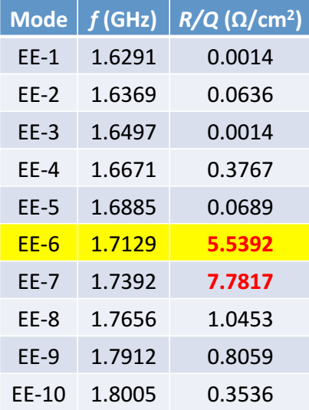
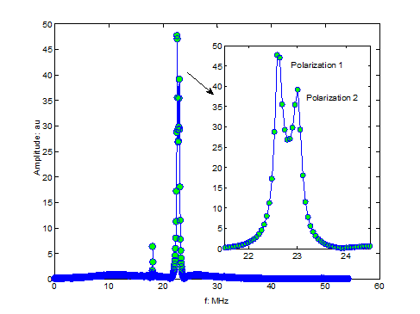
HOMBPMs at FLASH
R. Wanzenberg, TESLA 2001-33, 2001

Slide 6
  HOMBPM system at FLASH
  HOM Data acquisition at FLASH
  Data analysis and results
  Summary and Outlook.
HOM: Higher Order Mode
SVD : Singular Value Decomposition
NNT: Neural Network

Slide 7
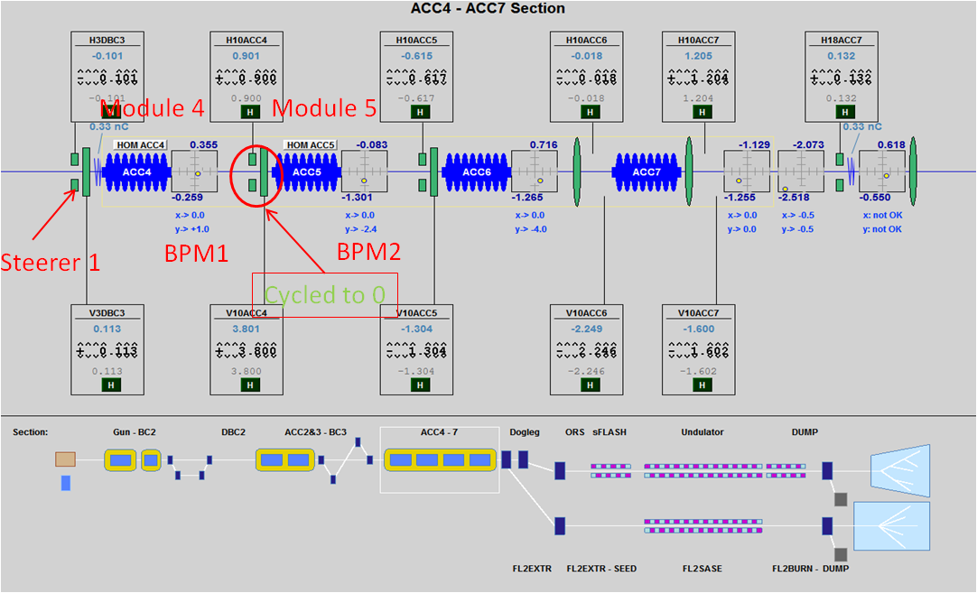
Working procedure for HOM measurements
A section of control panel for FLASH
Courtesy of DESY

Slide 8
Working procedure for HOM measurements
Working condition:
  Single bunch
  0.5 nC charge
  10 Hz repetition rate
  RF inside the cavity off
  Magnets in between off
Data acquisition:
  Dipole waveforms are gathered via DOOCS.
  Each measurement is put in a single mat file.
  Each file includes all necessary information for calibration

Slide 9
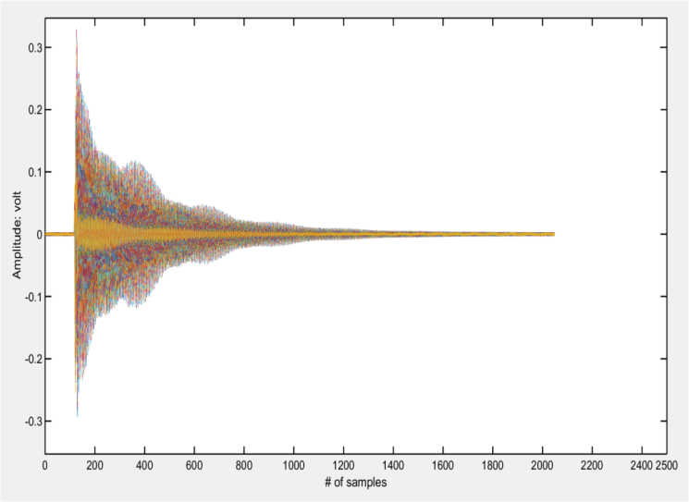
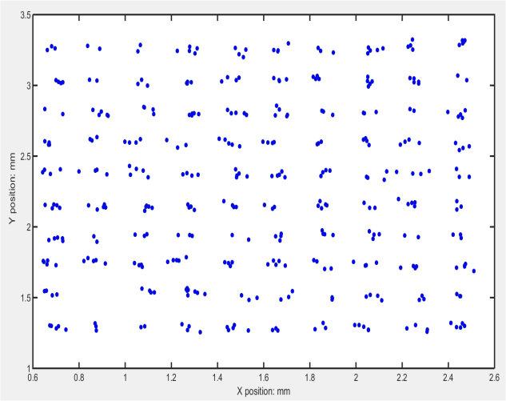
Working procedure for HOM measurements
Recorded waveforms used for obtaining
the spectrum at module 5 cavity 1.
There are 386 records in total.
Interpolated beam position at module 5
cavity 1. Accordingly, there are 386 beam
Position records.
We have made measurement on Jan 23, 25 and 28 2015

Slide 10
  HOMBPM system at FLASH
  HOM Data acquisition at FLASH
  Data analysis and results
  Summary and Outlook.
HOM: Higher Order Mode
SVD : Singular Value Decomposition
NNT: Neural Network

Slide 11
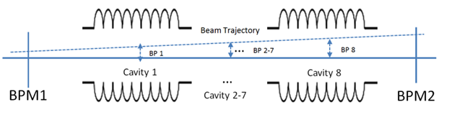
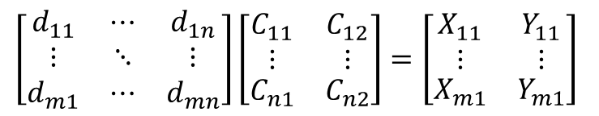
Calibration of an HOMBPM
Calibration of an HOMBPM
Beam position inside each cavity is interpolated from two BPMs.
Dipole signals are measured via each HOM port.
The correlation between dipole signal and beam positions can be established.
$$\left[\begin{matrix}d_{11} & ⋯ & d_{1n} \\ ⋮ & ⋱ & ⋮ \\ d_{m1} & ⋯ & d_{mn}\end{matrix}\right]\left[\begin{matrix}\begin{aligned}C_{11} \\ ⋮\end{aligned} & \begin{aligned}C_{12} \\ ⋮\end{aligned} \\ C_{n1} & C_{n2}\end{matrix}\right]=\left[\begin{matrix}\begin{aligned}X_{11} \\ ⋮\end{aligned} & \begin{aligned}Y_{11} \\ ⋮\end{aligned} \\ X_{m1} & Y_{m1}\end{matrix}\right]$$

Slide 12
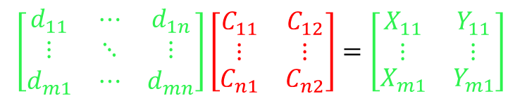
Calibration of an HOMBPM
$$\left[\begin{matrix}d_{11} & ⋯ & d_{1n} \\ ⋮ & ⋱ & ⋮ \\ d_{m1} & ⋯ & d_{mn}\end{matrix}\right]\left[\begin{matrix}\begin{aligned}C_{11} \\ ⋮\end{aligned} & \begin{aligned}C_{12} \\ ⋮\end{aligned} \\ C_{n1} & C_{n2}\end{matrix}\right]=\left[\begin{matrix}\begin{aligned}X_{11} \\ ⋮\end{aligned} & \begin{aligned}Y_{11} \\ ⋮\end{aligned} \\ X_{m1} & Y_{m1}\end{matrix}\right]$$
Data matrix
?
Position matrix
1. What can be put inside the data matrix?
Waveforms are natural selection, but the system is vulnerable to noise.
So we put spectrum (FFT of waveforms) in the matrix.
2. Spectrum directly or processed?
3. How to obtain the red unknown matrix?
Perform Linear Regression. 2. Mapping the relation from Data matrix to
Position matrix

Slide 13
  HOMBPM system at FLASH
  HOM Data acquisition at FLASH
  Data analysis and results
    DLR vs SVD LR
  Summary and Outlook.
HOM: Higher Order Mode
DLR: Direct Linear Regression
SVD : Singular Value Decomposition
NNT: Neural Network

Slide 14
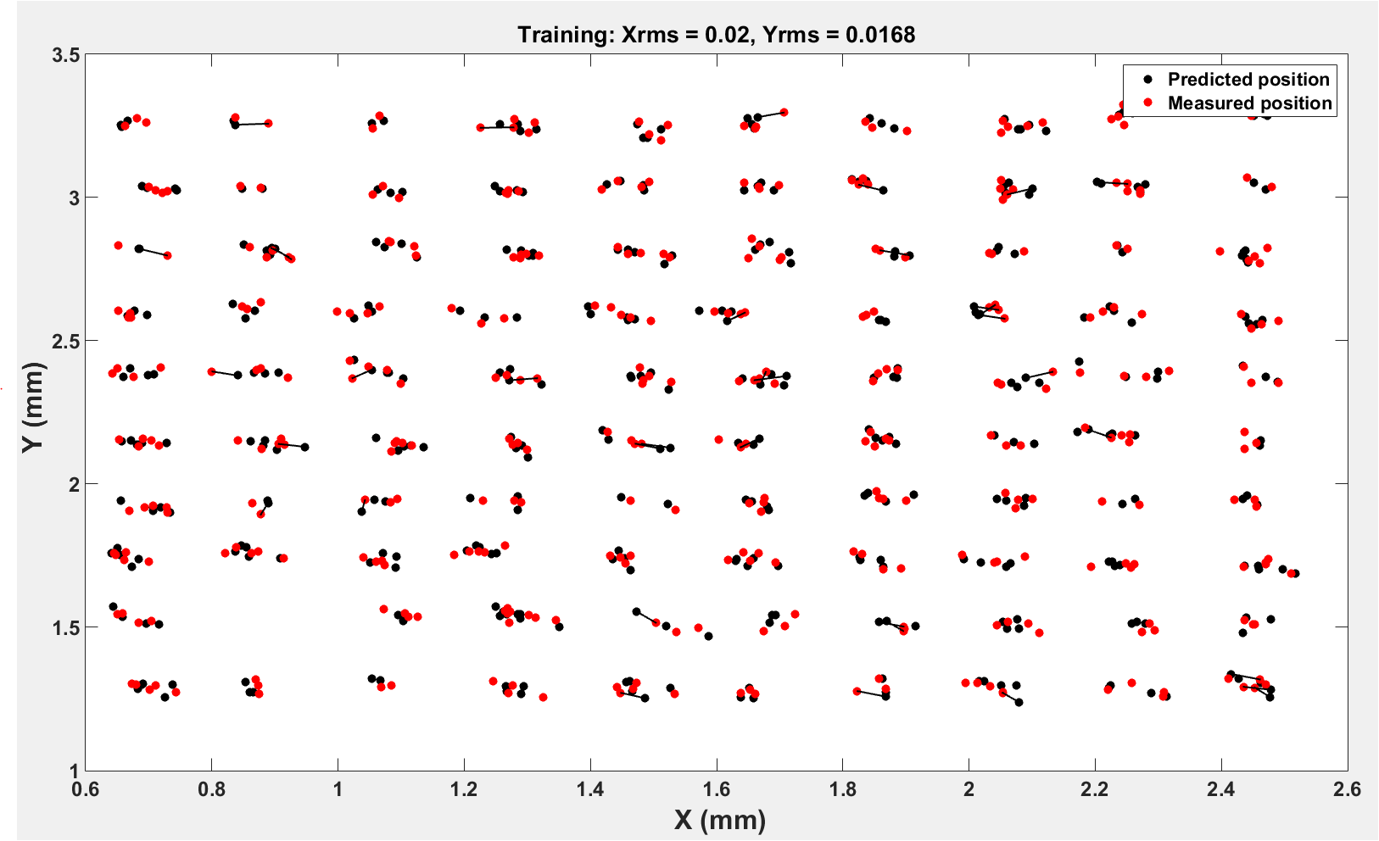
DLR- Direct Linear Regression- Jan 28
Xrms = 20 µm, Yrms = 17 µm

Slide 15
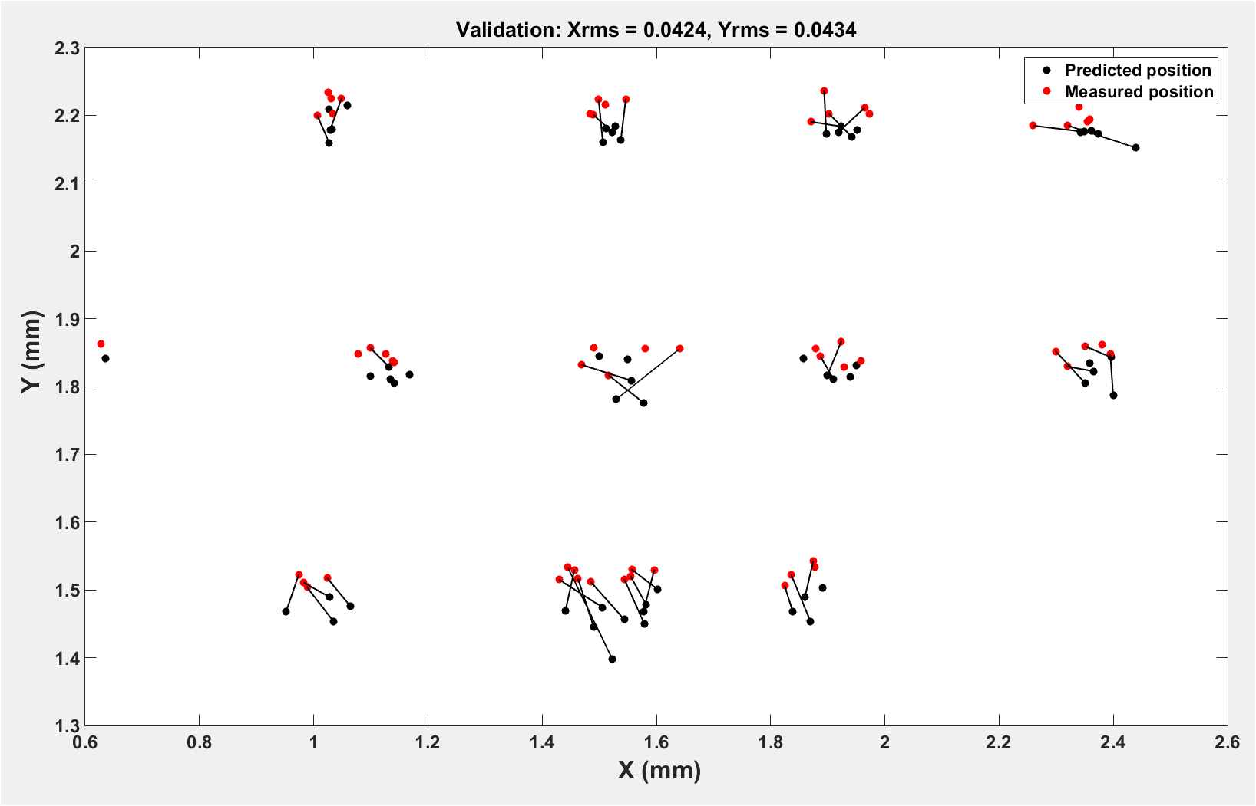
DLR- Direct Linear Regression- Jan 25
Xrms = 42 µm, Yrms = 43 µm

Slide 16
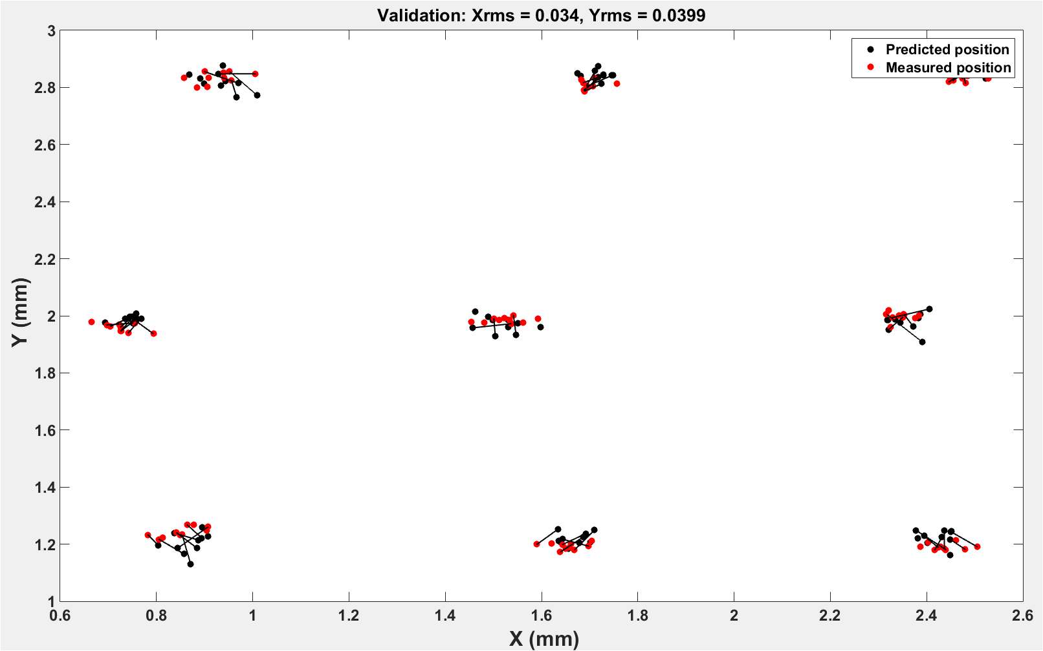
DLR- Direct Linear Regression – Jan 23
Xrms = 34 µm, Yrms = 39 µm

Slide 17
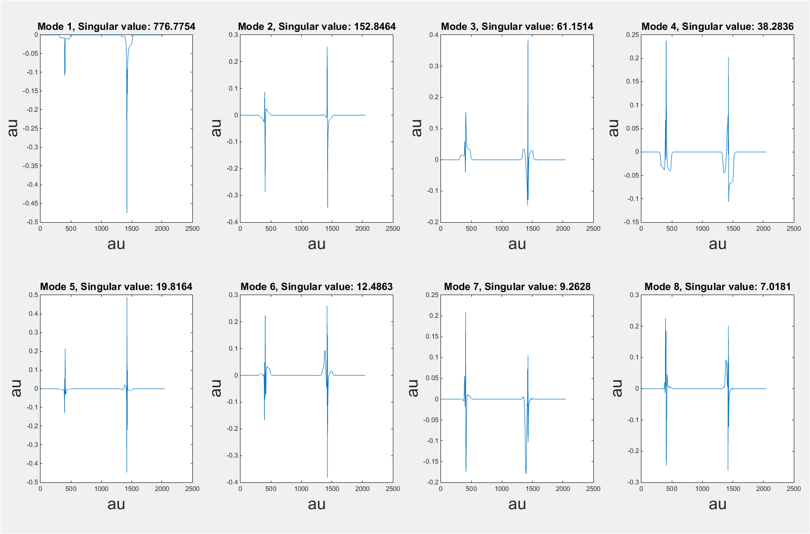

SVD based LR
$\left[\begin{matrix}d_{11} & ⋯ & d_{1n} \\ ⋮ & ⋱ & ⋮ \\ d_{m1} & ⋯ & d_{mn}\end{matrix}\right]$ = U*S*V’
Top eight modes
for dipole
spectrum

Slide 18
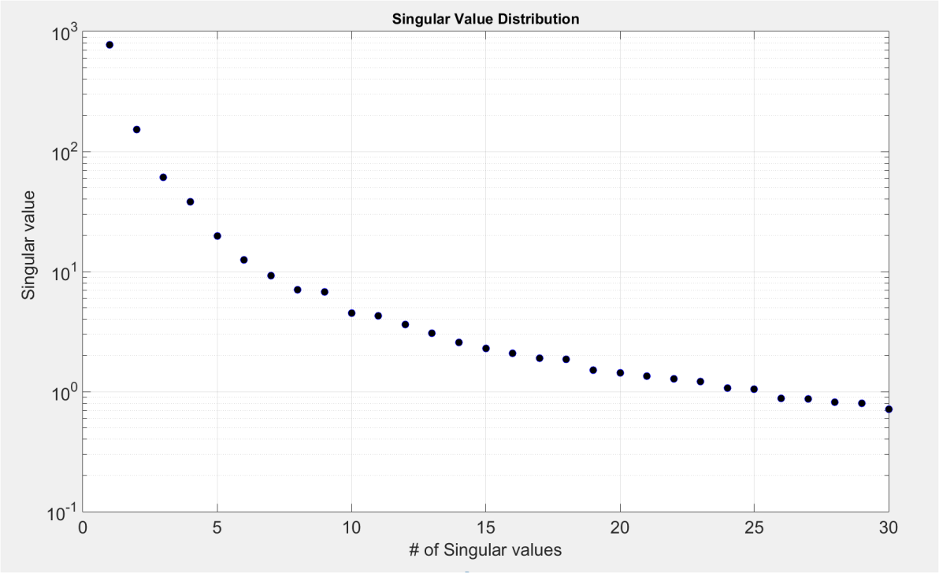
SVD based LR
$\left[\begin{matrix}d_{11} & ⋯ & d_{1n} \\ ⋮ & ⋱ & ⋮ \\ d_{m1} & ⋯ & d_{mn}\end{matrix}\right]$ = U*S*V’
67 %
80 %
85 %
Top eight modes account for 93%
of total variance
93 %
Amplitudes in V space are
put in the data matrix

Slide 19
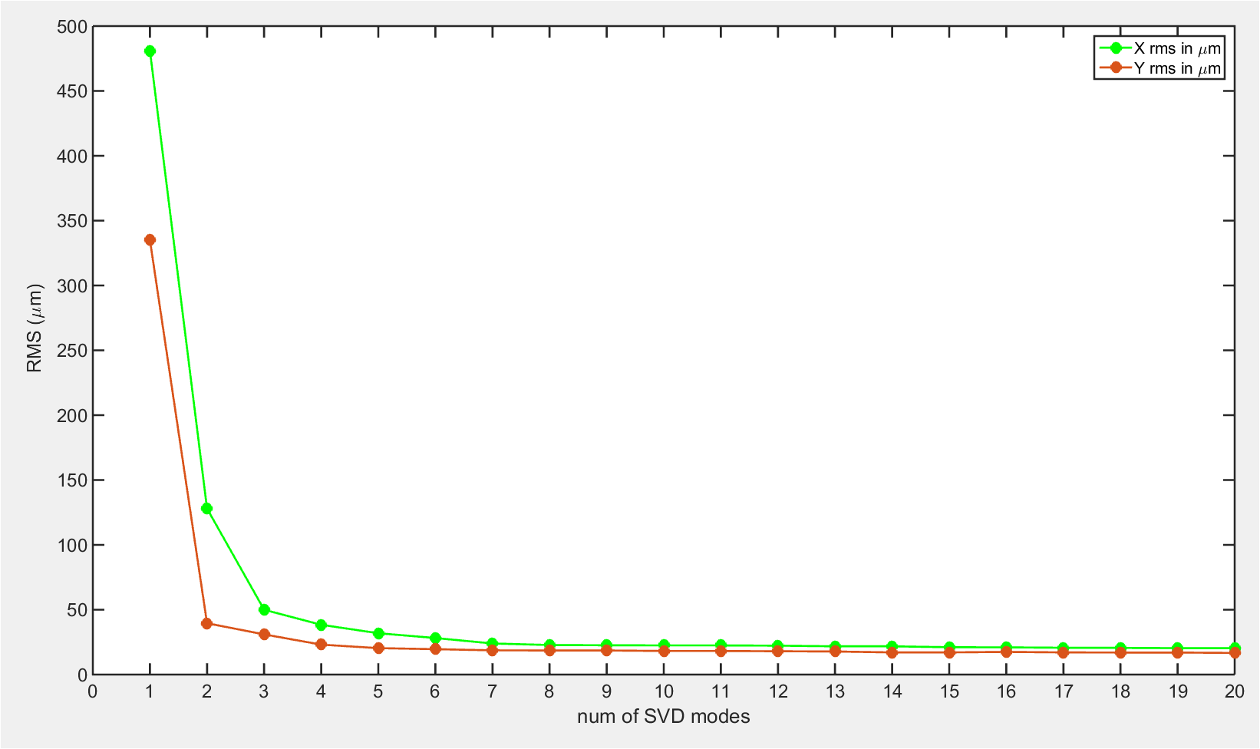
SVD based LR
$\left[\begin{matrix}d_{11} & ⋯ & d_{1n} \\ ⋮ & ⋱ & ⋮ \\ d_{m1} & ⋯ & d_{mn}\end{matrix}\right]$ = U*S*V’
Calibration on Jan 28:
Xrms = 20 µm, Yrms = 17 µm
Validation on Jan 25:
Xrms = 48 µm, Yrms = 38 µm
1. Top eight modes were used
Validation on Jan 23:
Xrms = 44 µm, Yrms = 38 µm
2. There is minor change in rms
by taking more modes for
calibration

Slide 20
  HOMBPM system at FLASH
  HOM Data acquisition at FLASH
  Data analysis and results
    DLR vs SVD LR
    NNT based calibration
  Summary and Outlook.
HOM: Higher Order Mode
DLR: Direct Linear Regression
SVD : Singular Value Decomposition
NNT: Neural Network

Slide 21
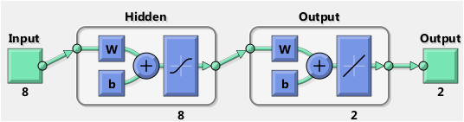
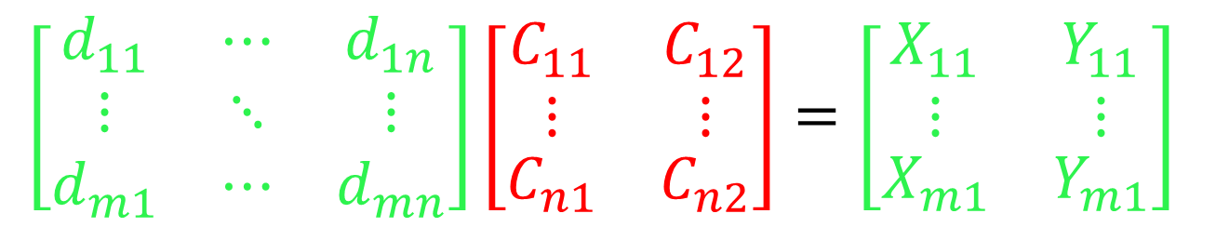
NNT based calibration
$$\left[\begin{matrix}d_{11} & ⋯ & d_{1n} \\ ⋮ & ⋱ & ⋮ \\ d_{m1} & ⋯ & d_{mn}\end{matrix}\right]\left[\begin{matrix}\begin{aligned}C_{11} \\ ⋮\end{aligned} & \begin{aligned}C_{12} \\ ⋮\end{aligned} \\ C_{n1} & C_{n2}\end{matrix}\right]=\left[\begin{matrix}\begin{aligned}X_{11} \\ ⋮\end{aligned} & \begin{aligned}Y_{11} \\ ⋮\end{aligned} \\ X_{m1} & Y_{m1}\end{matrix}\right]$$
Top Eight Eigen modes
Position Outputs
Ten networks were trained, and the average was taken as the output

Slide 22
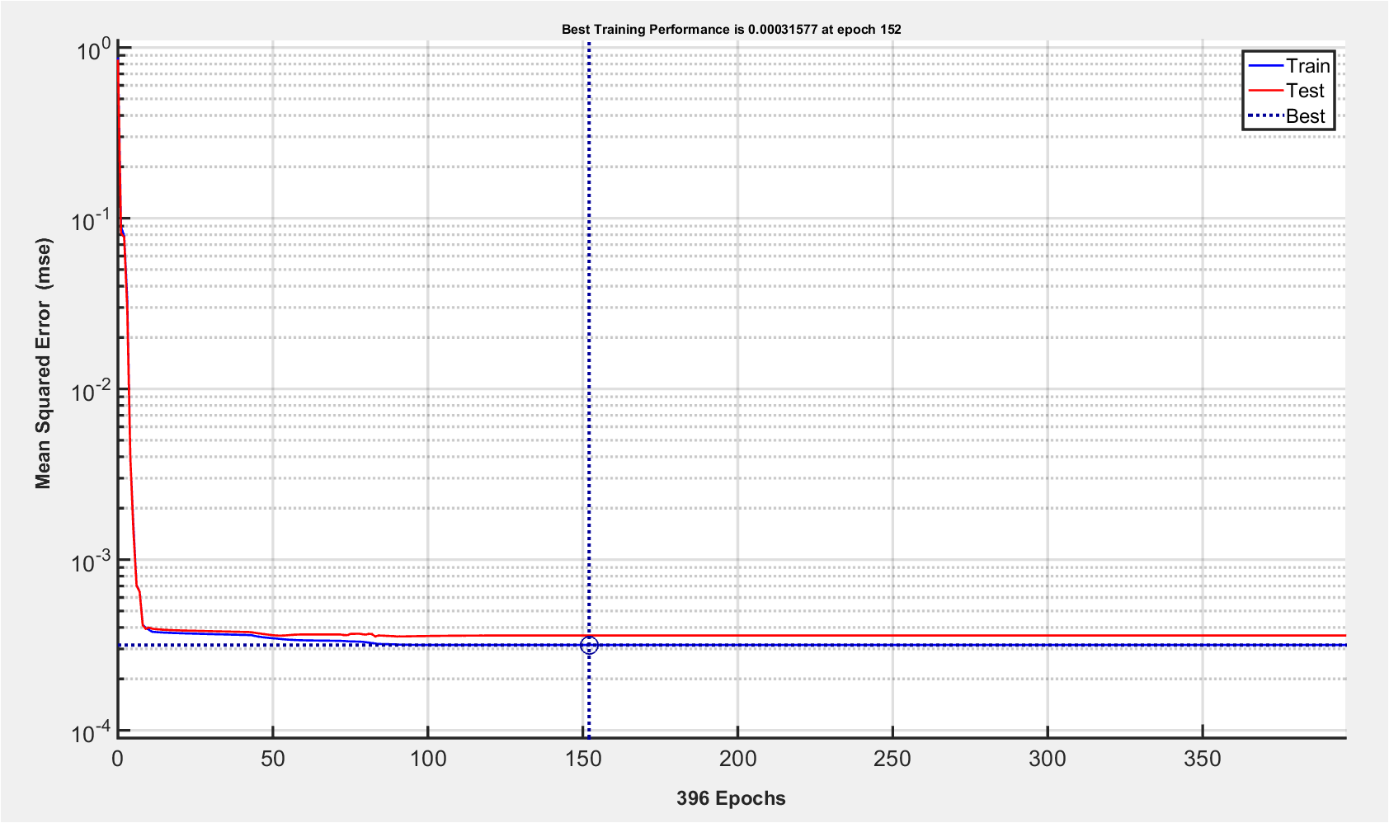
NNT based calibration
Best training performance was found around iteration number of 152 based on MSE

Slide 23
RMS summary of DLR, SVD, NNT
(X, Y) | Jan 28 (Calibration) | Jan 25 (Validation) | Jan 23 (Validation)
DLR (f domain) | (20,16 µm) | (42,43 µm) | (34,39 µm)
NNT (f domain) | (17,15 µm) | (42,44 µm) | (34,39 µm)
SVD LR (f domain) | (22,18 µm) | (48,38 µm) | (44,38 µm)
SVD NNT (f domain) | (19,16 µm) | (48,38 µm) | (44,41 µm)
SVD LR (t domain) | (62, 60 µm) | (983, 1590 µm) | (1250, 1690 µm)
Top 8 modes were used based on singular values in SVD methods
Note: Directly using data in time domain gives unacceptable RMS degradation over time.
RMS does not necessarily become worse over time.
NNT gives comparable results when compared with other methods. There is no bias from
algorithm side

Slide 24
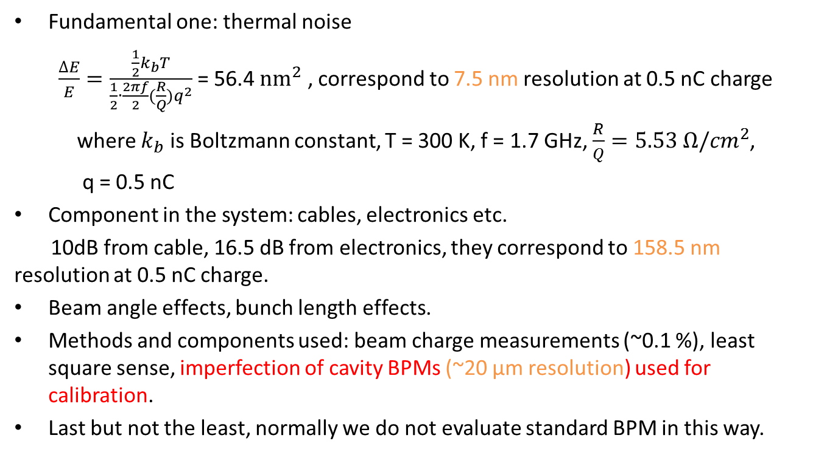
Resolution limits of HOMBPM
Fundamental one: thermal noise
$\frac{∆E}{E}=\frac{\frac{1}{2}k_{b}T}{\frac{1}{2}∙\frac{2πf}{2}(\frac{R}{Q})q^{2}}$ = 56.4 ${nm}^{2}$ , correspond to 7.5 nm resolution at 0.5 nC charge
where $k_{b}$ is Boltzmann constant, T = 300 K, f = 1.7 GHz, $\frac{R}{Q}=5.53 Ω/{cm}^{2}$,
q = 0.5 nC
Component in the system: cables, electronics etc.
10dB from cable, 16.5 dB from electronics, they correspond to 158.5 nm resolution at 0.5 nC charge.
Beam angle effects, bunch length effects.
Methods and components used: beam charge measurements (~0.1 %), least square sense, imperfection of cavity BPMs (~20 µm resolution) used for calibration.
Last but not the least, normally we do not evaluate standard BPM in this way.

Slide 25
Summary
All methods converge to below 50 µm, and the resolution did not degrade over time.
Positive results in frequency domain tell us phase noise plays a vital part in the HOMBPM system.
We are far from the theoretical resolution limits and current results are mainly limited by cavity BPMs used for calibration.
Outlook
Figure out how much beam angle plays in the calibration and validation.
More beam time data to verify the results.
Similar study for HOMBPM for 3rd harmonic module.
HOM based beam phase monitor measurement.

Slide 26
Thank you for your attention!

Slide 27
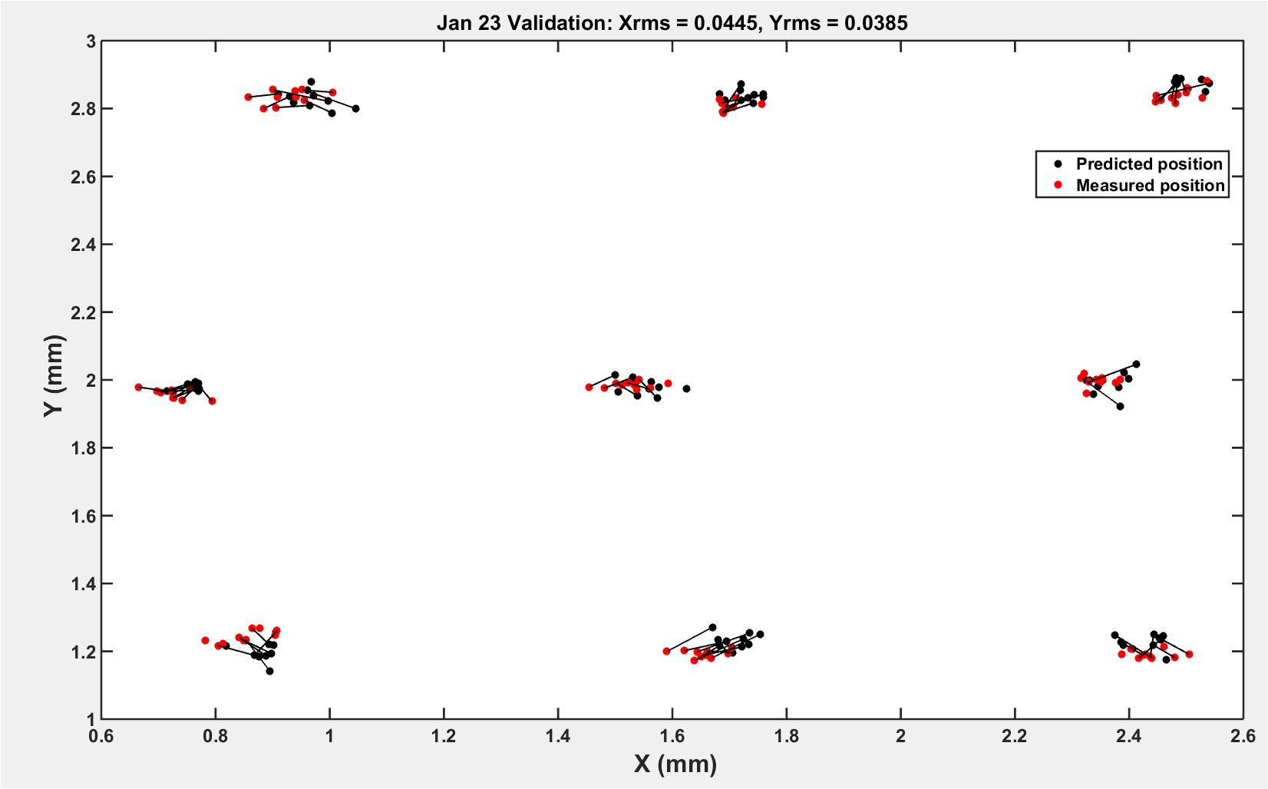
SVD LR

Slide 28
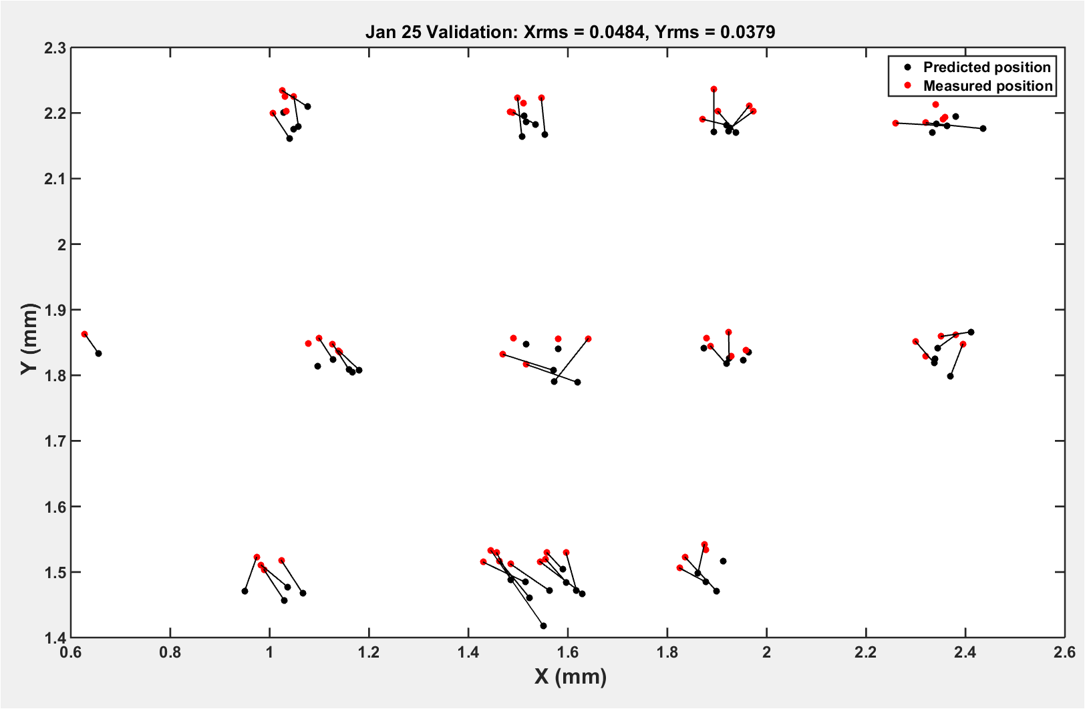
SVD LR

Slide 29
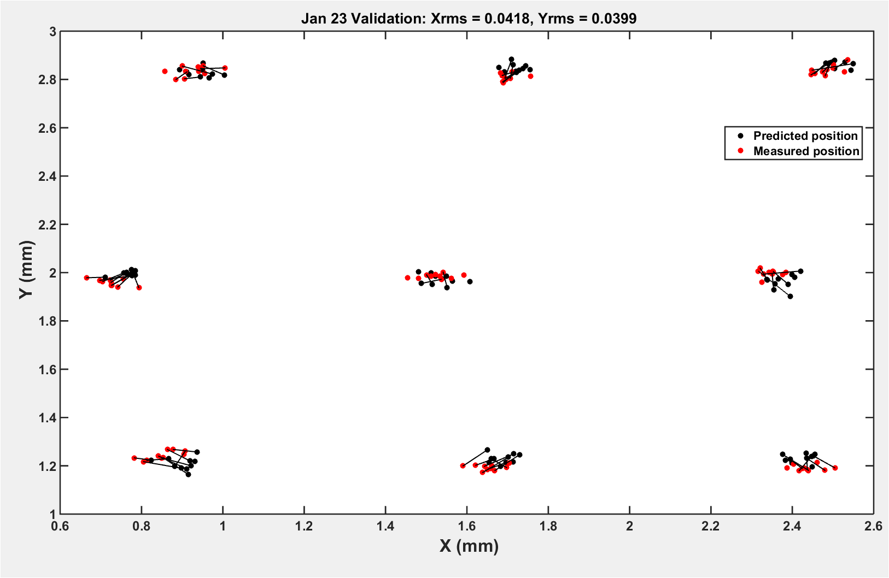
NNT

Slide 30
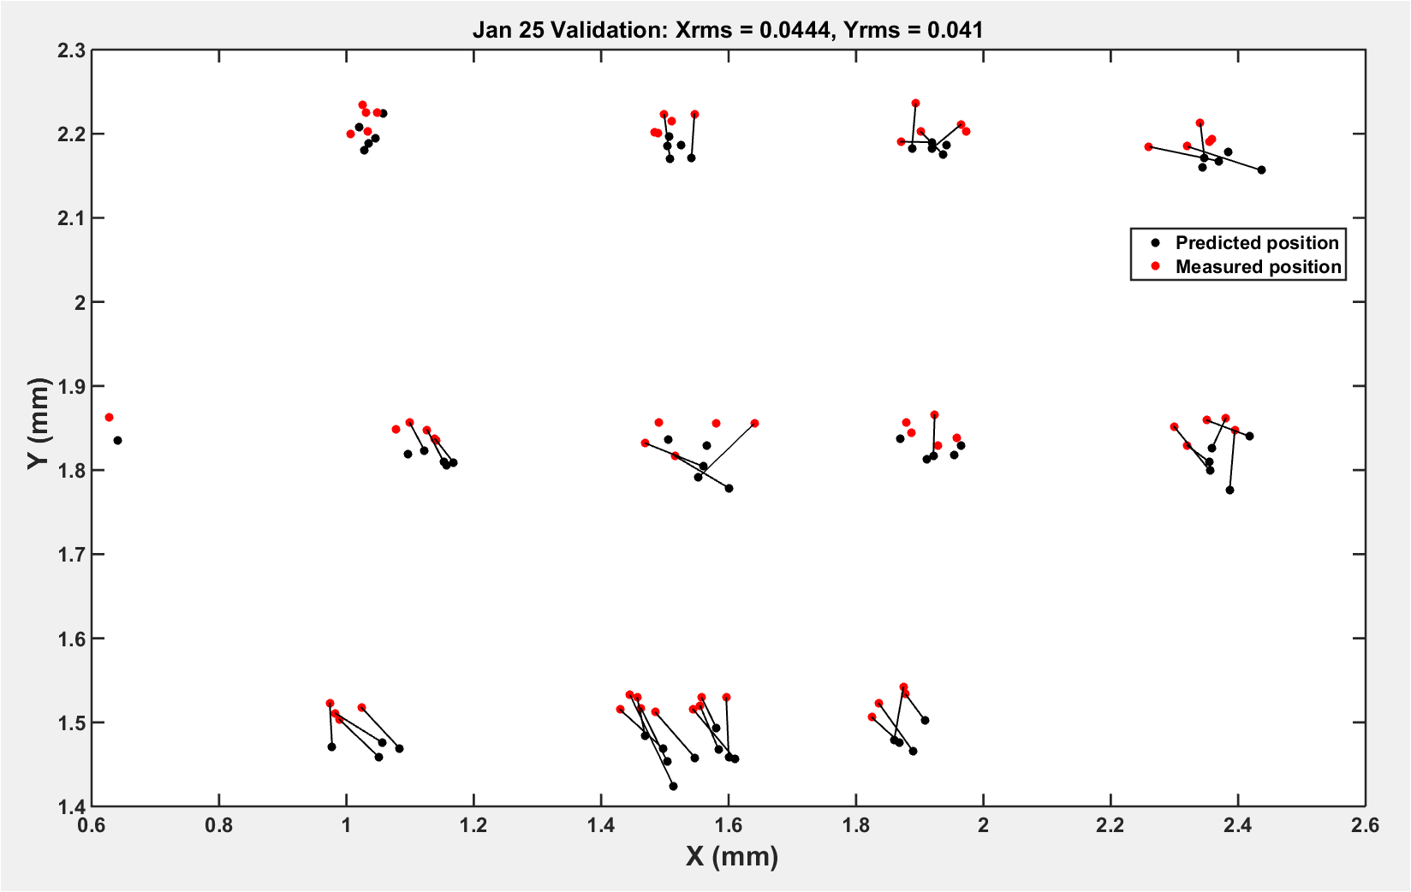
NNT

Slide 31
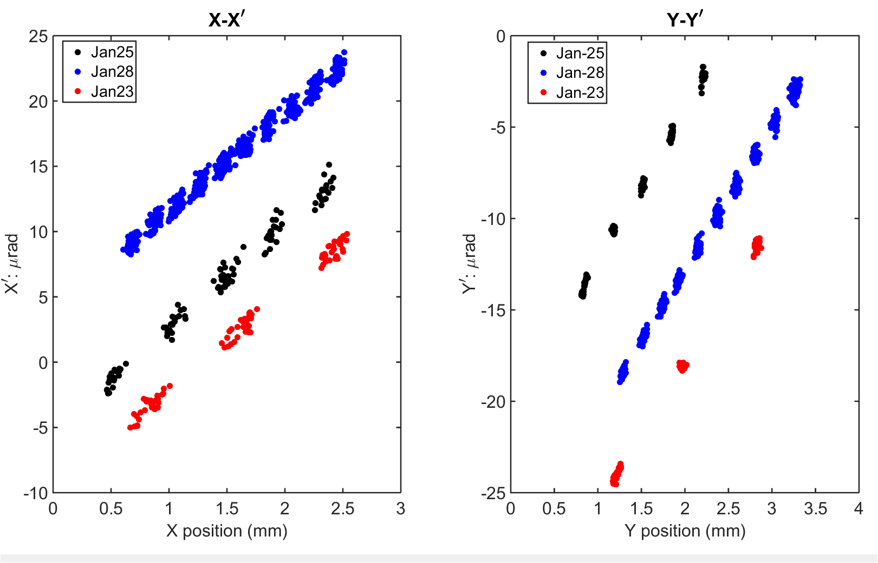
Beam angle

