Slide 1

Operation of the quadrupole resonator at HZB
Oliver Kugeler, Raphael Kleindienst, Sebastian Keckert, Jens Knobloch, Axel Neumann and Andrew Burrill
EUCARD2
WP12 meeting
8.4.15-9.4.15 DESY, Hamburg

Slide 2
Contents
Motivation / QPR measurement principle
Manufacture
Commissioning at JLAB and HZB
Planned upgrades
Outlook

Slide 3
Motivation
Going beyond bulk niobium
  Thin film niobium
  Alternative Superconductors with high potential (Nb₃Sn, NbN, MgB₂)
  Multilayers
Advantage of testing flat samples over cavities:
  Easier to produce, faster turnover rate
  No curvature effects
Adress open questions in SRF and sc thin film
  Origin of mid field Q-slope
  Understand dynamics of flux trapping

Slide 4
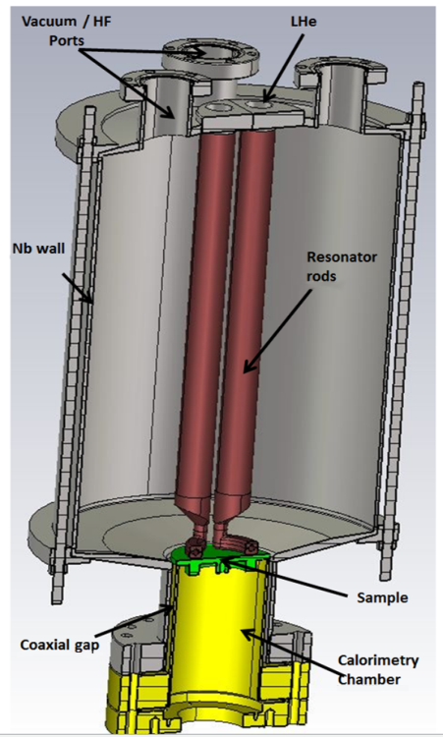
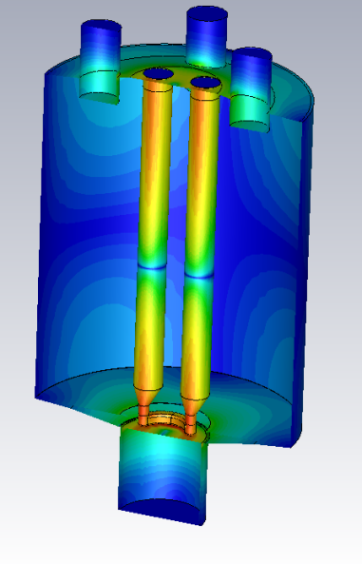
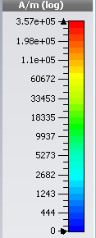
Quadrupole Resonator
Pillbox-like cavity with four pairwise-connected niobium rods
Quadrupole modes have high magnetic rf-fields on sample surface, decay in coaxial gap
Sample and Resonator thermally decoupled
Sample not in direct contact with liquid helium
Calorimetric measurement of RF-losses
  at frequencies = 433, 866, 1300 MHz
  within wide magnetic field range
Samples can be characterized at arbitrary temperatures, also near and above T_{c}.
Original setup at CERN¹, changes to RF design presented at SRF 2013²
1: E. Haebel et al. „ The Quadrupole Resonator, Design Considerations and Layout of a New Instrument for the RF Characterization of Superconducting Samples “, EPAC 98
2: R. Kleindienst, „Developement of an Optimized Quadrupole Resonator“, SRF 2013

Slide 5
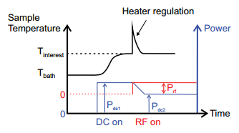
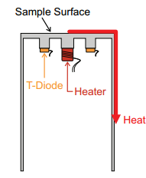
RF-DC Compensation Measurement
Sample is kept at a constant temperature throughout the measurement by heater
RF losses on sample identified by difference in heater power with RF on and off
Stored energy of cavity measured with weakly coupled loop antenna, simulation parameter relates stored energy to fields
Resolution of measurement increases with higher field and lower thermal conductivity
[ S.Aull, „High Resolution Surface Resistance Studies“, SRF 2013 ]

Slide 6
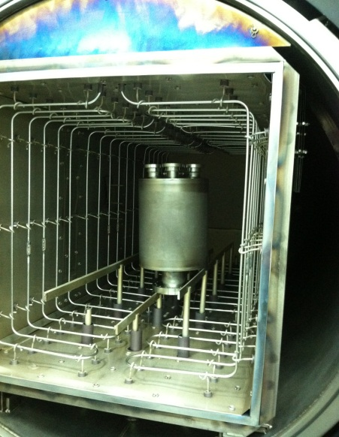
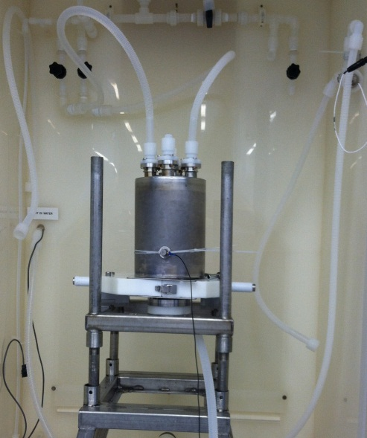
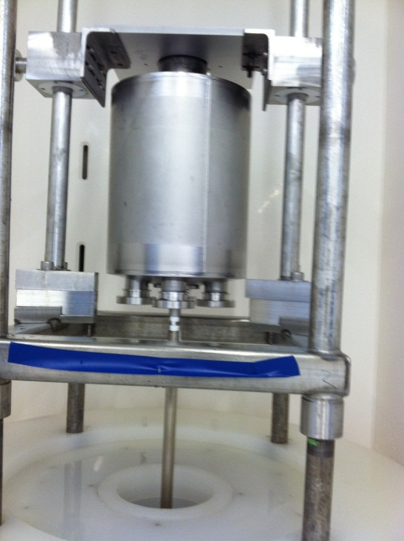
Manufacturing / Processing
Manufacture at Niowave
Cavity processing at Jefferson Lab with ‚standard treatment‘ for SC cavities
  150 µm BCP
  600° C bakeout for 12 hours
  120° C bake for 48 hours
  20µm BCP
  Ultrasonic rinse to resistivity
  High pressure rinse

Slide 7
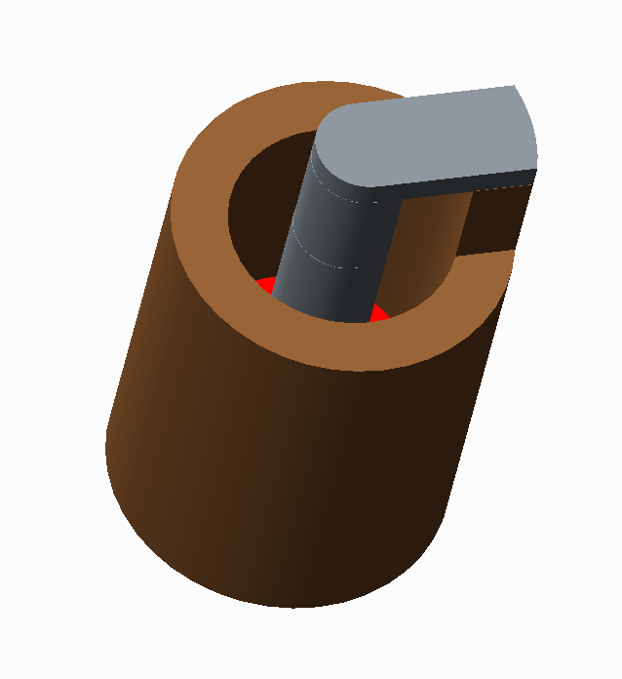
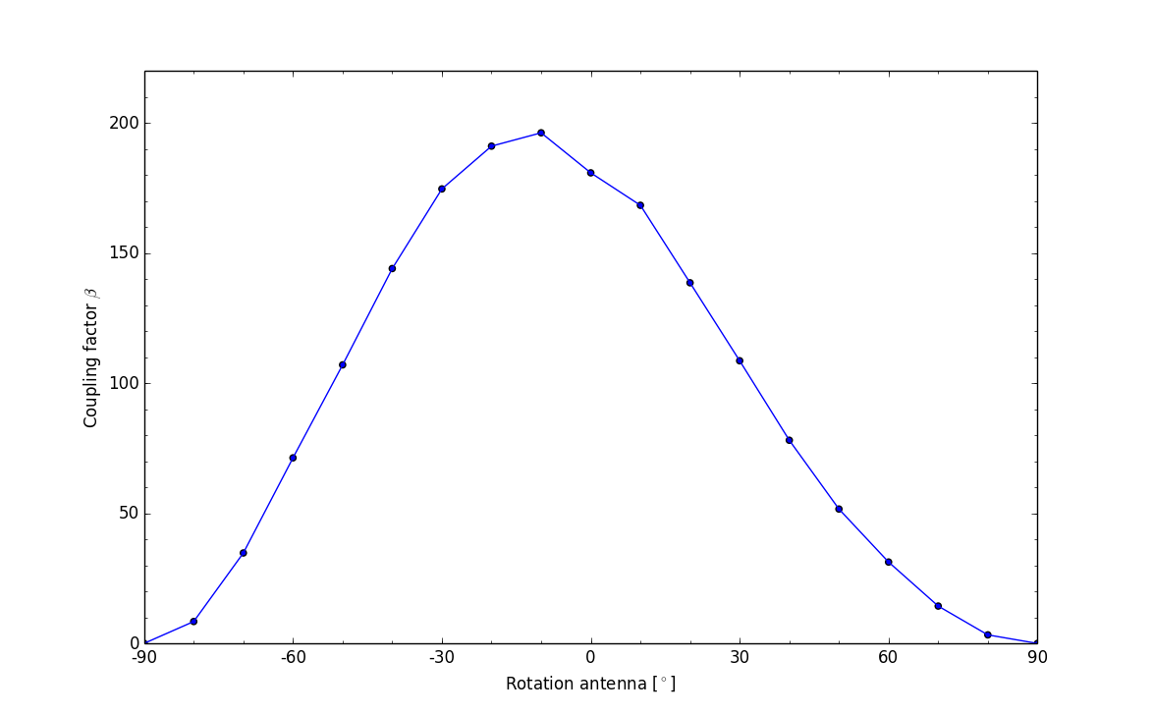
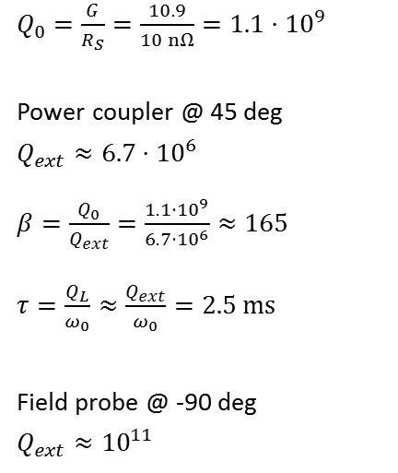
Antenna simulation
Loop coupler on
rotatable CF35
Adjust beta up to 200
(high beta can reduce
multipacting)
$Q_{0}=\frac{G}{R_{S}}=\frac{10.9}{10 nΩ}=1.1⋅{10}^{9}$
Power coupler @ 45 deg
$Q_{ext}≈6.7⋅{10}^{6}$
$β=\frac{Q_{0}}{Q_{ext}}=\frac{{1.1⋅10}^{9}}{6.7⋅{10}^{6}}≈165$
$τ=\frac{Q_{L}}{ω_{0}}≈\frac{Q_{ext}}{ω_{0}}=2.5 ms$
Field probe @ -90 deg
$Q_{ext}≈{10}^{11}$

Slide 8
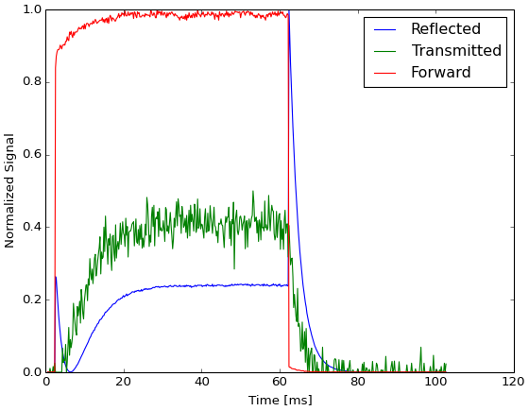
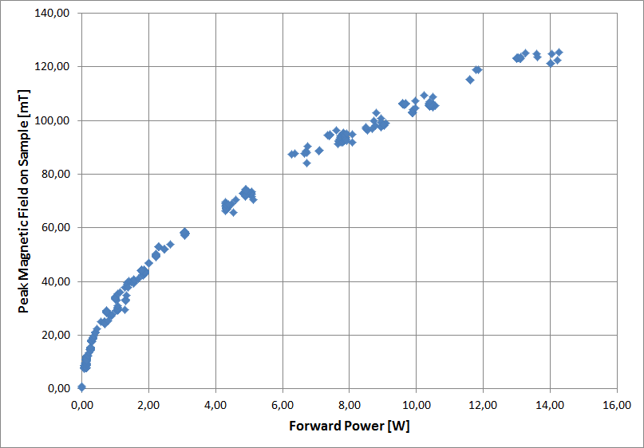
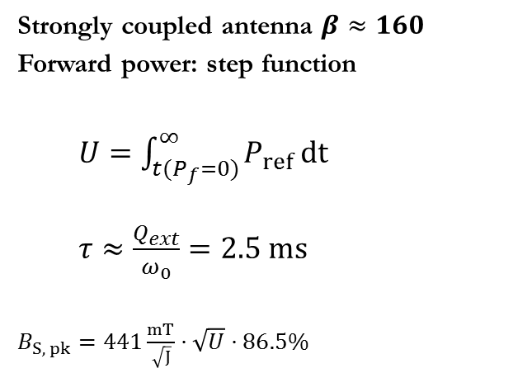
First test at JLAB
Strongly coupled antenna $β≈160$
Forward power: step function
  $U=\int_{t(P_{f}=0)}^{∞}{P_{ref}}dt$
  $τ≈\frac{Q_{ext}}{ω_{0}}=2.5 ms$
$B_{S, pk}=441\frac{mT}{\sqrt{J}}⋅\sqrt{U}⋅86.5\%$
Maximum achieved field = 125 mT
(needs confirmation at HZB)

Slide 9
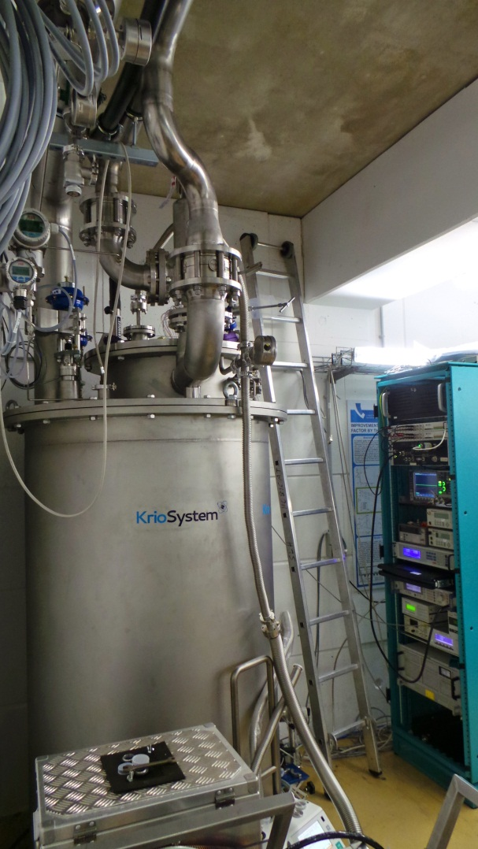
First Tests at HZB, March 2015
QPR was first cavity to be tested in the new Vertical Test Facility (VeSiCaT) at HZB
  Helium bath cryostat with passive radiation shield cooled by evaporating gas
  Double magnetic shielding for remnant fields below 1 µT
  Very good pressure stability (± 0,01 mbar)
433 MHz RF system based on phase-lock-loop used to track resonance frequency
Limited liquid helium supply is starting to
become the bottleneck for increasing
number of cryogenic installations at HZB

Slide 10
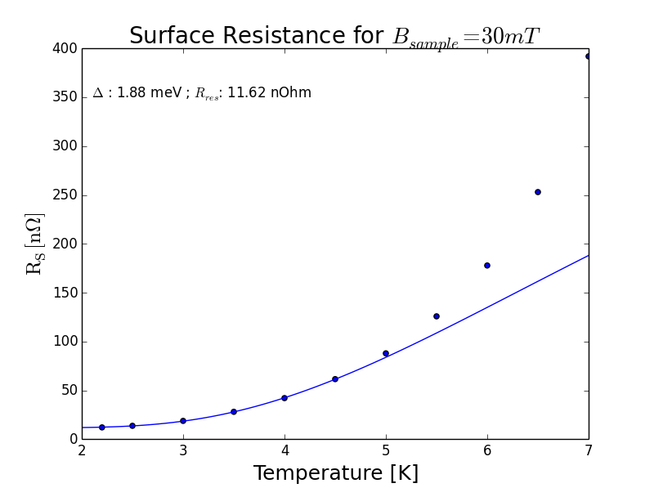
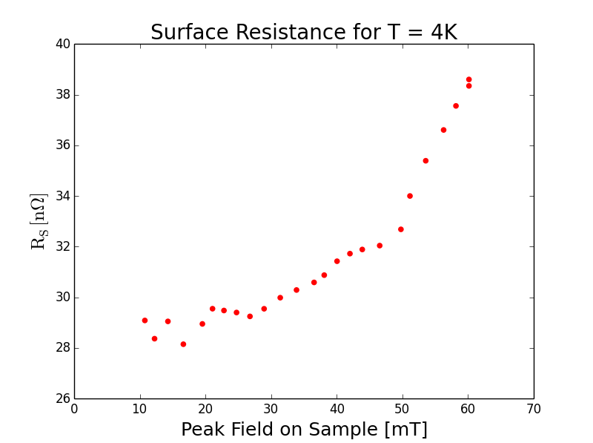
First results
First Sample tested was large grain, bulk Niobium with RRR=300
Fields limited to 30 mT in CW, 60 mT achievable in pulsed mode.
Surface resistance as a function of temperature follows BCS prediction:
Measurement against field shows increase in resistance with rising field, too much noise/drift though to make meaningful fit.

Slide 11
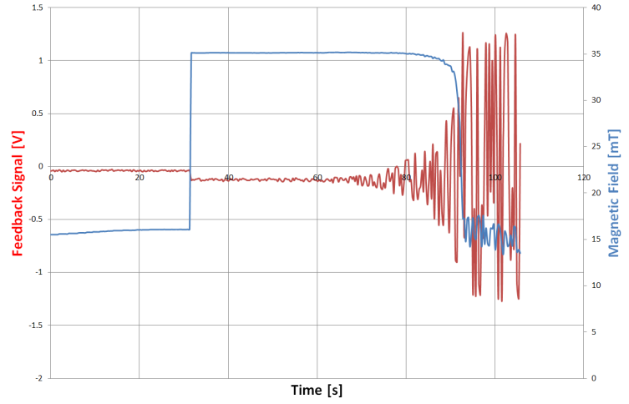
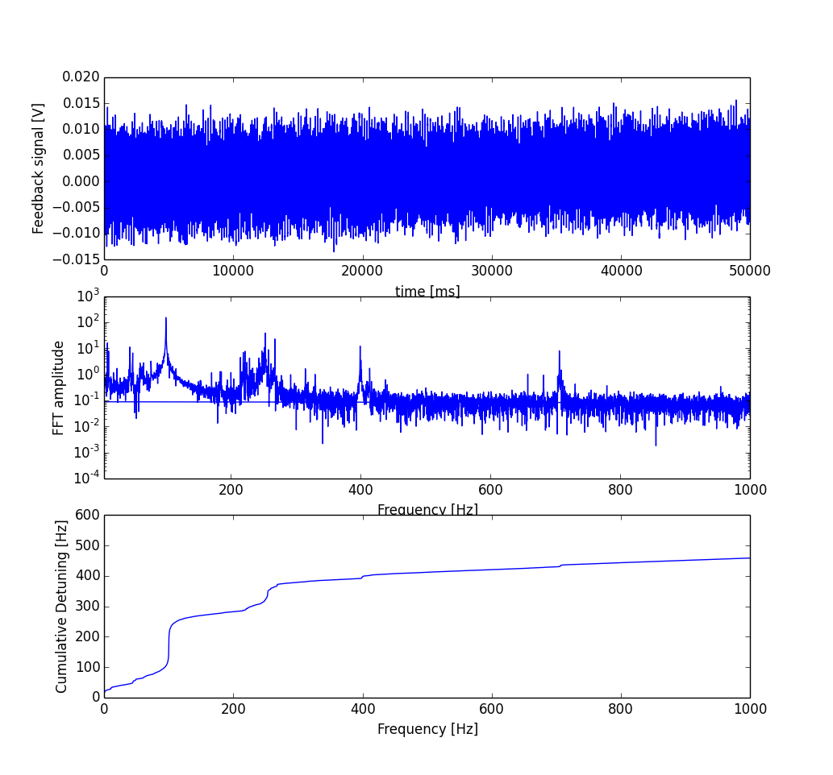
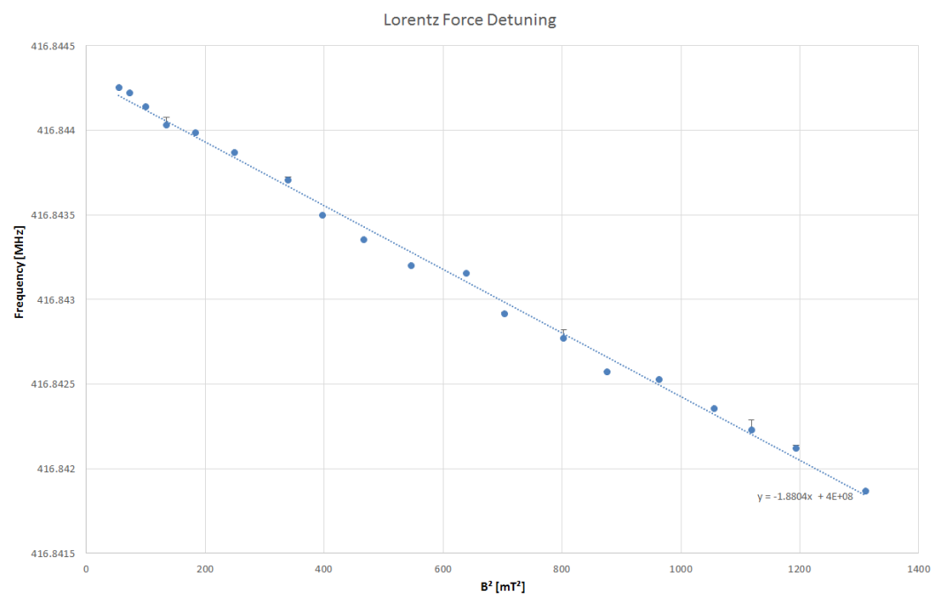
Field limitation
Typical candidates for field limitation field emission, multipacting, thermal quench
In CW, field limitation caused by runaway feedback signal
Resonator is very susceptible to mechanical deviations
  Pressure sensitivity df/dp = 2,7 kHz/mbar
  LF detuning coefficient = -1,85 Hz/mT²
  Frequency sensitivity of slit = 1 MHz/mm
Notes:
Tesla cavity: df/dp several Hz/mbar
Lf detuning 1.5 Hz/ MV/m -> 1 kHz for 30 MV/m

Slide 12
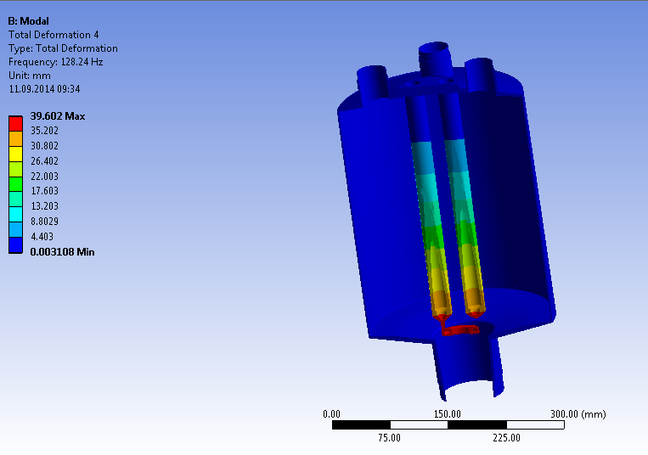
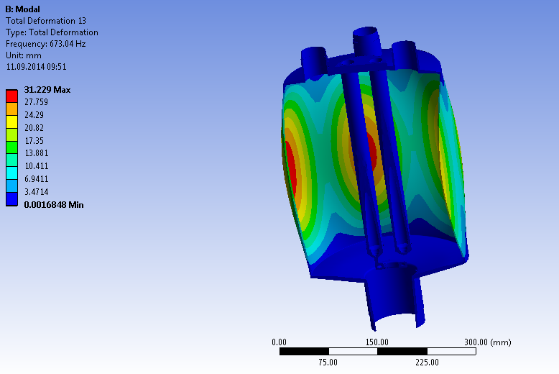
Simulation of mechanical eigenmodes
Frequency [Hz] | Description
113.59 | Rods
118.42 | Rods
127.68 | Rods
152.64 | Rods
298.86 | Thermometry Chamber vs Resonator
299.47 | Thermometry Chamber vs Resonator
331.48 | Resonator lids
472.69 | Rods
472.96 | Rods
560.16 | Rods
566.80 | Resonator walls
567.09 | Resonator walls
609.17 | Resonator walls
626.67 | Resonator lids
672.16 | Resonator Walls
672.20 | Resonator Walls
677.21 | Resonator Walls
677.42 | Resonator walls
734.32 | Rods
787.51 | Rods

Slide 13
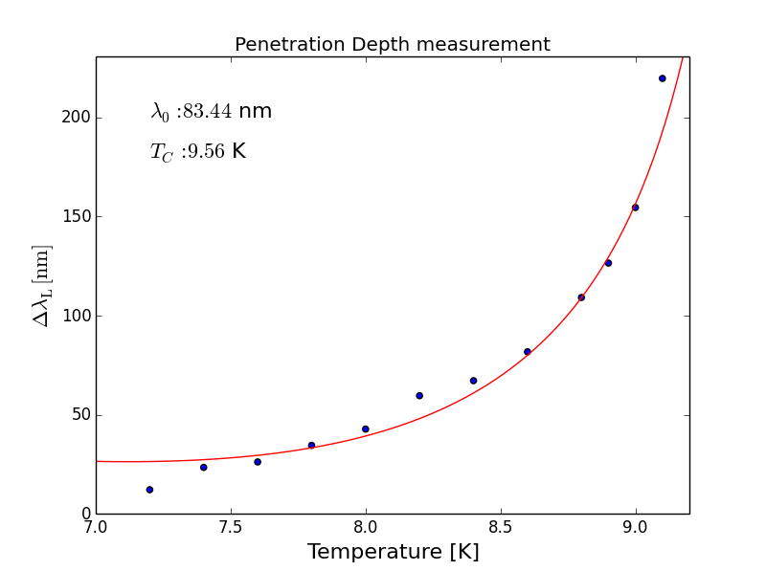
Example: Penetration depth measurement
Magnetic fields probe surface of superconductors to characteristic length λ_{L}
Empirical temperature dependence of penetration depth (Gorter Casimir)
Measure change of resonance frequency while increasing temperature of probe
Geometry factor of probe relates change in stored energy to change in magnetic volume = penetration depth
Fit data with Gorter Casimir to extract λ₀ and T_{C,}
Not very good match with literature values, different values for measurement with different modes
Penetration depth measurement can be used to obtain values for mean free path as well as RRR
Gorter Casimir relation
Slater theorem
Notes:
Tesla cavity: df/dp several Hz/mbar
-1.5 Hz/ MV/m -> 1.3 kHz @ 30 MV/m
5 kHz

Slide 14
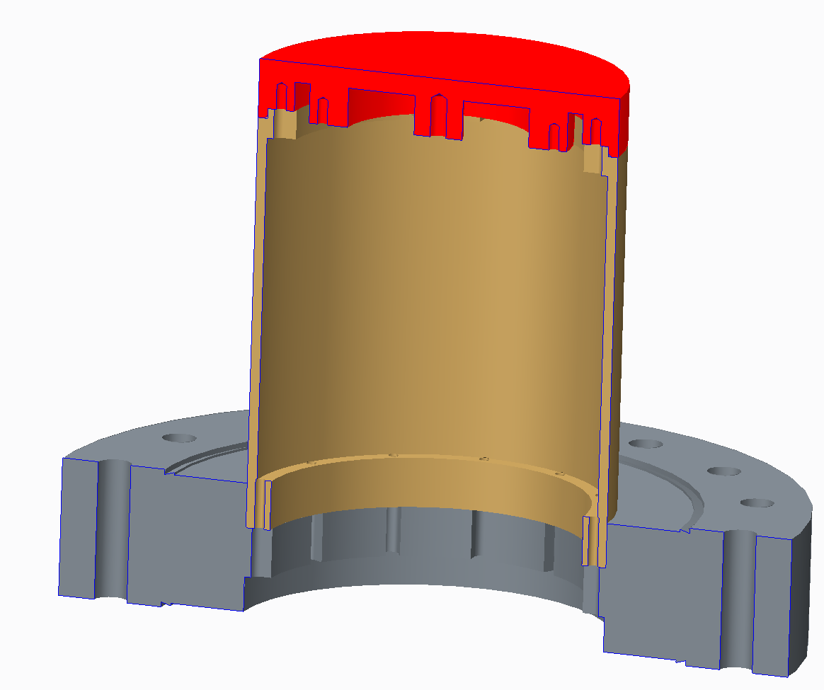
Alternative sample chamber
Avoid welds
Smaller sample size
Exchangeable sample
Helicoil inserts
(Ti or CuBe)
Indium gasket
Nb
Tested with CERN QPR

Slide 15
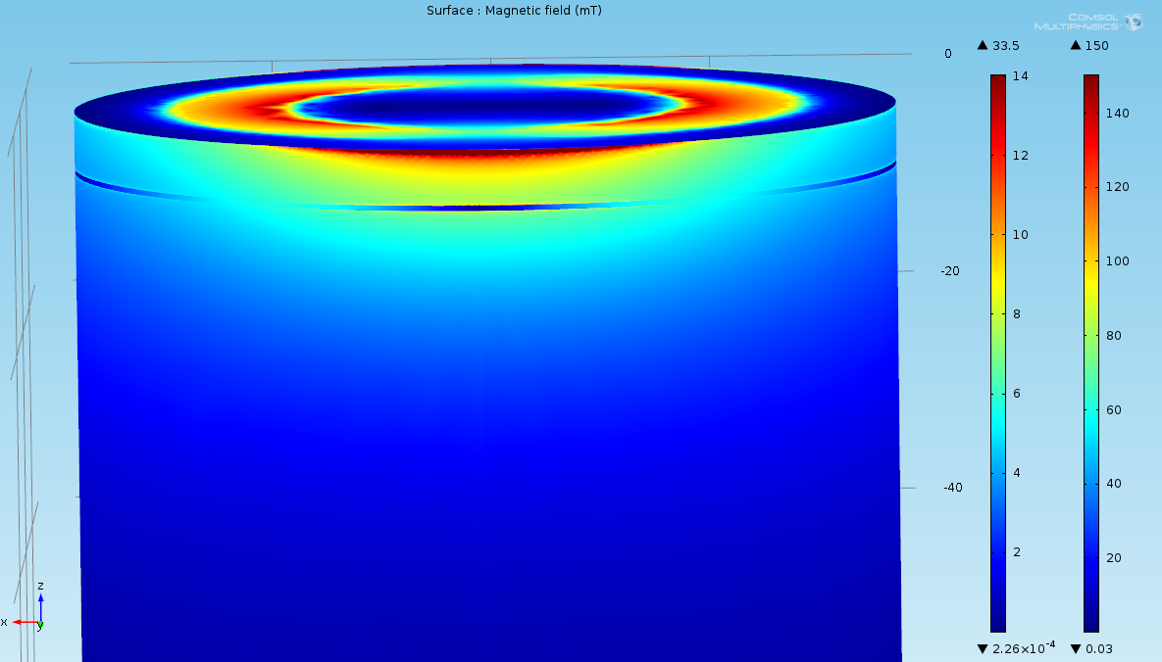
Alternative sample chamber, simulation
Position of circumferential gap: upper edge @ 5 mm below sample
Height of gap: 0.5 mm
Depth of gap: 1 mm
Normalization: Bpk, sample = 150 mT (right-hand color scale)
Color scale coax: max = 14mT = Bpk @ upper edge of gap
Comsol simulations
by S. Keckert
Want > 12 mm
sample height
for reasonable
field reduction
in coax gap

Slide 16
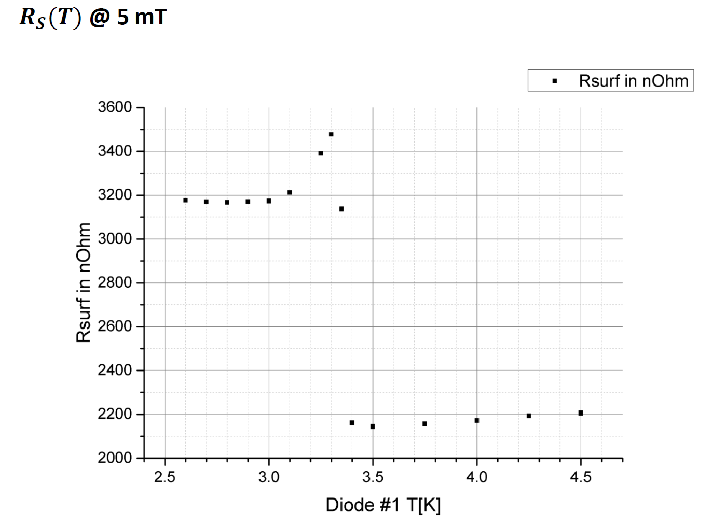
Results with alternative chamber obtained at CERN QPR
Indium sc transition
Increase in surface resistance at lower temperature. Why?
Too high residual resistance. Indium spilling?
Reduced thermal conductivity of sc indium is NOT the cause. Effect would be 2 oom smaller
S. Keckert, S. Aull
T_{c}(Indium) = 3.4 K

Slide 17
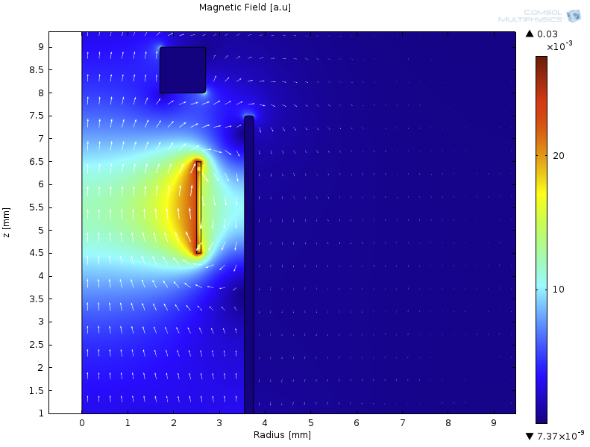
Upgrade: Solenoid coil in thermometry chamber
Designed coil to apply external magnetic fields during cool down
QPR rod
Create 50 µT at sample
sample
Thermometry
chamber
QPR chamber

Slide 18
Summary and outlook
Commissioning of Quadrupole Resonator almost complete
Microphonic issue seems to be limiting performance
Planned upgrades:
  alternative sample geometry
  integration of solenoid
Start process of obtaining samples
Measurement program:
  Alternative materials
  Origins of mid field Q-slope
  Dynamics of flux trapping

Slide 19
Acknowledgement
Thank you for listening
Thanks to Sarah Aull at CERN for providing access to the CERN QPR and facility
Thanks to Dirk Pflückhahn, Stefan Rotterdam, Michael Schuster, Sascha Klauke for engineering support

Slide 20
Backup

Slide 21
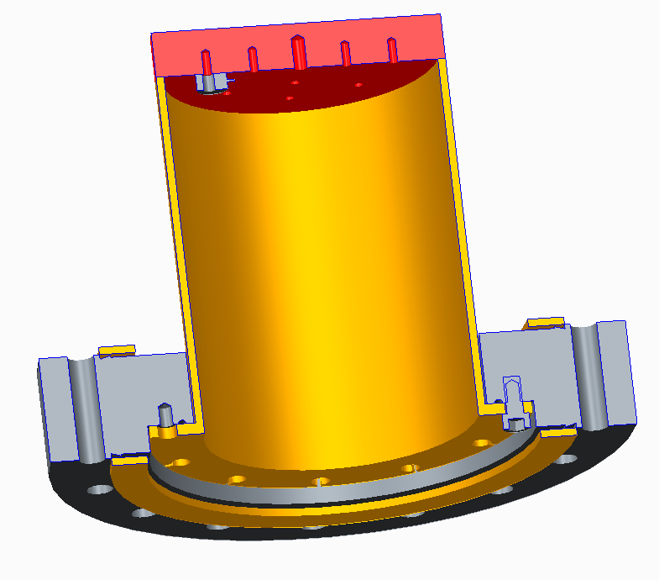
Thermometry chamber: Design modification
Indium or Kapton seal

