Slide 1
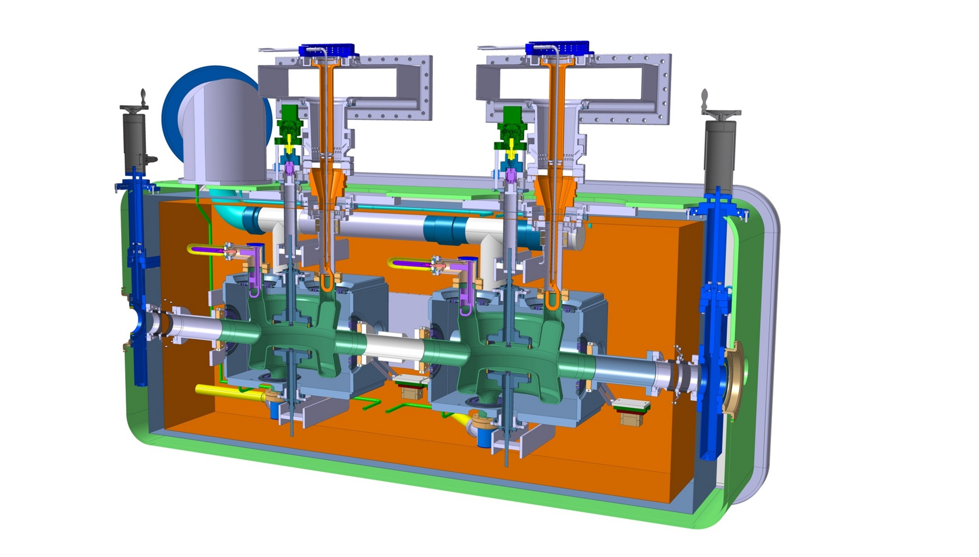
Cryomodule
Cryomodule with DQW cavities
Fundamental Power Coupler
Tuning system
Helium vessel
High Order Modes Suppressor
Thermal shielding
Cavity
Alignment monitoring system
Warm magnetic shielding
Vacuum vessel

Slide 2
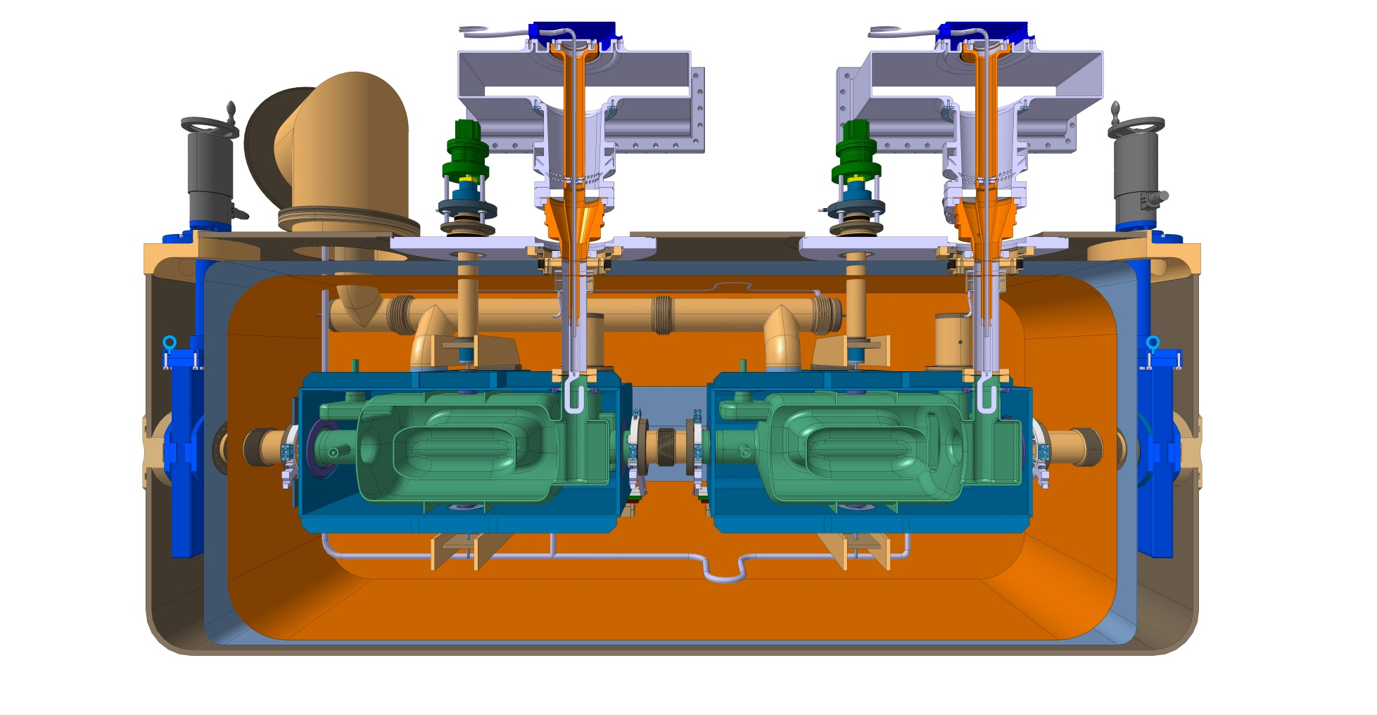
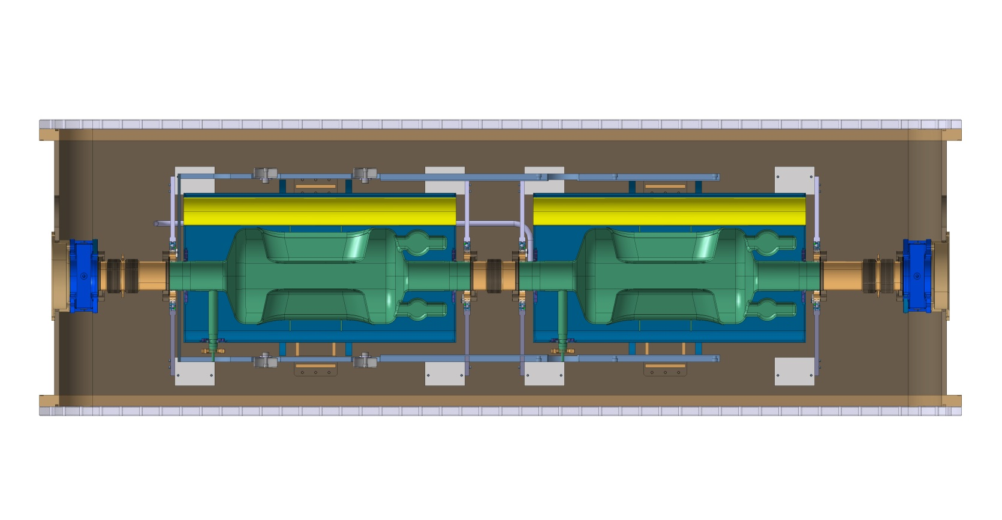
Cryomodule
Cryomodule with RFD cavities

Slide 3
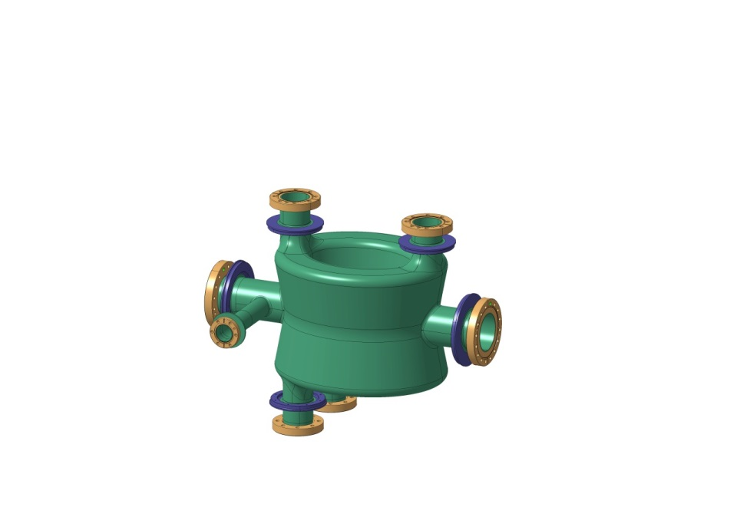
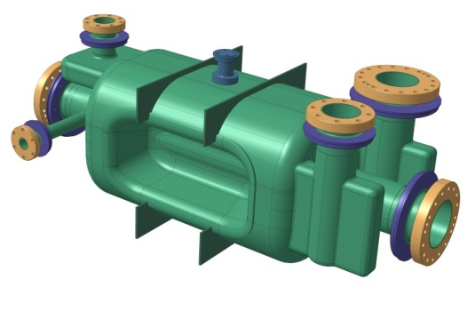
DQW
Bare cavities
RFD
FC, 20/November/2014
Engineering specification
EDMS 1389669 “Engineering Specification for the dressed bulk niobium Crab Cavities”
Manufacturing of cavities launched with Niowave in July

Slide 4
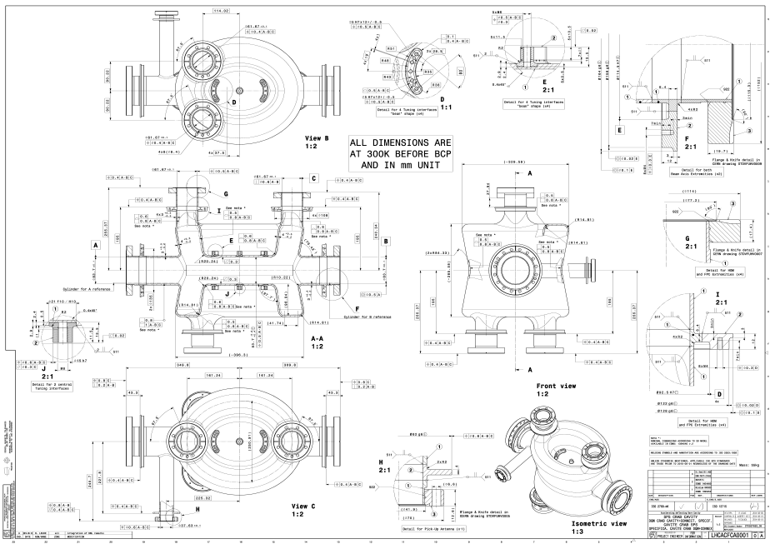
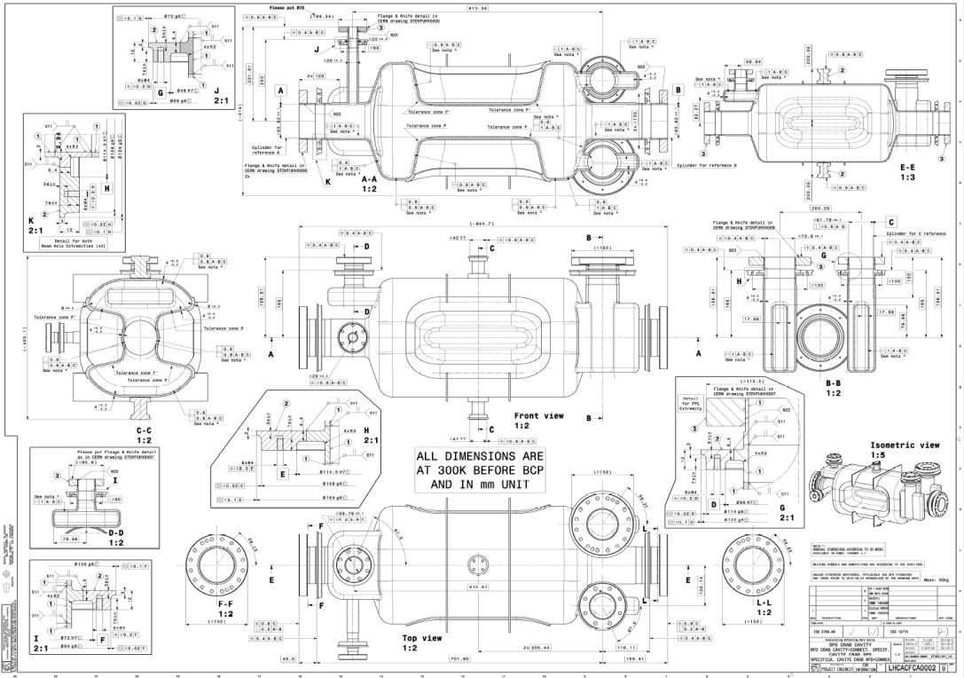
Bare cavities
FC, 20/November/2014
DQW Specification drawing – LHCACFCA0001
RFD Specification drawing – LHCACFCA0002

Slide 5
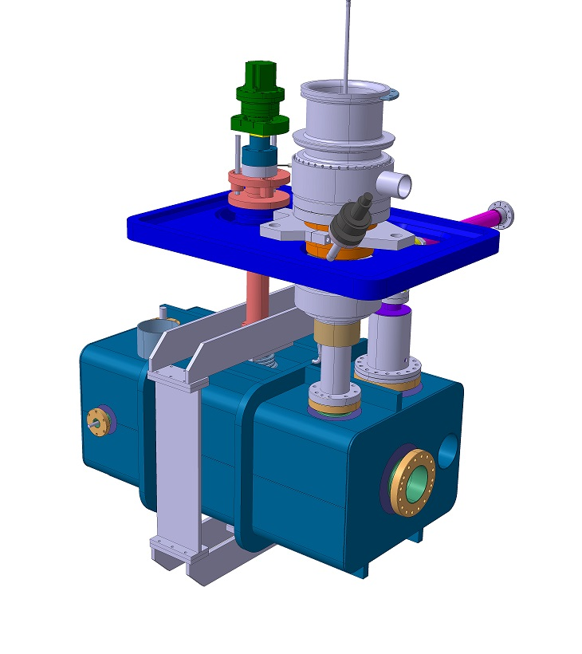
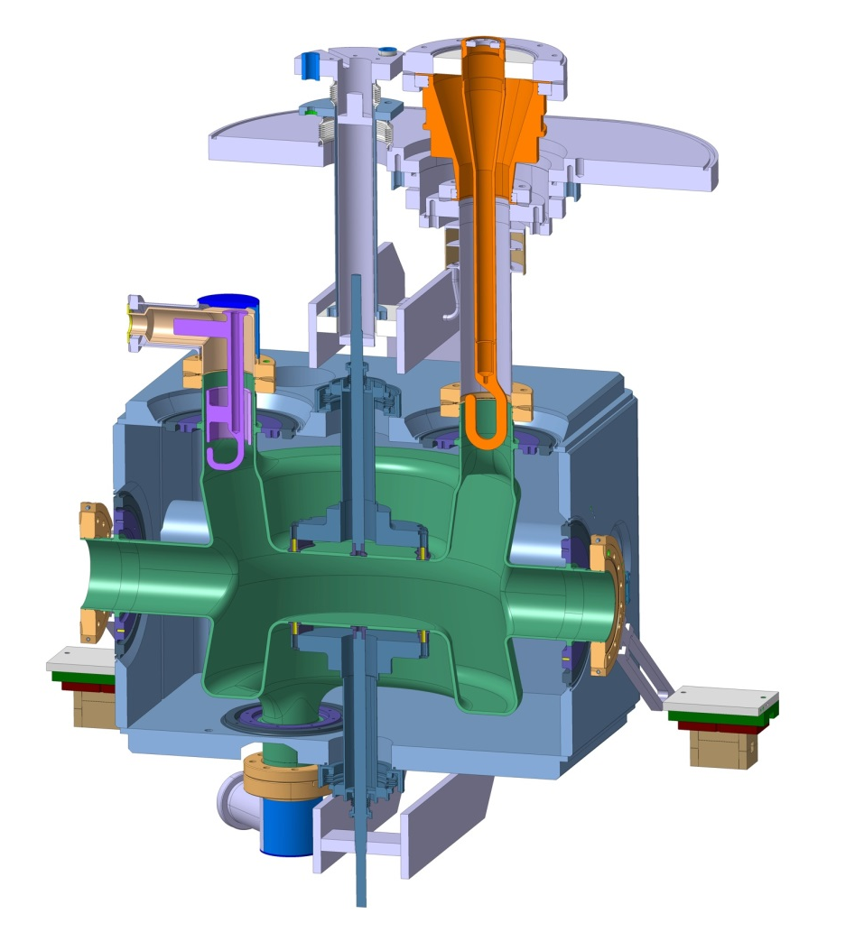
DQW
Dressed cavities
RFD
FC, 20/November/2014
Detailed design for manufacturing ongoing for:
Helium vessel + tuning, support, handling, alignment interface
HOM couplers
Cold magnetic shielding

Slide 6
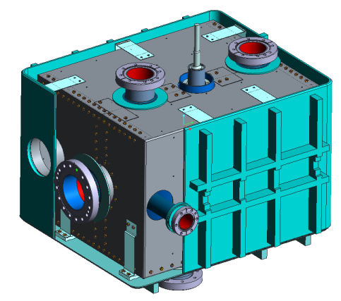
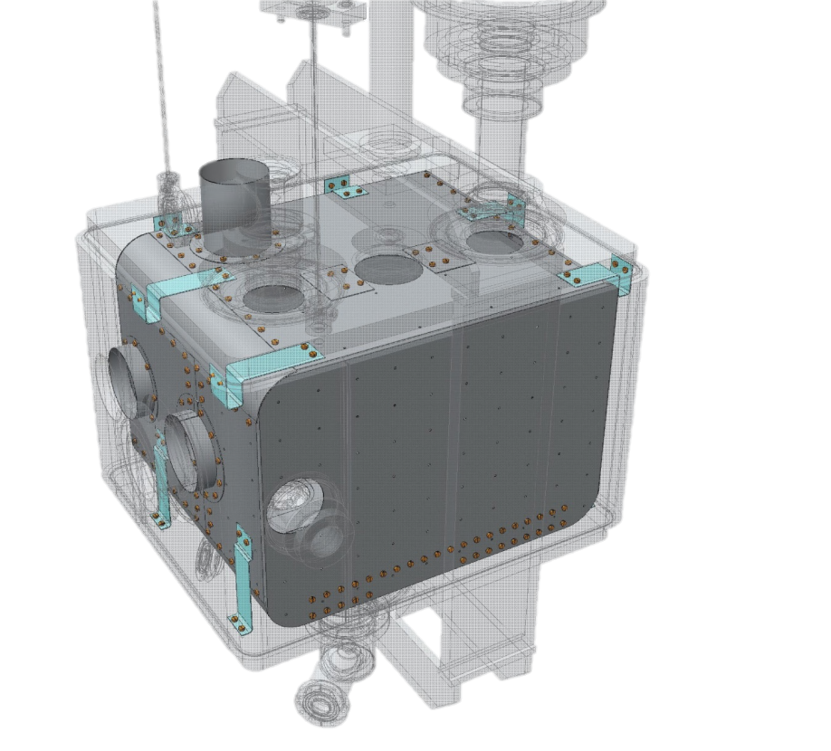
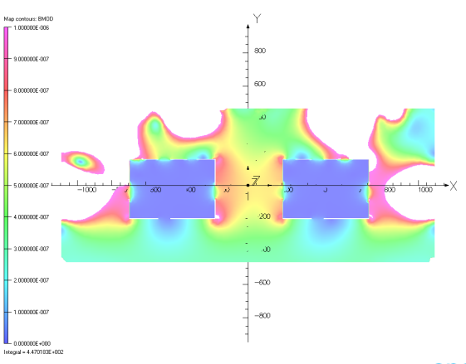
Cold magnetic shielding
Cold magnetic shielding inside helium vessel
Developed by colleagues from UK
FC, 20/November/2014

Slide 7
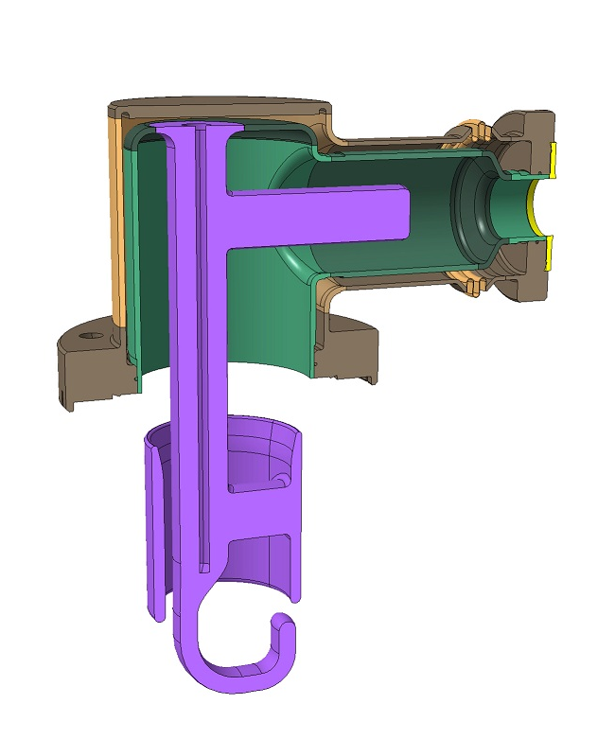
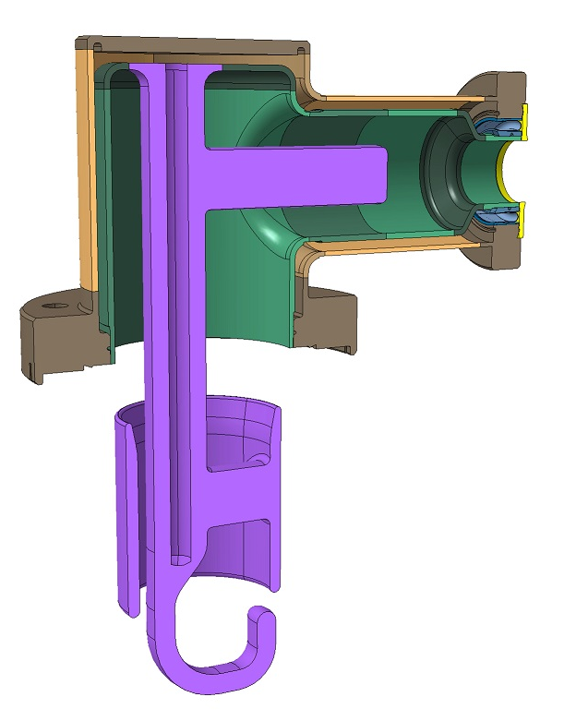
HOM
Detailed discussions ongoing / design and manufacturing:
FC, 20/November/2014

Slide 8
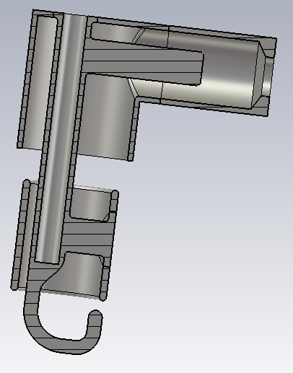
HOM
Detailed discussions ongoing / design and manufacturing
1&2
B
C
3
FC, 20/November/2014
4&6
D
5

