Slide 1
HL-LHC :
What is it and
What challenges it represents for VSC
V. Baglin on behalf of WP12
CERN-TE-VSC

Slide 2
Outline
Introduction
Inner Triplets
Layout
Crab cavities
Collimation
SC links and cryogenics
Options
LS2
Summary

Slide 3
1. Introduction

Slide 4
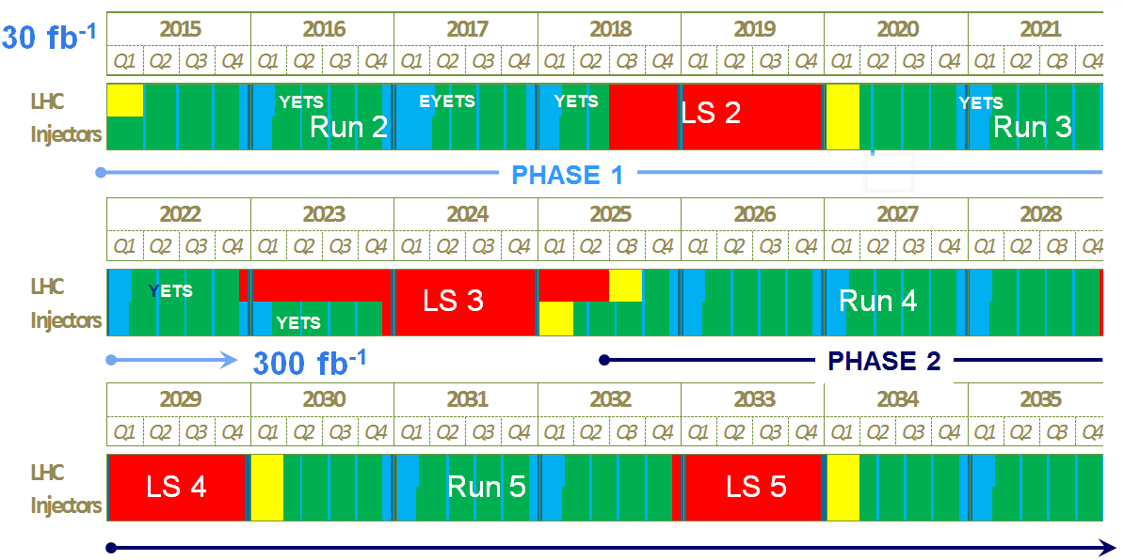
LHC roadmap: schedule beyond LS1
LS2 starting in 2018 (July) => 18 months + 3 months BC
LS3 LHC: starting in 2023 => 30 months + 3 months BC
Injectors: in 2024 => 13 months + 3 months BC
Physics
Shutdown
Beam commissioning
Technical stop
(Extended) Year End Technical Stop: (E)YETS
~ 100-
120 fb⁻¹
Goal of 3’000 fb⁻¹ by mid 2030ies
LIU + HL-LHC
F. Bordry

Slide 5
Run III
Run I
Run II
0.75 10³⁴ cm⁻²s⁻¹
50 ns bunch
high pile up ∼40
1.7 10³⁴ cm⁻²s⁻¹
25 ns bunch
pile up ∼45
1.7-2.2 10³⁴ cm⁻²s⁻¹
25 ns bunch
pile up ∼60
Lumi saturation &
Technical bottlenecks:
50 ⇒ 25 ns
Plan approved by CERN management upon preparation in HL-LHC Coord Group and RLIUP
L. Rossi
VSC Seminar, CERN, December 5, 2014

Slide 6
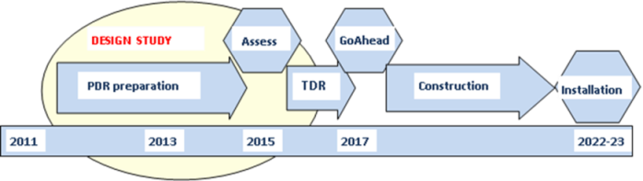
HiLumi Design Study: overview
PDR (preliminary design report) in 2014
Cost and Schedule Review by March 2015
TDR (technical design report) by 2015
HL-LHC installation:
    2018-2019 during LS2
    mainly 2023-2024 during LS3
19 Work Packages with 6 WP under the EU funded HiLumi Design Study
Integration started with vigor as well as Preliminary Technical Specifications and Quality Assurance
Several upgrades already in LS2: e.g. Cryo, SC link P7, Cryo-Collimators with 11 T , MoGr Coll’s)
Proof of main hardware by 2016
Final Prototypes to be tested by 2017-2018 (IT, D1, D2, LRBBwire, CC)
Start construction 2017/18 for IT, CC, other main hardware
IT String test (integration) in 2019-20; Main Installation 2023-24
Though schedule, but – based on LHC experience – feasible; 6 months shift of LS2 and 1 year shift of LS3 of the new LHC schedule ease the task.
Cost: 750 MCHF (Material, CERN accounting)
L. Rossi
A real challenge for VSC in the coming years !!!

Slide 7

HL-LHC Baseline Parameters - WP2 charge – PLC
Parameter | Nominal LHC​ (design report) | HL-LHC 25ns (standard)​ | HL-LHC 25 ns (BCMS) | HL-LHC 50ns
Beam energy in collision [TeV] | 7 | 7 | 7 | 7
N_{b} | 1.15E+11 | ​2.2E+11 | 2.2E11 | ​3.5E+11
n_{b} | ​2808 | ​2748¹ | 2604 | ​1404
Number of collisions at IP1 and IP5 | 2808 | 2736 | 2592 | 1404
N_{tot} | 3.2E+14 | 6.0E+14 | 5.7E+14 | 4.9E+14
beam current [A] | ​0.58 | 1.09 | 1.03 | 0.89
x-ing angle [μrad]​ | 285 | 590 | 590 | 590
β* [m] | 0.55 | ​0.15 | 0.15 | ​0.15
ε_{n} [μm]​ | 3.75 | ​2.50 | 2.50 | 3
r.m.s. bunch length [m] | ​7.55E-02 | ​7.55E-02 | ​7.55E-02 | ​7.55E-02
Geometric loss factor R0 without crab-cavity | ​0.836 | 0.305 | 0.305 | 0.331
Geometric loss factor R1 with crab-cavity | (0.981) | 0.829 | 0.829 | 0.838
Peak Luminosity without crab-cavity [cm⁻² s⁻¹] | 1.00E+34 | 7.18E+34 | 6.80E+34 | 8.44E+34
Virtual Luminosity with crab-cavity: Lpeak*R1/R0 [cm⁻² s⁻¹] | (1.18E+34) | 19.54E+34 | 18.52E+34 | 21.38E+34
Events / crossing without levelling w/o crab-cavity | ​27 | 198 | 198 | 454
Levelled Luminosity [cm⁻² s⁻¹] | - | ​5.00E+34 | 5.00E34 | 2.50E+34
Events / crossing (with levelling and crab-cavities for HL-LHC) | 27 | 138 | 146 | 135
Levelling time [h] (assuming no emittance growth) | - | 8.3 | 7.6 | 18.0
LIU required
Collision values
Impedance, efficiency etc.
New IT Quads & ATS
Crab Cavity
required
Levelling
required
Efficiency requires long fill times (ca. 10h)!
VSC to review performance compatibility with HL-LHC to identify consolidation
and build new systems compatible with HL-LHC
VSC Seminar, CERN, December 5, 2014

Slide 8
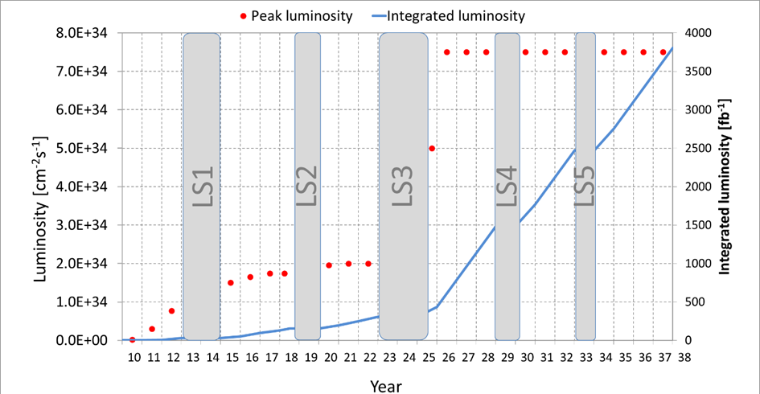
Only with 350 fb⁻¹/y (L_{lev}=7.5 10³⁴ and some optimism) the goal is reachable
M. Lamont
Quality management of LHC and its injector is a must to reach the required efficiency (R2E, R2P, spare, performance follow up … )

Slide 9
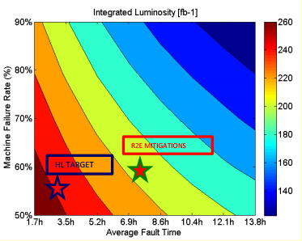
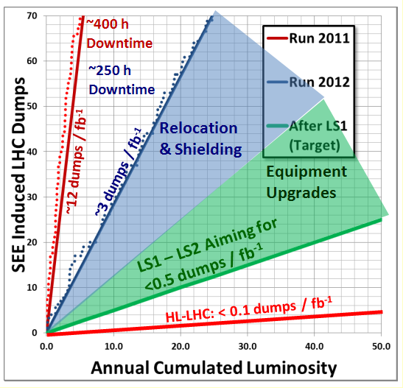
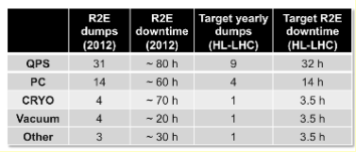
Availability and Downtime
D. Wolmann
M. Brugger
Upgrade of interlocking system (integration to avoid spurious dump)
Reduction of (generous) of interlock levels
R2E
Robust and reliable equipments
Identification of “fast” repair scenario
Etc.

Slide 10
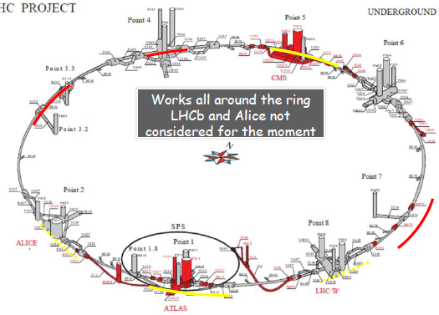
The HL-LHC Project
F. Bordry
New IR-quads Nb₃Sn (inner triplets)
  New 11 T Nb₃Sn (short) dipoles
  Collimation upgrade
  Cryogenics upgrade
  Crab Cavities
  Cold powering
  Machine protection
  …
Major intervention on more than 1.2 km of the LHC
Project leader: Lucio Rossi; Deputy: Oliver Brüning
Close collaboration across all the VSC sections is a must

Slide 11
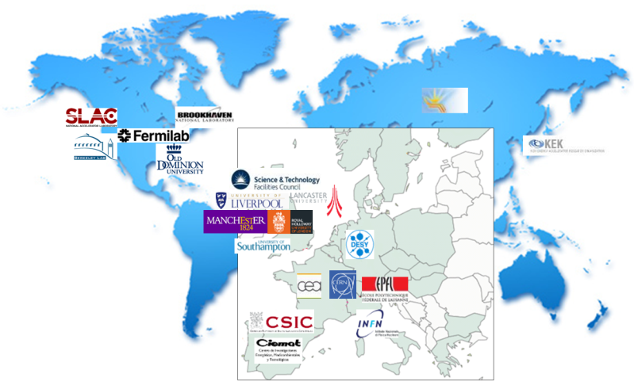
High Luminosity LHC Participants
L. Rossi
Identification of potential partners for future design studies, HL-LHC procurement and installation

Slide 12
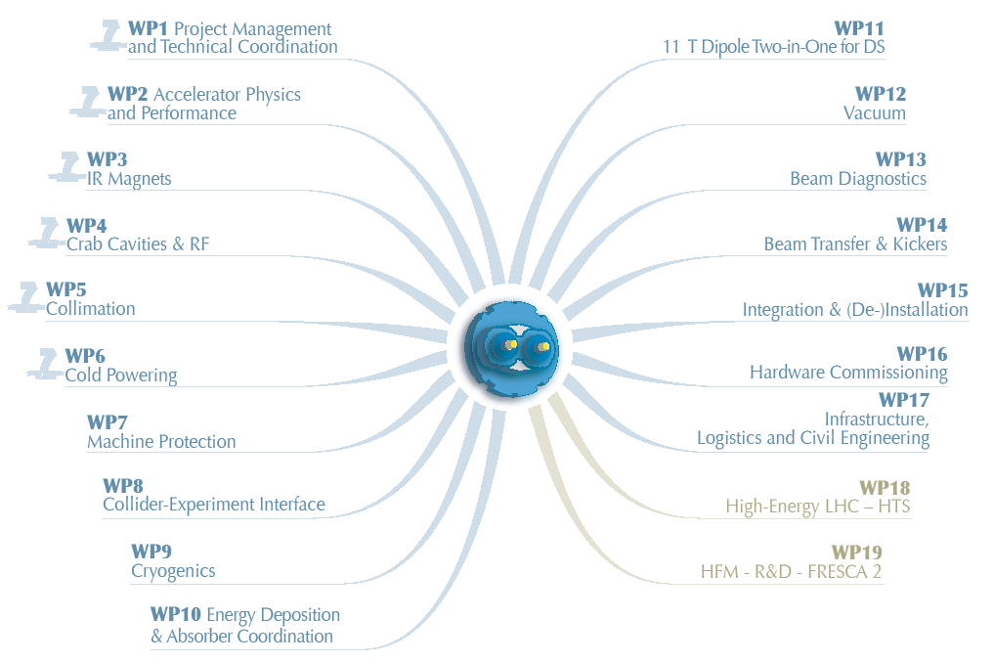
Organisation
https://espace.cern.ch/HiLumi/default.aspx
A single point of entry (VB and RK) for a TEAM work across VSC and partners

Slide 13
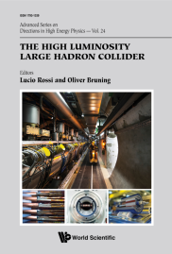
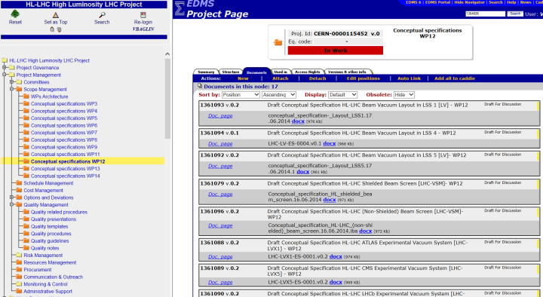
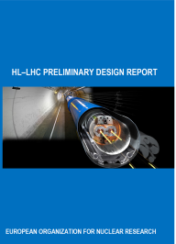
Documentation
Definition and follow up of HL-LHC TE-VSC project structure is needed

Slide 14
2. Inner Triplets

Slide 15
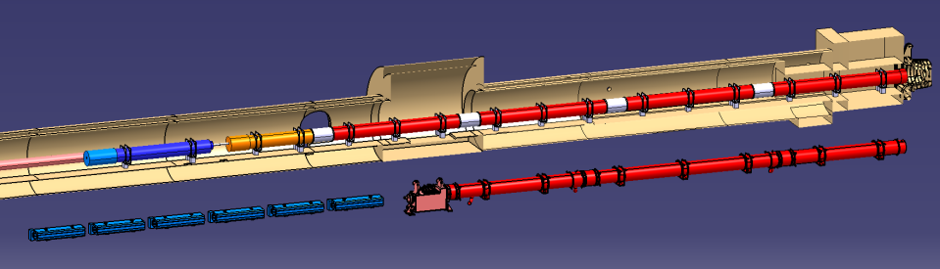





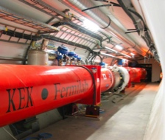
Focussing quadrupole and merging dipole
Decrease beta (i.e beam size) at collision point (beta*) from 55 cm to 15 cm
IT Quads.& D1
HL-LHC
IT Quads. w/ Nb₃Sn
Q1
ATLAS
CMS
Corrector
Package
Q2b
Q2a
Q3
SC D1
Present IT
NC D1
New : Q1, Q2, Q3, CP (corrector package), D1
All operating at 1.9 K
Magnet aperture increase in IT quads : 70 mm to 150 mm, 140 T/m
Superconducting D1 (aperture 150 mm, 5.6 T)
Present IT+D1 to be completely removed (radiation to personnel !!)
Interconnects to be redesigned

Slide 16
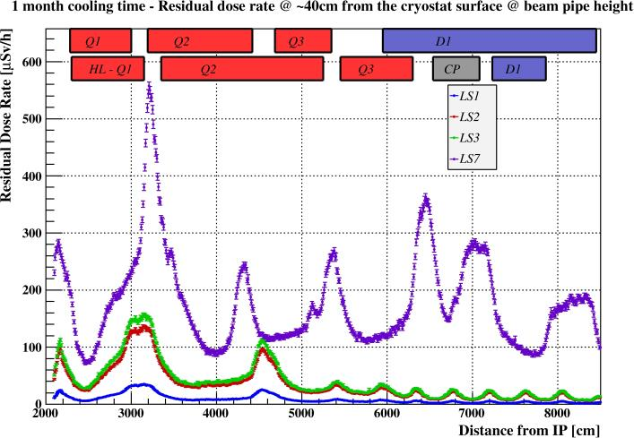
Impact of radiation to personnel around IT
1 month cooling time, dose rates at 40 cm from the cryostat
~ x16 wrt LS1
~ x4 wrt to LS3
Nominal scenario
Representing any LS after LS3
C. Adorisio

Slide 17
Impact of radiation to personnel around IT (2)
CERN Objective : 3 mSv/year maximum during LS (Rule for Cat B personnel : 6 mSv/y)
Case study : When ? any LS after LS3, nominal
 |  |  | Collective dose (man mSv)
What | Where | How ? | 1 month cooling time | 4 months cooling time
Valve exchange | TAS-Q1 | 3 teams 5 workers | 3 | 1
PIM exchange | Q1-Q2 IC | 6 teams 8 workers | 21 | 8
C. Adorisio
/2.5
Estimation of WDP (work dose plan) can also be done for LS3 and the removal of the present inner triplet magnets to optimize the work-methods
Dose maps available from TAS to D1
Optimisation of design, equipment robustness, intervention procedures (WDP) with use of remote tooling and training of people is MANDATORY

Slide 18
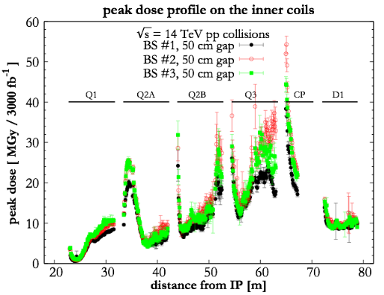
Impact of debris onto IT+D1
700 MJ per beam (7 TeV, 2.2 10¹¹ ppb, ~ 2800 b)
14 kW delivered in collisions, on each side:
  TAXS absorber with aperture, 54 mm, takes 750 W
  5 kW impact the machine ➔ shielding is needed to protect the cold masses
Target :
  < 4 mW/cm3
  < 40-50 mGy
Mainly Q3 affected
1 kW in the cold mass
800 W in the beam screen
F. Cerutti

Slide 19
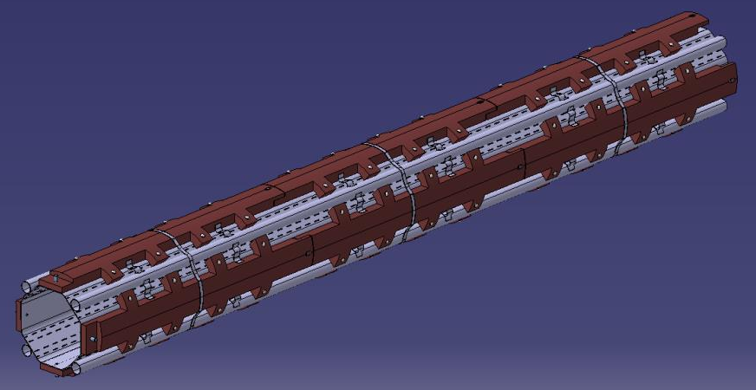
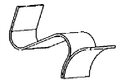
Impact of debris onto IT+D1: shielded beam screen
Operating temperature : 40 -60 K
16 mm absorbers in Q1, 6 mm absorbers from Q2 to D1
Assembly of the Q1 beam screen
Tungsten blocks
(mechanically connected to the beam screen tube)
Perforated Cu colaminated tube
Cooling tubes
Thermal links
Copper
Elastic supporting system
Ref: 13th HL-LHC Technical Committee – 7/10/204
C. Garion
Design studies underway
Mechanical analysis : impact of quench, heat transfer, supporting system
Tests with tungsten prototypes

Slide 20
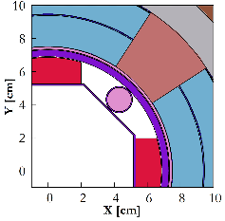
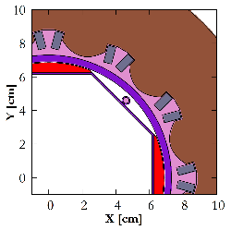
Impact of debris onto IT+D1: shielded beam screen (2)
New cold bores
Octagonal shape, 4 cooling channels
~ 700 kg per Quadrupole
16 mm absorber
(Q1)
6 mm absorber (Q2=>D1)
Q2-Q3 2015: short (1 m long) prototype
Defining, controlling tolerances and alignment is a challenge
To be validated by C&S review
Engineering specification and prototyping to start by 2015

Slide 21
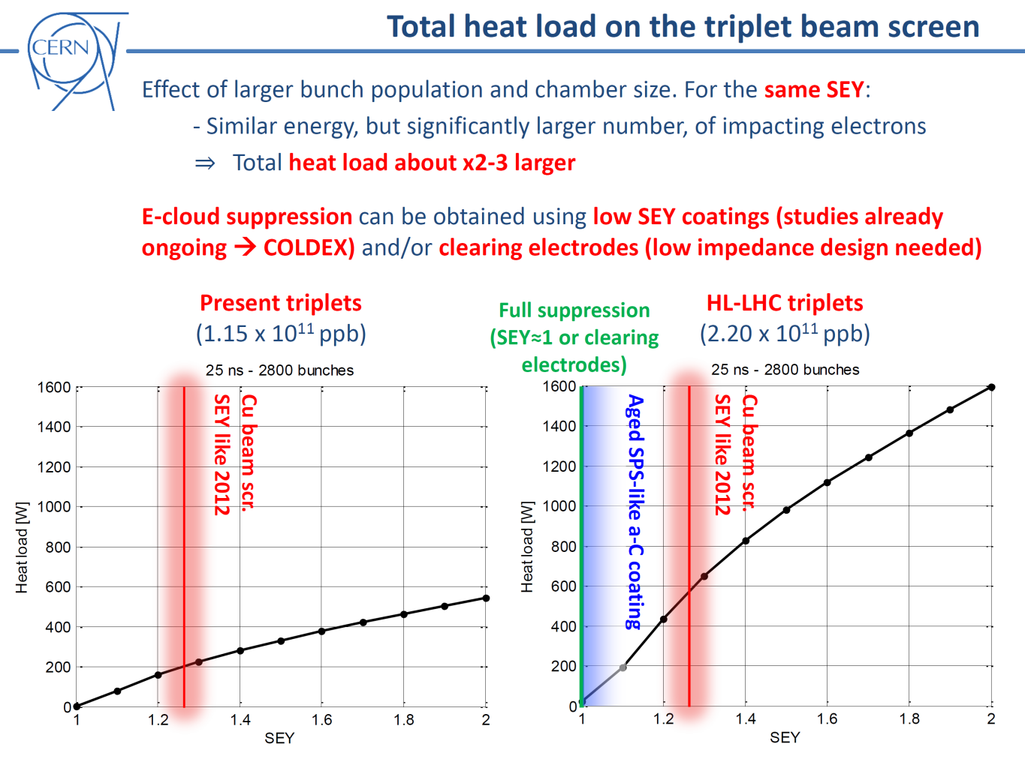
Impact of electron cloud onto IT+D1: a-C coating
Extrapolation for the HL-LHC of Run 1 observations predicts large heat load due to electron cloud on the beam screen of the inner triplets
This increase of heat load will be accompanied by increase of background to the experiments
To reduce the heat load to ~ 200 W on the beam screen, amorphous carbon (a-C) coating is proposed (SEY~ 1.1)
This base line must be validated at cryogenic temperature with LHC type beams
G. Iadarola, G. Rumolo
3rd Joint HiLumi LHC-LARP Annual Meeting, Daresbury
11-15/01/2013

Slide 22
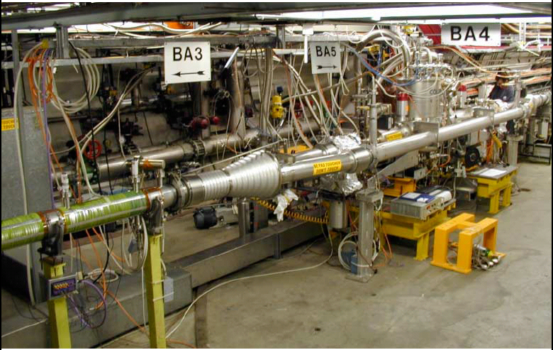
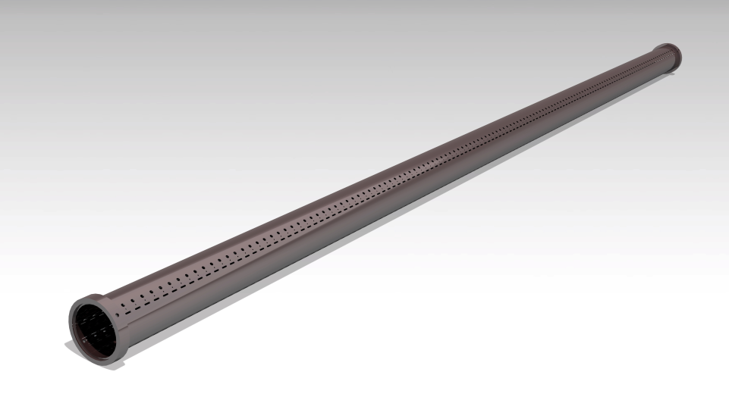
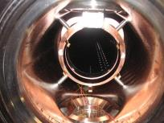
COLDEX in SPS with –a-C coating
a-C beam screen held at 50 K, 5 k then 10 K while cold bore ~ 4K
LHC type beams circulating in SPS (3 9/11/2014):
    Heat load < 1 W/m
    Pressure rise < 5 10⁻⁹ mbar
    Main gas is H₂
R. Salemme
Refurbishment and operation of COLDEX : strong support and commitment of many CERN groups: TE-CRG, BE-OP, BE-ABP, TE-EPC, EN-ICE
Thanks to L. Rossi, HL-LHC project leader, crab cavities, WP 4, and cryogenic, WP9, projects for their support to operate COLDEX during 2016
~2.2 m, ID 67 beam screen
Internally coated with amorphous carbon
a-C coating validation at cryogenic temperature must be continued

Slide 23
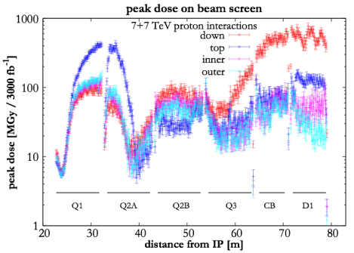
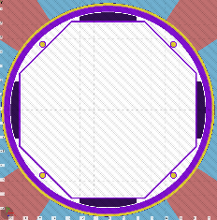
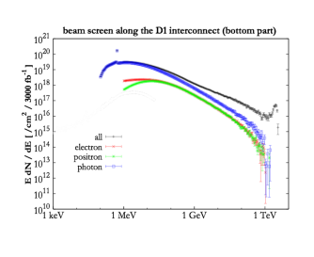
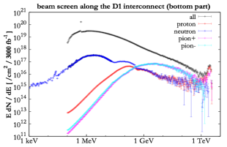
Radiation dose to a-C coating and shielded beam screen
dose up to GGy
dominated by electro-magnetic components
F. Cerutti
Behaviour of a-C coating under irradiation started
Electromagnetic
Hadronic

Slide 24
3. Layout

Slide 25
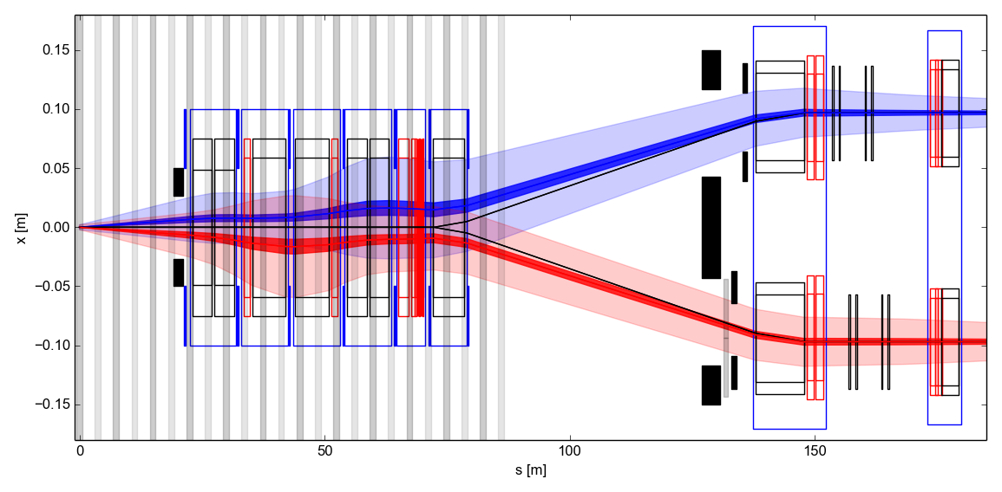
Optics: HL-LHC V1.1
New optic for HL-LHC : ATS (Achromatic Telescopic Squeezing), blow-up β in the arcs to reduce β*
New Matching section
S. Fartoukh
Changes in IR1/5
  TAS aperture reduced .
  Triplet, BPM, corrector layout update.
  D1-D2 length reduction.
  TAN new aperture and separation.
  Displacement Q4 by 10m towards the arc
  3 to 4 crab cavities per side per beam.
  New MCBRD – MCBYY length and strength
  for crab cavity beam based alignment.
  Additional masks and collimators
  Q5: MQYL to MQY at 200 T/m.
Changes in IR6
  Q5: MQYL to 2x MQY.
Triplet
D1
D2 Crab Q4
Cavities
TAS
Right side of IR1/IR5
R. De Maria
Complete dismounting of LSS1 & 5
New beam screens : procurement !
New layout

Slide 26
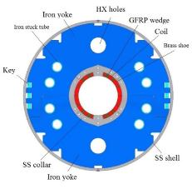
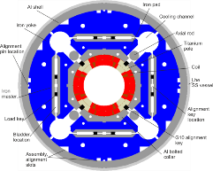
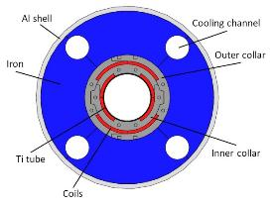
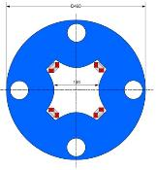
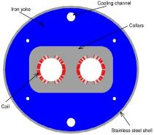
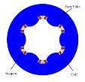
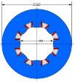
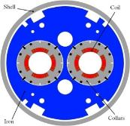
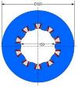
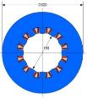
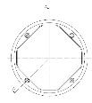
The magnet zoo in the IR
E. Todesco
Triplet QXF (LARP and CERN)
Orbit corrector (CIEMAT)
Separation dipole D1 (KEK)
Skew corrector (INFN)
Corrector sextupole (INFN)
Corrector octupole (INFN)
Recombination dipole D2
(INFN design)
Q4 (CEA)
Cross-sections in scale
Corrector decapole (INFN)
Corrector dodecapole (INFN)
Many beam screens with interconnects and cold warm transitions to be designed, produced & installed
C. Garion

Slide 27
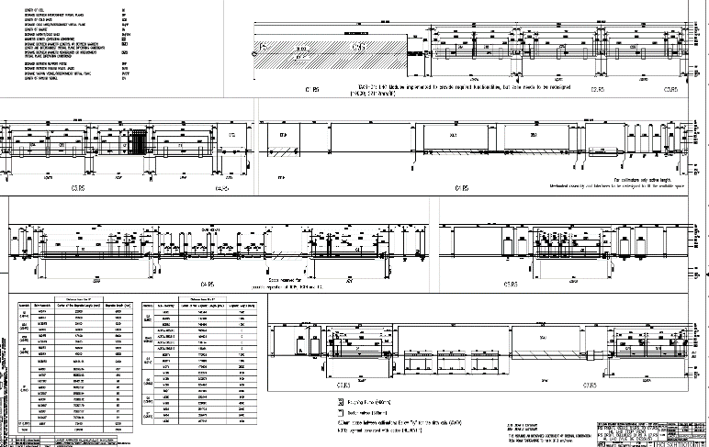
Layout
LHCLSXH__0010 and LHCLSXHT__0010
Vacuum functionalities introduced
Q1 to be shifted towards arc by ~ 1 m ?
Shorter TAN and innovative solutions to accommodate TCTs + masks
Large enough to accommodate cooling tubes
Space reservation for option: BBLR compensator
Masks in all cells
Dismountable CC modules
P. Fessia
DQR, no Alfa and DFBA removed
Optimisation of areas : TAS-Q1, interconnects, TAN-D2, crab cavities

Slide 28
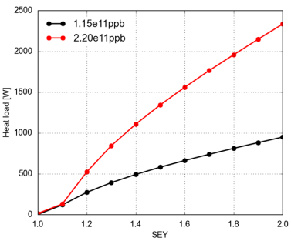
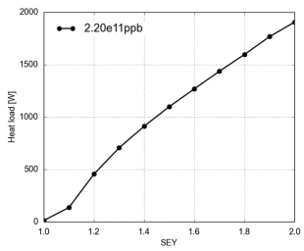
Heat load
Heat load working group to be resumed in 2015 (WP9)
  defines necessity on a-C coating with WP2 and WP12
  Total heat load on the beam screen cooling circuit IT+D1
  LHC: IR2 and 8
  HL-LHC: IR1 and 5
Acceptable
Limit = 100W ?
G. Iadarola
Need for heat load reduction for the triplets & D1 of IR1/ and IR2/8
Study in-situ coating and clearing electrodes
Optimise cooling efficiency
Identify beam screens to be treated for electron cloud

Slide 29
4. Crab cavities

Slide 30

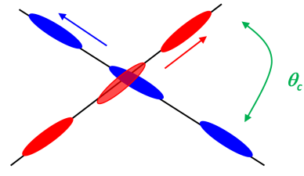
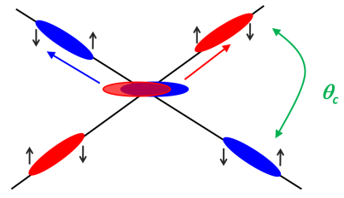
Crab cavities: luminosity
Increase instantaneous luminosity by a factor 16 by “crabbing” the bunches
Requires luminosity levelling to minimise number of event per crossing
F. Zimmermann, R. Calaga
B. Palmer
Crab cavities maximise luminosity and can be used for luminosity levelling:
  when luminosity is too high, CC are almost off and are slowly turned on to compensate proton burning ➔ allow to optimise integrated luminosity

Slide 31
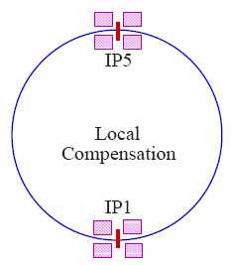
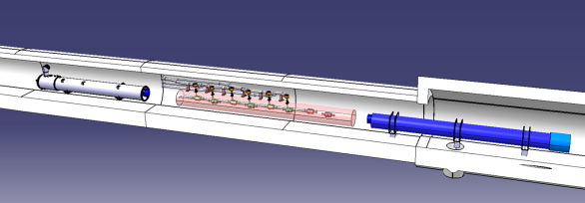


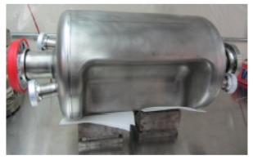
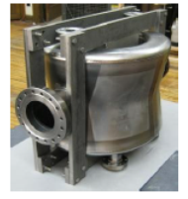
Crab cavities
Installed on left and right side of IP1 and IP5
Q4
D2
Installed between D2 and Q4
all CC operating at 2 K
Two designs to evaluate (RF dipole and double quarter wave cavities)
Bulk Nb cavities
LARP-ODU-JLAB
LARP-BNL

Slide 32
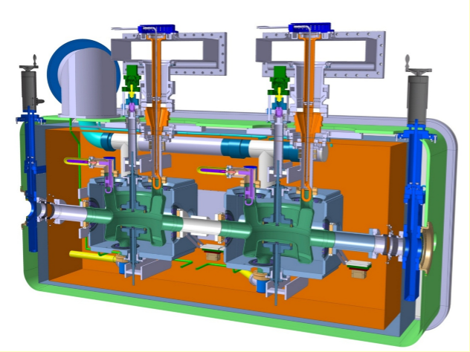

Crab cavities
Operating pressure ~ 10⁻¹⁰ mbar with beams
Vacuum instrumentation on the modules is under definition
Drawings and leak detection procedures needs to be validated by VSC
Cryomodules for the DQW (left) and RFD (right) cavities respectively
R. Calaga, O. Capatina

Slide 33


Crab cavities and electron cloud
  Bulk Nb treatment is well defined (EDMS 1389669, 150 micron chemical etching, 600 deg heat treatment, 10-20 micron chemical etching, high pressure water rinsing and finally a 120 deg bake)
Impact of the electron cloud in the CC modules must be evaluated for:
  Nb cavity itslef
  Inter-cavity tube
  Module cold warm transition
Samples needed for qualification
1.1 < Nb film SEY < 1.7
Electron conditioning
N. Hilleret et al., Appl. Phys. A 79, 1085-1091 (2003)
N. Hilleret et al. EPAC 2000, Vienna, Austria

Slide 34



Layout D2-Q4
side view
LHCLSXH_0010
A typical VA__
  Room temperature (except CC modules): bakeable and NEG coated
4 Sectorised CC modules:
  Standard sectorisation valves (VA__), length 655 mm, at extremity
  Specific sectorisation assembly, length 400, between modules. To be defined & designed. 2 beam line:
    2 roughing valve
    3 sector valve (beam interlocked)
    3 penning gauges + 2 ion pump + 2 pirani gauges

Slide 35

Layout D2-Q4: 2nd beam pipe
  The 2nd beam pipe is held at 2 K and has cold warm transition (CWT) !
  Current material is Nb, diameter limited by space
  In LHC, maximum length without beam screen is < 1 m (to be revised for HL-LHC)
  Detailed studies are needed to comply with vacuum stability and pressure level
CWT
CWT
A beam screen between
2 cryogenic pipes ?
A beam pipe with
Antechamber ?

Slide 36
5. Collimation

Slide 37


11 T – DS collimator
  Arc Dispersion Suppressor areas (Q7 to Q11) serve as “energy spectrometer” : a collimator is needed to reduce background to ALICE with ion operation and to reduce beam loss on the cold masses with proton beams
  Using NbSn₃ technology, the dipole field can be increased up to 11 T
  A standard LHC dipole can be replaced by two 11 T magnets and one collimator (TCLD)
F. Savary
By-pass cryostat
15660 mm
11 T dipole cold mass
Interconnect
Collimator

Slide 38

11 T – DS collimator
  The Target Collimator Long Dispersion suppressor, TCLD, collimator operates at room temperature and is sectorised
F. Savary
S. Redaelli
VSC needs to complete the integration (2nd beam line in particular)
Installation of two assemblies are expected in IP2 (left and right) for LS2 (2018-19)
  IR 7: 2 TCLDs per side to improve collimation cleaning
  IR 1/5: 2 TCLDs per side to allow high luminosity
LS3

Slide 39



Collimation and protection layout IP1/5
  Tertiary collimators, TCTs, in cell 4 and 5
  Better protection of apertures, asynchronous beam dumps and possible reduction of background to the experiments
S. Redaelli
  Upgrade of TCL4 mask: design with larger jaws
  TCLX4
  Upgrade of TAXN
  Inserting Inermet180
  Length reduce from 3.5 to ~ 2 m
F. Cerutti, L. Esposito
Drawing and performance validation on new components by VSC
Possible anticipated upgrade during LS2

Slide 40

Impedance upgrade
  IR 3/7 : 2nd generation secondary collimators, Target Colimator Secondary Pick-up Metallic, TCSPM, with Molybdenum Carbide Graphite (MoGr) and in jaw beam position monitors.
  Reduce impedance by 90 %, deployment in 2 batches
S. Redaelli
LS2
  IR 1/5 : 2nd generation tertiary collimators, Target Colimator Terticary Pick-up Metallic, TCTPM, with Molybdenum Carbide Graphite (MoGr) and in jaw beam position monitors.
  To be installed during LS3 (or during (E)YETS if needed)

Slide 41
Possible future upgrades
  IR 3/7, in the pipe line :
    Primary collimators, Target Collimator Primary Pick-up, TCPP, with in jaw beam position monitors.
    Shower absorbers, TCLA
    Passive absorbers, TCAP
At the end, the complete LSS3 and LSS7 might be upgraded for HL-LHC during :
  - (E)YETS
  LS2
  LS3
Optimisation of tooling, procedures (with WDP definition) and increase of equipment robustness is MANDATORY

Slide 42
6. SC links and
Cryogenics

Slide 43



Superconducting links
A. Ballarino
  SC links are used for cold powering systems.
  Provides protection against R2E
  DFAs will replace DFBs
  DFBAs and DFBMs will be removed from LSS7: installation during LS2
Y. Muttoni
  DFBA’s will be removed from LSS1/5
Requires dismounting of vacuum equipments
Impact on integration and vacuum layout
P. Fessia

Slide 44

Cryogenics
S. Claudet
  Creation of a cryoplant in LSS4 for the RF system: installation LS2
  LS3: upgrade of P1 and P5

Slide 45
7. Options: not in base line but under study

Slide 46

Options
  in IP1,5, 7 as previously but also IP4 and IP8
P. Fessia

Slide 47





Option: hollow e-lens
S. Redaelli
  Hollow electron beams running coaxially to the proton beam will provide an active control of beam halo population and beam loss rate. Installation LS2-LS3
  5T field
  3 m long
  RT vacuum system, bakeable
D. Perini

Slide 48


Option: mini-TAN IP8
I. Efthymiopoulos
  Installation in LS2 !
  Protects the D2 from increased luminosity in LHCb
  Under design: length ~ 2.2 m

Slide 49

Option: cristal collimation
S. Redaelli
  A possible mean to improve collimation cleaning while reducing impedance
  A test bed already (partially) installed in LSS7 !
  More details by the end of 2015 ….

Slide 50

Option: BBLR
Y. Papaphilippou
  Vague ideas:
    Short term : Exchange of a TCT with a TCT with embedded wire for LS2
    Long term: A co-linear 20 A electron beam located between TAN and D1 ?
D. Perini
H. Schmickler

Slide 51




Option: BI
R. Jones
  No schedule but ideas !
  Halo-diagnostics for HL-LHC
  Gas jet techniques
  Use of Beam Gas Vertex
  Use of scattered electrons
  Optical techniques using synchrotron radiation

Slide 52
8. LS2

Slide 53



Beam transfer and kickers
J. Uythoven
IP
  Injection protection elements to be installed in LS2
    TDIS can have about same integrated absorber length as present TDI
      Preliminary design: two modules with low Z absorber + one module with high Z absorber
      TDI interferometry on the way to be installed during run II
      3 x 1.5 modules
        2 x low Z material (graphite) + 1 x high Z material
    TCDD aperture reduction possibly necessary to protect D1
      D1 damage limit required, decision end 2014
    TCLIA and TCLIB likely not replaced for protection reasons
      However TCLIA IP2 larger opening because of ALICE ZDC?
These upgrades must be compatible with HL-LHC

Slide 54

Beam dumping system
J. Uythoven
  To be potentially upgrade in LS3 only
    Verification of TCDS for HL-LHC beams: will likely need to be upgraded.
    Check the already modified TCDQ : further upgrade not foreseen in the baseline.
    Check TDE heating after multiple dumps – nitrogen venting.
    Check TDE window – if this is an issue, might need to change dilution pattern. This is not part of the HL-LHC baseline.

Slide 55



Kickers and electron cloud
  LS1 MKI bypass tubes NEG coated, as nearby equipment.
  Ceramic tube can still be an issue with SEY values 6 – 10. Required SEY < 1.4
  Cr₂O₃ coated ceramics SEY ≈ 2, conditioned to < 1.4
  Contract placed to develop application method for Cr₂O₃ coating of MKI ceramic chamber to reduce SEY. If successful apply on prototype magnet
  Looking for position in machine for passive prototype
J. Uythoven, M. Barnes
Cr₂O₃
Conditioning
NEG coated bypass tubes

Slide 56



LHC Experiments upgrades
M. Gallilee
  Work packages for LS2 (EDMS 1065775)
  Reduced ALICE Be beam pipe
  New VErtex LOcator for LHCb
  Replacement of stainless steel to Aluminum chambers for CMS
These upgrades must be compatible with HL-LHC
(EDMS 13601088-91)

Slide 57
9. Summary

Slide 58

Summary
  HL-LHC is a vast project
  Installation will be in two phases : LS2 AND LS3
  Design already started in many fields
  Next important milestone is Cost and Schedule Review: 9-10-11 March 2015
      CONS project to be distinguish for HL-LHC project
  Technical design report, TDR, by 2015

Slide 59
Thank you for your attention

Slide 61

Focussing quadrupole and merging dipole
Decrease beta (i.e beam size) at collision point (beta*) from 55 cm to 15 cm
ATLAS
CMS
New : Q1, Q2, Q3, CP (corrector package), D1
all operating at 1.9 K
Present IT+D1 to be completely removed (radiation to personnel !!)
Interconnects to be redesigned

