Slide 1

Emergent phenomena and partonic structure in hadrons
Craig Roberts, Physics Division

Slide 2
Collaborators: 2013-Present
Students, Postdocs, Profs.
S. HERNÁNDEZ (U Michoácan) ;
Jing CHEN (Peking U.)
Bo-Lin LI (Nanjing U.)
Ya LU (Nanjing U.)
Khépani RAYA (U Michoácan);
Chien-Yeah SENG (UM-Amherst) ;
Kun-lun WANG (PKU);
Chen CHEN (UNESP, São Paulo);
Zhu-Fang CUI (Nanjing U.) ;
J. Javier COBOS-MARTINEZ (U Michoácan);
Minghui DING (Nankai U.) ;
Fei GAO (Peking U.) ;
L. Xiomara Gutiérrez-Guerrero (Sonora U.);
Cédric MEZRAG (ANL, Irfu Saclay) ;
Mario PITSCHMANN (Vienna);
Si-xue QIN (ANL, U. Frankfurt am Main, PKU);
Eduardo ROJAS (Antioquia U.)
Jorge SEGOVIA (TU-Munich, ANL);
Chao SHI (ANL, Nanjing U.)
Shu-Sheng XU (Nanjing U.)
Adnan Bashir (U Michoácan);
Daniele Binosi (ECT*)
Stan Brodsky (SLAC);
Lei Chang (Nankai U. ) ;
Ian Cloët (ANL) ;
Bruno El-Bennich (São Paulo);
Roy Holt (ANL);
Tanja Horn (Catholic U. America)
Yu-xin Liu (PKU);
Hervé Moutarde (CEA, Saclay) ;
Joannis Papavassiliou (U.Valencia)
M. Ali Paracha (NUST, Islamabad)
Alfredo Raya (U Michoácan);
Jose Rodriguez Qintero (U. Huelva) ;
Franck Sabatié (CEA, Saclay);
Sebastian Schmidt (IAS-FZJ & JARA);
Peter Tandy (KSU);
Tony Thomas (U.Adelaide) ;
Shaolong WAN (USTC) ;
Hong-Shi ZONG (Nanjing U)

Slide 3

What & where is mass?

Slide 4

Whence Mass?
Classical chromdynamics … non-Abelian local gauge theory
Remove the current mass … no energy scale left
No dynamics in a scale-invariant theory; only kinematics … the theory looks the same at all length-scales … there can be no clumps of anything … hence bound-states are impossible.
Our Universe can’t exist
Higgs boson doesn’t solve this problem … normal matter is constituted from light-quarks & the mass of protons and neutrons, the kernels of all visible matter, are 100-times larger than anything the Higgs can produce
Where did it all begin?
  … becomes … Where did it all come from?

Slide 5

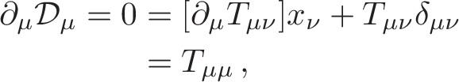
Whence Mass?
Poincaré invariance entails that the Energy-Momentum Tensor is divergence-free, i.e. it defines a conserved current:
Noether current associated with a global scale transformation:
  x → e^{-σ} x
  is the dilation current: D_{μν}=T_{μν} x_{ν}
In a scale invariant theory, the dilation current is conserved
Consequently, in a scale invariant theory
the energy-momentum tensor must be traceless.
T_{μν} can always
be made symmetric

Slide 6
Trace Anomaly
Classical chromodynamics is meaningless … must be quantised
Regularisation and renormalisation of (ultraviolet) divergences introduces a mass-scale
  … dimensional transmutation: mass-dimensionless quantities become dependent on a mass-scale, ζ
α → α(ζ) in QCD’s (massless) Lagrangian density, L(m=0)
  Under a scale transformation ζ → e^{σ} ζ, then α → σ αβ(α)
  L→ σ αβ(α) dL/dα
  ⇒ ∂_{μ}D_{μ} = δL/δσ = αβ(α) dL/dα = β(α) ¼G_{μν} G_{μν} = T_{ρρ} =: Θ₀
Straightforward, nonperturbative derivation, without need for diagrammatic analysis …
    quantisation of renormalisable four-dimensional theory forces nonzero value for trace of energy-momentum tensor
Trace anomaly
Notes:
Alpha -> alpha(zeta) seems to be enough to generate M(zeta), which is large for zeta small.

Slide 7

Where is the mass?

Slide 8

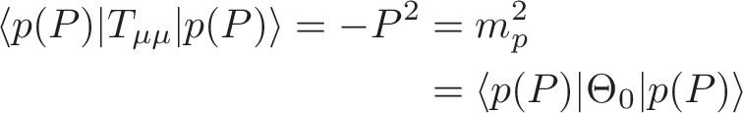
Trace Anomaly
Knowing that a trace anomaly exists does not deliver a great deal … indicates only that a mass-scale exists
Can one compute and/or understand the magnitude of that scale?
One can certainly measure the magnitude … consider proton:
In the chiral limit the entirety of the proton’s mass is produced by the trace anomaly, Θ₀
… In QCD, Θ₀ measures the strength of gluon self-interactions
… so, from one perspective, m_{p} is completely generated by glue.

Slide 9

On the other hand …

Slide 10
Trace Anomaly
In the chiral limit
⇒
Does this mean that the scale anomaly vanishes trivially in the pion state, i.e. gluons contribute nothing to the pion mass?
That is a difficult way to obtain “zero”
Easier, perhaps, to imagine that “zero” owes to cancellations between different operator-component contributions to Θ₀.
Of course, such precise cancellation should not be an accident.
  It could only arise naturally because of some symmetry and/or symmetry-breaking pattern.

Slide 11
Trace Anomaly
In the chiral limit
⇒
No statement of the question
“Whence the proton's mass?”
is complete without the additional clause
“Whence the absence of a pion mass?”

Slide 12
Whence?
Classical chromodynamics … non-Abelian local gauge theory
Local gauge invariance; but there is no confinement without a mass-scale
  Three quarks can still be colour-singlet
  Colour rotations will keep them colour singlets
  But they need have no proximity to one another
  … proximity is meaningless in a scale-invariant theory
Whence mass … equivalent to whence a mass-scale … equivalent to whence a confinement scale
Understanding the origin and absence of mass in QCD is quite likely inseparable from the task of understanding confinement. Existence alone of a scale anomaly answers neither question

Slide 13

A New Era for hadro-particle physics

Slide 14
Overarching Science Challenges for the coming decade
What is origin of mass in our Universe?
What is the nature of confinement in real (dynamical-quarks) QCD?
How are they connected?
How can any
  answers,
  conjectures
  and/or conclusions
be empirically verified?
Physics is an
Empirical Science

Slide 15


What is Confinement?

Slide 16

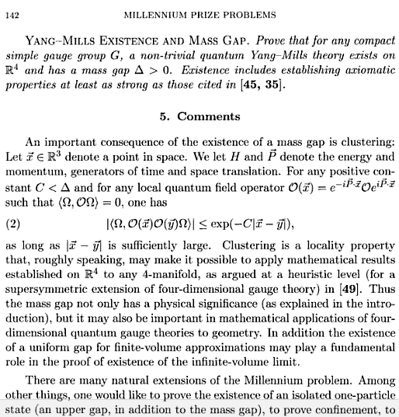
Confinement?
Millennium prize of $1,000,000 for proving that SU_{c}(3) gauge theory is mathematically well-defined, which will necessarily prove or disprove the confinement conjecture

Slide 17
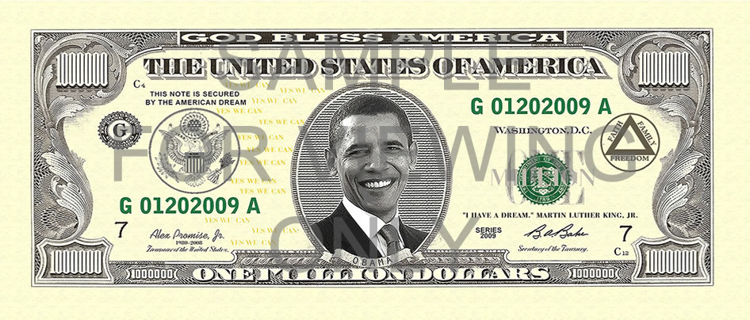
Confinement?
Millennium prize of $1,000,000 for proving that SU_{c}(3) gauge theory is mathematically well-defined, which will necessarily prove or disprove the confinement conjecture

Slide 18
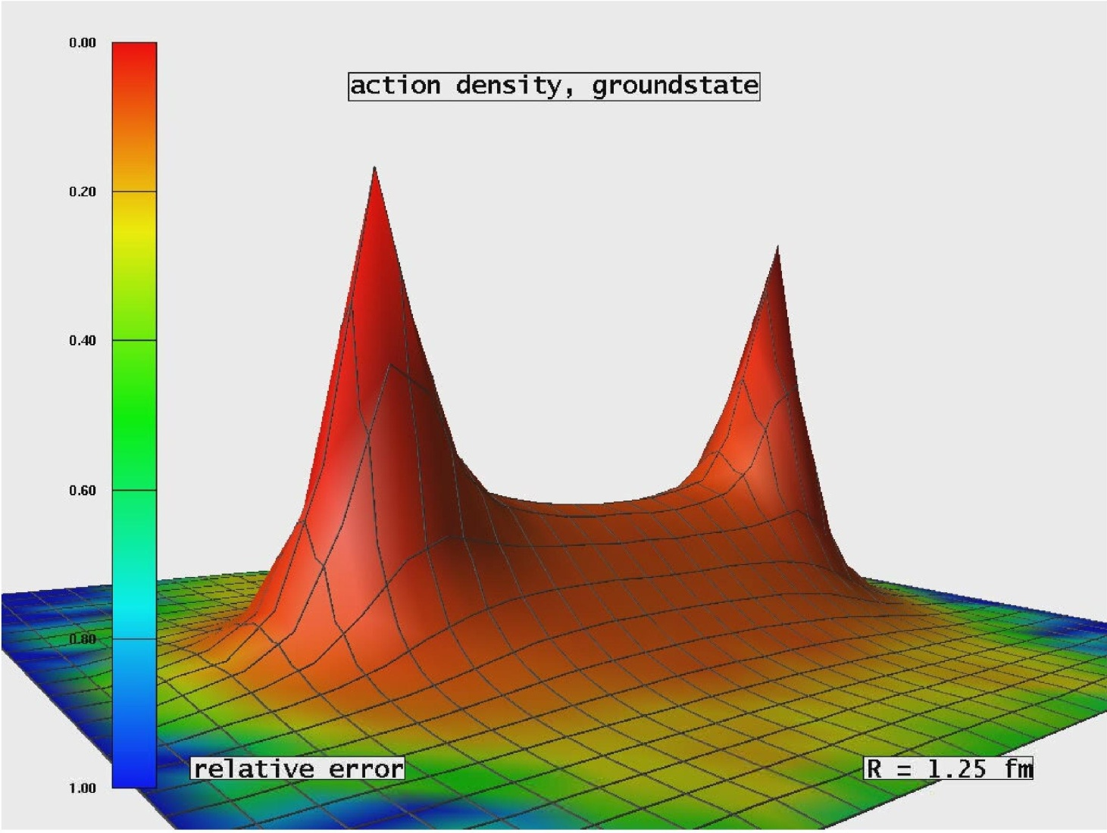
Light quarks & Confinement
Folklore … Hall-D Conceptual Design Report(5)
“The color field lines between a quark and an anti-quark form flux tubes.
A unit area placed midway between the quarks and perpendicular to the line connecting them intercepts a constant number of field lines, independent of the distance between the quarks.
This leads to a constant force between the quarks – and a large force at that, equal to about 16 metric tons.”

Slide 19
Light quarks & Confinement
Problem:
16 tonnes of force
makes a lot of pions.

Slide 20
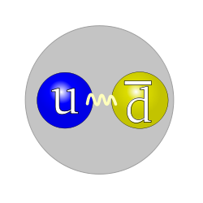
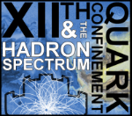
Light quarks & Confinement
Problem:
16 tonnes of force
makes a lot of pions.

Slide 21
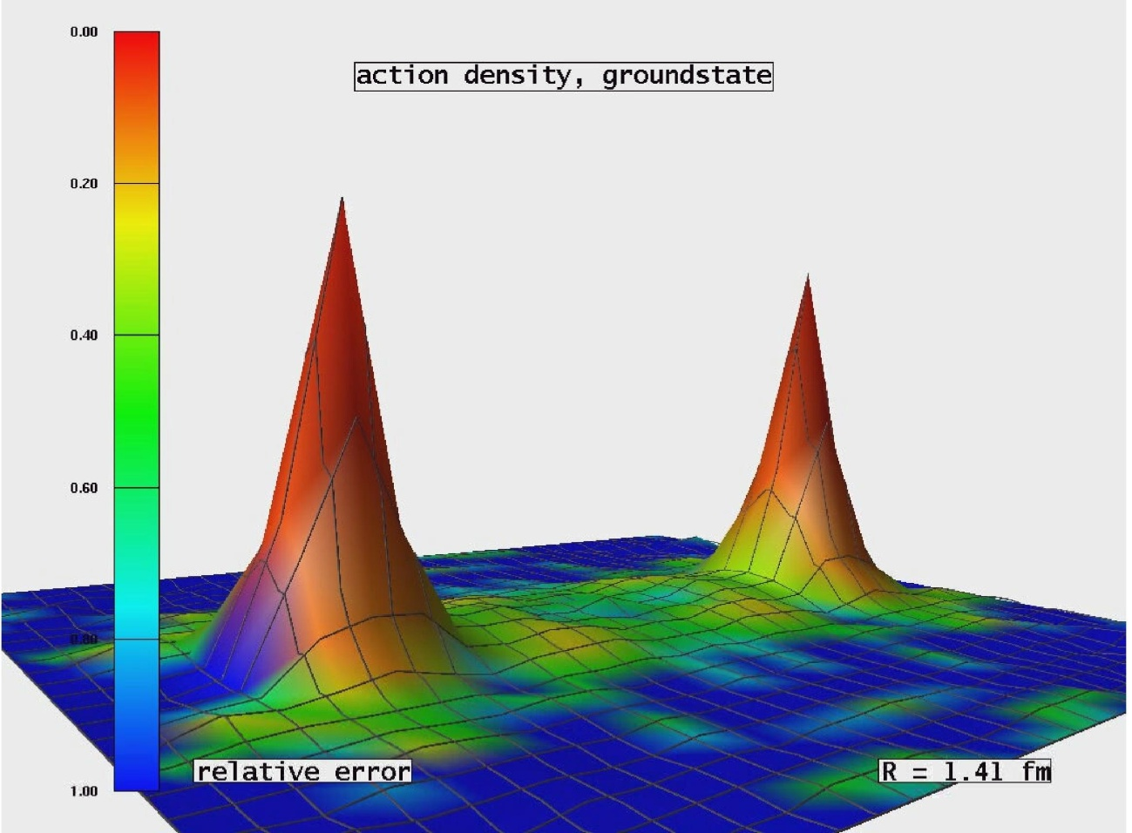
Light quarks & Confinement
G. Bali et al., PoS LAT2005 (2006) 308
In the presence of light quarks, pair creation seems to occur non-localized and instantaneously
No flux tube in a theory with light-quarks.
Flux-tube is not the correct paradigm for confinement in hadron physics

Slide 22
Light quarks & Confinement
G. Bali et al., PoS LAT2005 (2006) 308
In the presence of light quarks, pair creation seems to occur non-localized and instantaneously
No flux tube in a theory with light-quarks.
Flux-tube is not the correct paradigm for confinement in hadron physics
Confinement contains condensates
Brodsky, Roberts, Shrock,Tandy
arXiv:1202.2376 [nucl-th], Phys. Rev. C85 (2012) 065202
Nothing here, between the hadrons. No flux tubes, no condensates.
It’s the “trivial vacuum.”

Slide 23
Existence of mass-gap in pure-gauge theory
Strong evidence supporting this conjecture: lQCD predicts Δ ∼ 1.5 GeV
But Δ²/m_{π}² > 100,
  So, can mass-gap in pure Yang-Mills play any role in understanding confinement when dynamical chiral symmetry breaking (DCSB) ensures existence of an almost-massless strongly-interacting excitation in our Universe?
If answer is not simply no, then it must be that one cannot claim to provide an understanding of confinement without simultaneously explaining its connection with DCSB.
Pion must play critical role in any explanation of real-world confinement; and any discussion that omits reference to the pion's role is practically irrelevant.

Slide 24
Confinement is dynamical

Slide 25
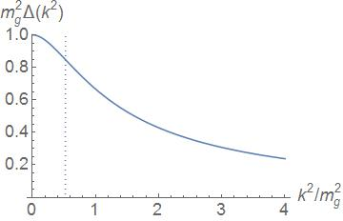
Confinement
All continuum and lattice predictions for Landau-gauge gluon & quark propagators exhibit an inflection point in k²
Violate reflection positivity = sufficient for confinement
Such states have negative norm
Negative norm states are not observable
All observable states of a physical Hamiltonian have positive norm
Inflexion point corresponds to σ ≈ 0.5 fm:
Parton-like behaviour at shorter distances; but propagation characteristics changed dramatically at larger distances.
m_{g} ≈ 0.5 GeV

Slide 26
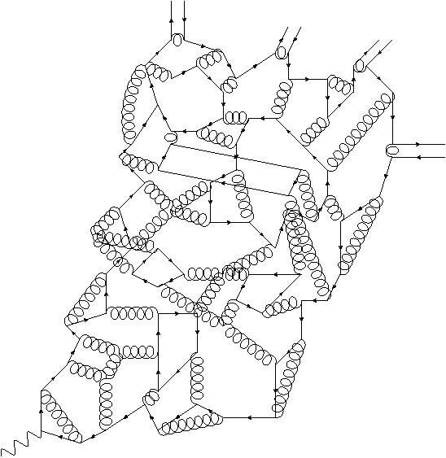
Quark Fragmentation
Test: compute fragmentation functions
& TMDs ⇒ compare with data
A quark begins to propagate
But after each “step” of length σ, on average, an interaction occurs, so that the quark loses its identity, sharing it with other partons
Finally, a cloud of partons is produced, which coalesces into colour-singlet final states
meson
meson
meson
meson
σ
Confinement is a dynamical phenomenon!

Slide 27
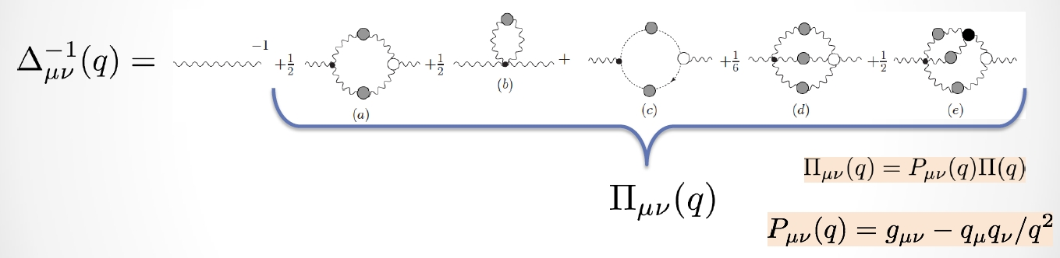
Gluon Gap Equation

Slide 28


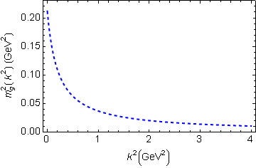
In QCD: Gluons also become massive!
Bridging a gap between continuum-QCD and ab initio predictions of hadron observables, D. Binosi et al., arXiv:1412.4782 [nucl-th], Phys. Lett. B742 (2015) 183-188
Running gluon mass
Gluons are cannibals – a particle species whose members become massive by eating each other!
Expression of trace anomaly:
Massless glue becomes massive
gluon mass-squared function
Power-law suppressed in ultraviolet, so invisible in perturbation theory
5%
Interaction model for the gap equation, S.-x.Qin et al., arXiv:1108.0603 [nucl-th], Phys. Rev. C 84 (2011) 042202(R) [5 pages]

Slide 29


Massive Gauge Bosons!
Gauge boson cannibalism
… a new physics frontier … within the Standard Model
Asymptotic freedom means
… ultraviolet behaviour of QCD is controllable
Dynamically generated masses for gluons and quarks means that QCD dynamically generates its own infrared cutoffs
  Gluons and quarks with
  wavelength λ > 2/mass ≈ 1 fm
  decouple from the dynamics … Confinement?!
How does that affect observables?
  It will have an impact in
  any continuum study
  Probably plays a role in gluon saturation ...
  In fact, a harbinger of gluon saturation?

Slide 30
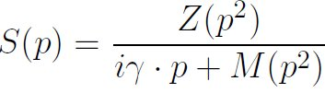
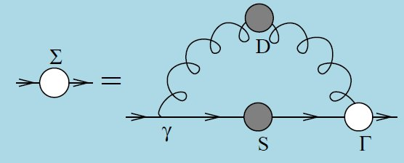
Quark Gap Equation

Slide 31
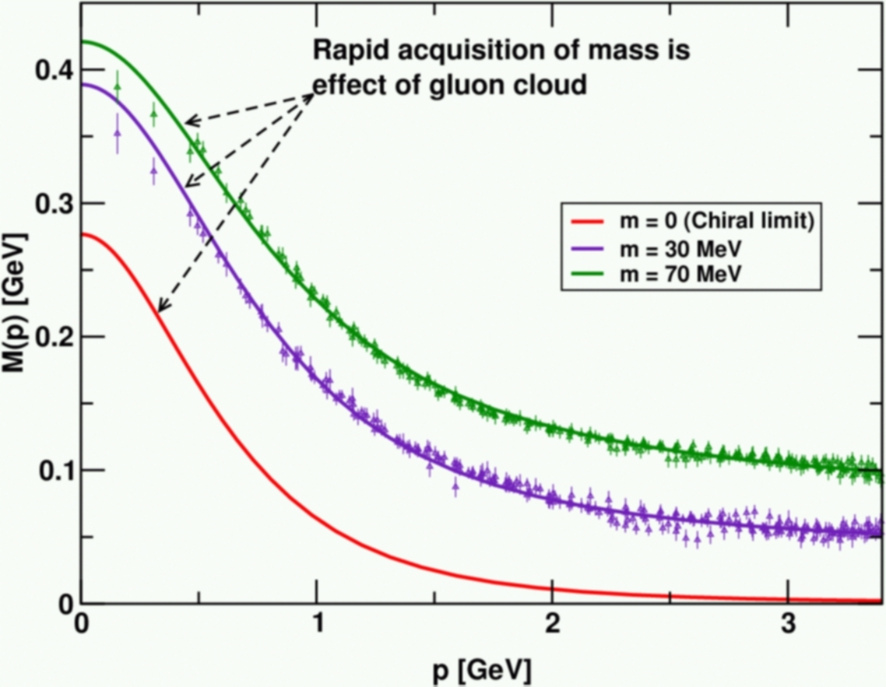
DCSB
Dynamical chiral symmetry breaking (DCSB) is
a critical emergent phenomenon in QCD
Expressed in hadron wave functions not in vacuum condensates
Contemporary theory indicates that DCSB is responsible for more than 98% of the visible mass in the Universe; namely, given that classical massless-QCD is a conformally invariant theory, then DCSB is the origin of mass from nothing.
Dynamical, not spontaneous
  Add nothing to QCD ,
  No Higgs field, nothing!
  Effect achieved purely
  through quark+gluon
  dynamics.
  Trace anomaly: massless quarks
  become massive

Slide 32

Continuum-QCD
& ab initio predictions

Slide 33
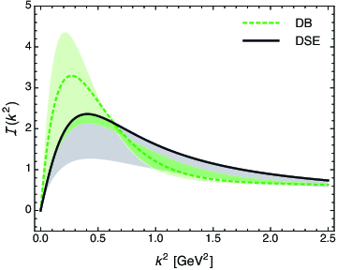
Top down & Bottom up
Bridging a gap between continuum-QCD
& ab initio predictions of hadron observables
D. Binosi (Italy), L. Chang (Australia), J. Papavassiliou (Spain),
C. D. Roberts (US), arXiv:1412.4782 [nucl-th] , Phys. Lett. B 742 (2015) 183
Modern kernels and interaction, developed at ANL and Peking U.
One parameter, fitted to ground-state properties without reference to gauge-sector studies.
Modern top-down and bottom-up results agree within 3% !
  Top-down approach – ab initio computation of the interaction via direct analysis of the gauge-sector gap equations
  Bottom-up scheme – infer interaction by fitting data within a well-defined truncation of the matter sector DSEs that are relevant to bound-state properties.
  Serendipitous collaboration, conceived at one-week ECT* Workshop on DSEs in Mathematics and Physics, has united these two approaches
Top-down result = gauge-sector prediction
  – Interaction predicted by modern analyses of QCD's gauge sector coincides with that required to describe ground-state observables using a sophisticated matter-sector DSE truncation

Slide 34
Top down & Bottom up
Bridging a gap between continuum-QCD
& ab initio predictions of hadron observables
D. Binosi (Italy), L. Chang (Australia), J. Papavassiliou (Spain),
C. D. Roberts (US), arXiv:1412.4782 [nucl-th] , Phys. Lett. B 742 (2015) 183
Modern kernels and interaction, developed at ANL and Peking U.
One parameter, fitted to ground-state properties without reference to gauge-sector studies.
Modern top-down and bottom-up results agree within 3% !
  Bottom-up scheme – infer interaction by fitting data within a well-defined truncation of the matter sector DSEs that are relevant to bound-state properties.
  Top-down approach – ab initio computation of the interaction via direct analysis of the gauge-sector gap equations
  Serendipitous collaboration, conceived at one-week ECT* Workshop on DSEs in Mathematics and Physics, has united these two approaches
Significant steps toward
parameter-free prediction of hadron properties
Top-down result = gauge-sector prediction
  – Interaction predicted by modern analyses of QCD's gauge sector coincides with that required to describe ground-state observables using a sophisticated matter-sector DSE truncation

Slide 35
Reconciliation demands dressed-gluon-quark vertex
Natural constraints on the gluon-quark vertex, Binosi, Chang, Papavassiliou, Qin & Roberts, nearing completion
Significant progress since 2009:
dressed Γ_{μ} in gap- and Bethe-Salpeter equations …
In principle, ∃ unique form of Γ_{μ} , but it’s still obscure.
To improve this situation, used the top-down/bottom-up RGI running-interaction
  Computed gap equation solutions with
  1,660,000 distinct Ansätze for Γ_{μ}
Each one of the solutions tested for compatibility with three physical criteria
Remarkably, merely 0.55% of solutions survive the test
Even a small selection of observables places extremely tight bounds on the domain of acceptable, realistic vertex Ansätze

Slide 36
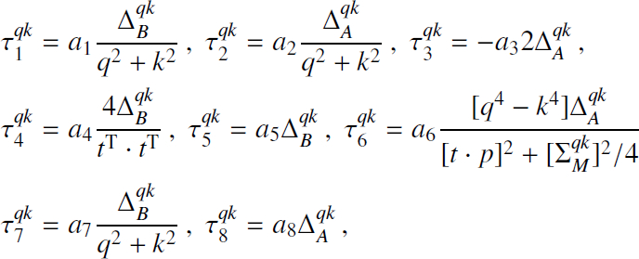
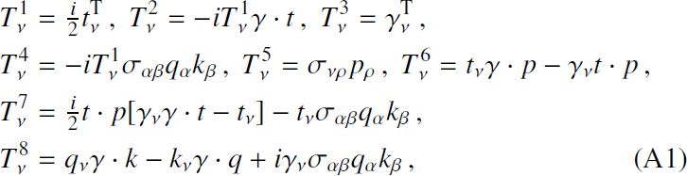
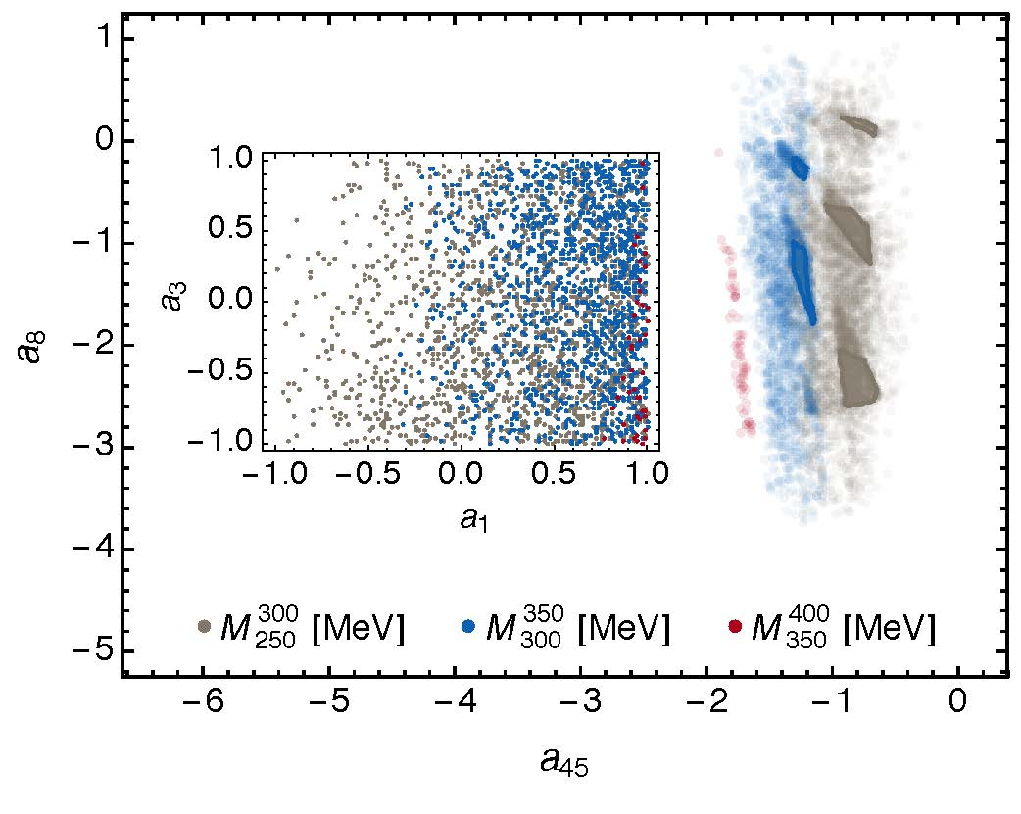

Dressed-gluon-quark vertex
Bashir, Bermudez, Chang, Roberts, arXiv:1112.4847 [nucl-th], Phys. Rev. C85 (2012) 045205 [7 pages]
Even a small selection of observables places extremely tight bounds on the domain of acceptable, realistic vertex Ansätze
Meson spectrum ⇒ a_{2,6,7} = 0
(Sixue Qin et al.)
In R⁴ … subset of (almost) zero measure
Gap equation only “feels” a₄₅=a₄-3a₅

Slide 37
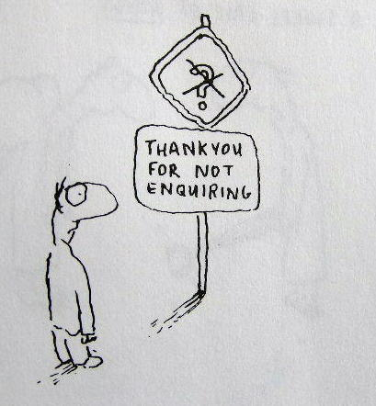
Enigma of Mass

Slide 38
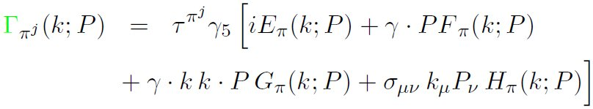

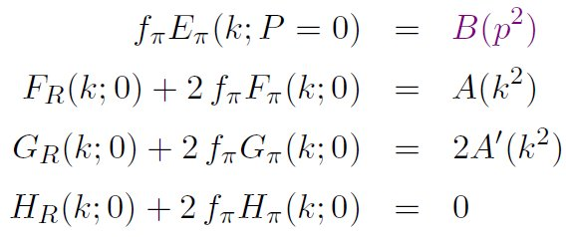
Pion’s Goldberger
-Treiman relation
Maris, Roberts and Tandy
nucl-th/9707003, Phys.Lett. B420 (1998) 267-273
Pion’s Bethe-Salpeter amplitude
Solution of the Bethe-Salpeter equation
Dressed-quark propagator
Axial-vector Ward-Takahashi identity entails
B(k²)
Owing to DCSB
& Exact in
Chiral QCD
Miracle: two body problem solved, almost completely, once solution of one body problem is known

Slide 39
The most fundamental expression of Goldstone’s Theorem and DCSB
Rudimentary version of this relation is apparent in Nambu’s Nobel Prize work
Model independent
Gauge independent
Scheme independent
f_{π} E_{π}(p²) = B(p²)

Slide 40
Pion exists if, and only if, mass is dynamically generated
Rudimentary version of this relation is apparent in Nambu’s Nobel Prize work
Model independent
Gauge independent
Scheme independent
f_{π} E_{π}(p²)⇔ B(p²)

Slide 41
This is why m_{π}=0 in the absence of a Higgs mechanism
Rudimentary version of this relation is apparent in Nambu’s Nobel Prize work
Model independent
Gauge independent
Scheme independent
f_{π} E_{π}(p²)⇔ B(p²)

Slide 42
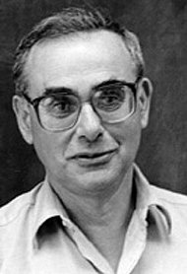
Enigma of mass
f_{π} E_{π}(p²) = B(p²)
This algebraic identity is why QCD’s pion is massless in the chiral limit
The quark level Goldberger-Treiman relation shows that DCSB has a very deep and far reaching impact on physics within the strong interaction sector of the Standard Model; viz.,
  Goldstone's theorem is fundamentally an expression of equivalence between the one-body problem and the two-body problem in the pseudoscalar channel.
This emphasises that Goldstone's theorem has a pointwise expression in QCD
Hence, pion properties are an almost direct measure of
the dressed-quark mass function.
Thus, enigmatically, the properties of the massless pion
are the cleanest expression of the mechanism that is
responsible for almost all the visible mass in the universe.

Slide 43
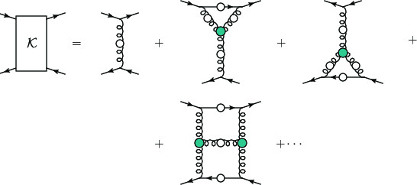
Pion masslessness
Renormalisation scale: ζ = 2GeV =: ζ₂
Pion’s Poincaré-invariant mass and Poincaré-covariant wave function are obtained by solving a Bethe-Salpeter equation.
This is a scattering problem
In chiral limit
  two massless fermions interact via exchange of massless gluons … initial system is massless; and it remains massless at every order in perturbation theory
But, complete the calculation using an enumerable infinity of dressings and scatterings

Slide 44
Pion masslessness
Munczek, H. J., Phys. Rev. D 52 (1995) pp. 4736-4740
Bender, A., Roberts, C.D. and von Smekal, L., Phys. Lett. B 380 (1996) pp. 7-12
Maris, P. , Roberts, C.D. and Tandy, P.C., Phys. Lett. B 420 (1998) pp. 267-273
Produces a coupled set of gap- and Bethe-Salpeter equations
  Bethe-Salpeter Kernel:
    valence-quarks with a momentum-dependent running mass produced by self-interacting gluons, which have given themselves a running mass
    Interactions of arbitrary but enumerable complexity involving these “basis vectors”
  Chiral limit:
    Algebraic proof that, at any finite order in a symmetry-preserving construction of the kernels for the gap (quark dressing) and Bethe-Salpeter (bound-state) equations, there is a precise cancellation between the mass-generating effect of dressing the valence-quarks and the attraction introduced by the scattering events
    Cancellation guarantees that the simple system, which began massless, becomes a complex system, with a nontrivial bound-state wave function attached to a pole in the scattering matrix, which remains at P²=0 … remains massless
Quantum field theory statement: in the pseudsocalar channel, the dynamically generated mass of the two fermions is precisely cancelled by the attractive interactions between them – iff –
f_{π} E_{π}(p²) = B(p²)

Slide 45
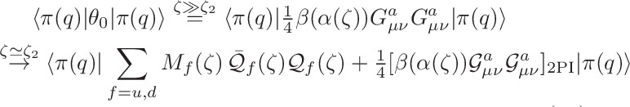
Pion masslessness
DCSB Paradigm
Parton-basis chiral-limit expression of the expectation-value of the trace-anomaly in the pion at ζ ≫ ζ₂
Metamorphoses into a new expression, written in terms of a nonperturbatively-dressed quasi-particle basis
  1st term = positive = one-body dressing content of the trace anomaly … Plainly, a massless valence-quark acquiring a large mass through interactions with its own gluon field is an expression of the trace-anomaly in the one-body subsector of the complete pion wave function
  2nd term = negative (attraction) = 2-particle-irreducible scattering event content of the scale-anomaly … Plainly, acquires a scale because the couplings, and the gluon- and quark-propagators in the 2PI processes have all acquired a mass-scale
Away from the chiral limit, and in other channels, the cancellation is incomplete.

Slide 46
Observing Mass

Slide 47
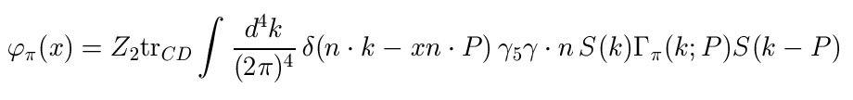
Pion’s valence-quark
Distribution Amplitude
Imaging dynamical chiral symmetry breaking: pion wave function on the light front, Lei Chang, et al., arXiv:1301.0324 [nucl-th], Phys. Rev. Lett. 110 (2013) 132001 (2013) [5 pages].
2012 … methods were developed that enable direct computation of the pion’s light-front wave function
φ_{π}(x) = twist-two parton distribution amplitude = projection of the pion’s Poincaré-covariant wave-function onto the light-front
Results have been obtained with the DCSB-improved DSE kernel, which unifies matter & gauge sectors
  ϕ_{π}(x) ∝ x^{α} (1-x)^{α}, with α≈0.5

Slide 48
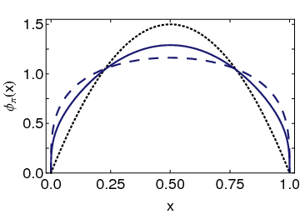
Pion’s valence-quark
Distribution Amplitude
Imaging dynamical chiral symmetry breaking: pion wave function on the light front, Lei Chang, et al., arXiv:1301.0324 [nucl-th], Phys. Rev. Lett. 110 (2013) 132001 (2013) [5 pages].
Continuum-QCD prediction:
marked broadening of φ_{π}(x), which owes to DCSB
Conformal QCD
DB
RL
Real-world PDAs are squat and fat

Slide 49
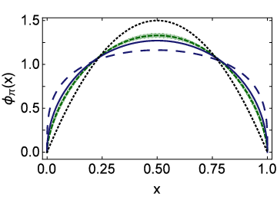
Lattice-QCD
& Pion’s valence-quark PDA
Pion distribution amplitude from lattice-QCD
I. C. Cloët et al., arXiv:1306.2645 [nucl-th], Phys. Rev. Lett. 111 (2013) 092001 [5 pages]
Flavour symmetry breaking in the kaon parton distribution amplitude, Chao Shi et al., arXiv:1406:3353 [nucl-th], Phys. Lett. B 738 (2014) pp. 512–518
Isolated dotted curve = conformal QCD
Green curve & band = result inferred from the single pion moment computed in lattice-QCD
Blue solid curve = DSE prediction obtained with DB kernel
DSE & lQCD predictions are practically indistinguishable

Slide 50
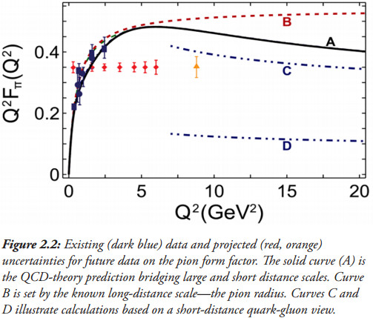
Pion’s electromagnetic form factor
Pion electromagnetic form factor at spacelike momenta
L. Chang et al., arXiv:1307.0026 [nucl-th],
Phys. Rev. Lett. 111, 141802 (2013)
A: Internally-consistent DSE prediction
Broadening has enormous impact on understanding F_{π}(Q²)
C: Hard-scattering formula with broad PDA

Slide 51
Pion’s electromagnetic form factor
Pion electromagnetic form factor at spacelike momenta
L. Chang, I. C. Cloët, C. D. Roberts, S. M. Schmidt and P. C. Tandy, arXiv:1307.0026 [nucl-th], Phys. Rev. Lett. 111, 141802 (2013)
A: Internally-consistent DSE prediction
Broadening has enormous impact on understanding F_{π}(Q²)
Appears that JLab12 is within reach of first verification of a QCD hard-scattering formula
C: Hard-scattering formula with broad PDA

Slide 52
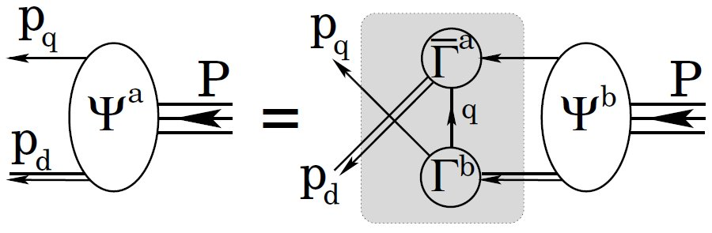
Structure of Baryons

Slide 53
Baryon Structure
R.T. Cahill et al.,
Austral. J. Phys. 42 (1989) 129-145
Poincaré covariant Faddeev equation sums all possible exchanges and interactions that can take place between three dressed-quarks
Confinement and DCSB are readily expressed
Prediction: owing to DCSB in QCD, strong diquark correlations exist within baryons
Diquark correlations are not pointlike
  Typically, r₀₊ ~ r_{π} & r₁₊ ~ r_{ρ} (actually 10% larger)
  They have soft form factors

Slide 54
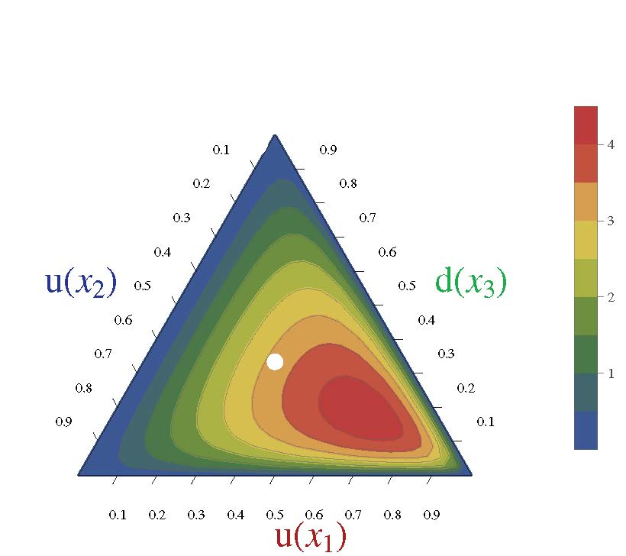
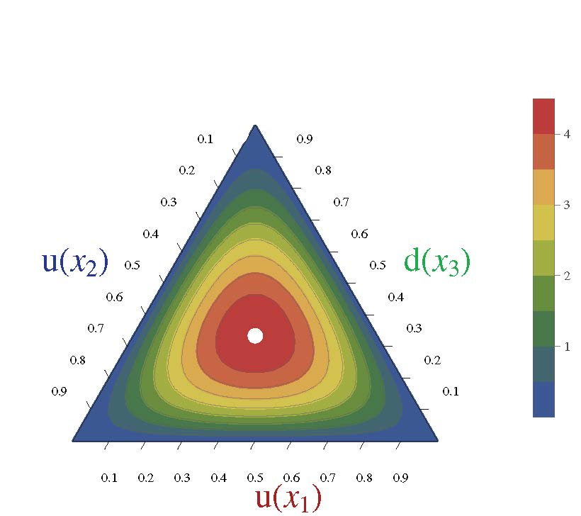
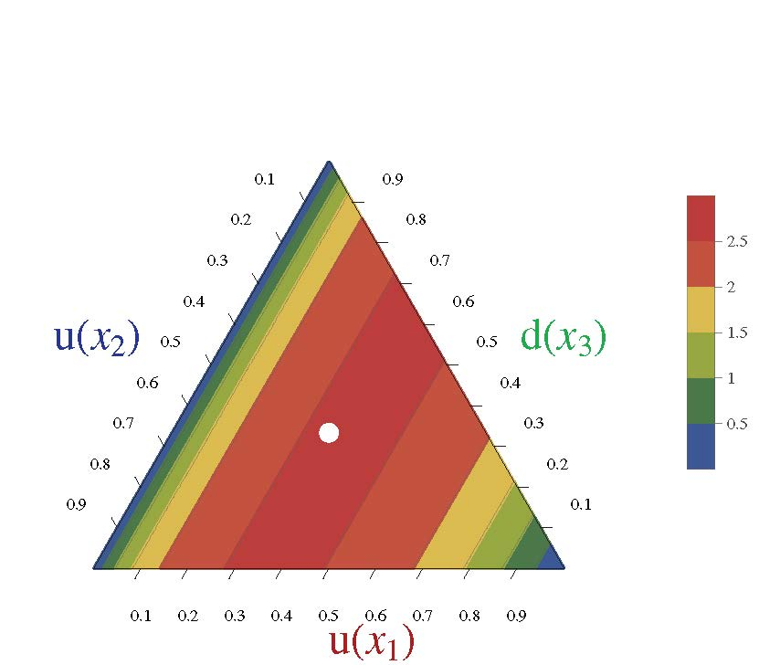
Nucleon Parton Distribution Amplitudes
Cédric Mezrag, et al. ANL
Computations underway. First results available.
Realistic, finite size (0.7fm) 0⁺ diquark [u(x₂)d(x₃)]
Diquark clustering skews the distribution toward the dressed-quark bystander, which therefore carries more of the proton’s light-front momentum
(0.6,0.2,0.2)
conformal limit:
120 x₁x₂x₃
〈x_{i}〉=⅓ … peak of the distribution
Pointlike 0⁺ diquark [u(x₂)d(x₃)]

Slide 55
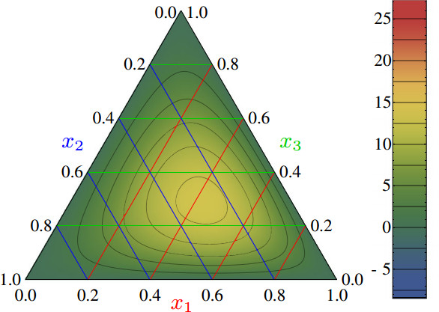
Nucleon PDAs
& lQCD
Light-cone distribution amplitudes of the nucleon and negative parity nucleon resonances from lattice QCD
V. M. Braun et al., Phys. Rev. D 89 (2014) 094511
Light-cone distribution amplitudes of the baryon octet
G. S. Bali et al. JHEP 1602 (2016) 070
First lQCD results for n=0, 1 moments of the leading twist PDA of the nucleon are available
Used to constrain strength (a₁₁) of the leading-order term in a conformal expansion of the nucleon’s PDA:
Φ(x₁,x₂,x₃)
= 120 x₁ x₂ x₃ [ 1 + a₁₁ P₁₁(x₁,x₂,x₃) + … ]
Shift in location of central peak is consistent with existence of diquark correlations within the nucleon
(0.5,0.25,0.25)
Notes:
The calculation is done using Nf = 2 + 1 flavors of dynamical (clover) fermions on lattices of different volumes and pion masses down to 222 MeV. Significant SU(3) flavor symmetry violation effects in the shape of the distribution amplitudes are observed.

Slide 56
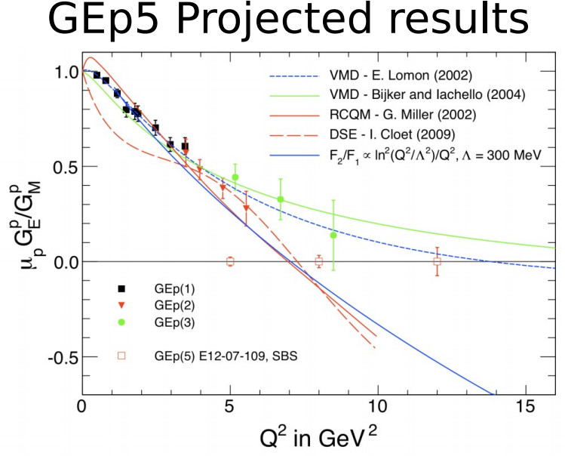
Nucleon Elastic FFs

Slide 57
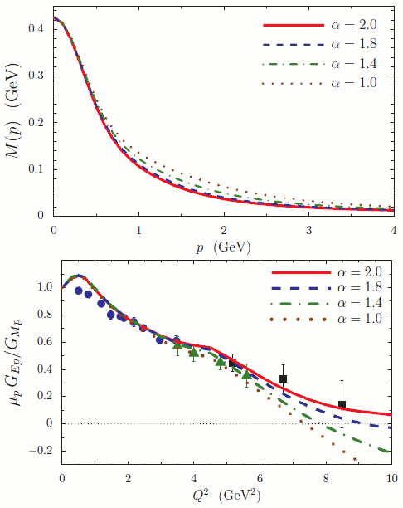
Visible Impacts of DCSB
I.C. Cloët, C.D. Roberts, A.W. Thomas: Revealing dressed-quarks via the proton's charge distribution,
arXiv:1304.0855 [nucl-th], Phys. Rev. Lett. 111 (2013) 101803
Possible existence and location
of a zero in the ratio of proton elastic form factors
[μ_{p}G_{Ep}(Q²)/G_{Mp}(Q²)]
are a direct measure of the rate at which dressed-quarks become partons again,
i.e. character of strong interactions in the Standard Model.

Slide 58
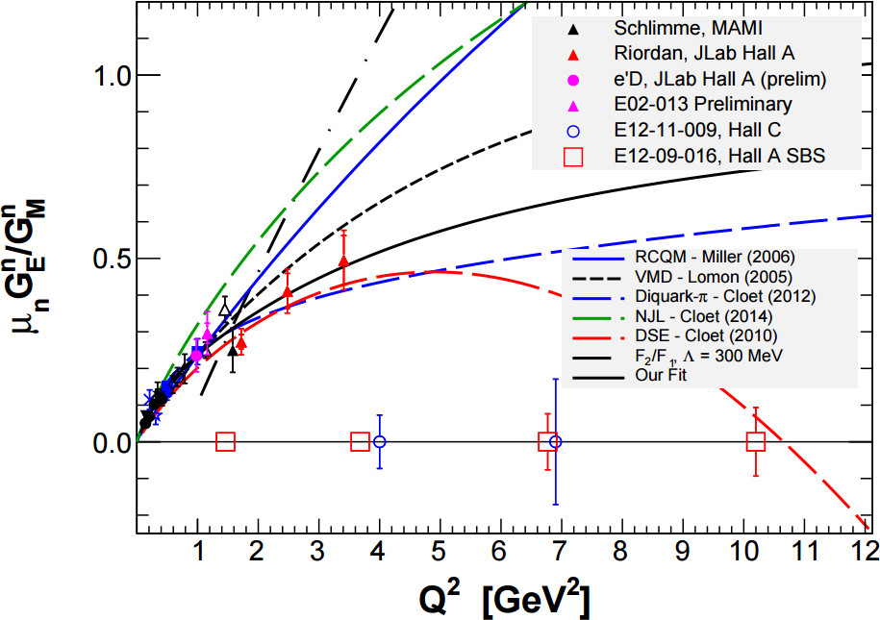
G_{En}
Numerous calculations on this figure; but only one viable prediction
DSE result (2008/2010) is not fitted to any data
  Predicts zero in G_{En}
  Owes to presence of running quark-mass & strong diquark correlations
  Verifiable at JLab12
G_{En} promises to be a harsh discriminator between descriptions of nucleon structure
Seamus Riordan, ECT*, April 2016

Slide 59

Epilogue

Slide 60
Epilogue
Conformal anomaly ... gluons and quarks acquire momentum-dependent masses … values are large in the infrared m_{g} ∝ 500 MeV & M_{q} ∝ 350 MeV … underlies DCSB; and has numerous observable consequences
Universe with light quarks ⇒ confinement is a dynamical phenomenon Confinement and DCSB are intimately linked in real-QCD
Origin and distribution of mass depend on the observer’s preferred frame of reference and scale … Contemporary and planned experiments, DCSB paradigm is the best way to explicate and understand the associated, emerging phenomena. Numerous verifiable predictions accessible
  form factors, PDAs and PDFs, GPDs and TMDs, etc.
What can experiments at an EIC add to this?
  Valence-quark region will be accessible
  However, focus is on low-x, where gluons dominate … mass generation in the gluon sector … must affect potential for gluon saturation; how?
Ability to compute valence-quark PDAs and PDFs has provided many new insights … must now begin to do the same for sea-quarks and glue

