Slide 1

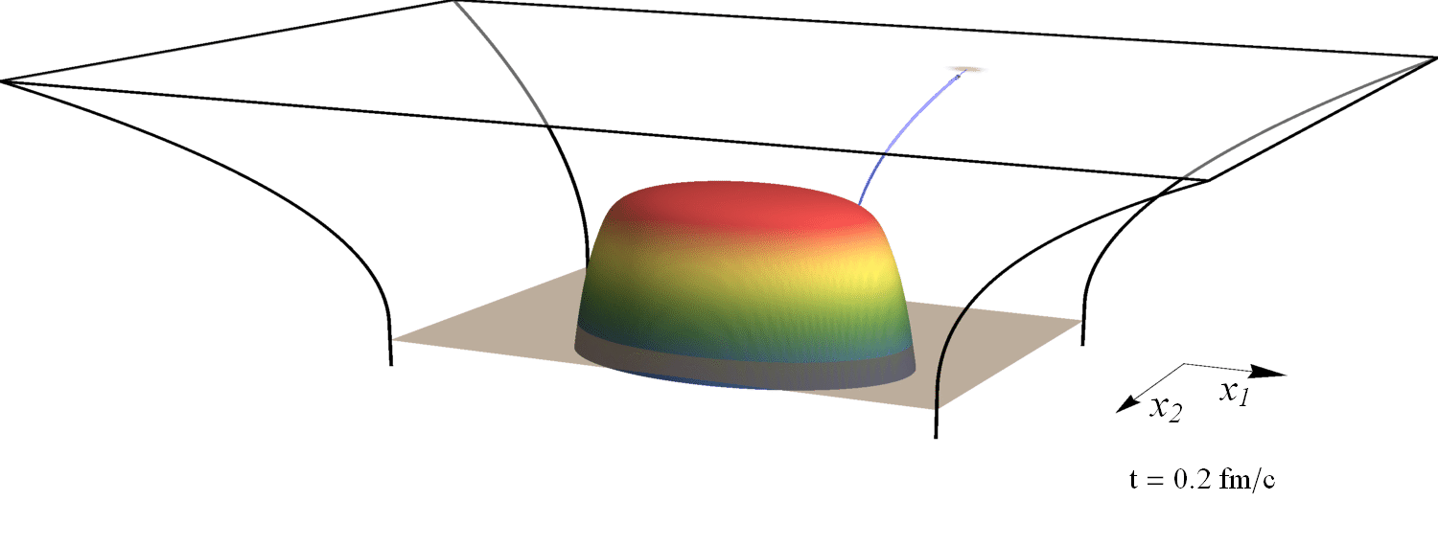

Early thermalisation, hydrodynamics, and energy loss in holographic heavy ion collisions
Towards quantitative results from holography
Based on work with Michał Heller, David Mateos, Jorge Casalderrey, Miquel Triana,
Paul Romatschke, Björn Schenke, Krishna Rajagopal, Andrey Sadofyev, Umut Gürsoy and Aron Jansen
References: 1507.02548, 1507.06789, 1602.04187, 1603.07724
Wilke van der Schee
XIIth Quark Confinement
Thessaloniki, 29 August 2016
(slowed down by 10²³)

Slide 2
Outline
Wilke van der Schee, MIT
Holography to model QCD
  AdS/CFT: first principle non-perturbative QFT computations
  Limitations: QCD(-like) theory with intermediate coupling is hard
Two simple models
  Colliding lumps of energy in super-Yang-Mills theory
    Obtain early hydrodynamics + rapidity distribution
  Shoot ensemble of jets through expanding and cooling sQGP
    Extract influence QGP on jet opening angle distribution
An outlook
  More refined models, more realistic phenomenology
Notes:
Many states + linearized

Slide 3
Ads/cft and holography
Wilke van der Schee, MIT
Exact equivalence between certain string theories and certain QFTs
  String theory only simple in large N_{c} and infinite ’t Hooft coupling
  Several examples known, but no known ‘real world’ QFT (yet?)
A typical strategy: start with `canonical’ example N =4 SYM
  Theory non-confining, but confining analogues exist
  Theory has 4 supersymmetries, but can be broken
  Requires large N_{c}, but 1/3² seems small from lattice QCD
  Infinite coupling strength (but QCD coupling runs only logarithmically…)
Holography provides a unique perspective
  Only way of computing far-from-equilibrium non-perturbative dynamics
  Study rich dynamics of general strongly coupled theories
Notes:
Note ihQCD: is possible to change from N=4 SYM

Slide 4

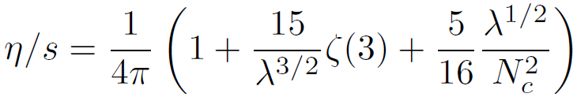
Ads/cft and holography
Wilke van der Schee, MIT
Heavy ion physics: a weak/strong coupling interplay?
  A ‘hybrid’ approach: make a model inspired by strong and weak models
  Bolder approach: strong coupling entirely
    Qualitative/quantitative trends can inspire better modelling
    In either approach some amount of fitting is required
Viscosity is good example:
  Canonical theory gives benchmark value
  Qualitative insight: viscosity scales as entropy
  Possible to compute corrections:
    Expected range: 0.08 – 0.12, link with weak coupling result?
Notes:
Note ihQCD: is possible to change from N=4 SYM

Slide 5
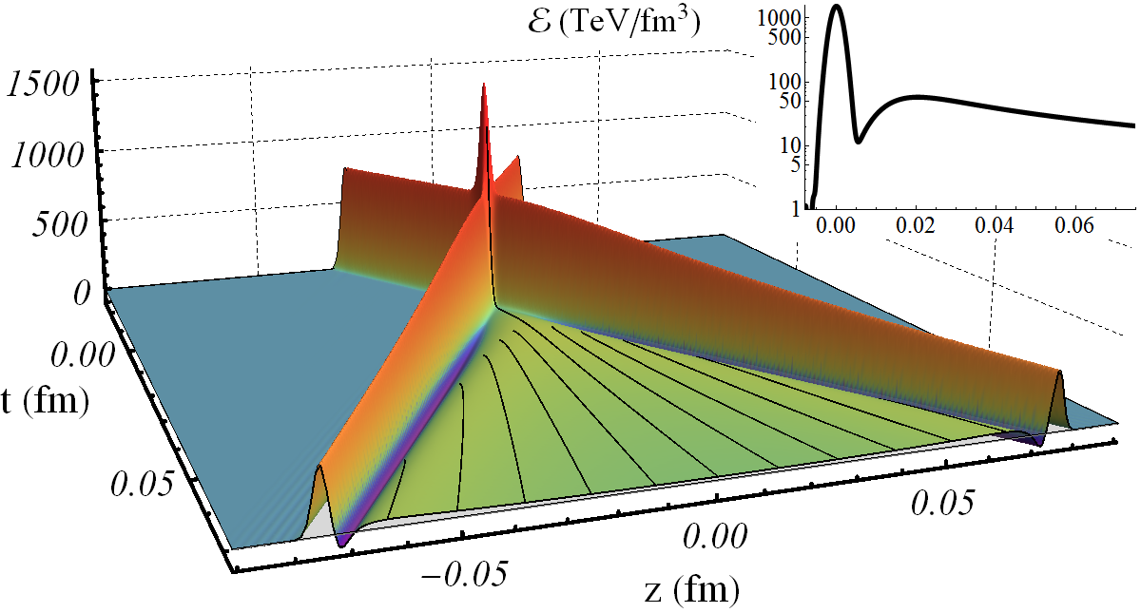

Collisions at infinitely strong coupling
Wilke van der Schee, MIT
Match longitudinal profile of energy density to nuclei
Approximately homogeneous in transverse plane
Benchmark:
J. Casalderrey-Solana, M.P. Heller, D. Mateos and WS, From full stopping to transparency in a holographic model of heavy ion collisions (2013)

Slide 6
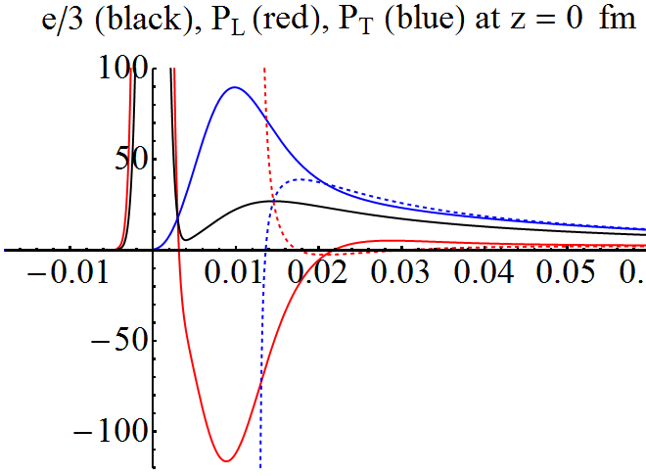
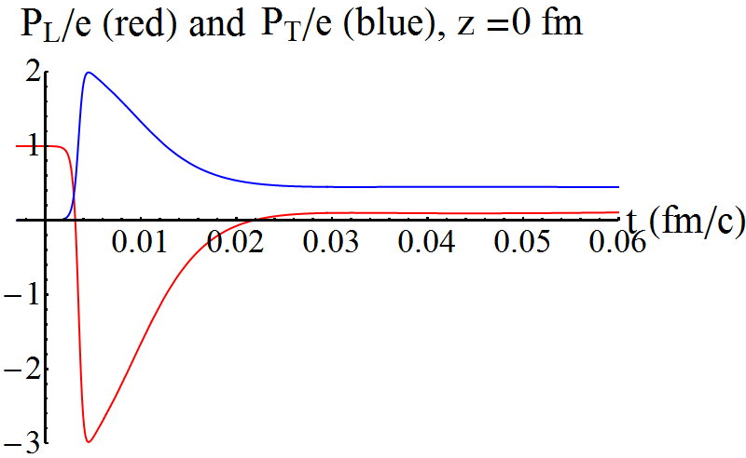
Thermalisation/pressures
Wilke van der Schee, MIT
Pressures, energy starts at zero, grows (unique to holography?)
Thermalises very fast (hydro applies in perhaps 0.02 fm/c)
  Thermalisation = relaxation non-hydro modes
  Gradients + viscous corrections are big
M.P. Heller, R.A. Janik and P. Witaszczyk, Hydrodynamic Gradient Expansion in Gauge Theory Plasmas (2013)

Slide 7
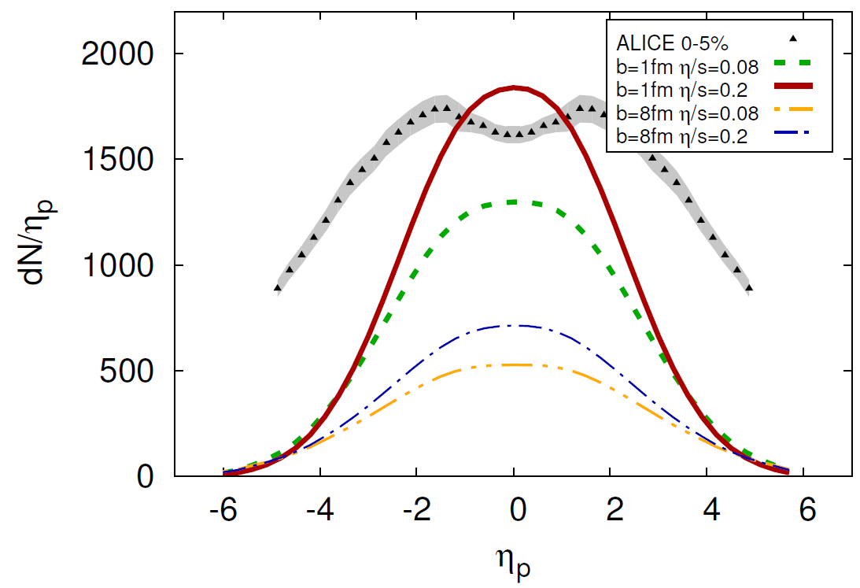
Rapidity profile + music
Wilke van der Schee, MIT
Particle spectra in longitudinal direction:
Rescaled initial energy density by factor 20
Profile is about 30% too narrow
WS and B. Schenke, Rapidity dependence in holographic heavy ion collisions (2015)
ALICE, Bulk Properties of Pb-Pb collisions at √s_{NN} = 2.76 TeV measured by ALICE (2011)

Slide 8
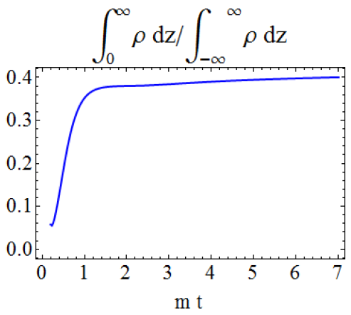
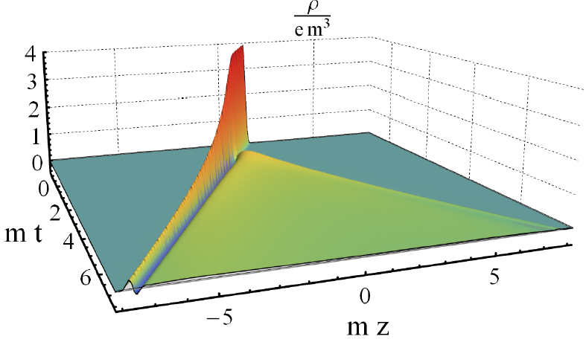

A new quantitative insight
Wilke van der Schee, MIT
Collide shocks with energy and charge
Now collide neutral with charged shock
41% of charge changes direction
→ strong interactions
J. Casalderrey-Solana, D. Mateos, WS and M. Triana, Holographic heavy ion collisions with baryon charge (2016)

Slide 9
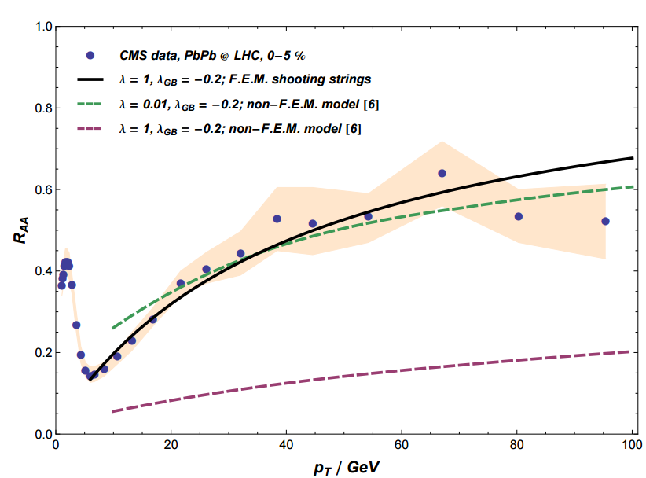
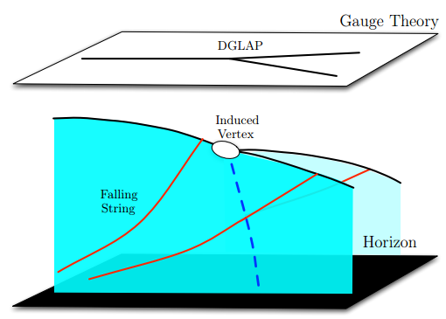
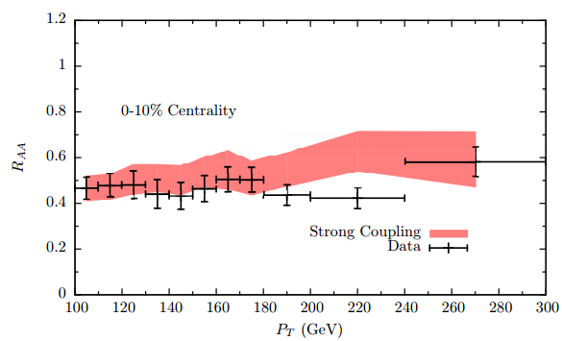
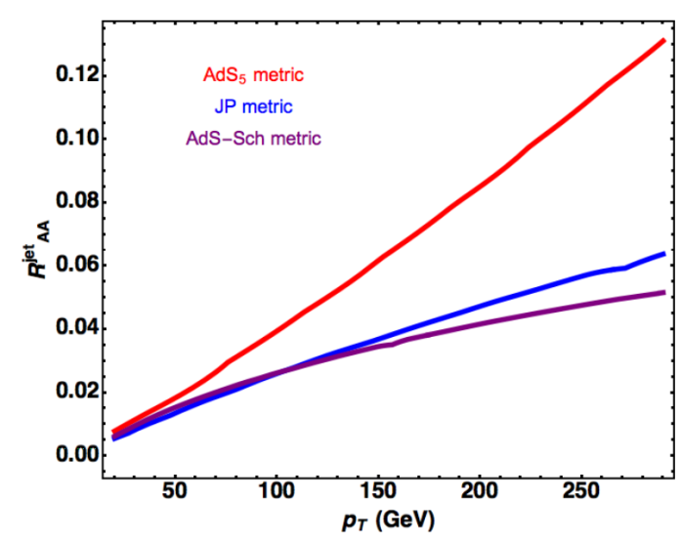
Recent holographic jet studies
Wilke van der Schee, MIT
J. Casalderrey, D. Can Gulhan, J. Guilherme Milhano, D. Pablos and K. Rajagopal, A Hybrid Strong/Weak Coupling Approach to Jet Quenching
R. Morad, W.A. Horowitz, Strong-coupling Jet Energy Loss from AdS/CFT (2014)
A. Ficnar, S.S. Gubser and M. Gyulassy, Shooting String Holography of Jet Quenching at RHIC and LHC (2013)
Notes:
Many states + linearized

Slide 10
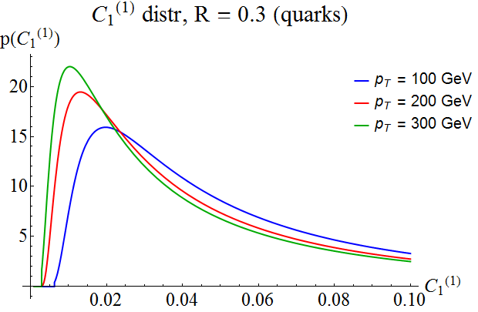
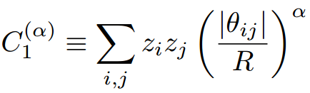
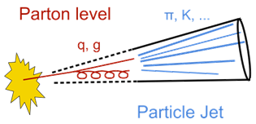
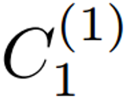
Matching both jet energy and jet width
Wilke van der Schee, MIT
Initial conditions in literature: minimize energy loss
Would like to mimic distribution of real QCD jets
  Extra motivation: how is distribution affected by QGP?
  Take from pQCD (compares well with PYTHIA)
Link jet width to AdS angle
z_{i}: fraction of jet energy
θ_{ij}: angle between particle i and j
R: jet radius parameter
A.J. Larkoski, S. Marzani, G. Soyez, J. Thaler, Soft drop (2014)
Notes:
Many states + linearized

Slide 11
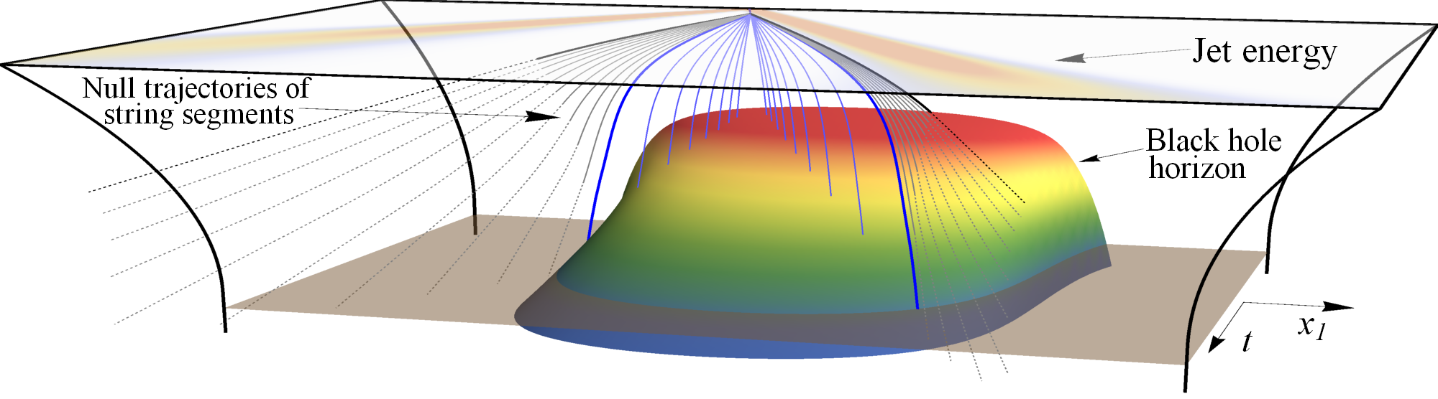
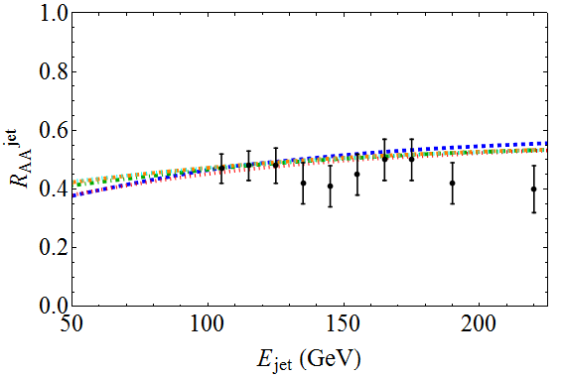
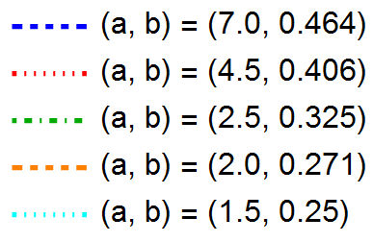

Results
Wilke van der Schee, MIT
Shooting about 50.000 jets through plasma
Naïve QCD:
a: parameter for angle
b: parameter for temperature
K. Rajagopal, A. Sadofyev and WS, Evolution of the jet opening angle distribution in holographic plasma (2016)
Notes:
Talk about time running

Slide 12
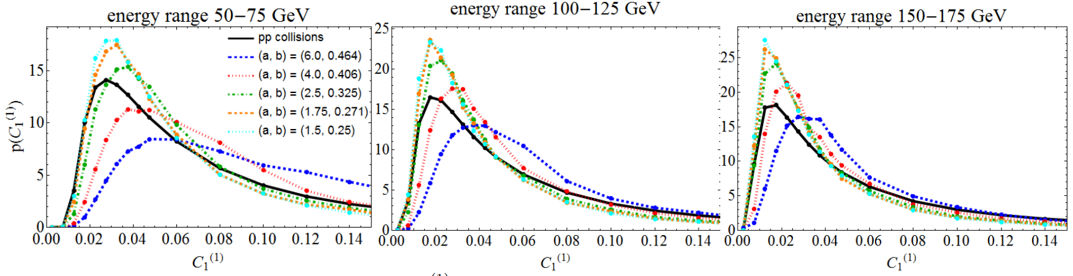
First effect: jets widen
Wilke van der Schee, MIT
Change of probability distributions of jet opening angle
Has not been measured ☺ (could/should be possible)
K. Rajagopal, A. Sadofyev and WS, Evolution of the jet opening angle distribution in holographic plasma (2016)
Notes:
Many states + linearized

Slide 13
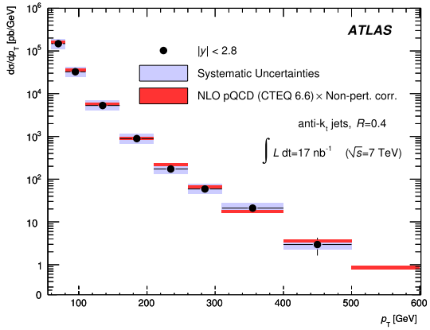
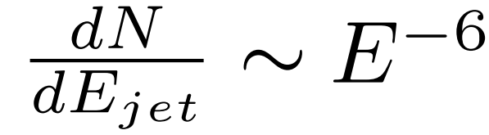
Second effect: Narrower jets
Wilke van der Schee, MIT
Energy distribution
falls steeply (~E⁻⁶)
Wide jets lose (much)
more energy
→ selection bias on
narrow jets
ATLAS, Measurement of inclusive jet and dijet cross sections in proton-proton collisions at 7 TeV centre-of-mass energy (2011)
Notes:
Many states + linearized

Slide 14
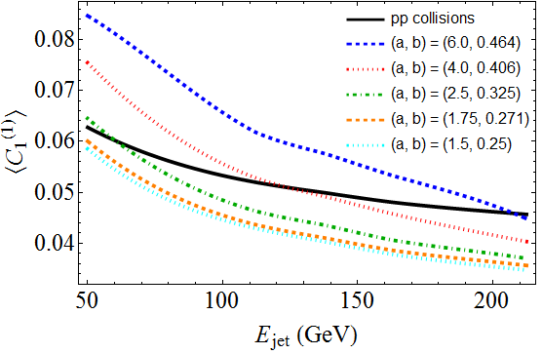
Unclear which effect dominates
Wilke van der Schee, MIT
Average jet width can go up or go down (larger for lower energy)
Notes:
Many states + linearized

Slide 15

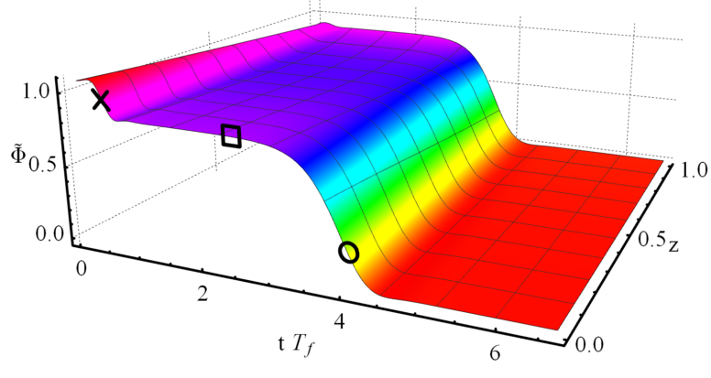
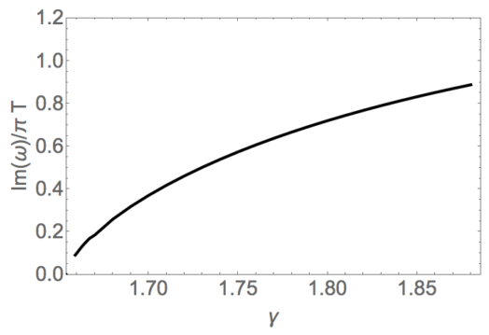
Outlook: improved models
Wilke van der Schee, MIT
Start with (versions of) improved holographic QCD
Simplest version just amounts to adding scalar with potential:
(dimension d, dimension scalar Δ, free parameter γ)
Richer phase diagram:
thermalisation in two stages
Relaxation time (=1/frequency) depends on parameter theory (γ)
U. Gürsoy, A. Jansen and WS, A new dynamical instability in asymptotically Anti-de-Sitter spacetime (2016)
(see also work by T. Ishii, E. Kiritsis and C. Rosen, and by R. Janik, J. Jankowski and H. Soltanpanahi)

Slide 16
Discussion
Wilke van der Schee, MIT
Holography and heavy ion collisions
  AdS/CFT essential tool for insights in strongly coupled matter
  Complementary with weak coupling modelling
Qualitative lessons and quantitative modelling
  Fast applicability of hydrodynamics
  Most of energy stopped at moderate rapidity, Gaussian shape
  Energy loss jet has crucial interplay with jet width
Outlook
  More quantitative comparisons with experiment, perhaps fitting width rapidity spectrum etc
  Improved models closer to QCD, include finite coupling corrections
Notes:
Many states + linearized

