Slide 1

Muon Forward Tracker a novel silicon detector for the ALICE upgrade
Stefano Matthias PANEBIANCO – CEA Saclay for the ALICE MFT project
XIIth Quark Confinement and the Hadron Spectrum
September the 1st 2016
Thessaloniki, Greece
Notes:
We would appreciate feed-back from our referees

Slide 2
The ALICE experiment
The unique LHC experiment fully devoted to the study of QGP
Central region (ITS)
Muon Absorber
Muon Arm

Slide 3
The physics case
Complement to the present muon spectrometer with vertex capability
In medium charmonium dynamics, dissociation/regeneration mechanism
  Separation between prompt and decay J/ψ
  Measurement of the ψ(2S)
  Production yields and nuclear modification factors R_{AA} down to p_{T} = 0

Slide 4
The physics case
Complement to the present muon spectrometer with vertex capability
In medium charmonium dynamics, dissociation/regeneration mechanism
Medium density and mass dependence of in-medium parton energy loss
  Charm and beauty p_{T}-differential production yields
  Charm in the single muon channel down to p_{T} = 1 GeV/c

Slide 5
The physics case
Complement to the present muon spectrometer with vertex capability
In medium charmonium dynamics, dissociation/regeneration mechanism
Medium density and mass dependence of in-medium parton energy loss
QCD phase transition and its chiral nature
  Measurement of QGP thermal radiation and spectral shape of low mass vector mesons

Slide 6
MFT design goals
Vertexing for the Muon Spectrometer at forward rapidity
  5 detection disks of silicon pixel sensors O(25 μm x 25 μm)
  0.6% of X₀ per disk
  -3.6 < η < -2.45
  Disk#0 at z = -460 mm, R_{in} = 25 mm (limited by the beam-pipe radius)
Good matching efficiency between MFT and MS
  Disk#4 at z = -768 mm (limited by FIT and the frontal absorber).
Fast electronics read-out
  Pb-Pb interaction rate ~50 kHz, pp interactions ~200 kHz.

Slide 7
MFT Layout
920 silicon pixel sensors (0.4 m²) in 280 ladders of 2 to 5 sensors each.
Disk#4
Disk#2
10 half-disks
2 detection planes each
Disk#3
Disk#1
Disk#0
Radiation doses
< 400 krad
< 6x10¹² 1 MeV n_{eq}/cm²
10-fold security factor
-3.6 < η < -2.45
5% of the ITS surface
Twice the ITS inner barrel
IP region
z = -76.8 cm
z = -46.0 cm

Slide 8
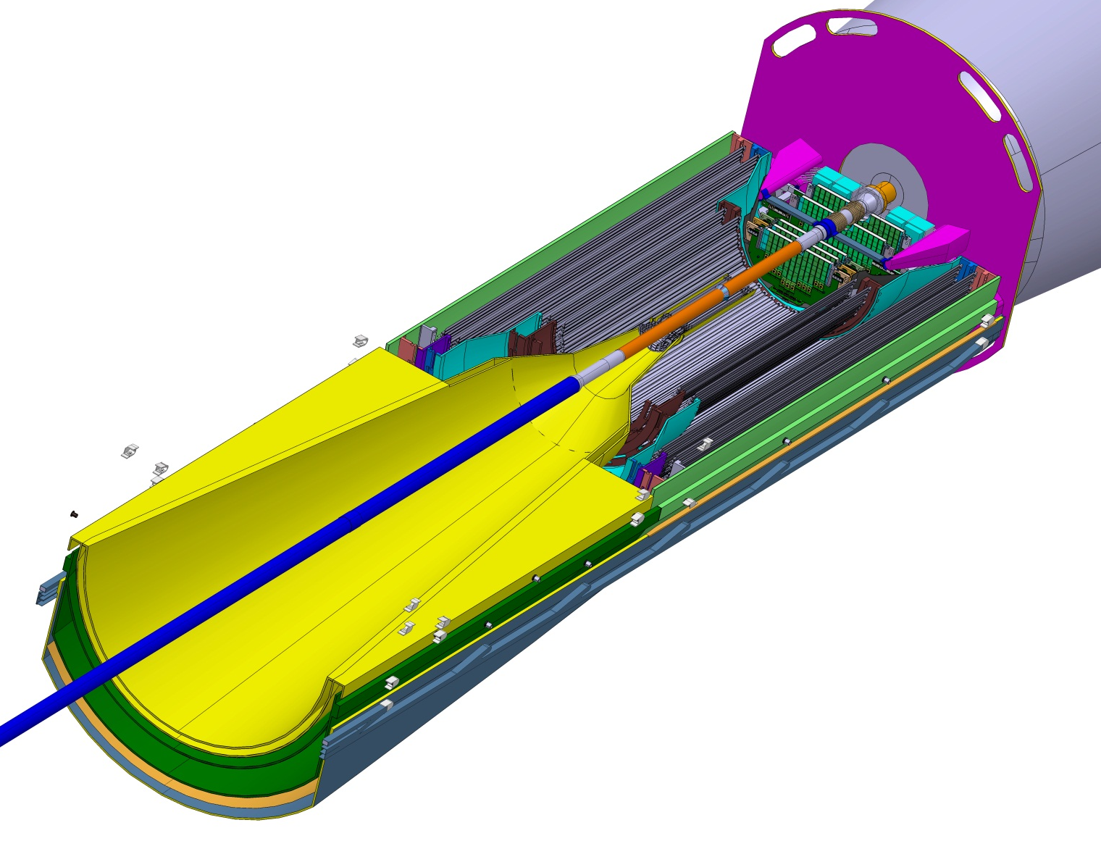
MFT environment
Central region
Absorber
Cage
ITS Outer barrel
ITS inner barrel
Beam Pipe

Slide 9
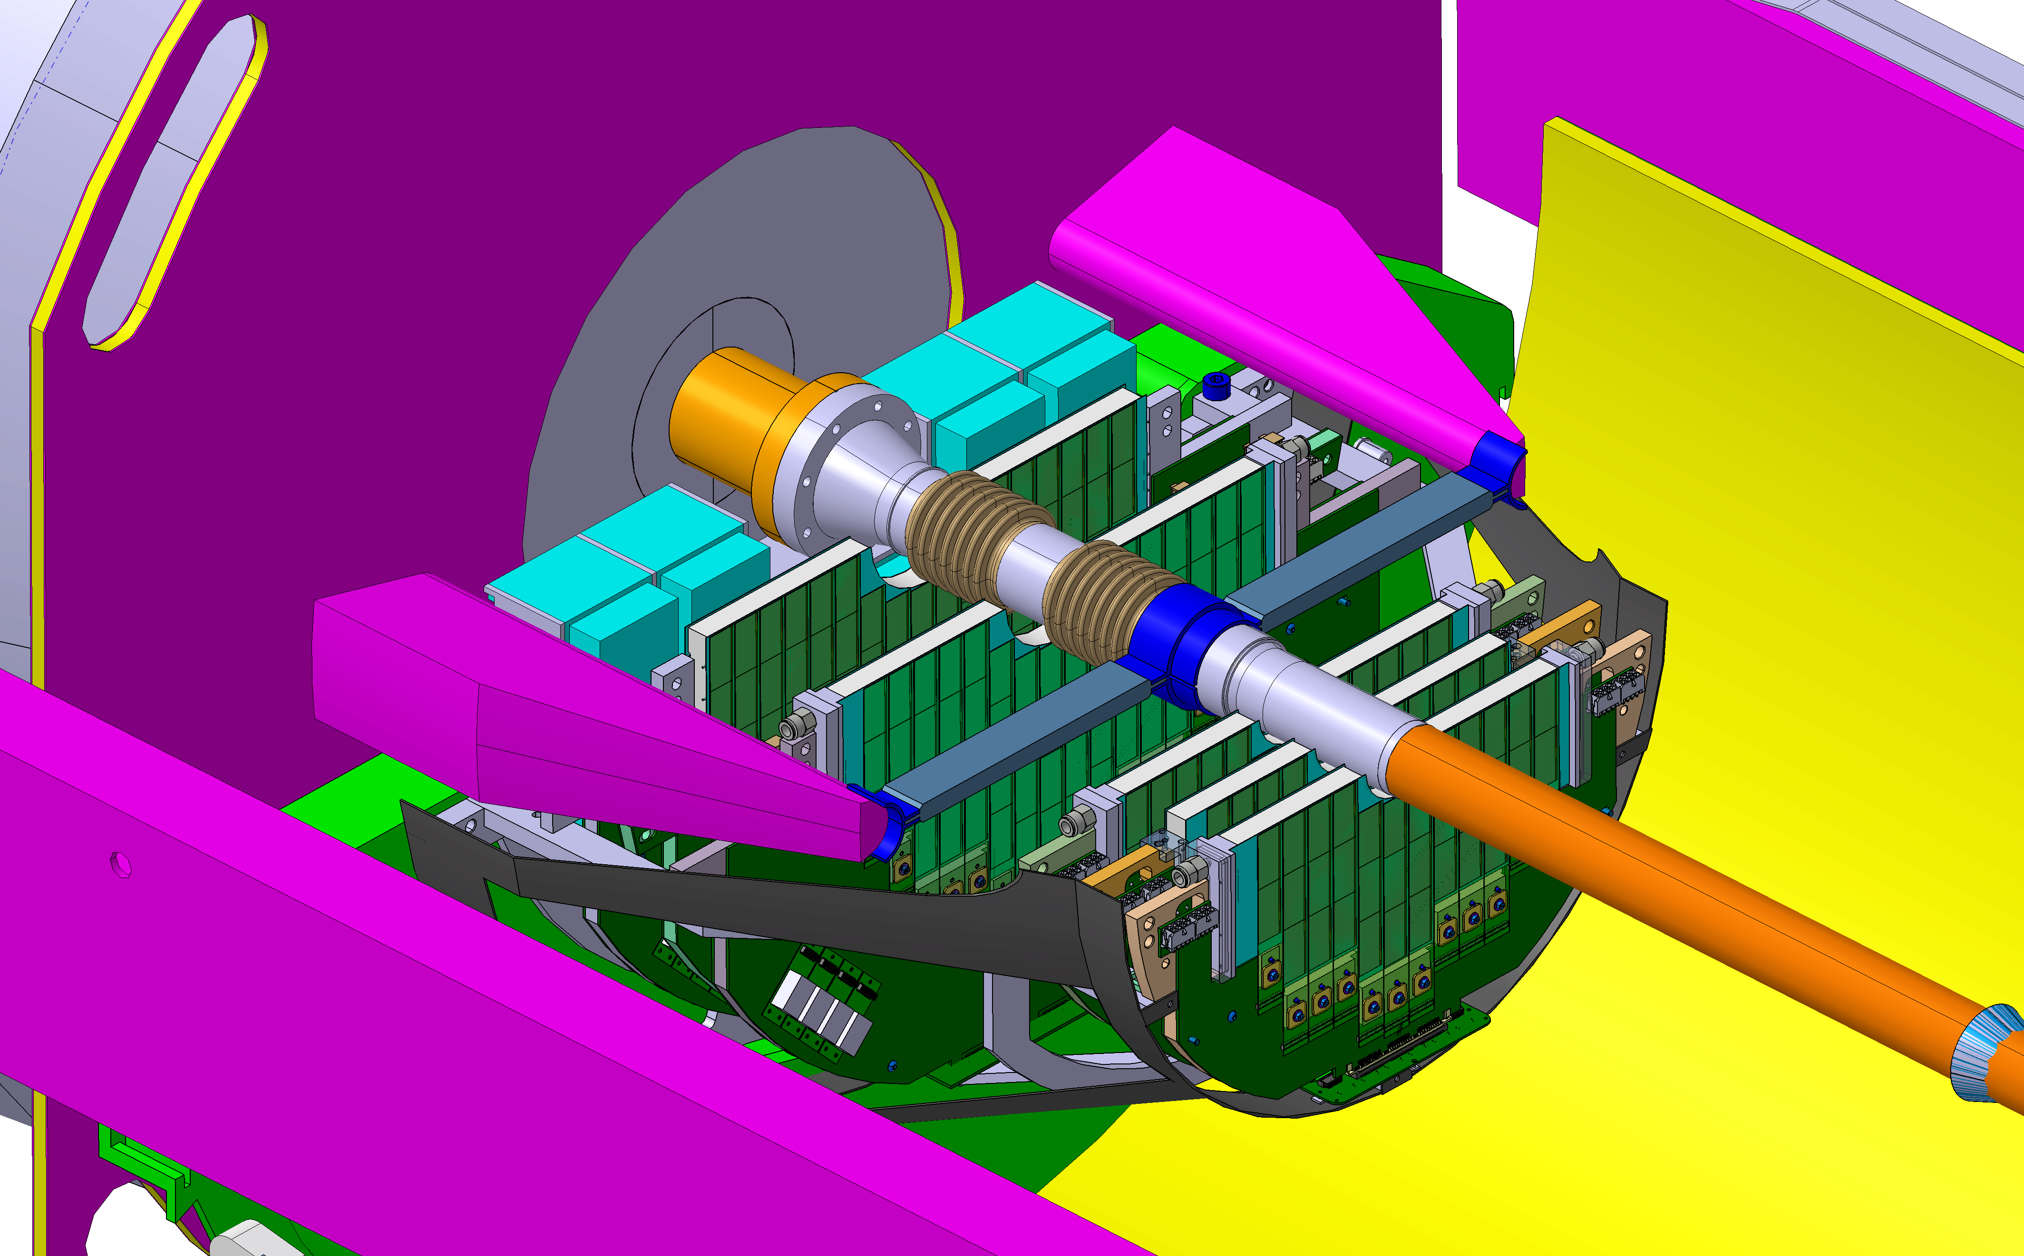
MFT environment
MFT & FIT region

Slide 10
Joint ITS-MFT strategy
Technical specifications of ITS inner-barrel and MFT are almost identical
ITS-MFT common sensor:
  same chip (participation to chip in-lab and in-beam tests)
  similar flex printed circuit (same industrial process)
  same interconnection technique (wire bonding)
  same read-out architecture (common RU)
  same cooling strategy (water cooling)

Slide 11
Brief history of the project
03/2011: Expression of Interest (EoI)
2011-2013: preliminary design studies
12/2013: Letter of Intent (LoI)
09/2015: Technical Design Report (TDR)
05/2015: funding finalized and approved
01/2016: Coordination Board composition updated
02/2016: Memorandum of Understanding (MoU)
06/2016: new Organization Breakdown Structure
08/2016: finalization of the ladder R&D

Slide 12
ITS-MFT sensor : ALPIDE
Pixel Sensor using TowerJazz 0.18μm CMOS Imaging Process
High-resistivity (> 1 kΩ cm) p-type epitaxial layer (25 μm) on p-type substrate
Very small n-well diode (2 μm diameter), low capacitance
Application of reverse bias voltage to substrate to increase depletion zone
Deep p-well shields n-well to allow full circuitry within active area
Total chip thickness: 50 μm

Slide 13
ITS-MFT sensor : ALPIDE
Chip performances: pALPIDE3
MFT test benches
Proto pALPIDE3 (8 sectors with different pixel characteristics)
Efficiency and fake rate within specifications
Degradation due to irradiation fully compensated by applying back bias
Positive EDR end of 2015; ALPIDE pre-production in progress

Slide 14
MFT ladder
From ALPIDE chip to Hybrid Integrated Circuit (HIC)
Chips are interconnected to a Aluminum Flexible Printed Circuit (FPC)
FPC design almost final (optimization according to the interconnection technique)

Slide 15
MFT ladder
From ALPIDE chip to Hybrid Integrated Circuit (HIC)
Main baseline (ITS-TDR): laser soldering
Abandoned on February 2016 : yield < 95%
Alternative solutions:
  New baseline: wire bonding
  Alternative: conductive glue
Several test realized with conductive glue
Test with wire bonding ongoing

Slide 16
MFT ladder
From ALPIDE chip to Hybrid Integrated Circuit (HIC)
Several test realized with conductive glue
Test with wire bonding ongoing
Automatic positioning of chips on FPC: Module Assembly Machine (MAM)

Slide 17
MFT ladder
From HIC to ladder: the encapsulation
Main goals
  Allow ladder removal without dispersing Si pieces
  Allow ladder gluing on disk
  Provide electrical insulation between ladders and disk
Encapsulation technique
  Gluing adhesive Kapton (K104 Saint Gobin) on the sensor side of the HIC
  Total encapsulation thickness (Kapton+glue): 37μm
  Kapton thermal conduction: 0.16 W/mK
Process definition almost finalized
Creation of grey room at CEA Antenna
Ladder EDR: end of September

Slide 18
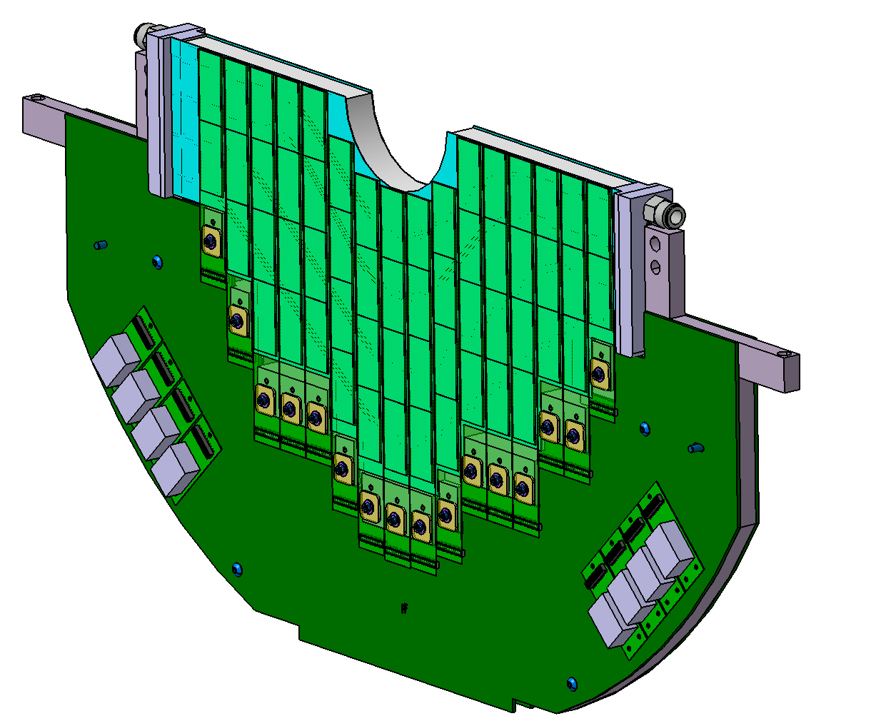
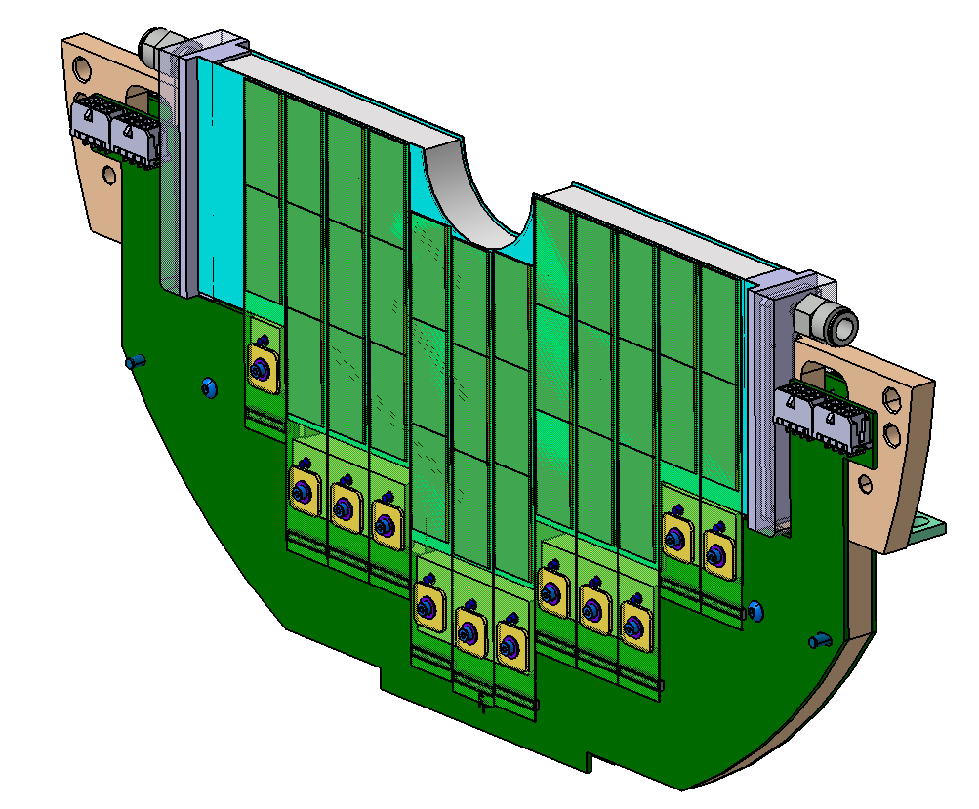
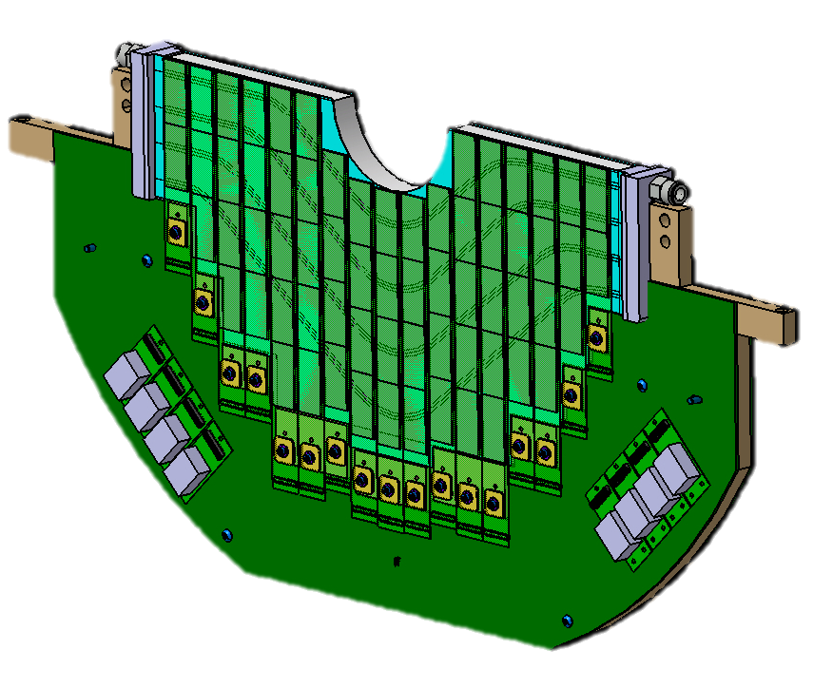
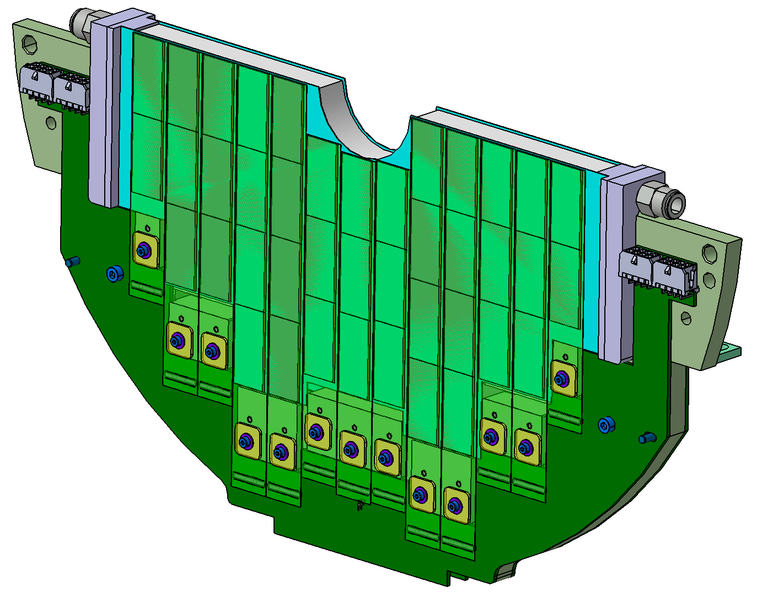
MFT disk
From ladder to disks: half disks overview
Half-Disk #3
32 ladders
114 sensors
Half-Disk #0-#1
24 ladders
66 sensors
Half-Disk #2
26 ladders
82 sensors
Half-Disk #4
34 ladders
132 sensors

Slide 19
MFT disk
Half disk structure
Two detection planes
  Coverage around the beam pipe
  Water cooled plate in between
  Redundancy (50%)
PCB: signal/voltage routing
  DC-DC converters (disk 3 and 4)
Heat Exchanger
  Rohacell + cold plates
  Cold plate: assembly of carbon papers with embedded polymide water pipes (∅ 1 mm)
  Manifold
Disk support (Peek material)

Slide 20
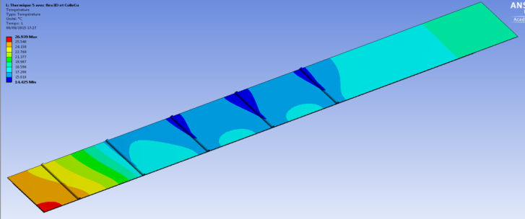
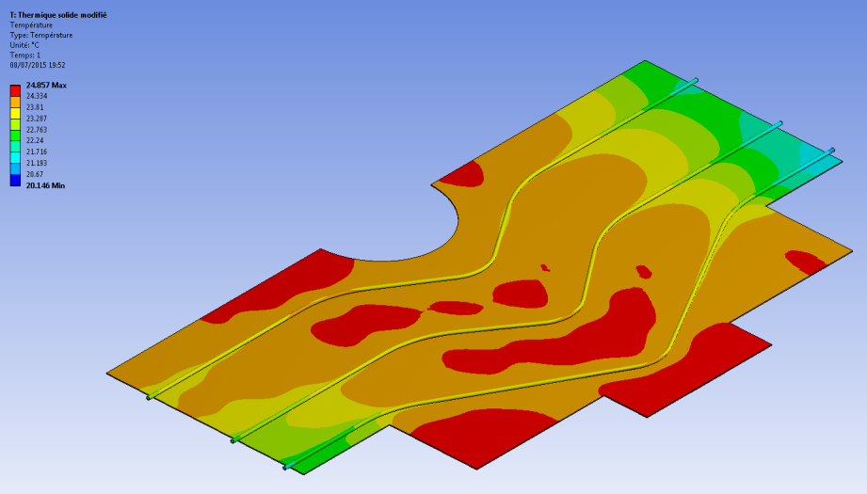
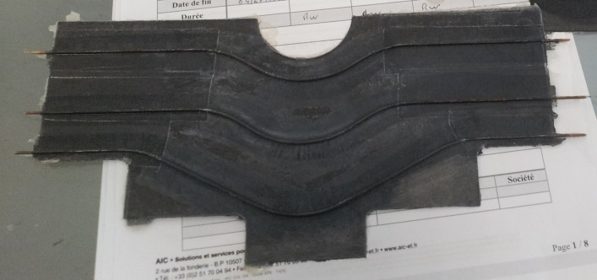
MFT disk
Disk Exchanger R&D
Study and optimization of C-fiber stacking
  Comparison between 5-layer carbon fibers
  Optimization of ply orientation
Ladder thermal tests
  Validation of mockup thermal behavior
  Validation of the simulation parameters
Cold plate prototypes
  K13D2U material (high conductivity) made at CERN
  MJ55 material (lower conductivity) made at Subatech (Nantes)
  Feasibility of production in India

Slide 21
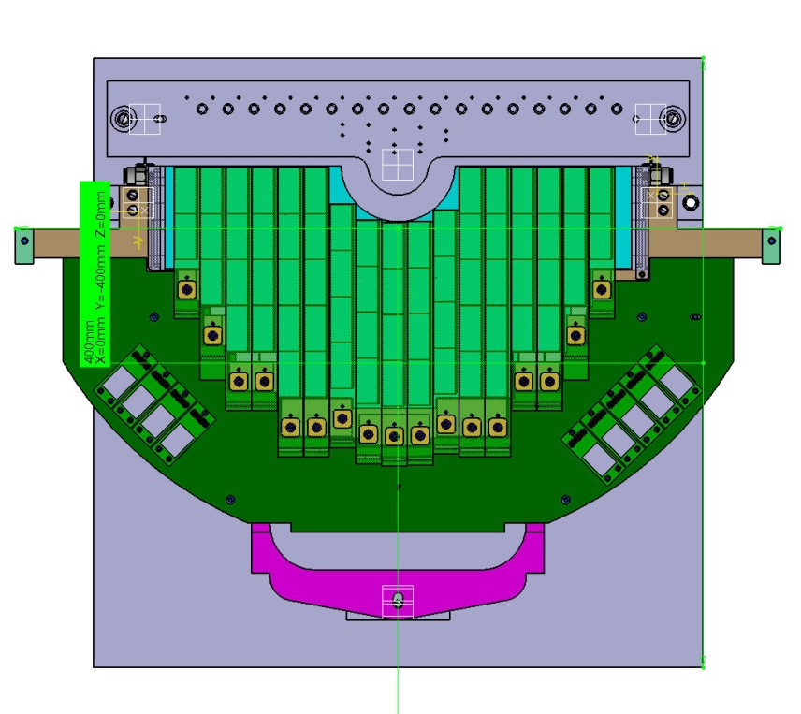
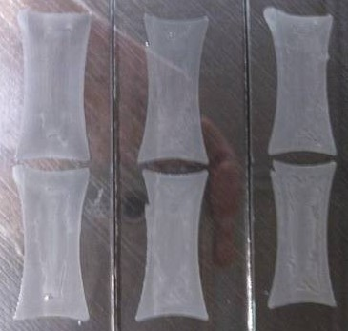
MFT disk
Disk assembly
Ladders are glued on heat exchanger
  Dedicated positioning tool
Choice of the glue
  Silicon (SE4445) for easier removal and longer working time
  Used in ATLAS experiment (radiation hard)
Ongoing R&D on automatic glue deposition
  Automatic machine (IPN Lyon)
  Deposition pattern: curved spiral
Survey of chips position on 3D machine

Slide 22
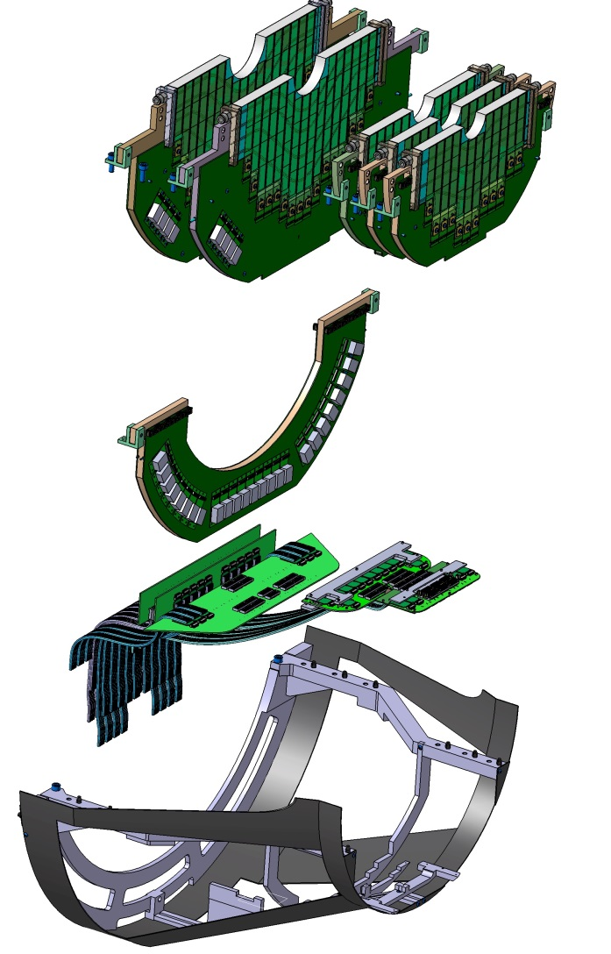
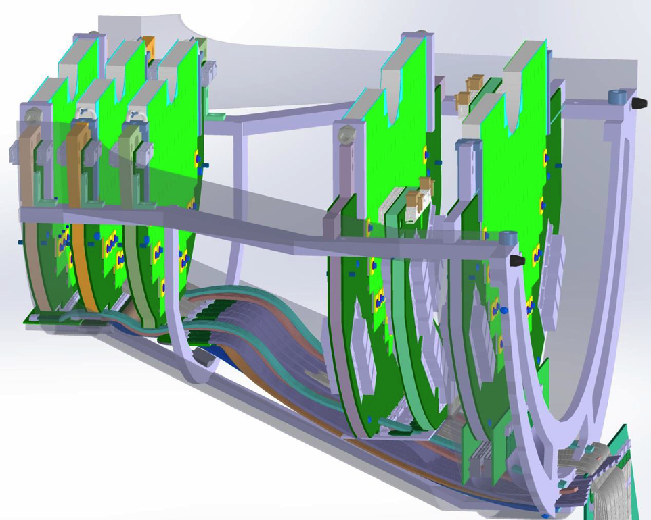
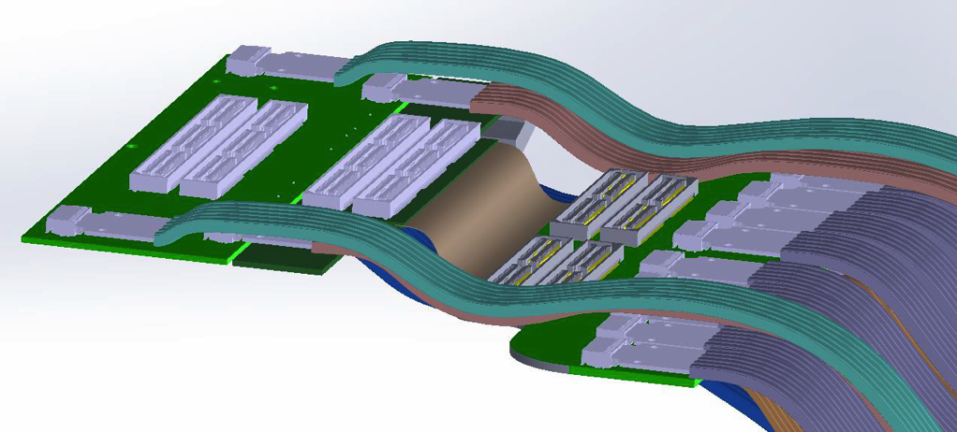
MFT cone
Global layout of half MFT
5 half disks
Power Supply Unit
Mother Boards
Cone structure

Slide 23
MFT Barrel
Integration scheme

Slide 24
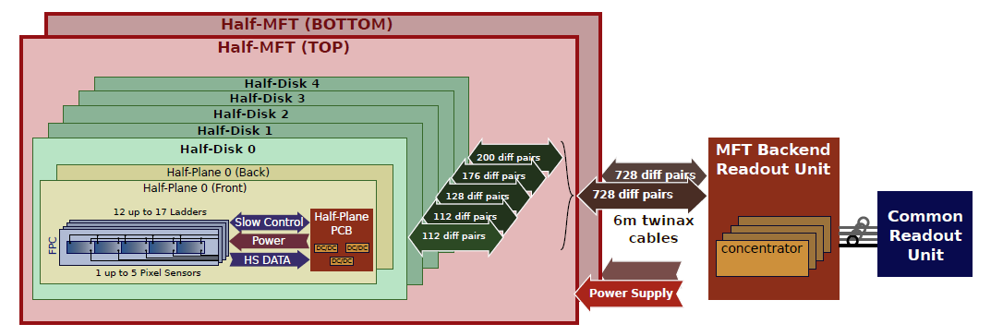
MFT readout
On-Detector
Barrel Patch Panel
Off-Detector
CTP
728 diff pairs
728 diff pairs
5-7 m Twinax cables
Power Supply
Power Supply
Optical fibers
Between 132-264 high speed data signals (1.2 Gb/s) per disk
Between 96-136 clock and slow control signals per disk
Total of 1480 twinax cables for read-out
80 concentrator boards (RU) ~ 4 m away, where TID about ~ 1 krad

Slide 25
Milestones

Slide 26
Conclusions
MFT: an innovative silicon tracker for the ALICE upgrade
Precision tracking in the muon spectrometer acceptance
  Vertexing capabilities
  Muon matching
Major improvement on several physics cases:
  Open heavy flavours
  Charmonia
  Low mass mesons
MFT collaboration: 16 groups for 8 countries.
Project in its final R&D phase
Chip production starting soon, the rest will follow
Installation in ALICE cavern foreseen during first semester of 2020

Slide 27
Backup material

Slide 28
MFT design goals
Vertexing for the Muon Spectrometer at forward rapidity
  5 detection disks of silicon pixel sensors O(25 μm x 25 μm)
  0.6% of X₀ per disk
  -3.6 < η < -2.45
  Disk#0 at z = -460 mm, R_{in} = 25 mm (limited by the beam-pipe radius)

Slide 29
MFT design goals
Vertexing for the Muon Spectrometer at forward rapidity
Good matching efficiency between MFT and MS
  Disk#4 at z = -768 mm (limited by FIT and the frontal absorber)

Slide 30
ITS-MFT sensor : ALPIDE
Chip architecture
15 mm
30 mm
Matrix of pixels (29.24 μm x 26.88 μm) + peripheral bias/readout/control/interface
Matrix zero-suppressed readout via Priority Encoders sent to 11b ADC
Differential signal transmitted at 1.2 Gb/s
Power consumption density: 35 mW/cm²

Slide 31
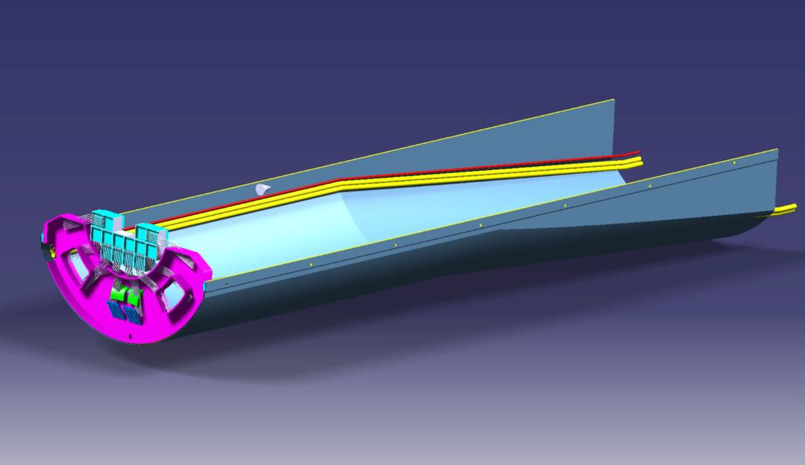
MFT Barrel
Global layout of half barrel
FIT
Water pipes
Power lines
Carbon Fiber Structure
Patch Panel
Barrel function: MFT insertion and positioning
Full scale mock-up built for integration studies

Slide 32
MFT Services
LV architecture: provide analog, digital and back bias power
Cooling plant: water cooling of disks and RU
DCS architecture: standard setup and monitoring of operation conditions

