Slide 1
FAIR Accelerators
Jens Stadlmann
(GSI Helmholtzzentrum für Schwerionenforschung,
SIS100/SIS18 Division)

Slide 2
Outline
(very) short FAIR introduction
FAIR injectors
  SIS18 upgrade
  recent UNILAC improvements
  FAIR phase 0
FAIR accelerators
  overview
  procurement status
Conclusion
Extra slides (protons@fair and spill structure)

Slide 3
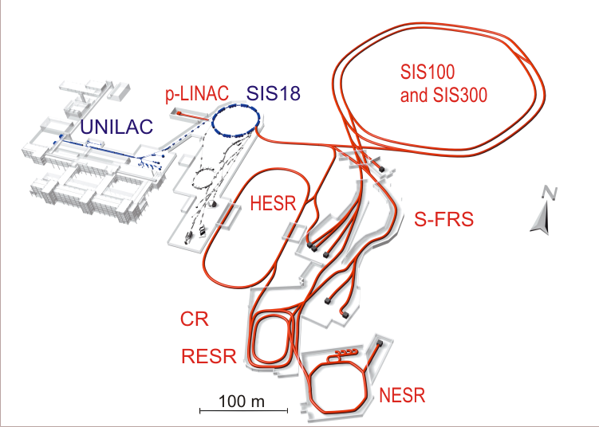

The Facility for Antiproton and Ion Research (FAIR)
Beam intensity increase:
  Primary beams: x 100 – x 1000
  (5*10¹¹ uranium ions per spill)
  Secondary beams: x 10.000
Beams:
  Anti protons
  Protons to uranium, RIBs
Beam quality:
  Cooled anti proton beams
  Cooled, intense RIBs
Beam pulse structure:
extreme short pulses to
quasi continuous
1.5 GeV/u ²³⁸U beams to the
S-FRS for instance
FLAIR

Slide 4
Requirements to the FAIR accelerators
Beam intensity increase:
  Primary beams:
  x 100 – x 1000
  Secondary beams:
  x 10.000
Beams:
  Anti protons
  Protons to uranium
  RIBs
Beam quality:
  Cooled anti proton beams
  Cooled, intense RIBs
Beam pulse structure:
extreme short pulses to
quasi continuous
Modularized
start version
SIS18
UNILAC
CBM
Design ion beam: U²⁸⁺ with 2.7 GeV/u, 5x10¹¹ Ions/Cycle
Protons up to 29 GeV
Heavy ion beams up to about 11 GeV/u

Slide 5
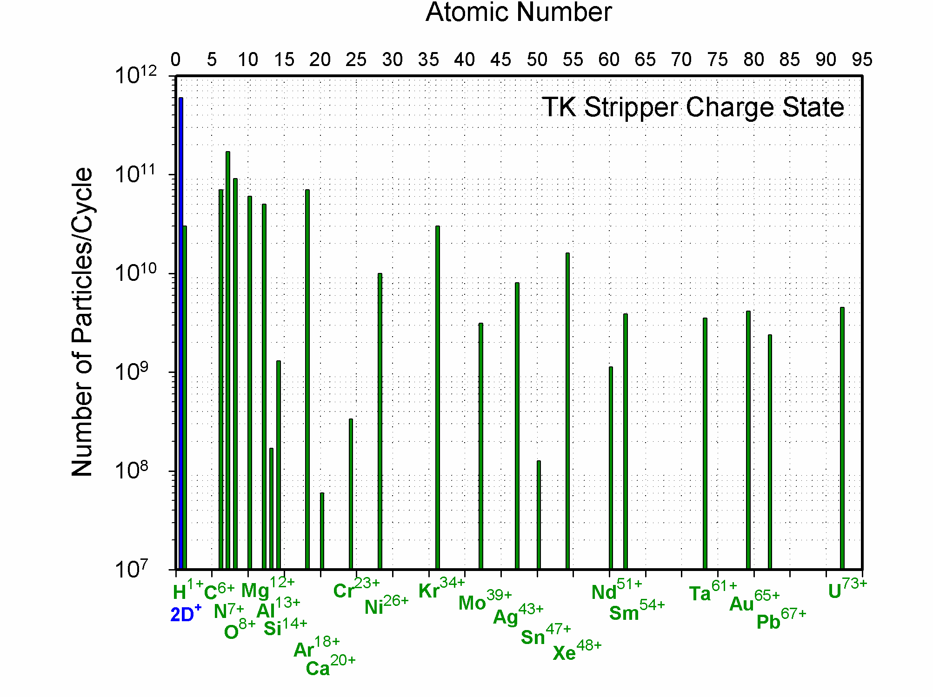
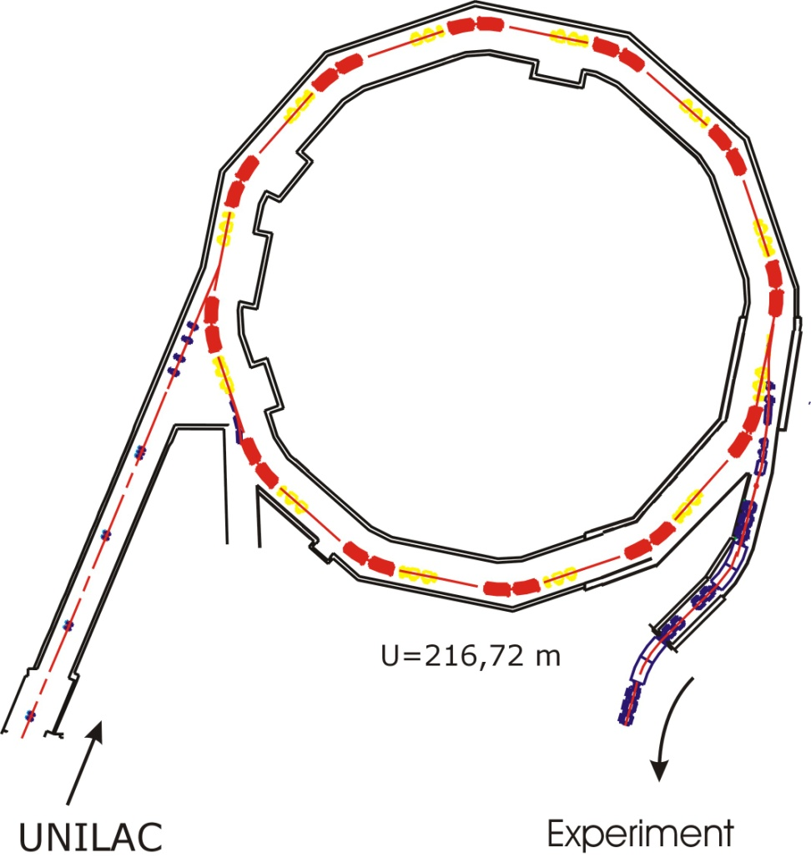
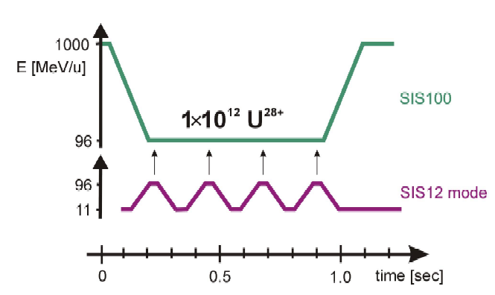
SIS 18 as Injector for SIS 100
≈ 1,5x10¹¹
U²⁸⁺
SIS 18
≈ 2x10¹⁰
U⁷³⁺
U²⁸⁺
SIS 100 cycle
Choice of U²⁸⁺ as design ion:
+ Lower space charge
→ higher intensity N_{max}~A/Q²
+ No stripping losses
- Lower beam lifetime
0.7Hz
5x10¹¹ U²⁸⁺
2.7Hz
SIS 18
Notes:
5
5

Slide 6
FAIR Requirements for SIS18
 | Today | FAIR Booster | Today | FAIR Booster
Reference Ion | U⁷³⁺ | U²⁸⁺ | P | P
Maximum Energy | 1 GeV/u | 0.2 GeV/u | 4 GeV | 4 GeV
Maximum Intensity | 4x10⁹ | 1.5x10¹¹ | 2x10¹¹ | 2.5x10¹²
Repetition Rate | 0.3 - 1 Hz | 2.7 Hz | 0.3 – 1 Hz | 2.7 Hz
Main challenge: Intermediate charge state heavy ions,
dynamic vacuum and ionization beam loss

Slide 7
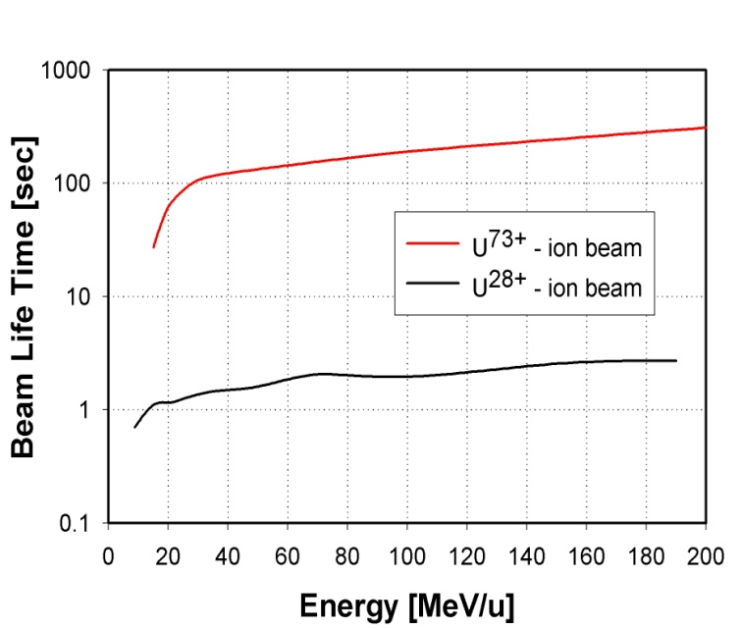
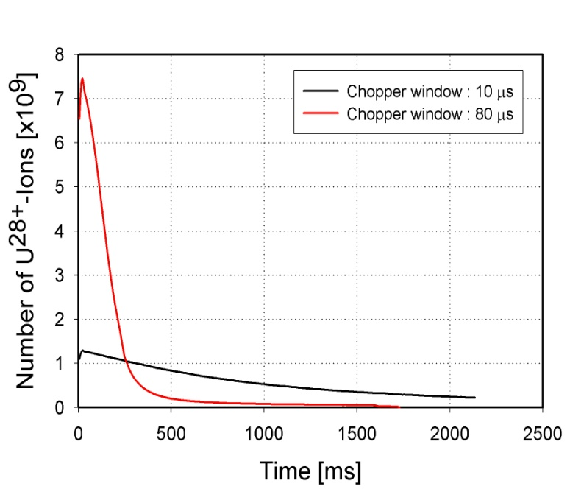
Life Time and Beam Loss:
dynamic vacuum effects limit ion intensities
Life time of U²⁸⁺ is significantly lower
than of U⁷³⁺
Life time of U²⁸⁺ depends strongly on the
residual gas pressure and composition
Ion induced gas desorption (η≈ 10 000)
increases the local pressure
Beam loss increases with intensity
(dynamics vacuum, vacuum instability)

Slide 8
Dynamic Vacuum effect and collimation
P. Puppel

Slide 9
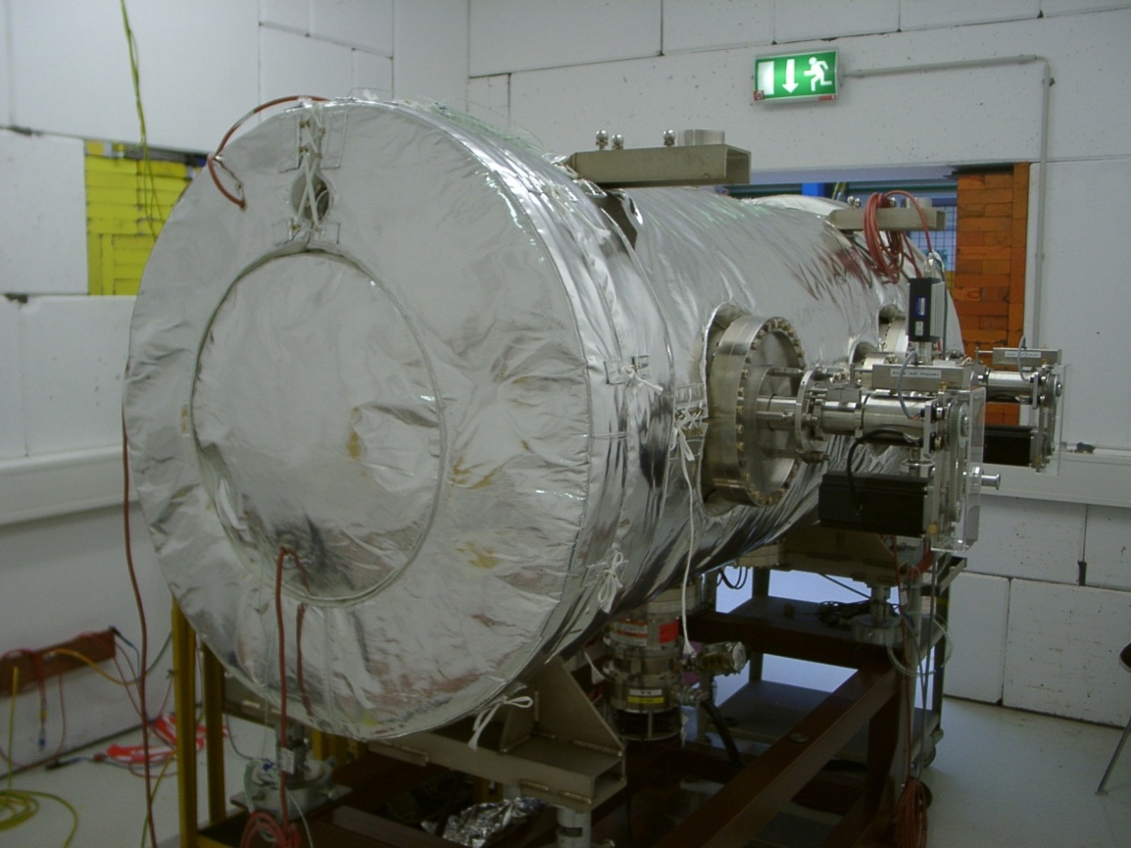
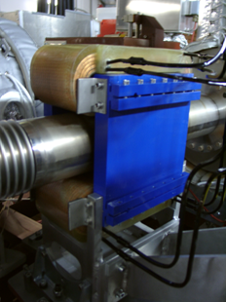
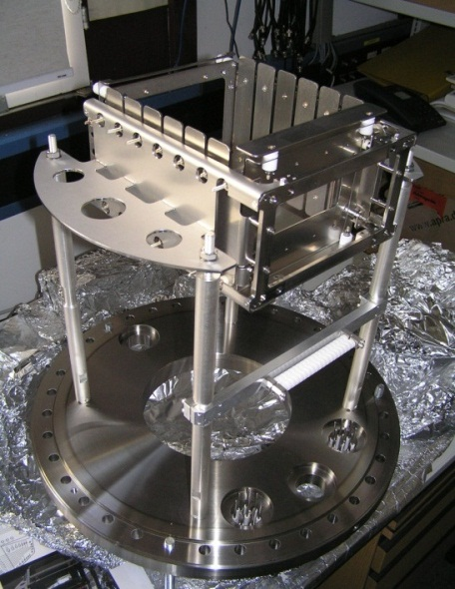
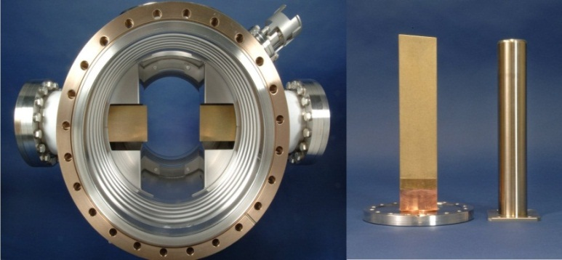
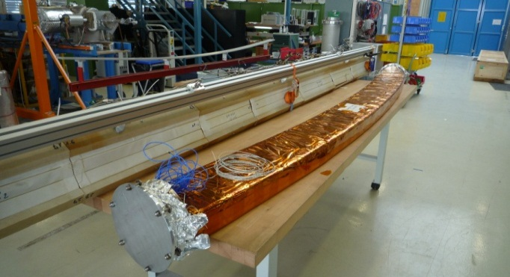
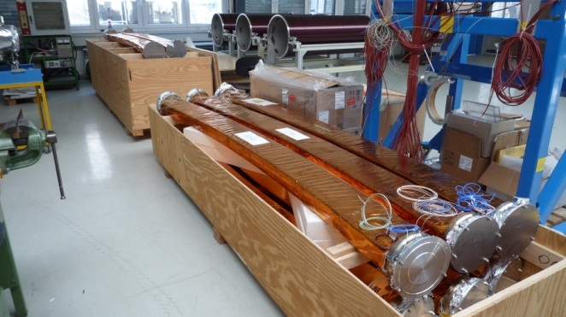
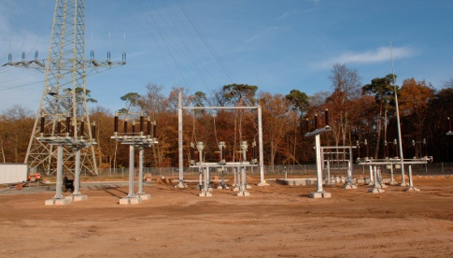
SIS18 Upgrade Program 2005 - 2013
Dedicated to intermediate charge state heavy ion operation and FAIR booster operation
300 kV Injection Septum
Inj. V Steerer
HV unit of ionisation beam profile monitor
Low desorption ion catchers
NEG coated thin wall magnet chambers (all dipoles and quadrupoles)
New power grid connection

Slide 10
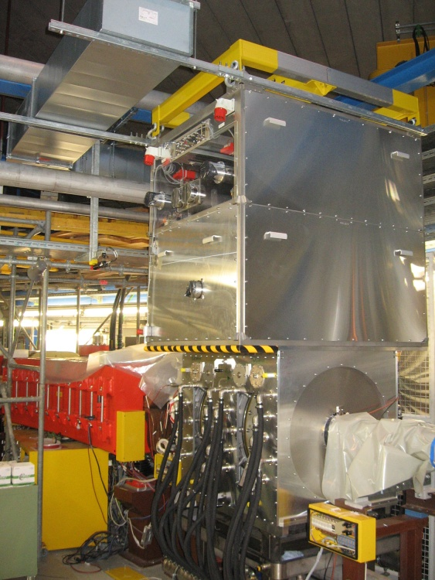
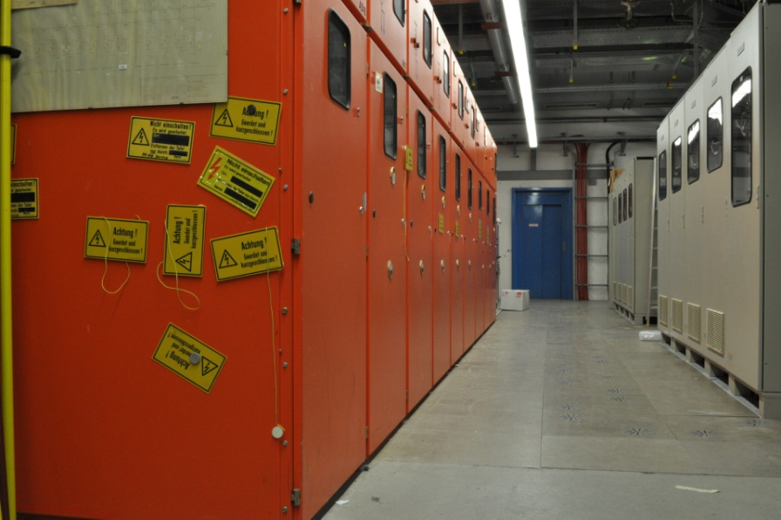
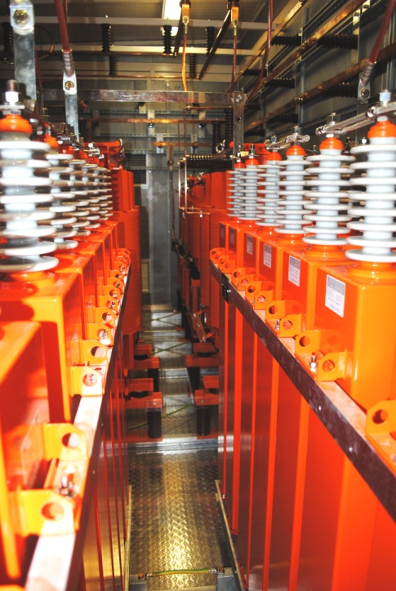
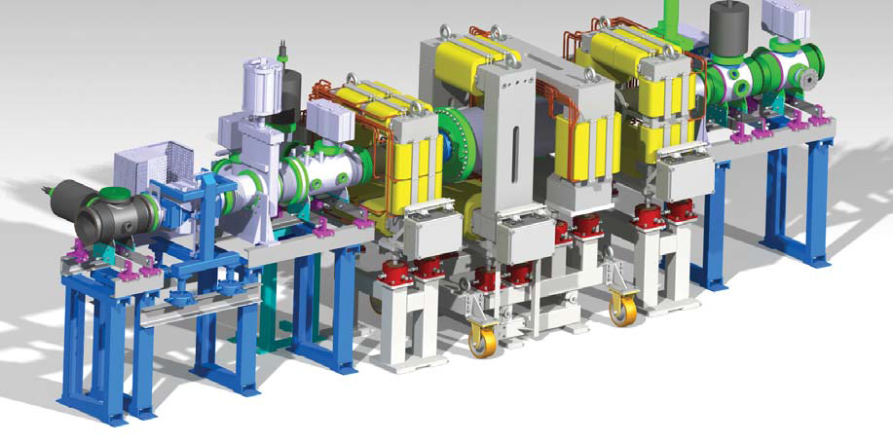
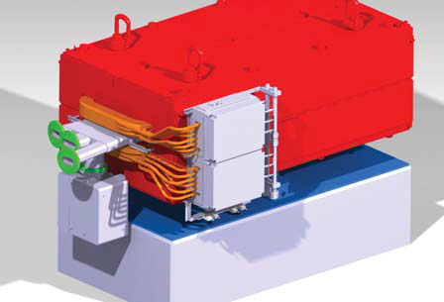
SIS18 Upgrade Program 2013 - 2017
Dedicated to intermediate charge state heavy ion operation and FAIR booster operation
Replacement of main dipole power converter completed (10 T/s, 50 MW)
Three new MA acceleration cavities installed (50 kV, h=2)
SIS18/SIS100 IPM magnet system ordered
Bipolar dipole magnet for the link to tunnel 101
The originally defined SIS18upgrade program will be completed in 2018.

Slide 11
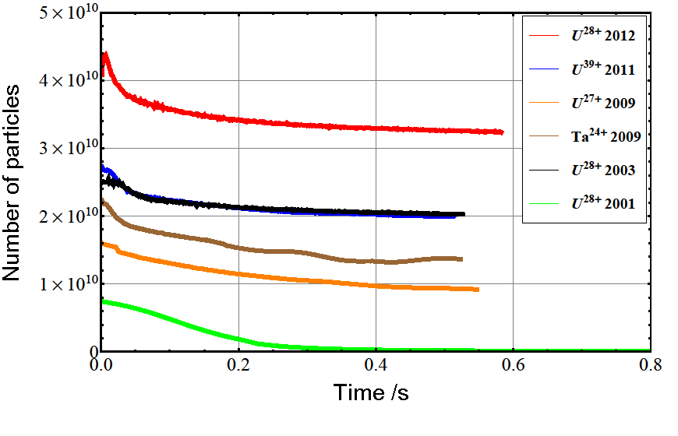
Status U²⁸⁺ -Beam Intensity
World record intensity for intermediate charge state heavy ions in heavy ion booster.
The feasibility of high intensity beams of intermediate charge state heavy ions has been demonstrated.
World record
Stacking in SIS100 (4x)
SIS100 commissioning:
An intensity of U²⁸⁺ of 1-2 x10¹¹ per cycle is already possible today.
2001 FAIR conceptual design report (FAIR proposal)
Further upgrade measures are required for reaching the goal for the most heavy ions (e.g. Uranium with 1.5x10¹¹ per cycle at a (high) repetition rate of 2.7 Hz.)

Slide 12
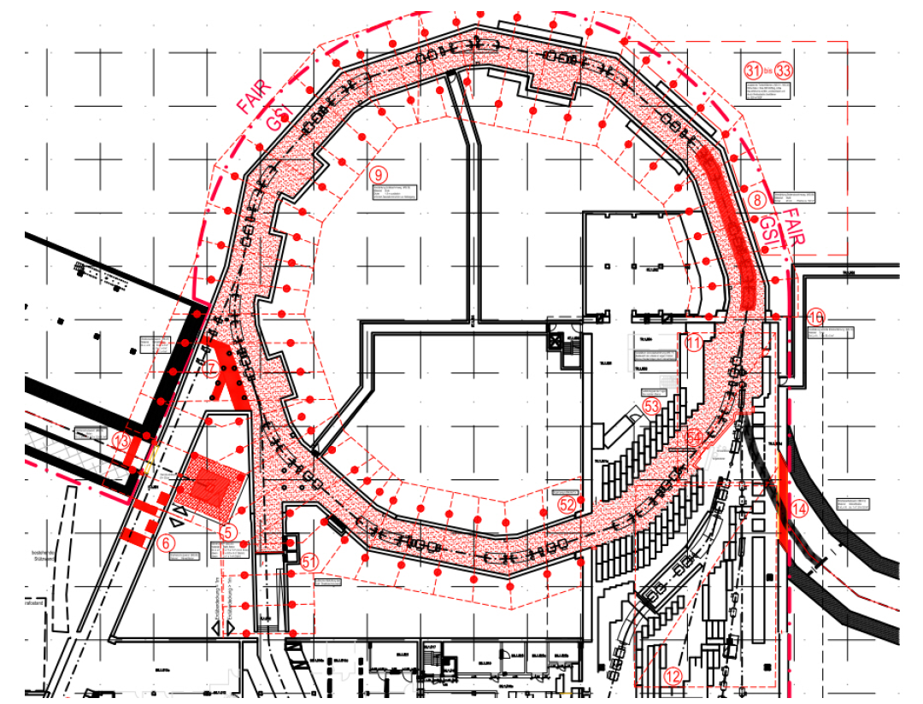
SIS18 Civil Construction 2016/2017
Link existing facility –
civil construction comprises:
the shielding enhancement by means of a
table construction on top of the existing
tunnel
other radiation protection measures
e.g. steel plates below extraction system
under pressure generation in the tunnel
(treatment possibly activated air)
link to FAIR via new tunnel “101”
Consequences from Heuer review:
1. all measures for the connection of the
p-Linac are removed and postponed
2. a staged (two stage) upgrade of the shielding in the TR hall:
a) operation between 2017- 2021 (FAIR phase 0)
b) FAIR operation 2021 -> “11@2022” (11 main Experiments in 2022)
(at the beginning with limited p and U-intensities)

Slide 13
Staged Beam Intensity Increase
Case a) Experiment Operation 2018 – 2021 (FAIR Phase 0)
Basis:
Operation with TK stripper (highly charged ions)
Routine operation with high ramp rates (1.3 T/s > 10 T/s)
No high repetition modes (limit 1 Hz) (or with restricted intensity per cycle)
Operation with two Rf harmonics (enhanced space charge limit)
Improved slow extraction efficiency
Enhance gas pressure in post stripper
Case b) Booster Operation 2021... (FAIR Module 1 – First FAIR Experiments)
Basis:
Operation without TK stripper (intermediate charge states)
Routine operation with high ramp rates (10 T/s)
Maximum repetition rate (2.7 Hz)
Betrieb ohne TK Stripper (niedrig geladene Ionen)
Routinebetrieb mit hohen Rampraten (10 T/s)
Operation with two Rf harmonics
Improved slow extraction efficiency
Enhanced gas pressure in post stripper

Slide 14
Staged Beam Intensity Increase
Protons |  | SIS operation today | SIS operation after upgrade (2017-2021) | SIS operation booster mode >2021
Reference Ion |  | p | p | p
Maximum Energy |  | 4,7 GeV | 4,7 GeV | 4,7 GeV
Linac Current |  | 1 emA | 3 emA | 70 emA (**)
Maximum Intensity per Cycle |  | 2·10¹¹ | 1·10¹² | 6·10¹²
Magnet Cycle | Fast Extraction | 2,8 s 0,36 Hz | 0,45 s 0,1 Hz (*) | 0,45 s 2,2 Hz
 | Slow Extraction (5 s Spill) | 7,8 s 0,13 Hz | 5,45 s 0,09 Hz | -
Maximum Intensity per Second | Fast Extraction | 7,2·10¹⁰ /s | 1·10¹¹/s | 5·10¹²/s (***)
Maximum Intensity per Second | Slow Extraction | 2,6·10¹⁰ /s | 9·10¹⁰ /s | -
Slow extr. efficiency (**) |  | 50 % | 75 % | -
(*) Limitiert. maximal possible 2.2 Hz – no user for high rep. rate and fast extraction known
(**) from p-Linac at 70 MeV
(***) Determined by SIS100 cycle

Slide 15
Staged Beam Intensity Increase
Uranium |  | SIS operation today | SIS operation after upgrade (2017-2021) | SIS operation booster mode >2021
Reference Ion |  | U⁷³⁺ | U⁷³⁺ | U²⁸⁺
Maximum Energy |  | 1 GeV/u | 1 GeV/u | 0,2 GeV/u
UNILAC Current |  | 1 emA | 3 emA | 15 emA
Maximum Intensity per Cycle |  | 4·10⁹ | 1,5·10¹⁰ | 1,5·10¹¹
Magnet Cycle | Fast Extraction | 2,2 s 0,46 Hz | 0,37 s 1 Hz (*) | 0,37 s 2,7 Hz
 | Slow Extraction (5 s Spill) | 7,2 s 0,14 Hz | 5,37 s 0,19 Hz | -
Maximum Intensity per Second | Fast Extraction | 1,8·10⁹ /s | 1,5·10¹⁰ /s | 3·10¹¹ /s (**)
Maximum Intensity per Second | Slow Extraction | 5,6·10⁸ /s | 2,8·10⁹ /s | -
Slow extr. efficiency |  | 50 % | 75%
(*) Limitiert, maximal möglich: 2.7 Hz
(**) Determined by cycle time SIS100

Slide 16
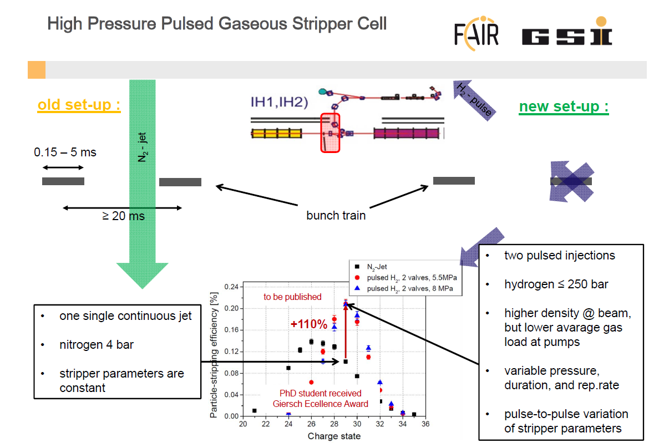
PROGRESS UNILAC Intensities

Slide 17
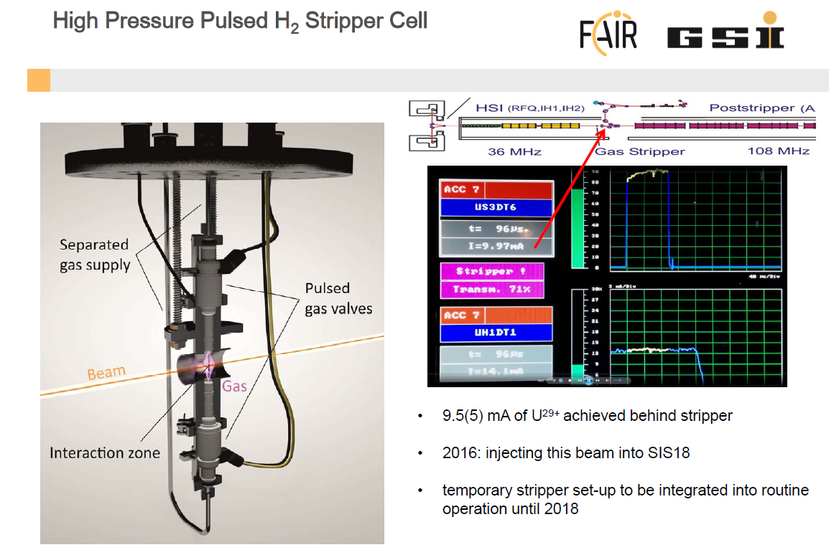
PROGRESS UNILAC Intensities

Slide 18
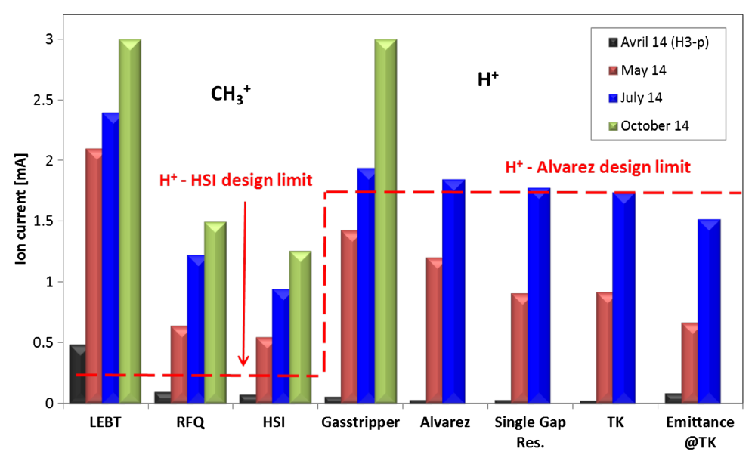
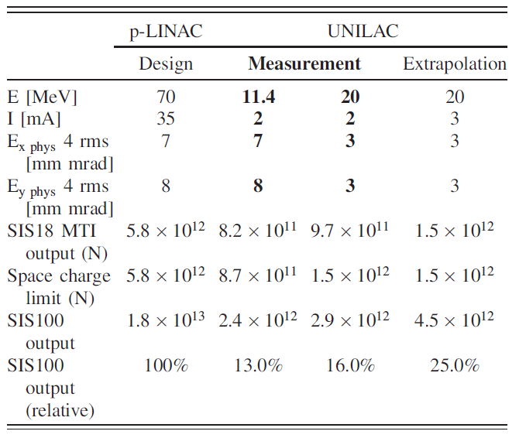
PROGRESS UNILAC p Intensities

Slide 19
SIS18 Schedule – Status Q2 2016
SIS18 Operation
Decay of activation (hands on maintanance)
Upgrade of dipole power converter
Set-up of transformer station north
Installation of new MA acceleration cavities
GaF civil construction measures, Shielding upgrade
Magnetic septum: shielding upgrade and cooling circuit
IPM magnets, TS1MU1
Complete re-alignement
Controls and software re-commissioning
Q2 Q3 Q4 Q1 Q2 Q3 Q4 Q1 Q2 Q3 Q4 Q1 Q2
2015 2016 2017 2018

Slide 20
Recommissioning of the existing facility in 2018 and Operation in Phase 0
SIS18 and ESR need to be „recommissioned“ in 2018
The complete control system is been modernized now (LSA Framework).
New FAIR timing system will be used (BUTIS, White Rabbit).
Many old front end electronics are being replaced.
Good news:
The new data supply has been already tested in various machine experiements and works very well.
Many modern devices already use new frontends today
The Cryring was successfully tested (only basic operation) some weeks ago with new software and FAIR timing system.

Slide 21
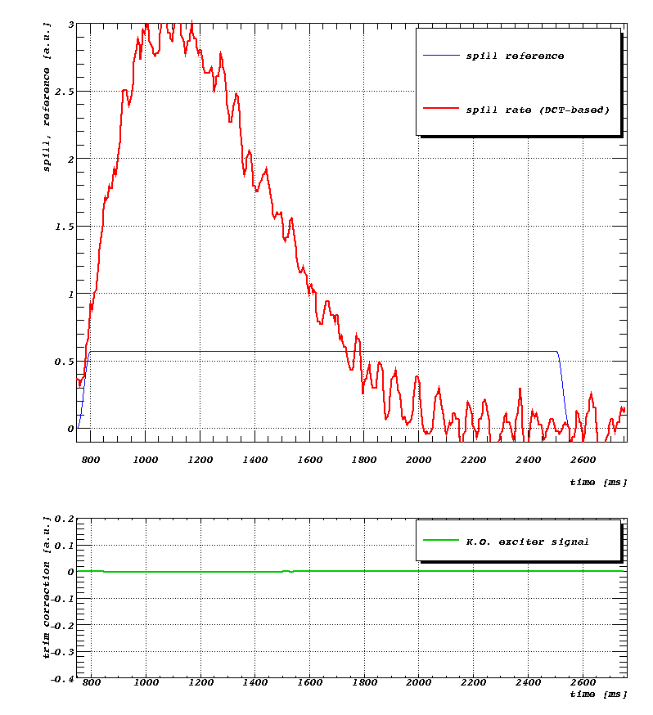
What can we already do with the new
FAIR control system?
Fun with LSA:
slow extraction profile „optimized“ with a feed forward algorithm during 2016 machine experiments.
(R. Steinhagen, D. Ondreka, B. Schlei, H. Liebermann et. Al.)

Slide 22
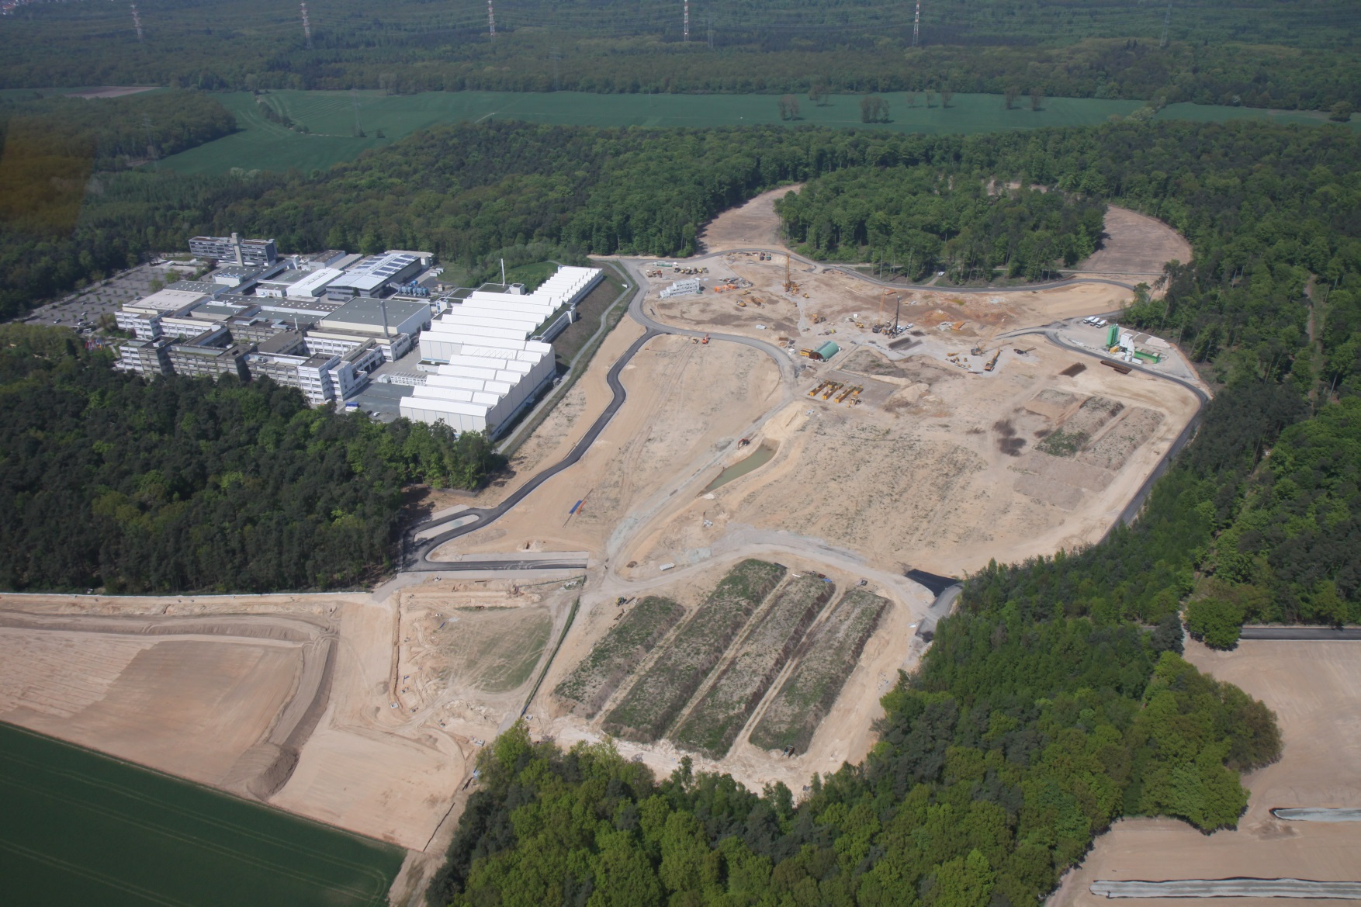
Status of FAIR accelerators and procurement

Slide 23
All prepared! What about FAIR now?
As Klaus Peters already reported yesterday experiments are well set up for FAIR phase 0 and full operation (and he was bold enough to show a schedule) .
The international partners agreed to the baseline project.
A full schedule will be prepared till end of 2016 aiming for 11@2022.
First applications for building permits are submitted now.
Link existing facility (SIS18 to SIS100) building permit granted. Internal pre-work has started and project will start end of the year.
Overview of accelerator procurement ->

Slide 24
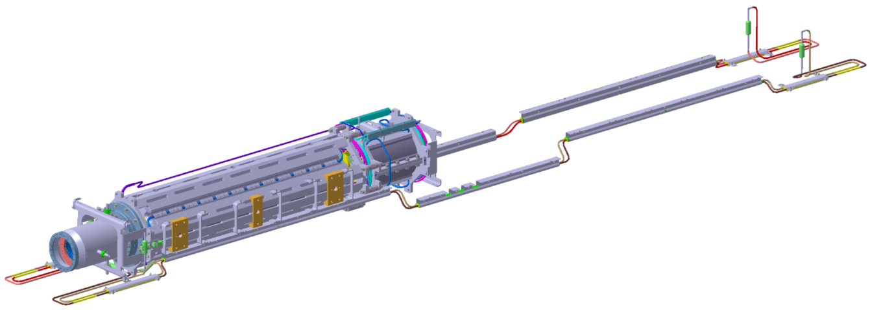
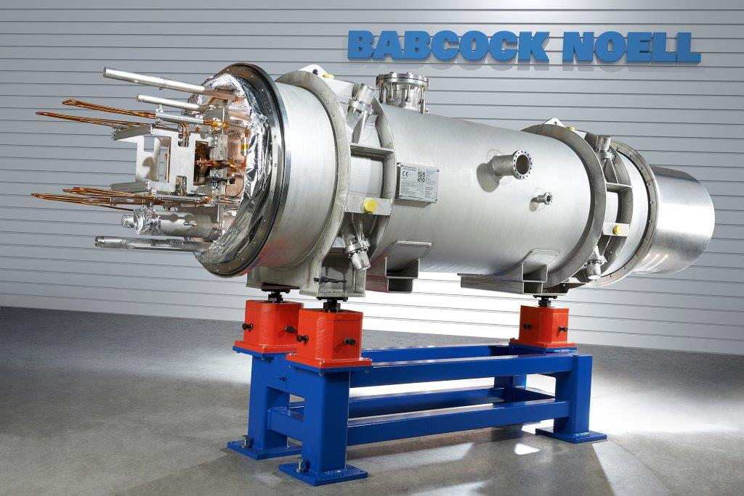
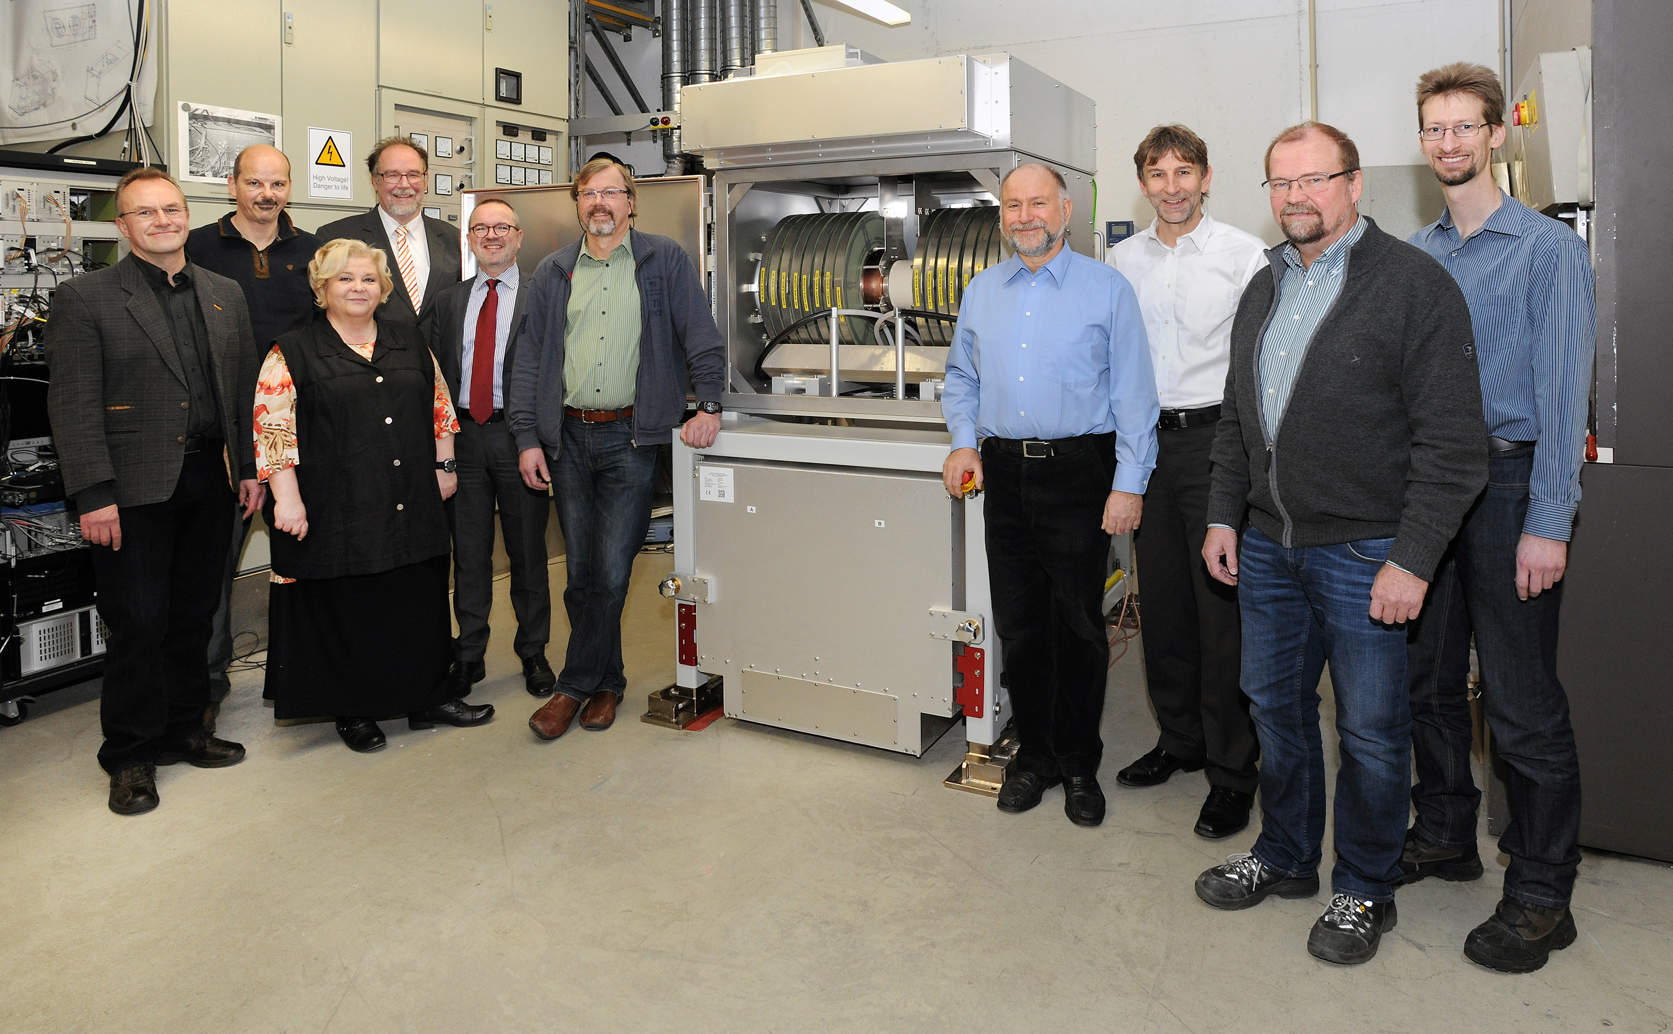
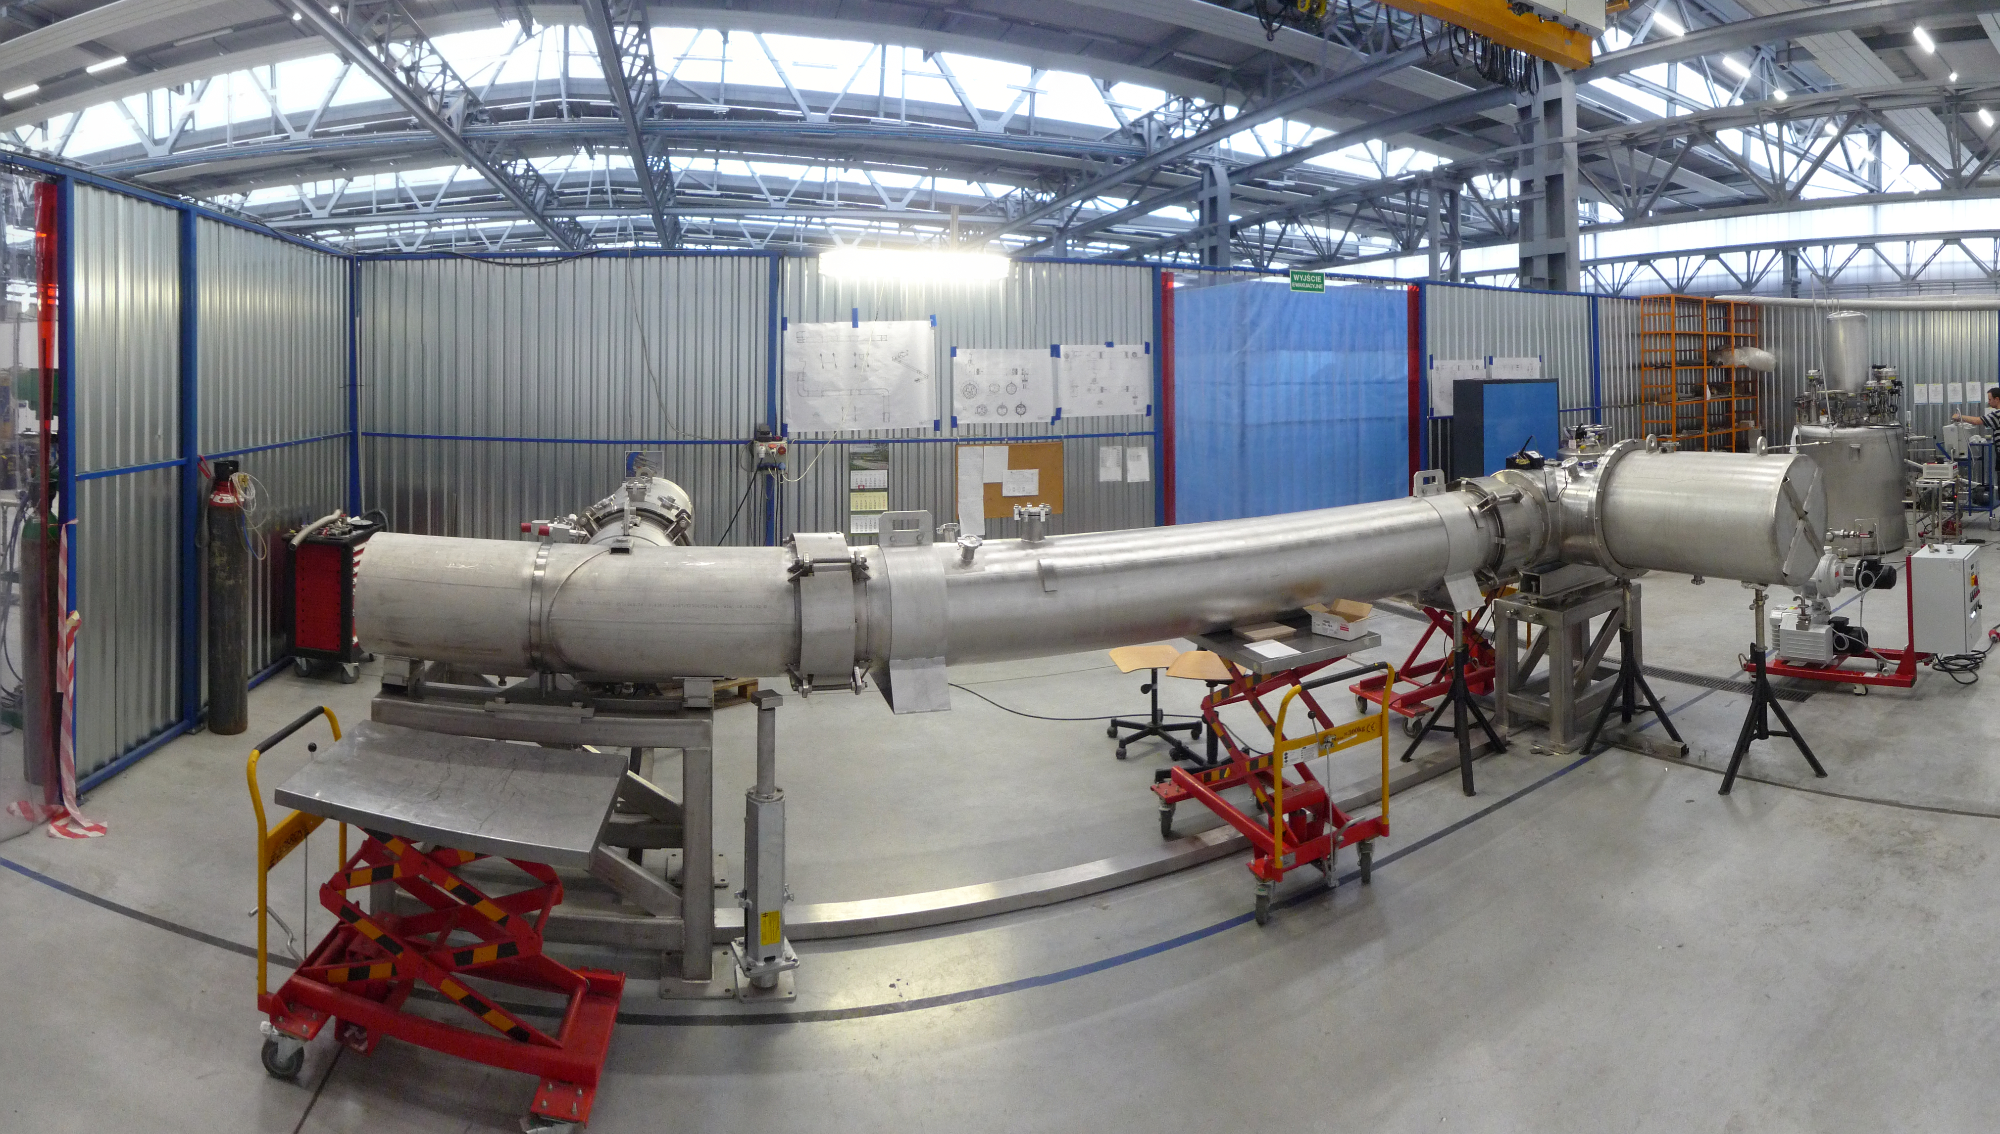
Procurement Highlights SIS100
SIS100 s.c. quadrupole units production started at JINR
SIS100 s.c. dipol magnet: Release of series production in July 2016
First SIS100 bunch compressor cavity delivered
All main magnets, all main Rf and all injection devices under contract. 50 % of M3 and M4 milestones achieved. 65 % of SIS100 value under contract.
First cryogenic bypass line ready for shipment

Slide 25
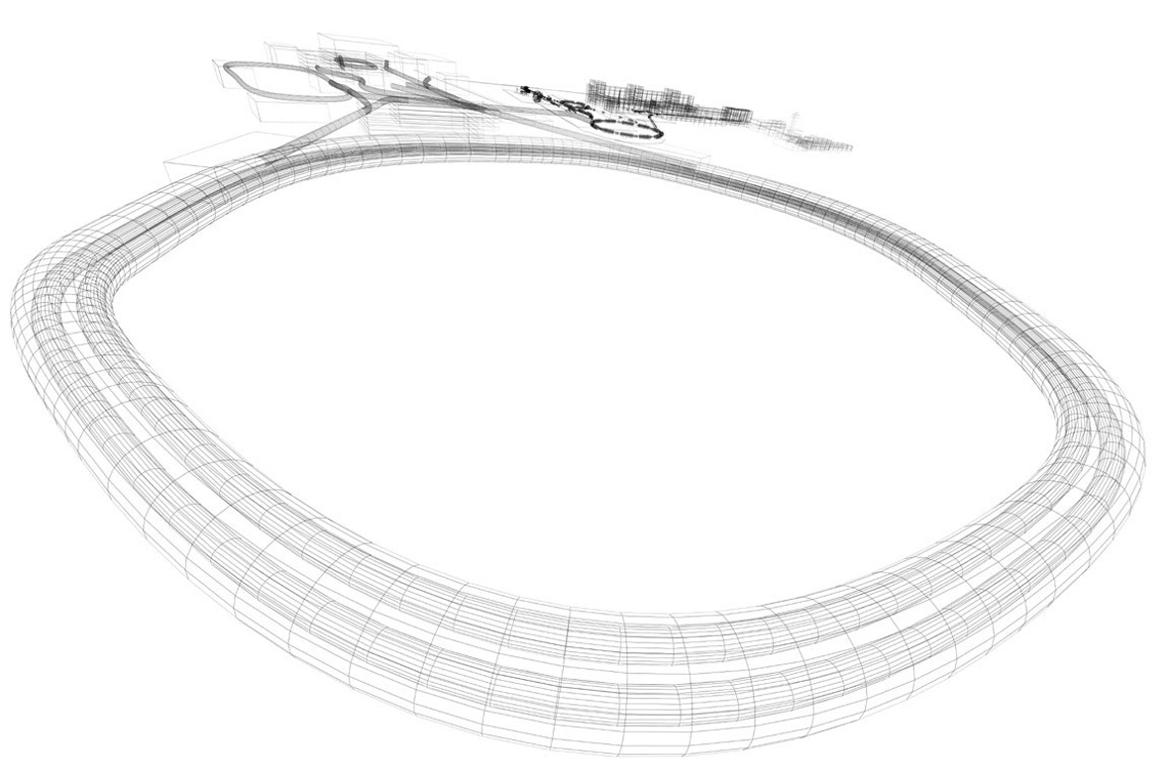






Laser Cooling @SIS100
Funding:
BMBF
POFIII ARD
only cooling method
in SIS100
laser spectroscopy
(fine structure)
SIS100
cw and pulsed
laser beams
fluorescence
from the ions
(xuv, x-ray)
bunched
ion beam
laser-cooled relativistic
heavy ion beams
Z_{ion}= 10 – 60 (3 – 19 electrons)
γ up to 13 (huge Doppler-shift)
extraction of very cold and very short
ultra-relativistic ion bunches

Slide 26
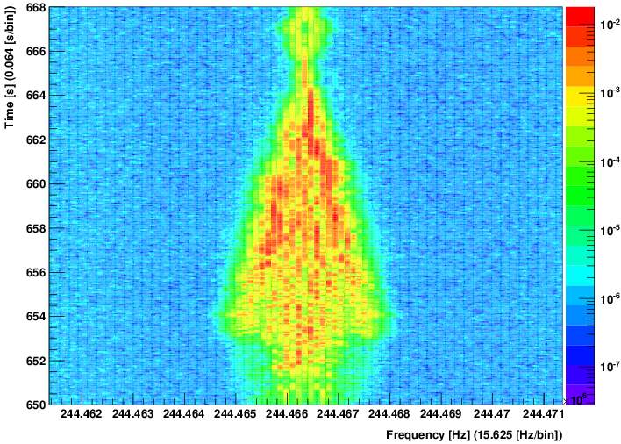
C³⁺ ions stored in the ESR, 122 MeV/u, scanning the laser frequency
2s→sp
transition
cold beam
Δp/p~10⁻⁷
time (s)
scanning
cw laser
heating by
intra-beam
scattering
10 s
Schottky power density [arb.units]
Δp/p
hot beam
Δp/p~10⁻⁴
frequency (MHz)
In general, within a few seconds, the scanning laser can effectively cool all the ions
in the bunch. If the laser scans faster, or if a pulsed laser is used, this greatly improves!
Notes:
26

Slide 27
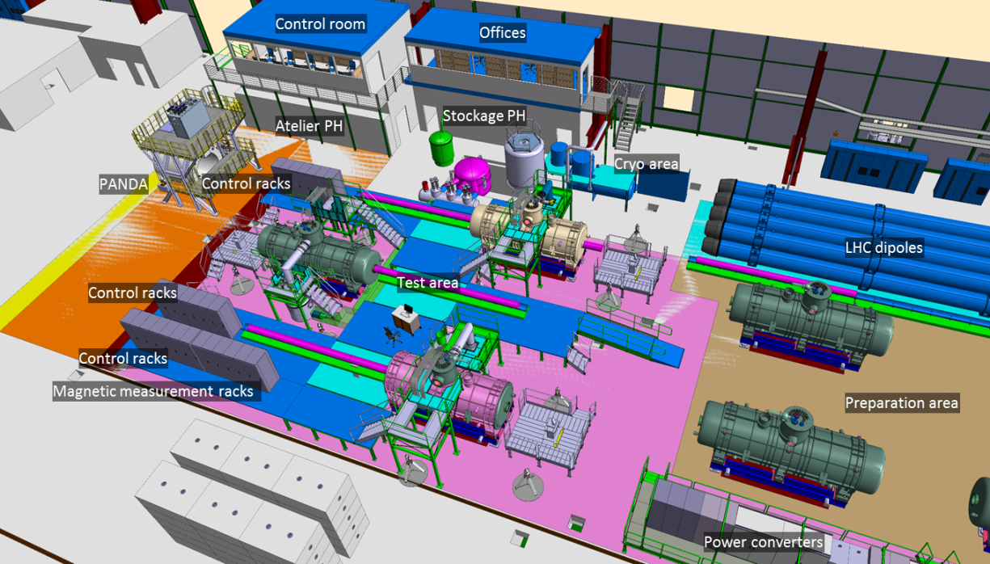
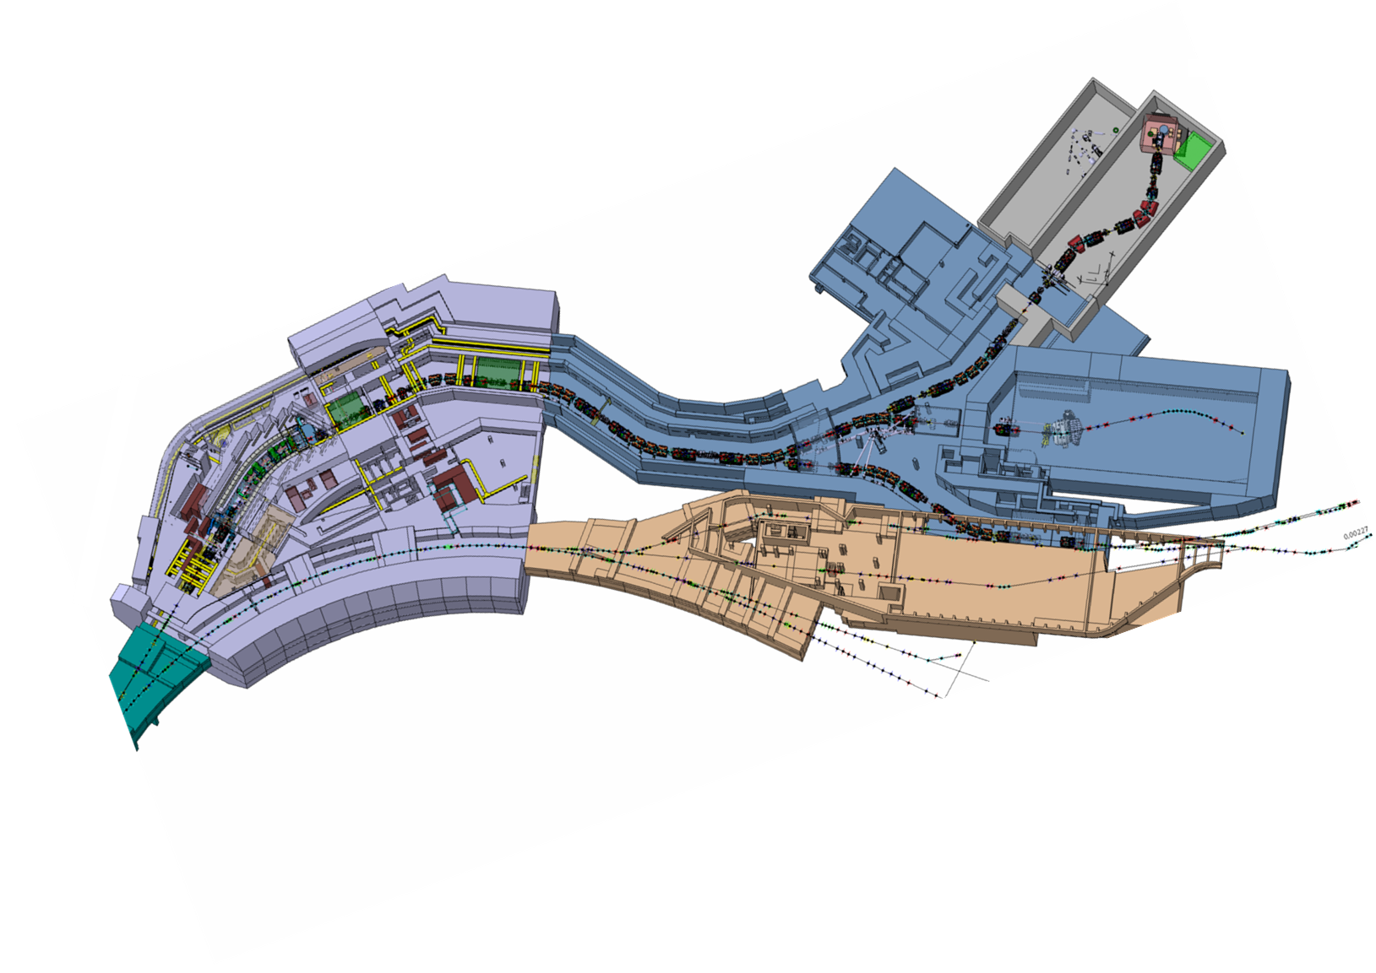
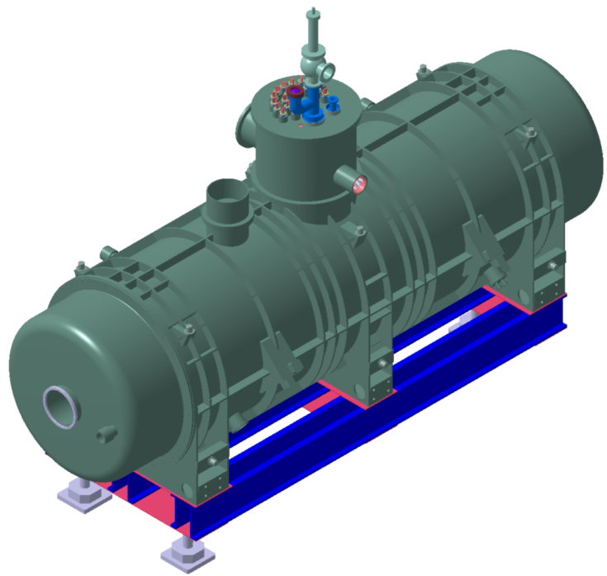
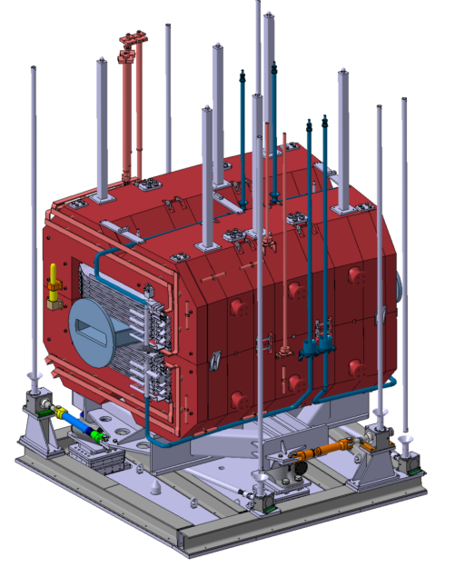
Super FRS
Set-up test facility started at CERN
S.c multiplett awarded to ASG
Radiation hard dipole. Prototype und testing. Tendering on short term.
Engineering design completed by CEA, Tendering on short term

Slide 28
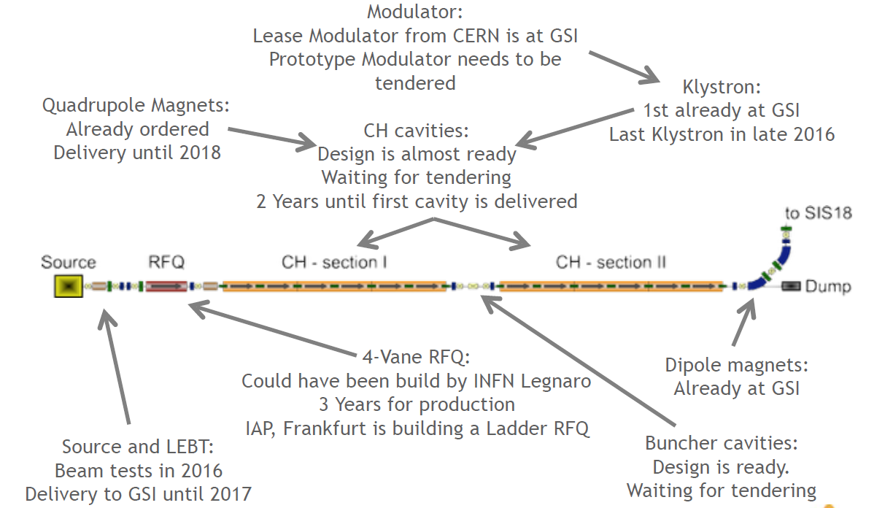
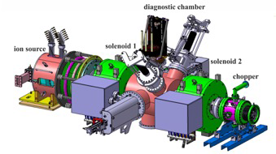
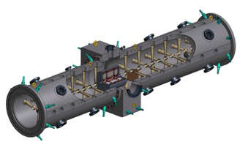
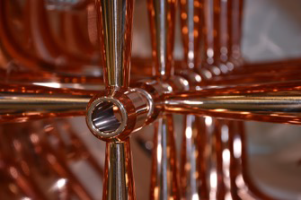
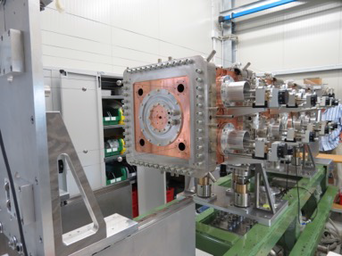
p Linac status
After the „Heuer review“, excecution of project has been limited to the so far started activities.

Slide 29
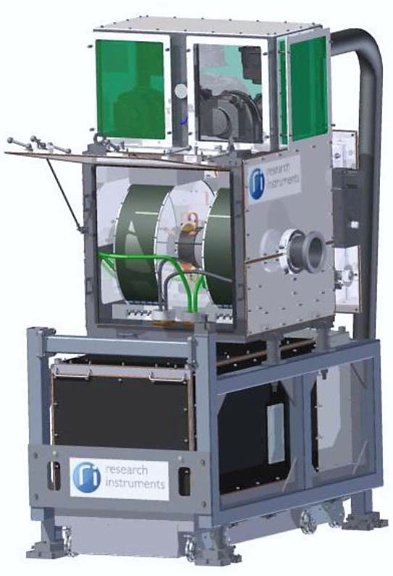
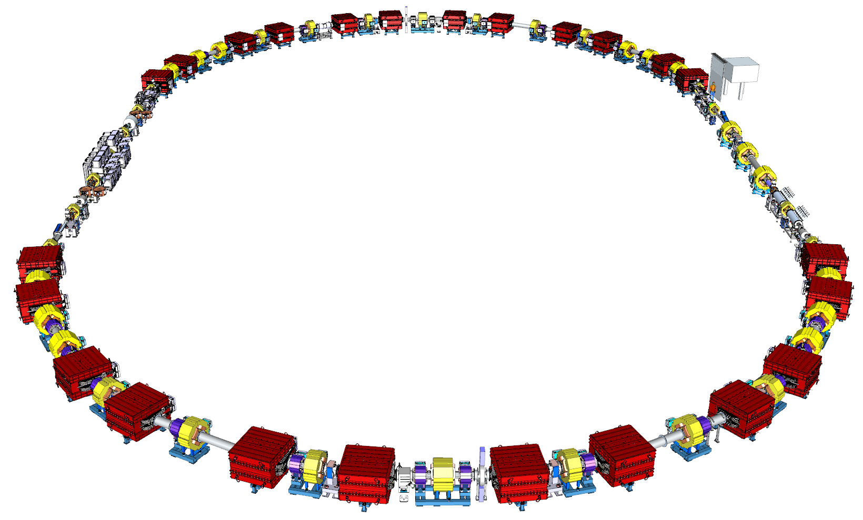
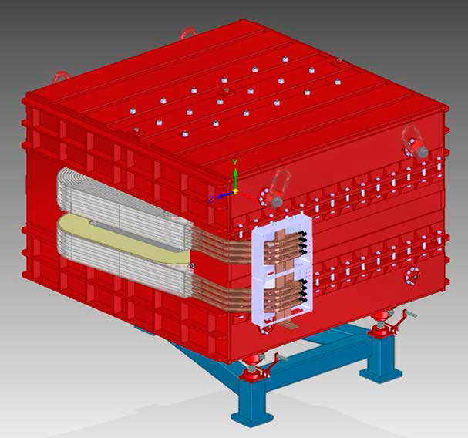
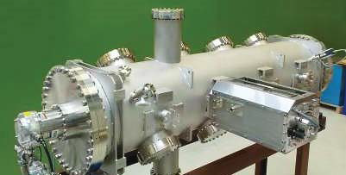
CR Storage Ring
FOS debuncher cavity delivered
Engineering design and specification for most components available
Prototype stochastic cooling tank at GSI
System Design Status (BINP):
  The update of TDR (Annex) is ready. Presently under approval.
  The full 3D model of CR system is ready (DMU model).
  RF debuncher under construction (FAT/SAT of FoS is ongoing).
  Prototype of Stochastic cooling Pick–up under development.

Slide 30
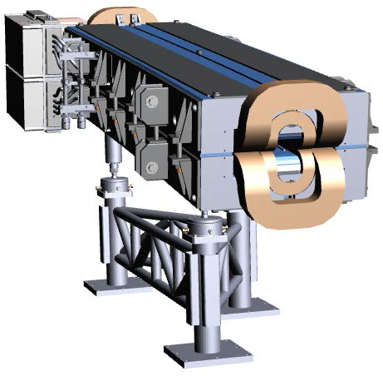
HEBT (High Energy Beam Transport)
Almost all HEBT magnets are contracted (EFREMOV/BINP)
First FOS magnet under testing at GSI
BINP has delivered several 3 models (contract signed Oct.15)
Second FOS magnet ready for assembly
Preparation for series production started at EFREMOV
Contracts over 196 power converter closed with BOSE/ECIL India (first deliveries expected in Q2 2017). Indian inkind standard diagnostics chambers in preparation.

Slide 31
HESR
Four magnets delivered to GSI after integration of UHV chamber
Large amount of dipole and quadrupole delivered to FZJ
All dipole chambers delivered and shipped to GSI for NEG coating
27 quadrupole PCs delivered to FZJ

Slide 32
Conclusions
Planed upgrade of SIS18 will be finished till 2018. Further steps will follow to reach full FAIR performance.
Many UNILAC improvements. Alvarez upgrade design not fixed yet -> planned end of 2016.
Procurements are progressing well for SIS100, HEBT, HESR
Procurements for Super-FRS started. Major procurements start on short term.
CR technical design report and engineering layout completed.
  FOS devices or prototypes for German in-kind components to CR built.
P-Linac and pbar target limited to the continuation of started activities but recent UNILAC improvements can somewhat compensate for the delay.

Slide 33
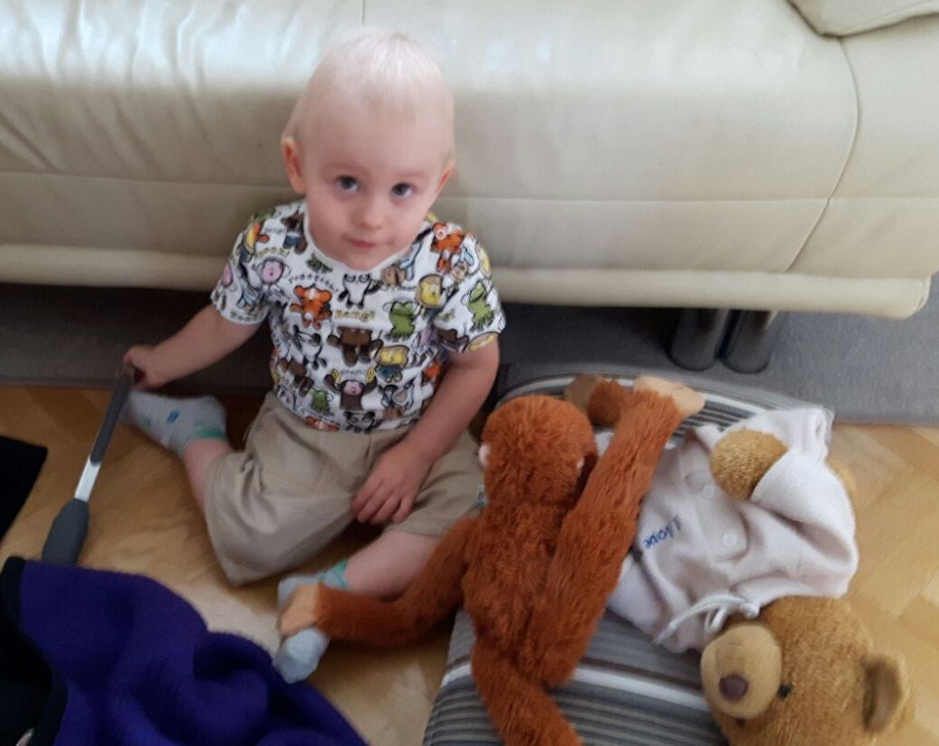
Thank you for your attention and all the colleagues for their passion and work put into the FAIR project. (and for the stolen slides)
Special thanks to poor Tim
who keept asking for his
dad all weekend.

Slide 34
Extra Slides

Slide 35
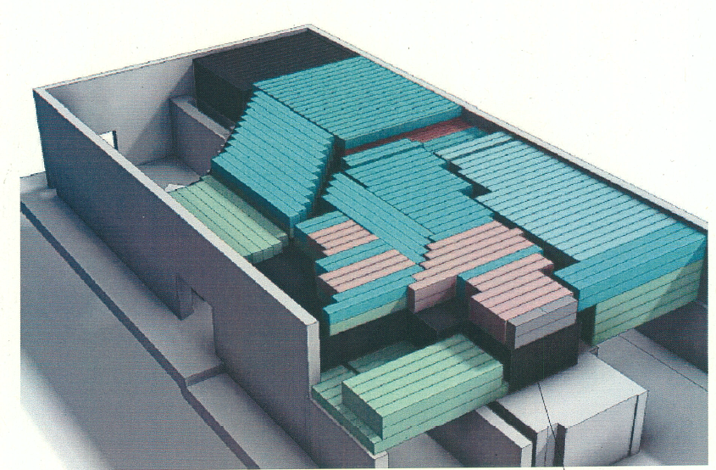
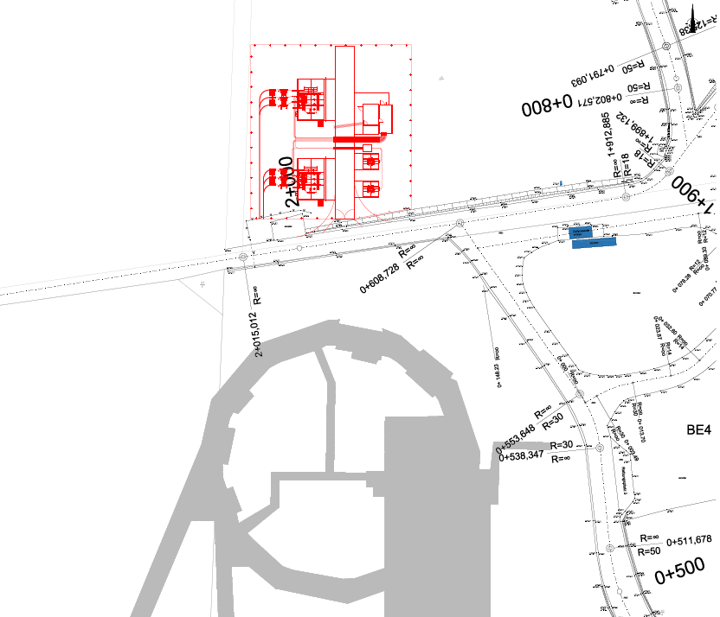
Link Existing Facility –
Transformer Station North
Shielding upgrade postponed until start of booster operation > Limited SIS18 repetition rate (1 Hz) at highests intensities in FAIR phase 0
New transformer station north
About 50 MW pulse power in booster mode. Fast ramping with 10 T/s enabled by new transformer station in 2018.
Fast ramping helps to overcome ionization beam loss.

Slide 36
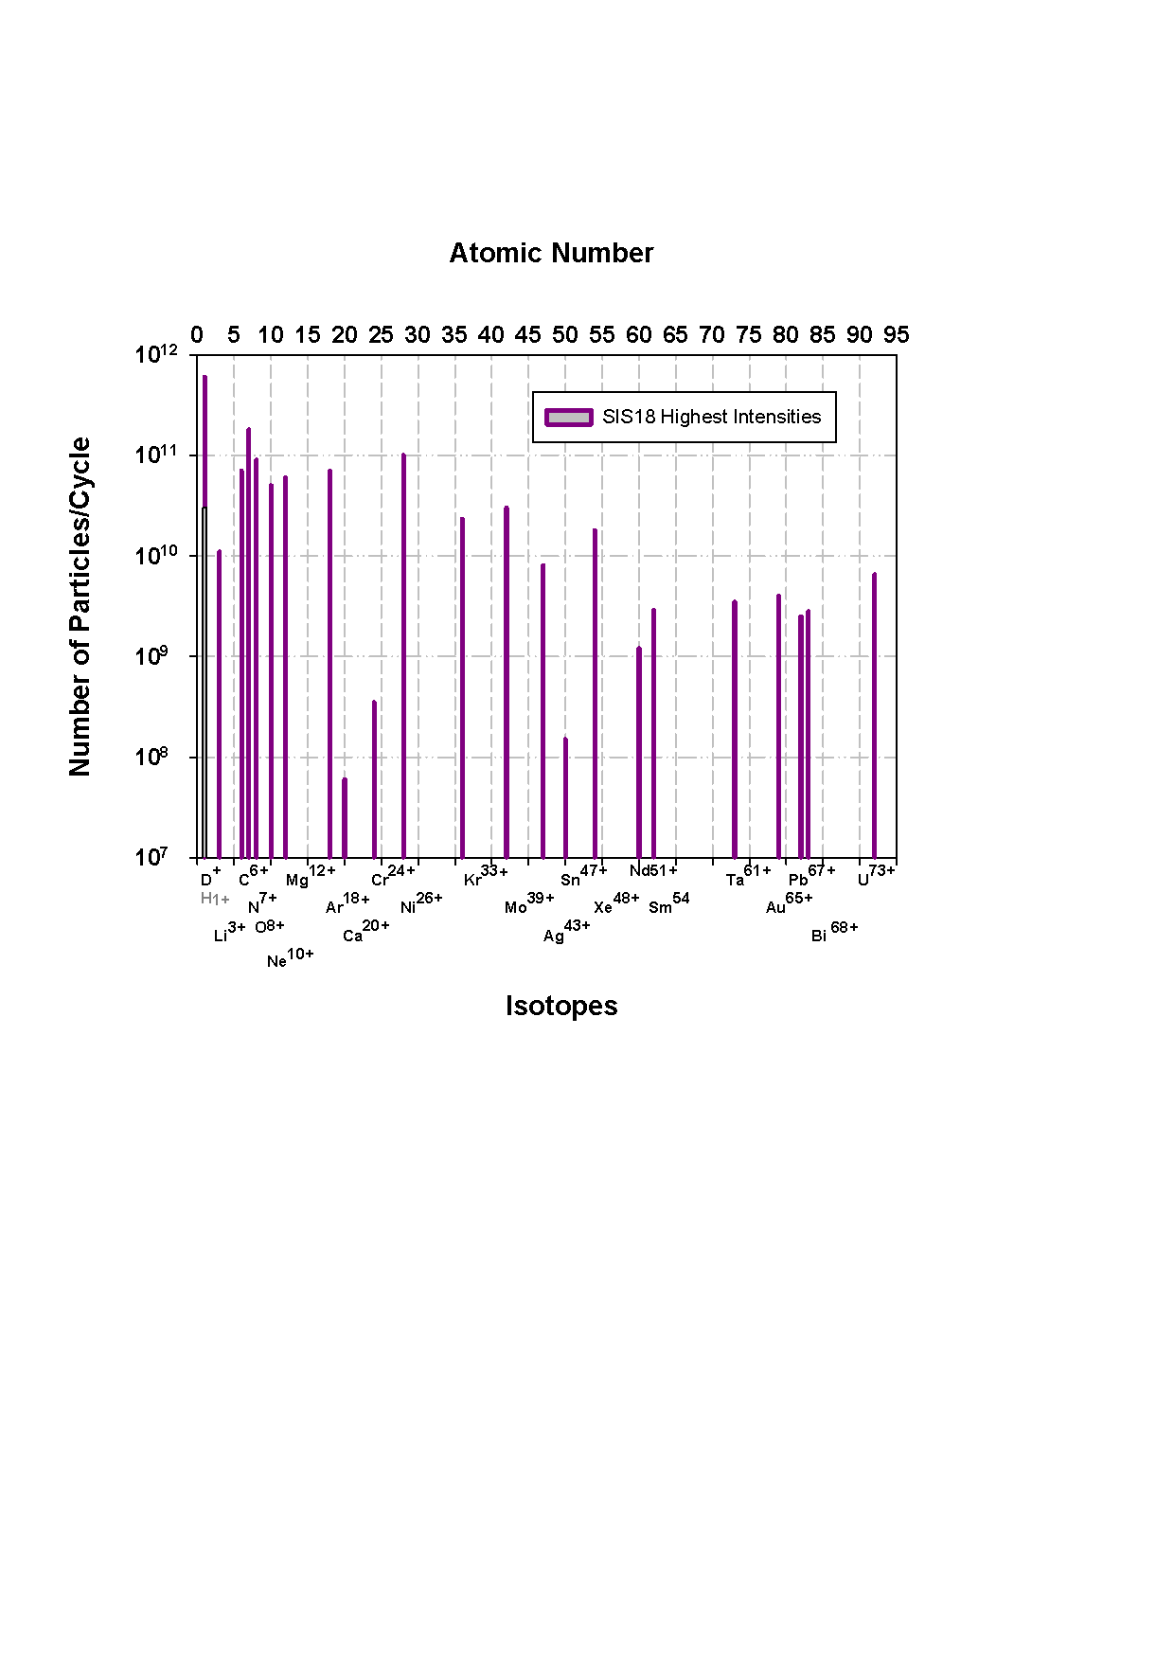
SIS18 Peak Intensities
The space charge limit is reached for many light ions.
The space charge limit is missed by a factor of ten for the most heavy ions.
The goal is to reach the space charge limit for all ions !
For FAIR: Transition to intermediate charge states (no TK stripper) > Enhanced space charge limit

Slide 37
Protons @ FAIR
Slowly extracted protons for HADES and CBM
HADES @ SIS18
  4.5 – 4.7 GeV/u
  10⁸ p/cycle
  10s extraction
CBM @ SIS100
  2 – 29 GeV/u
  10¹² p/cycle
  10s extraction

Slide 38



SIS18: Protons at High Gamma
Protons @ 4.5 GeV/u (May 2014)
Protons for PRIOR (2014)
  Protons up to 4.5 GeV/u (18Tm)
  Reduced ramp rate to minimize losses at end of ramp (~ 1T/s)
  High sensitivity to radial position
  Max. 10¹¹ particles/cycle
  No losses during acceleration and extraction up to 4 GeV/u
MD in 2016 with LSA
  Original aim: slow extraction at max. rigidity
  Not feasible due to severe technical problems
  Improved optical model successfully tested with fast extraction
Courtesy C. Omet
Extraction bump and kick for shifted optics at 18Tm

Slide 39


SIS18: Slow Extraction at High Gamma
SISMODI parametrization of shift
Optics with shifted γ_{t} not designed for slow extraction
Protons with max. energy rarely requested from experiments
Past scheme (Franczak, 2001):
  Acceleration with γ_{t} shift during ramp
  De-bunching of the beam on flattop
  Restoration of normal extr. optic
  Slow extraction of coasting beam
Little operational experience at GSI
Routinely done at COSY (FZ Jülich)
Probably limited in intensity due to instabilities close to transition
Should be feasible for intensities requested by HADES

Slide 40




SIS100: Protons for p-bar Chain
Proton optics with transition shift
Transition shift
  Asymmetry in QF to change γ_{t}
  Irregular optic with large hor. beta function and oscillating dispersion
  Large Q_{h} for intrinsically high γ_{t}
Transition jump
  Small Q_{h} for intrinsically low γ_{t}
  π-doublet for transition jump
  Large difference in dispersion at both jump quadrupoles required
Both optics designed exclusively for fast extraction of single high intensity bunch at max. energy
Q_{h} | 21.8
Q_{v} | 17.7
γ_{t} | 45
Proton optics with transition jump
Q₁
Q₂
Q_{h} | 10.4
Q_{v} | 10.3
γ_{t} | 8.9
Δμ_{x} ≈ π
  $$∆γ_{t}^{} \sim k\left({D_{1}}_{}^{2}−{D_{2}}_{}^{2}\right)+O(k^{2})$$

Slide 41


SIS100: Crossing with Optic for Ions
Properties of shifted slow extraction optics
Proton intensity for CBM relaxed
  10¹²/cycle vs. 2·10¹³ for p-bar
  No single bunch required
Crossing γ_{t} with slow extraction optic for ions seems feasible
  Moderate long. blow-up expected
  RF parameters can be optimized to minimize blow-up
  Beam physics group studies
Transition shift for ions
  γ_{t} can be shifted splitting F quads
  Useful for speeding up crossing or shift/de-bunch/restore scheme
Potential dead band at transition
Shifted slow extraction optic with γ_{t}=18.2

Slide 42
SIS100: Proton Energy Range
Bρ[Tm]
γ
E[GeV/u]
100
32.0
28.8
Range requested by CBM
Technical upper limit
90
28.8
25.9
80
25.6
22.9
70
22.4
19.9
60
19.2
17.0
50
16.0
14.0
Transition in slow extraction optic
40
12.8
11.0
30
9.6
8.0
Ion slow extraction lower limit
20
6.5
5.1
Maximum transfer energy
Proton injection energy
10
3.3
2.2
Technical lower limit

Slide 43
Proton Summary
HADES requirements for SIS18 can be granted
  No collective effects due to very low intensity requirements
  10⁸/12s, 24/7, 14 days => 10¹³ protons
  Electro-static septum not critical if operation with 10¹¹ N works
CBM requirements for SIS100 more critical
  Use of slow extraction optic mandatory
  Crossing transition seems feasible with slow extraction optic
  Requested energy range can’t be fully served
    6 ... 11 GeV/u and 14 ... 29 GeV/u appear to be safe
    Energies below 5 GeV/u will probably not work at all
    Difficulties expected around transition for 11 ... 14 GeV/u

Slide 44


Power Converter Ripple
Dipole PC ripple @Flattop
Measurements on dipole and quadrupole power converters
  Ripple on flattop
  No simultaneous measurement with spill
Frequency spectrum shows peaks at multiples of 150Hz
Simulations of spill ripple
  Good correspondence of spill spectrum with PC spectrum, BUT:
  PC ripple seems too small to explain observed spill ripple
Data courtesy H. Welker/M. Kirk
Simulated spill ripple with Hardt condition
Data courtesy M. Kirk

Slide 45


Spill Ripple Measurements
Some reports from early 1990’s available
Data from more recent machine experiments
Results obtained so far
  Multiples of power grid frequency visible in the spill spectrum
  Spill structure not dominated by these lines
Conclusions
  We do not understand the origin of spill ripples in SIS18
  New ideas necessary
(Non-)Influence of 50Hz harmonics
P. Moritz, 1994
KO@HADES: Lines at harmonics of 150Hz
Data courtesy M. Kirk/C. Kleffner

Slide 46

Ripple Mitigation: Spill Feedback
First attempts in 1994
  Artificial ripple on PCs to measure beam transfer function during SE
  Group delay of 50us measured
  Promising attempts at spill regulation, but not continued
Realization with KO extraction relatively simple
  Might be testable short-term using analog feedback
  For FAIR real-time digital intensity signal should be provided by experiments (covered by FC2WG)
Attempts at spill regulation
Suppressed
150Hz line
P. Moritz, 1994

Slide 47


Ripple Mitigation: Stochastic Extraction
Xe@600MeV/u: Slow extraction
Beam driven into resonance by longitudinal excitation
  Idea: higher dQ/dt for particles at stability limit
  Supposed to be less sensitive to PC ripples by design
Experimentally tested at SIS18 in the early 1990’s
  Long shaping time
  No improvement of micro structure over slow extraction
  Never made operational at SIS18
  Maybe room for improvements
Xe@600MeV/u: stochastic extraction
J. Pinkow, PhD Thesis, 1994

Slide 48

Ripple Mitigation: High Frequency Cavity
Spill smoothing by extracting controlled bursts at high frequency
  Empty bucket channeling
  Creation of mini-bunches
Bunched extraction at SIS18
  5 MHz maximum
  Used for therapy
  Some experiments at FRS seem to profit (AGATA)
Higher frequencies require new RF cavity (e.g. >50MHz)
  Theoretical studies for SIS18 necessary
  Substantial R&D for HW required
Improved spill at AGS with channeling

Slide 49
Next Steps
Common effort to clarify origin of spill ripples
  Simultaneous measurement of power converter and spill ripple
  Comparison of quad driven and KO extraction
  Influence of chromaticity and resonance strength on ripple sensitivity
  Inclusion of experimental detectors for spill analysis
Machine Experiments 2016
Simultaneous ripple measurements
Comparison of extraction methods
Influence of chromaticity and res. strength
Spill feedback using KO?

Slide 50


Long Term Strategy
Why do particles seem to cluster?
Major problem pile-up
  Deviations from random distribution not understood
Studies on origin of particle clustering
  Very difficult to observe in the ring
  Theoretical models required
    Identification of possible mechanisms
    Predictions for observables
  Experiments to verify or refute certain mechanisms
R&D for technical measures
  (Digital) Spill feedback
  High frequency cavity
Extensive machine development program done 2016. Data still under analysis
H. Simon, HIC4FAIR WS 2015
How does bunching help?
C. Stahl, PhD Thesis, 2015

