Slide 1
Introduction: Setting the Stage overview of accelerator projects in the future
Andrei Seryi
John Adams Institute for Accelerator Science
University of Oxford, Royal Holloway University of London and Imperial College London, UK
Accelerators Revealing the QCD Secrets
3-5 September 2016
Makedonia Palace, Thessaloniki, Greece

Slide 2
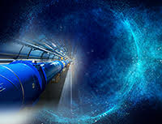
Contents
Hadron colliders (and not only colliders)
  HL-LHC, HE-LHC, FCC, SPPC
  FAIR, NICA, SPIRAL2
Electron - ion
  LHeC & FCC-he
  eRHIC
  Jlab e-ion
Lepton colliders
  FCC-ee & CepC
  CLIC and ILC
  Super-B factory
  c-tau factory
Advanced approaches
  LPWF & PWFA collider roadmaps & AWAKE

Slide 3
Acknowledgements
Many thanks to Michael Benedikt, Tom Browder, Eckhard Elsen, Edda Gschwendtner, Mike Harrison, Vladimir Kekelidze, Eugene Levichev, Katsunobu Oide, N. Ohuchi, Boris Sharkov, Steinar Stapnes, Edward Temple, Frank Zimmermann, Nick Walker, Yifang Wang, Akira Yamamoto, and many other colleagues for materials for this overview

Slide 4
Contents
Hadron colliders (and not only colliders)
  HL-LHC, HE-LHC, FCC, SPPC
  FAIR, NICA, SPIRAL2
Electron - ion
  LHeC & FCC-he
  eRHIC
  Jlab e-ion
Lepton colliders
  FCC-ee & CepC
  CLIC and ILC
  Super-B factory
  c-tau factory
Advanced approaches
  LPWF & PWFA collider roadmaps & AWAKE

Slide 5
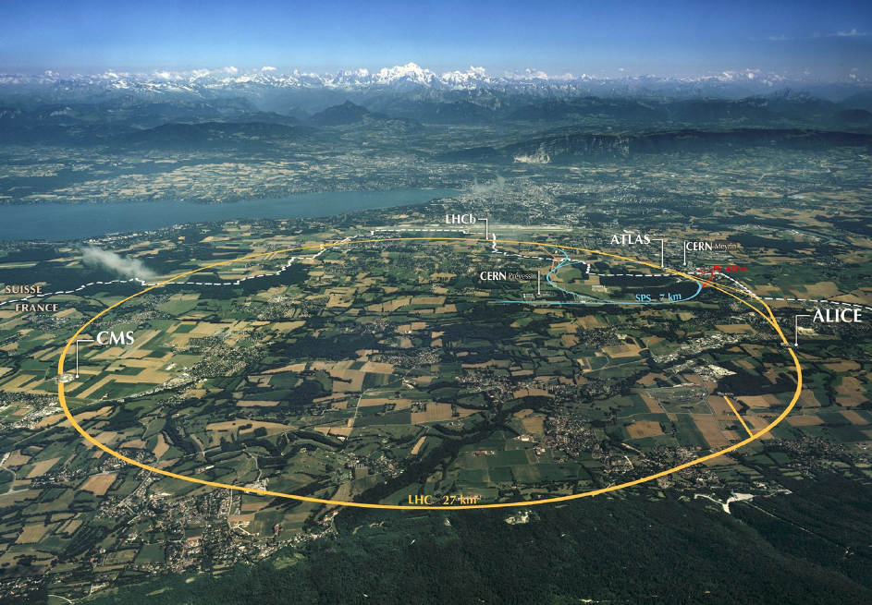
High Lumi LHC
FP7 Design Study completed in 2015
first (short) 11 Tesla magnet operational
HL-LHC now underway as a project at CERN

Slide 6
High Lumi LHC

Slide 7
Higher energy hadron collider
High field magnets – the key to higher energy
Nb3Sn may lead to ~16 T magnets
HL-LHC magnets provide a ~1.2 km test of Nb3Sn technology
HTS inserts may increase field to 20 T
HE-LHC – use of high field magnets in existing LHC tunnel
FCC-hh
European Design Study for ~100 TeV pp collider in a ~100 km ring – EuroCirCol
CDR by end of 2018 & input to European Strategy
(JAI / Oxford is coordinating EuroCirCol WP3 on Experimental Interaction Region design)

Slide 8
Magnet R&D
LHC: nominal 8.3 T
HL-LHC:
- 11 T dipoles in dispersion suppression collimators
- 12-13 T low-𝛽 quadrupoles at ATLAS and CMS IR’s
March 2016: Nb3Sn quadrupole model (1.5m long, aperture 150mm) reached current of 18 kA (nominal 16.5 kA) at FNAL. 2 coils from CERN and 2 coils from US
Dec 2015: 2 in 1 dipole of 1.8 m length reaches nominal 11.3 T
Nb3Sn matrix

Slide 9
Hadron colliders parameters
parameter | FCC-hh |  | SPPC | HE-LHC* | (HL) LHC
collision energy cms [TeV] | 100 |  | 71.2 | >25 | 14
dipole field [T] | 16 |  | 20 | 16 | 8.3
circumference [km] | 100 |  | 54 | 27 | 27
# IP | 2 main & 2 |  | 2 | 2 & 2 | 2 & 2
beam current [A] | 0.5 |  | 1.0 | 1.12 | (1.12) 0.58
bunch intensity [10¹¹] | 1 | 1 (0.2) | 2 | 2.2 | (2.2) 1.15
bunch spacing [ns] | 25 | 25 (5) | 25 | 25 | 25
beta* [m] | 1.1 | 0.3 | 0.75 | 0.25 | (0.15) 0.55
luminosity/IP [10³⁴ cm⁻²s⁻¹] | 5 | 20 - 30 | 12 | >25 | (5) 1
events/bunch crossing | 170 | <1020 (204) | 400 | 850 | (135) 27
stored energy/beam [GJ] | 8.4 |  | 6.6 | 1.2 | (0.7) 0.36
synchrotr. rad. [W/m/beam] | 30 |  | 58 | 3.6 | (0.35) 0.18
*tentative

Slide 10
Contents
Hadron colliders (and not only colliders)
  HL-LHC, HE-LHC, FCC, SPPC
  FAIR, NICA, SPIRAL2
Electron - ion
  LHeC & FCC-he
  eRHIC
  Jlab e-ion
Lepton colliders
  FCC-ee & CepC
  CLIC and ILC
  Super-B factory
  c-tau factory
Advanced approaches
  LPWF & PWFA collider roadmaps & AWAKE

Slide 11
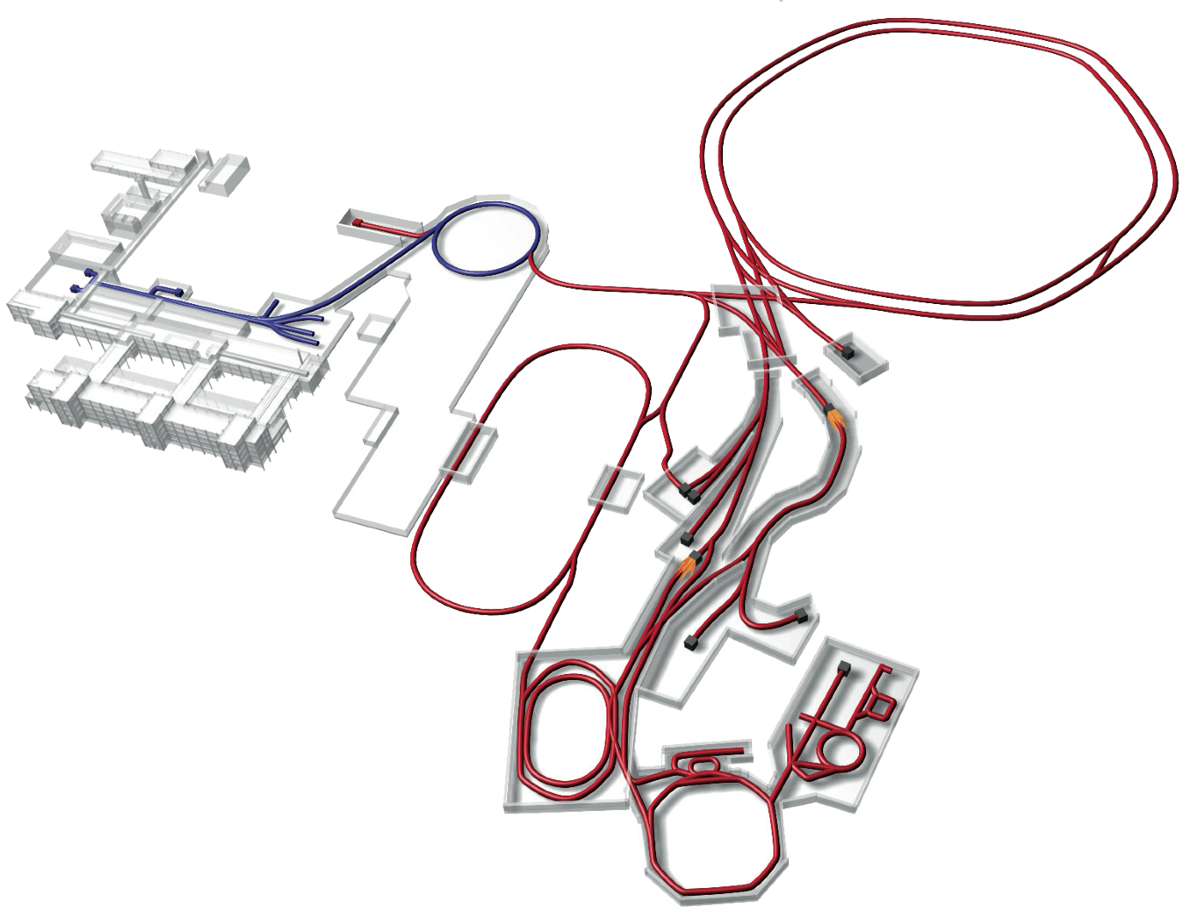

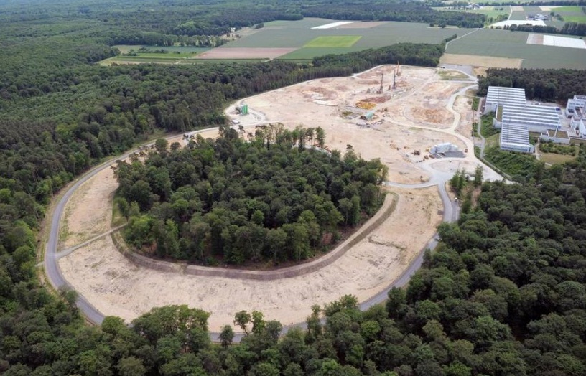

Facility for Antiproton and Ion Research
– new international research laboratory under construction
to explore the nature and evolution of matter
in the Universe
p-Linac
SIS18
SIS100/300
UNILAC
HESR
Rare-Isotope
Production Target
Anti-Proton
Production Target
CR &
RESR
Cryring
NESR
100 m

Slide 12
FAIR – accelerator facility
Primary Beams
10¹²/s; 1.5 GeV/u; ²³⁸U²⁸⁺
10¹⁰/s ²³⁸U⁷³⁺ up to 35 GeV/u
3x10¹³/s 30 GeV protons
p-Linac
SIS18
SIS100/300
UNILAC
Secondary Beams
range of radioactive beams up to
1.5 - 2 GeV/u; up to factor 10 000 higher in intensity than presently
antiprotons 3 - 30 GeV
HESR
Rare-Isotope
Production Target
Anti-Proton
Production Target
Storage and Cooler Rings
radioactive beams
10¹¹ antiprotons 1.5 - 15 GeV/c,
stored and cooled
CR &
RESR
Cryring
NESR
100 m
Technical Challenges
cooled beams, rapid cycling superconducting magnets

Slide 13
Physics at FAIR
Nuclear Structure & Astrophysics
(Rare-isotope beams)
Hadron Physics
(Stored and cooled
14 GeV/c anti-protons)
p-Linac
SIS18
SIS100/300
UNILAC
QCD-Phase Diagram
(HI beams 2 to 45 GeV/u)
HESR
Rare-Isotope
Production Target
Fundamental Symmetries
& Ultra-High EM Fields
(Antiprotons & highly stripped ions)
Anti-Proton
Production Target
Dense Bulk Plasmas
(Ion-beam bunch compression
& petawatt-laser)
CR &
RESR
Cryring
Materials Science & Radiation Biology
(Ion & antiproton beams)
NESR
100 m
Accelerator Physics

Slide 14
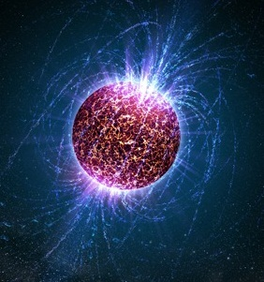
FAIR – four research pillars
CBM
nuclear matter at high densities
APPA
ions in extreme electro-magnetic fields
PANDA
hadron physics with antiprotons
NUSTAR
neutron-rich nuclei

Slide 15

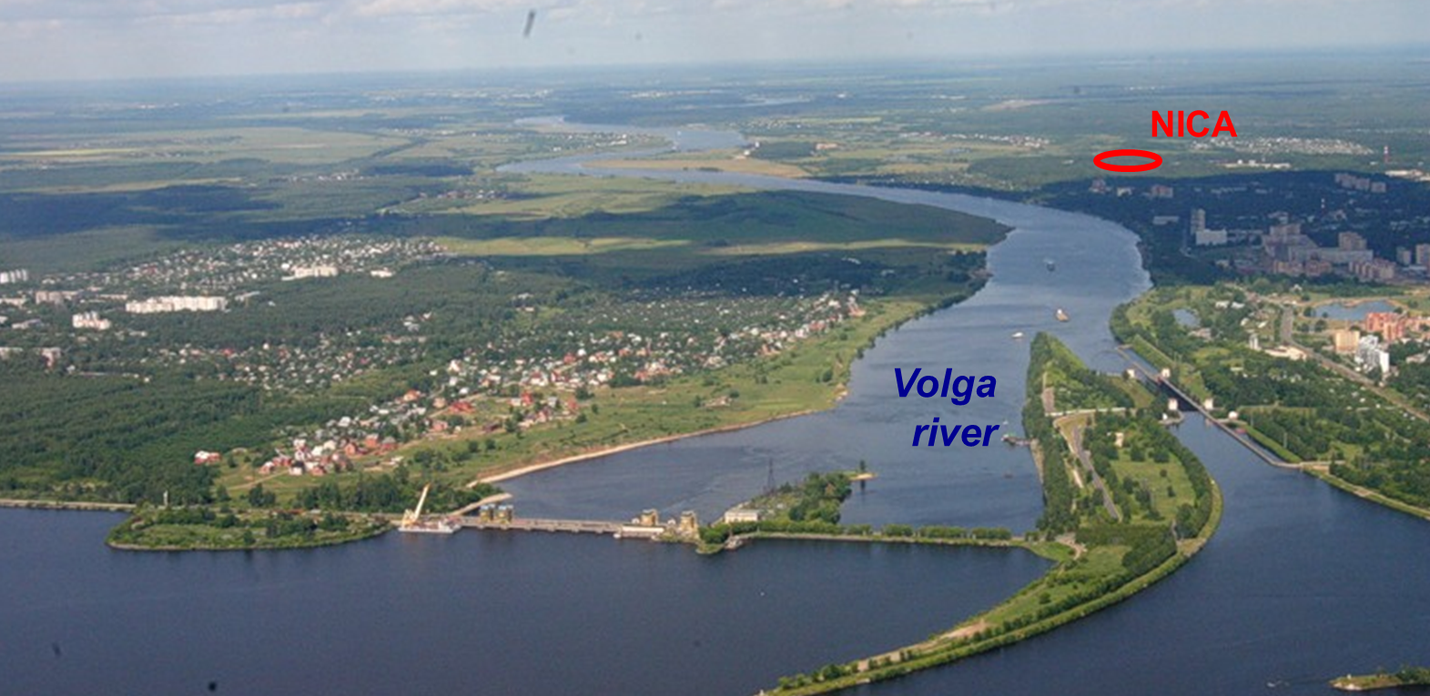
NICA – Nuclotron based Ion Collider fAcility

Slide 16
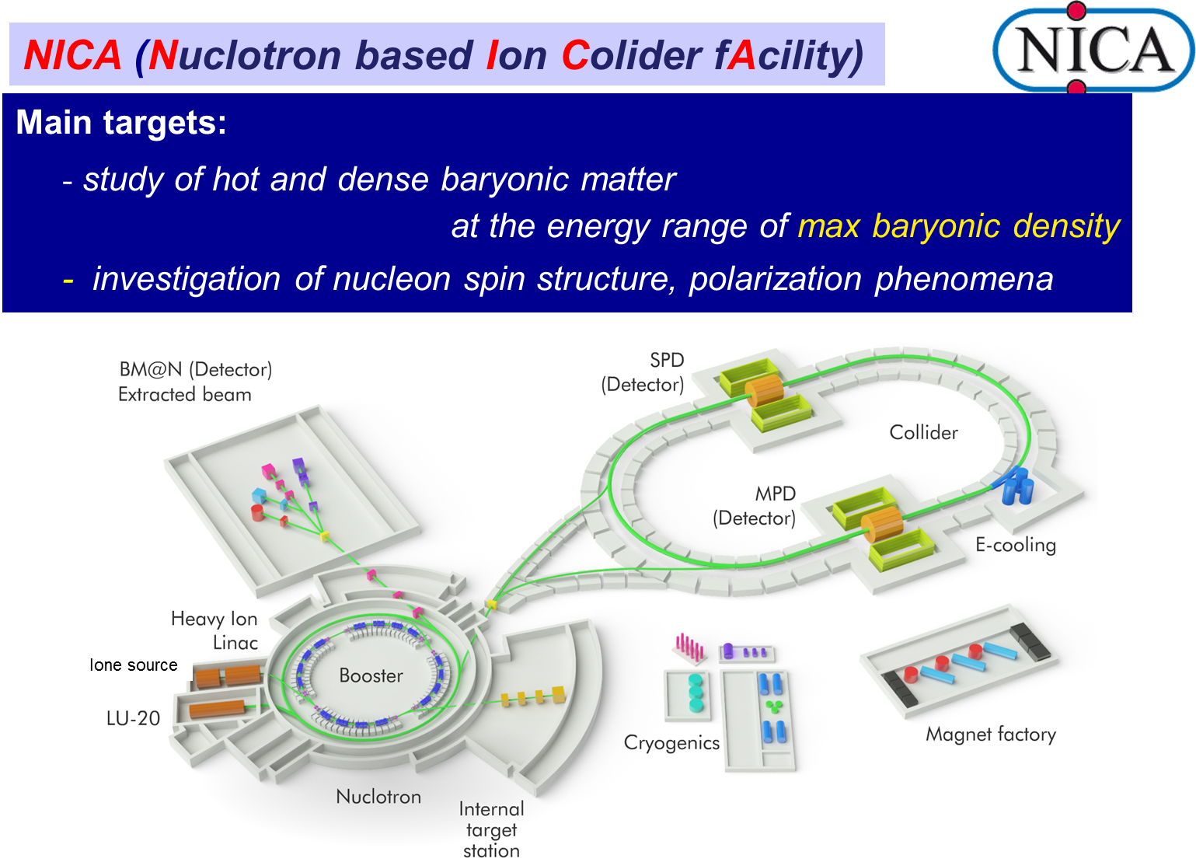
NICA – science goals

Slide 17
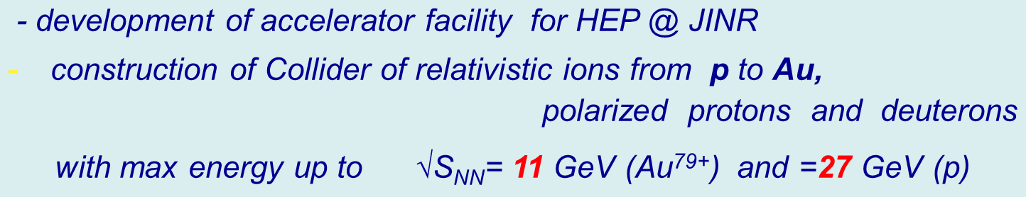
NICA – science goals

Slide 18
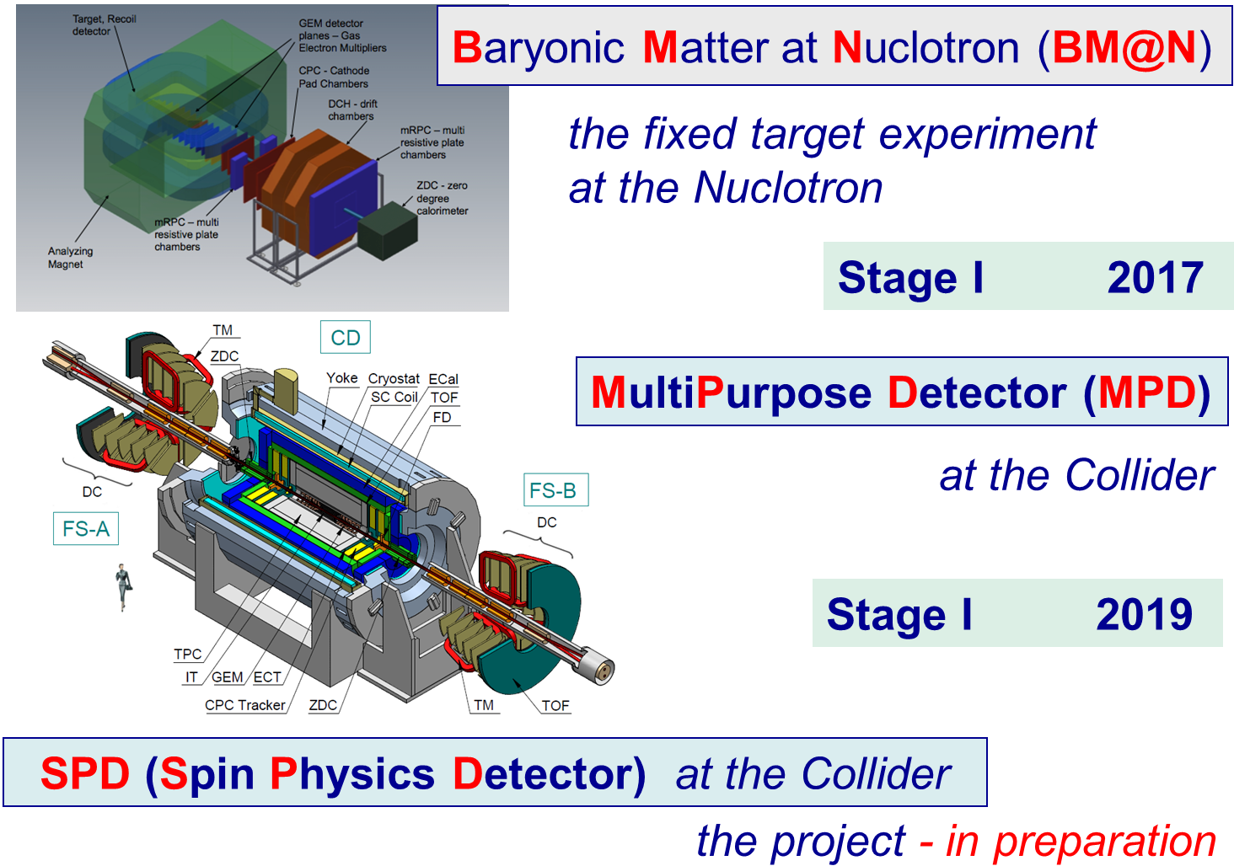
NICA – three detectors

Slide 19
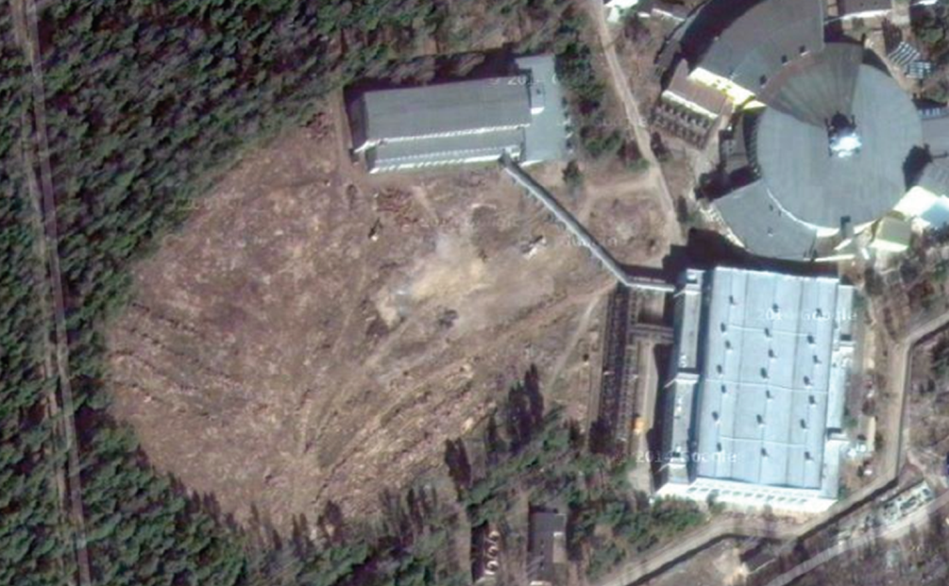
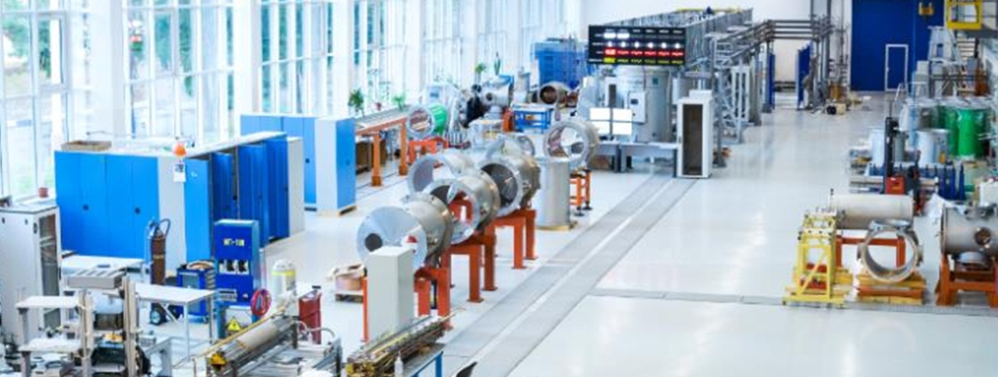
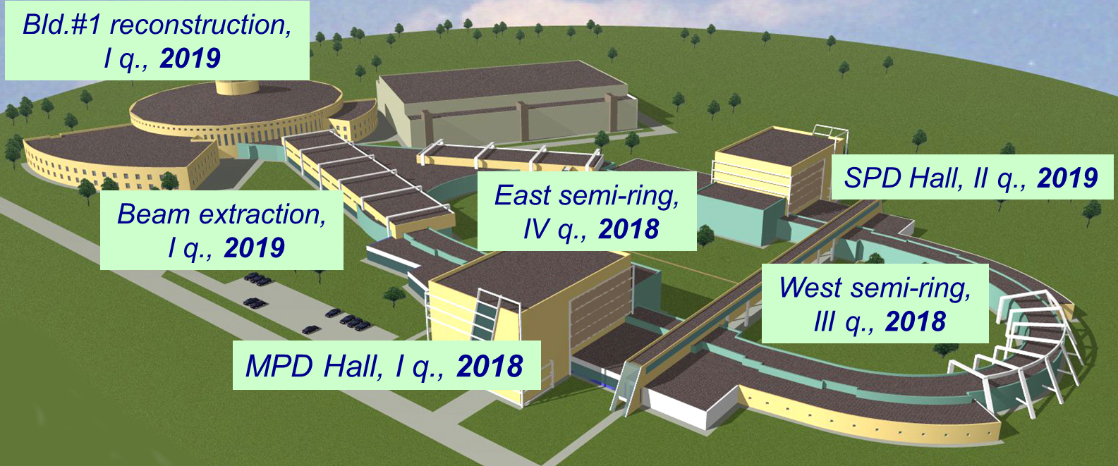
NICA – status and construction plans
Left – aerial photo of the place prepared for construction
Top – workshop for production of magnets for NICA & FAIR

Slide 20
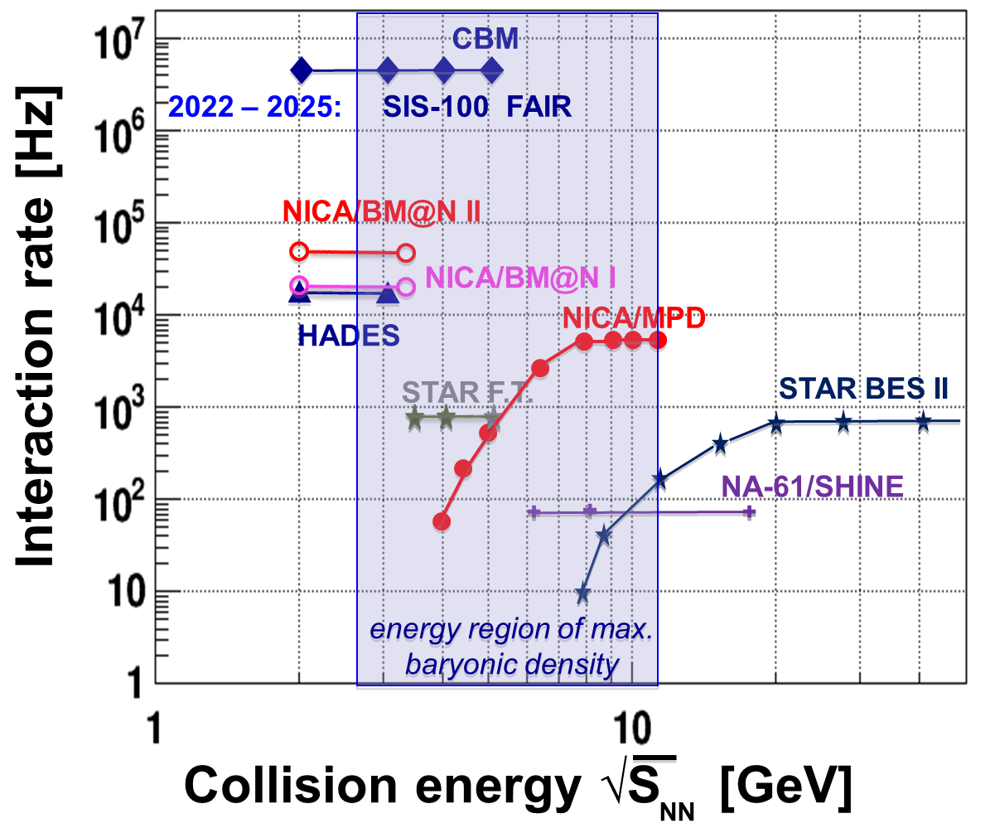
Present and future Heavy Ion experiments

Slide 21
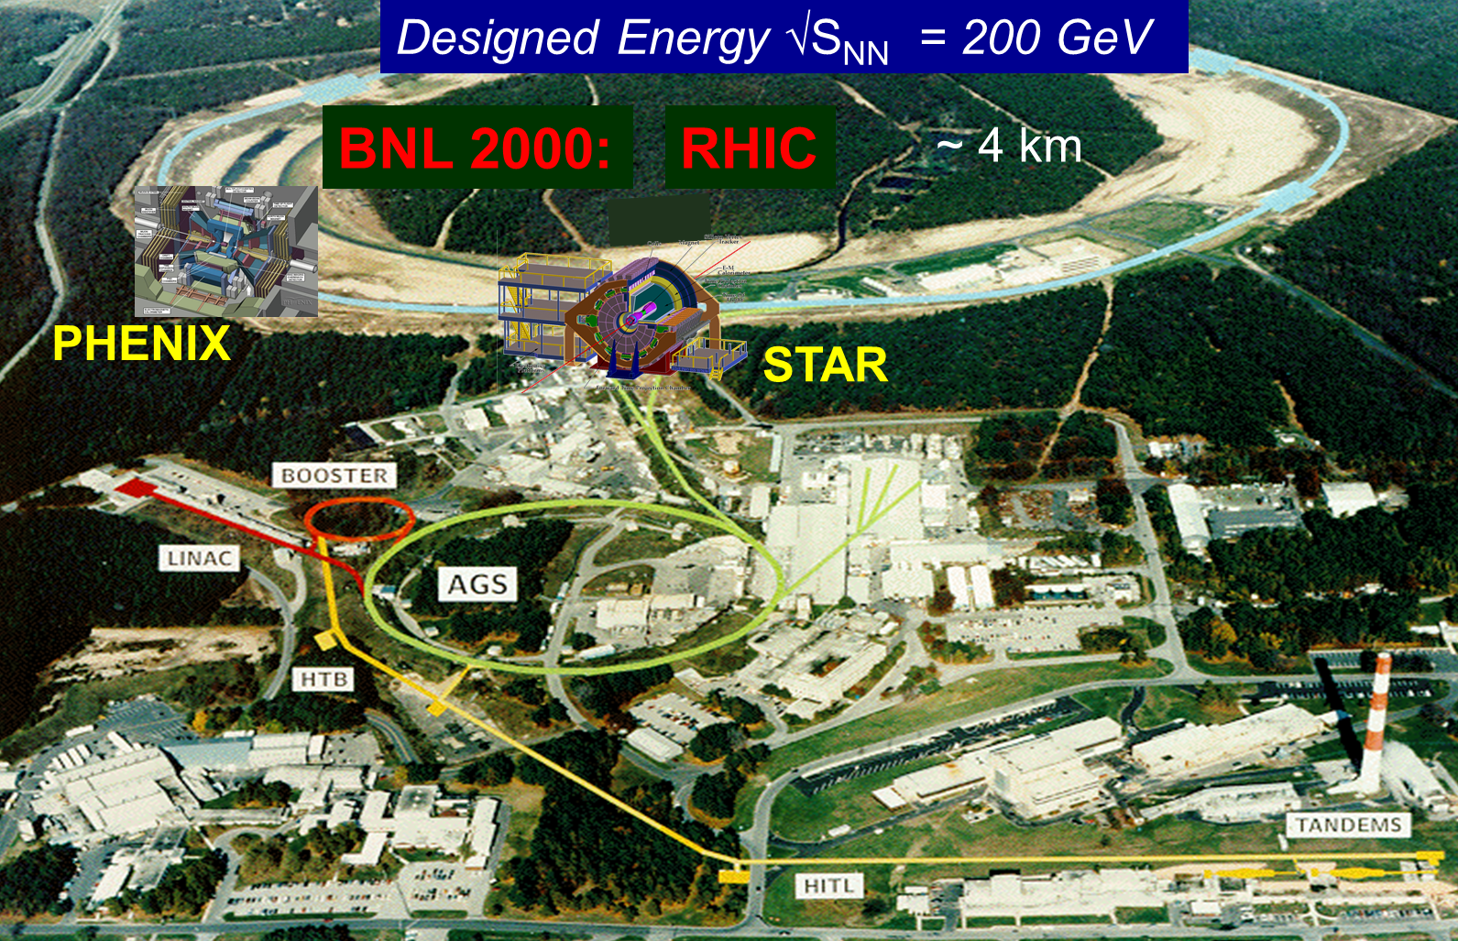
RHIC – Relativistic Heavy Ion Collider

Slide 22
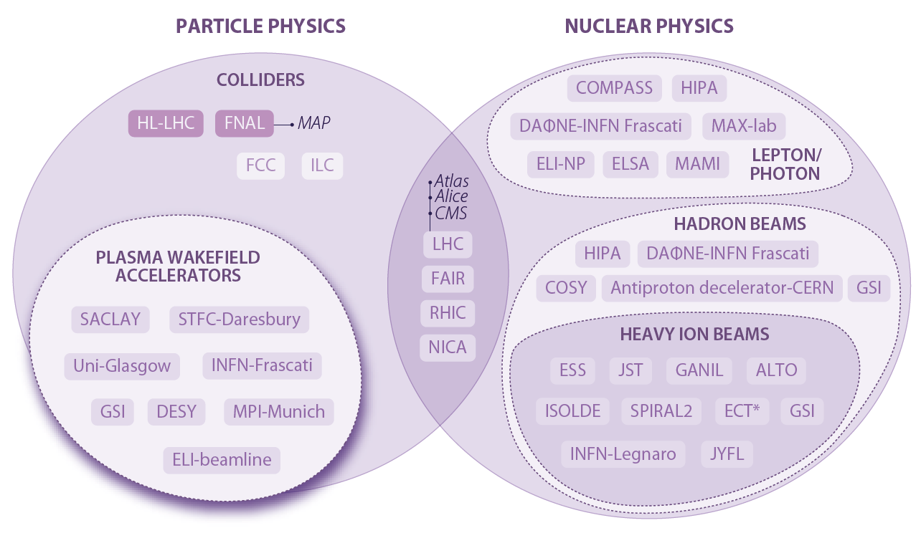
ESFRI roadmap 2016
Main Research Infrastructures in Particle and Nuclear Physics
ESFRI – European Strategy Forum on Research Infrastructure.

Slide 23
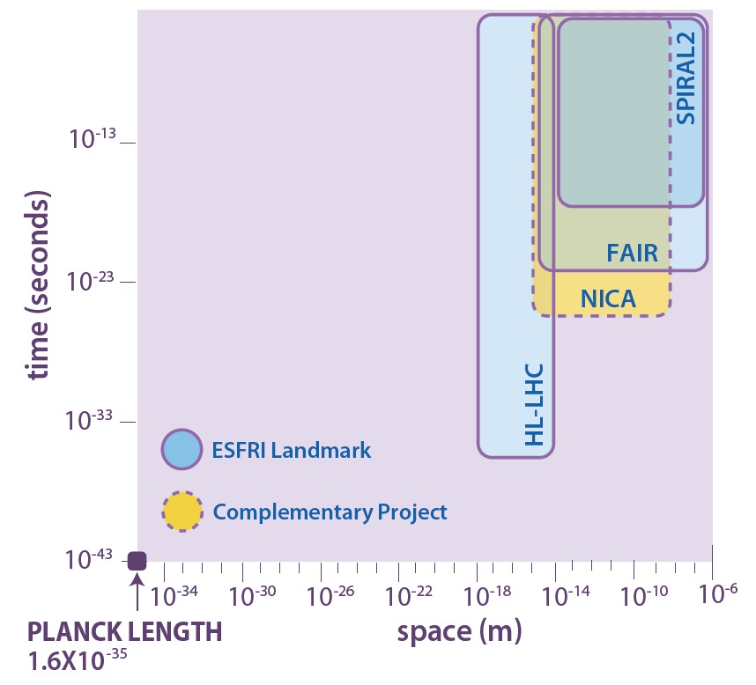
ESFRI roadmap 2016
Space and time domain of investigation of the ESFRI Landmarks and Projects

Slide 24
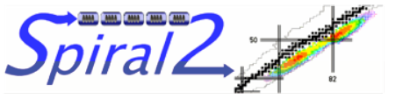
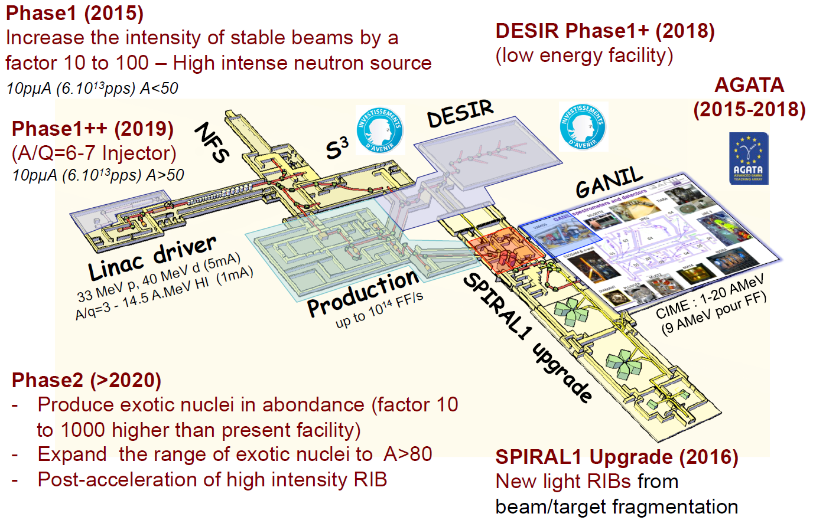
SPIRAL2- Système de Production d’Ions Radioactifs en Ligne de 2e generation

Slide 25
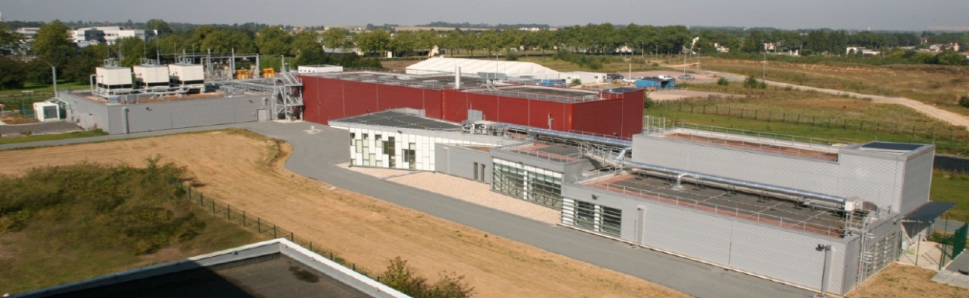
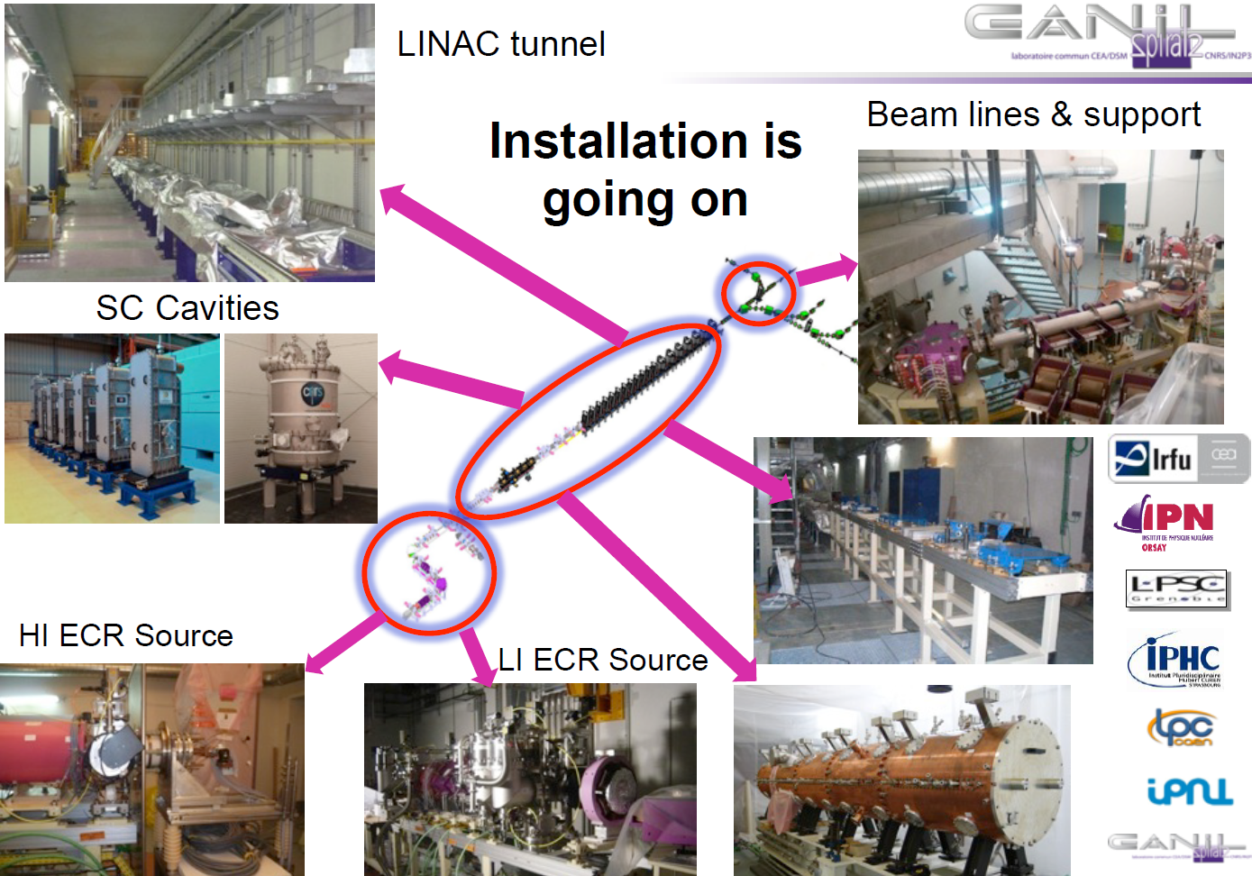
SPIRAL2 – construction at GANIL, France
Phase 1 Civil Construction is finished
RFQ

Slide 26
Contents
Hadron colliders (and not only colliders)
  HL-LHC, HE-LHC, FCC, SPPC
  FAIR, NICA, SPIRAL2
Electron - ion
  LHeC & FCC-he
  eRHIC
  Jlab e-ion
Lepton colliders
  FCC-ee & CepC
  CLIC and ILC
  Super-B factory
  c-tau factory
Advanced approaches
  LPWF & PWFA collider roadmaps & AWAKE

Slide 27
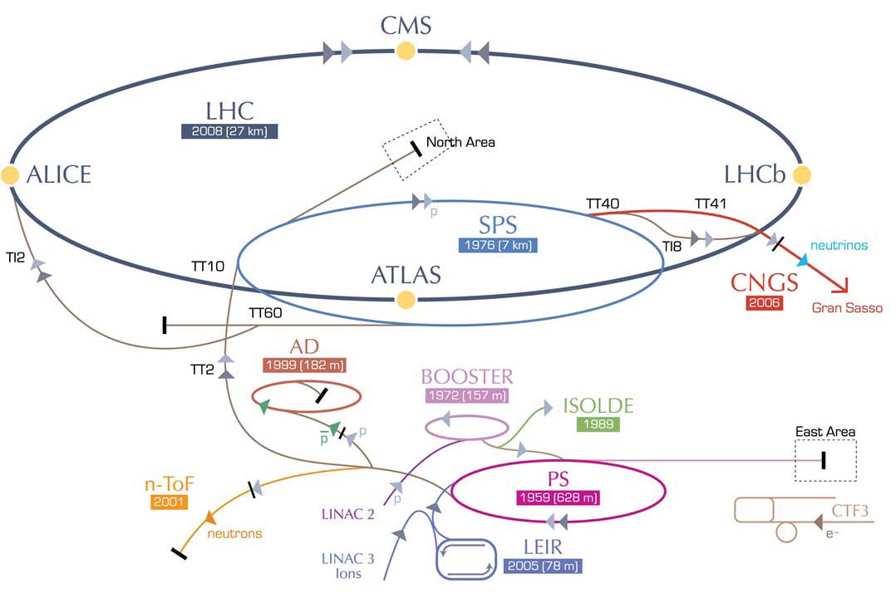
Electron – Ion : LHeC
RR LHeC:
new ring
in LHC tunnel,
with bypasses
around
experiments
LR LHeC:
recirculating
linac with
energy
recovery
RR LHeC
e-/e+ injector
10 GeV,
10 min. filling time

Slide 28
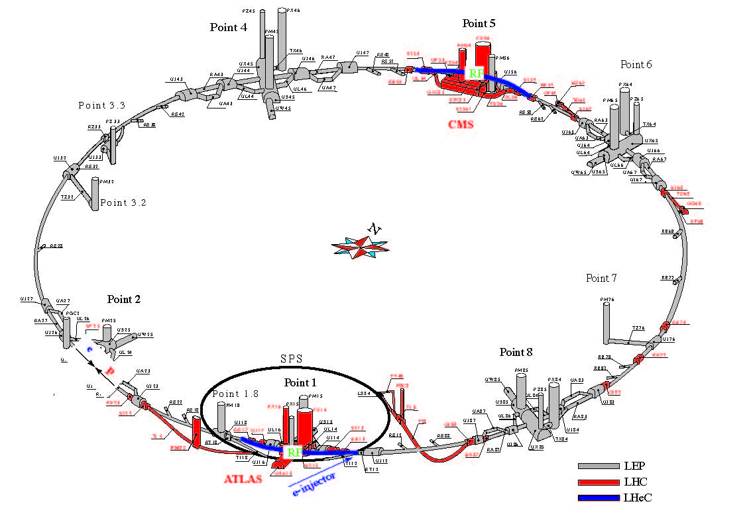
LHeC ring-ring
Two LHeC bypasses shown in blue - each 1.3 km long. RF in the central straight sections of the two bypasses (<500 m total). The bypass around Point 1 also hosts the injection.

Slide 29
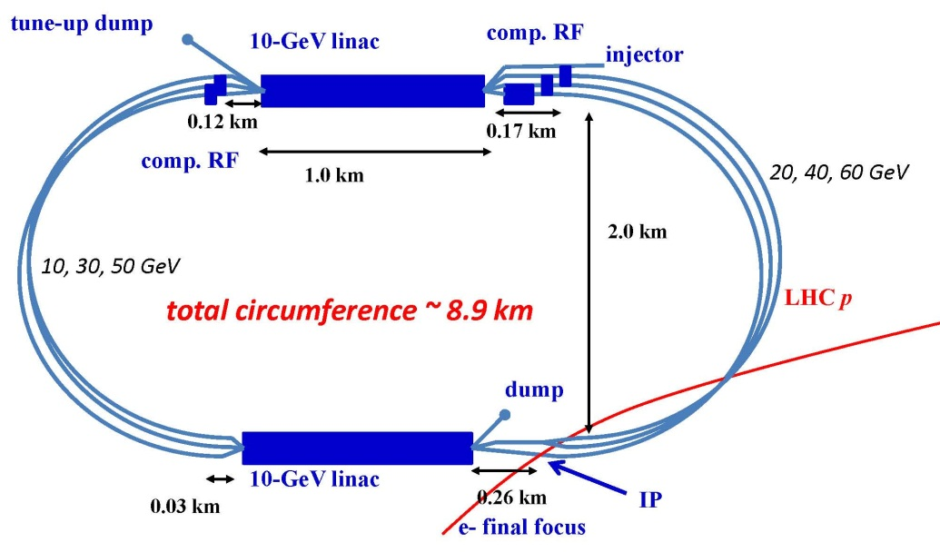
LHeC linac-ring
Two 10-GeV SC linacs, 3-pass up, 3-pass down; 6.4 mA, 60 GeV e-’s collide w. LHC protons/ions

Slide 30
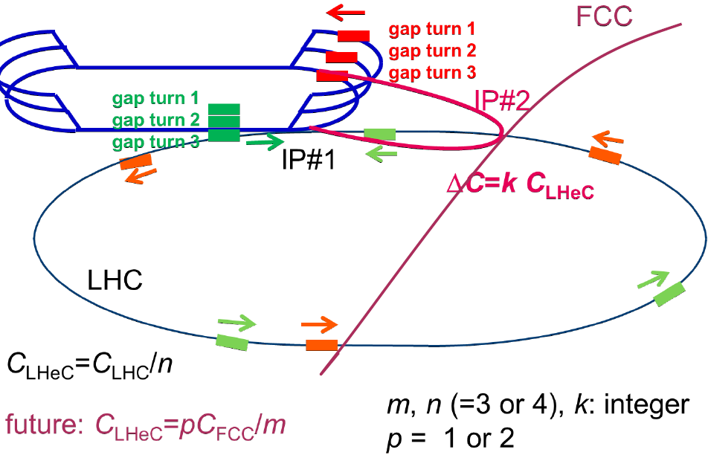
FCC-he option
FCC-he: e- from ERL, reusing the “LHeC
Ie~26 mA, σ _{x,y}*~2 μm, luminosity/nucleon ~ 3x1E34 cm-2 s-1

Slide 31
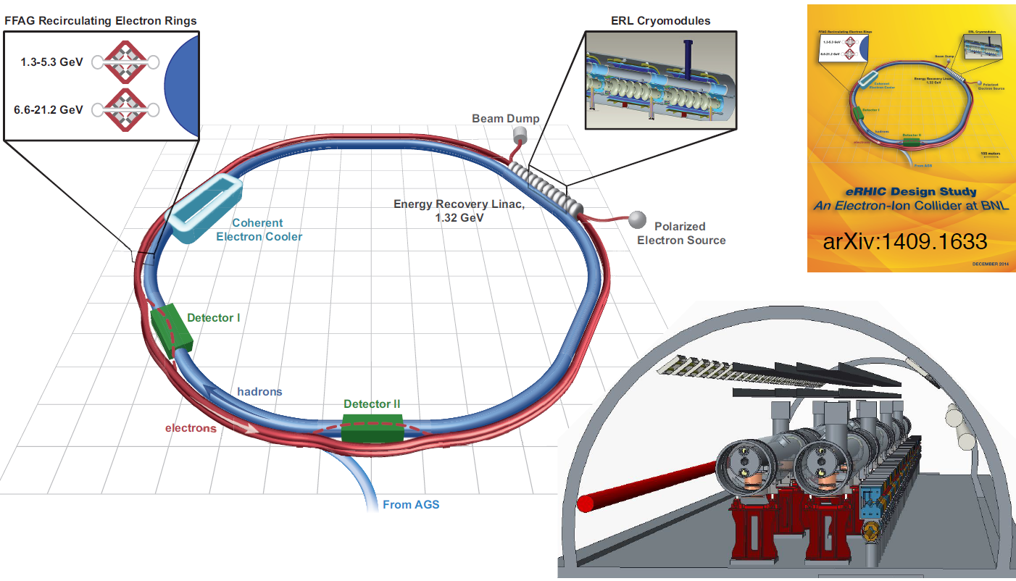
Electron – Ion : eRHIC (BNL)
e- colliding with protons, 3He or heavy ions (up to Au)
E: 5-21 GeV e-, 50-250 GeV polarized p or up to 100 GeV/u gold ions
L: >1E34 for e-p, > 1E32 cm-2s-1 for e-Au
High polarization of e-, proton and 3He beams
Electron acceleration in a SC E-recovery e-linac
Electron beam is used for collisions only on one pass (linac-ring collision scheme)
Multiple recirculations of e-beam done by beam transport in two FFAG beamlines
IR design with 10 mrad crossing angle and crab-crossing

Slide 32
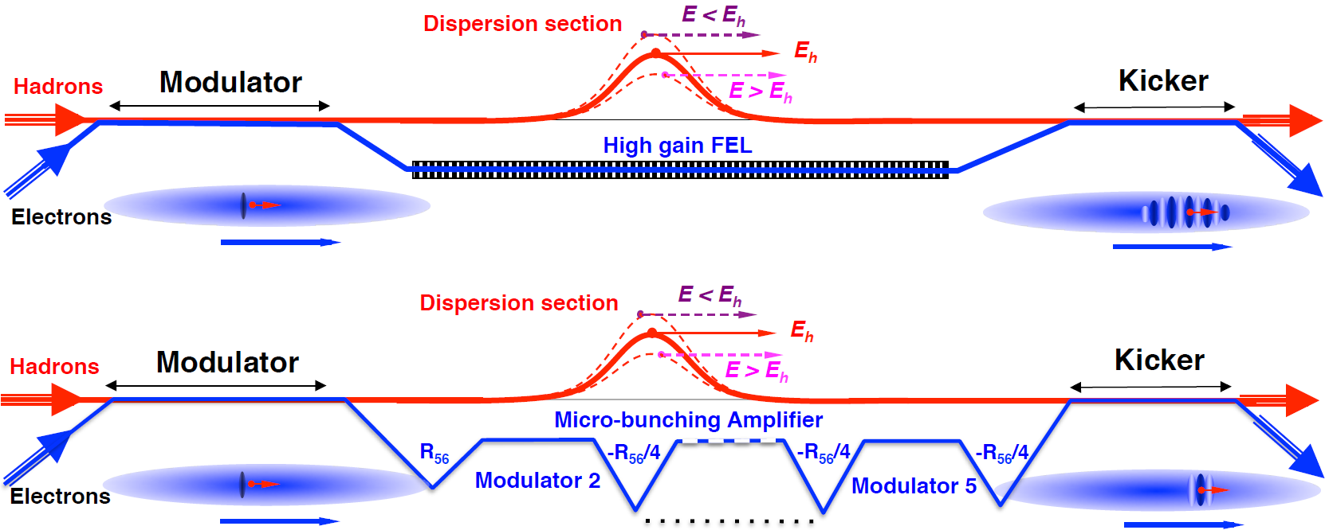
eRHIC – coherent electron cooling
Idea from 1980 (Y. Derbenev) further developed by V. Litvinenko into a novel scheme
Very high bandwidth (~ 10 - 100 THz) stochastic cooling using electron beam as medium
Made possible by high brightness electron beams and FEL technology
Proof-of-principle demonstration planned with 40 GeV/n Au beam in RHIC (2016)
Micro-bunching amplifier test also planned with same set-up

Slide 33
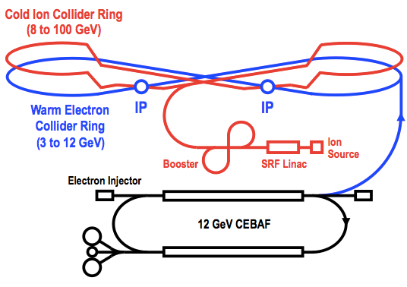
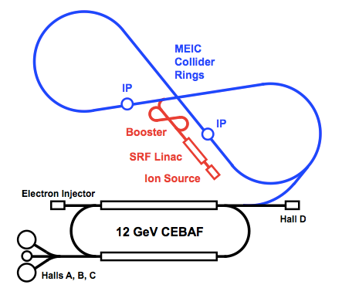
Electron – Ion : MEIC (JLAB)
Ring-ring design based largely on conventional technology
High rep rate CW colliding beams
CEBAF is a full energy injector
Energy: from 15 to 65 GeV
Electrons 3-10 GeV, protons 20-100 GeV, ions 12-40 GeV/u Ions:Polarized light ions: p, d, 3He, and possibly Li
Un-polarized light to heavy ions up to A above 200 (Au, Pb)
Luminosity: 1E33 to 1E34 per IP in a broad energy range
Polarization: longitudinal for both beams, transverse for ions only

Slide 34
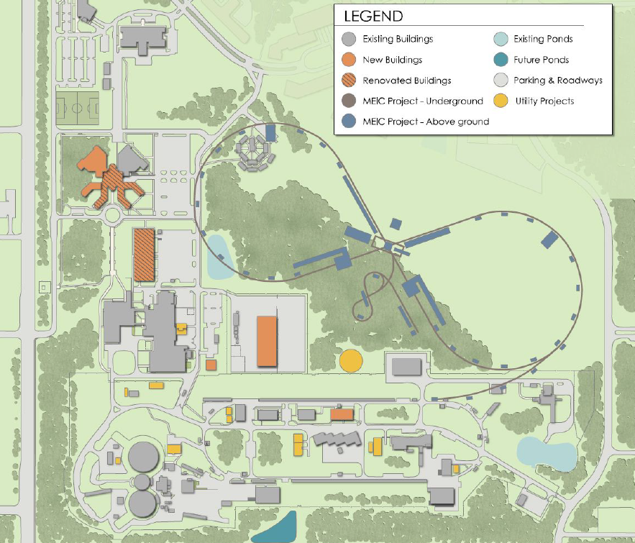
Electron – Ion : MEIC (JLAB)
Campus layout
Tunnel consistent with a 250+ GeV upgrade

Slide 35
Contents
Hadron colliders (and not only colliders)
  HL-LHC, HE-LHC, FCC, SPPC
  FAIR, NICA, SPIRAL2
Electron - ion
  LHeC & FCC-he
  eRHIC
  Jlab e-ion
Lepton colliders
  FCC-ee & CepC
  CLIC and ILC
  Super-B factory
  c-tau factory
Advanced approaches
  LPWF & PWFA collider roadmaps & AWAKE

Slide 36
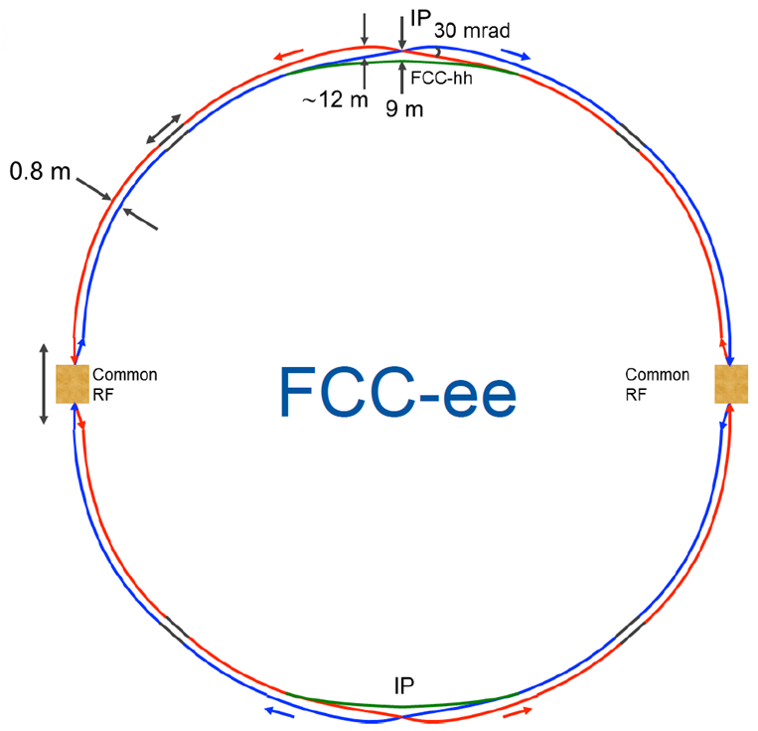
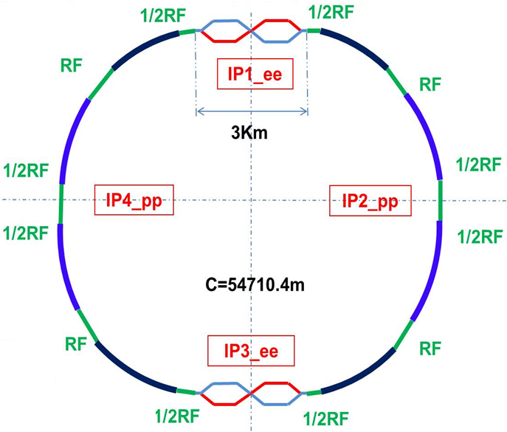
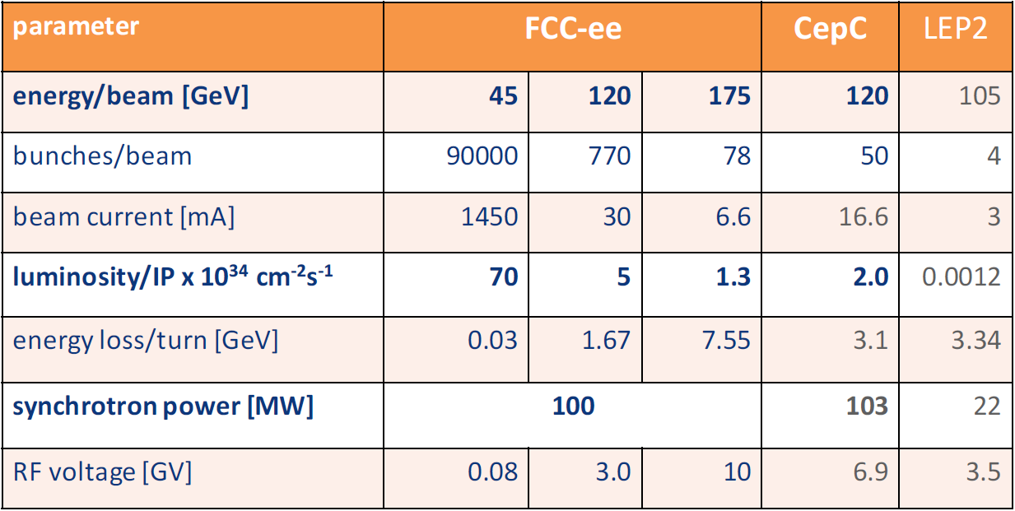
FCC-ee & CepC
FCC-ee (Europe)
2 rings and one booster
Both: 2 IP with crab waist
Single ring – more difficult beam dynamics
CepC
CepC (China)
1 ring with double ring sections

Slide 37
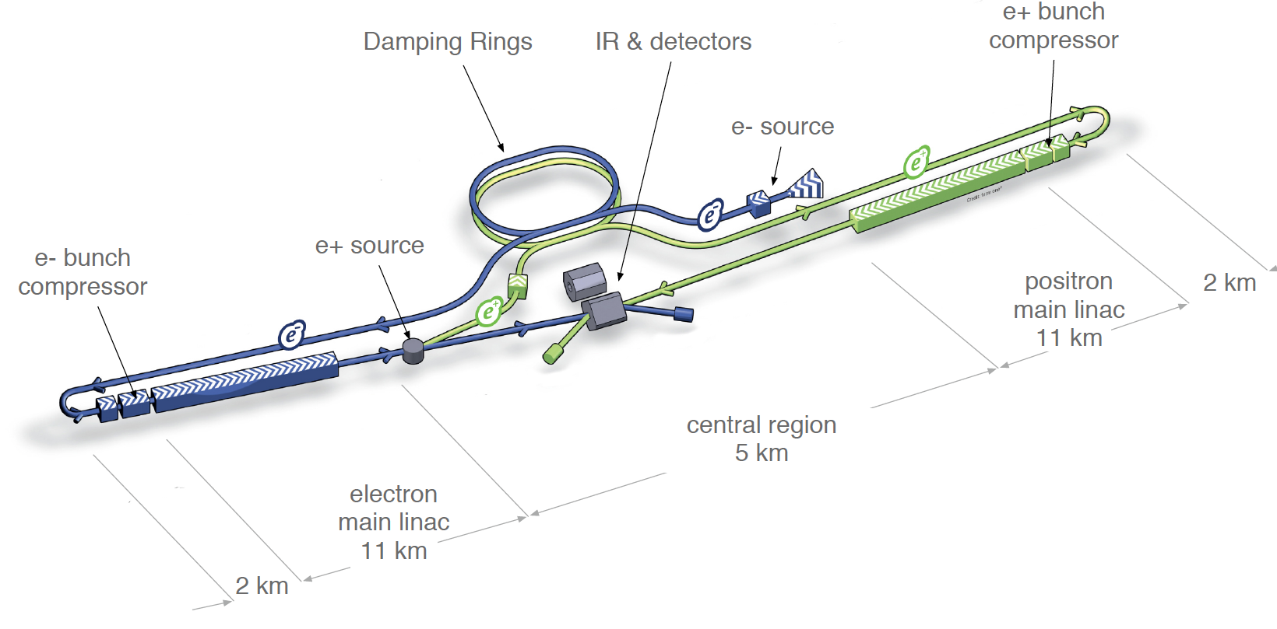
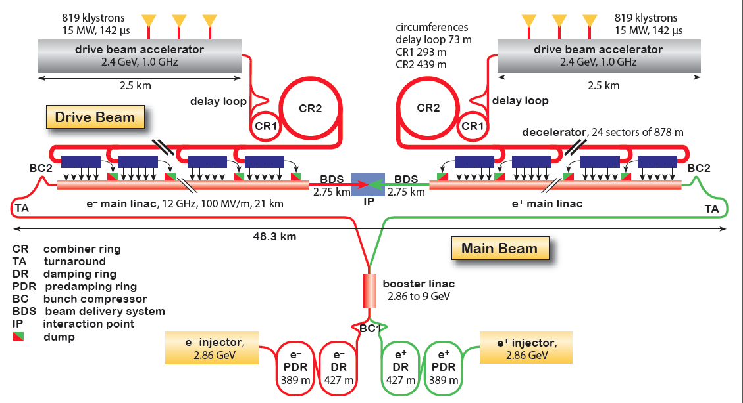
CLIC and ILC
ILC
0.5 TeV CM, upgreadable to 1 TeV
SC RF industrialized
mature design (TDR in 2012)
Possibility of hosting is evaluated by Japanese government
CLIC
Two-beam scheme, 1-3 TeV CM
Option for 380 GeV explored (klystrons)
CTF3 facility – key R&D done
Ready for demonstrator project

Slide 38
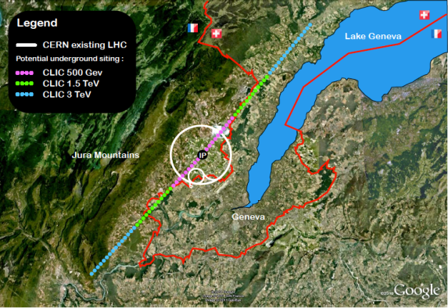
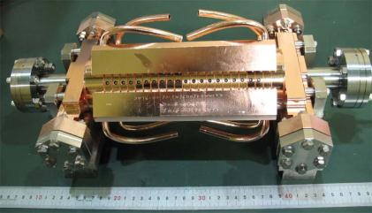
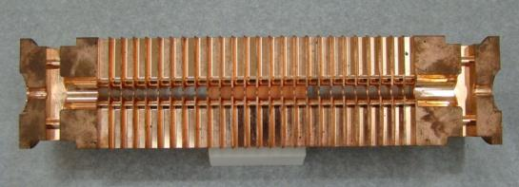
CLIC project
Key features:
High gradient (energy/length)
Small beams (luminosity)

Slide 39
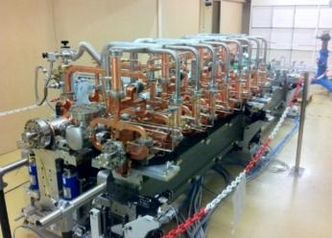
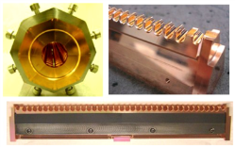
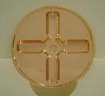
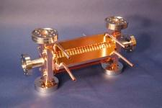
CLIC two beam scheme
Drive beam time structure - initial
Drive beam time structure - final
240 ns
240 ns
5.8 μs
140 μs train length - 24 × 24 sub-pulses
4.2 A - 2.4 GeV – 60 cm between bunches
24 pulses – 101 A – 2.5 cm between bunches
Main Beam Generation Complex

Slide 40
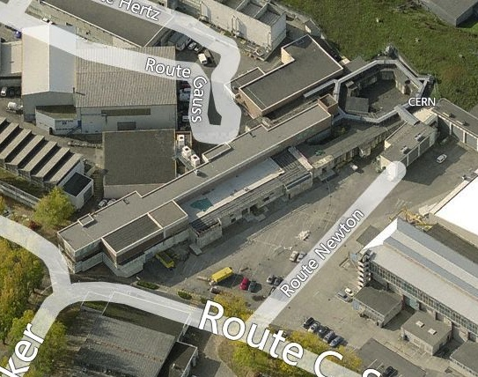
CLIC test facility (CTF3)

Slide 41
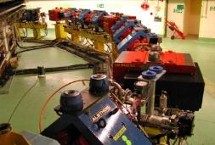
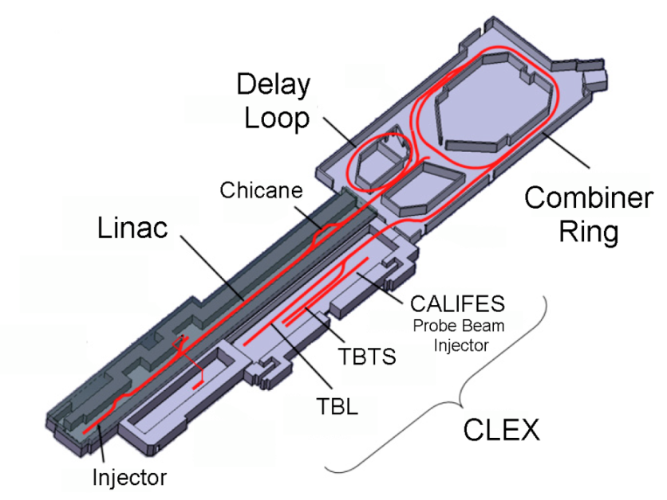
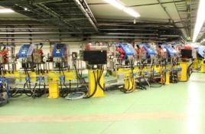
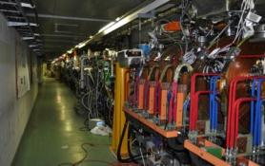
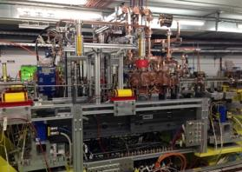
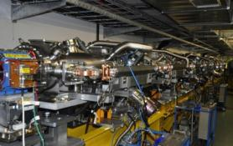
CLIC test facility (CTF3)
DELAY LOOP
COMBINER
RING
DRIVE BEAM LINAC
TBL
Two Beam Module

Slide 42
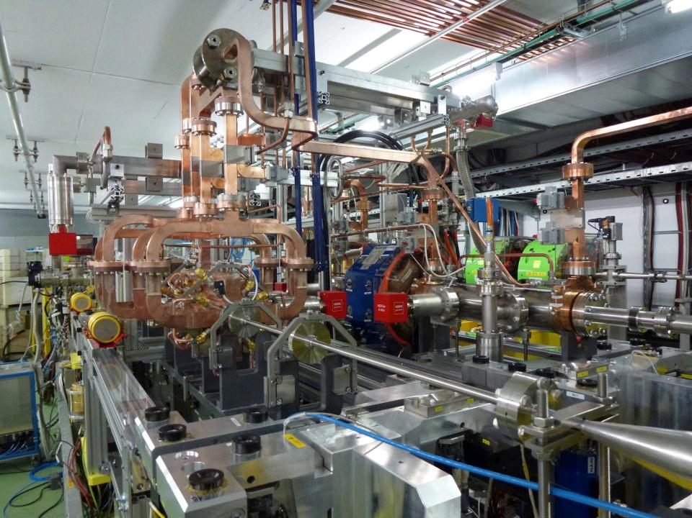
2-beam acceleration module in CTF3
drive beam
Has reached 145 MV/m (2012)
main beam

Slide 43
ILC project

Slide 44
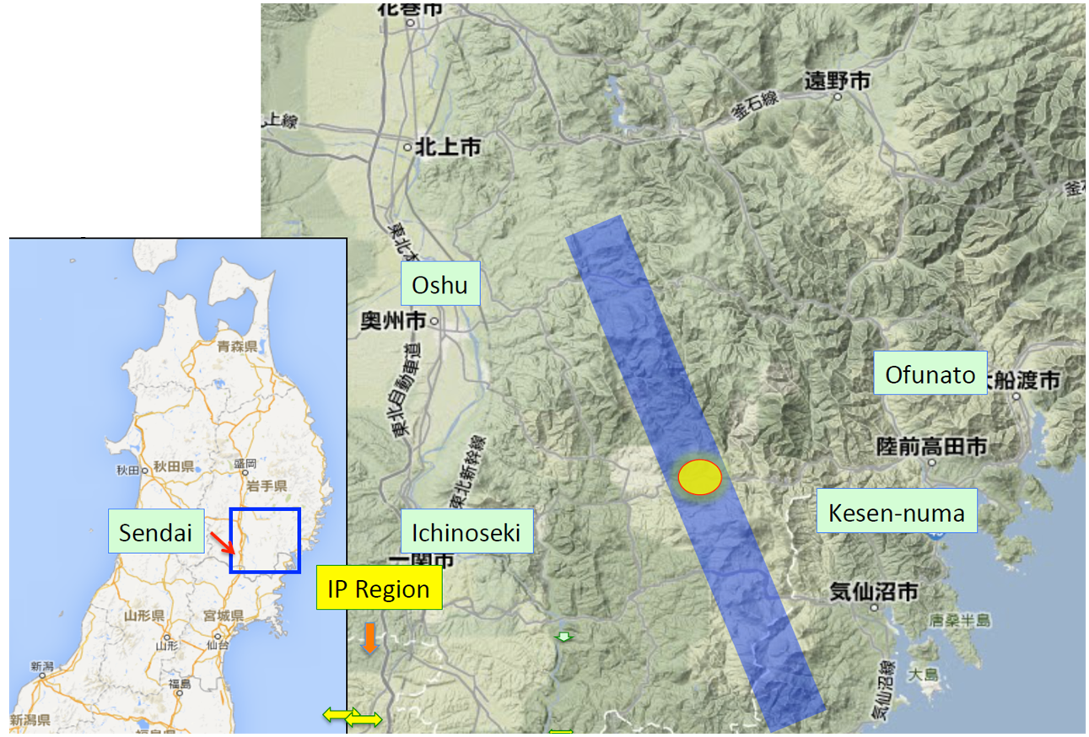
ILC site specific design

Slide 45




ILC SCRF technology development
SCRF cavities gradient 31.5 MeV/m
Cavity Input Coupler
Cavity tuner

Slide 46



ILC cryomodule and string tests
Cryomodule test at Fermilab reached < 31.5 > MV/m, exceeding ILC specification
String test of cryomodules at KEK - STF

Slide 47


ILC & CLIC nanobeams at ATF2/KEK
ILC and CLIC rely on final focus with local chromatic correction
P.Raimondi, A.Seryi, PRL, 86, 3779 (2001)
ATF2 at KEK is a scaled down model of ILC/CLIC final focus
(with local chromatic correction)

Slide 48
Nanobeams at ATF2 Final Focus
Beam Size 44 nm observed*,
(Goal (ideal size): 37 nm
corresponding to 6 nm at ILC)
Operation of Final Focus with local chromatic correction verified successfully
*) Effects (wakefields and magnet nonlinearities) contributing to ATF2 beam size (at 1.2 GeV) would not matter at ILC energy

Slide 49
Contents
Hadron colliders (and not only colliders)
  HL-LHC, HE-LHC, FCC, SPPC
  FAIR, NICA, SPIRAL2
Electron - ion
  LHeC & FCC-he
  eRHIC
  Jlab e-ion
Lepton colliders
  FCC-ee & CepC
  CLIC and ILC
  Super-B factory
  c-tau factory
Advanced approaches
  LPWF & PWFA collider roadmaps & AWAKE

Slide 50



SuperKEKB factory
Crabbed waist – P.Raimondi
~50nm size at IP
Standard collision, ~1um size at IP

Slide 51


KEKB to SuperKEKB

Slide 52




SuperKEKB Belle II and IR magnets

Slide 53


SuperKEKB status
June 21, 2016:
Reached 1 A in LER.
Beam dose is 720 Ah in LER and 630 Ah in HER.
Vacuum scrubbing almost done

Slide 54


Super Charm-Tau factory project at BINP
Beam energy from 1.0 to 2.5 GeV
Luminosity ~1E35 at 2 GeV
Crab waist collisions
Existing injection complex
c-tau factory project status:
CDR completed in 2013
Discussion with government and potential collaborators
Project recently re-energized (Aug 2016) with the International Advisory Committee created

Slide 55


BINP colliders: VEPP-4M
VEPP-4M
SR
VEPP-3
SR
Detector KEDR
VEPP-4M
E = 1 – 5 GeV
Energy calibration 1E-6

Slide 56








BINP colliders: VEPP-2000
VEPP-2000
E = 1 GeV
Round beams
Two detectors

Slide 57
Contents
Hadron colliders (and not only colliders)
  HL-LHC, HE-LHC, FCC, SPPC
  FAIR, NICA, SPIRAL2
Electron - ion
  LHeC & FCC-he
  eRHIC
  Jlab e-ion
Lepton colliders
  FCC-ee & CepC
  CLIC and ILC
  Super-B factory
  c-tau factory
Advanced approaches
  LPWF & PWFA collider roadmaps & AWAKE

Slide 58



Advanced accelerator techniques
Many ideas are being developed for multi-TeV colliders with gradients >100 MeV/m, & lower capital & operating costs
  Wakefield Acceleration using plasmas or dielectrics
  Direct Laser Acceleration
  Both particle beam (PWFA) and laser (LWFA) driven wakefield approaches are thought to offer effective gradients of O(1 GeV/m)
LWFA
PWFA
Dielectric accelerating structure
W. Gai, ANL, 2016 DOE workshop
Simon Hooker, JAI
M. Hogan, SLAC, 2016 DOE workshop
One of the main common R&D design goals for these methods for the next decade is insuring the luminosity (emittance preservation)

Slide 59



Advanced accelerator community marching towards new challenges
AAC & EAAC workshops attract ~300 researchers (many grad students and postdocs) each year
And conquering them!
A highlight of AAC-2016
(Jul 31-Aug 5, 2016, Washington DC) – efficient plasma acceleration of positrons!
Acceleration of e+ was believed to be one of key challenges on the path to a plasma collider, as e+ are not focused, but defocused by ions in plasma bubble
e+ gaining 5 GeV in just 1.3 m of plasma
S. Corde et al., Nature 524, 442 (2015)

Slide 60


Concepts of plasma acceleration based colliders
Laser-driven
Beam-driven
Esarey et al, Rev. Mod. Phys. (2009)
A. Seryi et al, SLAC-PUB-13766, 2009

Slide 61



Advanced accelerator community developing roadmaps toward plasma-based collider in 2040
Laser-driven
Concepts of plasma-based colliders
Beam-driven
Esarey et al, Rev. Mod. Phys. (2009)
A. Seryi et al, SLAC-PUB-13766, 2009

Slide 62


AWAKE: proton driven plasma acceleration
AWAKE = Advanced Proton Driven Plasma Wakefield Acceleration Experiment
Proof-of-concept demonstration of a novel acceleration technique: use SPS
protons to generate powerful wakefields in a 10m plasma cell → wakefields
accelerate externally injected electron beam.
Aim at electron acceleration of several GeV/m → compact accelerators
Experiment starts end 2016.
6 June 2016 – first p beam in AWAKE beamline

Slide 63
Difficulties of plasma acceleration based colliders
Laser-driven
One of the main difficulties: emittance growth between plasma-acceleration stages
Beam-driven
Esarey et al, Rev. Mod. Phys. (2009)
Can we cool the emittance between plasma acceleration stages?
A. Seryi et al, SLAC-PUB-13766, 2009

Slide 64












Laser-plasma stage with ε cooling
NEW!
Cool ε
Cool ε
FEL or collider
Accelerate
Disperse
Zero ΔE/E
Focus
T
T
FEL
Laser pulse shape
Screw-shaped laser pulse => Giga-gauss solenoidal field in plasma bubble => Fast SR cooling of transverse DOF=> new approach to design laser-plasma FEL or collider
Screw-shaped laser pulse and trajectories of electrons
Bubble shape (top) and solenoidal field map (bottom)
A. Seryi, Zs. Lecz, I. V. Konoplev, A. Andreev
arXiv:1604.01259 & AAC-2016

Slide 65










Training of next generation of accelerator scientists
is necessary, for our community to be able realise the aspirations of building next generation machines – ILC or CLIC, FCC, CEPC or HE-LHC, or plasma-based collider
Coordinated efforts of accelerator institutes (JAI, Cockcroft) and international and regional accelerator schools (USPAS, CAS, JUAS)
…will allow to overcome the shortage of accelerator physicists and be ready for construction and operation of new projects

Slide 66
Conclusions
Variety of projects and bright opportunities for studies of QCD challenging questions
Accelerator science continue to bring novel ideas which allow to aim at ever increasing performance
Technology development is key for realization of next project, and often stimulate new design ideas
Keep an eye on advanced concepts!
Training of next generation of accelerator scientists is key for continuing success of our field

