Slide 1
Magnet challenges for FCC-hh
Gijs de Rijk
CERN
Workshop "Accelerators Revealing the QCD Secrets”
Thessaloniki
4 September 2016

Slide 2
Contents
Very short intro on superconductors and SC magnets
The early High Field Magnet epoch (1986-2004)
Conductor development
Basic magnet technology development for HILUMI and beyond (2004-2013)
The HILUMI magnet development (2013-2016)
FCC magnet development (2014 - ... )

Slide 3
FCC-hh requested B field levels
FCC-hh
  E_{cm}=100 TeV , 100 km ring: B = 16 T Project Baseline
  E_{cm}=100 TeV , 80 km ring: B = 20 T
What would this mean in the LHC ring for a potential HE-LHC ?
  E_{cm}=25 TeV , 27 km ring: B = 16 T
  E_{cm}=33 TeV , 27 km ring: B = 20 T

Slide 4
Magnets for Accelerators
Dipoles
  Design for B field which is the highest feasible and economic, to reduce the bending radius (NB. bending radius LHC = 2803.95m)
Quadrupoles
  Design for the largest feasible integrated gradient to reduce the magnet bore size, and gradient to increase the dipole filling factor
Beam energy
Bending radius
Dipole field
FODO cell length
Integrated quadrupole gradient
Beam size
Emittance
Lorentz factor
Beta function
High field (SC) accelerator magnets !

Slide 5
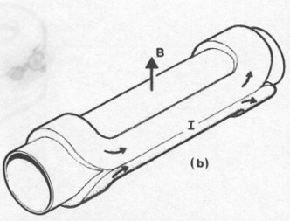
What is specific about accelerator magnets ?
Cylindrical volume with perpendicular field
Dipoles, quadrupoles, etc
Field quality:
Field quality formulated and measured in a multipole expansion,
Long magnets: dipoles from 6 m (Tevatron) to 15 m (LHC)
Often magnets are bent (9.14 mm sagitta for the LHC dipoles)
Artist view of a dipole, from M. N. Wilson « Superconducting Magnets »
CosΘ coil : J = J₀ cosΘ

Slide 6
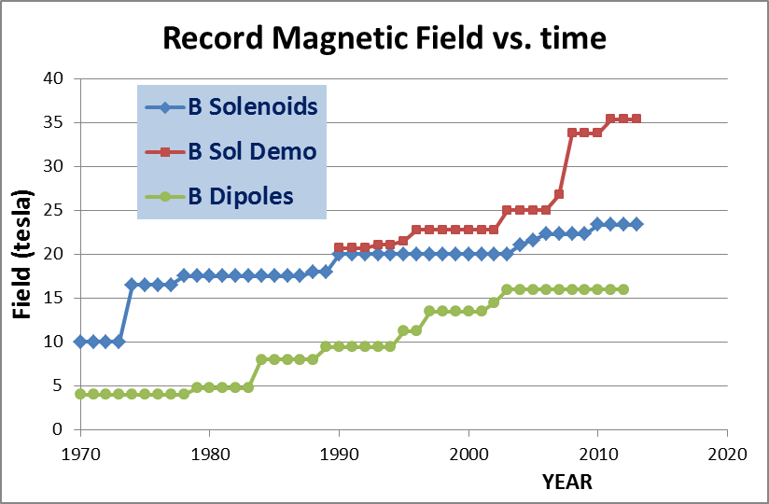
The state of the art:
Comparison between dipoles and solenoids
We can see roughly a factor 2 due to Coil «efficiency» and to force-stress management
Courtesy L. Rossi

Slide 7
High Field accelerators magnets, the state of the art
Maximum attainable field slowly approaches 16 T
  20% margin needed (80% on the load line):
  for a 16 T nominal field we need to design for 20 T
NB. HFM is a imprecisely defined term: It is mostly used to indicate magnets at a field level we do not yet have

Slide 8
Superconductors
Critical surface
for Nb-Ti
Below a the critical surface the material is “superconducting”. Above the surface it is “normal conducting”
Θ_{c} Critical Temperature (at zero field and current density)
B_{c2} Critical Field (at zero temperature and current density)
J_{c} Critical Current Density ( at zero temperature and field)
The Critical surface depends on the material type Nb-Ti, Nb₃Sn, etc) and the processing
Superconductivity is a macroscopic quantum effect. Resistance = 0
J: few x 10³ A/mm² inside the superconductor
Courtesy M. Wilson

Slide 9
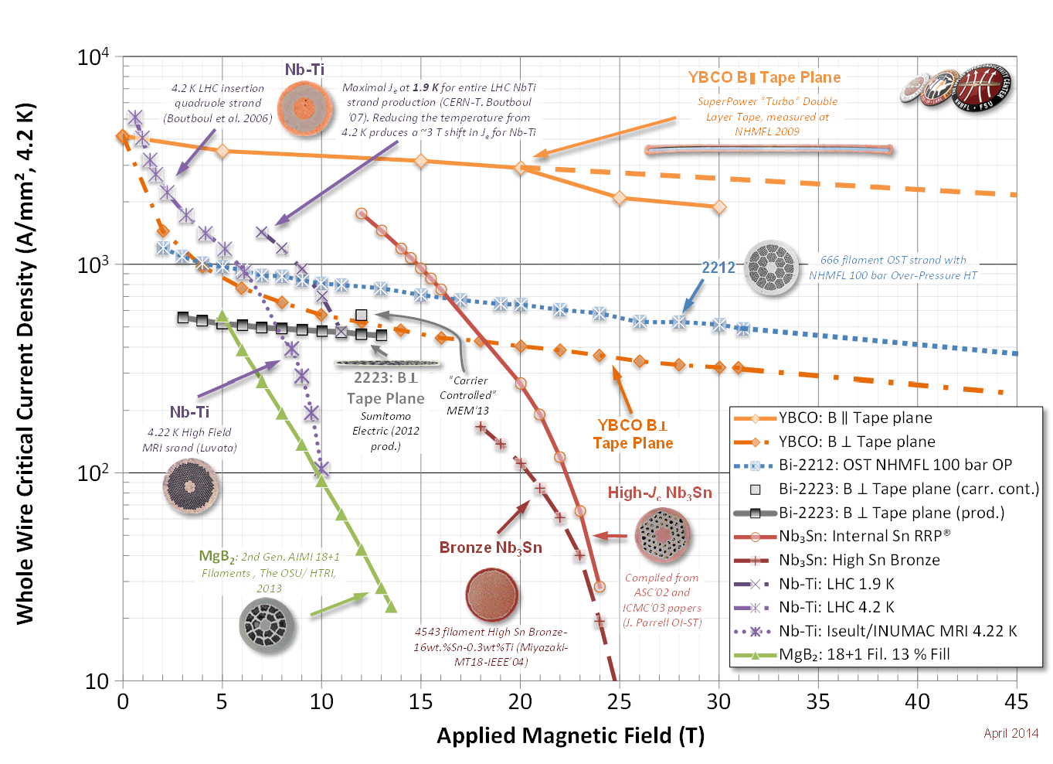
Available Superconductors
Nb-Ti: the workhorse for 4 to 10 T
  Up to ~2500 A/mm² at 6 T and 4.2K or at 9 T and 1.9 K
  Well known industrial process, good mechanical properties
  Thousands of accelerator magnets have been built
  10 T field in the coil is the practical limit at 1.9 K
Nb₃Sn: towards 20 T
  Up to ~3000 A/mm² at 12 T and 4.2 K
  Complex industrial process, higher cost, brittle and strain sensitive
  25+ short models for accelerator magnets have been built
  ~20 T field in the coil is the practical limit at 1.9 K, but above 16 T coils will get very large
HTS materials: dreaming 40 T (Bi-2212, YBCO)
Current density is low, but very little dependence on the magnetic field
Used in solenoids (20T range), used in power lines – no accelerator magnets have been
built (only 1 model) – small racetracks have been built

Slide 10
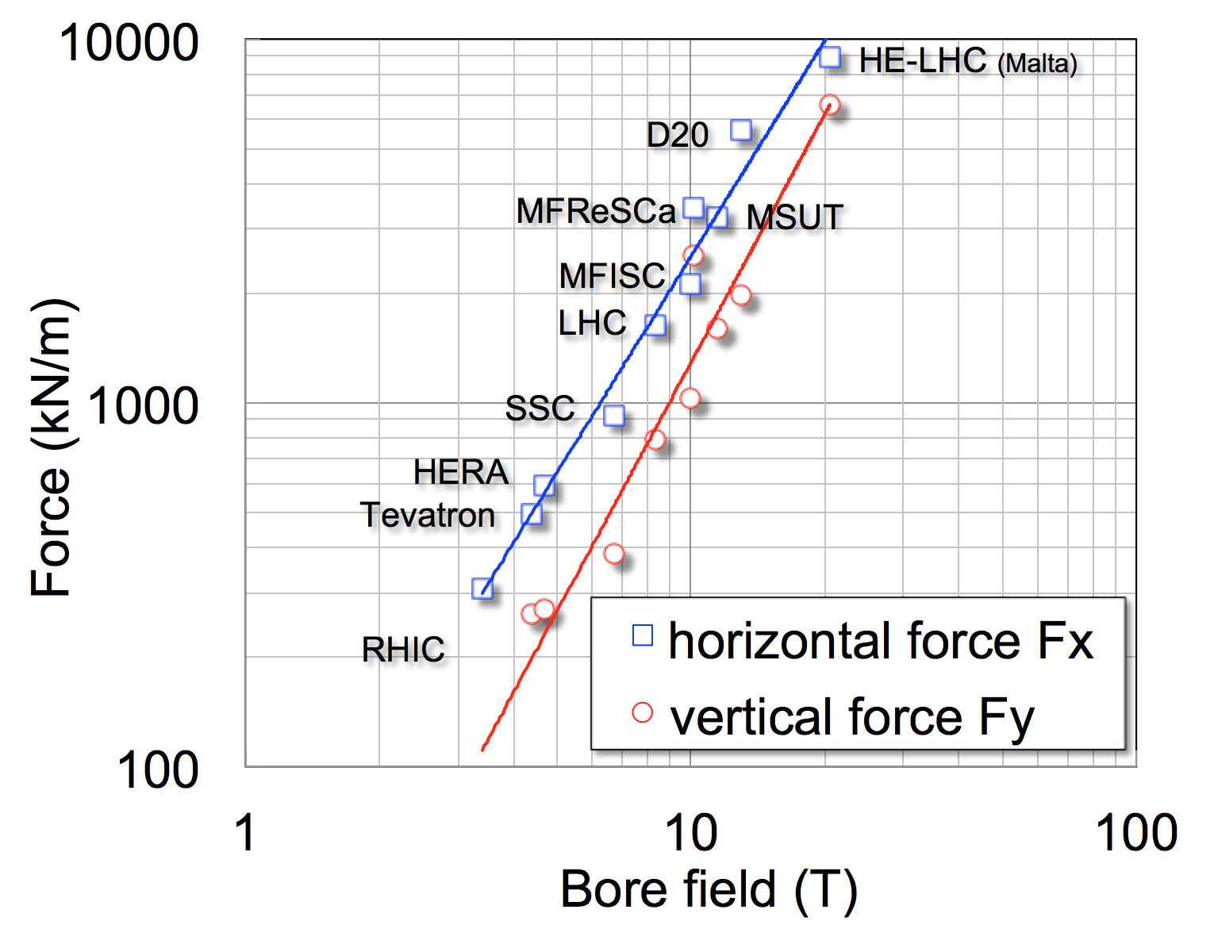
Forces
Scaling of force on coil quadrant vs. Field
Plot for recent production and R&D dipoles
The electromagnetic loads in a 20 T dipole would be a factor 5 to 8 larger than in the LHC dipoles

Slide 11
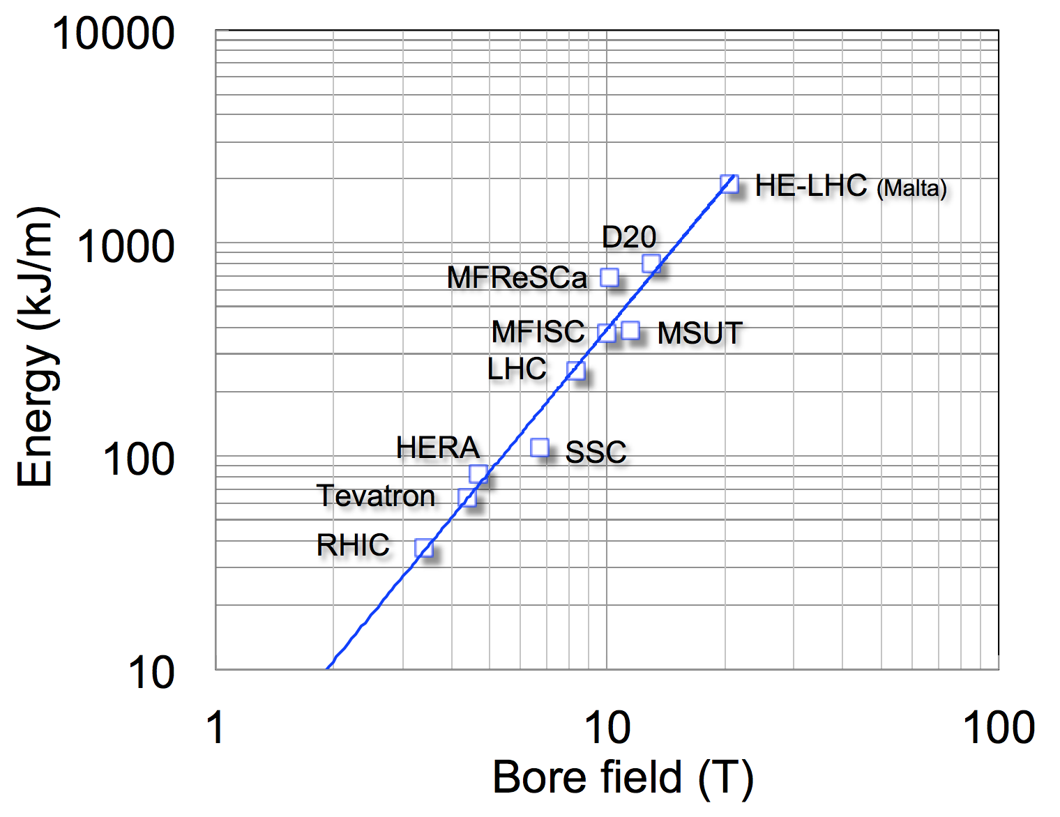
Stored Energy
Scaling of the energy per unit length of magnet vs. Field
Plot for recent production and R&D dipoles
Scaling of the energy per unit length of magnet in recent production vs. R&D dipoles
x10

Slide 12
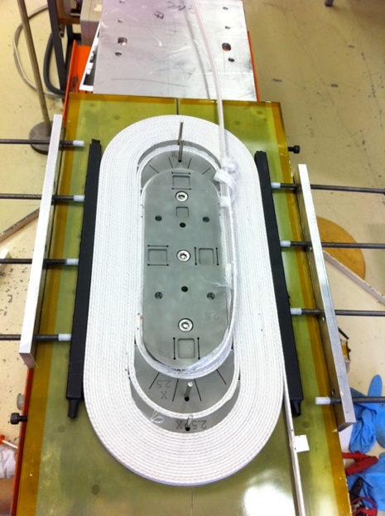
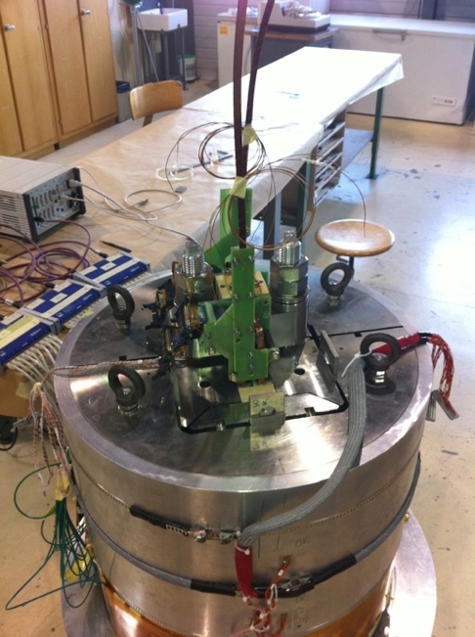
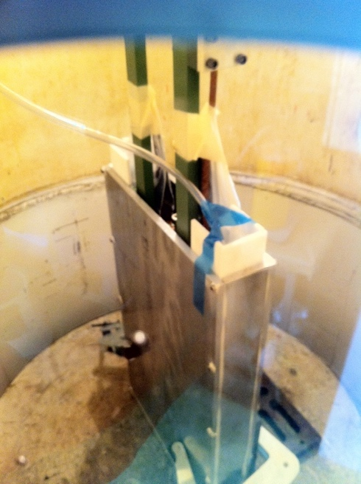
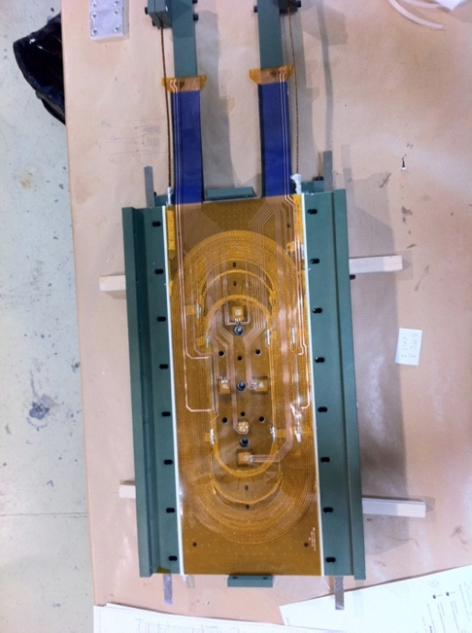
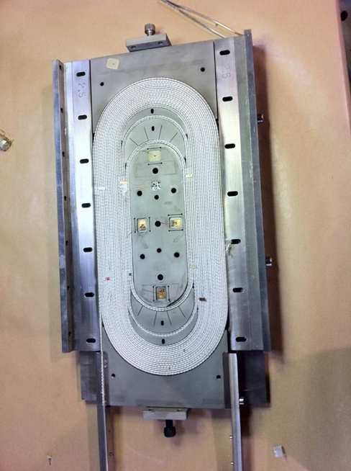
Using Nb₃Sn conductor in magnets
Nb₃Sn has to be reacted after winding for ~100 hours at 650°C (wind and react)
Cables have to be insulated with a non-organic woven insulation: glass or ceramic fibres
After reaction the coils has to be impregnated to prevent any movements and to take care that stresses are distributed, instrumentation connections are moulded in
Reacted Nb₃Sn is brittle and stress sensitive

Slide 13
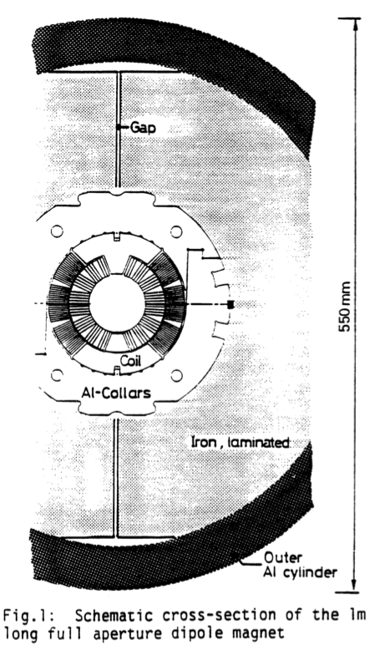
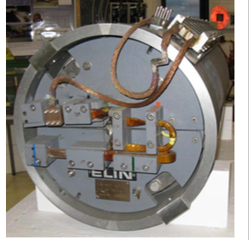
The early High Field Magnet epoch, I
LHC options: 1988-1995
CERN
In 1986 Nb₃Sn was still considered an option for the 10T LHC magnets.
The magnet by A. Asner & R. Perin in 1989 went up to 9.5 T at 4.3 K.
It used a 17 mm cable an a wind and react technology.
A single coil in a mirror reached 10.1 T.
Many problems though remained in the fabrication
Twente
In 1995 Twente constructed the MSUT that was powered up to 11.3 T.
It had a 50 mm bore, graded, 33 PIT strand PIT cables with 192 filaments.
This magnet showed that fields above 10T are feasible.
A. den Ouden, H. H. J. ten Kate et al., in Proc. of 15th International Conference on Magnet Technology, Eds. Beijing, China: Science Press, pp. 137-140, 1998.
S. Wenger, A. Asner, F. Zerobin, IEEE Trans. Mag, 25(2) 1989

Slide 14
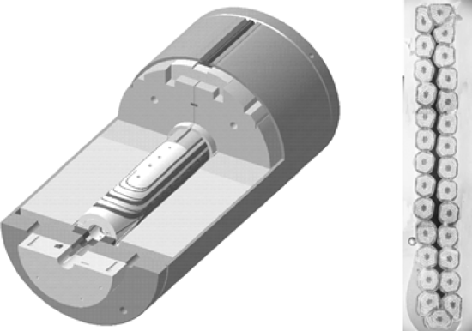
The early High Field Magnet epoch, II
Mixed results (1995-2004)
CEA quadrupole
A 210T/m @ 4.2K Nb₃Sn quadrupole as alternative to the Nb-Ti @ 1.9K design
A very difficult construction with collars done like for the Nb-Ti version
Lots was learned, only one was built, it did not reach nominal field.
FNAL 10T program for VLHC (HFDA)
Several magnets were built, reaching after long training 10T at 4.2K Rediscovery of conductor instabilities
Tough to fabricate !

Slide 15
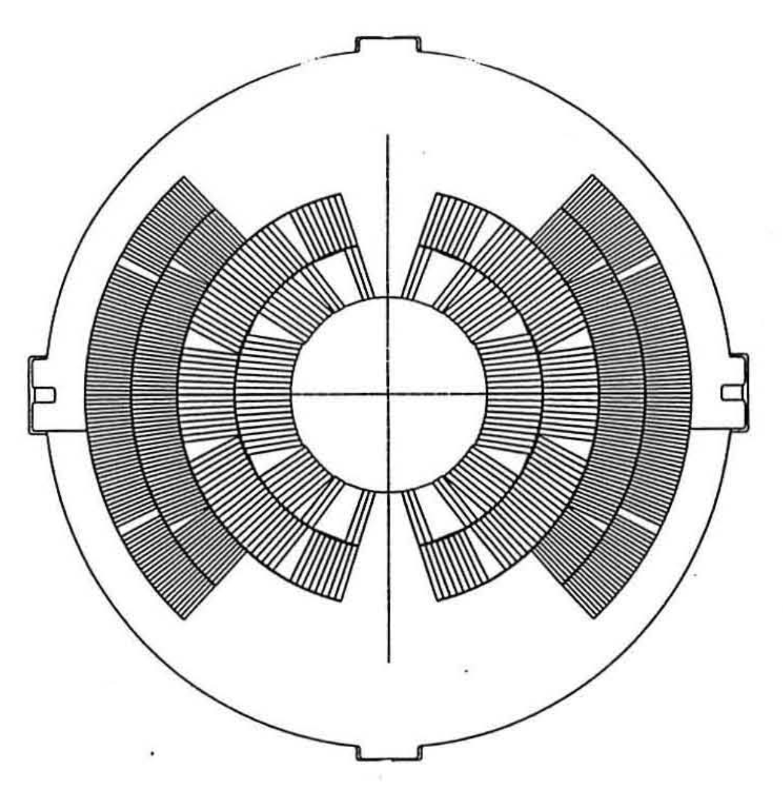
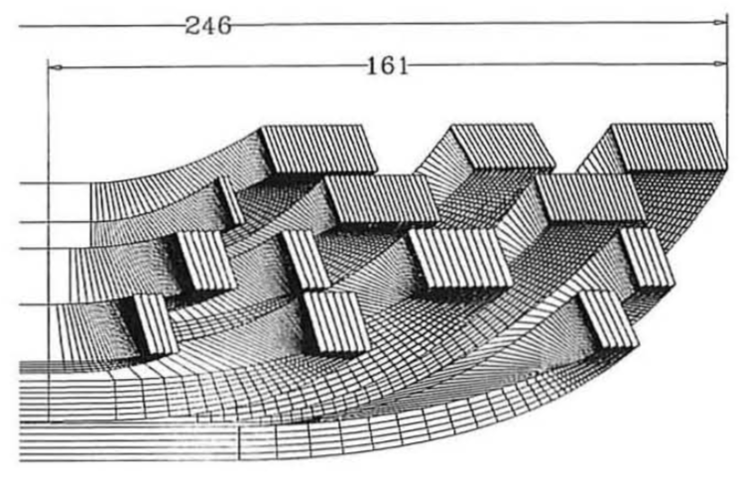

The early High Field Magnet epoch, III
Some achievements at LBNL (1995-2004)
Since 20 years LBNL is running a high field dipole development program
Some achievements:
D20, 50 mm aperture, cosQ 4 layer dipole, reached 13.5 T@1.9K
HD1, flat block coil, 8 mm aperture, reached 16 T
HD2, flared end block coil, 36 mm aperture, reached 13.8 T
These pose a clear breakthrough above 10 T with a new coil layout (block coil) and a mechanical structure aimed (shell-bladder and keys) at high fields
A.D. McInturff, et al., Proc. of PAC 1997, 3212

Slide 16
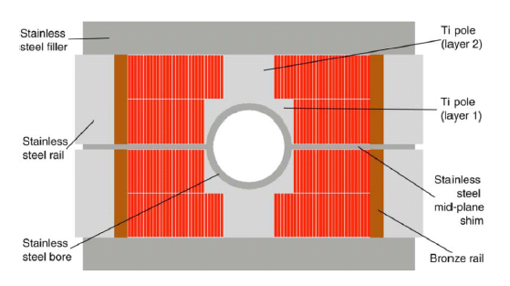
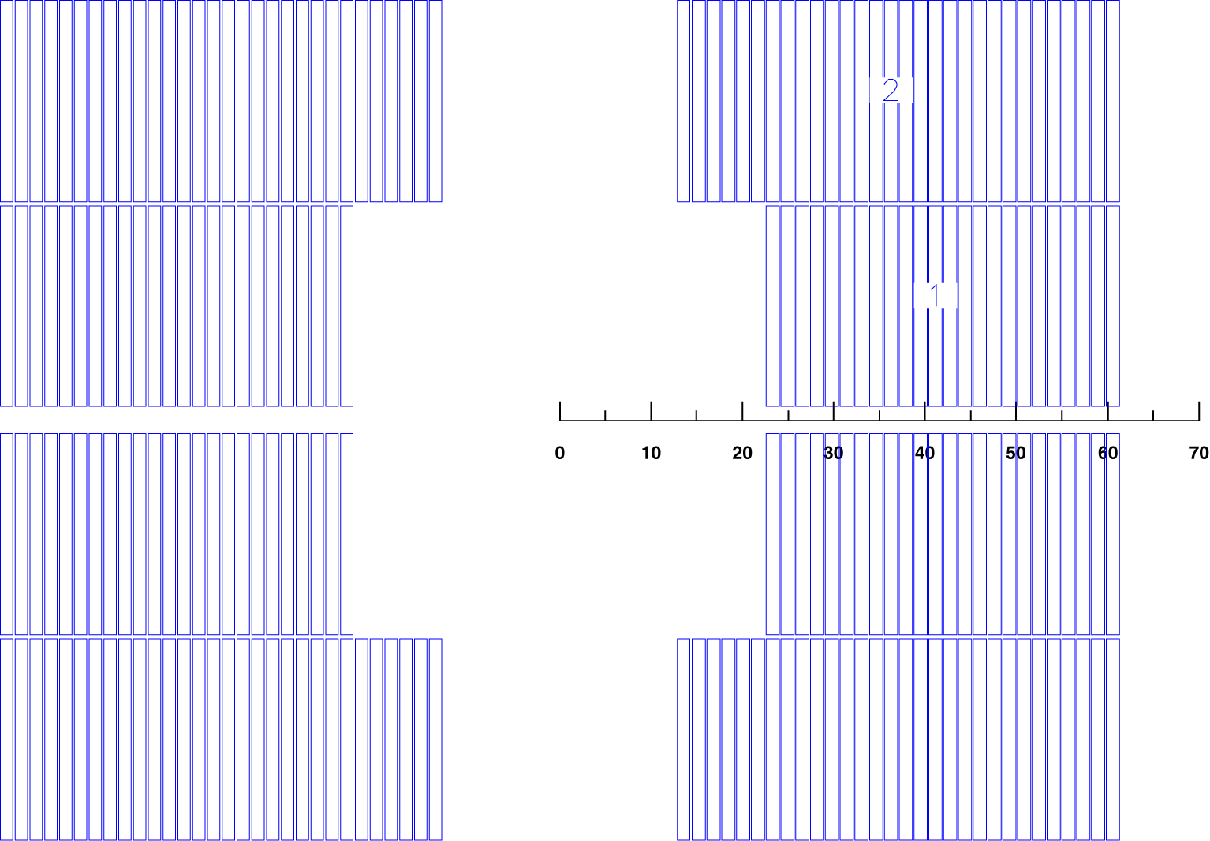

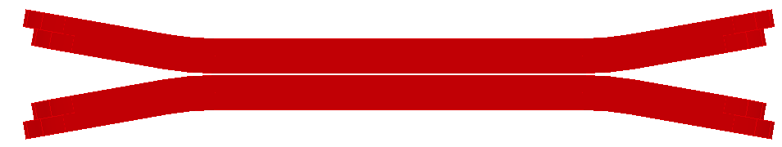
The early High Field Magnet epoch, IV
New geometry: Block coils
LBNL block coil designs
When used with wide coils the field quality is naturally homogeneous
Not yet used in accelerators
  Is less efficient (~10%) wrt to cos(Θ) for quantity of superconductor used
  The EM forces cause a stress buildup at the outside edge of the coil where the fields are lower
  The straight part is very easy : rectangular cable and wedges (field quality)
  ‘flared ends’ look easy but there is little experience making them
HD2
Courtesy LBNL

Slide 17
The early High Field Magnet epoch, V
Realizing what the challenges are
=== It should in principle be possible to go up to 16T with Nb₃Sn===
But: it will be hard to get there in a reliable way and good enough for an accelerator.
A number of issues were identified:
High J_{c} (J_{c}>1500 A/mm²) conductor is a must to reach high fields
Conductor instabilities can occur at high current and low fields with certain types of Nb₃Sn strands (high J_{c}, thick strands, big sub-elements, low RRR of the Cu stabiliser)
Insulation is tricky (650ºC reaction cycle)
Nb₃Sn stress sensitivity can be an issue and is poorly understood
Construction tooling are critical items, as important as the magnet itself
Putting a Nb₃Sn coil in a pure Nb-Ti structure does not work
The coils are very sensitive and fragile
To get up to high fields other coil geometries and force containment / pre-stress structures will be needed

Slide 18
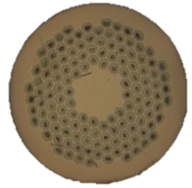
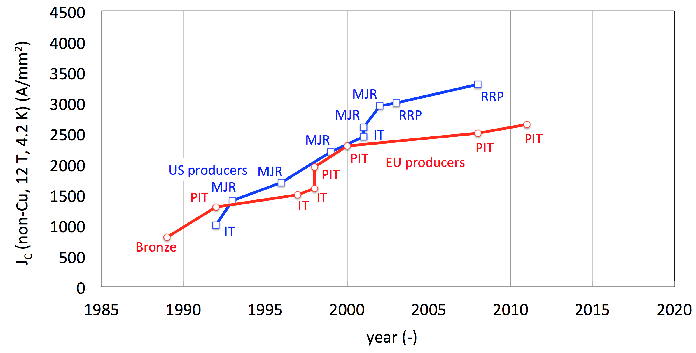
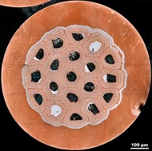
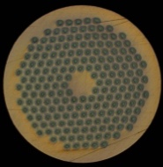
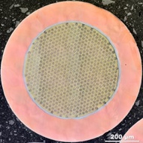



Conductor development (1998-2008)
HL-LHC
ITER
FCC specs
HL-LHC specs
CARE-NED
EuCARD
US-CDP
FCC
after 10 years of development the US and EU development gave us the Nb₃Sn conductor for HILUMI.

Slide 19
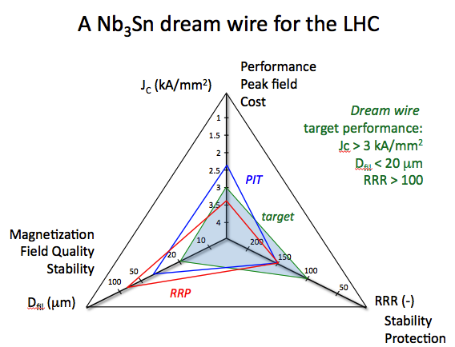
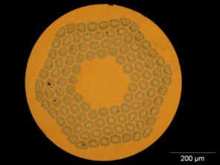
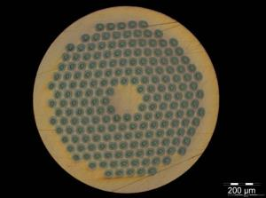
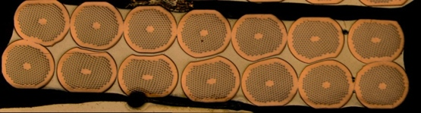
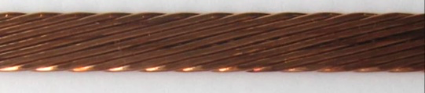
Nb₃Sn Conductor specification for HEP
0.7 mm, 108/127 stack
RRP from Oxford OST
1 mm, 192 tubes
PIT from Bruker EAS
Courtesy L. Bottura, B. Bordini
Between HL-LHC and FCC the Jc target shifts from 12 T to 16 T !

Slide 20
Basic magnet technology development for HILUMI and beyond (2004-2013) ; Europe
European programs
2004-2008 FP7-CARE-NED project (Next European dipole)
  European accelerator grade Nb₃Sn conductor ➔ Powder In Tube (PIT) conductor now available from Brucker
  Various studies on design options and materials
2009-2013 PF7-EuCARD-HFM project (High Field Magnets)
  100mm aperture 13 – 15 T Nb₃Sn dipole “Fresca2”
  HTS insert with ΔB = 6 T (inside Fresca2)
  HTS current link
  Nb₃Sn helical undulator
2008 – 2014 CERN High Field Magnet project
  Development of Nb₃Sn technology magnets for LHC upgrades and new projects (conductor, small models, materials, etc)

Slide 21
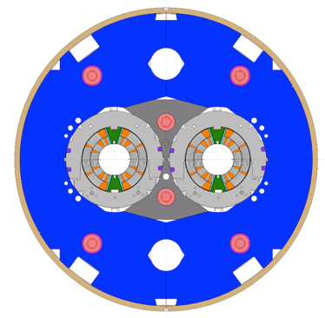
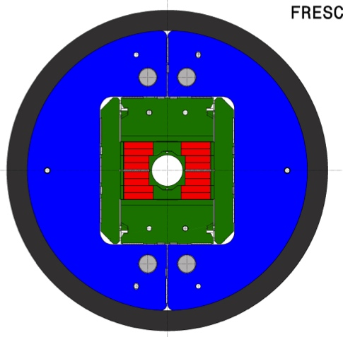
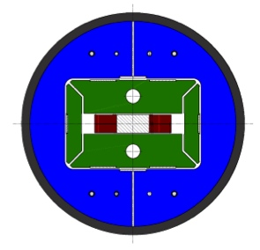
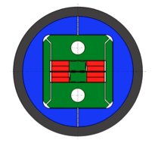
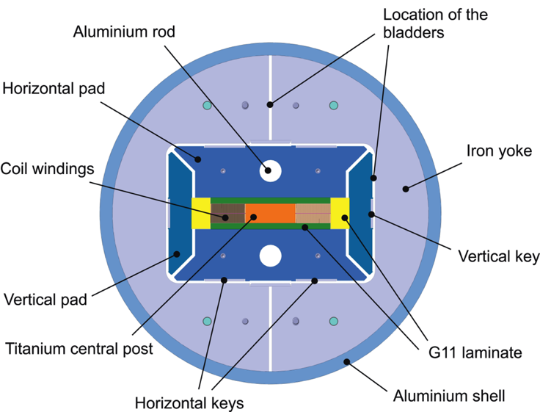
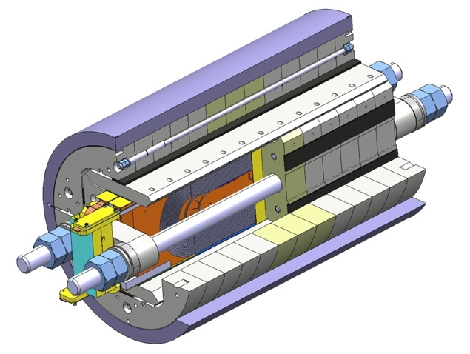
CERN-European development evolution
FReSCa2
Nb₃Sn Dipole
Short Model Coil
Race-track
Model Coil
11 T dipole
(CERN)
RMC (Racetrack Model Coil)
SMC (Short Model Coil)
FReSCa2
Horizontal Pad
Nb₃Sn Coil
Vertical Pad
Electrical connexion box
Laminated Yoke
Aluminium Shell
Longitudinal Rods

Slide 22
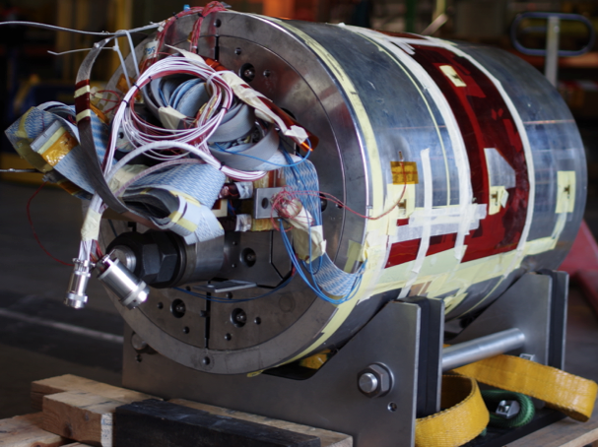
RMC3 16T: first milestone for FCC 16T !
RMC reached 16.2 T (on coil) end summer 2015 at CERN
Joining LBNL at the 16T record level
.

Slide 23
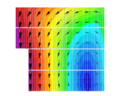
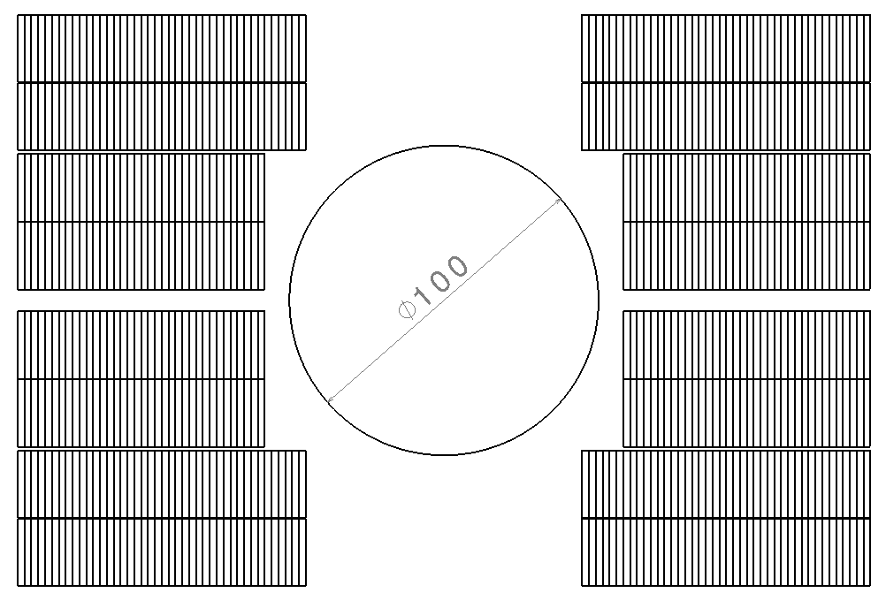
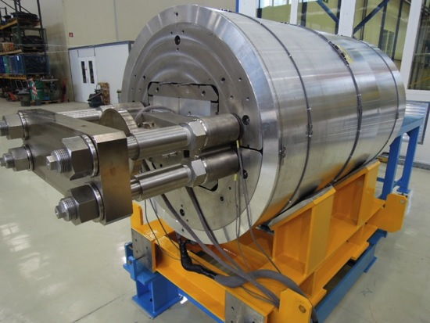
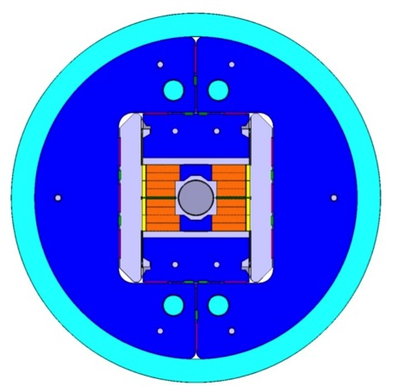
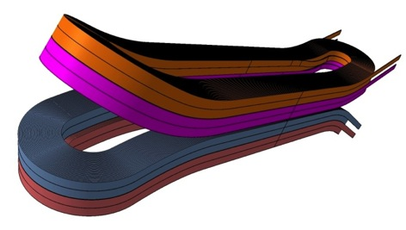
EuCARD high field dipole (FRESCA2)
FRESCA2 : CERN, CEA construction phase
First tests end 2015
156 turns per pole
Iron post
B_{center} = 13.0 T
I_{13T} = 10.7 kA
B_{peak} = 13.2 T
E_{mag} = 3.6 MJ/m
L = 47mH/m
Diameter Aperture = 100 mm
L coils = 1.5 m
L straight section = 700 mm
L yoke = 1.6 m
Diameter magnet = 1.03 m
42
42
36
36
13 T bore field (“nominal”)
  ~79% of I_{ss} at 4.2 K
  ~72% of I_{ss} at 1.9 K
15 T bore field (“ultimate”)
  86% of 1.9 K I_{ss}
Courtesy Attilio Milanese, Pierre Manil

Slide 24
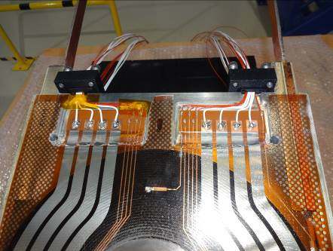
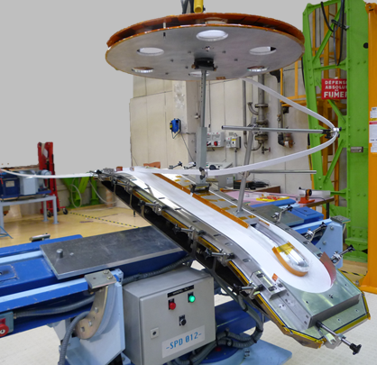
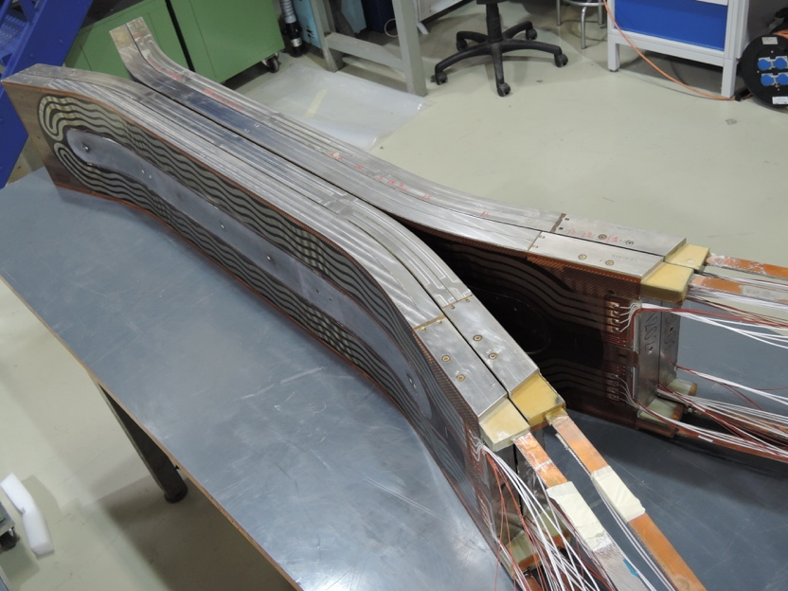
Fabrication of Fresca2 coils
Straightforward technology to wind block coils with flared ends:
This is a lesson for FCC magnets !

Slide 25
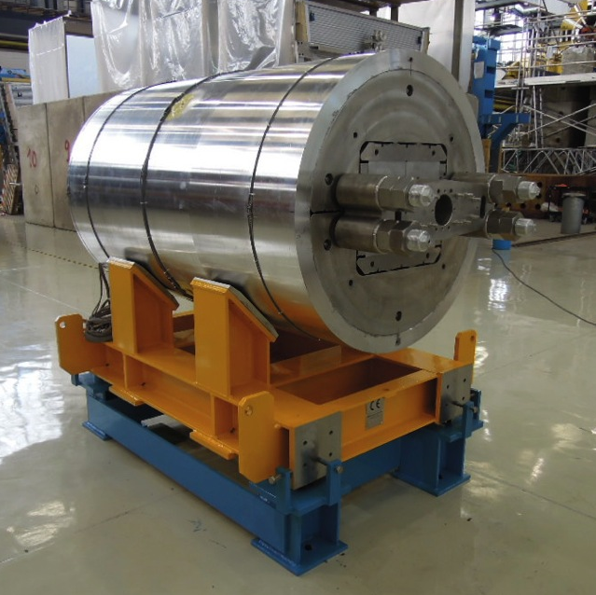
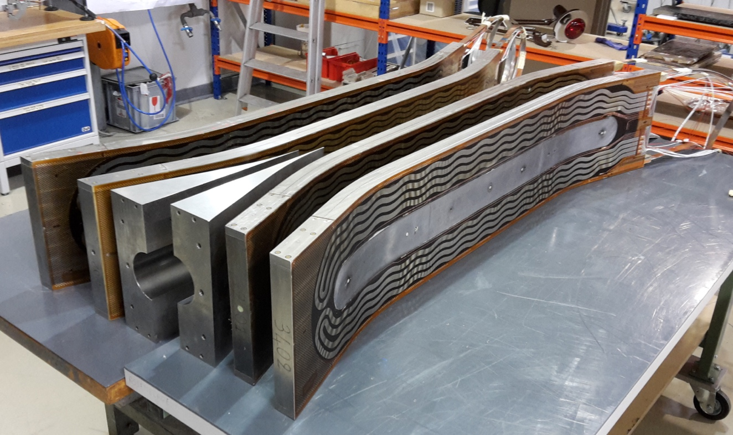
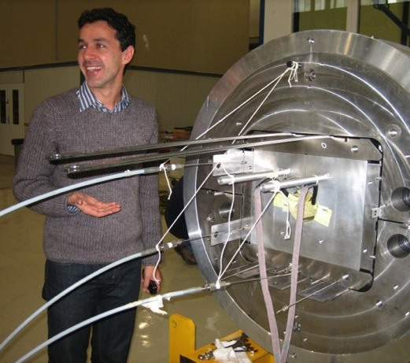
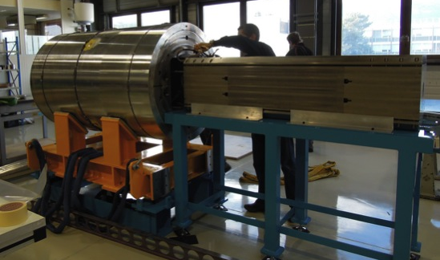
Fresca2 : the 15T FCC milestone by end 2016 ?
Magnet assembly in September, to be tested end this year
First test: 13T loading,
then warm up and loading for 15T,
Second test: go up to 15T

Slide 26
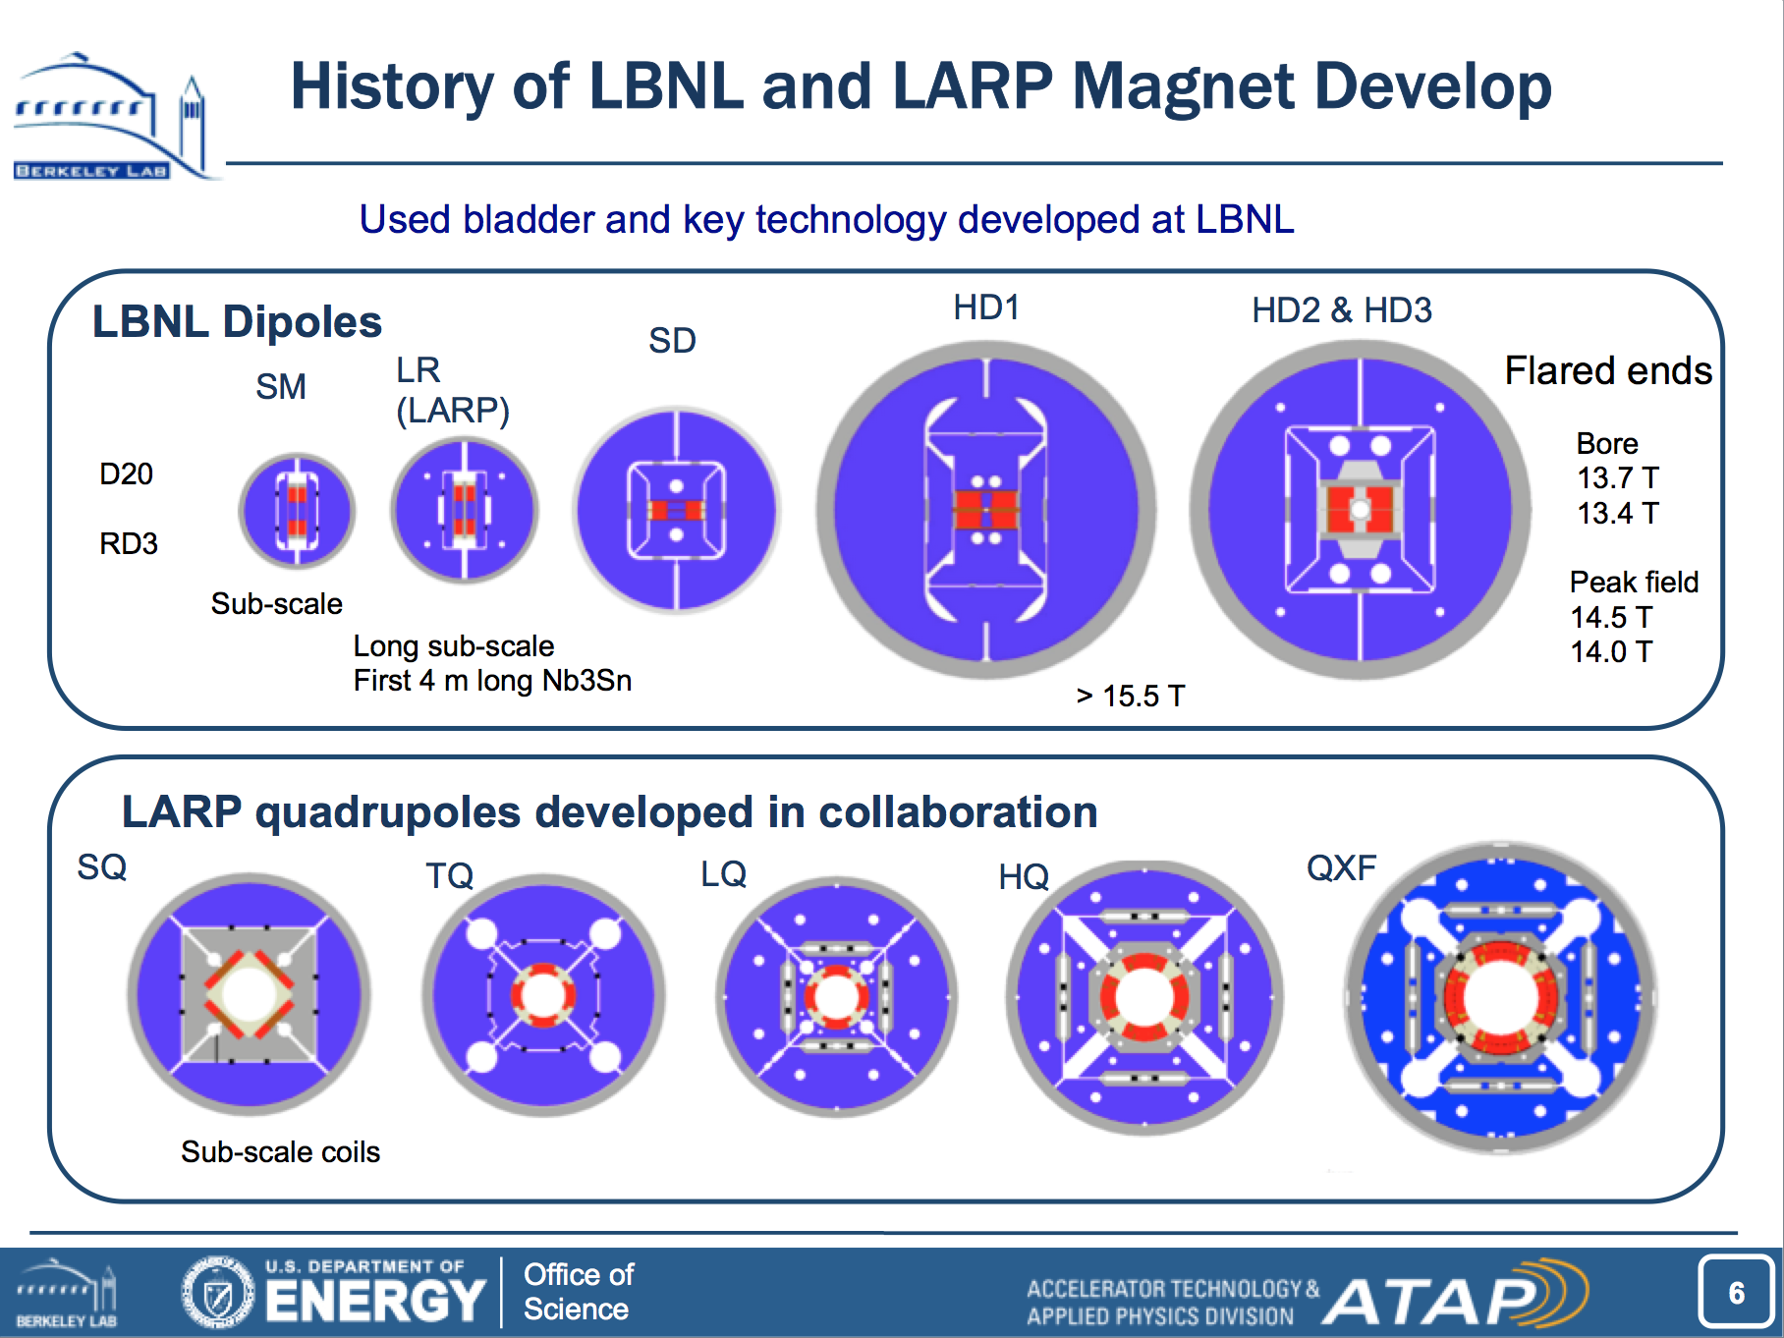
Basic magnet technology development for HILUMI and beyond (2004-2013) ; US development evolution
By courtesy of D. Dietderich, LBNL

Slide 27
Basic magnet technology development for HILUMI and beyond: Results
This phase of development gave us
  Conductor pre-FCC grade in both US and EU
  Basic coil manufacturing technology close to FCC standard
  New coil and structure geometries
2 milestones
  HD1 & RMC 16T on the coil (no aperture) Achieved mid 2015
  Fresca2 13T→15T in a large aperture end 2016 !

Slide 28

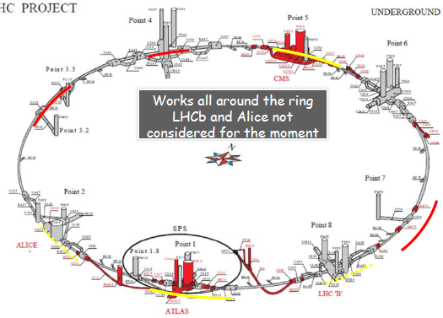
:HILUMI magnet development (2013-2016)
HILUMI means new magnets in ~1 km of the the LHC main ring
The ultimate test-bed for the feasibility of Nb₃Sn magnets in accelerators!

Slide 29



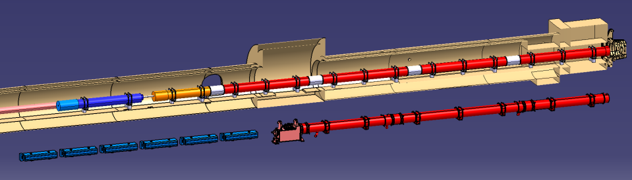






New triplet for HHILUMI
Lower β value in the interaction points : larger apertures needed in the triplet of the machine (from 70 mm to 150 mm)
Q2a
Q1
Corrector
Package
Q2b
Q3
SC D1
NC D1
Present triplets
Q4
CC
D2

Slide 30

HILUMI IT magnet zoo
Courtesy E. Todesco

Slide 31






LHC IP Quadrupole design and technology evolution
Aperture (optics)
70
90
120
150
Courtesy L. Bottura

Slide 32





HL-LHC: MQXF low beta Nb₃Sn quadrupole
Spring 2016 the first model achieved the nominal and ultimate field at FNAL !
A CERN LARP collaboration.
Nominal Gradient 132.6 T/m
Aperture diameter 150 mm
Peak Field 12.1 T
Current 17.5 A
Loadline Margin 20% @ 1.9 K
Stored Energy 1.32 MJ/m
By courtesy of G. Ambrosio (FNAL), P. Ferracin (CERN et al)

Slide 33





HILUMI: The 11T Dipole Two-in-One for DS
Create space in the dispersion suppressor regions of LHC, i.e. a room temperature beam vacuum sector, to install additional collimators (TCLD), (needed to cope with beam intensities that are larger than nominal, such as in the HL LHC)
Replace a standard MB by a pair of 11T dipoles (the 11T dipole is also called MBH)
By-pass cryostat
15660 mm
11 T dipole cold mass
Interconnect
Space for Collimator

Slide 34


HL-LHC: 11 T Dispersion suppressor magnet
First Nb3Sn magnet to go into an accelerator (2019) !
Present model program (CERN and FNAL)
  demonstrated the required performance (11.25 T at 11850 A) and Achieved accelerator field quality
Nominal Field 11 T
Aperture diameter 60 mm
Peak Field 11.35 T
Current 11.85 kA
Loadline Margin 19.7% @ 1.9 K
Stored Energy 0.96 MJ/m

Slide 35
conclusion from previous and running programs
We now have all the elements in hand to develop 16T magnets
  11 T dipoles: we have working models (at CERN and FNAL)
  12 T quadrupoles: we have working models (made together by LARP and CERN)
  We showed 16T is feasible on flat coils (at LBNL and CERN)

Slide 36

FCC development (2014 - ... )
Geneva
PS
SPS
LHC
LHC
27 km, 8.33 T
14 TeV (c.o.m.)
HE-LHC
27 km, 20 T
33 TeV (c.o.m.)
FCC-hh
80 km, 20 T
100 TeV (c.o.m.)
FCC-hh
100 km, 16 T
100 TeV (c.o.m.)i

Slide 37






FCC: Magnet design for 16 T dipoles, LTS Nb₃Sn
P. McIntyre, 2005
E. Todesco 2013
D. Schoerling 2015
Blocks
J.M. Van Oort, R. Scanlan, 1994
Cos-θ
Common coils
Canted Cos-θ
R. Gupta, 1997
E. Todesco, 2013
GL. Sabbi, 2014
S. Caspi, 2014

Slide 38











US program lines
cos-θ
canted-cos-θ
common coils
2017
5T Nb-Ti
2014-2015
10T Nb₃Sn
2015-2016
2018
2016

Slide 39





FCC plan for 16T baseline
Real estate
Pinning
Conductor R&D
ERMC
RMM
Opportunity for prototypes built in industry
16 T models

Slide 40








EuroCirCol Program for FCC 16 T dipole
Complete conceptual design and select a baseline for the FCC accelerator dipole
Engineering design of the FCC accelerator dipole (assuming high-performance wire)
Engineering design of 16T dipole model for the following R&D program (assuming existing wire performance)^{(*)}
Manufacturing folder for 16 T dipole model
Manufacturing folder for the 16 T dipole model construction tooling^{(*)}
Japan
KEK
WP 5
Finland
TUT
Netherlands
UT
France
CEA
CERN&UNIGE
Italy
INFN
Spain
CIEMAT

Slide 41

FCC Nb₃Sn performance targets
D_{strand}: 0.5…1 mm
J_{C} (16 T, 4.2 K) > 1500 A/mm²
μ₀ΔM (1 T,4.2 K) <150 mT (D_{fil} < 20 μm)
RRR > 150
UL > 5 km
Cost(16 T, 4.2 K) < 5 USD/kAm
Large cables, cabling !
Field quality
Stability, protection
ITER material cost per kg
All single parameters are in reach, their combination is the challenge !
Ultimate Nb₃Sn ? Pursue the idea of improved high field pinning
(D. Dietrich and R. Scanlan, A. Godeke)

Slide 42














FCC Conductor R&D Program
Four year’s program (2016-2019) focused on the increase of J_{C}(16 T, 4.2 K) ≥ 1500 A/mm2 with high RRR ≥ 150
At this stage all “expedients” are considered: maximize Nb₃Sn fraction, grain refinement, APC
Worldwide R&D, coordinated by national institutes:
  EU – CERN: BEAS (partly in preparation)
  JA – KEK: SH Copper, Furukawa, JASTEC; Tohoku University, NIMS
  RU – Bochvar: TVEL
  KO – KAT: Kiswire
Material characterization and advanced analysis
  EU – Technisce Universitaet Wien (Atominstitut)
  US – ASC at NHMFL

Slide 43




FCC: 16T dipole options
Block coil
Cos-theta coil
Common coils
C. Lorin, M. Durante (CEA)
S. Farinon, P. Fabbricatore (INFN)
F. Toral (CIEMAT)

Slide 44
FCC 20T option: HTS program
Early phase: EuCARD HTS insert magnet (2009 – 2016)
First step to an HTS accelerator magnet: EuCARD2 (2013 – )
  10kA rated ReBCO cable (Roeble cable)
  5T stand alone accelerator quality ReBCO magnet
We are now starting a long term HTS magnet development program at CERN and collaborating institutes (2016 – 2024)

Slide 45

FCC 20T option: HTS program
Preliminary HTS magnet development program
Courtesy , J. van Nugteren, CERN

Slide 46



  EuCARD2 5T accelerator quality ReBCO magnet
5 Tesla stand alone, (18 T–20 T in 13 T background or other), @ 4.5K, 40 mm aperture, 10 kA class cable, Accelerator Field quality
http://eucard2.web.cern.ch/

Slide 47



Feather0 - Feather-M2.0
Feather0: First coil in the test station
Feather2: winding of first coil with dummy cable in progress

Slide 48


Synergy programs
16 T LTS and 20 T HTS accelerator dipoles and associated technologies
ISBN: 978-0-309-28634-3
30 T (NMR) to 60 T (user facilities) HTS solenoids
By courtesy of S. Gourlay (LBNL)

Slide 49













Conclusions
LHC Run-II provides results to define future HEP roadmap (European Strategy 2018)
HL-LHC demonstrates large-scale use of Nb₃Sn
End of LHC useful life
Accelerator-grade HTS 5 T demo
2015
2016
2017
2018
2019
2020
2025
2030
2035
2040
12 T accelerator technology
16 T magnet model(s)
20 T magnet model(s)
16 T accelerator technology
FCC CDR (EuroCirCol) propose a new energy frontier accelerator
FCC construction decision

Slide 51
FCC-hh magnet parameters
 | B / G (T) / (T/m) | B_{peak} (T) | Bore (mm) | Length (units x m)
MB | 16 | 16.4 | 50 | ≈4500 x 14.3
MQ | 450 (> 350) | 13 | 50 | ≈800 x 6
MQX | 225 | 13 | 100 (<150)
MQY | 300 | 13 | 70
MBX | 12 | 12.5 | 60 | (4x2) x 12
MBR | 10 | 10.5 | 60 | (4x3) x 10
Inter-aperture distance ≈ 250 mm
Yoke diameter ≤ 700 mm
Stray field ≤ 100 mT

