Slide 1
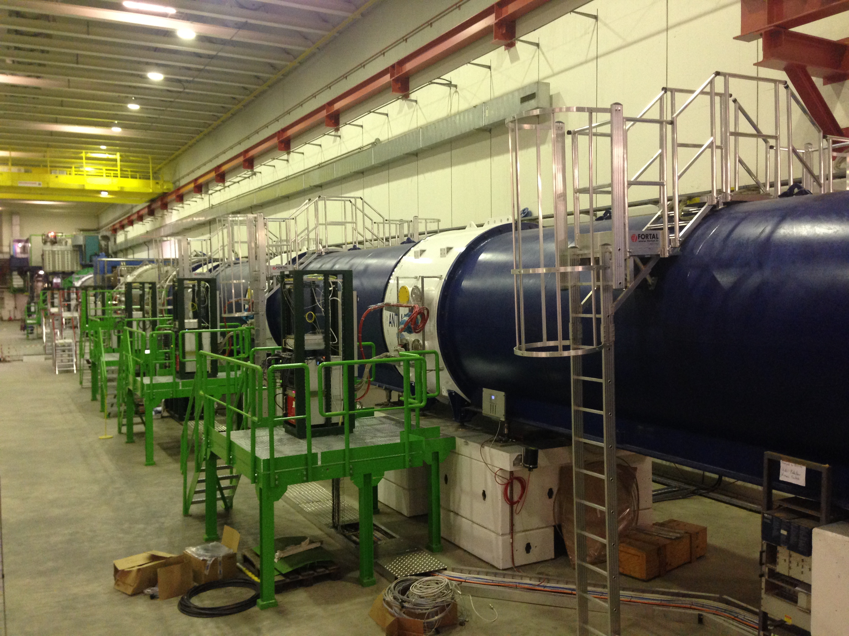
Vacuum controls of the NA62 experiment
Fernando Mateo TE-VSC-ICM

Slide 2
Introduction
Experimental layout
Vacuum equipment layout
Controls architecture
Control crates
Racks layout
Interlocks
Software
PVSS SCADA application
Commissioning

Slide 3
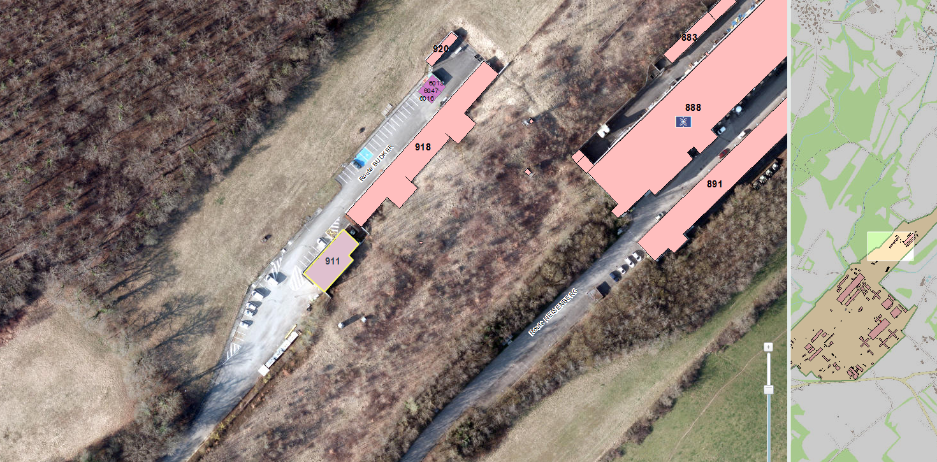
Introduction
NA62 is a fixed target experiment in the SPS North Area to study very rare decays of Kaons. It is a follow-up experiment of NA48 and it reuses a large amount of its equipment.
LOCATION:
SPS North Area (Bld. 911 – 918. Site of Prévessin)

Slide 4
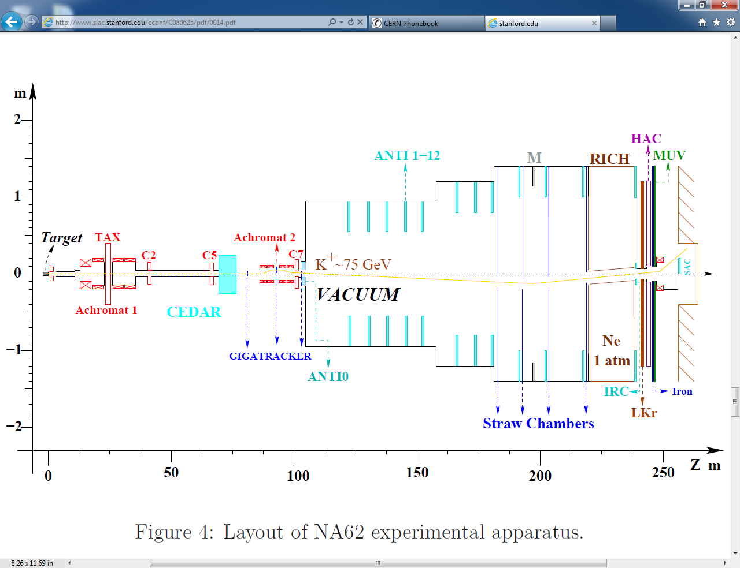
Experimental layout
Vacuum sectors:
T10 →TAX
TAX → CEDAR
CEDAR → Fast Gate Valve (99m)
Fast Gate Valve → Gate Valve (105m)
Decay volume + RICH (105m-240m)
LKr-Monotube (240m-243m)
Gate Valve → Dump & SAC

Slide 5
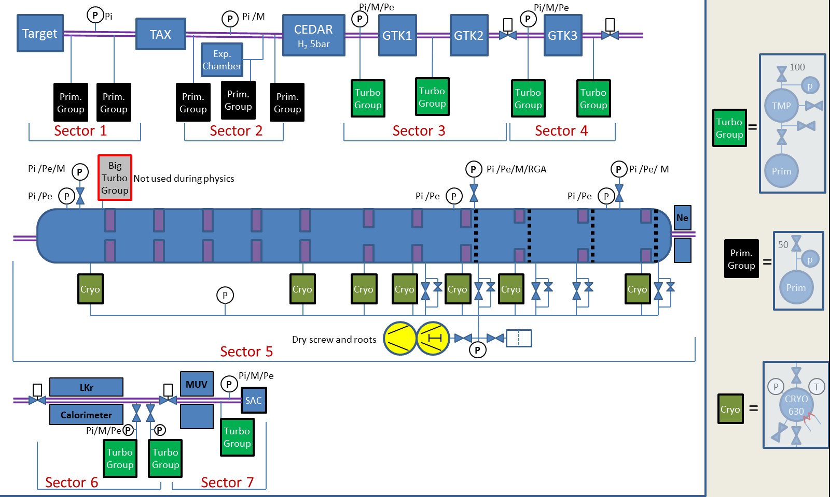
Vacuum equipment layout
Passive gauges,
no Profibus
Active gauges, no Profibus
Active gauges, Profibus
> 200 intruments (gauges, valves, pumps)
Vacuum layout : EDMS 1281885
Instruments list: EDMS 1790075

Slide 6
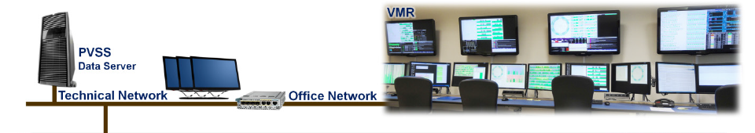
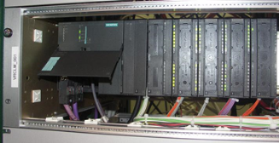
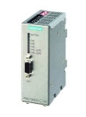
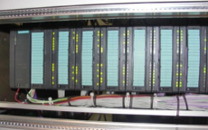

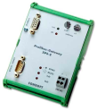
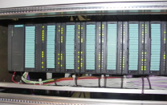
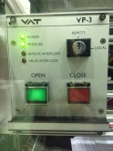
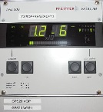
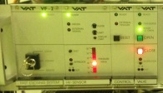



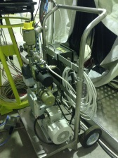
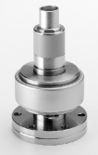
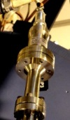
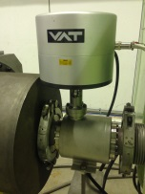
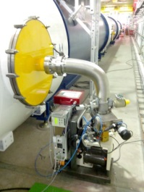
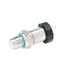

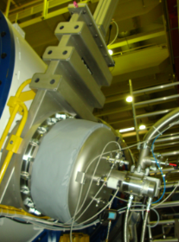
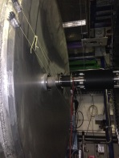
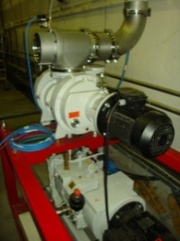

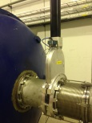
Controls architecture
Optical network
Profibus I / A / T
PLC master (VRLMS)
OLM (VRJCP006)
OLM (VRJCP006)
Remote I/O (VRLRG)
Remote I/O (VRLRG)
Remote I/O (VRLRG)
Profibus gateway (VRJCP007)
Remote I/O (VRLRG)
Fast valve controller (VRVRC)
Primary pump controller (VRPPH)
Turbo group controller (VRPGMF)
Cryo group controller (VRPYA)
DA valve controller (VAT_VP3)
VRGPT300
…
VGMB
VGM / VGF
VGPA
VGRA
Fast valve (VVQ)
Special DA valve (VVX)
Primary group (VPGR)
Roughing pumps (VPR)
Turbomolecular group (VPGT)
VGF
VV
Cryogenic group (VPGC)

Slide 7
Control crates
Commercial crates
CRATE STANDARD NAME | DESCRIPTION | UNITS
VRPP | Primary pump local crate | 5
VRVRC | VAT VF-2 Fast Valve Controller | 1
VRGPT300 | Gauge controller | 5
VAT_VP | Dual acting valve controller | 2
VRPYA | HSR PCA700C Cryo controller | 7
Custom-made crates
CRATE STANDARD NAME | DESCRIPTION | UNITS
VRLMS | PLC Master | 1
VRLRG type a | PLC Remote I/O station type a | 1
VRLRG type b | PLC Remote I/O station type b | 1
VRLRG type c | PLC Remote I/O station type c | 1
VRLRG type d | PLC Remote I/O station type d | 1
VRPGMF | Turbo pump controller | 8
VRPPH | Primary pump controller | 2
VRJTB | Turbo pump patch panel | 5

Slide 8
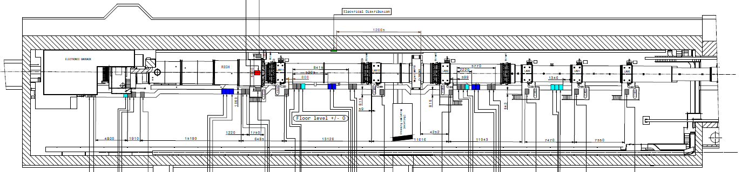
Racks layout
ECN3 cavern. Positions of VAC racks measured from T10 target.
Z (m)
VAC-06 (240.6m)
VAC-05 (215m)
VAC-04 (190m)
VAC-03 (177.2m)
VAC-02 (176.6m)
VAC-01 (176m)
FO patch panel
Remote I/O
Cryo pump controller
Primary pump controller
Remote I/O
Turbo pump controller
Cryo pump controller
Primary pump controller
Turbo pump controller
Cryo pump controller
VF2 Fast Valve controller
Cryo pump controller
Turbo pump controller
TPG300
VAT VP3
VAT VP3
TPG300
Cryo pump controller
Turbo pump controller
UPS
OLM
OLM
OLM
Turbo pump controller
Cryo pump controller
Cryo pump controller
Remote I/O
TPG300
Profibus
gateway

Slide 9
Interlocks
TYPE | NAME | DESCRIPTION
IN | NA62.DiEnablePumpS2S3 | Pumping Enable for Sector 2 and 3 (if no CEDAR window rupture)
IN NOT AVAILABLE!! | NA62.DiEnableVentS2S3 | Venting Enable of Sector 2 and 3 (if CEDAR at atmosphere pressure). CEDAR vacuum status on DIP published safety information.
OUT | NA62.DoAlrS2S3VacOk | Enable Inside CEDAR pumping (if S2 and S3 are under vacuum)
OUT | NA62.DoAlrS3S4VacOk | Enable GTK cooling (if S3 and S4 are under vacuum)
OUT | NA62.DoAlrS5HvOk | Enable High Voltage on LAV (if S5 atmosphere or under high vacuum)
OUT | NA62.DoAlrS5RichOk | Enable Inside RICH pumping (if S5 is under vacuum)
OUT | NA62.DoAlrS7HvOk | Enable High Voltage on SAC (if S7 atmosphere or under high vacuum)

Slide 10
Software
Many PLC functions have been reused from other systems (LHC):
  Primary groups
  Turbo groups
New functions have been developed for:
  Cryo controllers
  Profibus gauges
  Specific interlocks (HW/SW)

Slide 11
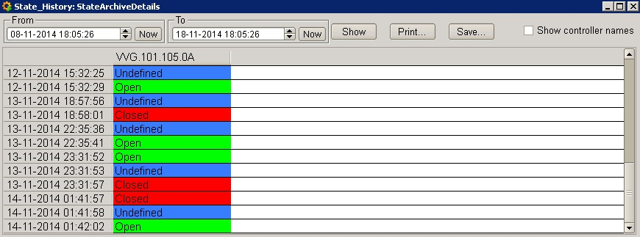
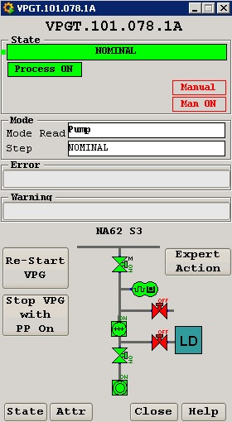
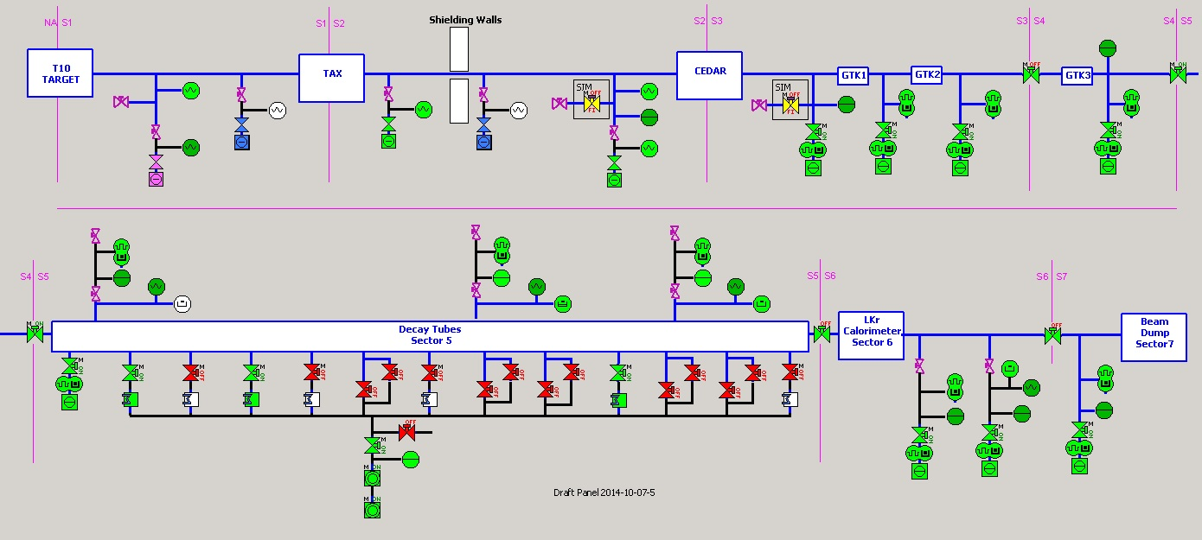
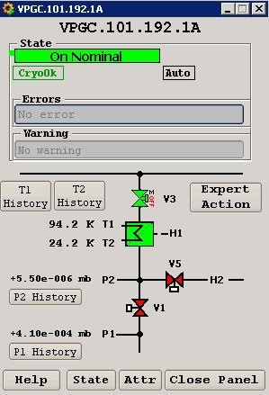
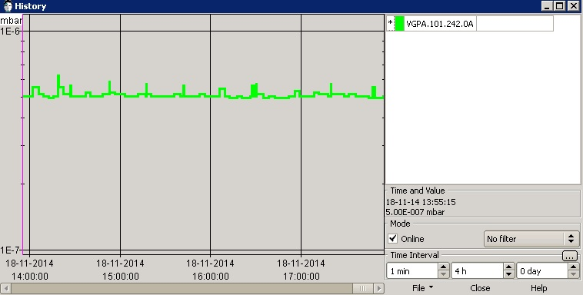
PVSS SCADA application
All vacuum equipment has been included in VacDB.
The PVSS application was developed in WinCC OA.

Slide 12
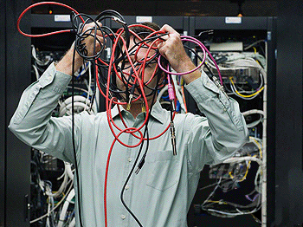

Commissioning
June 2014:
Fiber optic network test. Communication with PLC master.
Roughing pumps test. Communication with VRPPH controllers.
July 2014:
HW commissioning & leak test of blue tube
Profibus network test
September-October 2014:
Full pump-down with remote control system
Interlocks test
November-December 2014:
Documentation
Issues found and solved: bad connectors/cables, conventions mismatchs, cabling errors inside crates, profibus instabilities…

Slide 13
Conclusions
NA62 was a challenging experiment which involved dealing with a large variety of equipment and required the collaboration of several groups and sections of CERN.
Vacuum controls were a success: robust vacuum and nominal pressures achieved in all sectors.
Interlocks are fully operational.
The planning was strictly followed and deadlines were respected.
Few things to fix:
  Membrane gauge transfer function correction.
  Add relay boxes for VAT VP-3 controllers.
  Extra interlocks to be implemented? (2015 technical stop).
  Backup primary groups to be installed in sectors 1-2.
  Reorganize racks cabling, etc.

Slide 14
Thank you!
Special thanks to:
Abel / Rodrigo / Sebastien / Berthold Jenninger for support during commissioning.
Sebastien / Rodrigo for PLC software development.
Victor de Jesus (EN-MEF) for equipment installation.

