Slide 1
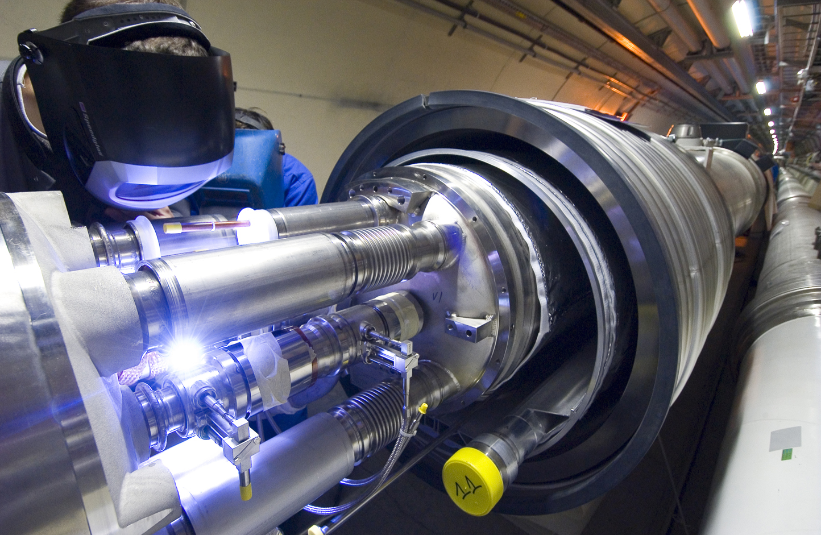
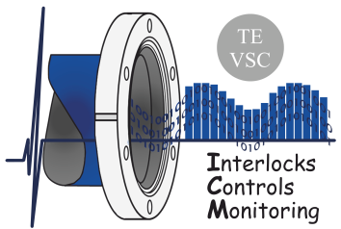

PLC DEVELOPMENTS FOR NEW VACUUM DEVICES IN THE
LHC AND NA62
TE-VSC-ICM Automation Forum
João Rodrigo Alvelos Ferreira
20th November 2014
TE-VSC-ICM

Slide 2
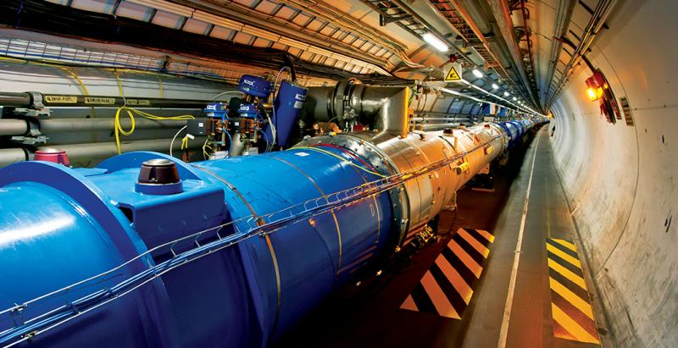
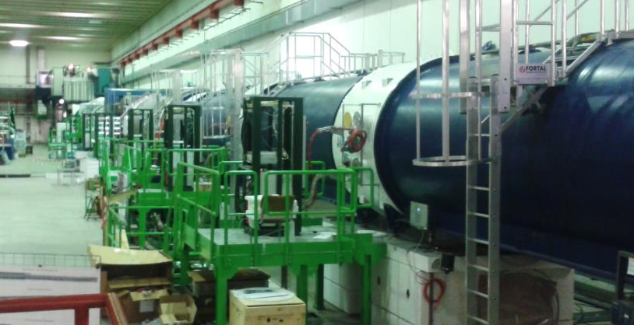
SUMMARY
LARGE HADRON COLLIDER
Cryogenic Interlocks for the Sector Valves
Control devices for the new NEG Pumps in the LSS
Controls devices for the new Thermocouples in the warm magnets
8DI_FE interlock monitor
NA62 EXPERIMENT
Control devices for the Cryogenic Pumps in the main tube
Control device for the Pulsed Valve VAT-VP3 controller
Control device for the Pfeiffer MPT-200 Full Range Gauge (DP)
ALARM_DO interlock generator

Slide 3
CONTROL DEVICES FOR THE LHC

Slide 4
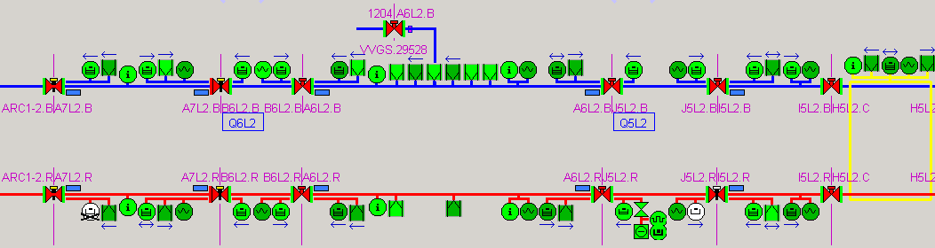
LHC | Sector Valve Cryogenic Interlocks
The LHC Sector Valves isolate the different vacuum sectors in the LHC. They are currently interlocked with the adjacent Sector Valves and local pressure and temperature values.
A new software interlock had to be implemented, closing the sector valves in case of temperature rise in the cryogenic system, which might lead to a pressure rise.

Slide 5
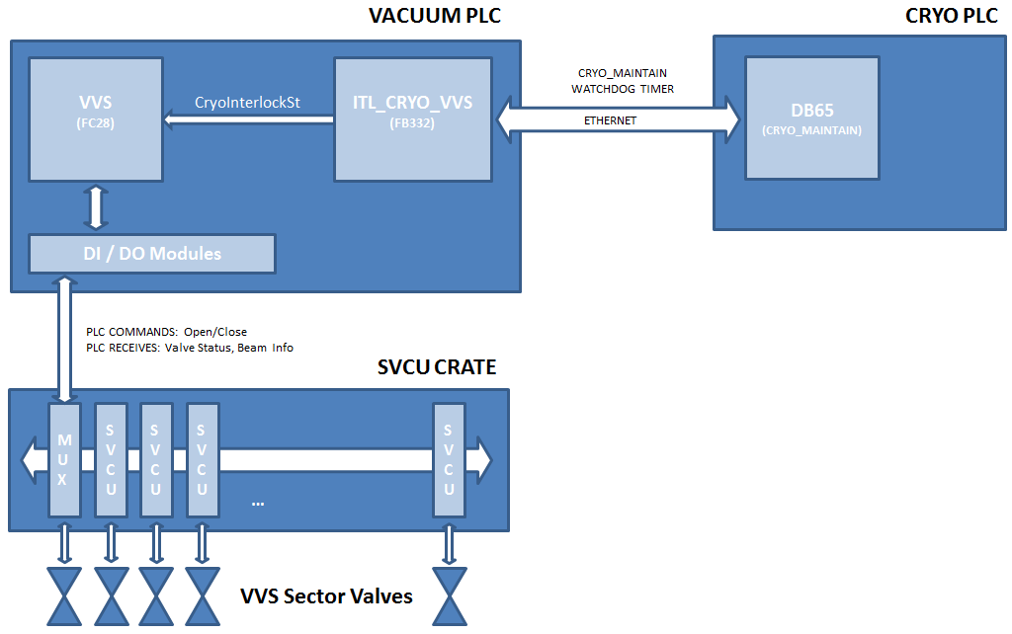
LHC | Sector Valve Cryogenic Interlocks
ITL_CRYO_VSS only produces a valid interlock signal in case there is no problem detected with the ethernet connection and the watchdog has increased
VVS will only close the valves in case the CLOSE_ENABLE bit is set (meaning that there is no chance the beam could be circulating)
Physical/Control Architecture of the SVCU sector valves cryogenic interlock

Slide 6
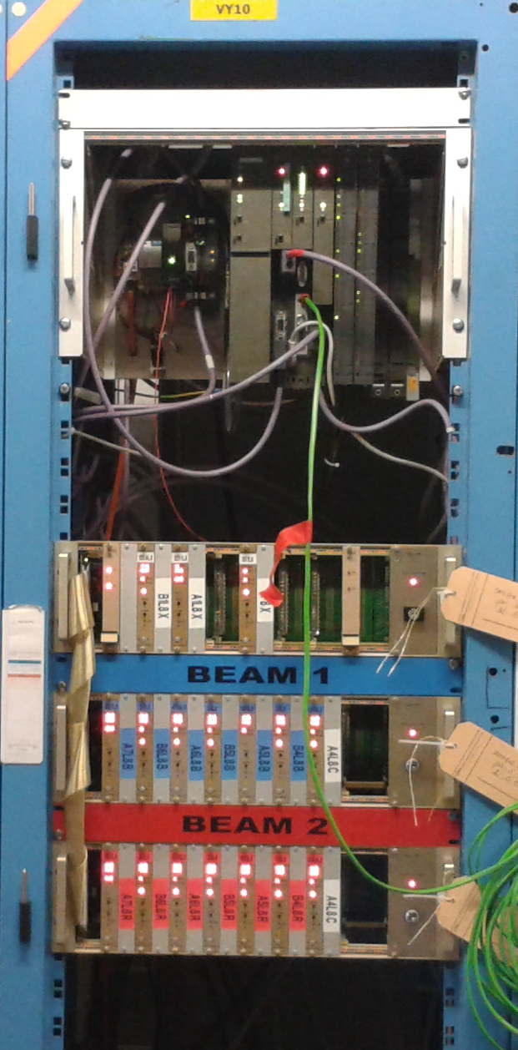
LHC | Sector Valve Cryogenic Interlocks
Reverse engineer the communication protocol between PLC and SVCU cards, in order to understand how to send commands (DONE)
Implement new code to obtain and process the CRYO_MAINTAIN signal from the Cryogenic System PLCs (DONE)
Implement the new interlock input and logic in the existing SVCU PLC control block (DONE)
Test the system in the lab (DONE)
Implement all the interlocks and deploy the solution to the LHC PLCs (WAITING FOR PERMISSION TO TEST ON THE LHC AND IMPLEMENT IN PRODUCTION)
SVCU Crates in the LHC

Slide 7
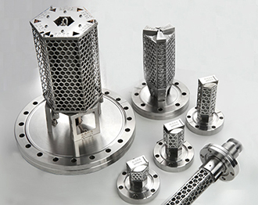
LHC | NEG Pumps
Getter pumps were installed during the LS1 in order to increase the pumping speed in the Long Straight Sections in the LHC.
These are essentially NEG cartridges, a material that once activated helps complete or maintain ultra high vacuum by adsorpting small ammounts of gas. The NEG is activated by being heated to a suitably high temperature, for a defined time.
NEG Cartridges
A control system must be developed to remotely activate the pumps once they’re installed in the LHC. Activation must be performed under certain conditions (the NEG must be under vacuum) and remotely monitored through the Vacuum SCADA.

Slide 8
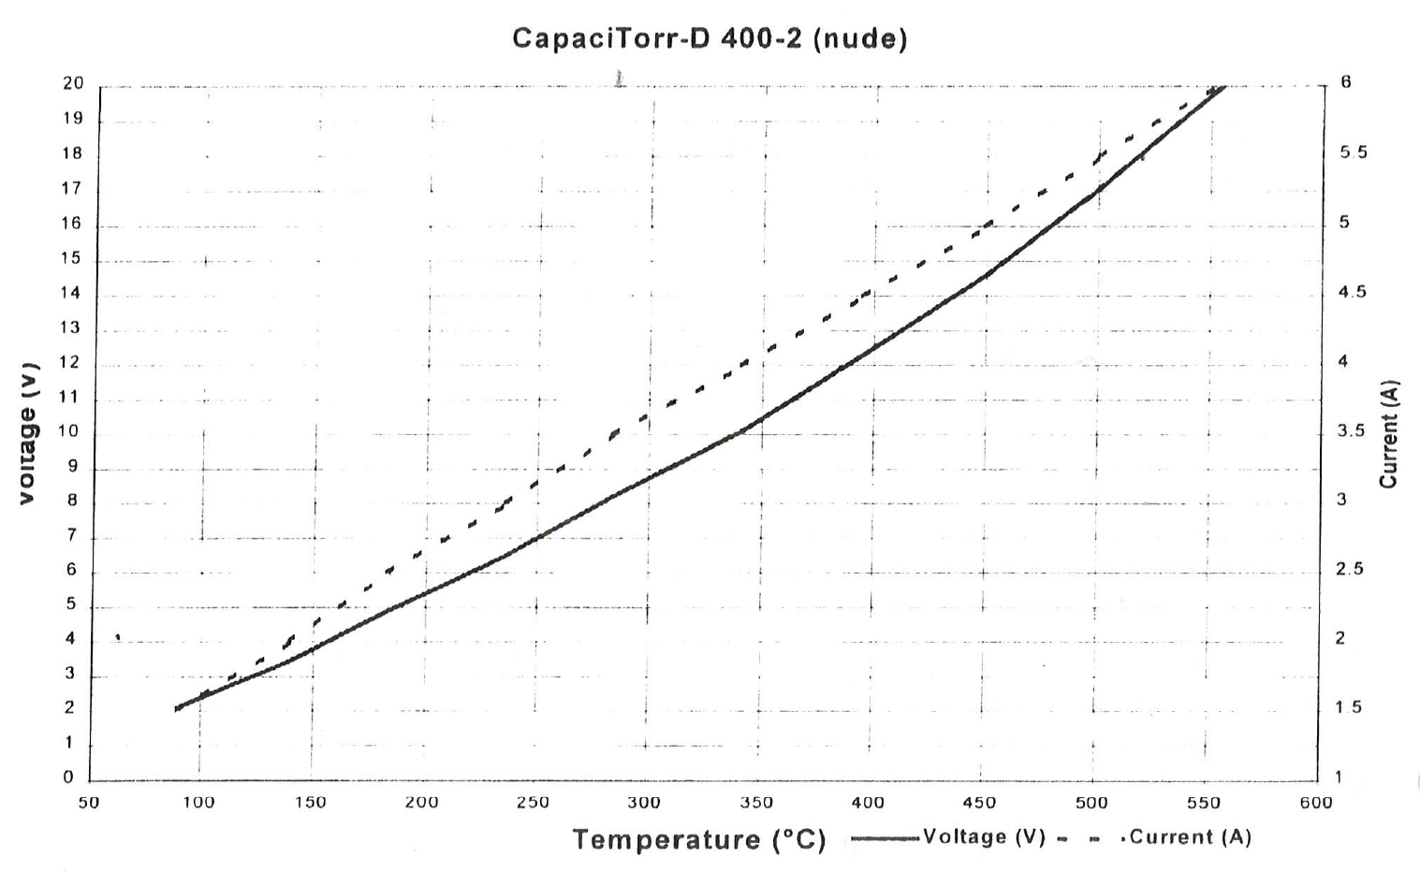
LHC | NEG Pumps
16 Volt for 60 minutes

Slide 9
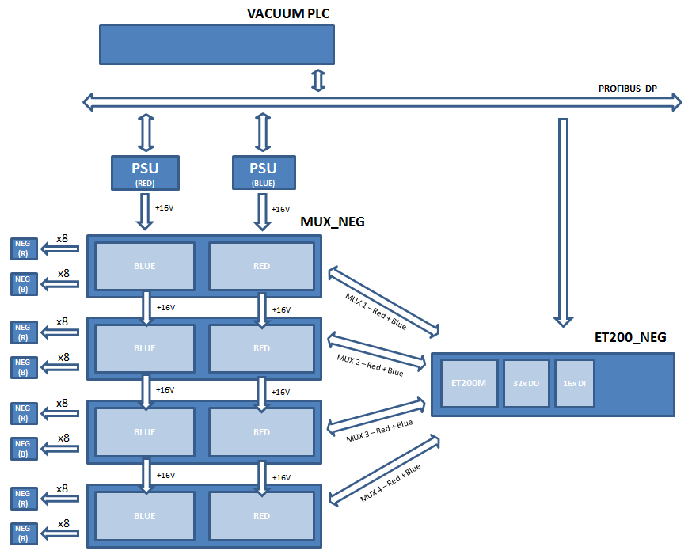
LHC | NEG Pumps
Physical Architecture of the NEG Pumping System

Slide 10
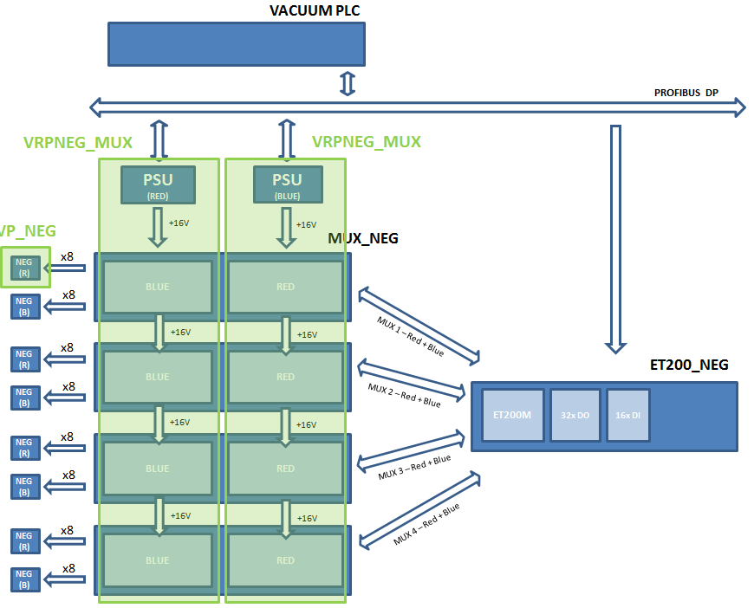
LHC | NEG Pumps
Control Architecture of the NEG Pumping System

Slide 11
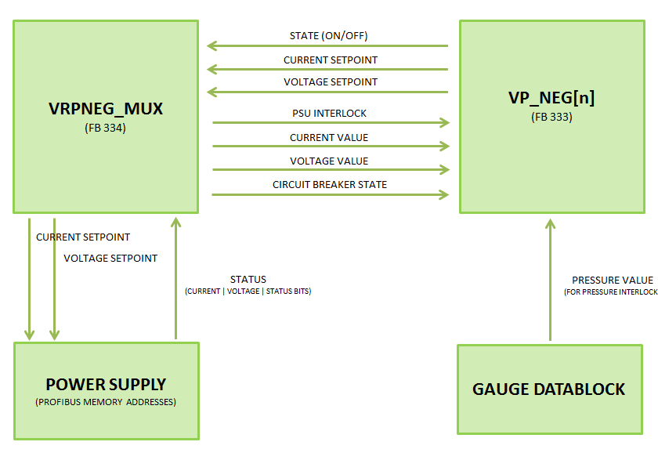
LHC | NEG Pumps
Block communication in the NEG pumping system

Slide 12
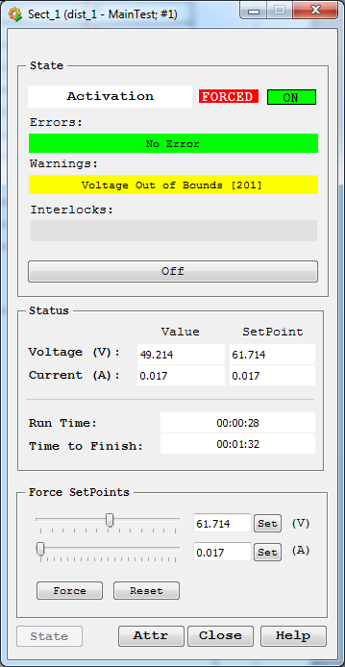
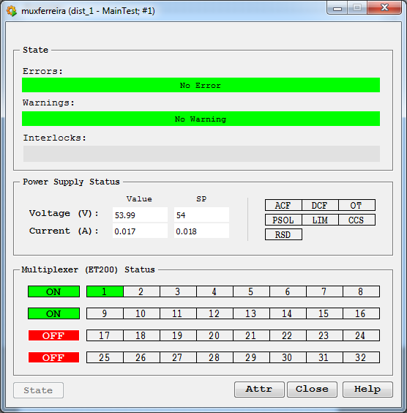
LHC | NEG Pumps
SCADA MUX + PSU Panel
SCADA NEG Pump Panel

Slide 13
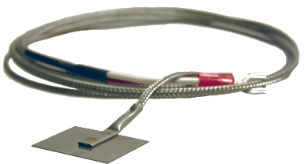
LHC | Thermocouples for Warm Magnets
Thermocouples were installed during the LS1 to measure the temperature of the warm magnets in the LHC-LSS. These measurements must be available in the vacuum SCADA and archived to the relevent databases.
Thermocouple
Thermocouples are the most common way to do it. They consist simply of two different conductors, placed in contact, which produce voltage due to temperature gradients. This voltage can be directly measured by a PLC and converted into a temperature.

Slide 14
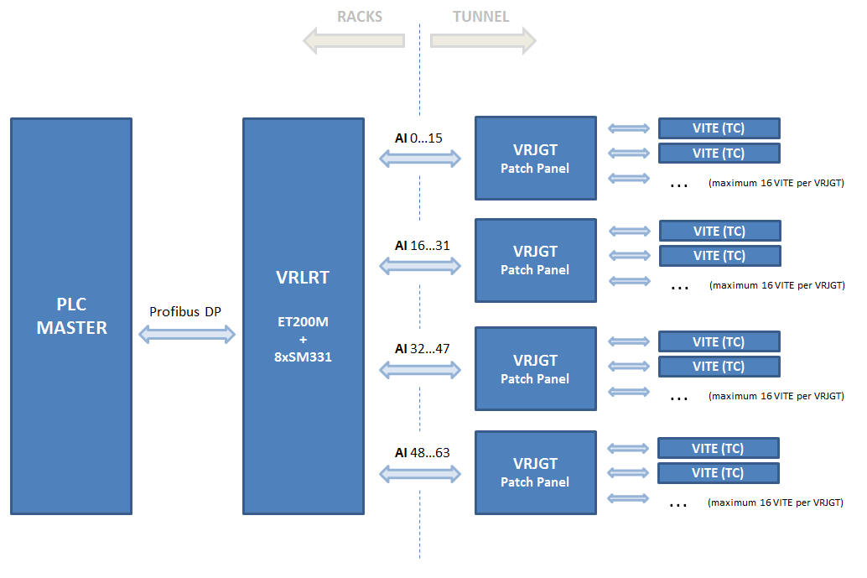
LHC | Thermocouples for Warm Magnets
Hardware Architecure for the temperature measurement system

Slide 15
LHC | Thermocouples for Warm Magnets
VRJ_TC
Hardware Architecure for the temperature measurement system

Slide 16
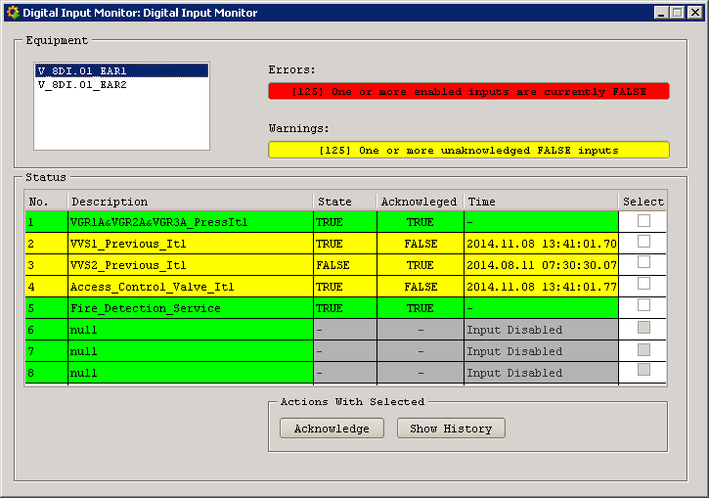
LHC | 8DI_FE Digital Input Monitor
Each device allows the monitoring of 8 digital inputs.
The main goal of the device is to monitor interlock signals, so falling edges are detected and timestamped and must be acknowledged.
Object States are implemented, so the device can be used and an interlock source (interlock is sent in case any of the monitored inputs is false)

Slide 17

CONTROL DEVICES FOR THE NA62 EXPERIMENT

Slide 18
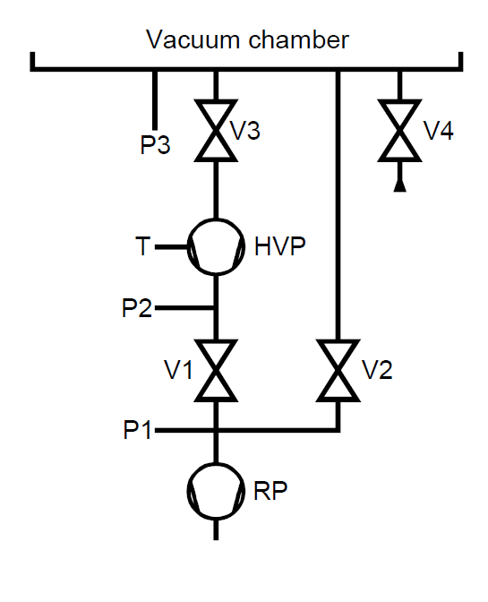
NA62 | Cryogenic Pumps
The vacuum level in the main NA62 tube must be particularly high, which is why seven cryogenic pumps are installed throughout its length.
These pumps consist of a complex assembly with valves, cryogenic head, compressors and gauges, all controlled by a PCA700C controller. This controller must be interfaced to the SCADA in order to provide remote control and monitoring.
Full Cryogenic Pump assembly

Slide 19
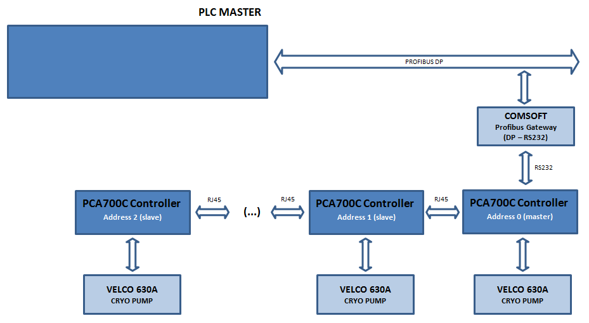
NA62 | Cryogenic Pumps
Hardware Architecture for the cryogenic pump control system

Slide 20
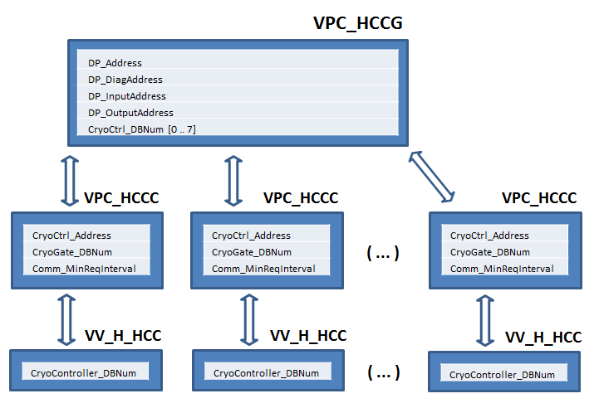
NA62 | Cryogenic Pumps
Control Architecture for the cryogenic pump control system

Slide 21
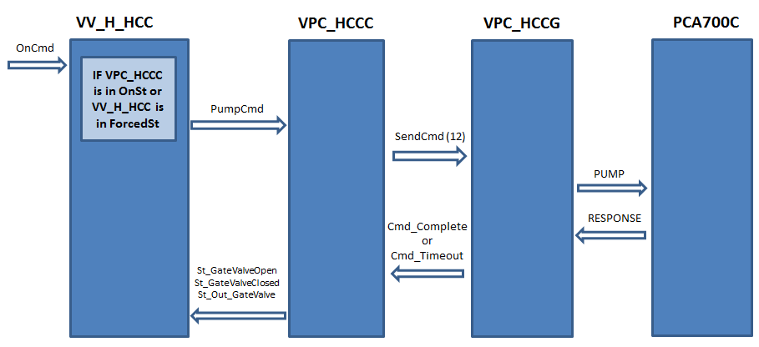
NA62 | Cryogenic Pumps
Example of command flow for the valve / pump / controller system

Slide 22
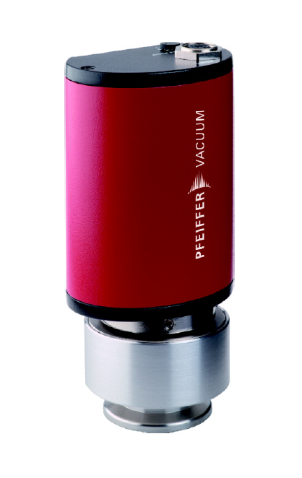
NA62 | Pfeiffer MPT-200 Full Range DP Gauge
The range of Pfeiffer DP gauges comes in different flavours – Penning + Pirani, Pirani + Membrane, Membrane, ...
All the measuring activities and sensor switching are handled by the gauge, which operates as a normal DP slace.
The VG_DP implements the communication and management of this gauge.
The device is based on VG_STD, so its use on the vacuum control software is perfectly transparent (read registers are similar and interlock data resides in the same memory addresses)
Peiffer MPT200 Full Range Gauge

Slide 23
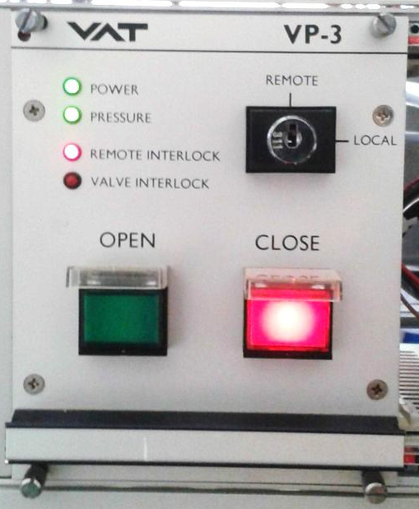
NA62 | VP-3 Pulse Valve Controller
The VAT VP-3 controls the large pulsed valves used to isolate the LKr Calorimeter in NA62.
It’s a bistable device. To open the valve a 10ms pulse is required in the OPEN digital input. To close it, the same must be done in the CLOSE DI.
The PLC control device that was developed is fully configurable: pulse width can be defined, monitoring of remote and inrush signals can be disabled or enabled. The device is also interlockable.
The PLC block can also be used to control the VAT-VF2 controller and the SPS pulsed valves (with no dedicated controller).
VAT VP-3 Pulsed Valve Controller

Slide 24
NA62 | ALARM_DO
Device 1
Device 2
Generates a new interlock signal from the state of two different devices.
Interlock source (Object State or Physical Value) can be chosen.
Combination logic (AND/OR) between the two devices can be chosen.
ALARM_DO can be used both as an interlock source (effectively working as an interlock multiplexer) or to generate a digital output signal from the state of the source devices.
ObjectSt
or
PhysObjVal
ObjectSt
or
PhysObjVal
ALARM_DO
InterlockSt
Device 3
DIGITAL OUTPUT

Slide 25
João Rodrigo Ferreira
rodrigo.ferreira@cern.ch
+41 764 871 719

