Slide 1
Power supply discussion
December 8th
Carlos Abellan

Slide 2
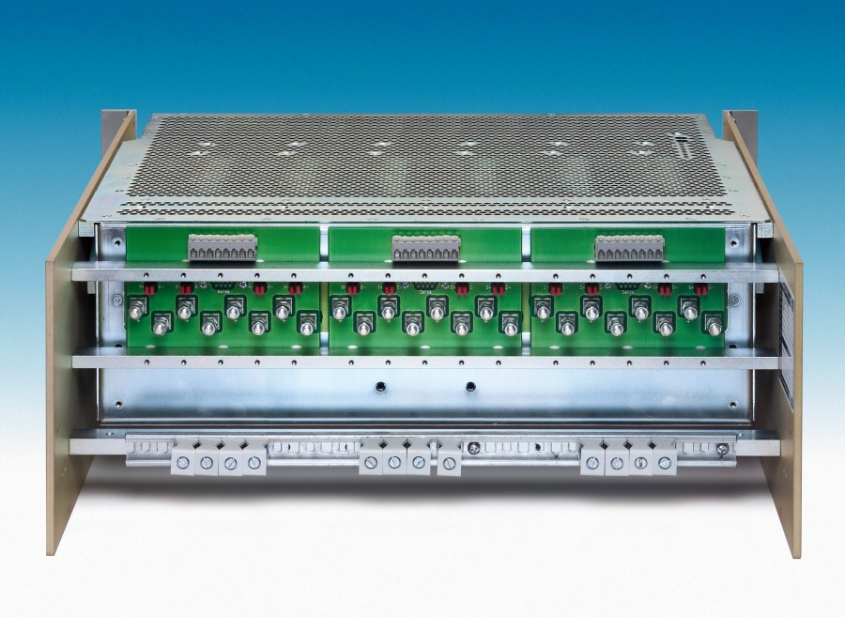
Power Supply Needs for UT
12 Maraton Needed
  Configuration:
    12 channels 2-8V @ 50A
      LV to be later regulated with a linear regulator
      Work at 75% of full load (35 A)

Slide 3
ST Power supply recycling
Available:
  4 (TT) + 4(IT) + 1 (SPARE) = 9 Maraton
  BUT:
    Currently 6CH 2-8V@50 A and 6CH 5-15V@20 A
    Need to modify these supplies
Cost estimates:
  New Maraton: 8956€
  Modify 6CH of a Maraton: 4540€ (~50% of a new one)

