Slide 1

Aspects of Big Data and Data Science outside of HEP
A short overview
Christopher Jung

Slide 2
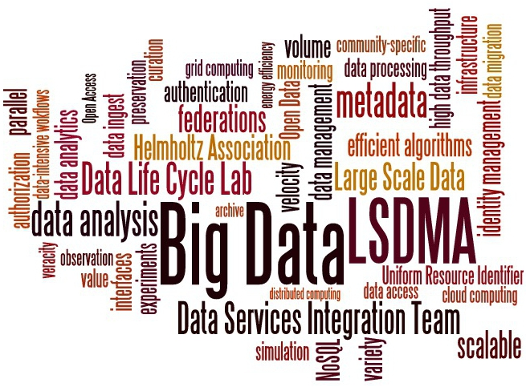
Overview
Definitions and motivation
Policies and regulations
Repositories
International projects
LSDMA
Example of a data facility
Education
Lessons learned, needs, trends

Slide 3
Is there anything to talk about?
HEP has lots of Big Data expertise
→ Why aren’t other scientific disciplines simply adopting HEP tools and approaches?
Because there are differences in
Knowledge of computing
Interest in computing
Size of collaborations
Funding
Role of computing in education
Attitude towards proprietary software
…

Slide 4
Definition Big Data
Volume
Velocity
Variety
Experiment
Observation
Data Taking
Data Sources
Simulation
Analysis
Workflows
Transfer
Formats
Visualization
Analysis methods
Unstructured data
Veracity
Value
Systematic uncertainty
Statistical uncertainty
(Non-)Reproducibility
Bias
Costs
Manipulated/suppressed data

Slide 5
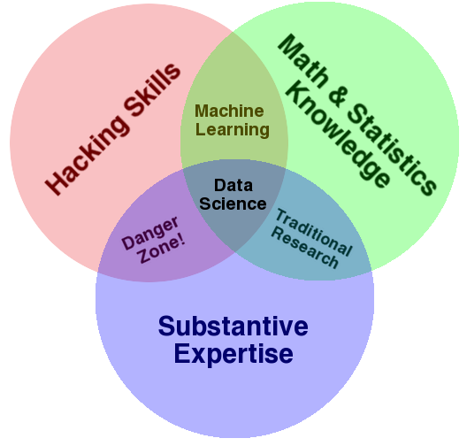

Definition Data Science
For Big Data more is needed!
Coding
Algorithms
Workflows
Finding bottlenecks
Debugging
Drew Conway Data Science Venn Diagramm (CC A-NC Linzenz), http://drewconway.com/zia/2013/3/26/the-data-science-venn-diagram,
animation added

Slide 6
Big Data kicking in
Science is very heterogeneous in data usage, approaches, culture, computing knowledge and much more
Usually, the challenge of Big Data is considered when it is imminent
  Amounts of data cannot be stored properly anymore
  Old data management system getting slow
  Research combines various sources of data
  Need to speed up data analysis because of emergence of competitive groups
  Old algorithms cannot deal with these amounts of data
  Regulations on data preservation
  Policies on data access
  …

Slide 7

Policies (I): Data Preservation
German Research Foundation‘s “Proposals for Safeguarding Good Scientific Practice“
Recommendation 7: Safeguarding and Storing of Primary Data
“Primary data as the basis for publications shall be securely stored for ten years in a durable form in the institution of their origin.’

Slide 8
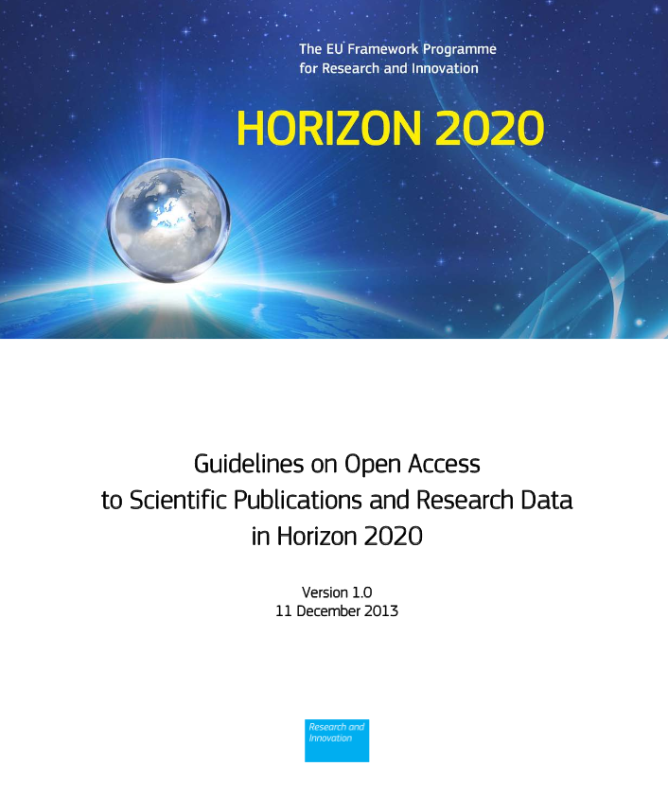
Policies (II): Open Access, Open Data
“Under Horizon 2020, each beneficiary must ensure open access to all peer-reviewed scientific publications relating to its results.”
H2020 open data pilot for several research areas, e.g. “Future and Emerging Technologies“ and “Societal Challenge: 'Secure, Clean and Efficient Energy’ - part Smart cities and communities”
  “Openly accessible research data can typically be accessed, mined, exploited, reproduced and disseminated free of charge for the user.”

Slide 9

Research Data Repositories
Definition: information infrastructure with the goal of making research data accessible for a long term, ideally permanently
Mainly disciplinary repositories, but also institutional, project and multi-disciplinary ones
Re3data: registry of repositories

Slide 10
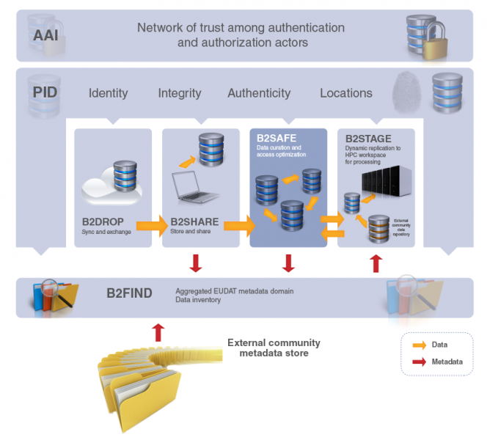
International projects (I): EUDAT
Establishment of a European collaborative data infrastructure
  sharing data within and between communities
  Enabling researchers to carry out their research effectively
Second project phase (EUDAT2020) will start on March 1st

Slide 11

International projects (II): RDA
Facilitates specific, short- term efforts that accelerate the sharing and exchange of research data promoting exchange between disciplines
Brings together researchers, data centers and funding agenices from all over the world
Structured in various Working Groups, Interest Groups and BoF Groups; covering an extremely wide range of topics from structural biology and data description registry interoperability to brokering and long tail of research data
Plenary meetings every six months; next one in March in San Diego

Slide 12
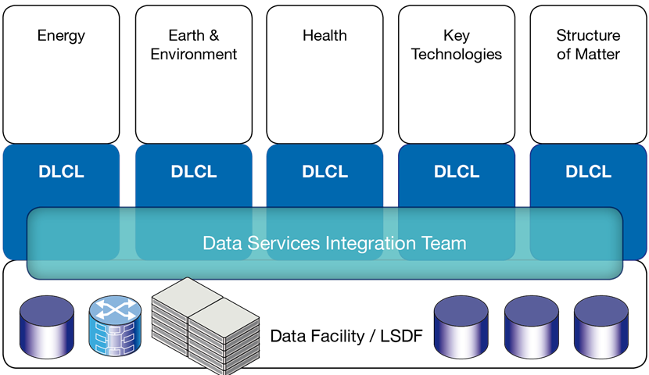

“Large Scale Data Management and Analysis”: Dual Approach
Data Life Cycle Labs
Joint R&D with scientific user communities
optimization of the data life cycle
community-specific data analysis tools and services
Data Services Integration Team
Generic methods R&D
data analysis tools and services common to several DLCLs
interface between federated data infrastructures and DLCLs/communities

Slide 13
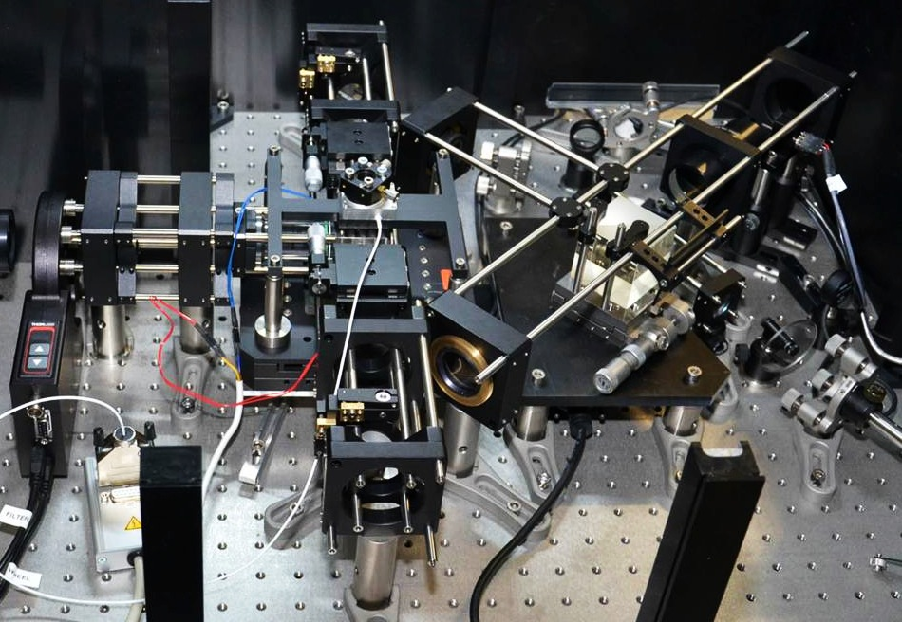
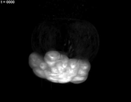
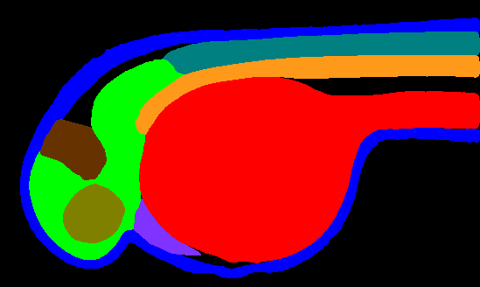

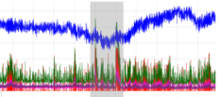
Selected LSDMA topics
Light Sheet Microscopy
Electrical Data Recorder: 3-phase voltage measurement at 12.8 kHz sampling rate, GPS-time synchronized
Mikut et al. (2013), Automated processing of zebrafish imaging data - a survey, Zebrafish 10(3), DOI:10.1089/zeb.2013.0886
Experimental Microscope
16 TB/d
Data Acquisition System
Data Ingest Client
400 MB/s
Repository
Automatic Processing
Analysis
EDR-Device 1
8.7 GB/d
Web
Server
Generic
Data
Services
LSDF
(HDFS/GPFS)
Data Analysis
…
  (eASiMoV
  modeling and analysis toolbox)
EDR-Device n
Metadata
Storage
8.7 GB/d

Slide 14
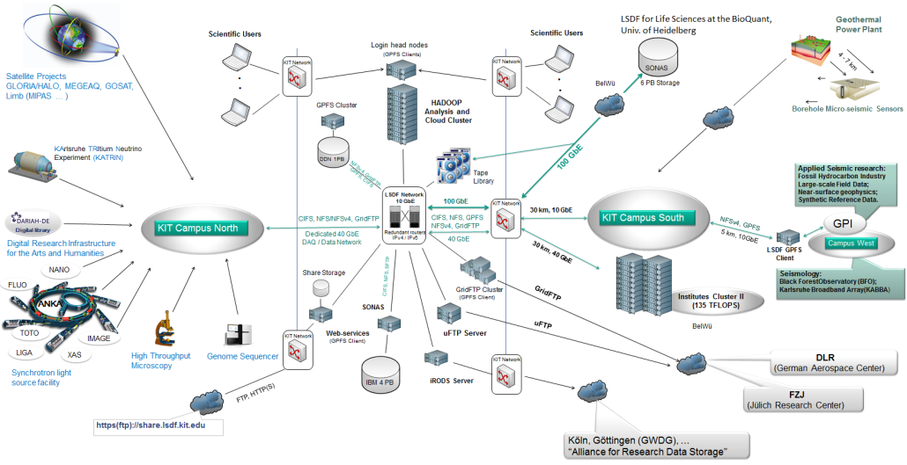


A multi-disciplinary data center: Large Scale Data Facility (LSDF)
Main goals
provision of storage for multiple research groups at KIT and U-Heidelberg
support of research groups in data analysis
Resources and access
6 PB of on-line storage, 6 PB of archival storage
variety of storage protocols
jointly funded by Helmholtz Association and state of Baden-Württemberg
Services and structures rather complex!

Slide 15
Teaching Data Science Skills
My personal experience (German ‘Diplom’ in physics)
  Mandatory
    Mathematics (analysis, linear algebra), Object-oriented programming language (C++ or Java)
  Recommended for High-energy physics
    Data analysis (statistics, tools for statistical analysis, …), ‘Computer use’ (linux and its tools, computer algebra, …), algorithms and data structures
  And of course lots of practical experience during my diploma thesis ☺
  -> Covers both ‘maths & statistics knowledge’ and ‘hacking skills’ very well
Outside of HEP
  Computing plays a small role, often is about the use of a defined set of software tools
  No data science curricula available
  As always: very heterogeneous requirements in different fields
  Lack of job profiles for data scientists (“something with data”)

Slide 16
Lessons learned, needs, trends
Communities
Differ in
  previous knowledge
  level of specification of the data life cycle
  tools and services used
Are often divided into small groups
Research
Becomes multi-disciplinary
Lacks financial resources for dealing with data (at least after publication)
Needs:
Integration of data science into curricula
Harmonized and realistic policies on dealing with (big) data
Consultation for communities
Incentives for researchers
Trends
HPC centers as Big Data centers
Citizen scientists
Road ahead: evolution, not revolution!

