Slide 2
ELQA and protection in the machine
Arjan Verweij, TE-MPE with input from E. Ravaioli, M. Bednarek, J. Ghini

Slide 3
D1, A1
D2, A1
D1, A2
D2, A2
PC
RB circuit:
153 x MB & 190 V converter & 2 x EE system

Slide 4
A few obvious general remarks
The 11-T dipoles have to comply to the existing RB circuit, especially concerning ELQA testing and current profile, and the protection has to work taking into account the noise and transients in the circuit.
One RB circuit might contain four 11-T dipoles. Initial training and retraining after a thermal cycle will have non-negligible impact on commissioning/powering. E.g.: 3 quenches per aperture → 24 quenches per circuit → 12 days.
We “over-commission” the RB to operational current +100 A. The 11-T dipoles should of course work in a stable way, without occasional “degradation” quenches.
The 11-T dipoles should not quench during an exponential current decay with τ=100 s.

Slide 5
ELQA tests performed on the RB circuit
The integrity of the instrumentation of the current leads: V-taps and TT sensors.
The resistance of the current leads (possibly related to cooling problems).
The continuity and total resistance of the circuit (warm and cold).
The electrical transfer function of the entire circuit (1 Hz-100 kHz, amplitude 10V).
The insulation of the circuit to ground and to other circuits.
The integrity of the instrumentation of each individual magnet.
The integrity of quench heaters:
  Insulation between the heater and the coil and ground
  Resistance of each heater

Slide 6
The 11 T dipoles have to comply to the same test requirements as the rest of the circuit.
Magnet and all its instrumentation must support voltages to ground up to 700 V @ 300 K and 2.1 kV @ 1.9 K. (The heaters are floating during this test).
Internal maximum worst case scenario voltage, including the FPA of the existing RB with a ground fault (1 kV), should not exceed the test voltage of 2.1 kV.
The insulation of the heaters to ground and to the coil can be freely defined (for info: the MB heaters are tested at 2 kV).
A set of tests for the trim circuit and for the checks of the instrumentation of the magnet have to be defined.
The current leads of the trim circuit should be easily accessible so that it is easy to disconnect DC warm cables.
All the connectors and cables routing V-taps and heaters should be easily accessible.
The option of performing all maintenance and test operations from a distance should be foreseen, as the surrounding of this magnet and collimator will quickly become 'hot'.

Slide 7
D1, A1
D2, A1
QPS
D1, A2
D2, A2
PC
U_D1A1 – U_D2A1 and U_D1A2 – U_D2A2 : Normal and symmetric quenches
U_D1A1 – U_D1A2 and U_D2A1 – U_D2A2 : Redundancy
Voltage detection between poles (e.g. U_D1A1P1-U_D1A1P2) might be considered. Voltage taps should be present.
Obviously, the noise of the trim converter should not trigger the QPS. Especially the 0 V transition could cause additional noise and possibly QPS trips.
Interaction between converter, trim converter, EE, and QPS should be studied!!!

Slide 8
QPS remarks
The main difference between stand-alone testing and operation in the LHC is the effect of voltage waves propagating through the chain caused by the converter shut-down and the opening of the energy extraction switches.
The thresholds that are applicable in the LHC might need to be larger than 100 mV, 10 ms.
In order to define these thresholds we need:
  Equivalent electrical circuit, based on frequency transfer measurements.
  Expected variation in the parameters of this circuit for the 4 apertures.
  PSpice simulations incorporating the 4 apertures in the RB string.

Slide 9
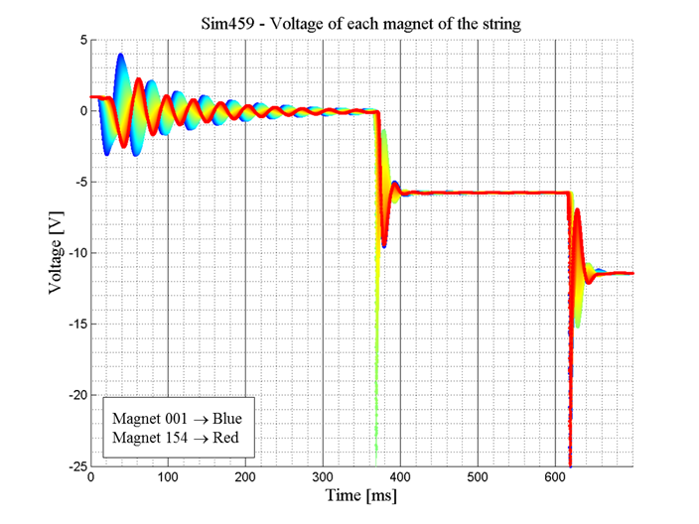
Example: Magnet voltage in the 154 dipoles of the RB circuit during converter shut-down and EE switch openings

Slide 10
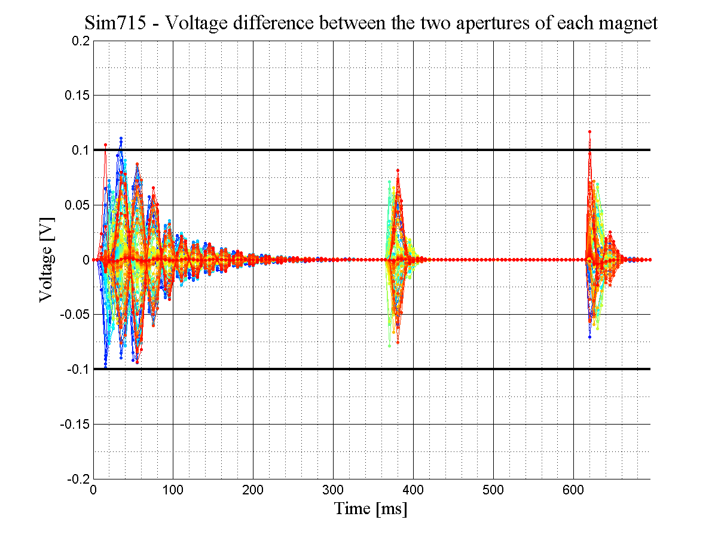
Example: U_{A1}-U_{A2} in the 154 dipoles of the RB circuit during converter shut-down and EE switch openings

Slide 11
CLIQ (Coupling Loss Induced Quench) could be a very good alternative for traditional quench heaters: Faster ⇒ lower hot-spot, and “easier” coil assembly.
CLIQ
CLIQ
D1, A1
D2, A1
D1, A2
D2, A2
CLIQ
CLIQ
PC
4 units of 30 mF, 500 V

Slide 12
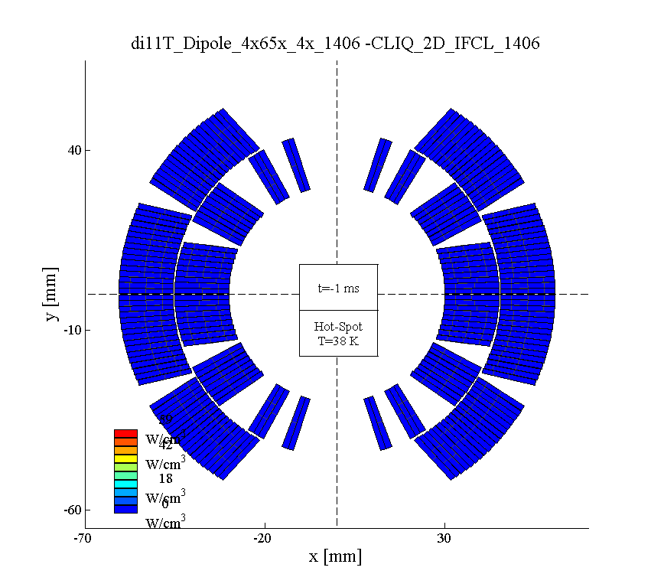

CLIQ for a 6 m long 11 T dipole
Iq=11850 A, U_{CLIQ}=500 V ⇒ Quench load=11.8 MIIts, T_{hot}=253 K

Slide 13
CLIQ
Protection using CLIQ seems feasible on the 11 T dipoles, resulting in lower hot spot than quench heaters. We still need:
Experimental data on a short model to validate the simulations.
Simulations of CLIQ in the RB circuit to check:
  effect on QPS of adjacent magnets
  effect on trim converter
  effect on maximum voltages (to ground, between coils)
Easily accessible CLIQ current taps to be foreseen.

Slide 14
Summary
Magnet and all instrumentation should withstand 2.1 kV!!!
All leads and instrumentation should be easily accessible.
Magnet should withstand an exponential current ramp-down with τ=100 s without quenching.
Interaction between main converter, trim converter, EE, and QPS to be studied.
100 mV, 10 ms might have to be increased, especially if the apertures have a different AC behaviour
CLIQ is a promising alternative for quench heaters and should be further studied and tested.

