Slide 1
International review of the HL-LHC 11T Dipole for DS Collimation
Collaring to cold mass finishing
09.12.2014
Christian Löffler

Slide 2
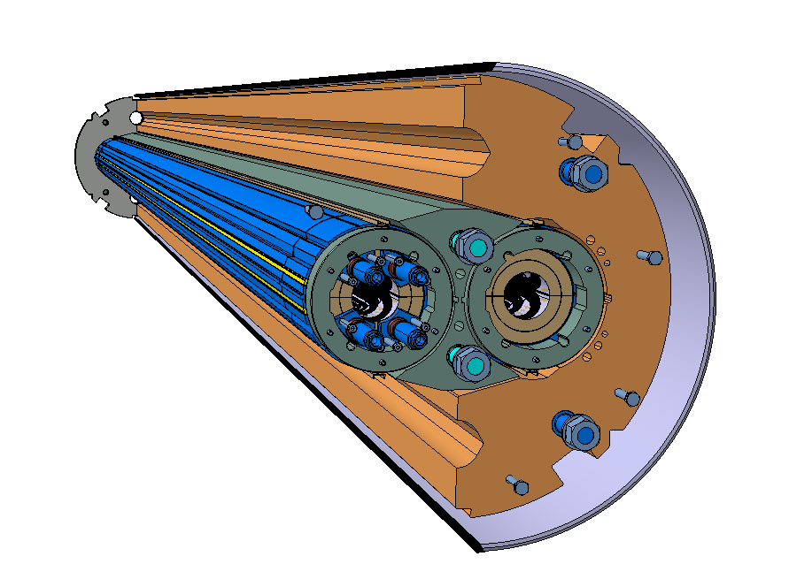
Outline
Available tooling and operational status
CMM of 5.5m coils
Instrumentation
Pairing of the coils
Collaring
Yoke lamination assembly
Cold-mass assembly
Skinning

Slide 3
Outline
Available tooling and operational status
CMM of 5.5m coils
Instrumentation
Pairing of the coils
Collaring
Yoke lamination assembly
Cold-mass assembly
Skinning

Slide 4
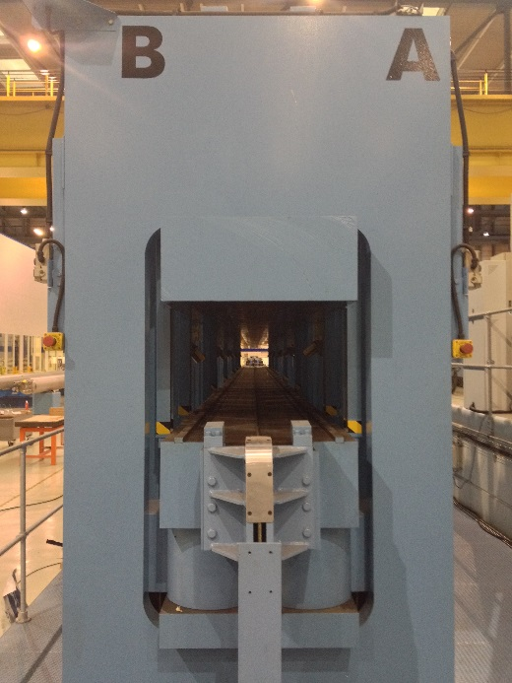
Collaring press
Large LMF collaring press
Length capacity | 16000 mm
Nominal hydraulic force | 26600t
LHC dipole collaring | 14MN/m
DS11T collaring (inc. tool) | 17MN/m
Top/bottom planarity | ±0.3mm/m
Stroke | 100 mm
To prepare the collaring press for the DS11T-magnet the collaring tool needs to be changed. In addition the hydraulic sectorisation needs to be implemented.

Slide 5
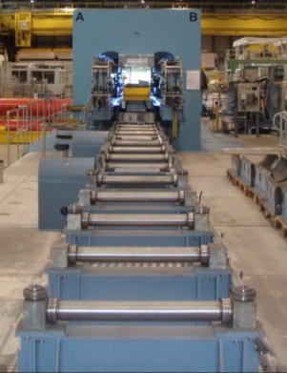
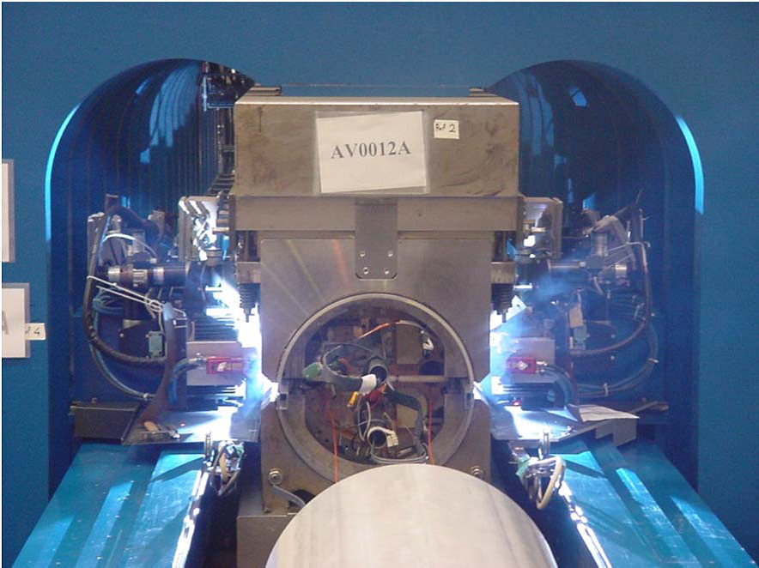
Welding press
Large LMF welding press, previously operated at Babcock Noell
Length capacity | 16000 mm
Nominal hydraulic pressure | 600 bar
LHC dipole welding | 400 t/m
Press capacity | 0.5MN/m – 12 MN/m
Widow size (closed position) | Width: 2200 mm Height: 1600 mm
Stroke | 100 mm
Adaptive laser tracking system
Currently: STT & MIG welding system
To prepare the welding press for the DS11T-magnet the cradles and the welding guns need to be replaced. The needed hydraulic sectorisation is under development.
MSC/LMF
Friedrich Lackner

Slide 6
Outline
Available tooling and operational status
CMM of 5.5m coils
Instrumentation
Pairing of the coils
Collaring
Yoke lamination assembly
model assembly
Skinning

Slide 7
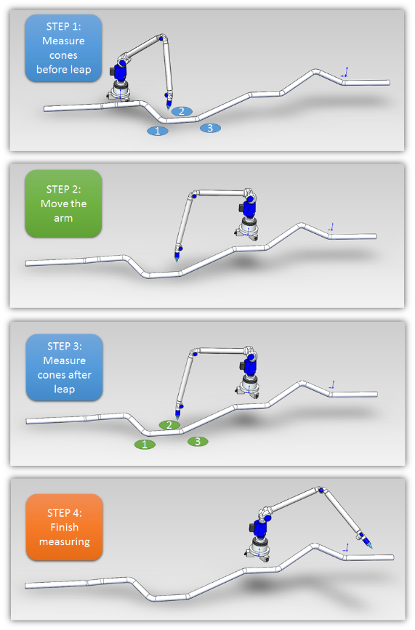
CMM of 5.5m coil
3d-measurement arm used in the short-model program can be used
  The max. area of the arm is 1.8m
  3 jumps of the arm would be required
  Global precision would be 60µm; local still 10µm
    Length of coil → 60µm
    Cross-section → 10µm
  Possible integration of new scanner technology
    Accuracy of ±25µm
    500k points/second

Slide 8
Outline
Available tooling and operational status
CMM of 5.5m coils
Instrumentation
Pairing of the coils
  Ground insulation
  Collar assembly
Collaring
Yoke lamination assembly
model assembly
Skinning

Slide 9
Instrumentation of 5.5m coils
Electrical
  main goal to protect the coil
Mechanical
  For the coil, depends on confidence we gain on CMM and simulation from the short model program
  Shell instrumentation for the first aperture
  Bullet gauges for the heads are foreseen

Slide 10
Outline
Available tooling and operational status
CMM of 5.5m coils
Instrumentation
Pairing of the coils
Collaring
Yoke lamination assembly
model assembly
Skinning

Slide 11
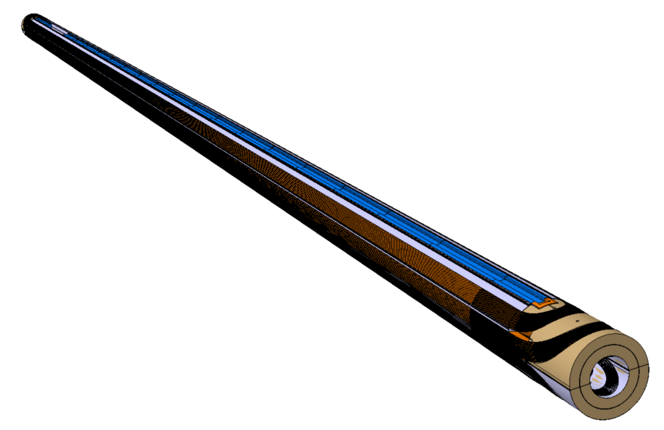
Pairing of coils
Same layout for the ground insulation as for the short models, overlapping lenghwise
Collaring shoe could be divided lengthwise
Tools for handling of the coils is in development

Slide 12
Outline
Available tooling and operational status
CMM of 5.5m coils
Instrumentation
Pairing of the coils
Collaring
Yoke lamination assembly
model assembly
Skinning

Slide 13
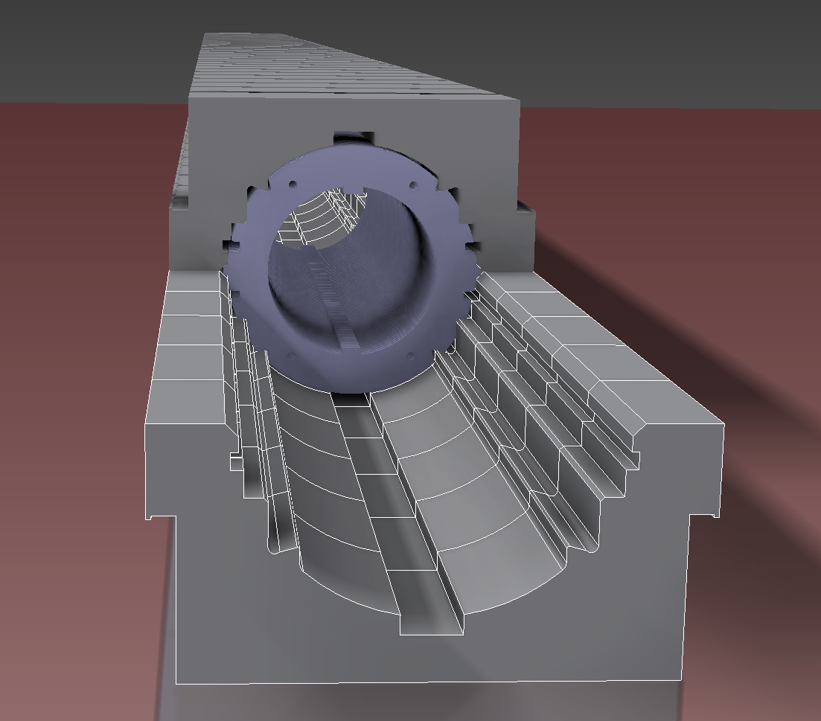
Collaring
Adapting the principal from the short-models
Segmenting the tool to allow more precise manufacturing
Segmenting also allows testing on short models before first collaring

Slide 14
Outline
Available tooling and operational status
CMM of 5.5m coils
Instrumentation
Pairing of the coils
Collaring
Yoke lamination assembly
model assembly
Skinning

Slide 15
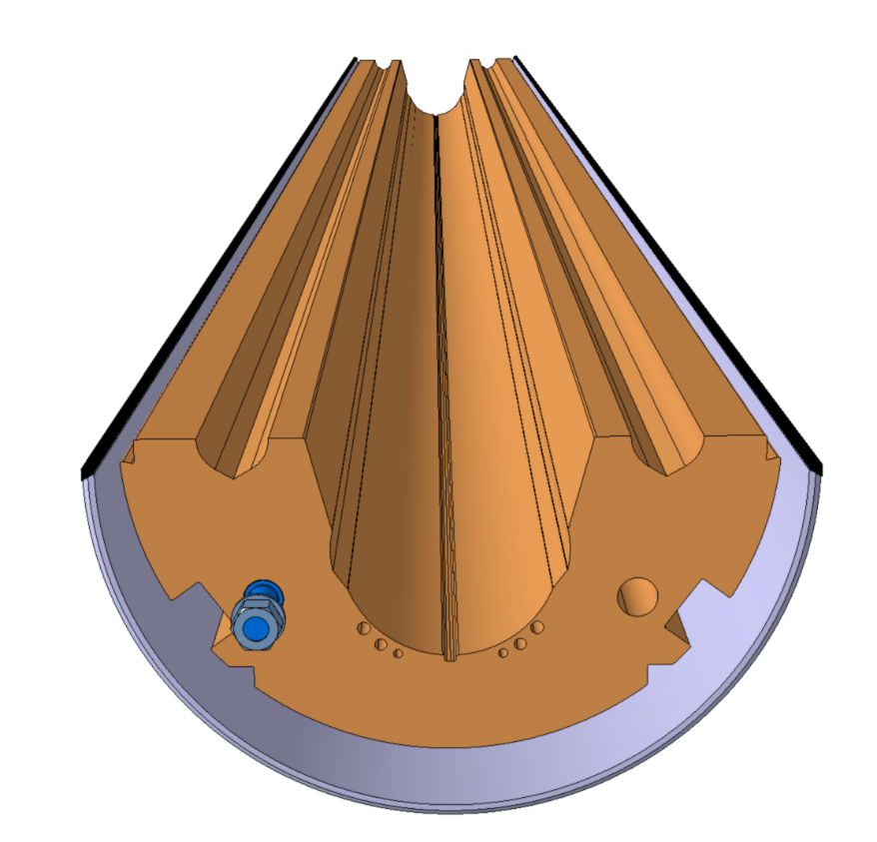
Yoke lamination assembly
Yoke lamination will be assembled in the shell
Rod through all the laminations used for compression
Yoke laminations for the 2 in1 are in stock
Compression rod

Slide 16
Outline
Available tooling and operational status
CMM of 5.5m coils
Instrumentation
Pairing of the coils
Collaring
Yoke lamination assembly
model assembly
Skinning

Slide 17
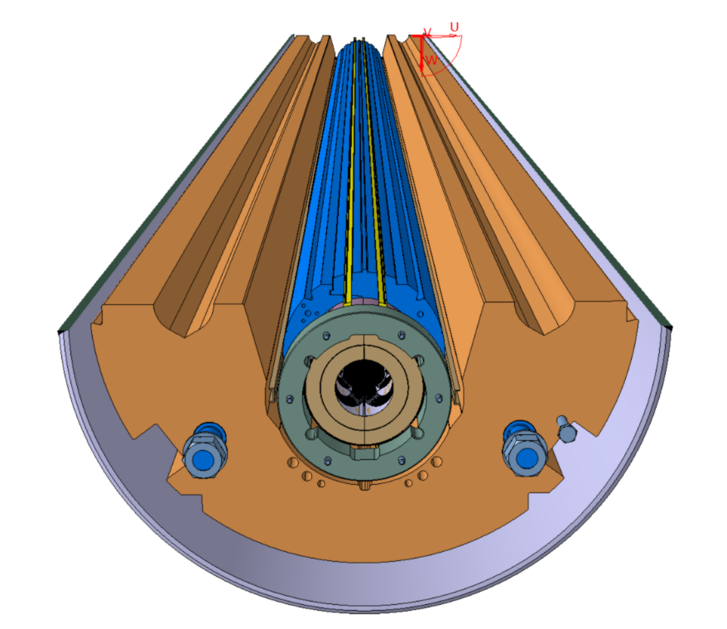
model assembly
After assembly of the bottom yoke the collared coil #1 is placed
Using the same interference plane with the yoke as the 1 in1 model

Slide 18
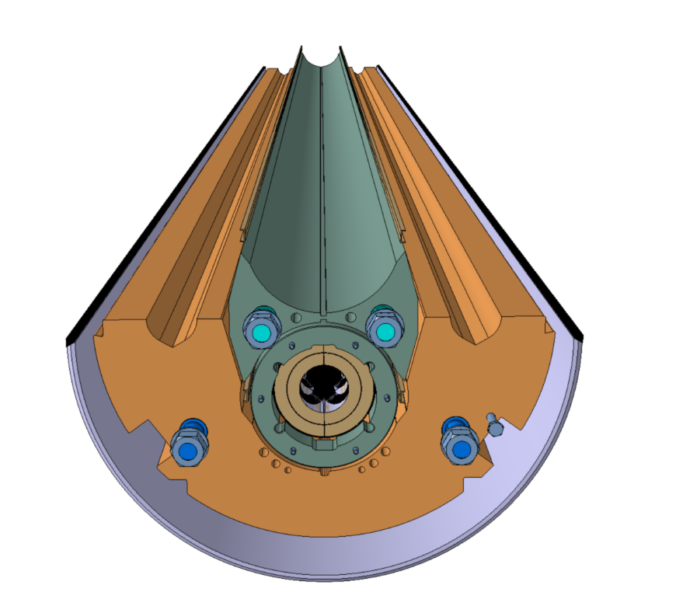
model assembly
Laminated yoke spacer is placed and compressed with rods
To separate the two collar coils
Compression rod

Slide 19
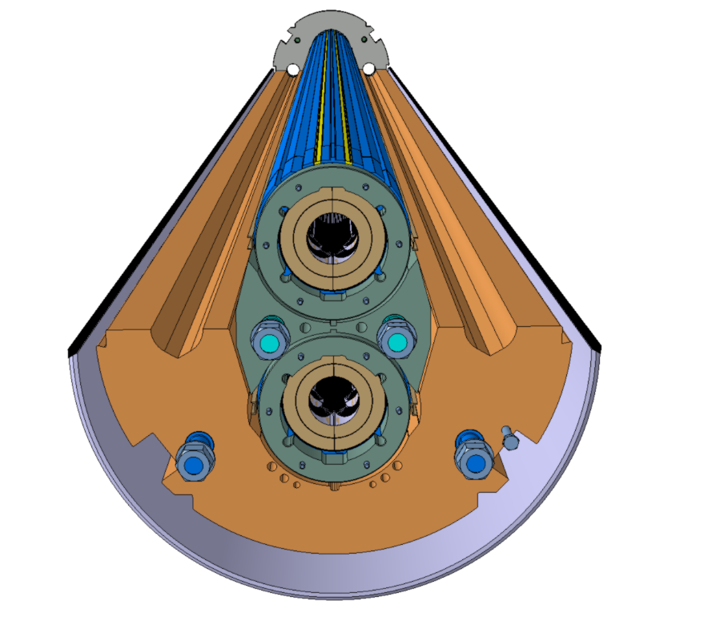
model assembly
Collared coil #2 placed on top of the yoke spacer

Slide 20
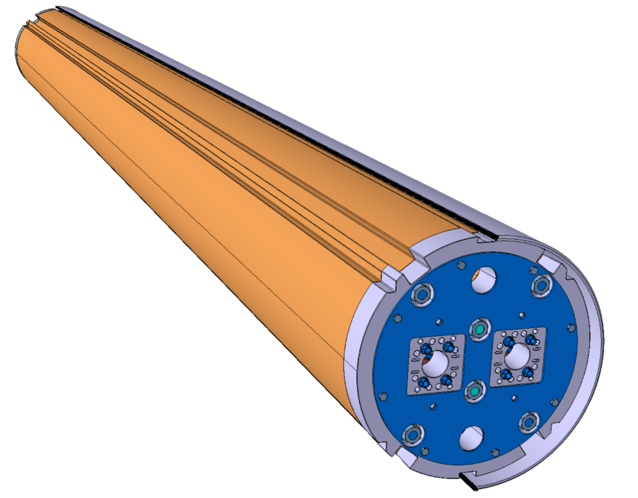
model assembly
Top yoke assembled on top of the collared coil #2
Yoke gap is open and will be closed under the welding press

Slide 21
Outline
Available tooling and operational status
CMM of 5.5m coils
Instrumentation
Pairing of the coils
Collaring
Yoke lamination assembly
model assembly
Skinning

Slide 22
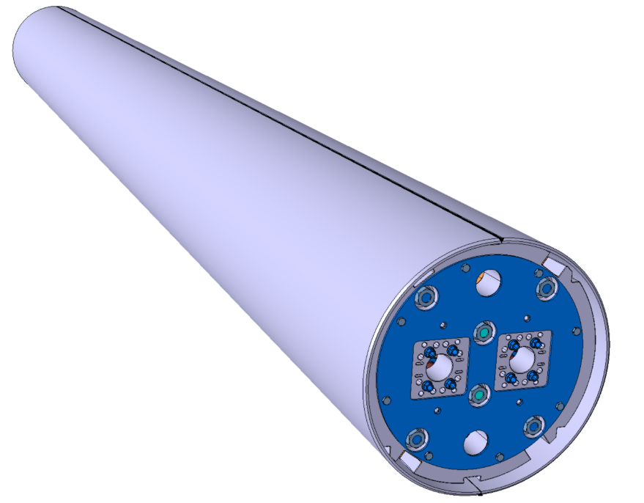
Skinning
Yoke gap is closed due to compression forces of the welding press
Shell will be welded with the goal to induce enough pre-stress to keep the yoke gap closed during powering

Slide 23
Conclusions
Scaling up from the short-models seems like the way to go for coil pairing and collaring
We need to assemble the first “2 in 1” to assess the problems during model assembly for the first prototype
Skinning is performing well from the short-models, contributes from the experience of the LHC
From the mechanical point of view there are no show stoppers in sight

