Slide 1
2nd International Review of the HL-LHC 11T Dipole for DS Collimation
11T dipole electrical circuit
Ludovic Grand-Clément & Hervé Prin
08/12/2014

Slide 2
Outlook
Introduction
Dipole
  Overview
  MBBR & MBBL
  MBAR & MBAL
11T
  Electrical circuit: Chosen solution
  Trim: Conduction cooled
  Slots concerned & wiring in the LHC
    MBAR: MB.B10L7 & MB.B8L7
    MBAL: MB.A10R2
    MBBR: MB.A10L2, MB.B8R7 & MB.B10R7
    MBBL
Quality assurance
  Procedure
  Test program
Conclusion
Ludovic Grand-Clement

Slide 3
Introduction
11T : Electrical integrity challenge
Small amount of space
Trim circuit to add
4 NbTi magnet variants to cover
MB NbTi
11T Nb3Sn
Collimator
11T Nb3Sn
Ludovic Grand-Clement

Slide 4
Outlook
Introduction
Dipole
  Overview
  MBBR & MBBL
  MBAR & MBAL
11T
  Electrical circuit: Chosen solution
  Trim: Conduction cooled
  Slots concerned & wiring in the LHC
    MBAR: MB.B10L7 & MB.B8L7
    MBAL: MB.A10R2
    MBBR: MB.A10L2, MB.B8R7 & MB.B10R7
    MBBL
Quality assurance
  Procedure
  Test program
Conclusion
Ludovic Grand-Clement

Slide 5
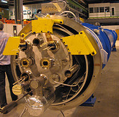
Dipole -1
Overview
External
Internal
2 x 10 x auxiliaries bus bars (spool pieces)
  14 or 18 go through
  6 or 2 supply corrector
4 x quadrupole bus bars
  2 x focusing
  2 x defocusing
2 x dipole bus bars
  1 go through
  1 supply dipole coils in serial
1 x protection diode
  In parallel of the coils
N line
Ludovic Grand-Clement

Slide 6
Dipole -2
MBBR & MBBL
M3
Int
MB
MCS
R
10-20
M1 & M2 (auxiliaries bus bars)
M3
Int
L
MB
MCS
10-20
M1 & M2 (auxiliaries bus bars)
  Bus bar M3 intern powers coils
  Spool pieces #10 & #20 supply MCS correctors
  Diode is left or right
Ludovic Grand-Clement

Slide 7
Dipole -3
MBAR & MBAL
M3
Ext
MCO MCD
MB
MCS
R
1-3-11-13
9-19
M1 & M2 (auxiliaries bus bars)
M3
Ext
MCO MCD
L
MB
MCS
1-3-11-13
9-19
M1 & M2 (auxiliaries bus bars)
  Bus bar M3 extern powers coils
  Spool pieces #1 #11 supply MCO correctors
  Spool pieces #3 #13 supply MCD correctors
  Spool pieces #9 & #19 supply MCS correctors
  Diode is left or right
Ludovic Grand-Clement

Slide 8
Outlook
Introduction
Dipole
  Overview
  MBBR & MBBL
  MBAR & MBAL
11T
  Electrical circuit: Chosen solution
  Trim: Conduction cooled
  Slots concerned & wiring in the LHC
    MBAR: MB.B10L7 & MB.B8L7
    MBAL: MB.A10R2
    MBBR: MB.A10L2, MB.B8R7 & MB.B10R7
    MBBL
Quality assurance
  Procedure
  Test program
Conclusion
Ludovic Grand-Clement

Slide 9
11T -1
Electrical circuit: chosen solution
M3
Type A/TypeB
Ext/Int
MCDO/No
L/R
MB
MCS
1-3-11-13/
Go through
9-19/
10-20
M1 & M2 (auxiliaries bus bars)
M3
Ext
Trim
MCDO
Dipole
Collimator
Dipole
MCS
L/R
1-3-11-13/
Bypassed
9-19
M1 & M2 (auxiliaries bus bars)
Two standards 11T magnets:
First with:
  One diode for both magnets
  MCD + MCO correctors always present and connected.
  Bypassed in case of B substitution
  Dipole
Second with
  MCS correctors always connected to 9-19
  Dipole, powered by the first magnet
Ludovic Grand-Clement

Slide 10
11T -2
Trim : Conduction cooled
DFB
M3
Ext
MCDO
Dipole
Collimator
Dipole
MCS
L/R
1-3-11-13/
Bypassed
Trim
9-19
M1 & M2 (auxiliaries bus bars)
N line
P.C.
(Power converter)
Conduction cooled leads
As DCF used by SSS
Supplied by power converter
Only one trim per pair of dipole is needful
Ludovic Grand-Clement

Slide 11
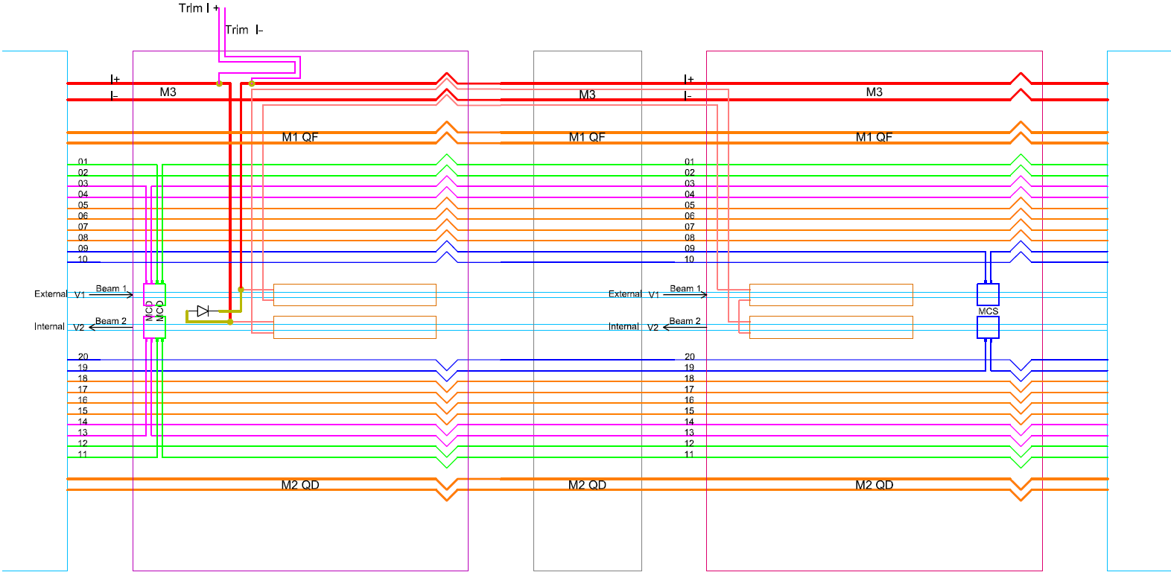
11T -3
MBAR: MB.B10L7 & MB.B8L7
Ludovic Grand-Clement

Slide 12
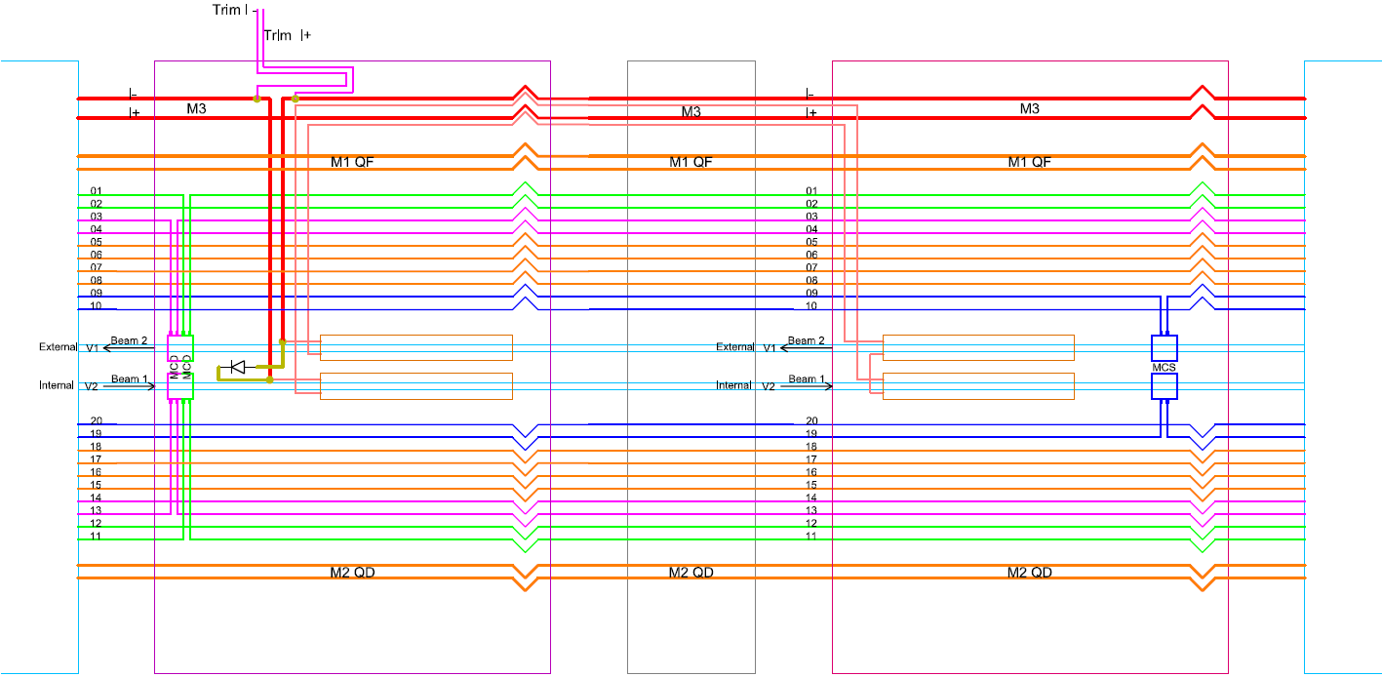
11T -4
MBAL: MB.A10R2
Ludovic Grand-Clement

Slide 13
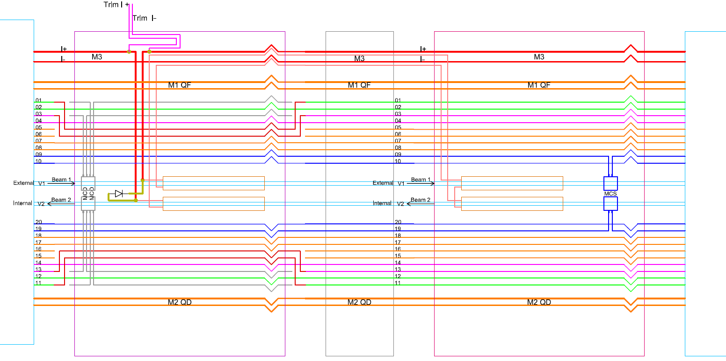
11T -5
MBBR: MB.A10L2, MB.B8R7 & MB.B10R7
Ludovic Grand-Clement

Slide 14
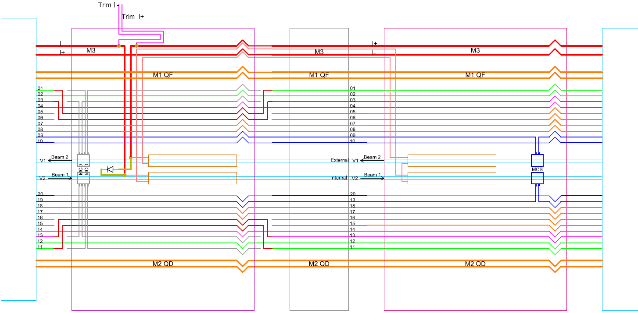
11T -6
MBBL
Ludovic Grand-Clement

Slide 15
Outlook
Introduction
Dipole
  Overview
  MBBR & MBBL
  MBAR & MBAL
11T
  Electrical circuit: Chosen solution
  Trim: Conduction cooled
  Slots concerned & wiring in the LHC
    MBAR: MB.B10L7 & MB.B8L7
    MBAL: MB.A10R2
    MBBR: MB.A10L2, MB.B8R7 & MB.B10R7
    MBBL
Quality assurance
  Procedure
  Test program
Conclusion
Ludovic Grand-Clement

Slide 16
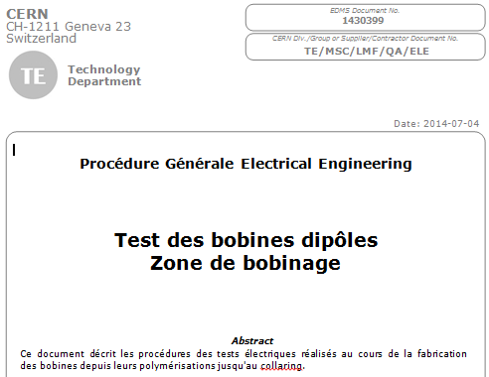
Quality assurance -1
Procedure
Experience of SC dipole & quadrupole
  Procedure to update
  Two documents:
    A procedure for all electrical tests
    A document indicating what test to use after each step
  Support of LMF-QA
Ludovic Grand-Clement

Slide 17
Quality assurance -2
Test program
Program
  Electrical test will be done after each step that could change electrical integrity
  Experience to SC magnets -> Program to update
HV & discharge test
  Support of doc EDMS #126452: Design and test guidelines (P. Fessia, G. Kirby, J. C. Perez, F. O. Pincot)
  More test will be done on different elements of Nb3Sn cable in order to determine the maximal voltage value that could be apply to qualify magnet
Internal External layers
Pole
R[DC]
L
R Insulation (SELV))
R[DC]
L
HV
Discharge test
R[DC]
L
Discharge
HV
Collaring
R[DC]
HV
Discharge
R[DC]
L,C
HV
Discharge
Final
R[DC]
L,C
HV
Discharge
HV
L, C
Adding instrumentation
Shell welding
Visual
Visual
Ludovic Grand-Clement

Slide 18
Conclusion
Electrical circuit schemes are clear
  Only one type of 11T
  Two variants depending of the diode polarity
  One trim per pair of 11T (1 MB dipole substitution)
Quality assurance
  Procedure and test program to update
  To take into account the differences with actual SC magnet (insulation / manufacturing method)
  Maximal voltage to apply has to be determined
Ludovic Grand-Clement

Slide 19

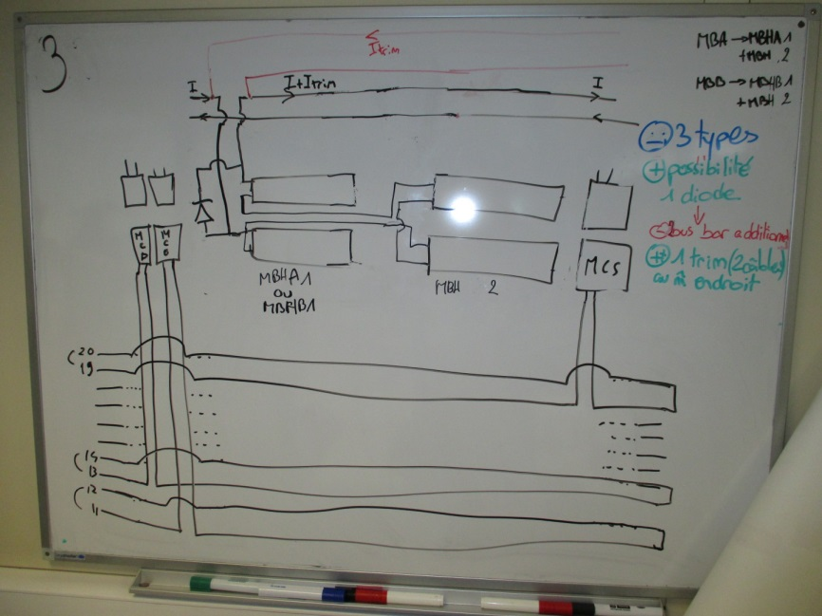
Thanks for your attention!
Ludovic Grand-Clement

Slide 20
ANNEXES
Ludovic Grand-Clement

Slide 21
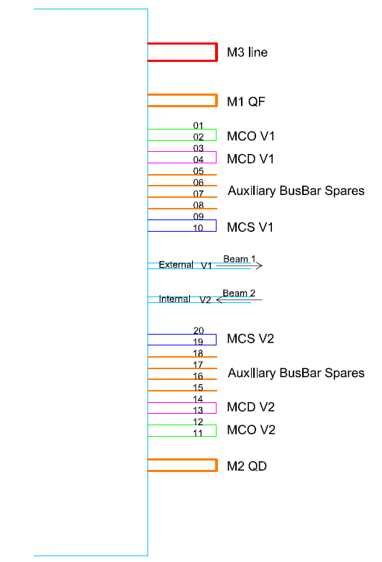
Electrical scheme LHC
Ludovic Grand-Clement

Slide 22
Test program -1
During cable insulation
Internal layer before drying
Internal & External after drying (with the mould)
Visual
Visual
Resistance
Continuity
Internal before winding of external layer
Visual
Inductance
Internal after drying (with the mould)
Insulation resistance (Very Low Voltage)
Internal & External after drying
Insulation resistance (Very Low Voltage)
Visual
Ludovic Grand-Clement

Slide 23
Test program -2
After adding instrumentation
Before collaring
Pole after impregnation in the mould
Pole after impregnation, out of the mould
Dielectric HV
Visual
R(DC)
Inductance
Dielec (Coil/spacer/shim
Discharge test (coil)
R(DC) coil, QHs, other circuits (sensor …)
Inductance (coil)
Discharge
Dielectric (coil,QHs)
R(DC) coil, QH, inst0rum
L, C
HV
Discharge coil & QH
During collaring
R(DC) coil
After collaring
R(DC) coil, QH, instrum
L, C
HV
Discharge coil & QH
Ludovic Grand-Clement

Slide 24
Test program -3
After collaring
R(DC) coil, QH, instrum
L, C
HV
Discharge coil & QH
Under load before welding
R(DC)
HV
During each welding pass
R(DC)
After shell welding
R(DC)
C
L
HV
Discharge
After longitudinal coil loading
R(DC)
C
L
HV
Discharge
After interconnection
R(DC)
C
L
HV
Discharge
Final
R(DC)
C
L
HV
Discharge
Ludovic Grand-Clement

