Slide 1
2nd International Review of the
HL-LHC 11 T Dipole for DS Collimation
Questions and answers
F. Savary

Slide 2
Question 1
Magnet design criteria for the prototype and production magnet to be tested before the installation into the tunnel
How much operational margin to be demonstrated in your plan? We think at least 5 % more excitation to be demonstrated in the real project, before installation

Slide 3
Answer 1 – full-length prototype
Train as high as the magnet will go, and do a thermal cycle
  Note that the magnet is designed (mechanical design) for 12 T
  Having a central bore field of 11.21 T means 93.4% => there is already a limit there
  CERN single coil model MBHSM101 went to 95.8% of its SSL @ 1.9 K (100% @ 4.3 K)
  FNAL
    SP02 and SP03 were trained to 11.7 and 11.6 T, ~80% of their SSL @ 1.9 K
    SM01 reached ~97% of its SSL @ 1.9 K and almost 100% @ 4.5 K
Plateau @ nominal operating current 11.85 kA for 12 hours

Slide 4
Answer 1 – Magnet for installation
Seen the above, it seems that testing up to nominal operating current + 5% is reasonable, i.e. around 12.5 kA, which corresponds to a field below the 12 T ‘mechanical’ limit
We will understand with the next models how much we can reduce the number of quenches to get there. However, 15 days on a test bench to get there, corresponding to ~ 30 quenches is still reasonable
Good memory is more important

Slide 5
Question 2
Magnet fabrication tolerance specially for the coil positioning to be more carefully discussed from a view point of higher order harmonics to be allowed for the 11 T dipoles
As we asked, it will be much appreciated, if Mikko can explain the mechanical design more detail, if it is the right approach

Slide 6
Answer 2
2. A. The presentation by A. Zlobin will address this point

Slide 7
Question 3
High voltage inspection criteria should be more clearly explained from the fabrication to the installation and operation

Slide 8
Answer 3
Technical specification for the MB’s is taken as a reference
EDMS 312601 - LHC-MMS/98-198 Rev. 2.0
Production
  Electrical tests on layers, poles and collared coils (Annex B10)
  Electrical tests during and after the cold mass assembly (Annex B22)

Slide 9
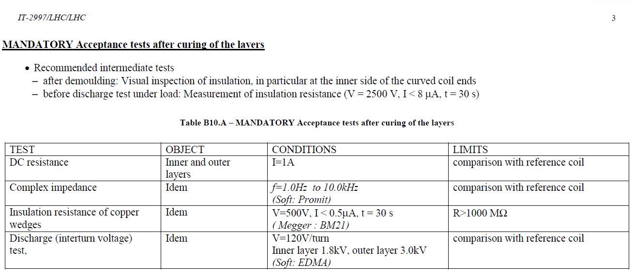
After curing of the layers
MB has got 40 turns, 15 inner and 25 outer

Slide 10
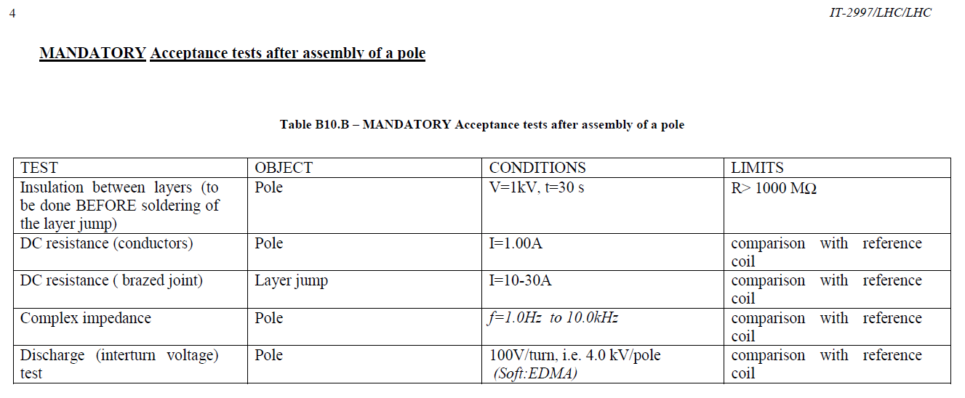
After assembly of a pole

Slide 11
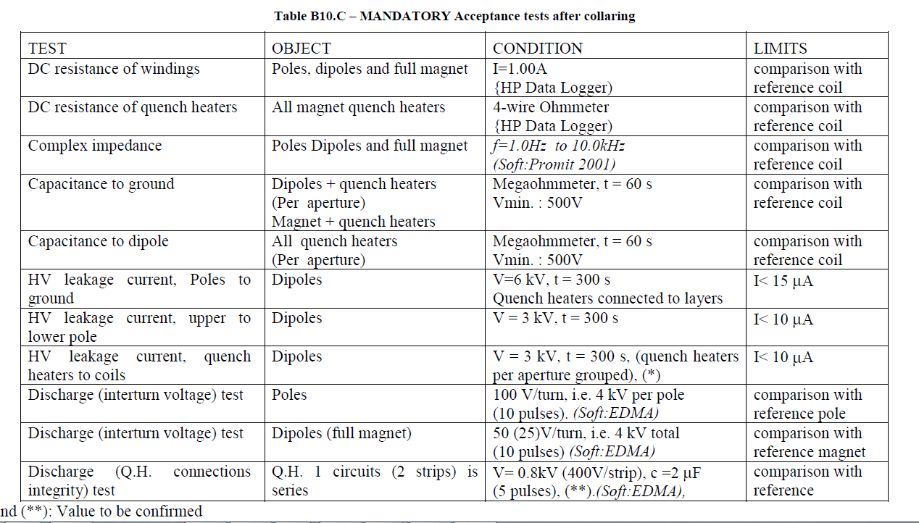
After collaring

Slide 12
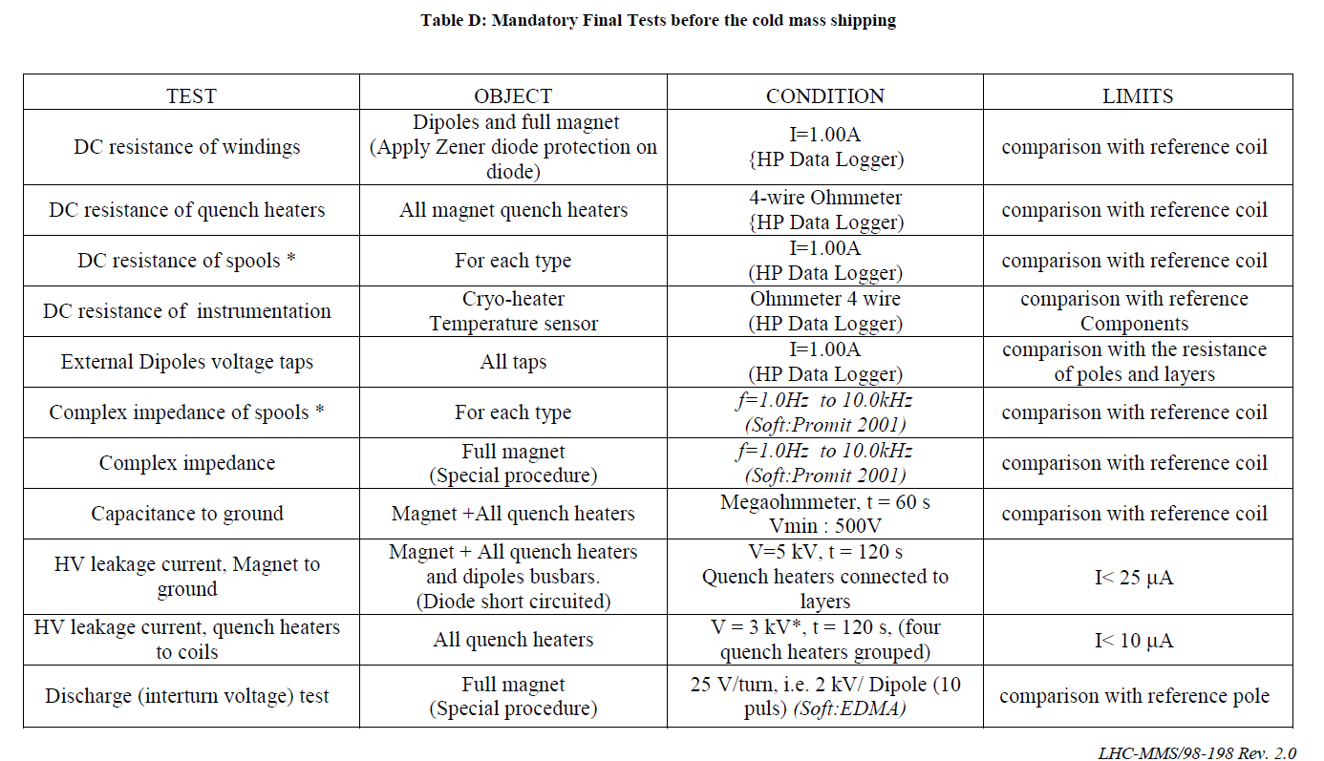
After cold mass completion

Slide 13
In addition, more recent document exists
EDMS 1264529
“GUIDELINES FOR THE INSULATION DESIGN AND ELECTRICAL TEST OF SUPERCONDUCTING ACCELERATOR MAGNETS DURING DESIGN ASSEMBLY AND TEST PHASE”

Slide 14
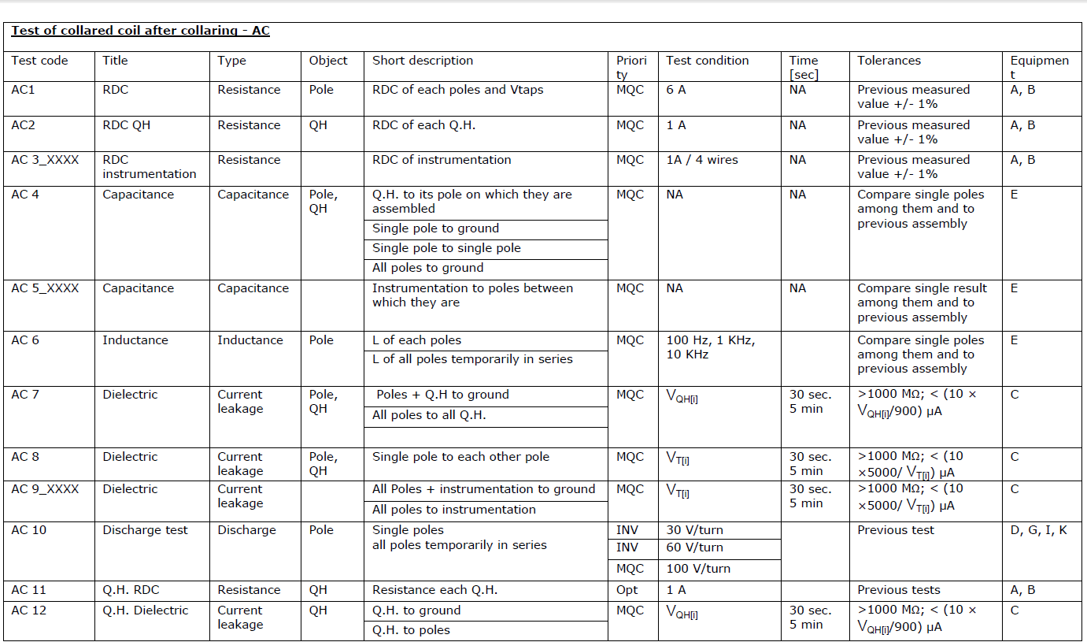
Example

Slide 15
Question 4
Project plan including the model work and the production period and also including the technical organization structure at CERN (who will be the person in charge for the technically practical decision).
See below (Joe’s mail).

Slide 16
Question 5
Detailed organization chart showing the different project elements (preferably by WBS) and who is responsible for each element. Who is the project leader? Who controls the schedule?
Work Breakdown Structure (WBS) showing the major elements and sub-elements of the project.
Detailed project plan (Gantt Chart) by WBS for both the R&D program and the production schedule with milestones.

Slide 17
Answer 4-5
Most of the answers are in the presentation on project plan and production strategy
Technical organization structure at CERN, who will be the person in charge for the technically practical decision?
  F. Savary, as responsible for the 11T dipole project, is
    Reporting to HL-LHC Project Management
    Coordinating the design and construction activities
    In charge of technical practical decision, which may be taken after consultation of experts in the MSC group or other groups at CERN, as needed, for example ABP for all matters regarding beam dynamics
  The 11 T dipole is also a responsibility of the MSC group led by L. Bottura. As a matter of fact, the group supports the project in providing resources

Slide 18
Long magnet (prototype and real for the machine)
Responsible person: F. Savary
Simplified WBS:
  Cryo-assembly: D. D. Ramos
  Cold mass assembly: H. Prin
  Collared coil assembly: C. Loffler
  Coils: D. Smekens
  Instrumentation and electrical testing: L. Grand-Clément
  Cold tests: G. Willering
  QA: R. Principe

Slide 19
Short models
Responsible person: F. Savary
Simplified WBS:
  Overall coordination in 927: J.C. Perez
  Coils: D. Smekens
  Reaction treatment and assembly: N. Bourcey
  Impregnation: R. Gauthier
  Collaring: C. Loffler
  Instrumentation: G. Maury
  Electrical testing: F.O. Pincot
  Yoking – shell welding and finishing: F. Lackner
  Cold tests: G. Willering
927
180
SM18

Slide 20
MDT - 927
Magnet Assembly
Winding
Reaction
Instrumentation
Quality Assurance
Mechanical Workshop
Polymer Laboratory
Safety

Slide 21
Covering models and long magnets
Responsible person: F. Savary
Background and expertise: A. Zlobin, M. Karppinen
Structural analysis: F. Lackner
Magnetic design: S. Izquierdo Bermudez
Quench heater performance: S. Izquierdo Bermudez
Quench protection system (machine): A. Verweij
Powering: H. Thiesen
Cable: A. Ballarino
Scheduling: R. Moron-Ballester
Magnetic measurements: L. Fiscarelli
QA: R. Principe

