Slide 1
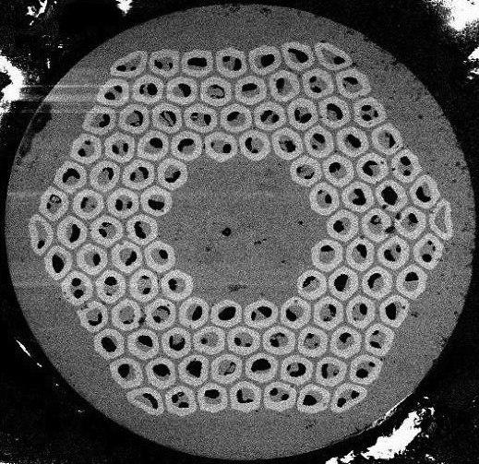
RRP conductor quench analysis in SMC-11T & DS-11T
H. Bajas, M. Bajko, Gerard Willering,
S. Izquierdo Bermudez, J. C. Perez

Slide 3
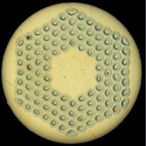
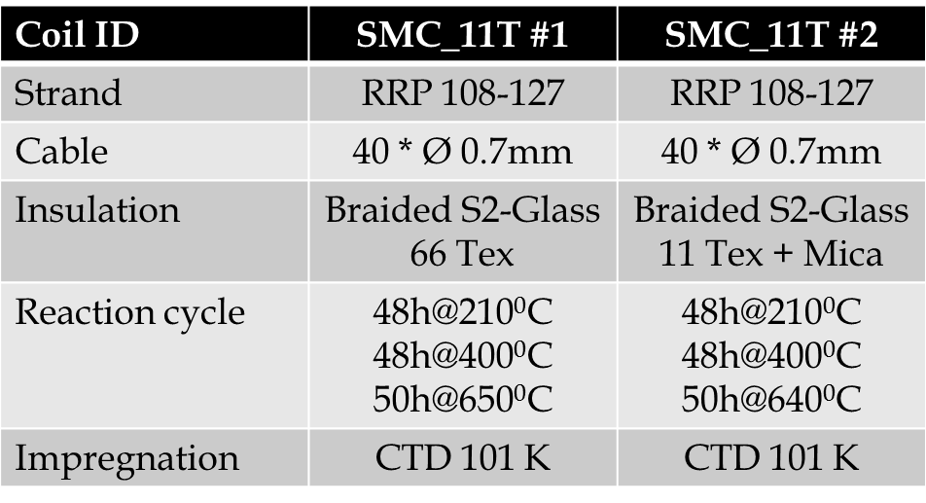

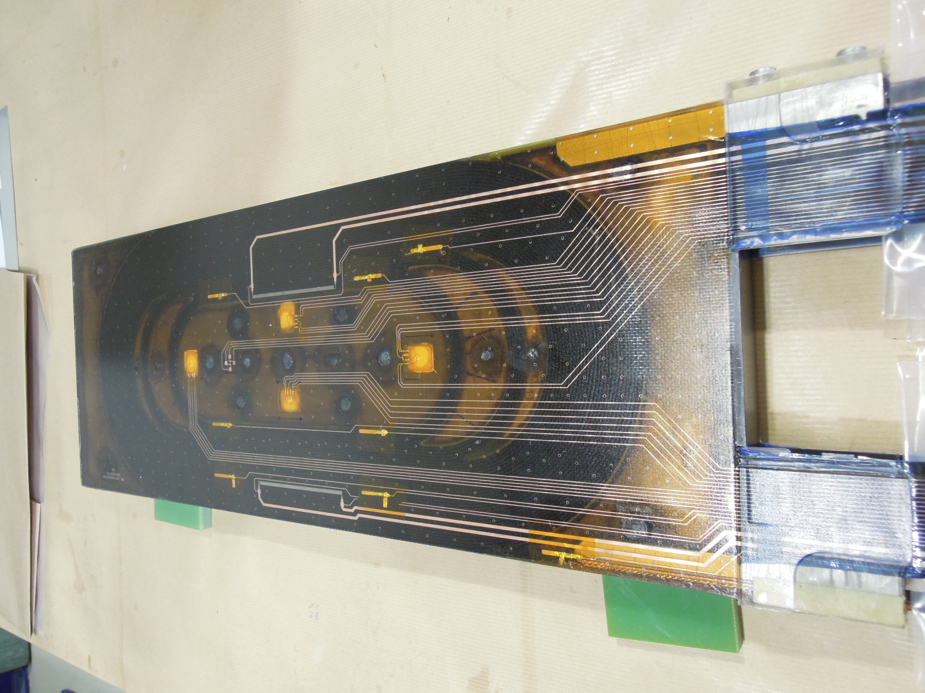
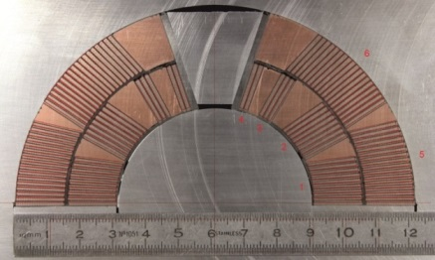
Nb₃Sn RRP strand
40-strand cable
SMC-11T coil
Number of strands | 40 | -
Strand diameter | 0.7 | mm
Copper non-copper ratio | 1.25 | -
Cable width | 14.85 | mm
Bare Cable Thickness | 1.202 | mm
Insulation thickness | 0.1 | mm
Copper surface | 8.55 | mm²
Total surface | 21.10 | mm²
Volume ratio Copper | 0.41 | -
Volume ratio Superconductor | 0.32 | -
Volume ratio insulation & impregnation | 0.27 | -
MBHSP101 coil

Slide 4
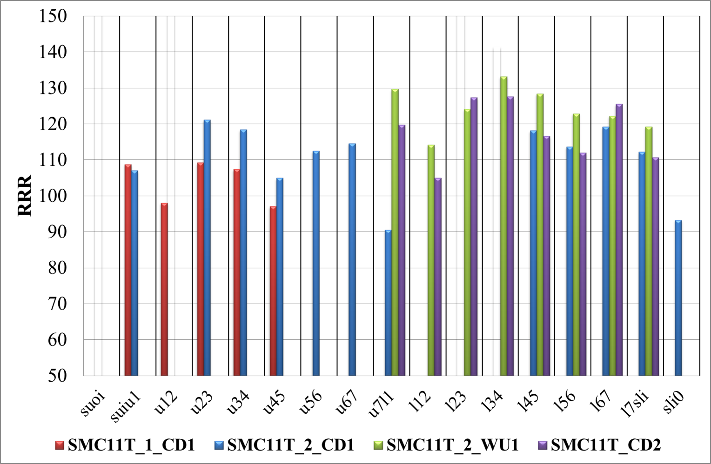

Slide 5
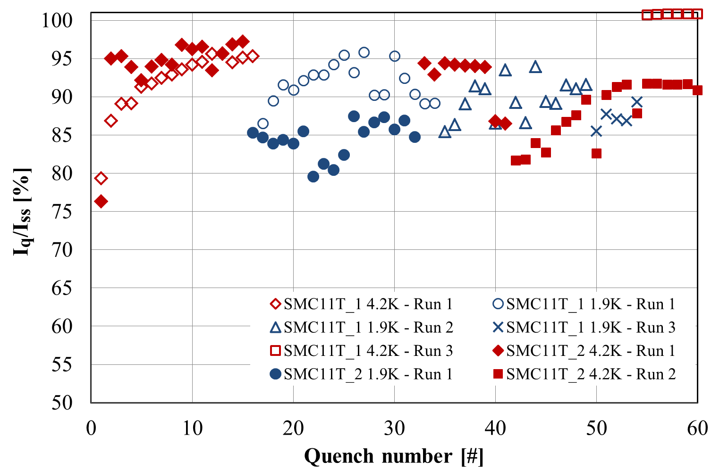
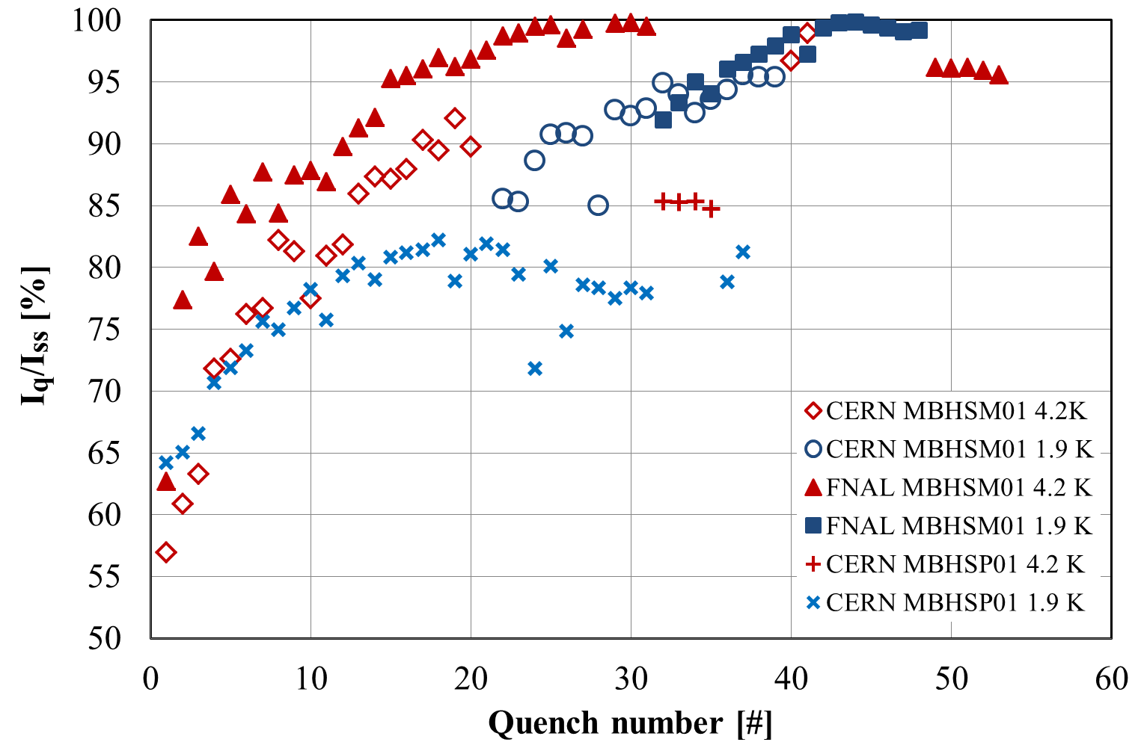
SMC 11T 1 & 2
Dipole 11T CERN & FNAL (mirror, double coil)
Compared to 4.3 K, the performances at 1.9 K are limited and less stable.

Slide 6
CERN SMC-11T quench analysis

Slide 7
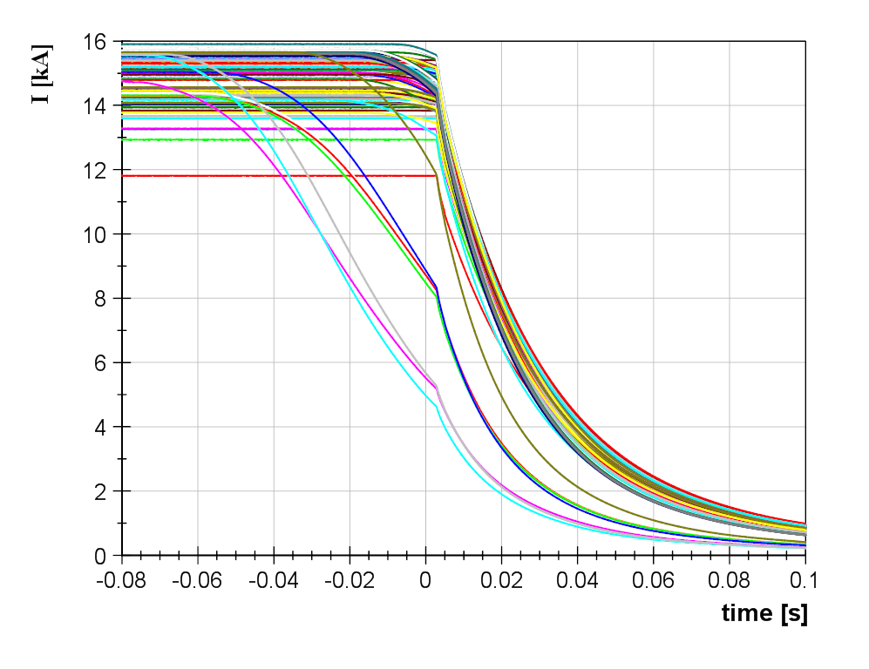
Current decays
SMC-11T-1
Training
MIITS < 7
Maximum Current= 15.9 kA
(13.5T)
Delayed extraction
MIITs > 7.5
Extraction

Slide 8
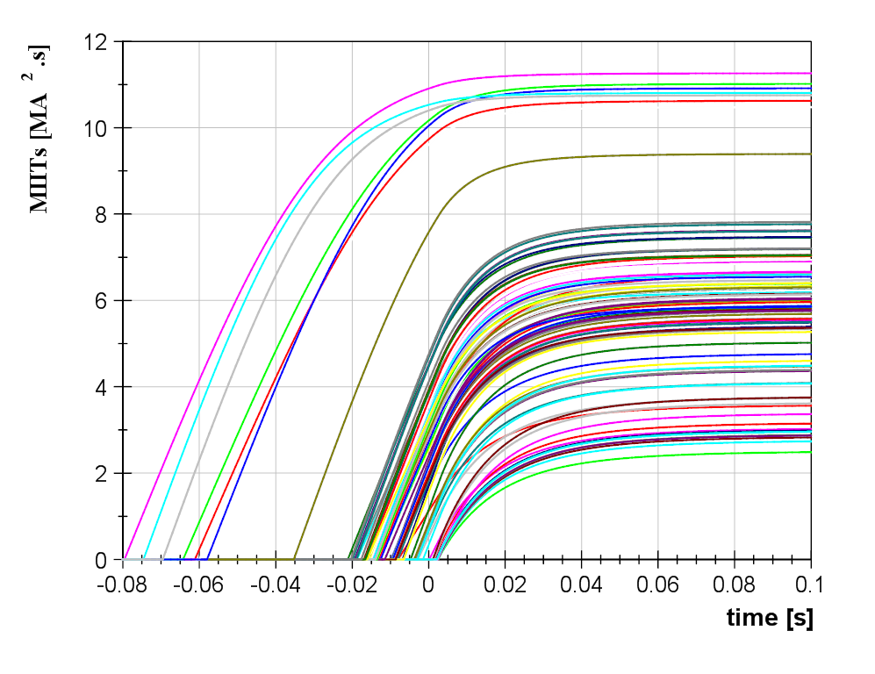
Delayed extraction
MIITs > 7.5
Maximum MIITs = 11.3
Training
MIITS < 7

Slide 9
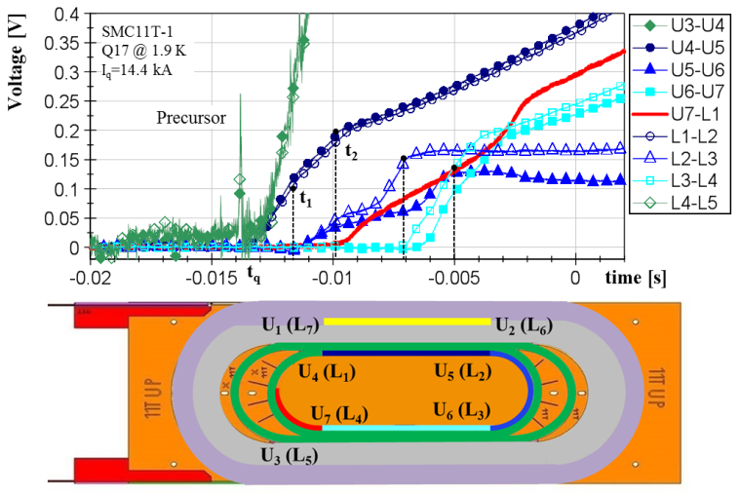
SMC11T: Typical quench pattern (longitudinal velocity along the pole turn)

Slide 10
Three independent methods to derive the temperature of the segments during the quenches from:
the experimental voltage and current signals
theoretical temperature dependences for the material
(Copper, Nb₃Sn, G10 ) properties (resistivity and heat capacity)

Slide 11
Resistive voltage
Transport Current I [A]
Measured voltage u [V]
Segment inductance L [H]
Resistivity ρ [Ω.m]
Segment length l [m]
Copper area S_{cu} [m²]
Resistivity:
Fully propagated

Slide 12
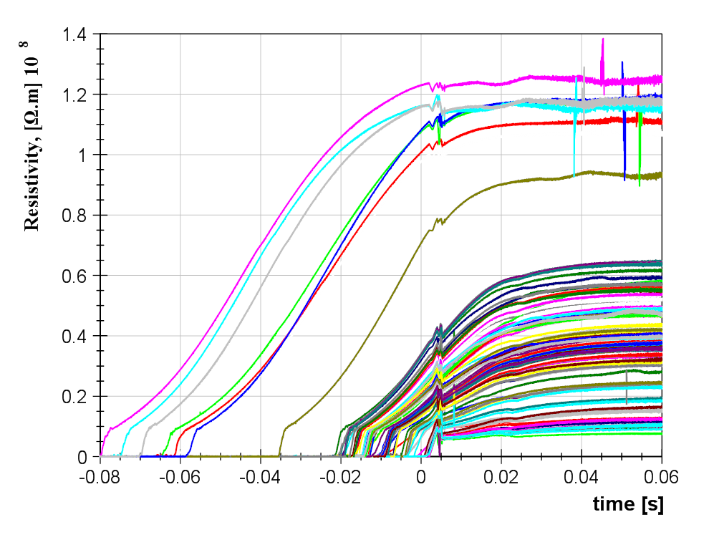
Resistivity as function of time for all the quenches (segment U4-U5)
High MIITs
tests
Training quenches
Delayed extraction

Slide 13
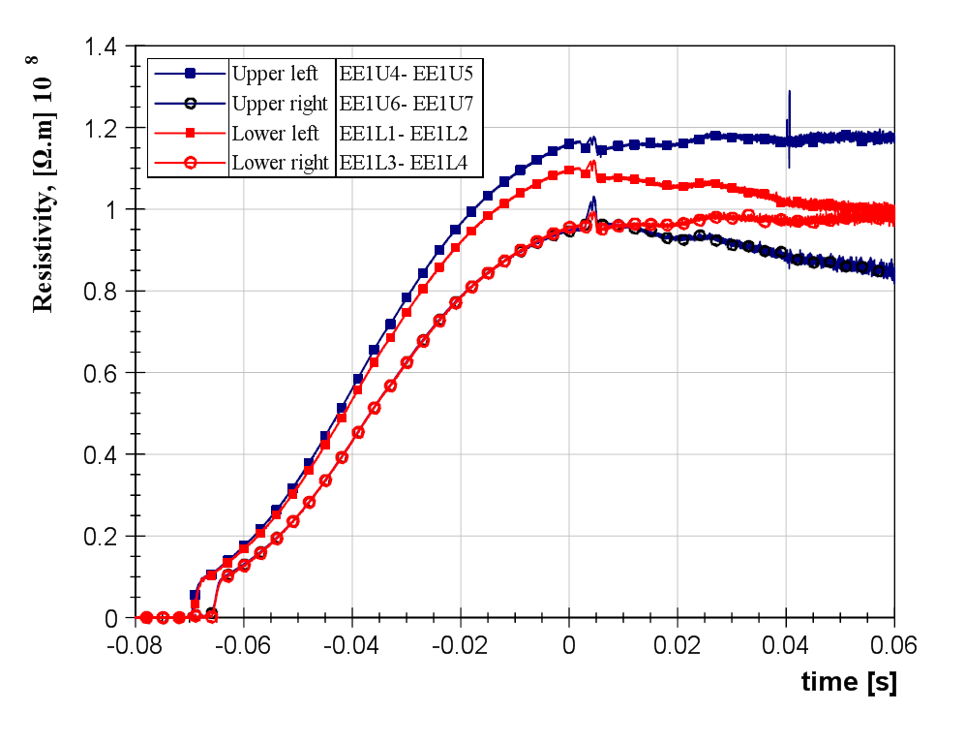
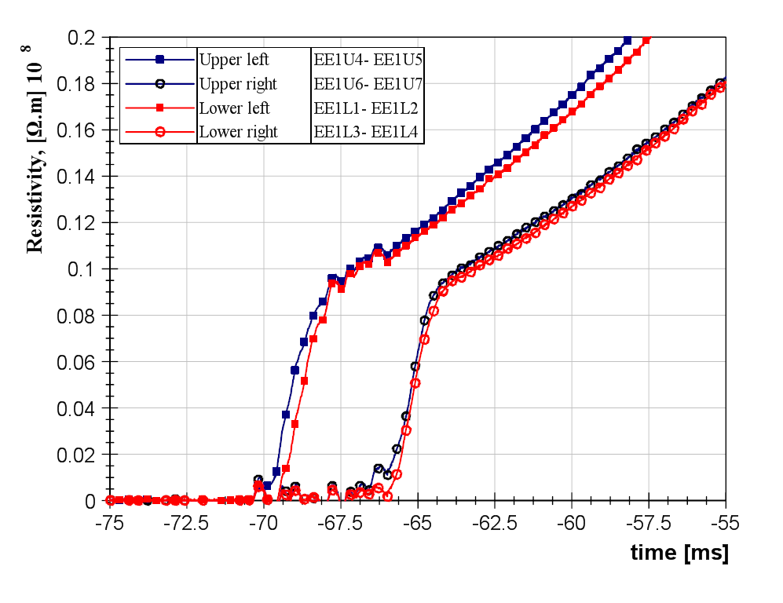
High MIITs case (11 MA².s) in SMC-11T-1
Extremely similar behavior
for the 4 segments.
Segment fully quenched
Symmetric quench (upper/lower)

Slide 14
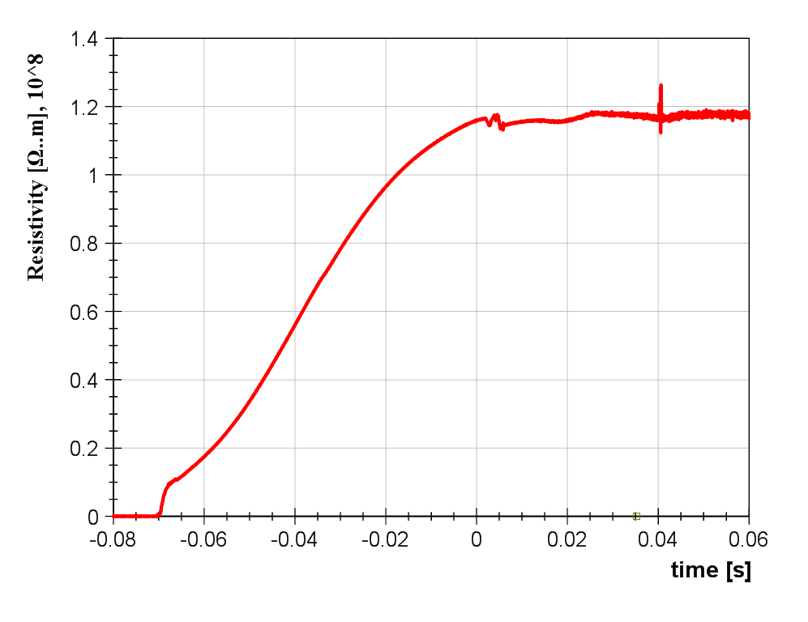
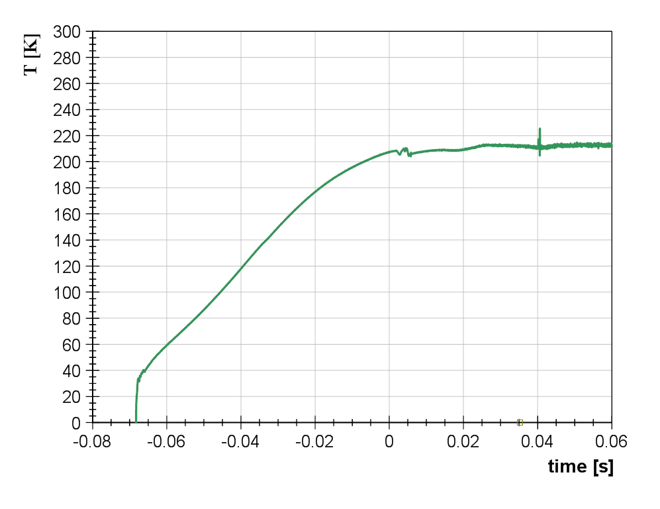
Method 1: Copper as thermometers for segment temperature estimates
Residual Resistivity Ratio RRR
Magnetic field B [T]
Temperature T [K]
m_{r}= 0.005 Ω.m/T
C₀= 1.7 Ω.m

Slide 15
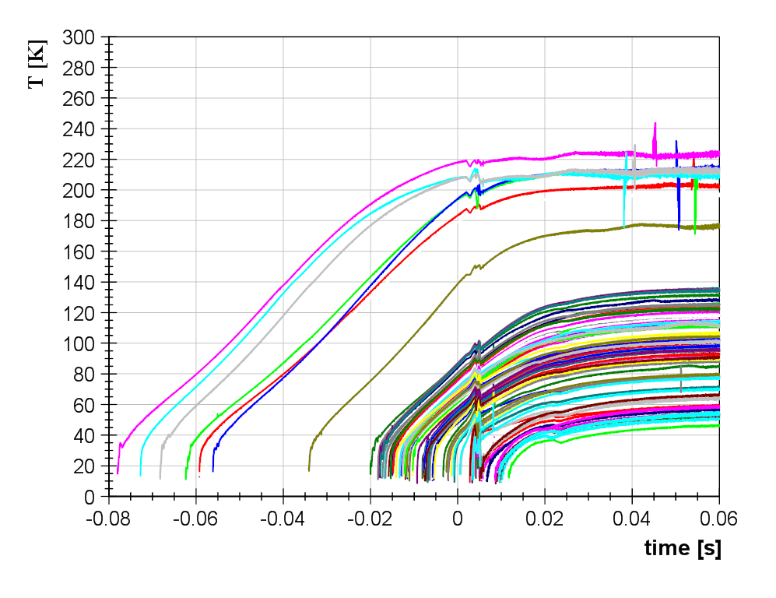
Temperature as function of time for all the quenches (segment U4-U5)
High MIITs
tests
Maximum Temperature 220 K
Training quenches

Slide 16
Copper area S_{cu} [m²]
Theoretic resistivity ρ_{th}
Generated Energy:
Two ways..
Composite total area S_{t} [m²]
Stored Energy:
Volumetric Heat capacity [J.m⁻³.K⁻¹]
Adiabatic assumption and integration:
Two HST estimates

Slide 17
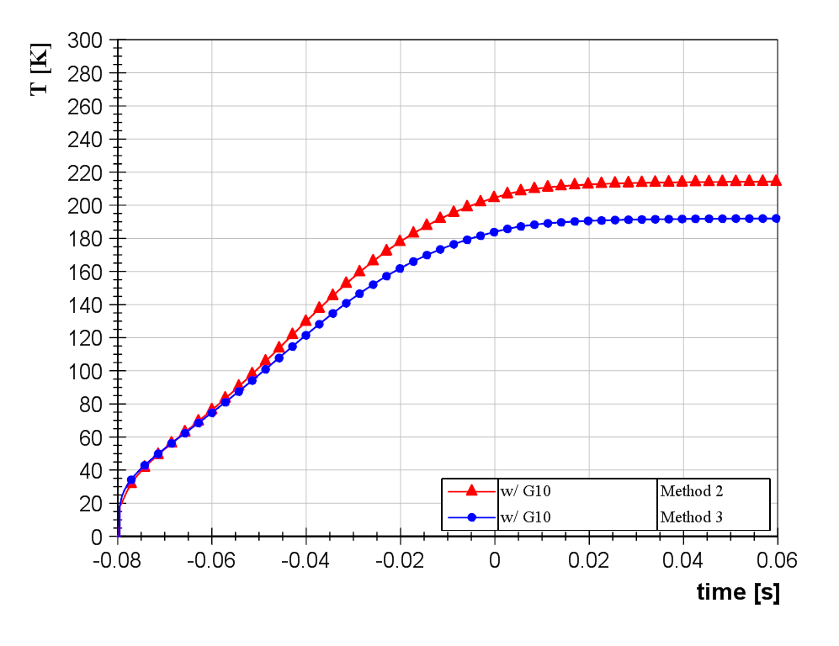
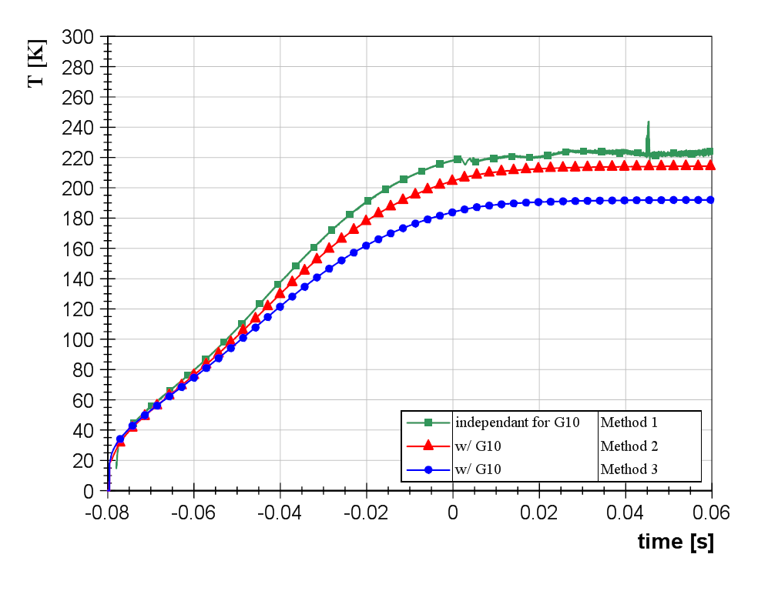
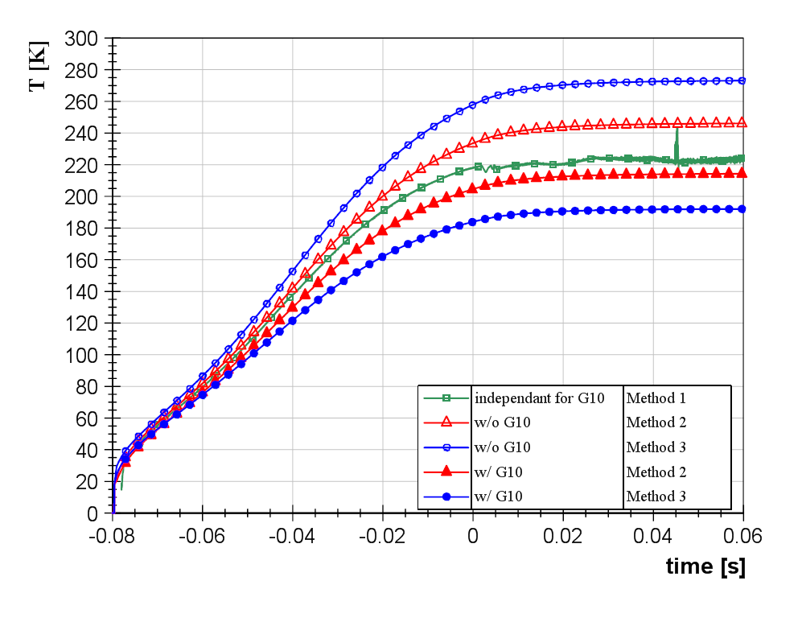
Temperature as function of time for all the quenches (segment U4-U5)
Effect of the insulation+ impregnation (G10 on the HST)

Slide 18
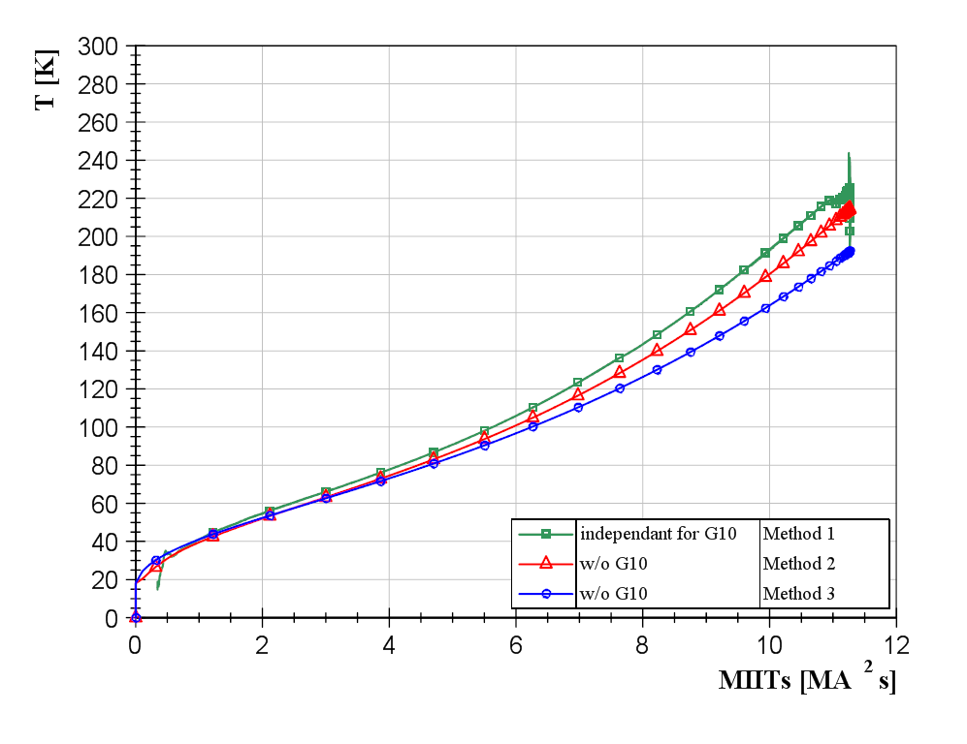
Temperature as function of time for all the quenches (segment U4-U5)

Slide 19
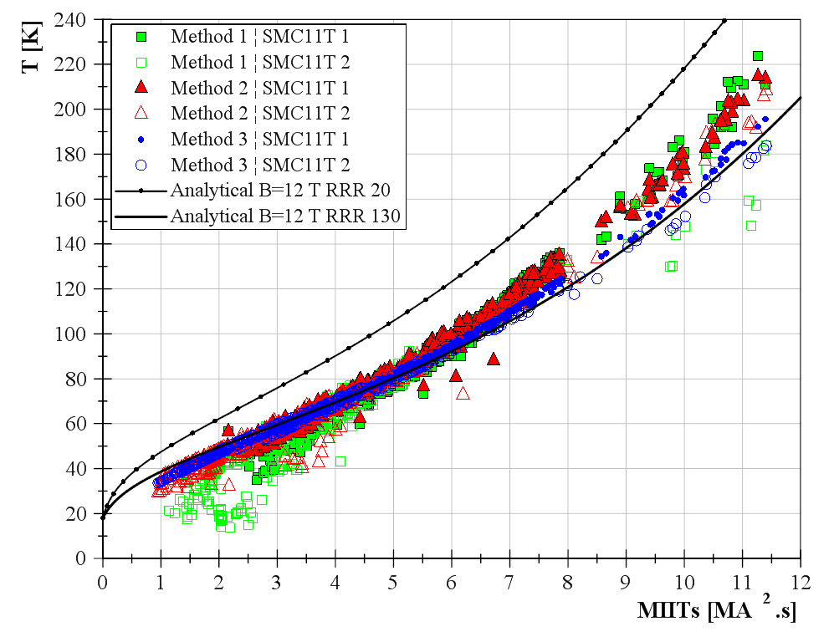
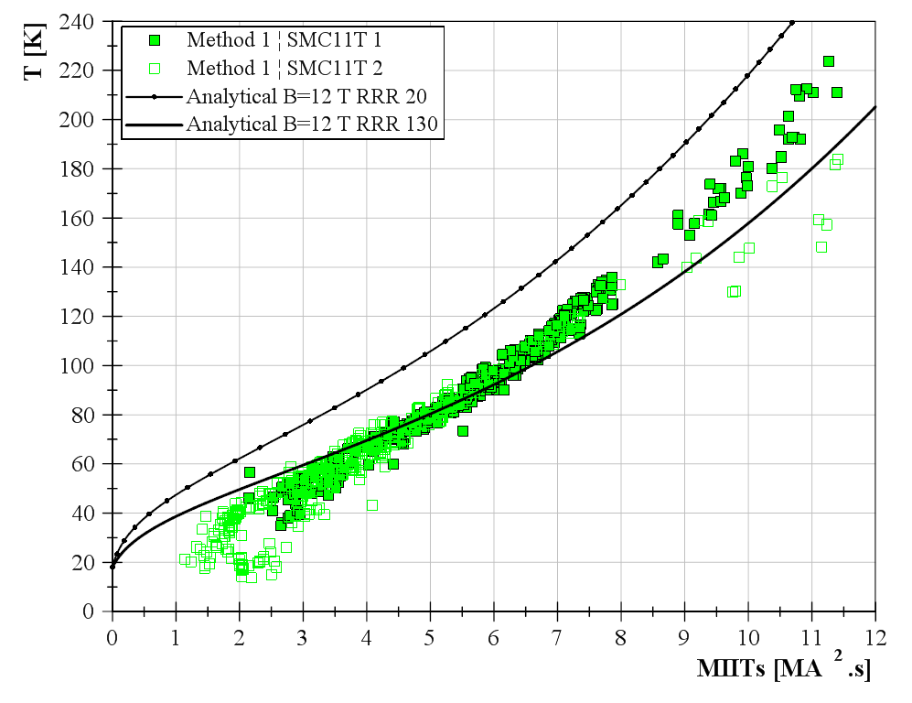
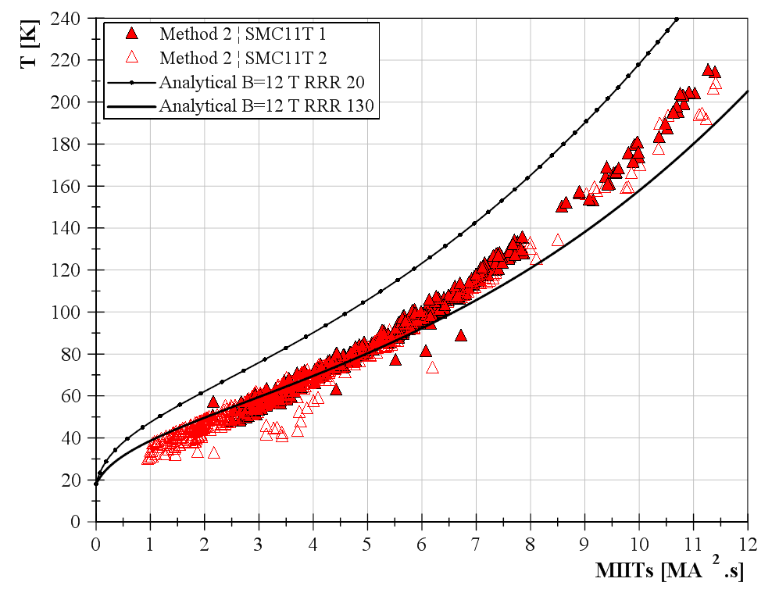
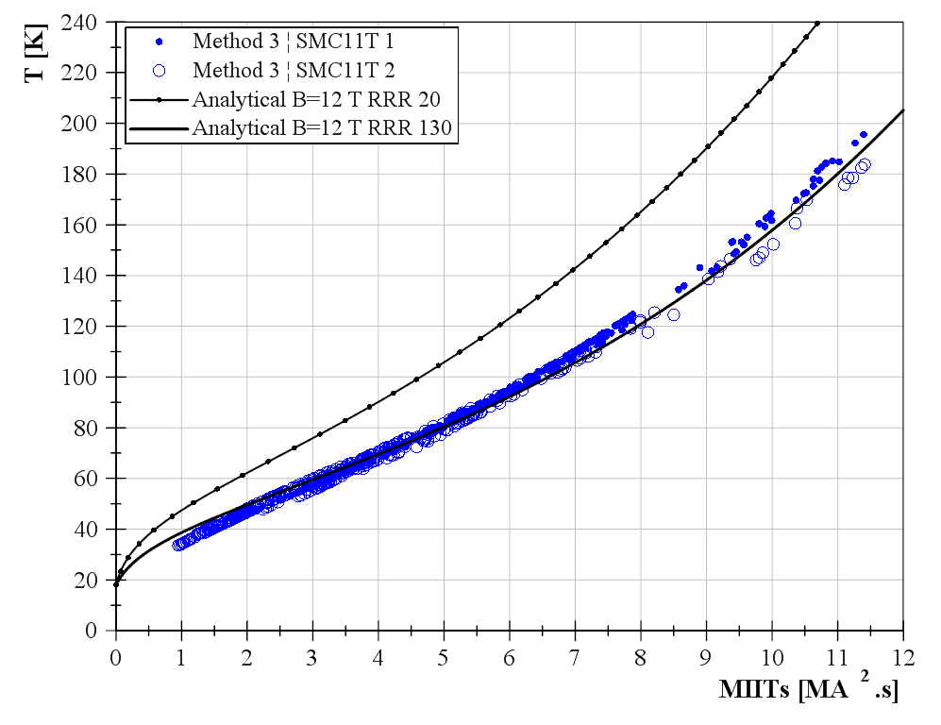
Maximum temperature as function of the maximum MIITs for
all quenches
all location
3 methods
Purely theoretical approach:
Relevant set of material properties as proved by the coherence of the 3 methods.
Good agreement with theory.
MIITs see by the segments

Slide 20
CERN MBHSP01 quench analysis

Slide 21
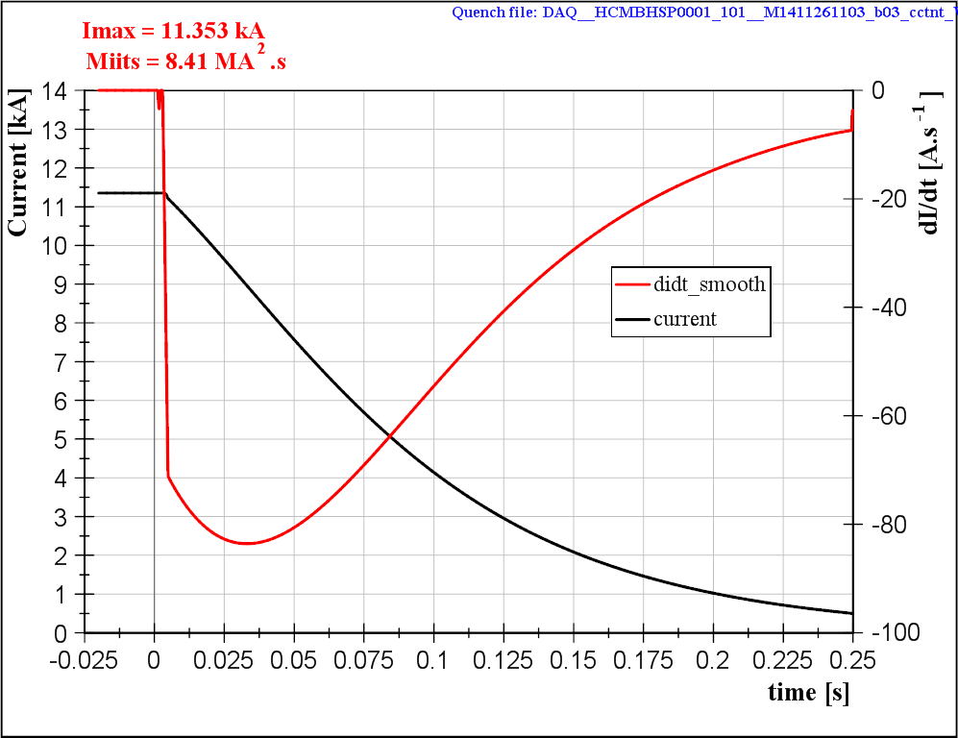
Training
Quench

Slide 22
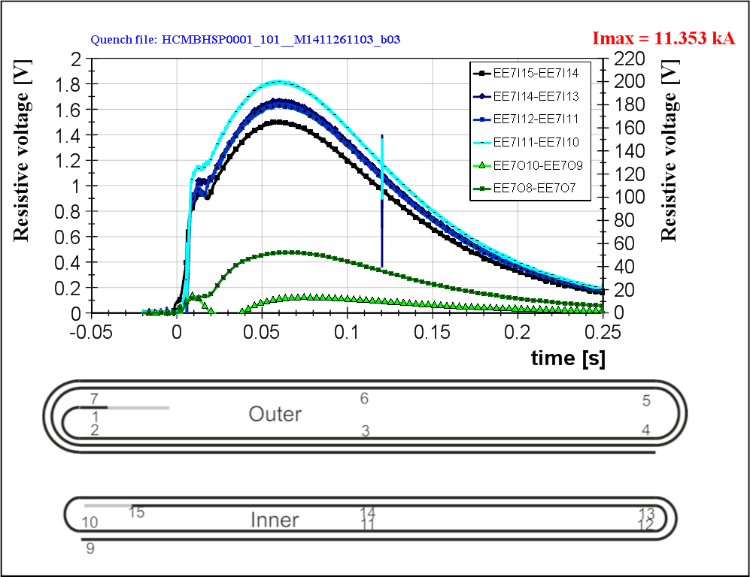
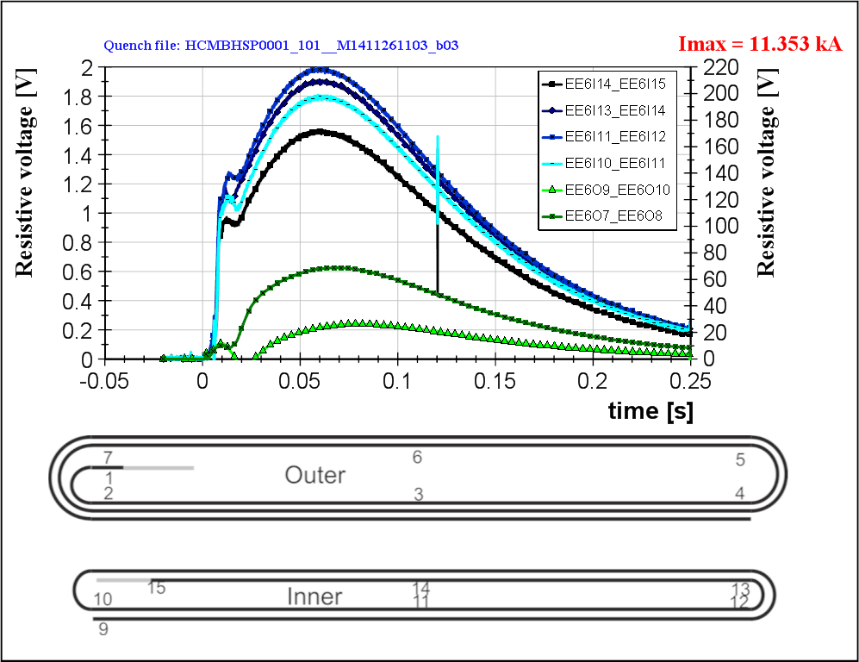
Training
Quench

Slide 23
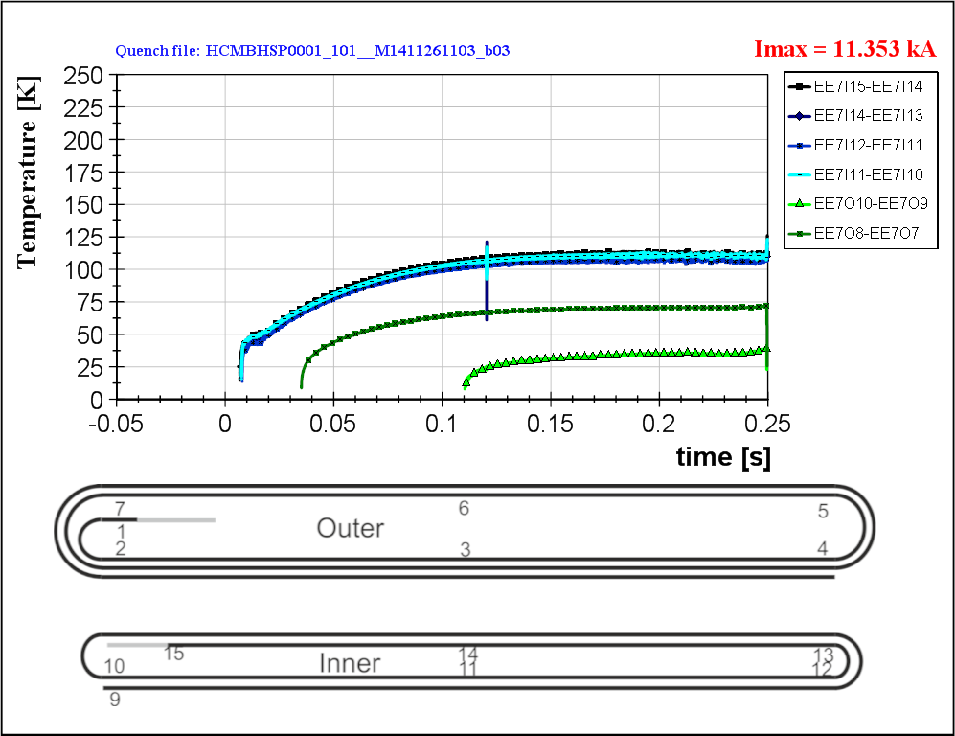
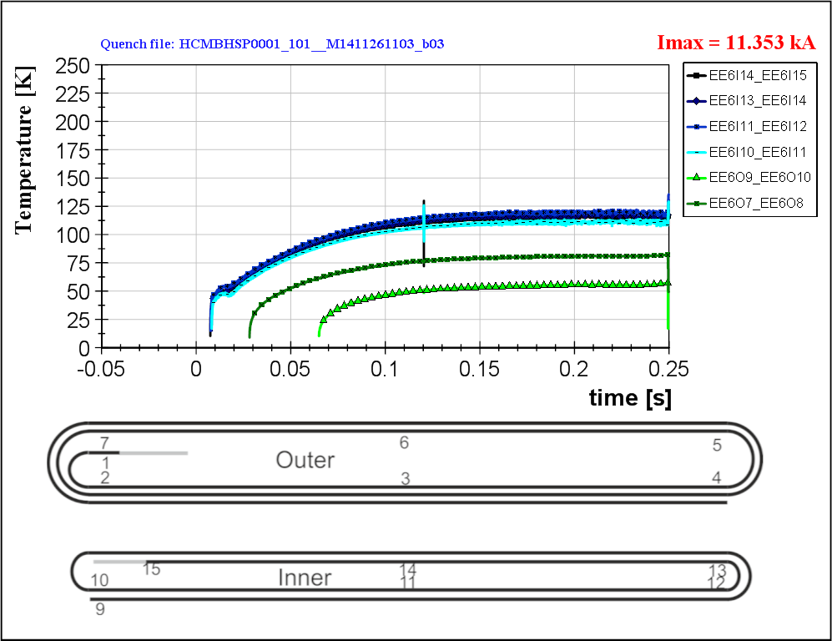
Training
Quench

Slide 24
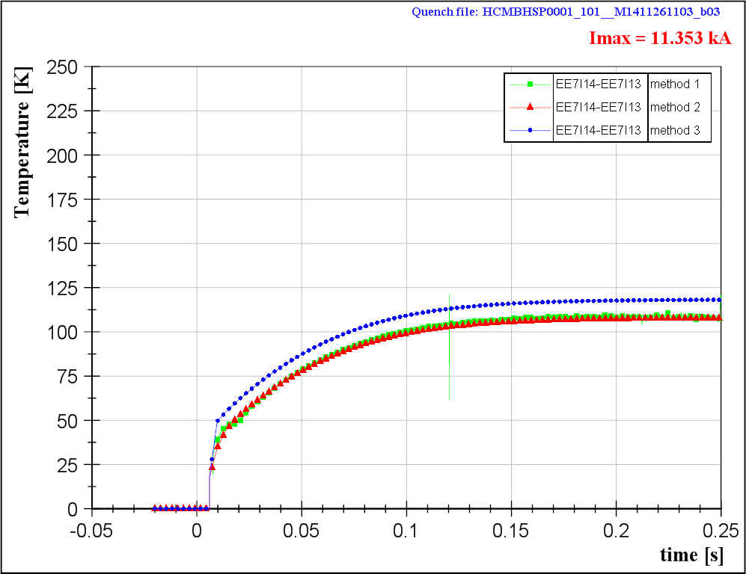

Slide 25
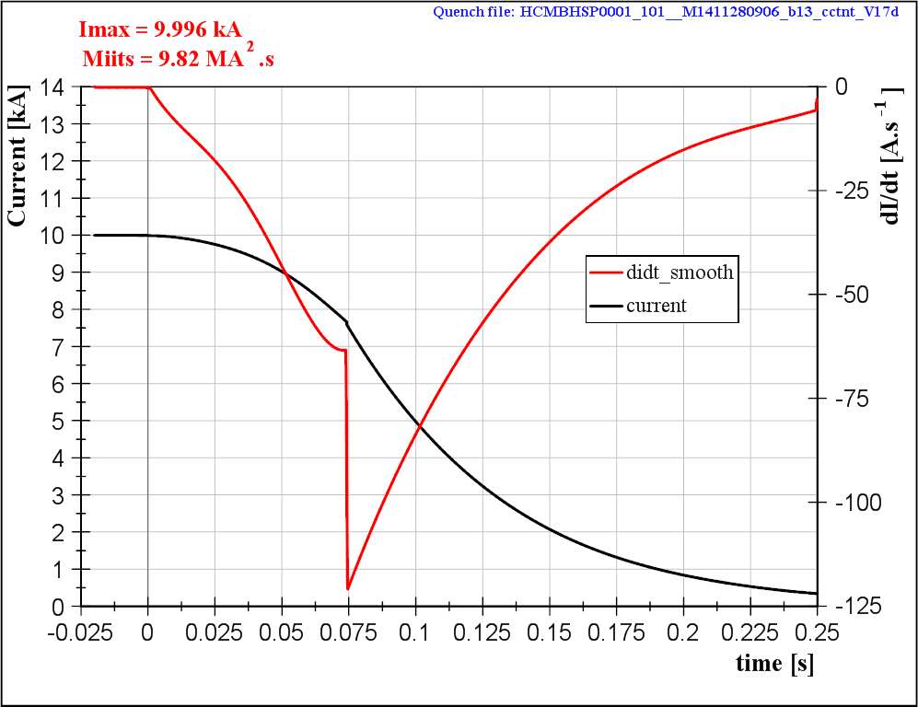
Quench Heater test (10 kA)

Slide 26
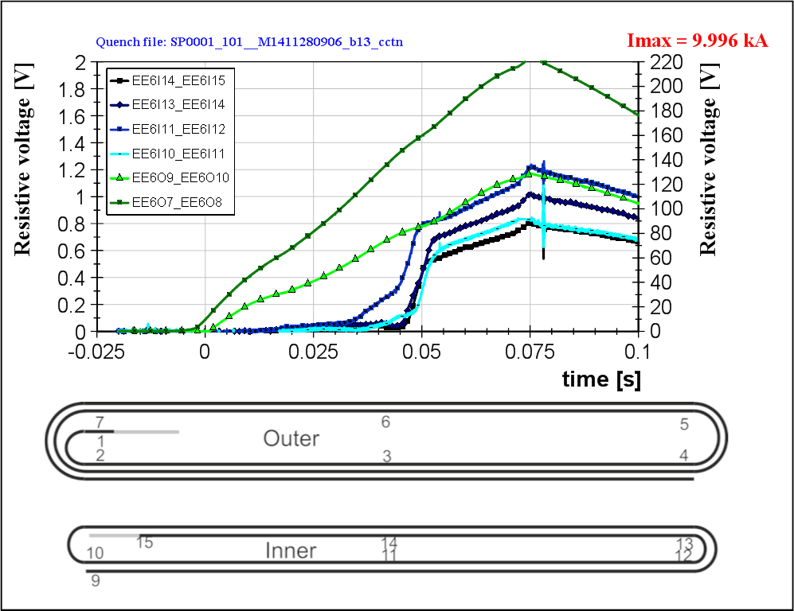
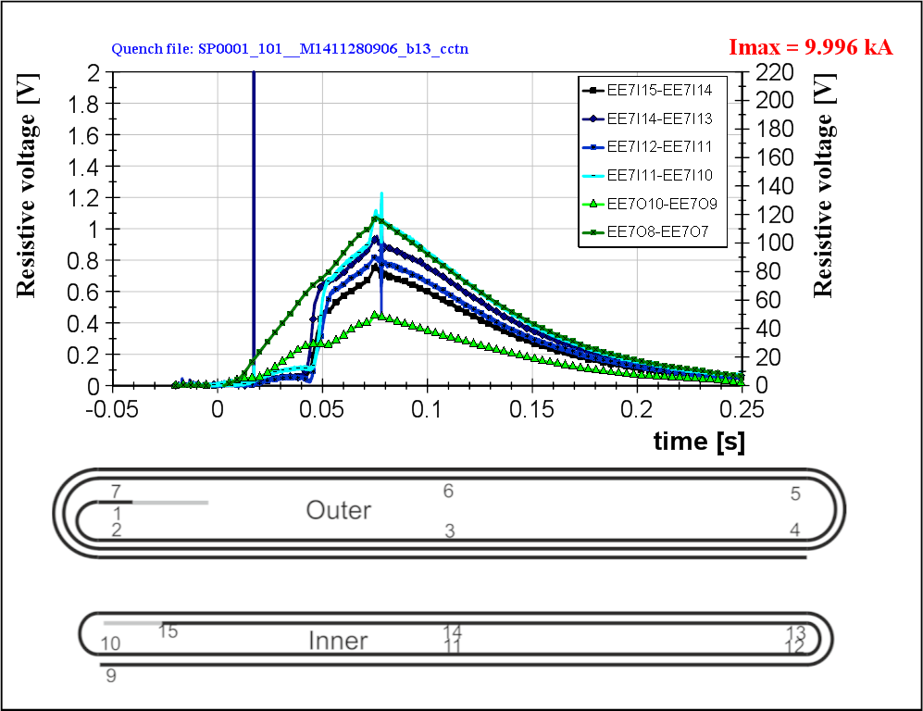
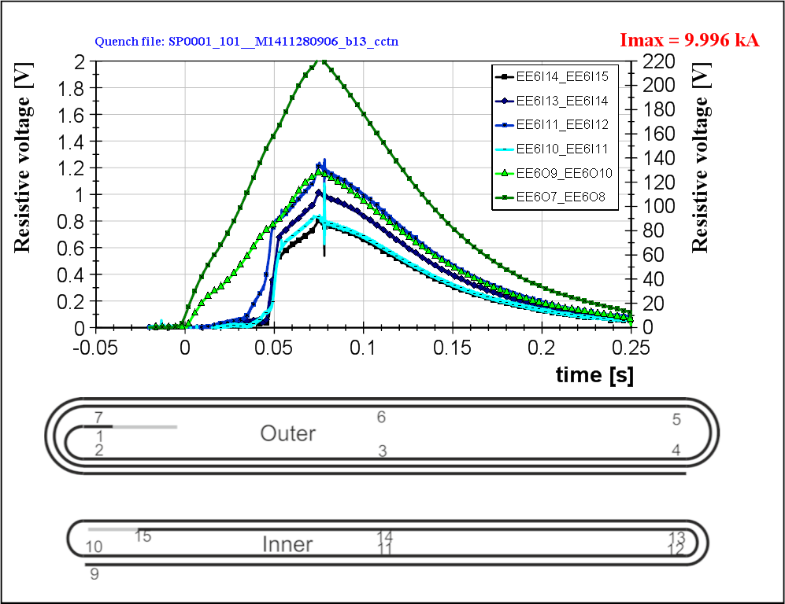
Quench Heater test (10 kA)

Slide 27
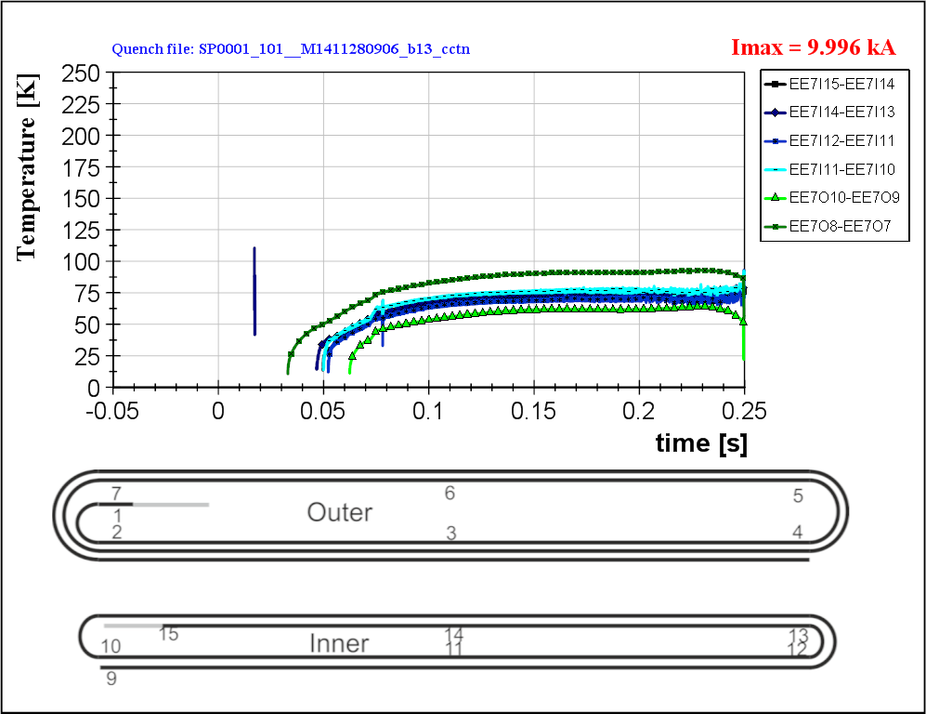
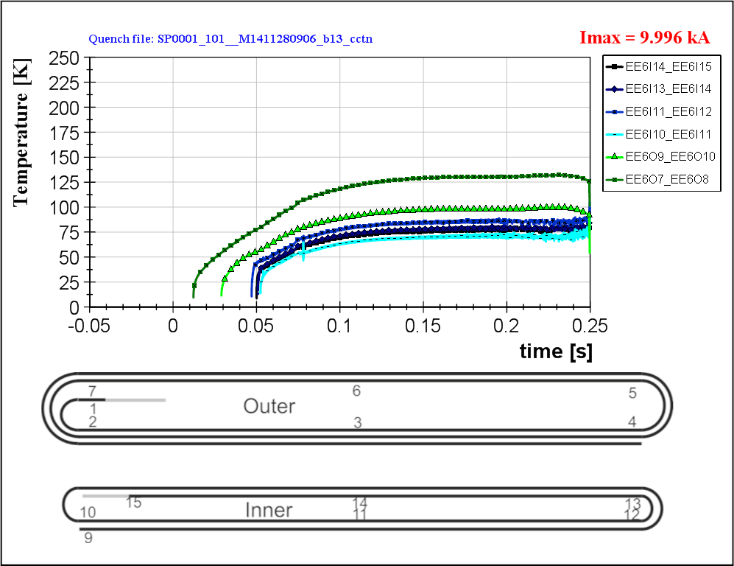
Quench Heater test (10 kA)

Slide 28
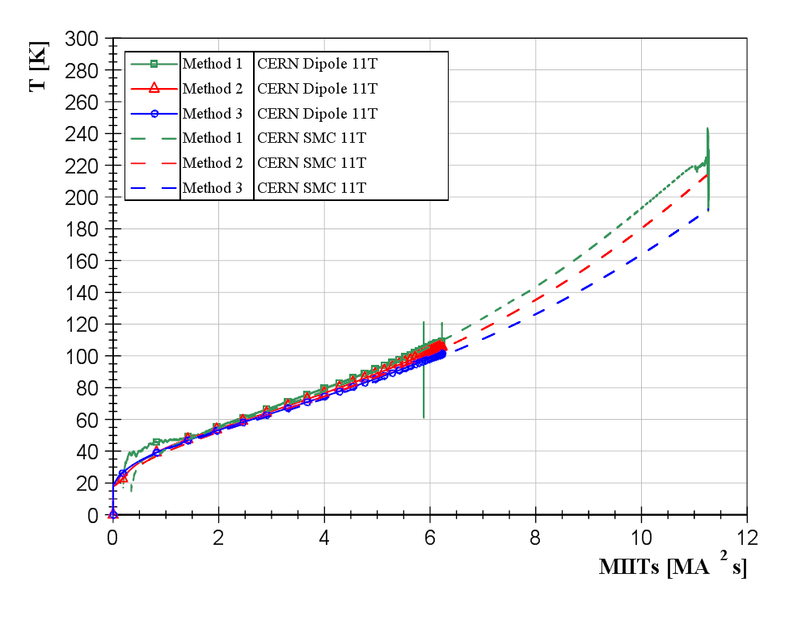
Good agreement with SMC11T behavior

Slide 29
Quench performance limited at 1.9 K as compared to 4.3 K.
With the present set of material properties, the Hot Spot Temperature can be computed from the 0D adiabatic model with good agreement with temperature estimates from experimental signals.
Good coherence between both SMC-11T and with 11T-dipole.

Slide 30
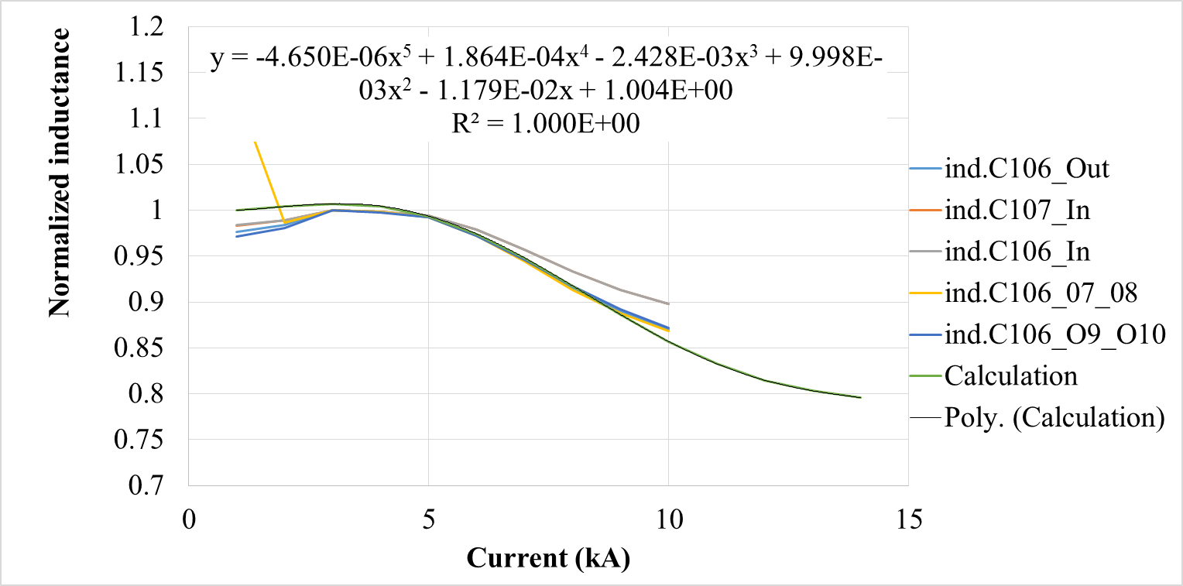

Slide 31
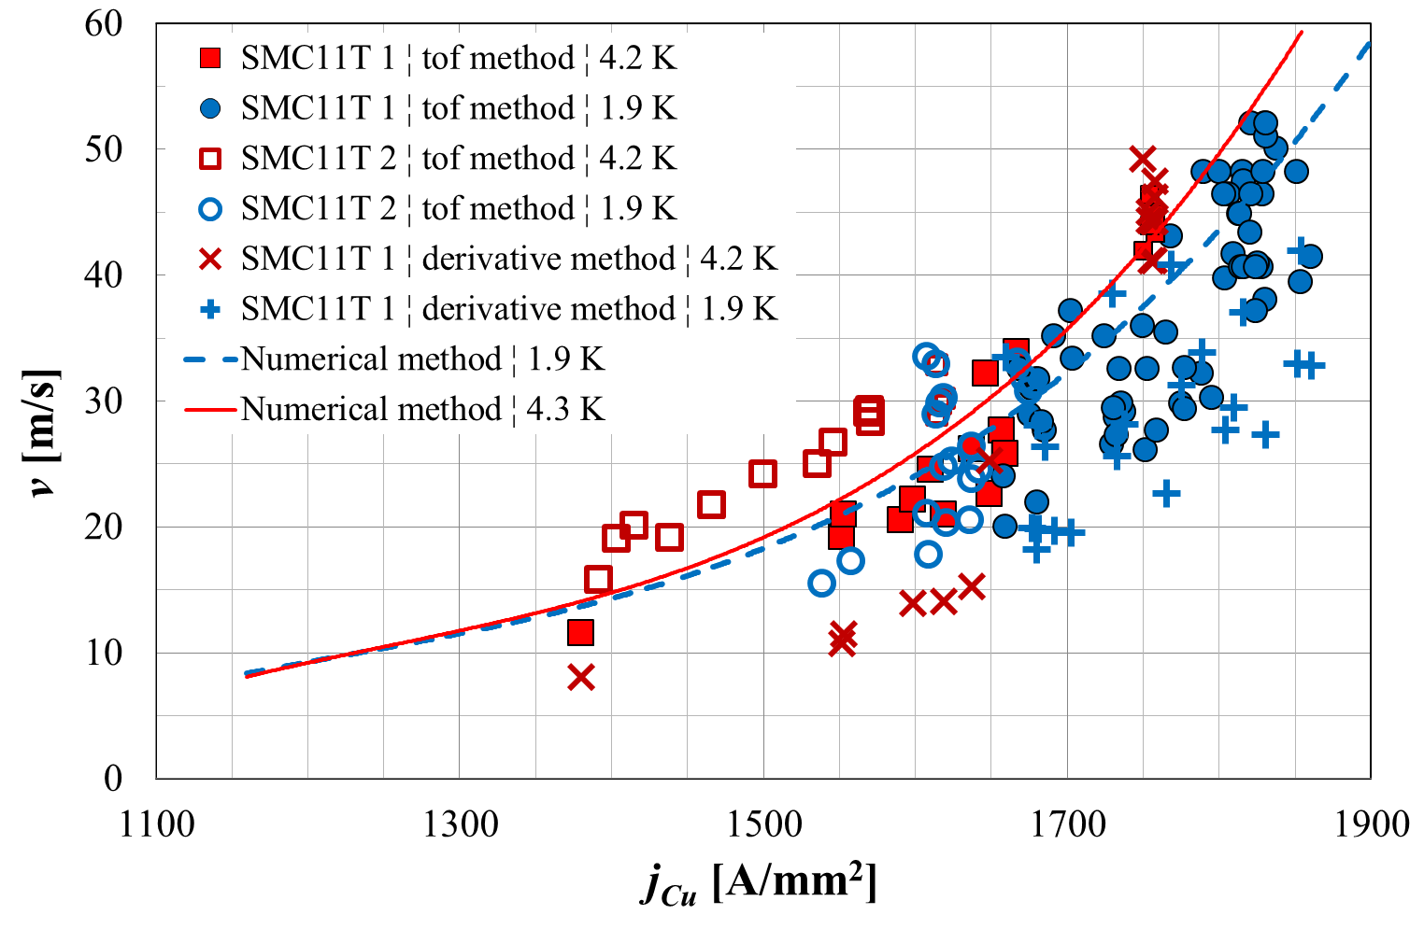

Slide 32
80-µm-thick C-shaped Mica film and a braided sleeve made of S2-glass fibers (total thickness = 100-µm^{[2]})

Slide 33
SMC11T-2
SMC11T-1
HCMBHSP0001-101

Slide 34
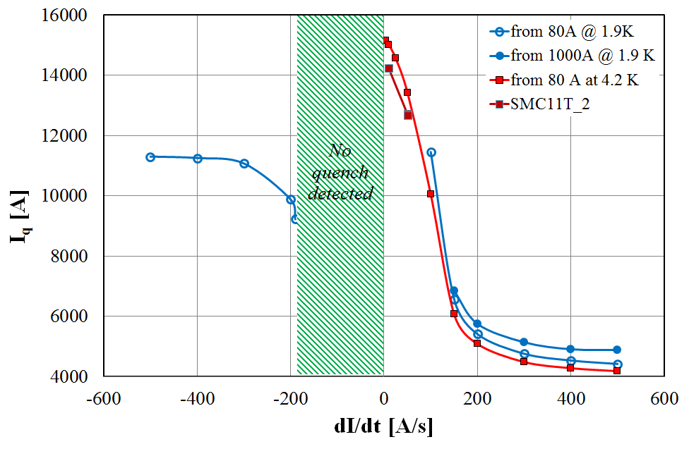

Slide 35
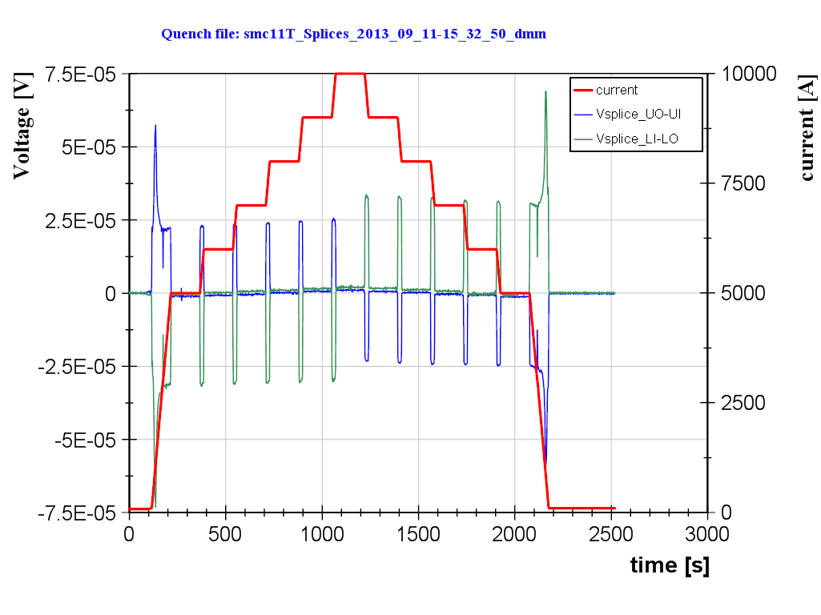
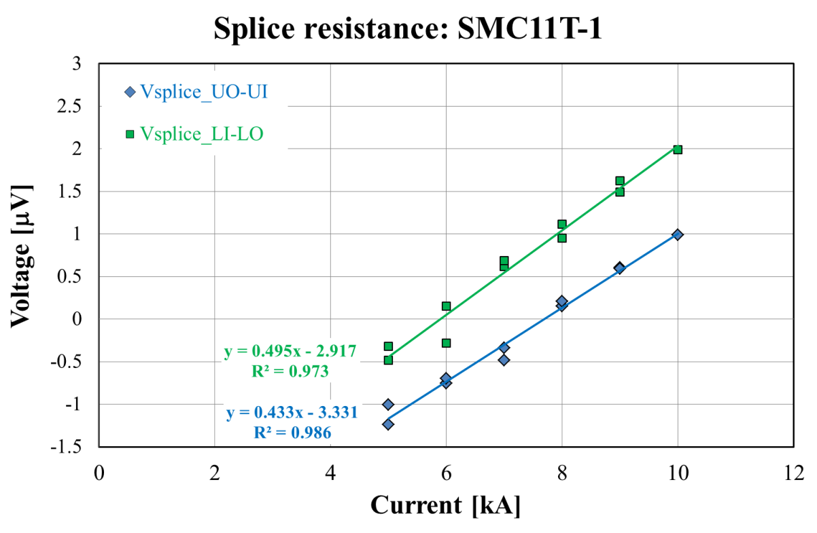
Splicing using MOB 39 as flux and solder 96/4 Tin/Silver

Slide 36
