Slide 1
2nd International Review of the HL-LHC 11 T Dipole for DS Collimation
Powering of the MB circuit
Hugues THIESEN TE-EPC

Slide 2
Outline
Introduction
Trim Power Converter
Circuit protection
Proposal
LS2
Conclusion

Slide 3
Introduction
Objective of the project:
  Replacement of few MB magnets by 11 T assemblies (2 x 11 T dipoles and additional collimators)
I_RB (kA)
Magnet | L [mH]
MB | 102
MBH | 132 ( = 2 x 66)
I_TRIM (A)

Slide 4
Introduction
The Main dipole circuit
  The 154 MB magnets are connected in series
  Half of the magnets are connected on the positive line, half of magnet are connected on the negative line
RB
[13kA/±200V]

Slide 5
Trim Power Converter
Each pair of 11 T dipoles needs a trim power converter
The pairs of 11 T dipoles are always connected to the positive line
RB
[13kA/±200V]
RTBH1
RTBH2

Slide 6
Trim Power Converter
Electrical Characteristics
  Current rating: 0 to -250A
  Voltage rating: ±1.5 V + V_cable (< ±40 V)
  Accuracy: 40 ppm (12 mA)
RB
[13kA/±200V]
I
V
RTBH1
RTBH2
P > 0
P < 0

Slide 7
Trim Power Converter
Common Mode voltage (V to earth)
  Important constraint for the trim PC
  The RB circuit is connected to the earth at the mid point of the negative EE system
  The Trim power converter have to be floating. The common mode voltage od the PC depends of the position of the 11 T dipole assembly.
  Worst case is for the 1st magnet

Slide 8
Trim Power Converter
Common Mode Voltage (V to earth)
  Worst case: 1st magnet
  Normal Operation (EE switches closed): 200 V
±200 V
±200 V

Slide 9
Trim Power Converter
Common Mode Voltage (V to earth)
  Worst case: 1st magnet
  Quench (EE switches opened): 700 V
-500V ±200 V
±200 V
1000 V
1000 V

Slide 10
Trim Power Converter
Common Mode Voltage (V to earth)
  Worst case: 1st magnet
  Quench + Earth fault: 1200 V
-1000V ±200 V
±200 V
1000 V
1000 V

Slide 11
Trim Power Converter
Current Control
  The RB power converter and the Trim power converters are coupled
  Decoupling control is not requested because the coupling effect is low (coupling impedance is 15.54 H)
  The current control of the Trim Power Converters will be based on FGC3 (digital RST current loop)

Slide 12
Circuit protection
Power Interlock Controller (PIC)
  All the LHC power converters are connected to the PIC for the protection of the circuit (Quench, Powering failure, etc…)
  As the RB power converter, the trim power converters have to be connected to the PIC
    Same PIC = no problem
    Different PIC = need communication between the PICs

Slide 13
Circuit protection
Trim Power Converter Failure
  The LHC power converters are voltage sources (low impedance)
  In case of Trim power converter failure the main current can pass trough the trim circuit
I_TRIM < 0
I_RB
RBH
RBH

Slide 14
Circuit protection
Trim Power Converter Failure
  Additional resistance
    If R_series <<, Then high over current
    If R_series >>, Then turn on of Diode (6V)
R_series
I_TRIM < 0
I_RB
RBH
RBH

Slide 15
Circuit protection
Trim Power Converter Failure
  No protection problem with I_TRIM > 0
    Diode in series
I_TRIM > 0
D_series
I_RB
RBH
RBH

Slide 16
Circuit protection
Open issue
  Interaction Voltage ripple (0.1 V – 0.5 V) and QPS
I_TRIM < 0
I_RB
RBH
RBH

Slide 17
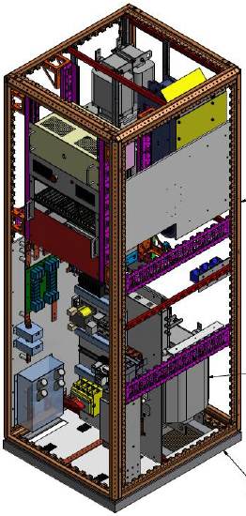
Proposal
The Trim Power Converter will be based on an existing power converter
  COMET PC [±250A/±120V]
  LxDxH: 0.8 m x 0.9 m x 2.3 m
  Total: 14 PCs + spares

Slide 18
Integration for LS2
Concerned Magnets in LS2
  Two options
    2 magnets in point LHC-2 (sector S12 and S23)
      MBB.A10.L2 and MBA.A10.R2
    4 magnets in point LHC-7 (sector 67 and 78)
      MBA.B8.L7, MBA.B10.L7 and MBB.B8.R7, MBB.B10.R7

Slide 19
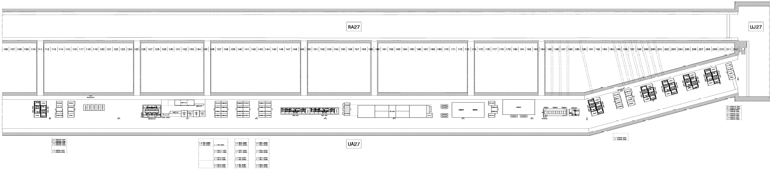
Integration for LS2
Point LHC-2
  The Trim Power converters can be installed in the UAs

Slide 20
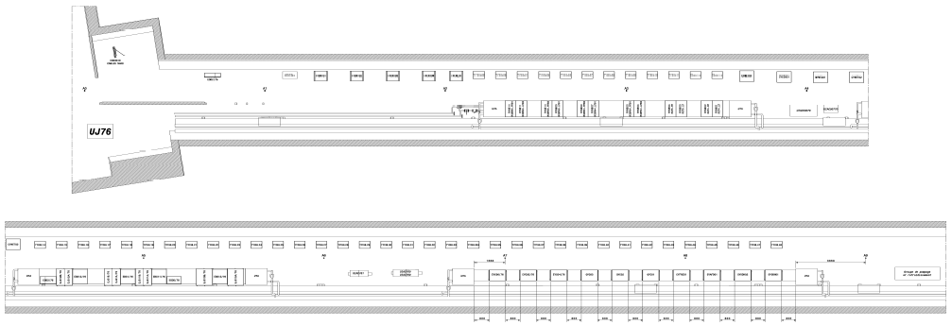
Integration for LS2
Point LHC-7
  The Trim Power converters can be installed in the TZ76

Slide 21
Conclusion
The proposal for the trim power converter is based on COMET power converter [±250A/±120V]
  Adaptation of the output voltage (< 40 V)
  Adaptation of the CM voltage (< 1500 V)
Open issues
  Protection of the circuit (R_series)
  Interaction QPS and V_ripple

Slide 22
Conclusion
Needs
  3 (2+1) power converters in LS2 (or 5)
  15 (12+3) power converters in LS3 (or 13)
Next steps
  Specification of the Trim power converters
  Design of the Trim power converters
  Production of the 1st batch

