Slide 1
Wecome to 11 T Int. Review
L. Bottura - L. Rossi

Slide 2
Scope and purpose
To review the basic design of the 11 T dipole, taking into account magnetic, mechanical and thermal operating conditions in the LHC P2: is the design meeting the targets with sufficient margin? Does the experience of the first R&D phase at Fermilab and CERN (and of ten years of LARP & USA magnet basic programs) support the chosen specifications and the feasibility of meeting them with adequate margin?
2. Is the engineering design including the 3D interfaces to other systems, namely the cold-warm-cold by-pass lodging the collimation system, sufficiently developed to assess that there be no show stoppers in the construction of the magnetic part, the cold mass assembly, the cryostating, and the installation and integration in the machine? Is the protection and circuit integration sufficiently analysed?

Slide 3
3. Is the final design taking stock of the best features demonstrated in the two development lines, i.e. FNAL and CERN?
4. Is the plan for models and prototypes well thought? Is the preliminary construction plan credible?
5. Are the design and manufacturing plans sufficiently well developed to engage in the upcoming significant procurements, i.e. Nb3Sn strand and cable procurement and production, and magnet components procurement (collars, yoke, shells, etc.)?
6. Is there any specific area in which the project is running important technical or managerial risks?

Slide 4
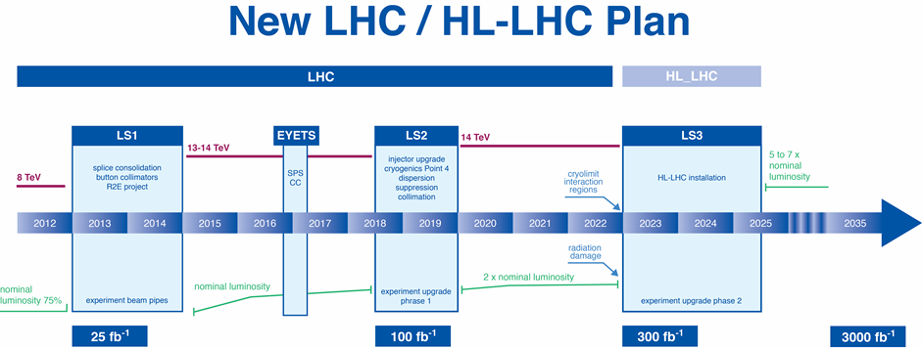
2 full cryo-assembly 11 T–11 m + spare ready by early 2019 for tunnel
We look for your much appreciate wisdom!

