Slide 1
International review of the HL-LHC 11T Dipole for DS Collimation
Models production data – CERN
Part I - Coil Technology
D. Smekens

Slide 2
Outline
Models Production Data - Coil Technology
  Status of Coil Production
  Inside Coils : Best features
  Tooling and Process
  3 coils tested, so far…

Slide 3
Status of coil production
Models Production Data – Coil Technology

Slide 4
Coil Production Status
Coil ID → | 101 | 102 | 103 | 104 | 105 | 106 | 107 | 108 | 109 | 110 | 201
Cable | Cu DUMMY | Cu DUMMY | WST DUMMY | RRP 54/61 DUMMY | RRP 108/127 | RRP 108/127 | RRP 108/127 | RRP 132/169 | RRP 132/169 | RRP 132/169 DUMMY | PIT 114 DUMMY
Winding Start Date | Jan 2011 | Oct 2011 | Nov 2012 | Feb 2013 | May 2013 | June 2013 | Sept 2013 | June 2014 | Aug 2014 | Sept 2014 | Nov 2104
Winding | GOOD | GOOD | GOOD | GOOD | GOOD | GOOD | GOOD | GOOD | GOOD | GOOD | Difficult
Curing | GOOD | GOOD | BAD | Difficult | GOOD | GOOD | GOOD | GOOD | GOOD | GOOD | GOOD
Reaction | GOOD | GOOD | - | Difficult | Difficult | GOOD | GOOD | BAD
Impregn. | GOOD | GOOD | - | Difficult | Difficult | GOOD | Difficult | Difficult
Impregn. End Date | Jan 2014 | Feb 2013 |  | Aug 2013 | Jan 2014 | Feb 2014 | April 2014 | Sept 2014
Assembly (pairing) | 101 105 | - | - | - | 101 105 | 106 107 | 106 107
Cold Tests Date: | - | - | - | - | GOOD Jul14 | GOOD Nov14 | BAD Nov14
Autopsy Date: |  |  | Done Mar-13 | On going
Magnet | MBH SM101 |  |  |  | MBH SM101 | MBHSP101

Slide 5
Inside coils : Best Features
Models Production Data – Coil Technology

Slide 6
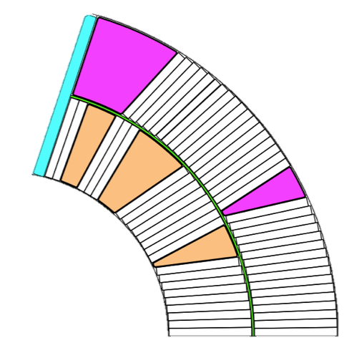
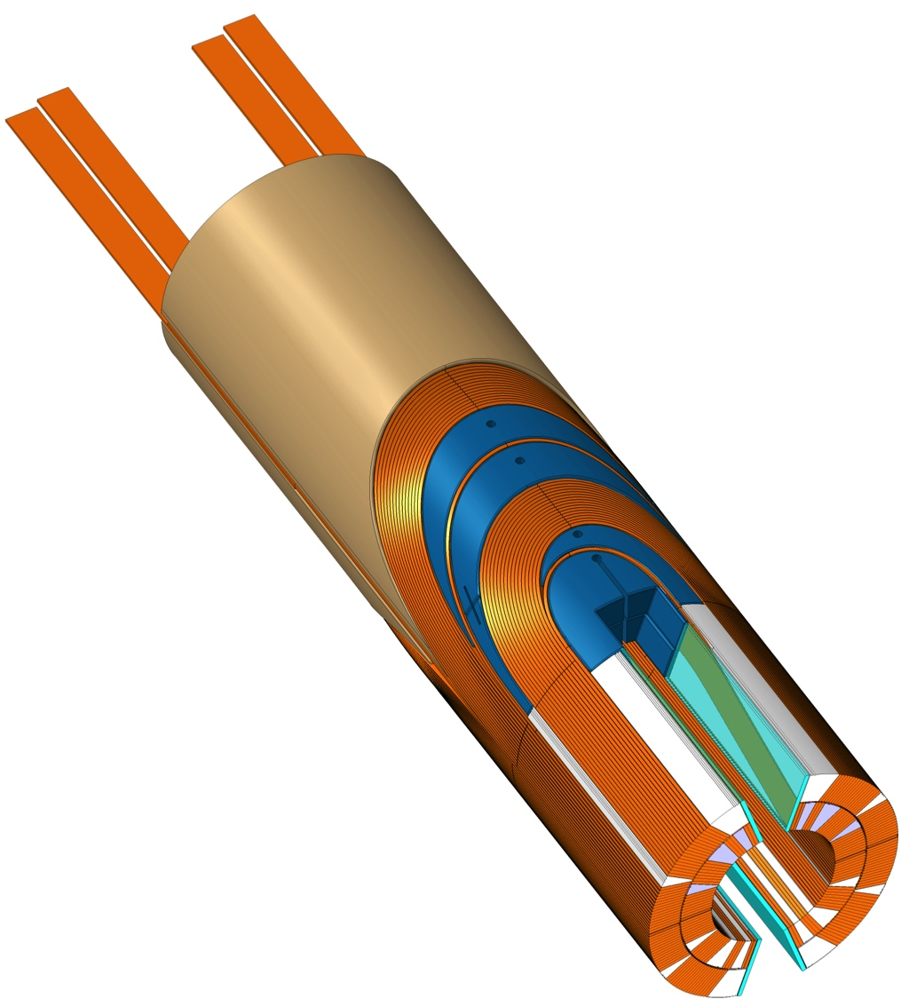
Naming conventions
b
Insulated cable
Filler Wedge
Loading plate
Inter-layer
Inner ground wrap
Outer ground wrap
f
c
6
d
5
e
7
4
a
3
2
Mid-Plane
Filler Wedge
Loading Plate
Key
SLS Spacer w/Flex Legs
Saddle with integrated splice block
Nb₃Sn / Nb-Ti Splice
1

Slide 7
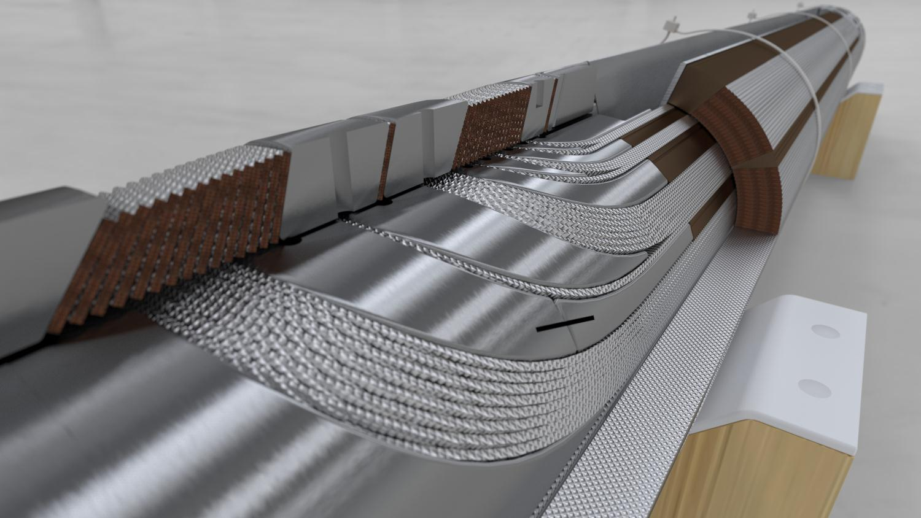
Technological choices: Overview
SLS End Spacers
with “springy legs”
Loading plate
2 mm 316LN
Braided 11-TEX S2-glass
on “open-C” Mica sleeve
ODS Cu-alloy
Wedges
Saddle-Splice Block: Single Piece G-11
Interlayer protection
heater R&D
Courtesy of D. Mitchell, FNAL

Slide 8
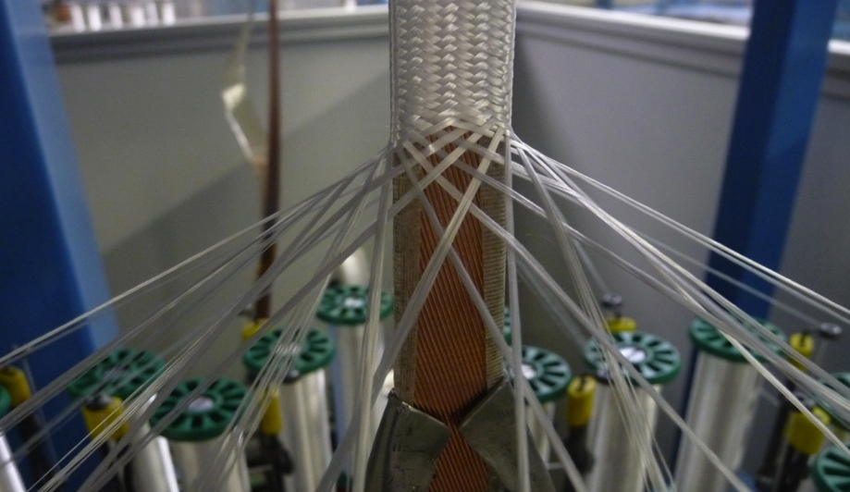
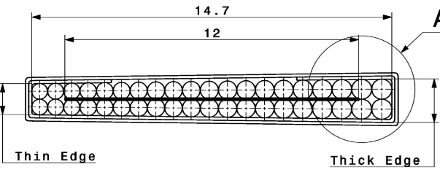
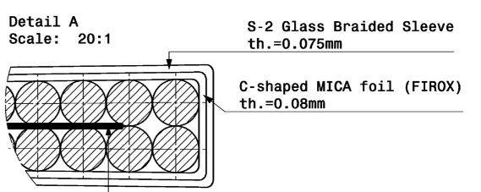
Cable Insulation

Slide 9
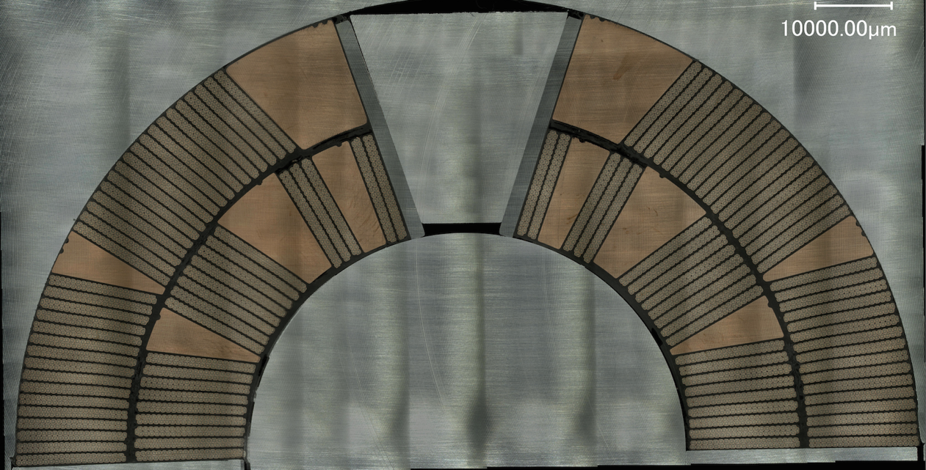
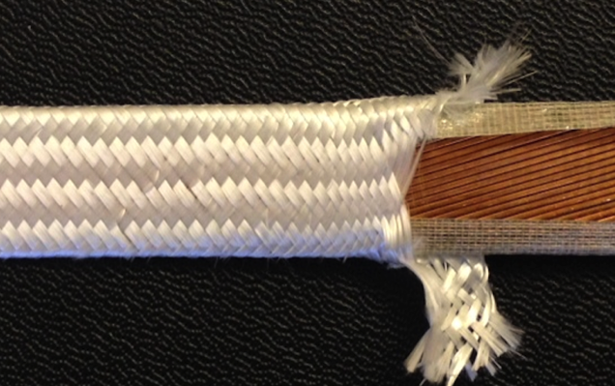
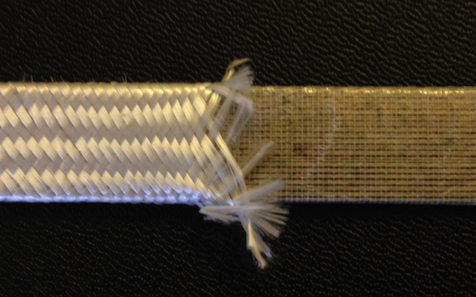
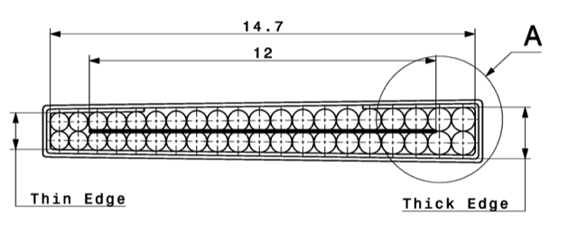
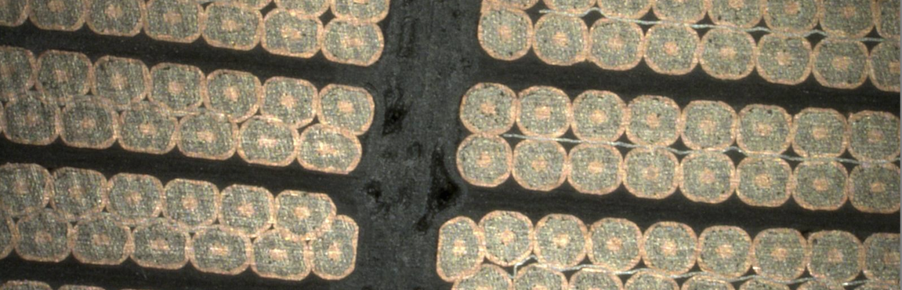
Cable Insulation
11T is designed with the following insulation system:
  A mica layer provides the main dielectric barrier (C shape MICA tape, MSUT)
  Glass overbraiding protects during production, later is a filler for the impregnation
  Epoxy bonds the components, impregnate the mica and reinforce the dielectric
Coil 104 (54/61) after impregnation
FIROX 80μ
S2 Glass Overbraided
Coil 54/61 after impregnation. All turns are fully impregnated.
Defects in the inter-layer and ground wrap. (Courtesy of X. Sarasola Martin)

Slide 10
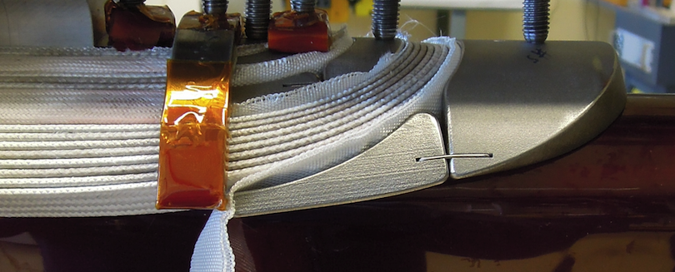
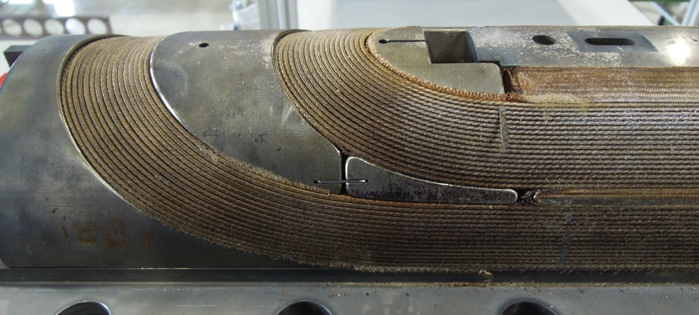
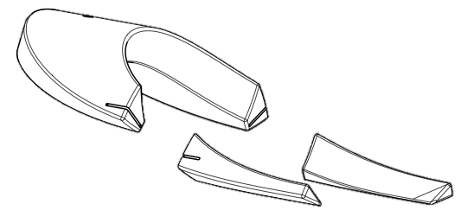
Coil Spacers: Laser Sintered + Flex Legs
SLS Spacers
  Coil End optimization much facilitated, not possible with conventional machining, short lead time to supply
  Flex-Hinge spacers fitting both winding geometry (loose) and cured geometry (compacted)
Insulation of spacers:
  Al₂O₃ by plasma coating does not withstand the reaction (peels off)
  Vitreous Enamels: no R&D available
  Al₂O₃ by PVD coating gives promising results, currently under development with the Danish Technological Institute
SLS technology implemented since coil101,
Flex legs since coil 104

Slide 11
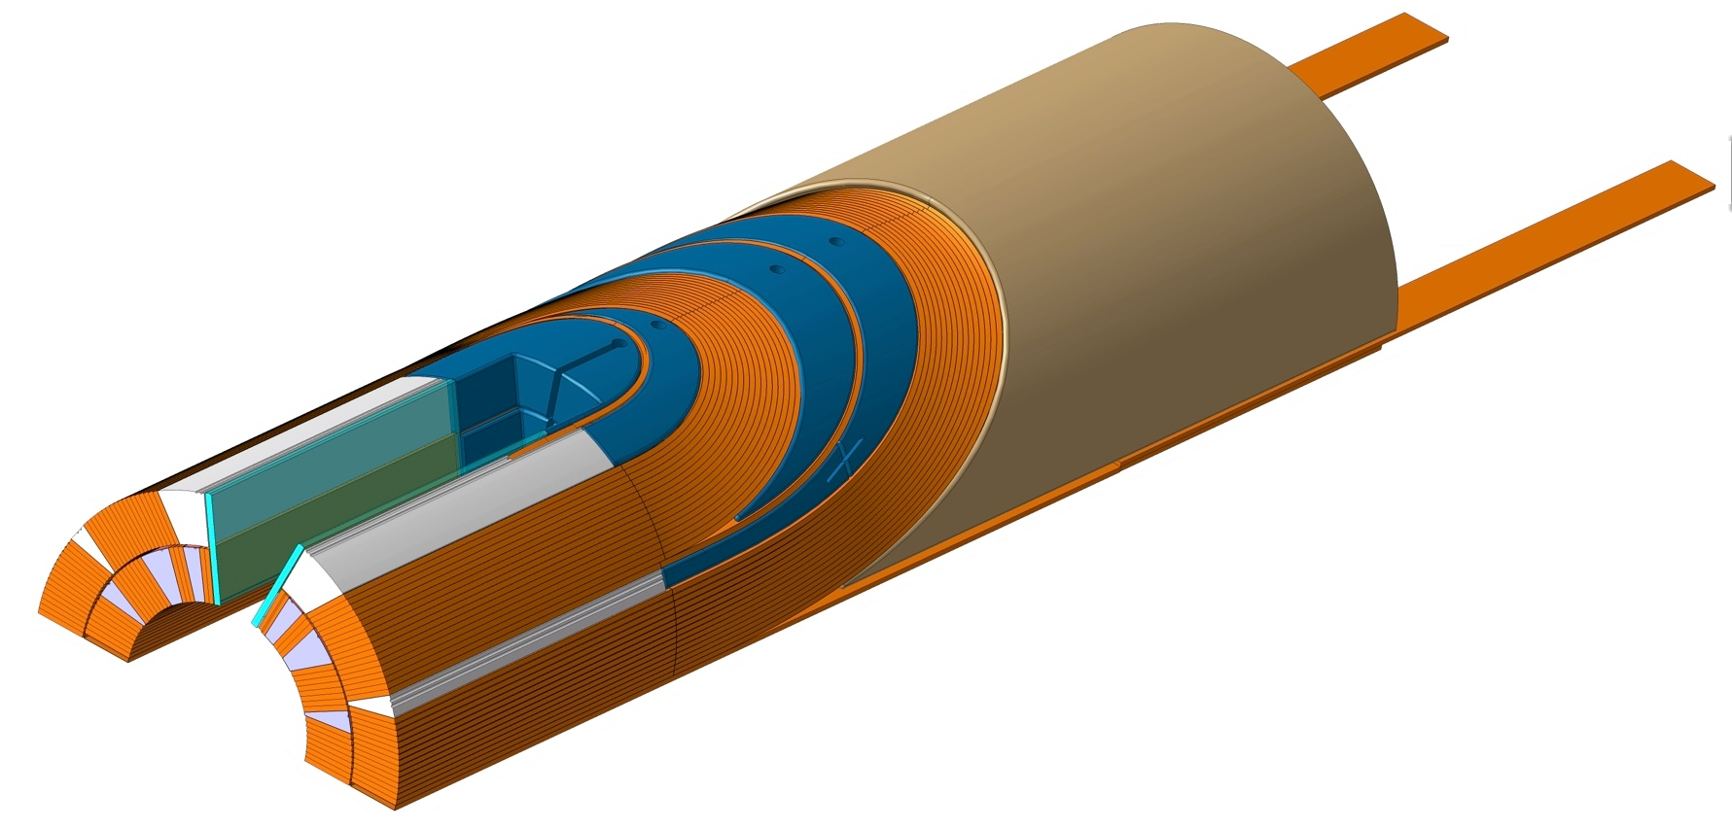
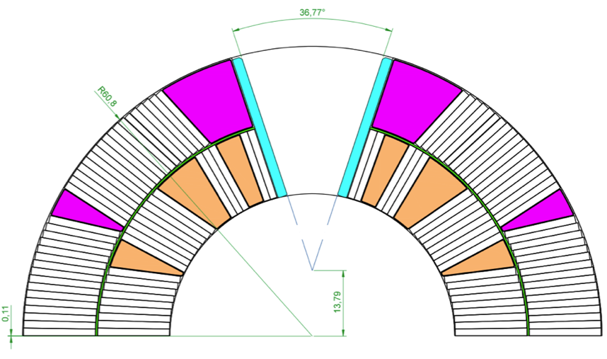
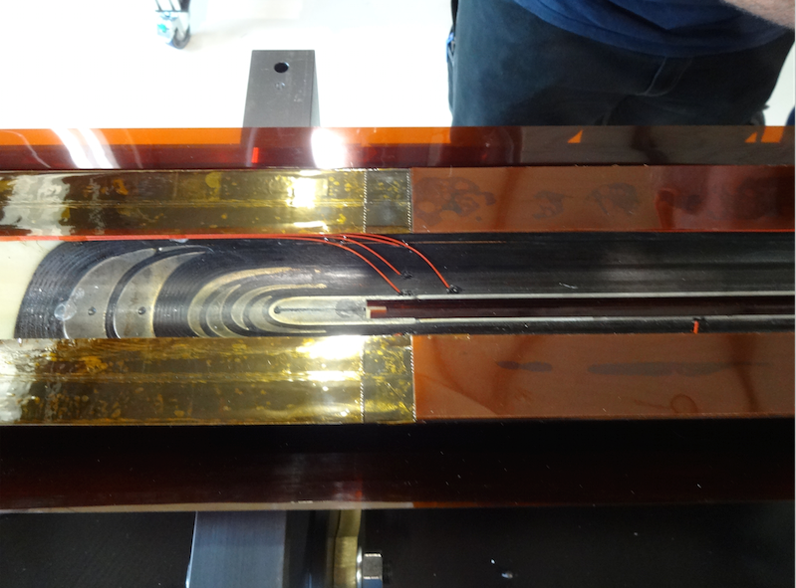
Loading Plate, Keys and Filler wedge
2
1
3
1. Filler Wedge
  Aligns the outer layer with the inner layer
  Encase the layer-jump
2. Loading Plate
  Protects the turns of the inner layer’s last block
  Distribute the azimuthal stress between both layers and minimize shear during collaring
  Protects the layer jump
3. Keys
  Makes the transition between the straight section (compression by shimming the poles)
  and the coil ends (shimming at mid-plane or radially)
Midplane shimming
of coil ends
(polyimide)
Coil 106 (view from inside bottom, inner layer)
The mid plane shimming of the coil end starts gradually at the end of the straight section

Slide 12
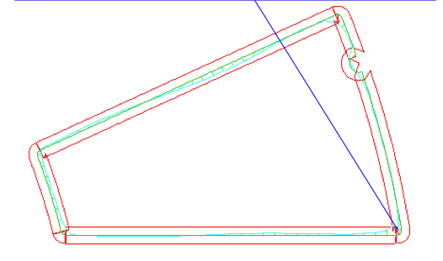
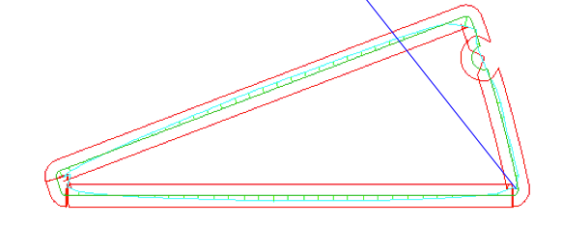
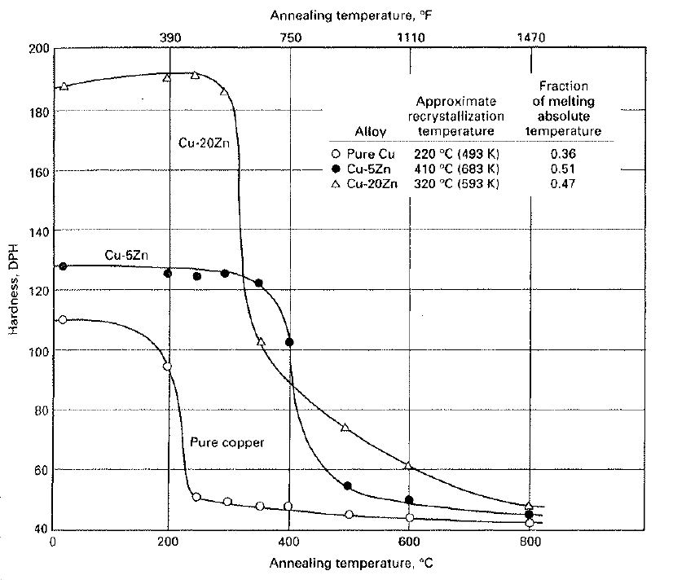
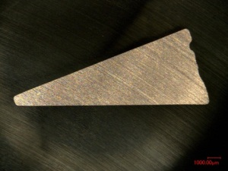
ODS Wedges
Searching for suitable material:
extrusion process
accepting reaction treatment without showing unacceptable grain growth, precipitation and annealing phenomena
Candidates:
Superalloys;
ODS copper alloys UNSC15715 (GlidCop, Discup)
Development with Luvata
HOGANAS (Glidcop) not interested
Luvata did…
Status:
Process now industrialized
Non annealable, No grain growth
Extrudable in long profiles
Match thermocontraction and high thermaconductivity of copper
Good geometry
Remaining Issues
Internal Stress (being improved by 2-pass cold drawing)
Strong superficial oxidation difficult to remove by pickling
Hardness Meas. on Preseries Wedge 3
A
EN Division-Materials and Metrology
CERN/EN/MME-MM/NJ-EDMS1216580
 | HV5
Test Location→ | A | B
Before Heat Treatment | 137.2±2.8 | 147.2±3.3
After Heat Treatment | 124.3±5 | 125.8±6.3
B
Implemented as from coil 104

Slide 13
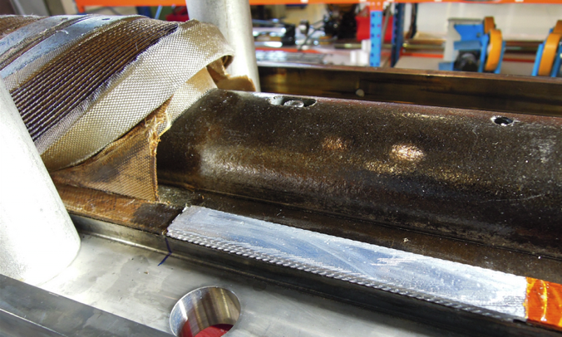
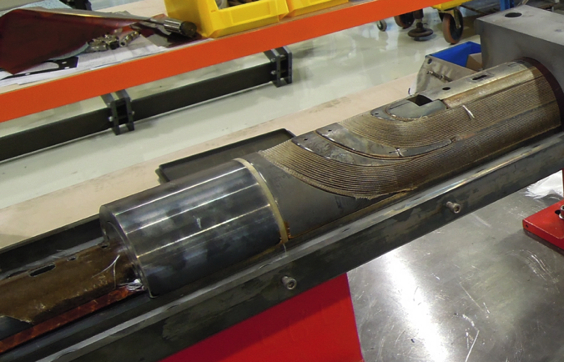
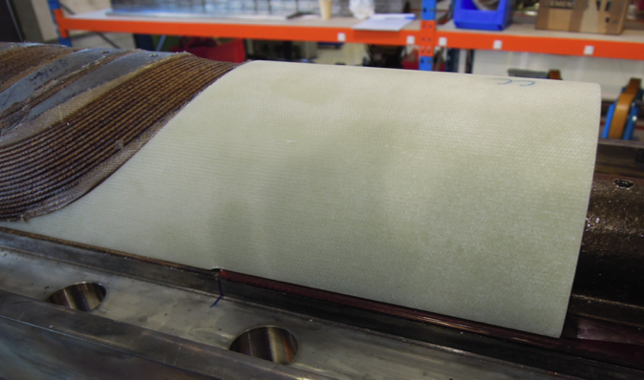
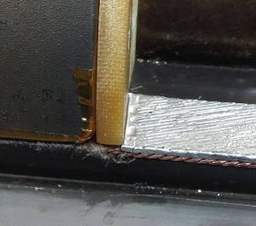
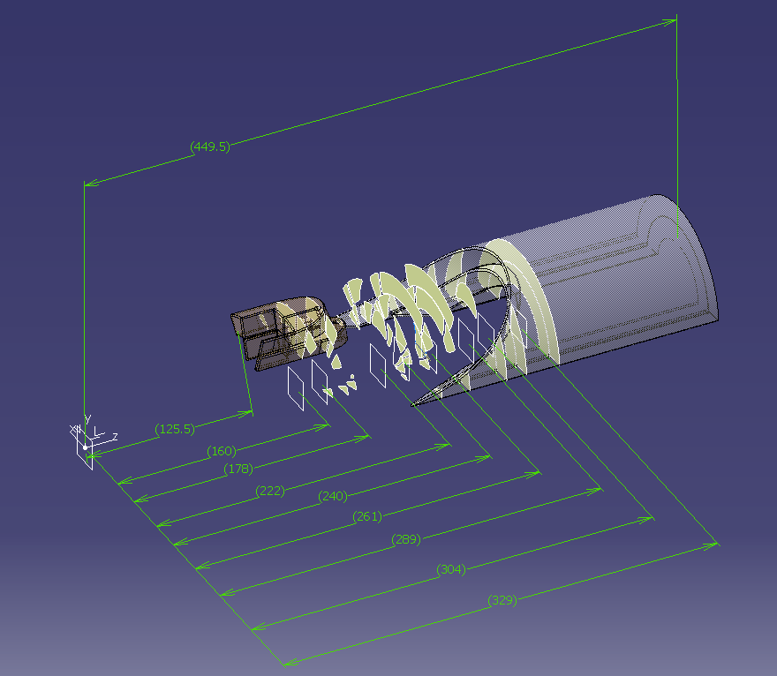
Single piece G11 Saddles
Single Piece G11 Saddles
After reaction, temporary metallic saddle is removed: full access for splicing the leads and to decontaminate the flux before inserting the G11 single piece saddle.
allow perfect coil length trimming
non conductive, insulate the splice area
Avoid large increase of modulus in the ends
Coil 101->105: conventional
Since coil 106

Slide 14
Implementation of Features, timeline
Coil ID → | 101 | 102 | 103 | 104 | 105 | 106 | 107 | 108 | 109
Cable | Cu | Cu | WST | RRP 54/61 | RRP 108/127 | RRP 108/127 | RRP 108/127 | RRP 132/169 | RRP 132/169
Insul. Thick. [mm] | S2/Mica 0.115 | S2 only ~ 0.115 | S2/Mica >0.15 | S2/Mica >0.15 | S2/Mica 0.115 | S2/Mica 0.115 | S2/Mica 0.115 | S2/Mica 0.107 | S2/Mica 0.107
Spacers | SLS | SLS | SLS | SLS-Flex | SLS-Flex | SLS-Flex | SLS-Flex | SLS-Flex | SLS-Flex
Saddles | SLS | SLS | SLS | SLS | SLS | G11 | G11 | G11 | G11
Wedges | 316L | 316L | 316L | ODS-Cu | ODS-Cu | ODS-Cu | ODS-Cu | ODS-Cu | ODS-Cu
Inter_layer | Nextel | E-Glass | Mica-QH | S-Glass | S-Glass | S-Glass | S-Glass | S-Glass | S-Glass
Binder | CTD1202 | CTD1202 | CTD1202 | CTD1202 | CTD1202 | CTD1202 | CTD1202 | CTD1202 | CTD1202
Splice | Pb-Ag | Pb-Ag | - | Pb-Ag | Pb-Sn | Pb-Sn | Pb-Sn | Pb-Sn | Pb-Sn
Gr.Wr. OD Gr. Wr. ID | Glass 0.1 Glass 0.1 | Glass 0.1 Glass 0.1 | - | Glass 0.1 Glass 0.1 | Glass 0.1 Glass 0.1 | None None | Glass 0.1 Glass 0.1 | Glass 0.1 Glass 0.1
Epoxy Impreg. | CTD 101K | CTD 101K | - | CTD 101K | CTD 101K | CTD 101K | CTD 101K | CTD 101K | CTD 101K
Remark | Short with spacers | Short with spacers - Splicing difficult | Insulation oversized- Disposed after curing | Insulation oversized- Splicing difficult | Short with saddle, Popped Strand, Azim. Oversized | ELQA OK - OK (no ground wrap) | ELQA OK - Dry spots after impreg. | ELQA OK - Impregn. defects | No binder in ends (In progress)

Slide 15
Tooling and Process
Models Production Data – Coil Technology

Slide 16
Coil Production flow chart
Cable Insulation
May-Pole Overbraider
Mica Foil insert
Winding-Curing
Reaction
Coil installed in Specific Tool
Reaction under Argon
S-Glass overbraiding
Specific poles
Wind IL
Cure IL (CB)
Place Inter-layer
Wind OL
Cure OL (CB)
Leads Splicing
Remove metallic spacer
Impreg. Prep.
Specific Tool and poles
Impregnation
Loading Plates
Splice Nb-Ti leads
Install G-11 Saddles
Vacuum impregnation
Epoxy
E-Glass ground wrap

Slide 17
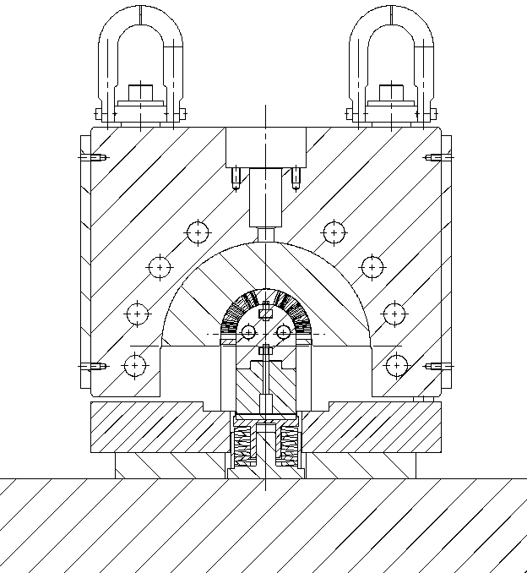
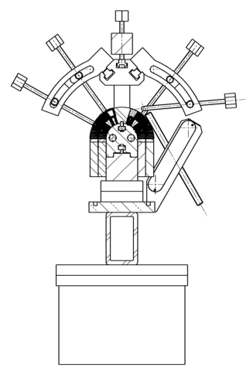
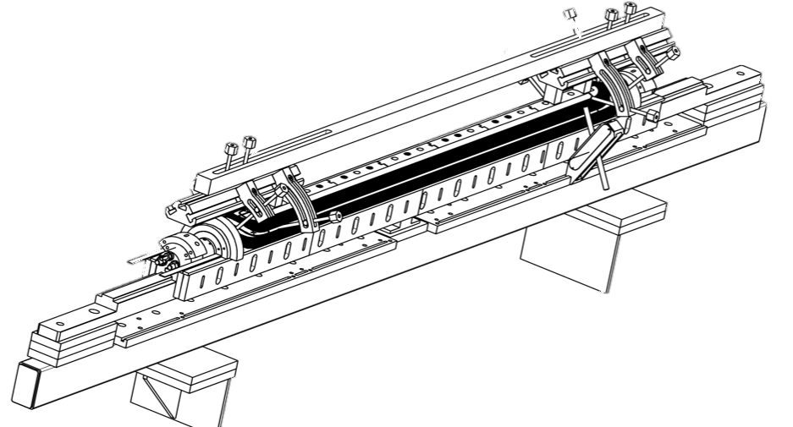
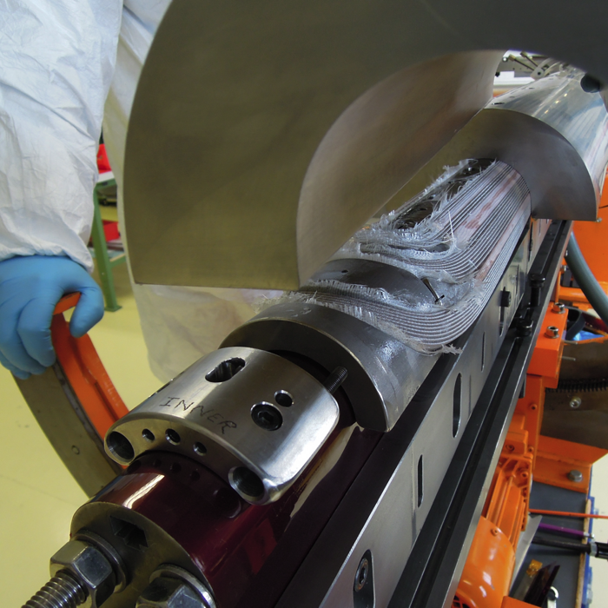
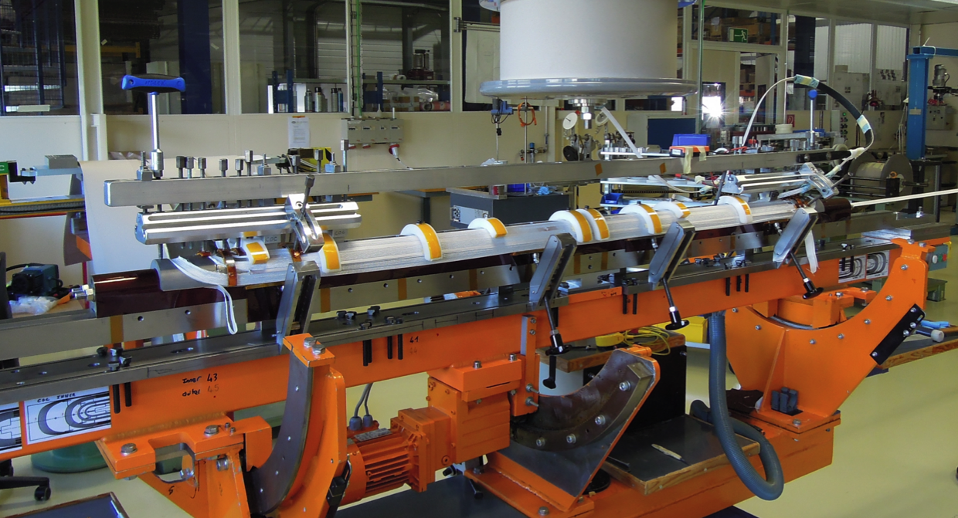
Tooling: Winding - Curing

Slide 18
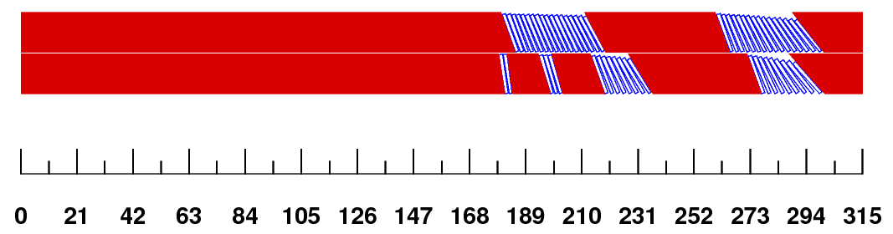
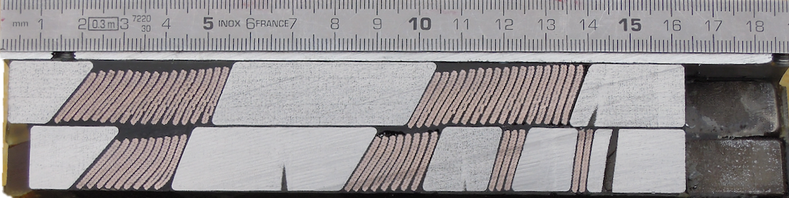
Winding – Curing: Characteristics
Winding Characteristics
Cable Tension IL: 350 N / OL : 250N
Cable behaviour: RRP Stable
Use of binder to stabilize the cable no longer necessary
Respect of Coil Overall Length: OK
Curing process: OK
Electrical integrity: solved with SLS Flex
Remaining Issues
Missing autopsy from 5 first coils
(coil end section, from last week only)
Mid-Plane: sensitive to damage
inter-layer with quench heaters under development
Possible issue w/ Layer jump
(from test data coil 107)
Schedule
to produce a cured coil: 3 weeks
Nota: Correct position of the turns in the ends is now achieved (since coil 108)
Photographs :courtesy of X. Sarasola Martin, N Peray, L. Lambert

Slide 19
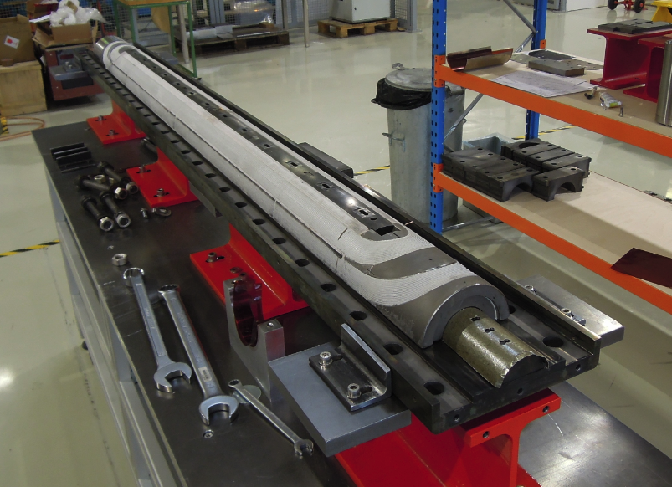
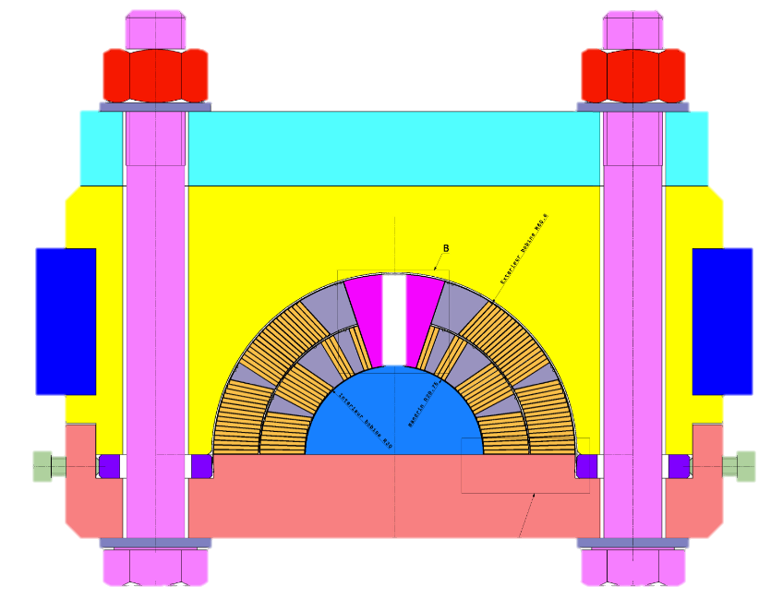
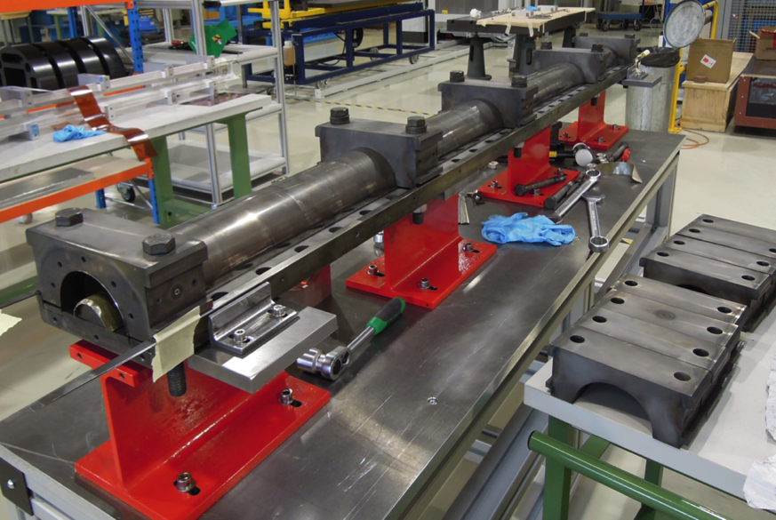
Reaction Fixture
Tooling Characteristics
Modular tool, cavity inner radius adaptable from
Nominal R60.6 to R60.95 mm for oversized coils
FNAL/LARP based design
Remaining Critical Points
Limited Argon flow circulating in the coil
No variation of coil length during reaction (cf. extra slides)
Schedule
to prepare a cured coil for reaction: 1 week

Slide 20
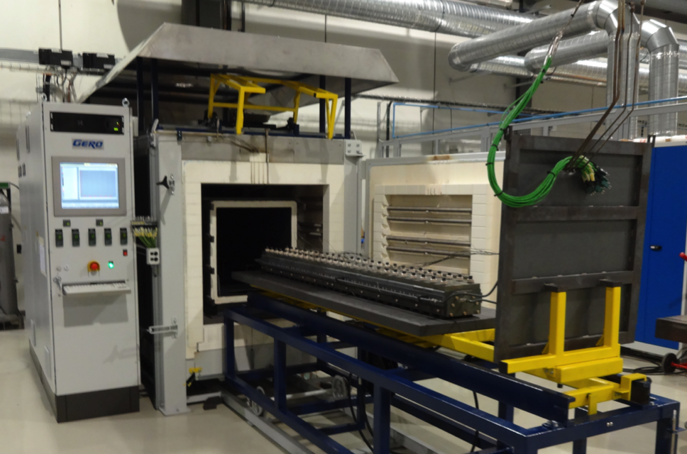
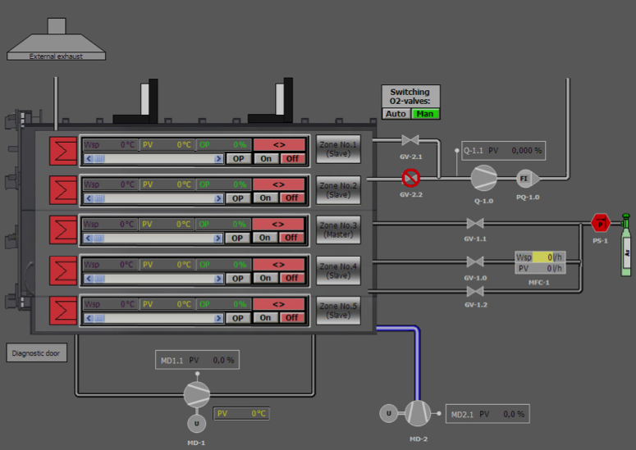
Reaction Oven: Characteristics
GERO 2500
Retort (Lxlxh) | 2.5m x 0.6m x 0.5m
Max. operating temperature | 1000 ⁰C
Temperature uniformity | ± 3 °C (25 ⁰C - 750 ⁰C)
Max. temperature ramp up | 70 °C/h (20 ⁰C - 900 ⁰C)
Maximum load | 600 kg/m
Inert gas atmosphere | Argon
Power | 165 kW
Remaining Issues
Still a young infrastructure
In rare cases, controller stopped during cycle
Repetitive failures of homogeneisation fan
Repetitive failures of Oxygen monitoring
O₂ level too high (Ti witness brittle)
Sensor calibration (operator training + equipment)
Schedule
To react a coil: 3 weeks

Slide 21
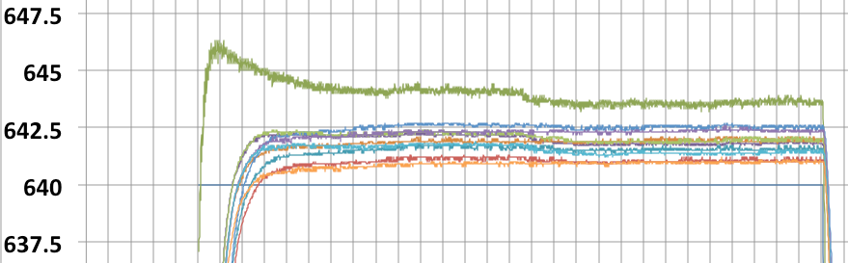
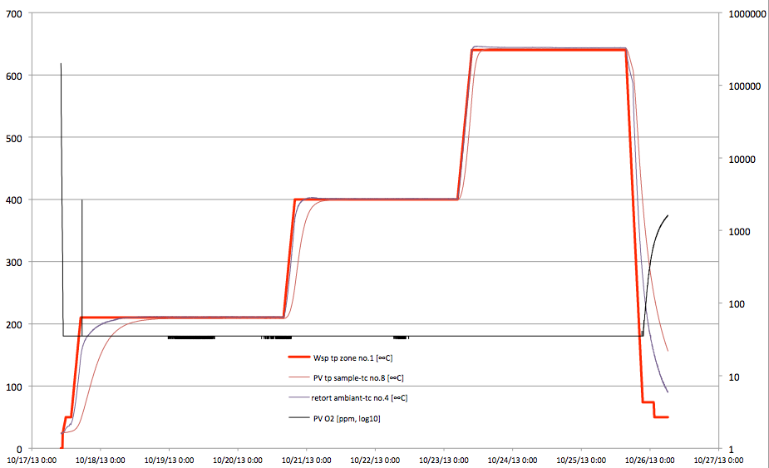
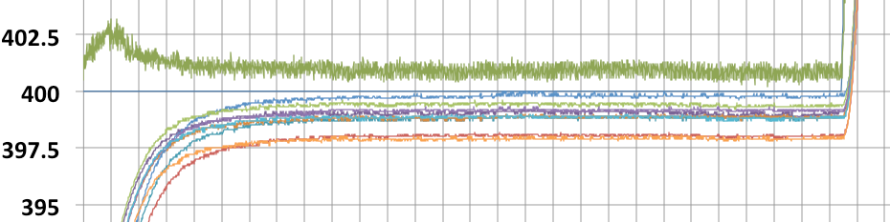
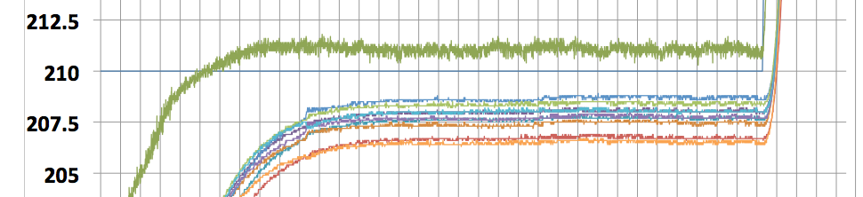
Reaction Cycle
Coil 105
OST RRP108/127
48h 210°C / 48h 400°C / 48h 640°C
Reaction date coil 105: Oct 2013
To be completed
Dwell duration
corrected to compensate for the inertia of the oven
71h 210°C / 57h 400°C / 54h 640°C
Sensor Calibration:
Previous calib. date: Sept.2012
Latest calibration: Nov. 2014 measured calibration drift at 640C : +6C
O₂ [ppm] (log₁₀ scale)
Green curve: Gas T in retort

Slide 22
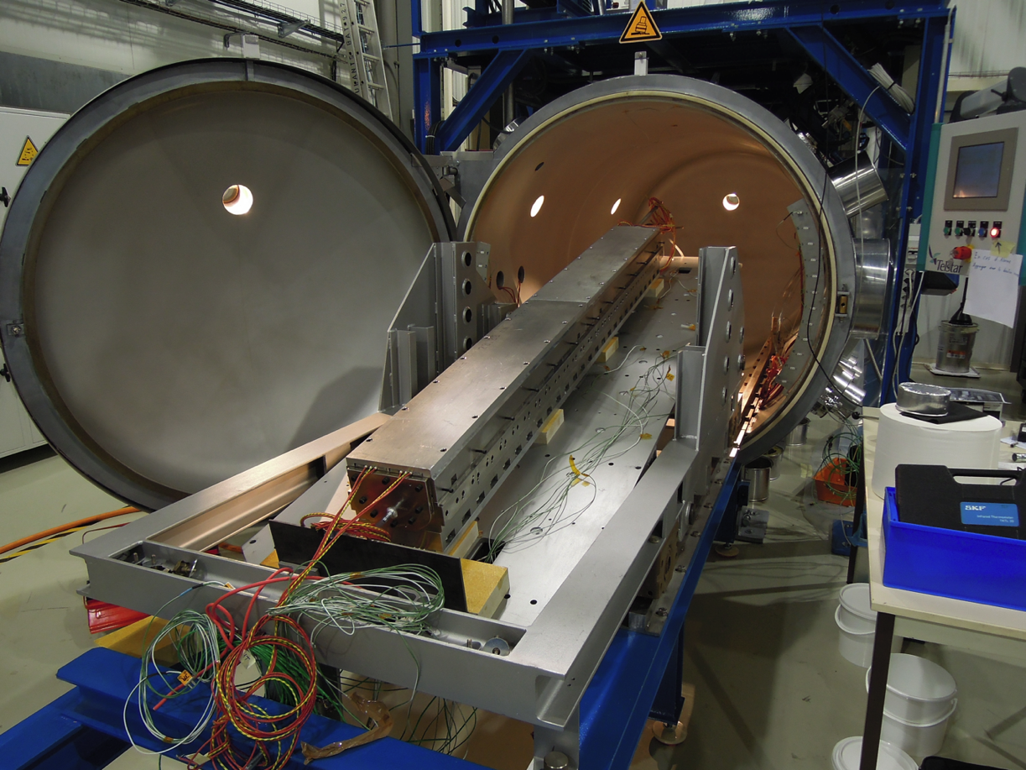
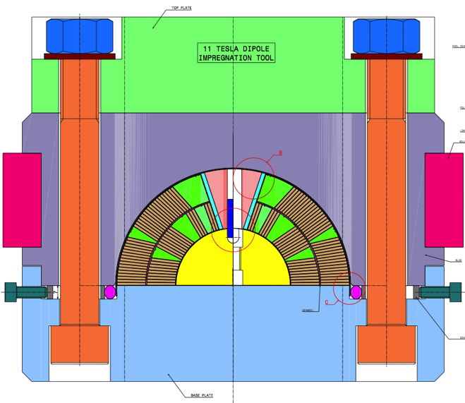
Tooling: Impregnation

Slide 23
Impregnation: Characteristics
Impregnation Characteristics
Epoxy: CTD-101K
Nitrogen dry-out for min. 3h
Coil degassing at 60C for 48h
Coil temperature: 60+/-1C ; resin 57.5 +/-2.5C
Very slow filling: 4 hours (target), (coil 106: 1h40, 107: 2h45, 108: 5h15)
Curing: 6h at 110C followed by 16h at 125C and slow cooling
Remaining Issues
Cable insulation still oversized
  improved to reach 0.107 mm (@ 30MPa), →minimum reached; in discussion with the supplier to have a new mica tape developed
  over-compression inside the tool with dry spots,
  Or tool not fully closed, and coil oversized
2 solutions for the future
removing the Ground wrap, will help impregnation and reduce quench heater delay
removing material from wedges 1&5 and spacer and keys, would give more room to the cables
Coil full X-section re-optimization, → too long
Schedule
Splicing, preparing, potting, de-molding a coil: 3 weeks
22*0.007*2
0.3 mm
34*0.007*2
0.48 mm
Insulation wall thickness 0.107 mm
design target: 0.1mm

Slide 24
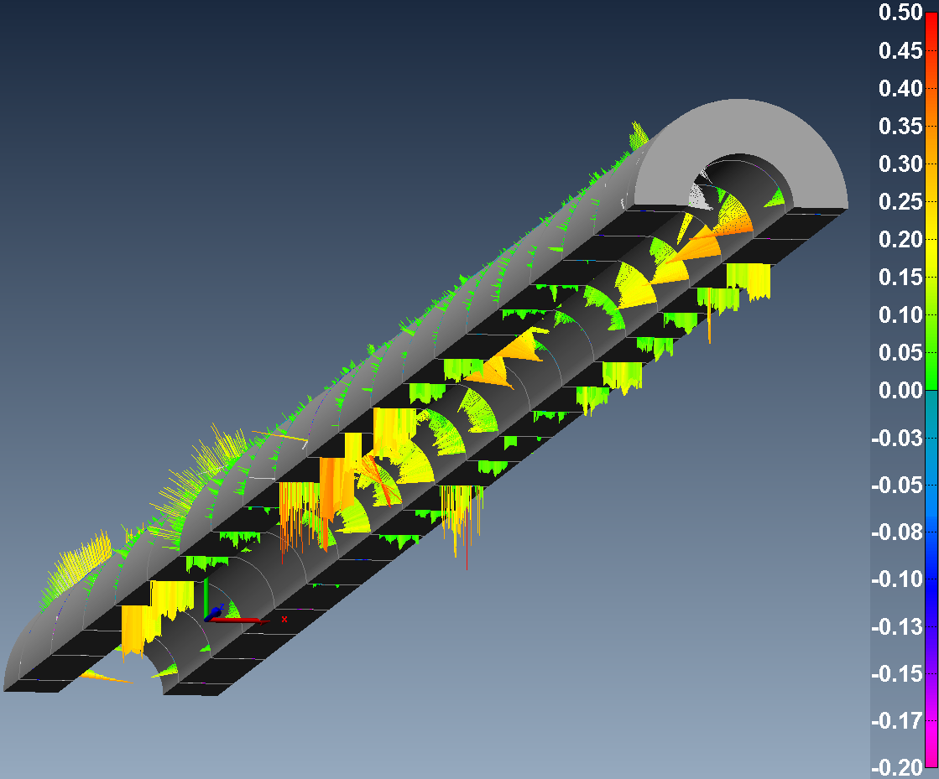
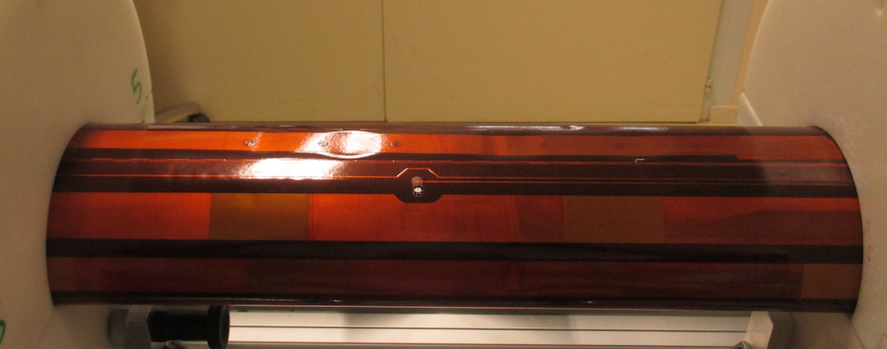
Final steps: CMM and Instrumentation
Coil Metrology
Goal: defining shimming
Extern. Heaters
Final Coil ELQA
R,L. meas.
QH + VTs on flexible PCB
Glued on coil OD
VTs wired by local melt down to reach conductor
Using 3D-measurement arm
Assess the geometry of coils
Coil-to-ground
QH-to-coil
Inter-Turn Testing
3d-measurement arm
  Tactile probe (accuracy 5µm)
  Laser scanner (40µm)
Remaining Issues
Operator’s influence on the measurement
Laser scanner not usable for coil
Schedule
CMM 1 coil: 3 days

Slide 25
3 coils tested, so far…
Models Production Data – Coil Technology

Slide 26
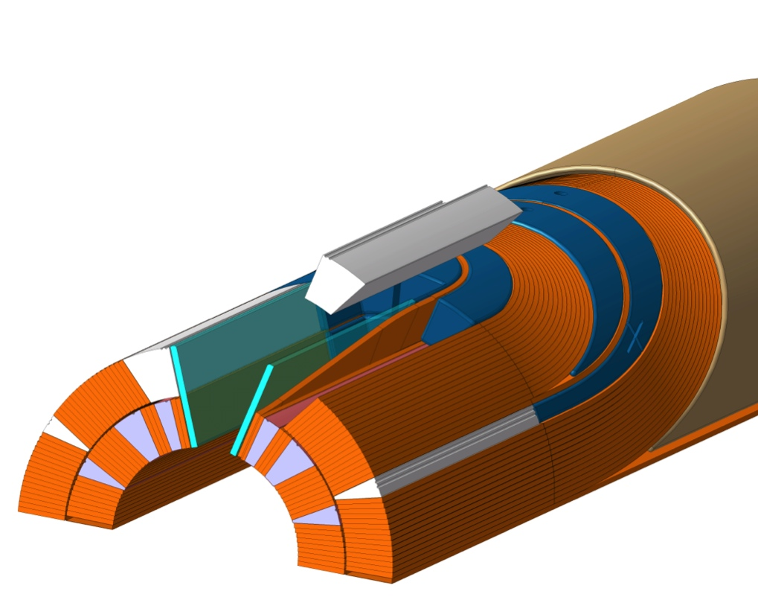
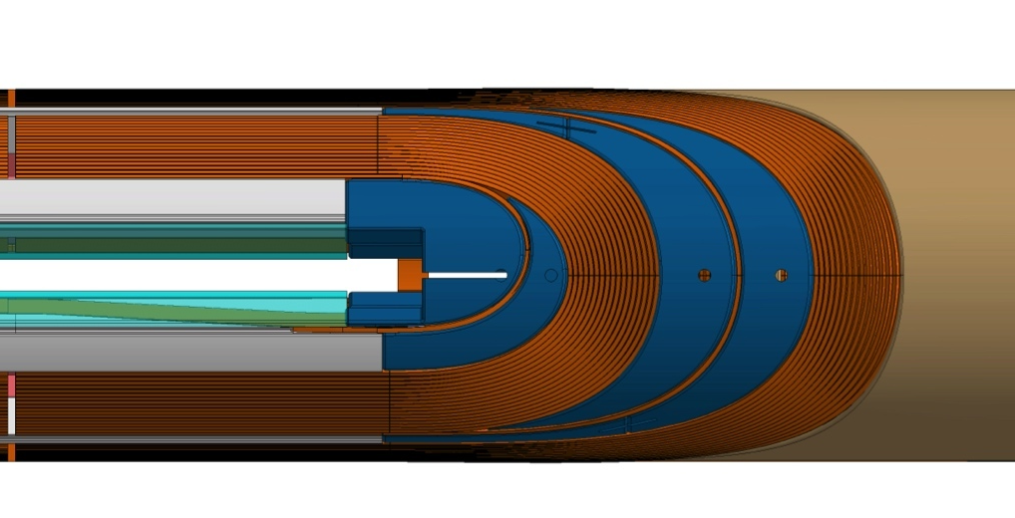
Inputs from testing at cold coils 105/106/107
Tests with 105, 106 and 107 gives confidence that coil production manage:
-> no damage to mid plane
-> good splice
-> 105 excellent performance for 1st trial
-> 106 above I_{nom} in 4 quenches
-> 107 shows degradation in the layer jump region, and limitations in the coil ends
Actions:
Layer jump/Key are regions currently being improved
Cable insulation thickness ←→ tooling/coil size mismatch
  -> remove totally ground wrap to leave room radially to the azimuthal oversizing (as for coil 106)
  -> rework wedges 1 and 5, OL keys and 1st IL spacer to leave more room

Slide 27
Analysis of Timeline Coil Prod. in 927
Coil ID → | 101 | 102 | 103 | 104 | 105 | 106 | 107 | 108 | 109 | 110 | 201
Cable | Cu DUMMY | Cu DUMMY | WST DUMMY | RRP 54/61 DUMMY | RRP 108/127 | RRP 108/127 | RRP 108/127 | RRP 132/169 | RRP 132/169 | RRP 132/169 DUMMY | PIT 114 DUMMY
Winding Start Date | Jan 2011 | Oct 2011 | Nov 2012 | Feb 2013 | May 2013 | June 2013 | Sept 2013 | June 2014 | Aug 2014 | Sept 2014 | Nov 2104
Winding | GOOD | GOOD | GOOD | GOOD | GOOD | GOOD | GOOD | GOOD | GOOD | GOOD | Difficult
Curing | GOOD | GOOD | BAD | Difficult | GOOD | GOOD | GOOD | GOOD | GOOD | GOOD | GOOD
Reaction | GOOD | GOOD | - | Difficult | Difficult | GOOD | GOOD | BAD
Impregn. | GOOD | GOOD | - | Difficult | Difficult | GOOD | Difficult | Difficult
Impregn. End Date | Jan 2014 | Feb 2013 |  | Aug 2013 | Jan 2014 | Feb 2014 | April 2014 | Sept 2014
Assembly (pairing) | 101 105 | - | - | - | 101 105 | 106 107 | 106 107
Cold Tests Date: | - | - | - | - | GOOD Jul14 | GOOD Nov14 | BAD Nov14
Autopsy Date: |  |  | Done Mar-13 | On going
Magnet | MBH SM101 |  |  |  | MBH SM101 | MBHSP101

Slide 28
Conclusions
Not yet meeting the LHC requirements, but getting close
“Best (Preferred) Features” are in, to meet those requirements
Process is not yet fully mastered, some issues remain on the way,
Aperture #1’s performance is limited by coil 107, showing signs of degradation.
Coil 108, reaction cycle was incomplete.
The first two CERN cosTheta Nb3Sn models (single coil 105, and 1-in-1 model with coils 106/107) are working honorably
Thanks to the very Successful collaboration with FNAL,
  FNAL ready much sooner
  Made all the important tool design
  Winding coils as we were developing our own tools
  Testing coil ends optimizations extensively
  Teaching and helping for every step
  Building and testing the first 11T FNAL model magnets

Slide 29
Acronyms
CB: ceramic binder
CEA: Commissariat à l’Energie Atomique
CMM: coordinate meas. machine
CTD: Composite Technology Development, Inc.
DS: Dispersion Suppressor
ELQA: electrical quality assurance
FNAL: Fermi National Laboratory, USA (Fermilab)
G11: NEMA Grade for fibreglass reinforced epoxy laminates
ID: inner diameter
IL: coil inner layer (22 turns)
LARP: U.S. LHC Accelerator Research Program
LBNL: Lawrence Berkeley National Laboratory, USA
LE: Coil lead end
MSUT: 11T Nb3Sn dipole model magnet, University of Twente, 1992
NED: Next European Dipole (Research Program)
OL: coil outer layer (32 turns)
OD: outer diameter
ODS: Oxide Dispersion Strengthened
OST: Oxford Superconducting Tech.
PIT: Powder in Tube
PVD: Physical Vapor Deposition
QH: quench heaters
RAL: Rutherford Appleton Laboratory (RAL), also STFC/RAL Science & Technology Facilities Council
RE: Coil return end
REX: Return of Experience
RRP: Rod Restack Process
S Glass: grade of fibreglass with enhanced performance compared to E-Glass
S-2 Glass: trademark of the S-Glass product line at AGY
SLS: Selective Laser Sintering
UL: unit length of cable (~235 m for a 2m long 11T coil shortmodel)
VT, VTs: Voltage Tap(s)

Slide 30
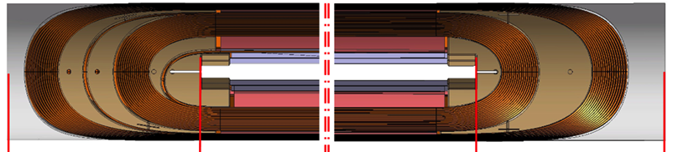
Variation of coil length during reaction
Expected Coil length variation after reaction, ratio: 0.997
Measured ratio on coils 106,107,108
L_{straight}
Coil ID | L_{straight} theoretical | L_{straight} (Inner Layer only) After curing IL | L_{straight} after curing | L_{straight} after reaction | Measured Ratio
106 | 1499 | 1499.35 | 1499.58 | 1499.41 | 0.9999
107 |  | 1499.61 | 1499.52 | 1499.7 | 1.0001
108 |  | 1499.49 | 1499.6 | 1499.28 | 0.9998
109 |  | 1499.45 | 1499.7 | No data yet

Slide 31
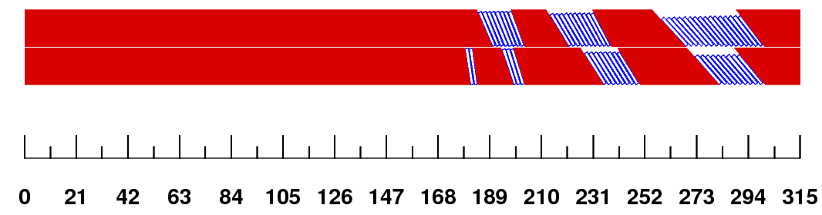



Coil End Design (slide from review Sept2012)
Initial Design Approach
Min. hardway bend
(practice coils)
More upright cables to minimize the gaps
(practice coils)
Reduced torsion,
incr. hardway
(FNAL MBH coils, CERN practice coil 01)
REX from FNAL MBH coils
“As built” (ver.3)
(CERN Practice coil #2 HCMBHSP003_002)
After reoptimization of block position for field quality (future CERN Coil HCMBHSP003_003)
Layer jump moves to keep overall length
(B. Auchmann)

