Slide 1
Summary of test results at FNAL
A.V. Zlobin, Fermilab

Slide 2
Outline
11 T Dipole R&D Program at FNAL
Magnet Design and Parameters
Model Magnet Design Features
11 T Dipole Basic Instrumentation & Test Plan
Quench Performance
Magnetic Measurements
Quench Protection Studies
Next Steps
Conclusions

Slide 3
11 T dipole R&D program
The original FNAL-CERN plan for FY11-14:
  Phase 1 (FY11-12): a single-aperture 2-m long dipole demonstrator
    11 T at 11.85 kA and 1.9 K in a 60 mm bore with 20% margin
  Phase 2 (FY13-14): two 2-m long, 2-in1 dipole models
    confirm the final magnet design, demonstrate the magnet performance parameters and their reproducibility
  Phase 3 (FY14-15): a 5.5-m long 2-in-1 dipole prototype
    technology scale up
In FY13 the FNAL plan was modified to take into account the reduction of the HFM budget as well as CERN priorities and schedule for U.S. contributions to HL-LHC
  the 3rd phase of the program has been cancelled
  the scope of the 2nd phase has been optimized
    the model length has been reduced from 2-m to 1-m to cut the cost of Nb₃Sn cable and magnet parts (mainly collar and yoke)

Slide 4
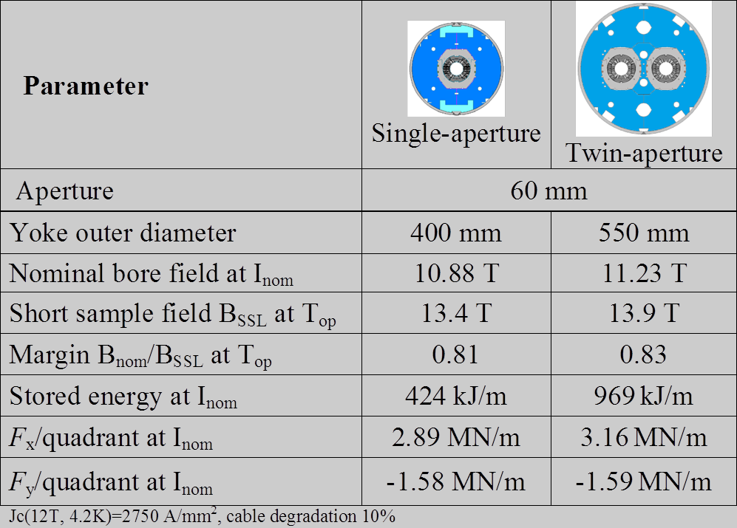
Magnet design and parameters

Slide 5
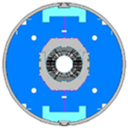
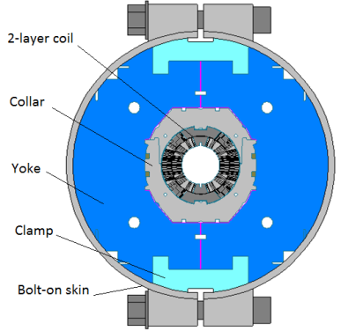
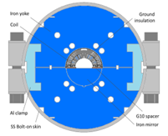
Model design features
MBHSP01: 2-m dipole demonstrator
  RRP108/127
  Cable w/o core
  Coils #2, 3
MBHSP02: 1-m dipole model
  RRP150/169
  Cable with 11.5 mm core
  Coils #5, 7
MBHSM01: 1-m dipole mirror
  RRP108/127 (114/127)
  Cable with 11 mm core
  Coil #8
  Optimized pre-load
MBHSP03: 1-m dipole model
  RRP108/127
  Cable with 11 mm core
  Coils #9, 10 – modified end parts (FNAL)
  Optimized pre-load
MBHSP01
MBHSP02, MBHSP03
MBHSM01

Slide 6
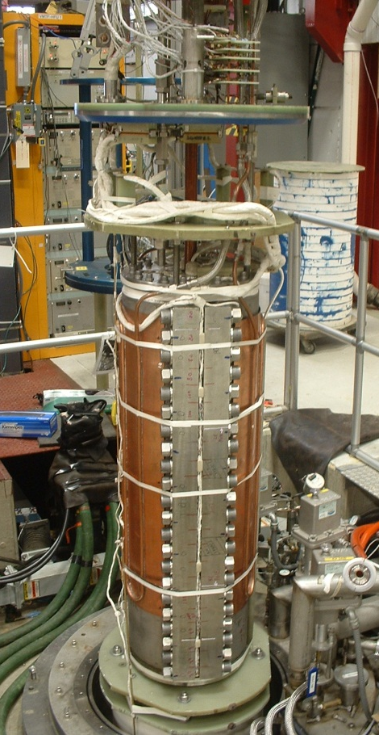
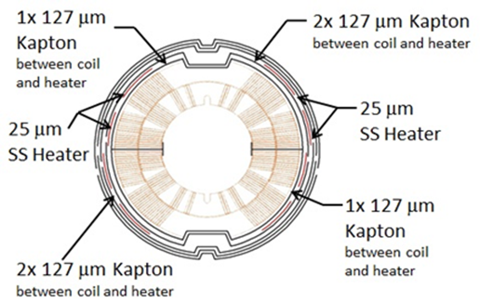
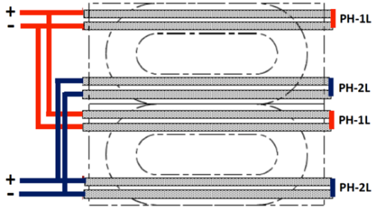
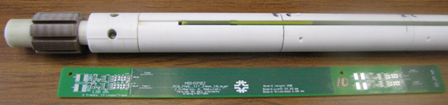
Instrumentation and test plan
Instrumentation
Voltage taps
Strain gauges
Temperature sensors
Quench antenna
Rotating probes
Vertical Magnet Test Facility (FNAL)
Temperature range 1.9-4.6 K
Coordinated with CERN
Test plan and procedures
Quench performance
Magnetic measurements
Heater study
Splice resistance
Coil RRR

Slide 7
Quench performance
Training
Ramp rate dependence
Temperature dependence
Plateau quenches

Slide 8
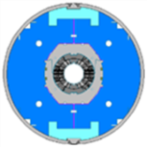
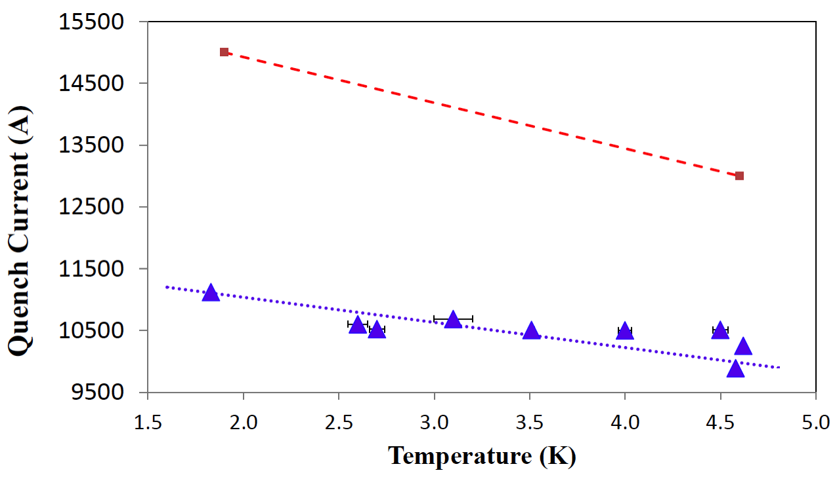
2-m long 11 T demonstrator
MBHSP01
MBHSP01:
B_{max}=10.4 T at 1.9 K, 50A/s
78% of SSL
strong ramp rate sensitivity
holding quenches

Slide 9
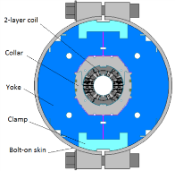
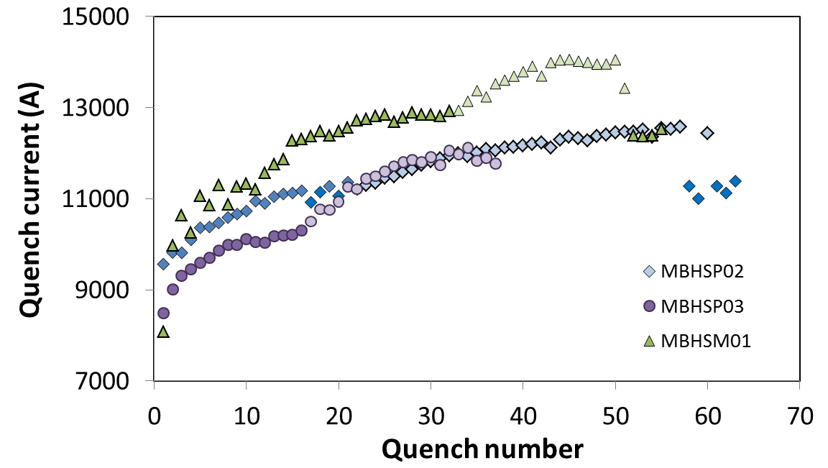
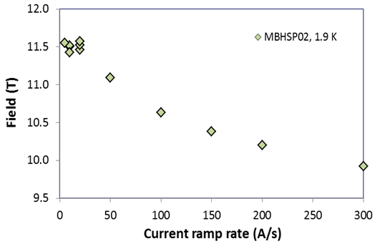
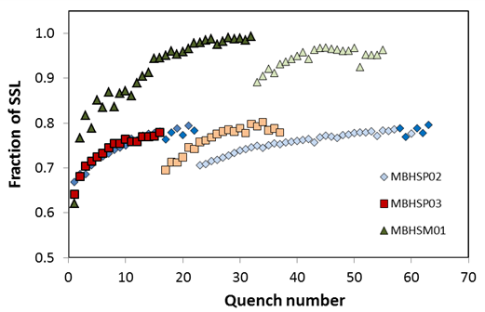
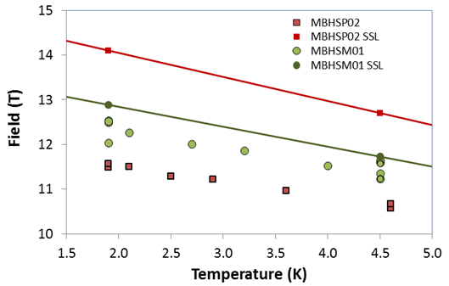
1-m long 11 T models
MBHSP02, 03
MBHSM01
MBHSP02:
  B_{max}=11.7 T at 1.9 K
  97.5% of B_{des}=12 T
  low ramp rate sensitivity
  holding quenches
MBHSM01:
  B_{max}=12.5 T at 1.9 K
  ~100 (97)% at 4.5 (1.9) K of SSL
  low ramp rate sensitivity
  no holding quenches
MBHSP03:
  B_{max}=11.7 T at 1.9 K
  97.5% of B_{des}=12 T
  low ramp rate sensitivity
  no holding quenches
I_{SSL}=14.3/16.0 kA

Slide 10
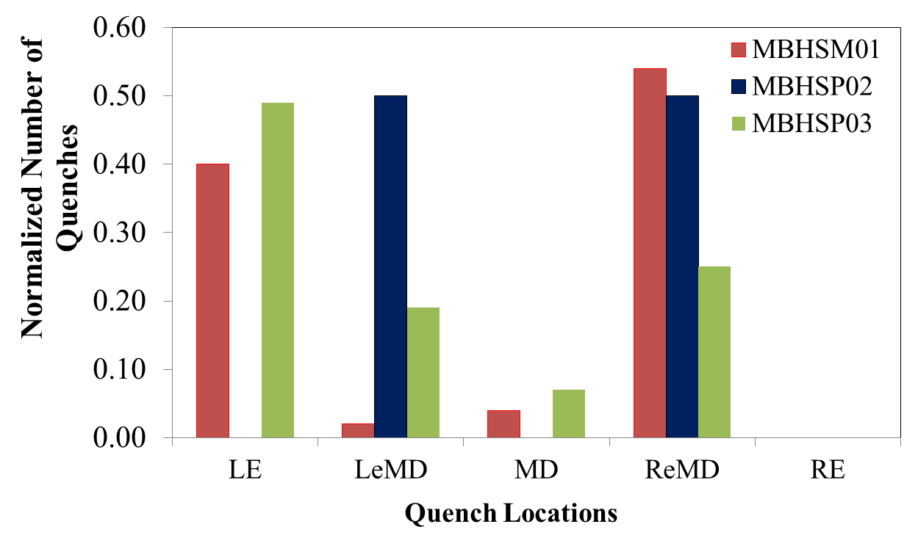
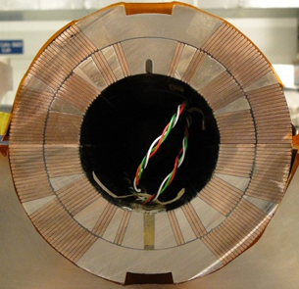
Quench origin

Slide 11

Field Quality
Transfer function B/I and field harmonics a_{n}, b_{n}
Coil magnetization
Iron saturation
Decay and “snap-back”
Geometrical harmonics

Slide 12
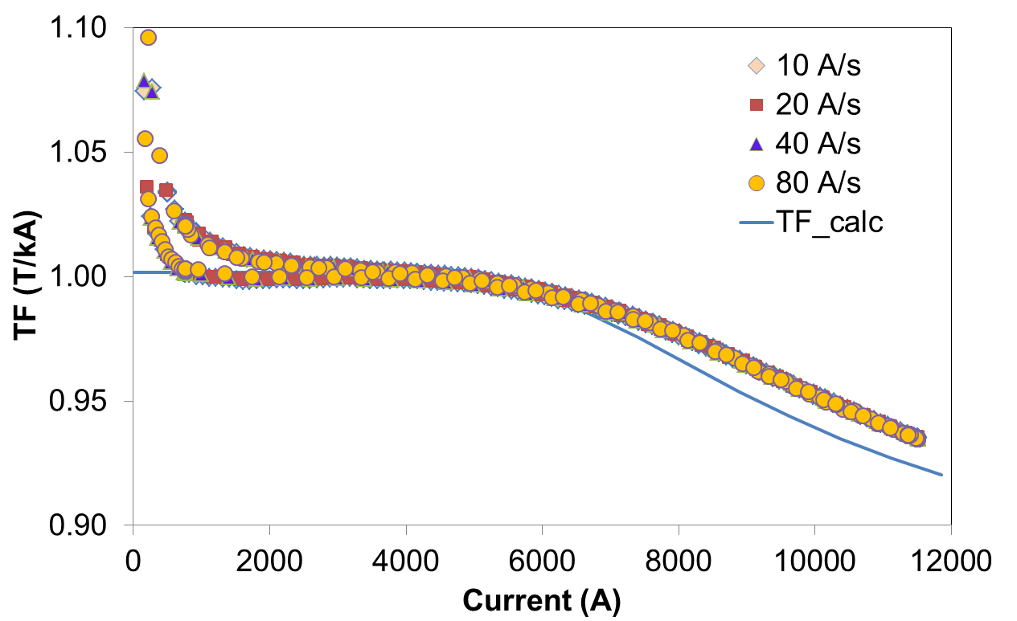
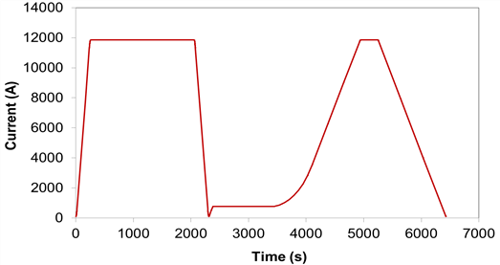
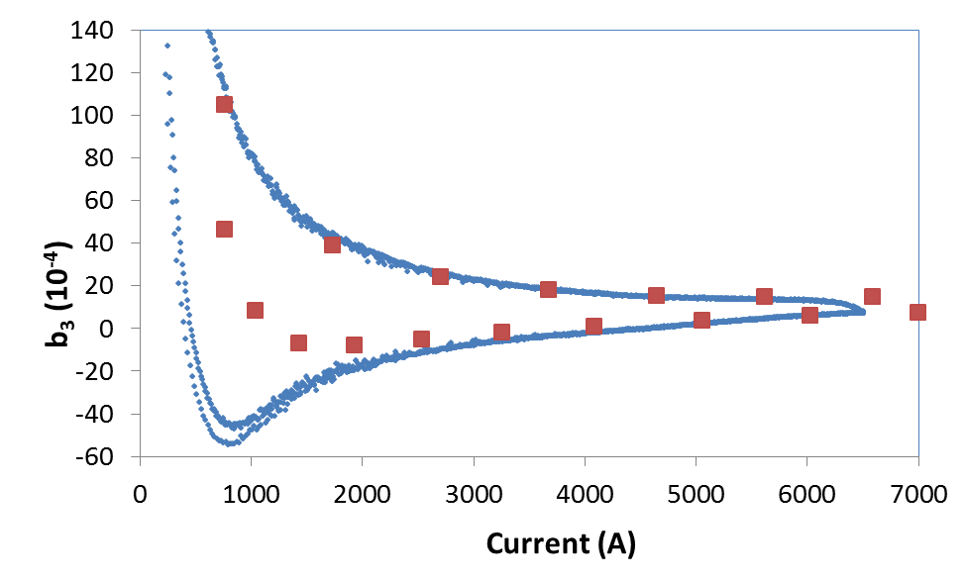
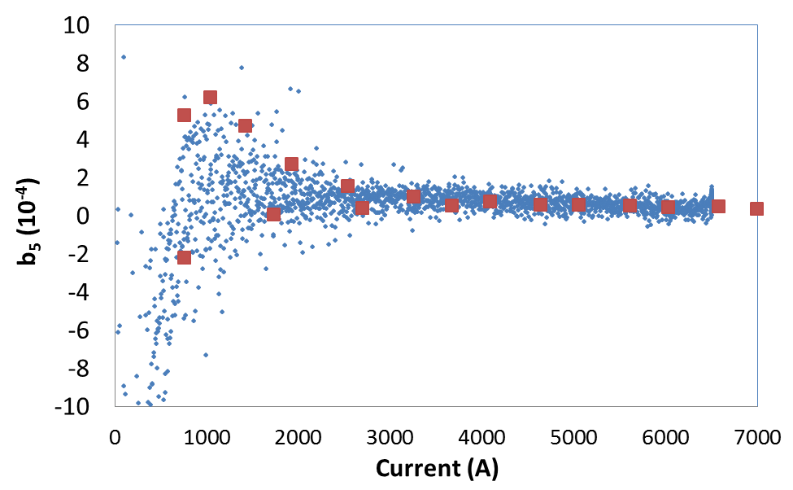
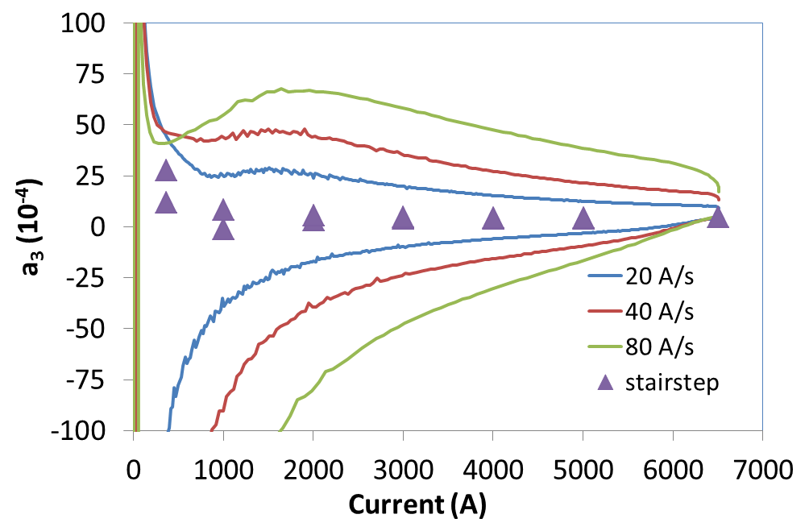
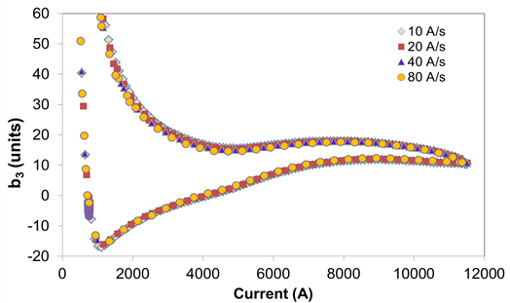
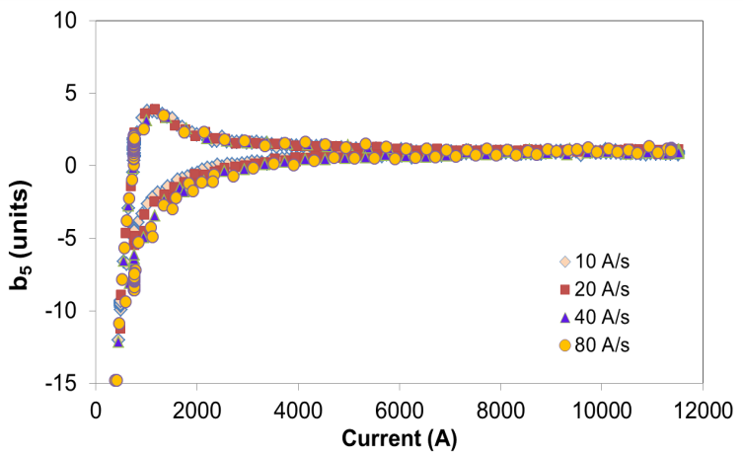
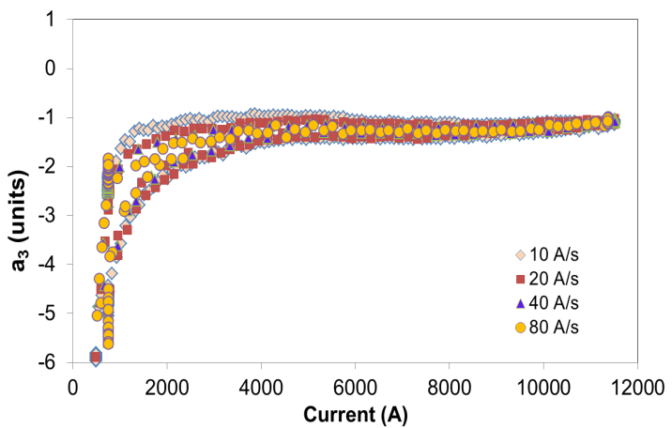
Magnetic measurements
MBHSP01
MBHSP02, 03

Slide 13
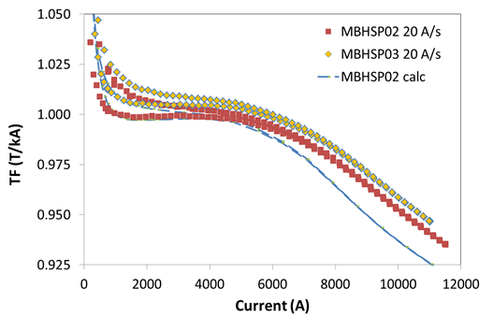
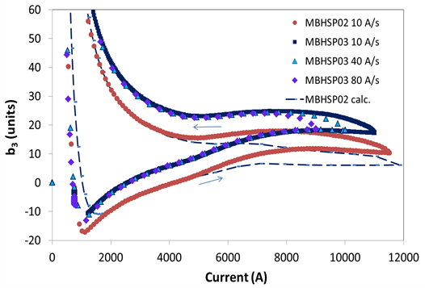
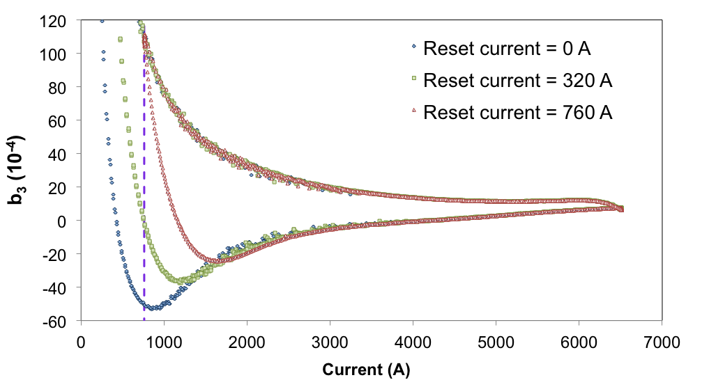
Coil magnetization & iron saturation
SC magnetization effect is large but understood
  reset current
  passive correction
Eddy current effect is large
  cored cable
Iron saturation effect
  Need better understanding

Slide 14
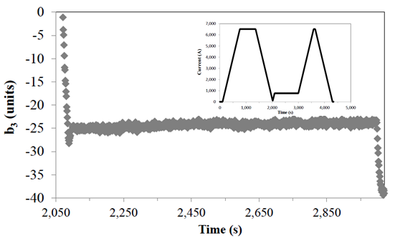
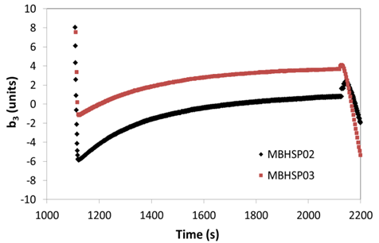
Decay and “snap-back”
LHC current profile:
injection current of 0.76 kA
injection plateau ~1000 s
non-linear ramp to the nominal current of 11.85 kA
MBHSP01:
b₃ decay is small <2 units
MBHSP02-03:
b₃ decay at injection porch is large 5-6 units
High repeatability
MBHSP01
MBHSP02, 03

Slide 15
Geometrical harmonics
Some improvement in MBHSP02,03 wrt MBHSP01
Still large values of b₃, a₃ and b₂
  coil shimming used to achieve the required coil pre-stress
  coil cross-section deformations during magnet assembly
  coil azimuthal misalignment inside the collar

Slide 16
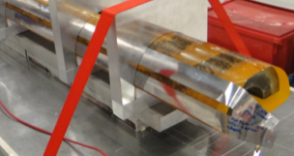
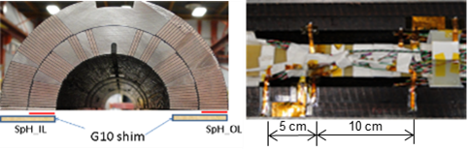
Quench Protection
Protection heater study
Quench propagation
Coil quench temperature

Slide 17
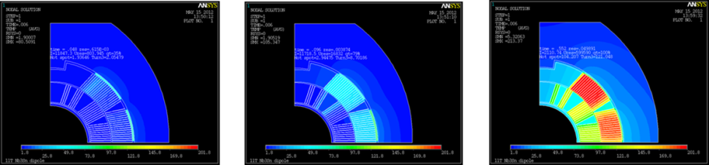
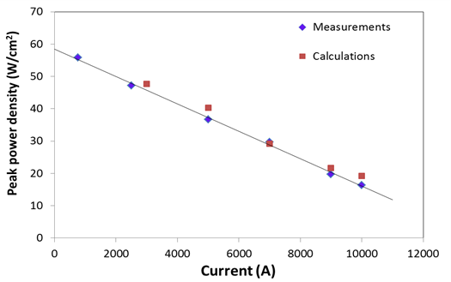
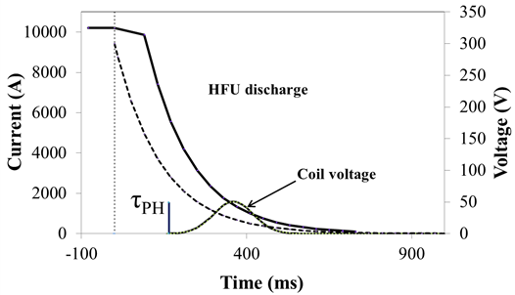
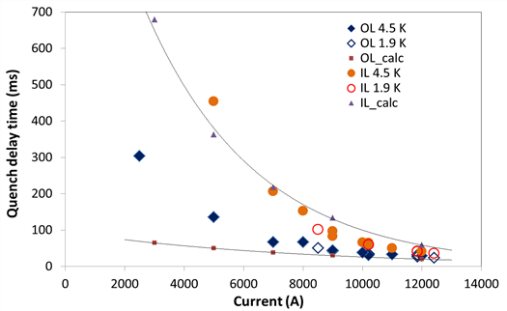
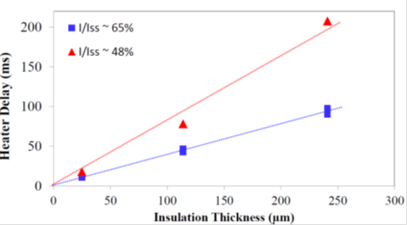
Protection heater studies

Slide 18
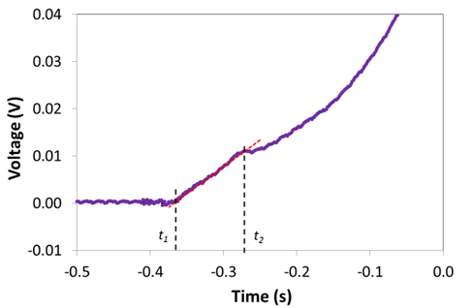
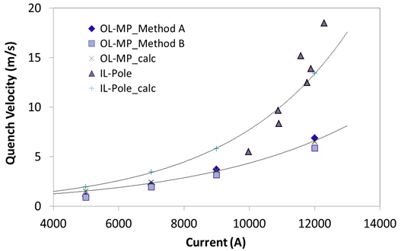
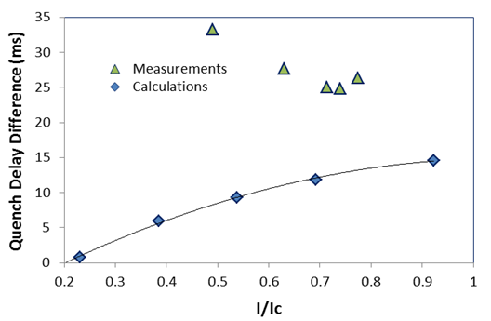
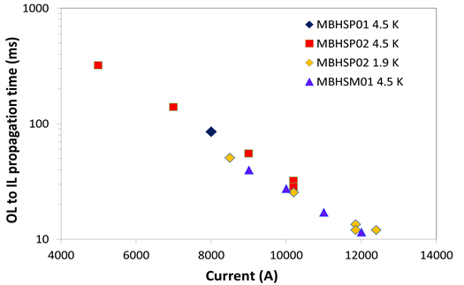
Quench propagation

Slide 19
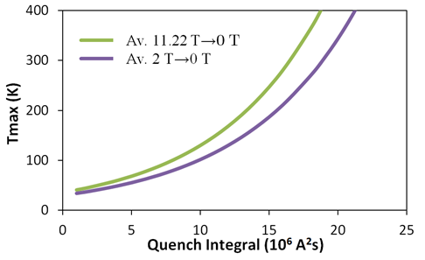
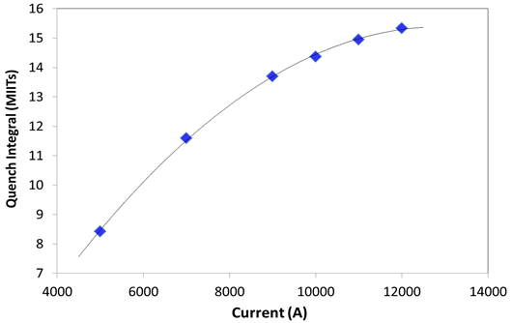
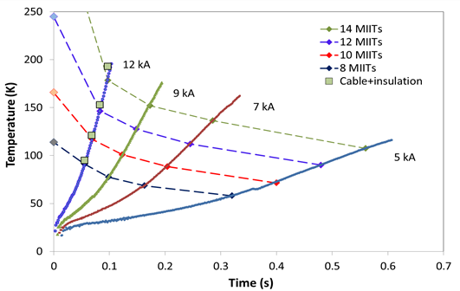
Coil quench temperature

Slide 20
Conclusions
Successful FNAL/CERN collaboration.
  2-m long 11 T dipole demonstrator was developed, fabricated and tested by FNAL/CERN collaboration
  technology transfer to CERN
  established coordinated fabrication and test procedures
9/10 1 m long coils were fabricated since 2012.
  RRP108/127 and RRP150/169 strand, cored cable, end parts
Four coils were assembled in two collared coil assemblies and tested in a single-aperture configuration.
  both collared coils were trained to ~11.6 T at 1.9 K, or 97% of the dipole design field of 12 T
  data on magnet quench performance, field quality and quench protection.
One 1 m long coil was tested in the dipole mirror configuration
  role of coil pre-load
  coil quench protection parameters
Assembly of the first twin-aperture 11 T dipole model is almost finished. Model test is planned in January 2015.

