Slide 1
Beam Dynamics targets
Massimo Giovannozzi and Riccardo De Maria
CERN
Acknowledgements: G. Arduini, R. Bruce, B. Holzer, S. Izquierdo Bermudez, J. Jowett, M. Karppinen, S. Redaelli, F. Savary, M. Schaumann.

Slide 2
Outline
Introduction
Analysis of specific points
  Mechanical aperture
  Transfer function
  Field quality
Conclusions and outlook

Slide 3
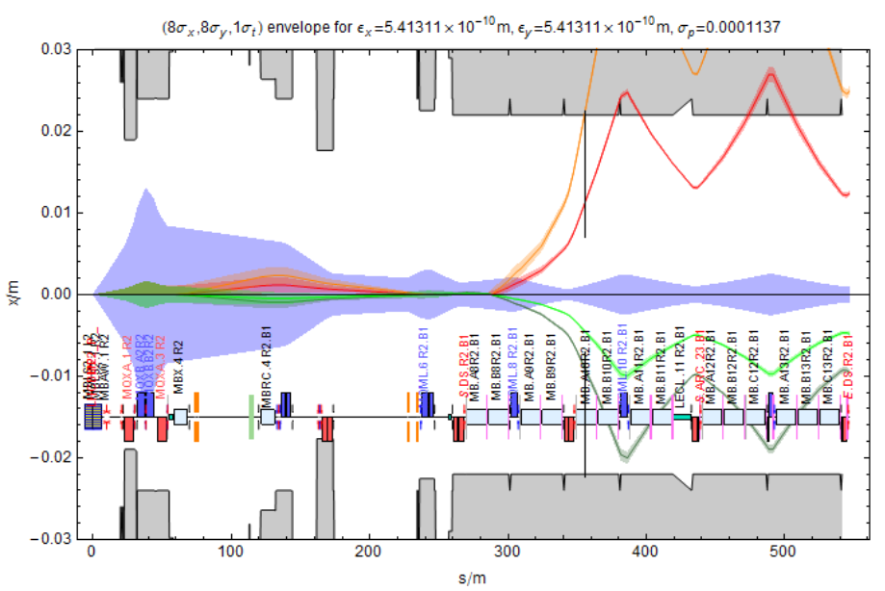
Introduction - I
11 T dipoles (MBH) will allow mitigating diffractive losses originated at the IP or at the collimators and being intercepted by the first dispersive aperture bottlenecks.
Post-LS2
  One TCLD/11 T
  dipole unit in DSs
  of IR2 (MB.A10)
TCLD location
J. Jowett, M. Schaumann

Slide 4
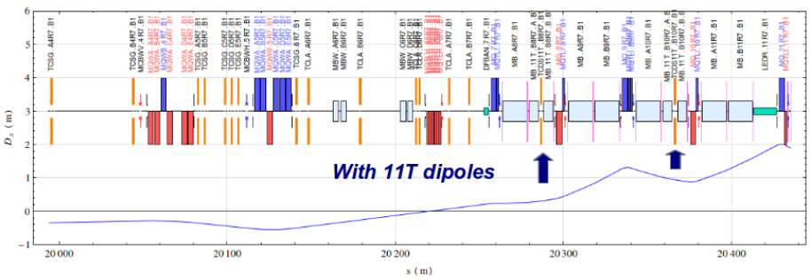
Introduction - II
Post-LS3 – A
  Two TCLD/11 T dipole units in DSs of IR7 (MB.B8, MB.B10)
Post-LS3 – B
  Two TCLD/11 T dipole units in DSs of IR7 (MB.B8, MB.B10)
  One TCLD/11 T dipole units in DSs of IR1/5 (MB.B9)
NB: LHC optics will be different for post-LS2 and post-LS3 runs. For the latter the so-called Achromatic Telescopic Squeezing (ATS) optics by S. Fartoukh will be used.
S. Redaelli
TCLD locations

Slide 5
Mechanical aperture and transfer function
Beam aperture: MBHs feature a straight geometry, with coil aperture of 60 mm (main dipoles have 56 mm coil aperture) hence with a potential loss of beam aperture.
Is a standard LHC beam screen adequate?
Transfer function: MBHs and main dipoles do not generate the same field for the same current. Possible solutions:
  A) install a trim power converter
  B) implement orbit bumps in the neighborhood of the replaced dipoles
Aspects to be considered:
  Aperture loss for the circulating beam at injection and collision
  Orbit corrector strength reduction at top energy

Slide 6
Aperture model
MBH
B1
MBH Beam screens parallel on the MBH central
reference orbit:
Straight nominal MB type (22 mm radius,17.15 mm half gap)
Optimised transverse positioning, by sharing sagitta (1.6 mm).
Aperture margin estimates for circulating beam:
At injection the parameters are being reviewed. In this study beam aperture is computed using standard parameters:
  Beta-beating: 20%; closed orbit: 4 mm; momentum off set: 1.5 10⁻³; spurious dispersion: 27cm; normalised emittance: 3.75 µm;
  At collision energy aperture for the circulating beam is generally available even with ATS, however for scattered particles new bottlenecks may introduced.
The target aperture is 7 sigma at injection.
B2

Slide 7
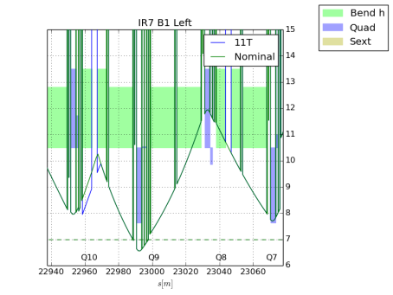
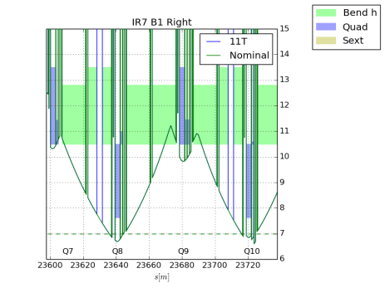
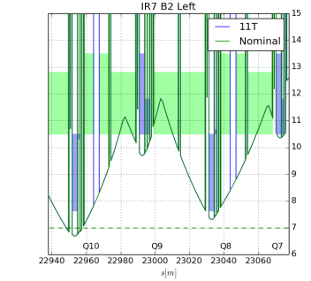
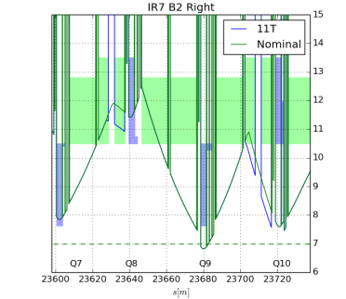
Impact on aperture at injection
IR7: no impact on aperture.
NB: no optics difference between nominal and ATS in IR7

Slide 8
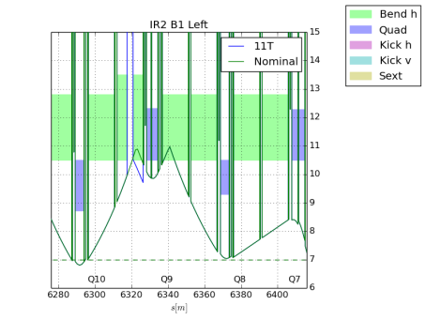
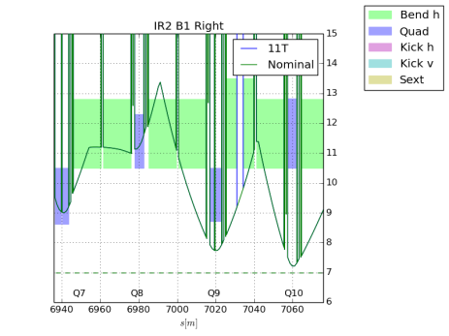
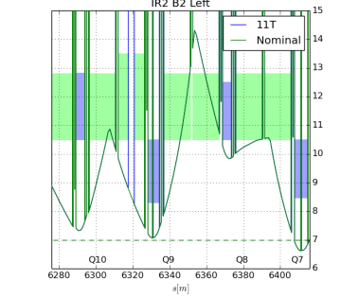
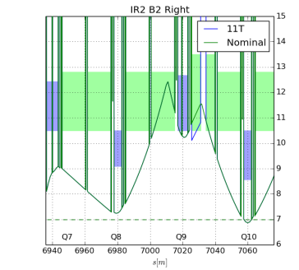
Impact on aperture at injection
IR2: no impact on aperture.
NB: optics differences between nominal and ATS in IR2

Slide 9
Summary: mechanical aperture
A straight nominal beam screen (22 mm radius, 17.15 mm half gap) is compatible with aperture requirements, provided:
  The cold mass is shifted horizontally by half the sagitta.
  No orbit bump is present (see next slides).
  Mechanical tolerances of the beam screen for MBHs are the same as for the main dipoles.
This conclusion holds for both nominal LHC and HL-LHC.

Slide 10
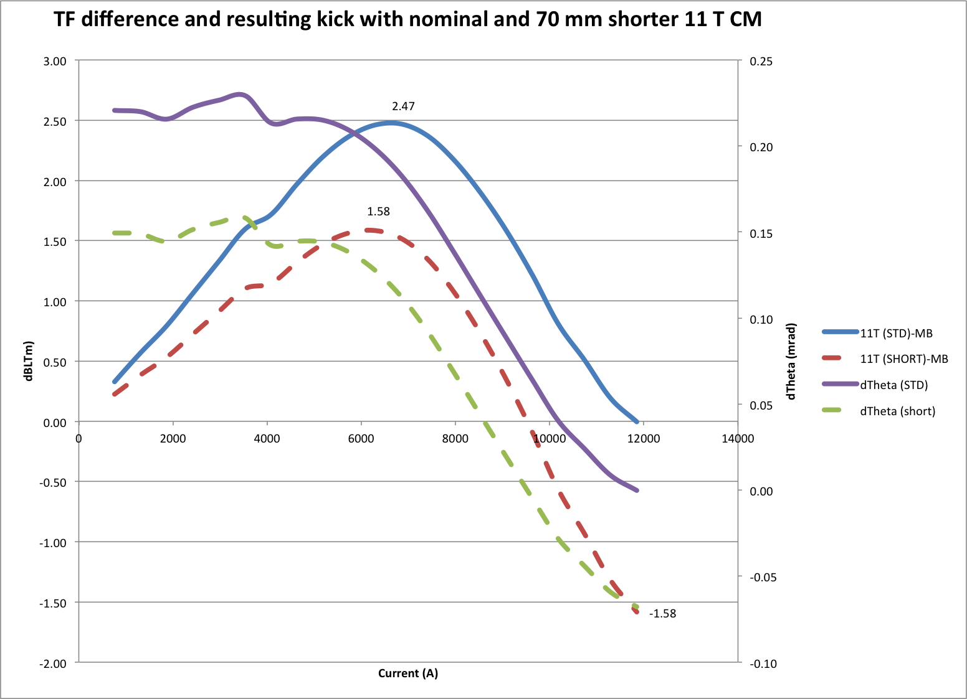
Transfer function
11 T dipoles have a different transfer function with respect to main dipoles. Solutions:
Use closed orbit correctors nearby
  Possible impact on beam aperture at
  injection
  Possible impact on corrector strength
  at top energy
  Possible impact on operation and on
  machine protection (failure of orbit
  correctors might prevent running the
  LHC)
Use trim power converter
  Simpler and better solution
  (from beam dynamics stand
  point)
Assumptions (for each MBH error):
~50 µrad at 0.45-3.5TeV
~15 µrad at 6 TeV
~0 µrad at 7 TeV
M. Karppinen

Slide 11
Orbit corrector budget
 | Q12 | Q11 | Q10 | Q10 HL-LHC | Q9 | Q8 | Q7
TYPE | MCB | MCB | MCBC | MCB IR1,5 | MCBC | MCBC | MCBC
Max [Tm] | 1.9 | 1.9 | 2.8 | 1.9 | 2.8 | 2.8 | 2.8
Max [µrad@7TeV] | 81 | 81 | 120 | 81 | 120 | 120 | 120
Used in OP (e.g fill 3375) | 30% | 30% | 50% | 75% | 50% | 50% | 50%
ATS disp corr. | 30% | 0% | 0% | 0% | 0% | 0% | 0%
Strength required for bumps correction
IR7 |  | 23% | 63% |  | 70% | 87% | 46%
IR2 |  |  | 45% |  | 70% | 19% | 112%
NB: Strength issues could be mitigated by using more correctors, but this would extend the bump over a longer section of the ring, with potential negative impact on aperture.

Slide 12
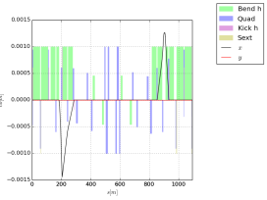
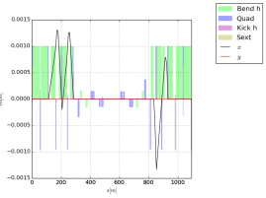
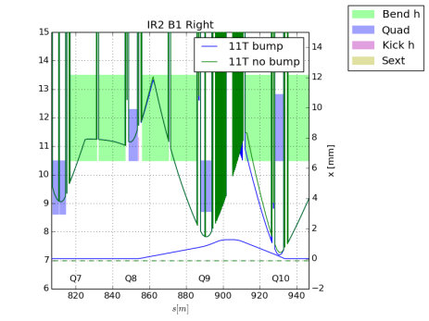
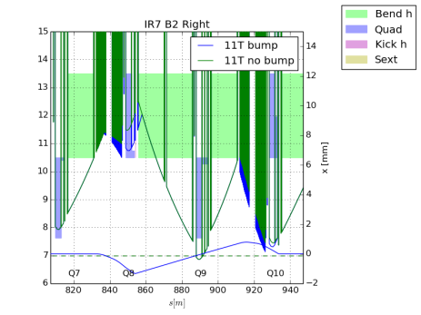
Aperture with bumps at injection
IR2B1
IR7B2
Typical shape of the closed orbit bumps in IR2 and IR7

Slide 13
Summary: transfer function
An error of 50 µrad for each MBH starts to degrade aperture at injection at some locations.
An error of 50 µrad is tolerable up to 3.5 TeV in terms of orbit correctors’ strengths. The error has to decrease linearly with energy to 7 TeV.
Any residual orbit at collision energy < 7 TeV needs to be carefully evaluated.
This conclusion holds for both nominal LHC and HL-LHC.
The trim power convert solves all these issues.

Slide 14
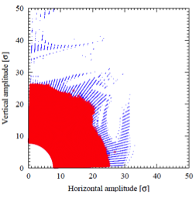
Field quality - I
Impact of magnets’ field quality is customarily
evaluated using numerical simulations to
compute the results dynamic aperture (DA) of the LHC ring.
Potential field quality issues:
  b₃ of about 108 units at injection energy (geometric and persistent current effects): direct impact on DA.
  b₂ of about 12 units at collision energy: direct impact on beta-beating.
Configurations to be studied:
  Energy: injection/collision
  Optics: nominal/ATS
  Scenarios for TCLD installation: number of MBHs installed in the ring
NB: the studies reflect assumptions that have been superseded. New studies are in progress.

Slide 15
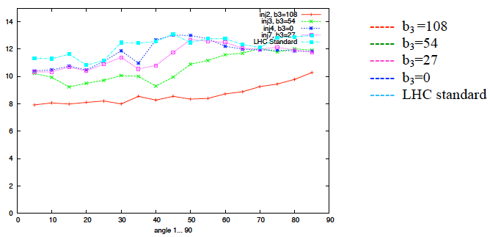
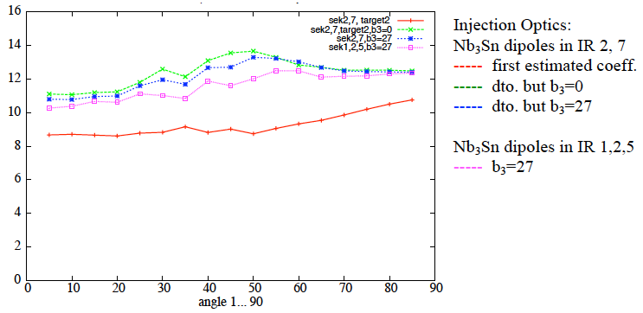
Field quality - II
Injection case, nominal optics: clear impact of b₃ on DA.
b₃ about 27 units is the upper value to have negligible impact on DA if IR2/7 are considered.
Minimum DA over 60 seeds vs. angles in physical space
B. Holzer
Injection case, nominal optics: clear impact of b₃ on DA.
b₃ about 27 units is affecting the DA if IR1/2/5 are considered.
Minimum DA over 60 seeds vs. angles in physical space

Slide 16
Summary: field quality
b₃ is the main MBH multipole affecting DA at injection (nominal or ATS optics).
b₃ of about 27 units allows preserving DA at injection when TCLDs are installed in IR2/7.
b₃ of about 27 units does not allow preserving DA at injection when TCLDs are installed in IR1/2/5.
At collision energy the field quality of MBHs has a negligible impact on DA (nominal or ATS optics).
One b₃ spool piece (for each TCLD, i.e., two MBHs) helps in preserving DA.
New field quality estimates and installation scenarios available: studies will be pursued for these new situations.

Slide 17
Conclusions and outlook
Mechanical aperture
  Standard beam screen (baseline solution) provides enough beam aperture, assuming that mechanical tolerances are the same as those of the main dipoles.
Transfer function
  A trim power converter (baseline solution) is essential to preserve mechanical aperture, strength margin of nearby orbit correctors, and reduce operational complexity.
Field quality
  Sextupolar component at injection has the strongest impact on DA.
  The presence of spool pieces (baseline solution) is essential for preserving DA.
  Prioritisation of spool pieces possible:
    Sextupolar and decapolar
    Octupolar
  Currently expected field quality seems to preserve DA.
  Follow up on field quality (magnetic measurements and beam dynamics simulations) is essential to ensure the required HL-LHC performance.

