Slide 1
International review of the HL-LHC 11T Dipole for DS Collimation
11T Design & Fabrication – FNAL
Fred Nobrega

Slide 2
Outline
Background
Mechanical Design
Model Magnet Features
Coil Technology and Fabrication
11T Dipole Plans
Summary

Slide 3
Background
Joint development program began in October 2010
Goal: to demonstrate feasibility and build a twin-aperture 11 T, 5.5 m long Nb₃Sn dipole prototype by 2016
  11 T dipole magnet must be compatible with the LHC lattice and main systems
  Synergy of FNAL HFM program goals and LHC needs
The FNAL plan was modified to account for the reduction of the HFM budget due to shifting U.S. priorities to LHC upgrades.
  Model magnet length reduced from 2 m to 1 m to cut conductor cost and magnet parts

Slide 4
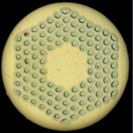
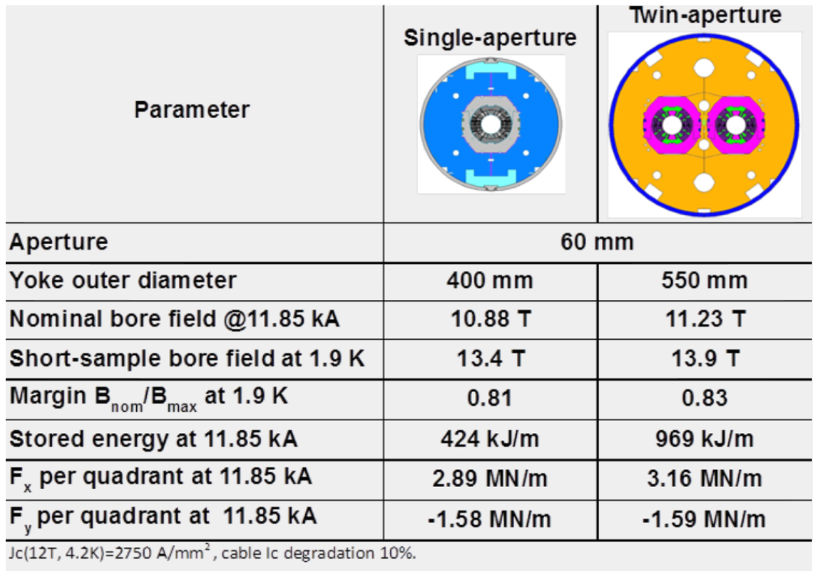

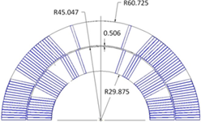
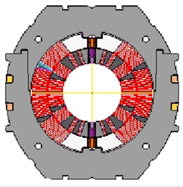
Magnet Design & Parameters
0.7 mm RRP-108/127
Nb₃Sn strand
40-strand cable, SS core
60-mm 2-layer 6-block coil
Stainless steel collar

Slide 5
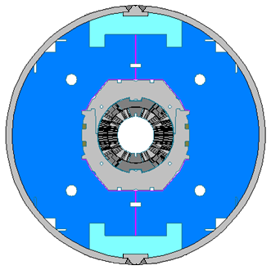
Mechanical Structure
Slightly elliptical stainless steel collar, 25 mm wide near mid-plane.
400 mm vertically split iron yoke.
Al clamps to control yoke position.
12 mm thick stainless steel skin.
50-mm thick end plates.
The coil pre-stress is created in three steps – during collaring, skin welding, and cooling-down to operation temperature.
The coil pre-stress during assembly has to be:
  sufficient to compensate for the difference in the coil and structure thermal contractions during cool-down, and Lorentz forces during magnet excitation
  Safe for brittle Nb₃Sn coils

Slide 6
Mechanical Design
Coil pre-stress
  Within 0..-165 MPa at all times
Separate collared coils
  Most of the coil pre-stress obtained by collaring
  Testing of collared coils in 1-in-1 structure
Vertically split yoke
  Assembly process less influenced by friction (vs. horizontal split)
Welded SS skin for the 1.8 m model MBHSP01
Bolt on skin for MBHSP02-03 and MBHMP01

Slide 7
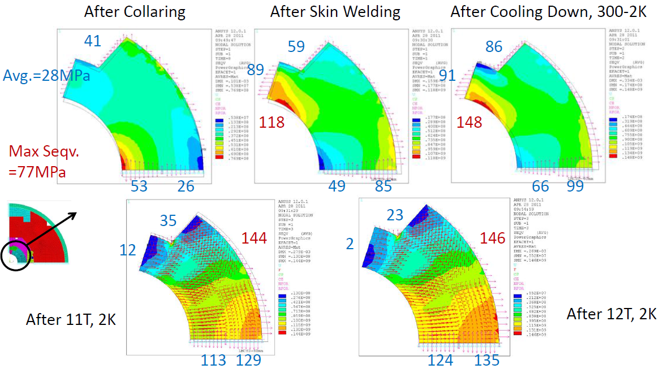
Coil Stress Distribution, MBHSP03

Slide 8
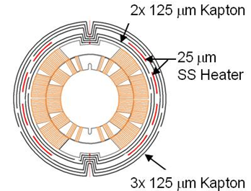
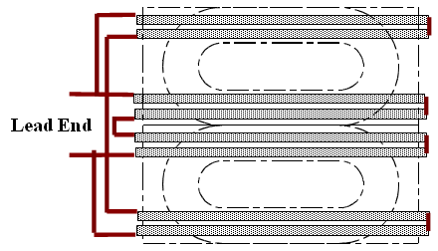
Quench Protection
Quench heaters are 0.025 mm thick stainless steel strips placed between the layers of ground insulation.
Quench heater studies included positioning heaters closer to the coil.

Slide 9
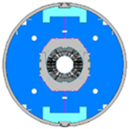
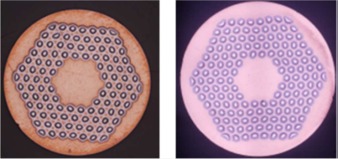
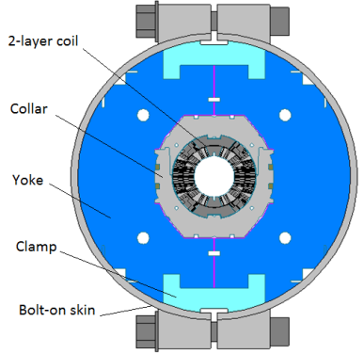
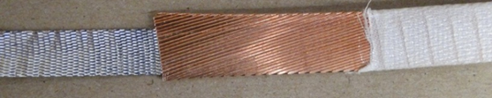
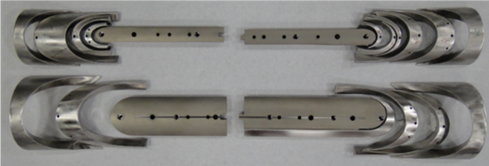
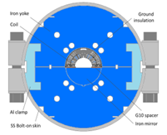
Model Design Features
MBHSP01: 2-m dipole demonstrator
  RRP108/127
  Cable w/o core
  Coils #2, 3
MBHSP02: 1-m dipole model
  RRP150/169
  Cable with 11.5 mm SS core
  Coils #5, 7
MBHSM01: 1-m dipole mirror
  RRP108/127 (114/127)
  Cable with 11 mm SS core
  Coil #8
  Optimized pre-stress
MBHSP03: 1-m dipole model
  RRP108/127
  Cable with 11 mm SS core
  Coils #9, 10 – modified coil end parts (FNAL)
  Modified collar, thicker protection shoe
  Optimized pre-stress
RRP 108/127 RRP150/169
MBHSP01
40-strand cored cable
Optimized end parts
MBHSP02, 03
MBHSM01

Slide 10
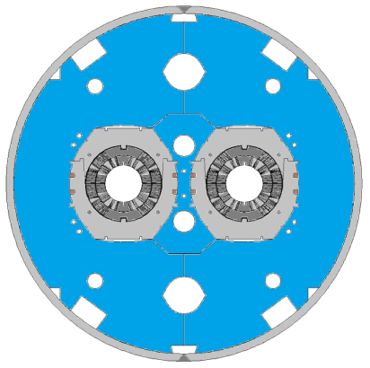
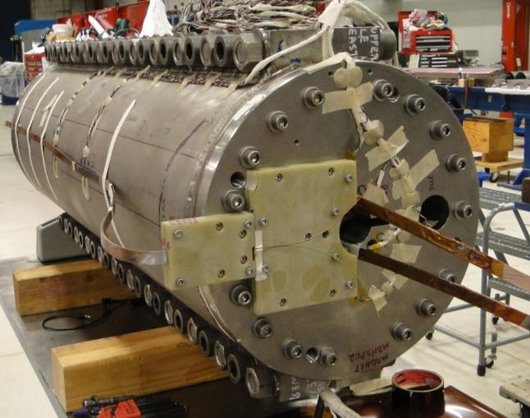
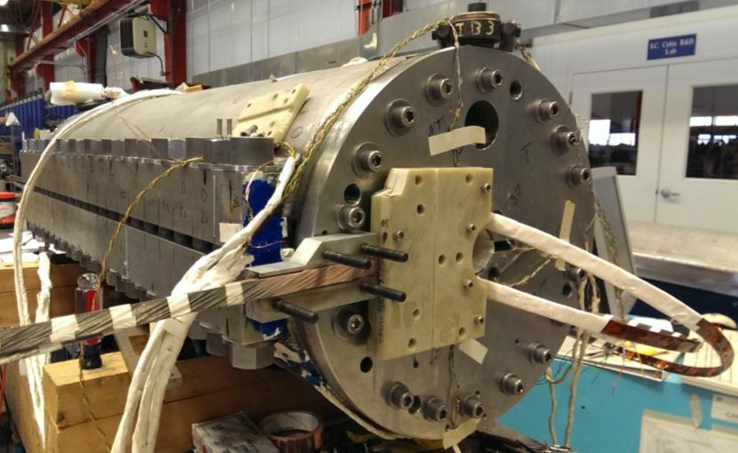
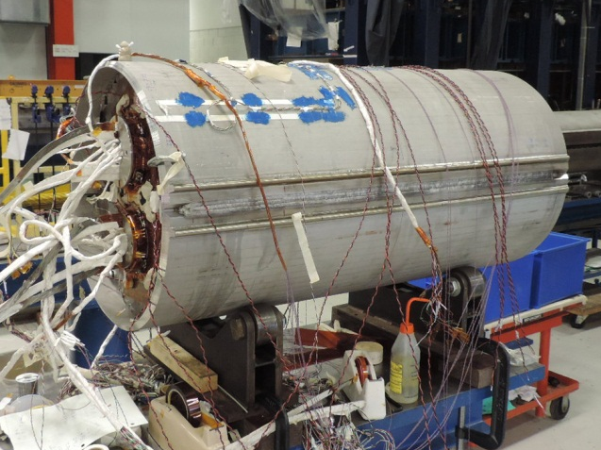
Model Design, con’t
MBHDP01: 1-m twin aperture
  MBHSP02: 1-m dipole model
    RRP150/169
    Cable with 11.5 mm SS core
    Coils #5, 7
  MBHSP03: 1-m dipole model
    RRP108/127
    Cable with 11 mm SS core
    Coils #9, 10 – modified coil end parts (FNAL)
    Modified collar, thicker protection shoe
    Optimized pre-stress
    Collared coil prestress increased using radial shims.
MBHDSP01
MBHSP02
MBHSP03
MBHDP01

Slide 11
Magnet-Coil History
mirror
2-in-1
FABRICATION | MBHSP01 | MBHSP02 | MBHSM01 | MBHSP03 | MBHDP01
Coil Winding & Curing
Coil(s) used | MBH02 & 03 (2m long) | MBH05 & 07 (1m long) | MBH08 (1m long) | MBH09 & 10 | MBH05,07,09,10
cable | RRP 108/127 | RRP 150/169, with SS core | RRP 108/127, with SS core | RRP 108/127, with SS core | RRP 108/127 & RRP150/169
end parts |  | Shortened leg length & saddle midplane reducing gap between current block and L2 coil spacer | Shortened legs to an angle and extended wedge to match | Shortened legs to an angle and extended wedge to match
curing shim in/out, mm | 1.0/1.0 (between saddles) | 1.0/1.5 (modified saddles) | 0.8/1.3 (modified saddles) | 0.8/1.3 (modified saddles)
Coil Reaction
HT cycle | 72 h at 210C, 48 h at 400C, 48 h at 640C | 72 h at 210C, 50 h at 400C, 50 h at 665C | 72 h at 210C, 48 h at 400C, 48 h at 640C | 72 h at 210C, 48 h at 400C, 48 h at 645C
mandrel shim, mm | 0 | 0 | 0.2 | 0.2
form block shim, mm | 0 | 0 | 0.2 | 0.2
Coil Impregnation
mandrel shim | 0 | 0 | 0.2 | 0.2
form block shim | 0 | 0 | 0.2 | 0.2
Radial material | 0 | 0 | 0 | 0
Tested
Tested
Tested
Tested
Assembly
Test, Jan, 2015

Slide 12
Magnet-Coil History, con’t
FABRICATION | MBHSP01 | MBHSP02 | MBHSP03
Collared Coil Assembly
collars | laser cut | laser cut, reworked at midplane | stamped, larger ID
collar shoe thickness, mm | 0.5 | 0.5 | 2 layer; 0.8+0.4=1.2
quench heater | 0.025 mm S.S. + 0.125 mm Kapton & 0.025 mm S.S. + 0.25 mm Kapton | 0.025 mm S.S. + 0.125 mm Kapton | 0.025 mm S.S. + 0.125 mm Kapton
collared coil shim plan, mm | 0.22 MP, 0.18 radial | 0.45 MP, 0.25 Radial w/ tapered ends | 0.23 MP, -0.15 Radial
Clamped Yoke Assembly
Collar-Yoke shim plan, mm | Graded: 0.24 MP --> 0.16 --> 0.19 | 0.216 w/ tapered ends | .01 mm
Final Assembly
Shell type | welded | bolt on | bolt on
Lead length, mm | 1000 & 500 | 1000 & 1000 | 1000 & 1000
coil stress (MP/Pole), MPa | -42/-62 | -57/-60 | -55/-25
Fabrication Time | 9/16/11-5/22/12 (8+ months) | 7/25/12-2/4/13 (6+ months) | 3/8/13-4/10/14 (1+ yr)* *Includes mirror magnet assy & test
Tested
Tested
Tested

Slide 13
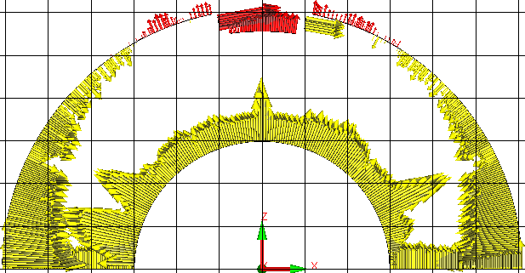
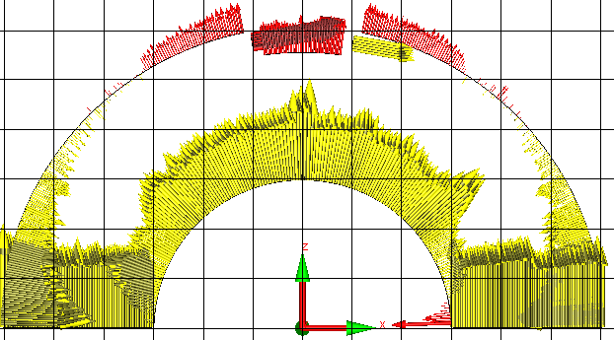
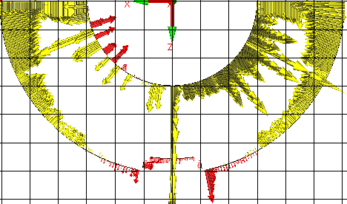
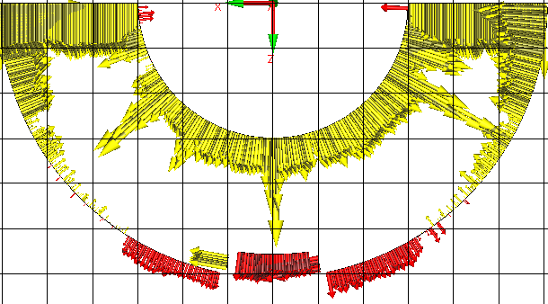
Coil CMM, used for coil shimming
MBHSP01
MBHSP02
MBH02
445 mm from RE
MBH05
467 mm from RE
(1 box = 101.6 μm)
MBH03
435 mm from RE
MBH07
4467 mm from RE

Slide 14
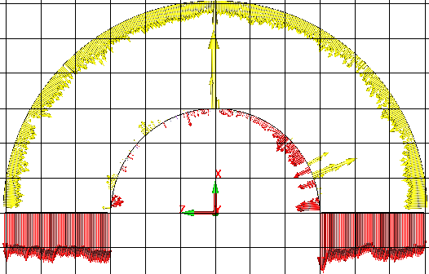
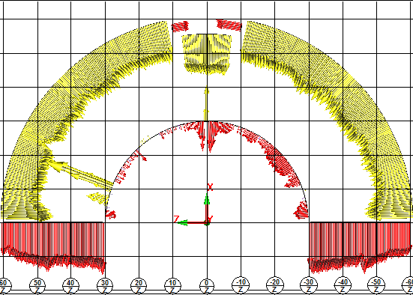
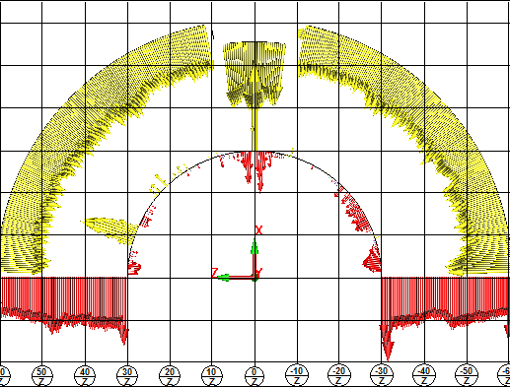
Cross Section #4 at 447.026mm from RETURN END
75 μm removed from OD during potting
(1 box = 101.6 μm)
MBH10
MBH08
MBH09

Slide 15
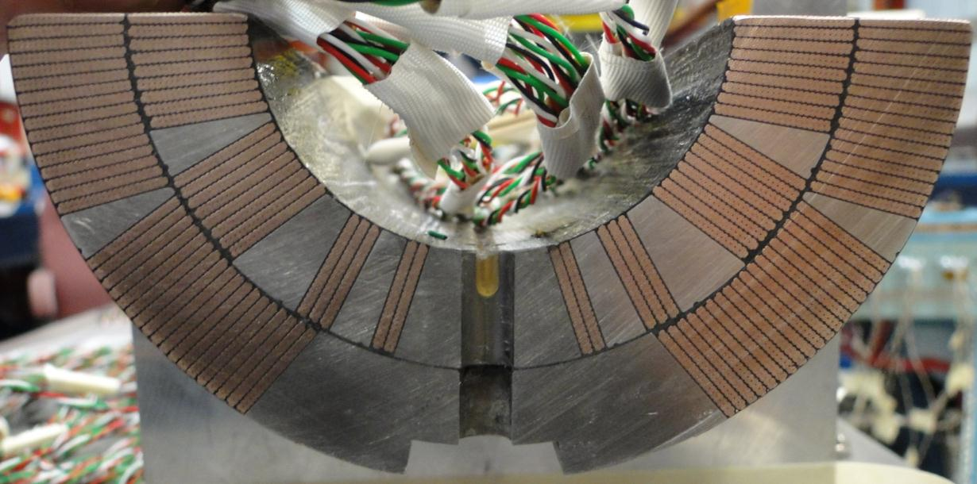
Coil Parameters
The coil has:
  56 total turns, 22 inner, 34 outer
  3 inner layer wedges and 1 outer layer wedge, copper
  SLS end parts, SS, provided by CERN
  Splice-less layer jump transitions between the inner and outer coils.
  Cable & wedge insulation half lap using 75 μm thick E-glass
Alignment notch in L2 pole pieces
Nb₃Sn cable expansion from phase transformation ~3% thickness & ~1% width

Slide 16
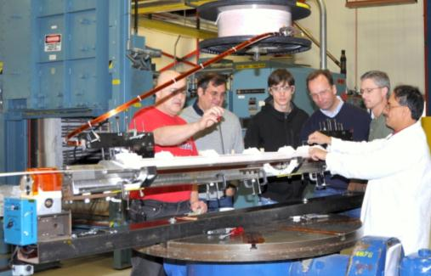
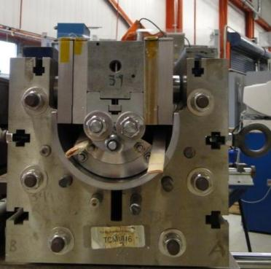
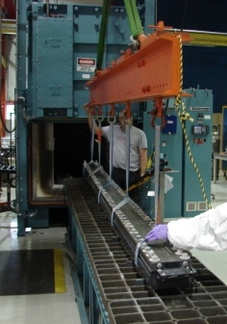
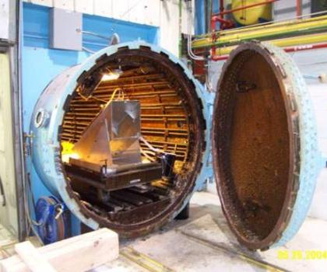
Coil Technology
Cure cycle is 150° C for 30 min. at ~27MPa.
Coil is compressed with 1 mm curing shim. Shim size is approximate sum of cable expansion during reaction and used to pre-compress insulation with binder.
Coil winding tensions is ~156 N.
Pole gap is maintained during winding and curing. Stored coil winding tension is near zero prior to reaction.
CTD-1202X ceramic binder used during winding of end turns to support cable to help prevent popped strands and cable collapse. Binder applied to entire coil prior to curing.
Modify end parts to shorten legs, adjust wedges to match
Impregnation is with CTD101K and is done in the IB2 vacuum oven at 30-50 μm Hg with epoxy temperature of 60° C.
Curing is done in a different oven at 125° C for 21 hours.
Reaction cycle is in an argon atmosphere and at 210° C for 72 hours, 400° C for 48 hours and 640° C for 48 hours. The heat treatment lasts about 9 days including ramp up and cool down.

Slide 17
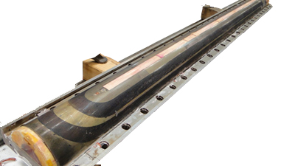
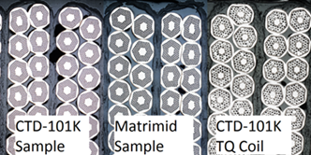
Coil Development with MATRIMID
(soluble thermoplastic polyimide)
Technology scale up
  2-m long 11T dipole coil was
  successfully potted with
  MATRIMID at Fermilab
Cable test stack program
  mechanical, thermal and electrical testing of stacks at room temperature and 4.5 K using cables of various types
MBH04
R.C Bossert et al., ASC2012, Sept 2012

Slide 18
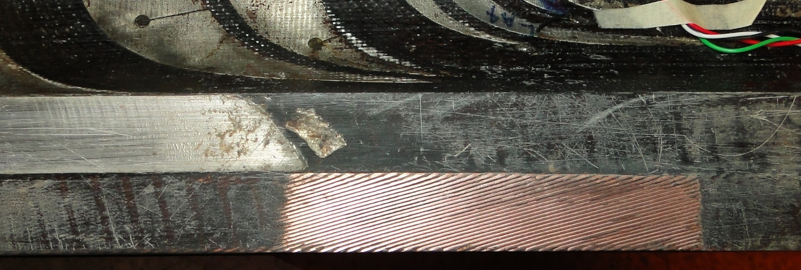
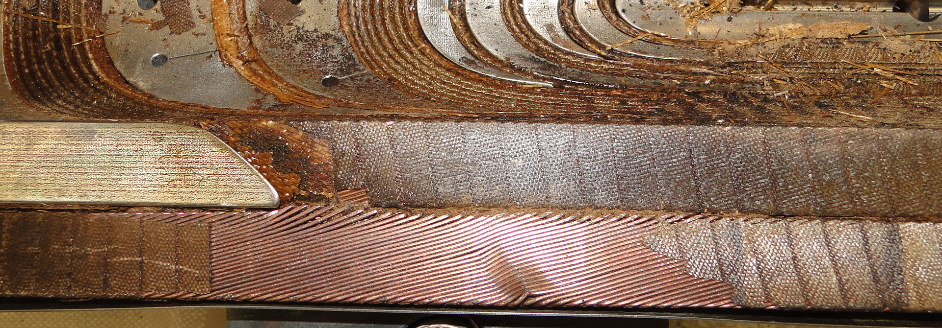
MBHSP01 Autopsy
MBH03
Used in MBHSP01.
Strand spacing observed in MBH04.
Strand spacing!
Cable width!
Reacted
MBH04
(scrapped)
Later potted
w/MATRIMID

Slide 19
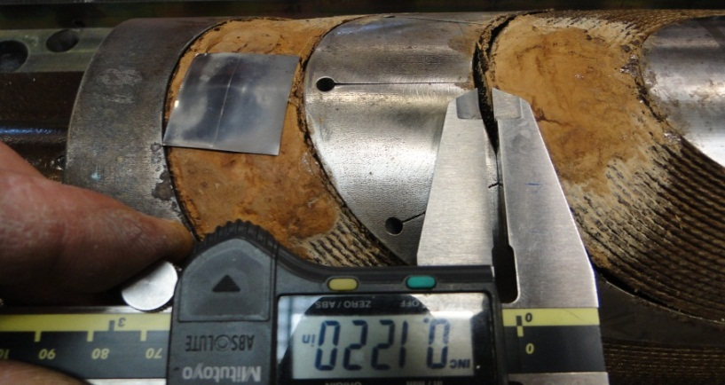
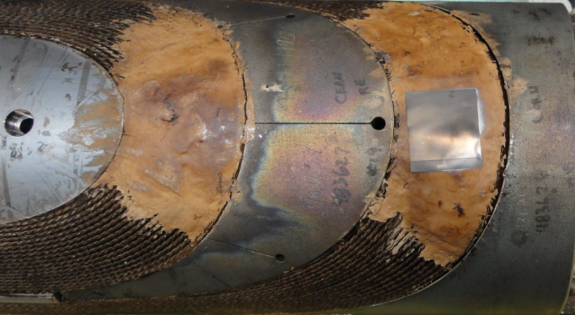
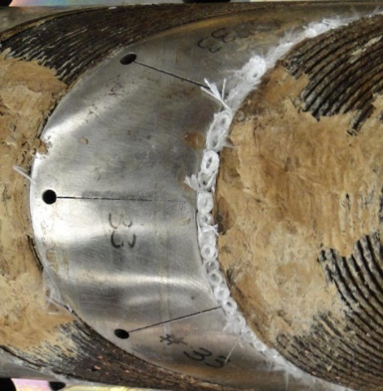
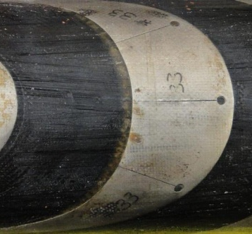
Coil Fabrication
MBH04
MBH04 (2m) with 3mm gap, used end stopper during reaction, spacer not modified
MBH05,07 & 08 (1m) Spacer legs shortened, saddles modified (1 mm removed from inner saddle parting plane, 1.5 mm from outer saddle), no reaction end stopper.
MBH09 spacer legs shortened to an angle
MBH05
Gaps between cable and end parts filled with S2-glass.

Slide 20
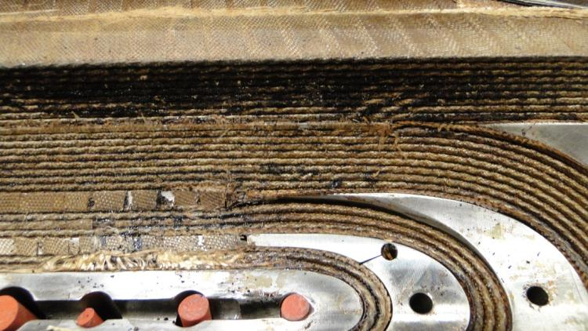
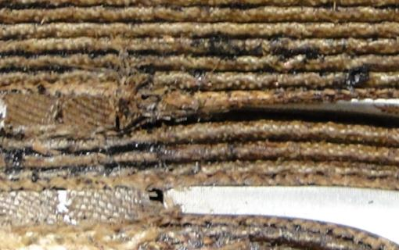
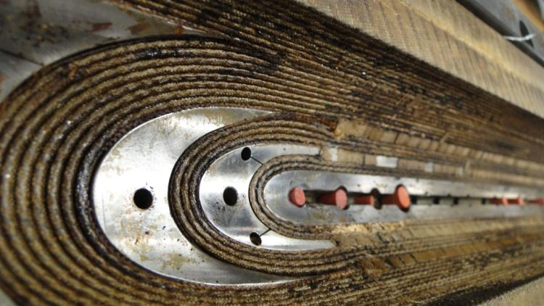
Coil Fabrication, MBH08
Stress Concentration

Slide 21
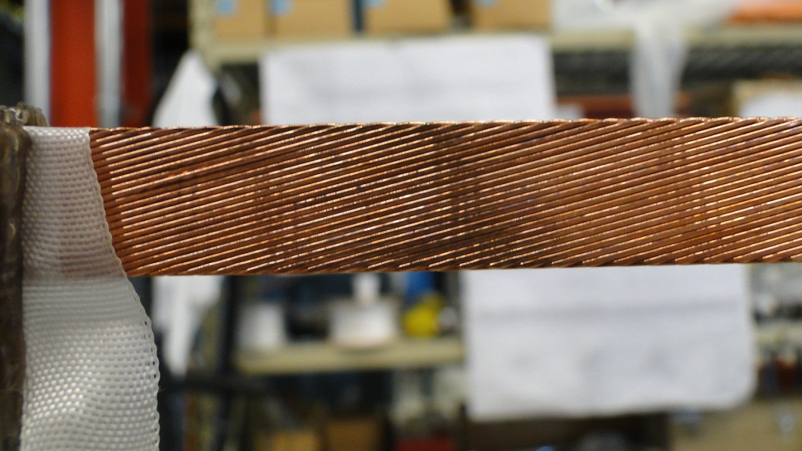
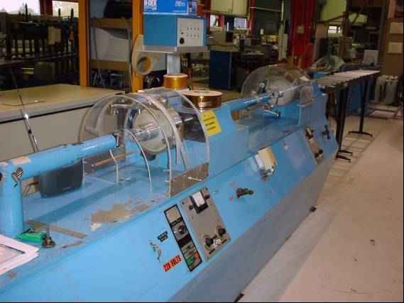
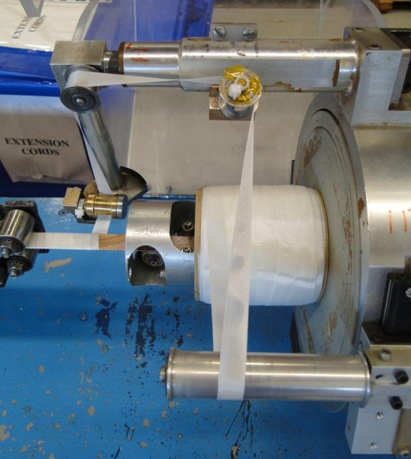
Cable Mechanical Stability, MBH08

Slide 22
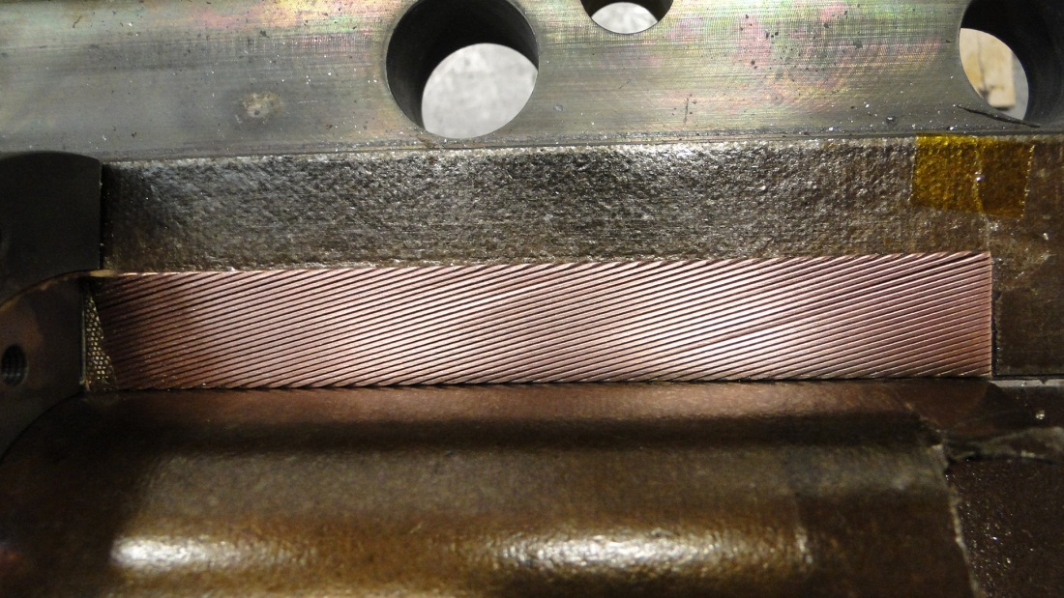
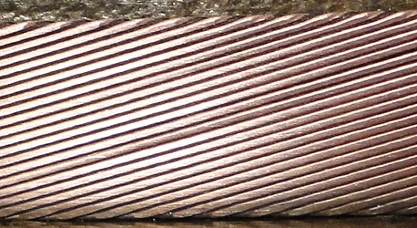
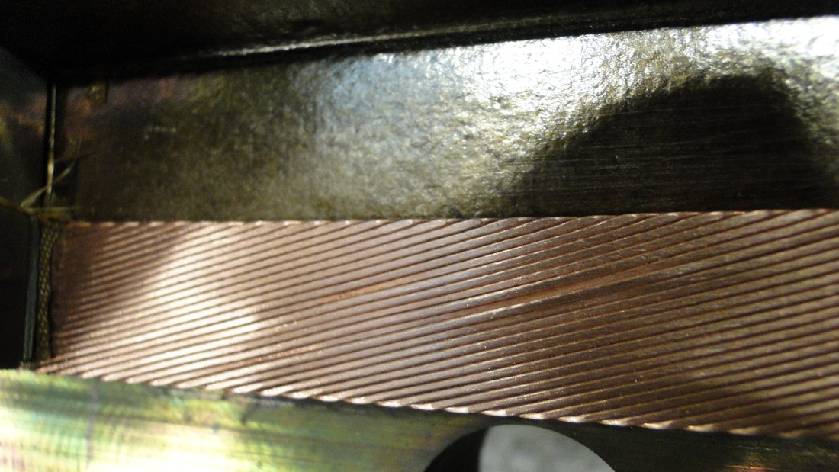

Coil Leads, MBH08

Slide 23
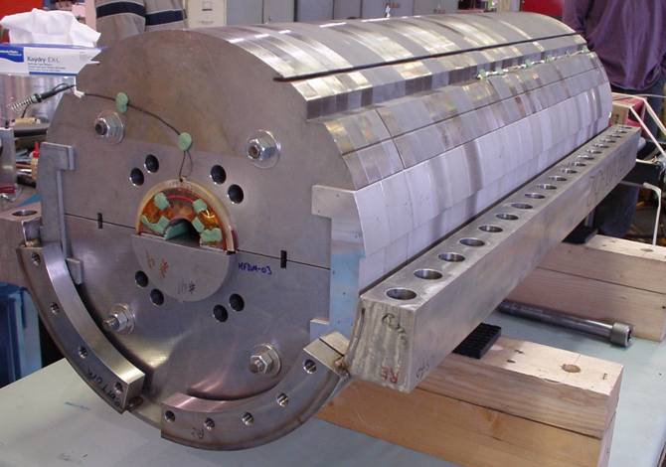

Mirror MBHMP01, Coil MBH08
Modified dipole, single coil, mirror structure, test Dec 2013
Coil MBH08: RRP-108/127, SS core, end part mismatch
Optimized coil preload
  reduce end load and coil bending
Improved performance
  B_{max}=12.5 T at 1.9 K

Slide 24
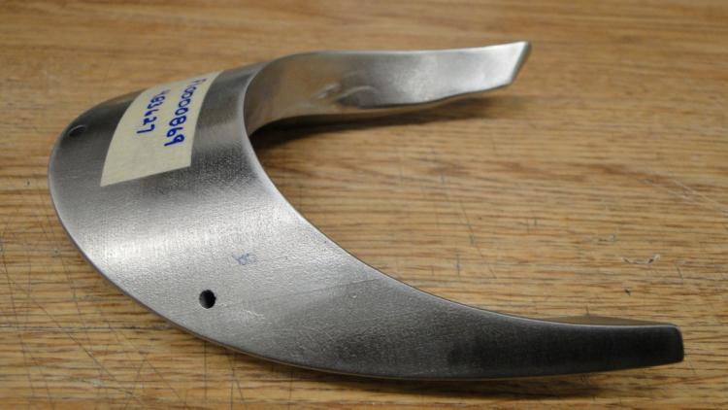
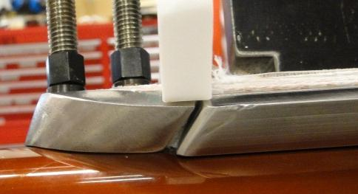
Magnet MBHSP03, Coils #9 & 10
Modified coil end parts and wedges in coils #9 & 10
Optimized & lowered per-stress
Similar approach to mirror MBHSM01
Faster training than MBHSP01 & 02

Slide 25
Coil Fabrication MBH11-12
Use tooling end saddles for curing → use nominal design saddle for reaction
Add ceramic binder for each end turn → added cable stability
Use flexible leg end parts with holes → minimizes end part modifications
→ improved cable support
→ lower effective end part modulus
Increase impregnation radial space by 75 μm → increased coil radius by ~60 μm
Continue with shimming react/impreg tooling → increases tooling volume for coil

Slide 26




End Part Designs
MBH11-15
CERN’s Flexible Leg Design

Slide 27


11 T Dipole Plan for FY15, FNAL
Steps to be done in FY15
  Assemble and test the 1st twin-aperture dipole model MBHDP01, Jan 2015.
  Instrument new coils MBH11 and MBH12
Steps to conclude the 11 T dipole program in FY15
  Assemble and test mirror MBHSM01b or dipole MBHSP04 w/o collar
    QP study, important for LARP QXF
MBHDP01
MBHSP02+MBHSP03
MBHSM01b
MBHSP04

Slide 28
Summary
10 magnet coils have been fabricated (2x 2 m, 8x 1 m)
  2 untested coils are epoxy impregnated, need instrumentation added
  cable and parts available for more 2 coils
3 short dipoles and 1 mirror have been fabricated and tested
  Coil fabrication improvements
    Process
    End parts
All fabrication technologies & results shared with our collaboration partners
Next steps
  Fabrication and test of the first 2-in-1 dipole model
  Fabricate and test mirror and/or dipole magnet with iron next to coils

