Slide 1
Electromagnetic design
Susana Izquierdo Bermudez
B. Auchmann, L. Fiscarelli, M. Karppinen, A. Zlobin
International Review of the HL-LHC 11 T Dipole for DS collimation
December 2014

Slide 2
Outline
Introduction
Magnet parameters at operation conditions
Coil cross section
Peak field
Load line and margin
Transfer function
Iron saturation
Fringe field
Persistent currents
Eddy currents
3D effects
Manufacturing tolerances
Summary

Slide 3
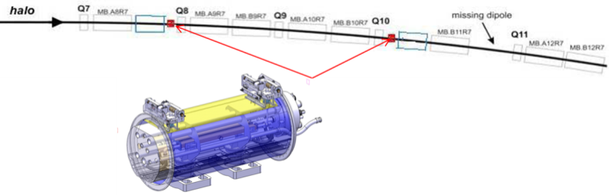
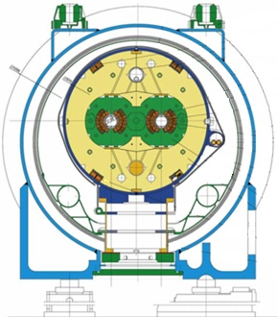
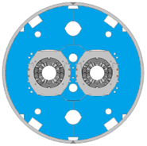
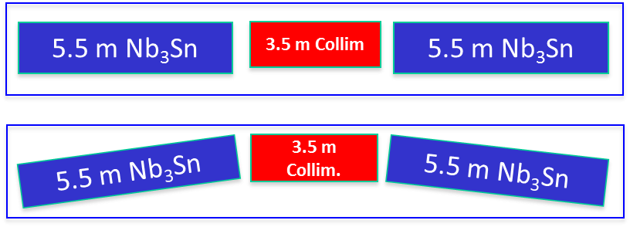
1. Introduction
Collimator
Collimator
  DS-11 T magnet must be 100 % compatible with the LHC lattice and main systems
  This has important consequences, as it is setting (many) important constrains in the design:
  Integrated field (pair of DS-11T dipoles): 118.8 Tm
  Operational point
  Yoke dimension/geometry
  Aperture
  Length
  …
Challenges: high field, forces, stored energy!

Slide 4
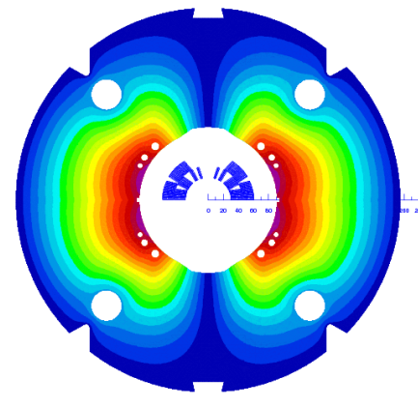
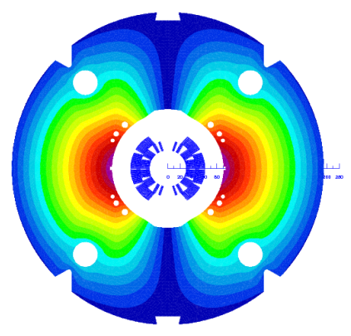
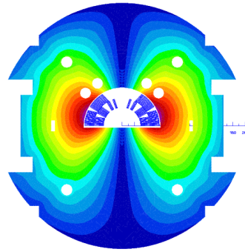
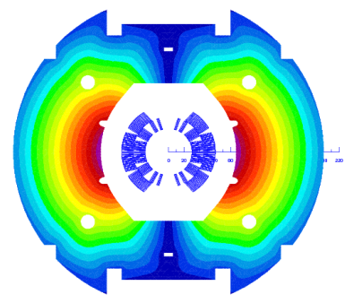
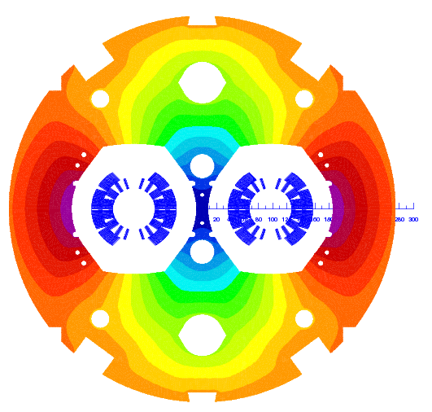
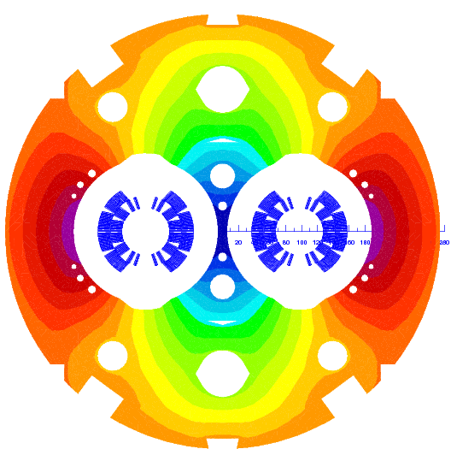
1. Introduction
Before getting to a full length operational magnet, FNAL-CERN R&D Program:
Mirror/Single coil assembly:
validate coil technology/assembly process
One aperture short models:
mechanics, quench protection, field quality (persistent current effects, eddy current effects)
FNAL
MBHSM01
CERN
MBHSM101
FNAL
MBHSP01/02/03
CERN
MBHSP101
Two aperture magnets
field quality (cross talk),iron saturation, mechanics (2D&3D), alignment
FNAL 2in1
CERN 2in1

Slide 5
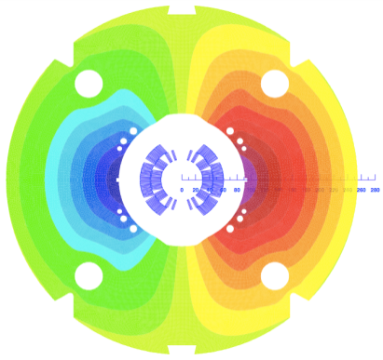
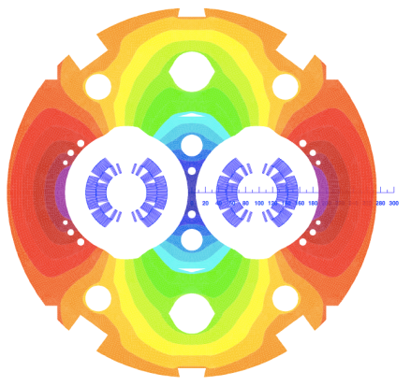
2. Magnet parameters
We will focus in the CERN 2 in 1 design
Details on FNAL design will be addressed by A. Zlobin
 | CERN 1in1 | CERN 2in1
Aperture, mm | 60
Nominal current, kA | 11.85
Yoke outer diameter, mm | 510 | 550
Central field at I_{nom}, T | 11.20 | 11.21
Peak field in the conductor at I_{nom} without strand self field, T | 11.53 | 11.59
Peak field in the conductor at I_{nom} with strand self field, T | 11.72 | 11.75
Horizontal EM-force F_{x} per side at I_{nom}, MN/m | 6.22 | 6.23
Vertical EM-force F_{y} per coil at I_{nom}, MN/m | 3.18 | 3.15
Longitudinal EM-force F_{z} per coil at I_{nom}, kN | 472 | 474
Differential inductance at I_{nom}, mH/m | 5.7 | 11.7
Stored energy at I_{nom}, kJ/m | 445 | 897
Magnetic length, m | 1.69 | 1.69/5.3

Slide 6
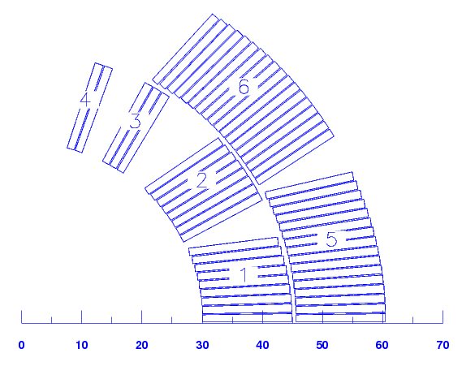
3. Coil cross section
CABLE: 40 strands cored cable. Assumptions on cable dimensional changes during heat treatment^{[1]}:
Thickness increase: 3%
Width increase: 1%
 | Before reaction | After reaction
Number of strands | 40
Core | Stainless Steel 11 mm x 0.025 mm
Bare cable width [mm] | 14.7 | 14.847
Bare cable mid-thickness [mm] | 1.269 | 1.307
Key-stone angle [degrees] | 0.79 | 0.81
Insulation Thickness | 0.155 | 0.100
INSULATION:
FNAL: 75-µm-thick E-glass tape. Double wrap (total thickness = 100-µm)
CERN: 80-µm-thick C-shaped Mica film and a braided sleeve made of S2-glass fibers (total thickness = 100-µm^{[2]})
COIL:
Same design FNAL/CERN
6 Blocks, 56 turns
Aperture = 60 mm, which avoids bending the Nb₃Sn coils in order to accommodate the LHC beam sagitta.
[1] Andreev 2001, Volume expansion of Nb3Sn strands and cables during heat treatment
[2] Actual insulation thickness ~ 110 µm

Slide 7
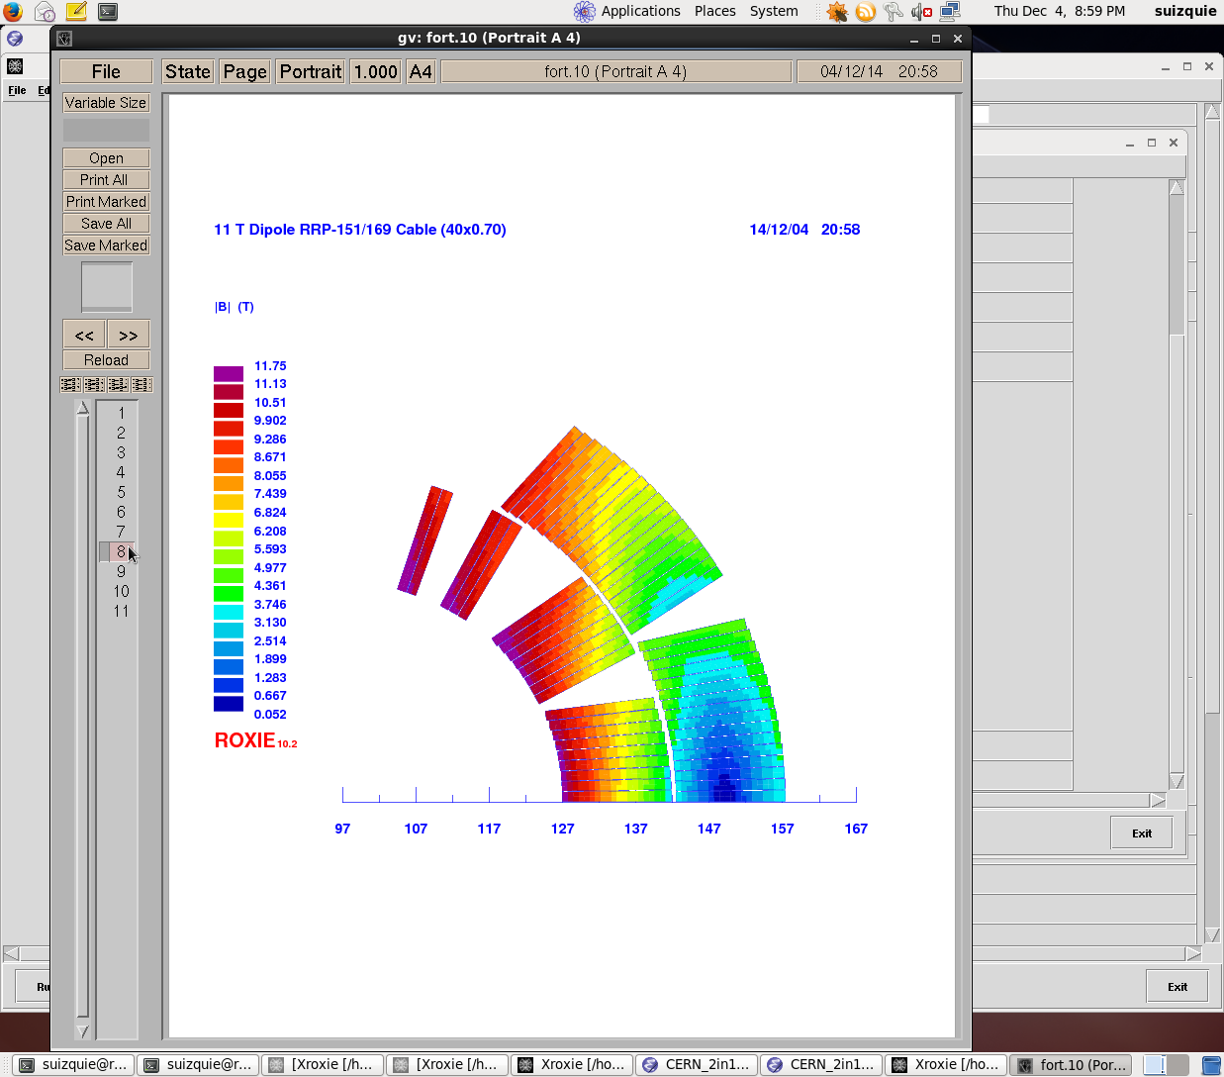
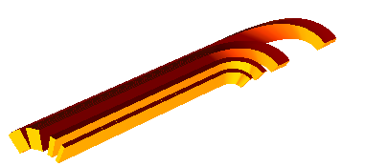
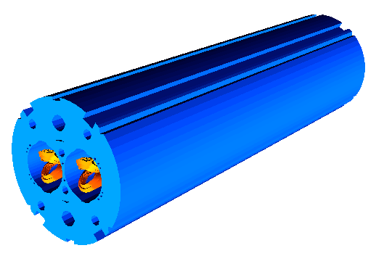
4. Peak field
Straight part
Pole tip
Peak field at I_{nom} = 11.85 kA in the straight part is 11.75 T (including strand self field).
Magnetic iron laminations covering the entire length → 0.16 T peak field enhancement at the ends.
0.16 T peak field enhancement
Arc length of the conductor
Pole tip
Straight part
Peak field is in the inner layer pole turn, before the pole tip

Slide 8
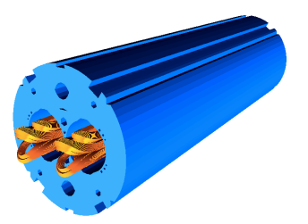
4. Peak field
The only way to reduce the peak field in the ends is to reduce the extension of the magnetic iron yoke
Straight part
Pole tip
No cut-back
cut-back
Pros of reducing the magnetic iron extension (cut-back):
Suppression of the peak field enhancement at the ends → ~ 1.5 % additional margin in the load line
Cons of reducing the magnetic iron extension (cut-back):
For the same integrated field, the coil should be 20 mm longer.
Additional complication in the procurement and manufacturing process (“Kawasaki steel” needed to have similar thermal contraction)
2 additional units of b₂. The impact in the rest of the harmonics is less than 0.05 units
 | 2D | Integrated (no cut-back) | Integrated (cut-back)
b₂ | -14.4 | -13.2 | -15.3

Slide 9
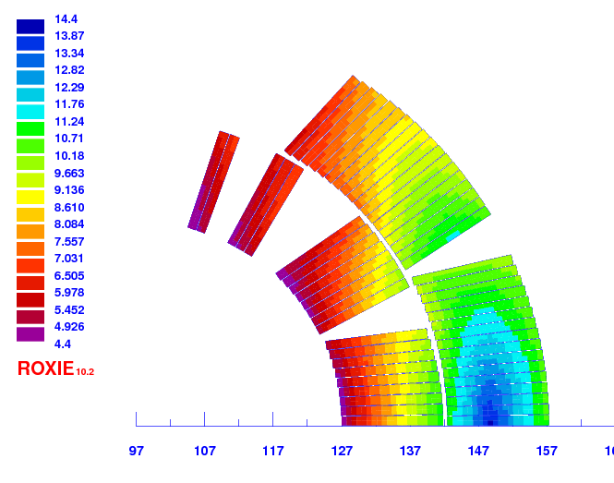
5. Load line and margin
Operational Conditions:
  I_{op} = 11.85 kA
  B_{peak} = 11.75 T
Margin in the load line
      80.6 % of I_{ss} at 1.9 K for the “yoke cut-back solution”
      81.9 % of I_{ss} at 1.9 K for the “full iron coverage solution”
Temperature margin 4.4 K – 14.3 K
I = 11.85 kA, T = 1.9 K
zoom

Slide 10
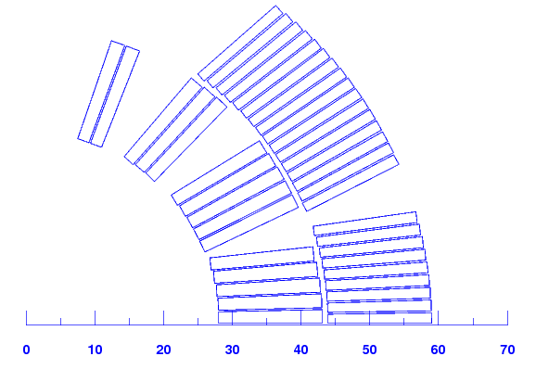
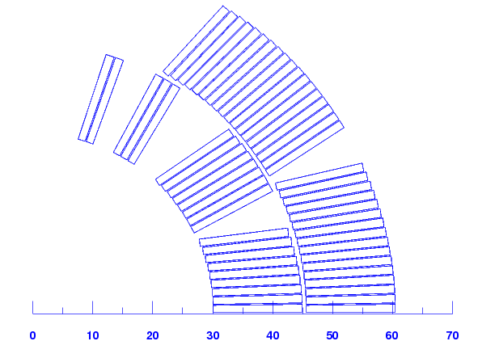
6. Transfer function
A discrepancy between MB and 11 T is inevitable:
  More turns than MB (56 vs. 40) ➔ 11 T dipole is stronger low field.
  More saturation ➔ reduction of transfer function at high field.
MB
11 T
Remedy:
  Option 1: Correct the orbit using MCBH corrector
    See talk [M. GIOVANNOZZI], beam specifications
  Option 2: Use a 300 A trim converter to compensate the effect
    Baseline solution

Slide 11
7. Iron saturation
Iron saturation effect in the transfer function is strong.
For the first aperture measured at CERN, the difference with respect to the model is ~ 55 units.
(LHC-MB Dipole, iron saturation effect is 70 units, and agreement with the model ~ 5 units)
The difference can be partly explained by the 100 % packing factor of the iron laminations observed during magnet assembly
[C. Loffler]
Difference in computed transfer function for 98.5% and 100% packing factor
Further investigation on the magnetic properties of the iron needed to understand the discrepancy between measured and expected values.
MBHSP101 (CERN first aperture)
[P. Hagen]

Slide 12
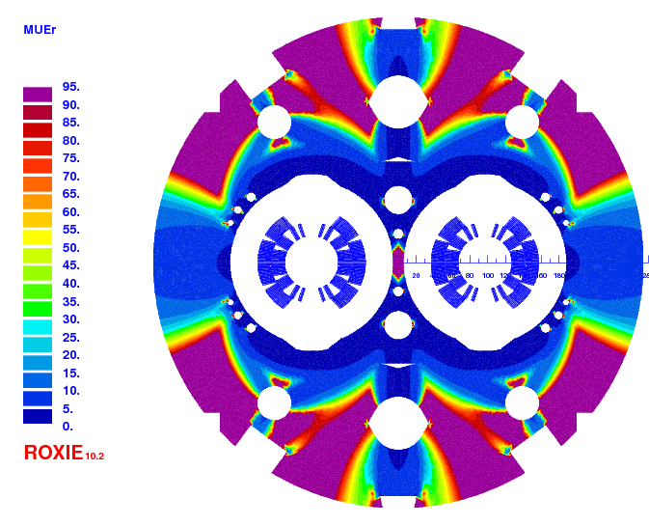
7. Iron saturation
Coil geometry optimized to have all harmonics below 1 units at R_{ref} = 17 mm
Yoke design
  The cut-outs on top of the aperture reduce the b₃ variation by 4.7 units as compared to a circular shape.
  The holes in the yoke reduce the b₃ variation by 2.4 units.
  The two holes in the yoke insert reduce the b₂ variation from 16 to 12 units.
  Iron gives 7.38 units of b₃ → coil re-optimization
[M. Karppinen]

Slide 13
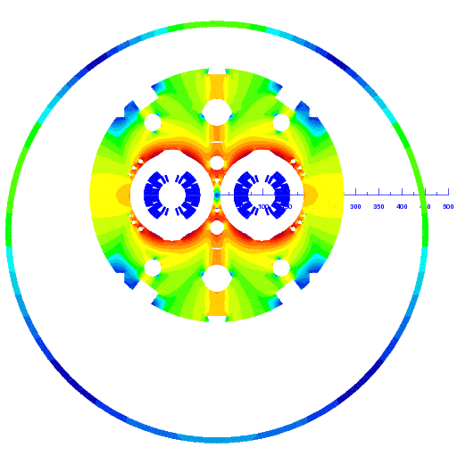
8. Fringe field
y-axis
The cryostat has the standard dimensions of the LHC Dipole, i.e., 915 mm outer diameter, 12 mm thickness and it is 80 mm off centred.
The main contribution to the harmonics is 3 units of a₁
x-axis

Slide 14
9. Persistent Currents Effects
  Dynamic aperture simulations accept b₃ up to 20 units at injection, and a variation +-20 units from injection to nominal
  Value at injection can be adjusted using current reset level during pre-cycle
Present value of magnetization are compatible with field quality requirements
For future study: assessment of the variability in wire magnetization and resulting uncertainty
I_{reset} = 500 A
I_{reset} = 350 A
Ireset = 100 A
  RRP108/127
  RRP150/169
I_{reset} = 100 A

Slide 15
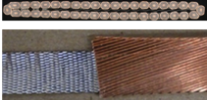
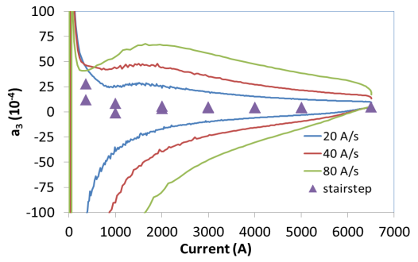
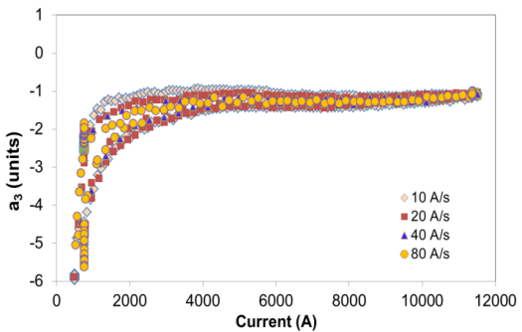
10. Eddy current effects
Stainless Steel Core to control the cross-over resistance R_{c}
Pros:
Suppression of ramp-rate dependence of field quality
Increased reproducibility
Cons:
Less quench back for protection
Stability (current sharing among layers)
Core dimensions: 11 mm x 0.025 mm (~80 % coverage)
Both measurements at FERMILAB and CERN show that Eddy Current effects is small.
Details will be addressed by [A. Zlobin] and [L. Fiscarelli]
MBHSP01 (no core)
MBHSP02 (core)
[A. Zlobin]
[A. Zlobin]

Slide 16
11. 3D effects
Reported values correspond to the solution with no-cutback
 | 2D | 3D | Δ
b2 | -14.42 | -13.15 | 1.27
b3 | 7.48 | 8.67 | 1.19
a1 | 0.00 | 1.25 | 1.25
a3 | 0.00 | -0.16 | -0.16
Measured data in MBHSP101 showed very consistent results for b₃. The agreement is not good for a₃
Meas.
coil
Meas.
coil

Slide 17
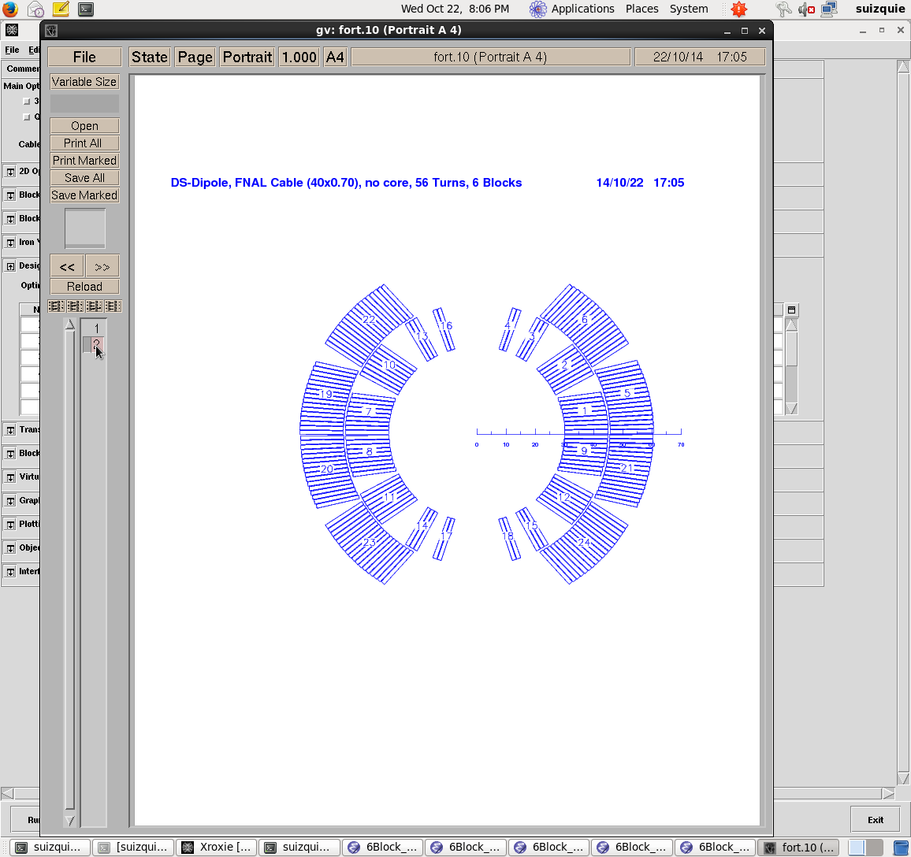
12. Manufacturing tolerances
Random component for the harmonic content defined by applying:
Radial and azimuthal shift applied independently to each block
+-10 µm variation on the thickness of conductor and insulation
Block | Radial shift (µm) |  | Azimuthal shift(µm)
1 | -100 | 10 | 0 | 15
2 | -100 | 20 | -10 | 10
3 | -100 | 20 | -14 | 6
4 | -100 | 20 | -16 | 4
5 | -100 | 20 | 0 | 15
6 | -100 | 20 | -14 | 6
[M. Karppinen]
Order | 2 | 3 | 4 | 5 | 6 | 7 | 8 | 9 | 10 | 11 | 12 | 13 | 14 | 15
Normal | 1.93 | 1.24 | 0.6 | 0.31 | 0.18 | 0.11 | 0.06 | 0.03 | 0.01 | 0.01 | 0.00 | 0.00 | 0.00 | 0.00
Skew | 2.87 | 1.66 | 1 | 0.64 | 0.38 | 0.2 | 0.06 | 0.05 | 0.03 | 0.02 | 0.01 | 0.00 | 0.00 | 0.00

Slide 18
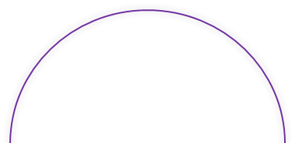
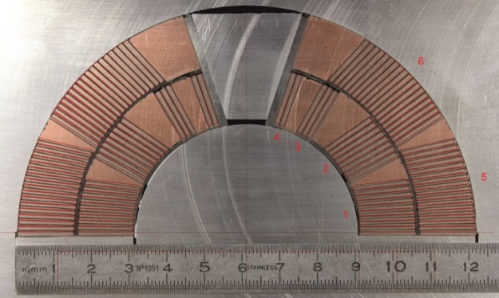
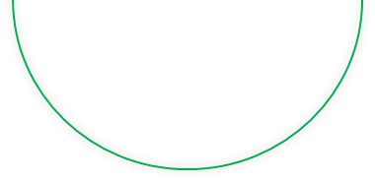
12. Manufacturing tolerances
CERN experience (MBHSP101)
Based on the defined manufacturing tolerances:
300 K | Measured |  | ROXIE
n | bn | an | bn | an
2 | -0.13 | 3.73 | 0.00 | 0.00
3 | 7.00 | -0.11 | 6.71 | 0.00
4 | 0.16 | -2.60 | 0.00 | 0.00
5 | 0.14 | 0.00 | 0.14 | 0.00
1.9 K | Measured |  | ROXIE
n | bn | an | bn | an
2 | 0.86 | 5.47 | 0.00 | 0.00
3 | 6.35 | -1.21 | 6.22 | 0.00
4 | 0.30 | 1.72 | 0.00 | 0.00
5 | 1.49 | 0.01 | 0.38 | 0.00
 | RANDOM
n | bn | an
2 | 1.93 | 2.87
3 | 1.24 | 1.66
4 | 0.6 | 1
5 | 0.31 | 0.64
Large a₂ and a₄ measured both at warm and cold. They are “compatible” with coil asymmetries
Very good agreement in b₃,both at warm and cold
It remains to be understood the large b₅ measured at cold
Coils were oversized → Reduction of the S2 glass wrap around the coil
0.2 → 0.0 mm
 | Inner radius [mm] | Outer radius [mm]
Nominal [mm] | 0.100 | 0.200
Coil 106 [mm] | 0.000 | 0.000
Coil 107 [mm] | 0.100 | 0.100
0.1 → 0.0 mm
0.1 mm
Cross section of coil 104 [X. Sarasola]
(discarded because it is too much oversized)
0.2 → 0.1 mm

Slide 19
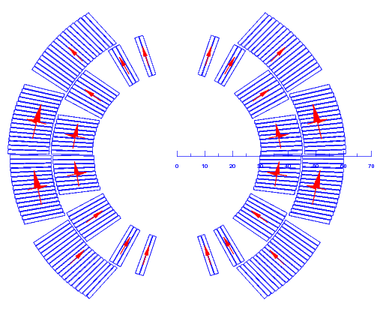
12. Manufacturing tolerances
 | Warm Mag. Meas. |  | ROXIE Original |  | ROXIE Shifted
n | bn | an | bn | an | bn | an
2 | -0.13 | 3.73 | 0.00 | 0.00 | 0.00 | 3.48
3 | 7.00 | -0.11 | 6.71 | 0.00 | 6.70 | 0.00
4 | 0.16 | -2.60 | 0.00 | 0.00 | 0.00 | -2.09
5 | -0.76 | 0.03 | 0.14 | 0.00 | 0.24 | 0.00
6 | -0.03 | 0.66 | -0.03 | 0.25 | 0.00 | 0.22
Radial displacements is giving a positive contribution to a₂ and a₄.
In combination with a rotation of the blocks close to the mid-plane, we get the negative contribution to a₄.
At cold, measured a₄ varies from 0-2 units depending on the longitudinal segment.
The good news are that for nominal coil dimensions, we should be able to stay within the stablished manufacturing tolerance limits.
Radial displacement coil106 = 350 µm
coil 106
Total offset mid-plane =
500 µm
0.69° Rotation
coil 107
Radial displacement coil107 = -350 µm

Slide 20
Summary
Field quality is in line with limits set by AP-studies
Main topics to be addressed:
  Impact of iron saturation in the transfer function
  Assessment of the variability in wire magnetization and resulting uncertainty on b₃ at injection

Slide 21
Additional slides

Slide 22
Margin

Slide 23
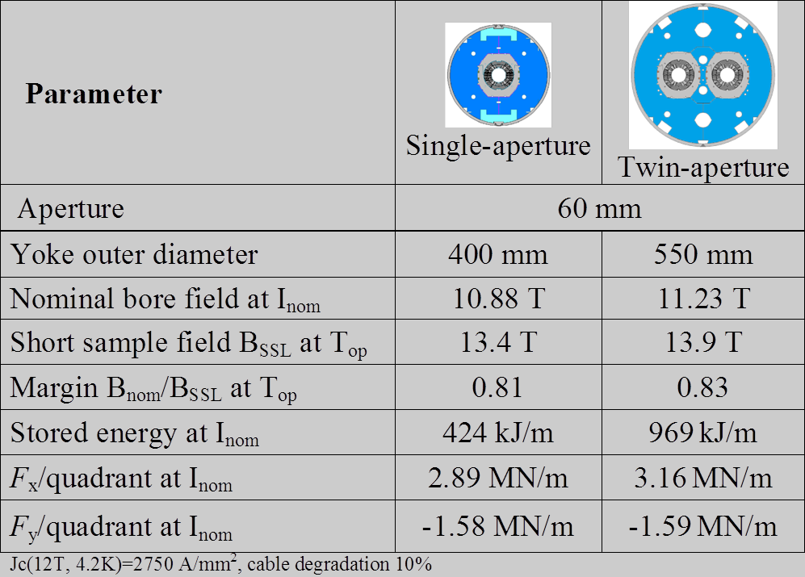
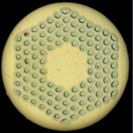

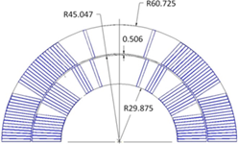
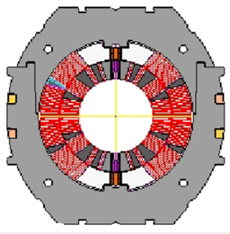
Magnet Design and Parameters (FNAL)
0.7 mm Nb₃Sn RRP strand
40-strand cable
2-layer coil
A. Zlobin
Stainless steel collar

Slide 24
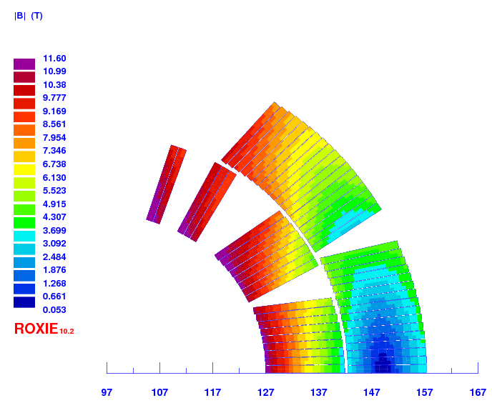
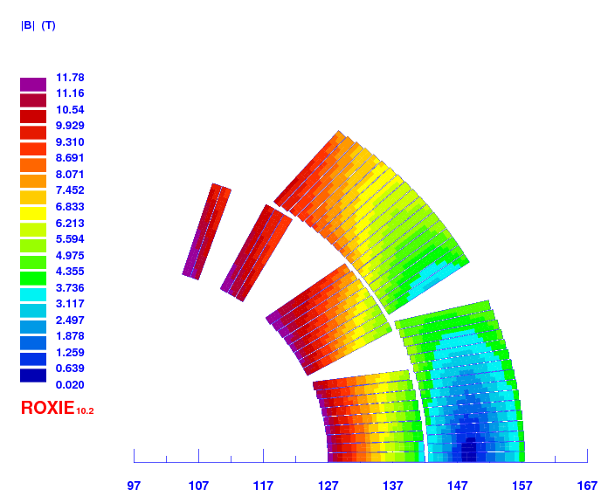
Field in the coil
Without strand self field correction
With strand self field correction

Slide 25
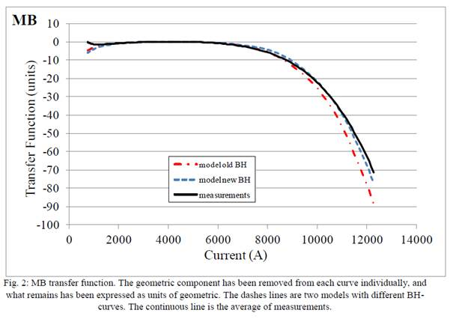
MB-Transfer Function

Slide 26
Difference in the transfer function
11T-DS dipole designed to match LHC-MB transfer function at nominal current
An alternative solution is to minimize the difference in TF with respect to the LHC_MB dipole
  In case of operate without trim, less corrector strength required
  In case of using a trim, it should be bipolar (difficult for protection!!)

Slide 27
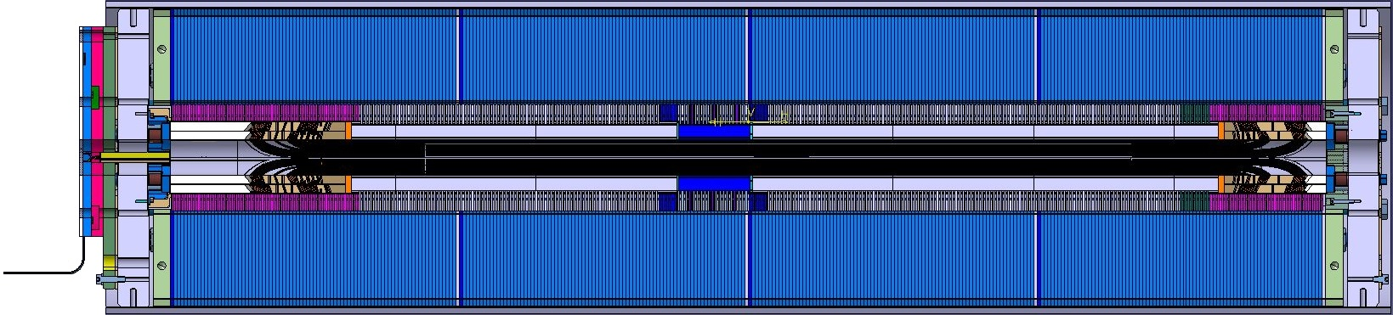
Magnetic and Physical lengths
Magnetic Yoke
Magnetic Length
Coil Length
Total Yoke Length
250 mm non magnetic
(43 laminations)
150 mm non magnetic
(26 laminations)

Slide 28
Eddy currents
Analysis based on MBHSP01
[B. Auchmann]
Assuming:
Uncored cable
R_{a} = R_{c} = 1-4 µΩ
(distribution defined to fit MBHSP01 data)
Cored cable
R_{a} = 1-4 µΩ
R_{c} = 30 µΩ (homogeneus)
According to ROXIE:
Impact of R_{a} is 100 times smaller than the impact of R_{c}
With an homogeneous R_{c} = 30 µΩ, we can only produce allowed harmonics B₁ and B₃ that are one order of magnitude smaller than in the uncored case.

Slide 29
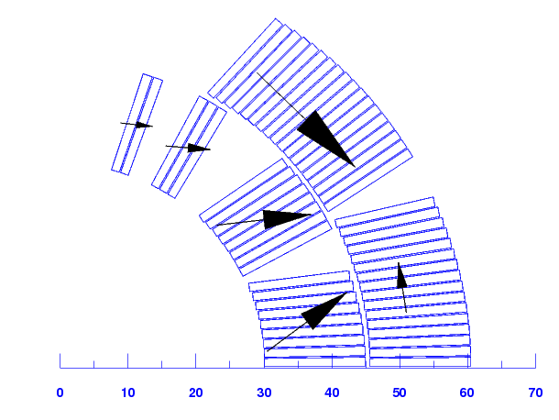
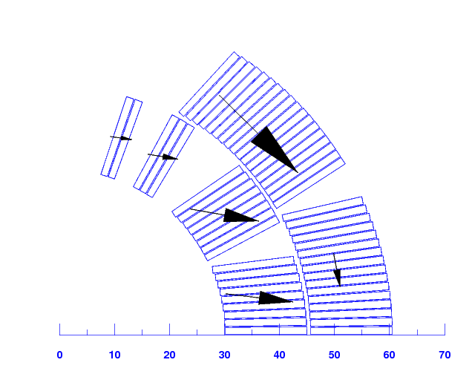
EM forces
Singe Coil
One aperture
Single coil
I(kA) | 14.24 | (80% Iss 2D) | Bp Coil (2D) (T) | 10.4
Block | FORCE -X- | FORCE -Y- | FORCE || | FORCE |- | FORCE |-/w
 | (N/m) | (N/m) | (N/m) | (N/m) | (MPa)
1 | 6.57E+05 | 4.88E+05 | 6.79E+05 | 4.44E+05 | 30
2 | 7.79E+05 | 8.53E+04 | 7.05E+05 | -3.32E+05 | -22
3 | 3.70E+05 | -2.96E+04 | 1.58E+05 | -3.36E+05 | -22
4 | 2.63E+05 | -2.86E+04 | 5.92E+04 | -2.58E+05 | -17
5 | -8.15E+04 | 4.09E+05 | -6.81E+04 | 4.17E+05 | 28
6 | 7.91E+05 | -7.95E+05 | 4.94E+04 | -1.13E+06 | -75
 |  |  |  |  | -40
Aperture
I(kA) | 11.85 | (80% Iss 2D) | Bp Coil (2D) (T) | 11.5
Block | FORCE -X- | FORCE -Y- | FORCE || | FORCE |- | FORCE |-/w
 | (N/m) | (N/m) | (N/m) | (N/m)
1 | 7.66E+05 | -9.39E+04 | 7.55E+05 | -1.42E+05 | -9
2 | 7.85E+05 | -1.39E+05 | 5.96E+05 | -5.26E+05 | -35
3 | 3.46E+05 | -5.70E+04 | 1.22E+05 | -3.29E+05 | -22
4 | 2.42E+05 | -3.34E+04 | 4.79E+04 | -2.39E+05 | -16
5 | 7.36E+04 | -3.85E+05 | 1.52E+04 | -3.95E+05 | -26
6 | 8.98E+05 | -8.82E+05 | 9.02E+04 | -1.27E+06 | -84
 |  |  |  |  | -97

Slide 30
Inverse analysis
Right/left symmetric
Top/bottom symmetry
b3
Right/left symmetric
Top/bottom anti-symmetric
a2, a4
 | R17 |  | R22
n | bn | an | bn | an
2 | 0.37 | 10.02 | -0.13 | 3.73
3 | 11.99 | -0.15 | 7.00 | -0.11
4 | 0.39 | -5.23 | 0.16 | -2.60
5 | -0.76 | 0.03 | 0.14 | 0.00
6 | -0.03 | 0.66 | -0.03 | 0.25
As we are looking for high a₂ and a₄, but b₁, b₃, a₁ and a₃ are small…let’s look for the right/left symmetric tom/bottom anti-symmetric deformation model
Right/left anti-symmetric
Top/bottom symmetry
b2,b4
Right/left anti-symmetric
Top/bottom anti-symmetric
a1, a3

Slide 31
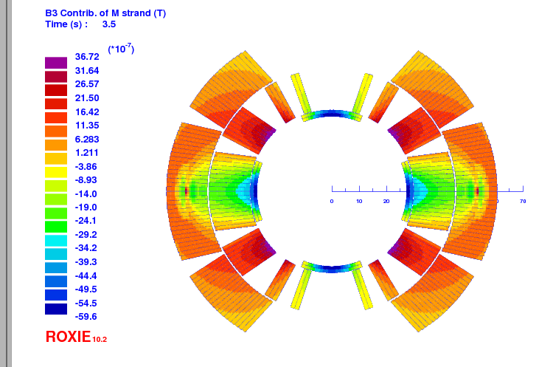
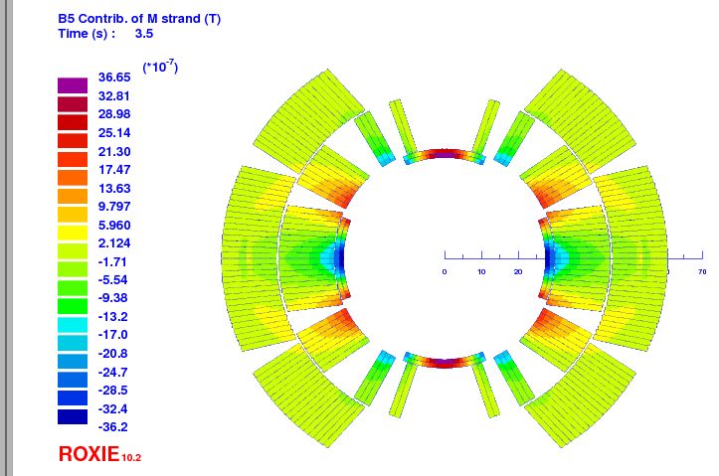
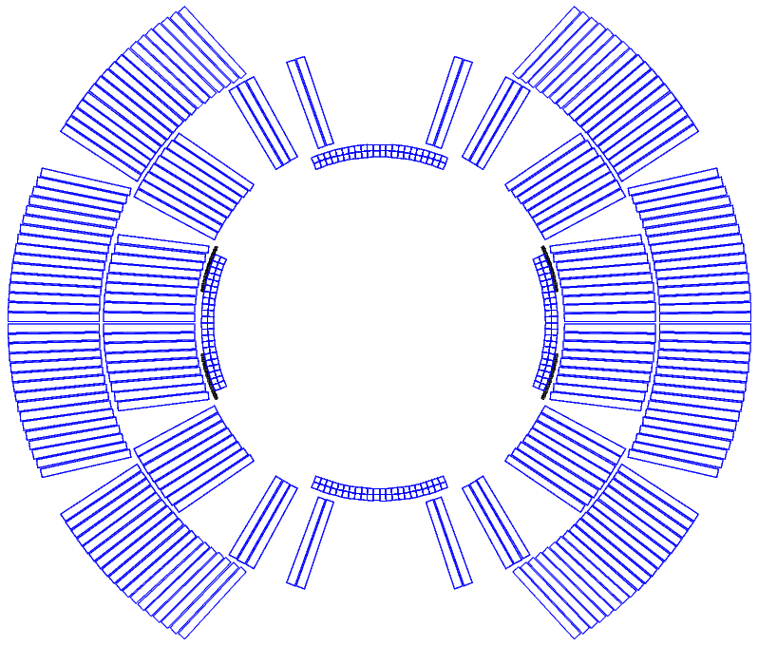
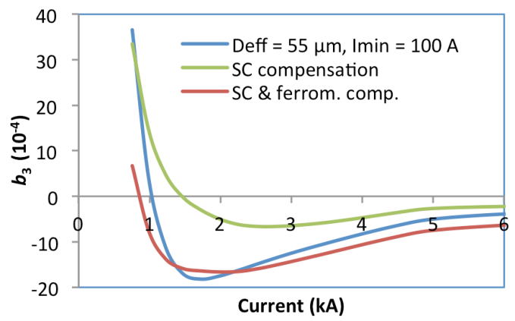
Mitigating the persistent-current induced sextupole
Passive compensation: ferromagnetic, passive strands
  Superconducting strands between cold bore and coil.
  Might reduce aperture by as much as 4 mm in diam.
However, the model cannot be used to predict effectiveness.
Design and construction should start now for test in the next magnet.
^{B3 from PC}
^{B5 from PC}
passive strands
ferromagnetic shims
Notes:
check aperture requirements with B. Holzer

