Slide 1
International review of the HL-LHC 11T Dipole for DS Collimation
Mechanical design
(TE – MSC – Large Magnet Facility)
F. Lackner, a summary of work performed by:
M. Karppinen, B. Auchmann, C. Kokkinos,
J. Murtomaki, T. Lyon, D. Smekens, C. Loeffler

Slide 2
Outline
CERN 11T design
  Design criteria - key parameters
  Cross-section of the 1in1 and 2in1 magnet
  Shimming and mechanical concept
Overview of magnet assembly process
Structural analysis
  Mechanical model
  Boundary conditions
  FEA - Coil pre-stress and peek-stress
    Assembly – 1.9 K – 12 T
Summary

Slide 3
  Mechanical design criteria's - key parameters
The presentation is focusing on the CERN design, not including comparison to other designs or concepts.
CERN 1in1
CERN 2in1
Main mechanical parameters | 1-1 | 2-1
Aperture [mm] | 60
Yoke outer diameter [mm] | 510 | 550
Magnetic length [mm] | 1690 | 1690/5300
Shell thickness [mm] | 12 | 15
Horizontal EM-force F_{x} per side at I_{nom} [kN/m] | 6.22 | 6.23
Vertical EM-force F_{y} per coil at I_{nom} [kN/m] | 3.18 | 3.15
Longitudinal EM-force F_{z} per coil at I_{nom} [kN] | 472 | 474
Stored energy at I_{nom} [kJ/m] | 445 | 897
Nominal current I_{nom} [kA] | 11.85 | 11.85

Slide 4
  Mechanical design criteria
The mechanical design of the magnet has to provide rigid support (clamping) of the Nb₃Sn coil.
It is essential to accommodate the coil with minimum distortion of the conductor positioning.
The intention is to clamp the magnet assembly by using thermal contraction in the welding shells.
The half yoke assembly interface shall mechanically protect the collared coil assembly during operation (Yoke gap shall remain closed). Providing rigid assembly.

Slide 5
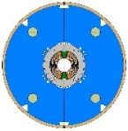
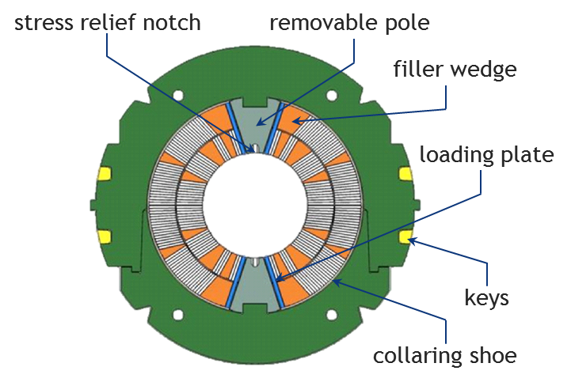
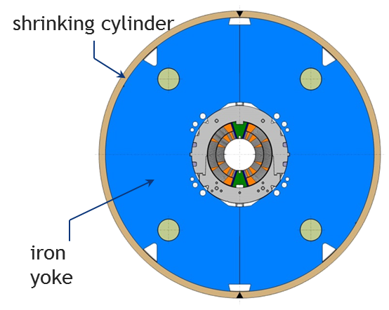
  Design: Separate collared coils
  Interchangeability of coils - testing of collared coils in a 1in1 structure

Slide 6
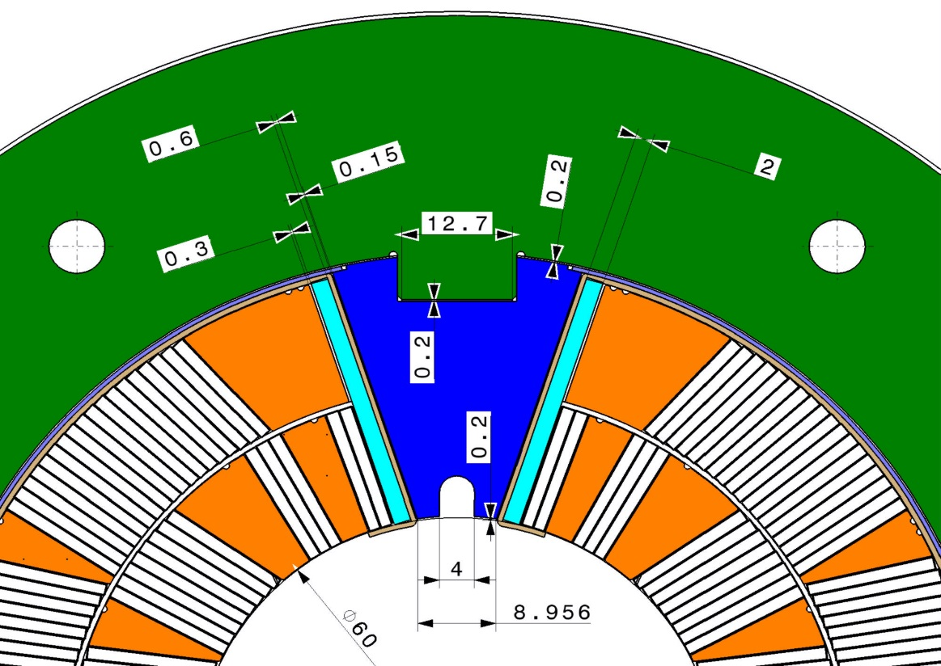
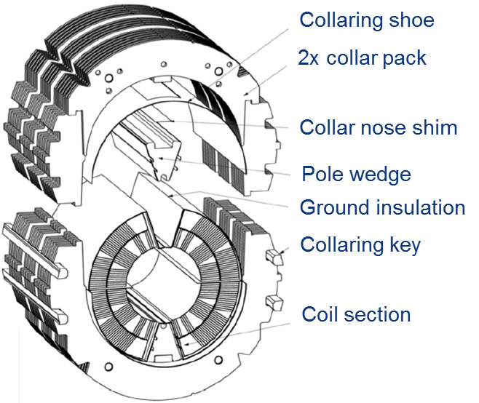
  The concept of pole loading
  Most of the coil pre-stress obtained by collaring
  Symmetric loading - low bending stress in the coil
  Better control of pre-stress - “sliding cinematic” on pole
Shim
Loading plate
Filler
wedge
Pole wedge
Courtesy of M. Karppinen
Collared coil assembly

Slide 7
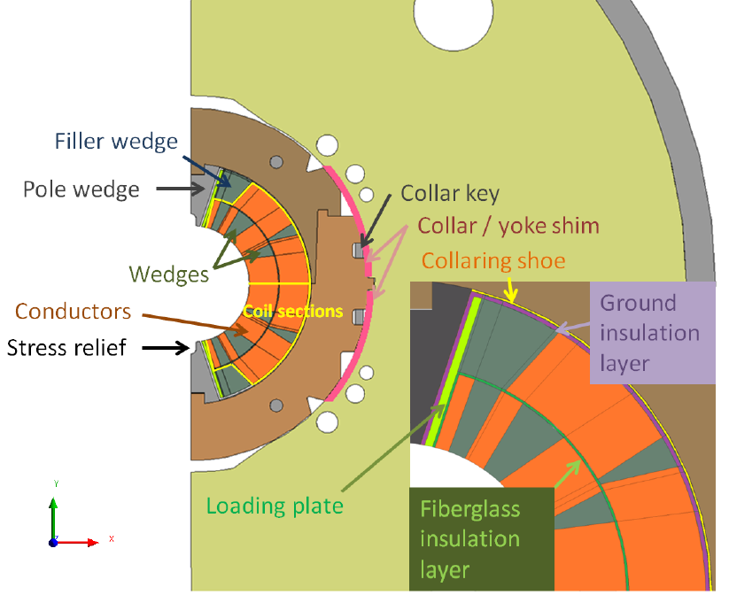
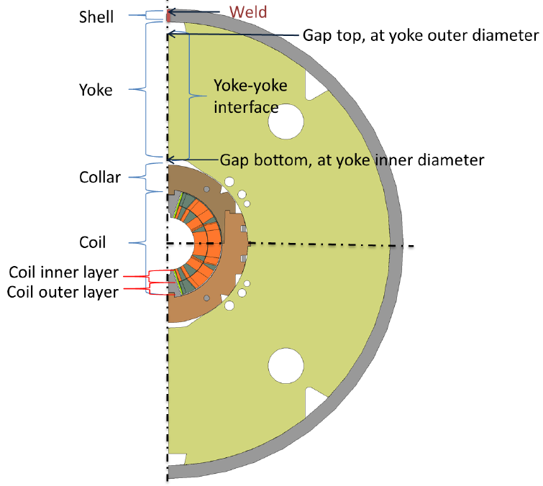
  A Close up of the magnet intersection
Overview: J. Murtomaki
J.

Slide 8
  Design features – 1in1
  Pole shim
  Collar/yoke shim (default: 0.4 mm)
  Pole adjustment shim (default: 0.2 mm)
  Gap closing @ room temperature
  remaining closed to 12 T.
  Stainless-steel shell
4.
3.
1.
2.
(3) is an optional knob.
(2) and (4) must be controlled in order to close the yoke gap at RT.
5.

Slide 9
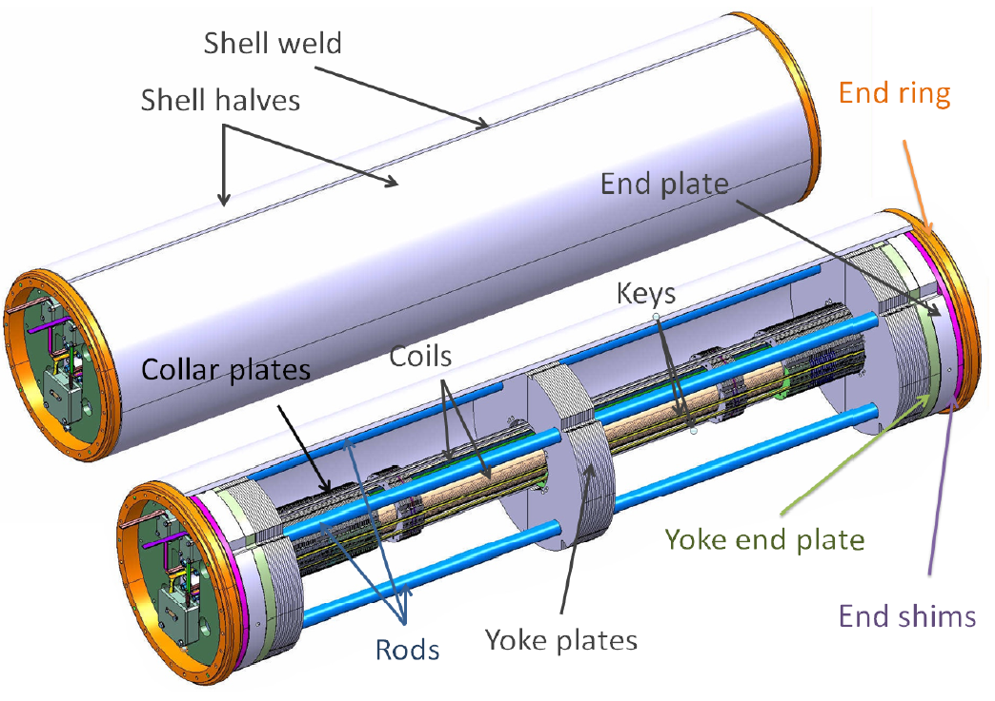
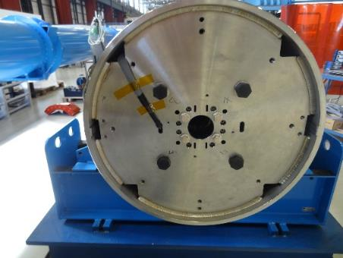
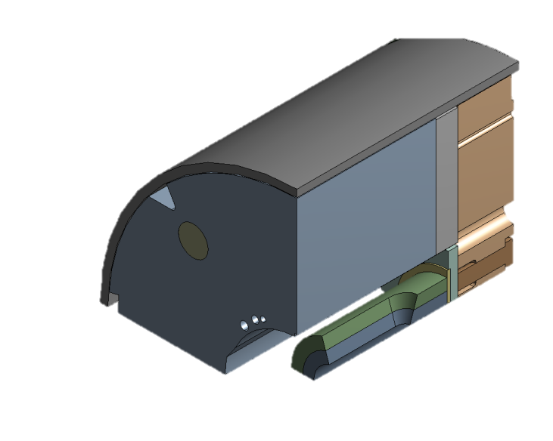
  Close up on magnet assembly
Welded end plates
Yoke
End Plate
Rod
Welding shell
End Plate
Original design foresees a welded end ring
Bolt pre-stress applied from end-ring to end-plate
Final design welded end plates (simplifying assembly)
Coil
End Plate
Yoke
Dummy
Coil Block

Slide 10
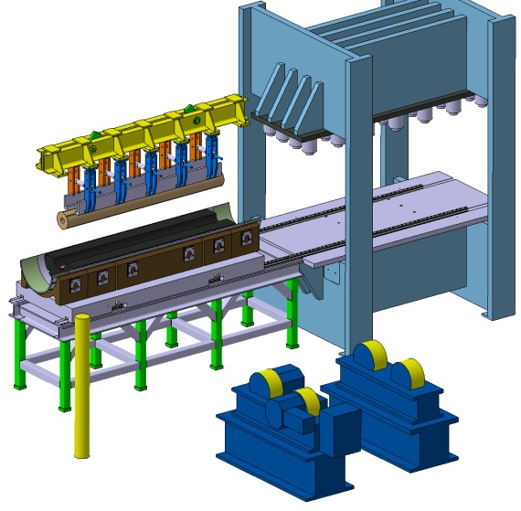
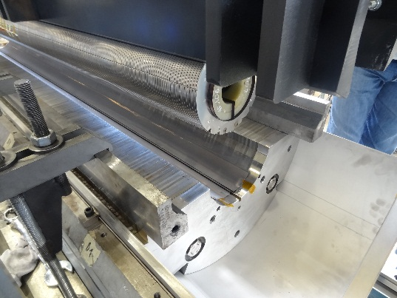
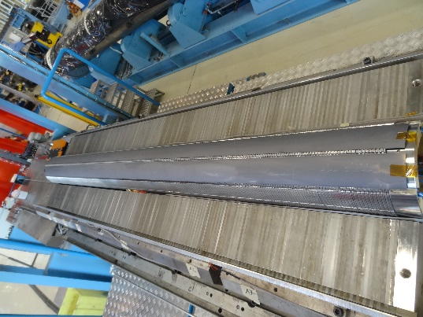
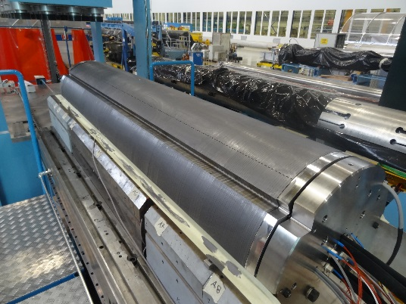
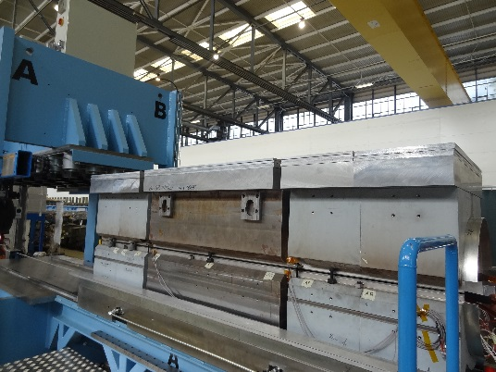
  Vertically split yoke
  Assembly process less influenced by friction (vs. horizontal split)
  Closed gap at RT and up to 12 T providing rigid support for the collared coil
  Better controlled (collared) coil deformation
MBHSP101 assembly
Collared coil shimming
Short model welding press (LMF), assembly in 90° rotation
Top yoke assembly
Prior insertion to welding press

Slide 11
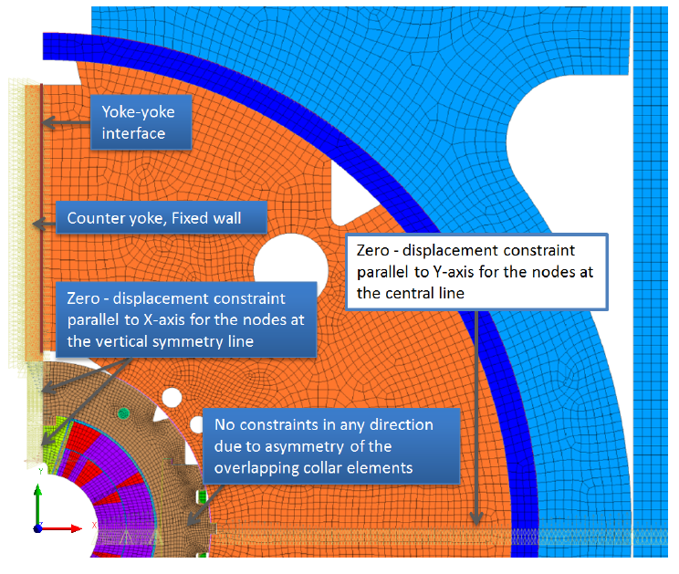
  FEA Coil pre-stress and peak stress 1
  Keep coils under compression at all stages, especially at cold/12T, and avoid excessive stresses during collaring (lower than 150 MPa)
  Minimal elliptic deformation
  Minimal stress gradient in the coils
  Easy tuning of pre-loading by shimming
Boundary conditions for the collared coil assembly

Slide 12
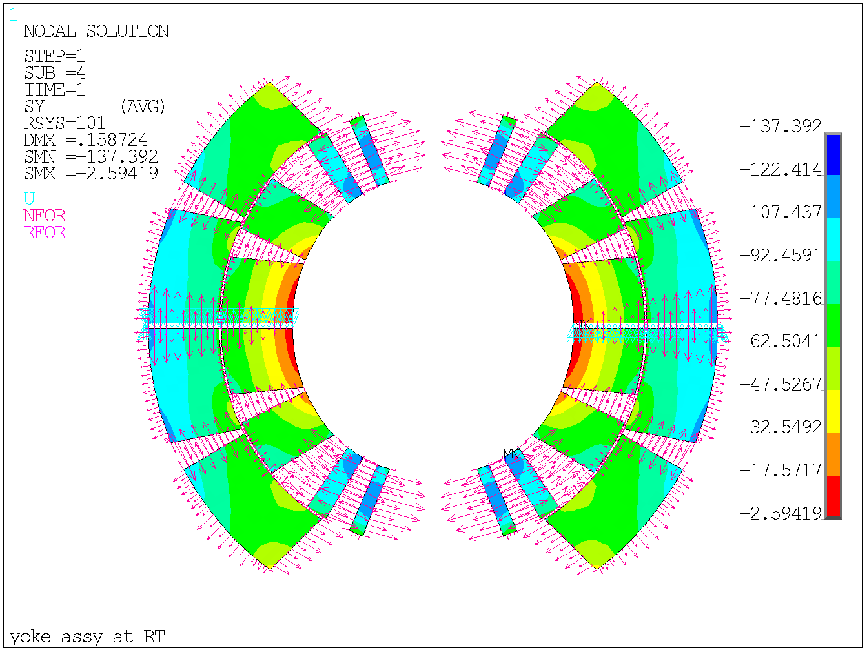
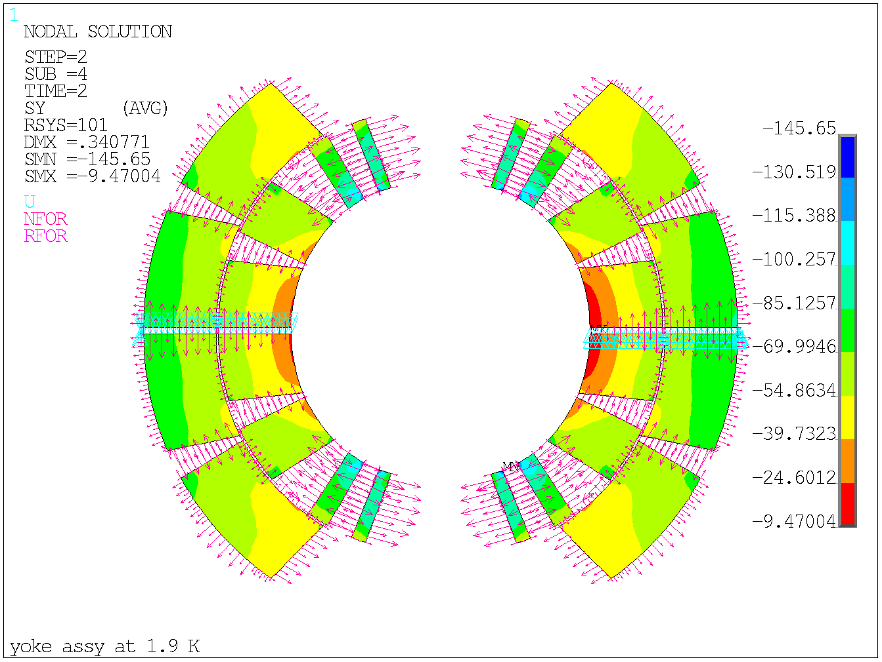
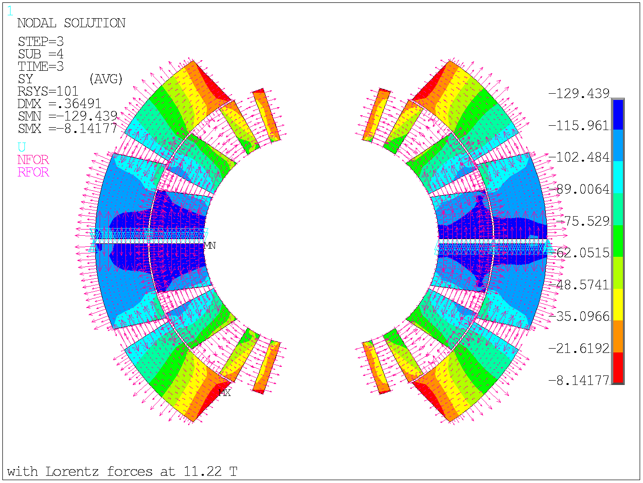
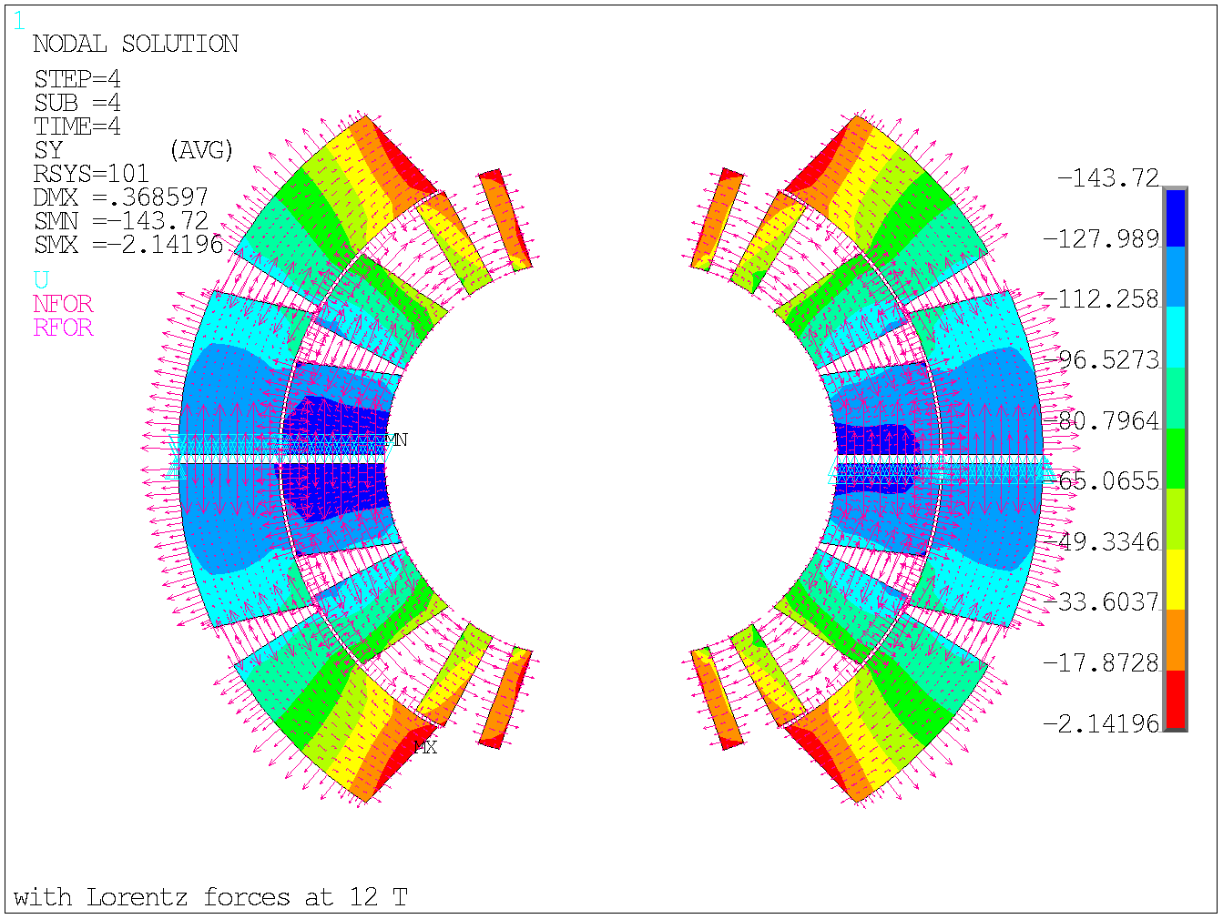
  FEA Coil pre-stress and peak stress 2
RT
1.9 K
11.22 T
12 T
Courtesy of H. Kokkinos

Slide 13
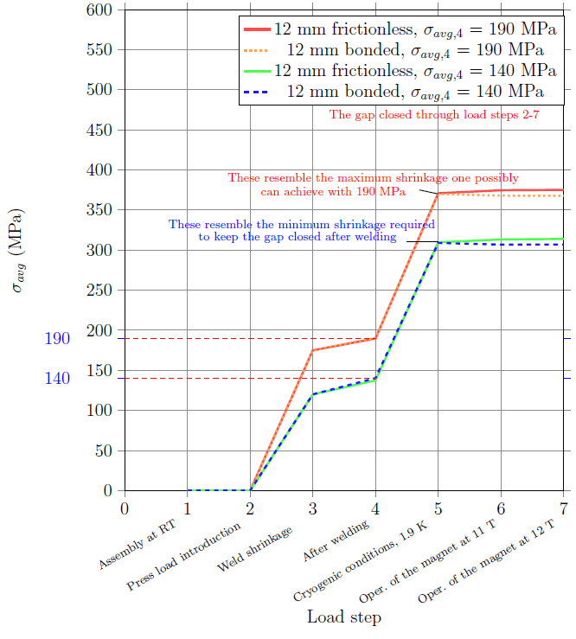
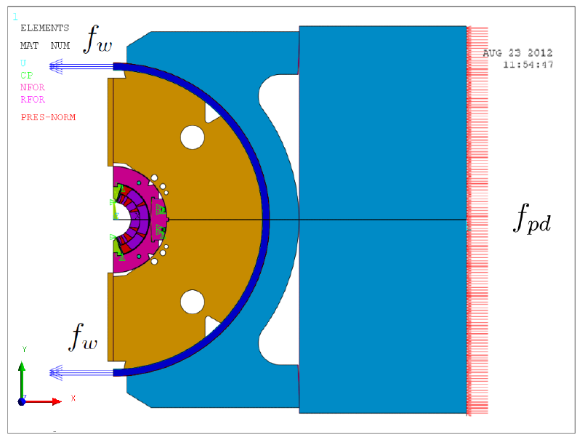
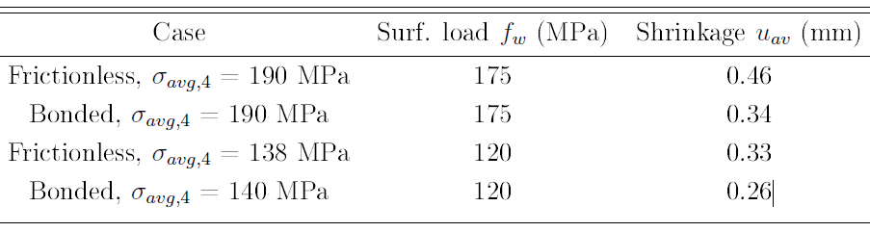
  Welded stainless steel skin
MIG welding tests, FEA on shell stress:

Slide 14
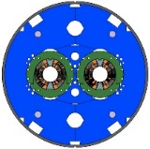
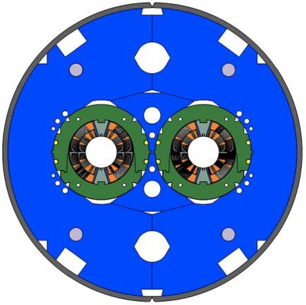
  Design features – 2in1
Separate collared coils
Most of the coil pre-stress obtained by collaring
Symmetric loading
Better control of pre-stress
Testing of collared coils in 1in1 structure
Vertically split yoke
Assembly process less influenced by friction (vs. horizontal split)
Closed gap at RT and up to 12 T to provide rigid support for the collared coil
Better controlled (collared) coil deformation
Rigid inner yoke
    Symmetric loading of collared coil
Welded stainless steel shell

Slide 15
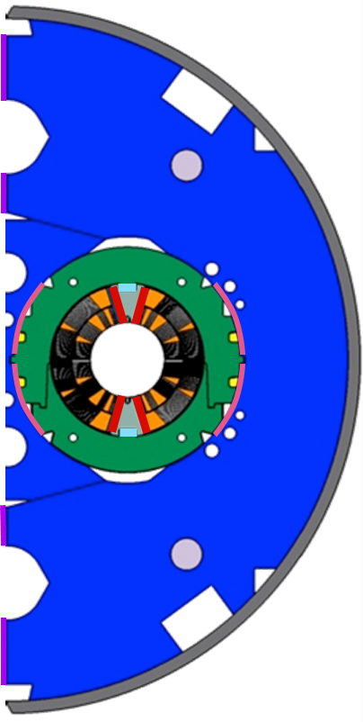
  Design features – 2in1
  Pole shim
  Collar/yoke shim (default: 0.4 mm)
  Pole adjustment shim (default: 0.2 mm)
  Gap closing @ room temperature
  remaining closed to 12 T.
  Stainless-steel shell
1
2
(3) is an optional knob.
(2) and (4) must be controlled in order to close the yoke gap at RT.
3
4
5

Slide 16
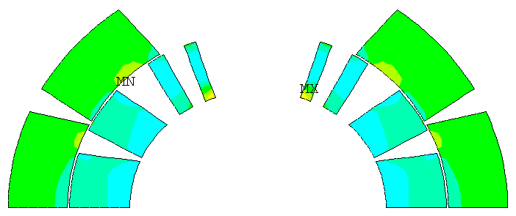
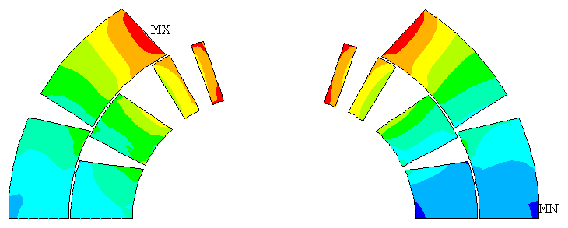
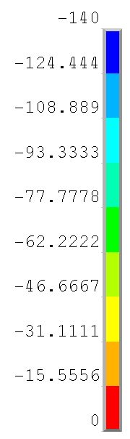
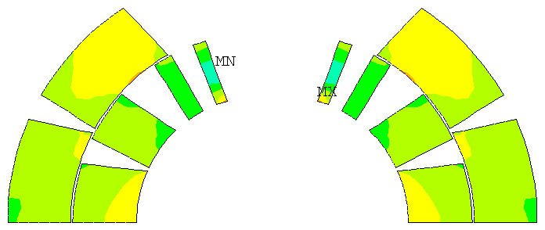
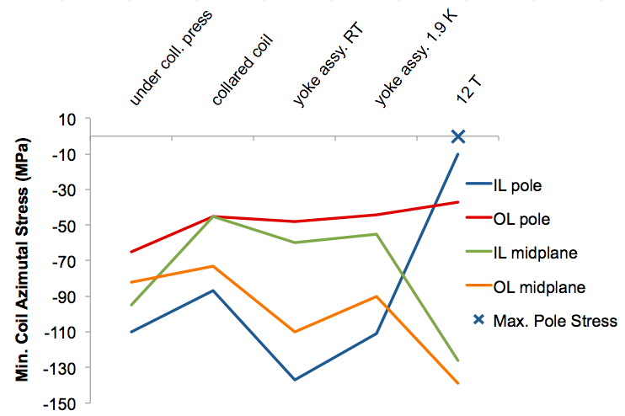
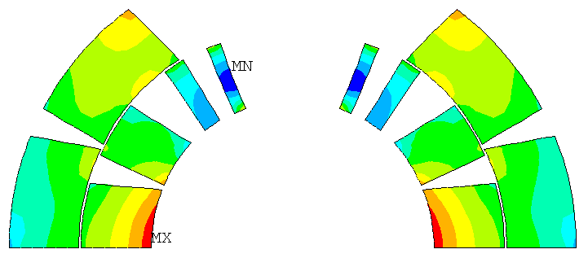
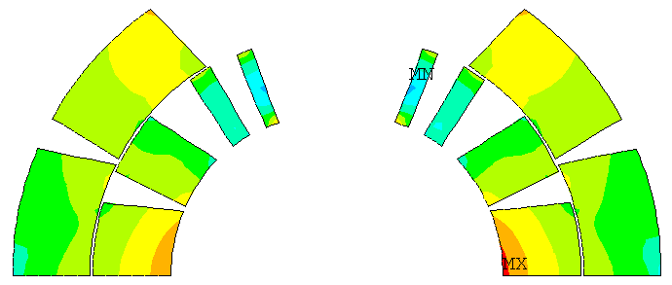
  FEA Coil pre-stress and peak stress
B₀ = 12 T
-138 MPa
Under collaring
press
-140
After collaring
-138 MPa
After CM assembly
at 293 K
0
At 1.9 K, I = 0 A
Courtesy of B. Auchmann

Slide 17
  Shell stress
Stress in the shell (average), 12 mm thickness:

Slide 18
  Shell stress
Stress in the shell (average), 15 mm thickness:
Max. achievable based on MIG technology

Slide 19
Summary
Pole loading concept was successfully tested on the demonstrator and first short model assembly; Important engineering features were confirmed:
  Efficient transfer of the collaring force into the coils;
  Good control and easy adjustment of the assembly parameters;
  Minimal bending of the coils;
  FEA shows that pre-stress is below 150 MPa under all operating conditions.
Further work:
  Improve understanding of required shimming based on metrological inspection of coils after short model tests and disassembly;
  Iterating FEA with updated model from metrological inspection on coil;
  Careful analysis and comparison of measured values required;
  Refinement of previous models used to verify axial stresses on bullets and end plate;
  Friction based FEA would allow another insight on the coil pre&peak-stress.

Slide 20
References
F. Savary et al., “Status of the 11 T Nb₃Sn Dipole Project for the LHC” This conference.
M. Karppinen et al., “Design of 11 T Twin-Aperture Nb3Sn Dipole Demonstrator Magnet for LHC Upgrades”, IEEE Trans. on Appl. Supercond., v. 22, no. 3, June 2012, p. 4901504.,
A.V. Zlobin et al., “Status of the 11 T 2-in-1 Nb₃Sn Dipole Development for LHC”, IPAC’2014, Dresden, June 2014.,
A.V. Zlobin et al., “Development of Nb3Sn 11T Single Aperture Demonstrator Dipole for LHC, Upgrades”, Proc. of PAC’2011, NYC, 2011, p. 1460.,
A.V. Zlobin et al., “Design and Fabrication of a Single-Aperture 11T Nb3Sn Dipole Model for LHC Upgrades”, IEEE Trans. on Applied Supercond.,
A.V. Zlobin et al., “Status of a Single-Aperture 11 T Nb3Sn Demonstrator Dipole for LHC Upgrades”, this conference., 2012,
M. Karppinen et al., “Design of 11 T Twin-Aperture Nb3Sn Dipole Demonstrator Magnet for LHC Upgrades”, IEEE Trans. on Applied Supercond., 2012,

Slide 21
Spare slides

Slide 22
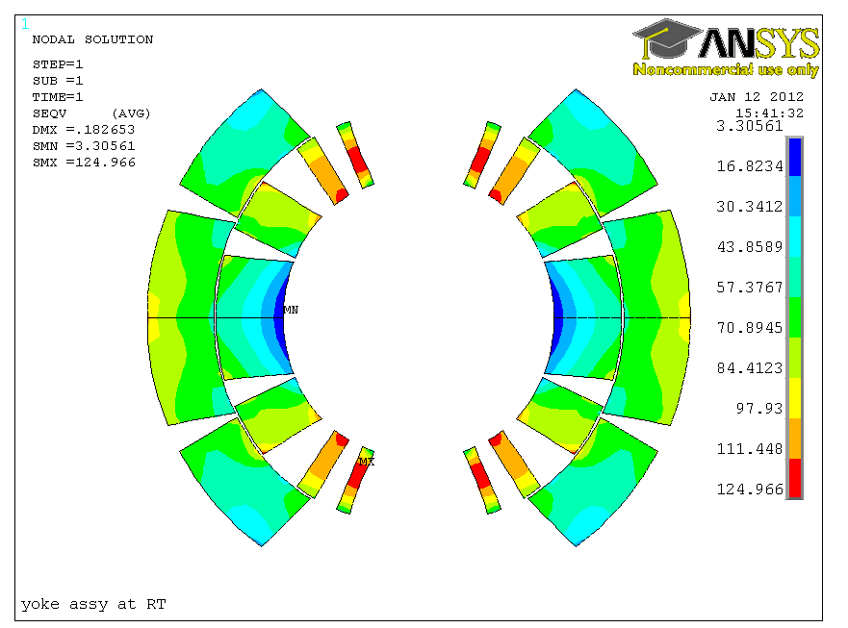
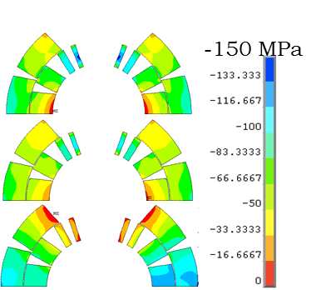
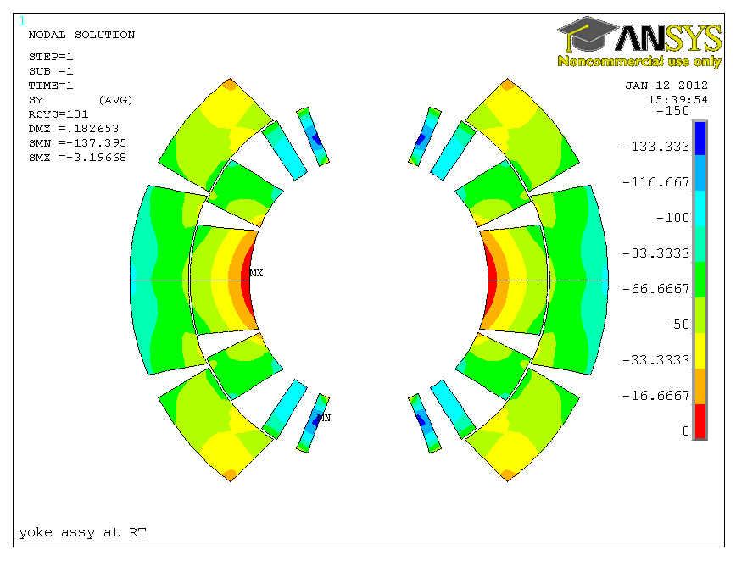
  Coil pre-stress and peak stress
Azimuthal coil stress:
Von Mises
 | P1 | P2 | M1 | M2
Under press | -110 | -65 | -95 | -82
Spring-back | -87 | -45 | -45 | -73
Yoke assy. | -137 | -48 | -60 | -110
Cool down | -111 | -44 | -55 | -90
12 T | -10 | -37 | -126 | -139
P2
P1
Yoke assembly RT
Azimuthal stress
M1
M2
Yoke assembly RT

Slide 23
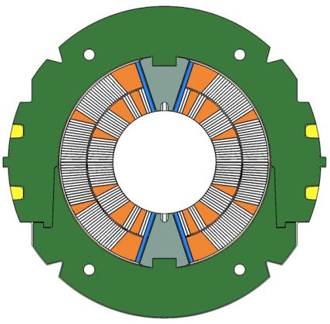
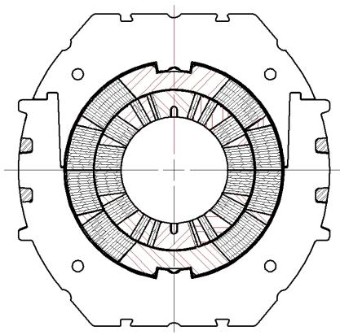
  Comparison CERN - FNAL
Pole loading design
Integrated pole design

Slide 24
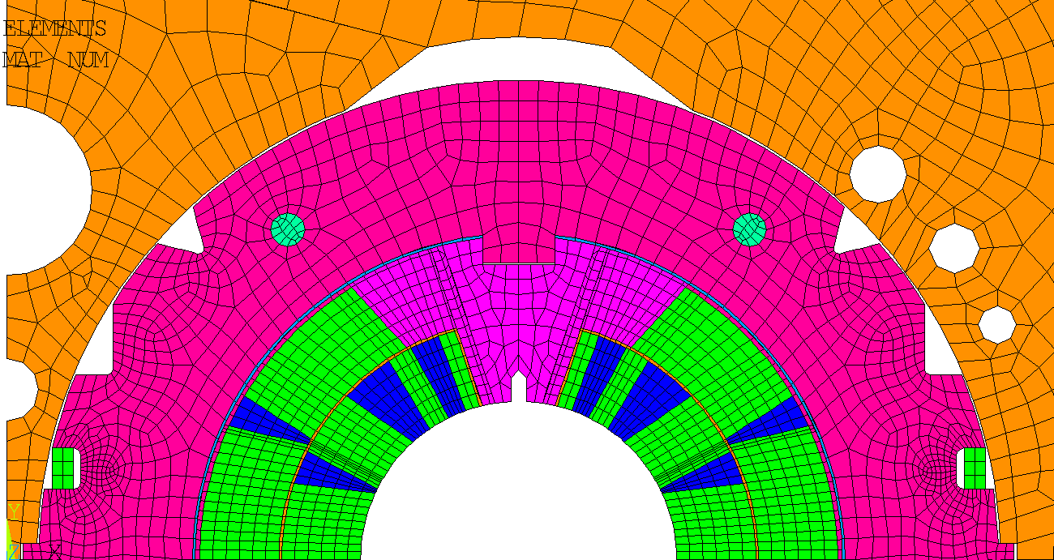
  Comparison CERN - FNAL
Steel (Nr.7)
E(293K) = 210 GPa
E(4.2K) = 225 Gpa
α= 2.05/(1000*293)
Nippon St. Steel (Nr.5)
E(293K) = 195 GPa
E(4.2K) = 215 Gpa
α= 2.7/(1000*293)
St. Steel (Nr.11)
E(293K) = 195 GPa
E(4.2K) = 215 Gpa
α= 2.9/(1000*293)
Titanium alloy (Nr.19)
E(293K) = 115 GPa
E(4.2K) = 125 Gpa
α= 1.7/(1000*293)
St. Steel (Nr.6)
E(293K) = 190 GPa
E(4.2K) = 210 Gpa
α= 2.64/(1000*293)
St. Steel (Nr.21)
E(293K) = 190 GPa
E(4.2K) = 210 Gpa
α= 2.64/(1000*293)
St. Steel (Nr.15)
E(293K) = 195 GPa
E(4.2K) = 215 Gpa
α= 2.7/(1000*293)
Cable (Nr.13)
E(293K) = 40 Gpa (r)/40 Gpa (θ)
E(4.2K) = 45 Gpa (r)/40 Gpa (θ)
αr= 2.9/(1000*293)
αθ= 3.3/(1000*293)
Insulation (Nr.18)
E(293K) = 28 Gpa (x)/34 Gpa (y)
E(4.2K) = 14 Gpa (x)/23 Gpa (y)
αx= 8.31e-6
αy= 2.42e-5
Kapton (Nr.16)
E(293K) = 2.5 GPa
E(4.2K) = 2.5 Gpa
α= 5.8/(1000*293)
Haris Kokkinos
Courtesy of H. Kokkinos

