Slide 1
Quench protection
Many thanks to H. Bajas, G. Chlachidze, J. Feuvrier, M. Karppinen, J. Rysti, G. Willering, A. Zlobin, and all the rest of the team that design, built and tested the magnets.
Susana Izquierdo Bermudez
International Review of the HL-LHC 11 T Dipole for DS collimation
December 2014

Slide 2
Why protection is a critical issue?
Comparing to the MB-LHC dipoles, in the case of DS-11 T we have:
1. Dramatically lower Cu/SC ratio → much lower margin in the cable
 | MB LHC inner layer | MB LHC outer layer | DS-11T
Total cable area, mm² | 33.52 | 27.04 | 22.67
Cu area, mm² | 15.53 | 13.43 | 8.23
SC area, mm² | 9.41 | 6.89 | 6.84
Insulation area, mm² | 4.83 | 4.70 | 3.25
Void area, mm² | 3.75 | 2.03 | 4.00
2. More stored energy and substantially larger temperature margins
 | MB | DS-11T dipole
Peak field in the conductor at I_{nom} (B_{p}), T | 8.6 | 11.6
Differential inductance at I_{nom}, mH/m | 6.9 | 11.7
Stored energy at I_{nom,} mH/m | 484 | 897
Magnetic length, m | 14.312 | 2 x 5.3
Temperature margin, K | 1.8-6.5 | 4.4-14.3
We need to detect fast, and quench in a fast and efficient way!!

Slide 3
The quench event
10 ms
5 ms
Quench detection
Validation and power supply off
Quench heater effective
Quench heater provoked quench
Quench initiation
Initial propagation of the quench zone
Quench heater delay and effectiveness
Quench propagation within the coil

Slide 4
Quench initiation and detection
10 ms
5 ms
Quench detection
Validation and power supply off
Quench heater effective
Quench heater provoked quench
Quench initiation
Initial propagation of the quench zone
Quench heater delay and effectiveness
Quench propagation within the coil

Slide 5
Longitudinal quench propagation
Longitudinal propagation velocity was measured at different current levels, in cable stacks, SMC-11T and 11T dipoles at FNAL/CERN.
(details for CERN-11T measurements will by addressed by [G. Willering])
In all the cases, measured propagation velocity is close to the expected values.
Important to keep on mind → propagation is very slow at low current levels
model
Measu.
High field region
(natural quench)
Natural quenches in the high field region
Low field region
(spot heater quench)
Remark: model considers conductor + insulation
SMC 11T. Experimental data from H. Bajas
MBHSM01. Experimental data from G. Chlachidze

Slide 6
Voltage Threshold & Detection time
At high current, the quench propagates fast, so a threshold voltage of 100 mV – 400 mV is not having a great impact on the detection delay.
It becomes critical for protecting the magnet at low current →
it should be kept as low as possible.
Design value: 100 mV threshold and 10 ms validation delay.
Expected resistive voltage growth for a quench initiated in the high field area

Slide 7
Quench heater delay and effectiveness
10 ms
5 ms
Quench detection
Validation and power supply off
Quench heater effective
Quench heater provoked quench
Quench initiation
Initial propagation of the quench zone, longitudinal quench propagation
Quench heater delay and effectiveness
Quench propagation within the coil

Slide 8
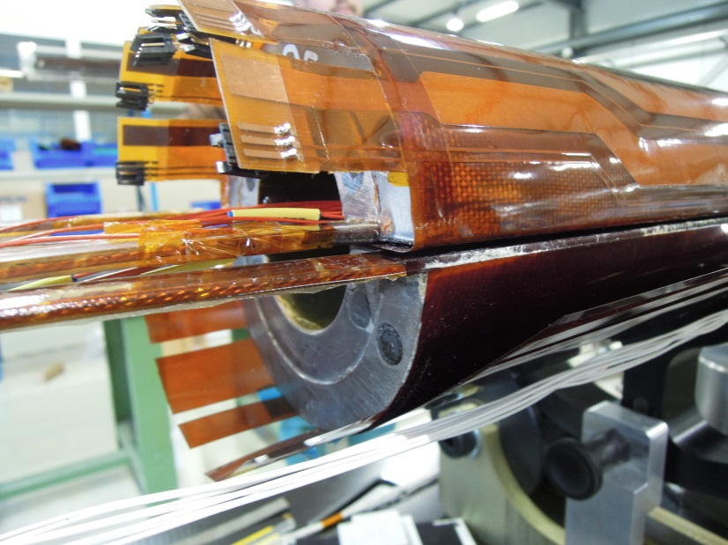
Heater design
Heaters are only present in the outer layer.
Heaters are copper plated to reduce the overall strip resistance (max. voltage across the heaters +-450 V).
Width of the heaters and distance between heater stations has been optimized to quench the coil in an uniform way.
4 heater circuits per aperture for redundancy (could be increased up to 8 per aperture).
width
Copper
SS
Copper
SS
Copper
Coverage
Distance between stations
 | Low field heater strip | High field heater strip
Coverage (mm) (Stainless steel part) | 50
Distance Between Stations (mm) (Copper plating) | 90 | 130
Width (mm) | 19 | 24
Stainless steel thickness (mm) | 0.025
Copper plating thickness (mm) | 0.005

Slide 9
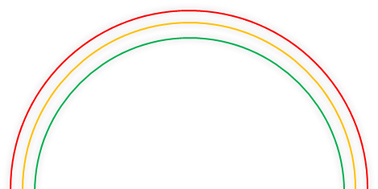
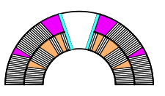
Heater delay
Quench heater onset
Heaters are glued on top of the coil after impregnation
The amount of insulation between heater and coil is the critical parameter
I_{heater} = 150 A
P_{dLF} = 145 W/cm²
P_{dHF} = 90 W/cm²
Conductor insulation + 0.2 mm S2 glass
Conductor insulation + 0.1 mm S2 glass
S2 glass (nominal = 0.2 mm)
0.025⁺ mm glue + 0.050 mm kapton
QUENCH HEATERS
4x0.5 mm kapton (ground insulation)
Conductor insulation + 0.1 mm S2 glass
Only conductor insulation
Thickness S2 glass between heater and coil
Coil 105 | 0.2 mm
Coil 106 | 0.0 mm
Coil 107 | 0.1 mm
[Coil 107: Preliminary data]
Minimizing the S2 glass between heater and coil, expected heaters delays in nominal operation conditions ~ 12 ms
Model [J. Rysti]
Experimental data [J. Feuvrier, G. Willering]

Slide 10
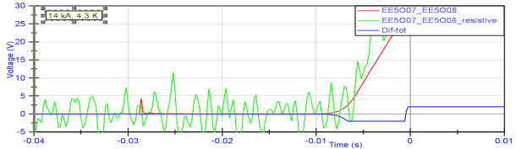
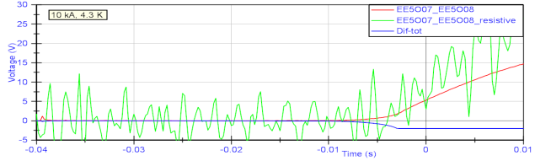
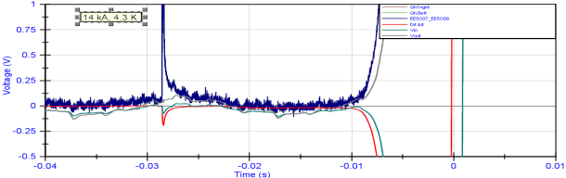
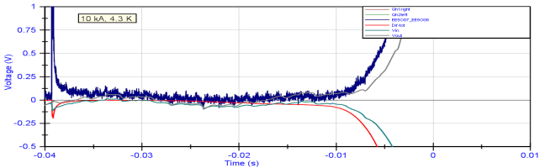
Heater efficiency
2 times to look at:
Quench heater onset (QO): start of the quench
Quench heater efficient (QE): time where slope of the resistive voltage cross the “time” axis
18 ms
21ms
28 ms
35 ms
Remarks:
At high current, the difference between QO-QE is very small, but at lower current there is an important offset to keep into account.
The difference between quench onset and quench efficient increases for low heater power density.
1.9 K, MBHSM101
Experimental data from G. Willering

Slide 11
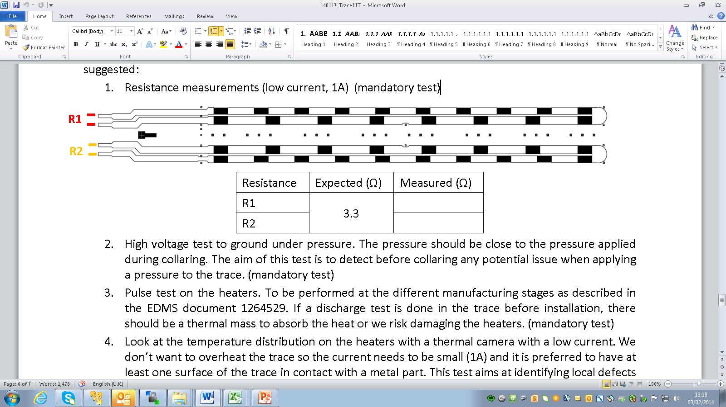
Heater efficiency
Quench heaters are covering ~ 1/3 of the magnet in the longitudinal direction, but resistance growth is well reproduced by the model assuming that the entire magnet length is covered my heaters
A decrease of the distance between the heater stations will not significantly improve the quench heater performance.
Copper
Stainless steel
Experimental data corresponds to MBHSM101
(CERN single coil assembly)
[G. Willering]
Heater pattern
I_{magnet} = 8 kA
I_{magnet} = 10 kA
I_{magnet} = 12 kA

Slide 12
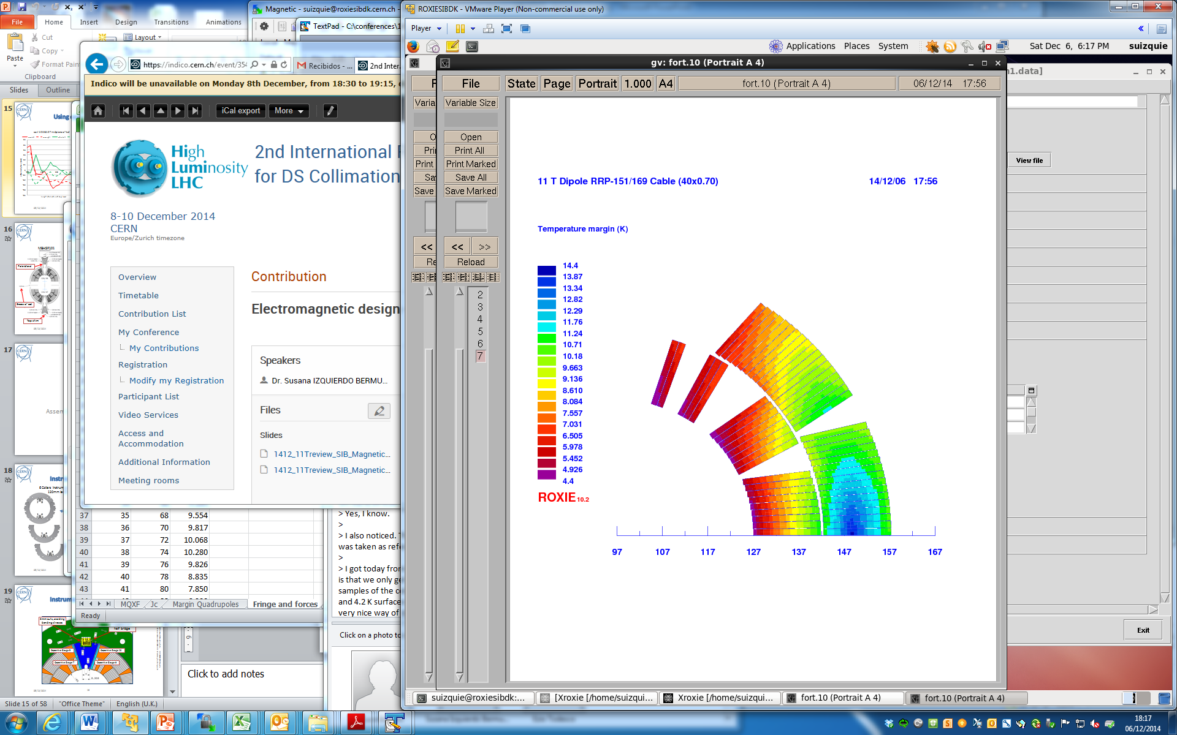
Can we further optimize the outer layer heaters?
The dominant parameters is the amount of insulation between heater and coil.
If the insulation between heater and coil is only the conductor insulation + 50 µm of kapton, further increase of the heater power density is not going to improve the heater performance.
Quench heaters are already covering most of the conductors in the outer layer. Two additional turns can potentially be covered if some voltage taps are removed, but the overall heater performance will not change significantly.
Additional turns that can be potentially covered
QH cover 16.5 turns (out of 18)
Not a lot of room for optimizing the outer layer heaters
(except further reduction of the insulation thickness between heater and coil)
QH cover: 14 turns (out of 16)

Slide 13
Quench propagation within the coil
10 ms
5 ms
Quench detection
Validation and power supply off
Quench heater effective
Quench heater provoked quench
Quench initiation
Initial propagation of the quench zone, longitudinal quench propagation
Quench heater delay and effectiveness
Quench propagation within the coil

Slide 14
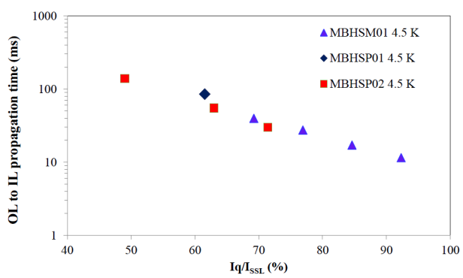
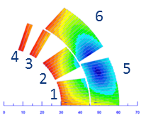
Quench propagation within the coil
Measurements at FNAL and CERN show quench propagation from outer to inner layer in the order of 15 ms for 80 % Iss.
1.9 K, MBHSM101
Experimental data from G. Willering
Experimental data from G. Chlachidze
Agreement with the model is reasonable, given the uncertainties in the thermal conductivity properties of the material in the interlayer
1.9 K, MBHSM101

Slide 15
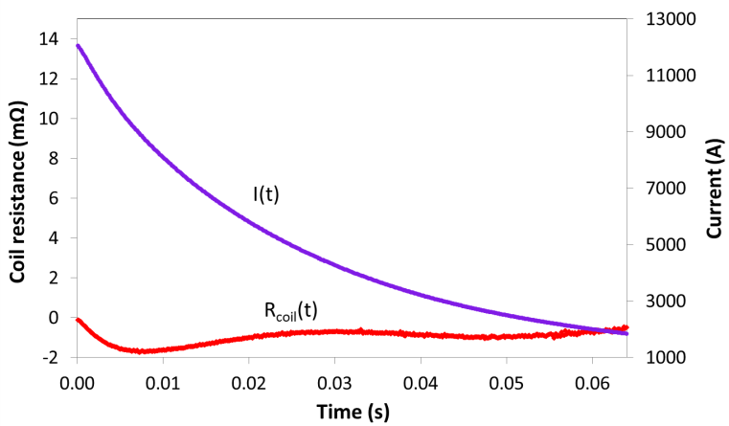
Quench Back & Dynamic Effects
Fast energy extraction tests were performed in the dipole mirror MBHSM01 shows that the “quench-back” effect is not present
Reduction of apparent inductance due to the IFCC does not seem to play an dominant role at the expected range of dI/dt: current decay is pretty well reproduced neglecting dynamic effects
Measured
(MBHSM101)
Model
Decay due to coil resistance growth, moderate dI/dt, small impact of IFCC
Extraction (dump), greater impact IFCC effect
For higher dI/dt, this effect can have an important impact on the decay.
Experimental data from [G. Chlachidze]
Experimental data from [G. Willering]
If present, it will help to spread the magnet stored energy, but as there is not clear evidence of it, it is not being consider for the model

Slide 16
Quench Integral Studies
Quench integral studies performed at FNAL (MBHSP02):
Provoke heater discharge manually at the desired current
No energy extraction system → magnet protection rely only on the heaters
Equivalent studies on-going at CERN in MBHSP101. See talk [G. Willering].
Measured difference = 1.2
According to the model = 1.4
Long heater delays (27 ms) compared to what we expect if the insulation between heater and coil is minimized (~15ms)
MBHSP02
Data from G. Chlachidze
MBHSP02
Data from G. Chlachidze

Slide 17
Hot spot temperature
Quenching magnet
L = 15.9 H
Quench under “accelerator conditions”:
V_{threshold} = 100 mV
t_{validation} = 10 ms
Quench starts in the high field region at the nominal operating current (11.85 kA)
Heater firing delay = 5 ms
Cold diode
U_{thr}=6V, R_{diff}=0.1 µΩ
R_{dump} = 150 mΩ
Outer layer heaters can protect the magnet, but it is not a redundant system
 | MIITs detection & validation [MA²s] | MIITs from heaters fired to effective [MA²s] | MIITs decay [MA²s] | TOTAL MIITs [MA²s] | T_{max} [K]
All the outer layer heaters fired | 2.5 | 2.5 | 11.0 | 16.0 | 335
Redundant configuration (only half of the heaters fired) | 2.5 | 2.5 | 12.5 | 17.5 | 400
Remarks:
MIITs vs. Tmax validated SMC-11T. Details will be addressed by [H. Bajas]
HQ02 high MIITs tests: 380+ K hot spot temperature without significant degradation

Slide 18
How to improve the situation?
Action: Quench faster the Inner Layer.
Options:
  CLIQ (Coupling Loss Induced Quench): careful study needed to understand the interaction with the rest of the circuit. We cannot count on it for LS2.
  Inter layer heaters: as the temperature margin in the inner layer is lower, they will be efficient even with low power density and they will provide the needed redundancy to the system.
[J. Rysti]

Slide 19
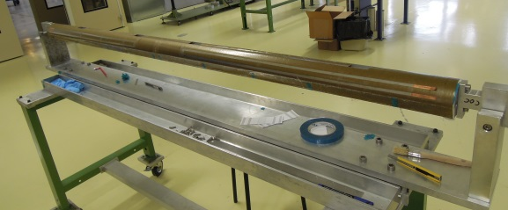
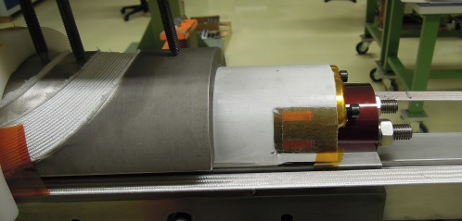
Inter layer Heaters
Inter layer heater under development.
Main concern: electrical integrity.
Design guideline: maximum voltage across the heaters ~ 150 V.
According to computations, at nominal magnet current, inter layer heaters are effective even if the power in the heater is low.
At lower magnet current, they will be also able to quench the magnet providing redundancy to the system.
Great technical challenge!
Nominal quench heater operation point
[J. Rysti]
But…if they don’t work, inter layer propagation might gets slower!
Inner layer heaters are not considered at the moment, but they are also a potential solution.
[J. Mazet]

Slide 20
Hot spot temperature
Quench under “accelerator conditions”:
V_{threshold} = 100 mV
t_{validation} = 10 ms
Quench starts in the high field region at the nominal operating current (11.85 kA)
Heater firing delay = 5 ms
Quenching magnet
L = 15.9 H
Cold diode
U_{thr}=6V, R_{diff}=0.1 µΩ
R_{dump} = 150 mΩ
 | MIITs detection & validation [MA²s] | MIITs from heaters fired to effective [MA²s] | MIITs decay [MA²s] | TOTAL MIITs [MA²s] | T_{max} [K]
All the outer layer heaters | 2.5 | 2.5 | 11.0 | 16.0 | 335
Outer layer in redundant configuration (only half of the heaters fired) | 2.5 | 2.5 | 12.5 | 17.5 | 400
Outer layer + Inter layer heaters | 2.5 | 1.7 | 10.5 | 14.6 | 290

Slide 21
Summary
The low Cu/SC ratio combined with the large stored energy and temperature margins make the protection of the 11T dipole a non-trivial problem
Efficient heat transfer from quench heaters to coil is a must:
  Minimize insulation thickness assuring electrical integrity.
  Current design of outer layer heaters in terms of coverage/power density demonstrated good results in MBHSM101 and MBHSP101.
Outer layer heaters can protect the magnet, but not in a redundant configuration.
In order to provide redundancy to the system, inter layer heaters are being explored.

Slide 22
Additional slides

Slide 23
MBHSP101

Slide 24
MBHSM101

Slide 25
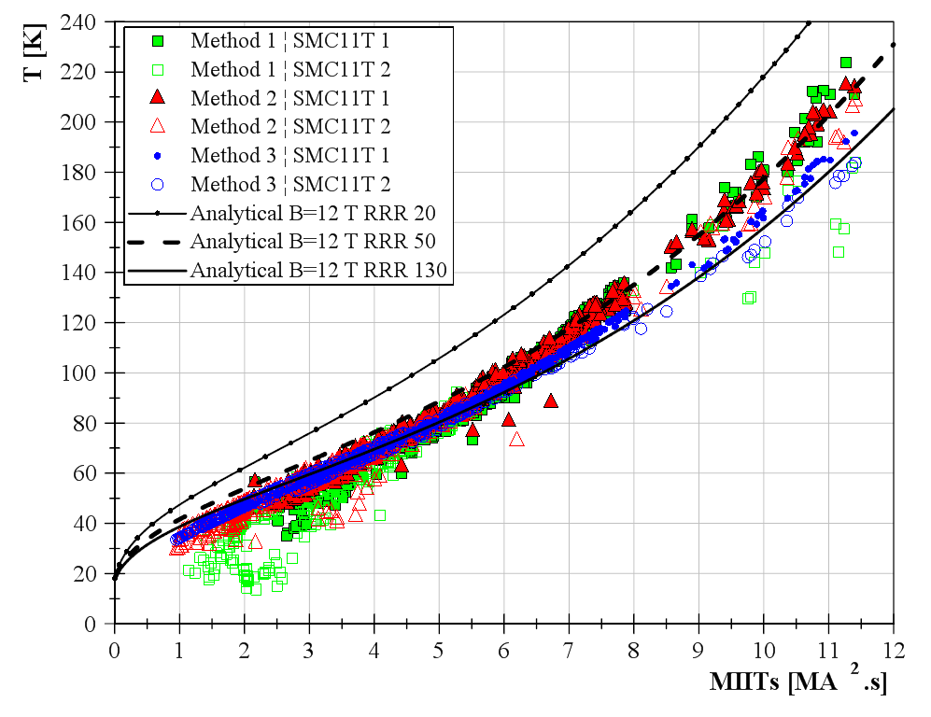
MIITs vs. T_{max}
H. Bajas

Slide 26
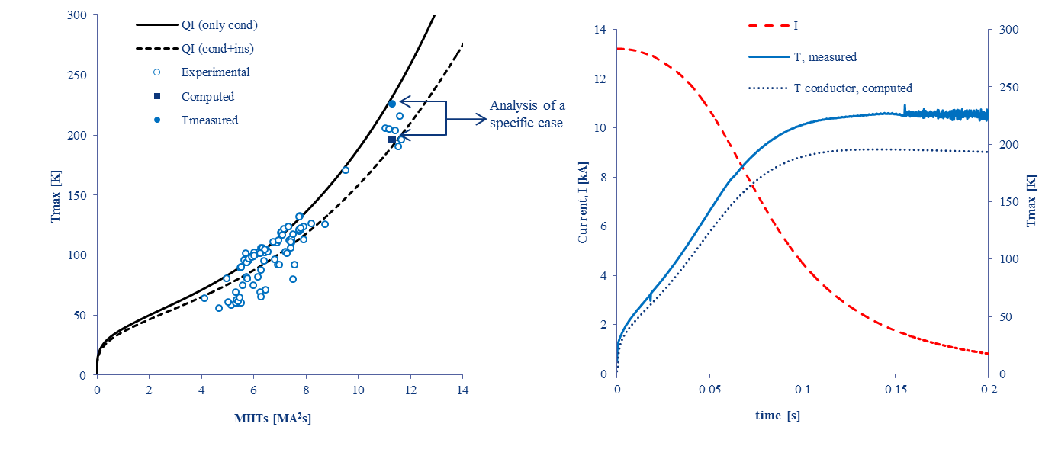
Model validation SMC-11T

Slide 27

“Time budget” for detectio
$$t_{budget}=\frac{MIITs}{I^{2}}−t_{detect}(V_{threshold})$$
Resistive voltage growth for a quench initiated in the high field area

Slide 28
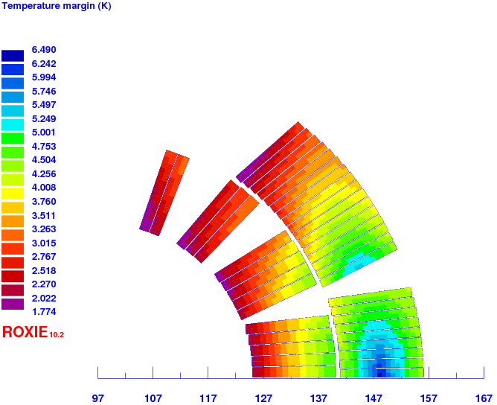
Temperature Margin
MB-LHC
DS-11T

Slide 29
QH Design Guidelines
Design should be suitable for a 5.5 m length magnet
The distance between heating stations should be such that the heat has to propagate between stations in less than 5 ms.
  For longitudinal propagation ≈ 10 m/s, distance ≈ 100 mm
Kapton insulation thickness from heater to coil should be minimized, but guarantee a good electrical insulation from heater to coil.
  50 µm seems to be minimum reliable Kapton thickness
Heat power density in the heating station should be as high as possible, but the temperature in the heater under adiabatic conditions should not increase above 350K.
  Experimental data from LARP magnets and 11T FNAL show that P_{O} ≈ 50-80 W/cm² heater delay starts saturating, but first short models P_{O} up to 150 W/cm² to find the optimal power density.
Heat as many turns as possible in the azimuthal direction.
Power density in the low field region should be higher than in the high field region to quench the magnet in a more uniform way.
No sharp edges, keeping the geometry of the heaters as simple and robust as possible.
If possible, use standard LHC QH power supply.
  Total capacitance 7.05 mF , maximum voltage ± 500V.
  Maximum current for continuous operation = 135 A
  Peak current at 25 ˚C for 10 ms =1700 A (it will probably destroy the PCB of the power supply)
  Can be safely operated up to 300 A
At least two independent circuits per aperture (for redundancy)

Slide 30
Overview QH design
width
Coverage
Distance between stations
  Main features:
  Stainless steel 25 µm thick, partially plated with 5 µm thick layer of copper to reduce their overall resistance (design suitable for 5.5 m length)
  Heating stations are 19 mm wide in the mid-plane (LF) and 24 mm wide in pole area (HF)
  The distance in between non-plated sections is 90 mm in the LF and 130 mm in the HF where quench propagation is faster in the longitudinal direction.
  The heaters are embedded in between two layers of polyimide insulation foils. The thickness of the insulation between the heater and the coil is composed of 0.050 mm of polyimide, about 0.025 mm of Epoxy glue plus the additions S2 glass added to the coil outer radius during impregnation.
  The trace is then glued to the coil and compressed radially during collaring to about 40 MPa.
0.2 mm S2 glass
0.025⁺ mm glue + 0.050 mm kapton
QUENCH HEATERS
4x0.5 mm kapton (ground insulation)
More details can be found in https://indico.cern.ch/event/311824/

Slide 31
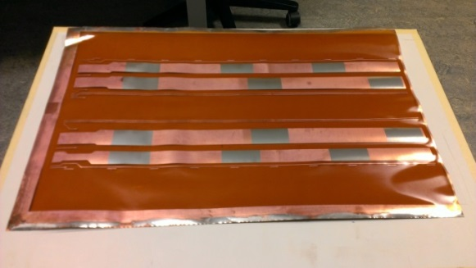
Trace manufacturing and characterization
Resistance measurements at RT and 77 K
  Stainless steel stations: Measured resistance close to expected values
    3% difference at RT
    8 % difference at 77K
  Copper regions: Measured resistance higher
  than expected value
    20% difference at RT
    25 % difference at 77K
High current test
  No degradation was observed in the bonding
Temperature cycling at 77 K
  No degradation
Kapton (25 µm)
Glue (50 µm)
Copper (5 µm)
Stainless Steel (25 µm)
Glue (<25 µm)
Kapton (50 µm)
Trace stack for 11T
ρ_{ss}=7.3·10⁻⁷Ωm, RRR_{SS}=1.34
ρ_{ss}=1.8·10⁻⁸Ωm, RRR_{SS}=30

Slide 32
Trace QA
Before trace installation
Resistance measurements at RT
High voltage test to ground under 20-30 MPa pressure (2kV).
After trace installation, every step of the manufacturing process
Expected value: R1=R2=1.65 Ω
Measured value ≈ 1.7 Ω
Resistance
QH to ground and QH to coil (1 kV)
Discharge test (pulse). Low thermal load to the heaters (under adiabatic conditions and assuming constant material properties, peak current defined to limit the temperature increase to 50 K) (only in the manufacturing steps after collaring)

Slide 33

Impact of insulation material/thickness

Slide 34
Quench Heater Delay
Large difference between “Quench Onset (QO)” and “Quench heater efficient (QE)” at low currents.
From now on, if not specified, heater delays plotted correspond to the “Quench Onset” and not “Quench Efficient”

Slide 35
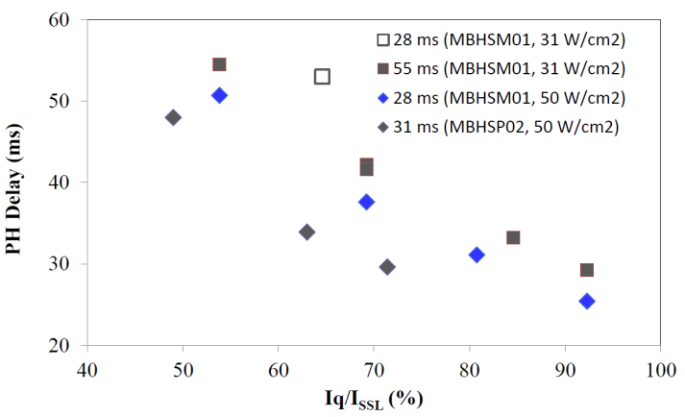
Comparison to FNAL 11T dipoles
FNAL MBHSM% insulation between heater and coil:
  0.125 mm of glass on the outer, impregnated with the coil
  0.125 mm of kapton between heater and coil
CERN MBHSM101insulation between heater and coil:
  0.200-0.250 mm of glass on the outer, impregnated with the coil
  0.050 mm of kapton between heater and coil + about 0.025 mm glue
MBHSM101
Heater delays are very close to delays measured in FNAL
FNAL data from https://indico.cern.ch/event/311824/
Slides from Guram Chlachidze

Slide 36
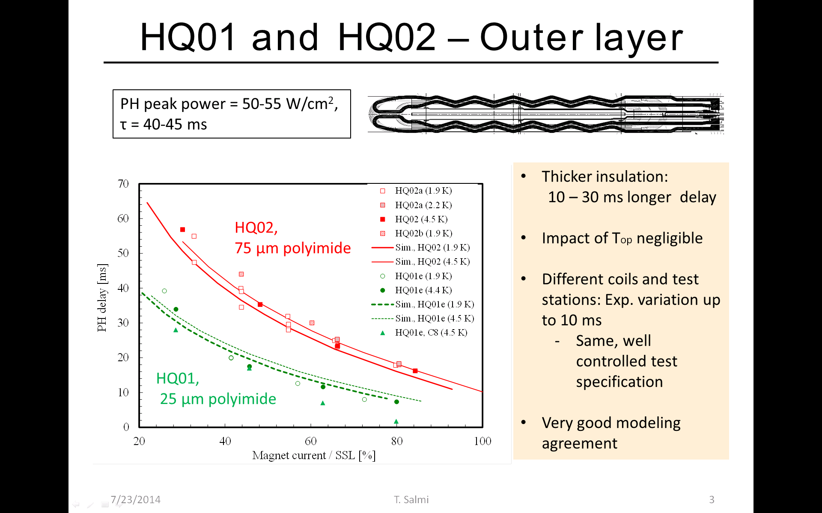
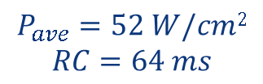
Comparison to HQ
$$P_{ave}=52 W/cm2$$
$$RC=64 ms$$
Significant longer delays than in HQ.
Main difference: in the case of 11T, heaters are glued on top of the coil after impregnation
HQ data data from https://indico.cern.ch/event/311824/
Slides from Tiina Slami

Slide 37
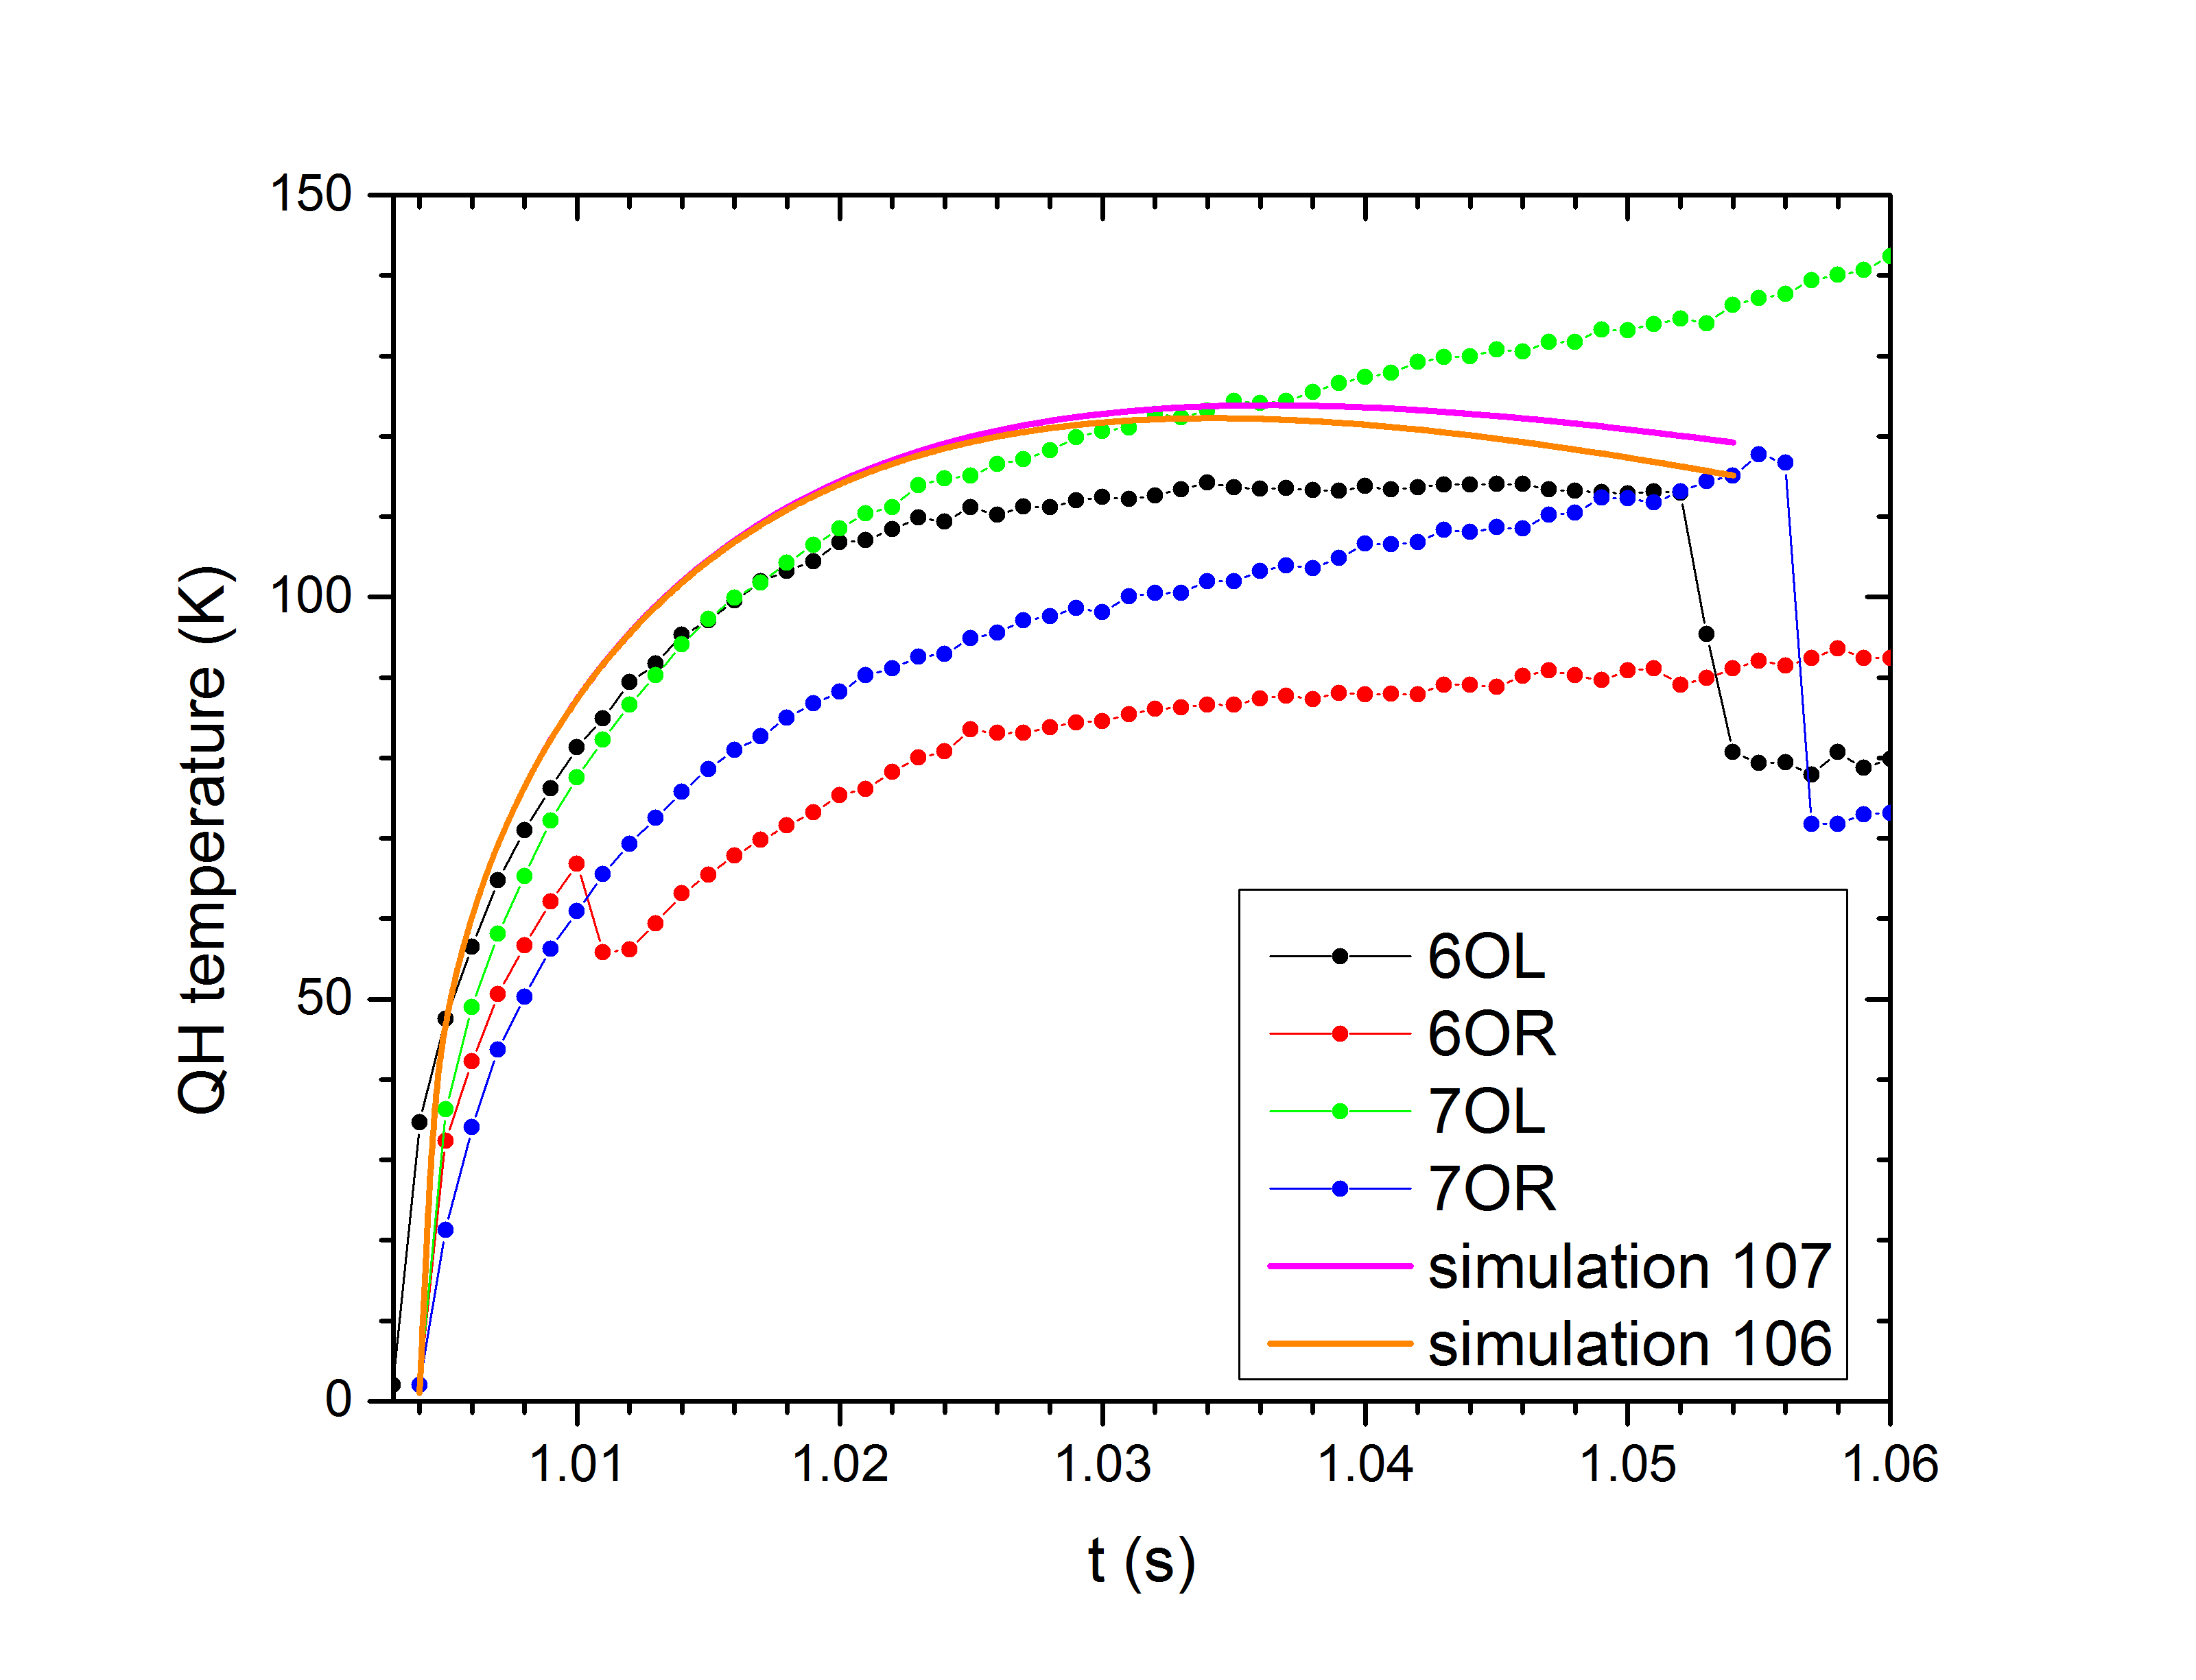
Quench Heater Temperature
I_{QH}= 150 A

Slide 38
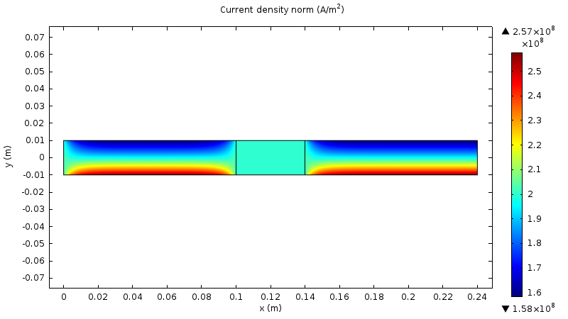
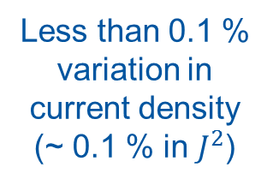
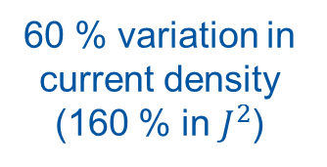


Scalar magneto-resistance
[J. Rysti]
Stainless steel
Cu
Cu
$$B=11 \text{T}$$
$$B=6 \text{T}$$
Less than 0.1 % variation in current density (~ 0.1 % in $J^{2}$)
60 % variation in current density (160 % in $J^{2}$)

Slide 39
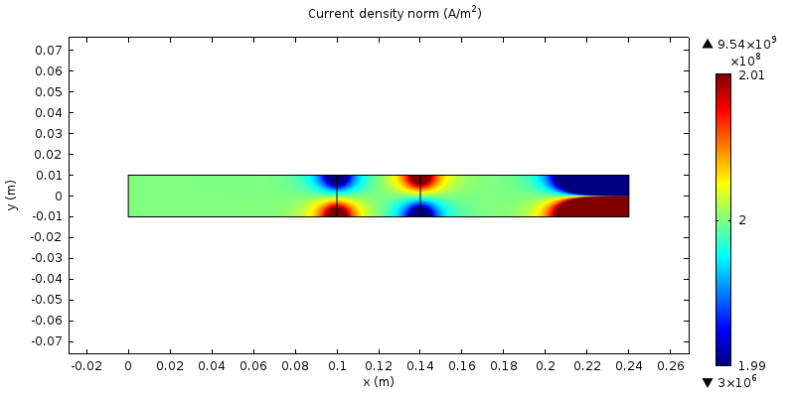
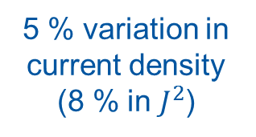



Hall effect
[J. Rysti]
$$B_{z}=\text{10 }\text{T}$$
Stainless steel
Cu
Cu
5 % variation in current density (8 % in $J^{2}$)
$$R_{HCu}=−7∙{10}^{−11}{ \text{m}}^{3}/\text{C}$$
$$R_{HSs}=3∙{10}^{−10}{ \text{m}}^{3}/\text{C}$$

Slide 40
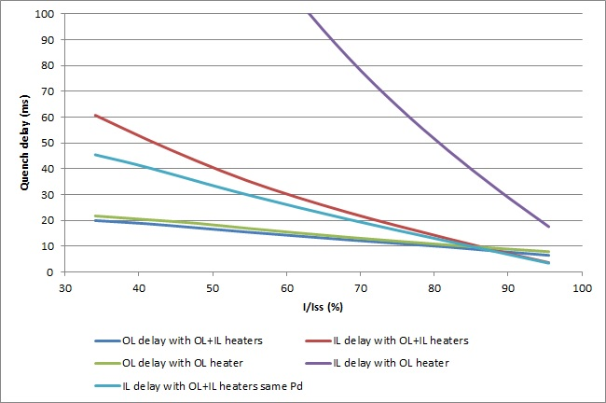
Inter layer heaters
Pd IL heaters = 50 W/cm2
Pd IL heaters = 100 W/cm2

Slide 41
Inter layer heaters

Slide 42
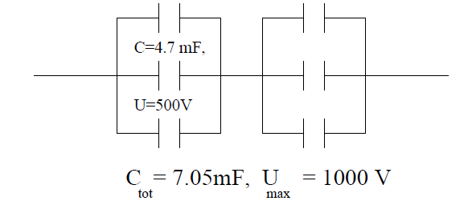

STANDARD LHC HEATER POWER SUPPLIES
Supply based on the thyristor-triggered discharge of aluminium electrolytic capacitors.
Each power supply contains a bank with 6 capacitors (4.7 mF/500V) where two sets of 3 parallel capacitors are connected in series → total capacitance 7.05 mF
Nominal operating voltage $±$ 450 V (90 % of the maximum voltage)
OPERATION: Peak current about 85 A, giving a maximum stored energy of 2.86 kJ
Actual limitations in terms of current
Power supply equipped with two SKT80/18E type thyristors rated for 80 A at 85 ˚C.
Maximum current for continuous operation = 135 A
Peak current at 25 ˚C for 10 ms =1700 A (it will probably destroy the PCB of the power supply)
Can be safely operated up to 300 A (resistive load in LHC from 12Ω in most of the circuits to 3.1 Ω in some systems such as D1 protection )
QUENCH HEATER EXPERIMENTS ON THE LHC MAIN SUPERCONDUCTING MAGNETS
F. Rodriguez-Mateos, P. Pugnat,S. Sanfilippo, R. Schmidt, A. Siemko, F. Sonnemann

Slide 43
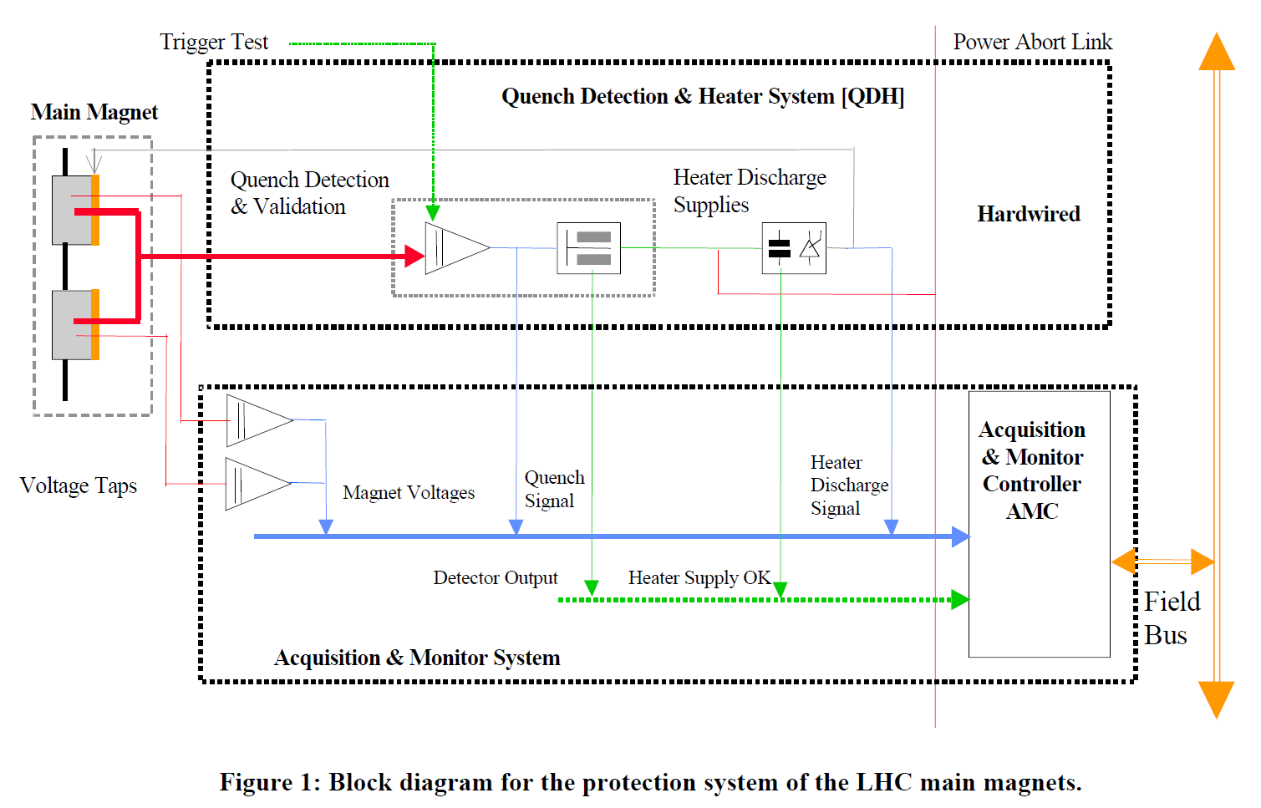
Protection System LHC Magnets
The Protection System for the Superconducting Elements of the Large Hadron Collider at CERN
K. Dahlerup-Petersen1, R. Denz1, J.L. Gomez-Costa1, D. Hagedorn1, P. Proudlock1, F. Rodriguez-Mateos1, R. Schmidt1 and F. Sonnemann2

Slide 44

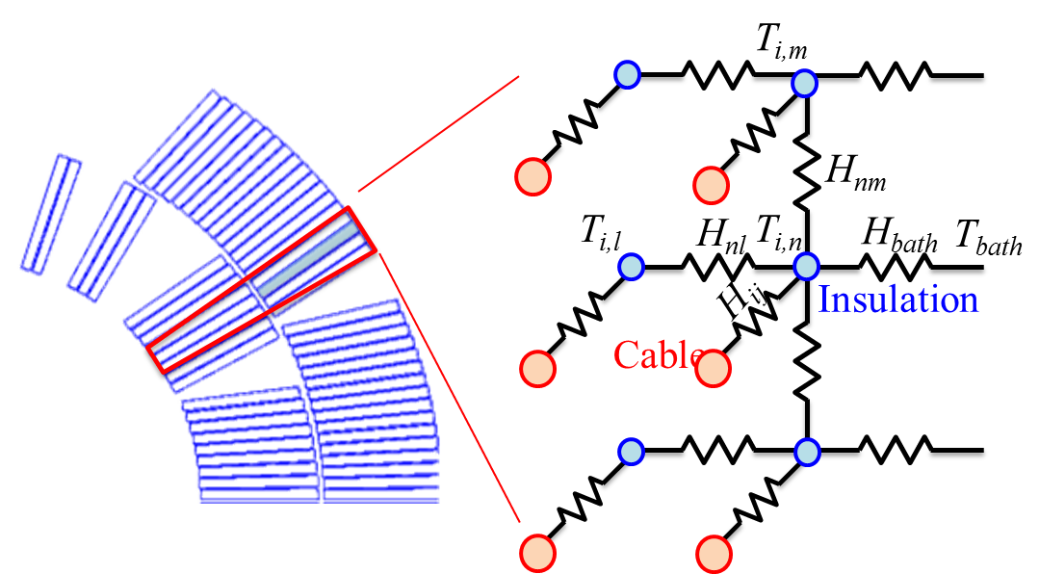
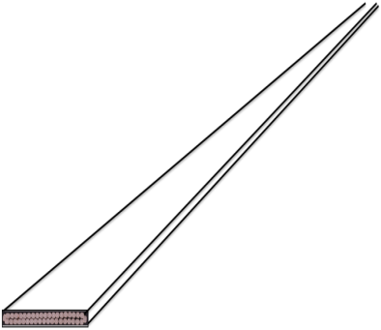
Modelling heat propagation within the coil
Two principal directions:
1. Longitudinal
Length scale is hundreds of m
2. Transverse
Length scale is tenths of mm
Power exchanged between components in the conductor
External heat perturbation
Power exchange between adjacent conductors
Joule heating
Longitudinal
Transverse
The conductor is a continuum solved with accurate (high order) and adaptive (front tracking) methods
2nd order thermal network explicitly coupling with the 1D longitudinal model:

