Slide 1

CERN – 8th December 2014
11 T cable development and procurement strategy at CERN
B. Bordini, A. Ballarino, L. Oberli, D. Richter
2nd International Review of the HL-LHC 11 T Dipole for DS Collimation

Slide 2
Outline
Wire Specifications and Procurement
  specs and magnet margin
  material received so far
  procurement strategy
Cable Parameters and Performance
  Cable Development at FNAL (by E. Barzi, S. Zlobin)
  Unit lengths produced with the RRP 108/127
  Unit lengths produced with the RRP 132/169
  Unit lengths produced with the PIT
Conclusions

Slide 3
Wire Specifications for the Magnet Series
For previous deliveries we accepted I_{c}> 390 A and RRR>100

Slide 4
Magnet Margin in Operating Conditions
Values extrapolated from I_{c} measurements
19.5 % Margin
4.4 K Margin

Slide 5
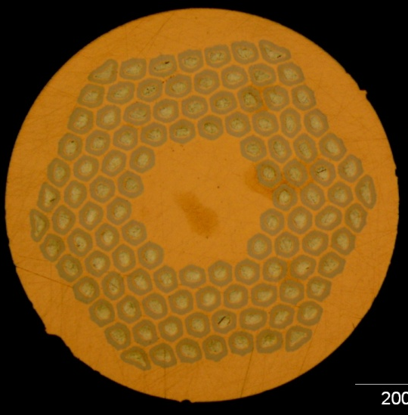
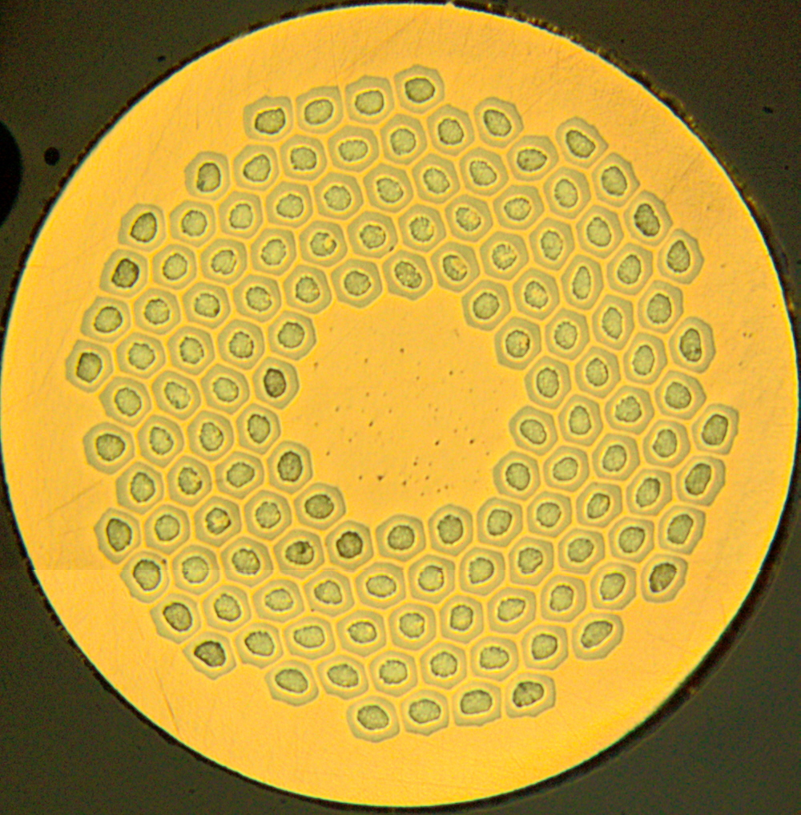
Wire Received so far
RRP 108/127
RRP 132/169
RRP 150/169
PIT 114
PIT 120

Slide 6
0.7 mm 108/127 RRP Wire
Electrical Performance
I_{c} New Spec., (A) | 438
I_{c} Average, (A) | 472.7
RMS, (A) | 9.3
J_{c} Average, (A/mm²) | 2735
RMS, (A/mm²) | 50
Wire Received 50 km

Slide 7
The importance of a large RRR
Larger RRR → conductor less sensitive to energy perturbations (epoxy micro-cracks, wire micro-motion etc.) that might initiate the self-field instability
Example, at 12 T and 1.9 K a perturbation of 3μJ on a 0.7 mm RRP 108/127 quenches the conductor:
  at 70% of its I_{c} if RRR 14
  At 85% of its I_{c} if RRR 130
0.7 mm RRP 108/127 wire
J_{c}(12 T, 4.3 K) ≈ 2800 A/mm²
Laser Energy ≈ 3μJ

Slide 8
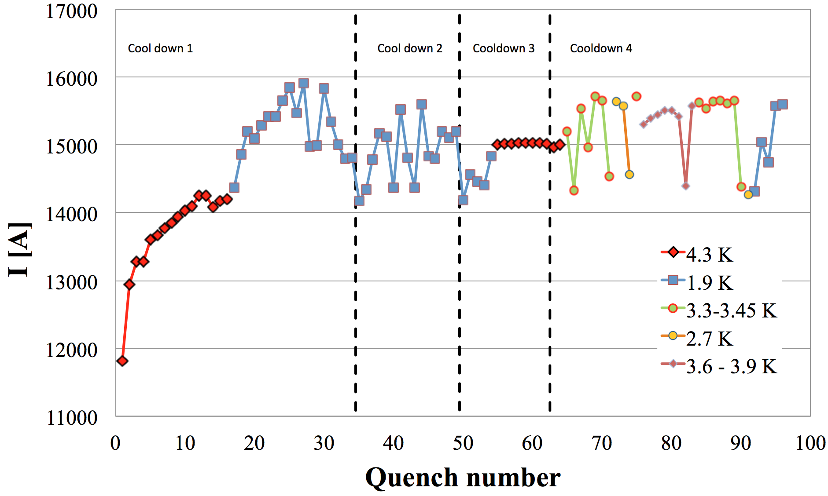
Instabilities in Magnets
1.9 K SS limit
4.3 K SS limit
SMC Magnet wound with the 11 T cable (based on the RRP 108/127 wire)
J.C. Perez et al. “The Short Model Coil (SMC) Dipole Performance Using the 11-T-dipole-type Nb₃Sn Conductor”

Slide 9
Is the conductor for the 11 T magnet intrinsically unstable ?
Even with a low RRR, cable and strand measurements shows that the conductor of the 11 T magnet is not intrinsically unstable for the magnet operating conditions
Measurement of a cable for the 11 T magnet based on the RRP 108/127 wire - low RRR extracted (50)
If the cable/strand is not subjected to perturbations (epoxy cracks, wire motion, etc.), the minimum quench current due to the self-field instability occurs around 7-8 T at a current level significantly larger than the ultimate current of the magnet 14.7 kA (367 A per strand).
… nevertheless if we assume the presence of perturbations, a large RRR is of great help ...

Slide 10
0.7 mm 169 restacks RRP Wire
I_{c} @ 12 T, 4.22 K
CERN has received 140 km of wire
I_{c} New Spec., (A) | 438
I_{c} Average, (A) | 436.4
RMS, (A) | 25.1
Old Spec.
390 A
150/169
132/169

Slide 11
0.7 mm 169 restacks RRP Wire
Residual Resistivity Ratio (RRR)
RRR New Spec. | 150
RRR Average | 186
RMS | 55
Old
Spec.
100
150/169
132/169

Slide 12
PIT Wire
Received 25 + 50 km of wire
Other 100 km will be received in 2015
Today the PIT wire has a critical current about 1-7 % lower than specs with a RRR around 100
Bruker-EAS is collaborating with CERN to further improve the PIT conductor
A modification, which should bring the wire to specs with a limited impact to the wire layout and production, has been identified and it will be implemented in the next months

Slide 13
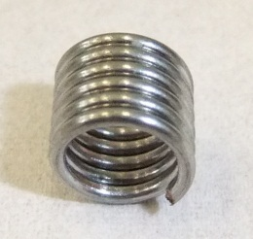
Magnetization of the 132/169 RRP wire
Mini-coil Sample
Billet 16236 (A02)
reacted 50 hrs at 640 C
J_{c}(12 T, 4.2 K) ≈2640 A/mm²
RRR ≈ 200
Measurements by D. Richter
Quantify the magnetization of the wire at 1.9 K
Study the temperature dependence of the J_{c}
Study the flux jumps in the low field region

Slide 14
Magnetization of the 132/169 RRP wire
Main Characteristics
At 1.9 K, below 3 T there are flux jumps
  They limit the conductor magnetization;
  The conductor is so unstable that the jumps are continuous and their amplitude gets smaller and smaller when reducing the field
DM(1.9 K, 3 T)=228 mT

Slide 15
Magnetization of 132/169 RRP wire
Reproducibility
Tesla
Billet 16236 (A02)
Reacted 50 hrs at 640 C
J_{c}(12 T, 4.2 K) ≈2640 A/mm²
Non-Copper 44.5 %
DM(1.9 K, 3 T)=228 mT
Billet 16314 (A01)
Reacted 50 hrs at 640 C
J_{c}(12 T, 4.2 K) ≈2360 A/mm²
Non-Copper 43.7 %
DM(1.9 K, 3 T)=219 mT
In this type of conductor the variability of the magnetization values are expected to be correlated only to the critical current density and the copper to non-copper ratio

Slide 16
Magnetization
RRP 132/169 vs PIT 120
mT
RRP - Billet 16236 (A02)
Reacted 50 hrs at 640 C
J_{c}(12 T, 4.2 K) ≈2640 A/mm²
Non-Copper 44.5 %
DM(1.9 K, 3 T)=228 mT
Tesla
PIT – Billet 36521 (A07)
Reacted 240 hrs at 620 C
J_{c}(12 T, 4.2 K) ≈2330 A/mm²
Non-Copper 45.6 %
DM(1.9 K, 3 T)=163 mT

Slide 17
Wire Procurement
Sent out (December the 5th ) the invitation to tender for the wire that will be used in the magnet-series for LS2
The invitation to tender concerns 1000 km of wire with the following scheduling:
  100 km by February 2016
  Additional 100 km by April 2016
  Additional 200 km every two months till completion of the contract (end 2016)
The procurement is based on double sourcing (OST, Bruker-EAS) and it is sufficient to completely fulfill the needs of the magnet series (700 km including foreseen spare coils)

Slide 18
Cable Parameters
Strand diameter | mm | 0.7
Number of strands | - | 40
Cable width | mm | 14.7
Cable mid thickness | mm | 1.25
Keystone angle | deg | 0.79
Cable transposition pitch | mm | 100
Aspect ratio | - | 11.76
Thin edge | mm | 1.149
Thick edge | mm | 1.351
t/2d thin edge | % | 82.5
t/2d thick edge | % | 96.5
Packing factor | % | 87.3
With stainless steel (316 L) core - 12 mm width and 25 μm thickness

Slide 19
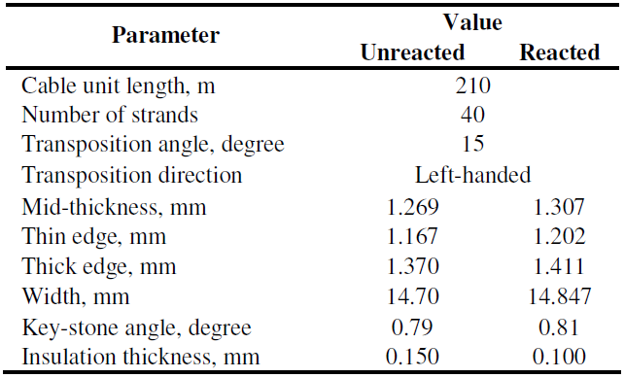
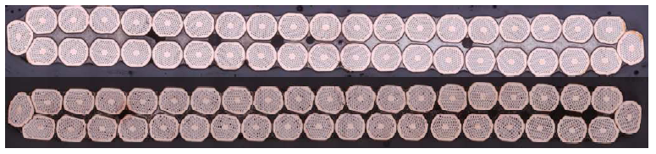
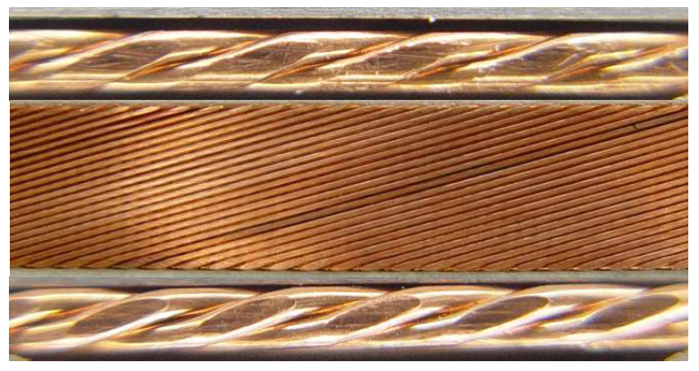
E. Barzi
S. Zlobin
Cable Requirements and Specs v.1
Factors used in selecting the initial cable geometry:
  Max strand number ≤ 40 limit of CERN cabling machine
  Strand size 0.7 mm to achieve 11 T at 11.85 kA
  Critical current degradation due to cabling < 10%
  Cable expansion: thickness3%, width 1%
Cable design constraints:
  Small edge deformation 1-h/2d ≤ 20% to minimize Ic degradation
  Large edge compacted ~2% for mechanical stability
  Width compaction > 1 to minimize Ic degradation
  Cable packing factor ~ 86%

Slide 20
E. Barzi
S. Zlobin
Cable Ic degradation and mechanical stability
RRP strand, 1-2 passes, intermediate annealing
Cable Ic degradation is small for v.1
Cable mechanical stability needs improvement
Reducing keystoned cable thickness of the cable from 1.27 mm to 1.25 mm improved cable mechanical stability and I_{c} degradation still within specs.

Slide 21
Cable Expansion for Tooling Design
E. Barzi
S. Zlobin
The coil dimensions in the winding and curing tooling are determined by the unreacted cable cross section, whereas the coil dimensions in the reaction and impregnation tooling are based on the reacted cable cross section.
Experimental data indicate that the Nb₃Sn cable cross section expands anisotropically during reaction:
- The average width expansion was 2.6%
- The average mid-thickness expansion was 3.9%
- The average length decrease was 0.3%
These numbers are slightly larger than it was expected in the specs

Slide 22
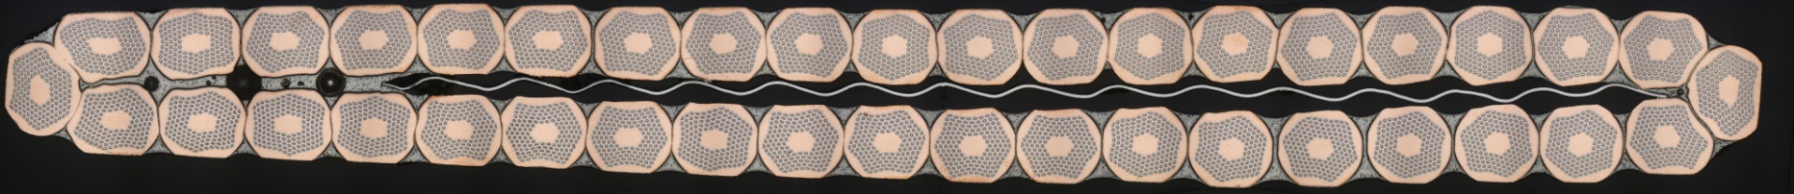
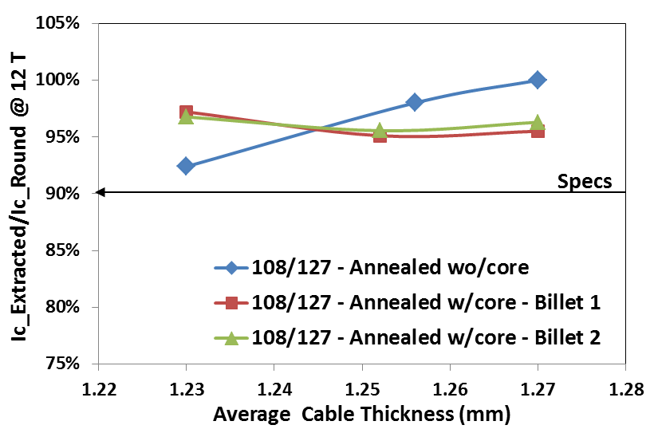
E. Barzi
S. Zlobin
Development of Cored Cable Technology
Better field quality, better ramp rate dependence
Stainless steel core 11 mm wide and 0.025 mm thick
Ic degradation is within the specs for the same cable thickness

Slide 23
I_{c} degradation and RRR for Cored Cable made of 150/169 RRP
E. Barzi
S. Zlobin
A mid-thickness of 1.25 mm meets the I_{c} degradation requirements also in the case of a cored cable.
Larger cable expansion can be absorbed by the cable insulation
This allows preserving the same magnet design when using cored or uncored cable based on RRP strand.

Slide 24
E. Barzi
S. Zlobin
Cable Fabrication at FNAL - ~2.5 km
Coil ID | Cable ID | Billets ID | Nb3Sn Type | Original cable length | Cable geometry | Core geometry | Cable fabrication
MBH02, MBH03 | DM-CF-01-0 | 12292, 12319, 12521-22, 13062-63, 13090 | 108/127 (Ta) | 414 m | 1.251±0.001 x 14.71±0.01 mm2, 15.0 deg | None | Jul. 2011, 2-pass w/intermediate anneal
MBH05, MBH07 | DM-CF-02-0B | 13548, 13613 | 150/169 (Ta) | 120 m, 230 m | 1.251±0.002 x 14.69±0.01 mm2, 15.0 deg | 11.0 mm x 25 μm SS | Sep. 2011, 2-pass w/intermediate anneal
MBH08 | DM-CF-07-03-01 | 14144, 14145, 14194, 14195, 9772 | 108/127 (Ta), 114/127 | 138 m | 1.252±0.004 x 14.71±0.01 mm2, 14.0 deg | 11.7 mm x 25 μm SS | Nov. 2012 1-pass
MBH09 | DM-CF-07-03-01B | 14144, 14145, 14194, 14195, 14700 | 108/127 (Ta) | 180 m | 1.249±0.002 x 14.70±0.01 mm2, 14.8 deg | 11.0 mm x 25 μm SS | Nov. 2012 1-pass
MBH10, MBH11 | DM-CF-07-03-01C | 14144, 14145, 14194, 14195, 14700 | 108/127 (Ta) | 220 m | 1.245 x 14.72 mm2, 15.0 deg | 11.0 mm x 25 μm SS | Nov. 2012 2-pass w/intermediate anneal
1-pass successful commissioning | DM_CF_08_01 | 11444 | 132/169 (Ti) | 216 m | 1.251 x 14.73 mm2, 15.6 deg | 9.5 mm x 25 μm SS | Mar. 2013 1-pass
 | R&D_CF_04_13 | A101 | Hard Cu | 600 m | 1.250 x 14.71 mm2, 16.8 deg | 11 mm x 25 μm SS | Oct. 2013 1-pass
MBH12, MBH13, MBH14 | DM-CF-07-13 | 15043, 15044, 15045, 15244, 15245, 15290 | 108/127 (Ti) | 374 m | 1.251±0.001 x 14.71±0.01 mm2, 16.8 deg | 11.0 mm x 25 μm SS | Oct. 2013 1-pass

Slide 25
Cable Produced with the RRP 108/127
Geometrical Parameters
3 unit lengths for model program (1 mirror and 1 dipole)
Cable ID | Run ID | Length | Width | Mid-thickness at 50 MPa | Keystone angle
H15OC0127A | 86A | 237 m | 14.715 mm (σ=0.0026) | 1.2498 mm (σ= 0.0011) | 0.779° (σ=0.029)
H15OC0127B | 86A | 235 m | 14.717 mm (σ=0.0023) | 1.2491 mm (σ= 0.0006) | 0.783° (σ=0.027)
H15OC0137A | 96A | 218 m | 14.7065 mm (σ=0.0030) | 1.2499 mm (σ= 0.0029) | 0.784° (σ=0.015)
Well controlled Geometry

Slide 26
Cable Produced with the RRP 108/127
Electrical Performance
Cable from Run 86A:
  Average I_{c} degradation (6 virgin and 6 extracted) : 1.3 % (- 0.4% to 4.9%)
  Average I_{c} extracted 384 A at 12 T, 4.3 K
Cable from Run 96A:
  Average I_{c} degradation (5 virgin and 5 extracted) : 1 % (- 0.6% to 3.1%)
  Average I_{c} extracted 425 A at 12 T, 4.3 K
For both cable runs: very limited I_{c} degradation nevertheless minimum integral RRR of extracted strand around 50
  Such a low RRR value is mainly due to the fact that for the 108/127 we accepted to use round wires with RRR lower than 100
HT: 48h/210C + 48h/400C + 50h/640C

Slide 27
Cable Produced with the RRP 132/169
Geometrical Parameters
3 unit lengths for model program
Cable ID | Run ID | Length | Width | Mid-thickness at 50 MPa | Keystone angle
H15OC0158A | 116 | 227 m | 14.698 mm (σ=0.0019) | 1.2460 mm (σ= 0.0023) | 0.787° (σ=0.021)
H15OC0162A | 119 | 241 m | 14.701 mm (σ=0.0020) | 1.2498 mm (σ= 0.0012) | 0.795° (σ=0.020)
H15OC0162B | 119 | 235 m | 14.701 mm (σ=0.0021) | 1.2505 mm (σ= 0.0008) | 0.805° (σ=0.017)
Well controlled Geometry

Slide 28
Cable Produced with the RRP 132/169
Electrical Performance
For both cable runs: very limited I_{c} degradation around 2 % in average and integral RRR of extracted above 100
Started a systematic investigation on local RRR
RRR virgin wire ≈ 160
Max value local RRR compatible with virgin wire
Min value local RRR ≈ 100
We are collecting more statistics
Local RRR measurement
48h/210C + 48h/400C + 50h/640 C

Slide 29
Cable Produced with the RRP 132/169
Electrical Performance
From the first local RRR measurements on the 11 T cable it seems that :
  Starting from a round wire with a RRR significantly larger than 150 does not drastically improve the minimum local RRR (110-120)

Slide 30
Cable Produced with the RRP 132/169
Electrical Performance
Run 119
Run 116
On the other hand it seems that starting from a round wire with a RRR just lower than 150 might produce local RRR values significantly lower than 100 (70-80) – collecting more statistics

Slide 31
Effect of Core on the Ramp-Rate Dependence
Cable measurement in FRESCA on a 11 T cable based on the RRP 108/127 without core
Without core there is a strong dependence of the quench current on the field ramp rate because of large inter-strand currents
Once the core was introduced this ramp rate dependence completely disappeared

Slide 32
Cable Produced with the PIT wire
Electrical Performance
Baseline Cable
  Average I_{c} degradation of baseline cable with PIT: 6.1 %
  Integral RRR down to 63
By increasing 40 microns the mid-thickness of the cable and hence its thin edge, we limited the average I_{c} degradation to less than 2 %

Slide 33
Conclusions
CERN has lunched the procurement for the conductor of the 11 T magnets that are expected to be installed in the LHC during LS2
  1000 km of wire: double sourcing procurement (OST and Bruker-EAS)
  First deliveries are expected by end 2015 (in line with the magnet production)
The OST wire is fulfilling the specifications while the Bruker-EAS wire has a critical current about 1-7 % lower today
The baseline cable developed in collaboration with FNAL limits the critical current degradation to
  less than 2.1 % in average (max degradation 4.9 %) for the RRP Wire
  6.1 % for the PIT wire
Increasing the thin edge thickness by 40 microns would limit the degradation of the PIT cable to less than 2 % (and it is expected to improve local RRR of RRP cable)

Slide 34
Conclusions
CERN has lunched the procurement for the conductor of the 11 T magnets that are expected to be installed in the LHC during LS2
  1000 km of wire: double sourcing procurement (OST and Bruker-EAS)
  First deliveries are expected by end 2015 (in line with the magnet production)
The OST wire is fulfilling the specifications while the Bruker-EAS wire has a critical current about 1-7 % lower today
The baseline cable developed in collaboration with FNAL limits the critical current degradation to
  less than 2.1 % in average (max degradation 4.9 %) for the RRP Wire
  6.1 % for the PIT wire
Increasing the thin edge thickness by 40 microns would limit the degradation of the PIT cable to less than 2 % (and it is expected to improve local RRR of RRP cable)

Slide 35
0.7 mm 169 restacks RRP Wire
J_{c} @ 12 T, 4.22 K
J_{c} Average, (A/mm²) | 2483
RMS, (A/mm²) | 148
150/169
132/169

