Slide 1
Cryostat for the 11 T magnets and collimator integration
D. Duarte Ramos, C. Mucher, L. Gentini, T. Sahner, H. Prin, R. Wawrowski, F. Savary, V. Baglin
HL-LHC 11 T Dipole for DS Collimation
8th to10th December, 2014

Slide 2
Outline
Main integration requirements
Conceptual design: Layout, main features, interfaces
Cryostat main components and assembly sequence
Collimator design
Beam vacuum equipment and collimator length
Current leads for the trim circuit
Work in progress
Conclusion

Slide 3
Main integration requirements
Compatibility with installation and transport constraints: not larger than existing cryostat (ø1055)
Create a room temperature vacuum sector in the LHC continuous cryostat
  Cold to warm transitions (CWT)
  Sector valve after each CWT for vacuum separation during magnet cooldown or collimator bakeout. RF-shielded gate valves and bellows for impedance reasons
  DN35 ports on the cold sectors to send an RF emitter ball through the full arc after warm up and before cooldown
Compatibility with existing cryogenic and electrical systems, ensuring their continuity
Prevent loss of alignment during evacuation with independent supports for collimator and cryostat
Minimise changes to other magnets: keep interconnects standard if possible
Vacuum enclosure
1.8K Heat exchanger
Magnet
RF emitter
RF emitter
Magnet
Beam vacuum
Collimator
Bus bars
Lines E, C’, K

Slide 4
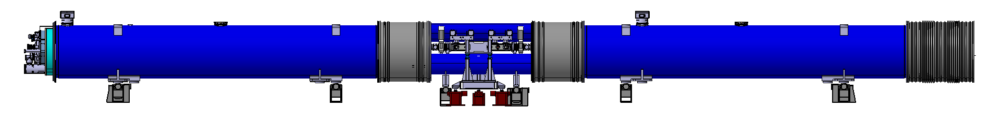
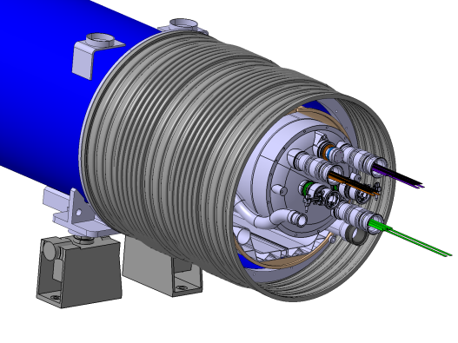
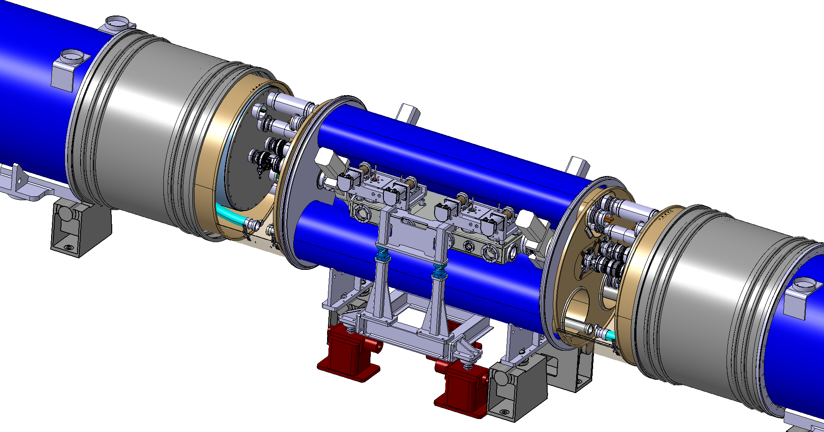
Solution: MB replacement unit
LHC MB replaced by 3 cryostats + collimator, all independently supported and aligned:
Same 15660 mm length between interconnect planes as an LHC MB
Connection cryostat between two 11 T magnets to integrate the collimator
Same interfaces at the extremities: no changes to nearby magnets, standard interconnection procedures & tooling

Slide 5
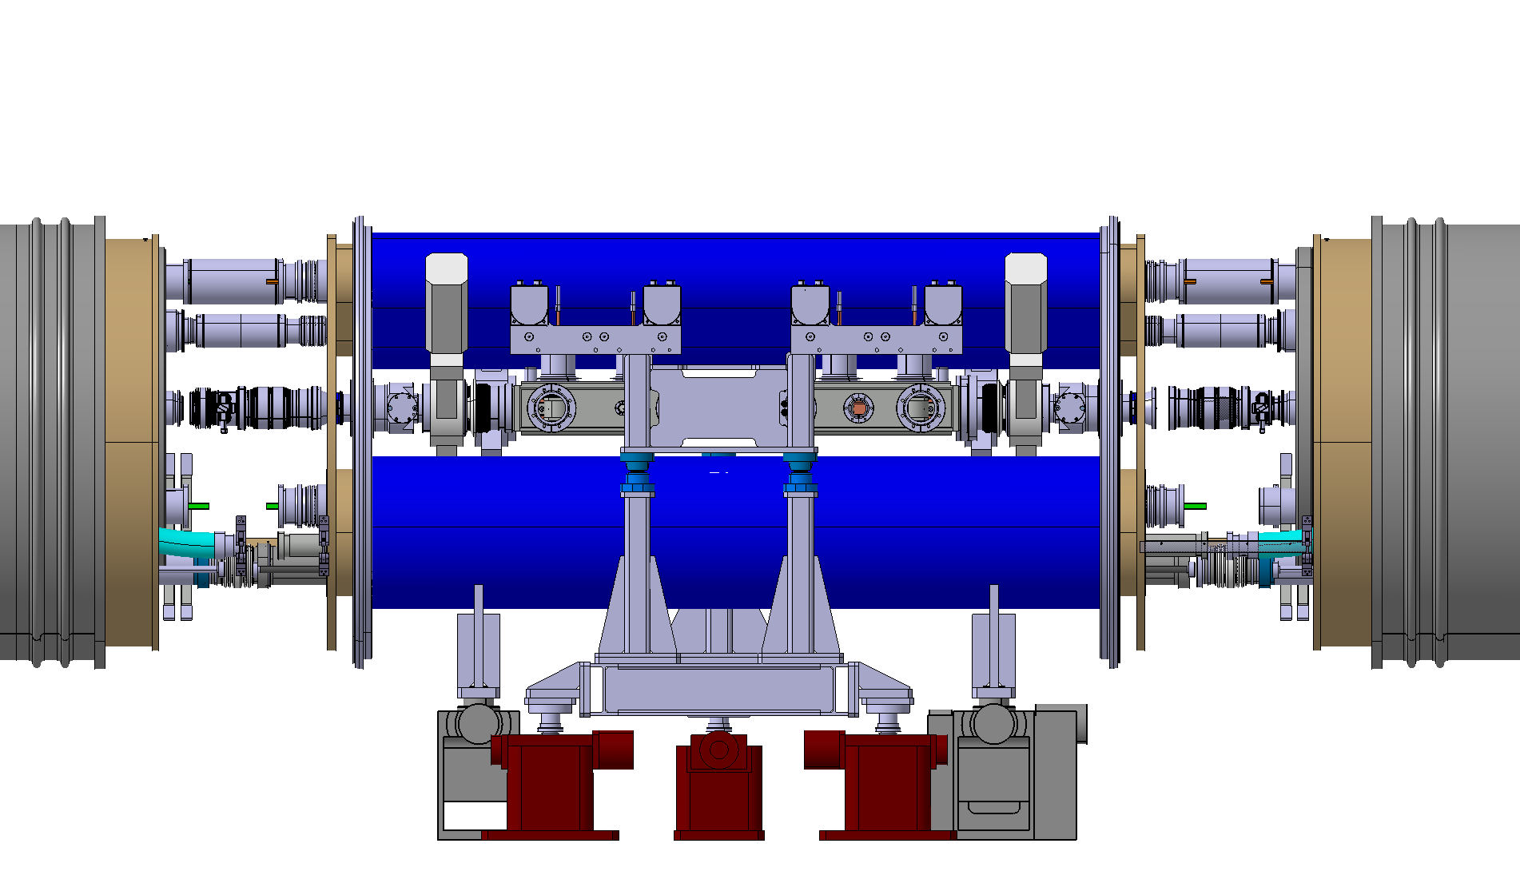
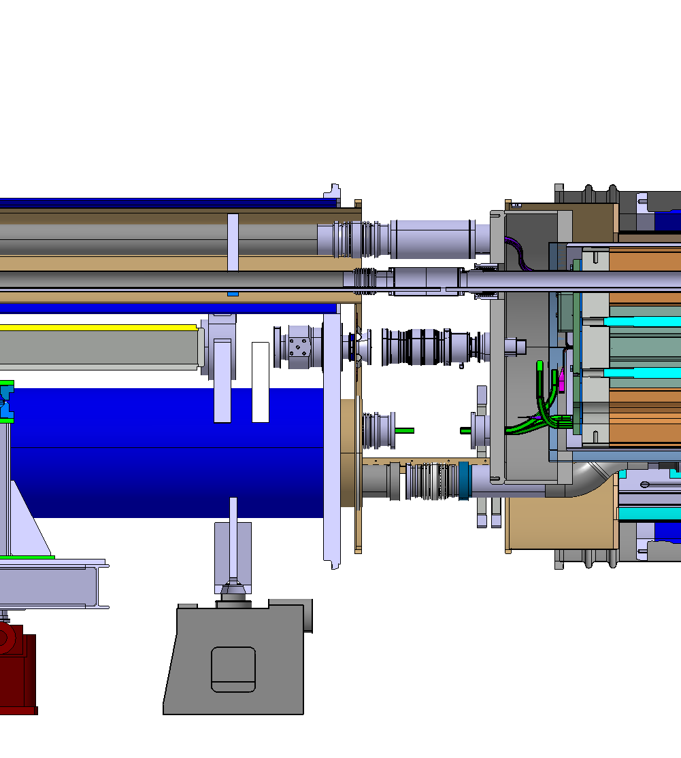
Connection cryostat for collimator integration
Cold mass enlarged to Ø750 on the collimator side
Constant LHC arc outer flange diameter: Ø1055
Flexible interconnects for alignment independency and thermal contraction
Interconnects use standard components and tooling despite the new compact layout
Collimator support jacks
Cryostat support jacks

Slide 6
Interfaces driving the design
X
Y
M2
M1
V2
V1
K2
K1
M3
N
E
C’
W
QRL side

Slide 7
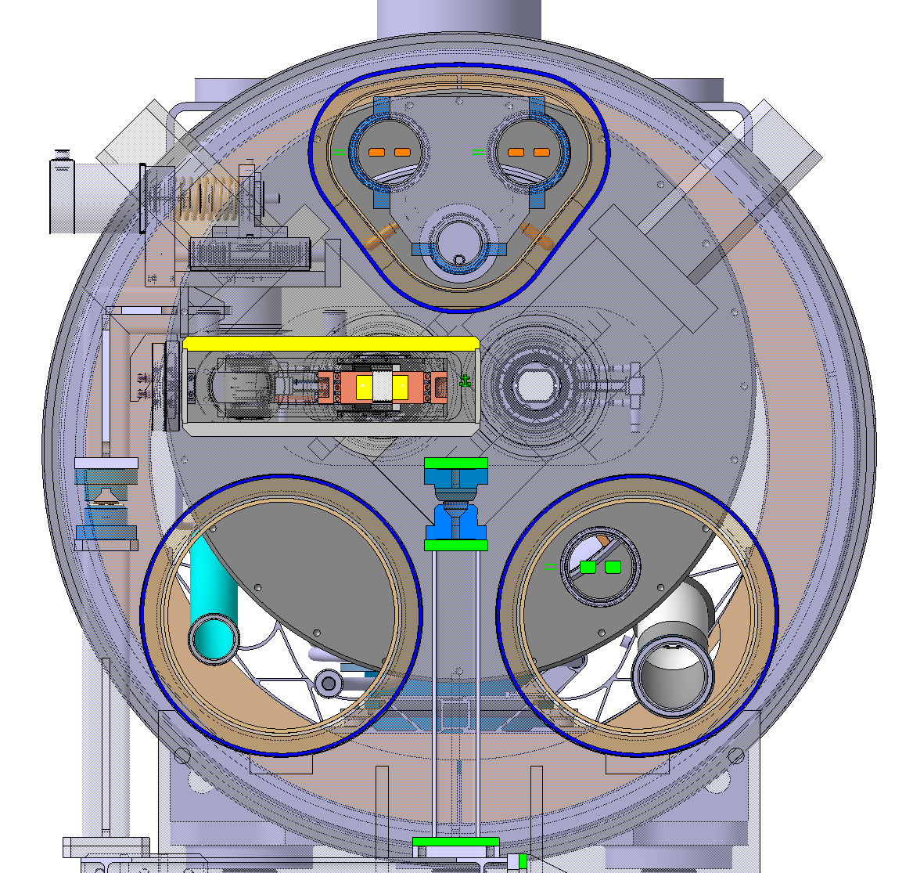
Cross section of the connection cryostat and collimator
Y
X
M2
M1
Dedicated collimator design.
One collimator design fits both beam lines
Larger cold mass extremity to open up space for the collimator
W
M3
Collimator supported directly on the concrete slab
N
E
C’

Slide 8
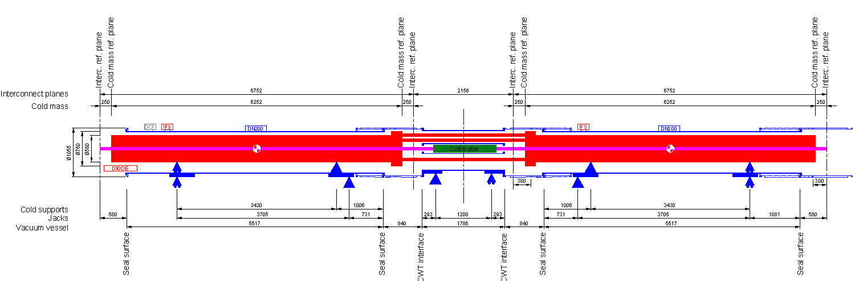
Cryostat support layout
Magnet’s fixed points near the centre: for small contractions at the intermediate interconnects and minimum change wrt replaced MB
Distance between jacks shared with DS magnets Q11, Q10, Q8: 3705 mm
Gives nearly ideal cold foot distance for minimum cold mass deformation: 3430 mm (estimated less than 0.1 mm sag even with a 10 mm thick shell)
W-sleeve on the downstream interconnect cannot be fully open but still acceptable for interconnecting work

Slide 9
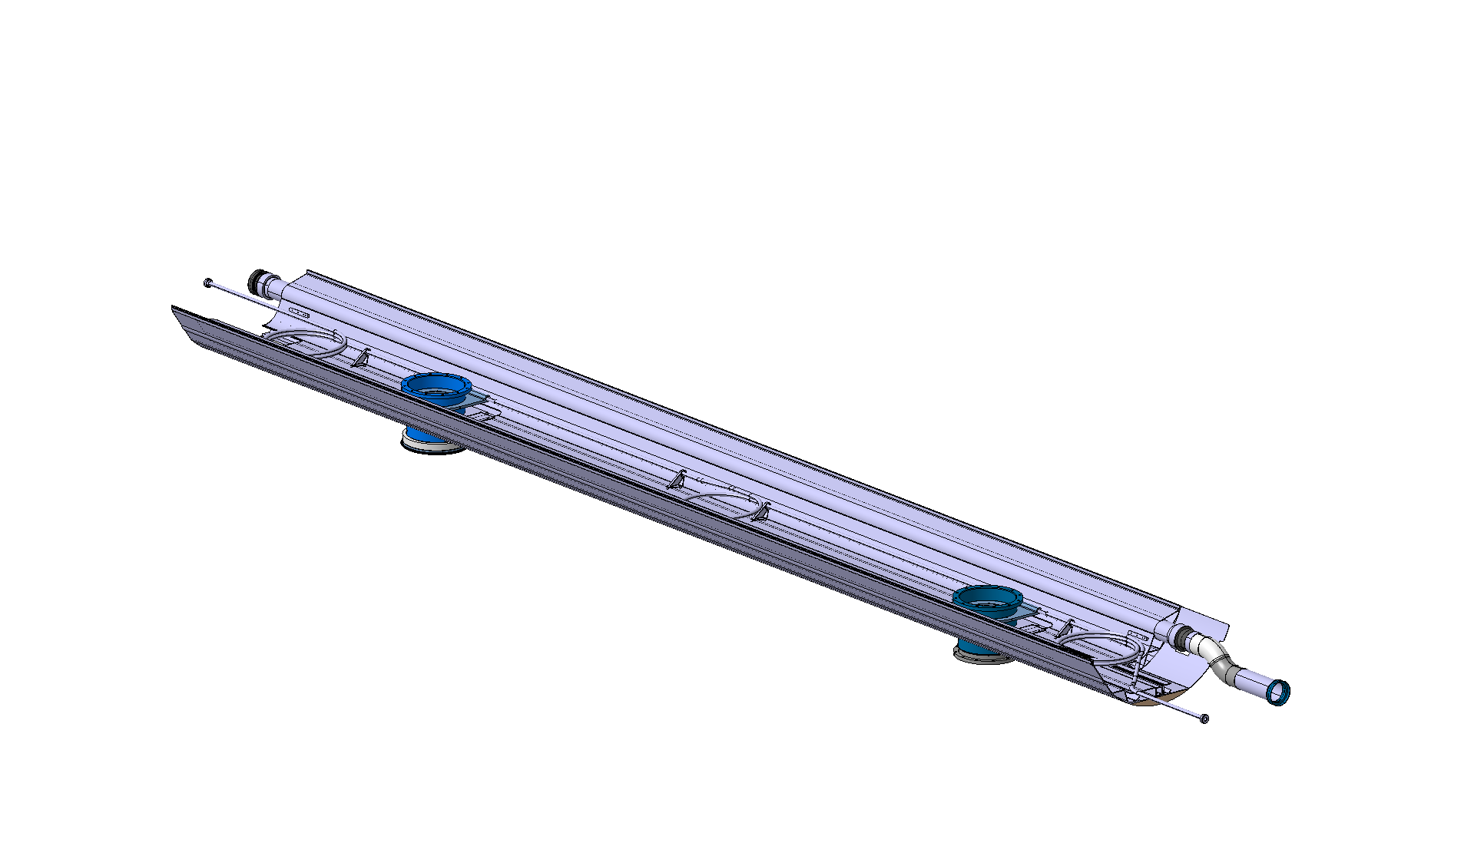
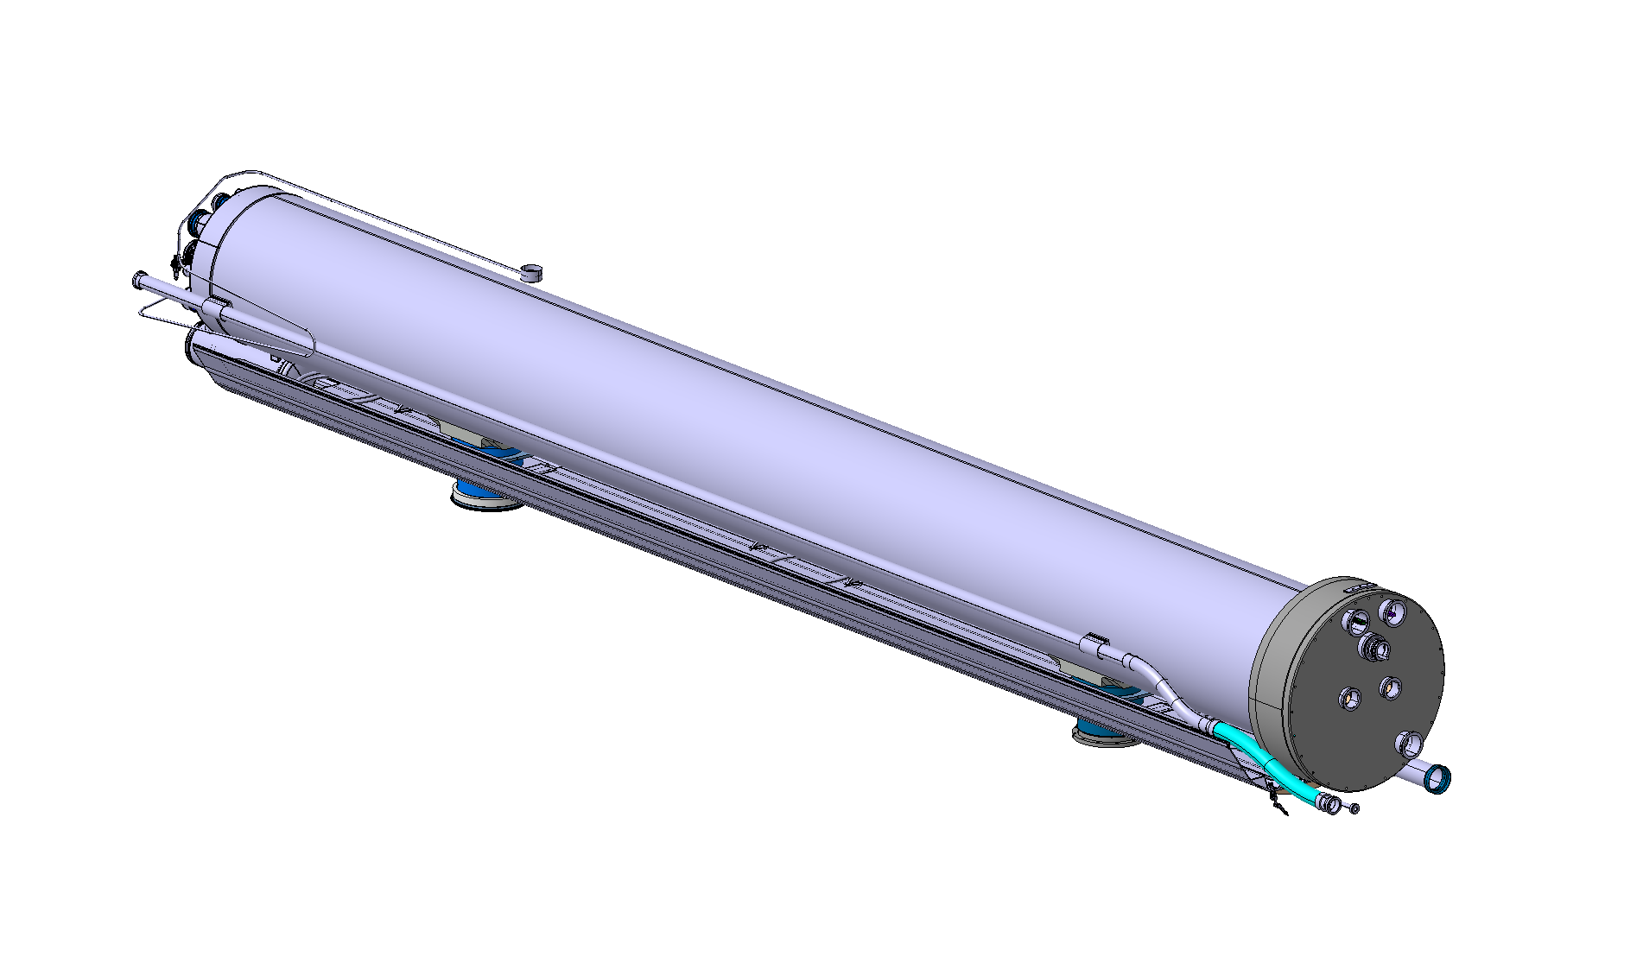
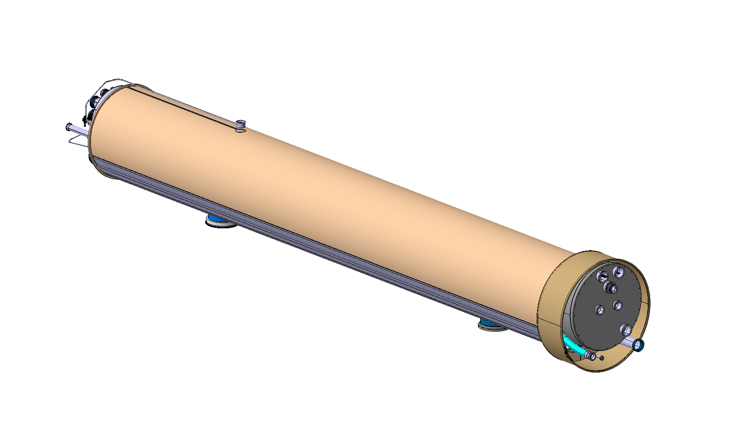
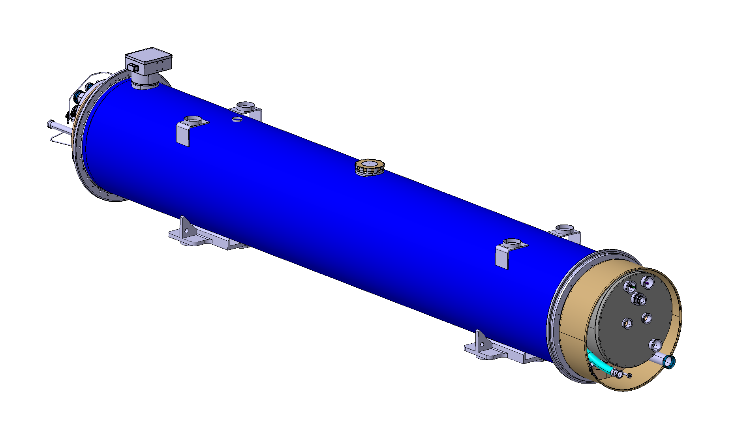
Magnet cryostats
Finished units are not interchangeable but many shared components, including the vacuum vessel.
Follows all LHC cryostat design principles.
1- Pre-assembly of bottom tray, E-line, support posts, C’-line
2- Cold mass and N-line subassembly placed on bottom tray
3- MLI and thermal shield
4- Insertion into vacuum vessel; finishing of instrumentation feedthroughs and current leads

Slide 10
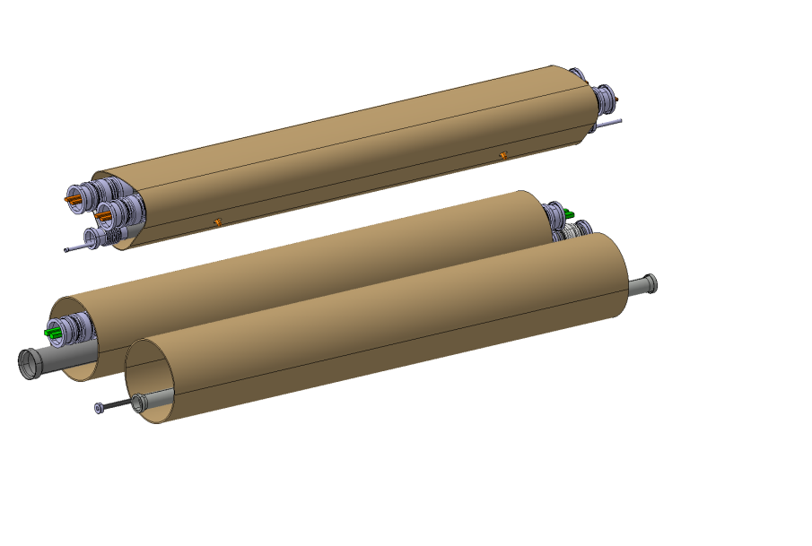
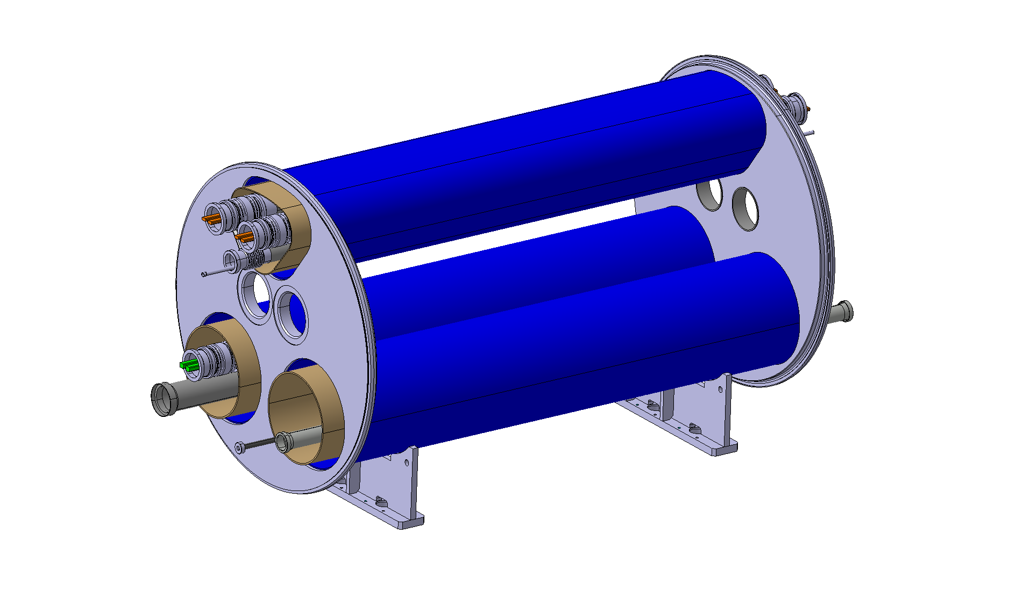
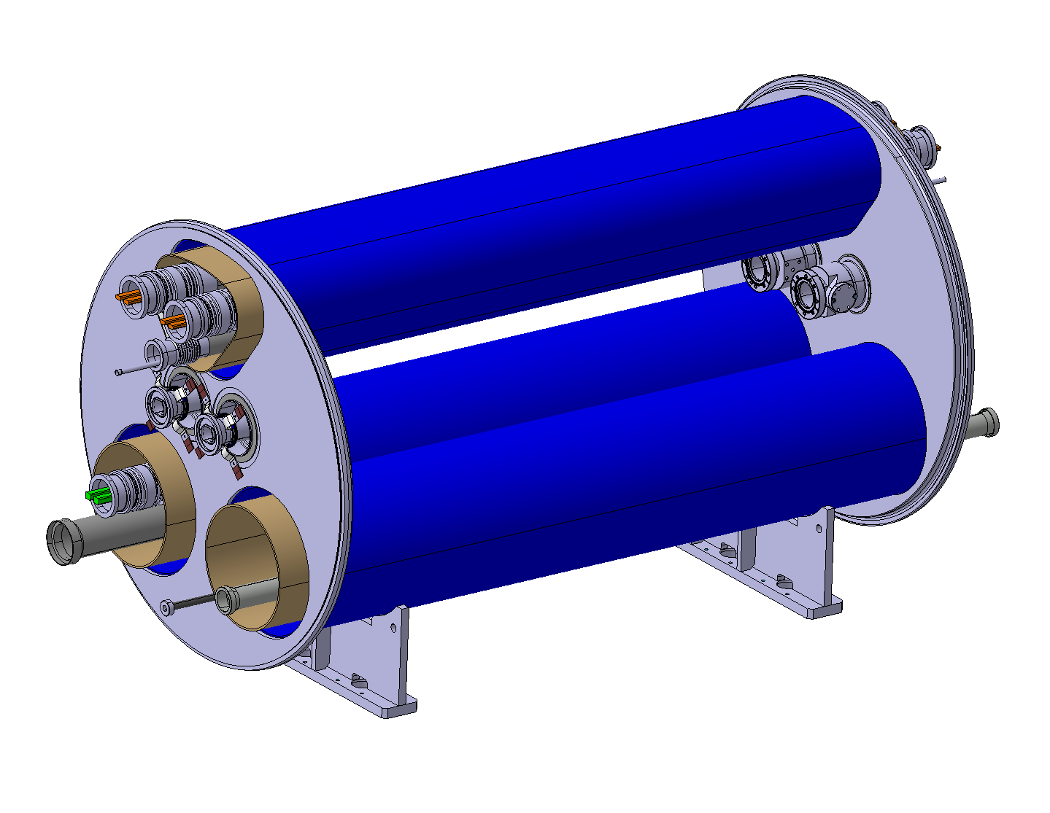
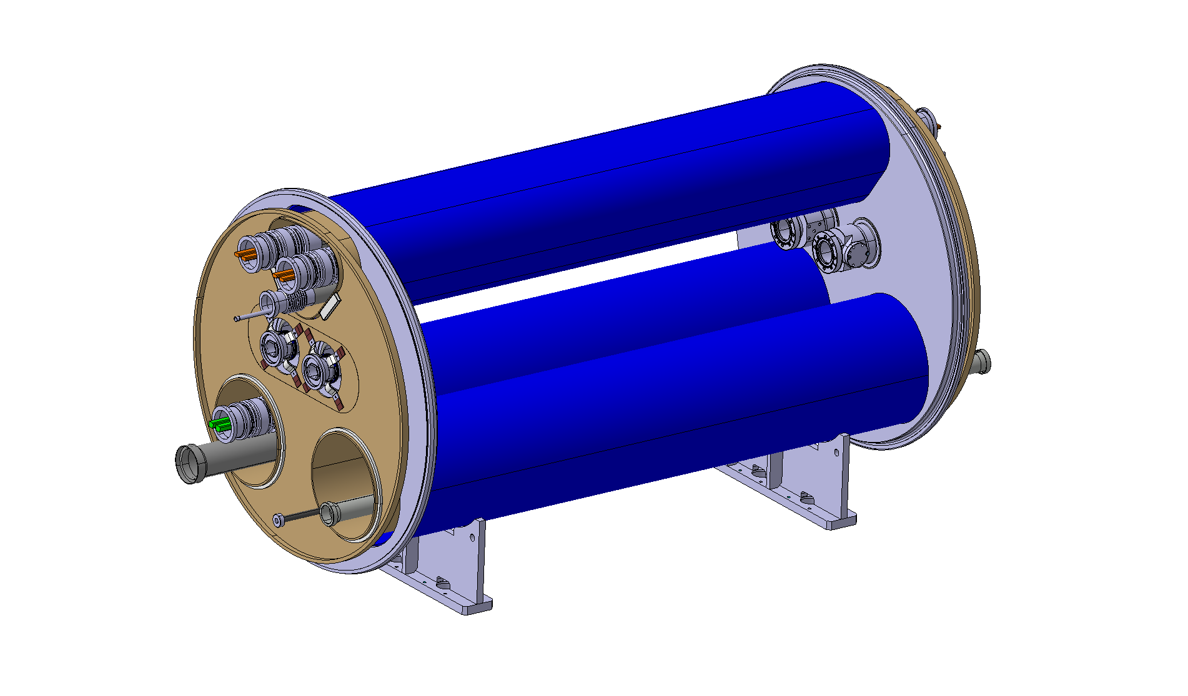
Connection cryostat
Simple vacuum vessel design. Precision machining of interfaces after welding.
1- Pre-assembly of transfer lines comprising piping, busbars, supports thermal shield and MLI (supports to be designed)
2- Insertion of transfer lines into vacuum vessel
3 - Alingment of tranfer lines and welding of cold to warm transitions
4 - Welding of thermal shield front plates and thermalizations

Slide 11
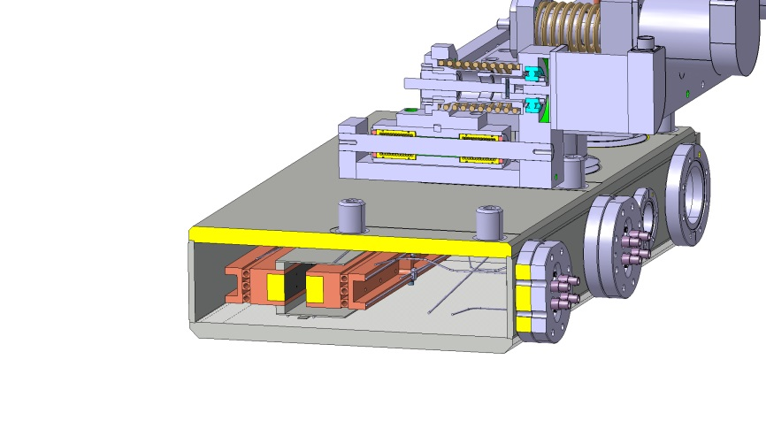
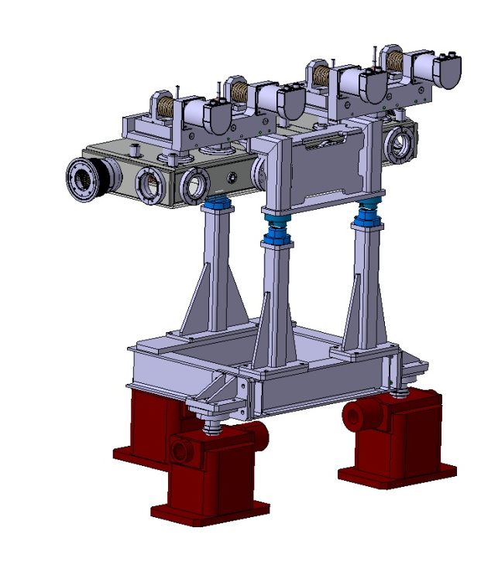
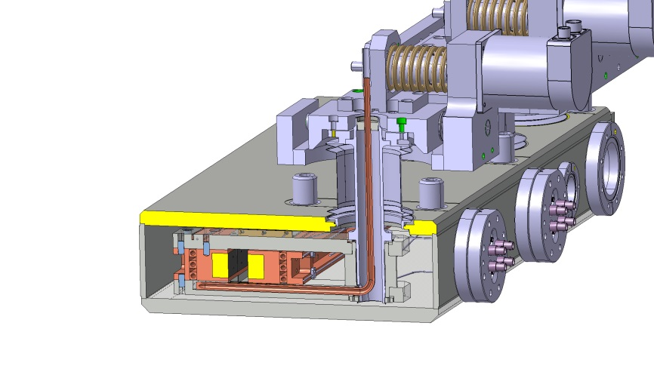
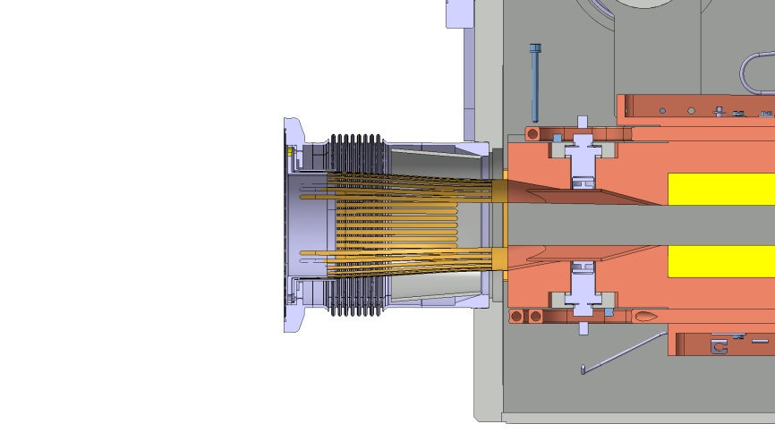
Collimator
New design of actuation system in order to comply with integration constraints
Collimator can be exchanged without re-alignment
Pre-aligned support stand
Based on TCLD design from 2010
BPM buttons
Integrated expansion joint with RF bridge
for alingnment and installation clearance
‘Quick’ CF flange for removal and connection of collimator

Slide 12
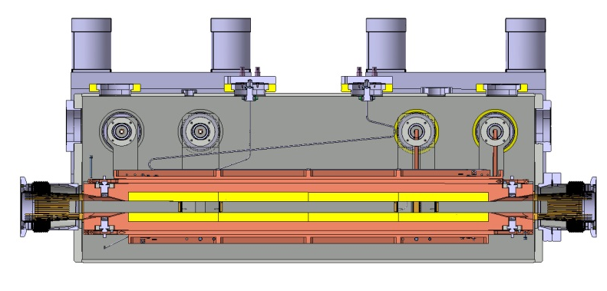
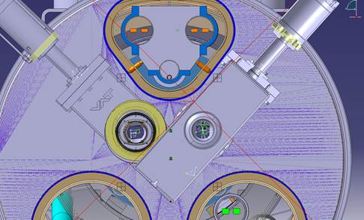
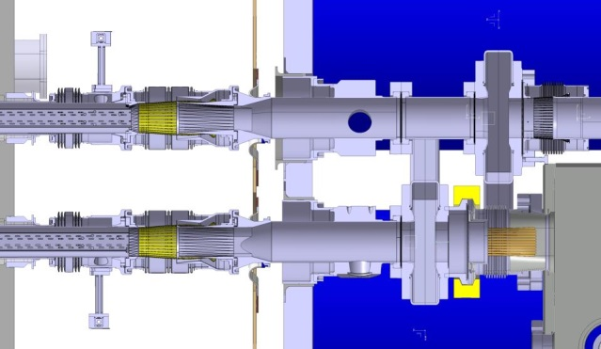
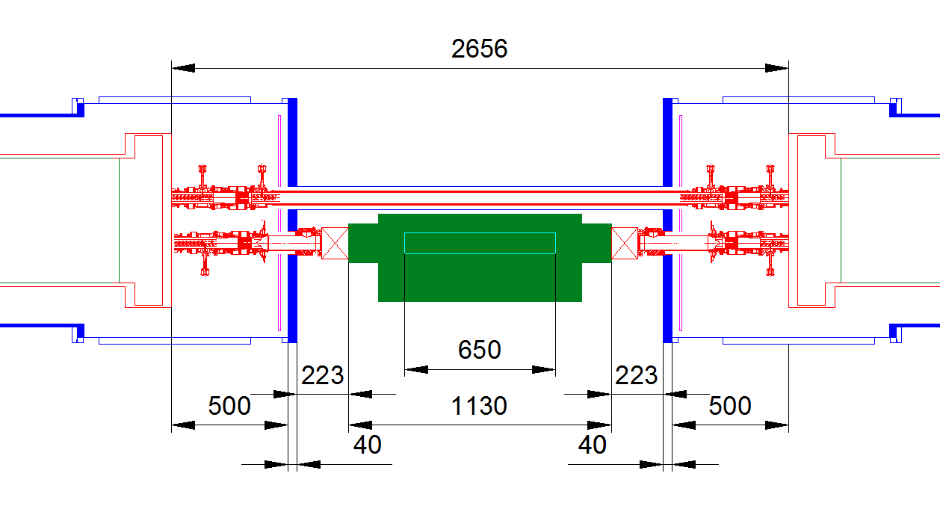
Beam vacuum and collimator length
Active jaw length in tungsten
Option A: Second beam line at room temperature (bakeable)
Sector valve on second beam line cannot be facing the collimator bellows as initially thought
Collimator length: 600 mm jaw (1080 flange to flange)
Total collimator length (active+480 mm)
Option B: Second beam line at 1.9 K
Beamscreen on second line imposes a minimum interconnect length
Collimator length: 650 mm jaw (1130 flange to flange)
Decision and validation to be done with full scale mockups

Slide 13
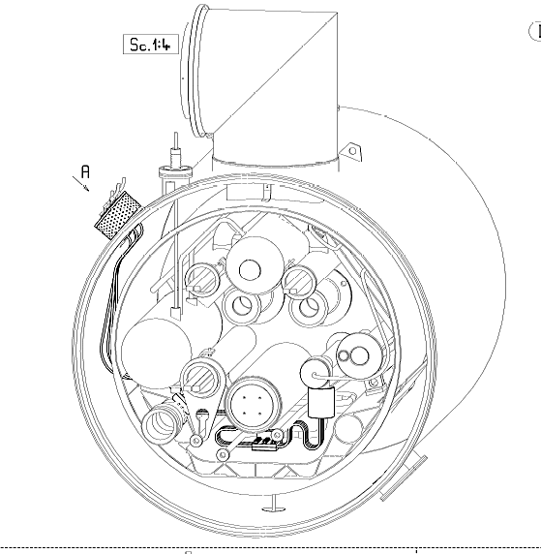
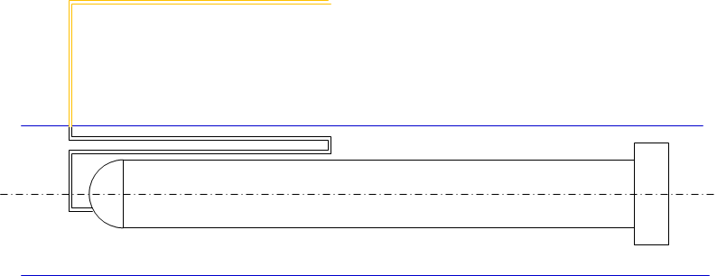
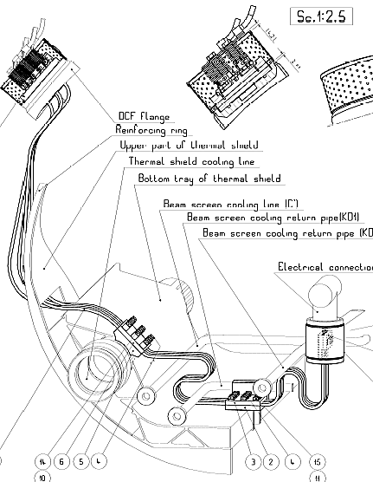
Current leads for the trim circuit
2x 300 A conduction cooled leads
Only one location is possible
Similar to a Dipole Corrector Feedthrough in the SSS (EDMS 328999)
RT copper cables → towards power converter
Integration and design to be started
Gas cooled leads not possible both for lack of space and cryogenics
Conduction cooled leads: about 3.6 W/kA to 1.9 K (c.f. A. Ballarino)
Local solution: applicable everywhere in the LHC

Slide 14
Work in progress
Mechanical and thermal calculations
Magnetic field induced by main busbars
Material selection
Detailed design of components (pipe routing, welding configurations, bellows, supports, etc.)
Connection to cold test bench
Handling and transport interfaces
Assembly breakdown structure, quality control requirements and procurement strategy

Slide 15
Conclusion
Integration has been the main challenge since the beginning of the project.
The present concept of cryostat maximises the length available for the collimator and room temperature vacuum equipment.
The integration of the current leads for the trim circuit are the next challenge. We are confident that it can be done, but this may no longer allow a single vacuum vessel design for both magnets.
The magnet cryostats follow the LHC design basics.
One configuration designed to fit all possible locations in the LHC (with local trim).
No changes required to nearby magnets.
Interconnecting work done in the tunnel takes advantage of existing procedures thanks to many LHC standard components and tooling.

Slide 17
Heat loads
Additional heat loads to 1.9 K with respect to replaced MB cryostat
  One additional magnet support post: 49 mW
  Connection cryostat supports: ~100 mW
  Cold to warm transitions:
    Option warm second beam line (4 CWT): ~8 W
    Option cold second beam line (2 CWT): ~4 W
  Current leads 2x300 A: 2.2 W

Slide 18
The first 11 T cryo-assembly concept
Independently cryostated and handled cold masses, linked through two short transfer lines
Transfer lines with expansion joints mechanically decouple cryostats A and B
Splice and piping interconnect in the tunnel, all other work prior to installation
Can use the existing TCLD collimator design with modified the supports
Independently supported collimator
Line X
11 T cold mass A
11 T cold mass B
Collimator
Lines M, E, N, K, C’
Busbar lyra
Reinforced jacks to widstand vacuum forces
Flexible S-shaped busbar stabiliser
Busbar splice and interconnect done in the tunnel

Slide 19
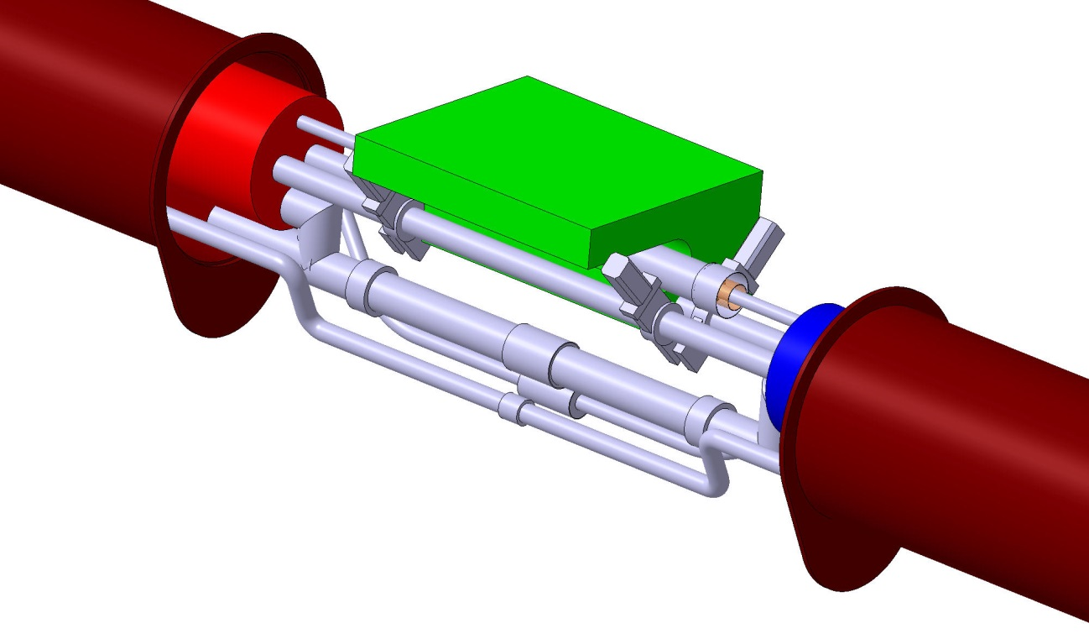
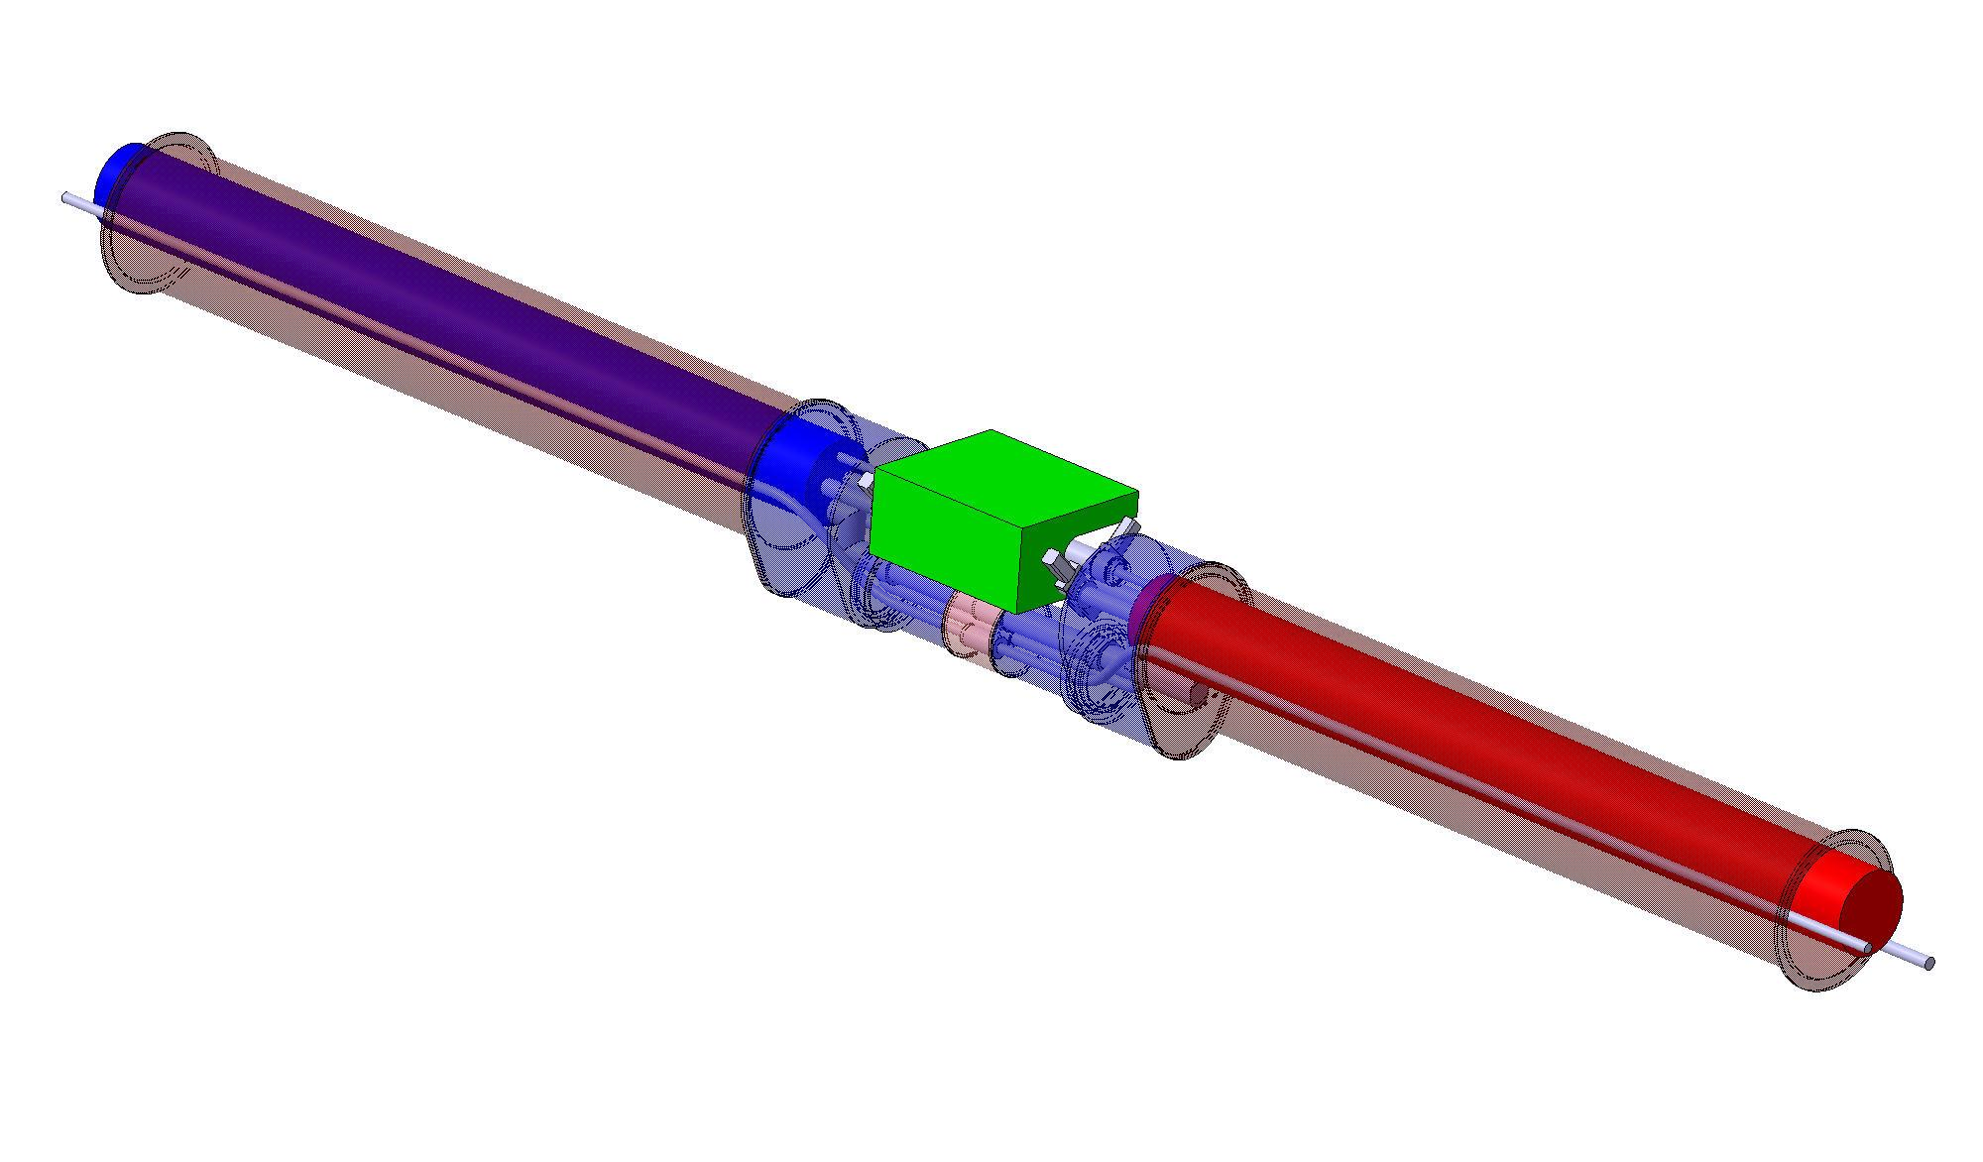
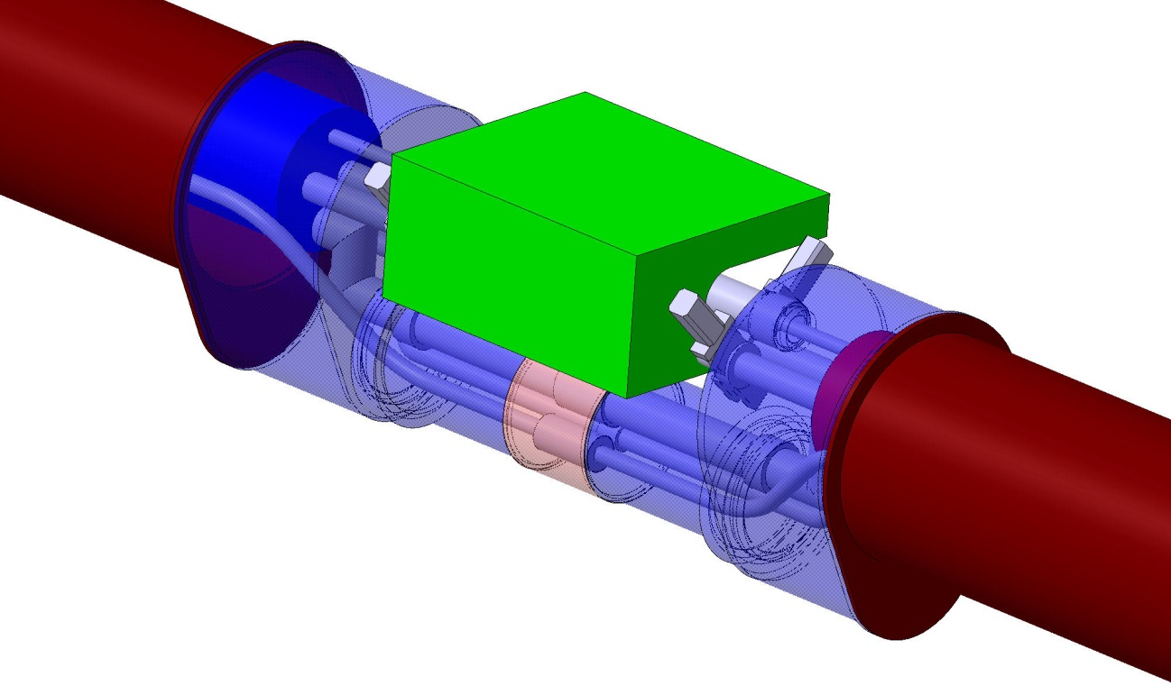
3D Integration

Slide 20
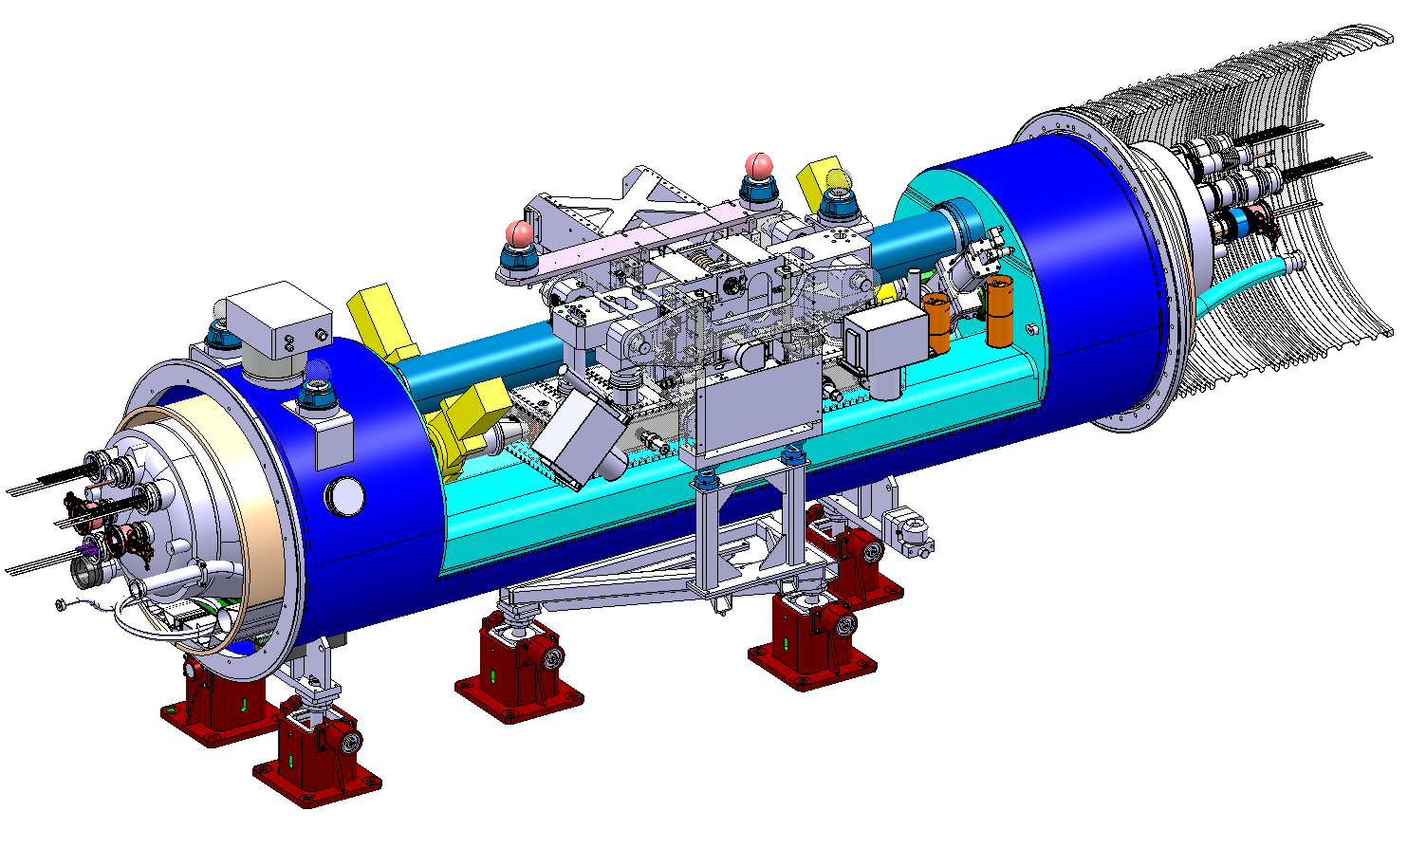
Before the 11 T magnet development: QTC (2010)
Main drawback: extensive machine layout changes to create space
4.0 m + 0.5 m interc. = 4.5 m installation length

Slide 21
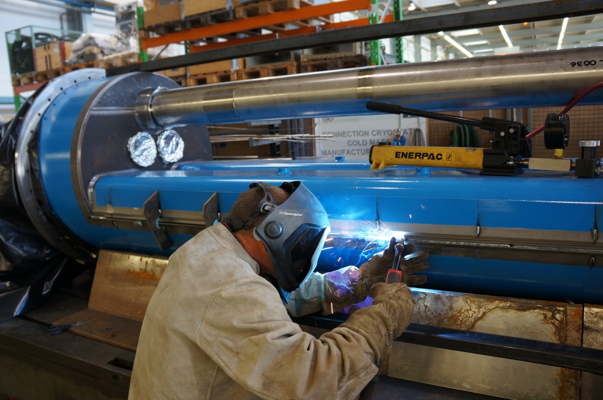
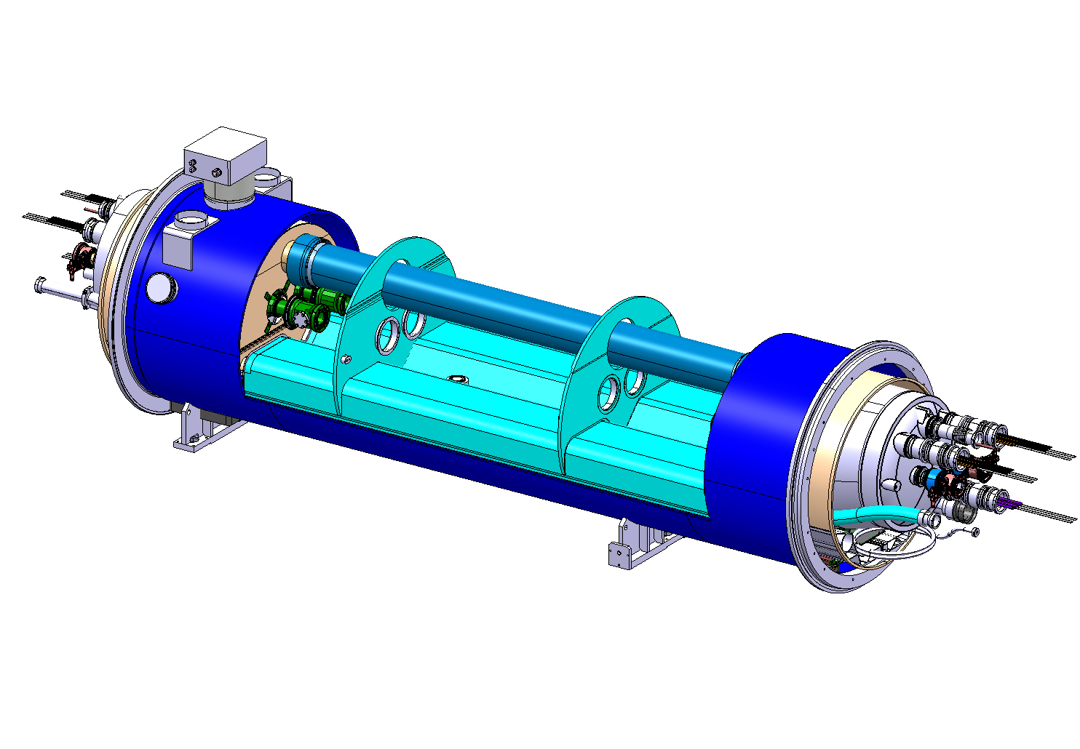
Could the QTC cryostat concept be “extended”?
Can only be finished after cryostating
Dealing with welding distortions is a major issue
  Distortions amplified with length
  Adjustment of cold supports posts is required
  Complicated assembly procedure
Cover closure w/ fillet welds
New approach needed
Longitudinal butt-welds

