Slide 1
Cold powering test results of the 11 T cosθ model magnets at CERN
Gerard Willering
With thanks to Jerome Feuvrier, Vincent Desbiolles, Hugo Bajas, Marta Bajko for the work on the tests and Susana Izquierdo Bermudez and David Smekens for providing feedback with the design data
Many thanks to all the persons that delivered the magnets with all its instrumentation for the test

Slide 2
Overview cold powering tests for the DS11T project so far.
With the LARP collaboration with COSθ coils
One single coil mirror configuration
Three single aperture configurations
See presentation by A. Zlobin
Racetrack coils
- SMC double racetrack coils
- RMC single racetrack coil
See presentation by H. Bajas
At CERN 2 COSθ coil tests
- June 2014 – Single coil (MBHSM101)
- November 2014 – Single aperture (MBHSP101)
This talk will cover the test results on the CERN built and tests COSθ coil tests. For magnetic measurements see presentation by L. Fiscarelli.
Note that most of the data is acquired in the last 3 weeks, so the analysis is still fresh
2014-12-09 - 2nd international review HL-LHC 11 T dipole
Gerard Willering – Cold powering tests 11T model coils at CERN

Slide 3
Content
Powering tests of the MBHSM101 and MBHSP101
Training and quench locations
Weak locations in coil 107
Holding current test
Quench heater efficiency test
Voltage threshold for protection and flux jumps
Summary
2014-12-09 - 2nd international review HL-LHC 11 T dipole
Gerard Willering – Cold powering tests 11T model coils at CERN

Slide 4
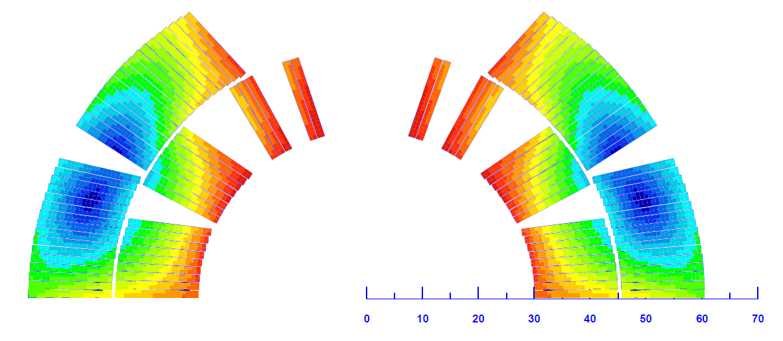
Training in the single coil HCMBHSM101- coil 105
Initial training 4.3 K mainly around the pole, but spread around
Initial training 1.9 K mainly in outer block 6 and a few in inner block 1
Slight detraining after the thermal cycle for 1.9 K, not for 4.3 K.
Conclusion
The training is rather random without real ‘weak spots’
No major memory loss
6
1
Roxie image by
S. Izquierdo Bermudez
2014-12-09 - 2nd international review HL-LHC 11 T dipole
Gerard Willering – Cold powering tests 11T model coils at CERN

Slide 5
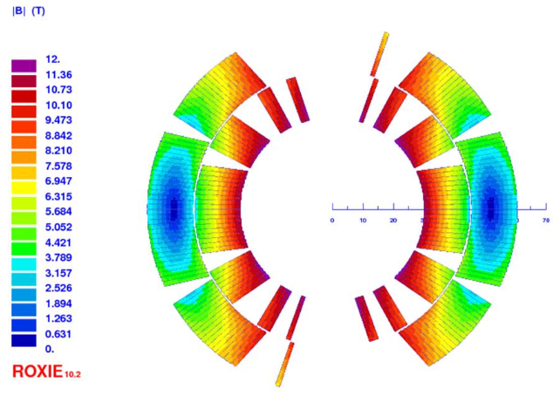
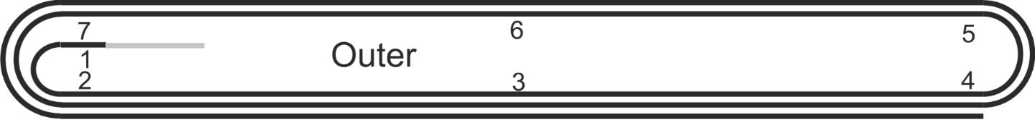
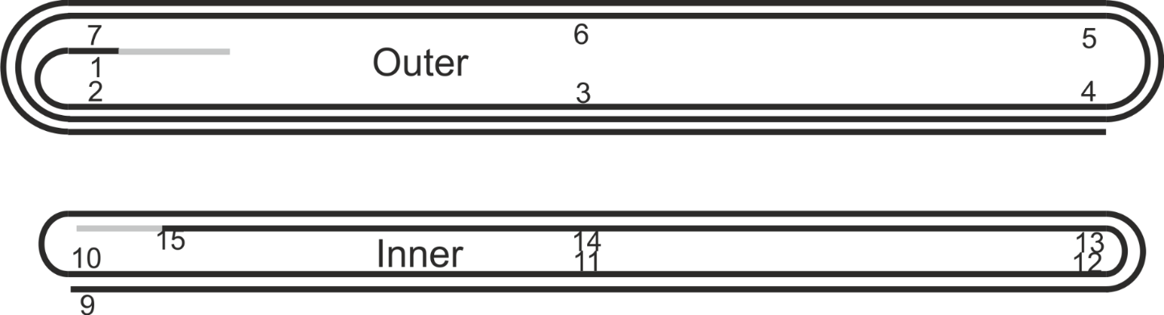
Training in the single coil MBHSP101- coil 106-107
Initial training in the single aperture at 1.9 kA
4 quenches initiated in coil 106, no more quenches from 10.6 to 11.9 kA!!
Initial training looks OK for coil 107 except for 2 specific spots.
Target of 11.85 kA is reached.
S. Izquierdo Bermudez
Initial training
Location | # quenches
Coil 106 | 4
Coil 107 at O1 | 7
Coil 107 inner layer pole head | 6
Coil 107 around I12 | 1
2014-12-09 - 2nd international review HL-LHC 11 T dipole
Gerard Willering – Cold powering tests 11T model coils at CERN

Slide 6
Detraining or possible degradation in the single aperture at 1.9 K
The detraining and quenches around voltage tap O4 are remarkable in quench 19 to 22
A strong detraining quench followed in quench 24.
S. Izquierdo Bermudez
Quench 19 to 22 | Outer layer, close to Vtap O4
Quench 23, 25 | At Vtap O1
Detraining 24 (50 A/s) | Close to Vtap I12
2014-12-09 - 2nd international review HL-LHC 11 T dipole
Gerard Willering – Cold powering tests 11T model coils at CERN

Slide 7
After thermal cycle at 1.9 K
Quench 26 to 31 at 1.9 K show a rather limited quench current, always quenching in the same location.
Apparently the coil was degraded after thermal cycle for 6 quenches, but after the tests at 4.3 K the quench level increased to 11.76 kA.
All quenches from quench 25 at 1.9 K in O1
2014-12-09 - 2nd international review HL-LHC 11 T dipole
Gerard Willering – Cold powering tests 11T model coils at CERN
S. Izquierdo Bermudez

Slide 8
4.3 K powering
The lower quench current at 4.3 K at 0.85*I_{ss} is not expected.
At 10 A/s 3 quenches at 11177 ± 4 A with identical quench location and pattern.
The quench at 50 A/s occurred at 11095 A with similar quench pattern.
Quench location is at voltage tap O2
2014-12-09 - 2nd international review HL-LHC 11 T dipole
Gerard Willering – Cold powering tests 11T model coils at CERN
S. Izquierdo Bermudez

Slide 9
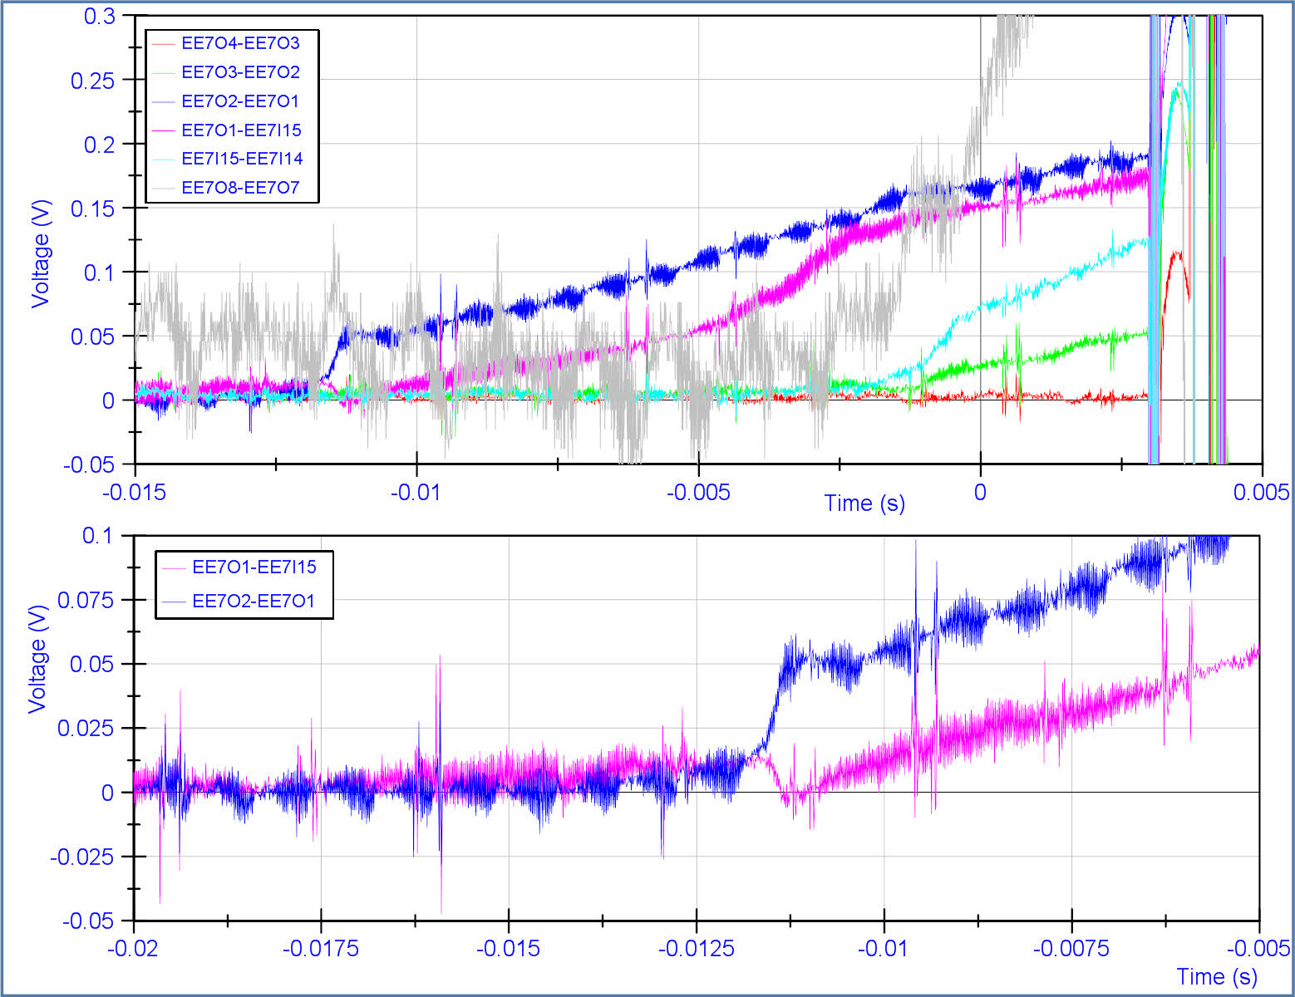
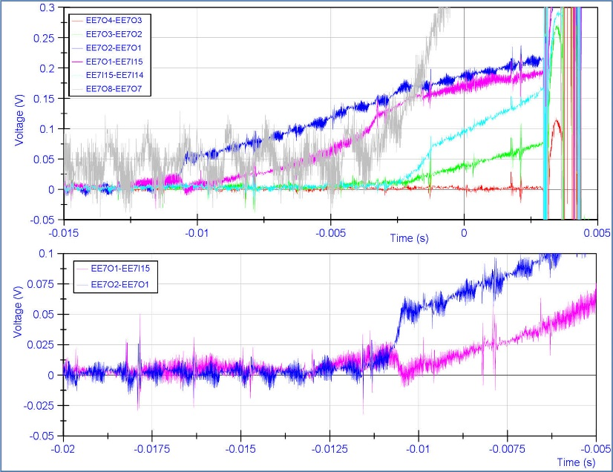
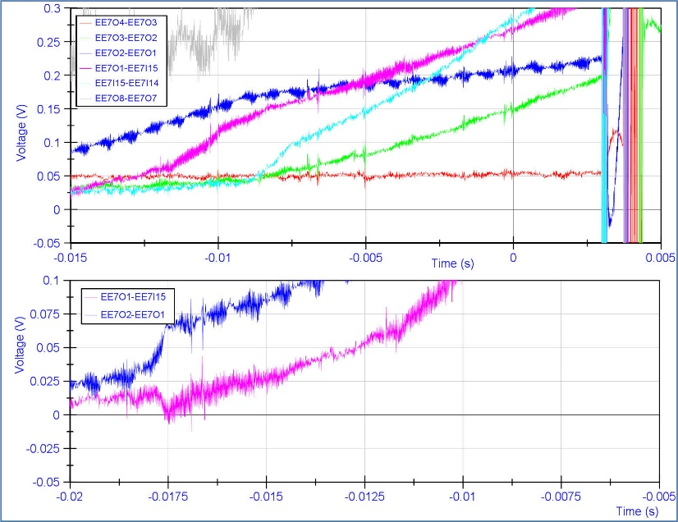
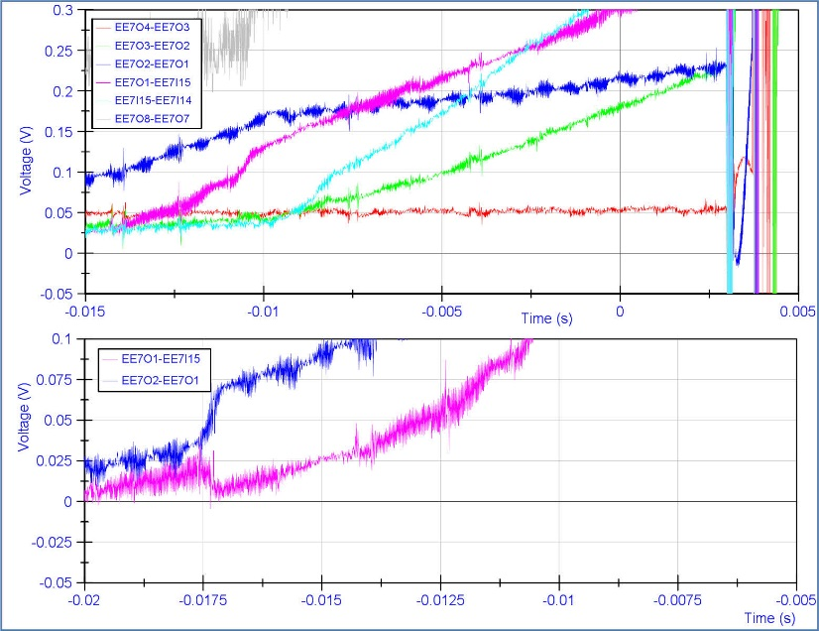
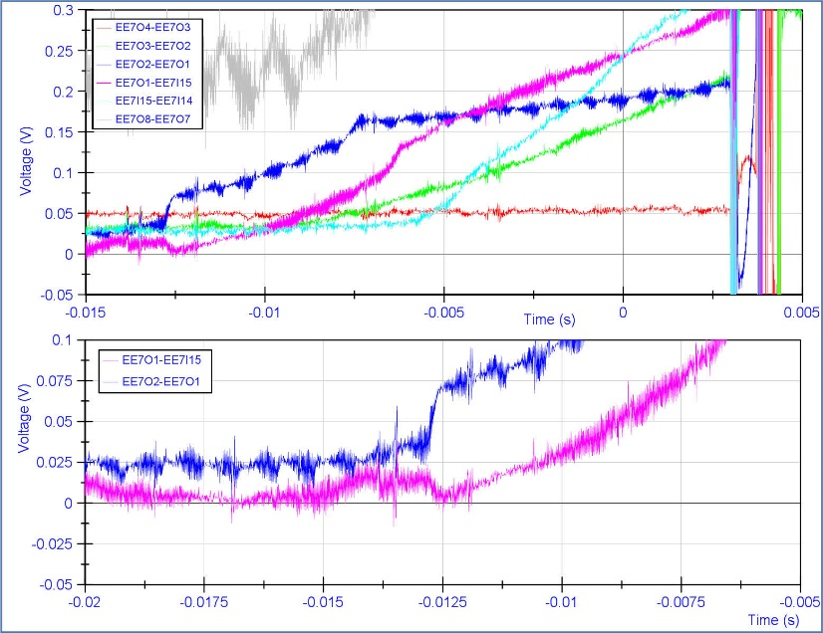
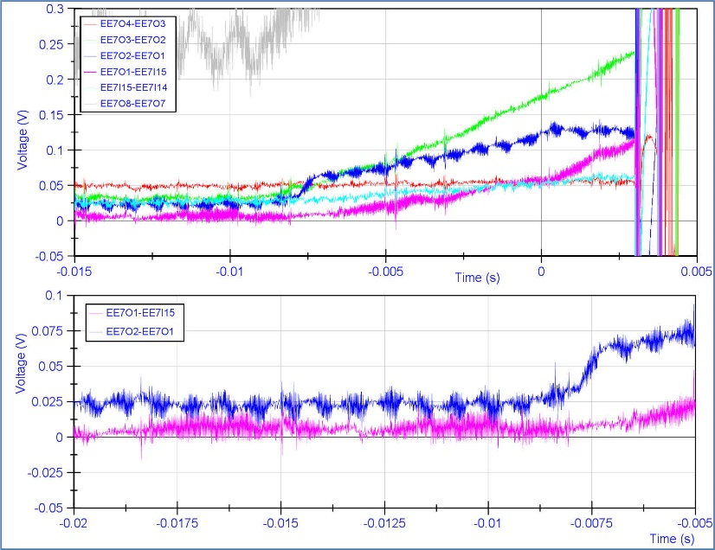
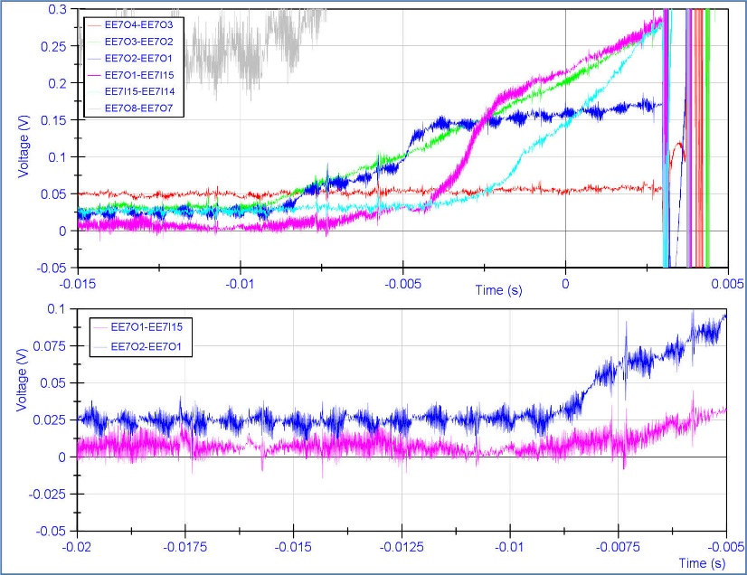
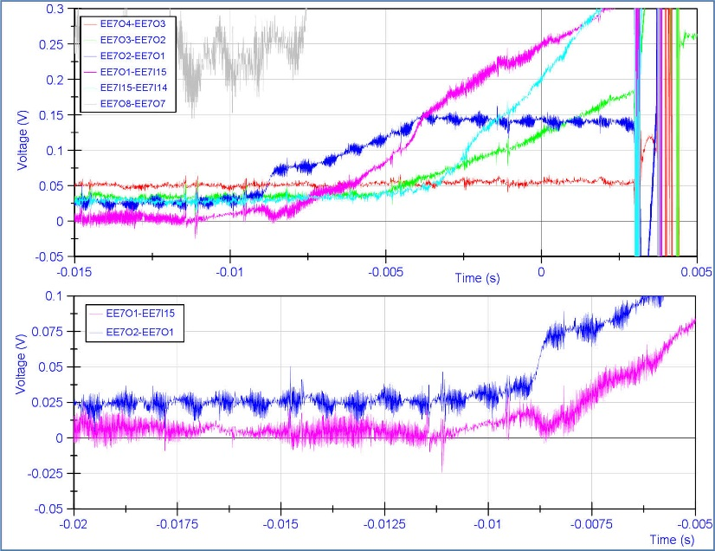
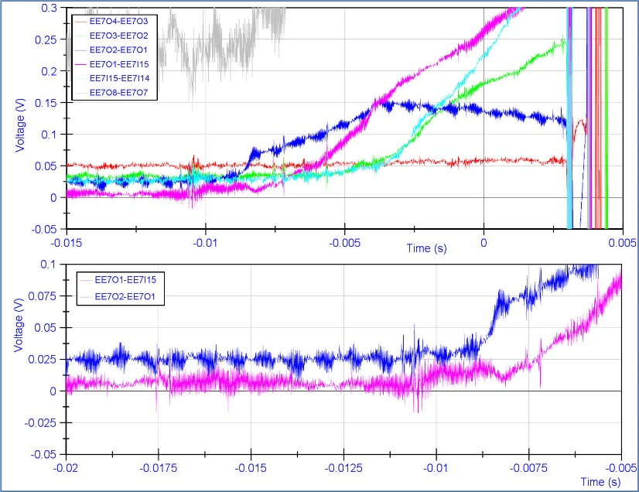
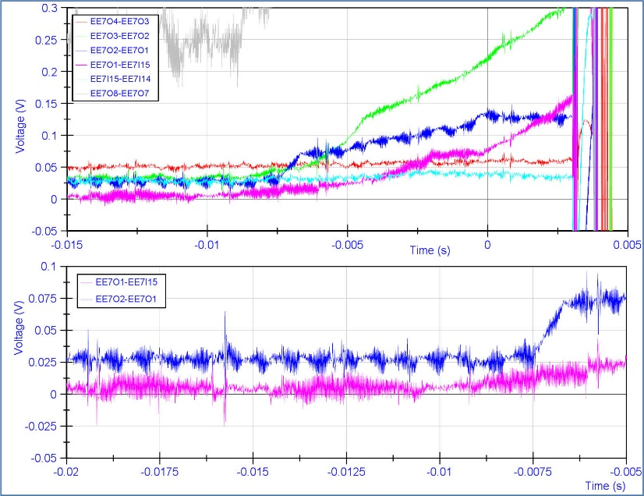
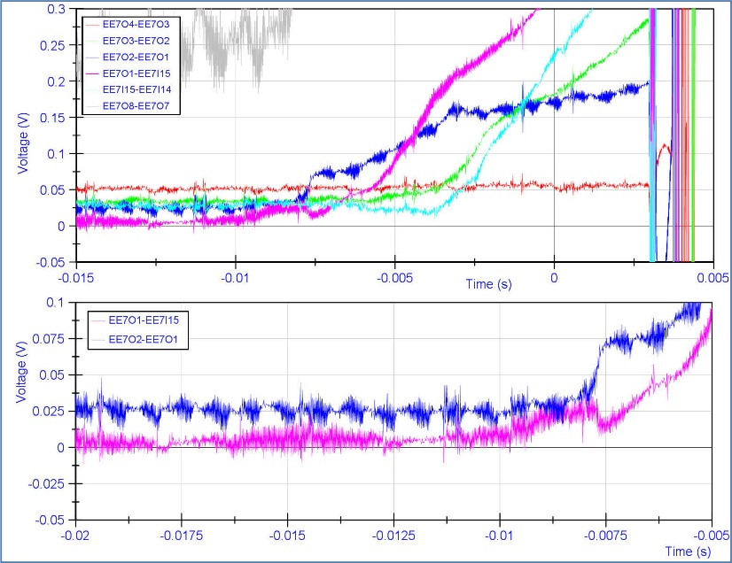
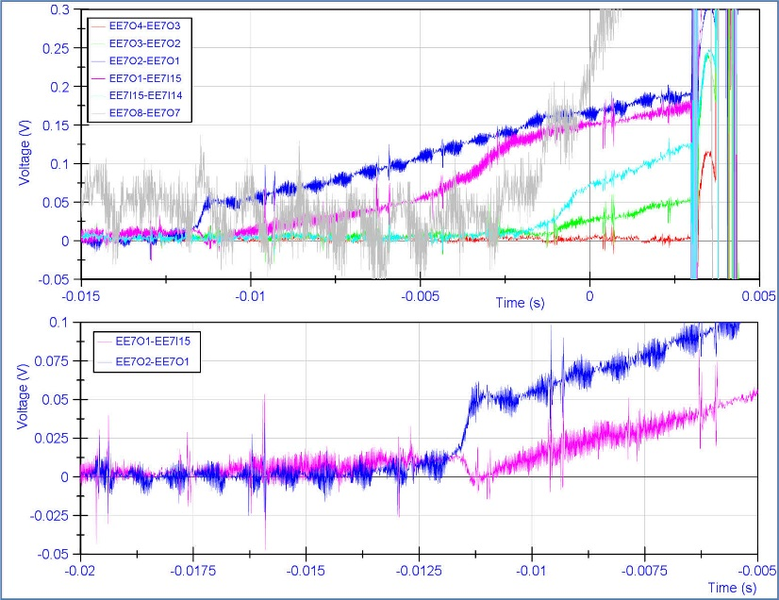
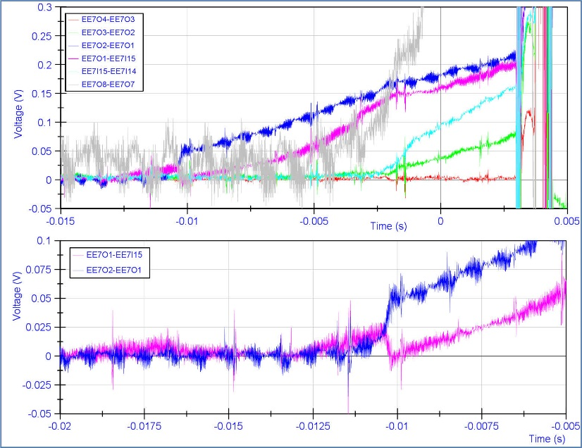
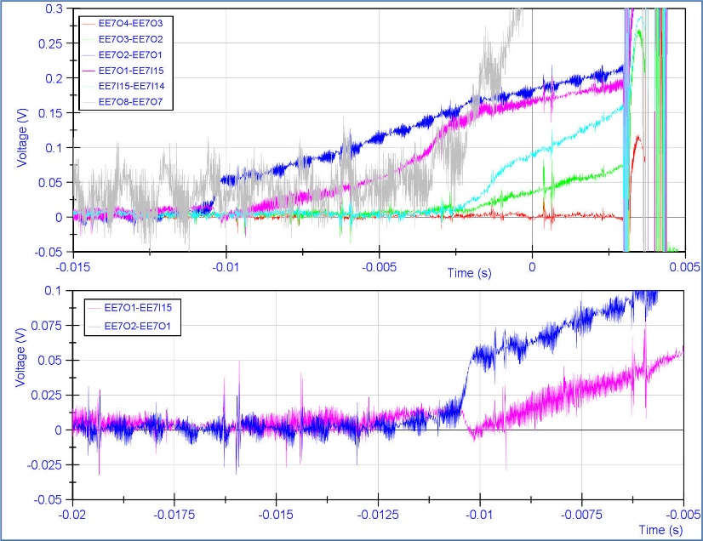
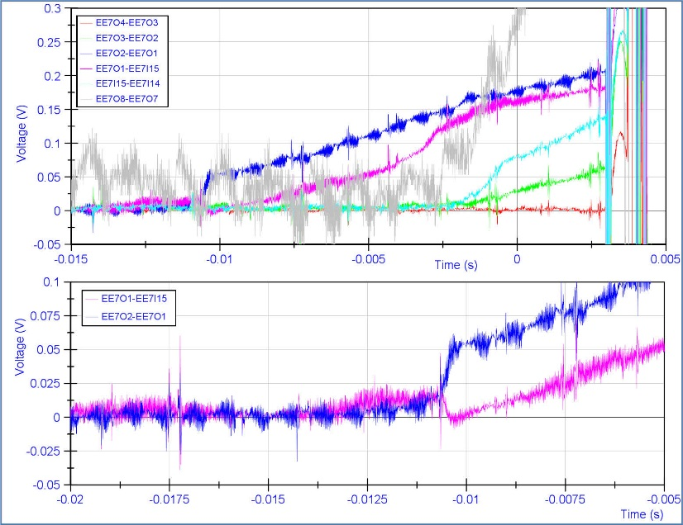
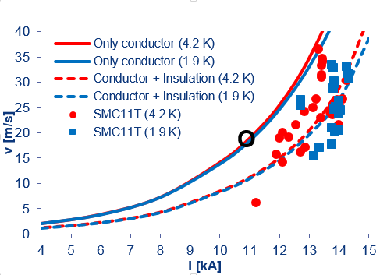
Quench localization tools
Clear propagation of quench into the next segments
O2-O3 8.4 ms
I14-I15 8 ms
Both segment lengths are 15 cm
Quench propagation velocity 18 – 19 m/s at 10.8 kA in the high-field zone.
Voltage signal suspicious
More data to be extracted. Preliminary data is shown below with respect to data from SMC (H.Bajas) and calculations (S.Izquierdo Bermudez), see the respective talks.
Although there is some time shift, the similar quench pattern is clearly visible.
2014-12-09 - 2nd international review HL-LHC 11 T dipole
Gerard Willering – Cold powering tests 11T model coils at CERN

Slide 10
Training MBHSP101 and MBHSM compared
Short sample limit is calculated by combining calculated loadline (Roxie, see presentation S.Izquierdo) and the measured critical current density of short samples (see presentation Bernardo).
Short sample limit for MBHSM has been passed by 2 %. Variations and calculations errors apply.
Coil 105 has a better performance than coil 107.
Note that coil 106 only showed 4 quenches before reaching 0.82*I_{ss}
2014-12-09 - 2nd international review HL-LHC 11 T dipole
Gerard Willering – Cold powering tests 11T model coils at CERN

Slide 11
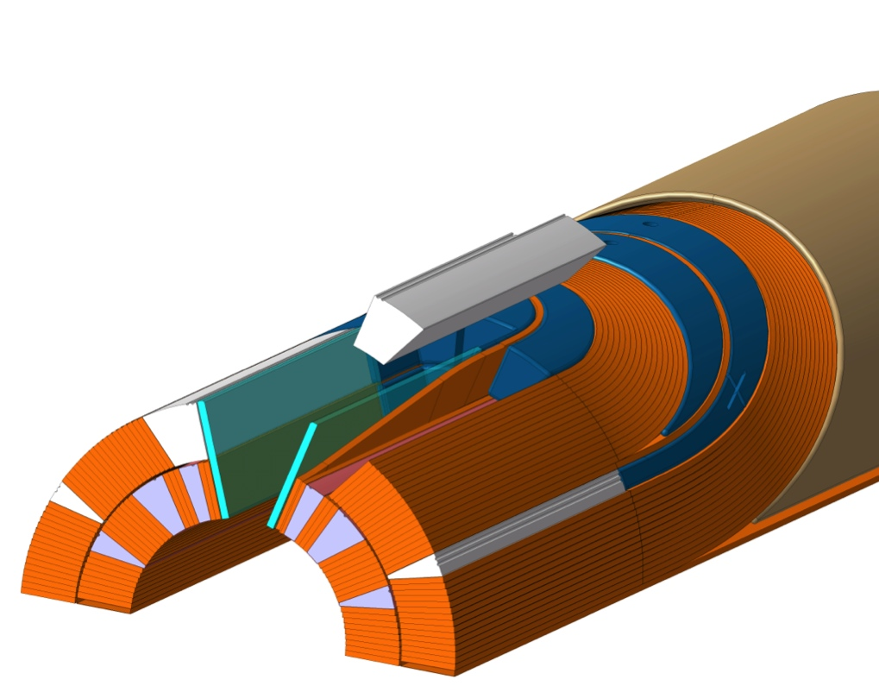
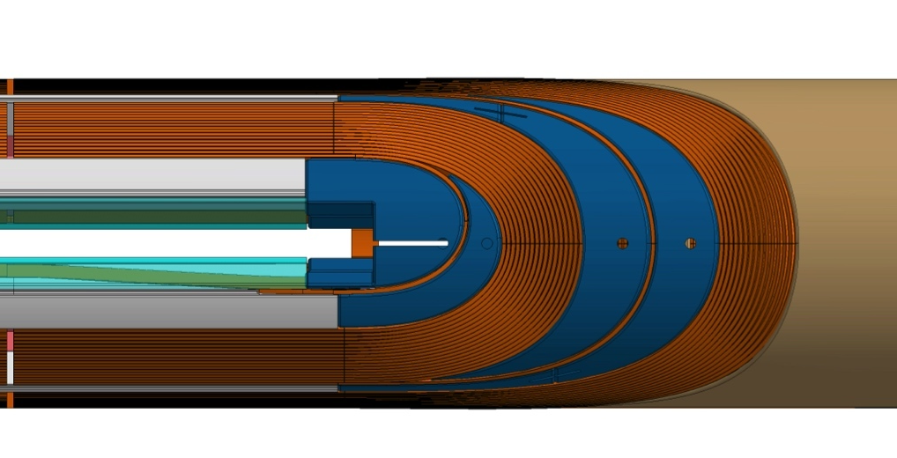
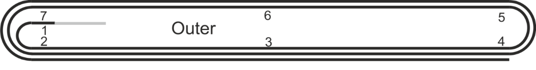
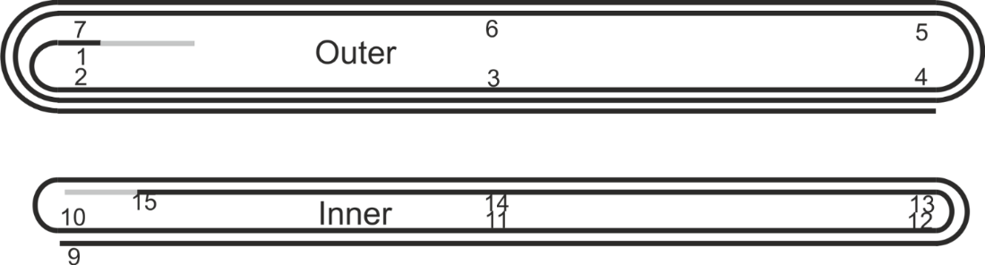
Summary of weak locations in coil 107
At voltage tap O1, just out of the layer jump.
    7 quenches during initial training
    Limiting point later on at 1.9 K
At voltage tap O2, opposite of O1.
  Limiting point at 4.3 K
Around voltage tap I12, close to the pole head with 6 training quenches and detraining.
X
1
Images courtesy N.Peray and D. Smekens
2
1
X
X
X
X
2
1
3
2014-12-09 - 2nd international review HL-LHC 11 T dipole
Gerard Willering – Cold powering tests 11T model coils at CERN

Slide 12
Ramp rate dependency
No ramprate effect recorded up to 80 A/s at 1.9 K up to nominal current.
Up to 80 A/s – no quench
50 A/s – no quench
50 A/s - Quench
The detraining quench (23) at 10.4 kA at 50 A/s, the others were at 10 A/s. Afterwards during the same day, the current was ramped up to 11.25 kA multiple times with a ramp rate of up to 80 A/s without quench.
The detraining quench has a similar signature as the other (detraining) quenches, so at this level of current (0.72*I_{ss}) we can conclude that there is no repetitive ramp rate effect.
Also the last quench at 11.76 kA was at 50 A/s.
Detraining at 50 A/s
2014-12-09 - 2nd international review HL-LHC 11 T dipole
Gerard Willering – Cold powering tests 11T model coils at CERN

Slide 13
Holding current tests
Single coil MBHSM101 – coil 105
40 minutes at 15 kA at 1.9 K.
(trip after 40 minutes due to warming of the Cu current leads)
Single aperture MBHSP101 – coil 106-107
30 minutes at 11.3 kA
followed by 30 minutes at 11.5 kA
Followed by quench during ramp at 11.6 kA
In both cases no holding quench occurred.
2014-12-09 - 2nd international review HL-LHC 11 T dipole
Gerard Willering – Cold powering tests 11T model coils at CERN

Slide 14
Quench heater efficiency tests
Quench heater efficiency test, test station point of view
Test sequence
Provoke heater discharge manually at the desired current
Detect the heater provoked quench
After a set delay, switch in the energy extraction.
Energy extraction
Direct data that can be extracted from the current decay in the magnet are
MIIts
Time constant of current decay
Total circuit resistance (including dump resistance)
10 kA, 1.9 K
2014-12-09 - 2nd international review HL-LHC 11 T dipole
Gerard Willering – Cold powering tests 11T model coils at CERN

Slide 15
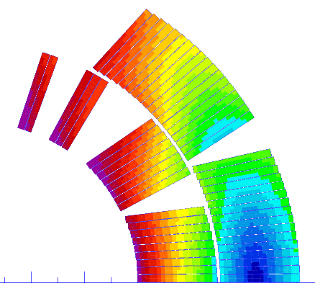
Resistance growth in the coils
Outer layer quench heaters only
MBHSP101
Outer layer blocks
Resistance growth in the coils at 10 kA, 1.9 K, quench heaters on blocks 5 and 6.
I_{QH} = 150 A.
The peaks at 90 ms correspond to the opening of the energy extraction.
Coil 106 contributes about 2 times more to the resistance than coil 107, due to difference in quench heater insulation.
6
4
Inner layer blocks
3
2
5
The contribution of the inner layers is measured clearly. It will form the base for model validations.
1
S. Izquierdo Bermudez
See for calculations of QH efficiency and protection studies the presentation by S. Izquierdo
2014-12-09 - 2nd international review HL-LHC 11 T dipole
Gerard Willering – Cold powering tests 11T model coils at CERN

Slide 16
Quench heater efficiency testing
In case of a natural quench quench heater firing is about 16 ms after the start of the normal zone with the current setup.
This will give for example 1.6 MIIts at 10 kA.
T | I | MIIts | T_hotspot
K | kA | MA²s | K
1.9 | 6 | 8.1 | 127 ± 16
1.9 | 8 | 9.5 | 156 ± 22
1.9 | 9 | 11.0 | 193 ± 30
1.9 | 10 | 11.8 | 217 ± 37
4.3 | 6 | 7.9 | 123 ± 14
4.3 | 8 | 9.8 | 163 ± 24
More indepth study on the hotspot temperature has been done with the SMC coils, see talk by H. Bajas
There is no consensus on the hotspot temperature level to cause damage to the coil. For this magnet test the goal is to be conservative.
One more test at 11 kA at 1.9 K was foreseen.
SMC measurement data by H. Bajas and calculated data by S. Izquierdo
Note that this data is specific to the test, depending on protection settings and energy extraction.
2014-12-09 - 2nd international review HL-LHC 11 T dipole
Gerard Willering – Cold powering tests 11T model coils at CERN

Slide 17
Protection and voltage detection
Differential voltage during initial training quenches
Typical magnet protection uses a differential, here V₁₀₇ – V₁₀₆
A negative voltage occurs for a quench in coil 106, positive for coil 107.
Typical voltage threshold for protection is 100 to 250 mV.
Time to reach the threshold depends on current and quench location.
In the curve a compilation of data is given, based on time between quench start (10 mV) to 100 mV and 250 mV.
Fresh data, further validation and investigation needed.
2014-12-09 - 2nd international review HL-LHC 11 T dipole
Gerard Willering – Cold powering tests 11T model coils at CERN

Slide 18
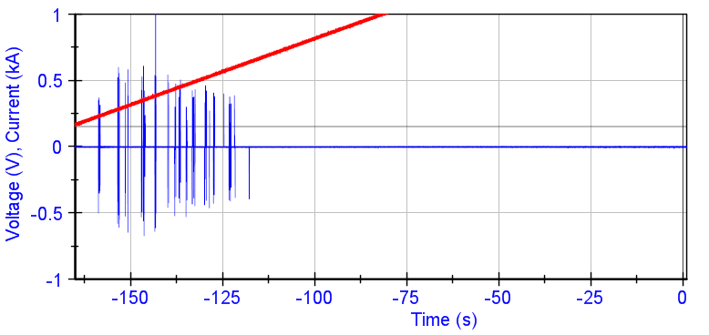
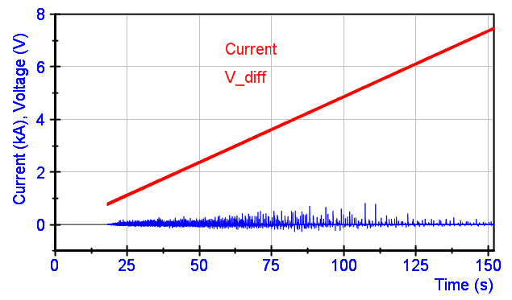
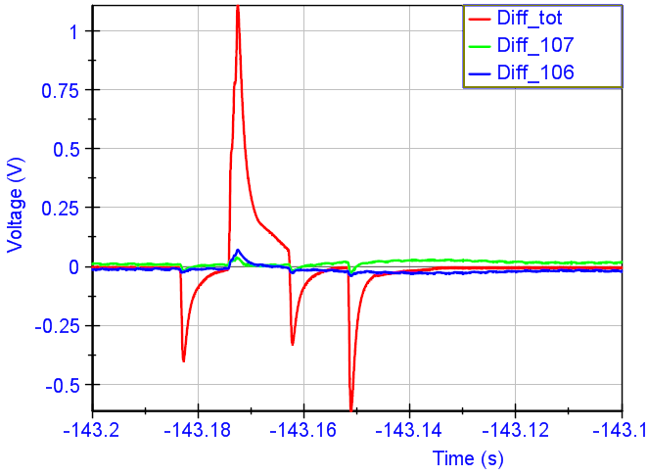
Protection and flux jumps
10 A/s 1.9 K
50 A/s 4.3 K
- Current
- V_{diff_tot}
Threshold and validation time are a trade-off between tight protection and avoiding unwanted trips.
During the test of the MBHSP101 single aperture at 4.3 K the test was perturbed by trips and the threshold needed to be increased. Further investigation needed.
Flux jumps at 1.9 K up to injection current.
Flux jumps at 4.3 K up to about 8 kA
1.9 K
For reference see talk by B. Bordini for the flux jumps in wires observed at 1.9 K and 4.3 K.
RRR measurements not yet conclusive validation ongoing
2014-12-09 - 2nd international review HL-LHC 11 T dipole
Gerard Willering – Cold powering tests 11T model coils at CERN

Slide 19
Summary
Coil 105
- trained up to 97 % of I_{ss} at 1.9 K
- good memory
Coil 106 assembled in MBHSP101
- 4 training quenches up to nominal current
Coil 107 assembled in MBHSP101
- 19 training quenches up to nominal current
- Limiting points at 1.9 K and 4.3 K are well localized
Large amount of data is available for protection studies
Resistance buildup during quench heater test well defined for coil 106 and 107, further validation and calculations needed. Coil 107 protection scheme is not sufficient, coil 106 much better.
No holding quenches observed.
2014-12-09 - 2nd international review HL-LHC 11 T dipole
Gerard Willering – Cold powering tests 11T model coils at CERN

