Slide 1
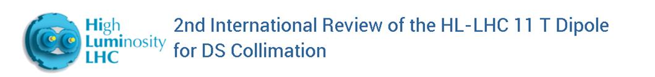
Design of the 6 m cold masses assembly
H. Prin, F. Savary, D. Duarte Ramos, L. Grand-Clement, C. Mucher, A. Temporal

Slide 2
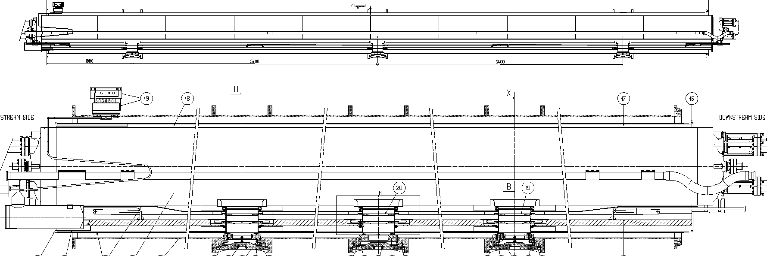

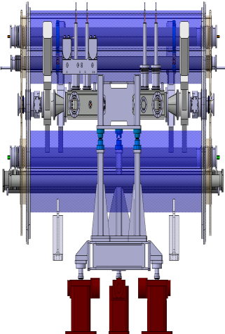
Cold masses as the result of the integration design
“Standard” extremities
“Transition” interconnects
“Transition” extremities
Collimator
Equipment routing
(Heat exchanger, bus bars,
instrumentation…)
See Delio’s and Stefano’s presentations

Slide 3
Out line
Cold masses main parameters
“Standard” extremities
“Transition” extremities
Interconnections and interfaces
Standardization
Components
Tooling
Conclusion

Slide 4
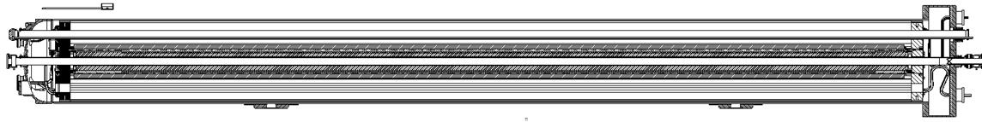
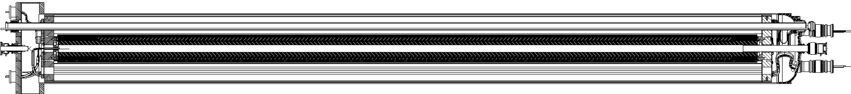
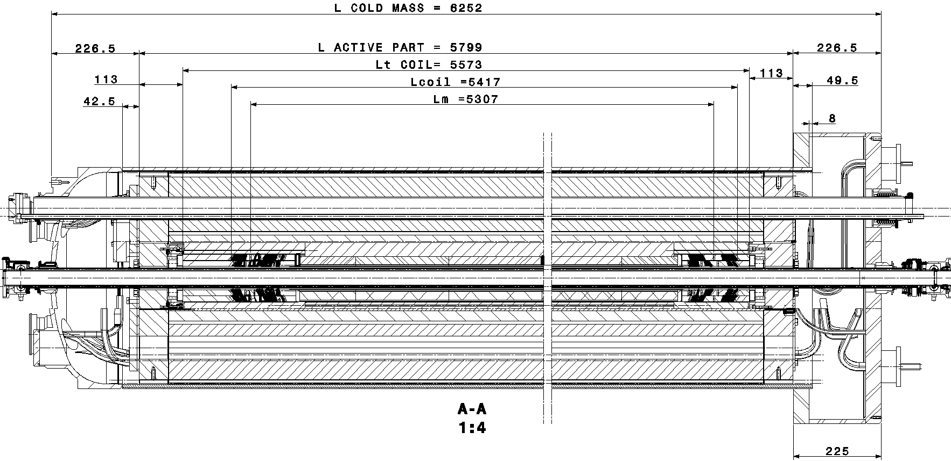
Cold masses main parameters
Cold Mass: leak tight envelope surrounding one or more superconducting magnets which acts as a helium pressure vessel and provide the mechanical rigidity to align the magnetic element(s). It is composed of two welded half-shells closed by two end covers in the extremities.
Two type of cold masses:
Identical lengths 6252mm
LMBH1 contains MBH + 2MCDO
LMBH2 contains MBH + 2MCS
MBH active part 5799mm
MBH impreg. coil 5573mm
MBH coils 5417mm
MBH mag length 5307mm
Common components:
MBH magnet
Welded half shells
Cold bore tubes
Heat exchanger tube
Supports
Distinctive components:
Bus bars routing and connections
End covers and interfaces
Diode
Instrumentation
Multipole Correctors
LMBH1
LMBH2

Slide 5
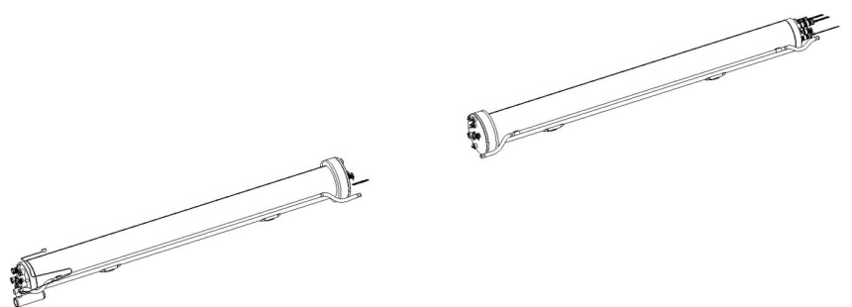
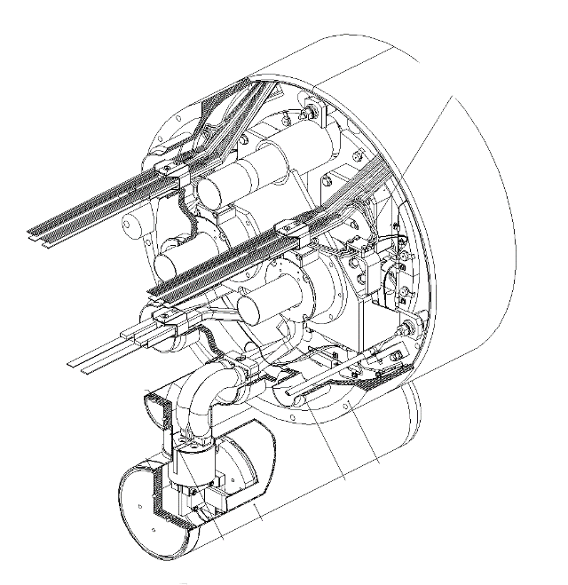
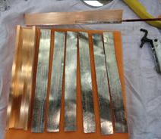
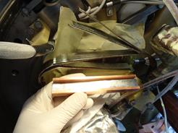
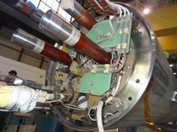
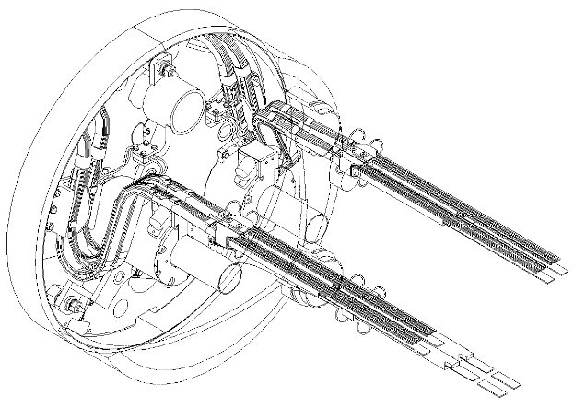
“Standard” extremities
MB end covers on both sides without any modification
Between end covers and the end plates, the configuration remains almost the same as for a MBA magnet (see next presentation)
the two apertures are not connected in series inside the first cold mass, additional bus bars have to connect the second cold mass (see next presentation)
Main bus bars routing is identical to the MBA configuration
Recent developments driven on MB2387 to connect 600A bus bars for “CLIQ test” to the internal splices could be applied for the trim
Instrumentation capillary (IFS) may have to be revised depending on the wiring

Slide 6
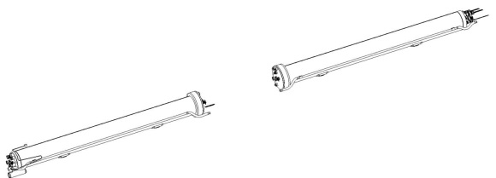
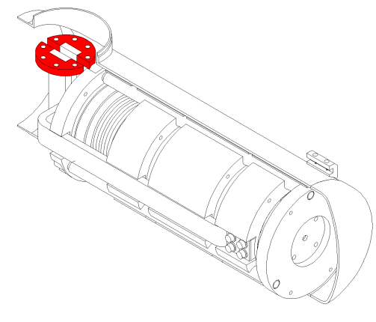
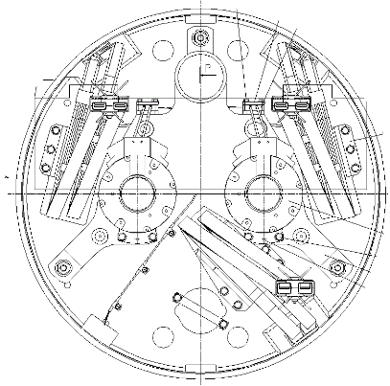
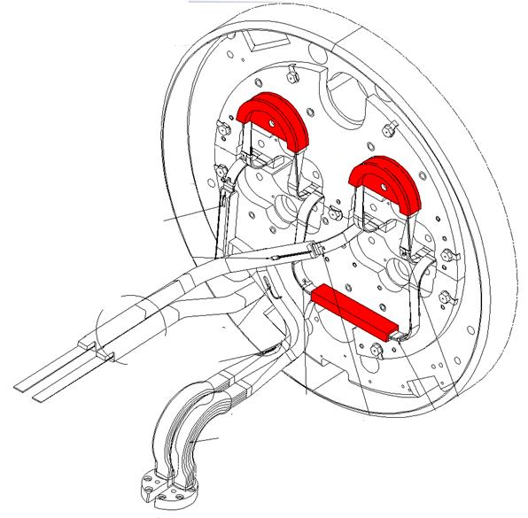
Possible design improvements
“Standard” extremities
Diode bolted connection
Proximity between the bus bar lyre and the corrector support
“Spiders” (bus bars spacers and centring) design and materials
Internal splices redesign?
Additional instrumentation?

Slide 7
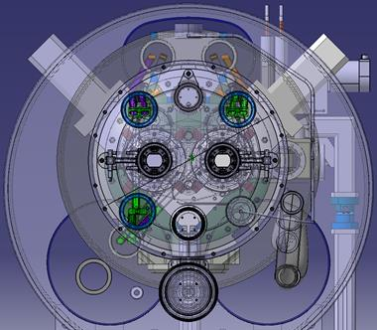
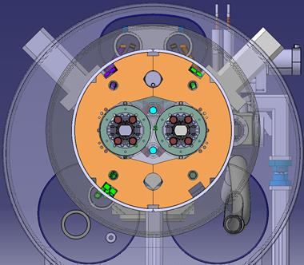
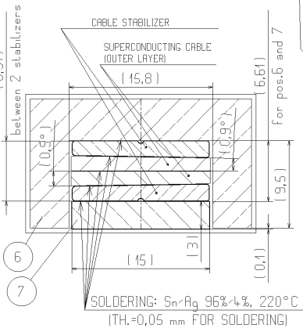
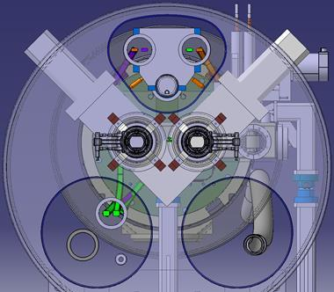
Interconnections
On the “standard” extremity sides, the interconnection to the adjacent magnets in the tunnel are the nominal ones for all the lines (V, M, X, y, N, E, k, c’).
Trim circuit connections out side the cold mass have to be define depending on the solution retained (see next presentation).
On the “transition” extremities, components to connect have the nominal geometry but their position differ from nominal ones:
  V, E, k, c’ are treated in Delio’s presentation
  X and y are nominal at the usual location
  M are standard interfaces (flanges, sleeves, bus bars preparation, splices and insulation) with adapted locations for collimator and valves integration
    The spools splices require the special ultrasonic welding machine (existing) or soldered joints (existing procedure)
  N line interconnection to be define: either similar to the SSS ones or continuous cables
up-stream view
Section inside
the up-stream cold mass
Bus bars to connect the two cold masses in series routing is under development such interconnection with this type of bus bars exists between the MB apertures but stabilization might be revised.
up-stream “transition” IC

Slide 8
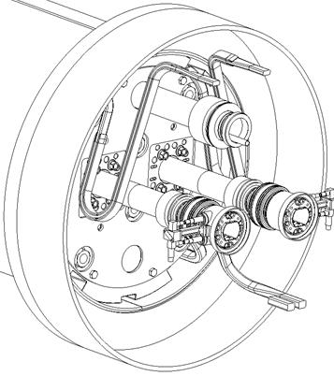
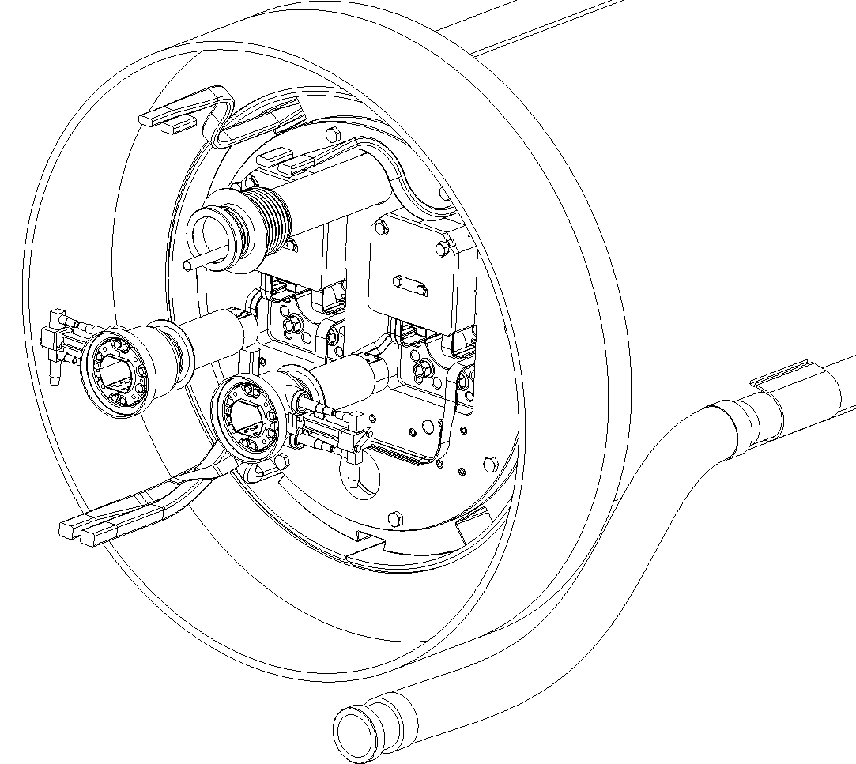
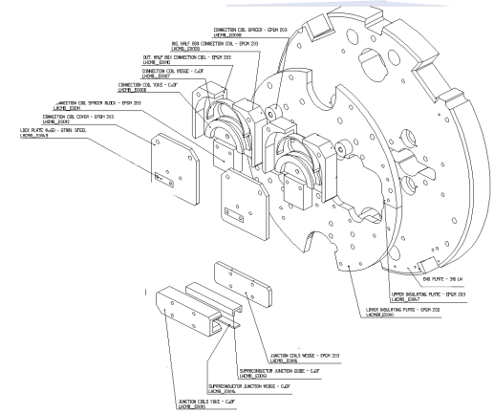
“Transition” extremities
Bus bars design under study:
Usual radius and twist used in the “standard” dipole lyras
Bending radius and twist to be developed
Typical MB splices (between poles and apertures), simpler than the ones in the standard end cover
Bus bars detailed routing to connect apertures in series is under study (global scheme in the next presentation).
N line routing under study to maximise elbows radius to ease cables insertion
Typical MB insulation pieces

Slide 9
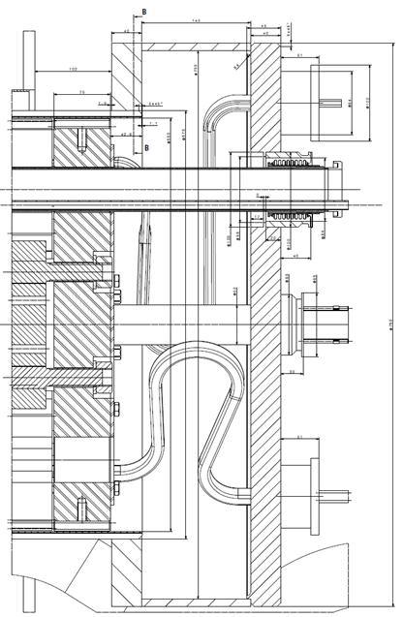
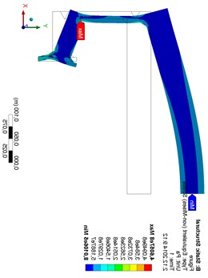
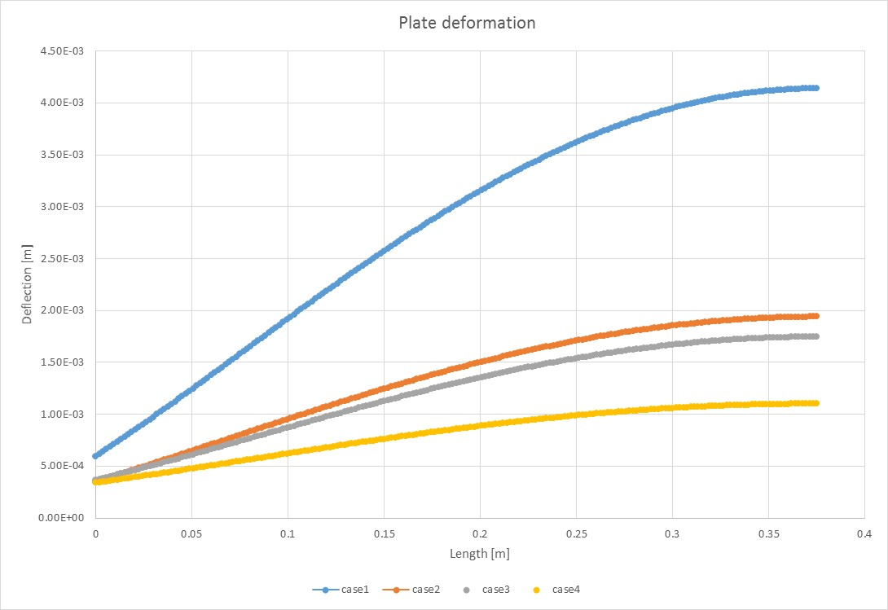
End plate calculations
B
Design | A [mm] | B [mm] | C [mm]
Case1 | 30 | 25 | 10
Case2 | 40 | 35 | 12
Case3 | 40 | 35 | 12
Case4 | 50 | 35 | 15
Design has been optimized in order to minimise the plate deformation under internal pressure and preventing plastic deformation during a quench.
Material thicknesses and welds location are such that the maximum deflection is about 1.1mm @ 20bars during a quench. The EN 13445 European pressure vessel code is used to validate stress distribution is the model.
During operation, since there is no yielding, 0.55mm of longitudinal deformation which results with negligible radial deformation of the beam pipes.
 Detailed calculation will follow with the exact end plate geometry including all apertures.
C
A
Material | R_{p 0,2} [MPa] | Design | f_{m} [MPa] | f_{l} [MPa] | f_{g}+ f_{m}+f_{b} [MPa] | Deform. [mm] | Check*
304L (EN10088) | 240 | 1 | 85 | 149 | 333 | 4.1453 | FAIL
 |  | 2 | 55 | 105 | 286 | 1.9403 | OK
 |  | 3 | 74 | 106 | 290 | 1.75 | OK
 |  | 4 | 66 | 100 | 272 | 1.102 | OK
316L (EN10088) | 260 | 1 | 85 | 149 | 333 | 4.1453 | OK
 |  | 2 | 55 | 105 | 286 | 1.9403 | OK
 |  | 3 | 74 | 106 | 290 | 1.75 | OK
 |  | 4 | 66 | 100 | 272 | 1.102 | OK
316LN (EN10088) | 320 | 1 | 85 | 149 | 333 | 4.1453 | OK
 |  | 2 | 55 | 105 | 286 | 1.9403 | OK
 |  | 3 | 74 | 106 | 290 | 1.75 | OK
 |  | 4 | 66 | 100 | 272 | 1.102 | OK
*According Standard EN13445
Courtesy of Jan Hrivnak

Slide 10
Standardization
As far as possible existing components and procedures are used in the proposed design:
Cold masses assembly
Main components are identical or derived from the ones used in the existing MB or SSS
Assembly procedures can be easily adapted from existing ones
Only one cold mass type per position independently of the variety of magnet that has to be substituted (no MBA or MBB type)
Cold tests
A pair of assemblies to substitute a MB dipole could easily be connected to the exiting SM18 test bench with standard components and procedures
Trim connection has to be studied since there is none at present, spool circuits could be used in case
Testing each assembly remains possible with work either on the bench or the cold mass interfaces
Installation in the machine
Interconnections in the “standard” extremities remain regular as everywhere else in the LHC arcs;
Interconnections in the “transition” extremities uses regular components design located in unusual location but with major efforts to keep them accessible
Usual tooling and procedures are applicable (splice soldering, shunt soldering, insulation, welding, cutting)

Slide 11
Components
Availability for LS2 deadline
Magnet yokes and related components
End plates
Stainless shells have to ordered, formed and machined
difficulties to order 316LN for the moment
experienced companies are already identified
Connexion and electrical insulation pieces
Welding flanges and flares
Cold mass supports
MCS and MCDO multipole correctors
Diode
Standard dished end covers
Bellows and hoses
N-Line
Bus bars
Hollow copper and sc cable available (spare stock to be refurbished)
Proven knowhow in the LMF busbar team
Insulated cold bore tubes
Ø50/53 Stainless steel tubes available for the requiered lengths
Insulation proven knowhow in the LMF busbar team
Heat exchanger tubes
Copper tube and Cu/SST transition in stock ⇨ BE to be done
Welding rings
Flat end covers

Slide 12
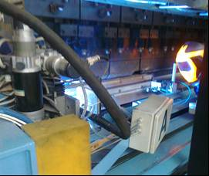
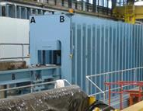
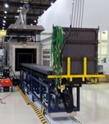
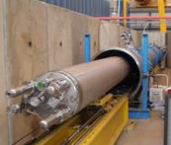
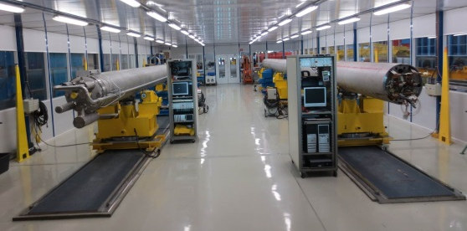
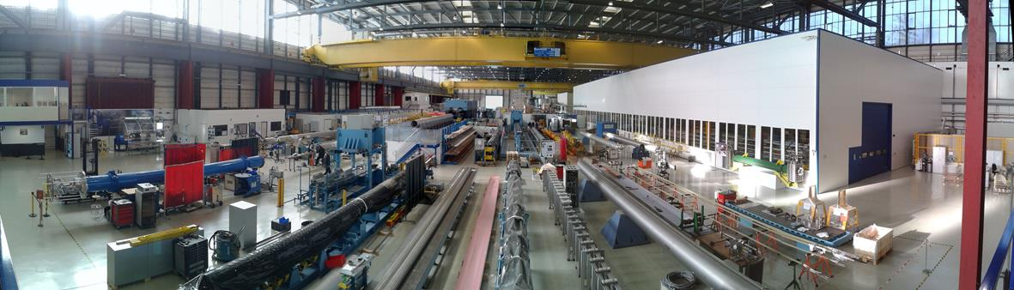
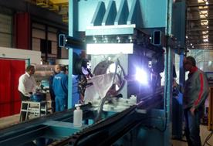
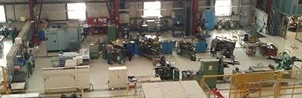
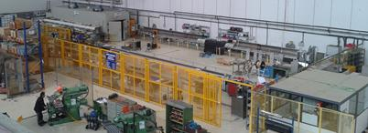
Tooling
Finishing benches
Geometry measurements
15m Welding press
15m Collaring press
Nb3Sn Reaction furnace
Pressure/leak bench
“Winding house”
cold mass magnetic measurement bench
Half Yoke returning bench
Cold mass assembly bench
Collared coil returning bench
Collared coil magnetic measurement bench
Welding press for 2m models
Mechanical workshop
Busbars workshop

Slide 13
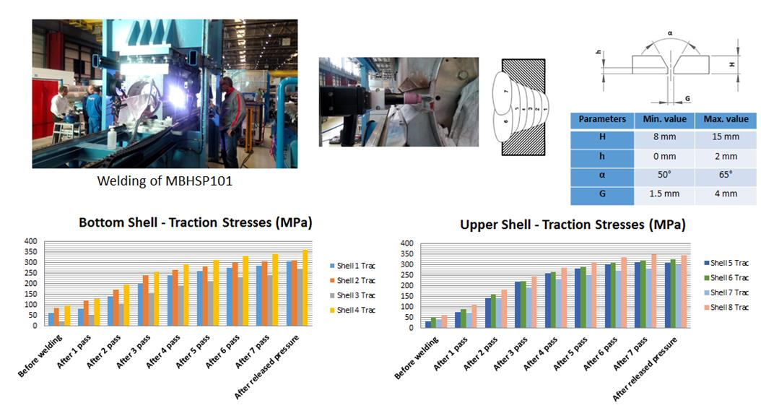


Tooling
Ongoing developments to replace STT by TIG welding technology
Courtesy of F. Lackner
About 300MPa azimuthal stress obtained in the second prototype shells after welding
Process more tolerant in terms of geometry
Quality of the weld
8 passes for 12mm thickness to be adapted for 15mm
Backing strip necessary for gap > 1.5mm

Slide 14
Conclusion
The cold masses design is the result of a global integration study, without margin in the longitudinal direction.
The design is based on several technologies already used for other cold masses in the LHC, mostly the main dipole but also standard and matching section cold masses.
Most of the components uses standard design, some of the critical ones are already available for the assembly of a full prototype and for the cold masses intended for LS2.
The assembly procedures are adapted from existing ones.
The tooling is available and has been proven.
The skills of the different teams who will participate to the realization of the components or their assembly has already been demonstrated for the cold mass consolidation after the incident in 2008 and after LS1.
The connection to the cold test benches in SM18 is standard or can be accommodated.
The connection in the tunnel is based on standard components, procedures and tooling.
The whole LMF section is motivated to go ahead with this project
The cold mass assembly project shows no real issue

Slide 15
Spare slides

Slide 16
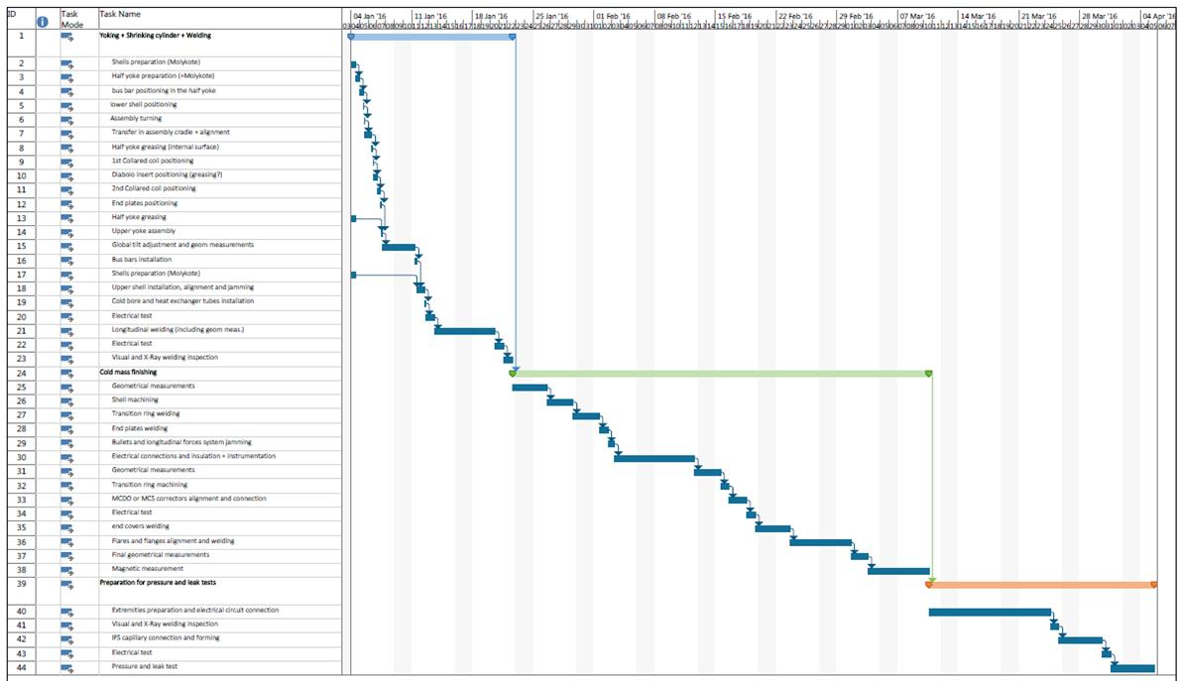
Cold mass assembly schedule
~ 3 month

Slide 17
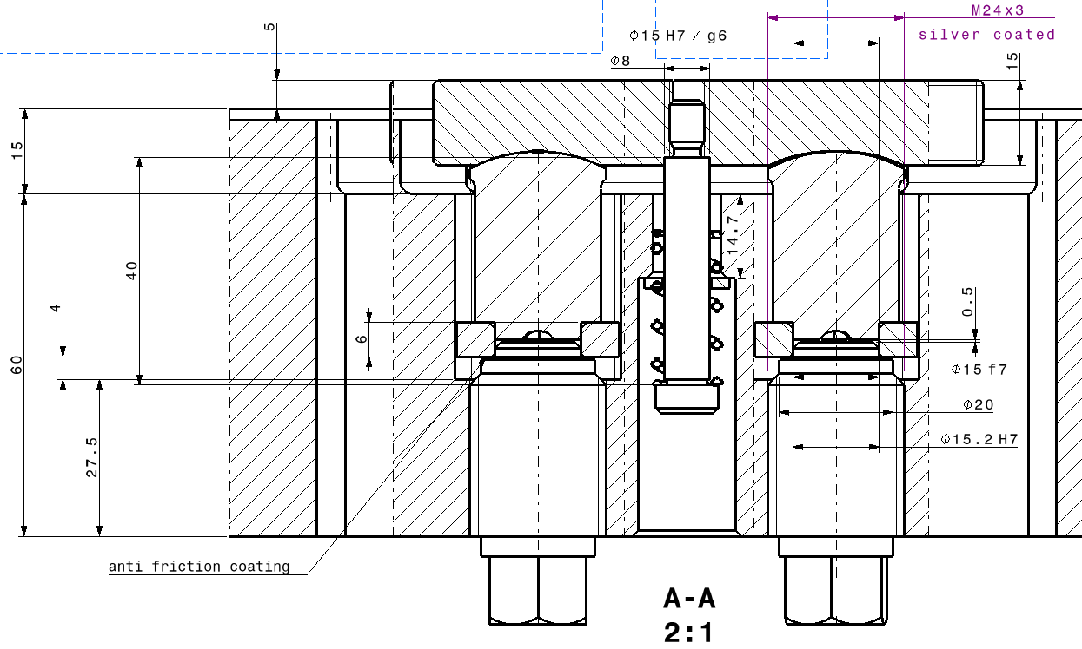
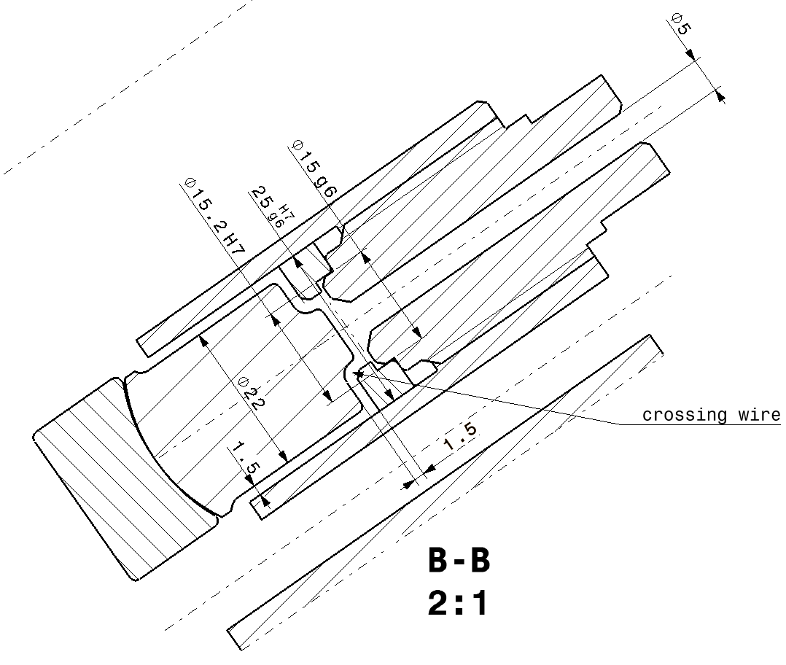
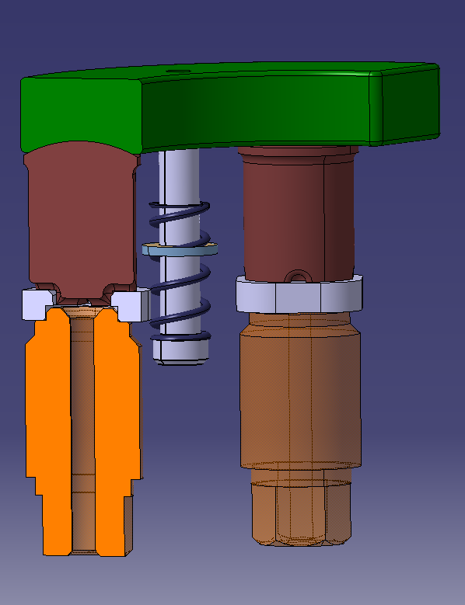
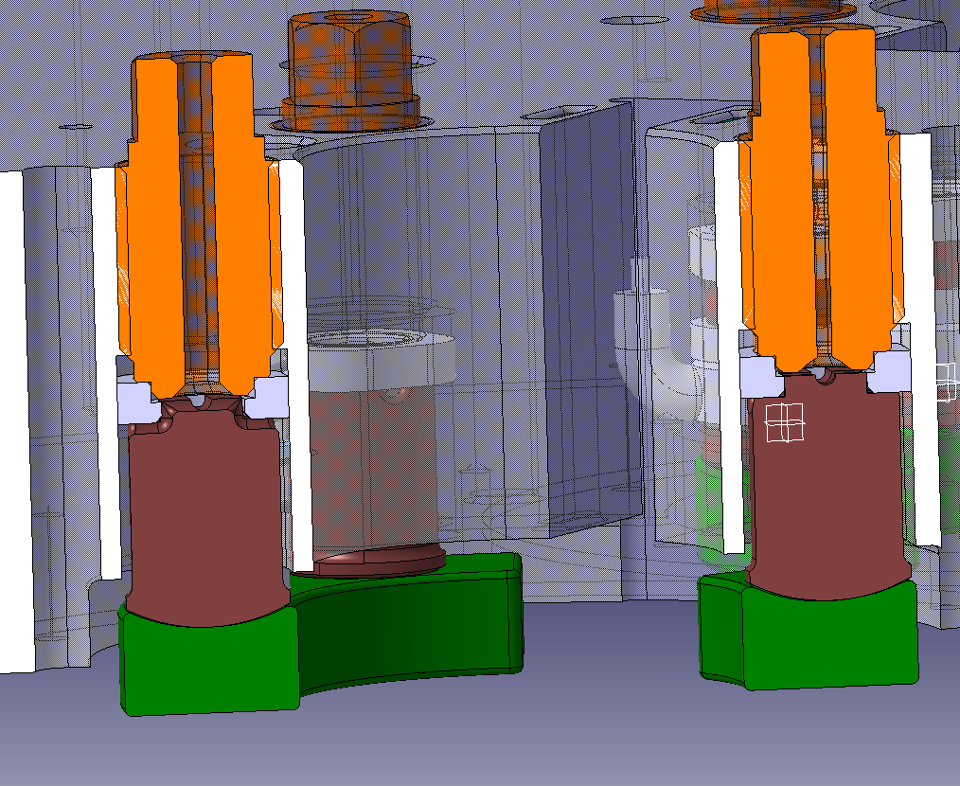
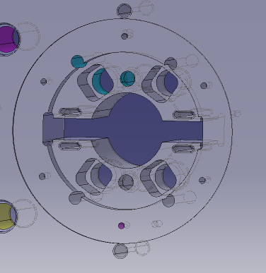
Design of the instrumented bullet gauges
Courtesy of A. Temporal

Slide 18
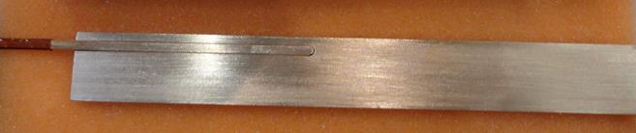
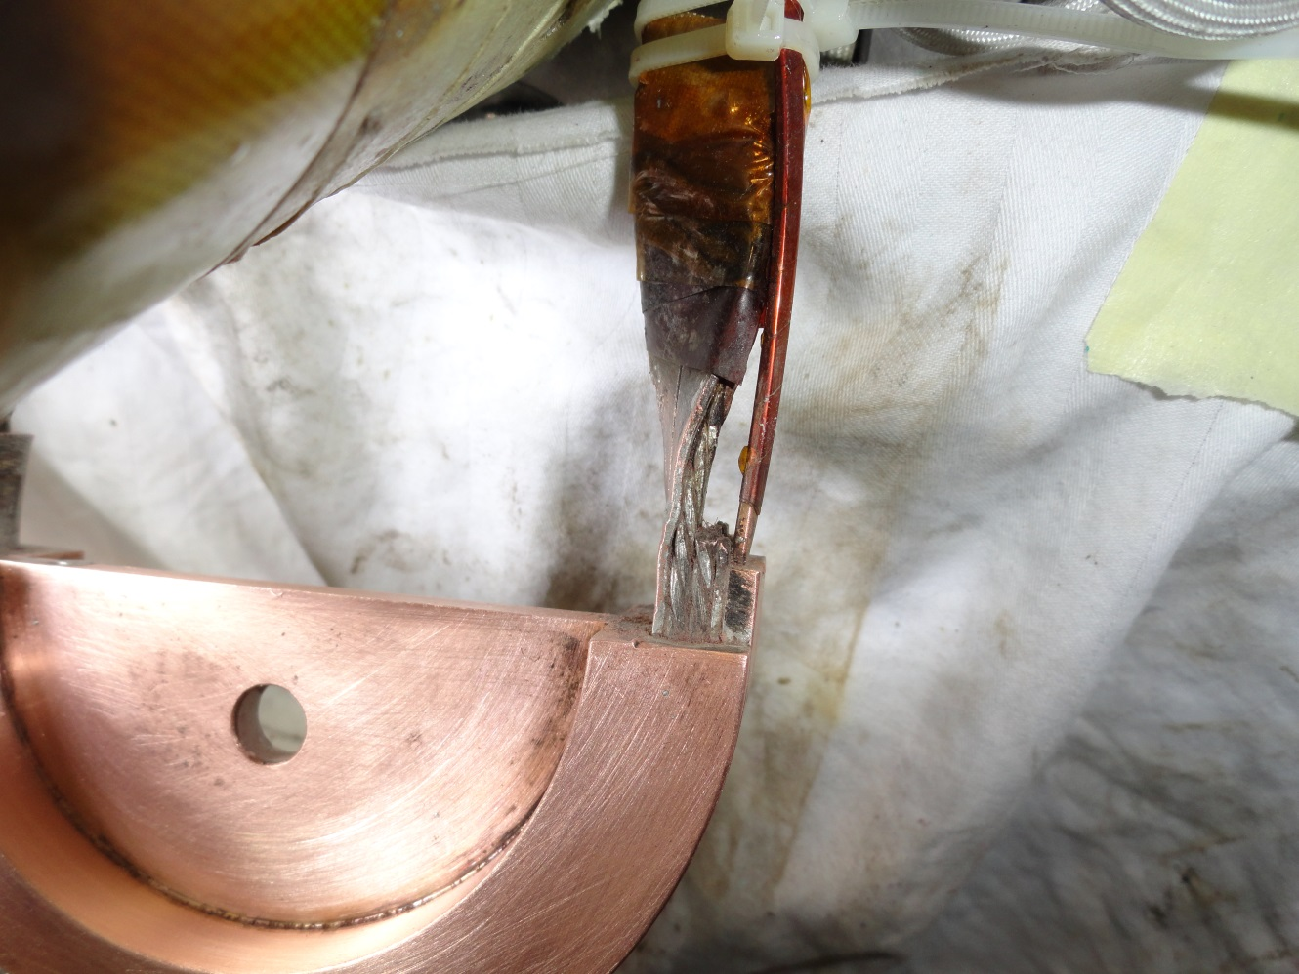
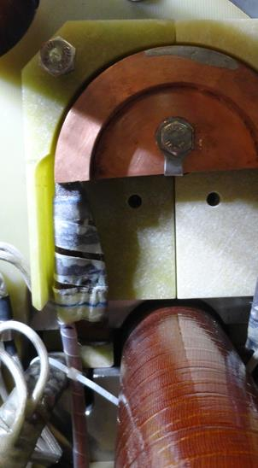
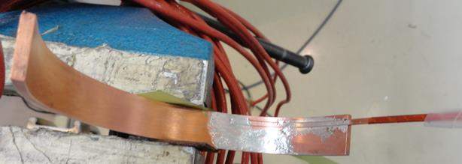
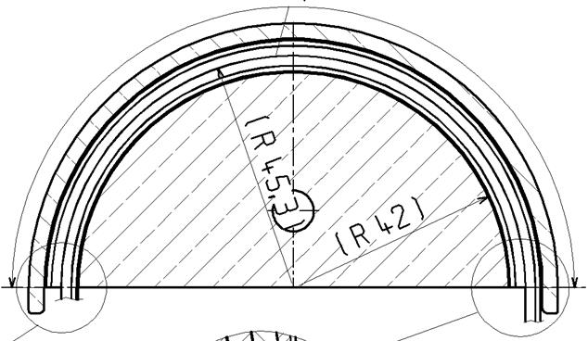
Trim cables connection

Slide 19
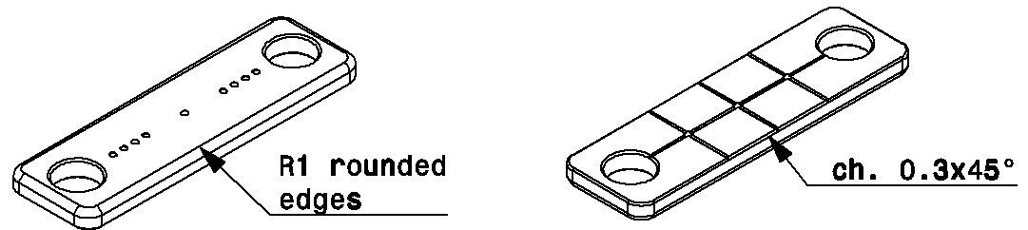
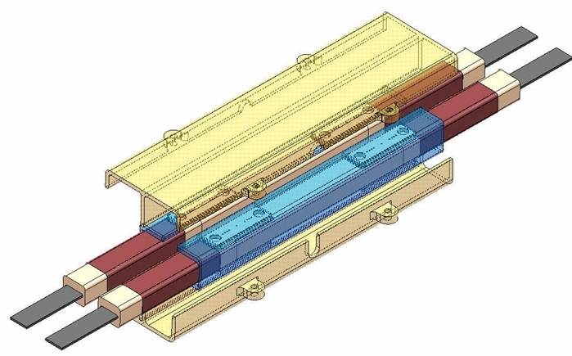
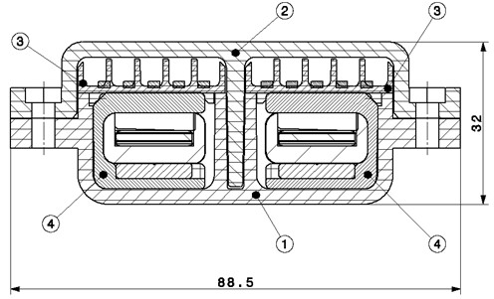

LHC standard insulated splices

