Slide 1
The 2nd Int. Nat’l Review of HL-LHC, 11 T Dipoles at Collimator Section
Closing Session Report
Internationl Review Panel
held at CERN on 8-10 December, 2014
URL: https://indico.cern.ch/event/354499/timetable/#20141208

Slide 2
Review Committee Members
Joe Minervini (MIT, Co-Chair)
Giorgio Apollinari (Fermiab)
Jim Kerby (ANL)
Shlomo Caspi (LBNL)
Arnaud Devred (ITER) *
Akira Yamamoto (KEK-CERN, Chair)
* Comment through e-mail (later)

Slide 3
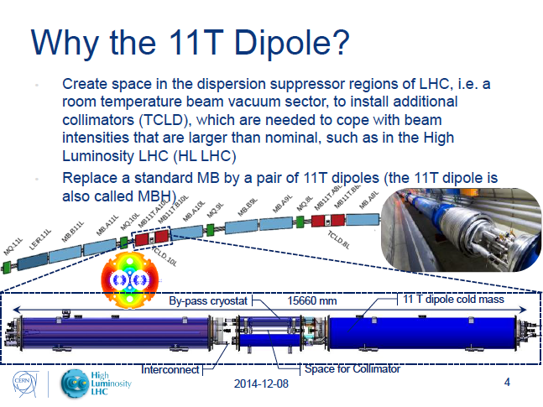
The 11 T Dipole Development Program to be reviewed
F. Savary

Slide 4
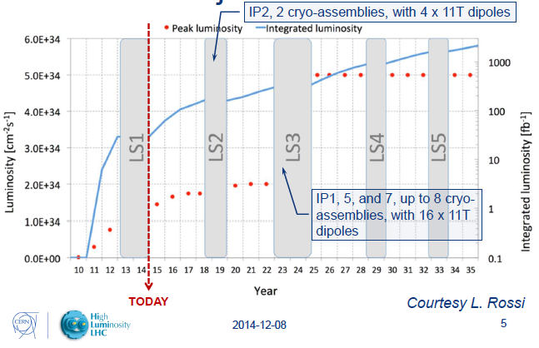
HL-LHC Project, and 11 T Dipole Plan

Slide 5
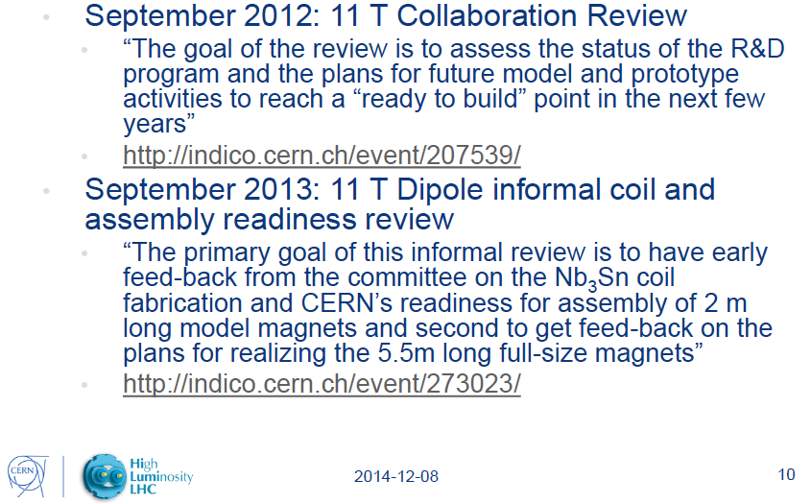
Previous Reviews

Slide 6
Charges and Responses (1)
1 | To review the basic design of the 11 T dipole, taking into account magnetic, mechanical and thermal operating conditions in the LHC P2: Is the design meeting the targets with sufficient margin? Does the experience of the first R&D phase at Fermilab and CERN (and of ten years of LARP & USA magnet basic programs) support the chosen specifications and the feasibility of meeting them with adequate margin
 | The current design margin is 80.9 % along the LL even in case of non-magnetic yoke at ends, The magnet should demonstrate B-bore = 12 T in stable operation before installation into the tunnel, Targets are not met either at FNAL (better) and CERN Quenches in the CERN model are clearly indicating a weak spot in the mechanical assembly. Probably, though several design choices have been made and were not clearly supported in the talks. These include but are not limited to: the island material, the pole piece 2D design (and effect on the transition region mating the 2D and end regions), quench heater location, allowable compressive stress in the coil during manufacture, ….….

Slide 7
Charges and Responses (2)
2 | Is the engineering design including the 3D interfaces to other systems, namely the cold-warm-cold by-pass lodging the collimation system, sufficiently developed to assess that there be no show stoppers in the construction of the magnetic part, the cold mass assembly, the cryostating, and the installation and integration in the machine? Is the protection and circuit integration sufficiently analysed?
 | We expect the same/similar scheme of the protection as like as the LHC-dipole interconnect. No specific presentation was made in terms of this question except for the general powering system. No major show-stopper evident on front of cryogenic and electrical integration. We urge the cryostat group to converge quickly on a design which defines envelopes for both magnets and collimators.

Slide 8
Charges and Responses (3)
3 | Is the final design taking stock of the best features demonstrated in the two development lines, i.e. FNAL and CERN?
 | Apparently not on mechanical structure. Yes on many other elements coil fabrication, conductor, etc. The best features of the FNAL design should be integrated with the CERN design through the mechanism of an internal review (to be discussed in full report)

Slide 9
Charges and Responses (4)
4 | Is the plan for models and prototypes well thought? Is the preliminary construction plan credible?
 | Justification for models is completely absent. How the model program informs the prototype and construction programs was not discussed. Both models and prototypes appear always too late to inform construction program. There is a plan, but the technical linkages / decisions were not presented in detail. We recommend to modify the plan to emphasize model magnets, practice coils, and practice assemblies as much as possible. Challenging construction plan with ~7 coils/year (20 coils total), with no assumption of rate of failing coils/magnets. Moderate space to optimize production rate by increasing tooling and concentrating construction in later years before LS2.

Slide 10
Charges and Responses (4)
4 | Is the plan for models and prototypes well thought? Is the preliminary construction plan credible?
 | Define the requirements and goals for upcoming magnets on a case by case basis This includes defining the actual electrical requirements, consistent w/ installation in the LHC.

Slide 11
Charges and Responses (5)
5 | Are the design and manufacturing plans sufficiently well developed to engage in the upcoming significant procurements, i.e. Nb3Sn strand and cable procurement and production, and magnet components procurement (collars, yoke, shells, etc.)?
 | Yes for RRP strand. No time for changes (key-stone, cross-section). Use of PIT strand in production magnets is postponed to after LS2. Mechanical structure (except end-part and wedges) still need to be demonstrated for CERN model, so major procurements might have to be delayed. Milestones for procurements should be integrated into the overall project plan because of the long lead time required.

Slide 12
Charges and Responses (6)
6 | Is there any specific area in which the project is running important technical or managerial risks?
 | Technically, the mechanical structure & operational margin remain to be proven. The overall Management and Project structure was not adequately presented. Team integration (across groups, Division and Departments) is a must for success. The committee believes more proactive technical integration is needed across the whole 11T+Collimator Project and within the 11 T Magnet Project. The project schedule as presented is designed for meeting a target date, but does not seem to take into account the severe technical risks involved in each stage of the project. The committee did not receive a detailed project plan for the 11 T magnet fabrication portion of the project or for the overall project implementation for LS2. It is apparent that the project team has an incredible amount of technical and fabrication experience as well as excellent production facilities, so the committee is secure that this project can be successfully completed. The main question is on what schedule.

