Slide 1
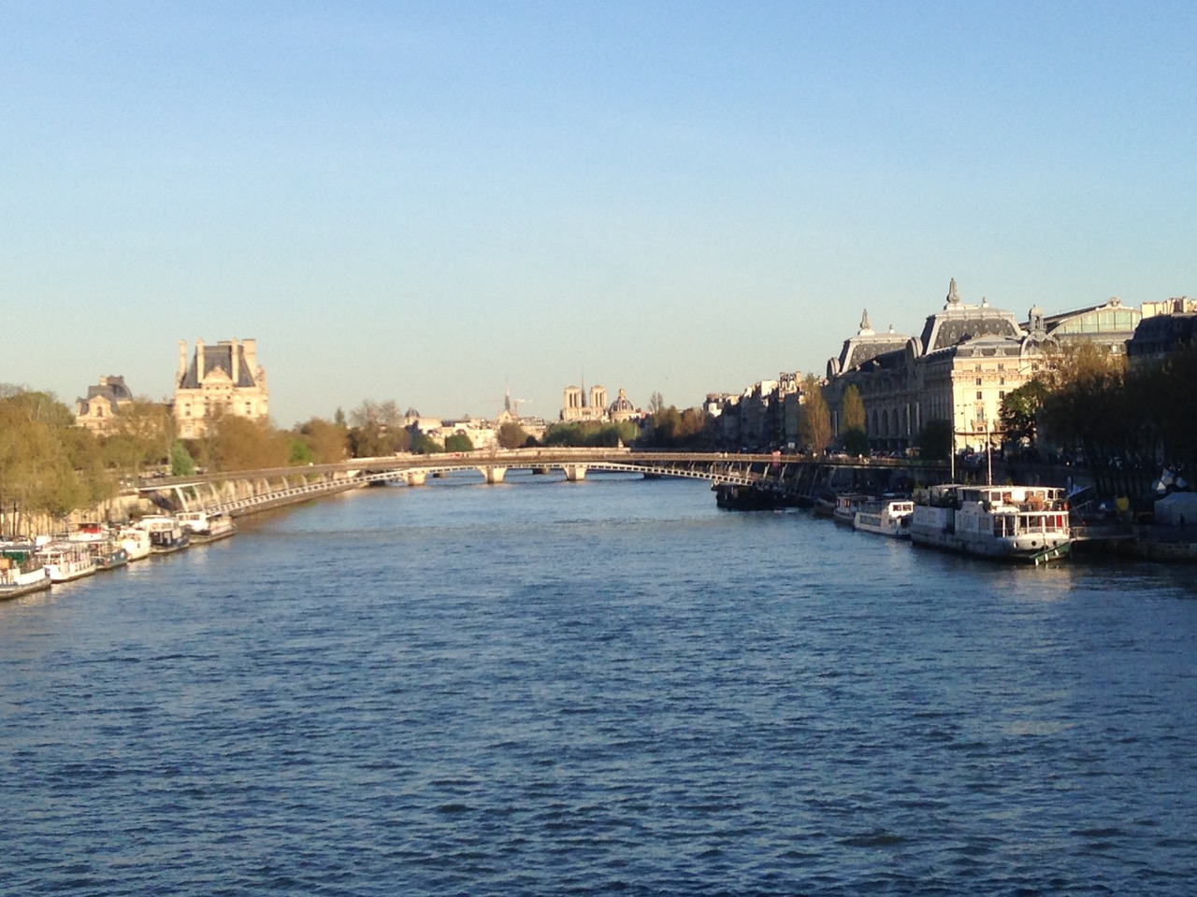
Wrap Up

Slide 2
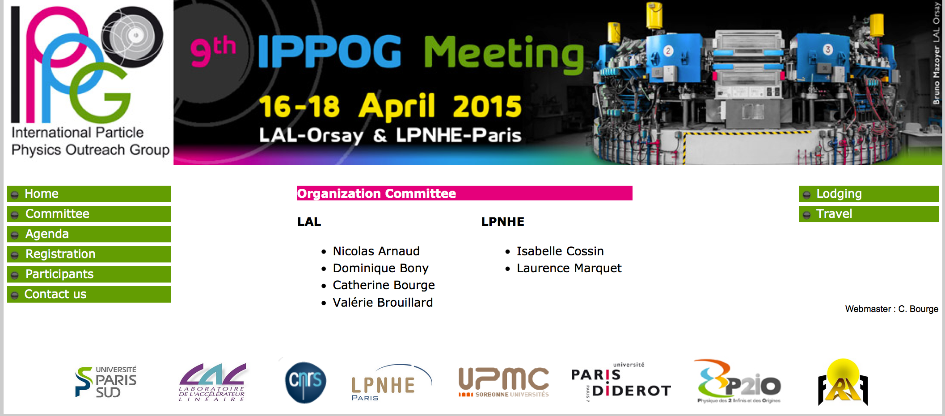
A big Thank You to Nicolas and his team to make this 9th IPPOG meeting possible In Paris !
We had a stimulating and interesting meeting at three wonderful locations. Organizing three sites in parallel was certainly a challenge, you managed well Nicolas and your team !

Slide 3
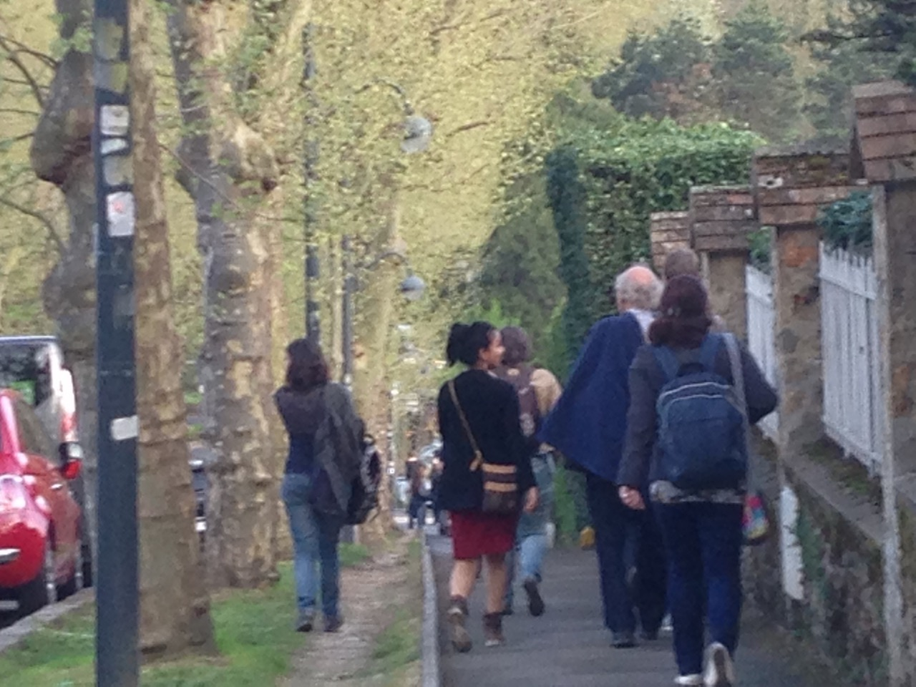
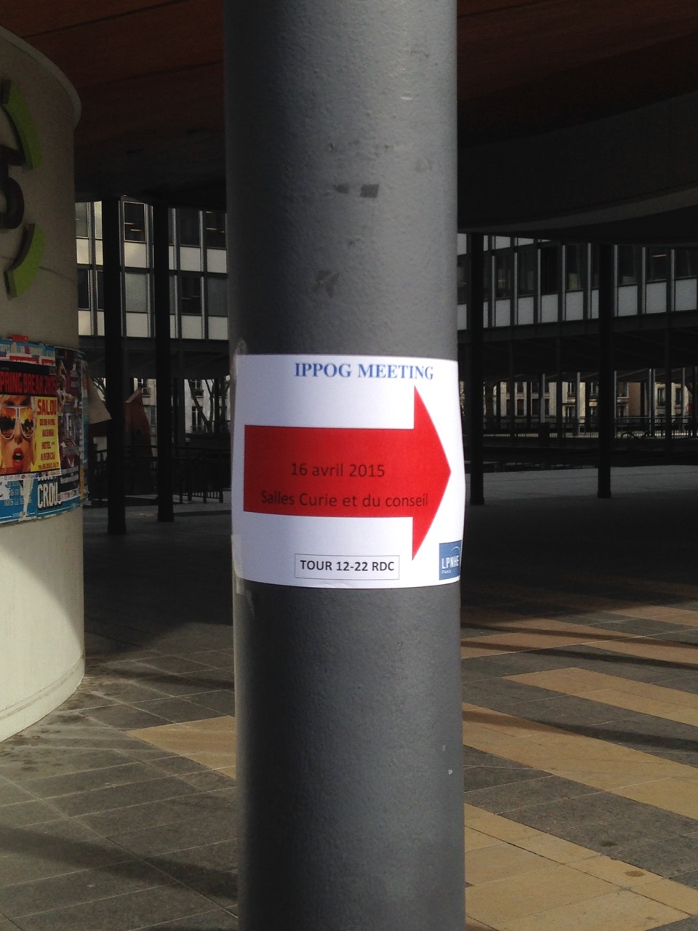
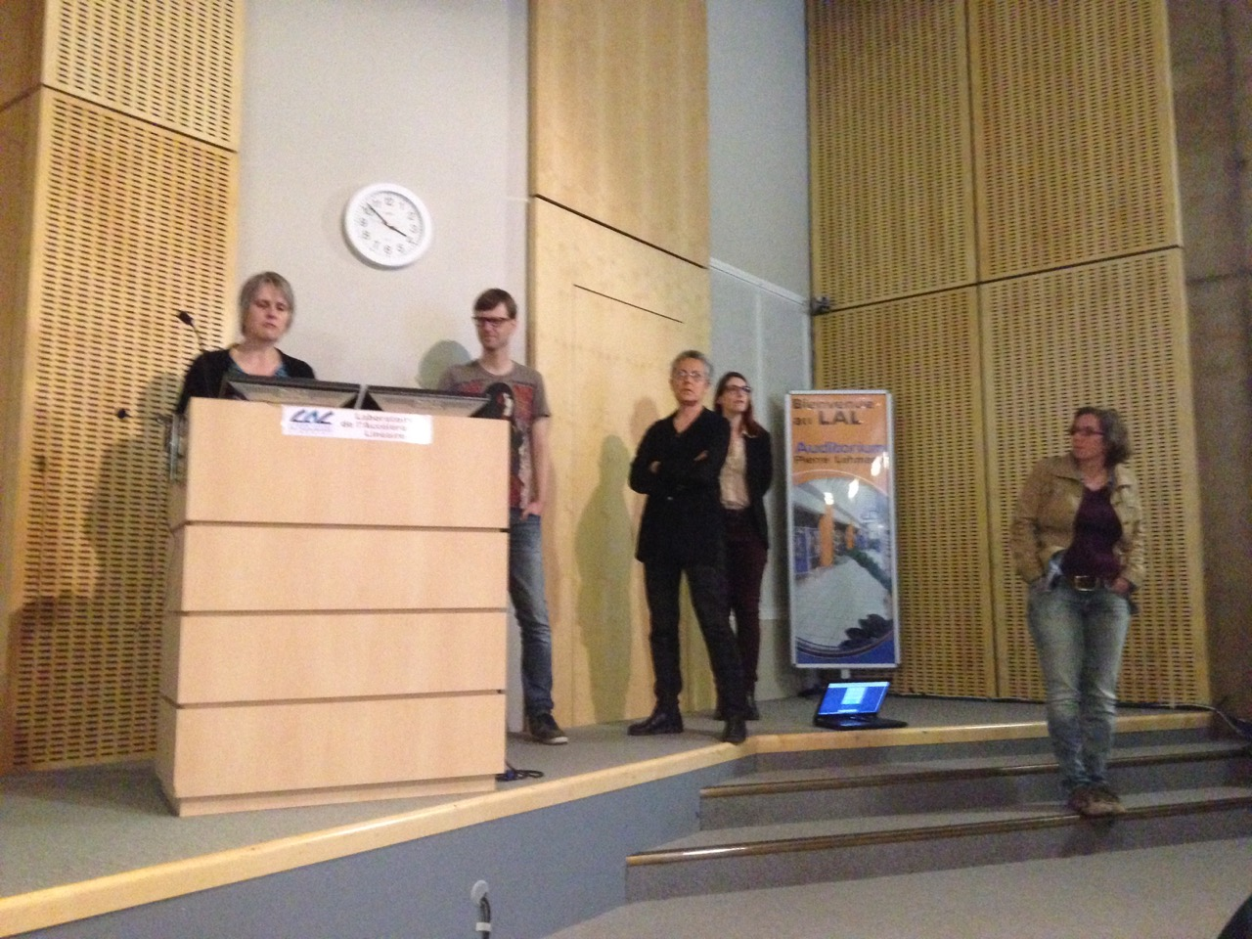
Three interesting sites…
…treasure hunting finding these
… eventually arriving save
for fruitful interesting exchange of ideas, outreach done, and outreach to be done

Slide 4
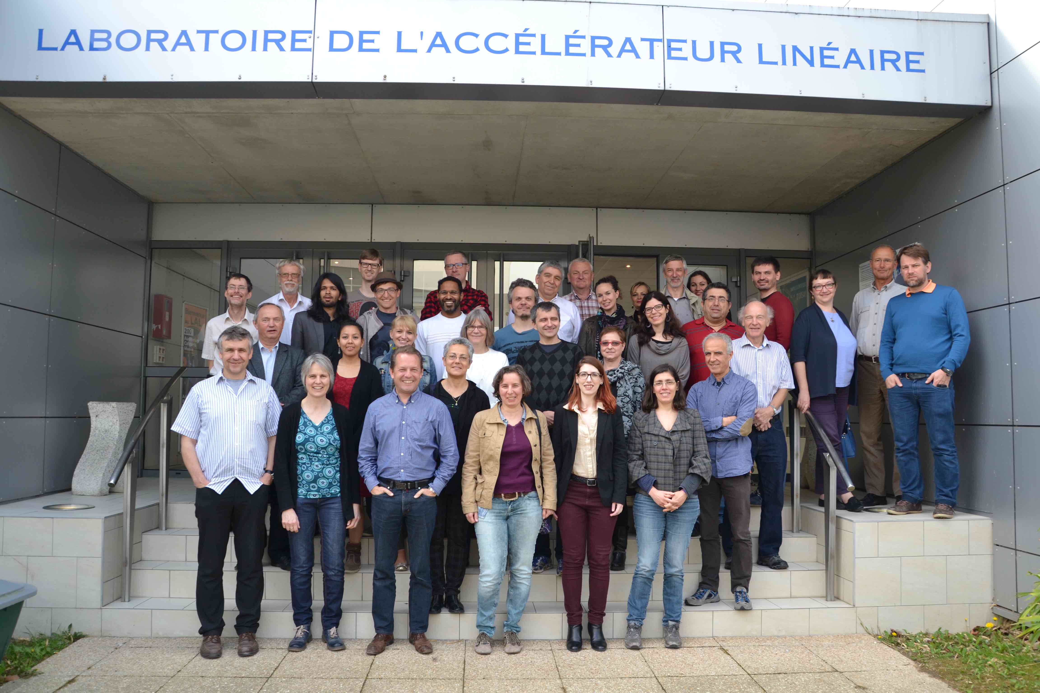

Slide 5
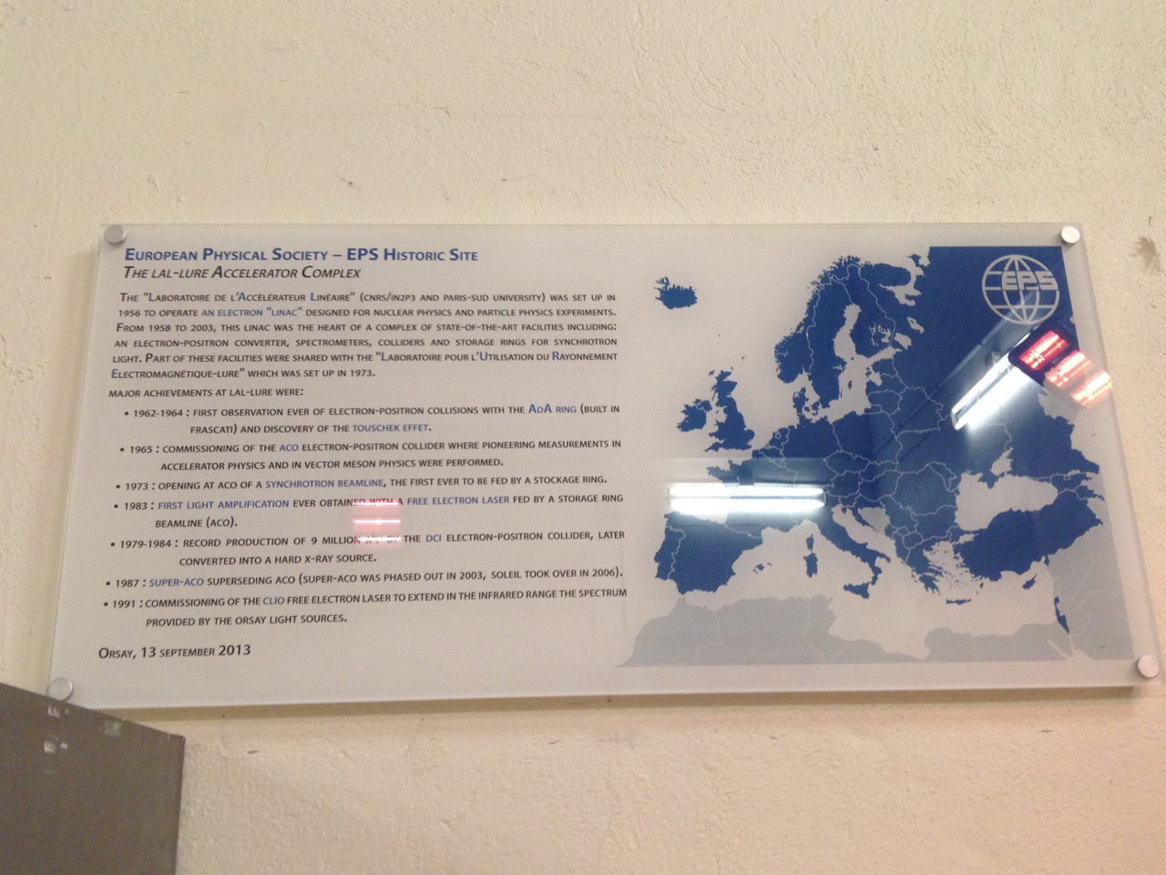
A fast moving field
A historic site in less than 50 years;
whereas other activities usually need to wait 1000’s (or many 100’s) of years…

Slide 6
A few take-home topics
Open Data for education and research offers a great, huge opportunity
Masterclass data repository could well be integrated in Open Data
Interesting and good panels
Cosmic rays going global
A wealth of national educational websites, games and exhibitions
LHC discoveries – Having found the Higgs is starting the scalar era!
What of only 1 Higgs? -> Need answers!
Competitions are great to stimulate and motivate students and teachers
needs prizes per country
needs overall winning prize
Including competition for teachers e.g.
propose data analysis challenges with LHC Open Data
…and let’s change the textbooks !

Slide 7
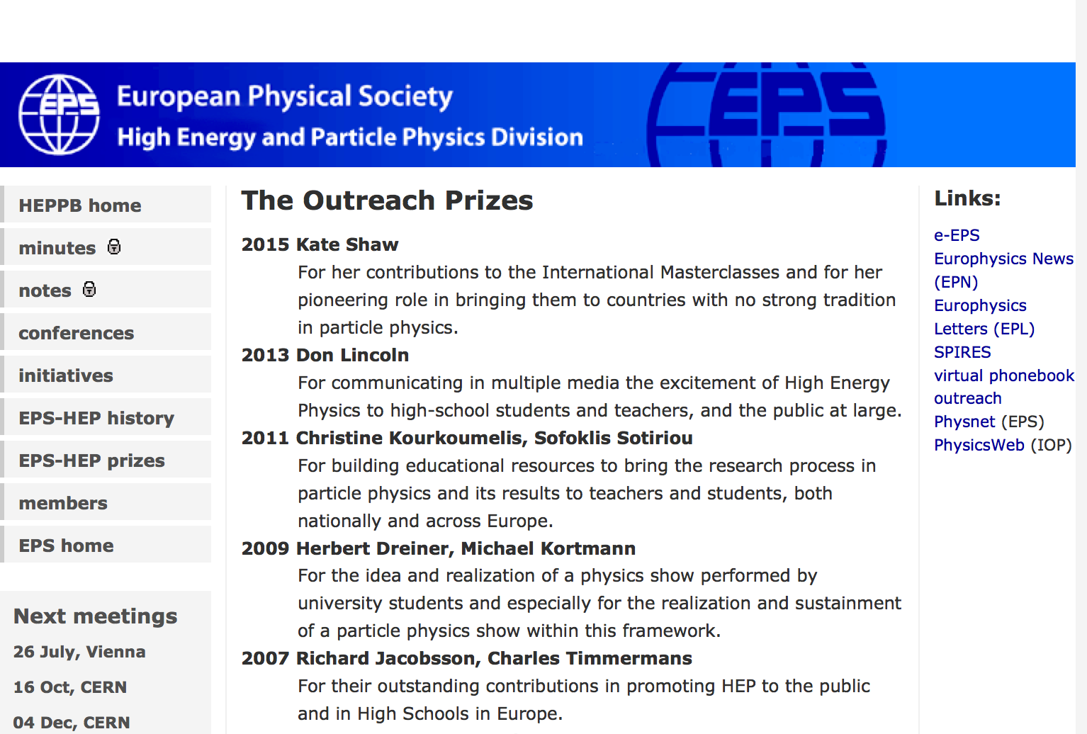


Slide 8
Next Meeting
Autumn 2015
CERN
Have a save trip back home and see you (latest) in the end of this year at CERN !
Thank you all
PS
If you would like to be host for the Spring 2016 meeting, please let us know early.

