Slide 1
TOOLS 2008
Concluding remarks
S. Katsanevas
IN2P3/CNRS

Slide 2
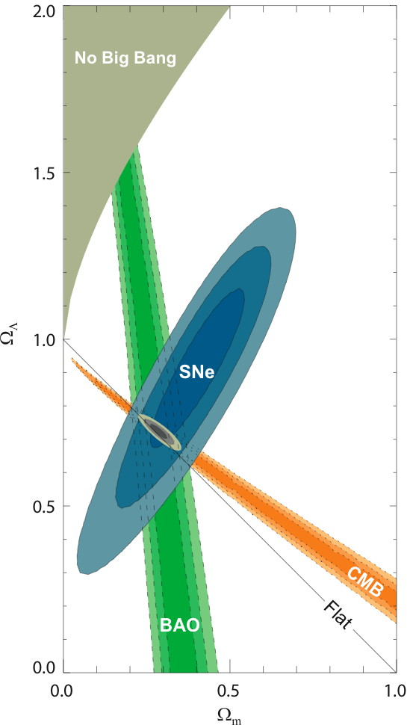
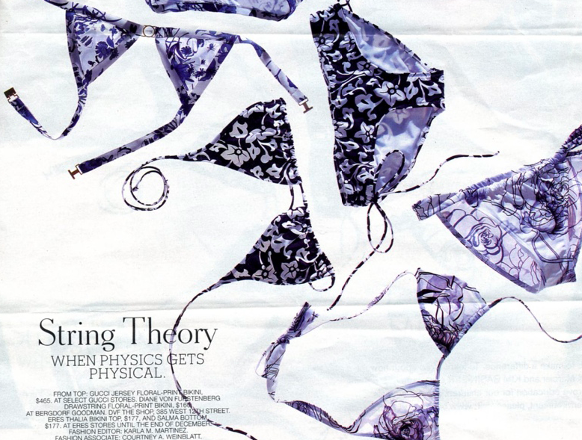
Two views on the state of our knowlege of the Universe
In this beginning of the 21st century, our knowledge of the Universe can be compared to the knowledge of the gases at the beginning of the 20th. We know with great precision the overall parameters and relations of macroscopic variables: in short its macrophysics, but we still lack the full knowledge of its elementary constituents: its microphysics
G. Smoot

Slide 3
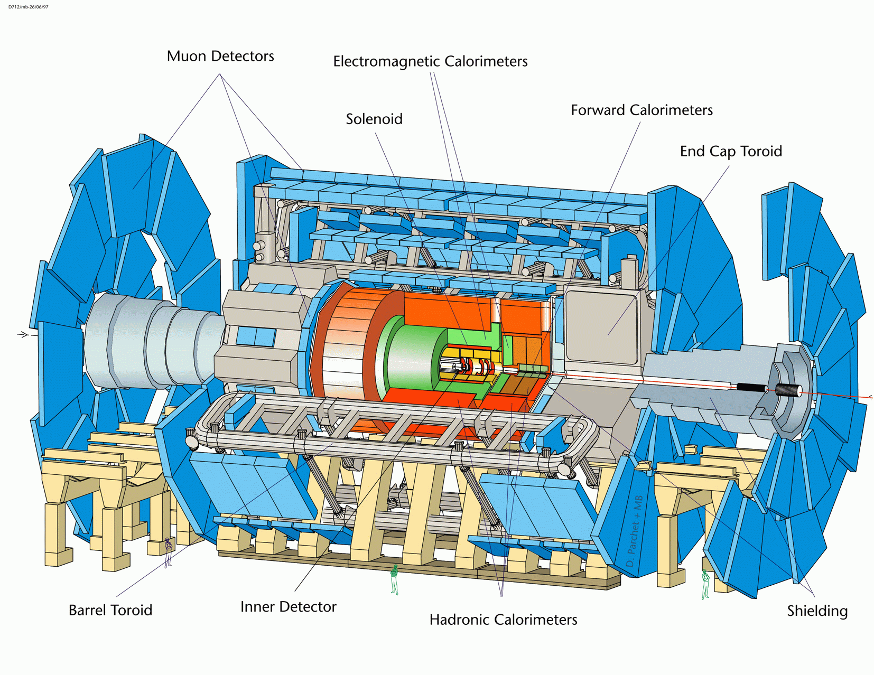
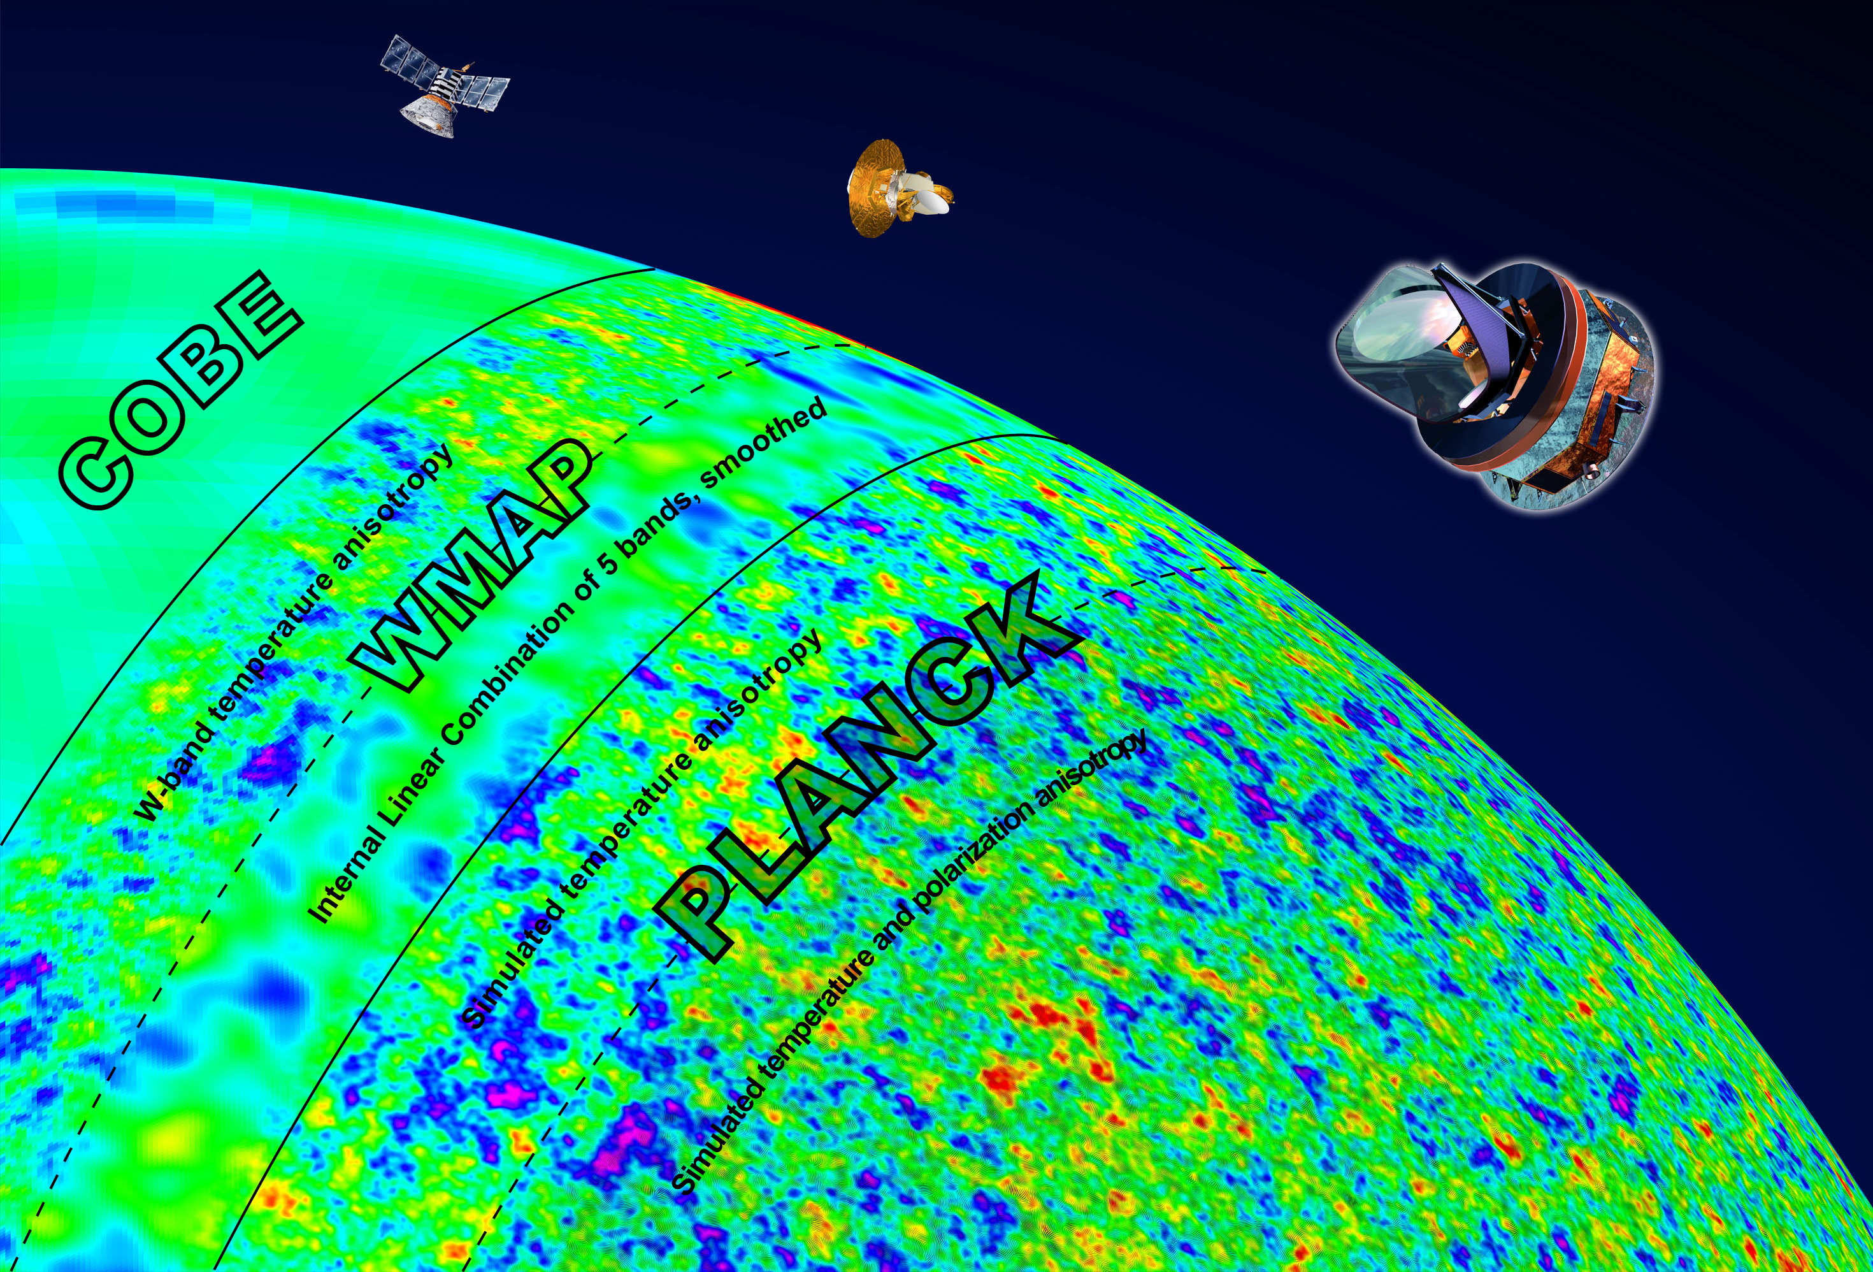
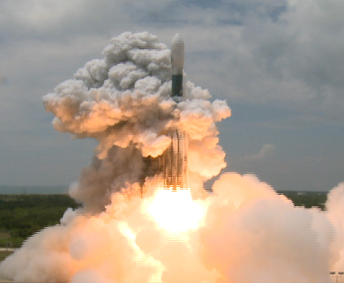
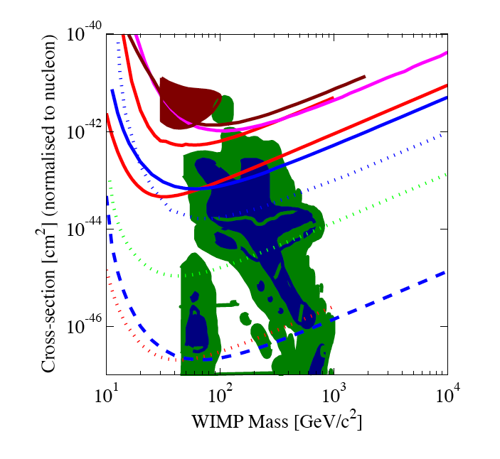
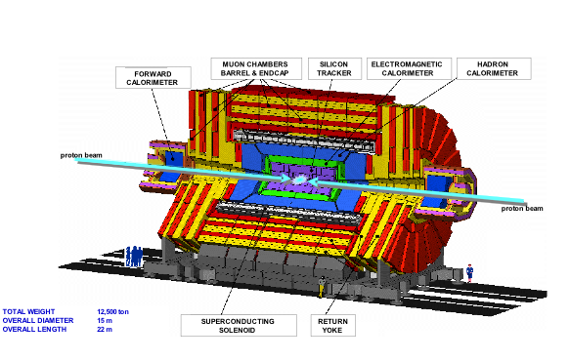
Observations are here. Are we ready to calculate?
LHC 2008
PLANCK 2008 (early 2009)
But also:
PAMELA(2008), VERITAS(2008)
HESS2/MAGIC2 (2008-2009)
ICECUBE(50%, 2008)
AUGER(2008)
ANTARES(2008)
AM S(2010?)
2008
2009-2010
1 ton
2015
Gondolo
GLAST 2008
Edsjo, Dark SUSY, Pukhov MicroMEGAS
Direct Dark Matter search

Slide 4
What does it mean « be ready » ? see also Peskin
Calculate the effect of BSM on precision variables
Calculate to LO, NLO (NNLO) the physics the SM and BSM
  « Dress » the SM/BSM to construct observables
  Calculate the SM backgrounds
  Invent the observables sensitive to BSM
  Analyse/fit the candidate BSM signals
Calculate the effects of BSM on cosmology and astroparticle physics
  Estimate densities/fluxes
  Estimate the propagation effects

Slide 5
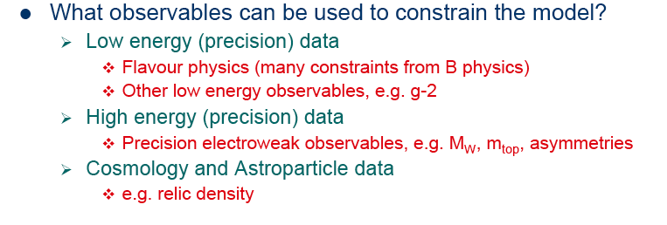
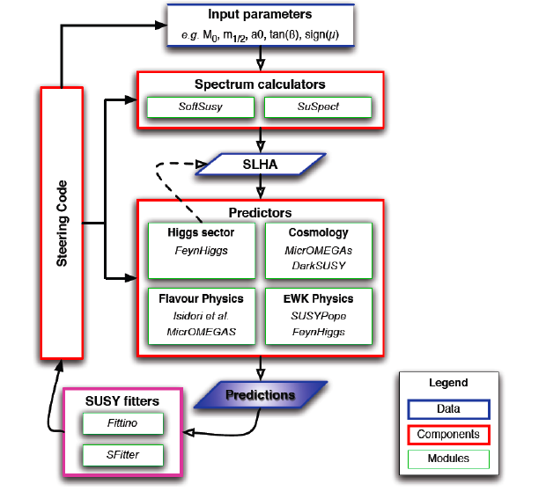
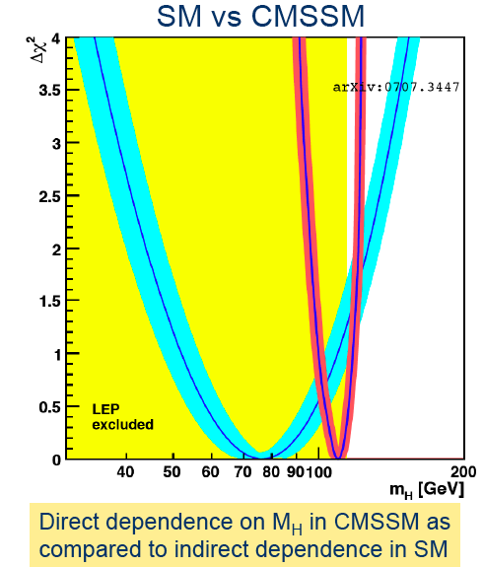
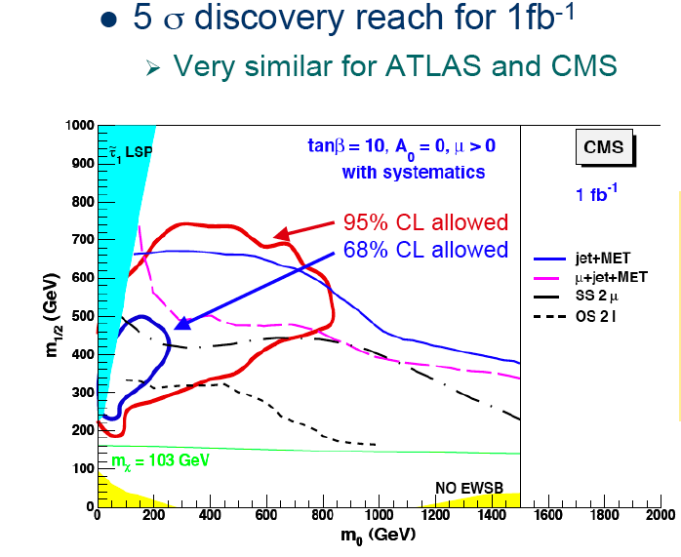
Framework for a New Physics impact on precision variables
Flacher
Public soon

Slide 6
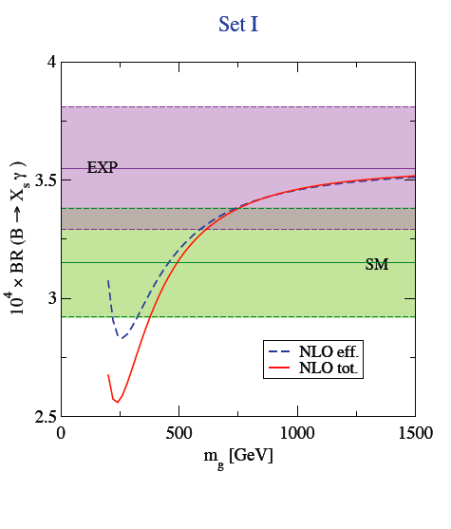
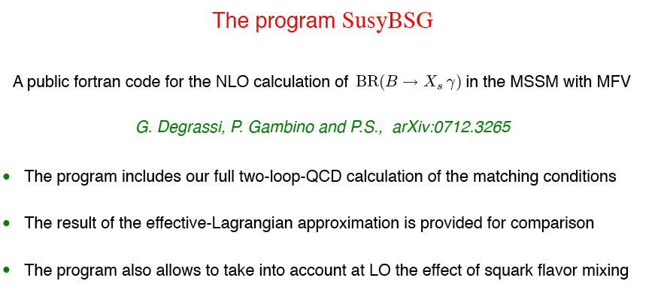
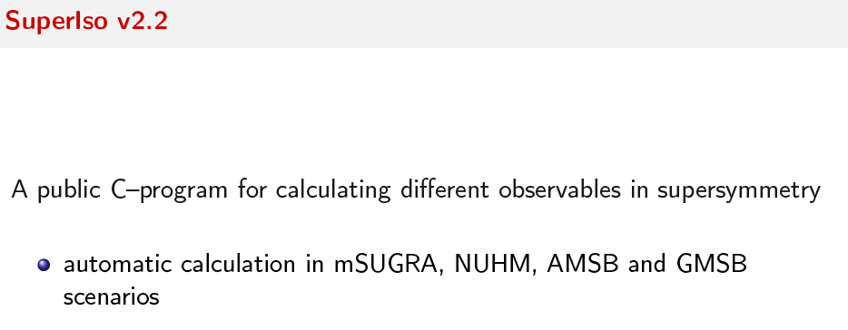
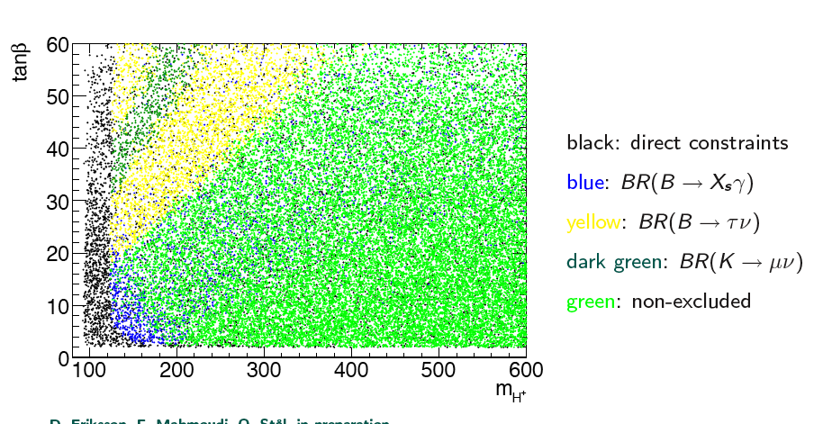
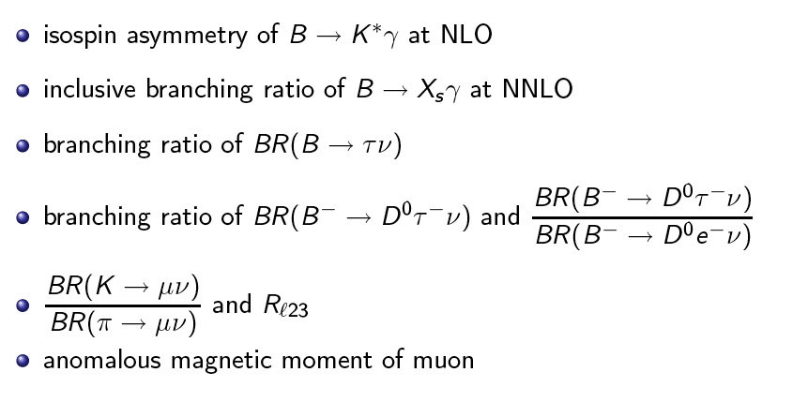
Flavor precision constraint tools
(Nazila, Slavich)
Study the case of SuperB?

Slide 7
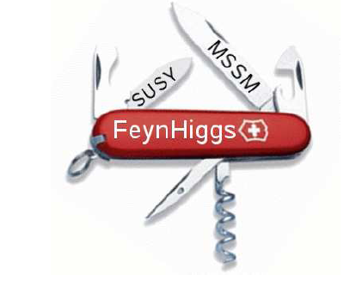

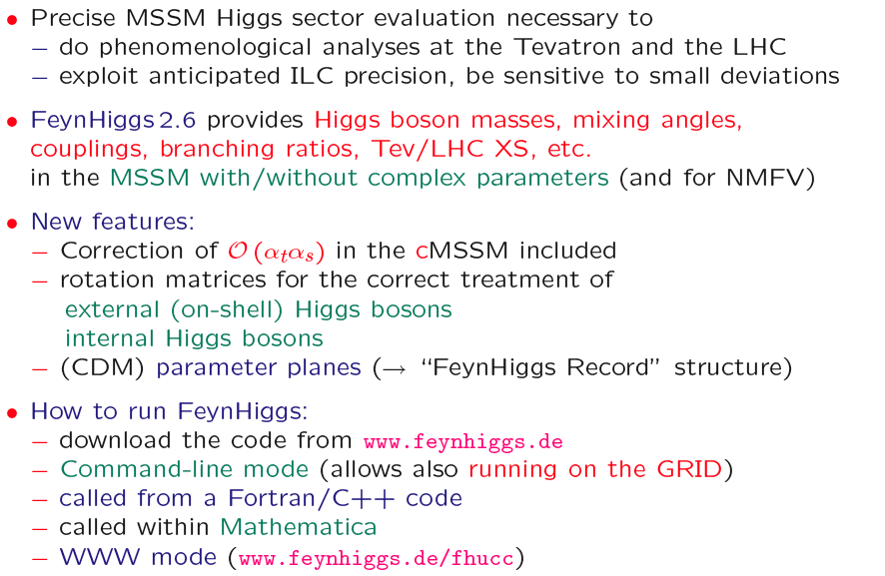
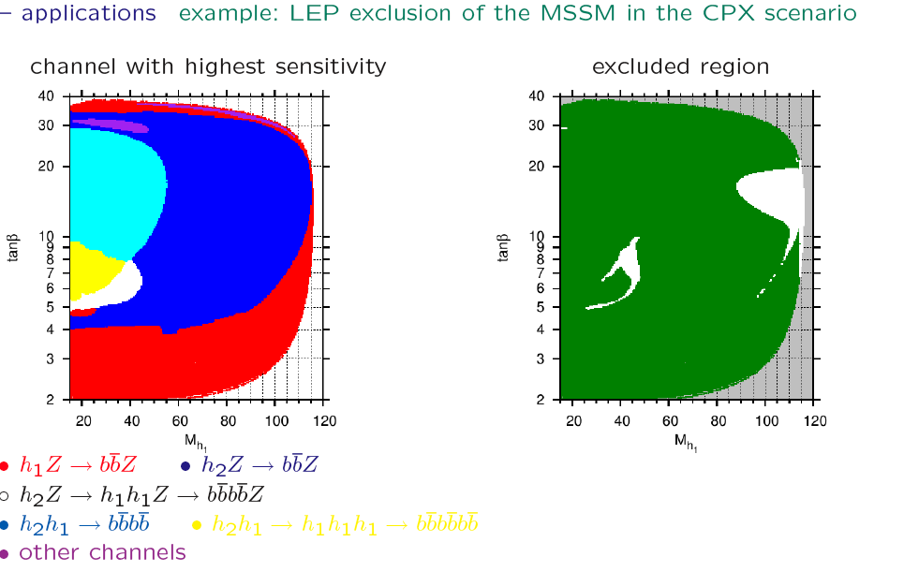
And the Higgs? (Brein, Williams, Heinemeyer)
Peskin
A method to analyse data with arbitrary types of Higgs

Slide 8
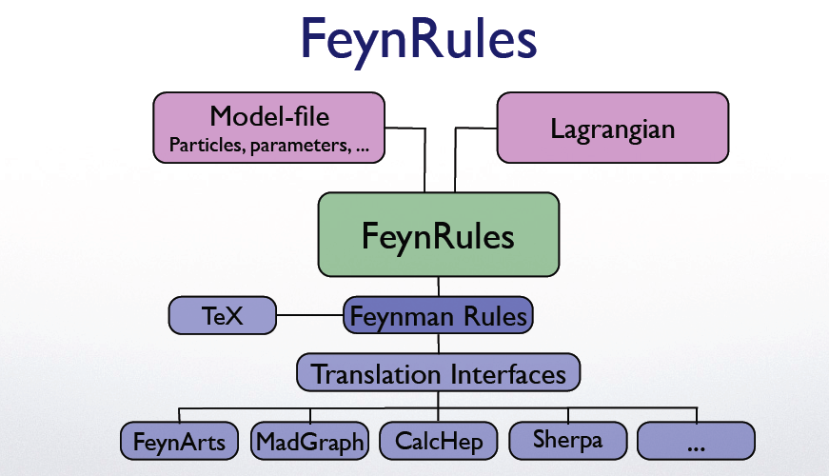
A higher level of Abstraction: FeynRules
Constructing Feynman rules out of any Lagrangian (Duhr,Christensen)
« Feynman diagrams are like the silicon chip they gave computation to the masses »
The jealous Julian Schwinger

Slide 9
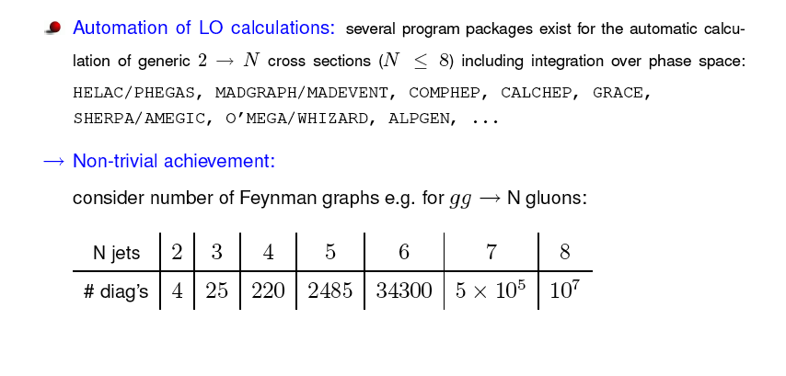
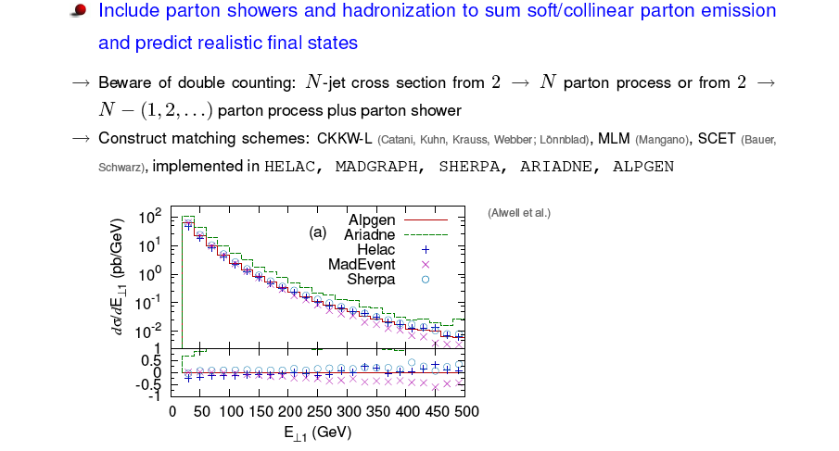
State of the art (Kramer, Maltoni)
Tree level calculations have falen in the public domain

Slide 10
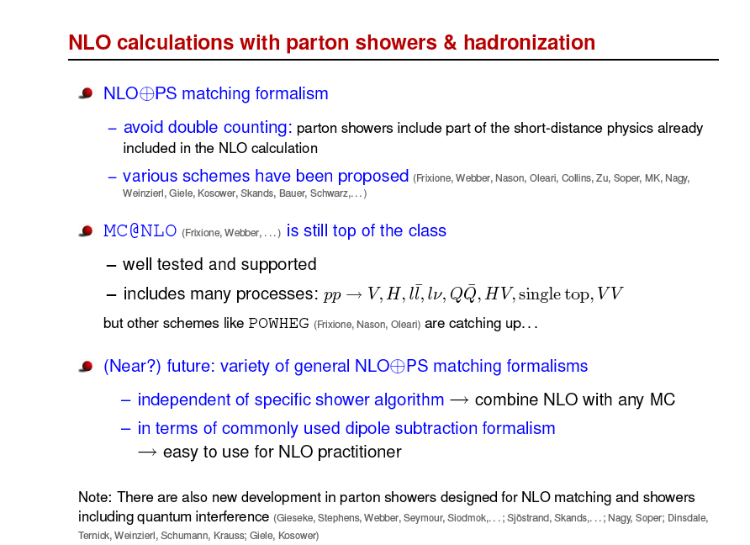
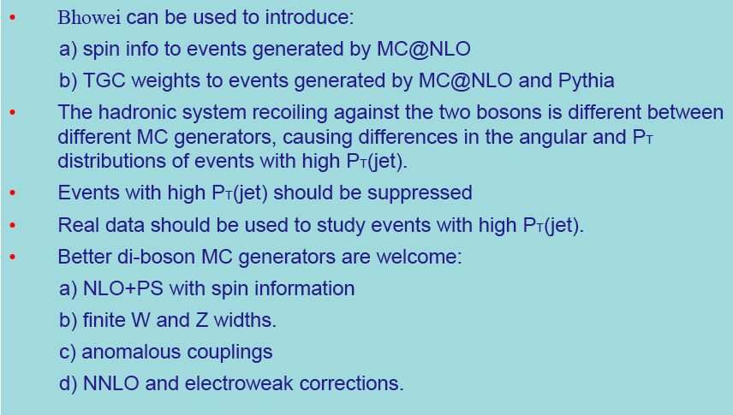
NLO
Booijmans, Bella
Dibosons

Slide 11
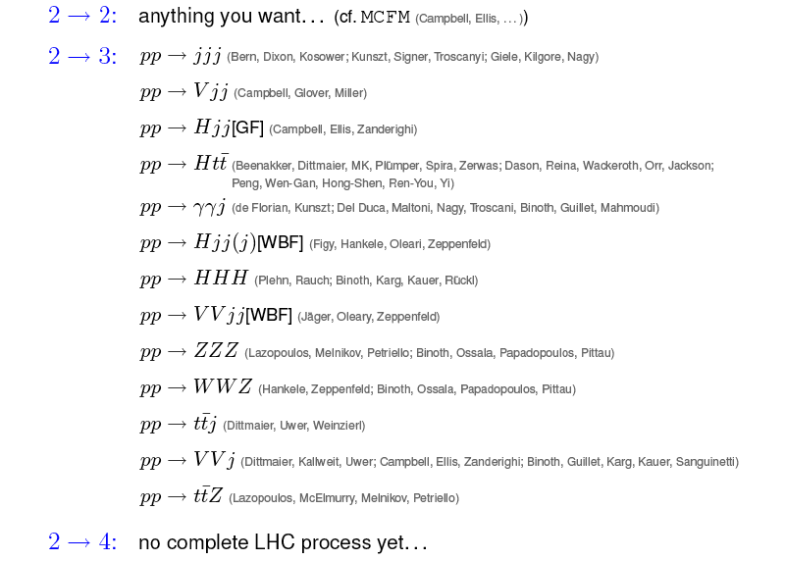
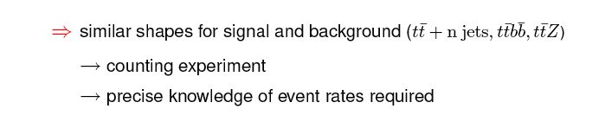
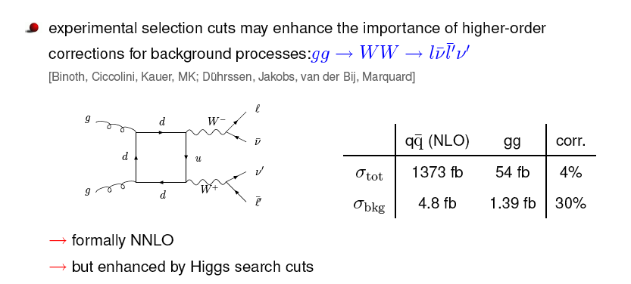
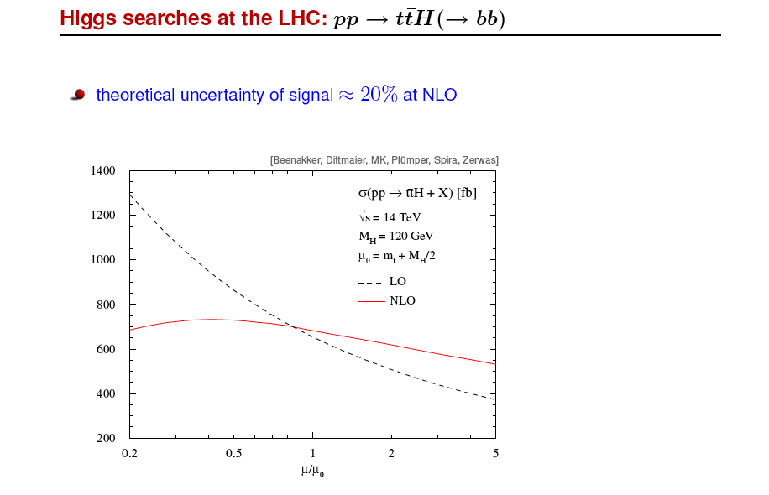
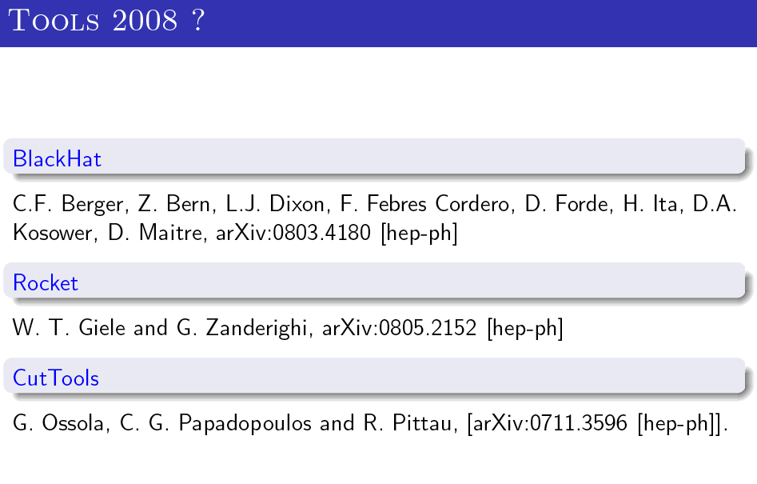
We need NLO at the LHC (Kramer, Papadopoulos)

Slide 12
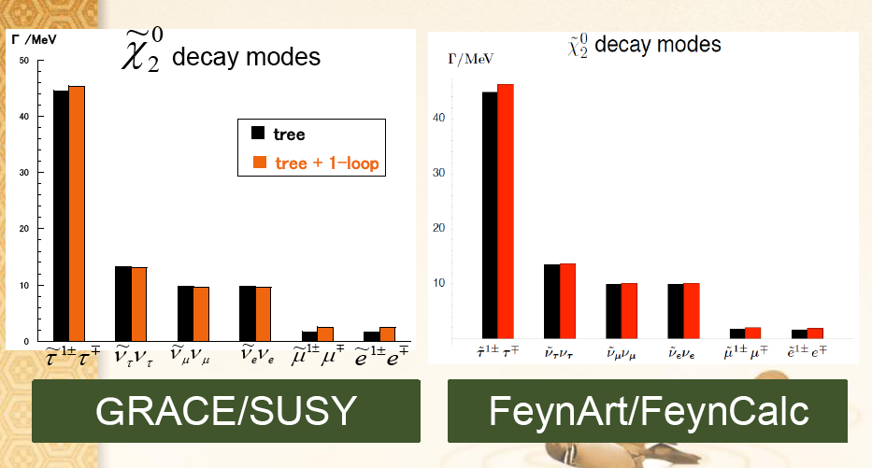
1-loop corrections (2->2, 1->3 processes)
GRACE/SUSY (Jimbo) but also FeynArts/FeynCalc
Comparisons GRACE/SUSY, FeyArts/FeynCalc in discussion
  2-loop Neutralino/chargino/gluino masses (POLXINO)
    Weakens renormalisation scale dependence, mandatory for gaugino-like neutralinos

Slide 13
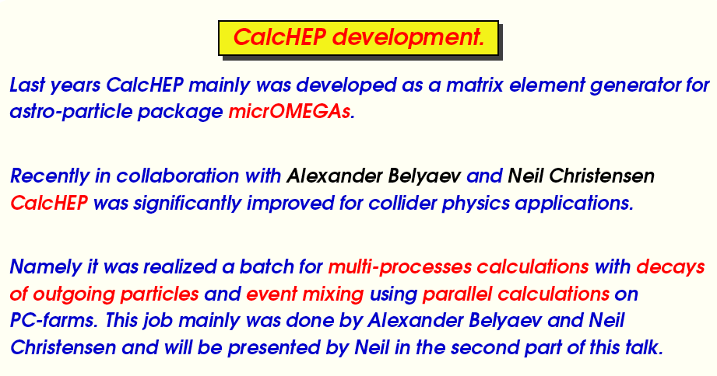
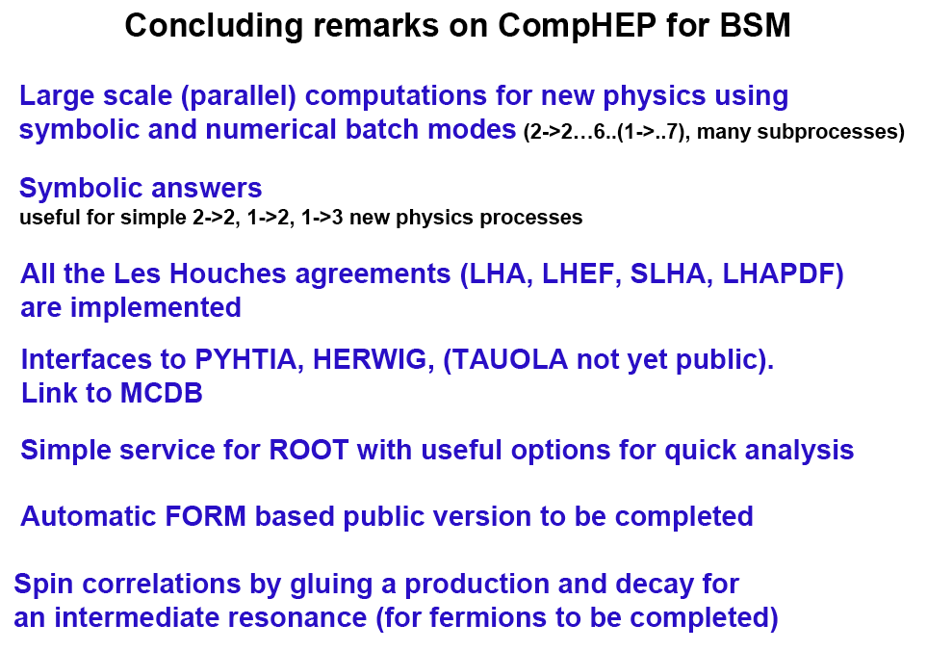
CalcHEP, CompHEP go parralel (among other features)
(Pukhov, Boos)
IN VIEW OF UPCOMING LARGE COMPUTATIONS PARALLLISM A NECESSITY?
CalcHEP application on WTC Frandsen

Slide 14

Generators in C++ PYTHIA 8.1 (Ask) and status report on Herwig++ (Richardson
Pythia v8.1 (C++) was released Oct 2007
  physics content should be at the same level or improved with respect to Pythia 6.Tuning from experimental data remains!
The initial focus was on SM physics (QCD / EW), the implementation of several BSM scenarios have just started !
Several possibilities to use it together with external programs, e.g. external BSM processes from
  LHA interface for parton-level event files from ME generators
  Semi-internal process which is used to implement a parton-level process based on dσ/dt
Herwig++ is an ongoing project to provide a replacement for the FORTRAN HERWIG program.
Based on the same physics philosophy but with improved physics simulation based on the theoretical developments of the last 10 years, not just a rewrite.
There are many improvements to the simulation for both Standard Model and BSM physics, e.g.
  CKKW matrix element matching; MC@NLO; IVAN soft underlying event model;

Slide 15
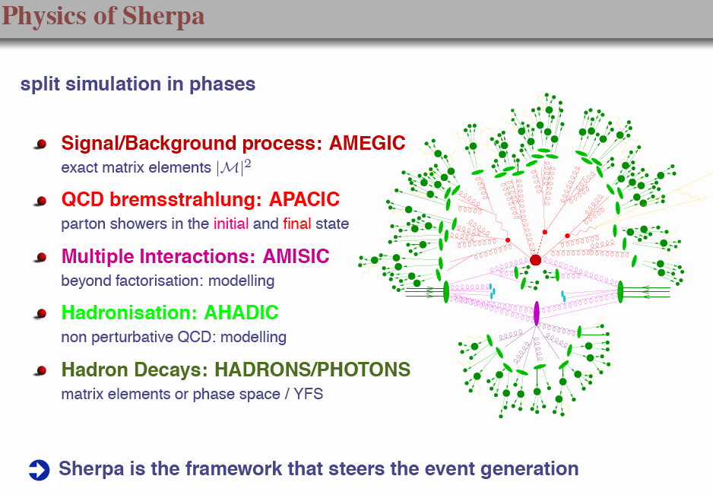
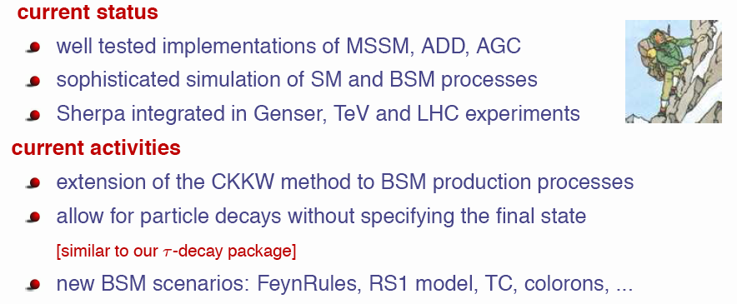

SHERPA (Schumann,Krauss)
Great tutorial

Slide 16
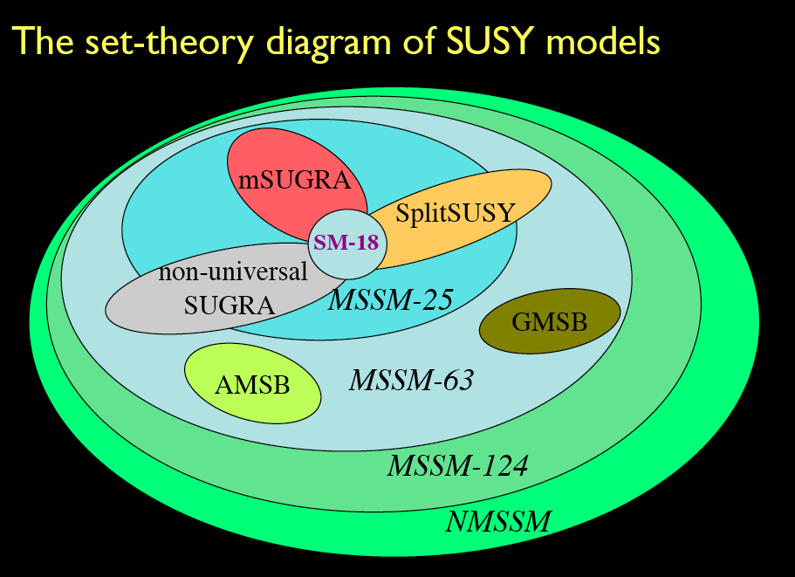
But do not forget: « PHYSIS KRYPTESTAI FILEI »
« Snature likes to be hidden » SHeraklitus
Phases?
At LEP2
SUSYGEN had them
NMSSM tools
C. Hugonie
SUSY is not the only theory ofcourse (Ohl)

Slide 17
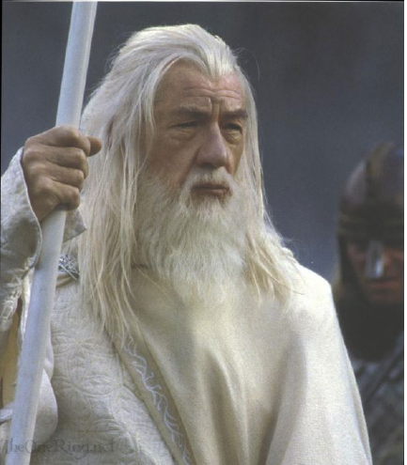
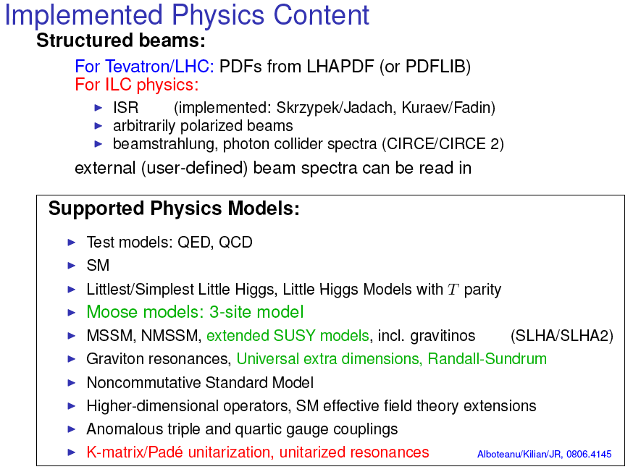
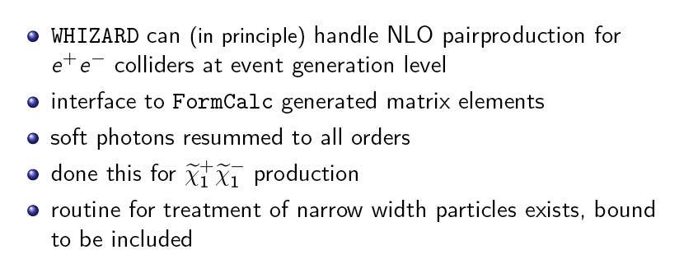
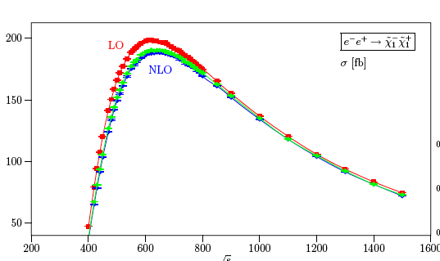
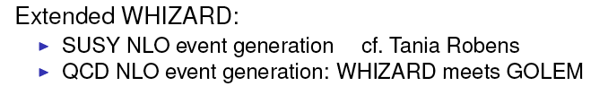
Whizard (Reuter,Robens)

Slide 18
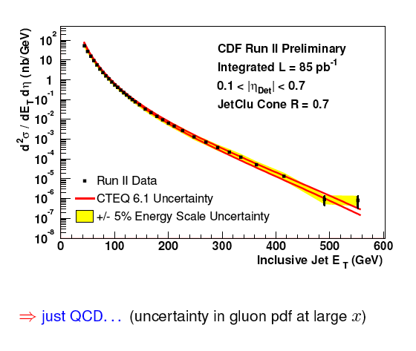
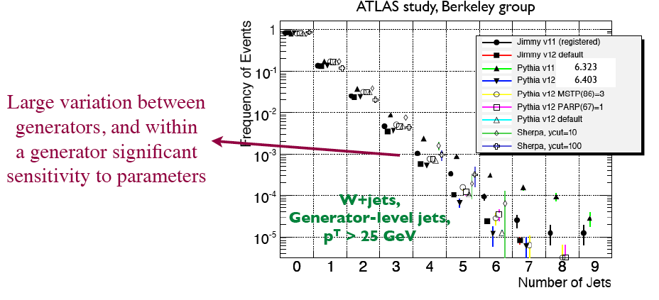
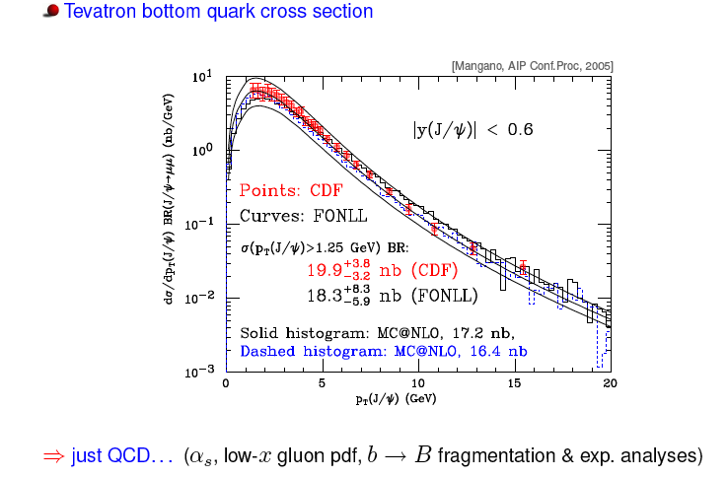
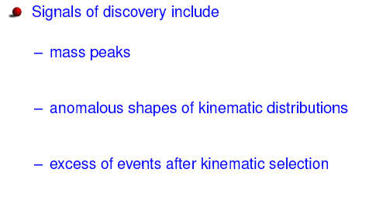
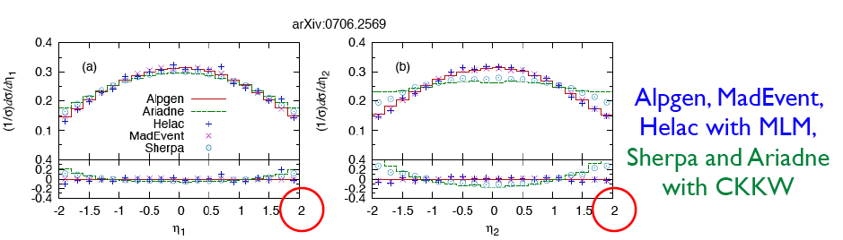
How may years till we understand LHC as we do the Tevatron. Is the Tevatron experience transferable? (Brooijmans)
Last MINUTE IDEA :
Use MCMC
with the standard model with a small excursion of paRameters to detect deviations from it?

Slide 19
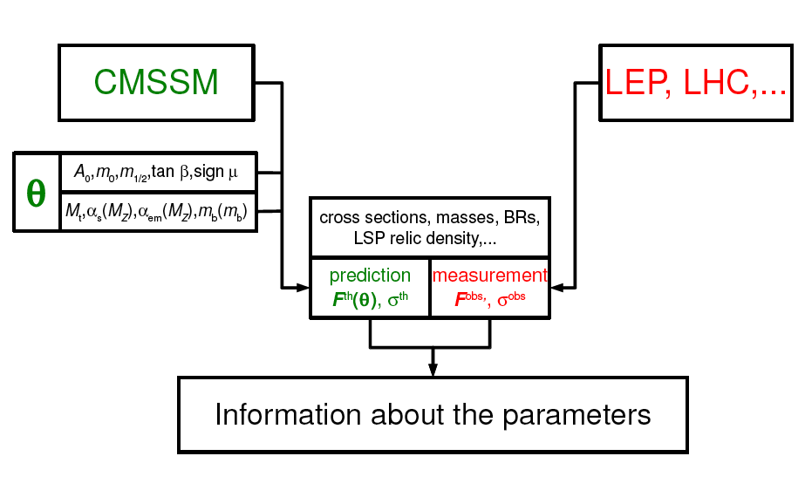
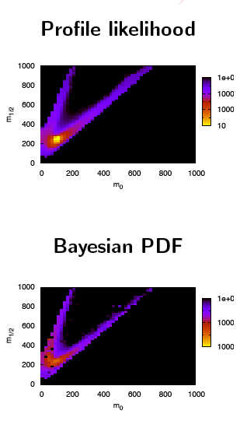
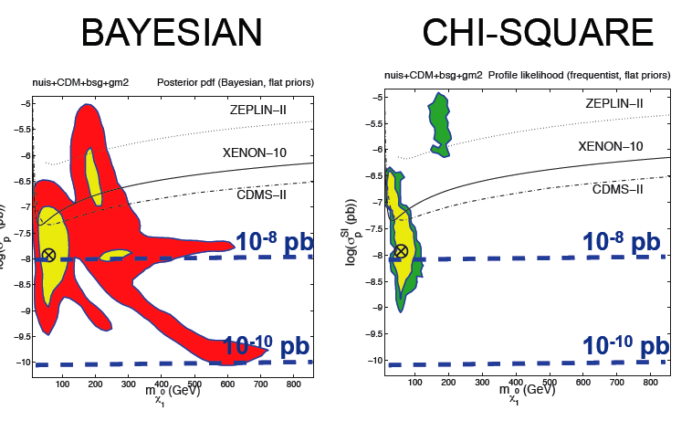
The hottest question. How does one extract information from candidate signals? (Schuster, Hamann, Trotta, Turlay) discussion at a higher level than eg susy-tools 2006
OSET (MARMOSET): Choose an appropriate set of candidate new particles. Approximate all production cross sections by constants. Choose appropriate decay modes for each particle. These might be 2-body decays or multi-body decays through effective operators. Approximate all decay matrix elements by constants. Fit the data to obtain the masses, cross sections, and branching fractions.
vs
MCMC,
Bayesian approach, likelihoods
SuperBayes,
Sfitter

Slide 20
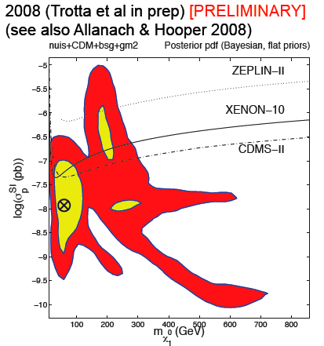
Fundamental questions and future infrastructures
1-n ton DM
LSST/SNAP/EUCLID…
ET/LISA
CTA/KM3/AUGERN
Megaton proton decay
1 ton neutrino mass
PLANCK/BPOL…
SuperBayes
Violent phenomena
galaxy formation and evolution
Unification
Proton decay
Neutrino
US=EU=175M€/y on astroaprticle
Dark
Mass/Energy
Gravitation
LHC/SLHC/ILC/CLIC…
ELT/TMT/JWST/SKA…
Origin
Cosmic
Rays
European roadmap
Enough work for TOOLS to the end of the Century

Slide 21
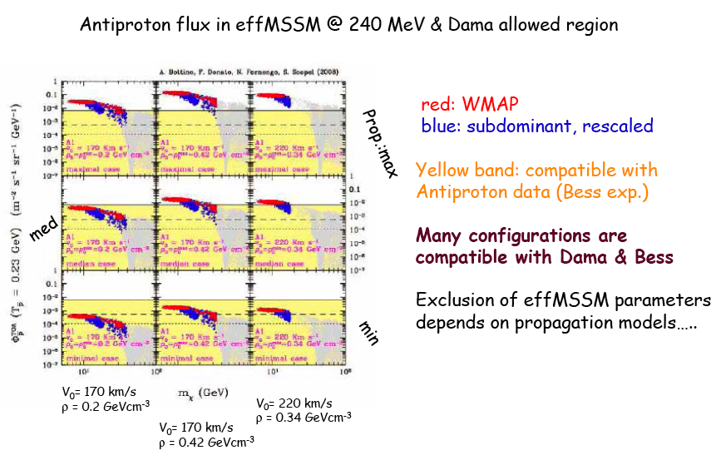



How can we link experimental domains in the search for DM ? (Donato, Gebauer, Lemrani, Trotta)
Is the DAMA modulation a DM signal?
Gerbier at SUSY08
In favour of MCMC, you need a model to link and give indices to the other domains
More data will help fix the astrophysical type distributions
DMtools:
Even theorists can analyse the data?
SuperBays : Looks Great

Slide 22




How one can influence the design of upcoming large infrastrcutures: example : SuperBayes and CTA

Slide 23
Conclusions
Two big questions for the XXIe: the nature of electroweak symmetry breaking and dark matter (Peskin)
  Do they have the same answer?
Many projects moved from the status of
  « Plan to implement » or « still private code but we hope to make it public soon » to
  mature packages of the type « you can find the code in www.mycode.org »
Also mature packages of cross-comparison of different domains (colliders, cosmology, astroparticle)
  More work needed here a lot of necessary codes of astrophysical type are private
  These codes are addressing part of the field, at what level should they be included in Tools?
A threshold has been crossed on automatic calculation of code. Entered its mature phase
  The nature of the calculation (and analysis) moves to large scale computing schemes, should we think about it?
A hot debate on how to analyse the data, it has become more precise since the time of SUSY2006, now at least 3 tools exist
The tools should give pecise answers to science policy questions (e.g. SuperB, CTA)
A LOT OF HARD WORK,accompanying billion type infrastructures, should we noot think of more advanced forms of coordination, organisation, education of the new generation?

Slide 24
Thanks to the organisers for preparing the last Tools conference of the pre-LHC era
Remember the old bet at the SLAC bet-book:
Okun against Gribov has entered
« I bet Supersymetry will be discovered before SSC enters into operation »
Did he win the bet : NO since Sid Drell (if i remember well) made the counterbet:
« I bet Supersymmetry will be forgotten before SSC enters into operation »
Let us hope that soon we will collect the money from both

