Slide 1
Multiphysics simulations of onset of vacuum electrical breakdowns
Flyura Djurabekova
Helsinki Institute of Physics and Department of Physics
University of Helsinki
Finland

Slide 2
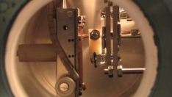
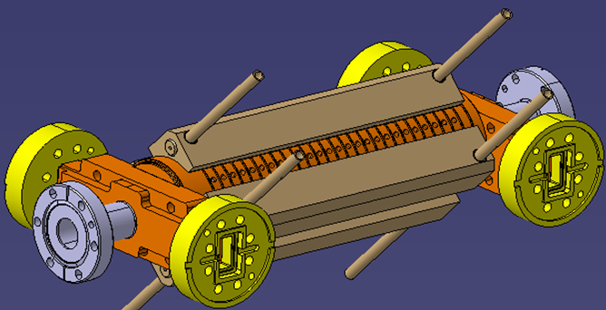
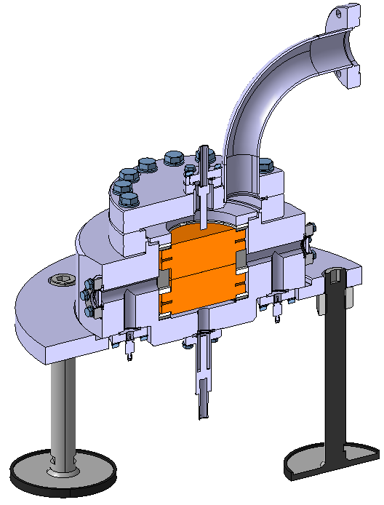
Breakdowns in ultra high vacuum
We are developing the model, which will be able to describe the processes involved in the processes of electrical breakdowns in rf and dc-fields.
Fixed gap DC setup
CERN DC setup
CLIC rf-AS

Slide 3
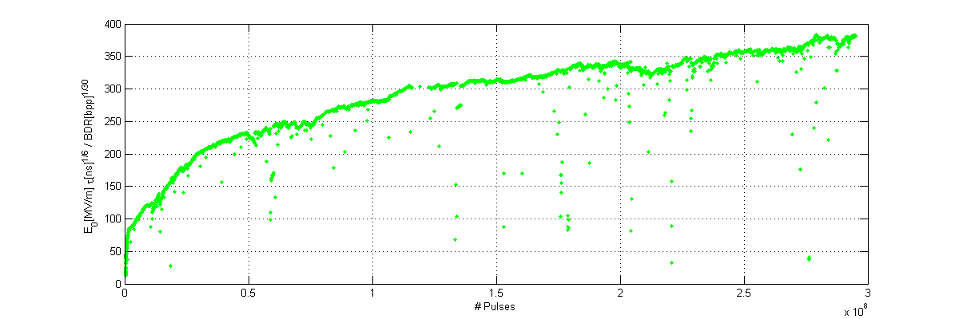
Conditioning history of AS at CERN
11168 BDs
CERN TD26R05CC conditioning history plot
The conditioning behaviour of a CLIC prototype accelerating structure. The time corresponds to over four months of operation at 50 Hz. The vertical scale is the accelerating gradient normalized for pulse length and breakdown rate.

Slide 4
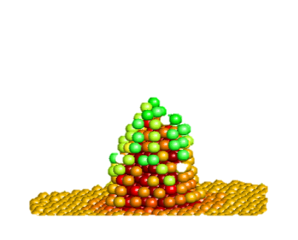
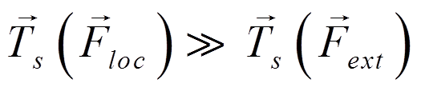

Mechanisms on and under the surface in the presence of electric fields
q_{s}↔F_{ext} interaction ⇒ surface tensile stress
-
-
-
Joule heating
- - - - - - - - - - - - - - - - - - - - - - - - - - - - - - - -
surface charges, q_{s}
electromigration
dislocations emitted from a void
Cu

Slide 5
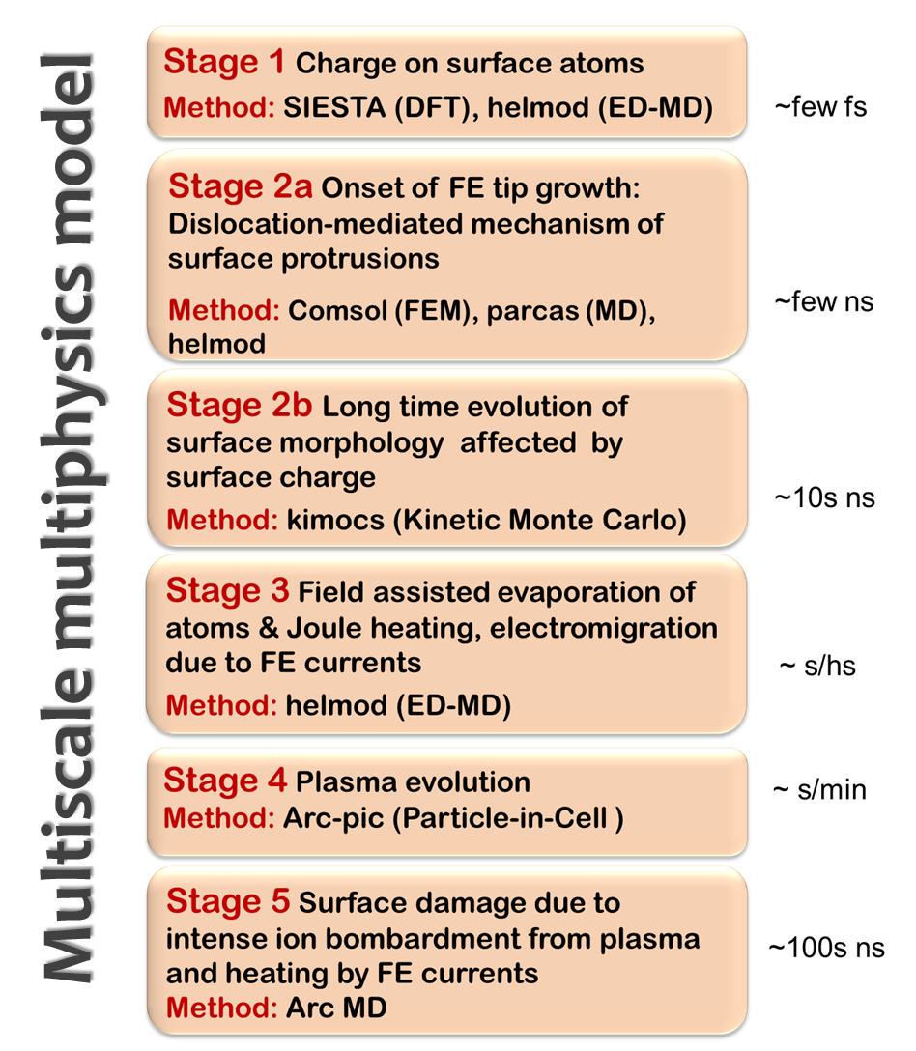
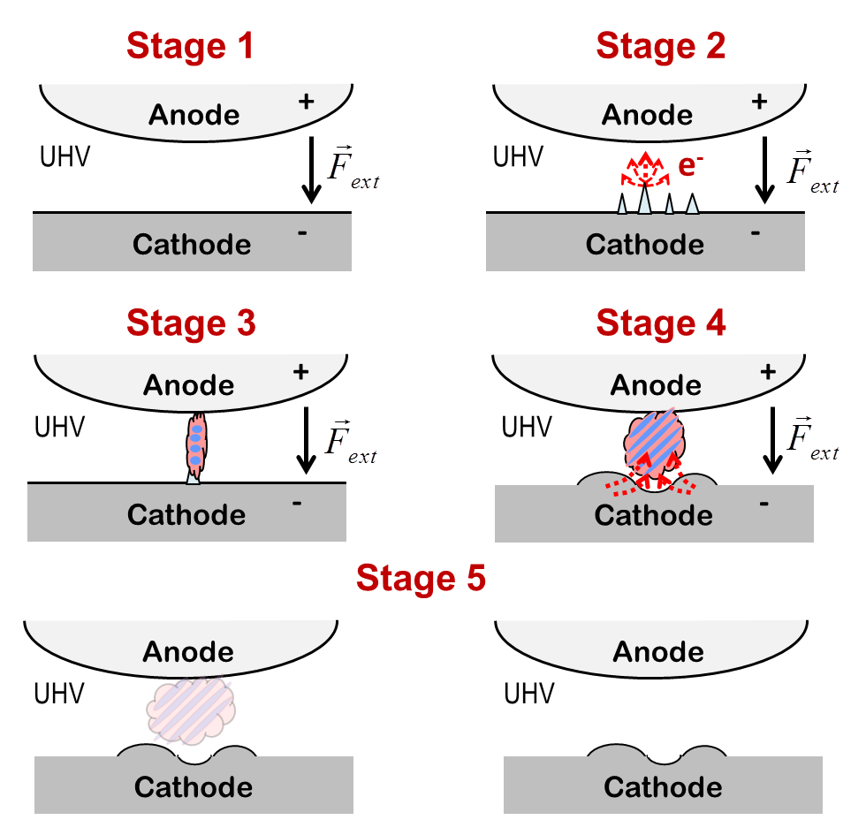
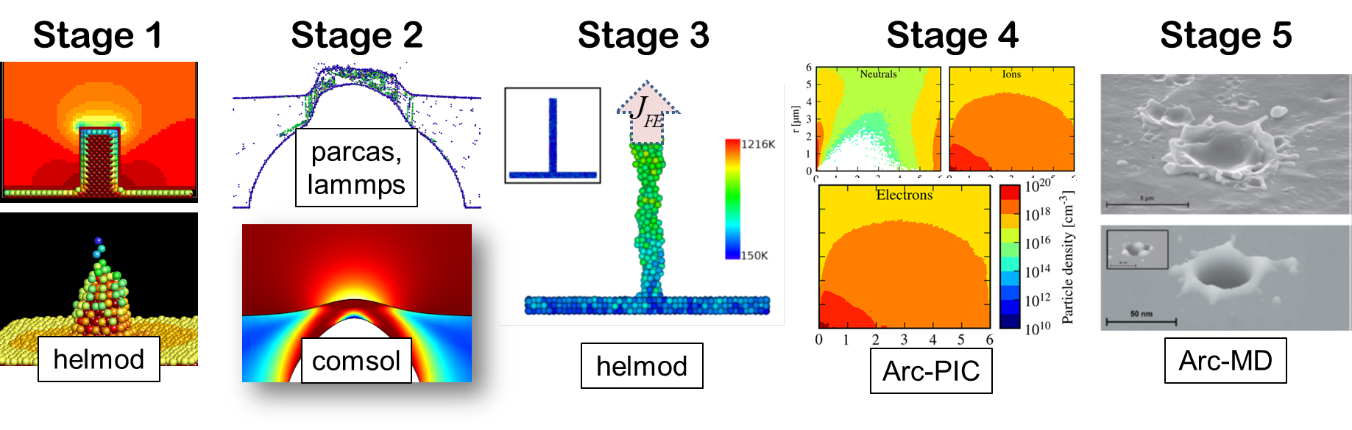

Slide 6


External electric field in MD simulations
Macroscopic field to…
Gauss law by ’pllbox’ technique
Due to the external electric field the surface attains charge
…the atomic level:
Two electric forces modify the motion of charged atoms:
+

Slide 7
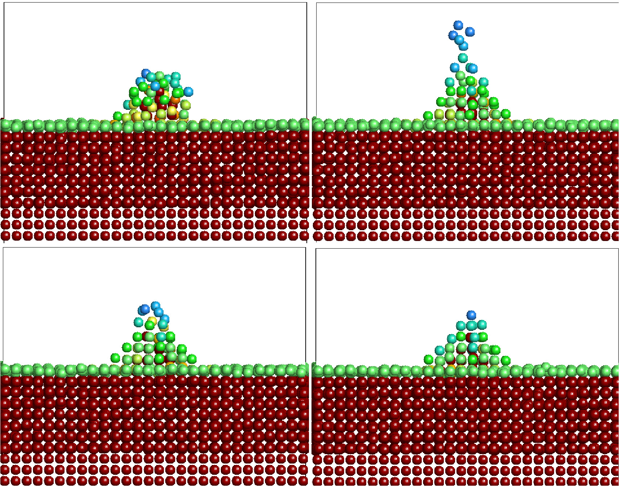
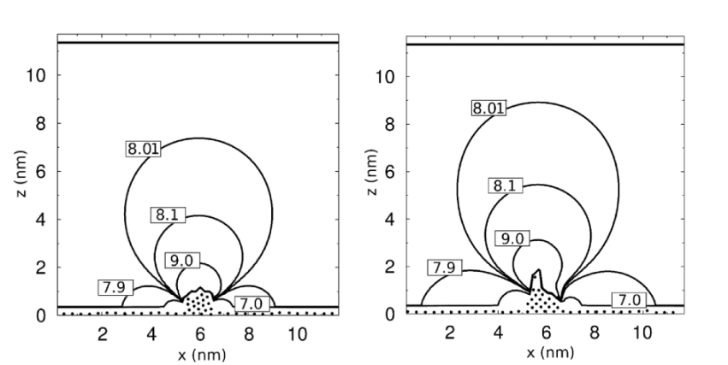
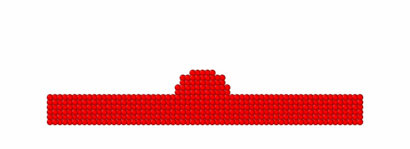
Charges on surface atoms in MD
Charges on surface atoms are calculated by using our helmod code – hybrid ED-MD code, based on classical MD (molecular dynamics) code.
The dynamics of atom charges follows the shape of electric field distortion on tips on the surface
The atoms leave the tip as a result of evaporation enhanced by pulling effect from the external electric field.
  No electromigration or interaction with electrons are taken into account so far
q_{at} ≤ 0.03e
Distribution of the electric field is dynamically calculated by solving Laplace equation
Details in [F. Djurabekova, S. Parviainen, A. Pohjonen and K. Nordlund, PRE 83, 026704 (2011)]
Notes:
Applied field F_{ext}=10 GV/m, the ambient temperature T=500 K
Ramping rate ΔF/Δt=0.05 V/Å⁻¹fs^{-1/2}

Slide 8
Helmod vs SIESTA
Comparison of the results of both approaches gives reasonable agreement
Defect | Helmod | DFT, SIESTA
An adatom | 0.043e | 0.034e
Double adatom | 0.035e | 0.025e
A vacancy | 0.009e | 0.014e
Double vacancy | 0.01e | 0.013
4 vacancy | 0.01e | 0.01e

Slide 9
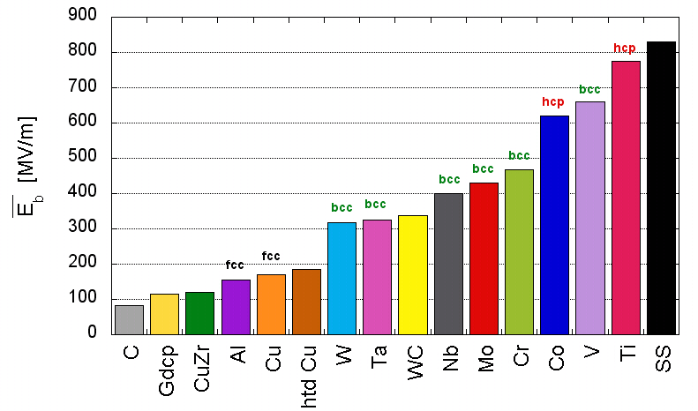
What are the field emitters?
Motivation to look in under the surface
The dislocation motion is strongly bound to the atomic structure of metals. In FCC (face-centered cubic) the dislocation are the most mobile and HCP (hexagonal close-packed) are the hardest for dislocation mobility.
A. Descoeudres, F. Djurabekova, and K. Nordlund, DC Breakdown experiments with
cobalt electrodes, CLIC – Note – 875 , 1 (2010).

Slide 10
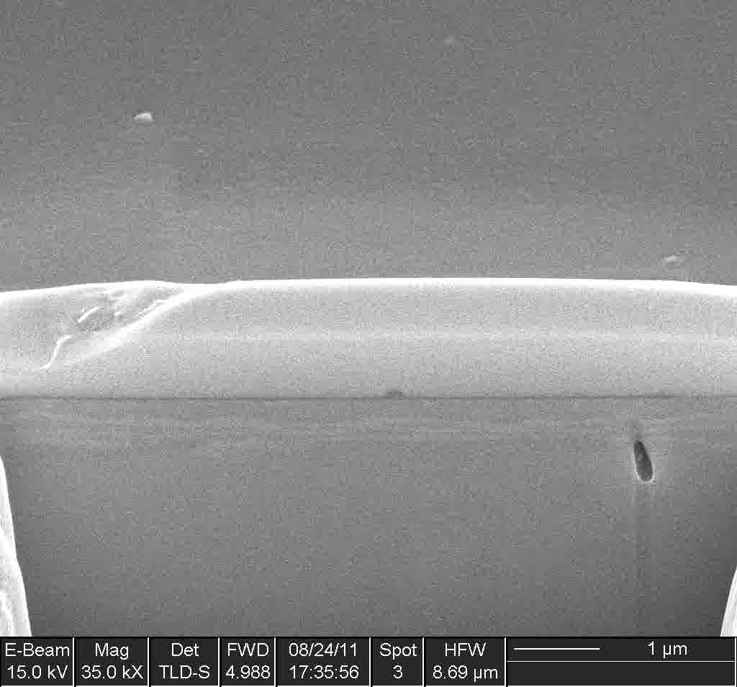
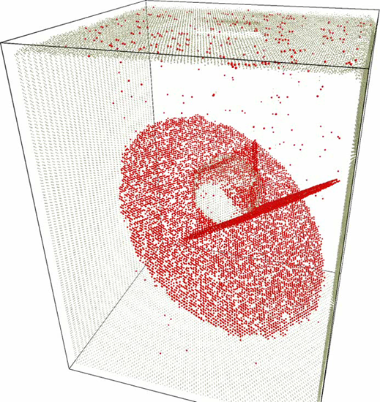
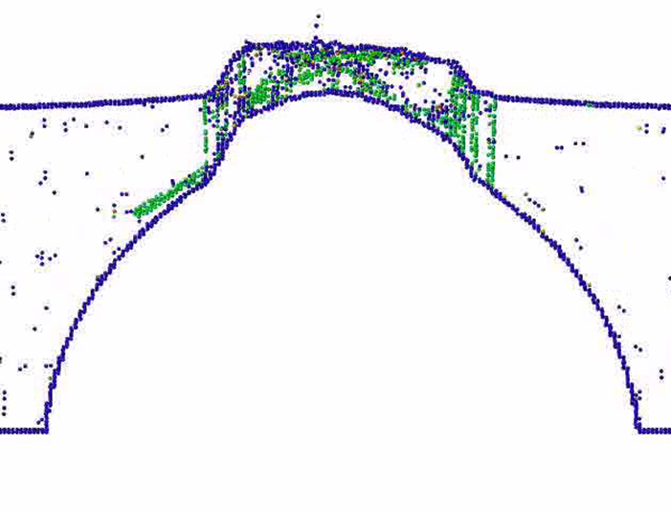
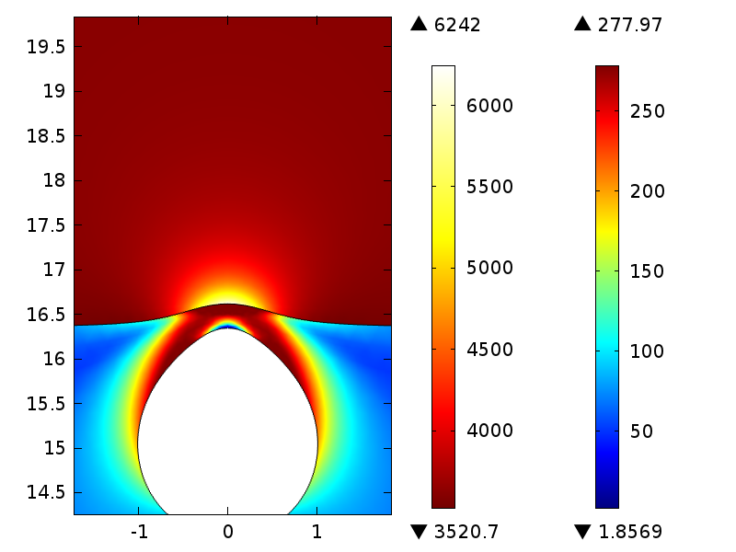
MD simulation of plastic activity under a high electric field
FEM
Behavior of a void under tensile stress due to an electric field (Simulations are done with the helmod code, where the electric field effect is accounted explicitly)
MD in [A. S. Pohjonen, S. Parviainen, T. Muranaka, and F. Djurabekova, JAP 114, 033519 (2013)]
FEM in V. Zadin, A.Pohjonen, A. Aabloo, K. Nordlund, and F. Djurabekova, Phys. Rev. ST-AB (2014),

Slide 11
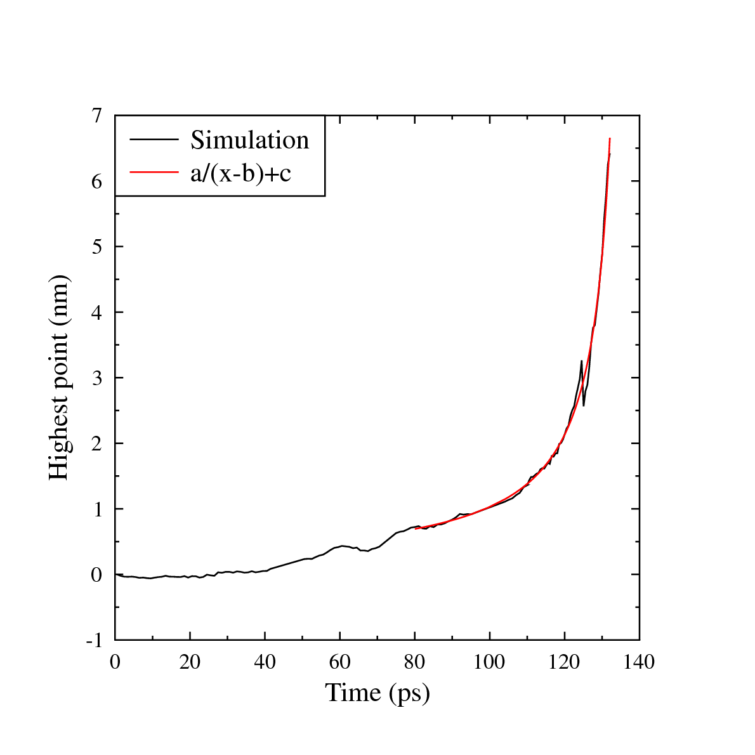
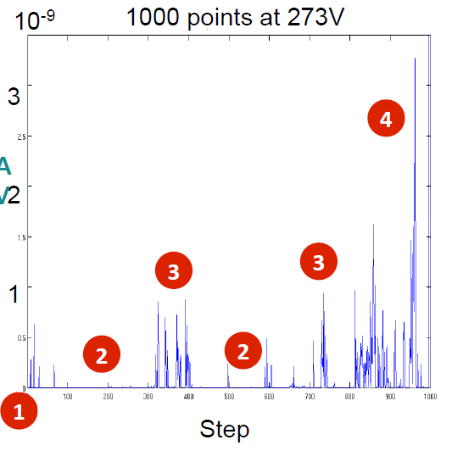
The “catastrophic” growth of a protrusion in the presence of the field
The analysis of the protrusion height increase shows an asymptotic character. Once it starts growing, the self-reinforcing effect of the field enhancement around the tip of the protrusion causes the increase of its height in the ”catastrophic” manner
Experiment by Tomoko Muranaka, CERN

Slide 12
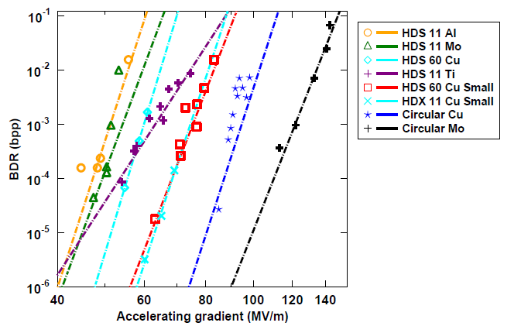
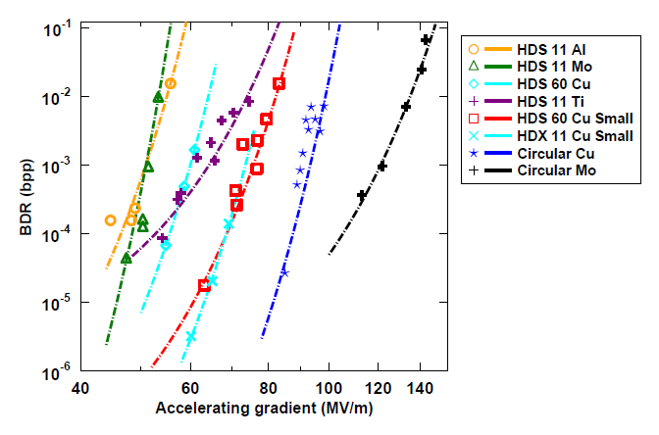
Dislocation-based model for electric field dependence
Now to test the relevance of this, we fit the experimental data
The result is:
Power law fit
Stress model fit
[W. Wuensch, public presentation at the CTF3, available online at http://indico.cern.ch/conferenceDisplay.py?confId=8831.] with the model.]
K. Nordlund and F. Djurabekova, Phys. Rev. ST-AB 15, 071002 (2012).

Slide 13
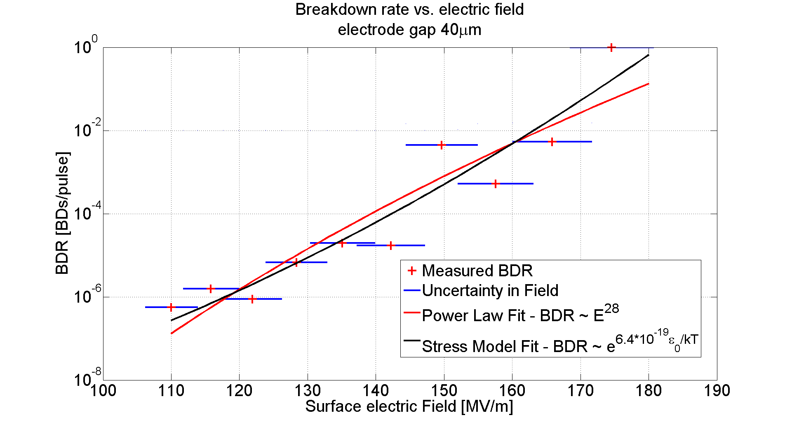
More data fit to the model
BDR in the pulsed dc (CERN)
Pulsed DC experiments also give a good agreement with the model.
As a preliminary test, we found that the same fitting parameters can reproduce both data taken from KEK (300K) and SLAC (45K) experiments.

Slide 14
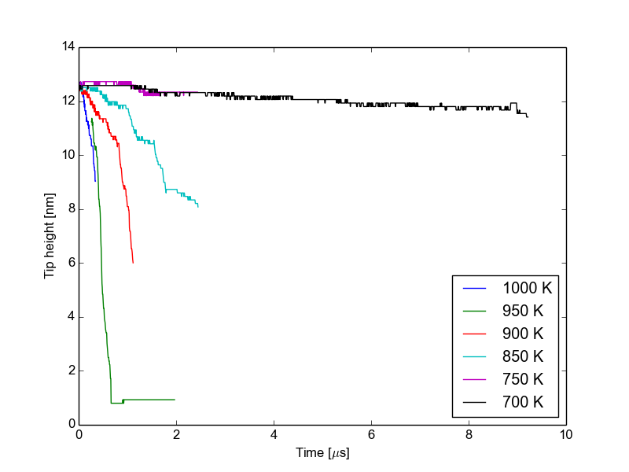
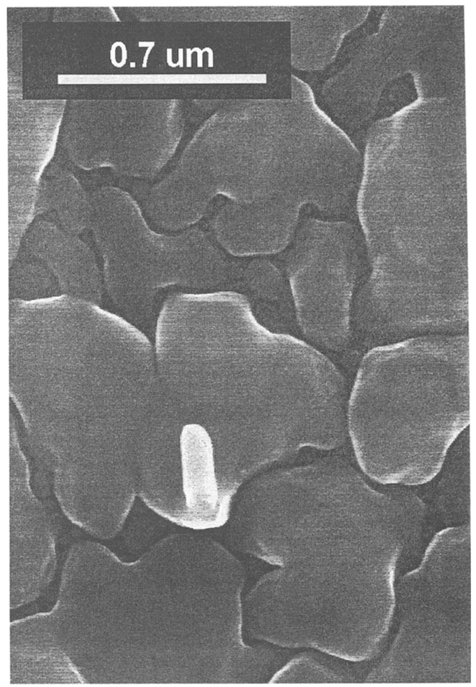
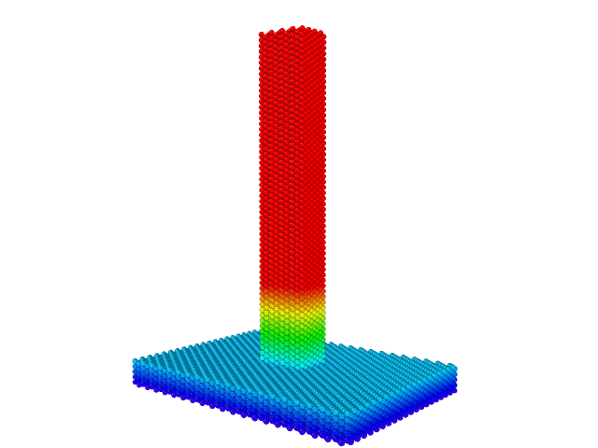
Stability of tips
By using different methods (MD, see talk by M.Veske and KMC, see talk by V.Jansson) we are analyzing the stability of the nanometric tips which can be the building up transient emitters
Copper tips with R <120 nm and H >300 nm have been found to be stable for months at RT
The height of the tip is as a function of time. At 300 K, the height was still unchanged after 10 ms.

Slide 15
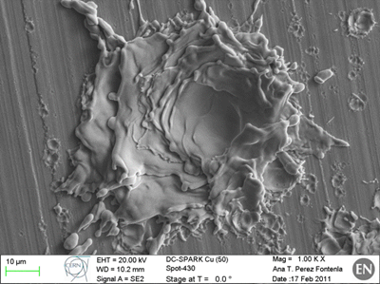
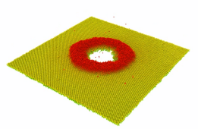
Surface damage by plasma ions
Plasma ions ( from actual PIC calculations):
E_{ion} = 55 eV
flux = 5x10²⁴ ion cm⁻²s⁻¹
1 ns
By combining two methods, MD and FEM, we can clearly distinguish between the regimes of crater formation and splashes (liquid phase instabilities) after the breakdown event (left).
Small size craters can be formed by the undeveloped plasma (sputtering yield (atom/ion) is less than 1) (bottom left)
Plasma time
11 ns
New T0
2.5 m
4 m
Old T0
Experiment

Slide 16
Summary
The model has been actively developed and gave many new insights in the physics of the plasma onset and surface damage
The model underlines the importance of mechanical properties of metal surfaces
Long term surface evolution is added into the model.
Surface damage formation is receiving a new perspectives

Slide 17
Thanks to:
Group in Helsinki
  Postoctoral researchers:
    Dr. Stefan Parviainen
    Dr. Ville Jansson
    Dr. Vahur Zadin (Tartu Univ.)
  Former group members:
    Dr. Aarne Pohjonen
    Dr. Helga Timko
    Dr. Lotta Mether
  PhD students
    Avaz Ruzibaev
    Simon Vigonski (Tartu Univ.)
    Mihkel Veske (Tartu/Helsinki)
    Ekaterina Baibuz
    Mrunal Parekh
Collaborators and colleagues
  Helsinki:
    Prof. Kai Nordlund
    Dr. Antti Kuronen
    Dr. Kenneth Österberg
  CERN:
    Dr. Walter Wuensch
    Sergio Calatroni
    Kyrre Ness Sjoebaek
  Hebrew university of Jerusalem
    Dr. Yinon Ashkenazy
You can find more information at http://research.hip.fi/hwp/acctech/accelerator-technology/m-a-t/

Slide 18
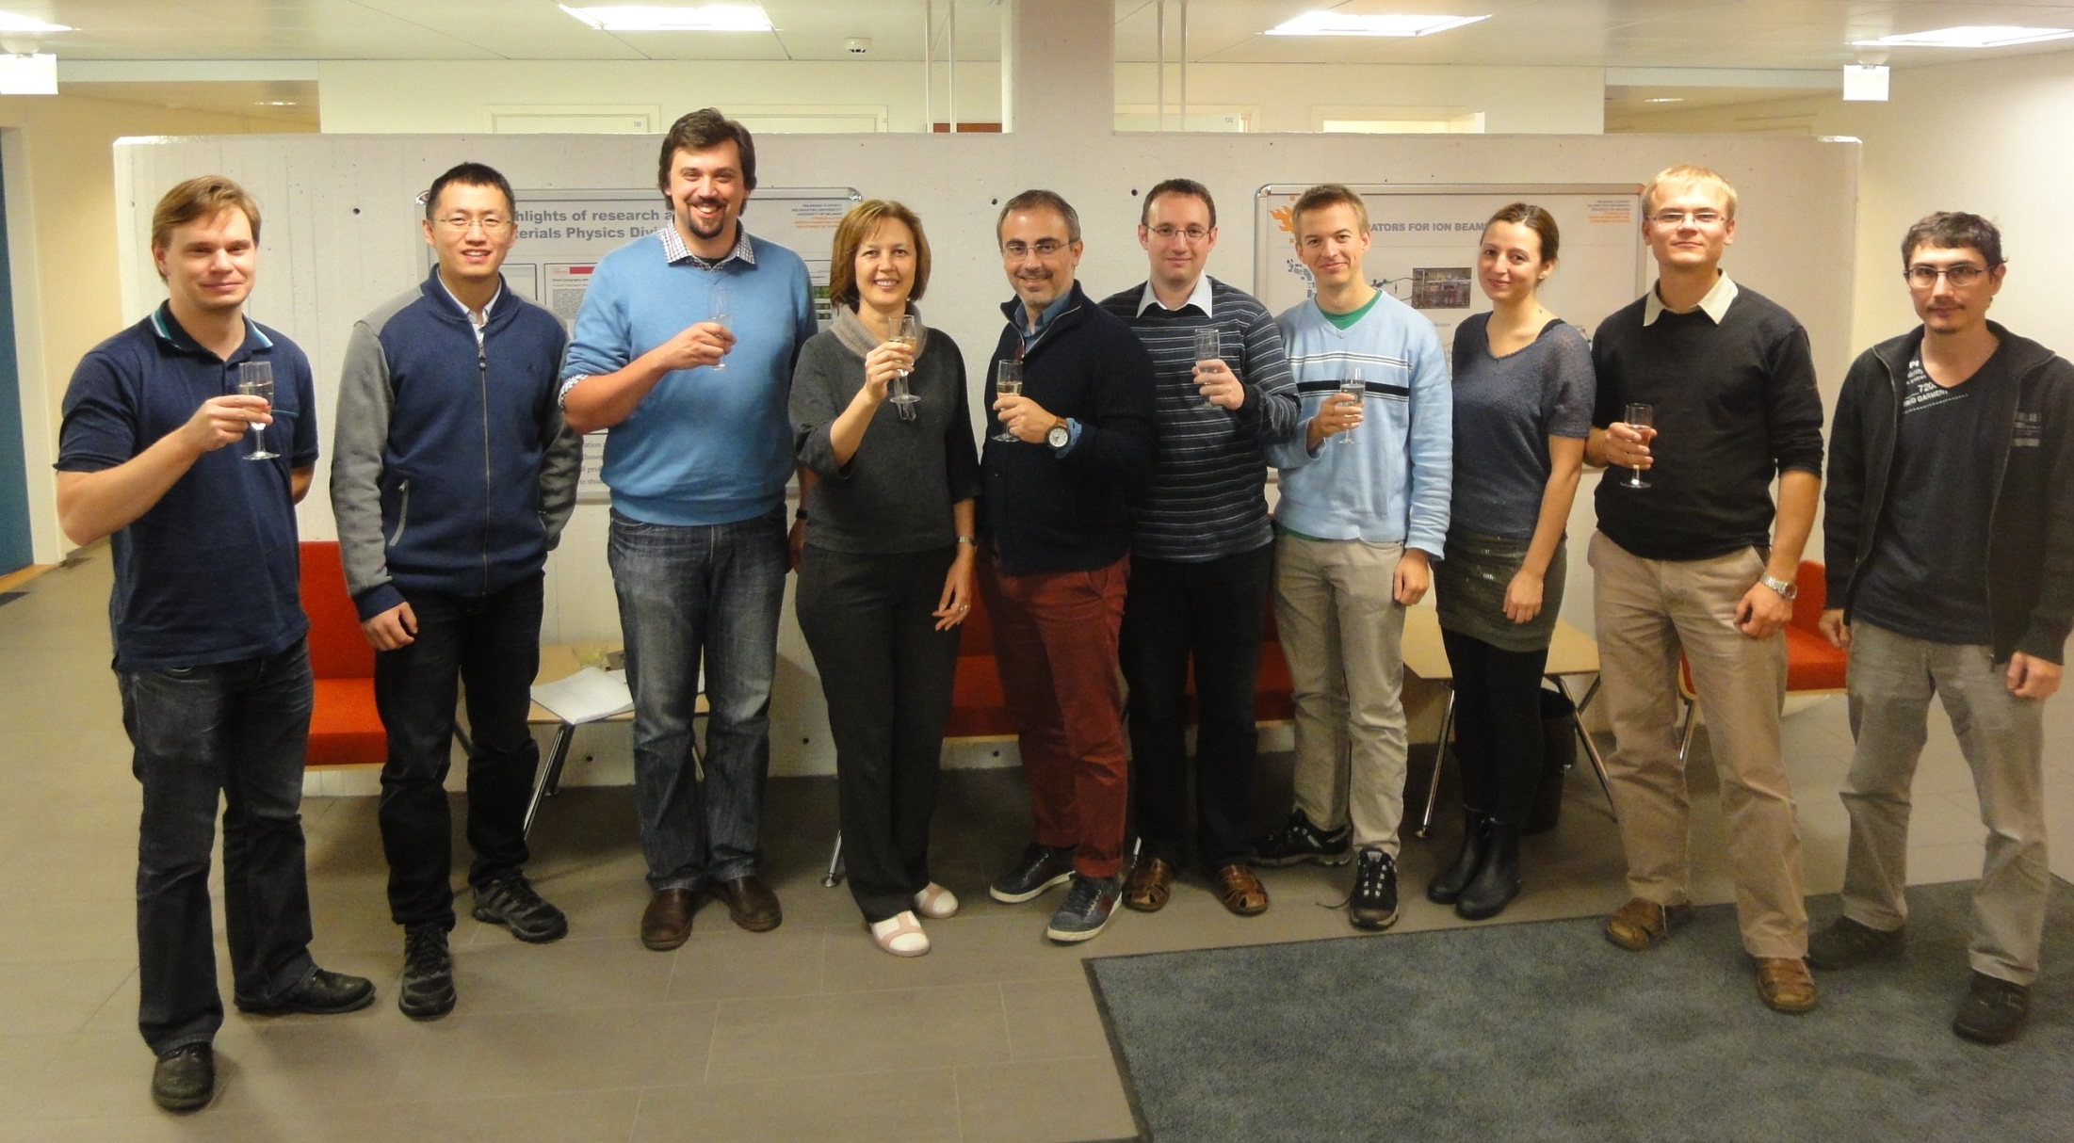
Thanks to:
Group in Helsinki
  Postoctoral researchers:
    Dr. Stefan Parviainen
    Dr. Ville Jansson
    Dr. Vahur Zadin (Tartu Univ.)
  Former group members:
    Dr. Aarne Pohjonen
    Dr. Helga Timko
    Dr. Lotta Mether
  PhD students
    Avaz Ruzibaev
    Simon Vigonski (Tartu Univ.)
    Mihkel Veske (Tartu/Helsinki)
    Ekaterina Baibuz
    Mrunal Parekh
Collaborators and colleagues
  Helsinki:
    Prof. Kai Nordlund
    Dr. Antti Kuronen
    Dr. Kenneth Österberg
  CERN:
    Dr. Walter Wuensch
    Sergio Calatroni
    Kyrre Ness Sjoebaek
  Hebrew university of Jerusalem
    Dr. Yinon Ashkenazy
You can find more information at http://research.hip.fi/hwp/acctech/accelerator-technology/m-a-t/

