Slide 1


Synthèse et Perspectives sur les Accélérateurs Linéaires
Maurizio Vretenar, CERN
Contribution Exceptionnelle de la France au CERN
12éme Réunion du Comité de Suivi du Protocole – Paris 28 Novembre 2014

Slide 2
Linacs: des accélérateurs qui s’affirment
 | LINEAR ACCELERATORS
 | Low Energy | High Energy
Protons | Injectors to synchrotrons, stand alone applications synchronous with the RF fields in the range where velocity increases with energy | Essential for higher beam intensity (increased luminosity or production of secondary beams) higher cost/MeV than synchrotron but: - high average beam current in the linac (high repetition rate, no resonances, lower beam loss) - higher accumulated intensity in the synchrotron (less space charge tune shift with higher energy linac)
Electrons | Conventional e- linac simple and compact | Linear colliders do not lose energy because of synchrotron radiation.
« traditional » linac range
« new » linac range

Slide 3
Linacs Protons et H- en Europe Occidentale
Renewed interest from late 80’s related to high-intensity
CONSTRUCTION
1960, RAL Linac,
50 MeV (70 MeV)
2016, CERN Linac4, 160 MeV
2020, ESS, 2.5 GeV
1959, CERN Linac1, 50 MeV
1969, CEA Saturne Linac, 20 MeV
1979, CERN Linac2, 50 MeV
1989, DESY Injector, 50 MeV
2020, FAIR injector, 70 MeV
IFMIF, D+,
1950
1960
1970
1980
1990
2000
2010
2020
Continued R&D 1990-2010 has built the competences for the new generation of linacs
ESS(1)
SPL (CERN)
CONCERT (F)
MYRRHA
IPHI (F)
CEA/CNRS and CERN have been at the forefront of these developments
PROJECTS

Slide 4
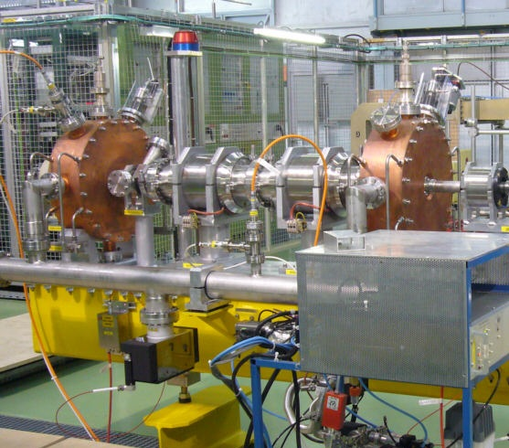
30 ans de collaborations fructueuses
Geographical proximity (CERN is 75% in France!) and historical relations allowed building a large number of frutiful collaborations in the field of proton linacs.
Favoured by close personal contacts, eg. Pierre Lapostolle.
EXAMPLES
First RFQs in Europe (CERN 1982, CEA 1983)
Test of IPHI DTL at CERN
Contribution to Linac4 Test Stand
Contribution to CEA Test Stand
Linac4 chopper
SC cavities
… (next slides)
Early collaborations
CERN-IPHI agreement (2001)
Exchanges SPL – CONCERT
HIPPI (High-Intensity Pulsed Proton Injectors)
JRA in CARE
Contribution Exceptionnelle Linac4
Linac4 chopper plates inside quadrupoles

Slide 5
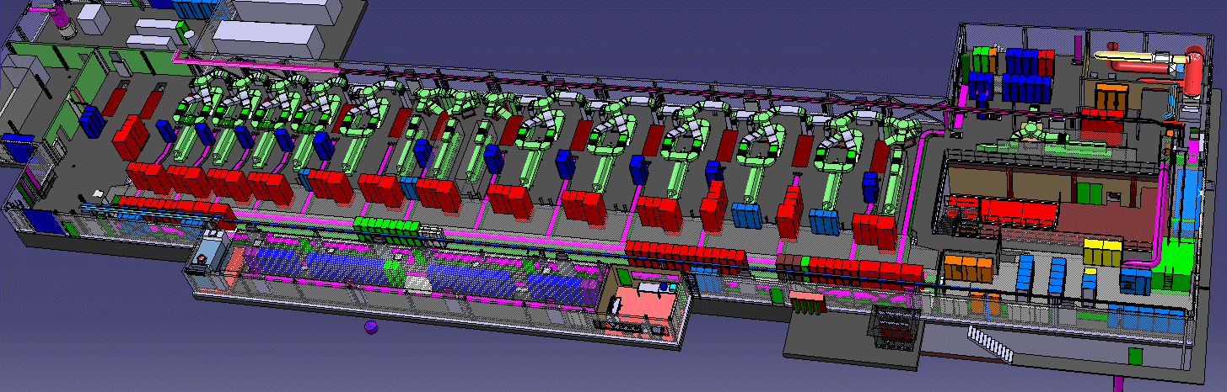
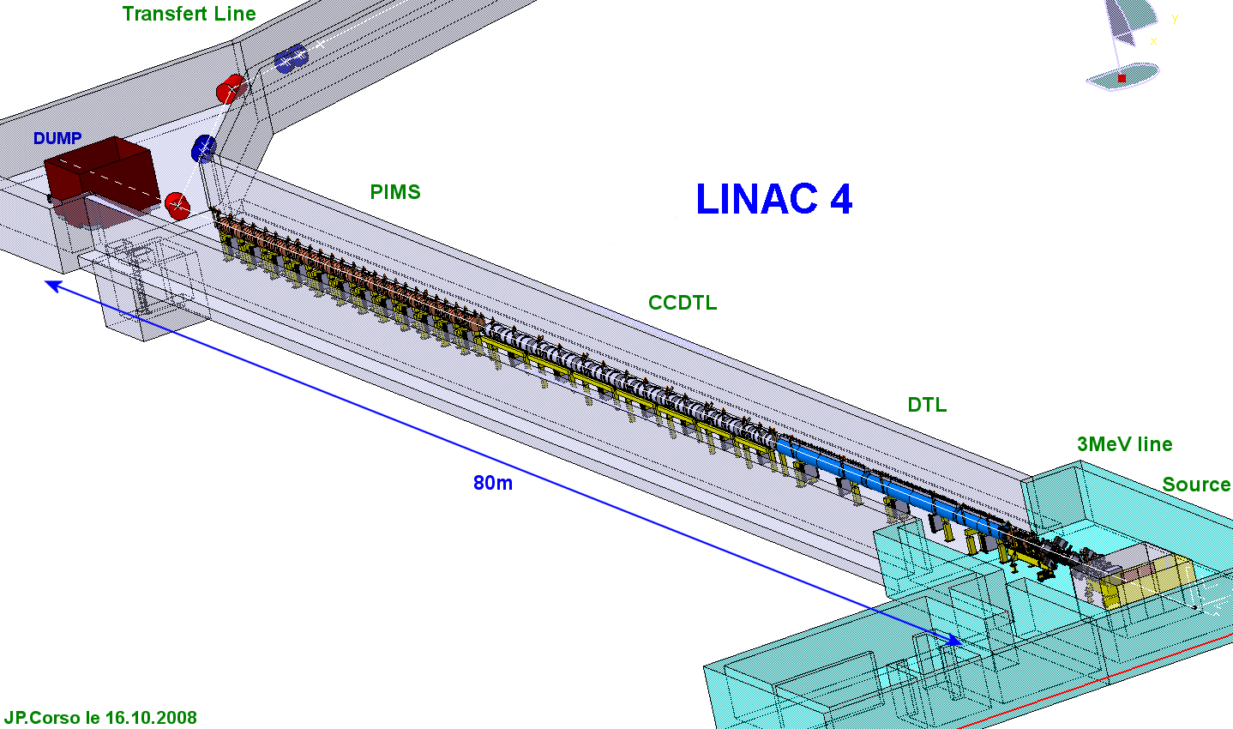
Les défis des linac modernes
Taking Linac4 as a reference
Radio-Frequency
Cost driver
Efficiency driver
Integration of new technologies (S.state, IOT,…)
RF distribution (cavities/klystrons)
Normal conducting section
Fabrication issues (β↑)
Integration of focusing scheme
Source and injector:
Performance driver (current, emittance)
RFQ fabrication and adjustment (cost, field quality)
And… the reliability !
(>95%)

Slide 6
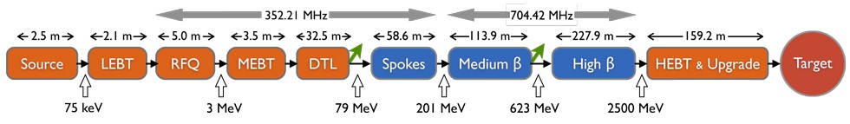
D’autres défis
Taking ESS as a reference
Superconducting section
Low β part (fabrication, focusing)
Vibrations, Lorenz detuning
SC cavities industrialisation
Cryomodule design
In general,
Beam optics for low loss
Details on the SC linac collaboration (SPL) in the next presentation

Slide 7
Les contributions au Linac4 - 1
Allowed to address together 2 technological challenges:
Accord Technique | Nom | Workpackages | Responsable WP CERN | Responsable WP CEA | Responsable WP CNRS
1 | L4 | 1.1 Design studies of the LINAC4 RFQ | C. Rossi | A. France | na
 |  | 1.2 Measurement and commissioning of the LINAC4 RFQ | C. Rossi | A. France | na
 |  | 1.3 Procurement and testing of buncher RF amplifiers | J. Broere | na | Y. Gomez
 |  | 1.4 Construction and test of klystron modulators | D. Nisbet | na | B. Mansoux
RFQ design, measurement, commissioning
RF related challenges: modulators, solid state amplifiers

Slide 8
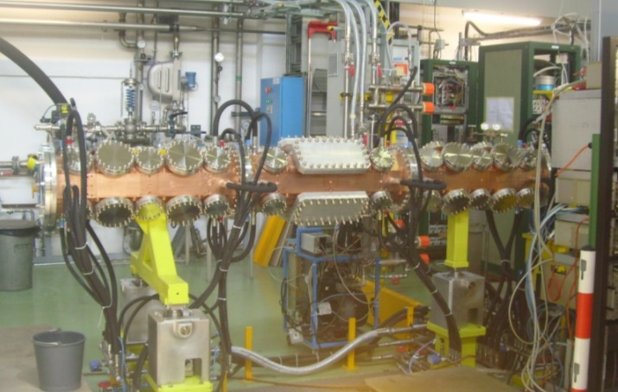
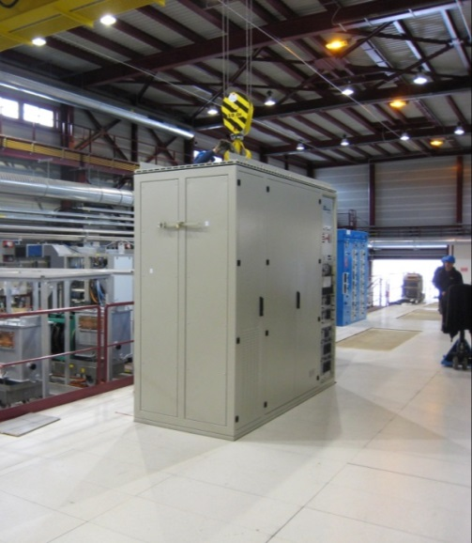
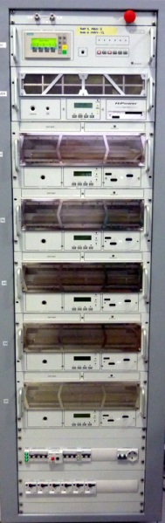
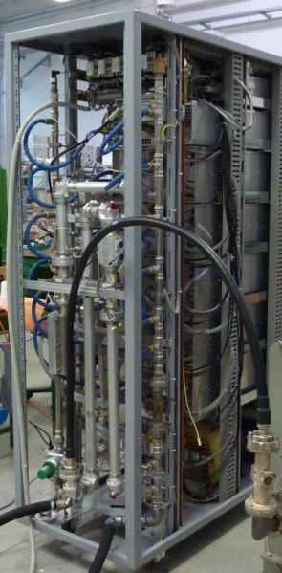
Les contributions au Linac4 - 2
The 3 Linac4 contributions have been a full success: the equipment is installed and properly running.
In the process we have encountered plenty of problems (see 11 CSP Meetings!) that were all solved together in an excellent collaboration spirit.
Examples (non-exaustive list): delays and brazing issues on the RFQ, vibrations on the measurement system, effect of copper tuners on field, selection of the modulator company, overcosts for modulators, EMC for amplifiers, delay in the amplifiers….

Slide 9
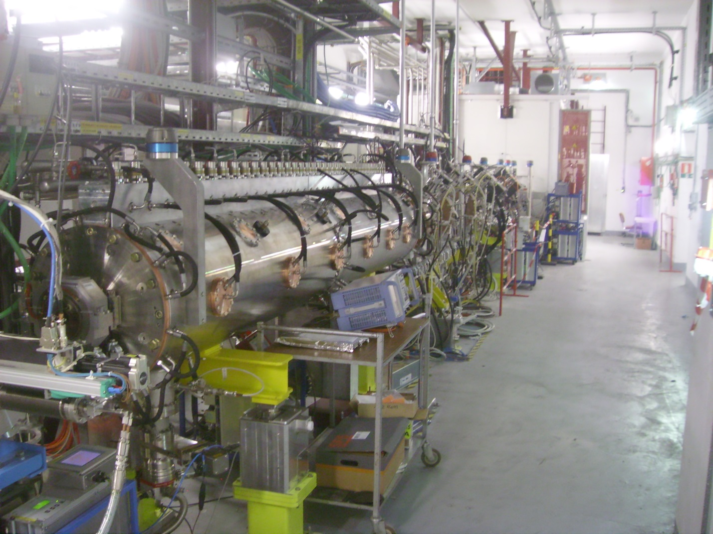
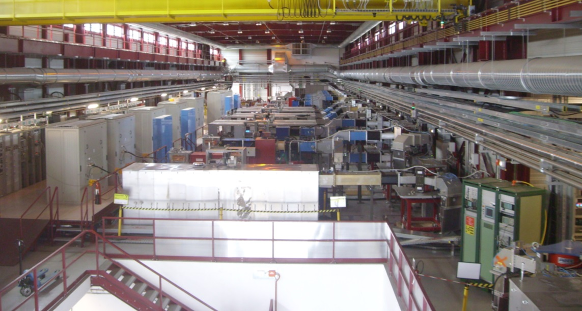
Linac4 Status November 2014
Installation in surface hall (klystrons and modulators) completed.
Presently installed in accelerator tunnel: ion source, RFQ, DTL tank 1 (12 MeV), 5 CCDTL modules.
DTL tank 1 (12 MeV) commissioned.

Slide 10
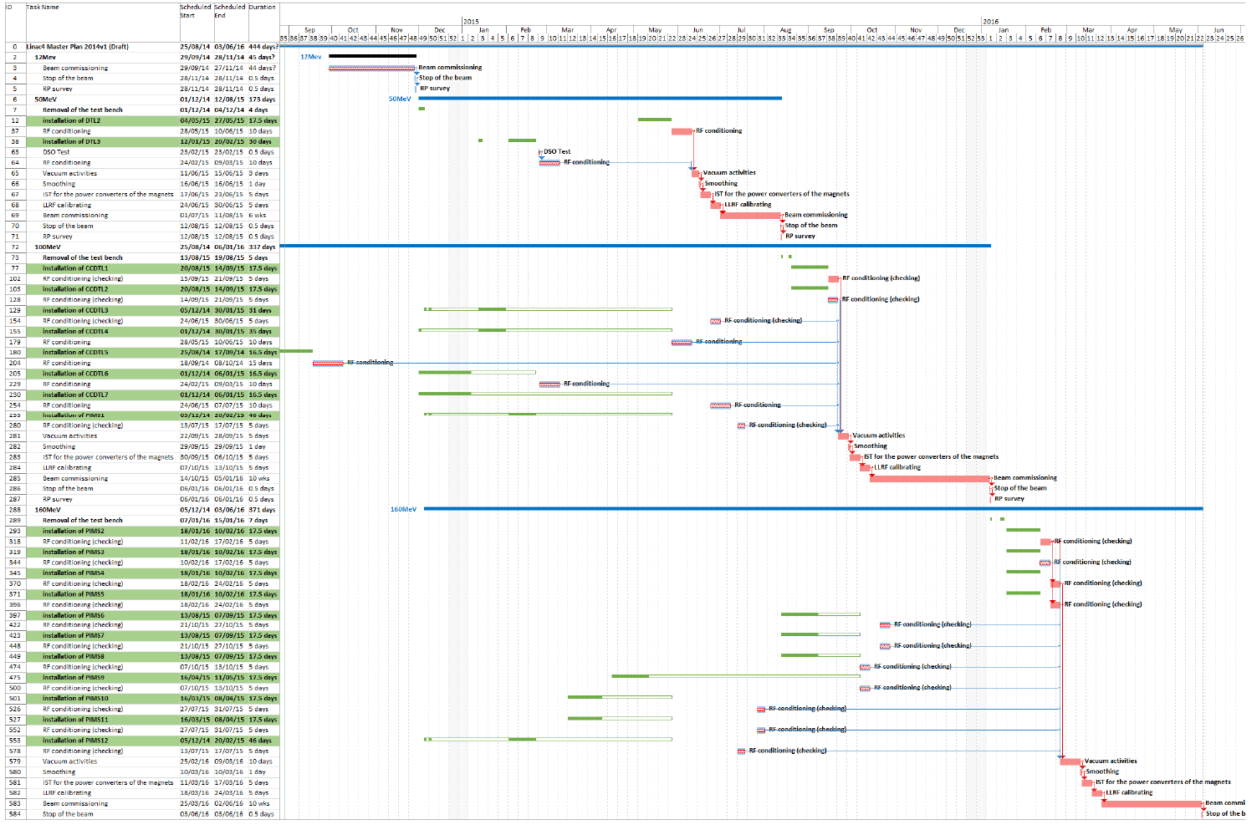
Linac4 Schedule 2014 - 2016
Connection to the LHC injector chain only in 2018/19
Reliability run and tests of H- injection in 2016/17
50 MeV June 2015
100 MeV Oct. 2015
160 MeV April 2016

Slide 11
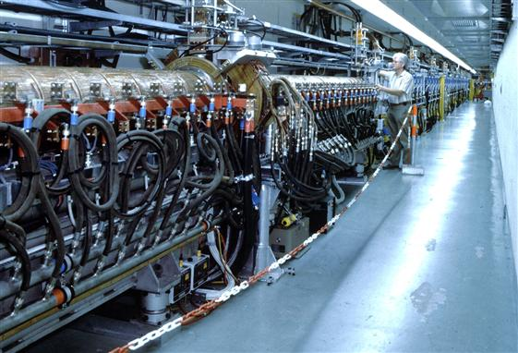
Les électrons…30 ans de collaborations fructueuses
LAL contribution to LIL (LEP injector linac):
In the 1980’s CERN decides to start with electrons…
The entire LIL (LEP Injector Linac) is designed and built by LAL Orsay, operating since 1988.
Continuation with CTF, CTF2, CTF3…
RF structures for CTF2 (HCS = High Charge Structure).
Gun type CLIO for CTF3,
etc…
And then it was CLIC (R&D started in 1988 – 26 years!)

Slide 12
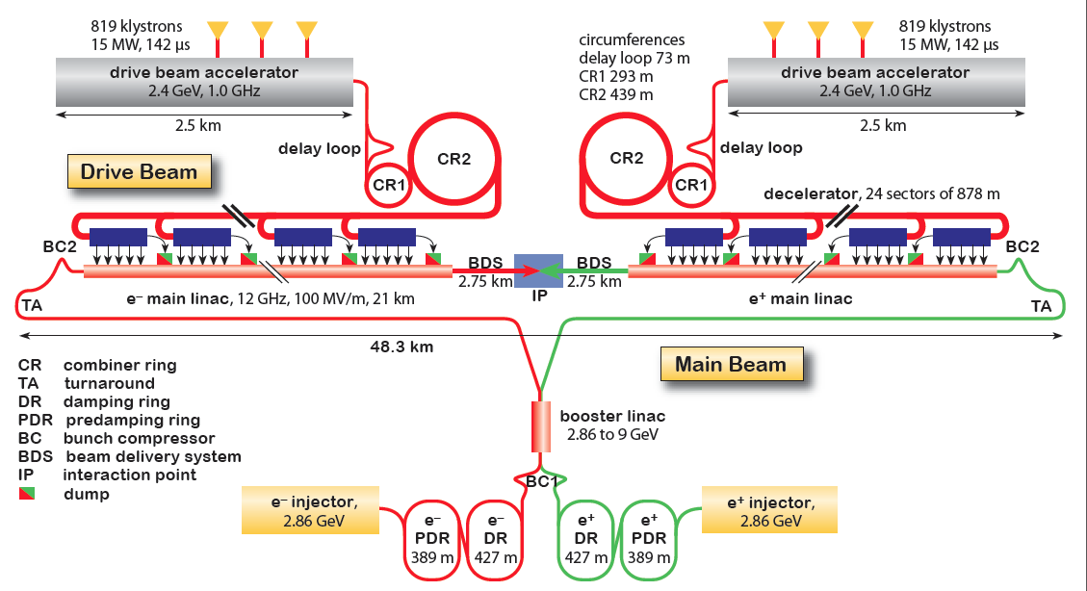
CLIC Challenges
CHALLENGES
drive beam generation
12 GHz accelerating structures
Small emittance beam
Focusing to nm beam size
Alignment of the components
- Power Efficiency
CLIC full 3 TeV version

Slide 13


Les défis CLIC et la Contribution exceptionnelle
Work Packages | Institut
4.1 Participation to beam studies and beam instrumentation | CEA
4.2 Participation in design of CLIC accelerating structures | CEA
4.3 12 GHz RF network for 8 PETS in TBL | CEA
4.4 Construction of a 12 GHz test stand: Modulator | CEA
4.5 Construction of a 12 GHz test stand: Pulse compressor | CEA
4.6 Construction of a 12 GHz test stand: RF network and components | CEA
4.7 Participation CNRS/LAPP a la stabilisation des elements optiques: instrumentation specifique | CNRS/LAPP
4.8 Participation CEA/IRFU a la stabilisation des elements optiques: instrumentation specifique | CEA
4.9 Source positrons. | CNRS/LAL
4.10 Klystron 1.5 GHz de reserve pour CTF3 | CEA
Addressed challenges:
Beam studies
Accelerating structures
RF and test stand
Stabilisation

Slide 14
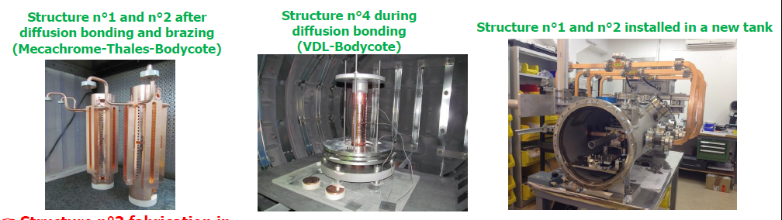
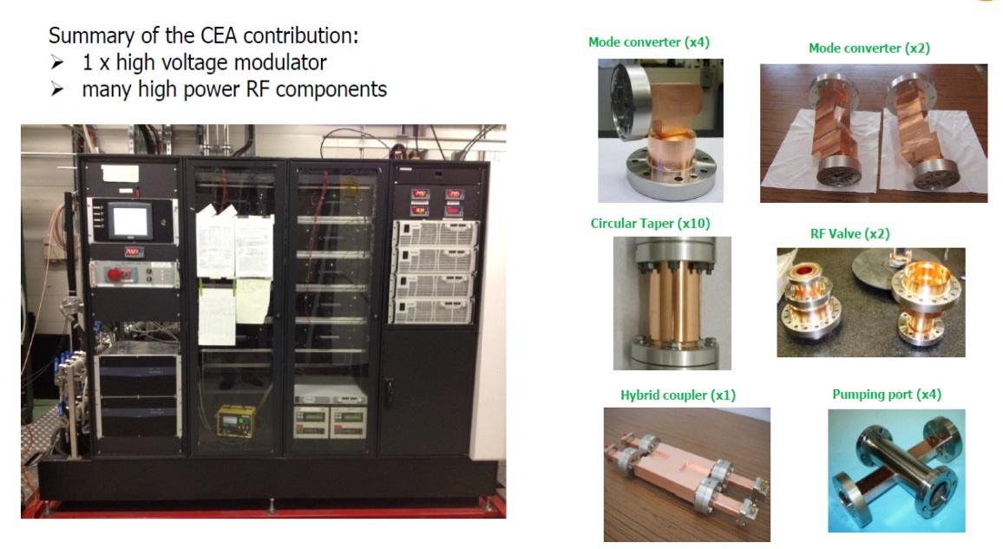
Les défis CLIC en détail - 1
Equipement for 12 GHz test station
CEA

Slide 15
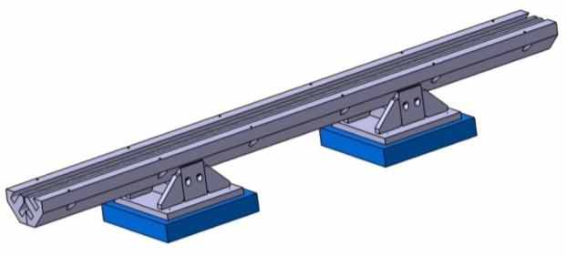
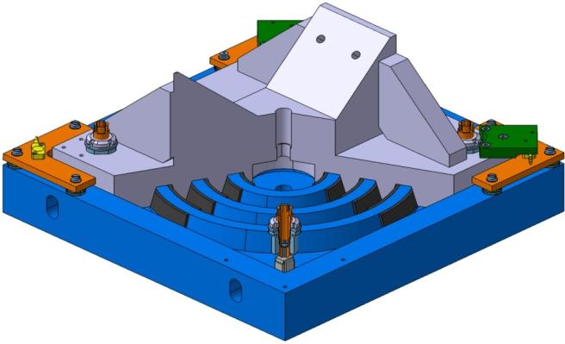
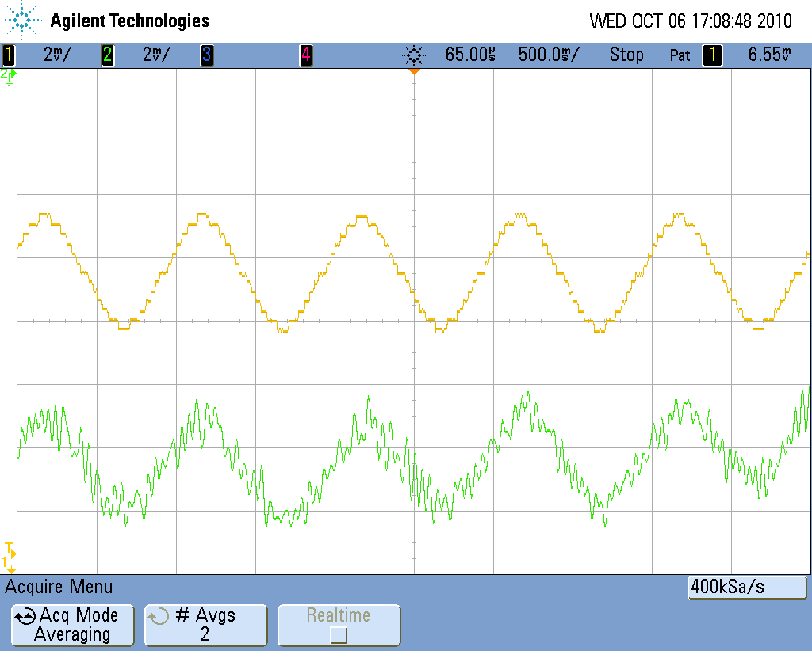
Les défis CLIC en détail - 2
Etudes de stabilisation nanométrique (CNRS/LAPP)
Capteur capacitif
culasse aimant
support aimant
1355mm
2mV=0.1nm
Actuateur Piézoélectrique

Slide 16
Perspectives pour les linacs…
Where will linear accelerators go in Europe in the next 10-20 years?
What are the technologies to develop and what are the trends?
Improving efficiency: is a must for CLIC, is an important requirement for the others (e.g. medical applications) → improved RF sources (klystrons, IOT’s, solid-state), cavity design, … and improving ancillaries!
We still miss experience with proton/deuteron CW operation: IPHI RFQ and IFMIF will provide important insights that could be applied to new challenging projects like MYRRHA.
Will one day neutrino physics come back into the European horizon (at ESS or somewhere else?) If yes, we should be ready for the construction of a high-intensity and high-energy linac.
Trend towards transfering our linac experience to medical applications: compact high-frequency linacs for therapy (and other) → convergency between CLIC and proton linacs.

Slide 17
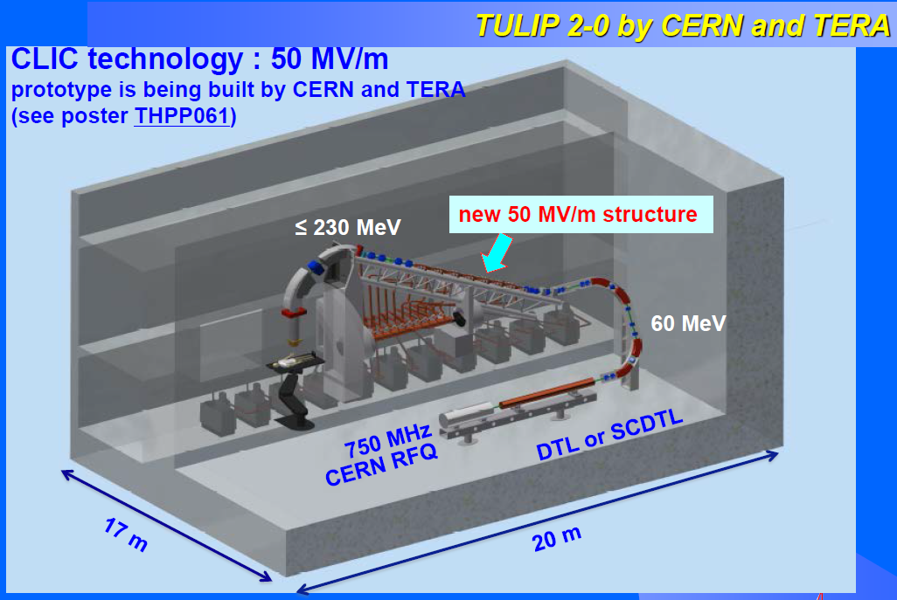
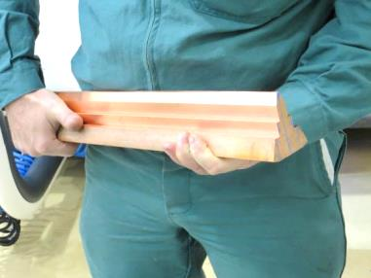
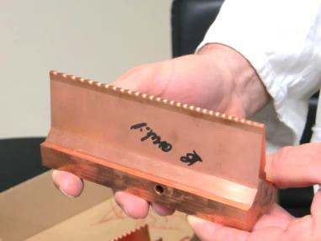
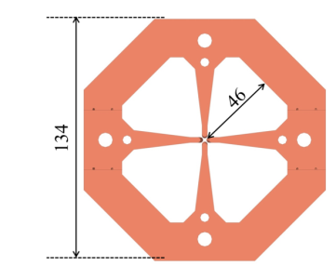
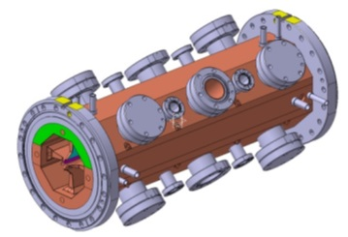
Applications médicales
Small activity at CERN on medical applications
Example: High-gradient CLIC technology and miniaturised RFQ for a p therapy linac mounted on a gantry.
RFQ can have applications to radioisotope production for PET scanning and brachytherapy
Input/Output Energy | 40 keV / 5 MeV
Length | 1.964 m
Vane voltage | 67.6 KV
Min aperture radius | 1 mm
Maximum modulation | 3
Final synchronous phase | -15 deg
Output current (max.) | 300 µA
Beam transmission | 30 %
Output transv. rms emit. | 0.027 p.mm.mrad
Output phase spread | ± 2 deg
Output energy spread | ± 20 KeV
RF Frequency | 750 MHz

Slide 18
Quelques conclusions
Une longue histoire de collaboration, qui a porté à réaliser des objectives:
«Hard»: réalisation de composantes de haute technologie, avec synergies entre les spécialisations des différents Instituts.
«Soft»: échange d’idées et de stratégies, formation de liens, promotion d’entreprises.
La construction de composantes industrielles («hard») se justifie dans le volet «soft»: rencontre entre les experts, partage des stratégies d’achats et de réception, valorisation des sociétés françaises.
La contribution exceptionnelle a été une étape importante:
Après l’histoire et la géographie, même l’économie et la politique nous ont encouragé à travailler ensemble!

Slide 19
Merci aux Instituts Français pour ces 30 ans de collaboration…
… et à vous pour votre attention pendant ces 20 minutes!

