Slide 1

Synthèse et Perspectives sur les aimants Supraconducteurs pour les Accélérateurs
Luca.Bottura@cern
CSP, 28 November 2014

Slide 2
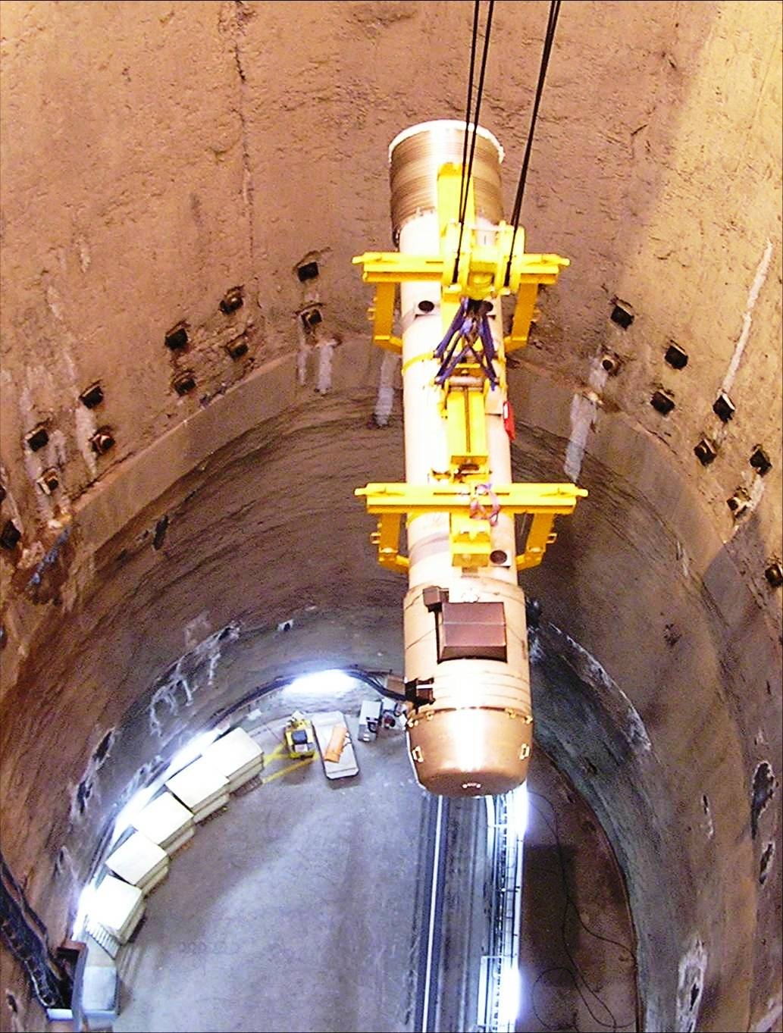
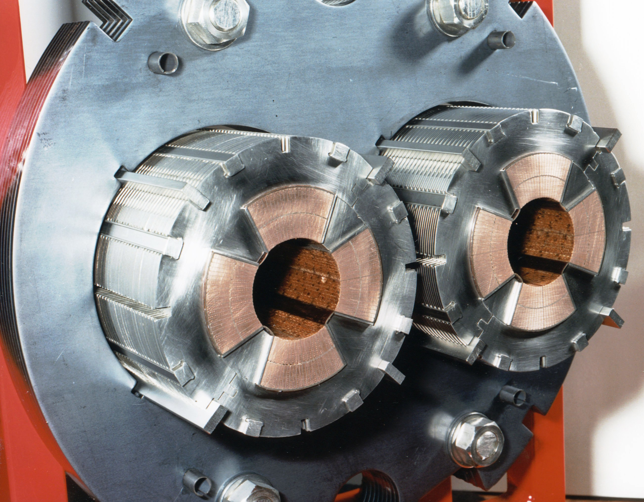
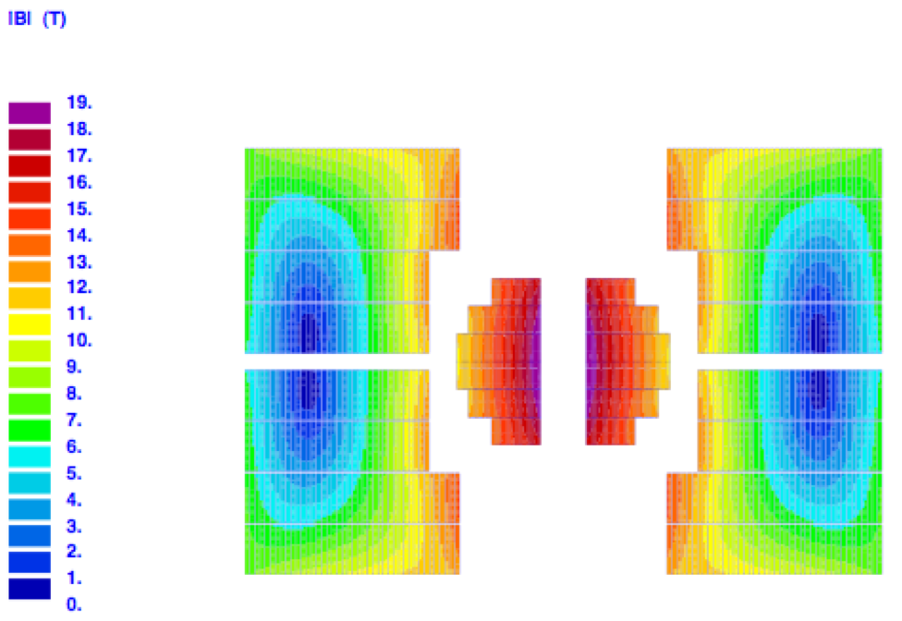
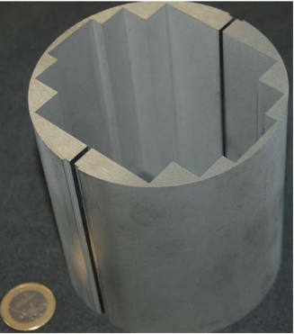
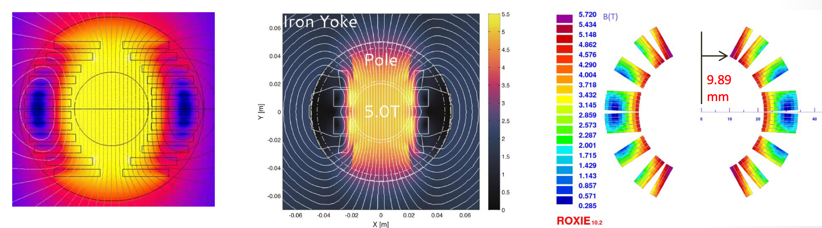
A long line of collaboration – 1/2
LHC quadrupoles: 1994-2006
CARE-NED: 2003-2009
EuCARD WP7: 2009-2013
EuCARD FRESCA2 HTS insert: 2009-2013
EuCARD2 5 T HTS dipole: 2013-2017

Slide 3
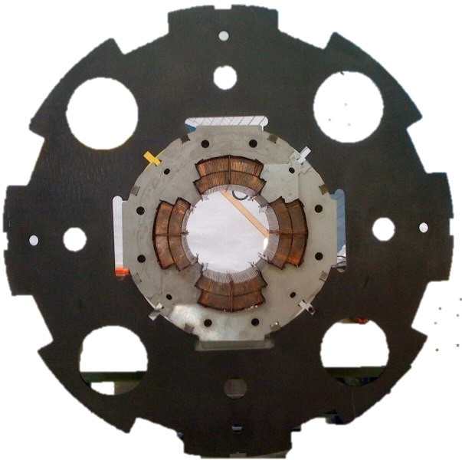
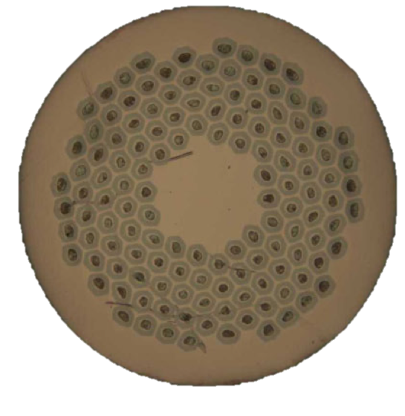
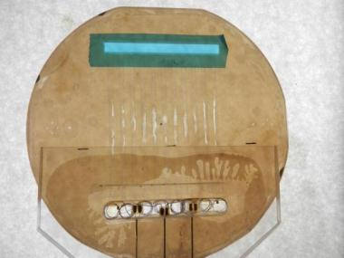
A long line of collaboration – 2/2
2009-2014: Contribution Exceptionnelle de la France au CERN – a major booster for HL-LHC
About 50 % of the work dedicated to “magnet” activities:
Spare components (cryostats, inertia tubes, …)
PFW for the consolidation of the PS main magnets
MQXC coils (phase I LHC upgrade prototype)
SMC coil winding and FRESCA2 initial works (tooling, tests)
½ ton Nb₃Sn SC wire order for FRESCA2 construction
Heat transfer studies
MQXC cross section
Nb-Ti
120 mm
120 T/m
Micro-channels He-II heat transfer experiment
OST RRP Nb₃Sn wire

Slide 4
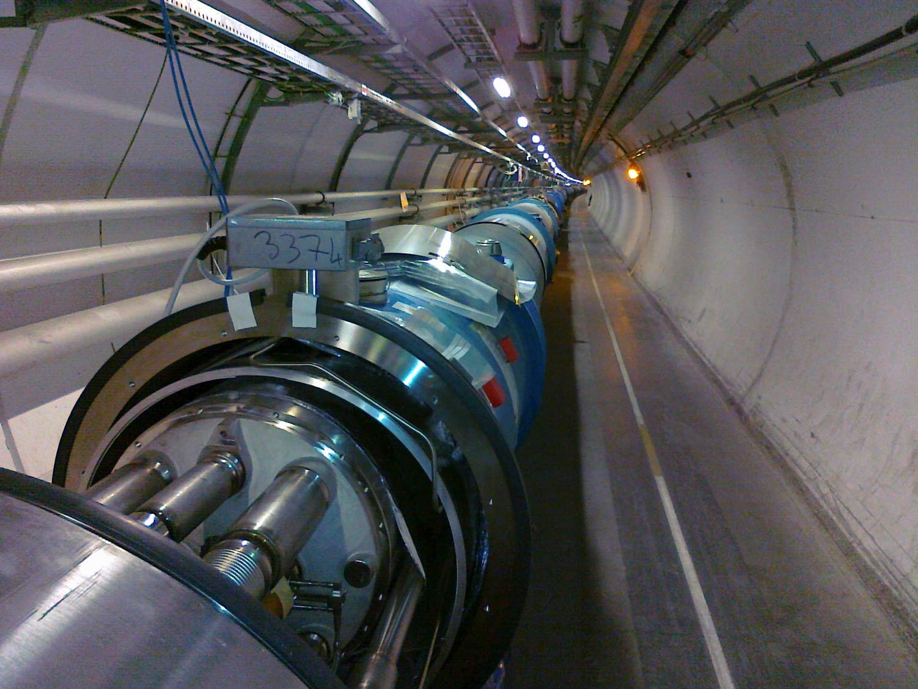
Injection | (GeV) | 450
Flat-top | (TeV) | 7
Length | (km) | 26.7
Dipole field | (T) | 8.3
Aperture | (mm) | 56
Temperature | (K) | 1.9
Commisioned |  | 2008
LHC

Slide 5
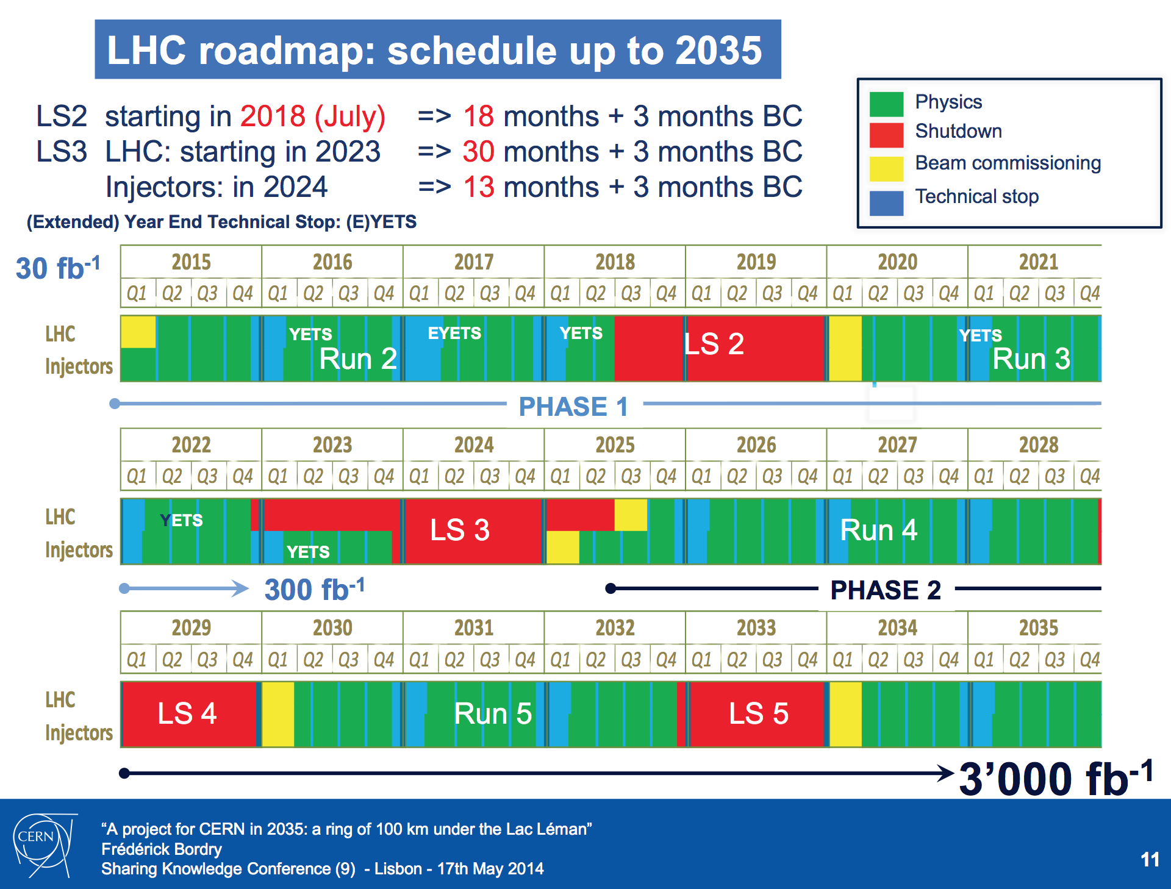

Slide 6





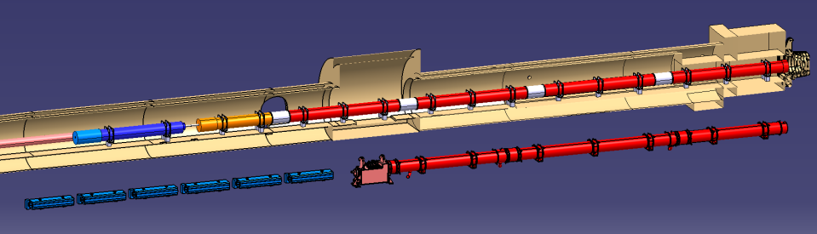

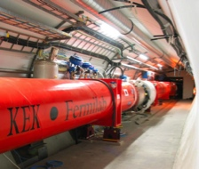
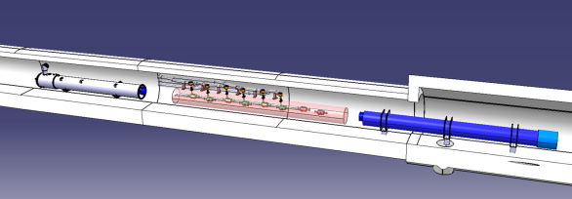


HL-LHC configuration
HL-LHC
Q2a
Q1
Corrector
Package
Q2b
SC D1
Q3
NC D1
Nominal LHC
Q4
CC
HL-LHC systems are entering detailed integration phase
New baseline expected within a few months (changes of the order of 2 m)
D2

Slide 7
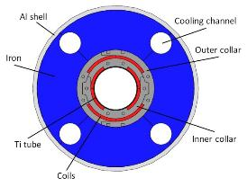
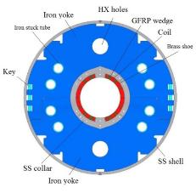
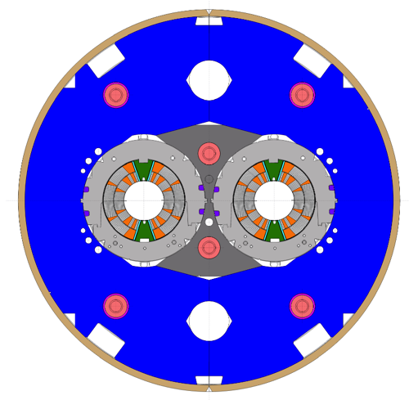
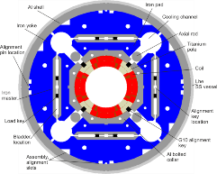
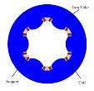
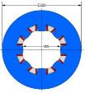
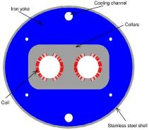
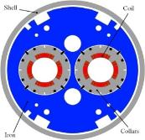
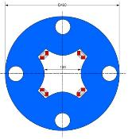
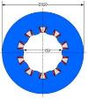
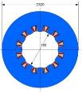
HL-LHC magnet zoo
Triplet QXF (LARP and CERN)
Orbit corrector (CIEMAT)
Separation dipole D1 (KEK)
11 T dipole (CERN)
Sextupole (INFN)
Octupole (INFN)
Skew quadrupole (INFN)
Recombination dipole D2
(INFN design)
Q4 (CEA)
Approximately 200 magnets for HL-LHC
Decapole (INFN)
Dodecapole (INFN)

Slide 8
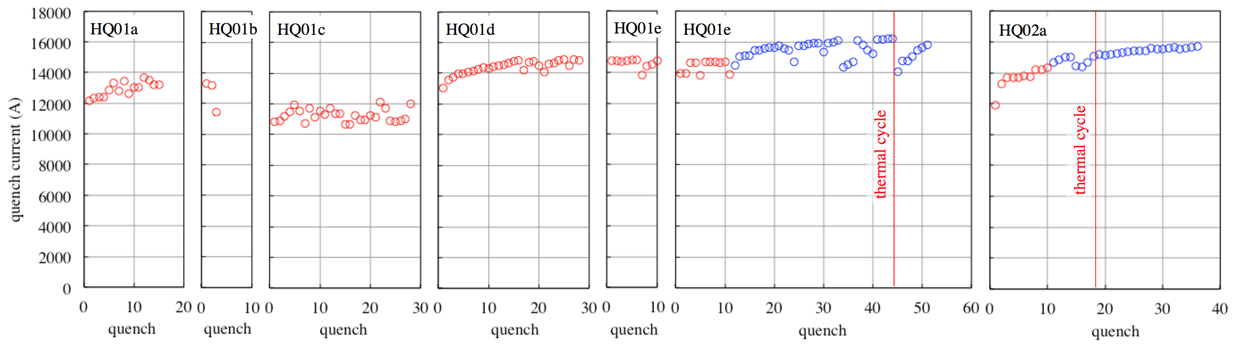
HQ performance (120 mm, 170 T/m)
170 T/m
4.2 K
1.9 K
2.2 K
May 2010
Jun 2010
Oct 2010
Apr 2011
Jul 2011
Jul 2012
Apr 2013
Sep 2013
Nb₃Sn magnets presently outperform their Nb-Ti brothers by about 50 % (same aperture), but…
... training is relatively long, and practical operating field is only 80 % of the maximum expected (in spite of three times larger temperature margin !)
Data by courtesy of G. Chlachidze (FNAL)

Slide 9

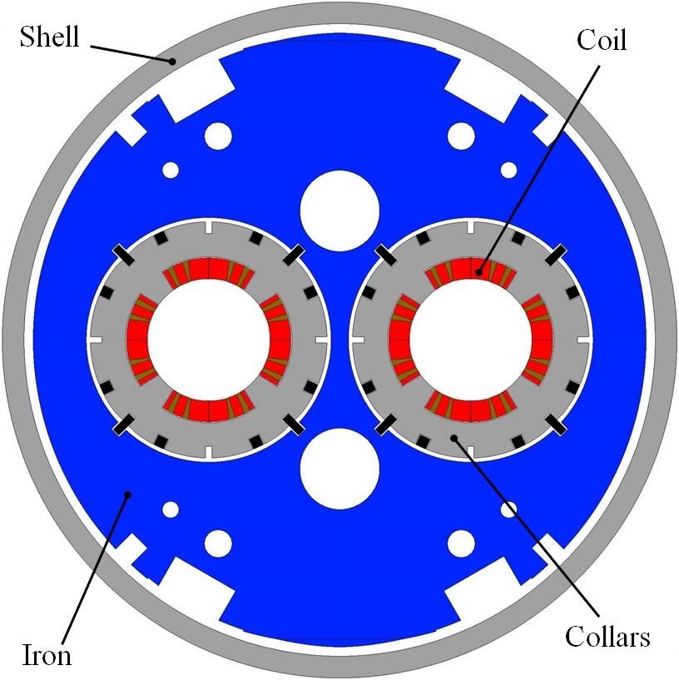
The HL-LHC Q4
Main challenges
Large aperture (90 mm)
Limited distance between the beams fixed in LHC to 194 mm
Large cross-talk
Parameters
1 layer
3 conductor blocks (octant)
14 turns (8 + 4 + 2)
Cable unit length (one coil) = 130 m
Cable length per magnet = 1040 m
Integrated gradient = 440 T
Magnetic length = 3.83 m
Nominal gradient = 115 T/m
Loadline margin = 20 %
Temperature = 1.9 K
Nominal current = 15650 A
Stored energy = 0.73 MJ
Differential inductance = 5.85 mH

Slide 10
The HL-LHC Q4
Parameters
Superconductor = Nb-Ti (MQ cable)
Strand diameter = 0.825 mm
Cu/No Cu = 1.95
Current density = 1990 A/mm2 @ 9 T and 1.9 K
Nb strands per cable = 36
Cable bare width = 15.1 mm
Cable bare mid-thickness = 1.48 mm
Insulation type EI#4 (Nb-Ti MQXC)
Radial thickness = 0.160 mm
Azimuthal thickness = 0.145 mm

Slide 11

Beyond the LHC

Slide 12
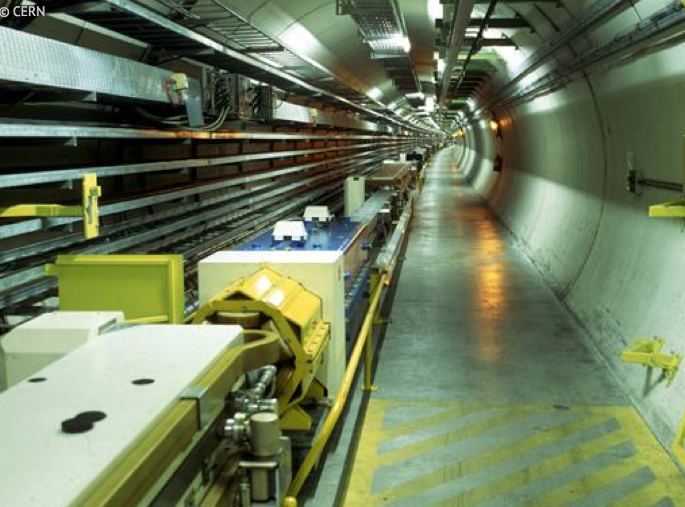
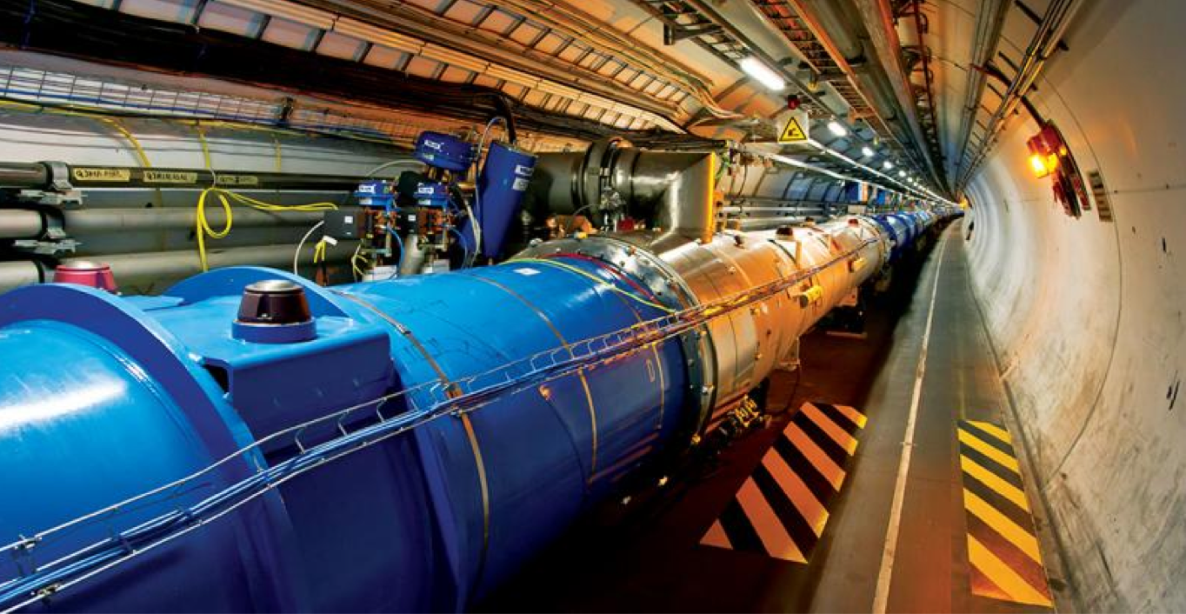


A timeline for HL-LHC and beyond
construction
LEP
physics
upgrade
Design R &D
prototyping
LHC
construction
physics
Design R&D
prototyping
HL-LHC
construction
physics
Design R&D
CDR
prototyping
FCC
construction
physics
1980
1990
2000
2010
2020
2030
2040

Slide 13
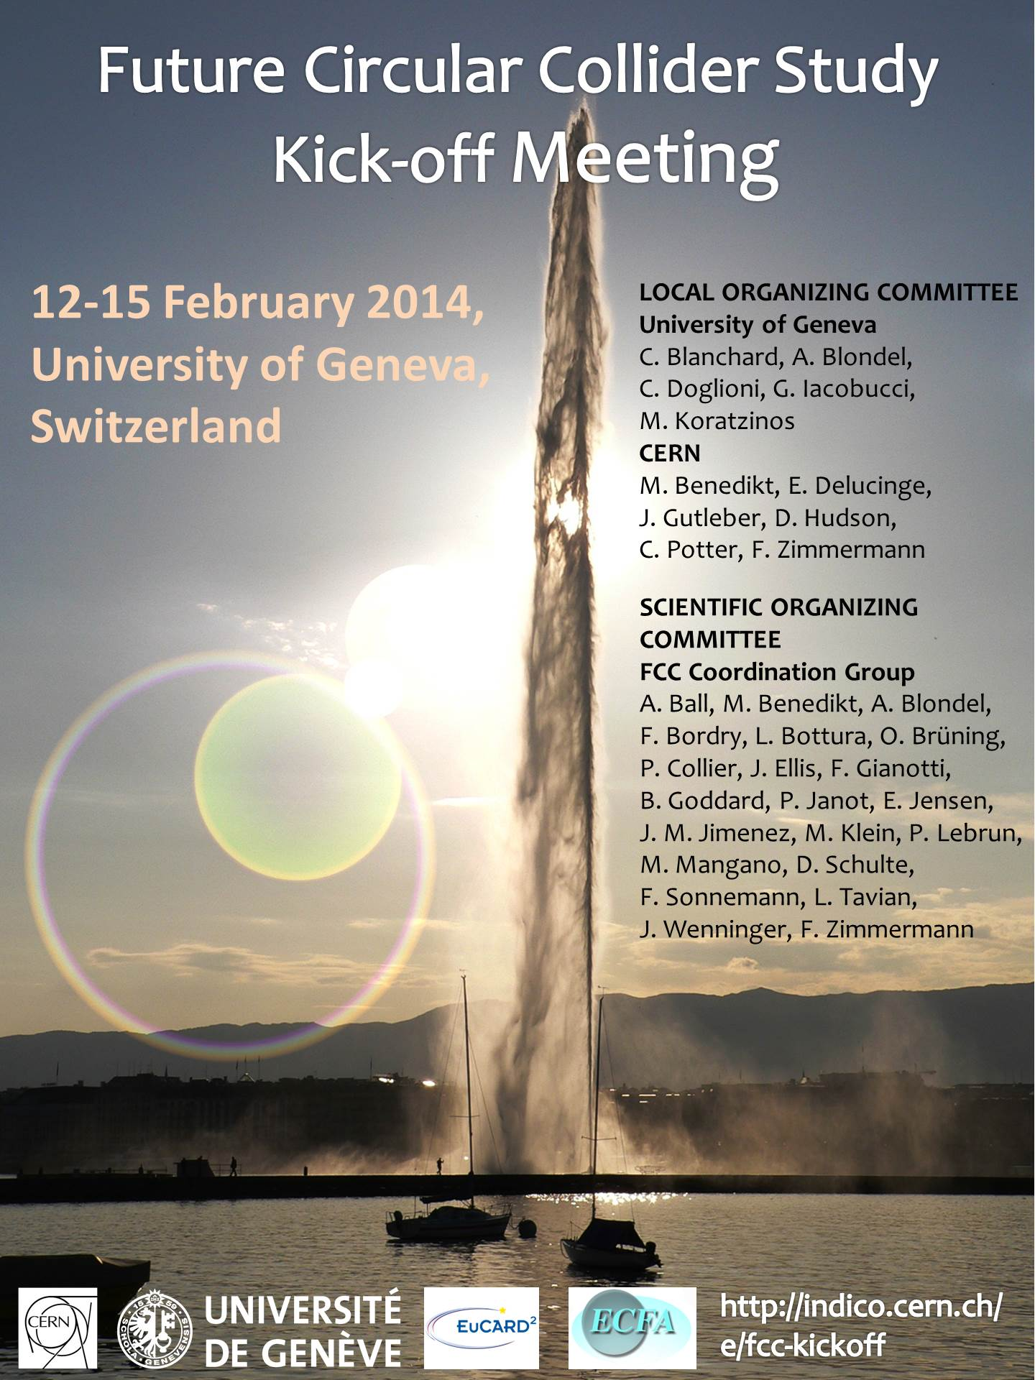
What is the FCC ?
The Future Circular Collider is a Design Study that CERN has launched in February 2014 to respond to the request from the EU Strategy Group on Particle Physics:
“to propose an ambitious post-LHC accelerator project at CERN by the time of the next Strategy update (NOTE: to take place in 2018)
…
d) CERN should undertake design studies for accelerator projects in a global context,
…
with emphasis on proton-proton and electron-positron high-energy frontier machines. These design studies should be coupled to a vigorous accelerator R&D programme, including high-field magnets and high-gradient accelerating structures, in collaboration with national institutes, laboratories and universities worldwide.

Slide 14
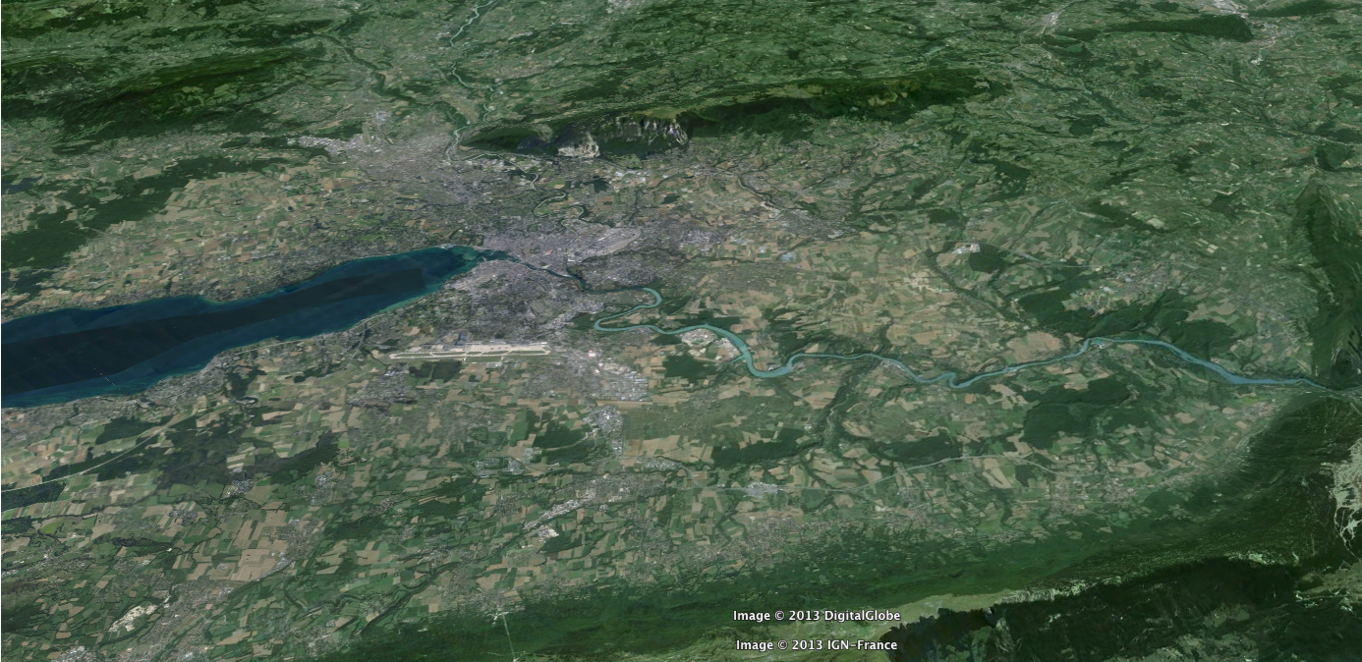
The FCC playground
Geneva
PS
SPS
LHC
LHC
27 km, 8.33 T
14 TeV (c.o.m.)
1300 tons NbTi
HE-LHC
27 km, 20 T
33 TeV (c.o.m.)
3000 tons LTS
700 tons HTS
FCC-hh
80 km, 20 T
100 TeV (c.o.m.)
9000 tons LTS
2000 tons HTS
FCC-hh
100 km, 16 T
100 TeV (c.o.m.)
6000 tons Nb₃Sn
3000 tons Nb-Ti

Slide 15
FCC magnets – LTS option
 |  | B / G (T) / (T/m) | B_{peak} (T) | dB/dt (mT/s) | Bore (mm) | Length (units x m)
FCC | MB | 16 | 16.8 | 16 | 40 | 4578 x 14.3
 | MQ | 375 | 10 | 10 | 40 | 762 x 6.6
 | QX | 200 | 12.5 | 12.5 | 90 | Optics ?
 | D1 | 12 | 13 | 13 | 60 | 4x2 x 12
 | D2 | 10 | 10.5 | 10.5 | 60 | 4x3 x 10
Booster in the FCC | MB | 1.1 | 2 | 2 | 50 | 4578 x 14.3
injector in the LHC | MB | 5 | 5.25 | 20 | 50 | 1232 x 14.3
injector in the SPS | MB | 12 | 12.5 | 100 | 50 | 892 x 4.7

Slide 16
FCC magnets – HTS option
 |  | B / G (T) / (T/m) | B_{peak} (T) | dB/dt (mT/s) | Bore (mm) | Length (units x m)
FCC | MB | 20 | 21 | 16 | 40 | 3662 x 14.3
 | MQ | 375 | 10 | 10 | 40 | 610 x 6.6
 | QX | 200 | 12.5 | 12.5 | 90 | Optics ?
 | D1 | 12 | 13 | 13 | 60 | 4x2 x 12
 | D2 | 10 | 10.5 | 10.5 | 60 | 4x3 x 10
Booster in the FCC | MB | 1.5 | 2.2 | 2.2 | 50 | 3662 x 14.3
injector in the LHC | MB | 5 | 5.25 | 20 | 50 | 1232 x 14.3
injector in the SPS | MB | 12 | 12.5 | 100 | 50 | 892 x 4.7

Slide 17
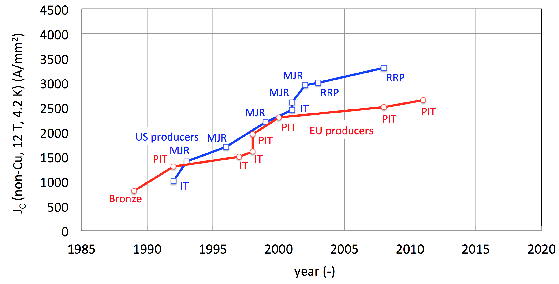
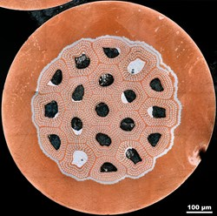
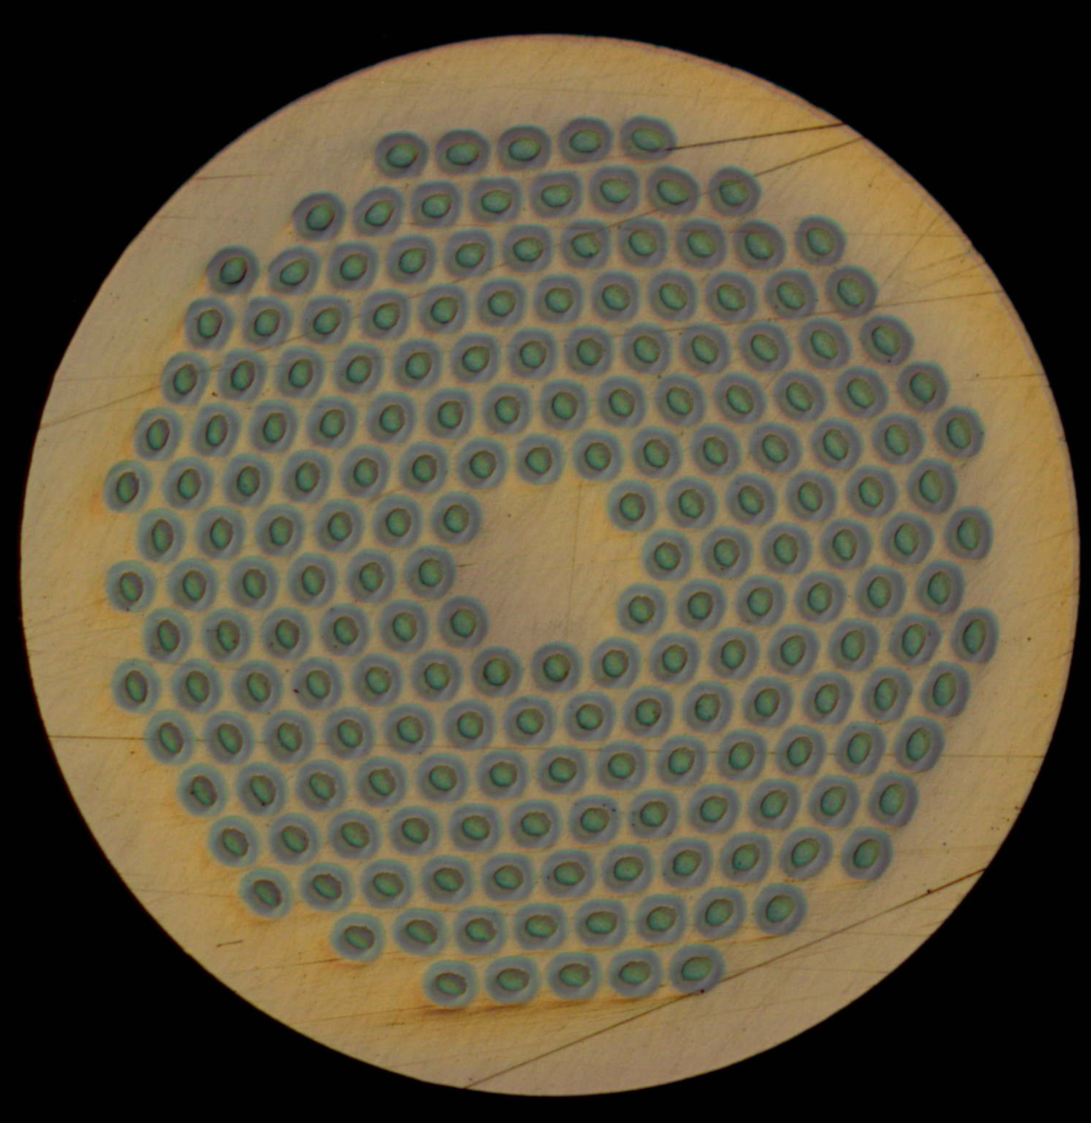
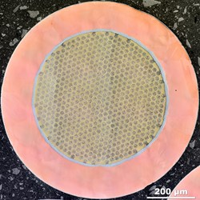


From ITER- to HEP-class Nb₃Sn
HL-LHC
ITER
FCC specs
HL-LHC specs
CARE-NED
EuCARD
US-CDP
FCC

Slide 18
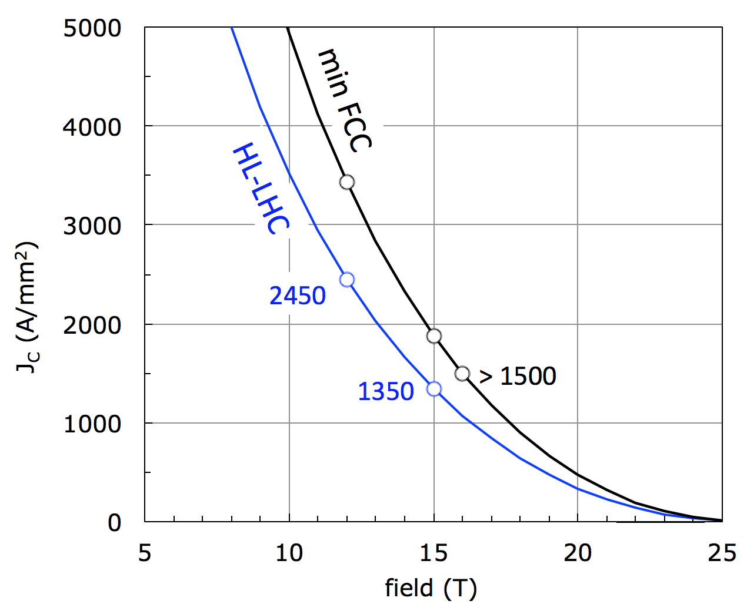
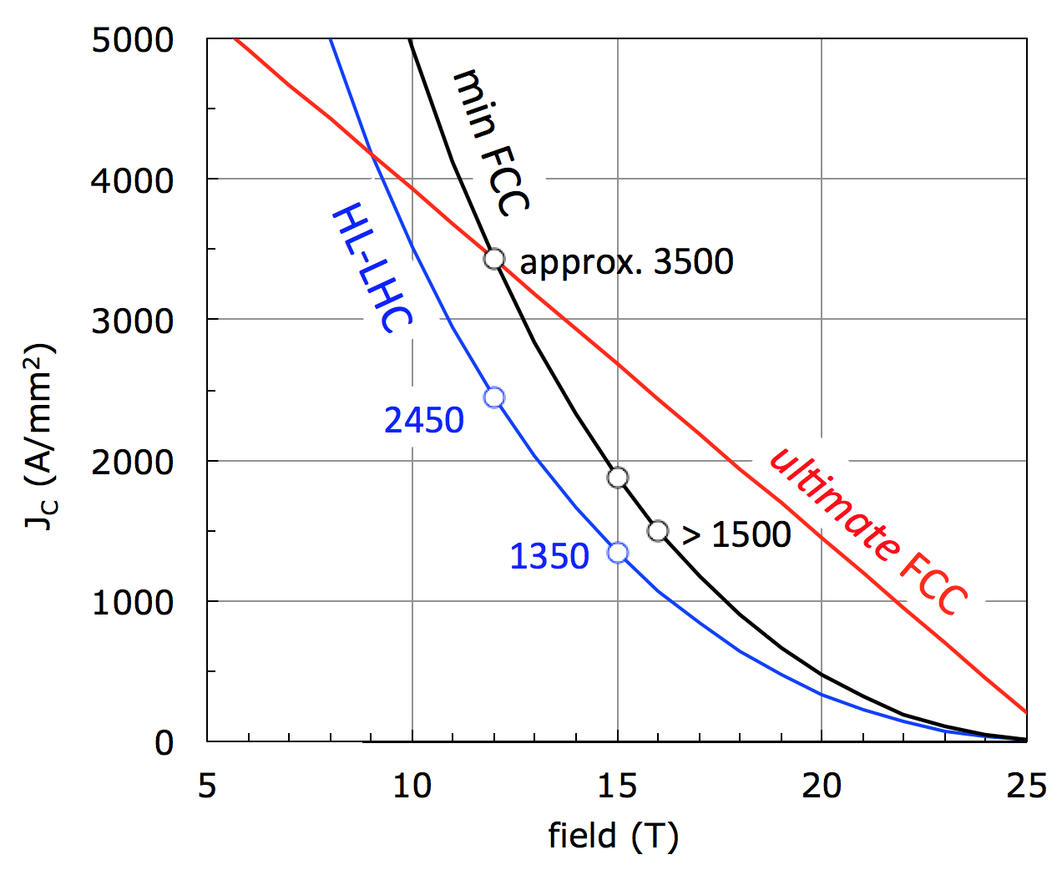
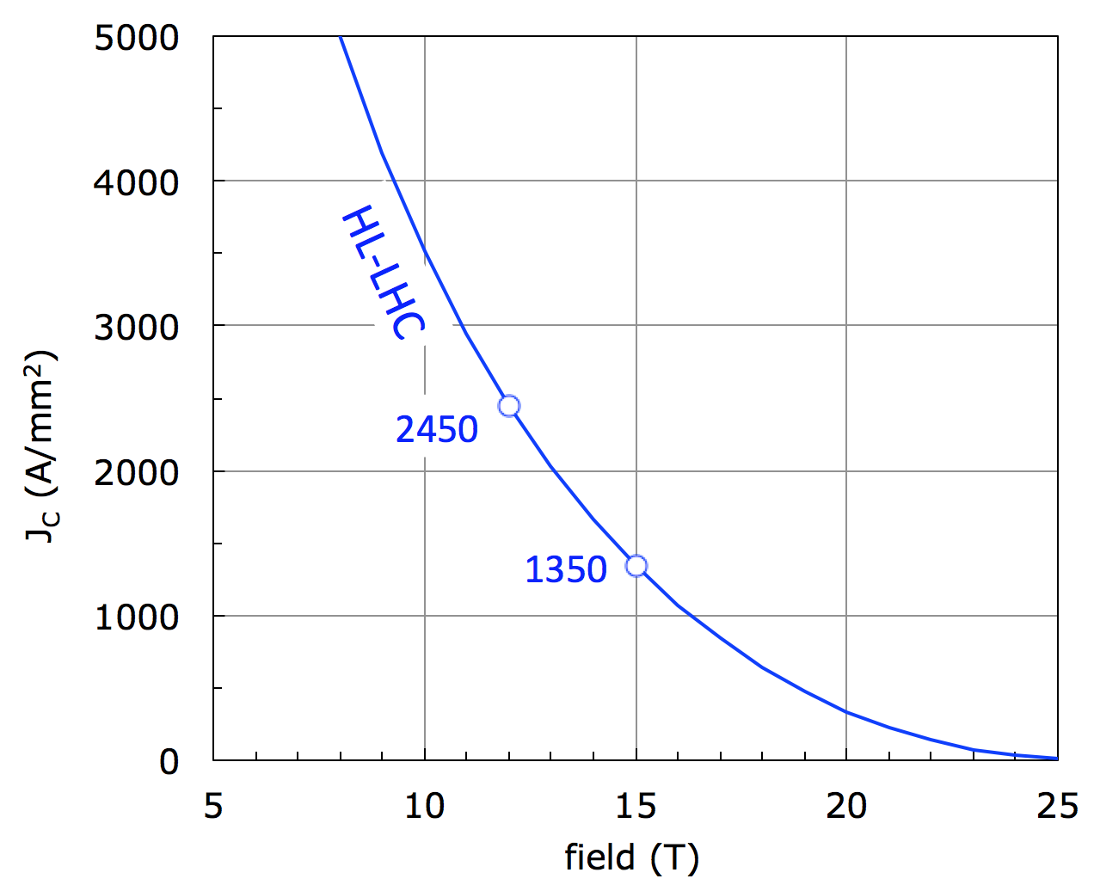
FCC Nb₃Sn performance targets
D_{strand}: 0.7…1 mm
J_{C} (16 T, 4.2 K) > 1500 A/mm²
ΔM (1 T,4.2 K) <150 mT (D_{fil} < 20 μm)
RRR > 150
UL > 5 km
Cost(16 T, 4.2 K) < 5 USD/kA m
Large cables, cabling !
Field quality
Stability, protection
ITER material cost per kg
All single parameters are in reach, their combination is the challenge !
Ultimate Nb₃Sn ? Pursue the idea of improved high field pinning (q=1)
(D. Dietrich and R. Scanlan, A. Godeke)

Slide 19
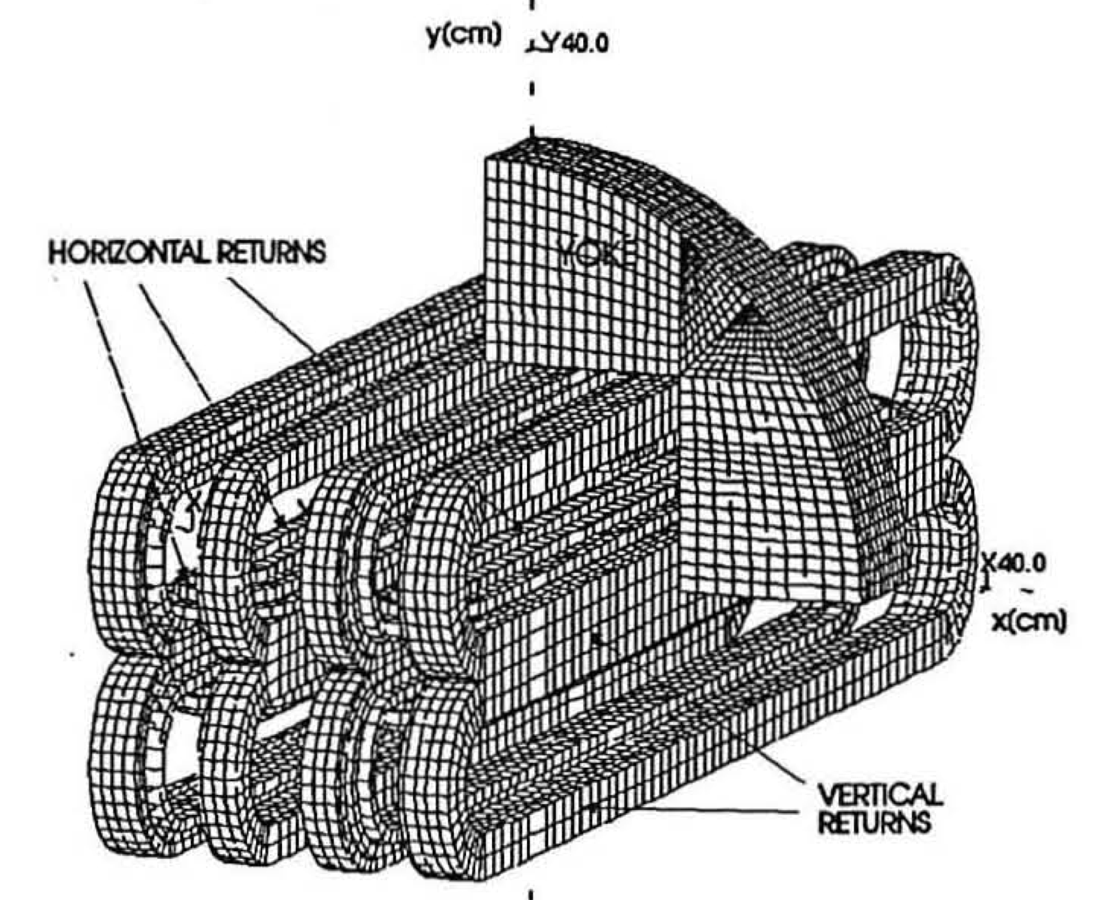
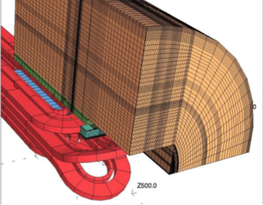
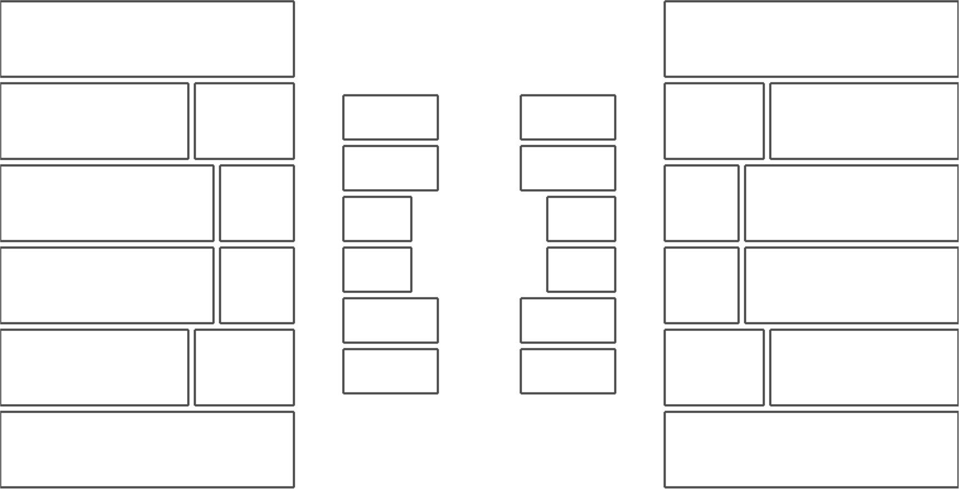
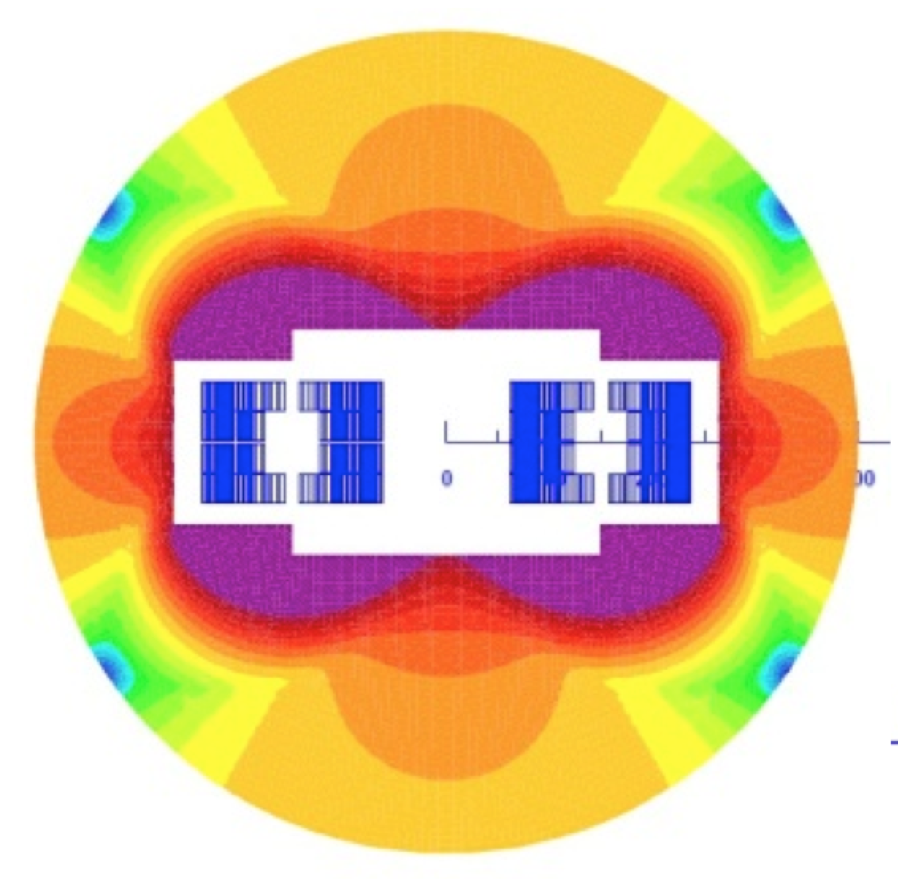
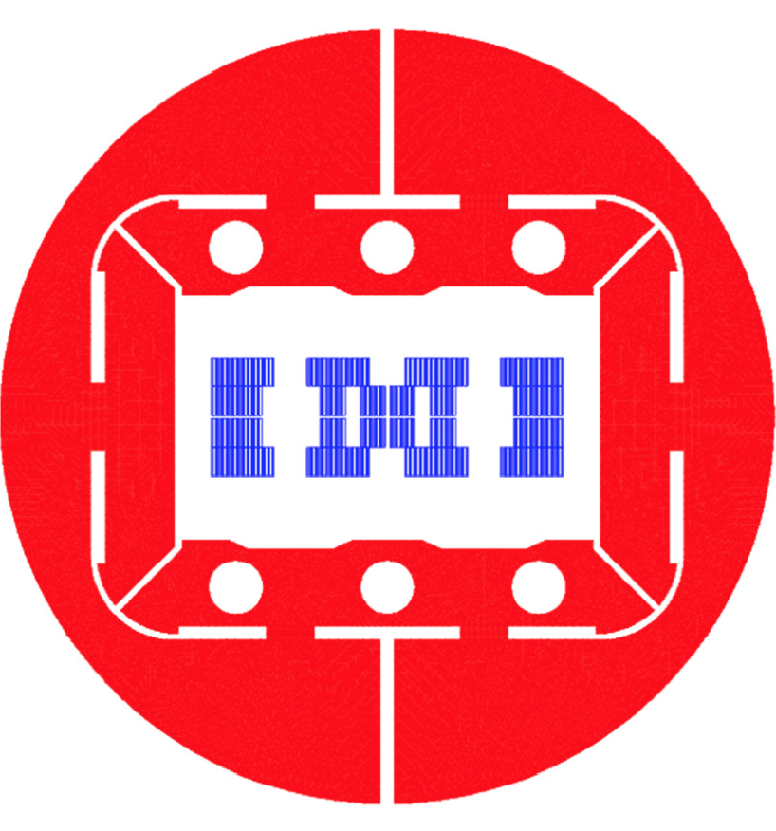
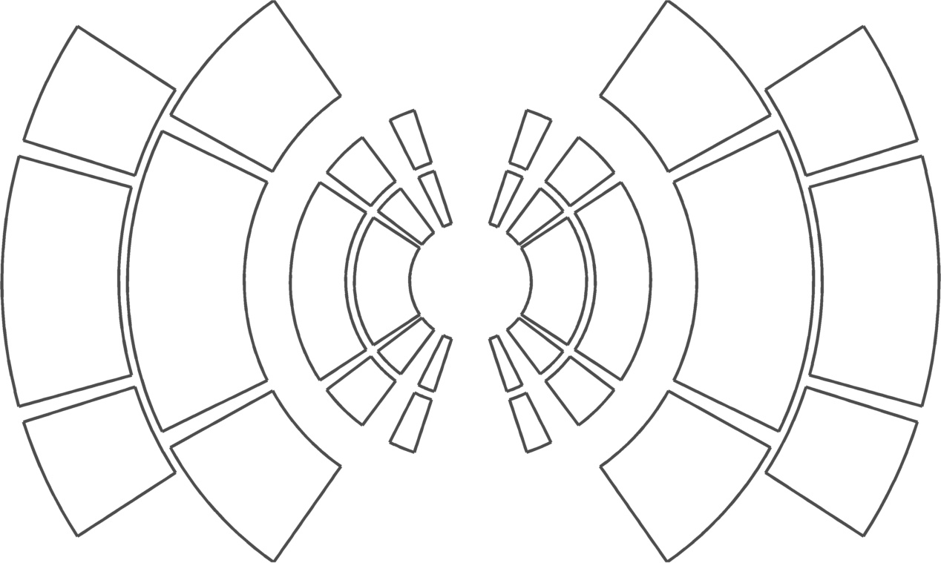
A 16 T dipole (with two bores)
McIntyre, 2005
Van Oort, Scanlan, 1994
J. van Nugteren, 2013
Todesco, 2013
Sabbi, 2014

Slide 20

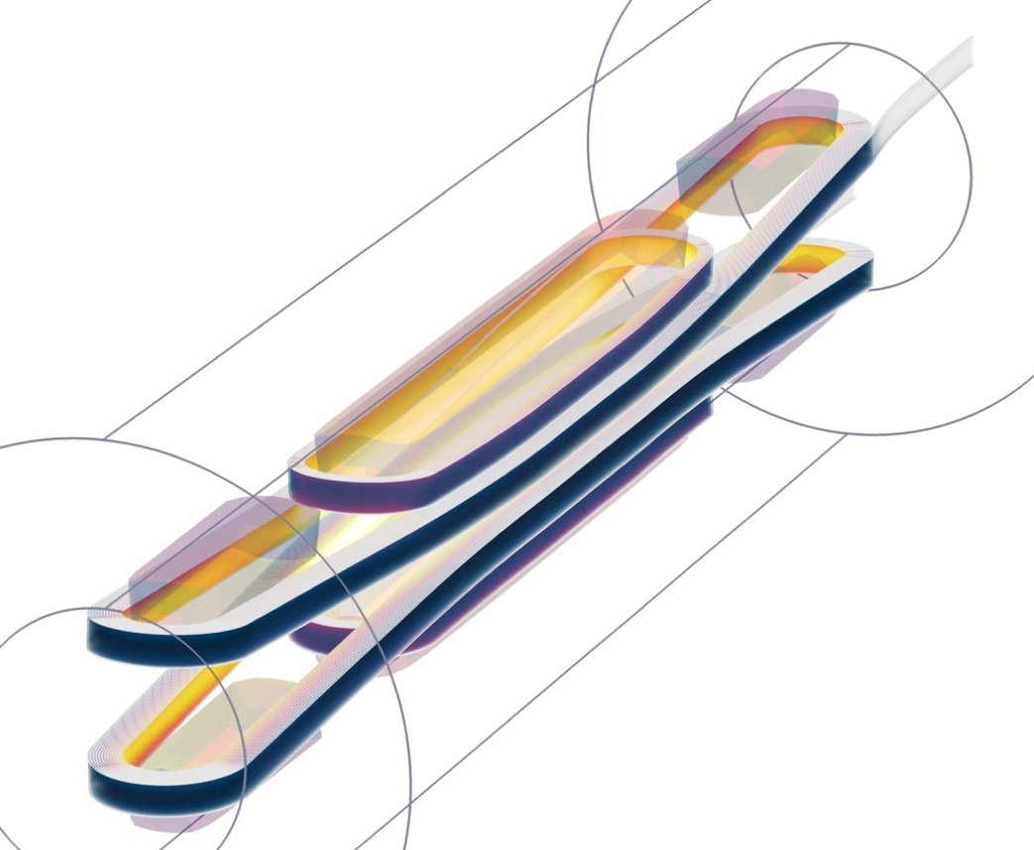
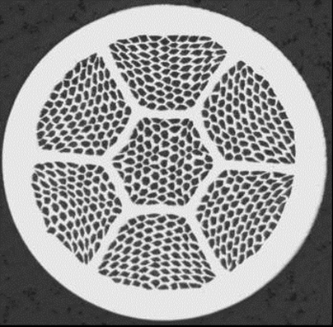
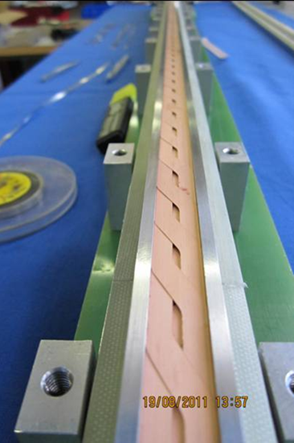
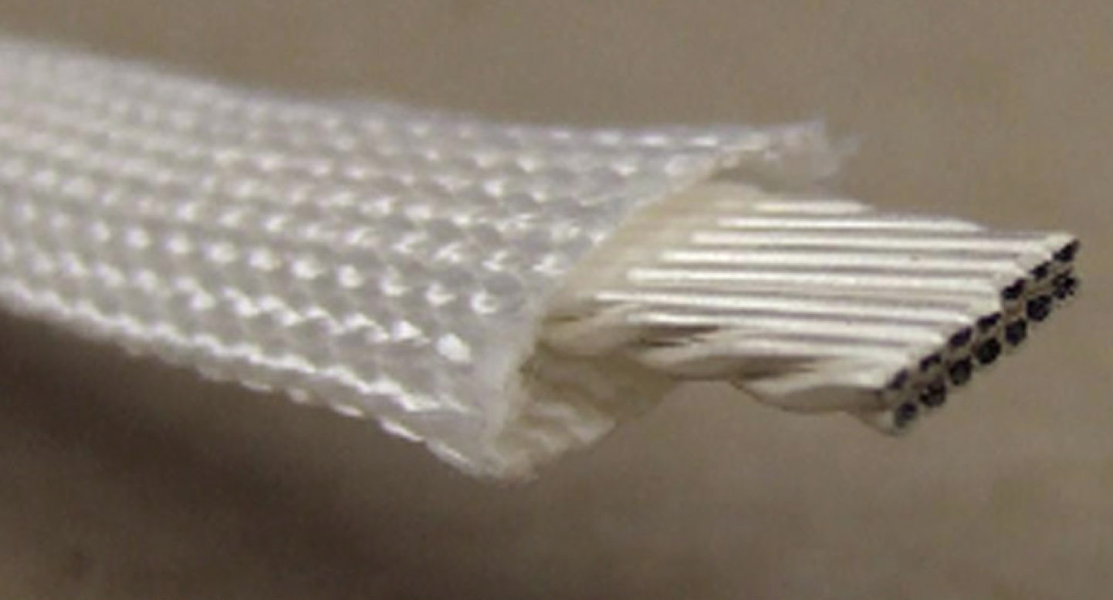
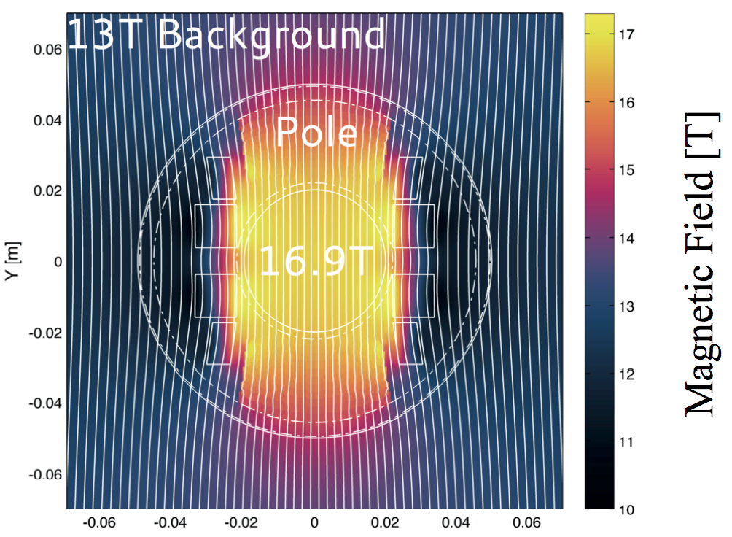
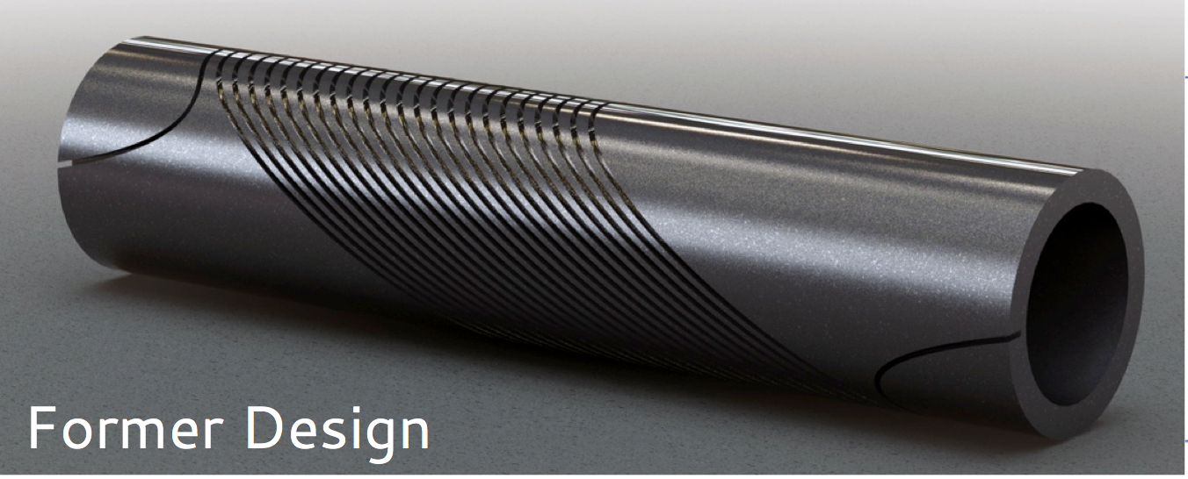
HTS for 20 T
BSCCO-2212, CERN provides precursor powders, US program produces wire and cable
Sample of US BSCCO-2212 cable
REBCO option (Roebel)
EuCARD2 program, targeting a 5 T, 40 mm aperture demonstrator, in collaboration with EU laboratories and industry
US-BSCCo program, testing alternative materials and coil configurations (CCT)

Slide 21
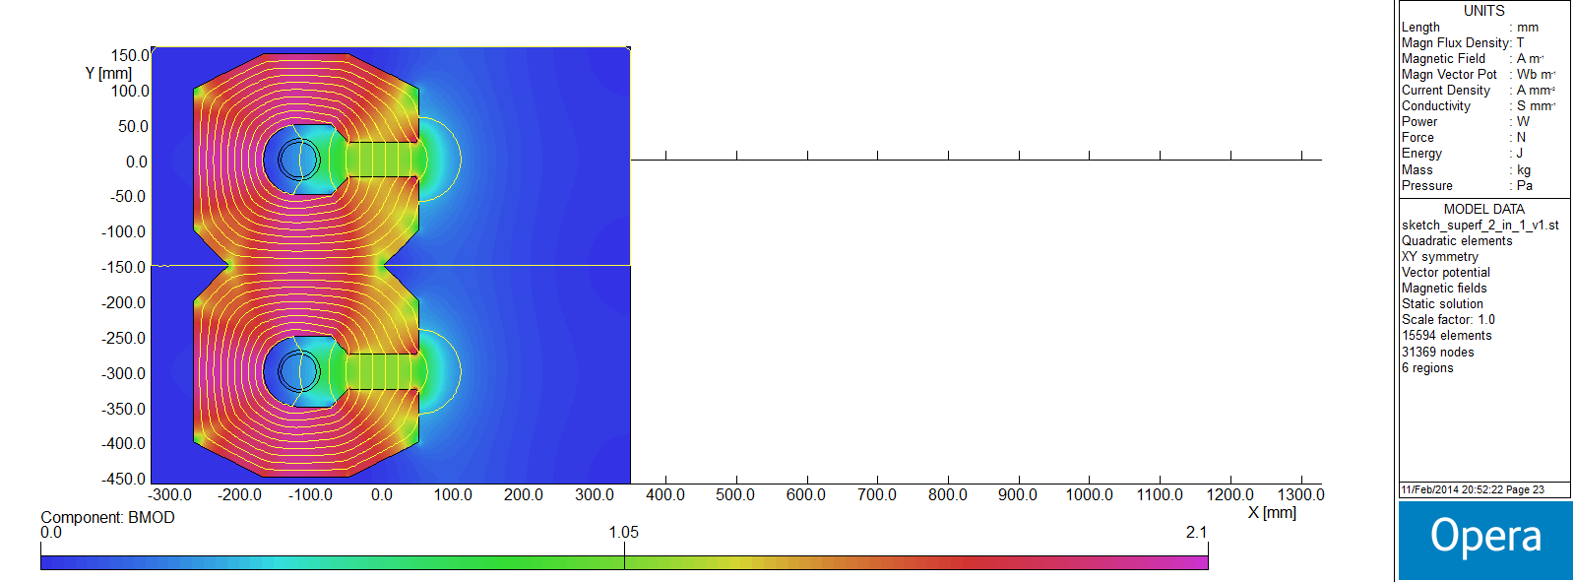
HEB magnets in a 100 km tunnel
HTS, transmission line, iron dominated, superferric, 2-in-1 dipole
Tentative parameters:
vertical full gap 50 mm
good field region ±20 mm
overall diameter of “super-cable”, including cryostat, 100 mm
50 kA-turns for 1.1 T (3.4 TeV)
At low current, the apertures could be used in bipolar operation as a lepton booster
∙
×
0.0 T
2.1 T
Study by A. Milanese, IPAC 2014

Slide 22
Challenges at the HEP frontier
HL-LHC
Demonstrate that the Nb₃Sn technology is available for use in the LHC – 2016
Prepare HL-LHC in LS2 – 2018
Install HL-LHC in LS3 – 2023
FCC and linear collider technologies
Conceptual design study for the next European Strategy Review – 2017
Prototyping of FCC high-field magnets – 2018-2025
Production of FCC magnets – 2025-2035

Slide 23

Impact

Slide 24
Structure of KE2275
 | Description | Impact
WP1 | Coordination and monitoring of activities
WP2 | Design and prototyping of a new Nb-Ti Q4 for HL-LHC | Responsibility for HL-LHC hardware
WP3 | Completion of the Nb₃Sn magnet FRESCA2 and participation to the tests | Nb₃Sn technology for HL-LHC and FCC, new high field test bed
WP4 | Support in the Nb₃Sn technology R&D | Nb₃Sn technology for HL-LHC and FCC
WP5 | Completion of the HTS insert winding for FRESCA2 | HTS technology for FCC
WP6 | Study of HTS magnets at high field | HTS technology for FCC
WP7 | Mechanical study of Nb₃Sn Rutherford cables | Nb₃Sn technology for HL-LHC and FCC

Slide 25



Opportunities
A significant improvement of the performance and cost of Nb₃Sn, as could be driven by the large scale demand for FCC (order of 6000 tons) could pave the way to:
Higher field MRI (5 BUSD year market):
5…7 T cryo-cooled MRI’s as hospital research commodity (presently priced at 6 MUSD)
MRI’s in excess of 10 T for a deeper understanding of the brain (the long term future of ISEULT ?)
High field NMR (23.5 T):
More compact, affordable high field NMR in the GHz range (presently priced at 12 MEUR)
High field science magnets (45 T):
Outsert of hybrid LTS/HTS magnets to reach the 60 T range

