Slide 1
Procedure for Removal of Material and Waste from LHC
P. Bonnal, N. Conan, I. Brunner, D. Forkel-Wirth,
H. Menzel, S. Roesler, C. Tromel, L. Ulrici,
with input from J. Feinhals, TUEV-Nord
LHC-ICC, 21/05/08 and LEMIC 10/06/08

Slide 2
Radiation Protection
The protection of people from the effects of ionizing radiation, and the means for achieving this.
…implies the control of material and waste leaving CERN’s radiation areas

Slide 3
LHC under RP regulation
Protons in LHC
Controlled Areas
(Collimation, Triplets,…)
Supervised Areas: (Access galleries,…)
IR7 Stage 1

Slide 4
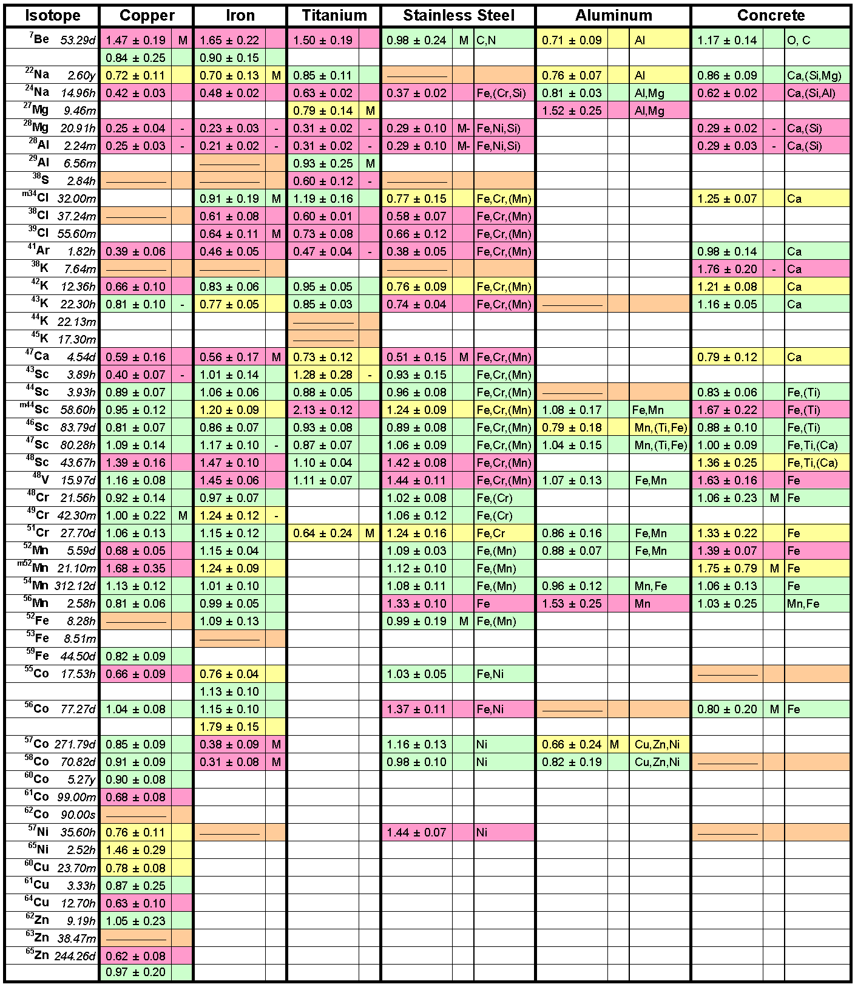
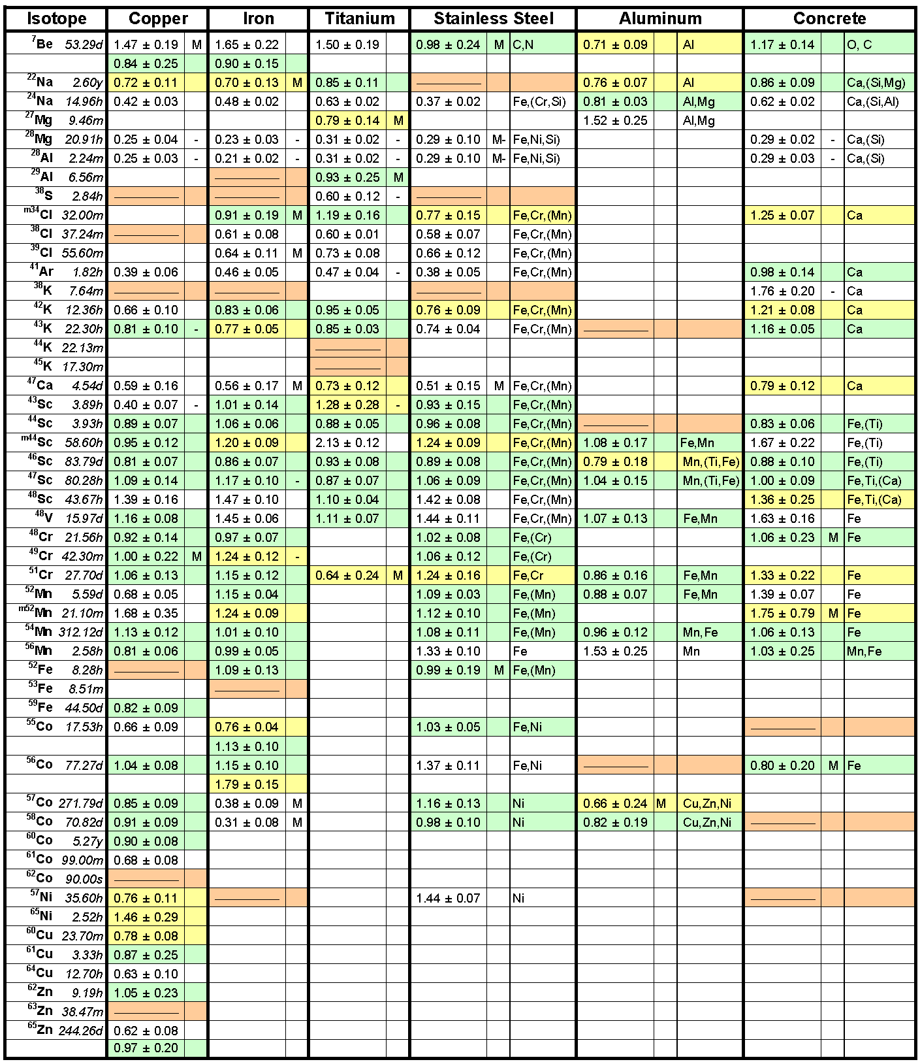
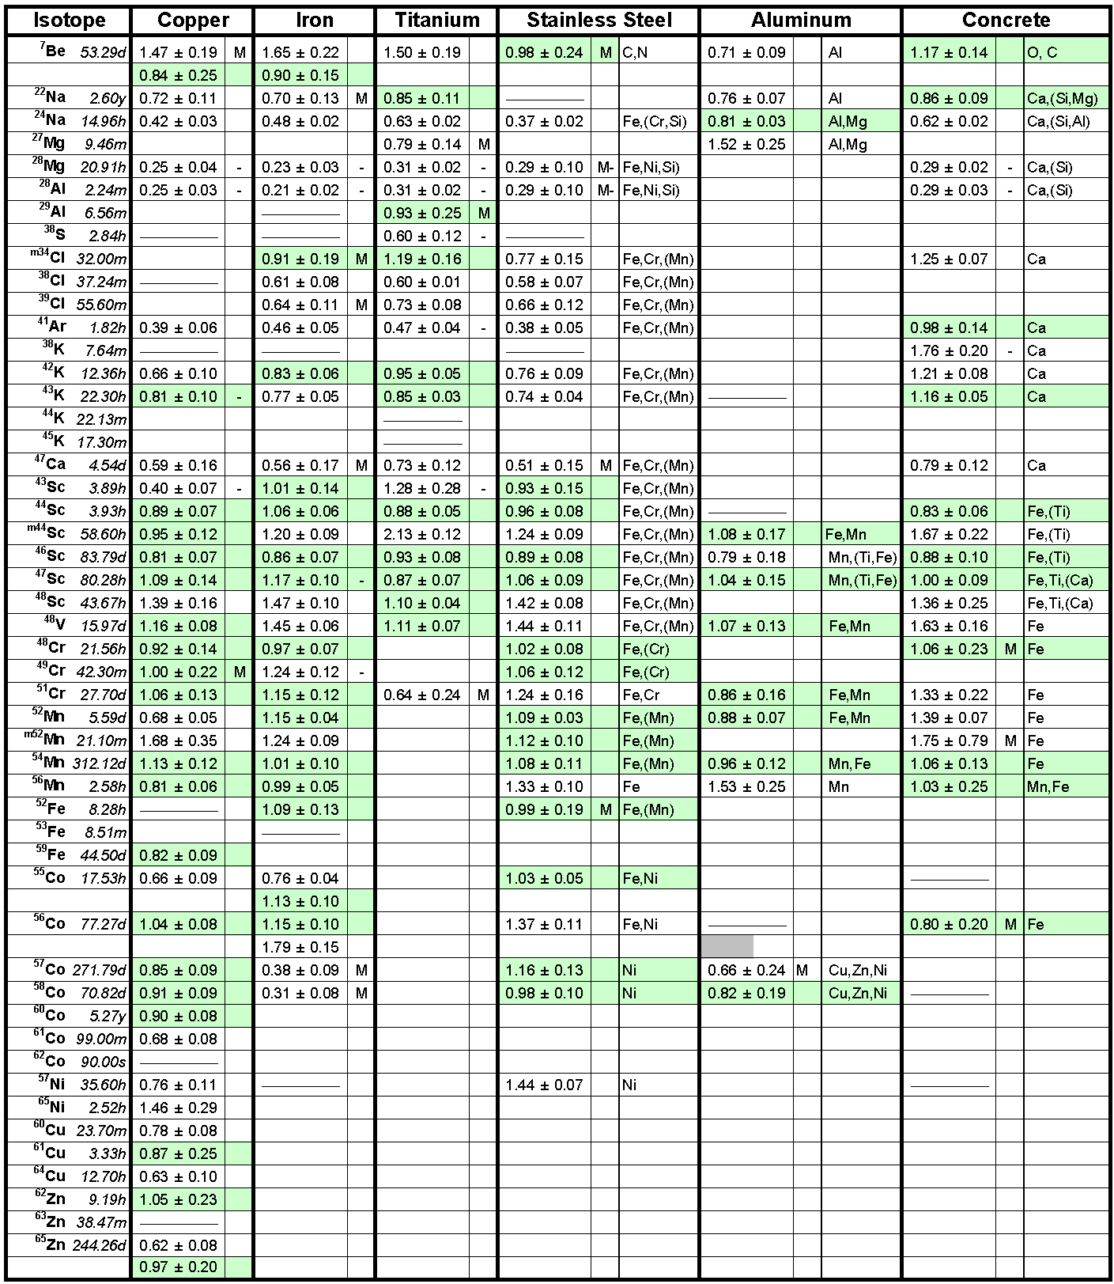
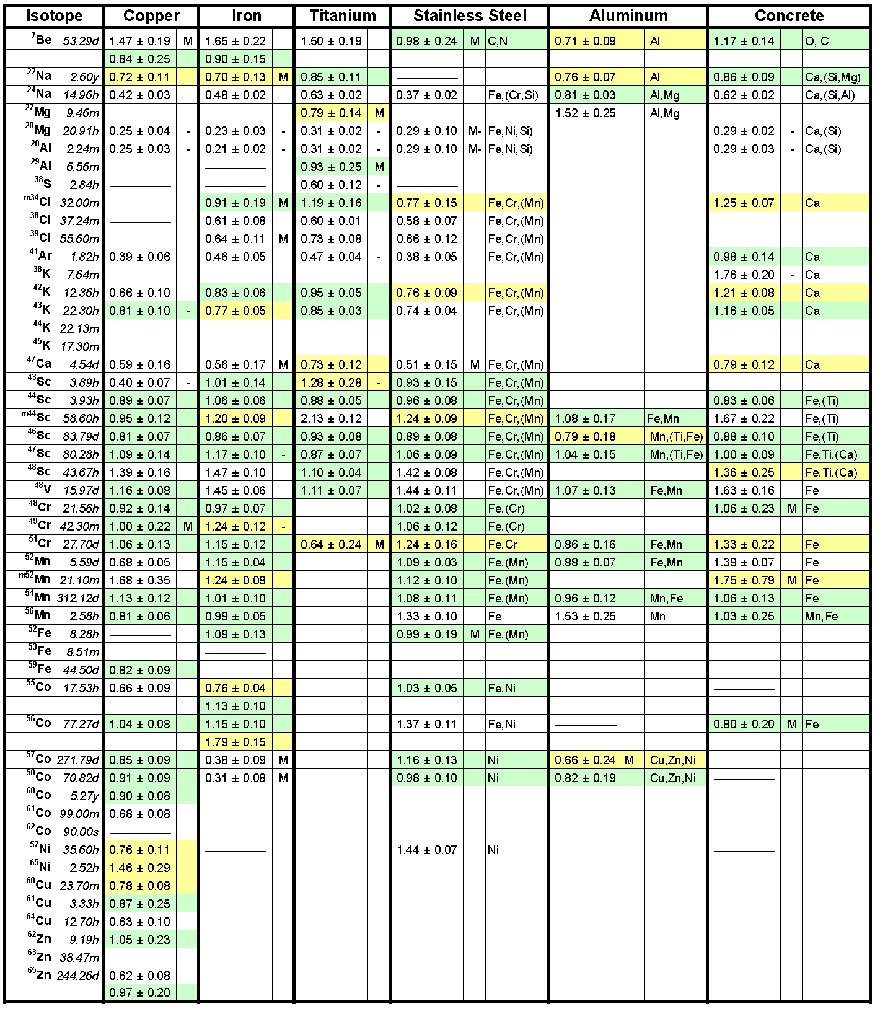
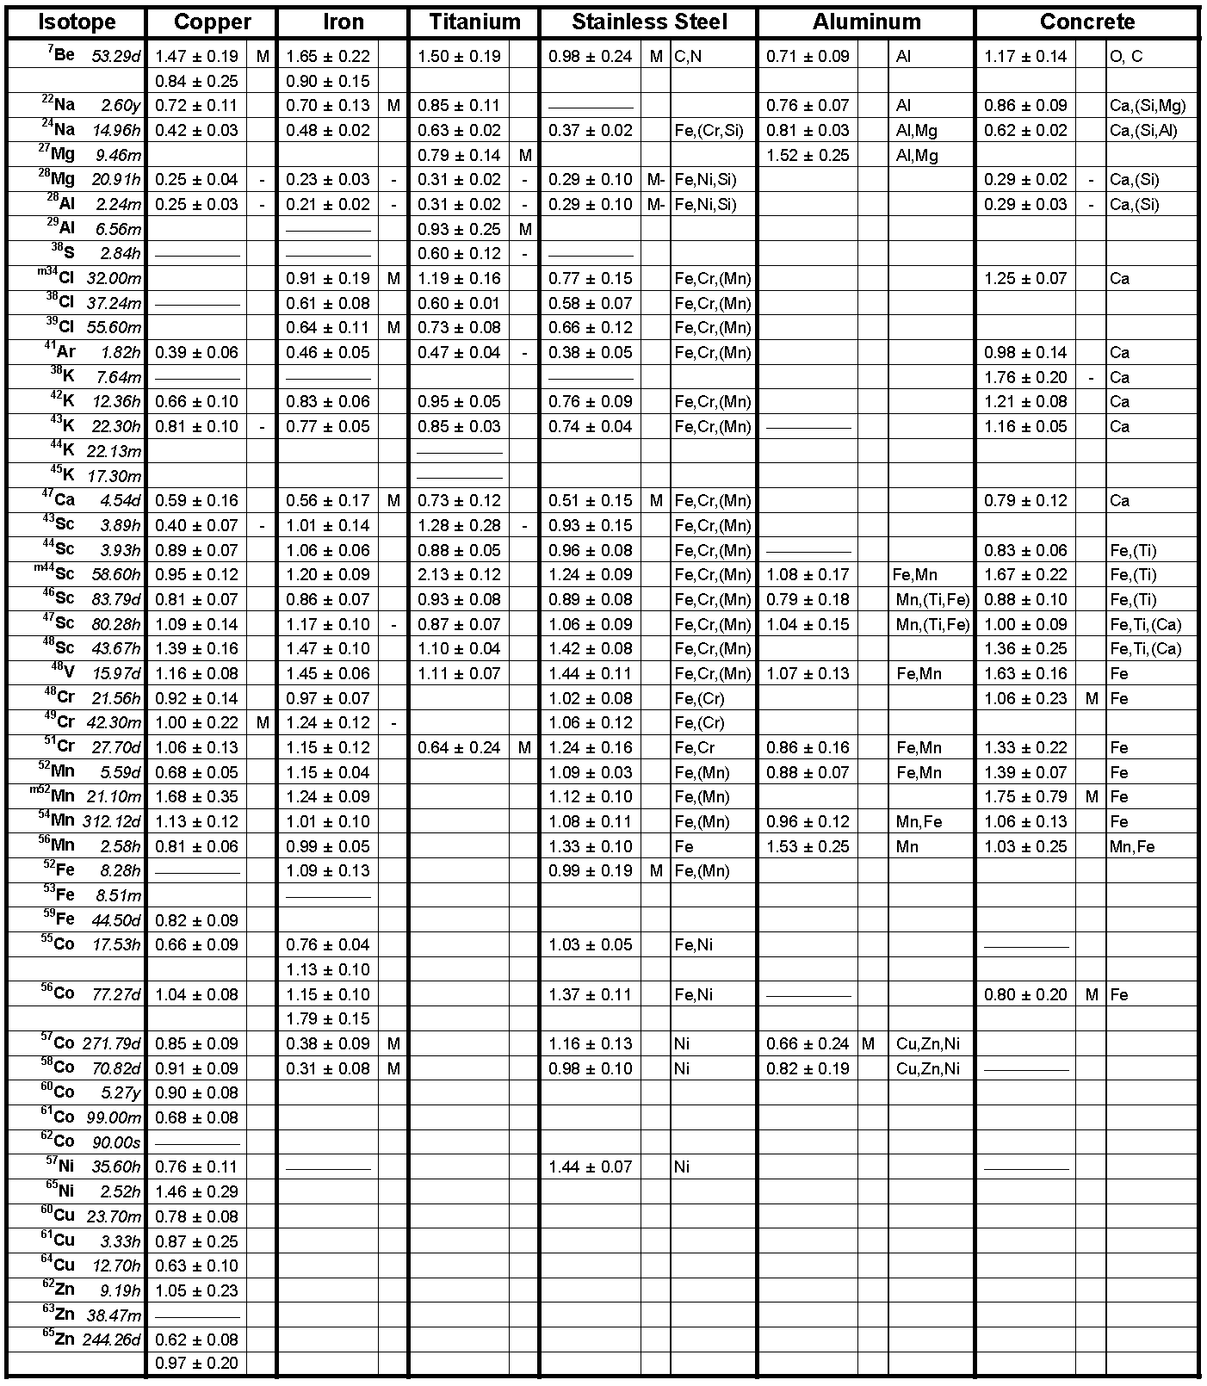
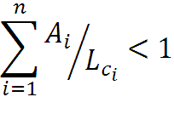




Activation of Material
R = Ratio FLUKA/Exp
0.8 < R < 1.2
0.8 < R ± Error < 1.2
Exp/MDA < 1
R + Error < 0.8 or
R – Error > 1.2
M. Brugger, A. Ferrari, S. Roesler and L.
Ulrici, “Validation of the FLUKA Monte
Carlo code for predicting induced
radioactivity at highenergy accelerators”,
Nucl. Instr. and Meth. A 562,
p. 814 (2006)

Slide 5
Removal of Material and Waste
All material and waste leaving LHC underground areas (with a few exceptions) has to be subject to a radiological control
Subsequent handling procedures for the material and waste depend on the
radiological classification of the material
-> non-radioactive or radioactive
so-called waste zoning
“Zone Déchets Conventionnels”, “Zone Déchets Radioactifs”

Slide 6
Waste Zoning
Purpose:
To predict the nature and amount of radioactive waste produced at the dismantling of the facility
Assumption:
10 years of nominal LHC operation, 100 days of “cooling” (LHC machine) (different assumption for experiments)
“Zone Déchets Radioactifs” kept to the minimum
ZDC
Zone dechet conventionnels
ZDR
Zone dechets
radioactifs
LHC

Slide 7
Material Controls & Waste Zoning
ZDC
SC-RP controls of material and waste
not systematically required
ZO
Zone operationnel
SC-RP controls required
ZDR
SC-RP controls required

Slide 8
Zoning
Definition of ZDR, ZO and ZDC → SC-RP
Colour code for ZDR
Choice of colour: violet
Data base

Slide 9
ZDR of type 0

Slide 10
ZDR of type 1 → Insertion regions

Slide 11
ZDR of type 2 and 3 → Collimation

Slide 12
Zonage Operationnel
x years of y-type LHC operation, 0.5 hour “cooling time” and more
Amount of radioactive Material is a function of operation and cooling time
“Zone Operationnelle “(ZO):
All material from the operational zone has to be controlled by RP
Only RP will be allowed to take the decision if the material has to be considered as radioactive or not
LHC machine tunnel (at least) will be defined as Zone Operationnel
(ZDR imbedded)

Slide 13
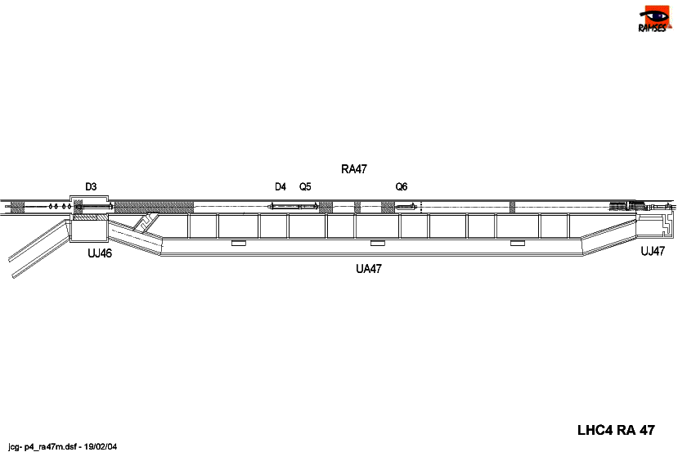
Zonage Operationel
Zone Opérationnelle (ZO) including Zone Déchets Radioactifs (ZDR)
Zone Déchets Conventionnels
(ZDC)

Slide 14
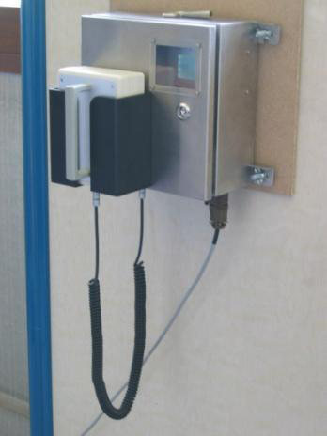
Removal of Material from “Zone Dechets Conventionnels”
RP clears the Zone Déchets Conventionnels ZDC (e.g. UA) by representative measurements (sampling, γ-spectroscopy mapping)
If clearance okay:
material non-radioactive,
can be removed by equipment owner,
equipment owner performs control measurements
using “Picomur” (for 2008)
In case of alarm: call SC-RP immediately
Clearance of area to be reconsidered
In the worst case: up-grade of ZDC to ZO
Don’t bring any radioactive material into ZDC !!!

Slide 15
“Removal of Material from Zone Operationnel” (1)
RP controls ALL material from Zone operationnel (ZO)
Areas of low level radioactivity:
Equipment owners
labels their materials
(nature, origin, ZDR yes or no, destination) brings the material into the buffer zone
Radiation Protection
controls the material (regular campaigns)
SC=RP gives feed back to the owner
Equipment owner
traces all material that is radioactive
traces all material that comes from ZDR

Slide 16
Removal of Material from “Zone Operationnel” (2)
RP controls ALL material from Zone Operationnel
Areas of elevated radioactivity (radiation veto applied):
Handling procedure of material part of job and dose planning done in collaboration between equipment owner and RP
(ALARA procedure II,III)
Radiation Protection
controls the material
RP gives feed back to the owner
Equipment owner
traces all material that is radioactive
traces all material that comes from ZDR

Slide 17
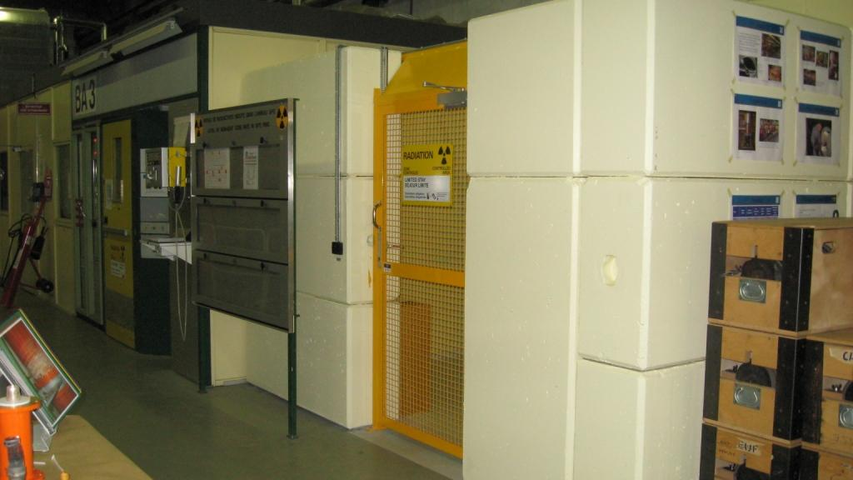
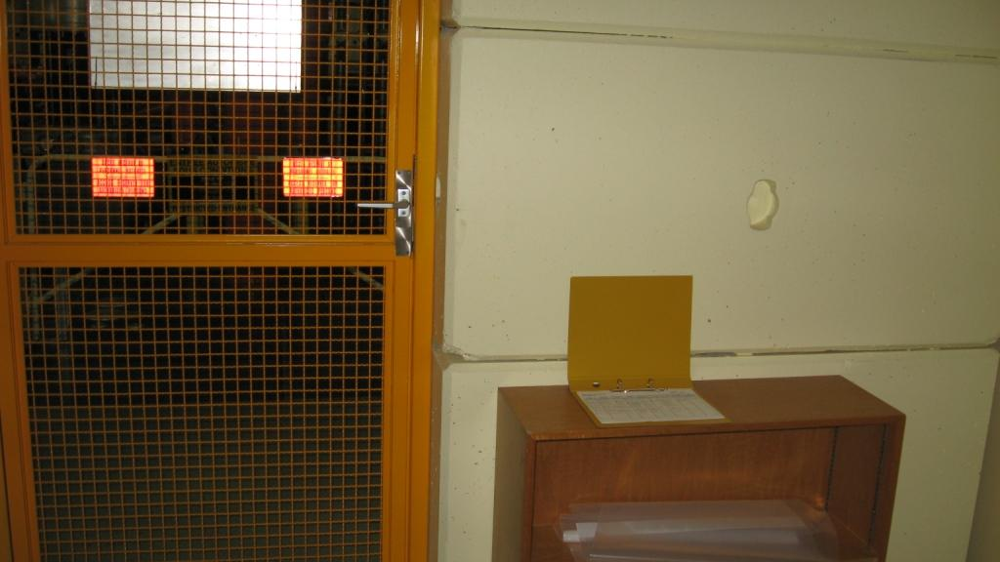
Removal of Material from “Zone Operationnel”
See Buffer zones SPS

Slide 18








Waste Handling
ZONE
TAMPON
Buffer zone
Waste from operational zone (ZO),
including ZDR :
Equipment owner labels his waste
(nature, origin, ZDR yes or no)
Waste from Zone Déchets Conventionnels (ZDC)

Slide 19
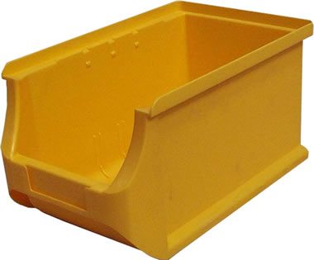
Material and Waste:
Material labeled and packed into plastic bags by equipment owner

Slide 20
Summary
LHC will be subdivided into three zones with respect to material and waste handling (ZDC, ZO, ZDR)
A major part of ZDC has to be regularly confirmed as conventional by SC-RP clearance measurements of areas
Clearance of ZDC is pragmatic SC-RP approach to allow easy handling of material and waste by the equipment groups and to respect good RP practice at the same time!
All material and waste from ZO has to be controlled by SC-RP, only SC-RP will be permitted to decide if material is radioactive or non-radioactive
All radioactive material (waste) and all material (waste) from ZDR has to be traced

