Slide 1
Standard ELQA measurements, ELQA for splice and proximity equipment consolidation
Piotr Jurkiewicz
The Henryk Niewodniczański Institute of Nuclear Physics – Polish Academy of Sciences, Kraków Poland

Slide 2
ELQA group activity during LS1
Presentation plan:
1. LS1-PAQ during SMACC
2. AIV during magnets replacement
3. ELQA Measurement Campaigns
4. Conclusions and statistics

Slide 3
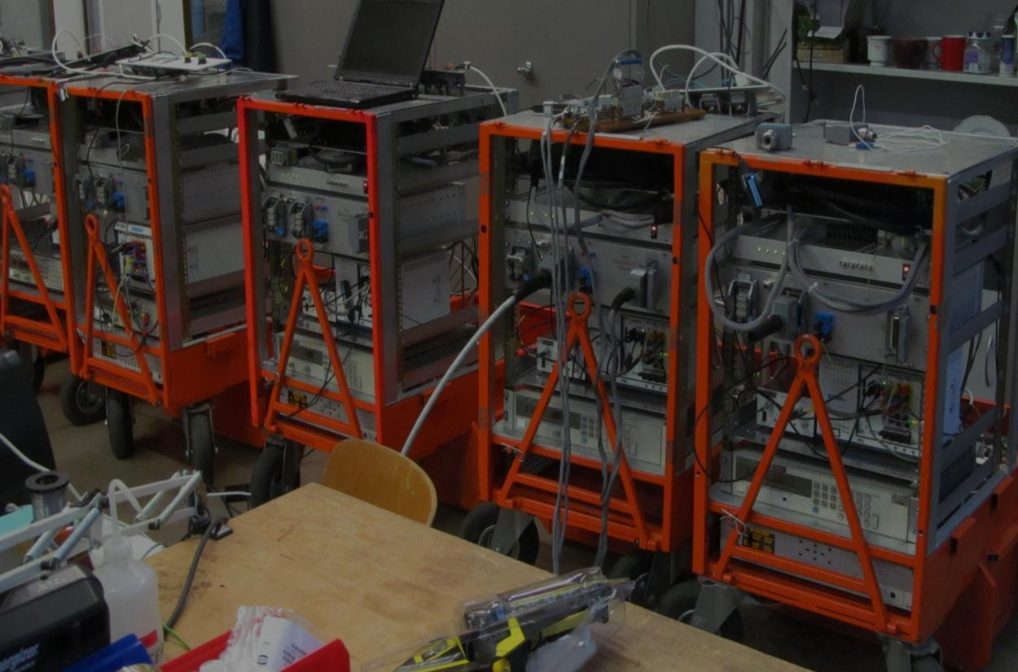
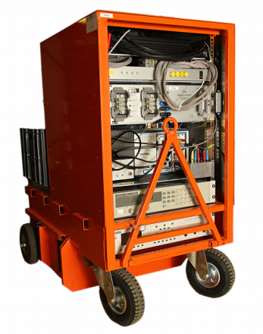
ELQA group activity during LS1
Within the framework of the preparations for LS1, 8 new mobile TP4 measurement systems have been designed and constructed at INP.
The main ELQA measurement tool
TP4 systems

Slide 4
1.PAQ during SMACC
The main objective of the SMACC consisted in
remaking all of the interconnections by assembling the
additional shunts on the copper stabilizers in all
connections between the magnets.
We took part in the SMACC activities
by measuring the connections quality by the end of each activity day.
To do it, special procedures, the so-called PAQ (Partial
Assembly Qualification), have been developed
and introduced.

Slide 5
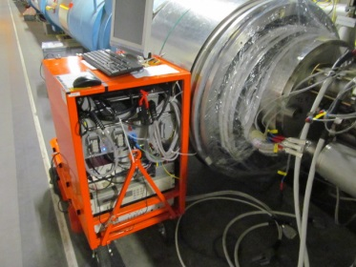
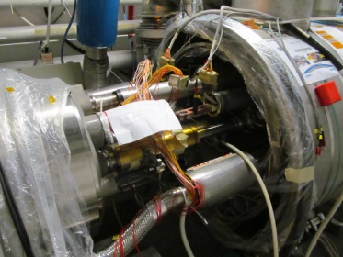
LS1-PAQ – test performed every evening in active sector
TP4 is connected to one end of the entire chain of the magnets in one sector (to the spools M1, M2 and the main bus-bars). The spool-pieces M1,M2 are cut mainly in the position near the odd point of the sector.
PAQ during SMACC
M1
M2spools
M2BB
Picture: TP4 QA mobile test bench in place for SMACC in S67
Notes:
PAQ test in SMACC active sector

Slide 6
Main goals of LS1-PAQ
‘on-line’ detection of any non-conformity which could indicate a degradation of the electrical quality of the superconducting circuits of the LHC, applied to the circuits under repair.
detection of any faulty connectivity, mainly mistakes in re-connection of the superconductors after SMACC's works are accomplished.
detection of both short circuit of the power line to ground or a degradation of the insulation quality (HV tests).
The following tests have to be performed:
continuity of circuits , high-voltage insulation quality tests.
Tests were performed on:
the main dipoles (M3 bus-bar) , quadrupoles (M1 & M2), main dipole
correctors supplied by the so-called spool-pieces M1, M2.

Slide 7
LS1-PAQ: Total time of pure mesurements

Slide 8
LS1-PAQ: Total time of pure mesurements
945 Hours - total PAQ in SMACC

Slide 9

The ELQA-SMACC campaign in numbers
Number of records produced during H.V. voltage qualification testing: 12’054
NOTE: 1’925 of them were identified as a inconsistent with the reference at least at the first attempt
Most of them resulted from the inaccurate preparation of the magnets circuits for a test by SMACC teams.
NONCONFORMITIES
  Finally, we have found 5 serious NC. I would like to present only
  two of them.
The ELQA SMACC Campaign in numbers:

Slide 10
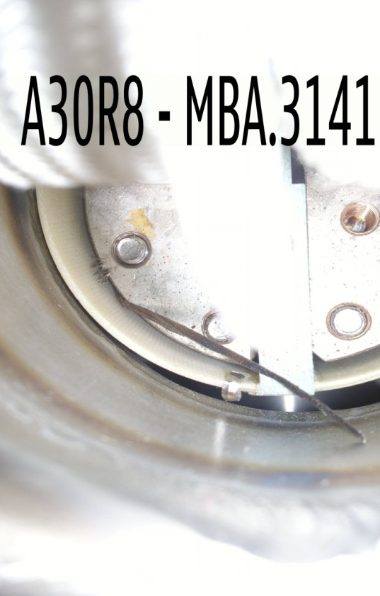
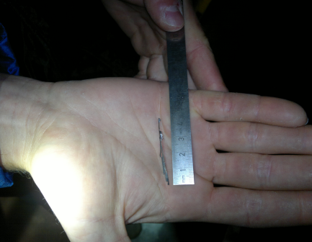
NC1- A short circuit between M3 external bus-bar and ground was detected by ELQA.
- After the investigation it turned out that the problem was localized in the diode box and it affected diode MDA0298-A30R8.
NONCONFORMITY
A long metallic piece between the half moon and ground

Slide 11
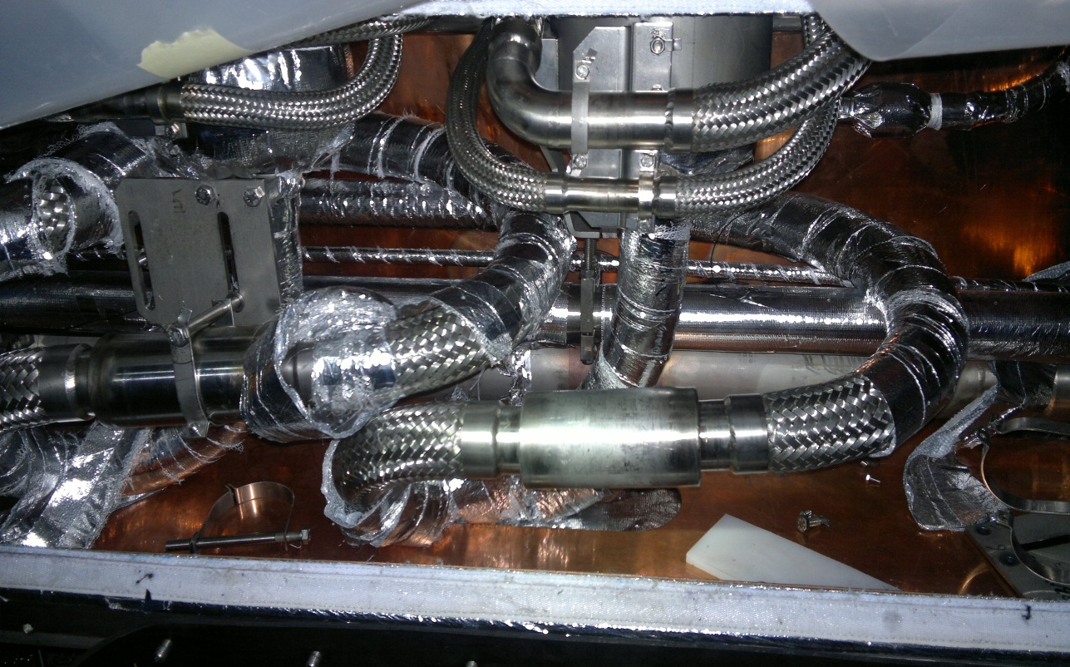
NONCONFORMITY
NC2 – Nonconformity in DFBA sector 7-8 (L8)
Short circuit between the bus-bar (M3-external) of the main dipole and ground. The short-circuit has been found on the output of DFBA, in the position of the bend of the bus-bar loop.
short

Slide 12
Just to find that one fault completely justifies the necessity of making these measurements - PAQ during SMACC.
NONCONFORMITY
Both layers of Bus-Bar insulation have been torn

Slide 13
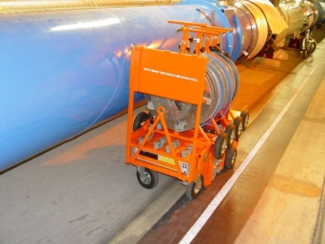
ELQA during Magnet Replacement Campaign
Another important task during LS1 was to replace the magnets classified as defected.
In this operation the ELQA group drew on its rich experience.
During the original installations of LHC, the magnets qualification after the installation in the tunnel was one of the main task of the ELQA group.
For this purpose we used a dedicated measurement system, the so-called
AIV (Arc Interconnection Verification).
AIV –System
Arc Interconnection Verification

Slide 14
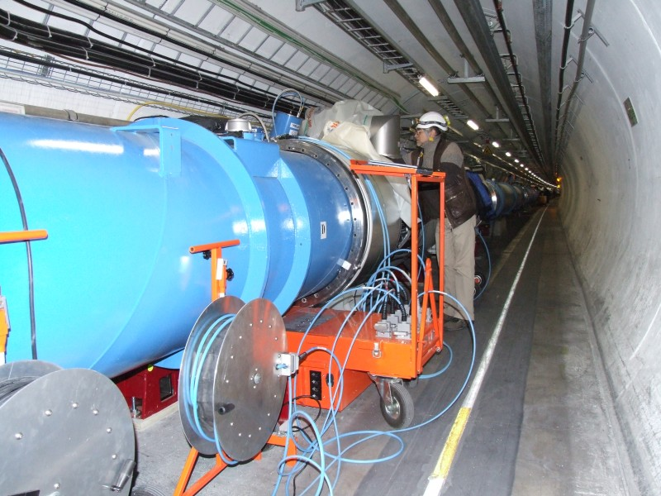
AIV procedures
The system is designed to verify the spoolpieces and N-line
during the interconnection work.
AIV system measurement consists of two procedures:
AIV1: after bus-bar, spools and Line N clamping
AIV2 : after their welding.
AIV1 and AIV2 are automated Labview procedures for continuity and polarity check.
Additional HV tests can be performed.

Slide 15
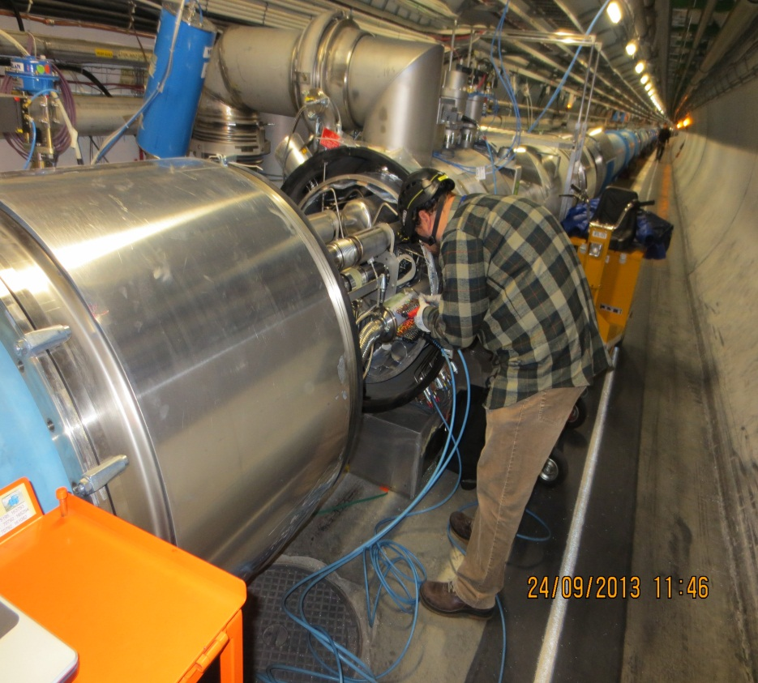
AIV procedures
Generally, according to the plan 15 main dipoles (6 in S12, 3 in S23, 2 in S34, S45 and S78) and 3 main quadrupols (all in S34) and Q5L8 have been replaced during LS1.
This replacement required performing about 50 AIV tests. Finally one NC has been disclosed. The extremity of the leads of the correction magnet have been swapped
Line N connecting to the AIV

Slide 16
ELQA Measurement Campaigns
The basic tasks of the ELQA group are being carried out within the measurement campaigns.
One full campaign consists in performing the measurements of relevant parameters of all types of superconducting magnets or groups of magnets and their infrastructure in the whole 27-km tunnel.
The main objectives of these tests are to qualify all the circuits for powering and to gather all the necessary parameters for the LHC operation.
Depending on the LHC temperature states, the campaigns are divided into two types:
1. Campaign at warm – (LHC at room temperature)
2. Campaign at cold - (after cooling down of the LHC)
One measurement campaign consists of 4 basic groups of tests:
1.TP4 2.DOC 3. MIC 4. C50

Slide 17
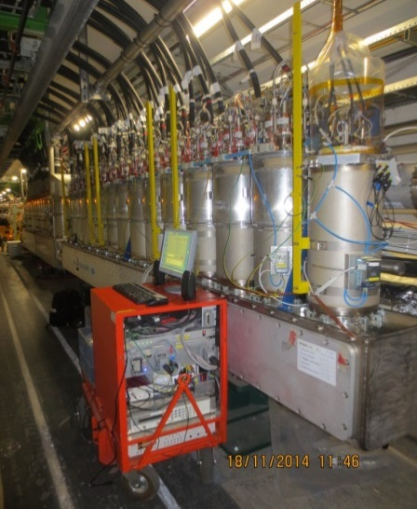
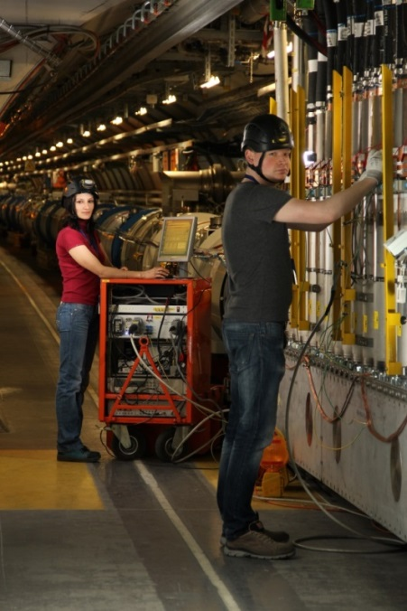
TP4 – measurement (test procedure 4)
ELQA-TP4 procedures concern all superconducting circuits of the magnets powered via DFBs and their infrastructure at the stage when all the electrical circuits are connected.
The main objectives of these tests are:
electrical qualification of these superconducting electrical circuits, including CLs.
verification of the integrity of the instrumentations used for the protection of the magnets and CLs.
TP4 System next to DFB during the TP4 tests

Slide 18
TP4 – measurement
All objectives of the TP4 procedures are carried out by the group and the following tests are performed:
1. ORC Ohm Resistance Check – resistance of the circuit is measured
between the two CL, it allows the continuity to be checked
automatically
2. ICC - Instrumentations Continuity Check - verifies that the
instrumentation wires of CL or the measured circuit are placed in
the right positions and are routed to the right connectors and pins.
3. IRC – Instrumentations Resistance Check - connection
resistance between V tap and CL is measured
4. TFM - Transfer Function Measurement – this measurement
determines the impedance as a function of frequency. The phase
and amplitude of the complex impedance are calculated.
5. HVQ – High Voltage Qualifications – each circuit is energized with
DC HV source. The test allows the current leakage or short to ground
to be detected (it shows the quality of insulation resistance).

Slide 19
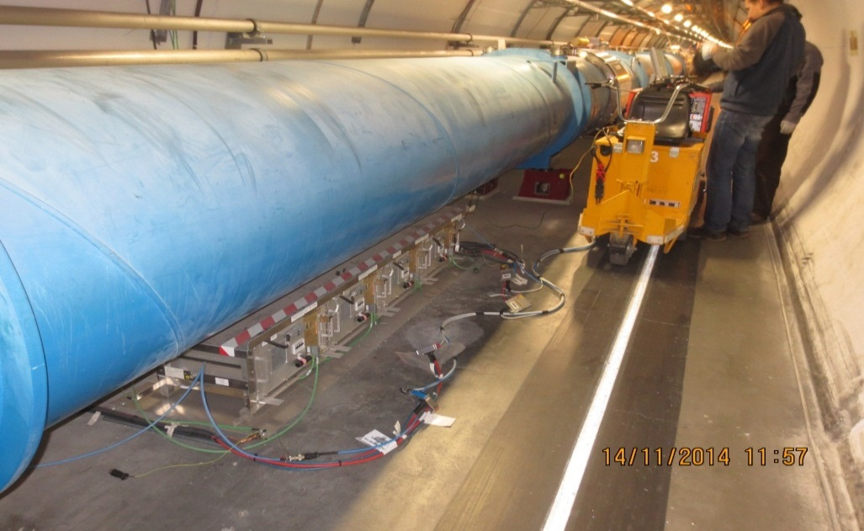
DOC – Dipole Orbit Corrector
The DOC test is intended to qualify the Dipole Orbit Corrector magnets, which are located in each of the main quadrupoles.
DOC measurements involve a group of tests similar to the TP4 test procedures:
1.ICC/ORC - ORC Ohm Resistance Check/ Instrumentations Continuity Check
the sequence of voltage taps is checked, the resistances of CL and the whole
circuit are compared with reference.
2.TMF – Transfer Function - analysis of the current and voltage over the circuit
allows us to calculate the impedance of the circuit.
3.HVQ – HV-DC - voltage is applied between the circuit and GND. The current
flowing through the insulation is measured.
Connection of the TP4 system for DOC measurements from the power converter side

Slide 20
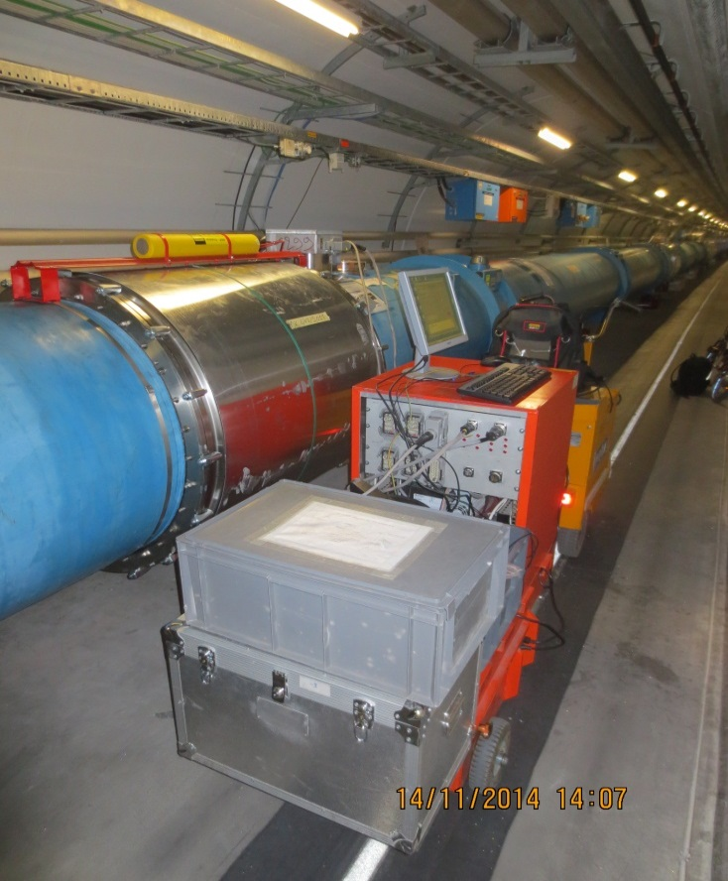
MIC - Magnet Instrumentation Check
-The goal of this procedure is to check the integrity of the voltage tap
wires and quench heaters of each individual magnet.
-In these tests first the resistance of the voltage taps (IRC) and quench
heater (ORC/ICC) are measured locally at the level of the IFS box.
-In the second step the quench heaters at HV versus ground and the rest
of the circuits are tested (HVQ) .
TP4 system back panel cables connected to the IFS box

Slide 21
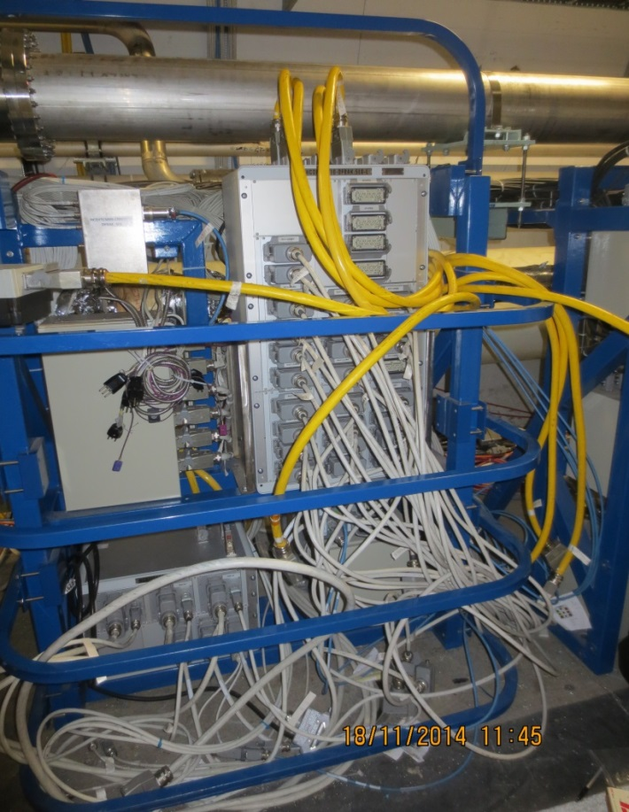
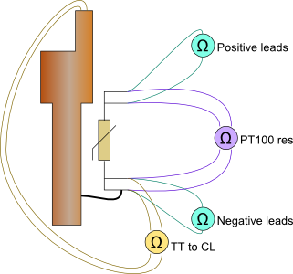
C50 procedure
This procedure checks the CL temperature sensors.
The connectors of the sensors are placed on the top of the Proximity Equipment - yellow cables.
Test setup
Proximity Equipment Box

Slide 22
Overall summary of our campaigns for the years 2013-2014
In the years 2013-2014 three full standard measurement campaigns were carried out:
1. Campaign at cold - to check the machine
status after first run
2. Campaign at warm - after LHC heating
3. Campaign at warm - after SMACC works
4. We are now at the end of the 4th
measurement campaign at cold - which is the
final campaign for releasing the magnets for
powering

Slide 23
Campaigns statistics by October 20, 2014
Total number of measurements = 66 373

Slide 24
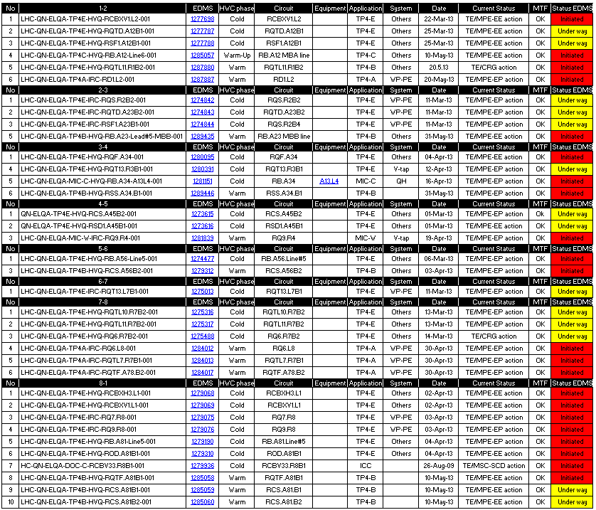
NC statistics in campaigns
The main results of the ELQA group measurements are reviled nonconformities

Slide 25
Nonconformities in statistical terms
Total ELQA NCs: (until 13.11.2014) | 115
Total at cold, before SMACC | 31
Total at warm, before SMACC | 0
Total at warm, before SMACC | 16
Total at warm, during SMACC(including DLM) | 39
Total at warm, after SMACC | 9
Total during cool-down, after SMACC | 0
Total at cold, after SMACC | 20

Slide 26
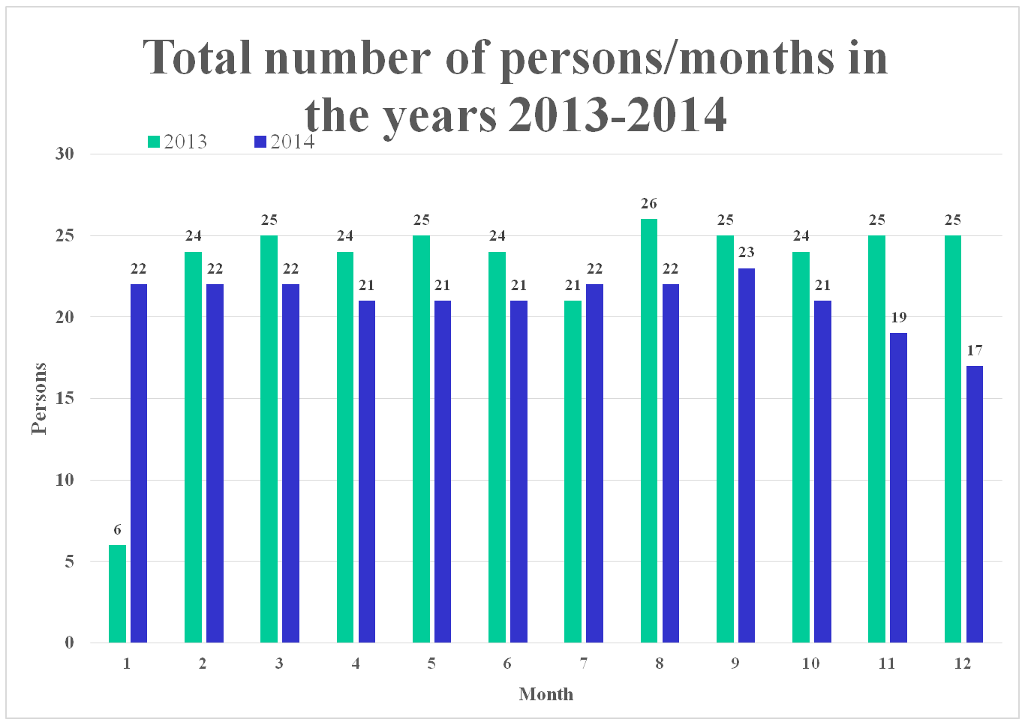

Slide 27
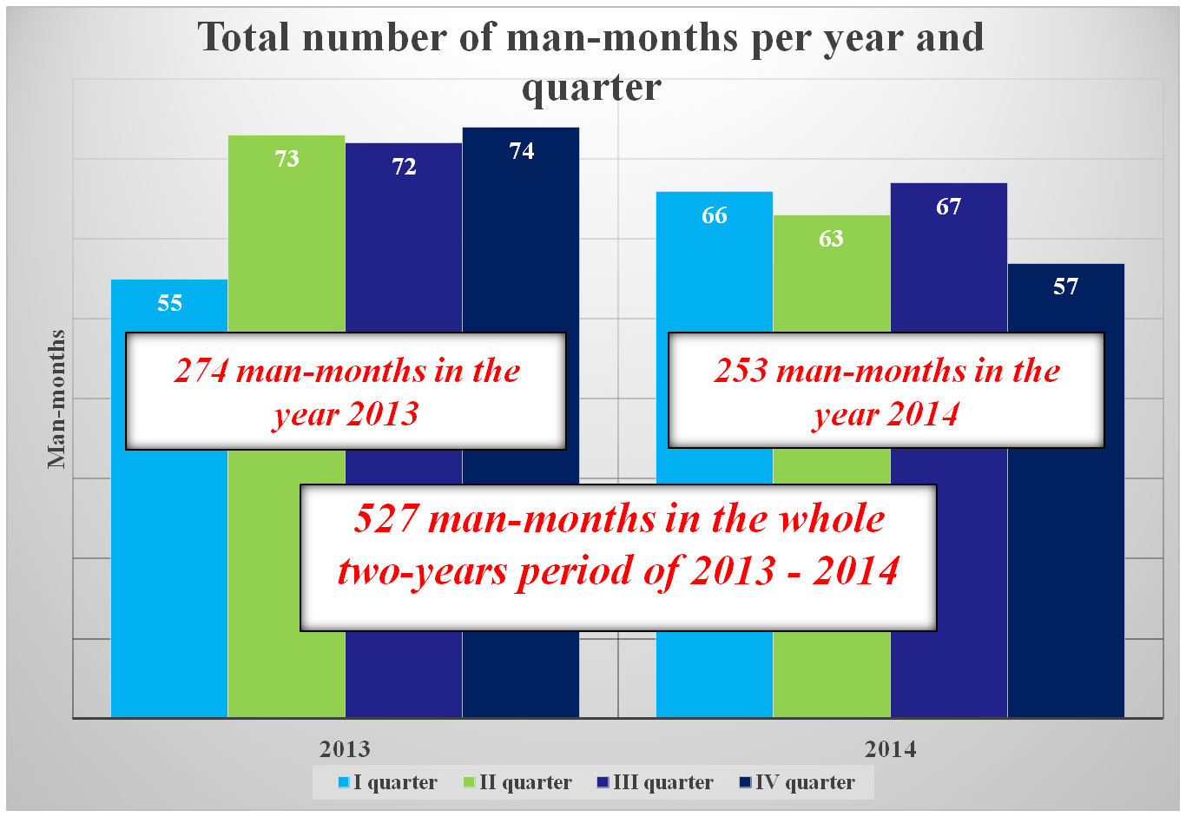

Slide 28
Thank you for your attention

