Slide 1
ELQA maintenance, diagnostics and data handling
Jaromir Ludwin
The Henryk Niewodniczański Institute of Nuclear Physics – Polish Academy of Sciences, Kraków Poland

Slide 2
WP definition
KE2058/TE
KE2059/TE
KE2060/TE
ELQA reference measurements at cold before starting LS1
ELQA reference measurements at warm before starting LS1
ELQA reference measurements at warm after splice consolidation campaign
ELQA monitoring during cool-down
Final ELQA campaign at cold before LHC restart
ELQA for splice consolidation
ELQA for replacement of magnets
Final check of 13kA splice resistance following the splices consolidation train
upgrade of the measuring chain of temperature sensor for 13kA circuits
relocation of current lead heating system racks of Inner Triplet located in IP1 (Left and Right) and IP5 (Right). – handled by CERN staff
updating of the cabling regarding 120 A circuit powered via DFBs
implementation of the spare cold temperature sensor for the current leads
upgrade of cabling at the level of the PE for some IPQs – handled by AGH team
Line N qualification in the surface. Preparation for the tunnel – done in the tunnel in the scope of magnet replacement WP
Follow-up of non-conformities related to ELQA matters: diagnostic and solving of all existing non-conformities and new non-conformities, encountered during LS1
Maintenance and data handling consisting in ensuring the maintenance of all ELQA measuring equipment and follow-up of data storage and validation
Software development and upgrade of existing programs
Team work coordination and administrative tasks
+ some
extra job

Slide 3
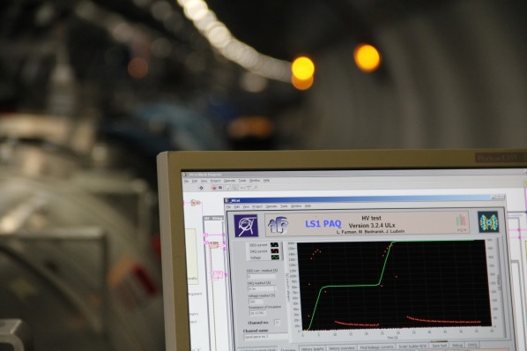
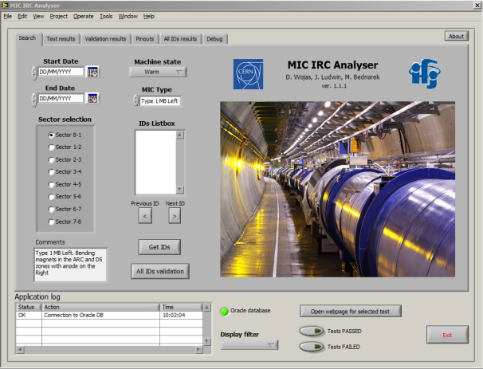
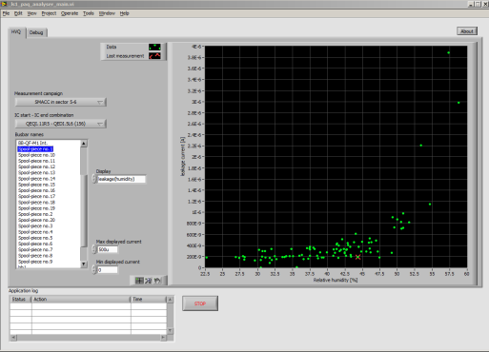
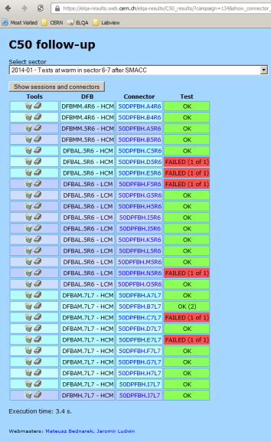
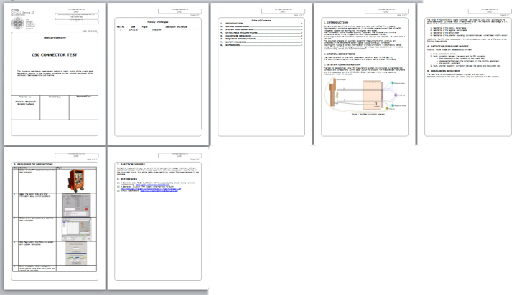
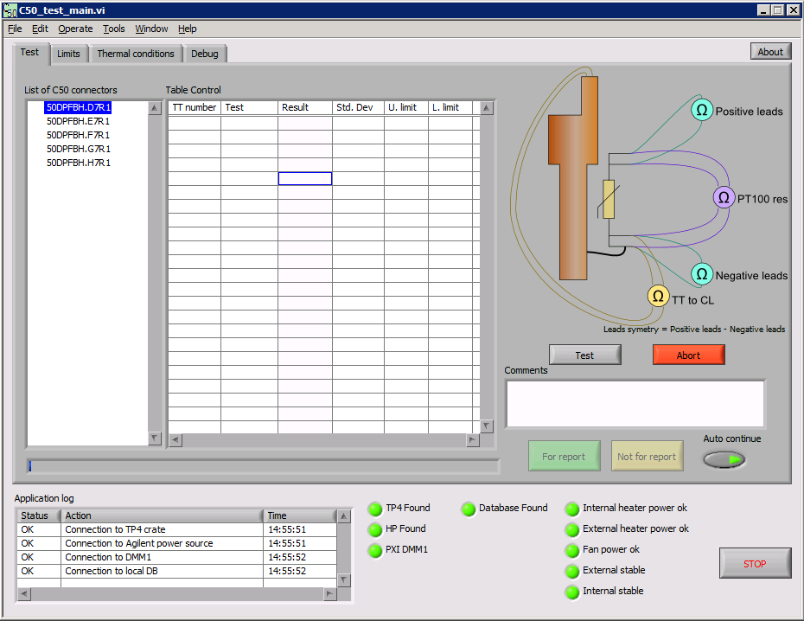
TP4 Software maintenance and development
141 commits to the TP4 SVN repository counting from the beginning of the LS1, including:
Development of the LS1 PAQ software
Introduction of the new test sequence: C50-TT validation
New tools for measurement data analysis and test parameters optimisation
Patches, fixes and improvements of existing software

Slide 4
TP4 Software maintenance and development
ELQA data base maintenance:
Over 50 000 standard ELQA + LS1 PAQ test results stored during LS1.
Additionally data form current transformers production and 600 A EE switch tests.
174 tables with more than 26 000 000 records.

Slide 5
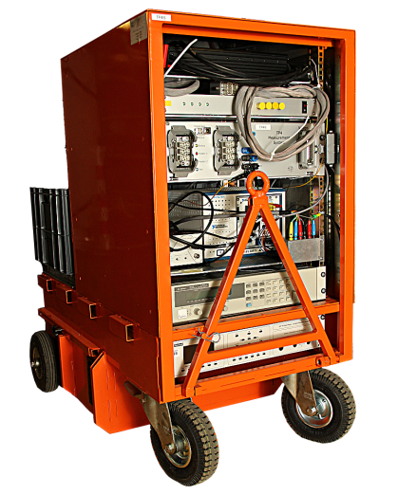
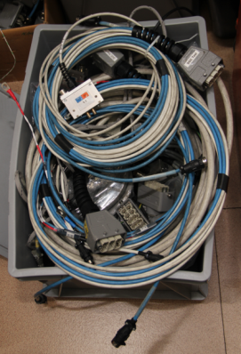
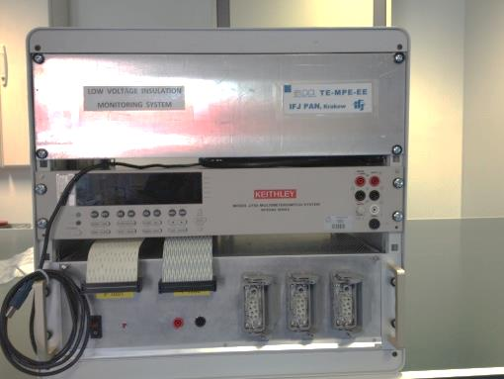
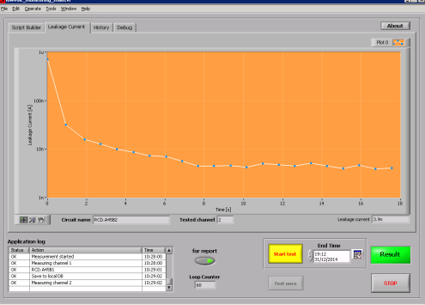
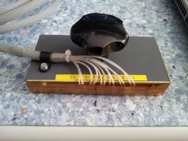
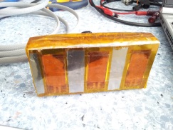
Hardware maintenance and development
Reparation of broken test cables
Improvements in the measurement systems construction in order to limit the wear
Maintenance of the tunnel bikes
Preparation of new cabling and test systems:
  Brand new insulation monitoring system for warm-up and cool-down
  LHC tunnel temperature profile measurement for warm bus-bar measurement compensation
extra job

Slide 6
Team work coordination and administrative tasks
The Polish part of the ELQA team was coordinated by Piotr Jurkiewicz and myself as his deputy
The administrative tasks were handled in different periods by:
  Beata Murzyn
  Magdalena Kostecka
  Malgorzata Res-Gunia

Slide 7
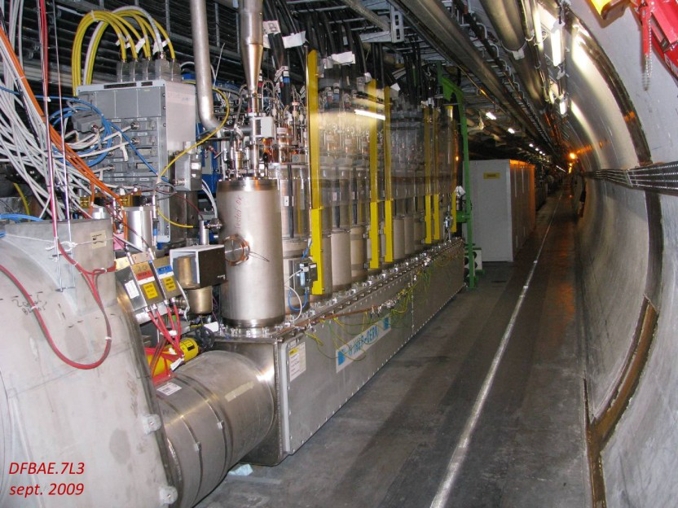
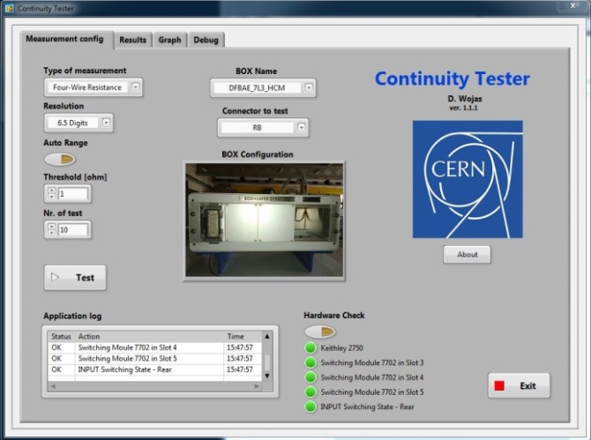
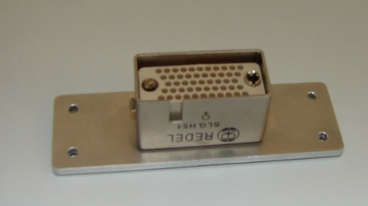
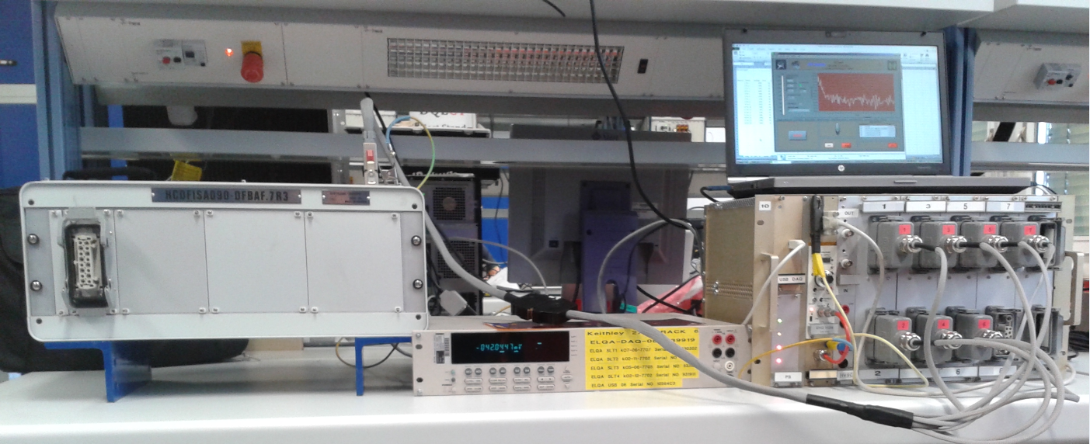
C50 upgrade
16 proximity equipment crates were upgraded
Electrical tests:
In the lab: specially prepared software and adapter cables
In the LHC tunnel: existing TP4 tests + new C50 tests

Slide 8
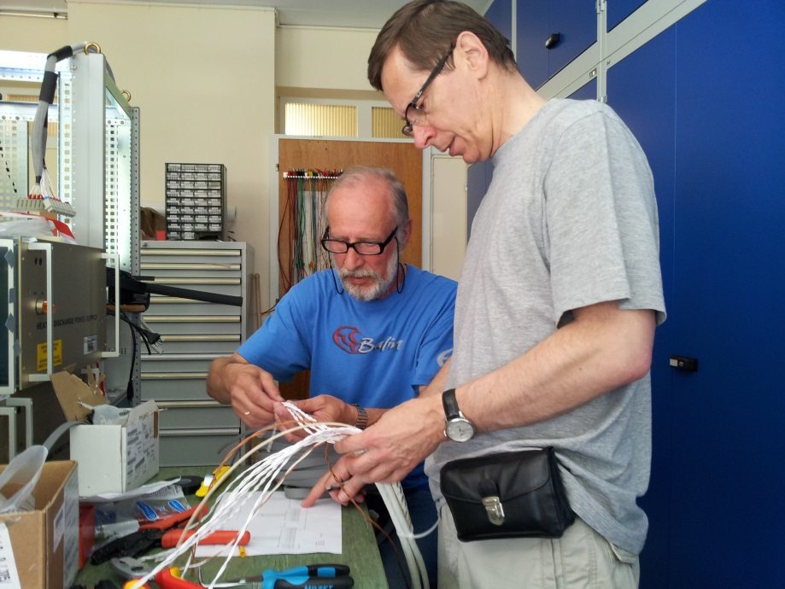
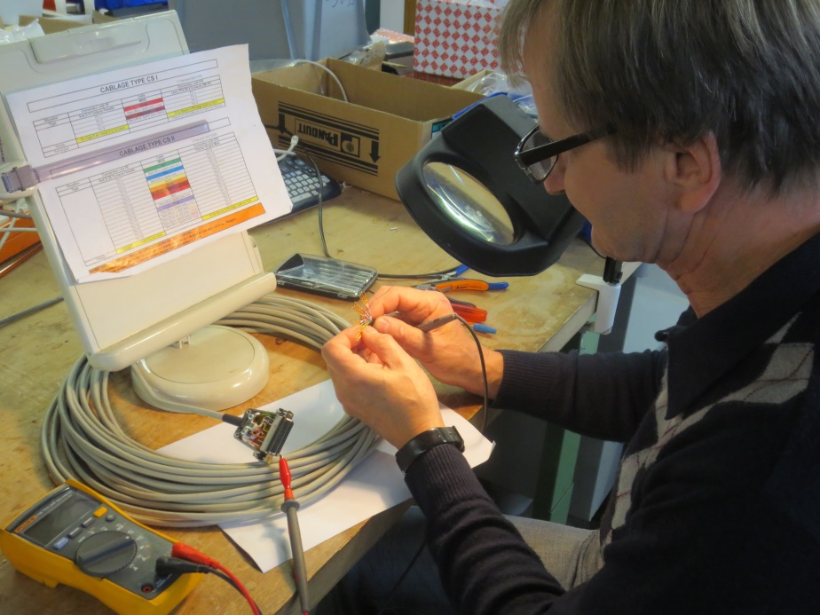
Cabling for QPS
Preparation of cabling for the QPS tests
Tests of the QPS cables in the LHC tunnel
Preparation of new cable segments between the current leads and proximity equipment
extra job
extra job
extra job

Slide 9
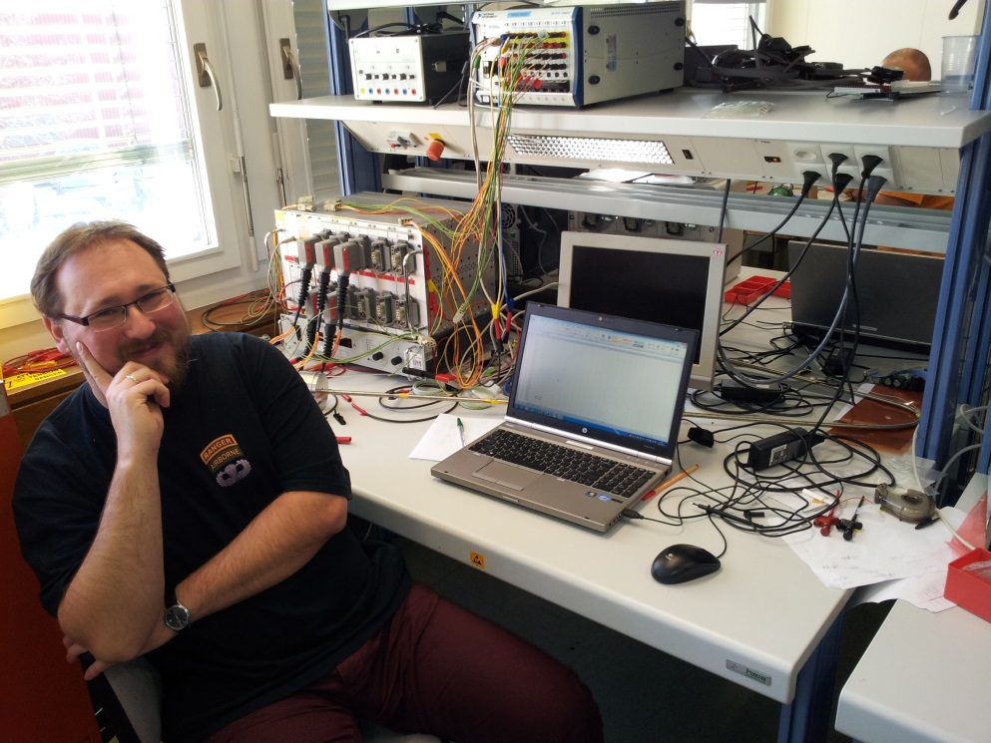
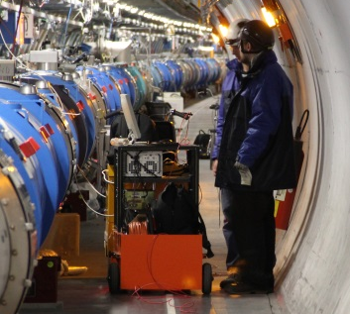
New hardware/software development
New measurement system for the dipole diode lead measurement:
Hardware built by IFJ-PAN team, programming and data analysis by Mateusz Bednarek
31 nonconformities found!
extra job
Dr Mikolaj Bednarski checking the thermal behaviour and insulation quality of the dipole capillary
Diode lead measurements in the LHC tunnel

Slide 10
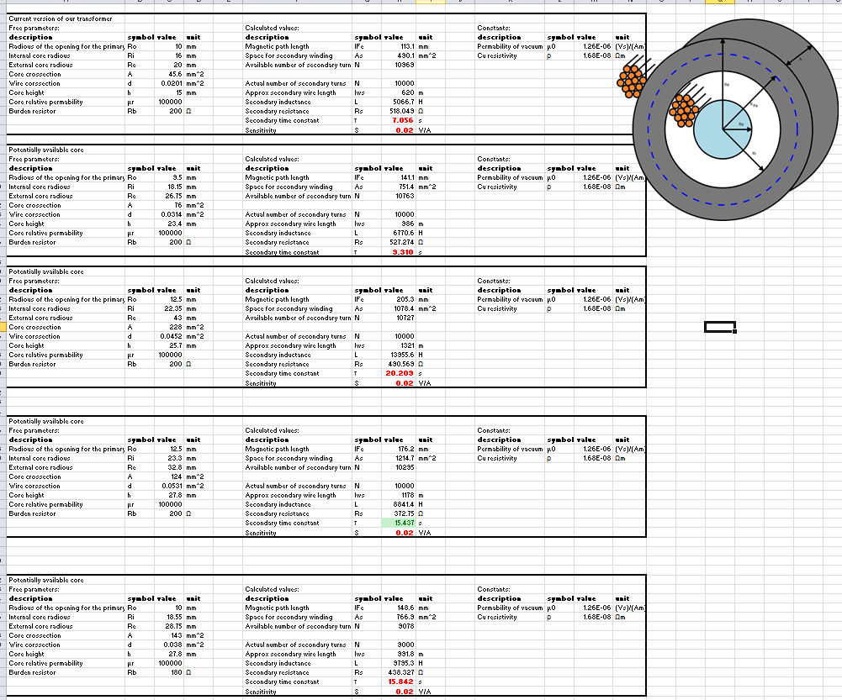
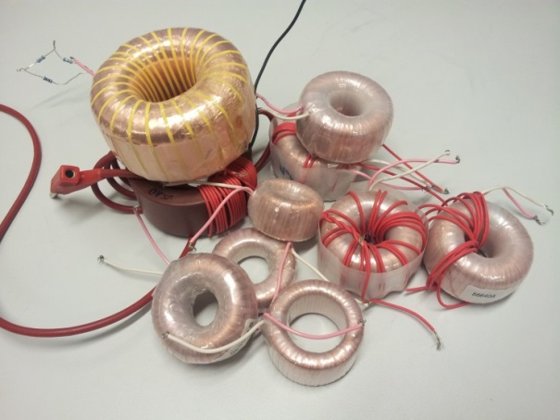
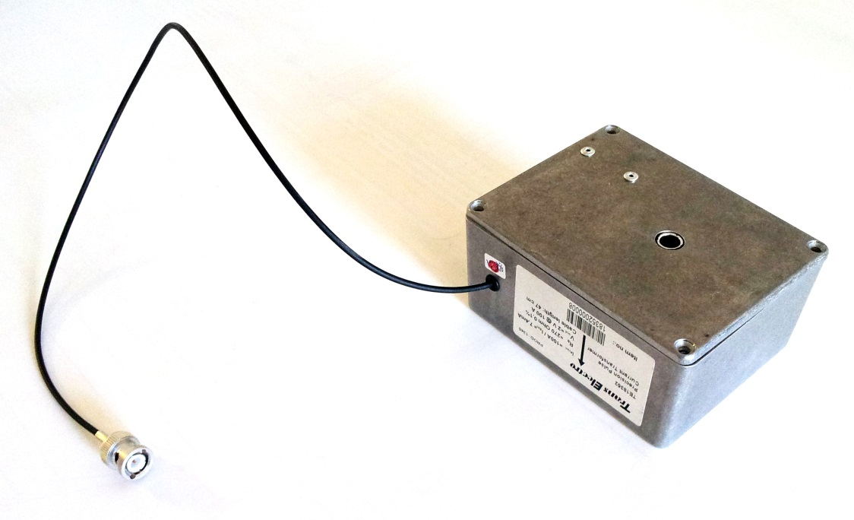
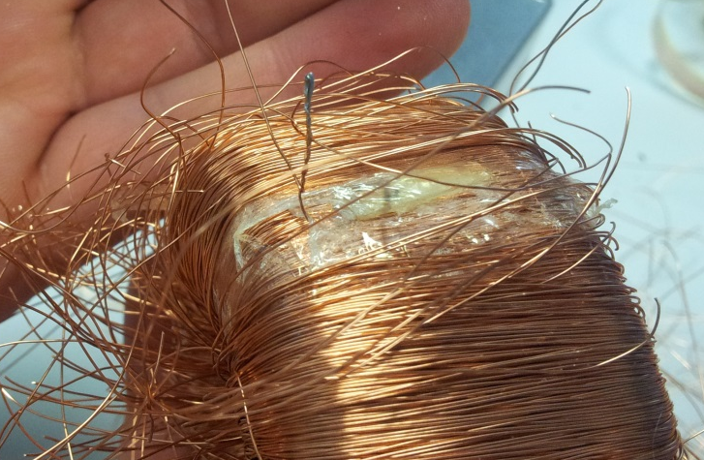
New hardware/software development
Design of the current transformer for the dipole quench heater discharge measurement
5200 units were produced
extra job
Detailed analysis of the prototype

Slide 11
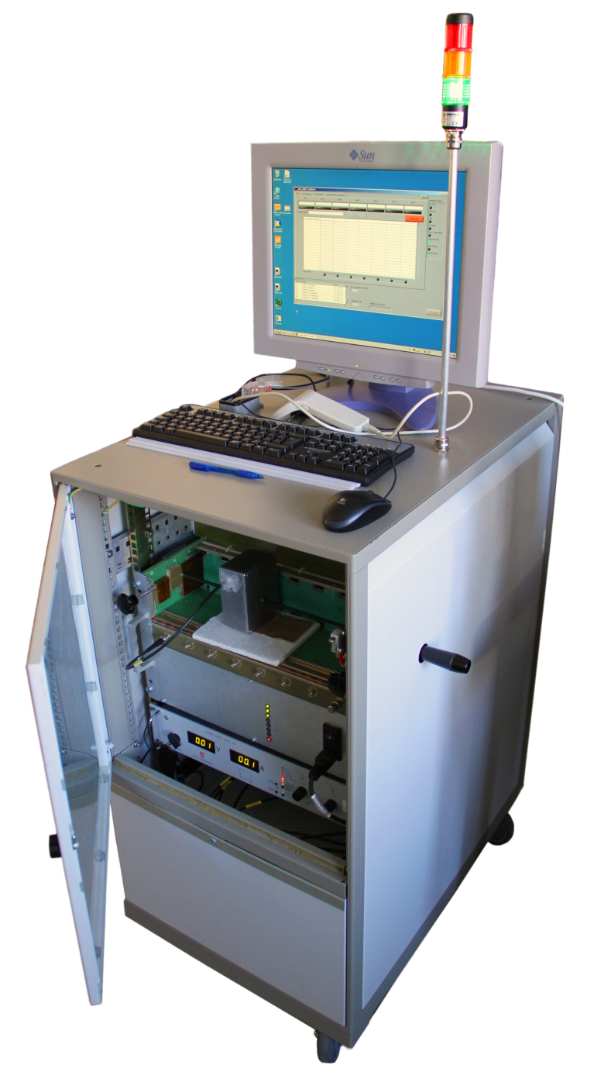
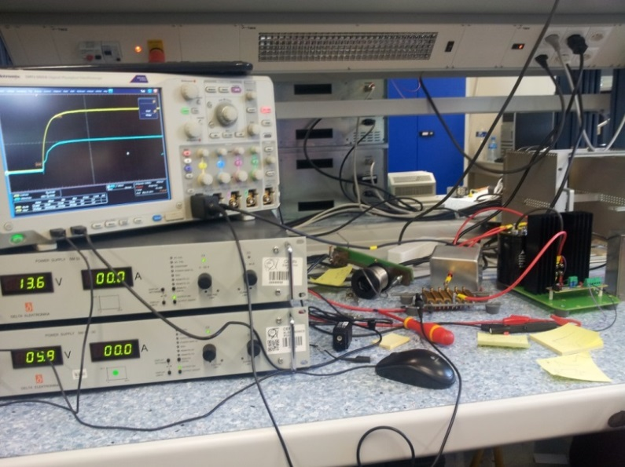
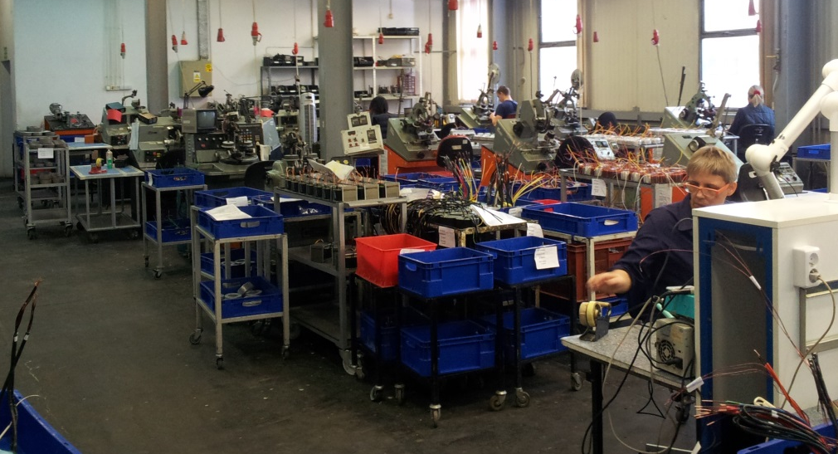
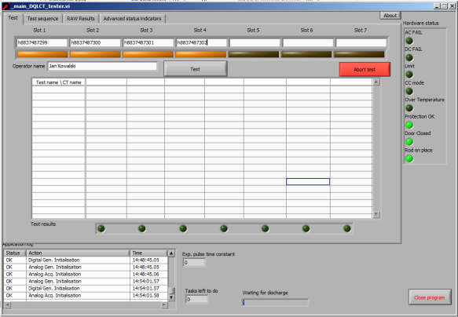
New hardware/software development
Current transformer tester
Designed, built, programmed and deployed in the factory (including the transport and training for the operators)
Special thanks to Ronaldus Suykerbuyk, who designed and manufactured the tester crate
extra job

Slide 12
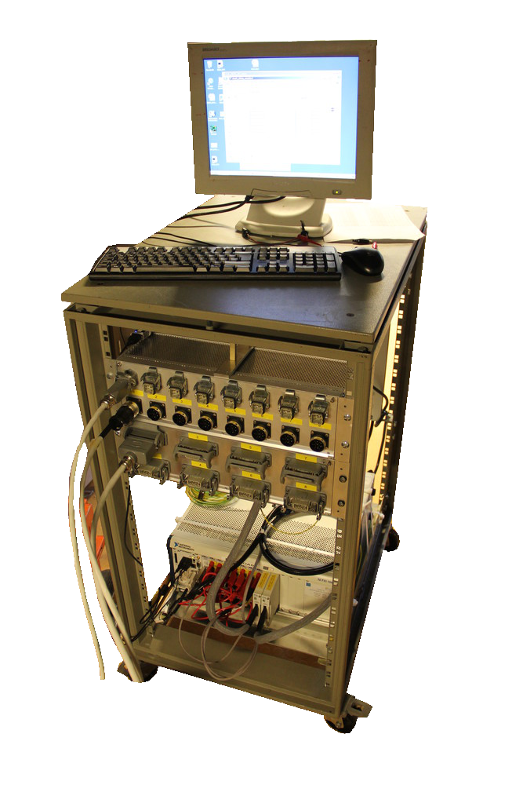
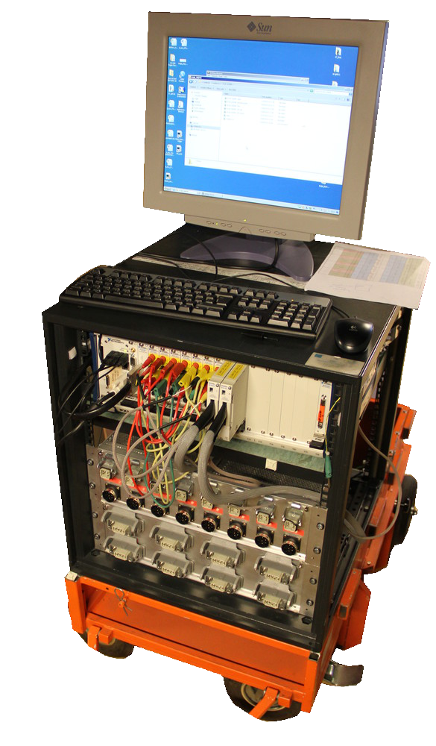
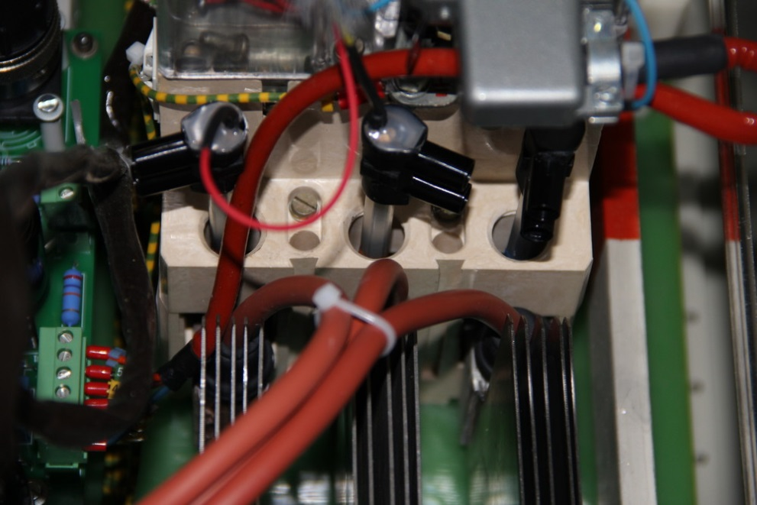
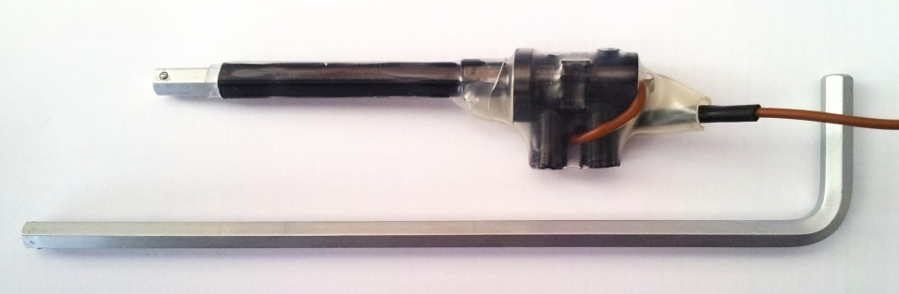
New hardware/software development
600 A Energy Extraction switch testers
Great improvement in safety
Test time reduction
Further improvements are still possible
extra job
First known application of the Allen key as a voltage probe

Slide 13
There were many other small, yet important activities.
I’d like to thank our AGH-UST and CERN colleagues for great cooperation.

Slide 14
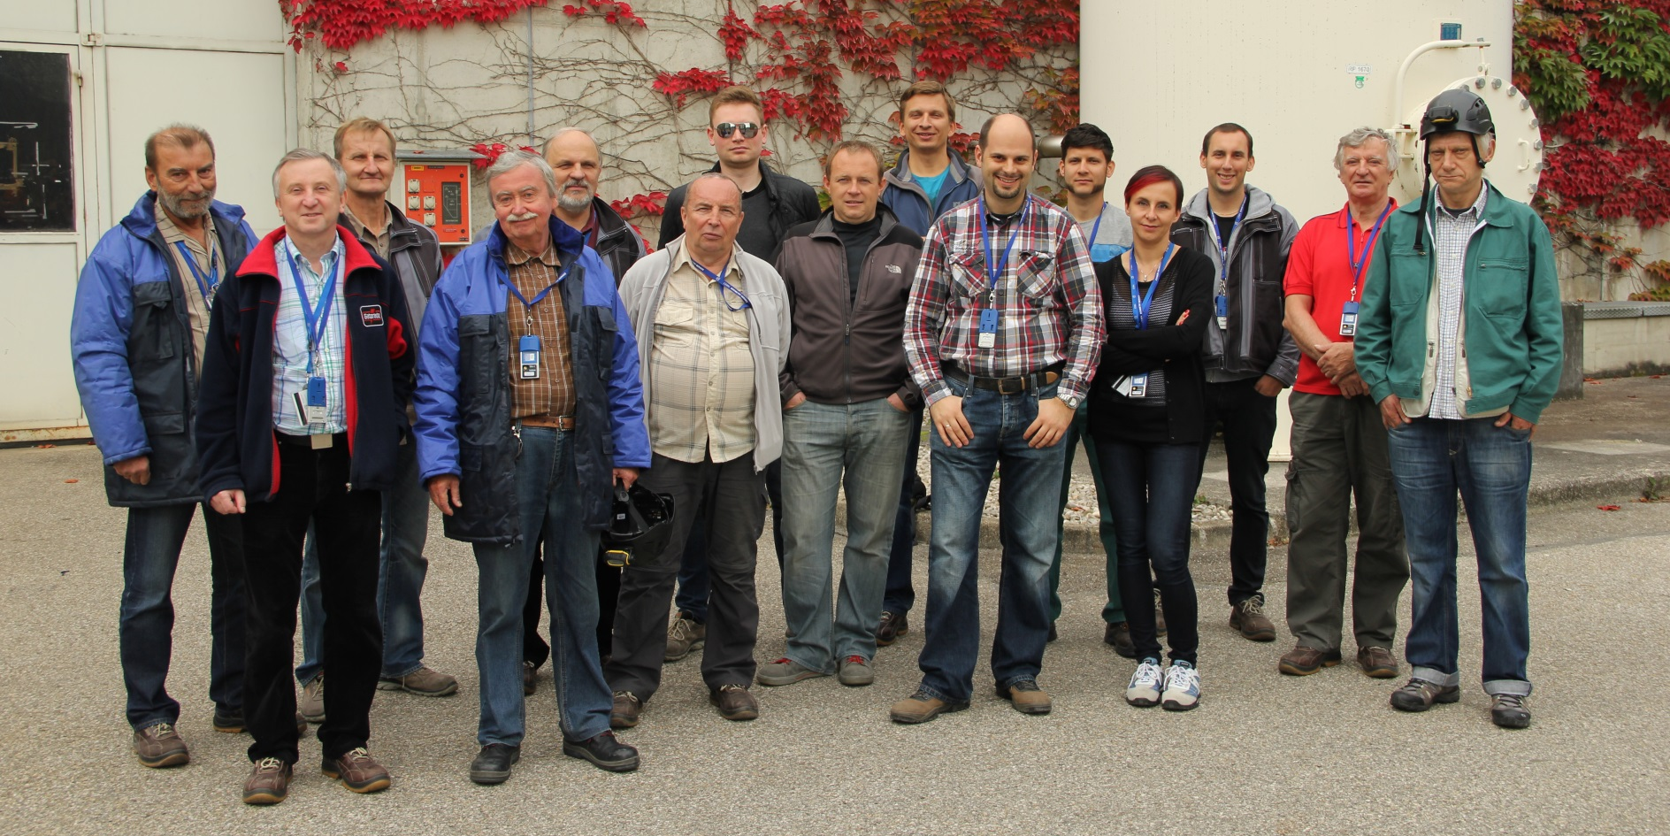
Thank you for your attention
we still have a plenty of work to do before the end of the LS1

