Slide 1




LS1 COLLABORATION SEMINAR
Thursday 27 November 2014
B
R
A
E
T
L
I
E
O
C
N
We commemorate today:
9 years (already) of an extraordinary scientific/technical cooperation with AGH-UST
  with first arrival to CERN of polish colleagues (A. Skoczen and A. Skala) in 2005
10 years (already) of the most rewarding collaboration with HNINP for ELQA quality
assurance campaigns and development of QA test equipment
  with first arrival to CERN of an engineer (A. Kotarba) from HNINP in 2004
We celebrate today:
That the first Long Shutdown of the CERN Accelerator Complex is successfully completed, with substantial contributions from AGH-UST and HNINP.
That the successful cooperation with both Institutes will continue – with signature of new agreements.
1 of 16

Slide 2



Planned upgrade of the QPS systems
The planned LS1 upgrade for QPS Systems
An ambitious program with many parallel activities - launched at the beginning of the LS1 shutdown in order to make efficient use of the time available.
The program included the following issues, which is the agenda for this presentation:
  Upgrade of Local Quench Protection Racks of the Arc Dipoles
  (the yellow racks) – incl. enhance monitoring of heater discharges
  Further improvements to be applied to the Quench Detection Systems
  Upgrades t6o be applied to the 13 kA Energy Extraction facilities
  Upgrades to be applied to the 600 A Energy Extraction Systems
  Issues related to the Cold Diodes
  First results from the warm interconnecting busbar segments, measured by nQPS system.
  But First: A one-slide presentation of the QPS
2 of 16

Slide 3
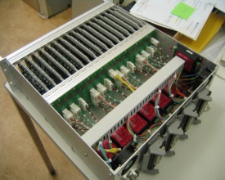
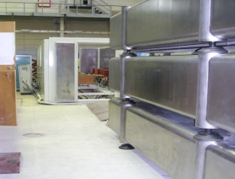
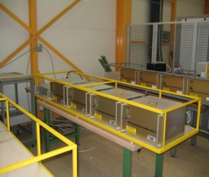
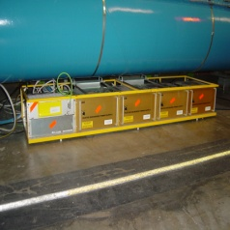
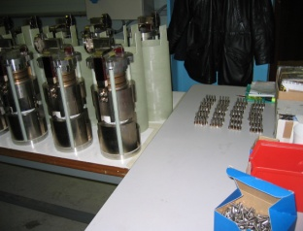
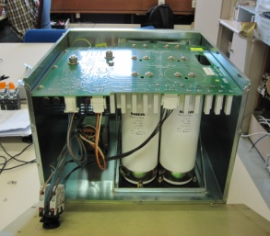
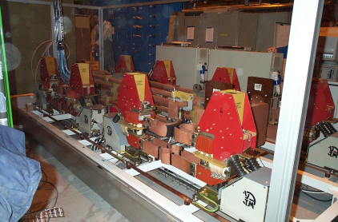
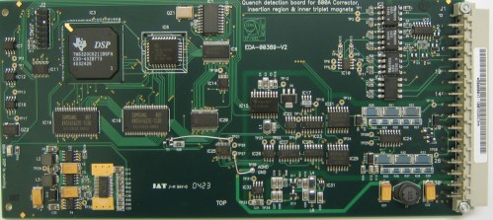
The Quench Detection and Quench Protection Systems are Safety-Critical Equipment. The four
Cornerstones of the LHC quench protection scheme for a superconducting powering circuits are:
K. Dahlerup-Petersen LS1 Seminar 27 November 2014
Quench Detection (QDS)
by resistive voltage recognition - followed by immediate activation of further protection measures
Cold Mass Heating by Strip Heater Powering through discharge of Power Sources with stored energy
By-passing of the
Quenching Magnet
through conduction
of a cold, parallel Diode
Extraction of the Stored Energy (EE) to resistor elements in the warm
part of the circuit. Obtained by high-current switching.
Note:
  Not all LHC s.c. circuits require all four protection features. Generally, the 94 individually powered insertion region magnets have only detectors and heaters, the 418 corrector magnet chains at 600 A have only detectors, internal parallel resistors and sometimes external EE.
  The 24 LHC Main Circuits require all four features.
  BASIC PRINCIPLE:
  AFTER DETECTION OF A QUENCH THE S.C. CIRCUIT MUST SUPPORT THE DECAYING CURRENT DURING THE DISCHARGE TIME (exponential if no quench-back).
3 of 16

Slide 4
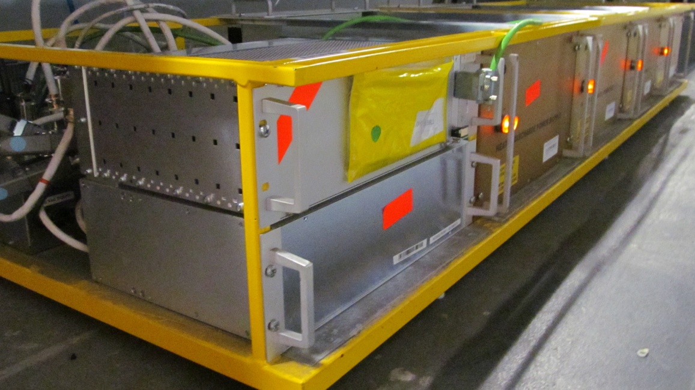
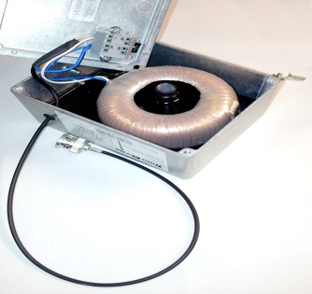
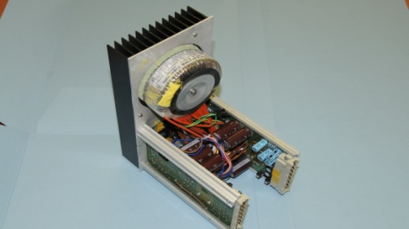
Reconstruction of the 1232 Local Protection Units for all LHC Main Dipoles:
Upgrade of the electrical systems, driven by the need to improve the quench heater supervision and diagnostics capabilities and to have a redundant powering scheme.
1. Enhanced monitoring of DQHDS Heater Discharges:
Voltage monitoring alone during discharges appears insufficient to track defects in Strip Heaters.
Pulse current precision measurements during discharges to be added.
Introduction of 5’000 Broadband Pulse Current Measurement Transformers.
Developed and produced in close collaboration with Polish trfo manufacturer.
Both AGH and HNINP engineers were involved in this project.
DYPB – ‘B’-dipole, with nQPS crate (DQQDL-S)
CT for precision current measurements
2. Powering of the QPS system in DYPB racks:
The iQPS systems never profited from the availability of the TWO independent UPS lines.
The existing switched-mode, tri-volt power supplies had shown some weaknesses during re-starts.
It was decided to launch the design and production of 2’700 new power supplies, each with 7 output voltages (floating and referenced to ground).
Production-to-print , complete design made at CERN/TE/MPE.
3. New electrical shuffling crate – the DQLIM:
For replacement of the so-called ‘Crawford box’, 1232 in total.
Each new crate shall house four pulse current transformers, two new power supplies, cable patches, voltage dividers etc. Assembled in Industry according to CERN drawings.
New Power Supply DQLPR
4 of 16

Slide 5
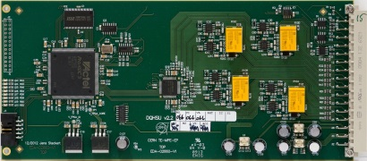
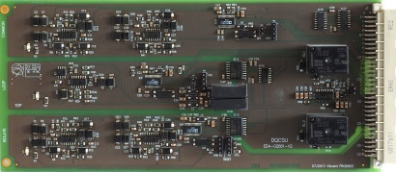
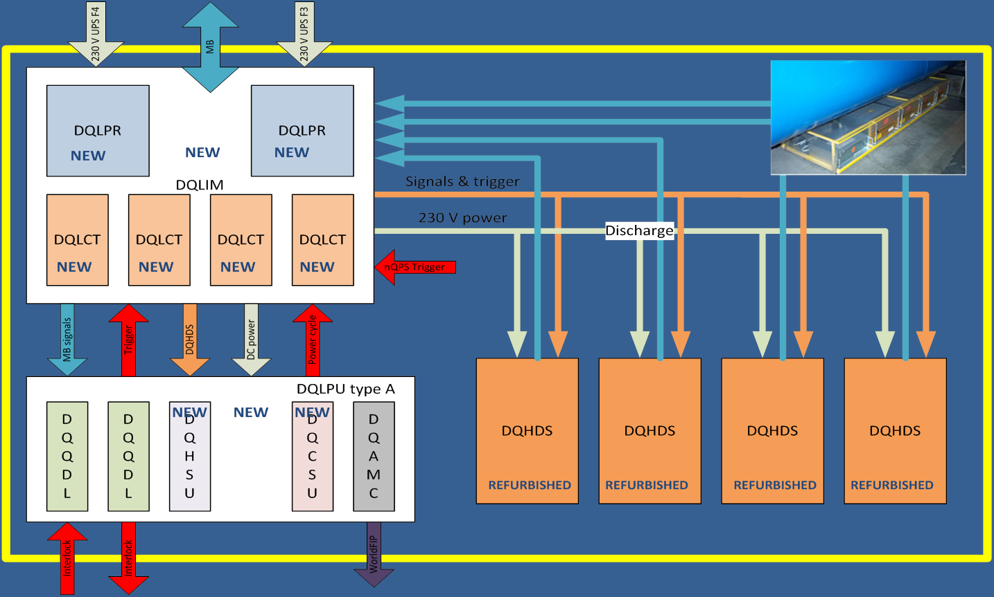
Reconstruction of Local Protection units (contd.)
4. New pcb board developments:
- DQHSU: Board for signal treatment of the pulsed CT output, with 16-Bit
and upto 192 kHz sampling of simultaneous discharge voltages and currents
- DQCSU: Board for crate supervision – i.e. monitoring of the quench loop,
supervision of all powering voltages and providing means for power
cycling of the crate
5 of 16

Slide 6
Other plans for QPS/QDS Improvements during LS1
- Insert into the nQPS protection crate of the foreseen and long-awaited
earth-voltage monitors for the 3 LHC main circuits (≈ 1300 boards).
- Improve the immunity to ionizing radiation by:
  Relocation inside the LHC tunnel, points 1 and 5 (the UJ locations),
  example: detectors and QH power systems of the Inner Triplet magnets
  Development of new radiation tolerant quench detector electronics, based on the FPGA technology (ProAsic3 Flash type). For all Stand-Alone magnets.
  Upgrade of the firmware for higher tolerance w.r.t. single events (redundancy, voting),
  example: the distributed Busbar Detector of the nQPS protection layer.
- Improve the immunity to EMI and simplify the configurations :
  Reroute/ re-cable the QPS instrumentation wiring (example: Q8, Q9, Q10 stand alone magnets) incl. a strong reduction of the number of different system configurations for all Stand-Alone magnets.
- Replace all the mid-point fuses of all ≈5000 heater power supplies to obtain shorter reaction time.
- Create a reference database for heater discharge currents and voltages.
- Revise/update the Quench Detection supervision :
Retrieve simultaneously PM data from both detector boards A and B , increase in PM sampling frequency and resolution, get intermediate PM buffers for 3 weeks, achieve automatic verification of system configuration, obtain doubling of the fieldbus segments for higher transmission rate.
Sector 67. Courtesy: Z. Charifoulline
6 of 16

Slide 7
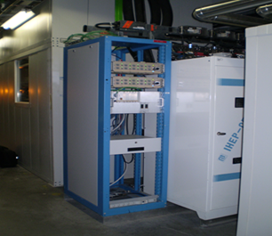
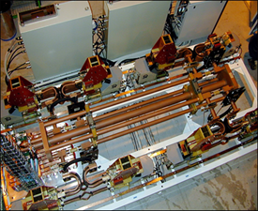
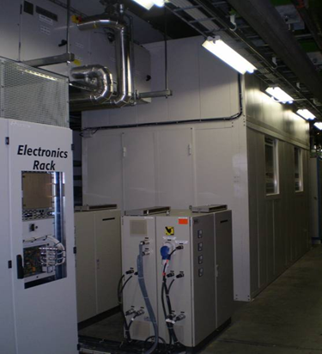
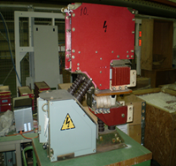
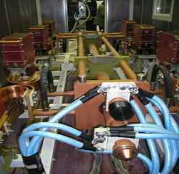
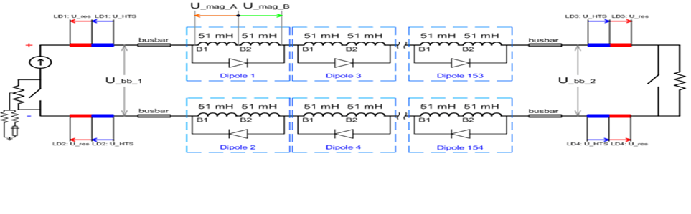
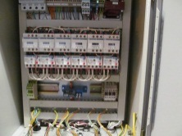
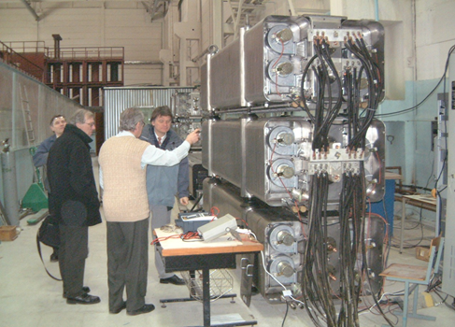
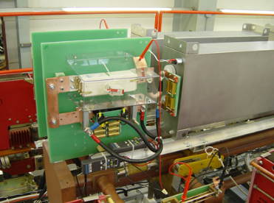
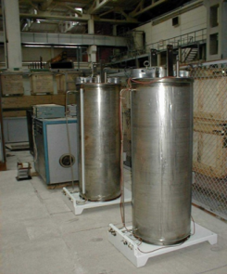
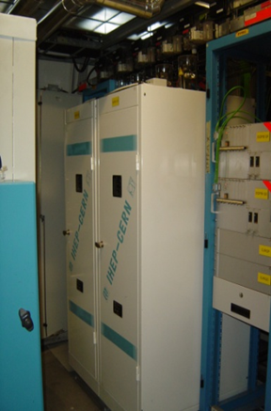
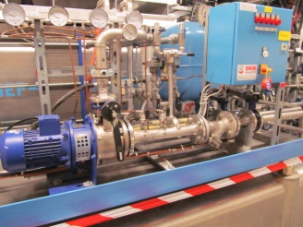
The 13 kA Energy Extraction Facilities
The LHC machine deploys 32 such extraction systems in the 24 superconducting Main Powering Circuits. They are safety critical systems for the protection of the magnets, busbars and leads.
The systems consists of:
Individual dc breaker 4.5 kA, 1500 VDC
EnergoMash, Ekaterinburg
Powering and controls cabinet (DJPC)
ECIL, Hyderabad, India
Interface module for signal dispatch and local controls
EFACEC, PT
The combined extractions switch with bus system - top view.
DQSQF/D enclosure for noise reduction and safety
IHEP, Protvino, RU
Power bus for improved current balance. BINP Novosibirsk
DQR control circuits (Morosov) BINP, Novosibirsk
Three dipole extraction resistors, each rated 430 MJ, assures the safe deposit of the stored energy. In total 48 such absorbers. IHEP, Protvino, RU
Snubber capacitance across the switches for arc suppression / commutation assistance
Electronicon, DE
Quadrupole extraction resistors, 24 MJ each
IHEP, Protvino, RU
DQRCS Cooling station for three DQRB’s
‘Roese’, DE
7 of 16

Slide 8
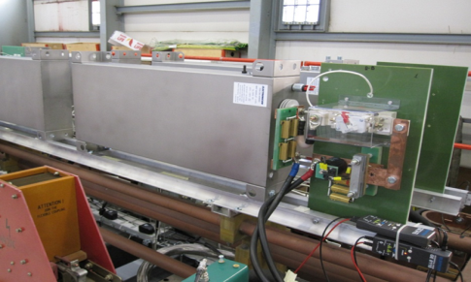
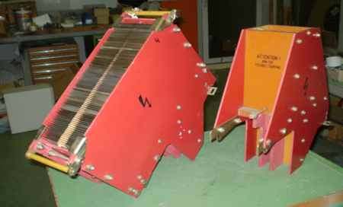
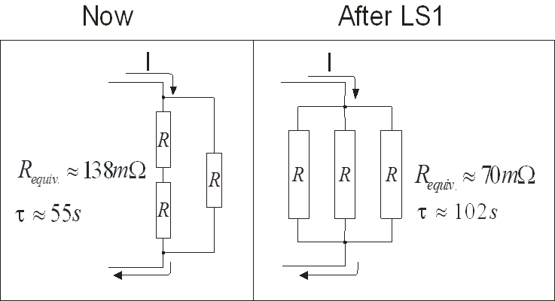
13 kA EE (24 systems): Programmed and scheduled upgrade:
Installation/connection of snubber capacitors and associated protection equipment across the extraction switches of RQF/D. Purpose: Suppression of the perturbations and transients from the electrical arcs during the commutation process. Sweeping of voltage waves have triggered the QPS.
Replacement of all arc chambers on the same quadrupole switches – new 1 kV version.
Purpose: Admitting higher discharge resistances at higher currents.
Reconfiguration of the dump resistance to return to nominal i.e. 102s (dipoles) and 32s (quads) Purpose: To return to nominal conditions after the busbar splice repair.
4x40mF, 1kV capacitor bank with fuse protection
New and previous Arc Chambers
8 of 16

Slide 9
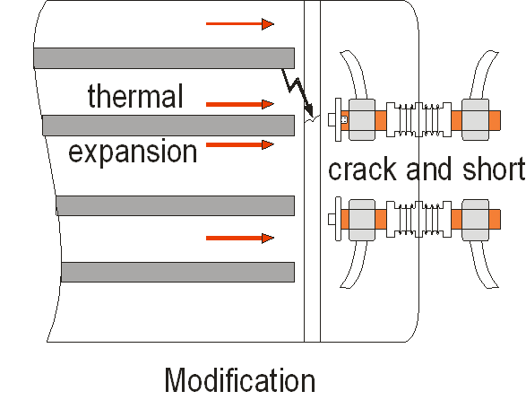
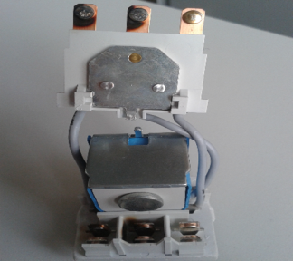
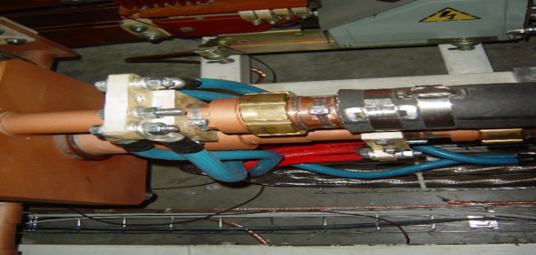
13 kA EE (24 systems): Programmed and scheduled upgrade (contd):
Application of constructional changes to the current leads of all 48 (+ spares) main dipole extraction resistors (DQRB). Purpose: to avoid damage and short-circuit due to expansion of the resistor body (in case of double energy deposit).
Replacement of all (failing, Curie-temp)) thermostats on all DQRB. Pupose: increase to 75ºC the threshold to regain Power Permit.
Signs from heavy arcing and erosion
  Replacement of circuit breakers and relays in the powering and control units (BCM).
  Purpose: to reduce contact erosion (AgSnO₂, higher peak current handling).
Participation in thermal testing following exchange of water-cooled cables.
Complete overhaul of all 256, 4kA extraction switches: Readjustment of gaps and spring forces, verification of signal actuators and electrical contacts, functional check.
9 of 16

Slide 10
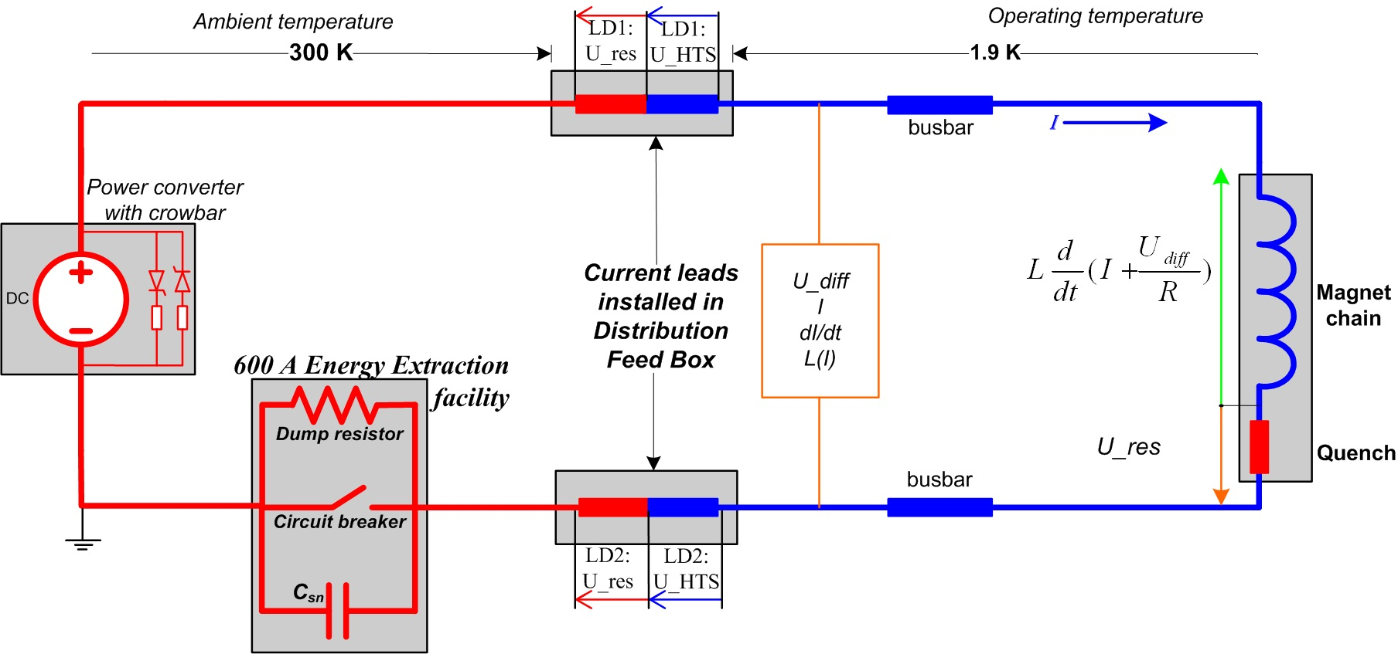
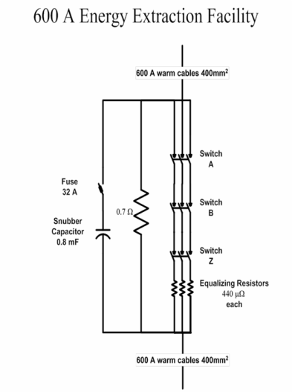
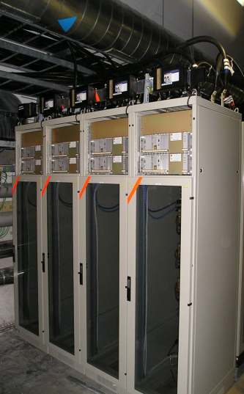
600A EE (202 systems): Programmed and scheduled upgrade:
Operational experience 2010-2013 has shown three types of hardware failures related to the closing:
One of the breakers failed to close upon demand
Origin: Fixation of the ‘closing and holding coil’ has broken off or got loose.
Remedy: Filling the gaps which allow the coil to move and deform its supports. Repair requires opening of each of the 606 breakers.
Failure rate: 2-10 / year, representing 95 % of all failures.
One of the breakers indicate wrong state (is open, indicates closed)
Origin: Misbehaviour of actuator (µcontact).
Failure rate: A few per year.
One of the breakers fails to reclose
    Origin: Rupture of link between Main axle and the driver at middle-pole position.
    Failure rate: 2 during operation, 2 during pre-testing.
    Remedy: Replacement of the unit. But there are pre-cursors.
10 of 16

Slide 11
600A EE (202 systems): Programmed and scheduled upgrade (contd.)
Consequently, the following upgrade was planned (and executed):
  Fixation of the ‘holding coil’ decided in agreement with the manufacturer (DZNVA, Krasnoyarsk, Russia):
    Supporting the coil fixation levers by insertion and fixing of insulating plates to prevent any movement.
      Testing has demonstrated the efficiency of this solution
    Profiting from the opening of all switches to clean the main contacts and adjust the closing mechanism
  The main axle rupture is treated by tracking the symptoms (pre-warning, increase in total system resistance):
    Hence introduction of a new enhanced voltage measurement channel, featuring:
      Low-impedance voltage divider, noise reduction circuit, separation amplifier and foreseen for
      a 24-bit ADC (same system shall measure a few mV as well as 400 V extraction voltage).
      NOTE: Endoscopy shall be used during LS1 to observe early signs of weakness.
  Over-current in a branch will be detected by the temperature of the equalizing resistors.
  The over-current may be due to low busbar contact pressure, dirty (oxidized) breaker contact or early symptoms
  of an axle rupture in the other branches.
    Thermostats (120ºC) shall be mounted on the hotspot of the resistors. Transmitted through a spare channel
    for interlocking.
    Requires re-programming of firmware and high-level software for automatic on-line analysis.
The upgrade is expected to improve the availability of the systems by up to 8 hours per year of operation, compared to the average of previous years.
11 of 16

Slide 12
Upgrade of Cold Diode Links for LHC Main Dipoles and Quadrupoles
Planned MPE Contributions to the Upgrade – related to Bypass Diodes:
1. Supply of diode stacks to equip the replacement magnets which will be inserted during LS1 (15 Dipoles and 3 Quadrupoles). Delivery of press-pack diodes (‘Dynex’, UK) and stack elements (‘Prodtek AB’, S). Assembly of the stacks, electrical testing at 300K, 78K and (by MSC-group) at 4.5K.
2. Perform global precision measurements of the warm resistance of the dipole diode leads
(the quadrupoles will be measured by MSC when tanks are opened for the connection plate upgrade).
Why this measurement campaign:
Because unexpected high resistances were observed during quench propagation tests in 2012.
A dipole diode stack ready for insertion
The test procedure and the execution of the campaign was entirely managed by M. Bednarek and the HNINP team of ELQA.
12 of 16

Slide 13
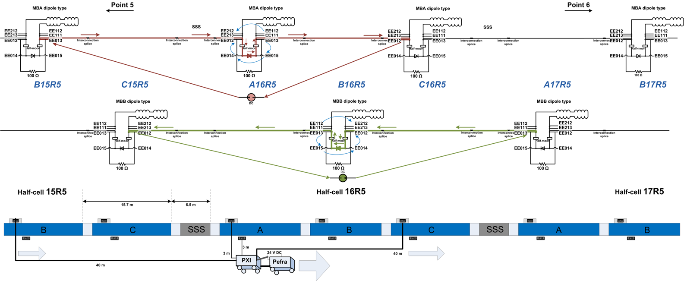
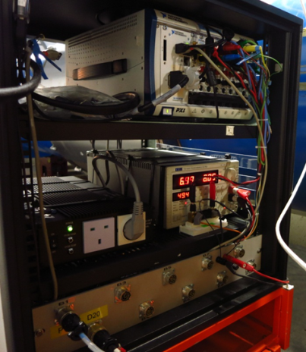
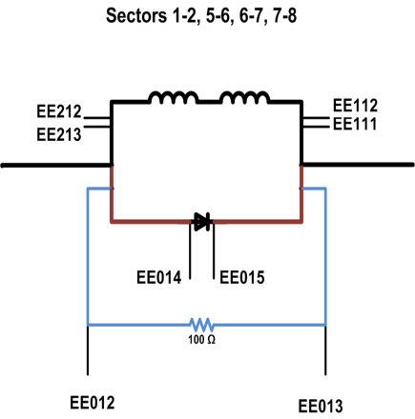
Upgrade of Cold Diode Links for LHC Main Dipoles and Quadrupoles
The general test set-up:
Courtesy: M. Bednarek
RESULTS :
The diode lead measurements include three bolted / clamped busbar
connnections: the half-moon, the busbar-to-heatsink and the
heatsink-to-press pack.
Acceptance threshold: 15,5 µΩ max.
All 8 sectors were measured! A significant task!
PXI – 6 boards
13 of 16

Slide 14
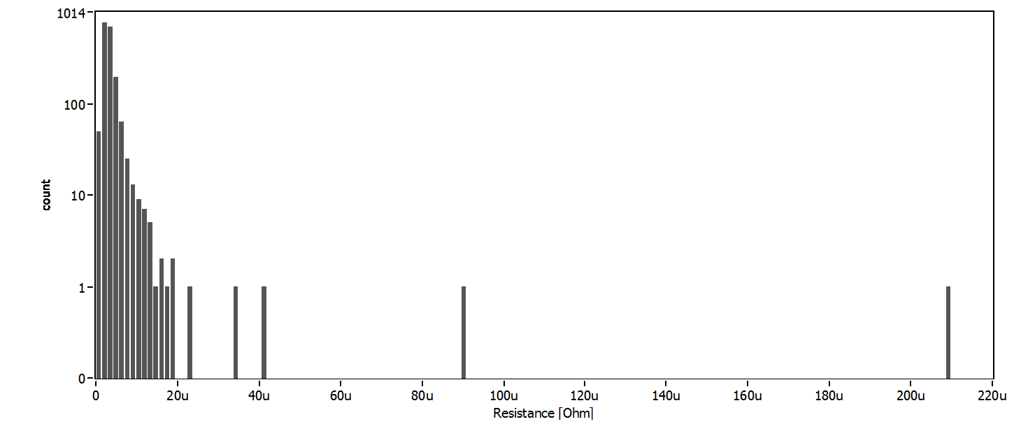
Upgrade of Cold Diode Links for LHC Main Dipoles (contd.)
From all sectors (except S45) - before correction of outliers. (1858 leads). Sum of three contact resistances.
Courtesy: M. Bednarek
Acceptance threshold
Non-Conformities were:
Lead resistance (before correction) outside limit: 8 places (one as high as 210 microOhm/90 microOhm)
Poor V-tap: 1 place
Swapped V-taps: 8 places
Swapped I and V-tap: 1 place
14 of 16

Slide 15
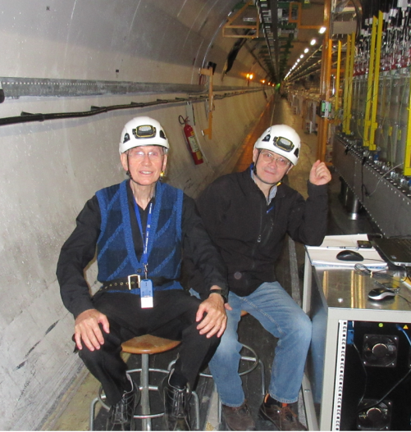
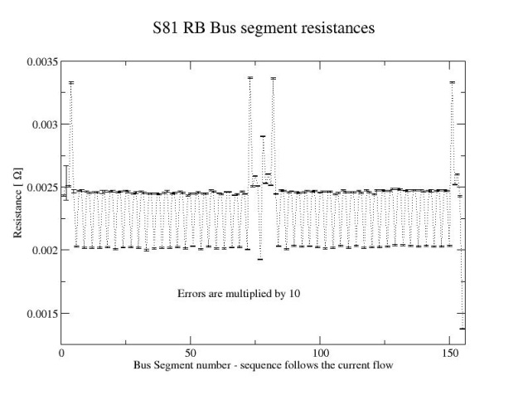
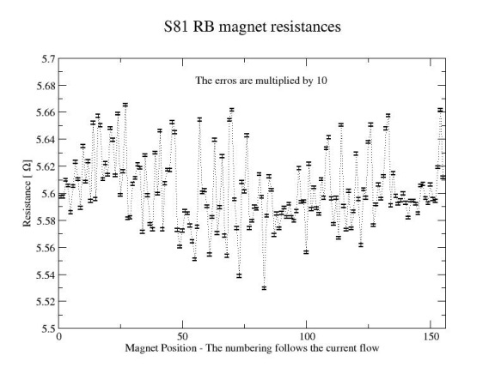
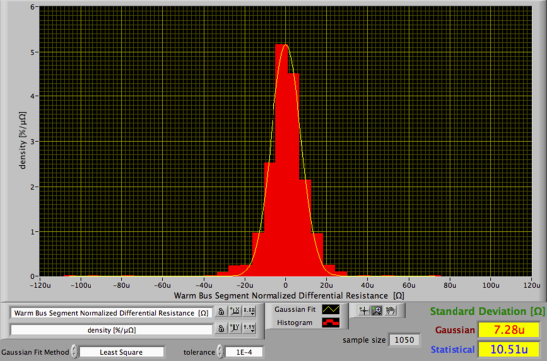
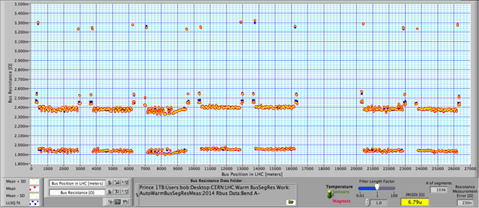
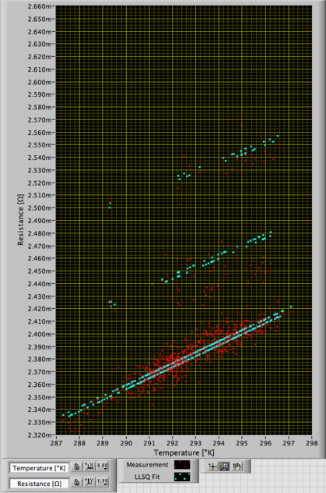
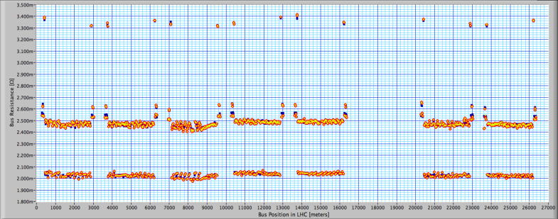
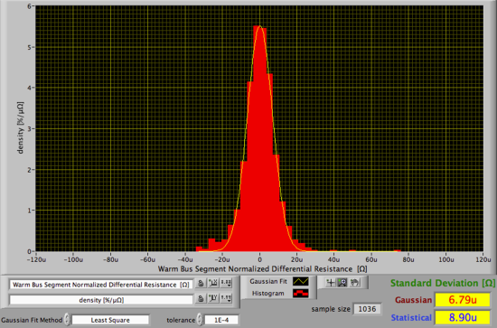
Completion of the Warm Busbar Measurements program
Preliminary results from the Dipole Circuit
The measurement team (Bob & Sandor), missing: Bozhidar and Luke.
Interconnecting busbar segment data from across sector 81, after compensation of the nQPS system loading. After LS1 upgrade.
Results of warm magnet resistance measurements across sector 81. After LS1 upgrade.
Board A: Busbar segments only
Busbar segment normalized differential resistances – Board B (busbar + diode leads)
Board B: Busbar + diode branch
All results of busbar segment resistances vs. temperature.
Results from the complete LHC dipole circuit, except S67, after LS1.
Busbar segment normalized differential resistances – Board A (no diode branches)
15 of 16

Slide 16
Thank you for your patience
16 of 16

