Slide 1
RF Dipole HOM Electromagnetic Design
Zenghai Li
(SLAC)
Subashini De Silva, Jean Delayen, Rocio Olave , HyeKyoung Park
(Center for Accelerator Science, ODU)

Slide 2
Outline
Mode analysis
Horizontal and vertical coupling
HOM filter design
Windows matching
Multipacting
Post-damping spectrum
Error analysis and tolerances
Power dissipation
Thermal analysis of static and dynamic loads
Final dimensions
Fabrication concept

Slide 3
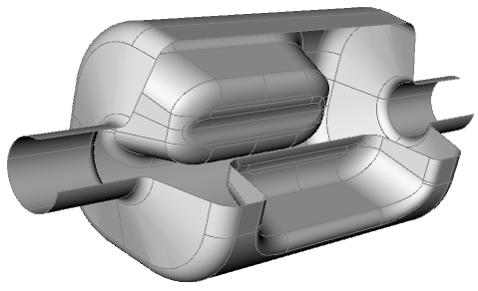
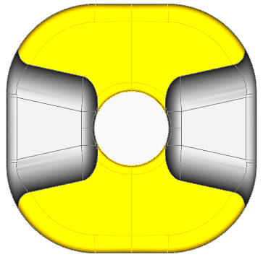
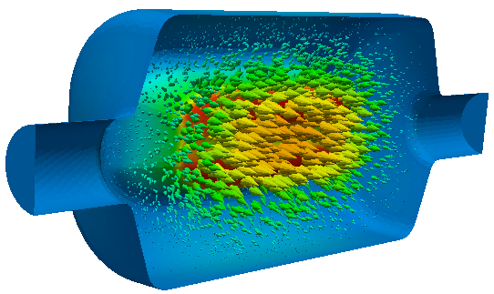
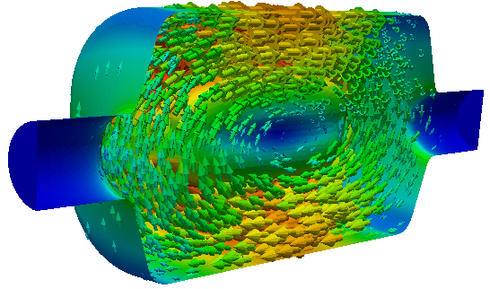
RFD Cavity Parameters
E B
RFD Crab Cavity
Frequency (MHz) | 400
Operating Mode | TE11
Lowest dipole HOM (MHz) | 633
Lowest acc HOM | 715
Iris aperture (diameter) (mm) | 84
Transverse dimension (mm) | 281
Vertical dimension (mm) | 281
Longitudinal dimension (w/o couplers) (mm) | 556
R_{T} (ohm/cavity) | 433
V_{T} (MV/cavity) | 3.34
Bs (mT) | 55.6
Es (MV/m) | 33.4
Deflect mostly by E field
No lower order mode
Compact, clears the second beam pipe
Pole face shaped to minimize higher multipole fields

Slide 4
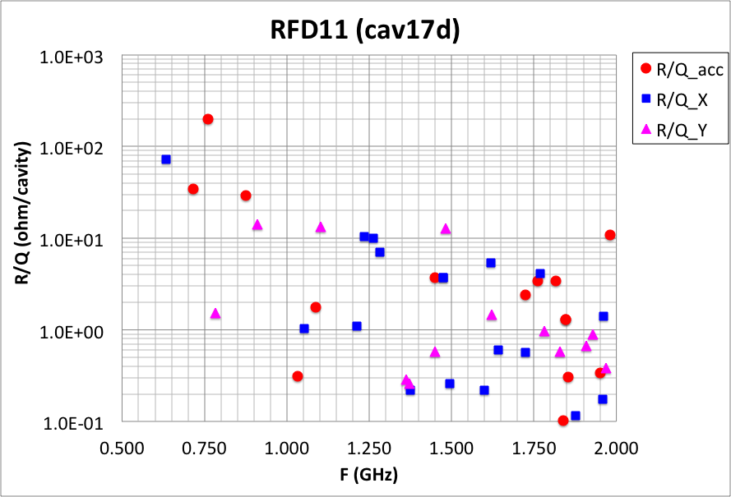
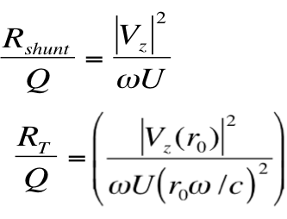
RFD Impedance Spectrum
Lowest HOM is at 630 MHz
Can utilize a high-pass filter HOM damper to damp the HOMs

Slide 5
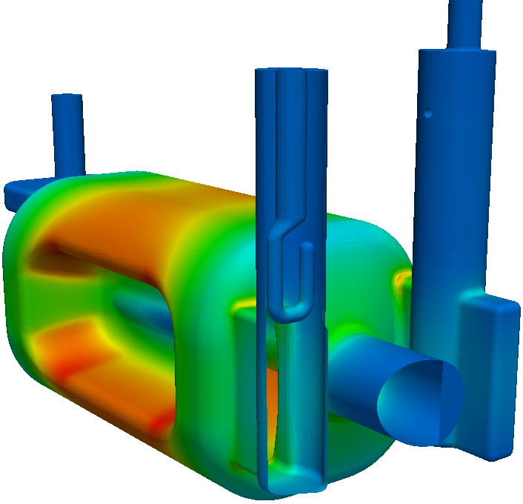
Considerations of Coupler Design
V-HOM
(selective coupling)
FPC
H-HOM
(Hi-pass filter)
Coupler at locations of low field region on cavity body
Minimizes RF heating on the coupler components
Minimal effects on the field asymmetry due to the openings
Selective coupling (V-coupler) to reduce the number of filters
FPC/HOM ports oriented to keep clearance for the second beam pipe

Slide 6
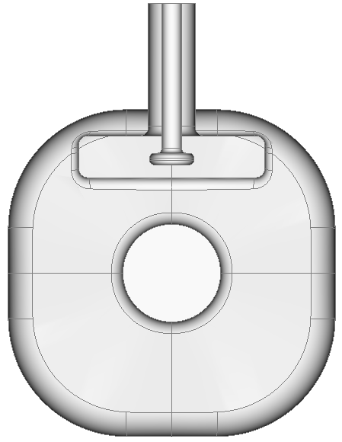
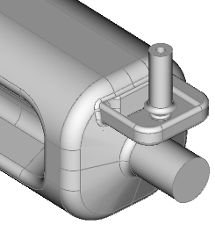
Vertical HOM Coupler
Selective coupling waveguide stub with a coaxial pickup
Selectively couples to HOMs, rejects deflecting mode. No filter needed.
No field enhancement in couplers

Slide 7
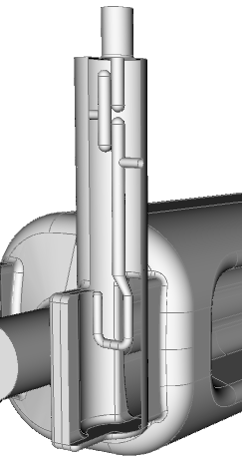
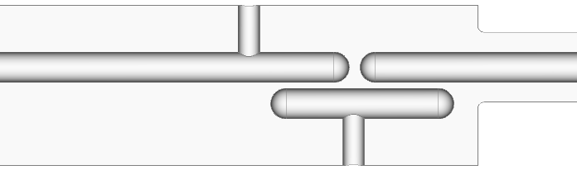
Hi-pass Filter H-HOM Coupler
H-HOM coupler with hi-pass filter and coupling hook
Hi-pass filter
Center rod diameter: 14 mm
Larger cylinder diameter: 74 mm
50 ohm port: 14mm/32.2mm

Slide 8

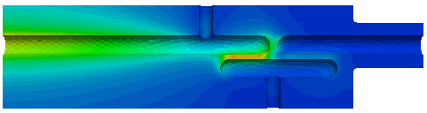
Hi-pass Filter & Transmission
rejection of operating mode
Broadband to > 2 GHz

Slide 9
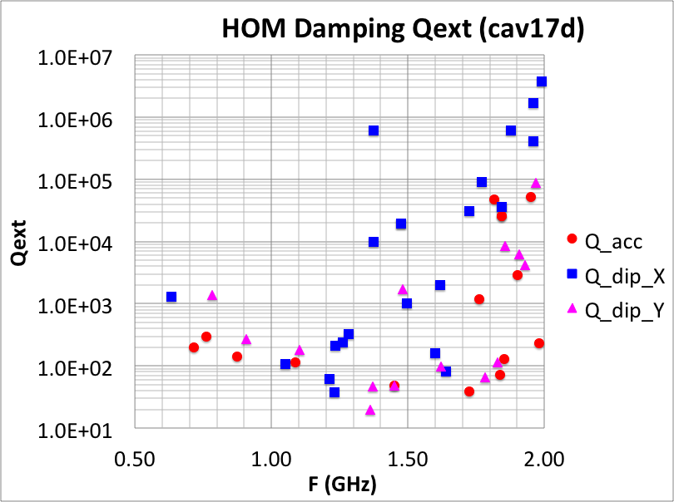
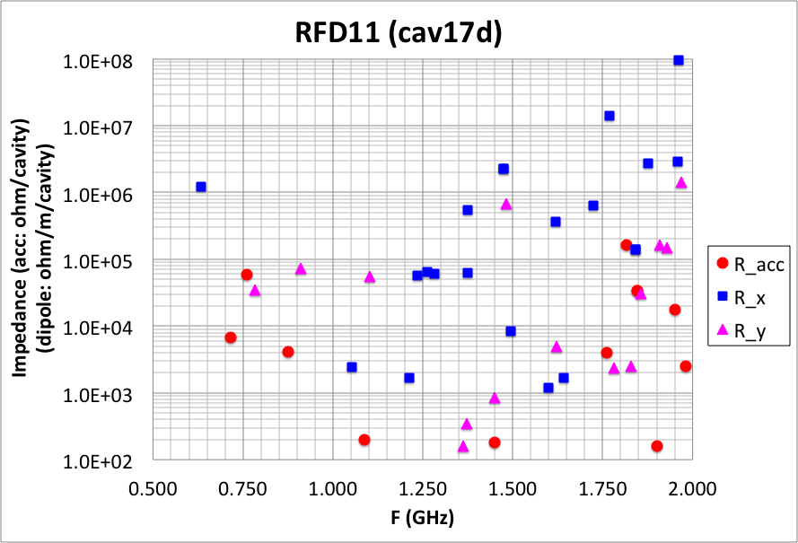
RFD (cav17d) HOM Parameters
Can be reduced by shaping the profile of the V-coupler probe tip
(does not have the (1/2) factor in “Impedance”)

Slide 10
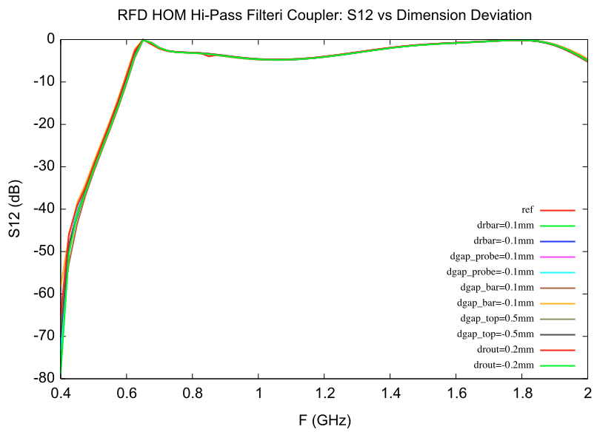
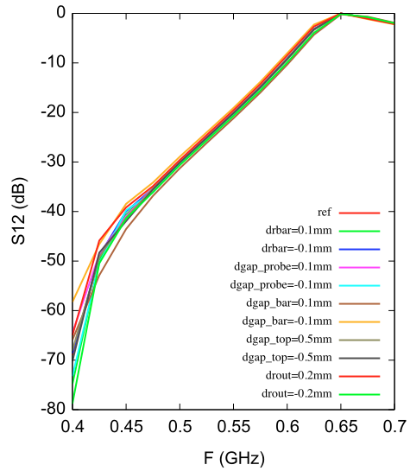
Filter S21 vs dimension deviations
HOM coupler filter dimension sensitivity:
Insensitive at frequencies above 0.65 GHz
Damping of 1st dipole mode at 0.63 GHz and operating mode rejection determine the filter dimension tolerance
Qext_def=9.8E10
Power leakage at 3.4MV: 0.27 W

Slide 11
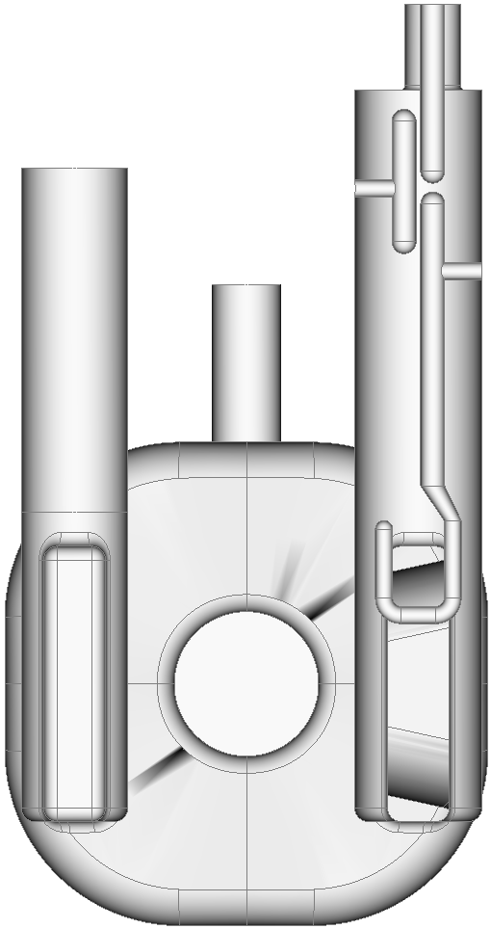
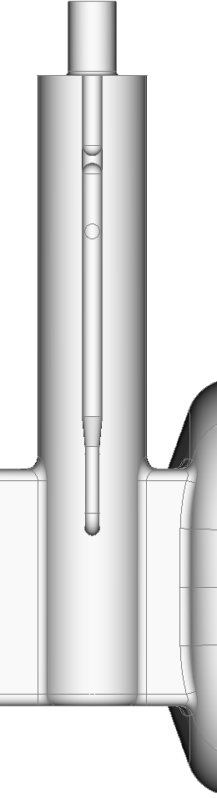
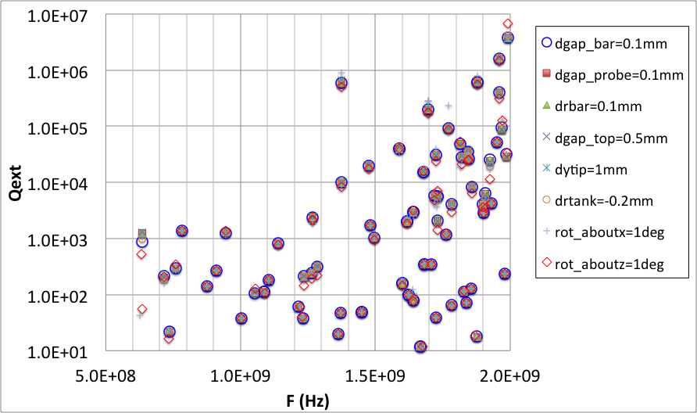
HOM Coupler Tolerance
gap_top
gap_bar
gap_probe
rot_about_x
(+)
rot_about_z
(+)
bar_radius
ytip
HOM damping is quite insensitive
The lowest dipole mode slightly more sensitive to dimension errors
Operating mode rejection slightly more sensitive to hook rotation, gap between metal bars. Max power leakage < 0.7W with calculated dimension errors
tank_radius
See Rocio’s talk
for More Detailed tolerance Analysis

Slide 12
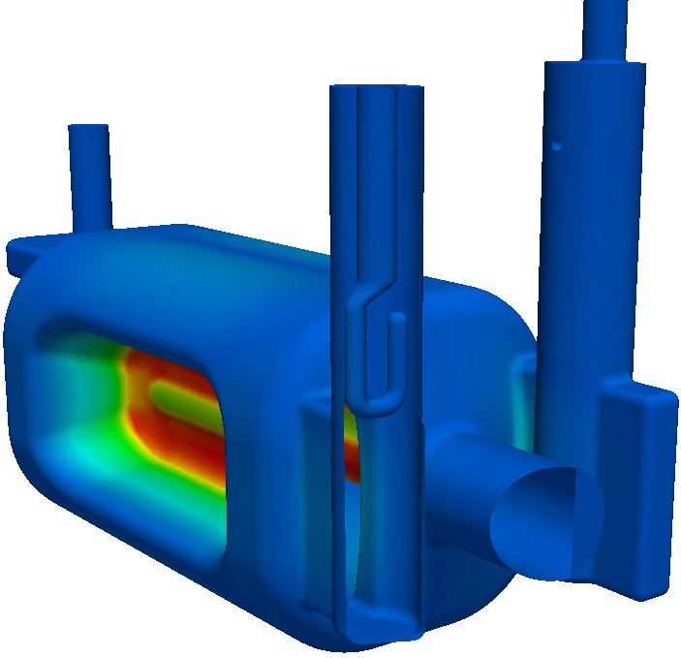
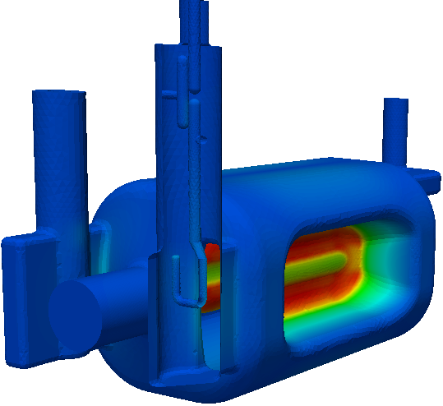
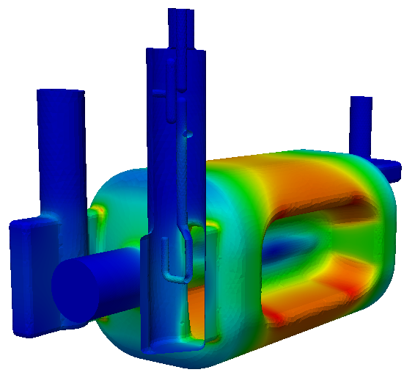
RFD: Surface Fields on Coupler Surfaces
E
B
E
B
FPC coupler
H-HOM coupler
At VT = 3.4MV | E_S (MV/m) | B_S (mT)
H-HOM Hook | 5.4 | 14
H-HOM T | 2.4 | 1.3
H-HOM probe | 0.6 | 0.4
FPC Hook | 1.4 | 7.6
Low surface fields in both FPC and HOM couplers

Slide 13
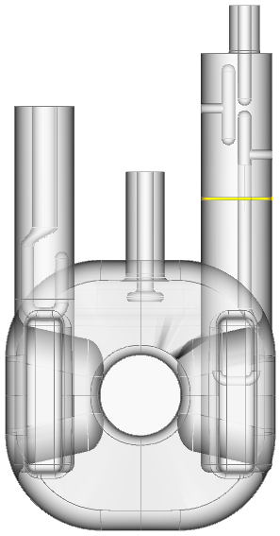
RF Heating: HOM Gasket
At 3.4MV deflecting voltage
Copper gasket at 2K (R=1mohm)
HOM coupler flange location optimized to minimize heating
Gasket y=204mm
yhom_joint

Slide 14
RF Heating on Coupler Surfaces
Deflecting mode: 3.4MV
Copper gasket at 2K (R=1mohm)
H-probe
H-T
Coupler part | RF Heating (W)
fpc-hook | 6.75E+01
HHOM Cu gasket | 1.07E-01 | 2K
H-hook | 5.99E-04 | 2K
H-T | 1.44E-06 | 2K
H probe | 4.90E-02 | 2K
V-probe | 4.66E-01 | RoomT
V-probe
Cu Gasket
FPC hook
H-hook
(Thermal analysis of HOM coupler see HyeKyoung’s talk)

Slide 15
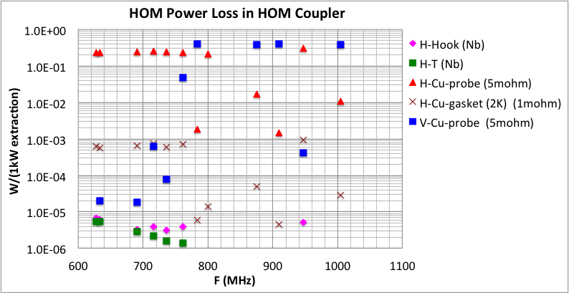
HOM Power Heating in Couplers
Due to higher-order modes
Assuming 1kW power extraction for each mode

Slide 16
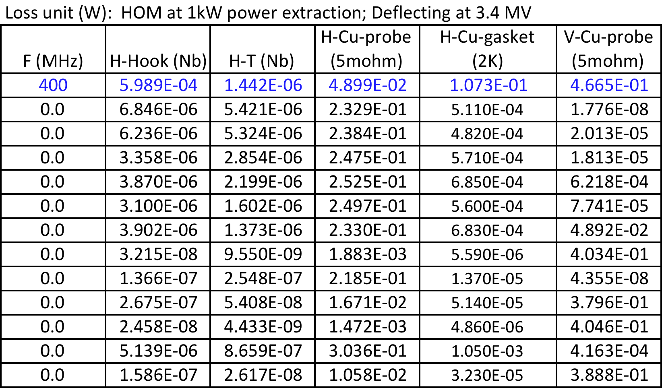
HOM Power Heating in Couplers
Hook joint at 240mm
HOM heating calculated assuming 1kW power extraction for each mode

Slide 17
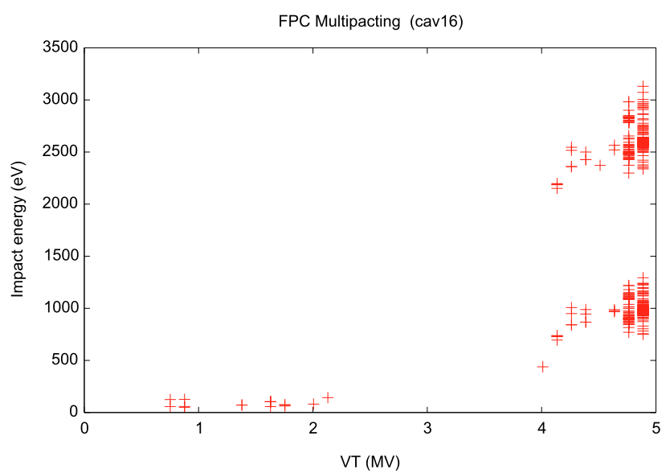
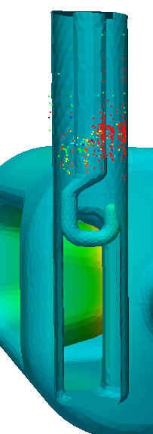
Multipacting in FPC Coupler
No multipacting in the hook region
Has resonant trajectories in the coaxial region at higher deflecting voltages
Nominal deflecting voltage VT = 3.4 MV
MP regular coaxial region at high VT

Slide 18
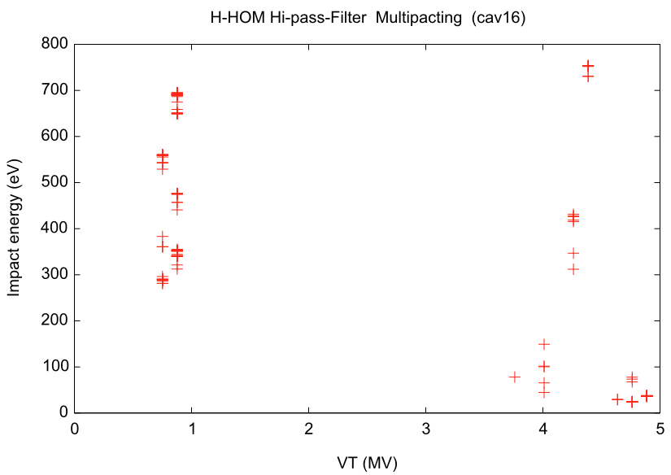
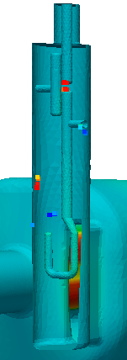
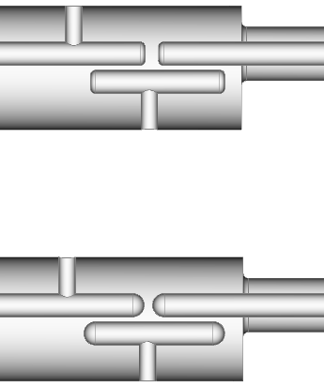
Multipacting in Hi-pass Filter H-HOM Coupler
MP resonances found in the gap if there are flat surfaces
Eliminated MP with a full rounding
Nominal deflecting voltage VT = 3.4MV
MP trajectories in the gap Removed

Slide 19
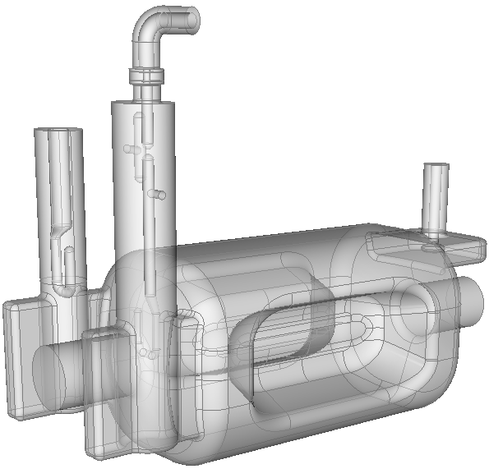
HOM Coupler Window and Bend
90 degree coax bend
ceramics windows
10-mm ceramics windows
Match to the 50 ohm pickup port
90 degree coax bend to load
Broadband up to 2 GHz

Slide 20
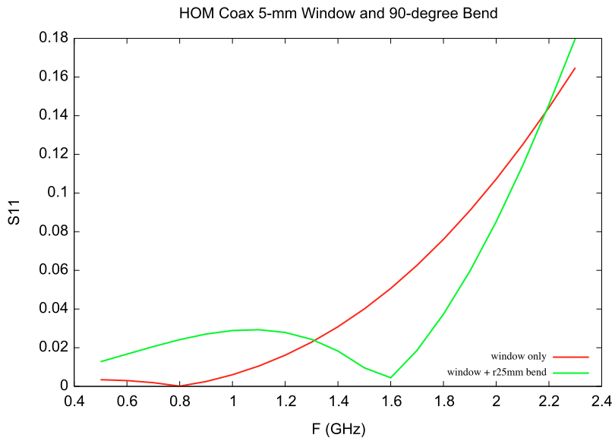
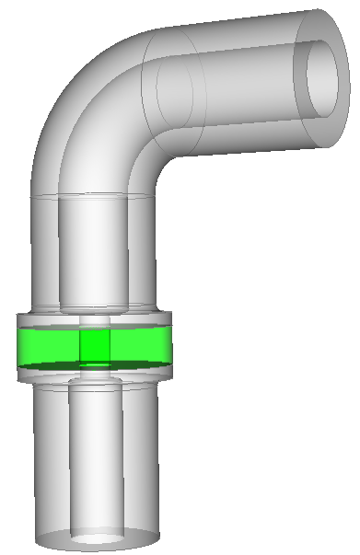
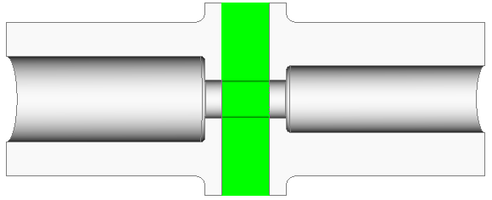
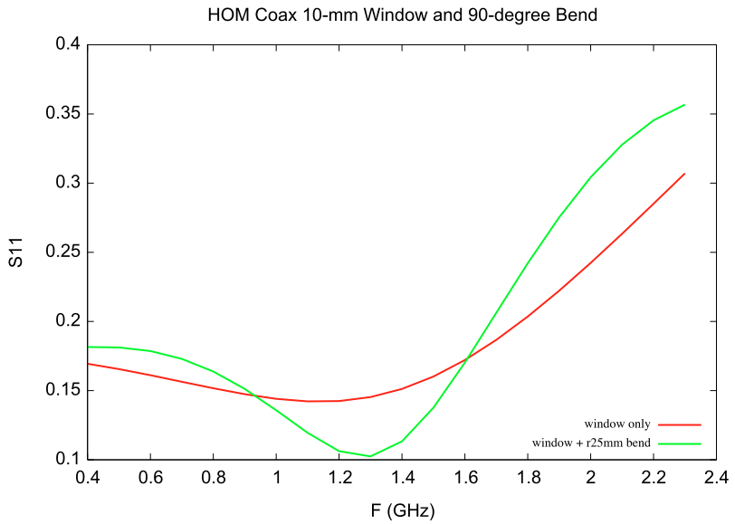
HOM Window and Bend
5-mm window and bend match
Window with a compact bend
10-mm window and bend match
window
10-mm window will be used

Slide 21
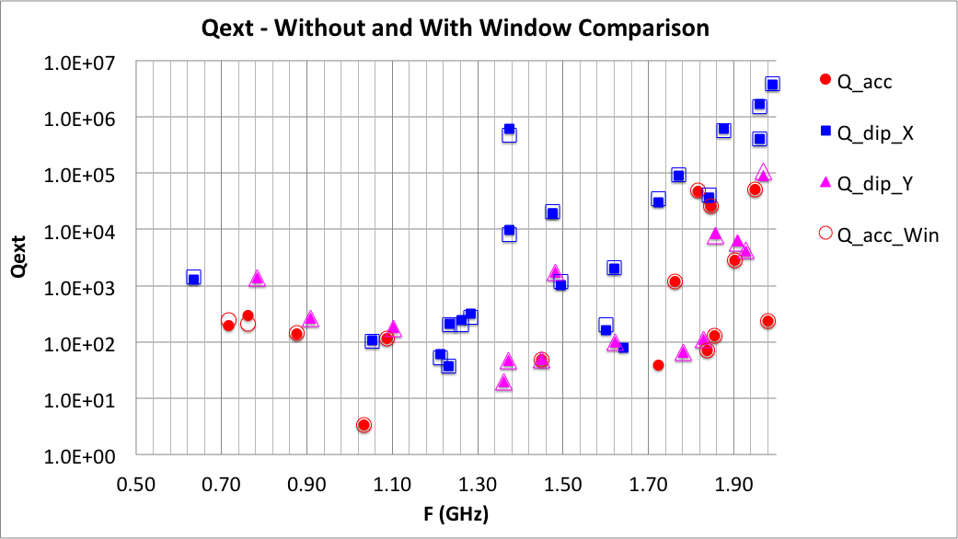
Qext With Coaxial Window
No significant change in HOM damping Qext due to finite reflection from the 10-mm window

Slide 22
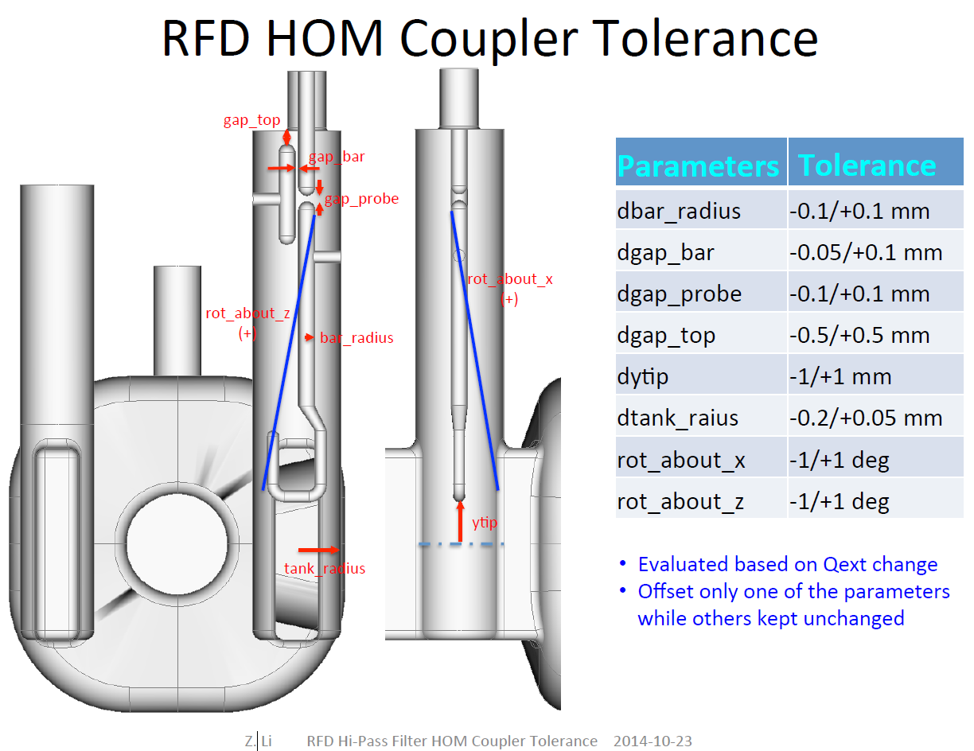
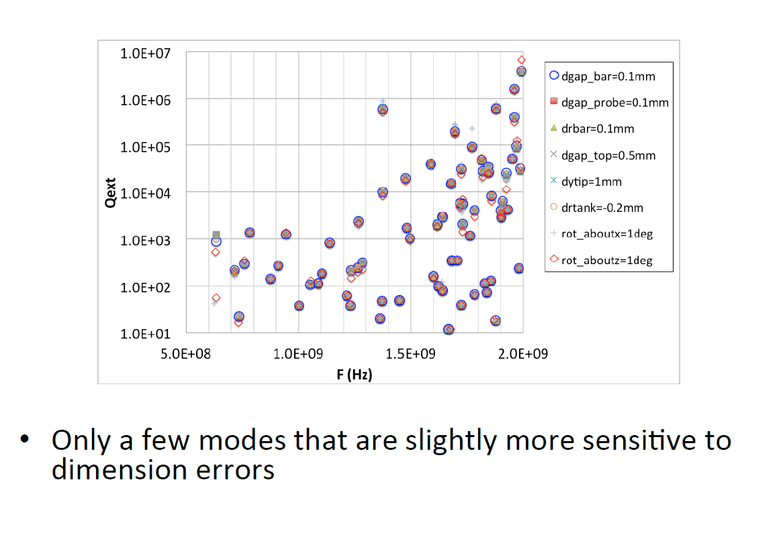
H-HOM Error analysis and tolerances

Slide 23
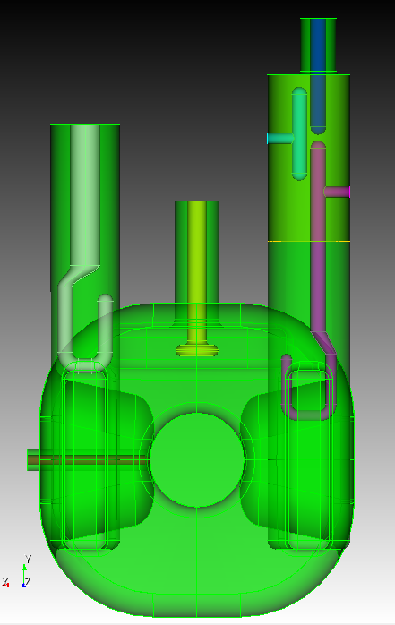
H-HOM Error analysis and tolerances
probe bar
tee
filter tank
hook

Slide 24
H-HOM Error analysis and tolerances

Slide 25
H-HOM Error analysis and tolerances

Slide 26
H-HOM Error analysis and tolerances

Slide 27
H-HOM Error analysis and tolerances

Slide 28
H-HOM Error analysis and tolerances

Slide 29
H-HOM Error analysis and tolerances

Slide 30
H-HOM Error analysis and tolerances

Slide 31
H-HOM Error analysis and tolerances

Slide 32
H-HOM Error analysis and tolerances

Slide 33
H-HOM Error analysis and tolerances

Slide 34
H-HOM Error analysis and tolerances

Slide 35
H-HOM Error analysis and tolerances

Slide 36
H-HOM Error analysis and tolerances

Slide 37
Imperfection of H-HOM coupler | Data points considered | Tolerance for Drawing Specifications | Source | Status considering Qext
Probe bar offset longitudinal | ± 0.1 mm, 0.5 mm | ± 0.3 mm | Stacking from flange connection, gasket thickness, alignment | ✓
Tee offset longitudinal | ± 0.5 mm, 1 mm | ± 0.3 mm | Welding, alignment | ✓
Hook offset longitudinal | ± 0.1 mm, 0.5 mm | ± 0.2 mm | Welding, alignment | ✓
Probe bar offset transverse | ± 0.1 mm, 0.5 mm | ± 0.1 mm | Welding, alignment | ✓
Tee offset transverse | ± 0.1 mm, 0.5 mm | ± 0.1 mm | Welding, alignment | ✓
Hook offset transverse | ± 0.1 mm, 0.5 mm | ± 0.1 mm | Welding, alignment | ✓
Hook rotation X-axis | ± 0.5 deg, 1 deg | ± 0.5 deg | Vacuum | ✓
Hook rotation Z-axis, Two pivot points | ± 0.5 deg, 1 deg | ± 0.5 deg | Vacuum, welding | ✓
Filter (all parts) rotation Y-axis | ± 0.5 deg, 1 deg, 3 deg | ± 0.5 deg | Stacked from cavity, flange connection, alignment | ✓
Filter (all parts) offset longitudinal | ± 1 mm, 3 mm | ± 1 mm | Stacked from cavity, flange connection, gasket thickness | ✓
Hook and tee (Nb parts) dimensions | ± 0.1 mm, -0.5 mm | ± 0.1 mm | BCP | ✓
Filter tank radius | ± 0.5 mm, -1 mm | ± 0.5 mm | Rolling and welding, BCP | ✓

Slide 38
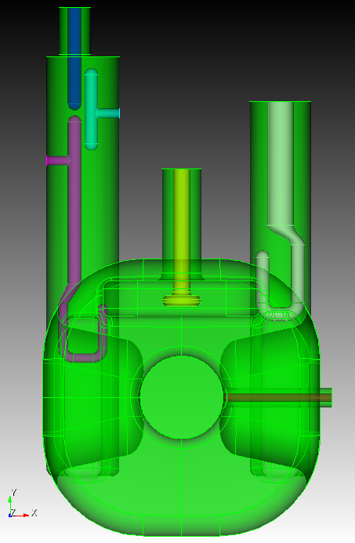
V-HOM Error analysis and tolerances
V-HOM coupler

Slide 39
V-HOM Error analysis and tolerances

Slide 40
V-HOM Error analysis and tolerances

Slide 41
V-HOM Error analysis and tolerances

Slide 42
Thermal Study - Procedure
Power dissipation
(calculated based on R_{s} ,
R_{s} is based on assumed temperature 2K)
Apply all anticipated heat load
Verify resulting temperature
Apply power dissipation from fundamental mode + HOM
HOM power dissipation → frequency dependent
Power dissipation on gasket → include anomalous skin effect
Static heat load from cable
Dynamic heat load (RF loss) of cable
Use temperature dependent thermal conductivity

Slide 43
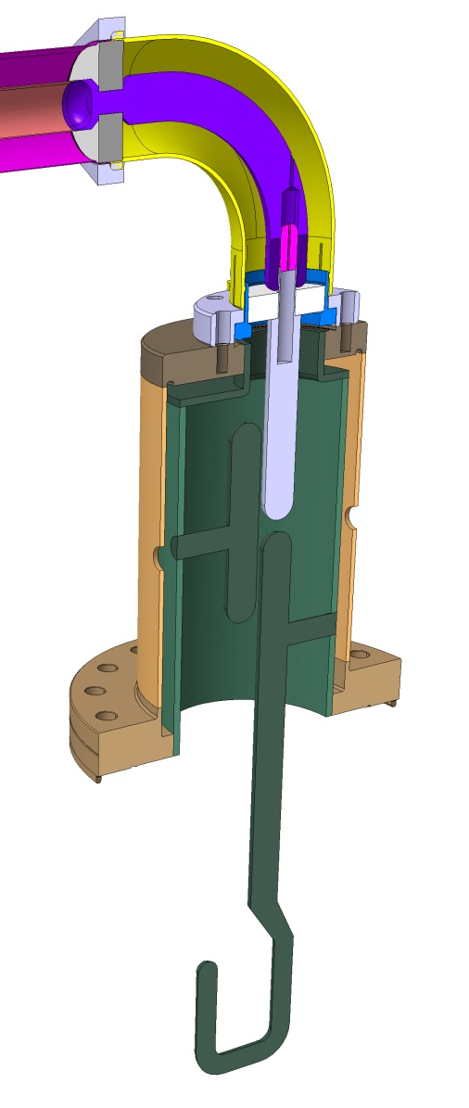
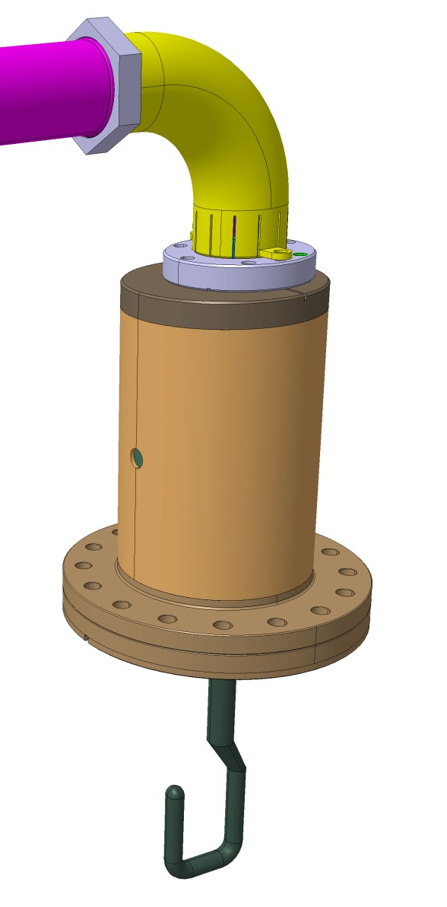
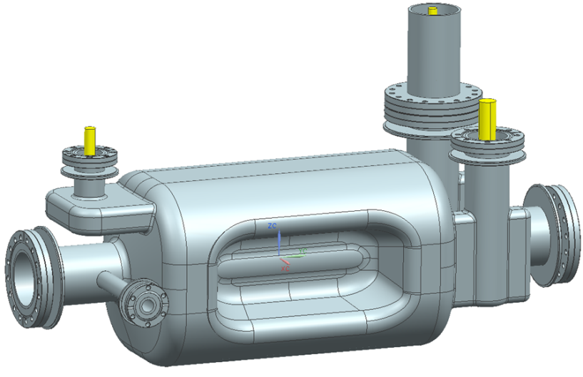
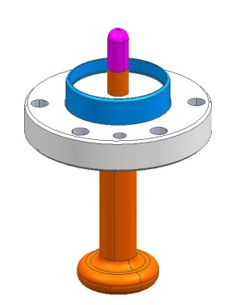
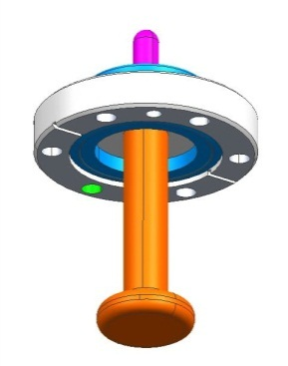
Coupler Design
FPC
Vertical HOM Feedthru
Same feedthru design from H-HOM coupler with different flange size and probe configuration
Horizontal HOM Coupler

Slide 44
Power Dissipation on High Pass Filter
Location | Power dissipation from fundamental mode [mW] | Power dissipation from 1kW HOM ¹⁾ [mW] | Total [mW] | Notes
Hook | 0.60 | 0.0069 | 0.607 | Rs=10 nΩ²⁾
Tee | 0.0015 | 0.0054 | 0.007 | Rs=10 nΩ²⁾
Probe | 49 | 481 | 530 | Rs=5 mΩ for fundamental Rs=8 mΩ for HOM
Gasket | 107 | 0.96 | 108 | Rs=1 mΩ²⁾ for both fundamental and HOM
1) Most dominant mode in terms of power dissipation value is selected.
2) To be adjusted according to the resulting temperature. The results show negligible temperature increase. Therefore, the assumed Rs is valid.

Slide 45
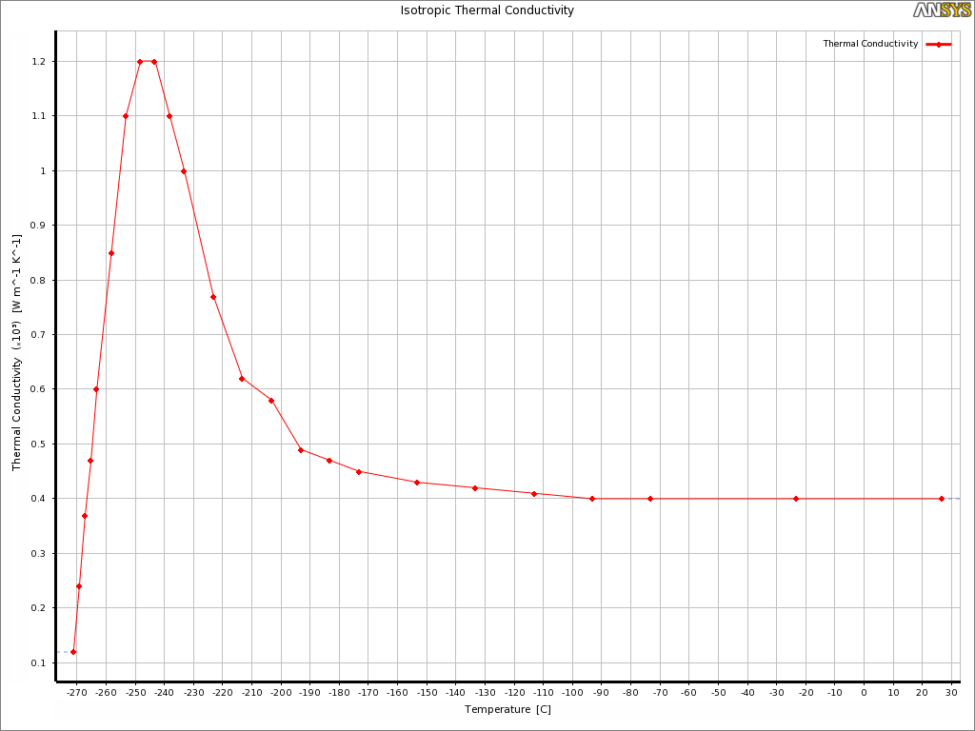
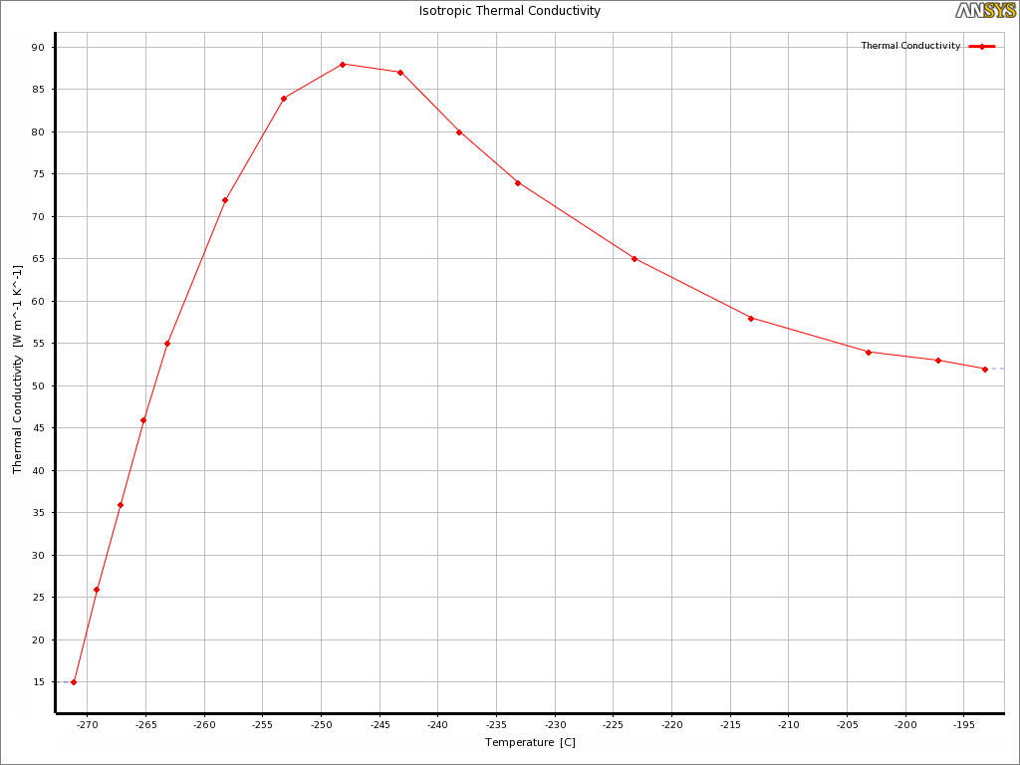
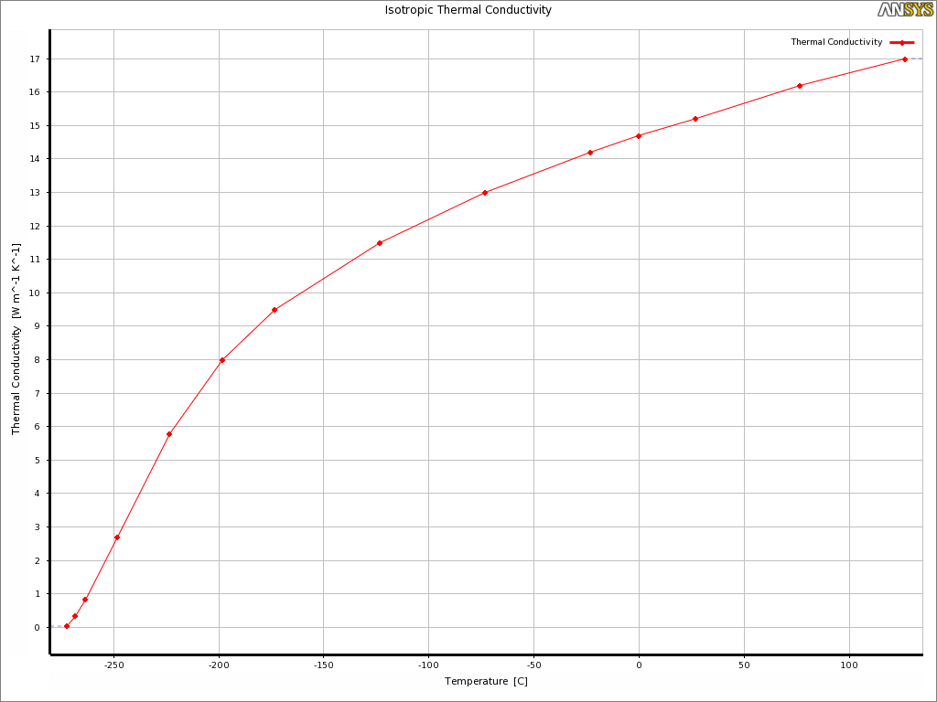
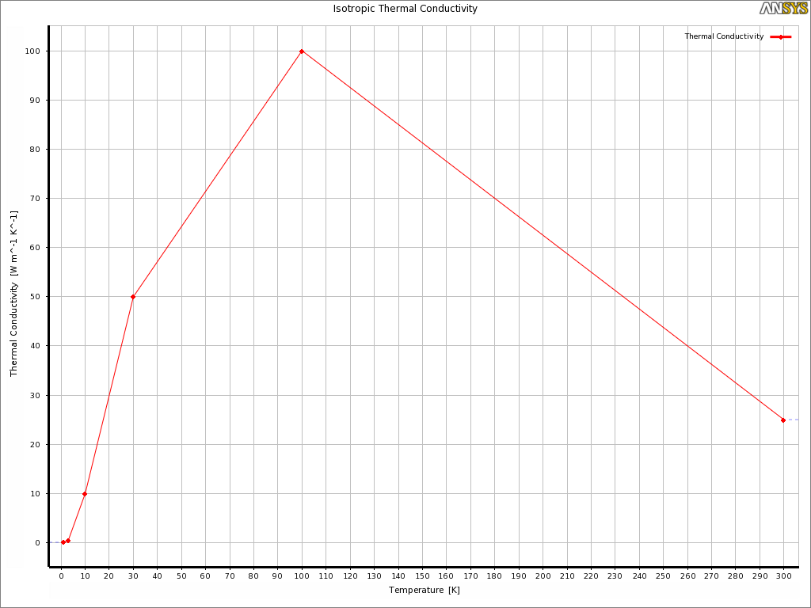
Thermal study – Material data
Cu
Nb
SS
Al2O3
Cu, Nb, SS Data from ‘BNL SELECTED CRYOGENIC DATA NOTEBOOK’
Al2O3 from CERN

Slide 46
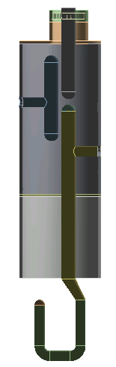

Boundary Conditions
Ceramic
Copper sleeve
Nb tank
*
Copper
Nb
* 1mohm increased to 2mohm to account the roughness and strain effect of copper. (Anomalous skin effect and resistive wall heating by Weiren Chou and Francesco Ruggiero, 9/8/1995 CERN)
Copper gasket
Power applied on extremity only

Slide 47




Results
Copper probe
Nb hook
Copper gasket

Slide 48
Conclusion – Thermal Study
Niobium hook and tee maintains 10 nΩ range temperature (< 2.1 K).
Copper gasket temperature under 2.3K with doubled heat load.
No thermal runaway → Estimated power dissipation all valid.
No internal helium channel is necessary.

Slide 49







Fabrication Concepts
Flange+Nb Braze
EBW
Assemble feedthru
EBW
EBW
Flange+Nb Braze
Precision machined fixture will be used during hook and tee welding for dimensional control.
BCP internal surfaces after completion.

Slide 50
Summary on the RF Design of HOM Couplers
Design complete
2 HOM couplers (1 high-pass filter, 1 straight coax)
No multipacting
Low power dissipation and very low magnetic surface field
Simple and robust design
Low sensitivity to manufacturing and assembly errors
Tolerances easily achievable
Manufacturing, processing, and assembly processes identified and “relatively” straightforward

Slide 51
Backups

Slide 52


FPC Coupler
Outer diameter: 62 mm
Inner diameter: 27 mm
(interface to LHC main coupler design)
Coupling hook
A hook shape antenna to enhance coupling, and thus minimizing RF heating on the FPC center conductor

Slide 53


FPC Coupler RF Heating
Using a hook coupling instead of a probe (Horizontal crabbing)
High RF surface heating on the probe shape antenna
Replaced with a hook coupling, optimized to reduce RF heating
✔
676 W 178 W 69 W
Hook heating at 3.4 MV deflecting voltage (Horizontal crabbing)

Slide 54

Backup
93 mm
35 mm
77.2 mm
42 mm

Slide 55

Backup
Zenghai Li/SLAC

Slide 56
Backup
f [MHz] | Rs (Cu) (RT) | H-Hook (Nb) | H-T (Nb) | H-Probe (Cu) (RT) |  | H-Gasket (Cu) (2K) | V-Probe (Cu) (RT)
 | [ohm] | (2K) |  | (5 mohm) | (Scaled) | (1 mohm) | (5 mohm) | (Scaled)
400 | 0.005147386 | 5.99E-04 | 1.44E-06 | 4.90E-02 | 4.90E-02 | 1.07E-01 | 4.67E-01
627.5 | 0.006447088 | 6.85E-06 | 5.42E-06 | 2.33E-01 | 3.00E-01 | 6.15E-04 | 1.78E-08 | 2.29E-08
633.8 | 0.006479371 | 6.24E-06 | 5.32E-06 | 2.38E-01 | 3.09E-01 | 5.76E-04 | 2.01E-05 | 2.61E-05
690.2 | 0.006761518 | 3.36E-06 | 2.85E-06 | 2.48E-01 | 3.35E-01 | 6.44E-04 | 1.81E-05 | 2.45E-05
716 | 0.006886733 | 3.87E-06 | 2.20E-06 | 2.53E-01 | 3.48E-01 | 7.54E-04 | 6.22E-04 | 8.56E-04
735.5 | 0.006979882 | 3.10E-06 | 1.60E-06 | 2.50E-01 | 3.49E-01 | 6.06E-04 | 7.74E-05 | 1.08E-04
761 | 0.007099848 | 3.90E-06 | 1.37E-06 | 2.33E-01 | 3.31E-01 | 7.23E-04 | 4.89E-02 | 6.95E-02
783.1 | 0.007202203 | 3.22E-08 | 9.55E-09 | 1.88E-03 | 2.71E-03 | 5.80E-06 | 4.03E-01 | 5.81E-01
800.5 | 0.007281778 | 1.37E-07 | 2.55E-07 | 2.19E-01 | 3.18E-01 | 1.40E-05 | 4.36E-08 | 6.34E-08
875.5 | 0.007615261 | 2.68E-07 | 5.41E-08 | 1.67E-02 | 2.55E-02 | 4.95E-05 | 3.80E-01 | 5.78E-01
909.5 | 0.007761722 | 2.46E-08 | 4.43E-09 | 1.47E-03 | 2.29E-03 | 4.56E-06 | 4.05E-01 | 6.28E-01
946.5 | 0.007918028 | 5.14E-06 | 8.66E-07 | 3.04E-01 | 4.81E-01 | 9.60E-04 | 4.16E-04 | 6.59E-04
1004.4 | 0.008156617 | 1.59E-07 | 2.62E-08 | 1.06E-02 | 1.73E-02 | 2.83E-05 | 3.89E-01 | 6.34E-01
Scaled from Zenghai’s table

