Slide 1
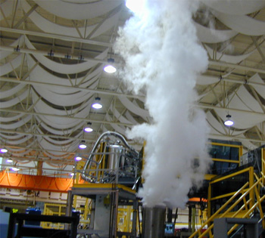
HTS Magnet Testing

Slide 2
Over view
Feather Zero & Two reminder
High temperature margin
Testing at high temperature 60K in gas.
Magnetic field Harmonics.
Magnet Quench calculations.
Test requirements

Slide 3
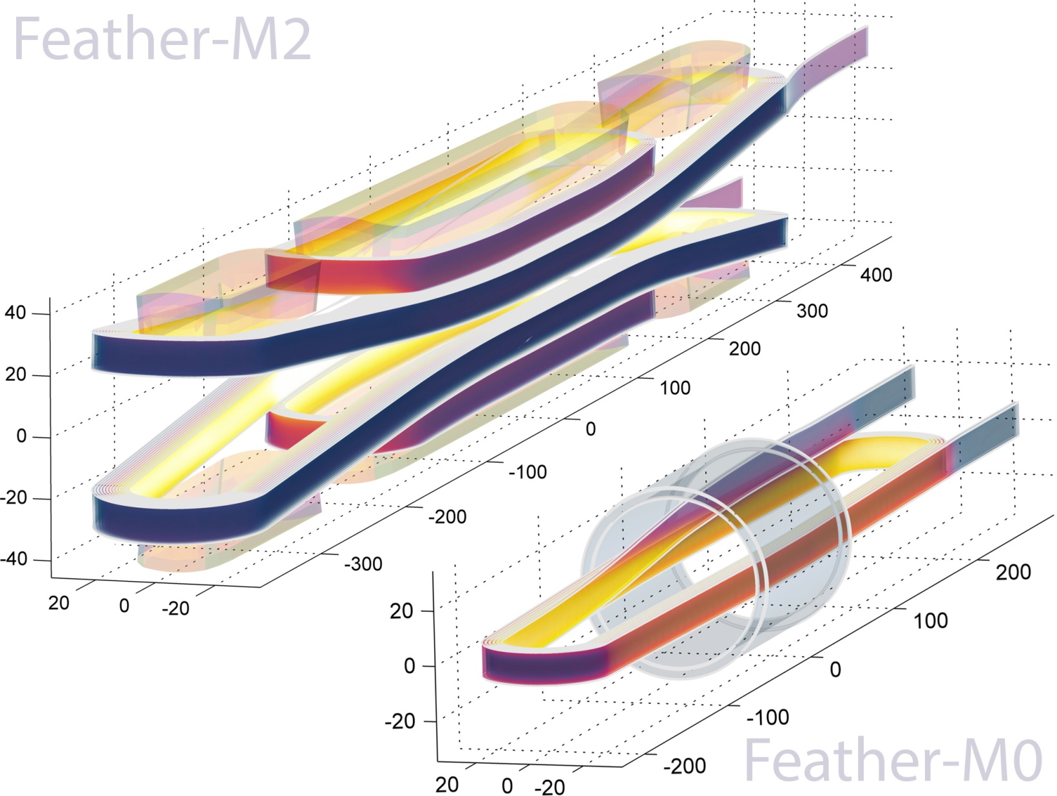
Feather-M0 and Feather-M2
Five Tesla
HTS Research
Insert-Magnet

Slide 4
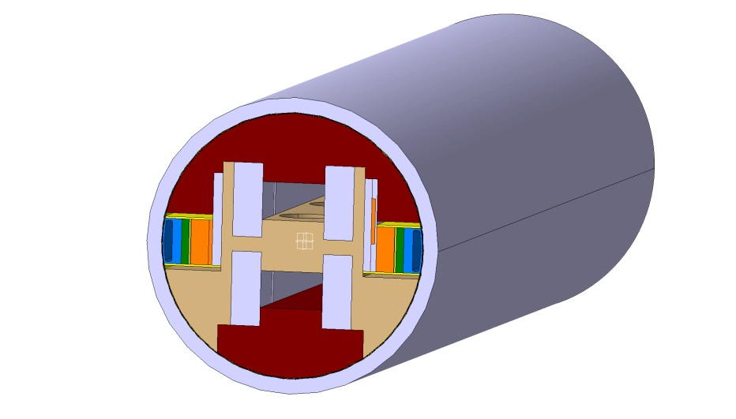
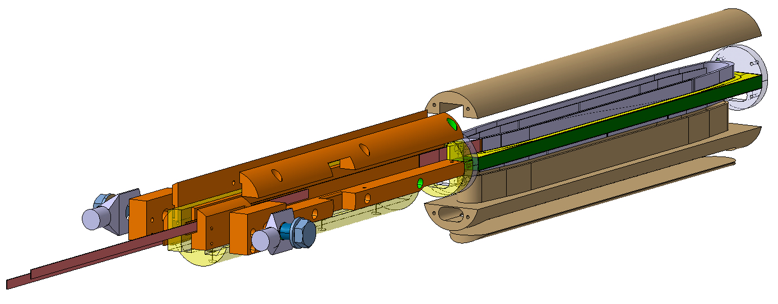
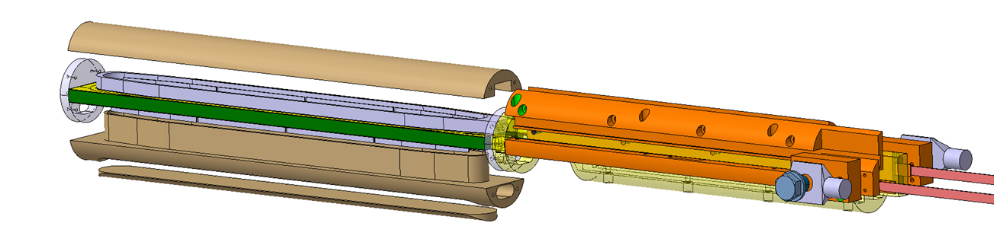
Feather Zero

Slide 5
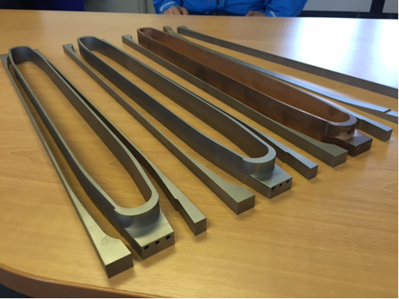
Feather Zero parts

Slide 6
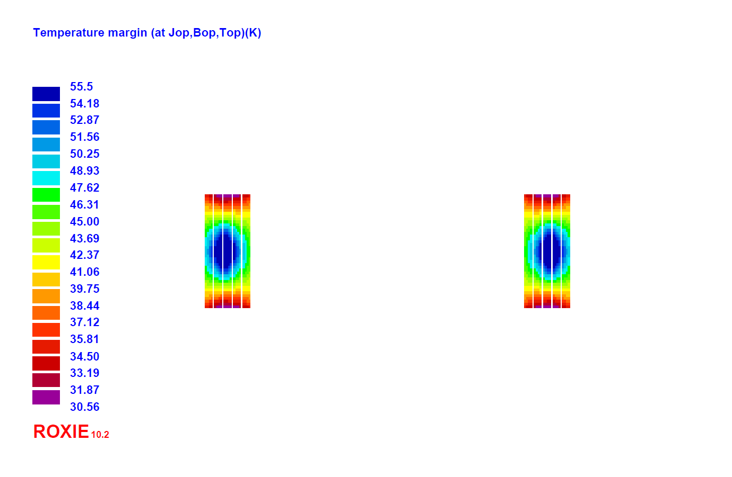
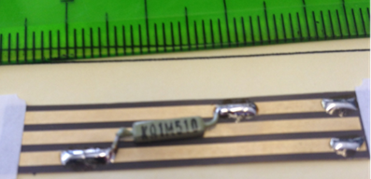
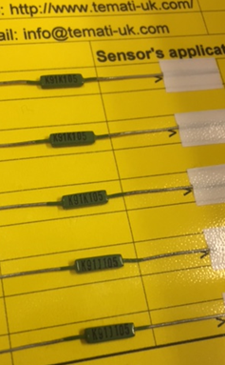
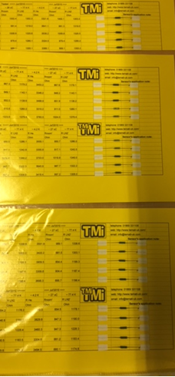
10 kA Temperature margin
30.5 `K
70 % SS
Temp. sensor CCS
55.5 K
Large temperature margin can we use this for quench detection?

Slide 7
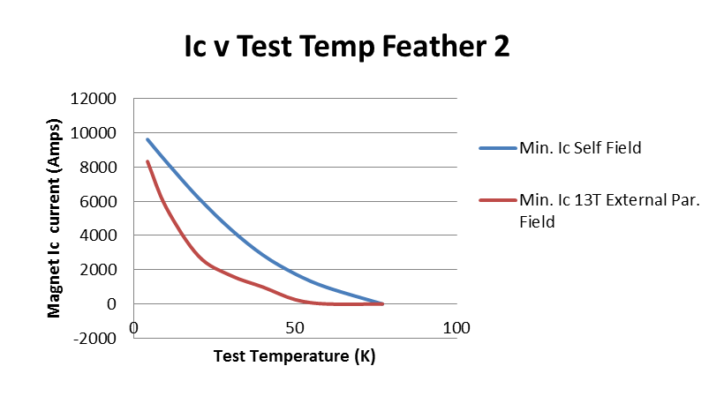

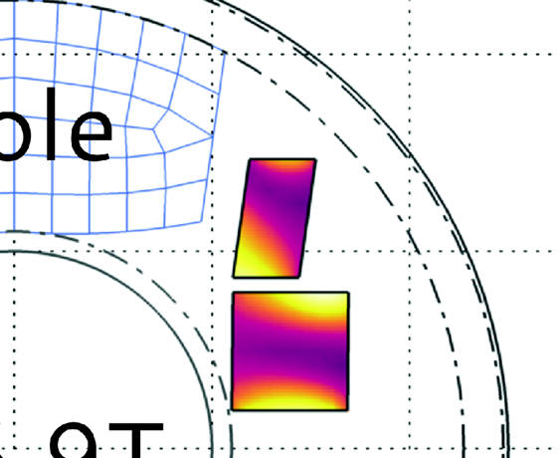
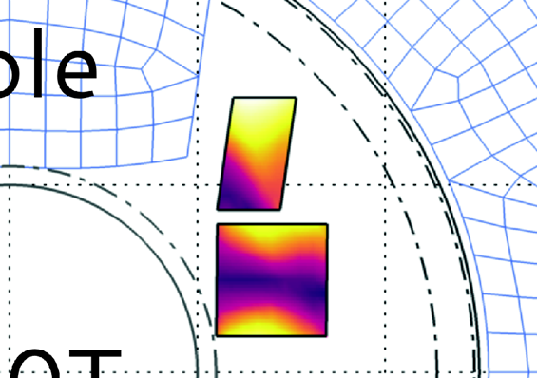
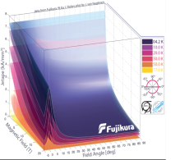
Position of short sample in coil
16.9 Tesla
5.0 Tesla

Slide 8
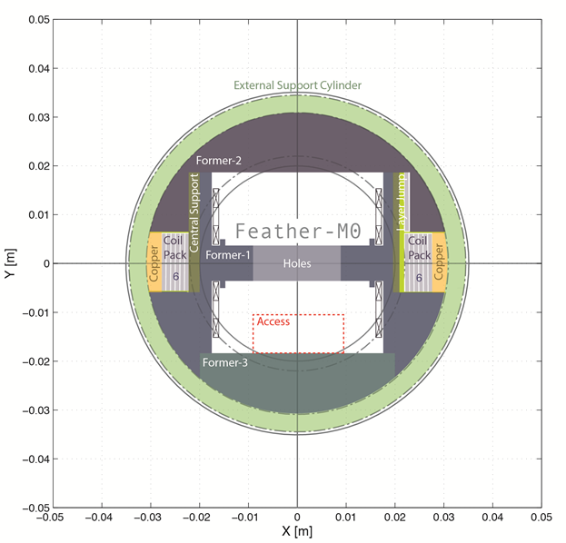
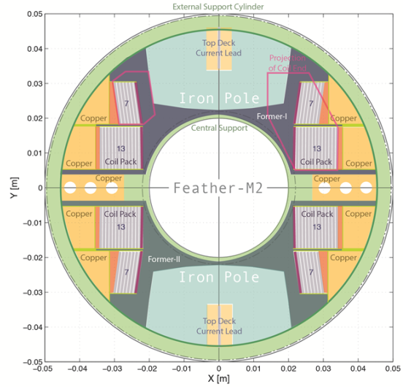

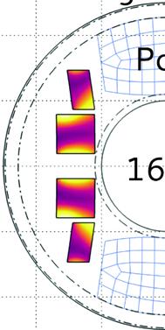
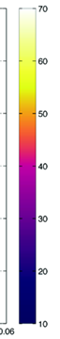
Ic v Test temperature
16.9 T
In the post

Slide 9
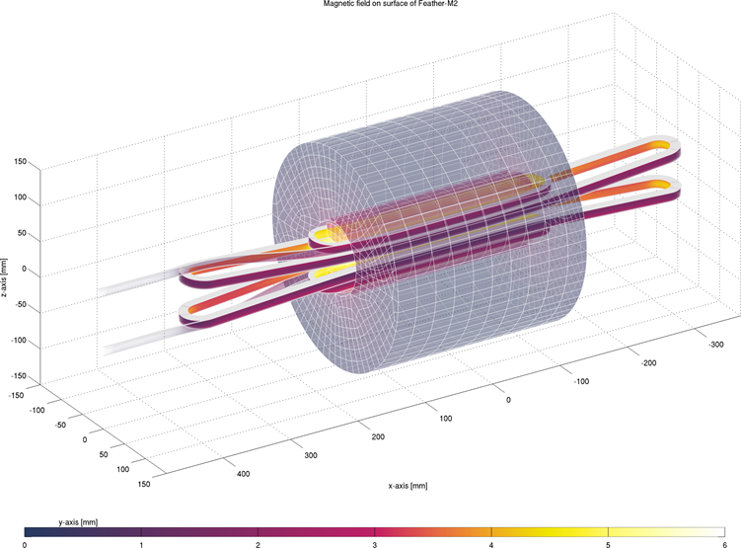
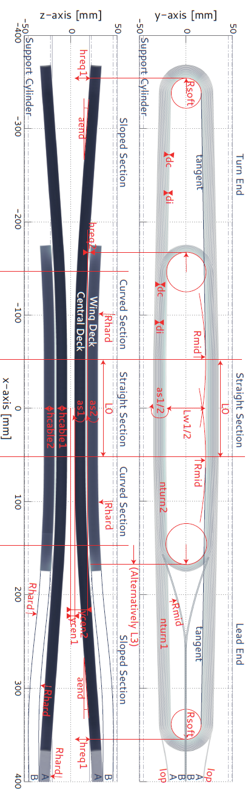

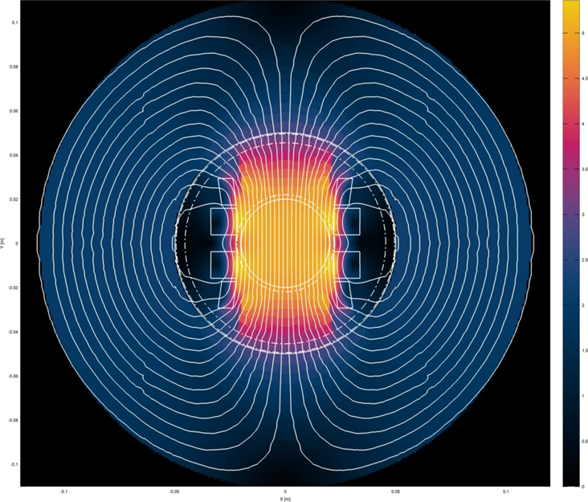
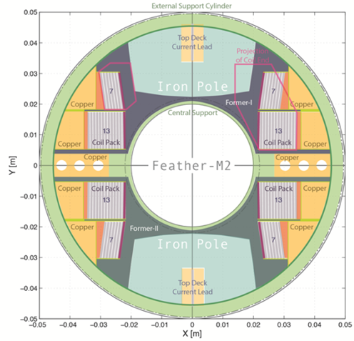
Feather 2
Iron OD ~ 240mm

Slide 10
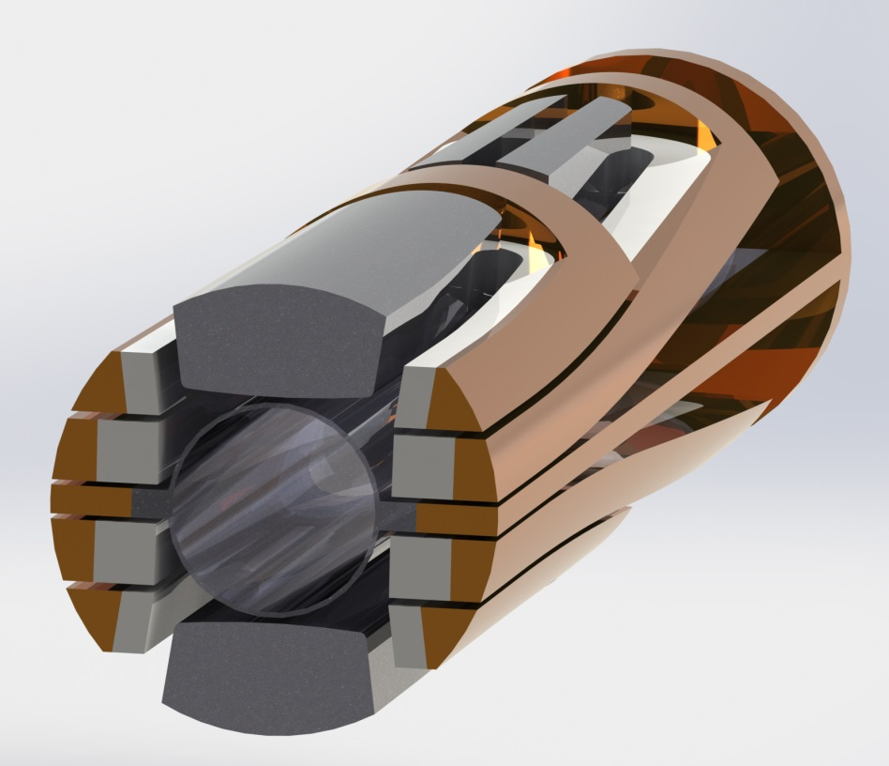
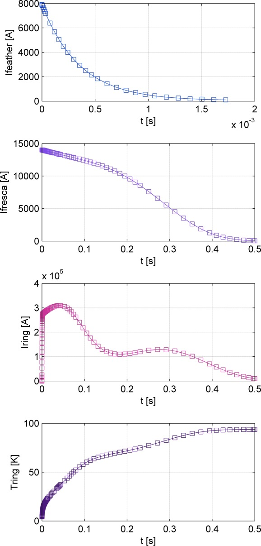
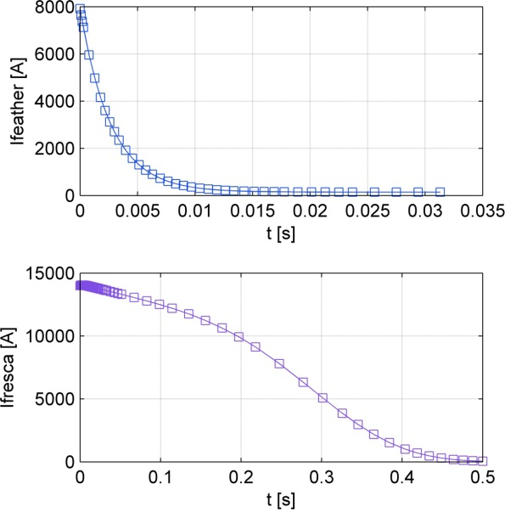
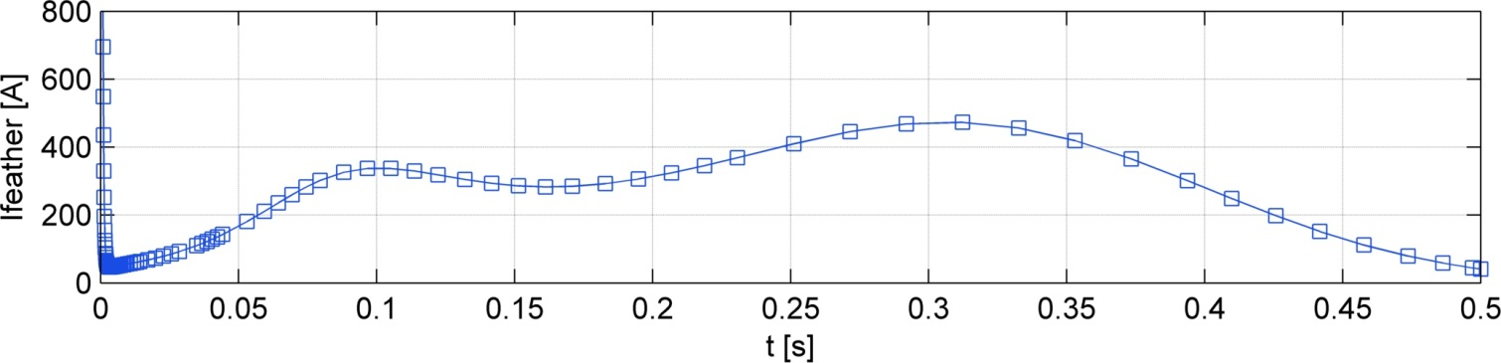
Quench Protection with Copper ICEE Loops
With Loops
Without Loops
1ms
10ms
Induced Current After Rampdown
95 K

Slide 11
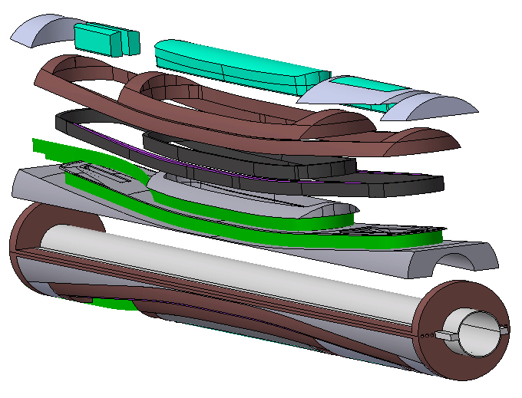
Review of Feather 2 components

Slide 12
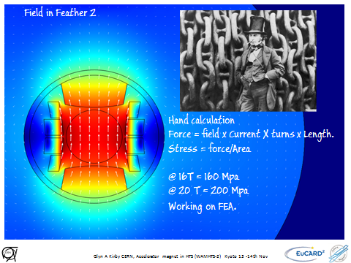
I_{c} versus transverse stress
T = 4.2 K
B = 10.5 T
Feather 2
Working range 150 to 200
No degradation up to 253 MPa
Degradation at higher pressures is irreversible

Slide 13
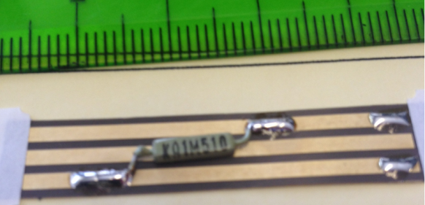
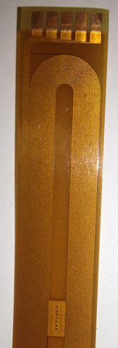
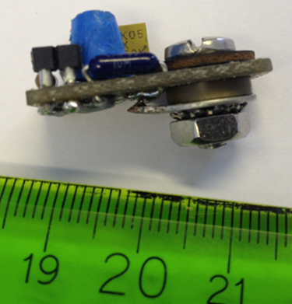
Quench detection
Voltage taps (low current)
Temperature sensors (high current)
Pickup coils high current (Feather zero trial)
Acoustics
Thanks to Maxim Marchevsky at LBL

Slide 14
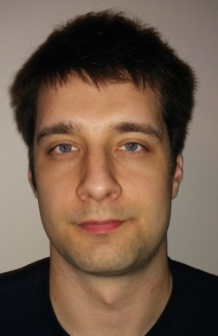

Feather-M0 Quench
Behaviour 4.5K f(current)
Erkki Härö
Finite Element Model using anisotropic thermal conductivities
Will we be able to see this in the cable ?

Slide 15

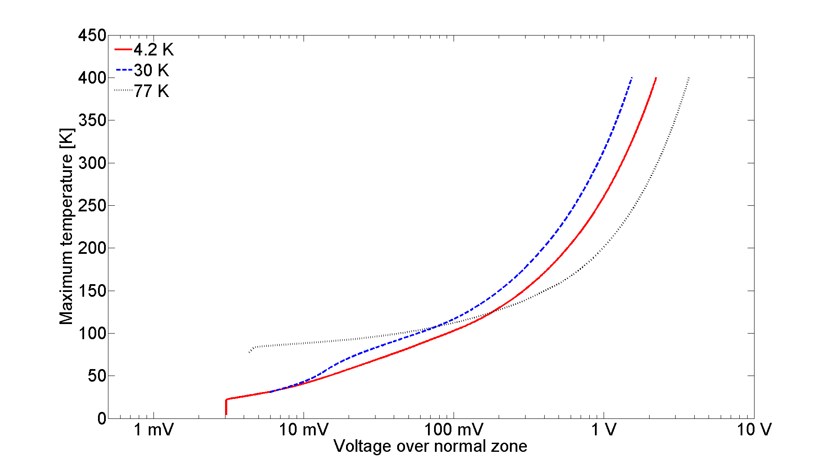
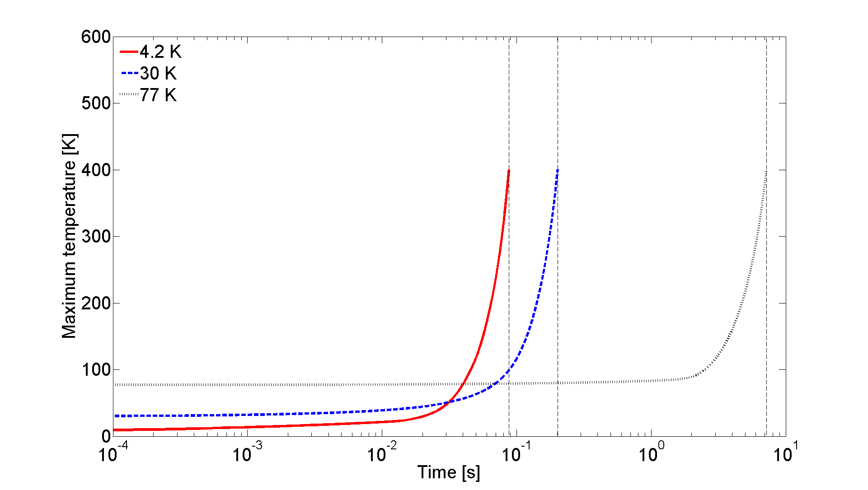
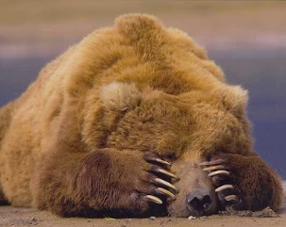
Feather M0 Quench
Behaviour f(test temp)
Quench simulation results for Feather-M0 with different operation temperatures:
4.2 K, 30 K and 77 K.
Operation currents with 4.2 K, 30 K and 77 K were 8960 A, 5616 A and 904 A,
respectively.
Operation current was chosen to be 80 % of the short sample Ic value.
202 ms
88 ms
7.2 s
4.2K
30K
77K
50 ms
2.5 s
20 ms
If we can see it in the Roebel cable and coil

Slide 16
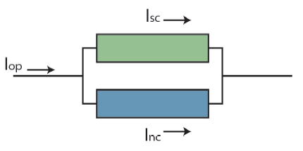
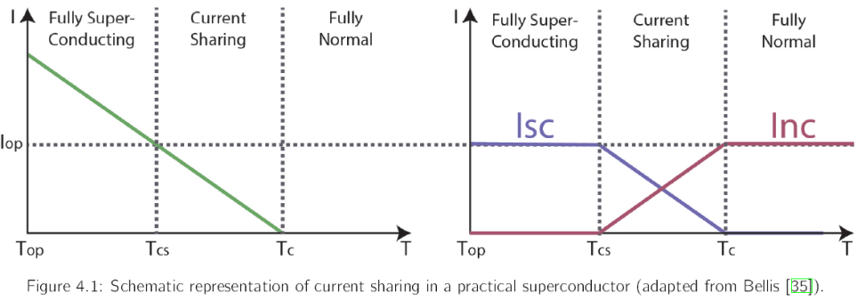
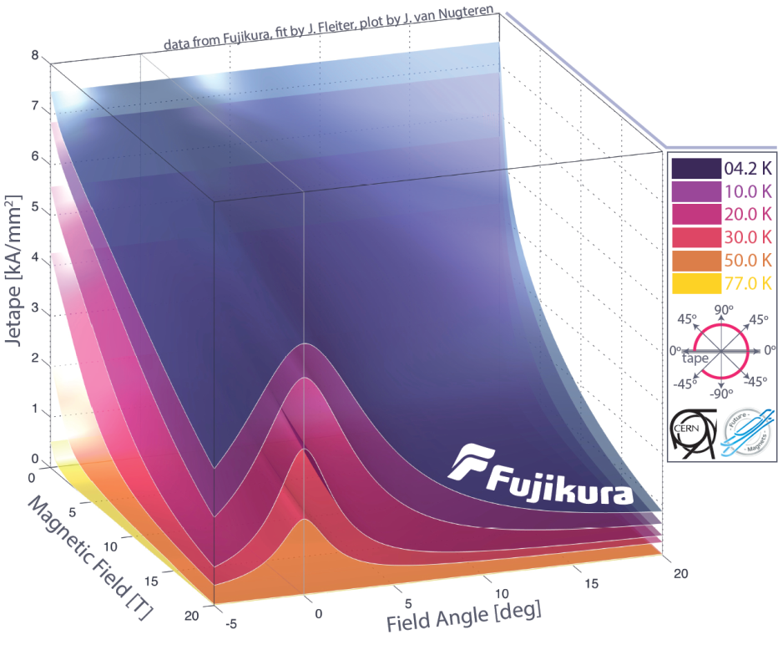
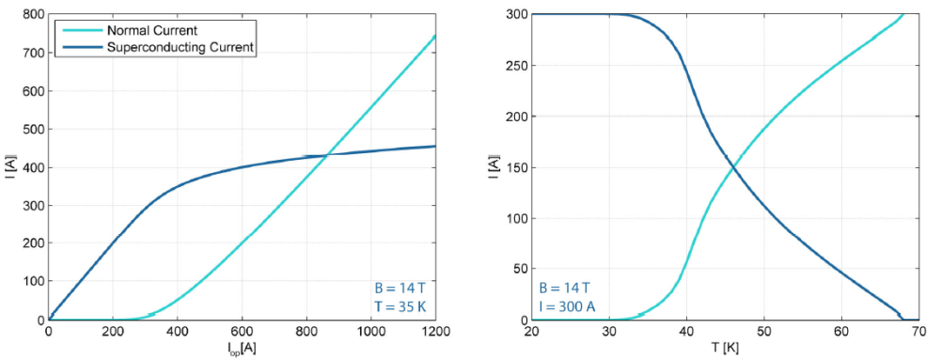
Non-Linear Current Sharing Model
Current sharing refers to the current distribution between the matrix material and the superconductor provides Vnl(I)
In the model three options are available:
  Pure power law (not useable for quench analysis because only valid below or just above Tcs)
  Linear transition between Tcs and Tc
  Superconducting power law element in parallel with resistive (matrix) element (implicit equation)
Current Sharing
Angular Dependent Critical Current
Inc
Inc
Isc
Isc
I [A]
T [K]

Slide 17
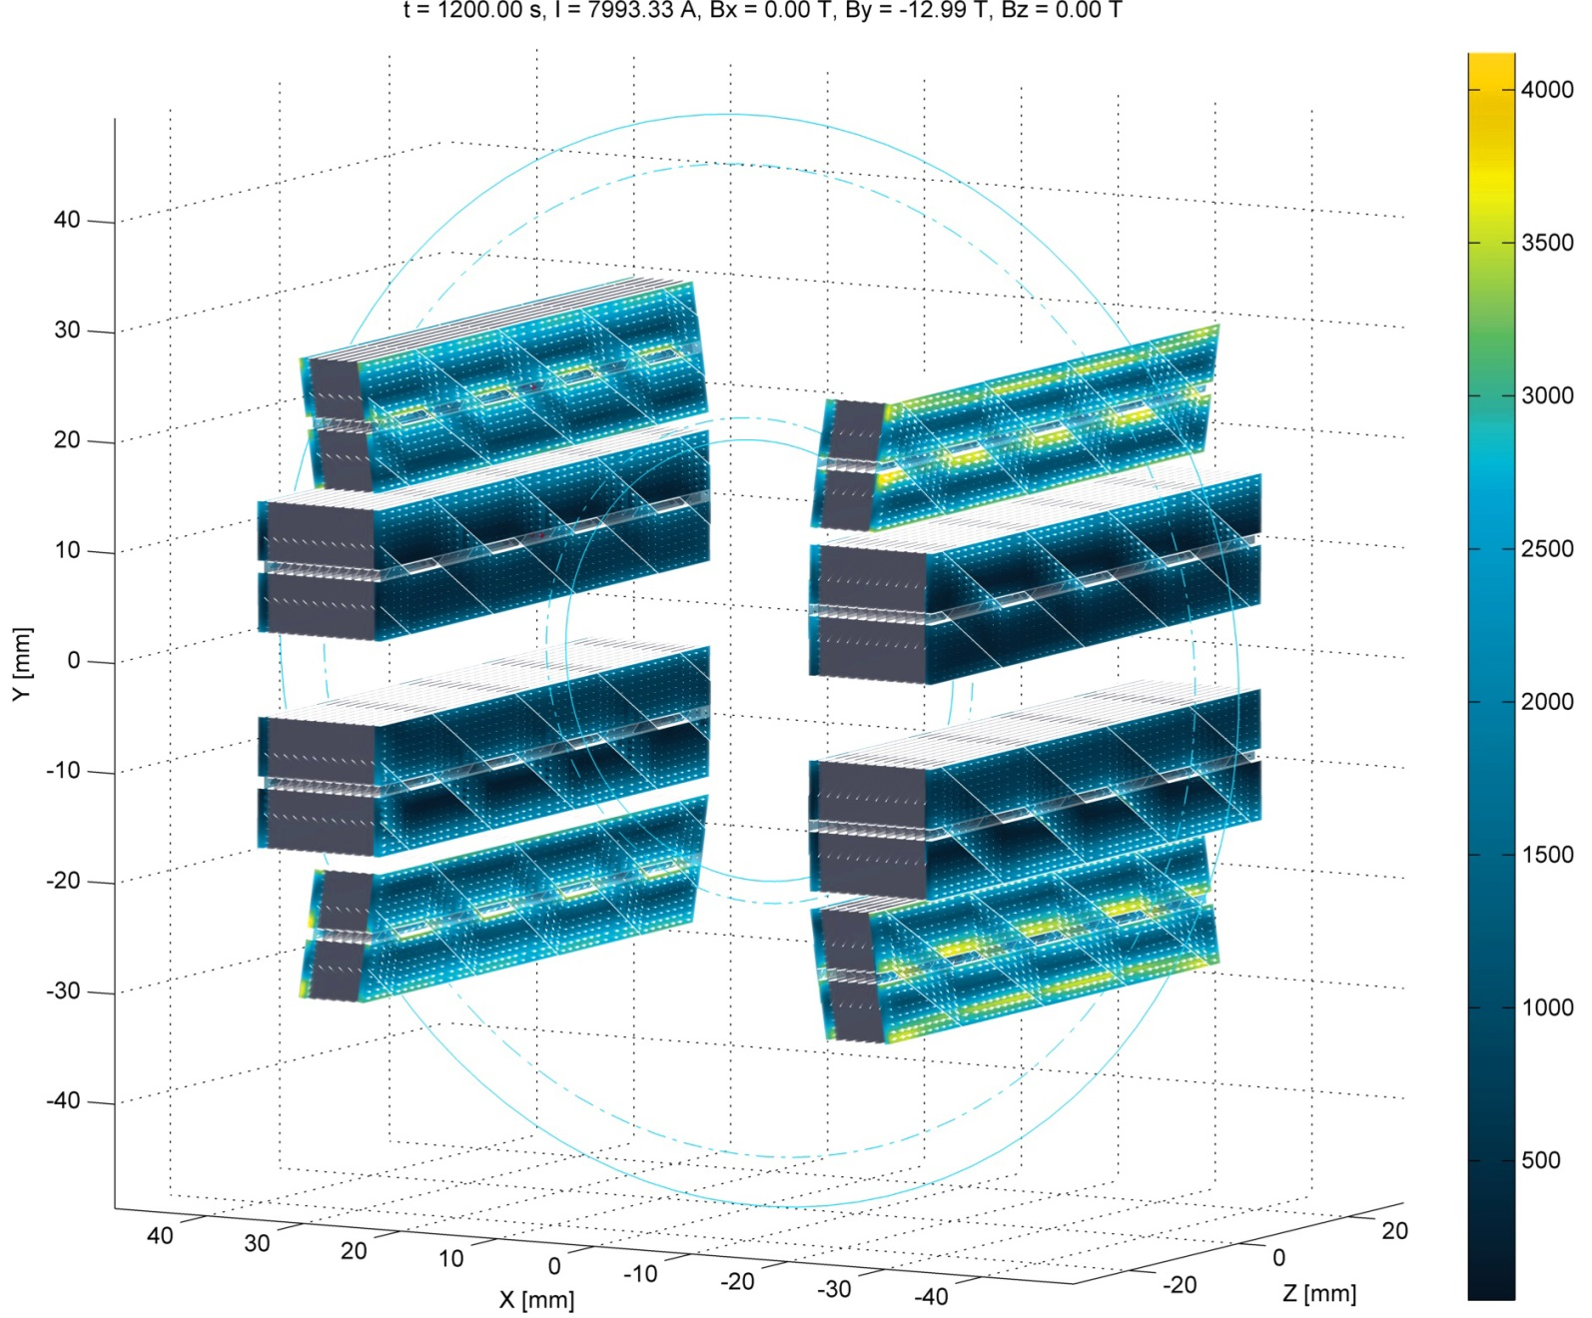
Feather–M2 Harmonics
Due to limitations of the BemFem no Iron pole (yet)
Simultaneous ramp of Fresca2 and insert over 20 minutes (1200 s)
Top deck generates more shielding currents due to field angle
Harmonics at 2/3 aperture less than 10 units
Keeping alignment during ramping could reduce the field error by a great deal
Top
Deck
Central
Deck
Central
Deck
Top
Deck

Slide 18
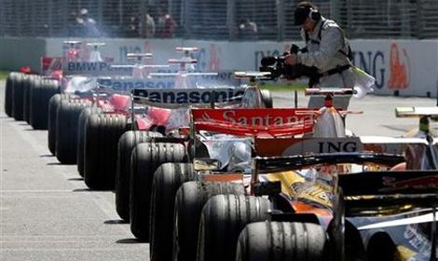
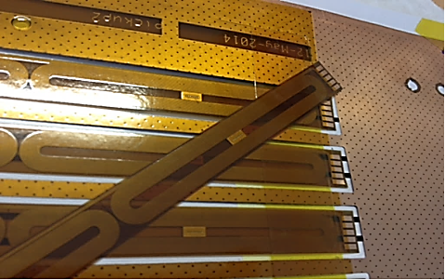
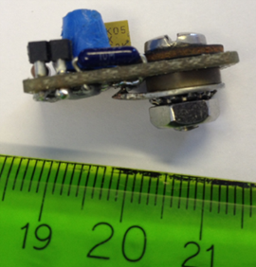
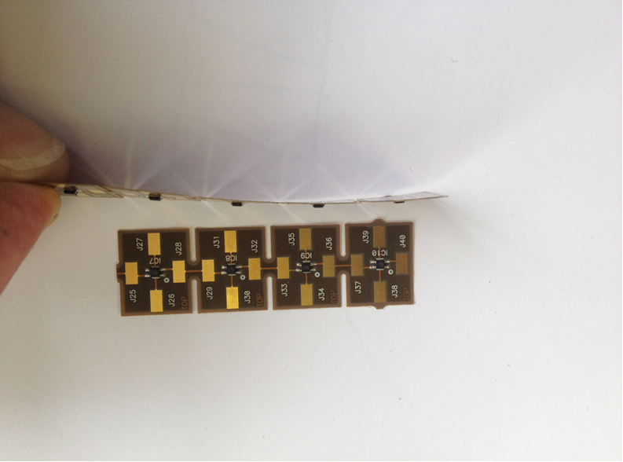
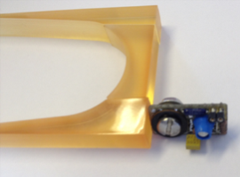
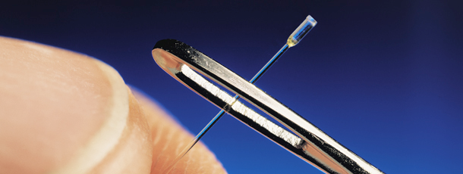
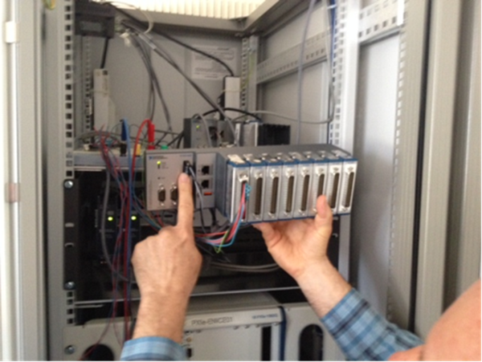
Quench Detection Race
Pick up Coils
Voltage Taps
Acoustics
Field Sensors
Temp sensors
FPGA -DAQ

Slide 19
Test station spec.
  Feather‘s Current ~10 kA
  Dump resistor.
  10 kA semiconductor Fast switch 1 or 2 mS
  Variable test temperature ~80 to 4K in steps! (temp stability, current leads opp.,
  Instrumentation. ( 224 channel FBGA DAQ)
  Temp sensors, voltage taps, pick up coils.
  Feather 2 dynamic field measurements. 40mm
  Feather 2 in Iron yoke od ~ 240 mm
  Feather 0 in Iron yoke od ~ 120mm

Slide 20
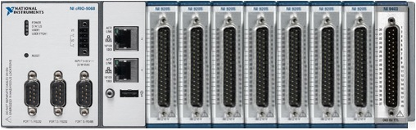
HTS Quench DAQ
NI-CompactRIO
224 total
Received at CERN 14 March
7 modules: 16 differential analog inputs each
+/- 200 mV till +/- 10 V input range
16 bits
7.8 kS/s per channel
1 module: 32 digital outputs
5 V TTL
7 µs response time
Also available: high speed module
4 differential analog inputs
16 bits
1 MS/s, simultaneous sampling
30 cm
Processor:
667 MHz dual-core ARM
512 MB RAM
1 GB storage
NI Linux Real-Time OS
FPGA:
Xilinx Artix-7
2 M cells
A similar system is used by the EL group to capture voltage transients on the electrical network caused by EDF switching, thunderstorms and internal load changes.

Slide 21
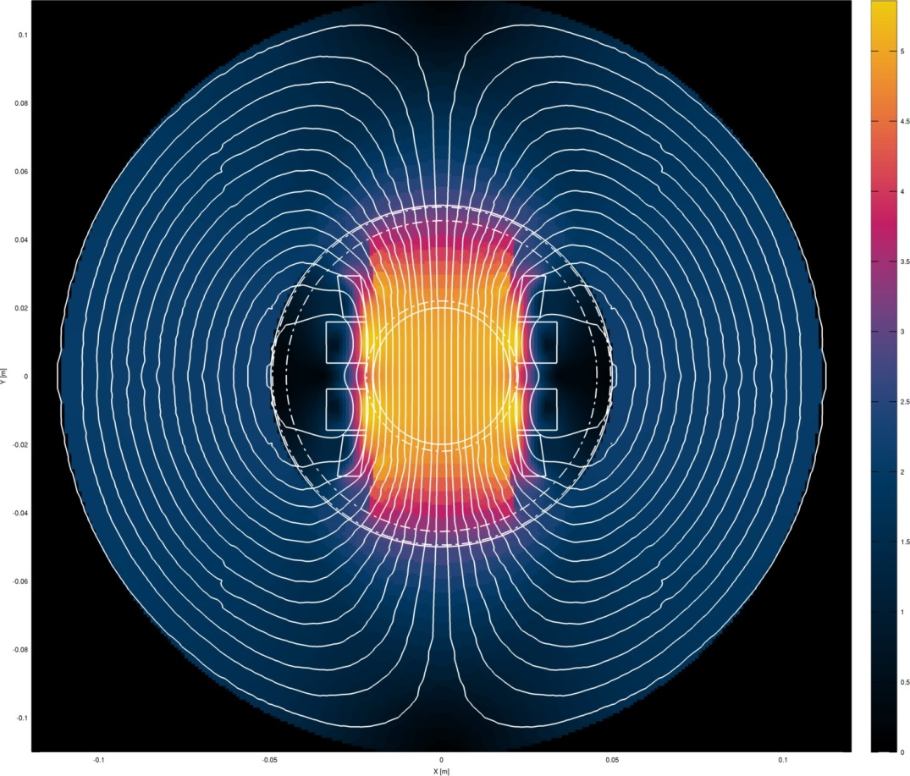

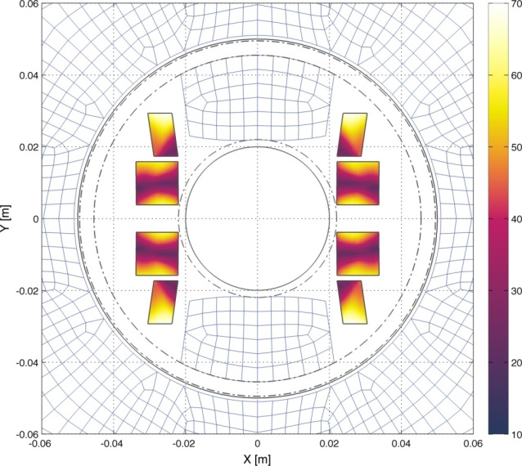
Cross section 5 T Stand alone
98 mm outer diameter, to be able to fit inside Fresca-2 without touching.
Standalone we may fit a simple magnetic yoke
Iron OD ~ 240mm
This is one of the many possible designs we are Thinking about: Placing IRON yoke to Exaggerate the change in field angle to assess angular dependence

Slide 22





Possible test ideas after stand alone
Fresca 2
Inner coil test 2015
KEK D1
due late 2015

