Slide 1
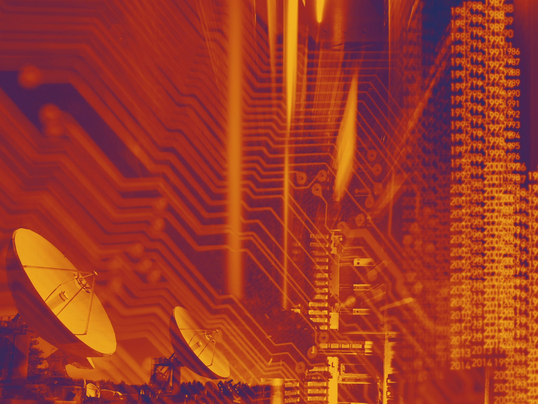


Session 4: Data preservation lessons learnt and future prospects
LTDP in HEP: Status, lessons learnt
and 2020 (2035 / 2050) outlook
Jamie Shiers
CERN & DPHEP
International Collaboration for Data Preservation and
Long Term Analysis in High Energy Physics

Slide 2
Outline
Long-term
Data Preservation
Future Re-Use
Lessons learnt & Outlook

Slide 3
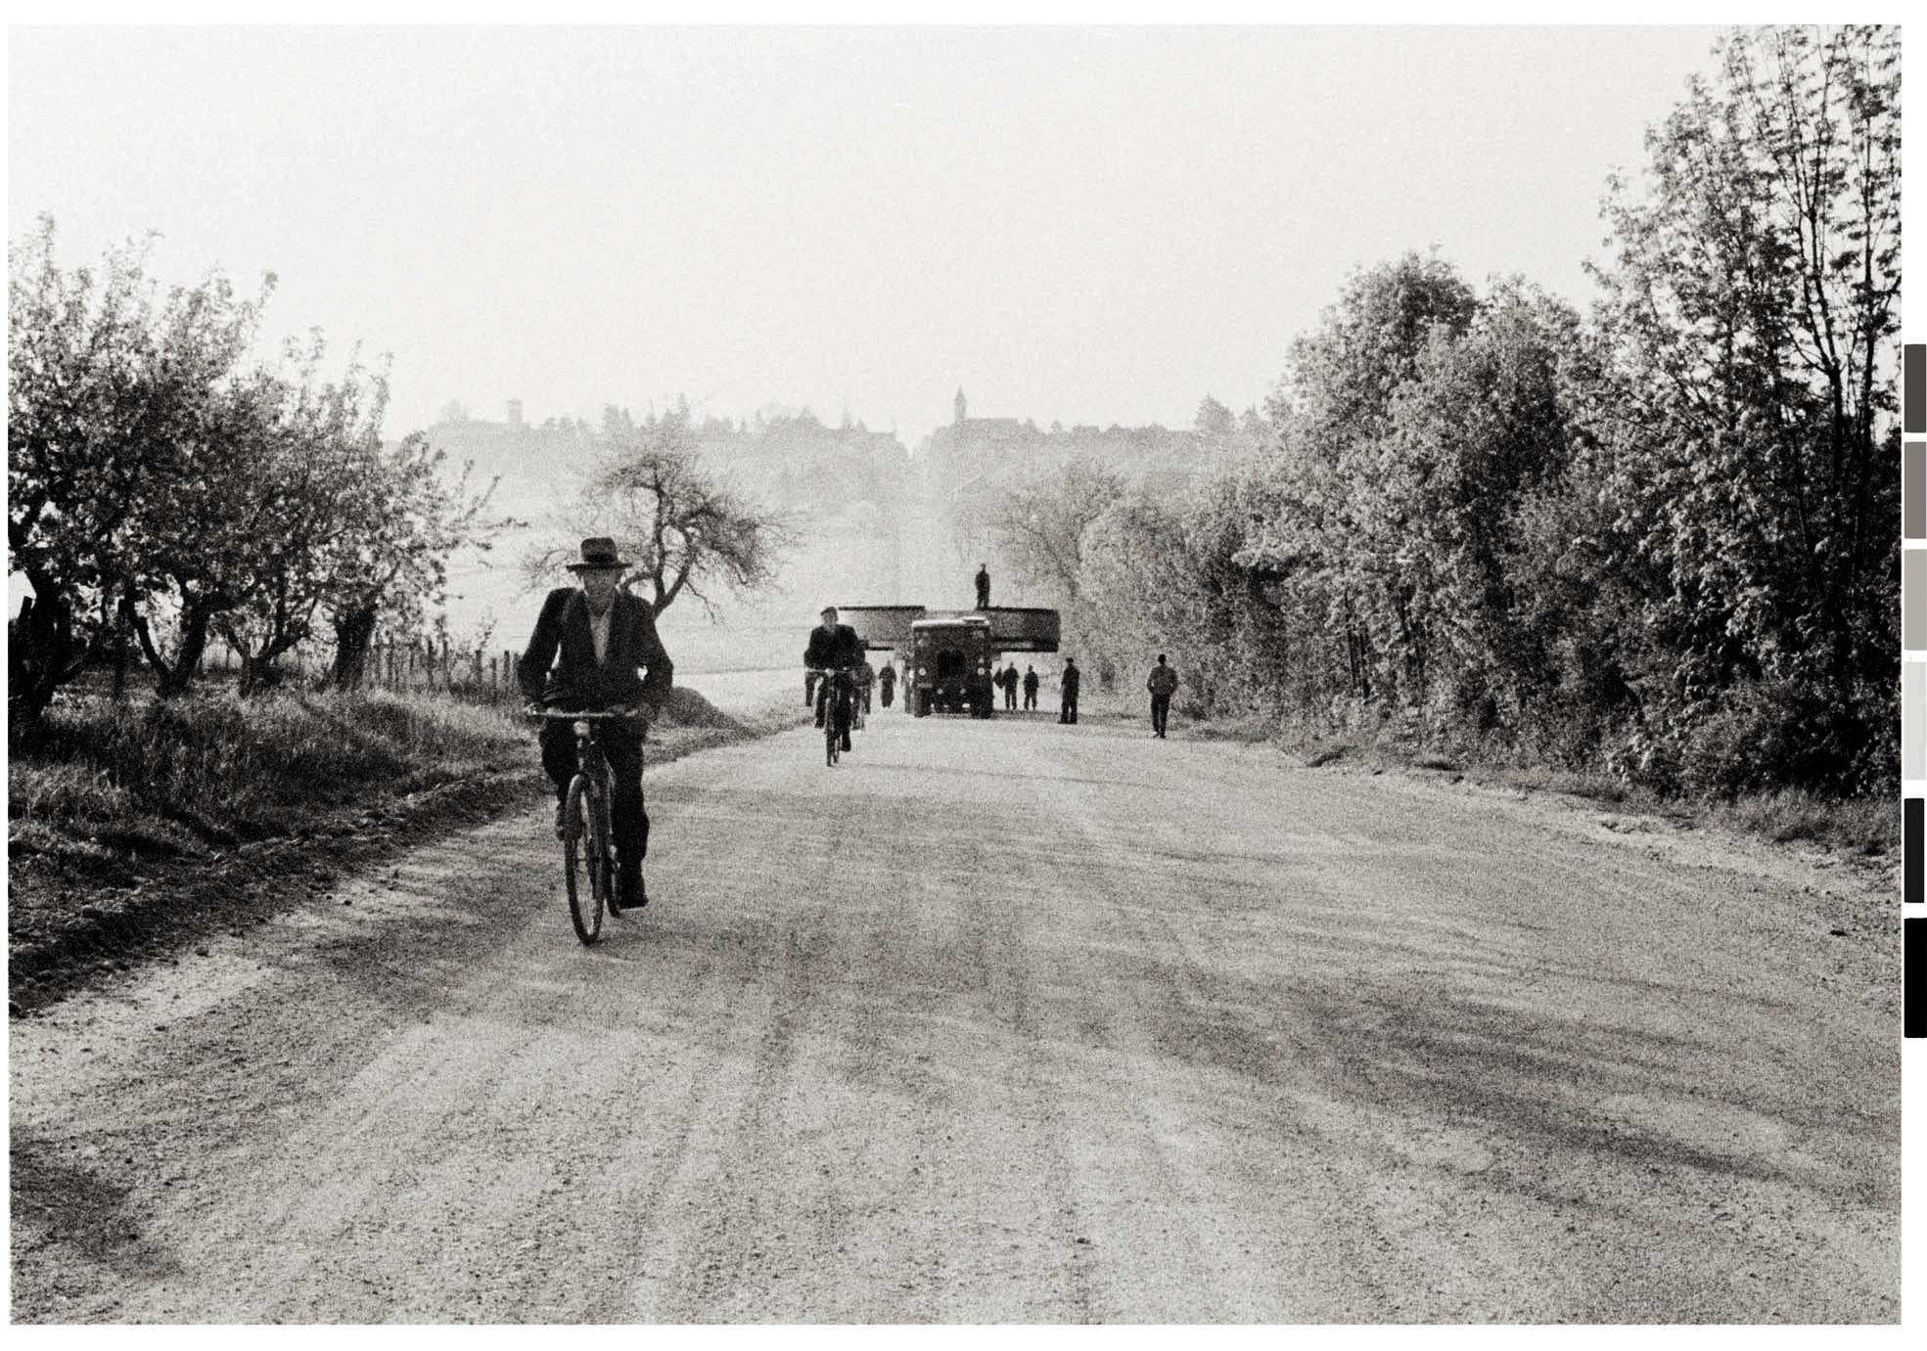
Long term

Slide 4
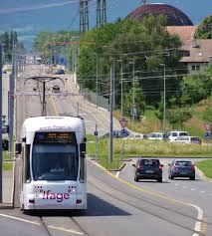
Long term

Slide 5
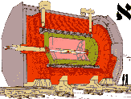
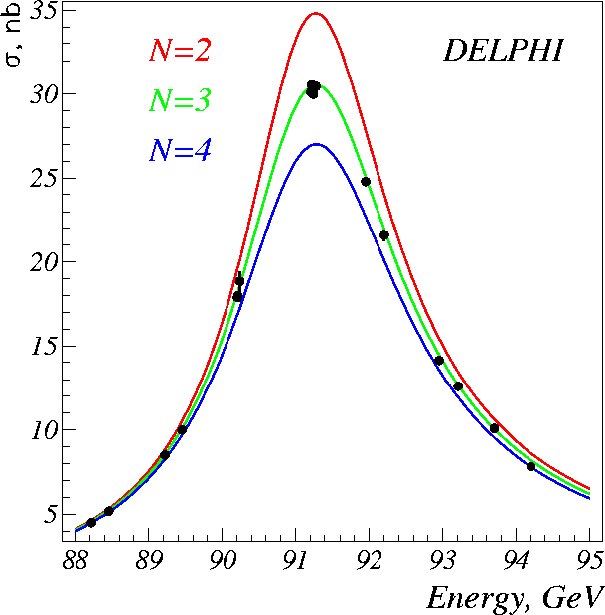
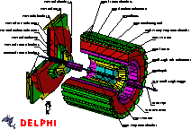

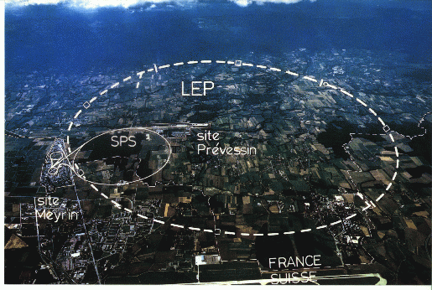
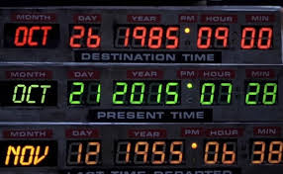
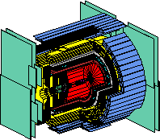

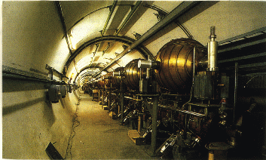

Slide 6
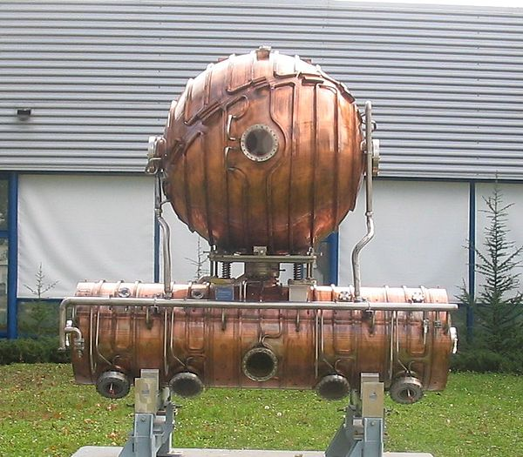

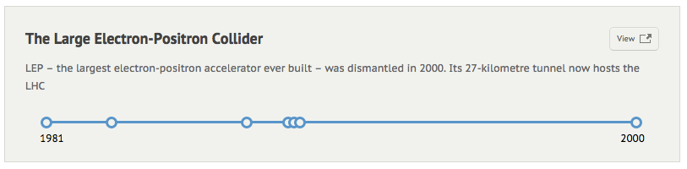
LEP ran as a Z⁰ factory;
Then produced W± pairs;
Energy scan up to 209 GeV
Total data: ~500TB (0.5PB)
This was “Big Data” at the time!
LEP experiments faced “constant change” –
a first for HEP. Probably why data is still around!
1983
1988
1989
LEP Events: approval, start / end of construction, start / end of data taking (~2 decades)

Slide 7
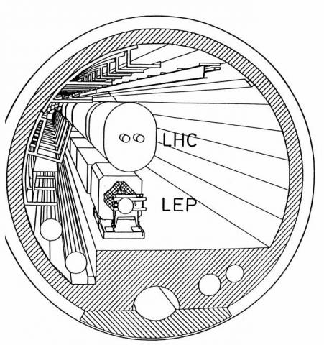

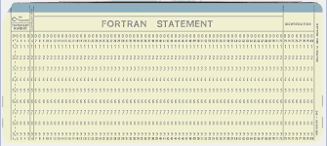
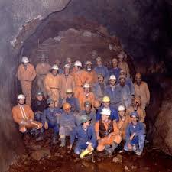
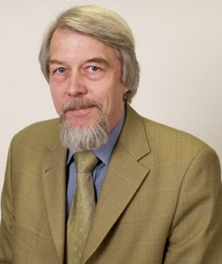
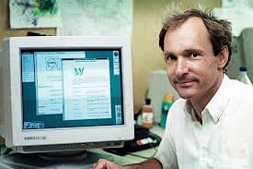

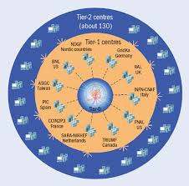
LEP Timeline
Date | Collider (e⁺e⁻) | Computing
1981 | Approved by Council | Card readers still exist!
1983 | Civil Engineering starts | Computing at CERN in the LEP era published
1988 | LEP Tunnel completed | Data Management project requested by experiments
1989 | 1st beams, collisions, 1st and results | Was the s/w really ready?
1992 | LHC Computing starts | Mainframes replaced by Unix, later PCs
1996 | LEP 2 (W pairs) starts
2000 | Final run of LEP | HEP gets bitten by Grid

Slide 8
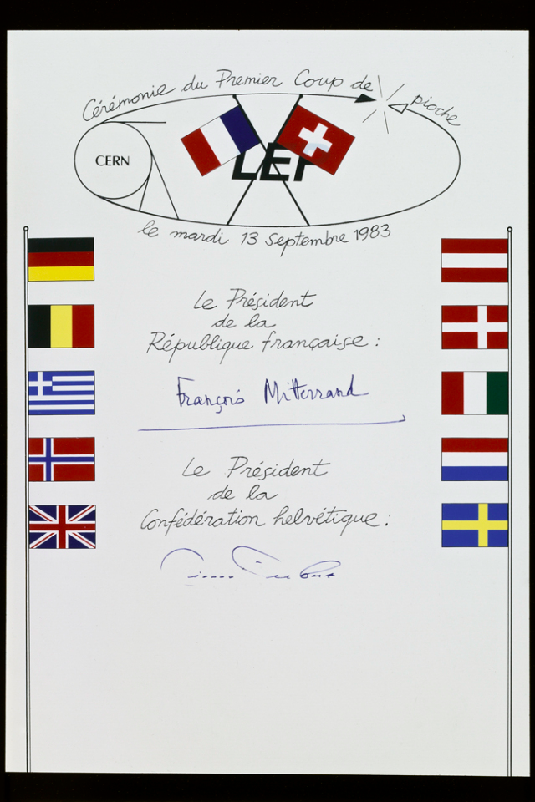
LEP Timeline
Date | Collider (e⁺e⁻) | Computing
1981 | Approved by Council | Card readers still exist!
1983 | Civil Engineering starts | Computing at CERN in the LEP era published
1988 | LEP Tunnel completed | Data Management project requested by experiments
1989 | First beams, first collisions, first results | Was the s/w really ready?
1992 | LHC Computing starts | Mainframe computing replaced by Unix, later PCs
1996 | LEP 2 (W pairs) starts
2000 | Final run of LEP | HEP gets bitten by Grid

Slide 9
CERN Circular Colliders + FCC
1980
1985
1990
1995
2000
2005
2010
2015
2020
2025
2030
2035
20 years
Constr.
Physics
LEP
Design
Proto
Construction
Physics
LHC
Design
Construction
Physics
HL-LHC
Future Collider
Design
Proto
Construction
Physics
HEP has a long history of planning, financing and executing multi-decade projects

Slide 10
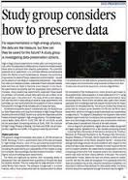
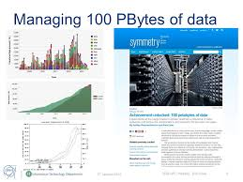
Data preservation

Slide 11
2020 Vision for LT DP in HEP
Long-term – e.g. FCC timescales: disruptive change
  By 2020, all archived data – e.g. that described in DPHEP Blueprint, including LHC data – easily findable, fully usable by designated communities with clear (Open) access policies and possibilities to annotate further
  Best practices, tools and services well run-in, fully documented and sustainable; built in common with other disciplines, based on standards
  DPHEP portal, through which data / tools accessed
    “HEP FAIRport”: Findable, Accessible, Interoperable, Re-usable
Agree with Funding Agencies clear targets & metrics

Slide 12
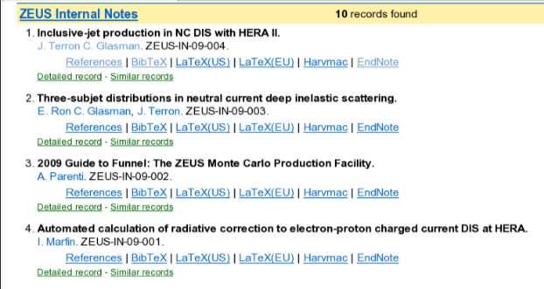
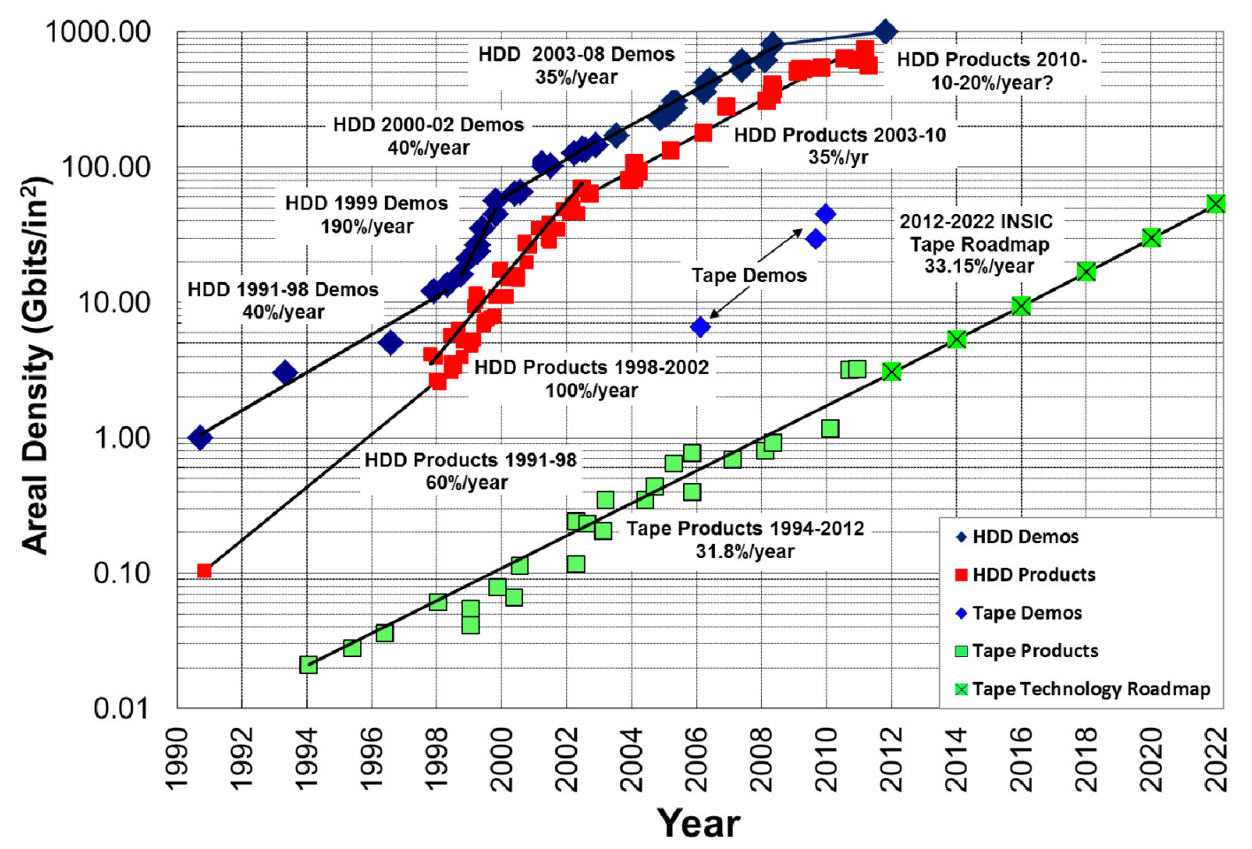
Aspects of LT DP
A common approach across the main HEP labs worldwide, including:
  Data (bit preservation) – state of the art at exascale (1PB-10PB-100PB-1EB etc);
  Software (and environment) – combination of validation + virtualisation;
  Documentation (I would say “knowledge”) – digital library technologies + regular testing as part of training and data re-use
LEP – and other Colliders worldwide – allow us to “see into the future” and compare different options for LTDP
Expectation for LEP is that data will be usable (and used) until ~2030 – 3 decades after end of data taking! (Copy on disk + 2 on tape @ CERN!)
Data will (should) be available much longer; “resurrection” of HEP data + software has been demonstrated but requires significant motivation + effort

Slide 13
Re-use ( = FUNDING)

Slide 14
Volume: 100PB + ~50PB/year
(+500PB/year from 2025)

Slide 15
Use Cases – “all HEP”
Bit preservation – basically OK (at CERN) but not a formal policy
  Data taken by the experiments should be preserved
Preserve data, software, and know-how in the collaborations
  Foundation for long-term DP strategy
  Analysis reproducibility: Data preservation alongside software evolution
Share data and associated software with (larger) scientific community
  Additional requirements:
  Storage, distributed computing
  Accessibility issues, intellectual property
  Formalising and simplifying data format and analysis procedure
  Documentation
Open access to reduced data set to general public
  Education and outreach
  Continuous effort to provide meaningful examples and demonstrations
Strategy and scope in approved policy documents for all (LHC+LEP) collaborations
  http://opendata.cern.ch/collection/data-policies
  LEP (and other?) access policies exist (L3?) – need to be uploaded & given DOI

Slide 16
CAP Use Cases (I) (=know-how?)
The person having done (part of) an analysis is leaving the collaboration and has to hand over the know-how to other collaboration members.
A newcomer would like join a group working on some physics subject
In a large collaboration, it may occur that two (groups of) people work independently on the same subject
There is a conflict between results of two collaborations on the same subject

Slide 17
CAP Use Cases (II)
A previous analysis has to be repeated
Data from several experiments, on the same physics subject, have to be statistically combined
A working group or management member within a collaboration wishes to know who else has worked on a particular dataset, software piece or MC
Presentation or publication is submitted for internal/collaboration review and approval: lack of comprehensive metadata
Preparing for Open Data Sharing

Slide 18
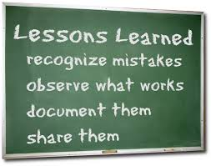
lessons

Slide 19
There are enormous benefits in working with other projects and disciplines: IMHO we have saved years (=money) AND we can also help others (if they want)
Having a Business Case and Cost Model is essential;
It is never too early to consider data preservation: early planning is likely to result in cost savings that may be significant. Furthermore, resources (and budget) beyond the data-taking lifetime of the projects should be foreseen from the beginning;
Caveat emptor: there are disruptive changes ahead. How does one prepare for these, particularly when a project is no longer in the active phase? (Don’t get hooked on any particular technical solution – it will change!)

Slide 20
There are enormous benefits in working with other projects and disciplines: IMHO we have saved years (=money) AND we can also help others (if they want)
Having a Business Case and Cost Model is essential;
It is never too early to consider data preservation: early planning is likely to result in cost savings that may be significant. Furthermore, resources (and budget) beyond the data-taking lifetime of the projects should be foreseen from the beginning;
Caveat emptor: there are disruptive changes ahead. How does one prepare for these, particularly when a project is no longer in the active phase? (Don’t get hooked on any particular technical solution – it will change!)
0. You can justify it; afford it
= do it!

Slide 21
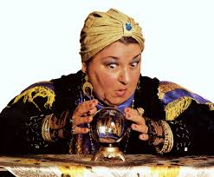
outlook

Slide 23
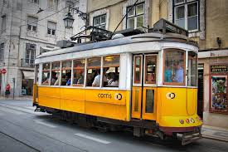
See DPHEP Workshop in Lisbon for more details, including:
  Original DPHEP Blueprint (2012)
  New status report (2015)
  And key work items for 2016 and beyond
https://indico.cern.ch/event/444264/

Slide 24

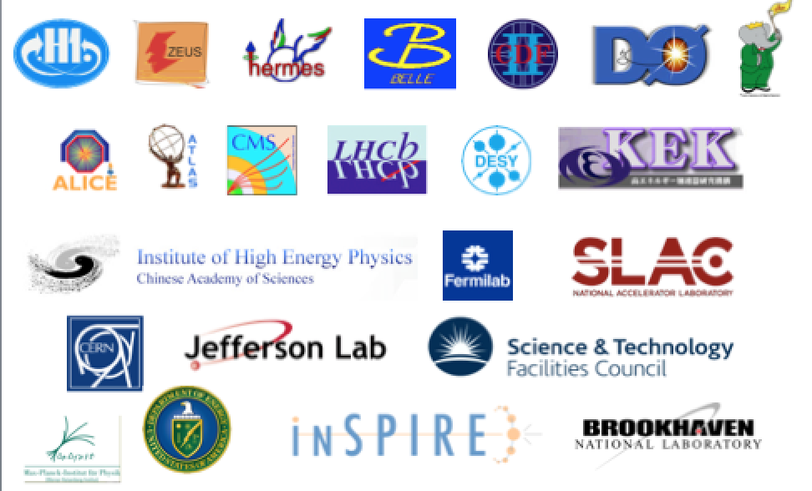
Data Preservation in High Energy Physics
The road to DPHEP
http://dphep.org

