Slide 1

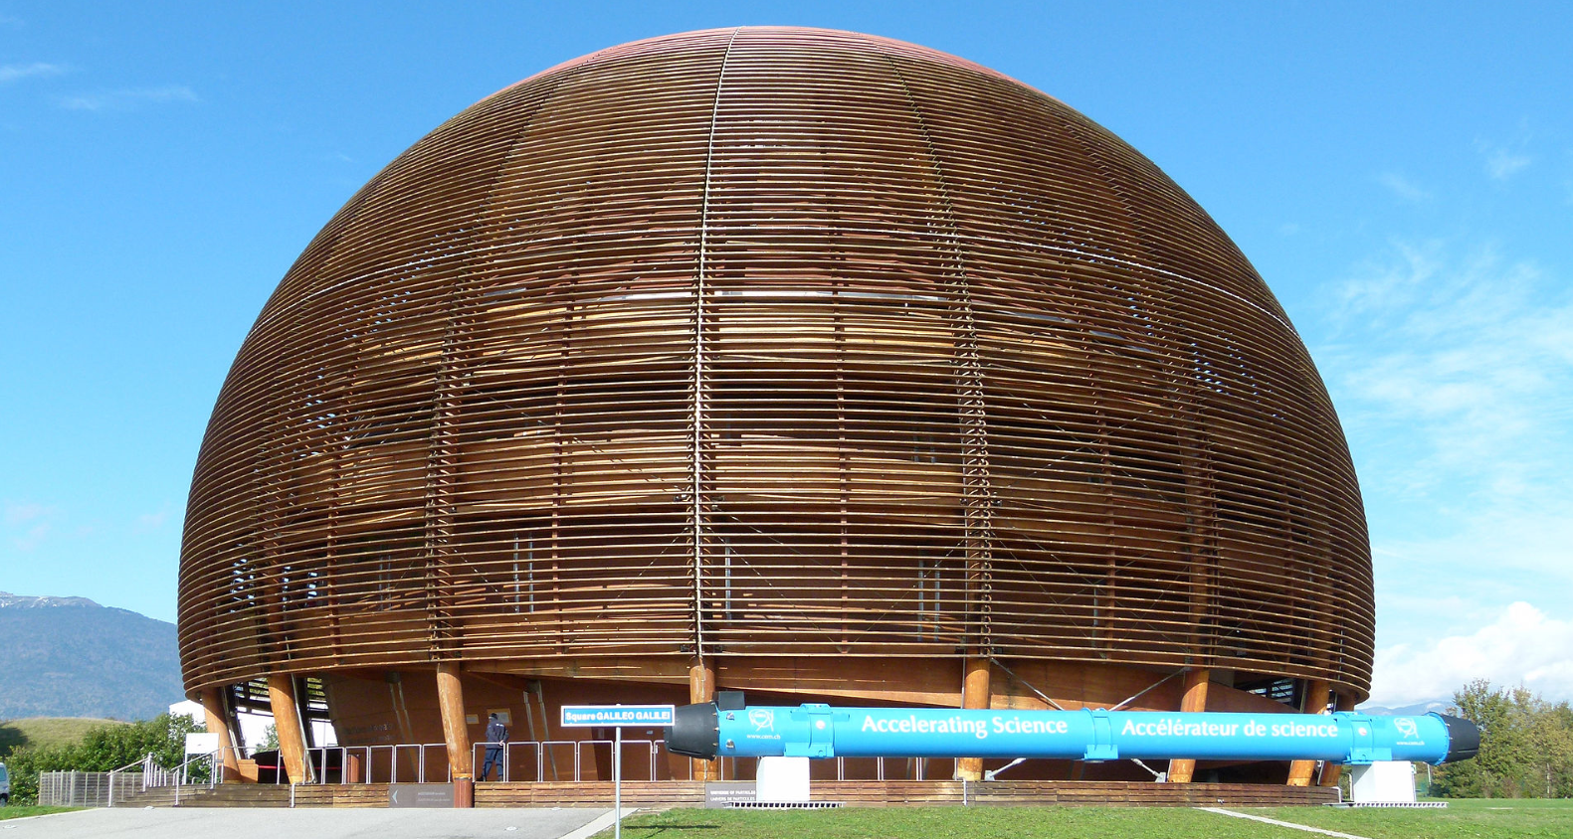


GN3plus : International Users Advisory Committee
Geneva Meeting
Niels Hersoug; General Manager GEANT Ltd; Project Manager GÉANT
December 2013
December 2014

Slide 2
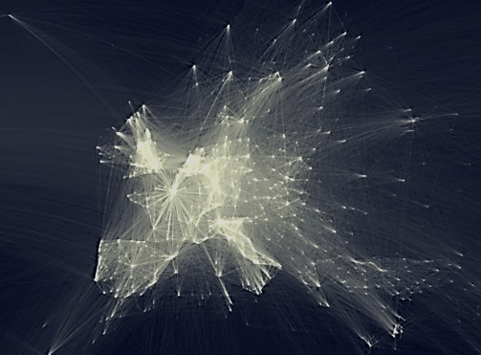
The Backdrop
Map of scientific collaboration between researchers by Olivier H. Beauchesne

Slide 3
Agenda
The merger of DANTE and TERENA
Future of IUAC
The Framwework Partnership Agreement with EC
The process towards a GÉANT Strategy
The influence from the IUAC
Map of scientific collaboration between researchers by Olivier H. Beauchesne
DANTE TERENA
Future of IUAC
FPA with EC
Strategy Process
IUAC influence on Strategy

Slide 4
Agenda
The merger of DANTE and TERENA
Future of IUAC
The Framwework Partnership Agreement with EC
The process towards a GÉANT Strategy
The influence from the IUAC
Map of scientific collaboration between researchers by Olivier H. Beauchesne
DANTE TERENA
Future of IUAC
FPA with EC
Strategy Process
IUAC influence on Strategy

Slide 5

TERENA and DANTE have joined forces!
The leading collaboration on network and related infrastructure and services for the benefit of research and education, contributing to Europe’s economic growth and competitiveness
A first website with basic information is at www.geant.org
¤
DANTE TERENA
Future of IUAC
FPA with EC
Strategy Process
IUAC influence on Strategy

Slide 6

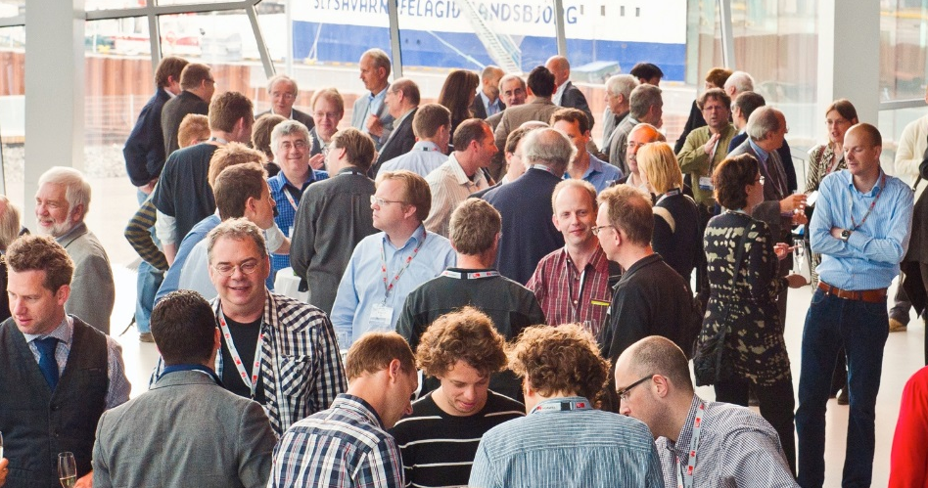
TERENA and DANTE have joined forces
On 7 October 2014, the GÉANT Association was formed, in response to the wishes of the community
The result is a single, more inclusive organisation that will strengthen the European research and education networking community as a whole
Support combined strategy to achieve the Horizon 2020 vision
¤
DANTE TERENA
Future of IUAC
FPA with EC
Strategy Process
IUAC influence on Strategy

Slide 7

What is the GÉANT Association?
One organisation comprising TERENA and DANTE staff, activities and ethos:
Networking. Services. People.
We are owned by our core
membership of:
  36 National Members (European NRENs)
  1 Representative Member (NORDUnet
  - on behalf of 5 Nordic NRENs)
Associates also welcome:
  including commercial organisations
  and multi-national research infrastructures
  and projects
¤
DANTE TERENA
Future of IUAC
FPA with EC
Strategy Process
IUAC influence on Strategy

Slide 8
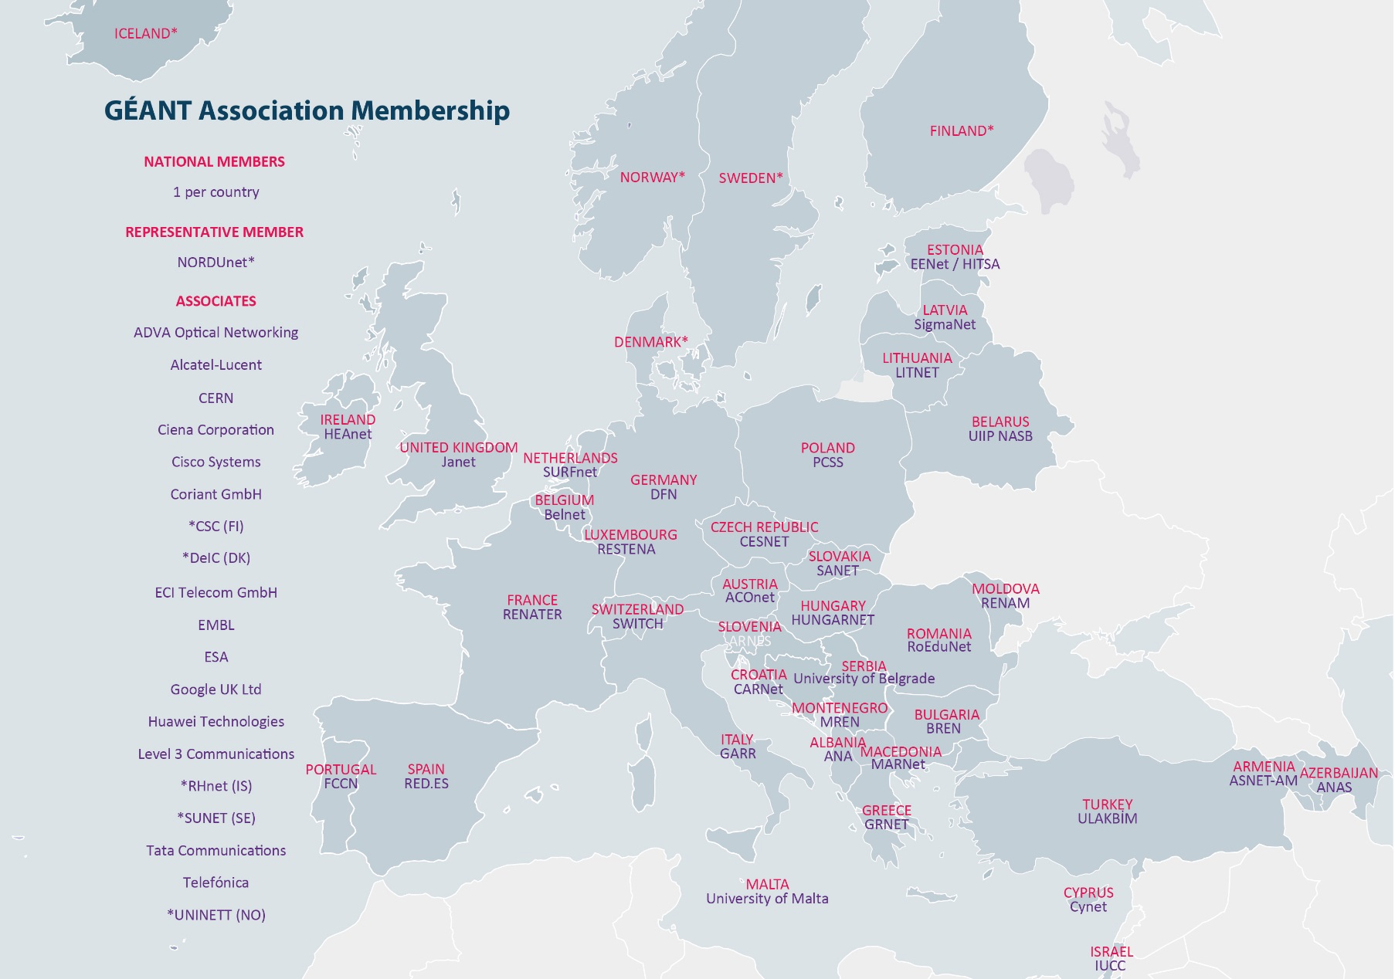
Current members
DANTE TERENA
Future of IUAC
FPA with EC
Strategy Process
IUAC influence on Strategy

Slide 9
Structure and benefits
GENERAL ASSEMBLY
National
Members
Representative
Members
Associate
Members
GA Committees
Board of Directors
CEO & Management
Staff
Simplified governance
& more efficient
management
Combined
expertise for more
flexible use
of resources
Enhanced
innovation, service
delivery and
knowledge-sharing
Strengthened
relationship with members and community
DANTE TERENA
Future of IUAC
FPA with EC
Strategy Process
IUAC influence on Strategy

Slide 10
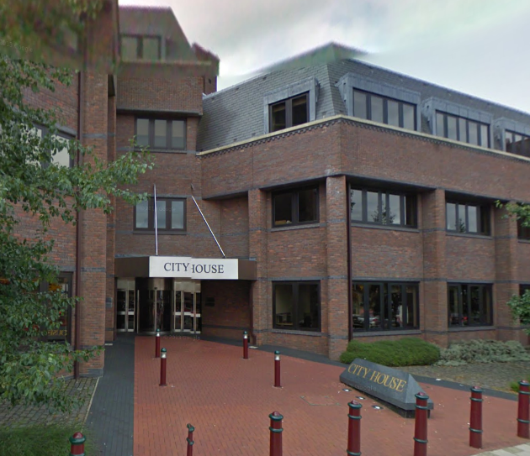
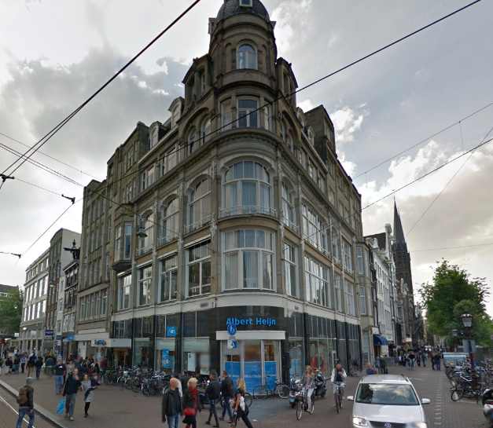
Locations
Cambridge office – 80 people
Information currently on www.dante.net
Legally established in the UK
Amsterdam office – 20 people
Information currently on www.terena.org
Legally established in the Netherlands
DANTE TERENA
Future of IUAC
FPA with EC
Strategy Process
IUAC influence on Strategy

Slide 11

What does the GÉANT Association do?
Physical networks
Manage research & education networking projects
Procure, build and operate large-scale, advanced international high-speed networks
  GÉANT (Europe)
  EUMEDCONNECT (Mediterranean)
  AfricaConnect (Sub-Saharan Africa)
  CAREN (Central Asia)
Support and assist other regional projects
  ORIENTplus (Europe-China collaboration)
  RedCLARA (Latin America)
  CKLN (Caribbean)
  TEIN*CC (Asia-Pacific)
DANTE TERENA
Future of IUAC
FPA with EC
Strategy Process
IUAC influence on Strategy

Slide 12
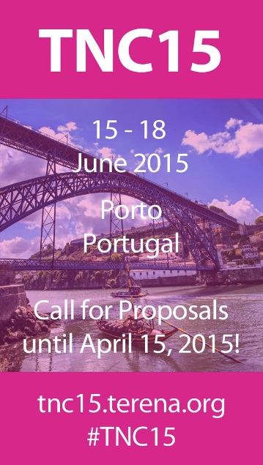


What does the GÉANT Association do?
Human networking
Organise workshops, meetings and conferences, including TNC – Europe’s largest networking conference for research
and education
Liaise with other e-infrastructure organisations, user communities,
industry and the European Commission
!
DANTE TERENA
Future of IUAC
FPA with EC
Strategy Process
IUAC influence on Strategy

Slide 13

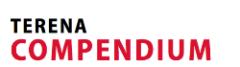

What does the GÉANT Association do?
Services
Develop, operate and support innovative services relating to such areas as
  Trust and identity,
  Security and certification,
  Mobility and access,
  Flexible connectivity options and test bed facilities
  Cloud Services and media and real-time communications
Provide practical support for members, educators, researchers and other partners to collaborate, innovate, share knowledge and agree on policies and strategies
DANTE TERENA
Future of IUAC
FPA with EC
Strategy Process
IUAC influence on Strategy

Slide 14
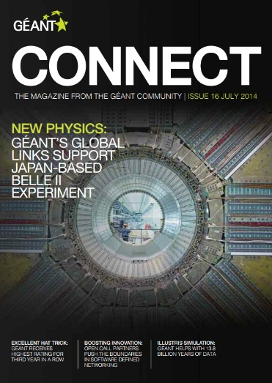




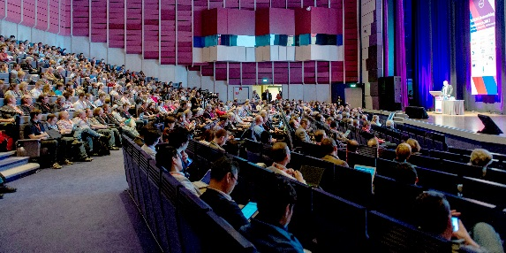
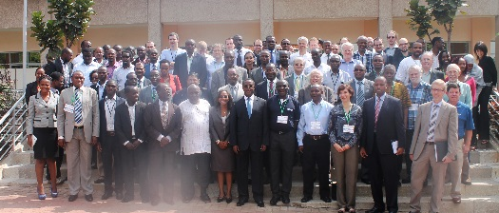
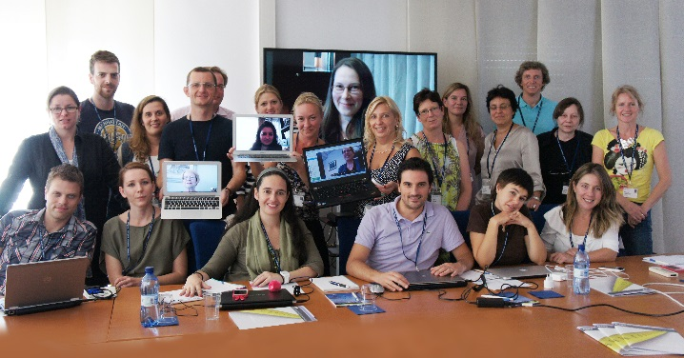
What does GÉANT Association do?
People
Provide expertise in procurement, project management, community engagement, network operations, and outreach including dissemination and training
Mobilise and coordinate community expertise to achieve collaborative innovation and knowledge sharing
DANTE TERENA
Future of IUAC
FPA with EC
Strategy Process
IUAC influence on Strategy

Slide 15
Evolving the Brand
GÉANT LOGOS
Identifiers added: ‘Association’ and ‘Project’
Stars retained on the
project logo, removed on the association logo
Each logo uses the main GÉANT colour plus one from its own palette.
This restructuring marks a new phase in almost thirty years of collaborative research and education networking in Europe.
The GÉANT Project is a major area of the Association’s work and we are proud to have adopted the GÉANT name.
DANTE TERENA
Future of IUAC
FPA with EC
Strategy Process
IUAC influence on Strategy

Slide 16
Agenda
The merger of DANTE and TERENA
Future of IUAC
The Framwework Partnership Agreement with EC
The process towards a GÉANT Strategy
The influence from the IUAC
Map of scientific collaboration between researchers by Olivier H. Beauchesne
DANTE TERENA
Future of IUAC
FPA with EC
Strategy Process
IUAC influence on Strategy

Slide 17
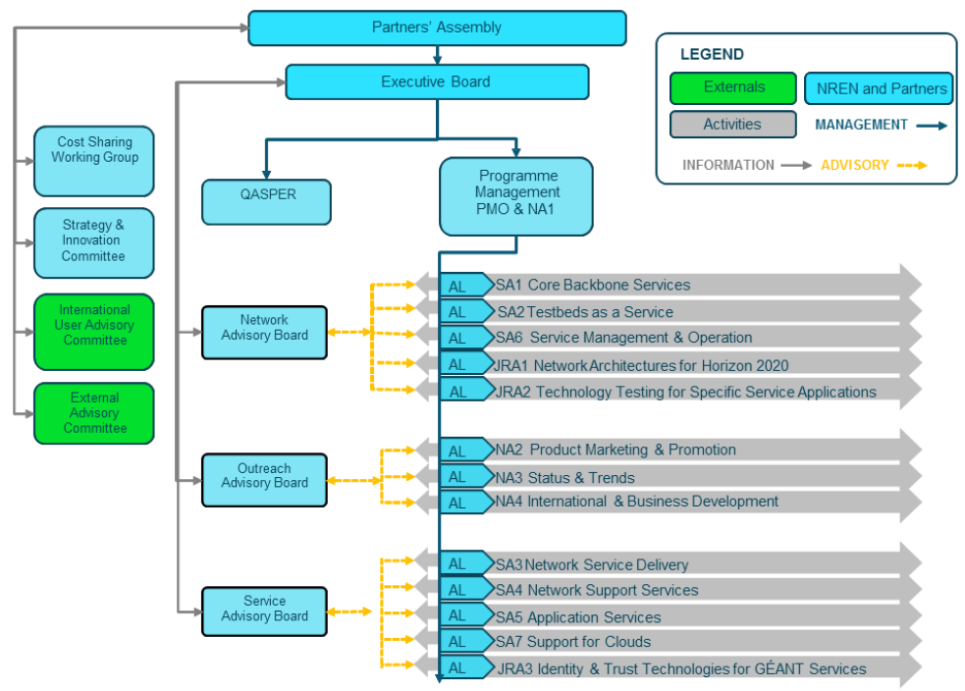
GN3plus governance
DANTE TERENA
Future of IUAC
FPA with EC
Strategy Process
IUAC influence on Strategy

Slide 18
GÉANT Association Governance Structure
….as defined by the Statutes
GÉANT Association Members
Representative Members
NREN groups; voting
National Members
NRENs; voting
Associates
Non voting
1 Chair
General Assembly
1 Chair
Committee
Assoc. Board
Min 6 NM/RM;
Max 2 non-NREN
Ldt. Board
Min 6 NM/RM;
Max 2 non-NREN
Advisory Council
Committee
Committee
Cost Sharing Committee
CEO
GÉANT / NL
GEANT / UK
Staff
NREN
Management
Externals
DANTE TERENA
Future of IUAC
FPA with EC
Strategy Process
IUAC influence on Strategy

Slide 19

GÉANT Association Governance Structure
......where does IUAC fit in ?
GÉANT Association Members
Representative Members
NREN groups; voting
National Members
NRENs; voting
Associates
Non voting
1 Chair
General Assembly
1 Chair
Committee
Assoc. Board
Min 6 NM/RM;
Max 2 non-NREN
Ldt. Board
Min 6 NM/RM;
Max 2 non-NREN
Advisory Council
Committee
Committee
Cost Sharing Committee
How is the user influence fitting into the governance?
CEO
GÉANT / NL
GÉANT / UK
Staff
NREN
Management
Externals
DANTE TERENA
Future of IUAC
FPA with EC
Strategy Process
IUAC influence on Strategy

Slide 20
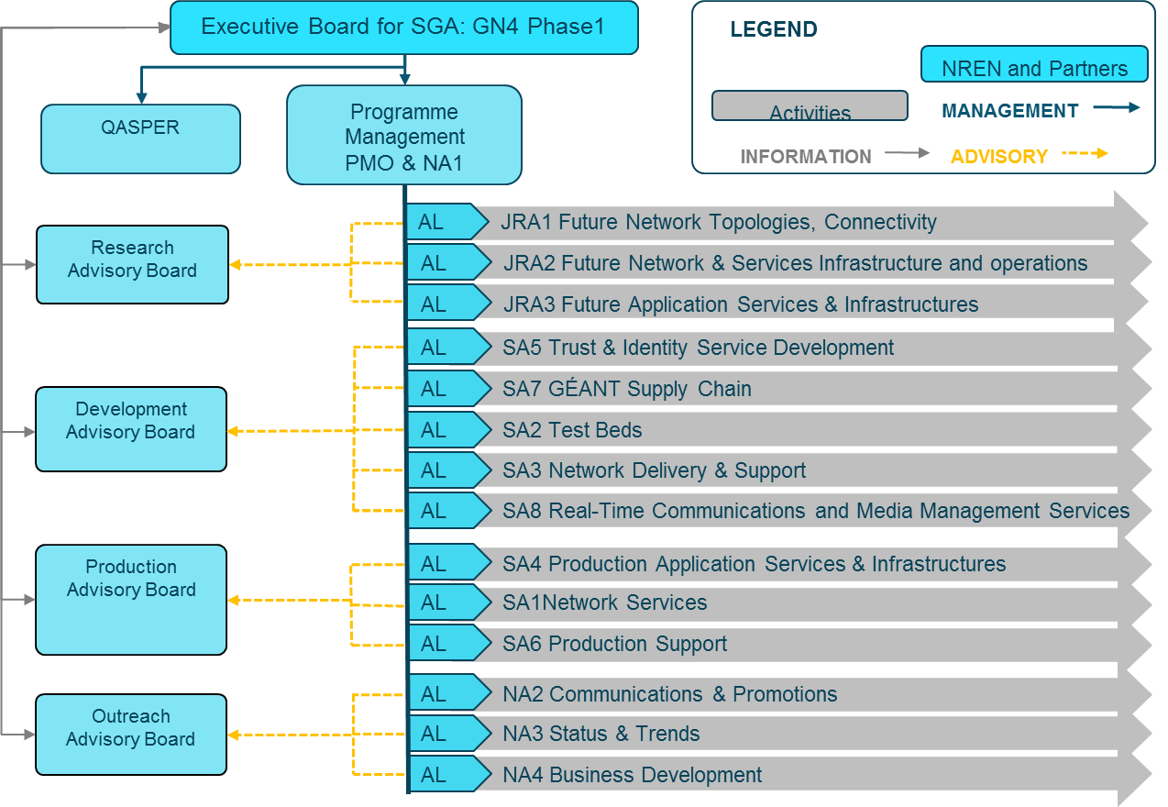
Possible GN4, SGA1 governance
DANTE TERENA
Future of IUAC
FPA with EC
Strategy Process
IUAC influence on Strategy

Slide 21
Agenda
The merger of DANTE and TERENA
Future of IUAC
The Framwework Partnership Agreement with EC
The process towards a GÉANT Strategy
The influence from the IUAC
Map of scientific collaboration between researchers by Olivier H. Beauchesne
DANTE TERENA
Future of IUAC
FPA with EC
Strategy Process
IUAC influence on Strategy

Slide 22
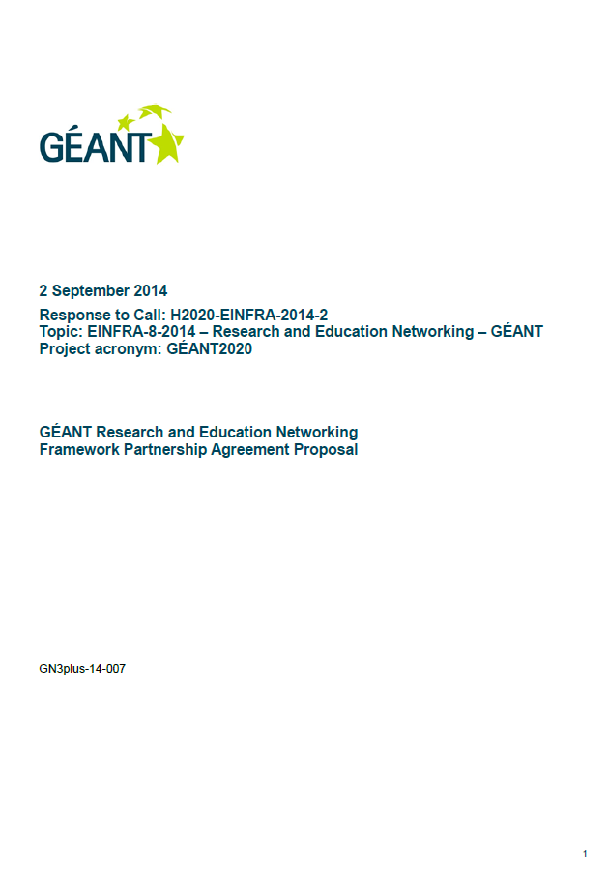
The Framework partnership Programme
Framework Partnership programme; FPA
  7 year partnership programme between The European Commission and GÉANT
  Consists of 3 x Special Grant Agreements (SGA)
    Duration 1+3+3 years
  EC Budget EUR 175mill; Total budget up to EUR 350 mill
  Start April 2015
FPA Actions
  A: Drive the Evolution of the Network
  B: Support the Knowledge Community
  C: Provide Security, Trust and Identity
  D: Deliver GÉANT’s Collaborative Ecosystem
  E: Develop the Human Capital of the GÉANT Partnership
  F: Ensuring the Long-Term Future of the GÉANT Infrastructure
¤
DANTE TERENA
Future of IUAC
FPA with EC
Strategy Process
IUAC influence on Strategy

Slide 23
Agenda
The merger of DANTE and TERENA
Future of IUAC
The Framwework Partnership Agreement with EC
The process towards a GÉANT Strategy
The influence from the IUAC
Map of scientific collaboration between researchers by Olivier H. Beauchesne
DANTE TERENA
Future of IUAC
FPA with EC
Strategy Process
IUAC influence on Strategy

Slide 24
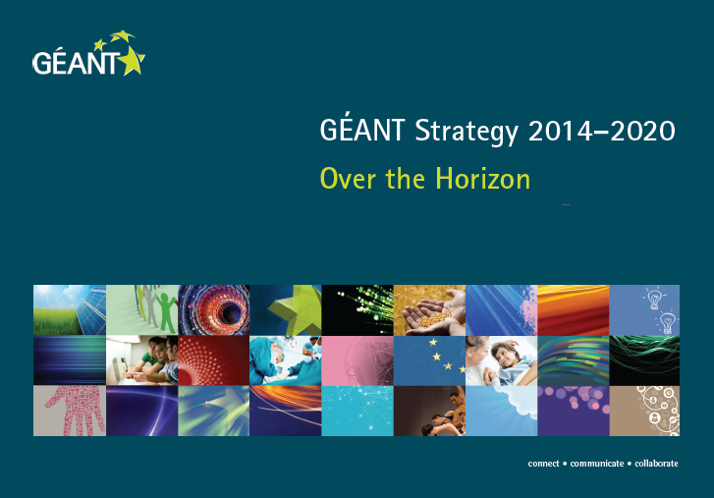
DANTE TERENA
Future of IUAC
FPA with EC
Strategy Process
IUAC influence on Strategy

Slide 25
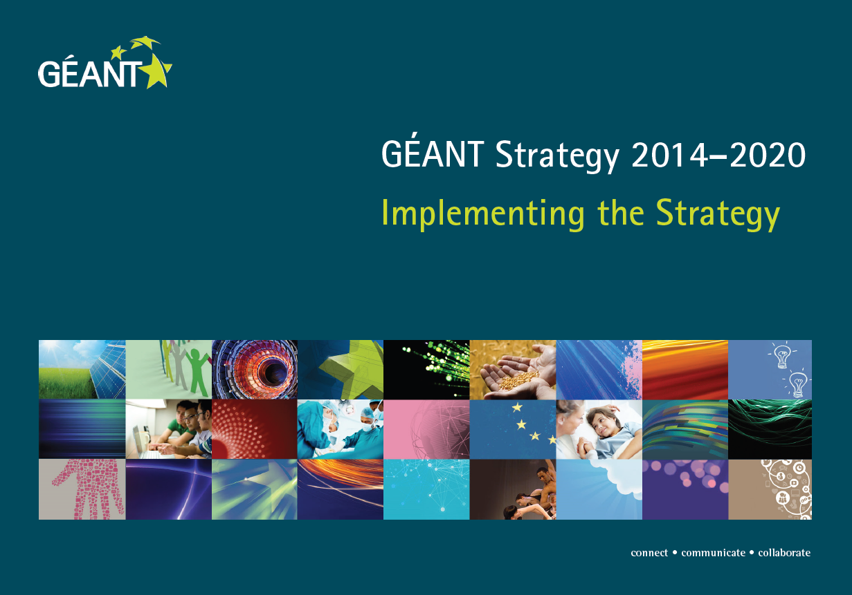
DANTE TERENA
Future of IUAC
FPA with EC
Strategy Process
IUAC influence on Strategy

Slide 26
Agenda
The merger of DANTE and TERENA
Future of IUAC
The Framwework Partnership Agreement with EC
The process towards a GÉANT Strategy
The influence from the IUAC
Map of scientific collaboration between researchers by Olivier H. Beauchesne
DANTE TERENA
Future of IUAC
FPA with EC
Strategy Process
IUAC influence on Strategy

Slide 27
Background
The IUAC were asked to review the GEANT strategy:
  November 2013:
    Questionnaire from GN 3plus Strategy and Innovation Committee (SIC)
  April 2014:
    Asked to comment on Draft version of “Over the Horizon” Strategy
This review is much appreciated and has been taken into account.
IUAC findings:
  Key recommendations from SIC questionnaire (December 2013)
  Recommendations on Strategy Draft (Version April 2014)
    Mission
    Sustainability
    Clouds
    Positioning towards commercials
¤
DANTE TERENA
Future of IUAC
FPA with EC
Strategy Process
IUAC influence on Strategy

Slide 28
1. Key IUAC recommendations on GEANT strategy (from SIC questionnaire)
Key decision factors which influence the choice of the network and service providers are:
  cost; service availability; sustainability of services and value for money.
Learn from other research networks like ESNet and Internet2 or area-specific governmental or international organisations.
Stronger user orientation, e.g. regarding end-user requirements to ensure innovation and sustainability.
Expansion of the European infrastructure and further development of connection to researchers outside of Europe.
Innovation should focus on research and new services (non-standard, higher-level and/ or procurement services)
¤
DANTE TERENA
Future of IUAC
FPA with EC
Strategy Process
IUAC influence on Strategy
Notes:
All these points are considered in the strategy

Slide 29
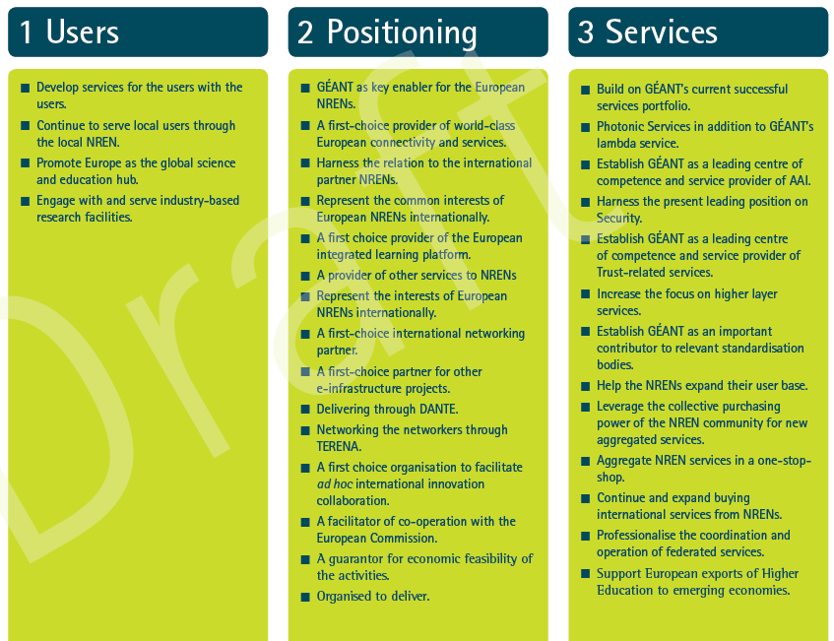

2.1. Mission
Finding:
  The three pillars GEANT is supposed to be based on are unevenly balanced. The user pillar appears to be less defined and clear in its strategy.
Response
  Complete revision of the Strategy document. New structure focusing on core aspects of GEANT: Innovation, Collaboration, Users, Services, People
Finding
  The mission statement is seen as to generic and it should be reflected that GEANTs core is networking.
Response
  A generic mission statement has been removed, networking service positioning strengthened.
  “Today the most evident core business of GÉANT and the NRENs is the network.[…] GÉANT IP, GÉANT Plus and GÉANT Lambda services are the core services currently made available through the provision of the GÉANT Network.”
¤
DANTE TERENA
Future of IUAC
FPA with EC
Strategy Process
IUAC influence on Strategy
Notes:
[Provide unique market offerings including procurements, joint purchasing, collaboration with industry and SMEs on service offerings, monitoring of cost-efficiency, fair and transparent pricing policy, bridging digital divide, drive global collaborative serviced offerings, benchmarking, greening of services, continue to facilitate FI activities]

Slide 30

2.2. Sustainability
Finding
  Sustainability should be considered within the strategy, it is not specified in the 1st version of the document.
Response
  Ensuring the Long-Term Future of the GEANT Infrastructure : “The key GÉANT stakeholders want confidence in its long-term sustainability.”
  “GÉANT projects and environment must provide a compelling value proposition to its partners – and thence to their customers and constituencies – as a means of cost effectively addressing aggregated national communities’ European and Global requirements, both in terms of connectivity, services, innovation, and collaboration more generally.”
¤
DANTE TERENA
Future of IUAC
FPA with EC
Strategy Process
IUAC influence on Strategy

Slide 31

2.3. Clouds
Finding:
  The role of GEANT still needs to be defined. As several NRENs already provide cloud services. It was repeatedly suggested that GEANT could act as a service broker and provide connection to Cloud services.
Response
  GEANT positions itself as trustworthy service broker, developing a supply chain management between provider, NREN and their customers and users
  “This GÉANT supply chain must yield a market-place for services, offered by both NRENs and other providers, that enables users to choose services, through the GÉANT Application Store, easily in the knowledge that they will be cost efficient, trustworthy, and integrated with other GÉANT and NREN offerings […] to provide the best possible user experience.”
DANTE TERENA
Future of IUAC
FPA with EC
Strategy Process
IUAC influence on Strategy

Slide 32
2.3 Clouds (cont.)
Finding
  While developing a cloud strategy, different user requirements have to be taken into account: from the single researcher up to big science projects.
Response
  Further expansion of the One-stop shop
  Development for the users with the users
  “The continued close dialogue with the users and GÉANT is considered vital for the survival of GÉANT. GÉANT is not a catalogue supplier delivering standard commodities, but a partnership where the GÉANT offerings are developed in a close dialogue with those users.”
¤
DANTE TERENA
Future of IUAC
FPA with EC
Strategy Process
IUAC influence on Strategy

Slide 33
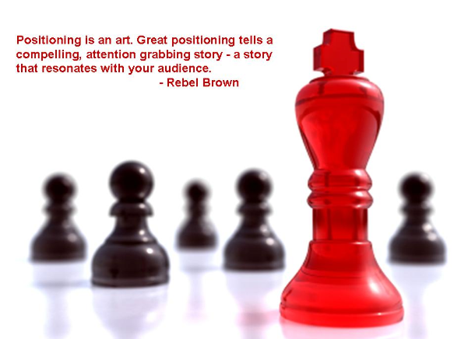
2.4. Positioning towards commercials
Finding
  The collaboration strategy with commercial providers should be defined more clearly, especially with regard to possible threats and opportunities […] GEANT should have a strategy that aims at a win-win relationship with the commercial sector.
Response
  Interaction, Partnership and Positioning towards Commercials play pivotal role in the Strategy
  Increased partnerships with commercials where appropriate,
  Increased partnerships with industry and SMEs especially with regard to Innovations (e.g. Open Calls)
Finding
  To be competitive with commercial providers different levels of reliability have to be provided.
Response
  → Not clearly addressed
¤
DANTE TERENA
Future of IUAC
FPA with EC
Strategy Process
IUAC influence on Strategy
Notes:
1.6 Develop partnerships with Industry and SMEs with the aim to transfer knowledge, develop human capital and identify opportunities for future service improvements, as well as increase cost effectiveness: Open Call projects, joint research/testing projects and privileged vendor relations (pre-release testing and pre-commercial procurement) […].
1.8 Future Internet (FI) will remain a very important research topic in Europe. The GÉANT Community, network services and Infrastructure, together with the NRENs, are well positioned to deliver in a range of areas related to this. GÉANT and the NRENs will facilitate the FI related activities providing adequate resources, testbeds and potential testing environments. Moreover members of the GÉANT Community may take part directly in these FI activities. GÉANT will also implement new solutions resulting from FI activities if they become feasible and useful for the community.
2. GÉANT [.] distinguishes itself from the market: by delivering high quality services targeted at the R&E community and by constantly innovating these services as required.
2.3 Guiding principle for innovation: The service/product is not available in the commercial market, at least not at the required conditions/level of trust.
2.4 The innovations done within the GÉANT community are done in an open and transparent way, involving commercial partners where appropriate. This assures that the knowledge build up within GÉANT is available to the commercial market in Europe to exploit.
5.2 with regard to Trust and Identity Services: Strategic alliances and partnerships with both commercial and non-commercial entities on initiatives that support the community’s needs.

Slide 34
2.4. Positioning towards commercials (cont.)
Finding:
  It is important to consider that GEANT is not just another ISP, and that both GEANT and the NRENs are moving up in the service chain.
Response:
  `It is therefore essential that we develop and maintain a portfolio of services that both meet our users’ requirements and that is unambiguously distinct from that of other providers.[…] GÉANT’s service portfolio will consist of the following key areas:
    Network services,
    Trust and Identity Services,
    Application services, specifically developed and tailored on users' needs relying on GEANT services.
¤
DANTE TERENA
Future of IUAC
FPA with EC
Strategy Process
IUAC influence on Strategy

Slide 35
Agenda
The merger of DANTE and TERENA
Future of IUAC
The process towards a GÉANT Strategy
The Framwework Partnership Agreement with EC
The influence from the IUAC
END
Map of scientific collaboration between researchers by Olivier H. Beauchesne
DANTE TERENA
Future of IUAC
FPA with EC
Strategy Process
IUAC influence on Strategy

Slide 36
Agenda: Extra material
The Framwework Partnership Agreement with EC
Map of scientific collaboration between researchers by Olivier H. Beauchesne

Slide 37
FPA SGA structure
Framework Partnership Agreement
  Partnership between EC and GÉANT
  7 years duration
  No money committed, but indications are same level as of now.
  High level strategic envelope of the work for the next 7 years
  Submitted September 2nd
Special Grant Agreements
  Agreements under the FPA
  Funds will be granted here
  Expected:
    SGA1 1 year Expected to start spring 2015
    SGA2 3 years
    SGA3 3 Years

Slide 38
The Framework partnership Programme
Framework Partnership programme; FPA
  7 year partnership programme between The European Commission and DANTE/TERENA (GÉANT Association)
  Consists of 3 x Special Grant Agreements (SGA)
    Duration 1+3+3 years
  EC Budget EUR 175mill; Total budget up to EUR 350 mill
  Start April 2015
FPA Actions
  A: Drive the Evolution of the Network
  B: Support the Knowledge Community
  C: Provide Security, Trust and Identity
  D: Deliver GÉANT’s Collaborative Ecosystem
  E: Develop the Human Capital of the GÉANT Partnership
  F: Ensuring the Long-Term Future of the GÉANT Infrastructure

Slide 39
Actions of the FPA
A:Drive the Evolution of the Network
FPA Action A :
  Continue to design, build and implement collaboratively-delivered, multi-domain services with appropriate Service Level Agreements (SLAs).
    These services comprise any user-accessible, network capability that directly or indirectly supports digital data transport between users of the GÉANT network services and international collaborators.
  Maintain its focus to develop and offer unique, very high-speed facilities in the network infrastructure to serve the intensive point-to-point data flows required by large international scientific endeavours.
  Represent the common interests of the collective European NRENs internationally as coordinator and facilitator of inter-continental connectivity and inter-continental collaborations.
  ¤

Slide 40
Actions of the FPA
B: Support the Knowledge Community
FPA Action B :
  The knowledge communities served by GÉANT are extremely diverse, including:
    Big Science projects that involve a large amount of data generation and widespread scientific collaborations to process the data,
  The long-term objective of the partnership is to offer all of these communities secure and trustworthy access from anywhere to the e-Infrastructure data sources and services relevant to their endeavours
    including: publications, raw data, remote control of instruments, computing resources and databases, videoconferencing, etc. This objective of a digital continuum will be pursued in cooperation with the other European e-Infrastructure providers.
    ¤

Slide 41
Actions of the FPA
C:Provide Security, Trust and Identity
FPA Action C
  Maintain and improve the world leading security position for GÉANT
  Cooperation with the worldwide community of Computer Emergency and Incident Response Teams.
  Operate pan-European Trust and Identity services to support secure, cross border access to services including network access (eduroam) and Single Sign-on (eduGAIN).
  ¤

Slide 42
Actions of the FPA
C:Provide Security, Trust and Identity
FPA Action C
  Authentication and Authorisation Infrastructure (AAI) services will be deployed to cope with the challenges of end-user mobility. These developments include:
    Global and cross-sector, inter-federated AAI service provision for the whole of the European R&E community and potentially, the rest of the world.
    Collaboration with research and learning institutions in Europe and worldwide, for access authorisation.
    ¤

Slide 43
Actions of the FPA
D: Deliver GÉANT’s Collaborative Ecosystem
FPA Action D
  Ongoing liaison with other e-Infrastructure suppliers for data repositories, computing services, important Research Infrastructure projects in Europe and beyond, in order to discuss and aim for:
    A safe environment in which users have a wide choice of services, independent of geographical location.
  Liaise and work with all relevant EC Directorates and large scientific projects using e-Infrastructures, in order to be aware of future requirements and adapt the development roadmap of the GÉANT infrastructure in good time.
. ¤

Slide 44
Actions of the FPA
E: Develop the Human Capital
FPA Action E
  The services offered by the GÉANT infrastructure are available to a huge and influential user community in Europe. The dissemination of advanced services such as eduroam, very high-speed networking, monitoring, AAI, security, etc. to inform and educate this influential user community of students, researchers and teachers/professors across all of Europe to the great benefit of the European ICT sector.
  ¤

Slide 45
Actions of the FPA
F: Ensuring the Long-Term Future
FPA Action F
  The unique and successful cost-sharing model in the GÉANT partnership will continue to be operated and refined, as required. The solidarity between the partners reflected in the cost-sharing model helps to mitigate many of the ongoing issues related to the Digital Divide.
  The cost effectiveness of the GÉANT infrastructure will be maintained as technology and requirements change. This will be realised in a number of ways, including:
    Continued capacity planning and sharing of relevant resources between the partners.
    Exploring the potential of new business models, including service provisioning through aggregation of demand and brokerage.
    Regular benchmarking against other advanced international Research and Education Networks.
    ¤

Slide 46
Agenda: Extra material
The Framwework Partnership Agreement with EC
END
Map of scientific collaboration between researchers by Olivier H. Beauchesne

