Slide 1
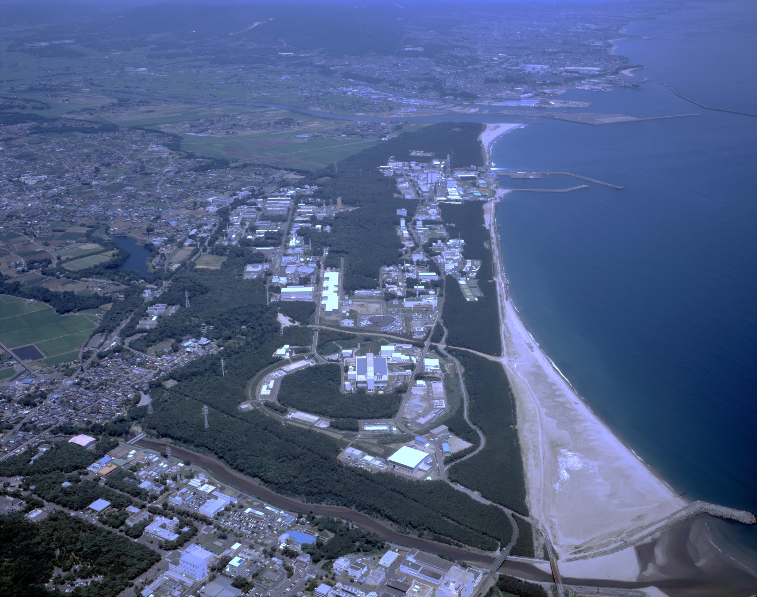
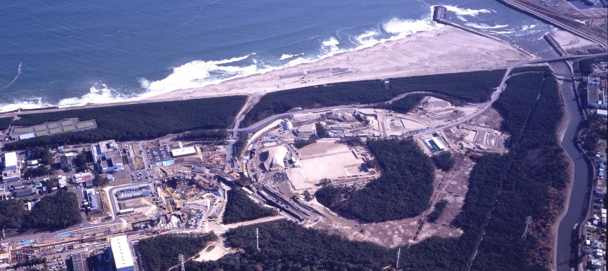
Studies of high density baryon matter with high intensity heavy-ion beams at J-PARC
H. Sako (JAEA) for J-PARC HI Collaboration
QM15 at Kobe, 2015/9/29
Outline
J-PARC Heavy-ion Program
Accelerator design
Spectrometer design
Dilepton simulation
Design of hypernuclear spectrometer
Summary
Notes:
It is my pleasure to show a future plan of J-PARC heavy-ion program in this QM conference at Kobe.
The out line of my talk is as follows.

Slide 2
J-PARC HI Collaboration
Nuclear Experimentalists and Accelerator Physicists
S. Nagamiya (JAEA/KEK/RIKEN)
H. Sako, K. Imai, K. Nishio, S. Sato, S. Hasegawa, K. Tanida, S. H. Hwang, H. Sugimura, Y. Ichikawa (ASRC/Japan Atomic Energy Agency)
H. Harada, P. K. Saha, M. Kinsho, J. Tamura (J-PARC/Japan Atomic Energy Agency)
K. Ozawa, K. Itakura, Y. Liu (J-PARC/KEK)
T. Sakaguchi, M. Okamura (Brookhaven National Lab.)
K. Shigaki (Hiroshima Univ.)
M. Kitazawa, A. Sakaguchi (Osaka Univ.)
T. Chujo, S. Esumi, B. C. Kim (Univ. of Tsukuba)
T. Gunji (CNS, Univ. of Tokyo)
H. Tamura, M. Kaneta (Tohoku Univ.)
K. Oyama (Nagasaki IAS)
H. Masui (Wuhan Univ.)
Y. Nara (Akita International Univ.) JAM model
T. R. Saito (Mainz Univ. and GSI) Hypernuclear spectrometer
Notes:
This is the collaborator list of this work.
It mainly consists of experimentalists working for RHIC, LHC and J-PARC, and accelerator physicists at J-PARC.
Especially in this work, Nara-san helped for JAM model and Saito-san helped for Hypernuclear design..

Slide 3
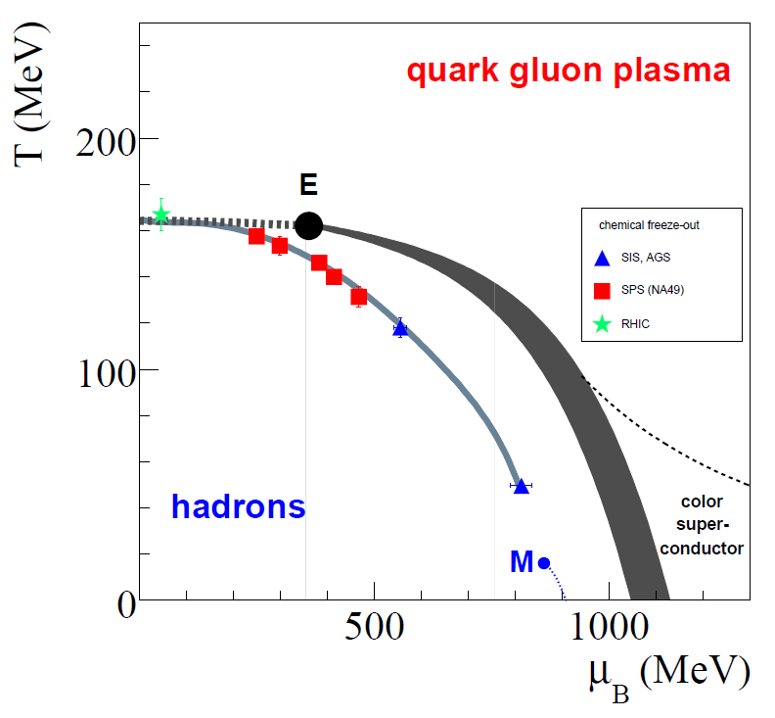
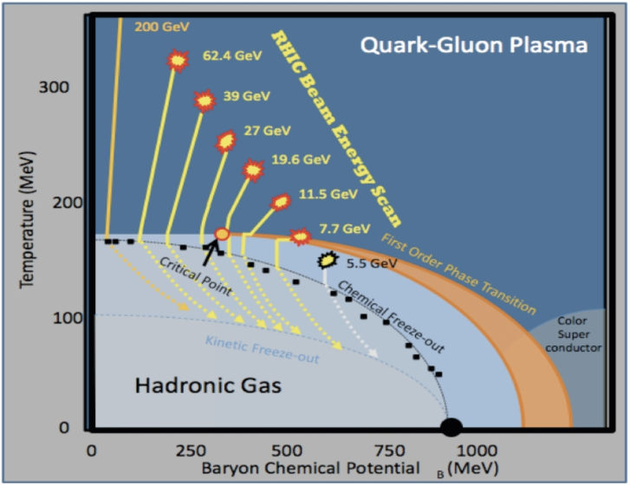
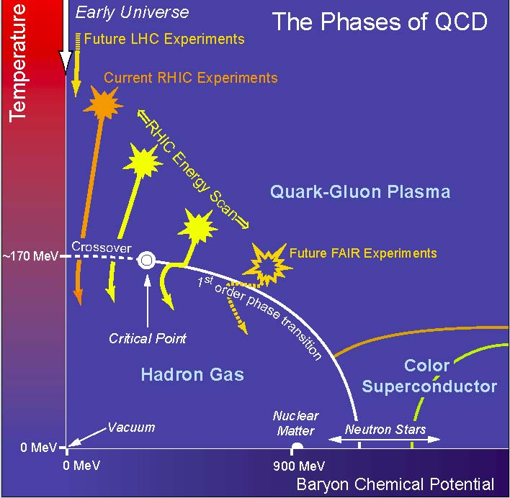
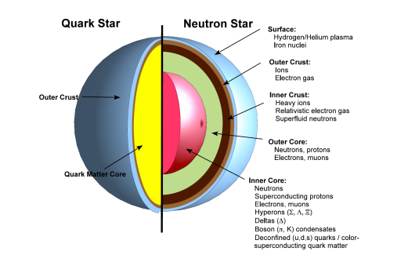
Introduction
At J-PARC, we aim at studies of dense matter in high baryon density regime with world’s highest intensity HI beams
Search for critical point and phase boundary
Onset of QGP
Properties of dense matter (~neutron stars)
LHC
RHIC
J-PARC
GSI-SIS
μ_{B}
Notes:
As you all know, at RHIC and LHC, QGP has been discovered at high temperature and low density.

Slide 4
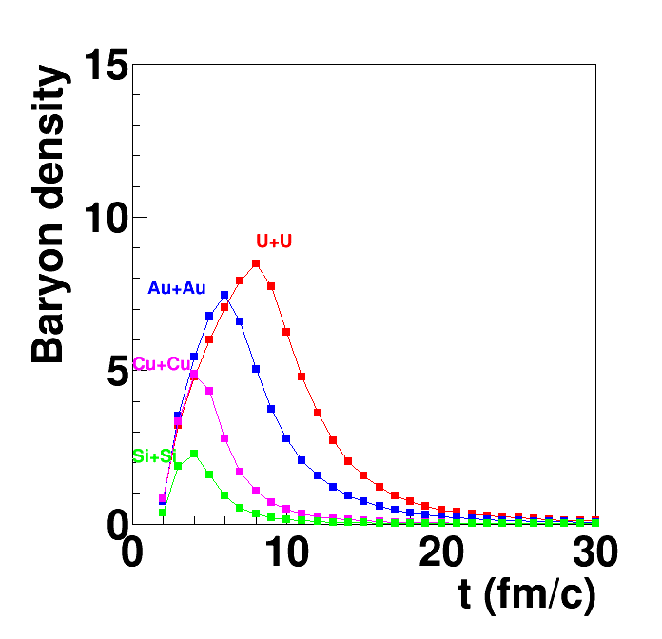
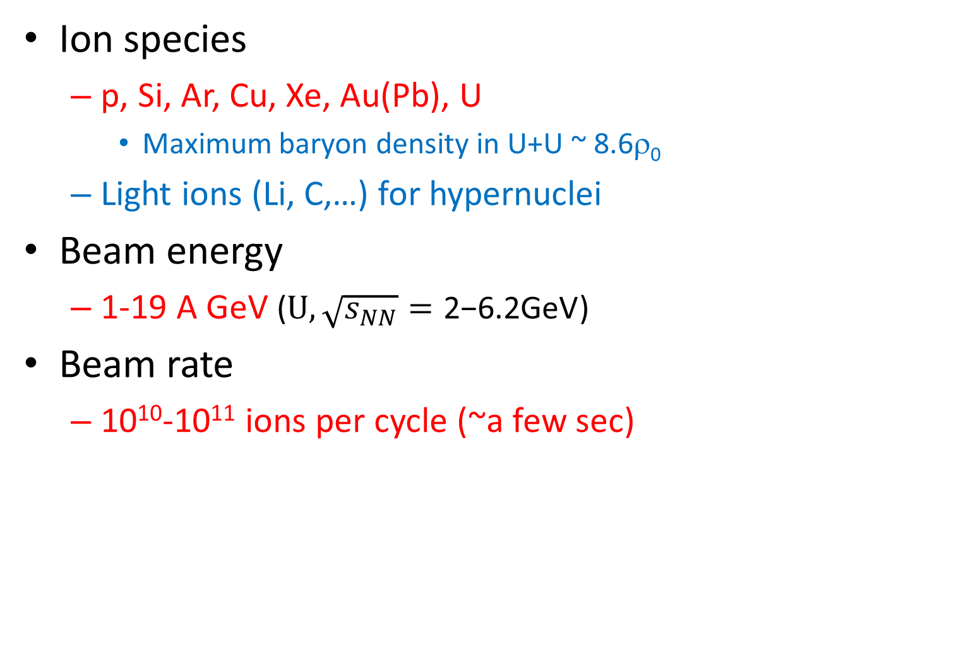
Future J-PARC Heavy-Ion Program
ρ/ρ₀
Ion species
  p, Si, Ar, Cu, Xe, Au(Pb), U
    Maximum baryon density in U+U ~ 8.6ρ₀
  Light ions (Li, C,…) for hypernuclei
Beam energy
  1-19 A GeV ($U, \sqrt{s_{NN}}=\text{2−}\text{6.2}\text{GeV}$)
Beam rate
  10¹⁰-10¹¹ ions per cycle (~a few sec)
Au+Au
U+U
    JAM model
    Y. Nara, PRC61 024901(1999)
Acceleration at J-PARC
Existing 3 GeV Rapid-Cycling Synchrotron (RCS) and 50 GeV Main Ring synchrotron (MR)
  Only HI injector should be added
Proven high proton beam rate
  1.3x10¹⁴ /cycle (2017)
Parallel RCS operations
  p beams : for Material and Life sciences Facility (MLF)
  HI beams : for MR
Limited freedom in RCS for operation parameters
→ The injector is designed to fit to RCS

Slide 5
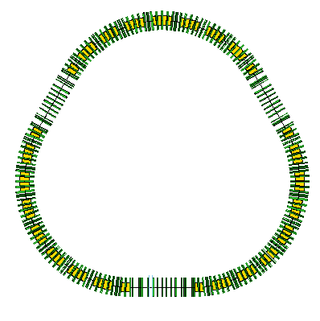
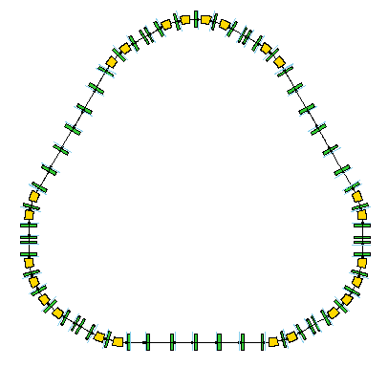

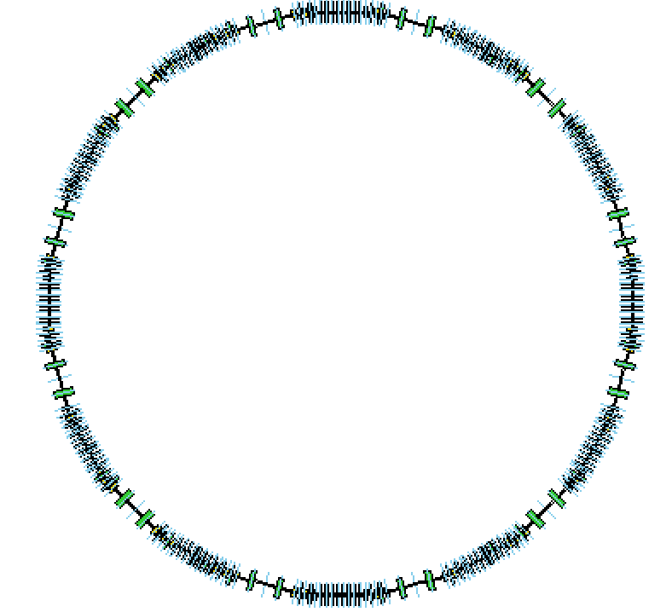
J-PARC HI accelerator scheme (preliminary)
Utilize existing 3-GeV RCS (Rapid-Cycling Synchrotron)
and 50-GeV MR (Main Ring synchrotron)
Proton beam rate ~ 1.3x10¹⁴ /cycle (2017)
  Parallel RCS operations : HI beams : for MR
  p beams : for Material and Life sciences Facility (MLF)
Simulation in RCS : >99.97% of beam can be accelerated without loss at 4×10¹¹/cycle
Existing proton accelerators
New HI injector
stripping
MR
HI LINAC
HI booster
RCS
MLF
Simulation result:
less than 0.03% beam loss at 1×10¹¹/bunch
H. Harada
P. K. Saha
H⁻ Linac: 0.4 GeV
U³⁵⁺
20.0 AMeV
U⁵⁵⁺→U⁶⁶⁺
67.0 AMeV
U⁸⁶⁺
735 AMeV
U⁹²⁺
11.2 AGeV
Notes:
We have already RCS and MR with extremely high proton rates

Slide 6
Physics goals
Dileptons (dielectron and dimuon)
Hadron measurements in high statistics
  Strange meson and baryons
  Event-by-event fluctuations
  Two particle correlations
    (YN, YY correlations in high baryon density)
  Flow (related to EOS?)
Rare probes
  Hypernuclei
  Exotic hadrons
    Λ(1405), pentaquarks
    Dibaryon (H-dibaryon, ΩN, ΔΔ,…)
    Kaonic nucleus (K⁻pp,…)
  Charm
    J/ψ, D, charmed baryons
Photons
  Thermal radiations from QGP
J-PARC E16 p+A
J-PARC π/K/p beams

Slide 7
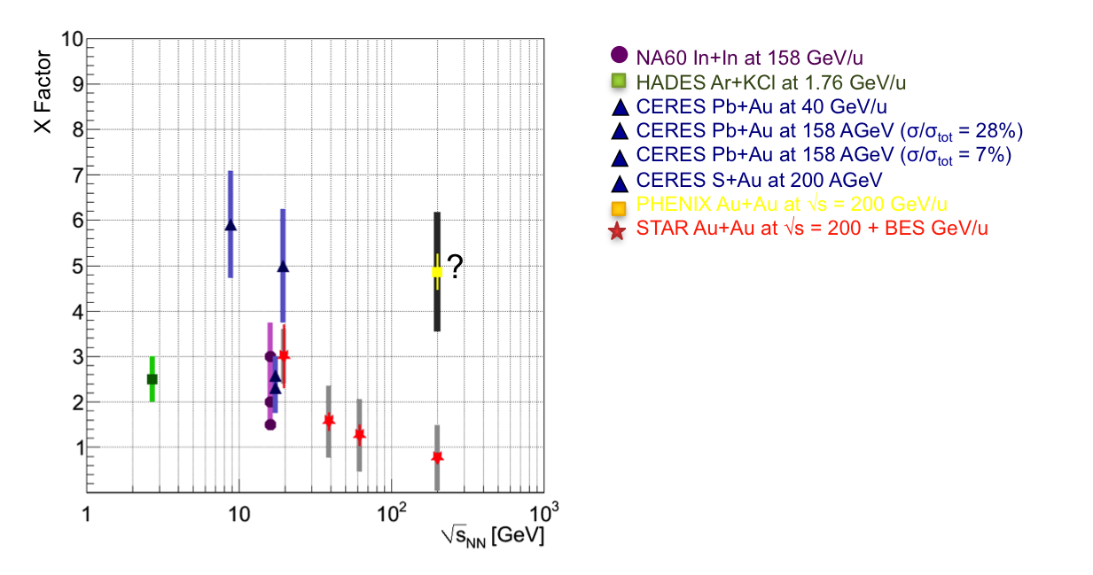
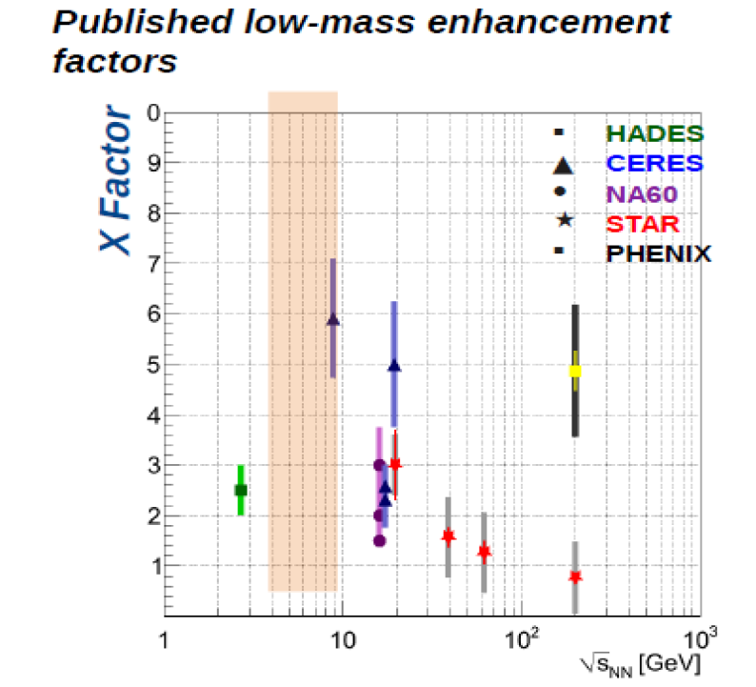

Low-mass dileptons
Low-mass dilepton enhancement factor
Measured / cocktail in m=0.2-0.8 GeV/c²
J-PARC
Maximum low mass enhancement around
J-PARC energies?
Dielectron
  γ conversion at low mass
Dimuon
  π,K → μ decay background
  Higher rate beam can be used?
High statistics at J-PARC
  Moment analysis
  →direct comparison to spectrum functions
  Hatsuda, Hayano, RMP82, 2949
Highest baryon density ~ 8GeV
(Randrup, PRC74(2006)047901)
NA60 In+In, 158AGeV/c
HADES Ar+KCl 1.76AGeV/c
CERES Pb+Au 40AGeV/c
CERES Pb+Au 158AGeV/c
CERES S+Au 200 AGeV
PHENIX Au+Au 200 AGeV
(PRC81,034911(2010))
STAR Au+Au
T. Galatyuk, EM probes
of Strongly Interacting Matter
ECT*, Trento 2007
$$\int{dm_{ee}N\left(m_{ee}\right){m_{ee}}^{n}}$$
●NA60 In+In, 158AGeV/c
HADES Ar+KCl 1.76AGeV/c
CERES Pb+Au 40AGeV/c
CERES Pb+Au 158AGeV/c
CERES S+Au 200 AGeV
PHENIX Au+Au 200 AGeV (PRC81,034911(2010))
STAR Au+Au

Slide 8
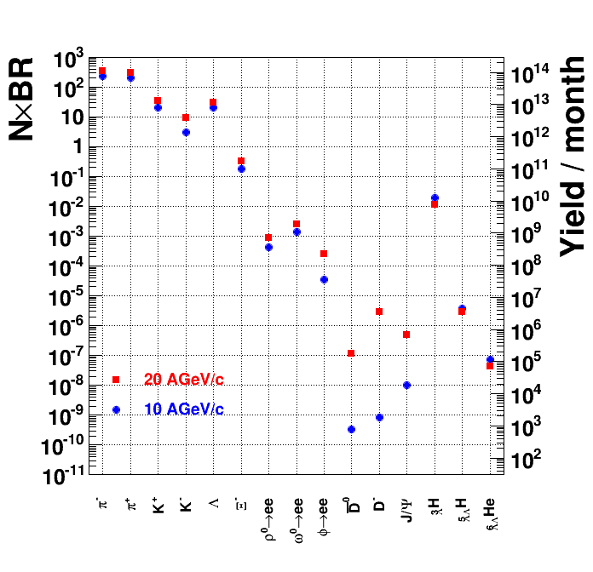
Particle production rates
Beam : 10¹⁰ Hz
0.1 % target
→ Min-bias event rate 10MHz
1% event selection (e.g. centrality)
→ DAQ rate = 100 kHz
In 1 month experiment:
ρ,ω,φ→ee 10⁷-10⁹
Hypernuclei 10⁵ -10¹⁰
AGS
Hypernuclei
Dilepton
HSD calculations in FAIR Baseline Technical Report (Mar 2006)
A. Andronic, PLB697 (2011) 203

Slide 9
Experimental challenges
High rate capability
  Fast detectors
    Silicon trackers, GEM trackers, …
  Extremely fast DAQ
    Min-bias event rate = 10MHz
    → Do we need triggerless DAQ?
High granularity
  Pixel size < 3x3mm²
  (at 1m from the target, θ<2deg, 10% occupancy)
Large acceptance (~4π)
  Coverage for low beam energies
  Maximum multiplicity for e-b-e fluctuations
Electron measurement
  Field free region for RICH close to the target
Toroidal magnet setup
  (CBM<30º, beam energy>=8AGeV/c)

Slide 10
Beam View
Muon Tracker
Neutron counter
JHITS
J-PARC Heavy Ion
Toroidal Spectrometer
EMCAL
RICH
Coils = insensitive
area
12-fold coils
Bφ variations ~+-20%
Toroid coils

Slide 11
Muon Tracker
Top
View
3.2m
EMCAL (e,γ ID)
PbWO_{4,} 15X₀
Neutron detector
EMCAL
Neutron detector
Toroid
coils
JHITS
TOF
0.65m
e-π separation
μ– π separation
Fe absorber
+tracker
1.90m
RICH
C₅F₁₂ radiator
p<3.4GeV/c
0.5m
ZCAL
R=1m
Beam
ZCAL
SVD
0.25m
4m
1.4m
Multiplicity
counter
GEM trackers
Centrality
MC + ZCAL

Slide 12
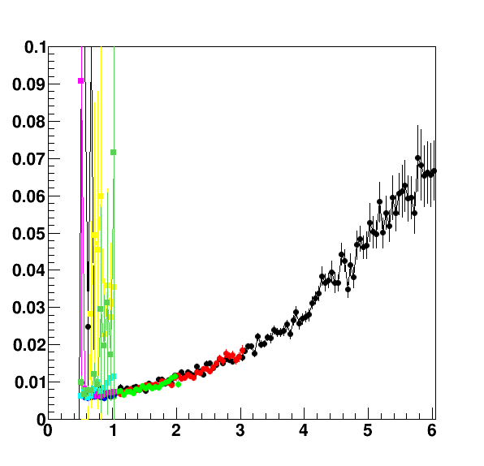
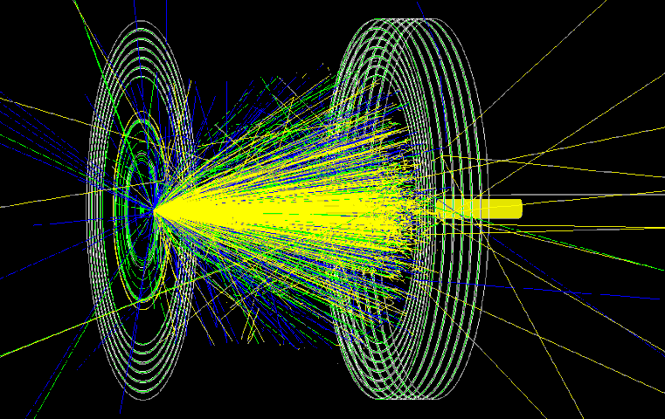
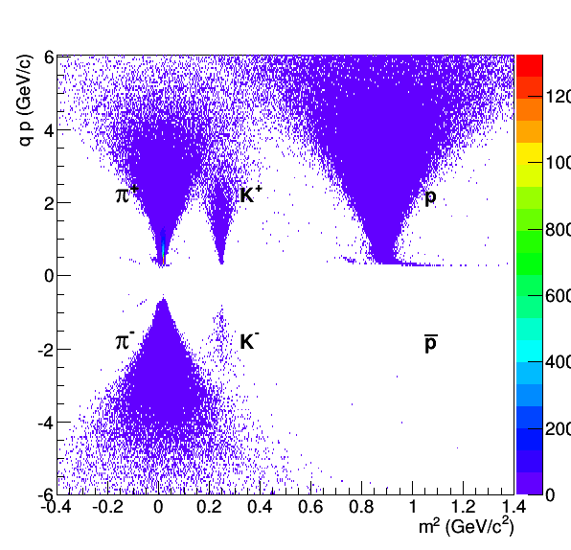
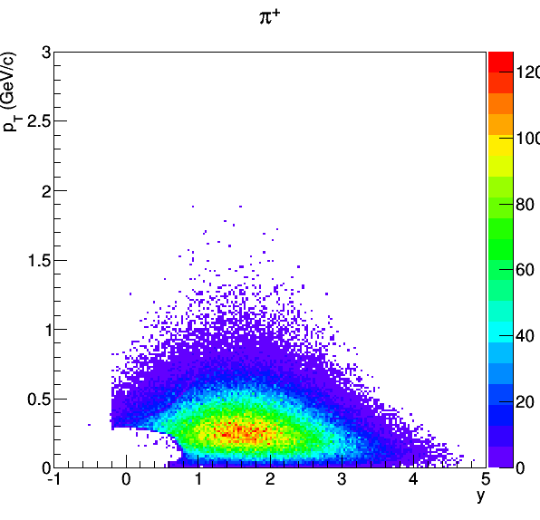
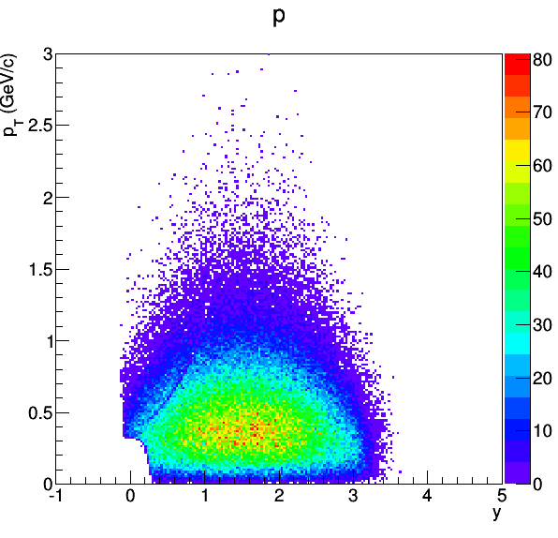
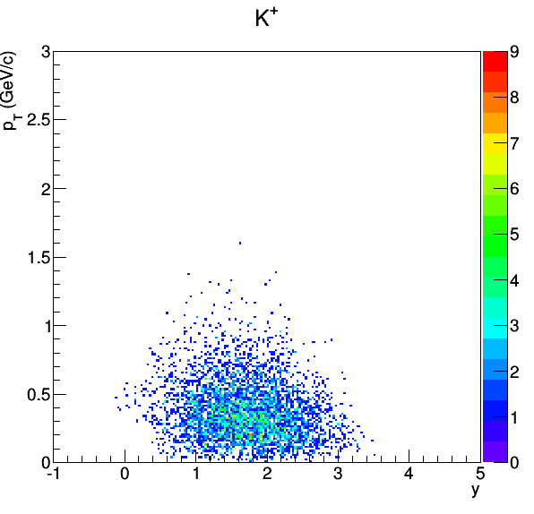
Spectrometer performance
U+U at 10AGeV/c with JAM + GEANT4
Assumption for simplicity
  Half-spherical toroidal shape
  Uniform B_{φ} field
  No dead area due to coils
Δp/p
  π/K separation 2.5GeV/c (2.5σ)
    Assuming TOF resolution of 50 ps
H. Sako, B.C. Kim
p(GeV/c)
Forward trackers
p/Z (GeV/c)
π⁺
p
Acceptance = 77.5%
Acceptance = 95.0%
Acceptance = 64.2%
y
y
m² (GeV/c²)

Slide 13
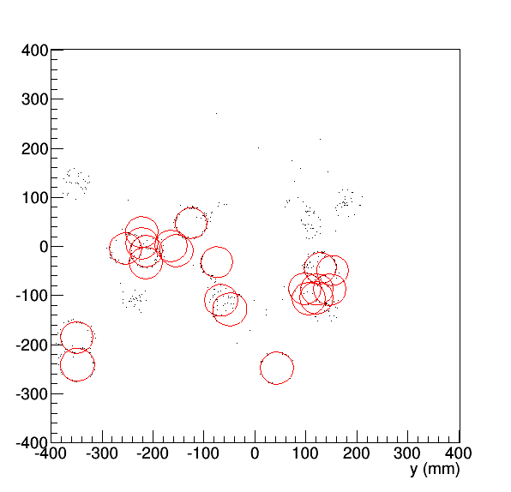
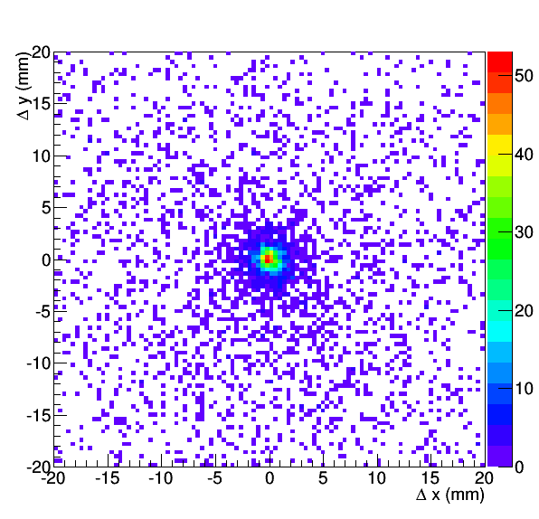
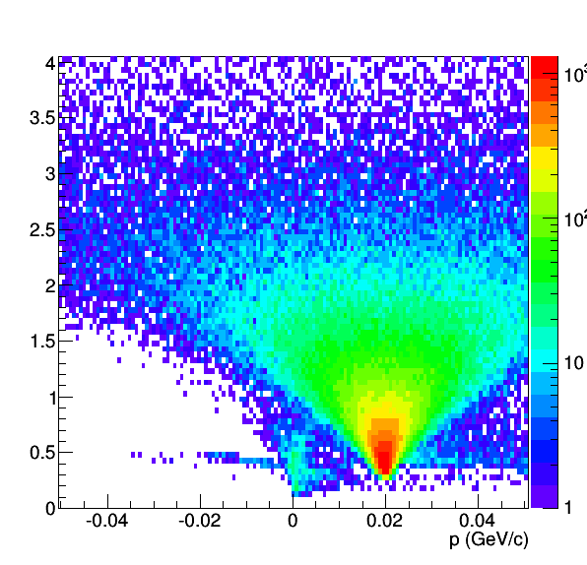
Electron reconstruction
Cherenkov ring reconstruction
Matching with electron candidate tracks
(U+U at 10 AGeV, JAM)
Cherenkov Ring fit
Ring-track matching
y(mm)
x(mm)

Slide 14
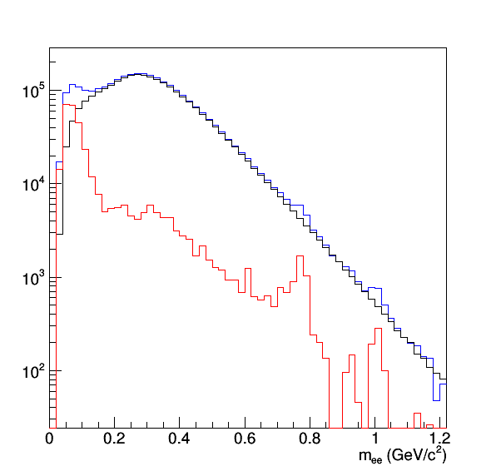
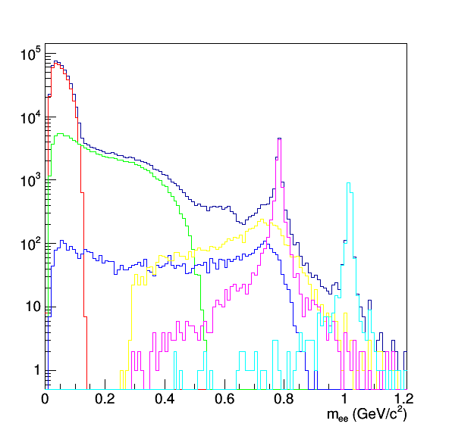
Dielectron spectrum
e⁺e⁻ cocktail corresponding to 8.6 M events
No background (external conversion etc.)
M_{ee} spectrum : like-sign pairs – like-sign mixed pairs
θ_{ee}>5º
2º<θ<80º
p_{T}>0.1 GeV/c
Reconstructed
Cocktail
Very Preliminary
π⁰→eeγ
η’→eeγ
η→eeγ
ρ→ee
Like-sign pairs
ω→ee
Like-sign mixed
φ→ee
Signal

Slide 15
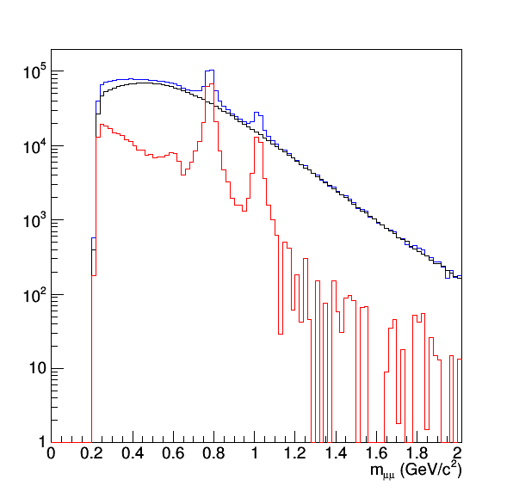
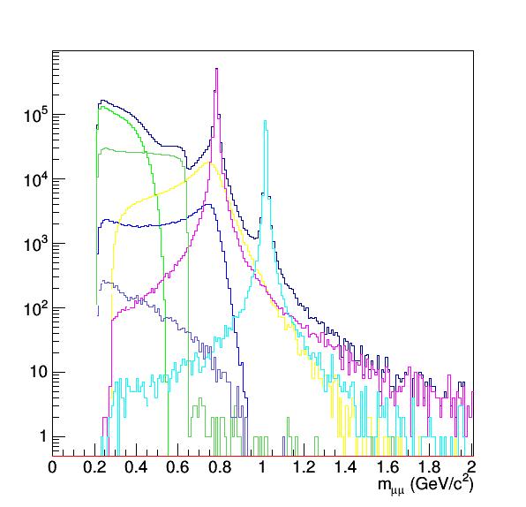
Dimuon spectrum
μ⁺μ⁻ cocktail corresponding to 500 M events
No π,K weak decay background
Full reconstructed tracks passing through 6λ_{int} absorbers
  μ efficiency=70%, p>1.5GeV/c, π suppression 2x10⁻³
M_{μμ} spectrum : like-sign pairs – like-sign mixed pairs
θ_{ee}>2º
2º<θ<80º
p_{T}>0.1GeV/c
Reconstructed
Cocktail
Like-sign pairs
η→eeγ
Like-sign mixed
η’→eeγ
ρ→ee
Signal
ω→ee
φ→ee
Very Preliminary

Slide 16
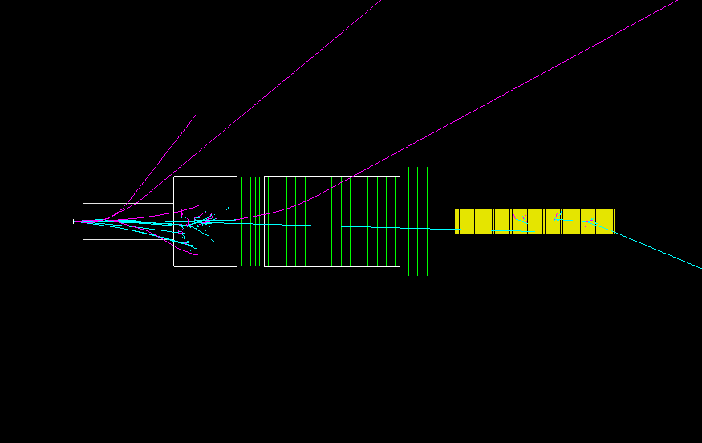
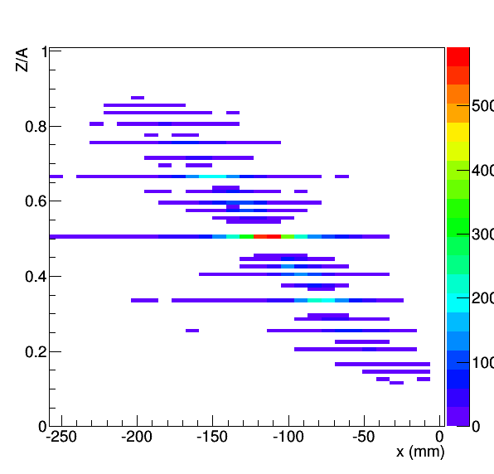
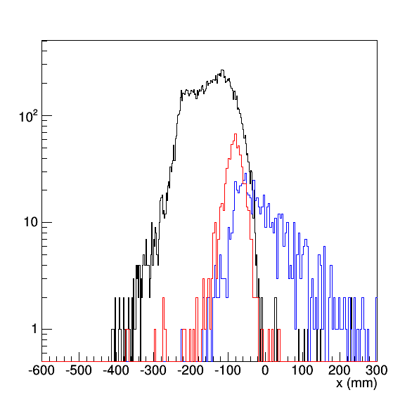
Hypernuclear spectrometer (preliminary)
Fragment separation at TPC
Hypernuclei in ion collisions
  S=-3, -4,.. Hypernuclei
  Proton-rich and neutron-rich hypernuclei
  Strangelet search (near neutral particle)
Hypernuclear measurement at y_{beam}
  Life time
  Magnetic moment
C+C at 15 AGeV/c
JAM-1.622 (RQMD/S mode)
+ GEANT4
Y. Nara, et al, Phys. Rev. C61,024901(1999)
M. Isse, et al, Phys.Rev. C72 (2005) 064908
Horizontal positions at TPC
All particles
JHIPER
Trigger counter for decay π-
Collimator (W)
1.5m
TOF
¹²C Target
1m
TPC
π-
beam
ZCAL
hypernucleus
1m
Beam
¹²C Beam
nucleus
    PRC54, R15 (1996)
    PRC76 011901(R) (2007)
Dipole magnet
0.5m
Beam hole
Charge
counter
  βγcτ(Λ) ~ 1.6m
Total BdL = 6Tm
→Precession angle ~ 68º (assuming μ_{Λ})
Precession magnet
³_{Λ}H→³He+π⁻ (q value = 37 MeV)
At 10⁷ Hz interaction rate
Track rate in TPC : 9.3x10⁶ tracks /s
Trigger rate : 4.0x10³ Hz
Experiment with full beam rate may be feasible!
Total BdL = 6Tm
→Precession angle ~ 68º (assuming μ_{Λ})
Ideas based on design for Japan Hadron Facility
and HypHI LOI
M. Asakawa et al, KEK Report 2000-11
T. R. Saito et al, HypHI Letter of Intent, 2005

Slide 17
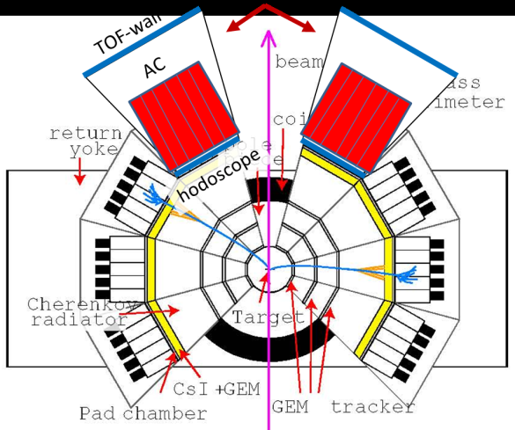
Summary
Design of heavy-ion program at J-PARC is in progress
  Acceleration schemes by adding a new injector to RCS and MR
  Dilepton simulation in a large acceptance toroidal spectrometer
  A hypernuclear spectrometer has been designed to utilize full intensity beams
Prospects
Detailed design of accelerators and experiments
  Detailed accelerator design and simulation
  Full simulation for other physics
    e.g. Photons, correlations and fluctuations
  Detector hardware design
R&D
  Fast TOF (Tsukuba, JAEA, KEK) in J-PARC E16 (p+A)
  DAQ (JAEA,Nagasaki IAS)
→A conceptual design report (white paper) in this fiscal year

Slide 18
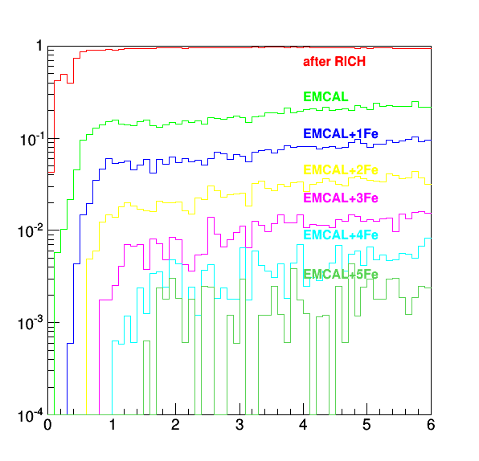
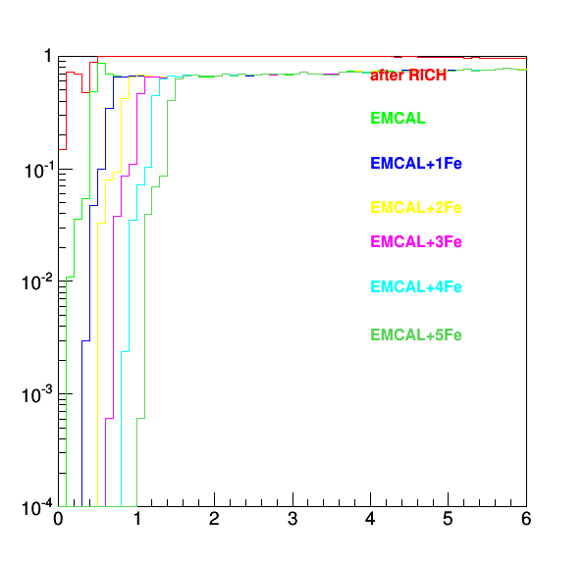
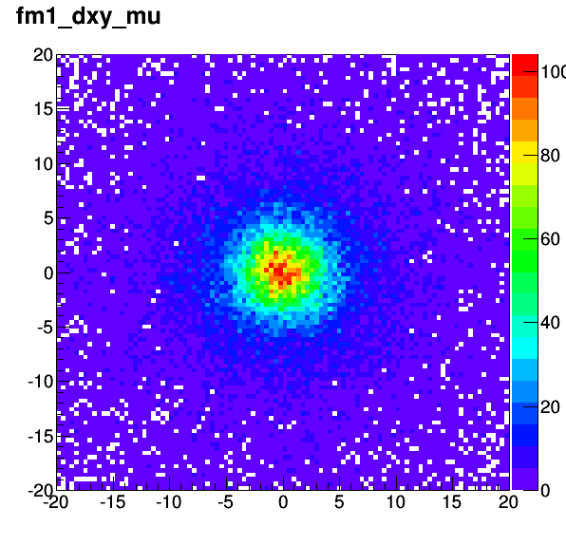
Muon ID performance
π⁺ survival probability
μ⁺ efficiency
~70%
Track matching before
and after the first absorber
Δy(mm)
6λ_{int} absorber
~2x10⁻³
p(GeV/c)
low p cut-off
~1.5GeV/c
p(GeV/c)
Δx(mm)

Slide 19
JAM RQMD/S mode (v1.622)
Inelastic hadron-hadron collisions are modeled by the resonance and string
productions and their decays (similar to the RQMD and UrQMD models).
Nuclear mean field is simulated based on the framework of the simplified
version of relativistic Quantum Molecular Dynamics.

Slide 20
γ external conversion
Material budget from the target to photon
L/X₀ ~ 4.32%
Nπ₀ = 240
e+ and e- from gamma conversion
~Nπ₀ * L/X₀ * 2 = 21 / event
detector | R(cm) | thickness | Material | L/X₀
Target(0.1%) | 0 | 0.051mm | Au(1/2) (0.508mm) | 1.52%
SVD | 7.5 | 0.3mm | Si(0.2mm)+polyimide | 1.24%
GEM Photon detector | 180 | 0.025mm 0.100mm 0.027mm | Kapton(286mm) Mylar(285mm) Cu(14.35μm) G-10 (1.5mm) | 1.52%
 |  |  |  | 4.32%

Slide 21
Muon weak decay
Muon multiplicity (U+U, JAM)
Nμ₊(p>1.5GeV/c)=2.07
Nμ₋(p>1.5GeV/c)=2.41
N(μ₊+μ₋) = 4.48
Weak decay rejection by track matching
  ~ 80%
The expected muon weak decay contamination
  4.48*(1-0.8) = 0.89 / event

Slide 22
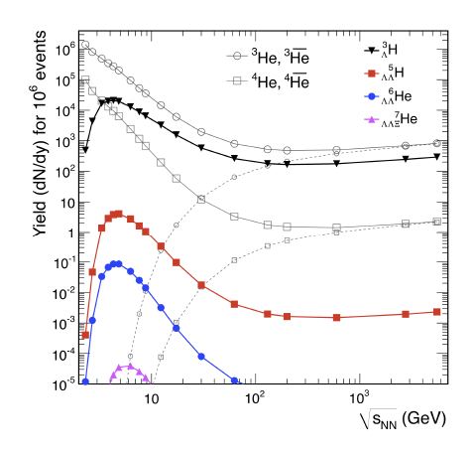
Hypernuclei
Maximum yield at J-PARC
Coalescence of high-density baryons
S=-3 Hypernuclei
Precise secondary vertex reconstruction (mid rapidity)
J-PARC
A. Andronic, PLB697 (2011) 203
KEK Report 2000-11
Expression of Interest for Nuclear/Hadron Physics Experiments at the 50-GeV Proton Synchrotron

Slide 23
Dileptons at J-PARC energy
  Penetrating probes of dense matter
Low Mass Range
  in-medium modification of vector mesons (link to chiral symmetry restoration)
  Thermal radiation
Intermediate Mass Range
  DD is suppressed
  Sensitive to QGP thermal radiation?
Axel Drees
T. Sakaguchi, JHI2014

Slide 24
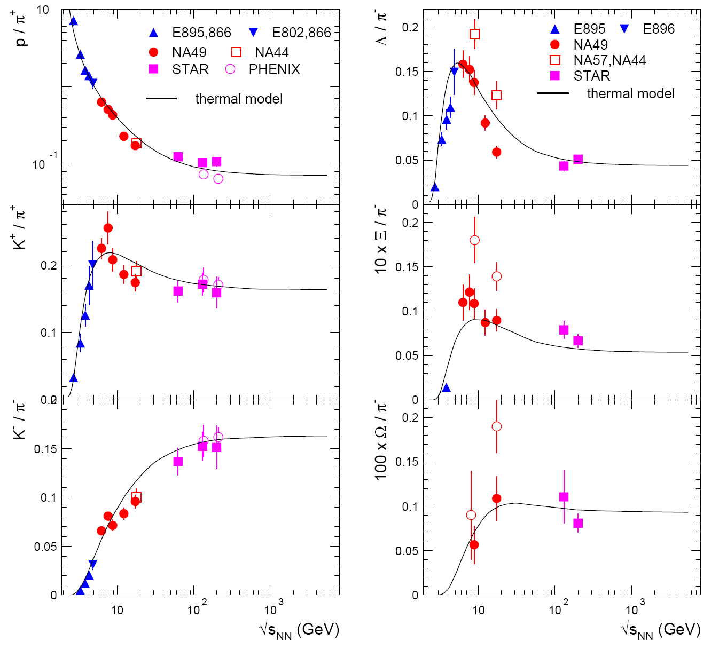
Strange meson/baryons
Systematic energy scan below the “horn” at ~8 GeV
There is almost no Ξ, Ω measurements
J-PARC
A. Andronic et al, Nucl. Phys. A 837 (2010) 65

Slide 25
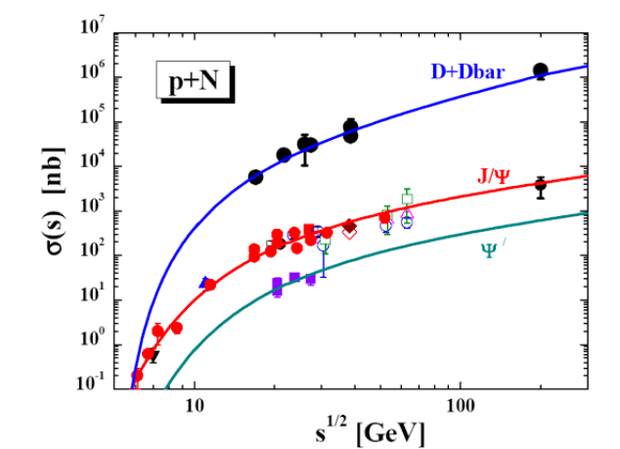
Charmed particles
c-c produced in the early stage of collisions
  D,J/ψ may be modified
  Probe of high density state
  J-PARC energies close to the production thresholds
  D (5.07 AGeV),J/ψ (4.77 AGeV)
  May be possible with increased beam energy 12 →19 AGeV/c
  √s= 4.9→6.2GeV (U)
  Enhancement due to multi-step processes in A+A?
CBM Physics Book,
W. Cassing, E. L. Bratkovskaya and
A. Sibirtsev, Nucl. Phys. A 691 (2001) 753

Slide 26
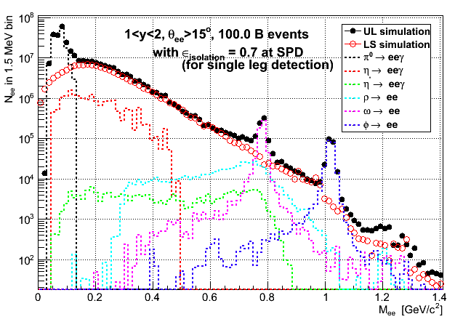
Simulated di-electron spectrum
(preliminary)
π⁰
Based on π⁰ spectra of JAM
Other hadrons m_{T}-scaled
b<1fm (0.25% centrality)
Momentum resolution 2%
Electron efficiency 50%
(No detector response)
10¹¹ events
⇔100 kHz
x 1 month running
ε_{isolation} = rejection efficiency of close opening angle Dalitz pair
ω
ρ
φ
Calculations by T. Gunji and T. Sakaguchi
Solenoid+Dipole setup

Slide 27
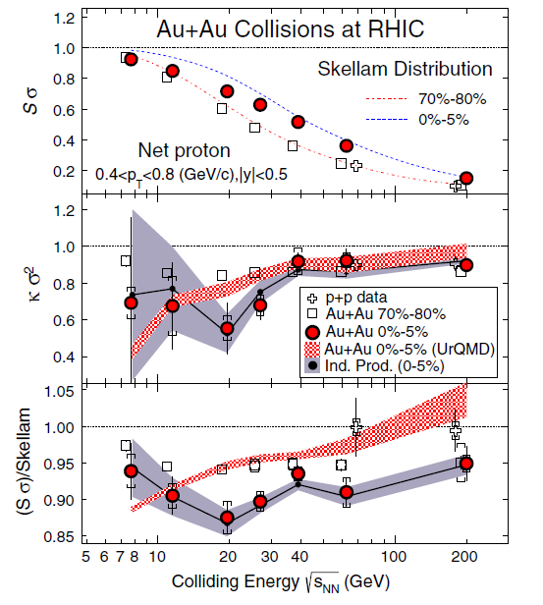


Event-by-event fluctuations
Search for the critical point
and phase boundary
w/ 3rd and 4th-order fluctuations
Direct comparison to lattice-QCD may be possible
Net-charge
Net-proton
Strangeness
High statistics in J-PARC
Wide y-p_{T} acceptance required
STAR PRL112 (2014) 032302
S$σ≅\frac{χ_{B}^{3}}{χ_{B}^{2}}$
${κσ}^{2}≅\frac{χ_{B}^{4}}{χ_{B}^{2}}$

Slide 28
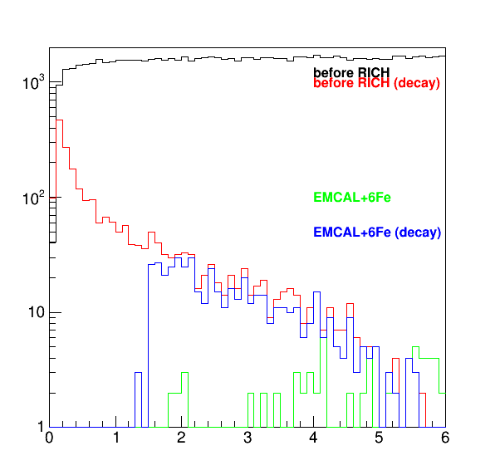
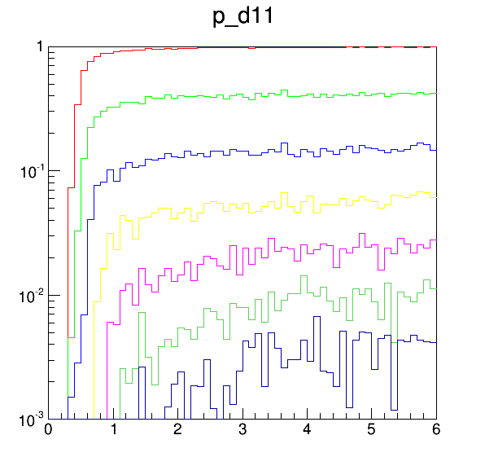
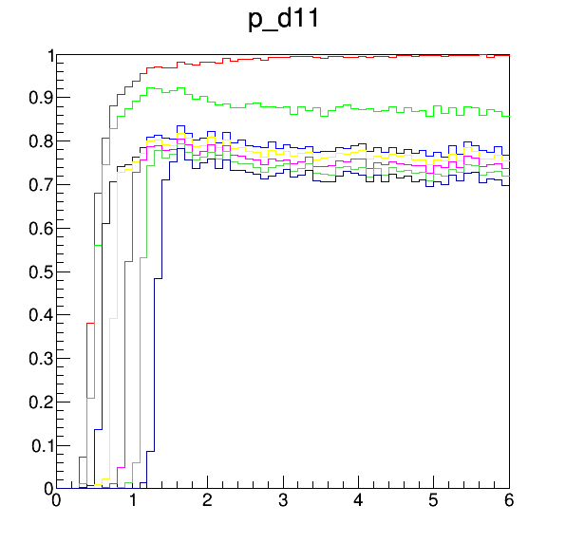
Pion rejection power by Muon tracker
PbWO₄ 14cm (~1λ_{int} )+Fe absorber 15cm (~1λ_{int})x6
Pion suppression = 2-4 x 10⁻³
Muon efficiency = 70%, cut off p>1.4 GeV/c
Survived π / (μ decayed from π) = 0.16
Decayed μ/ π (1.4GeV/c) = 3x10-2
Nπ ~ 240 (U+U 10AGeV/c)
μ+- from π decay = 240*2*3x10⁻² = 14.4
  Decay identification inefficiency = 15%→ 14.4*0.15 = 2.2 (survived)
π decay rejection by track matching ~85%
K decay rejection by track matching ~95%

Slide 29
Electron study
No aerogel, only gas radiator (C₅F₁₂, n=1.002 )
RICH ring reconstruction
  Hough transformation
  Ring fit
  Matching with reconstructed tracks
  Additional cut in TOF

Slide 30
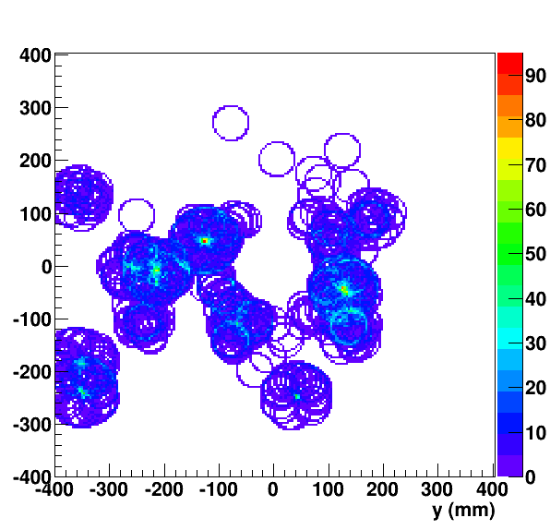
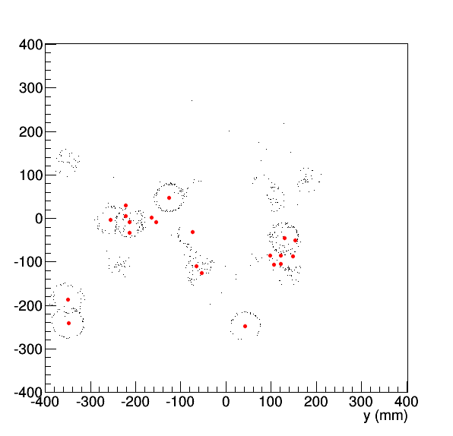
Ring reconstruction
Hough amplitude dist
Assumed 2x2mm² pad size of photon detector
Transform to spherical photon detector surface coordinate
Hough transformation : r = 32.4mm (β=1 ring)
1 JAM U+U event
Ring fit
Hough clusters

Slide 31
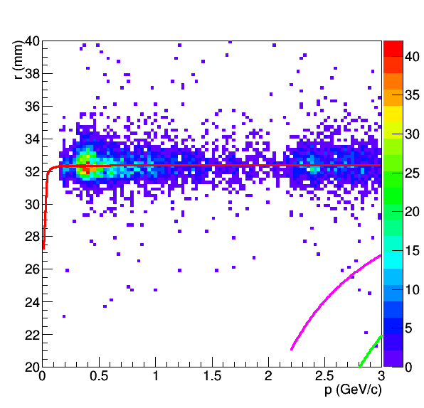
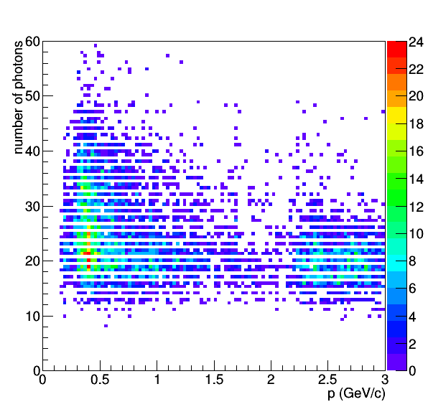
RICH-track association
Ring-track matching at photon detector plane
R = 32 mm
No. of photons / ring ~ 22
Ring radius vs momentum
Number of photons / ring vs momentum
e
π
μ
π

Slide 32
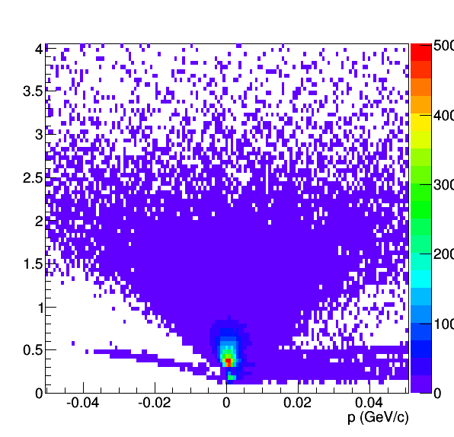
Electron ID with p vs m2
Electron-like track cut
P<3GeV/c, m²<0.017GeV/c2
JAM + GEANT
Electron cocktail + GEANT

Slide 33
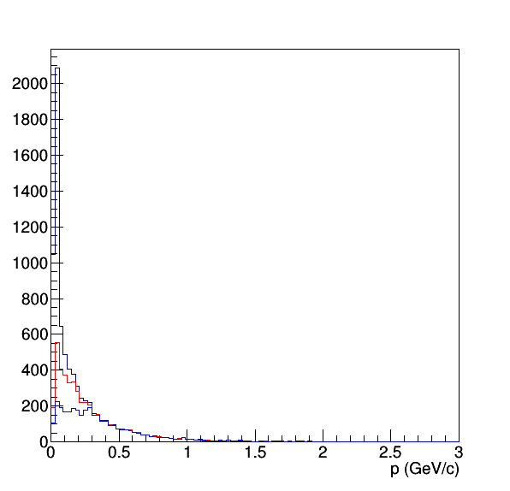
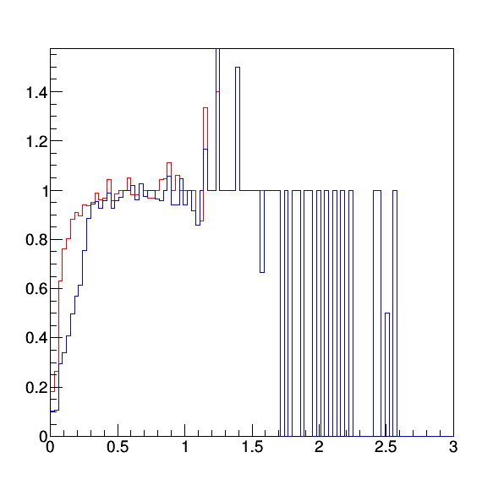
Electron reconstruction eff
B=2T
Eff ~ 100% (p>=0.5 GeV/c)
  50% at p=0.2 GeV/c
reconstructed rings/generated tracks
reconstructed ring+tracks/generated tracks
generated e tracks
reconstructed rings
reconstructed ring+tracks

Slide 34
Acceptance
Acceptance = 77.5%
Acceptance = 64.2%
Acceptance = 95.0%
TOF hits required

Slide 35

Hypernuclei spectrometer for JHF
(Closed geometry setup)
Problem : too long dipole magnet before the collimator compared to the hypernuclear life time
A poor tracking system
Setup proposed for J-PARC
Asakawa et al (JHF)
Select near-neutral fragments
With 1st dipole magnet/collimator
Measure spin precession of polarized hypernuclei in dipole magnet by weak decay of hypernuclei
25AGeV, C or Li beams (10¹⁰-10¹² Hz)

Slide 36

JHF : Separation of hypernuclear beams
Separation of beams depending on Z/A
Hypernucleus / fragments = 10⁻⁵-10⁻⁶

Slide 37


GEANT4 simulation
U+U at 10AGeV/c with JAM
For simplicity
  Half-spherical toroidal shape
  Uniform B_{φ} field
  No dead area due to coils
H. Sako, B.C. Kim

Slide 38


GEANT4 (C+C @ 15AGeV/c)
Proper physics list necessary for ion-ion collisions

Slide 39





JAM-1.622 (Y. Nara)
JAM-RQMD mode with clustering
  Some physics description necessary from Nara-san
15 AGeV C+C, minimum bias, 1000 events
fragment
Λ hypernuclei
Multiplicity
Nch = 33.77
Nfrag=1.968
NhypΛ=0.010
NhypΣ=0.007
NΛ = 0.343
hypΛ/Λ = 0.029
³_{Λ}H/Λ = 6x10-3
Σ0 hypernuclei
Σ- hypernuclei
Σ+ hypernuclei

Slide 40






y-p_{T} distributions
Looks reasonable
Mesons peak at y_{mid}, nucleons/fragments peak at y_{beam} and y_{target}
π+
p
d
t
3He
4He

Slide 41
Strategy to measure Hypernuclear weak decays
Stop produced particles except fragments and beams with a collimator after the first dipole magnet
Beams pass through the hole in the TPC but a part of fragments either Z/A<0.5 or Z/A>0.5 pass the sensitive area of TPC
Weak decays of hypernucleus to pi- and a nucleus will be measured by the TPC
The secondary vertex can be reconstructed if the mother hypernucleus passes the TPC
Alternative approach is to remove beams after the target, to extract fragments with an angle with respect to the beam. In this case, we don’t need to make a hole in the TPC but measure all the fragments. An produced angle is necessary to polarize the produced hypernucleus for magnetic moment measurements

Slide 42


Polar angle selection
Polar angle cut of θ<10mrad with a collimator rejects most of charged particles except protons
p
Charged particles
fragments
θ(rad)
θ(rad)

Slide 43


Bending power of magnets
X-deflection vs Z/A
After 1st dipole (before collimator)
After 2st dipole (end of TPC)

Slide 44


Horizontal track positions
At collimator
At end of TPC
Collimator hole
TPC hole
All charged
Charged + fragment
In TPC
fragments
fragments
Pass fragments in the collimator
But stop other particles
Make a hole in the TPC to be insensitive
to the beam, but measure fragments with
Z/A<0.5 or Z/A>0.5

Slide 45



Λ magnetic moment
Polarization measurement
(from p asymmetry w.r.t the reaction plane)
Precession angle vs BdL
■:B=0
●:B in y+ direction
〇:B in y- direction

Slide 46
Hypernuclear physics with HI
Goals
Discovery of new hypernuclei and extension of hypernuclear chart
  S=-1,-2,-3 hypernuclei
  Proton-rich and Neutron-rich hypernuclei
  Can be done in mid-rapidity or beam/target rapidity
  Identification with weak decay to a (light) nucleus + π-
Study of weak decays at beam rapidity
  With meson beams, due to short decay length these measurements are difficult
  life time measurement
  Mesonic decay e.g. ⁴_{Λ}H→ π⁻+⁴He (⁴He ground state)
    standard way to identify a hypernucleus
  Non-mesonic weak decay
    Λp → pn (p,n : high momentum) the rest nucleus is exited state, and will break.
    Measurements of residues
  magnetic moment
    never measured!
    sensitive to hyperon wave function inside hypernucleus
    Spin and angular momentum structure
    Spin-dependent YN interaction
Special closed-geometry setup is required
We could utilize full 10¹⁰ Hz beam?
Simulation study necessary

Slide 47
Introduction
Hypernuclear production in heavy-ion collisions
HI collision : Spectator-participant picture
K+
beam nucleus
beam fragments
spectators
Λ
Λ absorption in
fragments
π+
Λ
participants
Λ
p
n
target nucleus
target fragments
coalescence
rapidity

Slide 48




Vertex resolution
Barrel xca
Forward xca
Xca,zca
Closed approach
Of the track
To the target
Position
Good resolution
With 4 layer
40umx40um
and
80umx80um
pixels
σ=51um
σ=45um
Barrel zca
Forward zca
σ=54um
σ=62um

Slide 49

HypHI at GSI
⁶Li beam 3x 10⁶ /s
3.5-day experiment
¹²C graphite target
8.84g/cm²→interaction prob 10%
B=0.75T
TR0-TR2 : SciFi
BDC, SDC: drift chambers
π-
Positive
particle
fragments
Reconstructed decays
Vertex cut required!

Slide 50

HypHI Results
Comparison of the absolute yields (dN/dy)
  ⁶Li+¹²C minimum-bias cross section : σ_{total} =0.667b
  N(Λ) = 2.6x10⁻³
  N(³_{Λ}H)= σ(³_{Λ}H)/σ_{total} = 3.9x10⁻⁶/0.667= 5.8x10⁻⁶
  N(⁴_{Λ}H)= σ(⁴_{Λ}H)/σ_{total} = 3.1x10⁻⁶/0.667= 4.6x10⁻⁶
~3x10⁻⁶ in p+C
at E16?
p+C/Li+C~1/6
Energy cor=3

Slide 51



p+C at 50 GeV
Multiplicity
p+C cross section=0.62b
N=43x10⁻⁶/0.62=7x10⁻⁵

Slide 52


Slide 53

Candidate TOF position?
Flight path ~1.25m?
15<θ<45
S0
S1
S0:-15<θ<15
S1: 15<θ<45
S2: 45<θ<75
S3: 75<θ<105
S4: 105<θ<135
MRPC : 0.67mx0.67m at 1.25m distance
Δθ = Δφ = 30
Fit in 1 section
S2
S3
S4

Slide 54


Slide 55

AGS-E886 strangelet search using D6-line

Slide 56



10^{-6~-7} sensitivity (near target rapidity)
PID of fragments is easy if Z can be measured
TOF

Slide 57

X. Luo, CPOD2014

Slide 58
Exotic particles in HI collisions
Dibaryon
  H→ΛΛ→π-pπ-p
  d*(2380)→dπ+π-
Kaonic nucleus
  K-pp→Λp→π-pp
Resonances
  K*(892)→πK
  Δ(1232)→pπ
  Σ(1385)→Λp
  Λ(1520)→pK-
  Ξ(1530)→Ξπ
  Ω◊ΛΚ−
  Ξ−◊Λπ−
Penta quarks
  Θ+(uudd sbar)→pKs
  Θ+++(uuuu sbar)→pπ+π+
  Θ0(uddd sbar)→pK-
  Ns(uudd ubar)→ΛK
  Σ5(udds ubar)→Λπ
  Σ5→(uuds dbar)pK0bar
  π-p→φn (udd ssbar)

Slide 59

Y. Nara, Heavy Ion Pub
2015/07/14

Slide 60


RICH
Design based on HADES-RICH
Target shifted to downstream of RICH center
  Slightly small theta acceptance (<80deg)
  But rings detected at photon detector at larger theta (avoid overlap with high density charged track at the photon detector
Radiator C₅F₁₂ radiator (n=1.002)
  π rejection p<3.4 GeV/c
1m
RICH
0.5m
R=1m
0.25m
1.8m
Photon
detector

Slide 61
Preliminary setup
TOF (5m from target)
Top View
TOF
RICH
Dipole
(BL=1.5Tm)
RICH
Muon
tracker
Solenoid (BL=1Tm)
30º
Silicon pixel/strip
trackers
2m
target
GEM trackers
1.5m
0.3m
2m
1m
hadron-ID (θ<110º)
e-ID : θ<30º
μ-ID : θ<30º
20º = y_{mid} at 10AGeV/c
1m
GEM Trackers
EMCAL

Slide 62


QCD和則とスペクトル関数
comment by 初田さん
International Conference on Soft Dilepton Production
LBNL, 1997
http://macdls.lbl.gov/DLS_WWW_Files/DLSWorkshop/proceedings.html
スペクトル自身よりも、積分値の方がより直接的に実験とQCD凝縮を比較できる
See also, Hatsuda, Hayano, RMP82, 2949
※実験的に積分値を出すのは誤差との戦いか？

Slide 63





Toroid (12 coil configuration)
Increasing number of coils improves phi uniformity
12 coil configuration is good
CLAS12
z=250mm, R at coil center
z=750mm
z=1300mm
B(T)
rφ(mm)

Slide 64
Muon ID performance(preliminary)
EMCAL (~1λ_{int} )+Fe absorber (~1λ_{int})x6
+GEM trackers （7 layers）
・Goal π suppression：1/10 of π→μ decay probability (5m,2GeV/c):4.4x10⁻³
Π, μ rejection performance by simulation
Π suppression = 2-4 x 10⁻³
μ detection eff ~70%
punch through π / μ (π decay) = 0.16
Decay rejection by track matching
  P (80%), K (95%)
π+
survival probability
μ+
Survival probability
π⁺ and decayed μ+
before/after muon absorbers
π⁺
μ⁺
p (GeV/c)
p (GeV/c)
p (GeV/c)

Slide 65

Kaonic nuclei production in HIC
Andronic, PBM, et al, NPA 765 (2006) 211–225
J-PARC
J-PARC
Evidence of K⁻pp state at J-PARC (E27) (π⁺+d → K⁺+K⁻pp), but no other states yet
Statistical thermal model calculation
Maximum yields at J-PARC energy range

Slide 66

Exotic hadrons in HIC
ExHIC collab (A. Ohnishi, et al)
Yields depend on the system size assuming a coalescence model (RHIC or LHC)
J-PARC?
Λ(1405) is KbarN or 5-quark state?

Slide 67

Support beam/piping

Slide 68
Hypernuclear physics with HI
Goals
Discovery of new hypernuclei and extension of hypernuclear chart
  S=-1,-2,-3 hypernuclei
  Proton-rich and Neutron-rich hypernuclei
  Can be done in mid-rapidity or beam/target rapidity
  Identification with weak decay to a (light) nucleus + π-
Study of weak decays at beam rapidity
  With meson beams, due to short decay length these measurements are difficult
  life time measurement
  Mesonic decay e.g. ⁴_{Λ}H→ π⁻+⁴He (⁴He ground state)
    standard way to identify a hypernucleus
  Non-mesonic weak decay
    Λp → pn (p,n : high momentum) the rest nucleus is exited state, and will break.
    Measurements of residues
  magnetic moment
    never measured!
    sensitive to hyperon wave function inside hypernucleus
    Spin and angular momentum structure
    Spin-dependent YN interaction
Special closed-geometry setup is required
We could utilize full 10¹⁰ Hz beam?
Simulation study necessary

Slide 69


(T , μ_{B} ) and √s_{NN}
A. Andronic, et al, NPA837 (2010) 65-86
Focusing effect toward the critical point in the system evolution
We can measure (T,μ_{B}) as a function of √s with fine steps (almost continuously) and systemactically with the same spectrometer
Signature for the critical point = step structure?
?
?
Higher √s
M. Stephanov PRL81(1998)4816

Slide 70





EOS from flow
To measure EOS is one of the ultimate goals of nuclear experiments
Flow as a function of sqrt(s) may have important information of EOS
  Danielewicz et al., Science 298 (2002) 1592

Slide 71
Vertex resolution
Barrel xca
Forward xca
Xca,zca
Closed approach
Of the track
To the target
Position
Good resolution
With 4 layer
40umx40um
and
80umx80um
pixels
σ=51um
σ=45um
Barrel zca
Forward zca
σ=54um
σ=62um

Slide 72

μ/π separation with RICH
P<0.8GeV/c
TOF (MRPD)
3σ separation
σ_{t}=30ps , L=5m
0.8<p<1.5GeV/c
RICH(aerogel)
P>1.5 GeV/c
Fe absorbers
+trackers

Slide 73

J-PARC
(JAEA & KEK)
400 MeV H⁻ Linac
3 GeV Rapid Cycling Synchrotron (RCS)
1 MW
50 GeV Main Ring Synchrotron (MR) [30 GeV at present]
0.75 MW
JFY 2006 / 2007
JFY 2008
Hadron Experimental Hall (HD)
JFY 2009

Slide 74



U+U at 5 AGeV/c

Slide 75


U+U at 1 AGeV/c

Slide 76

J. Randrup et al., PRC 74, 047901 (2006)

Slide 77


Exceeding phase boundary at J-PARC
System evolution trajectories
(t=1fm/c step)
Mixed phase
Critical point
Au+Au→U+U
  Baryon density
    7.5ρ₀ → 8.6ρ₀
  Duration at ρ>5ρ₀
    4 → 7 fm/c
U beam is necessary
at J-PARC!
Au+Au(t=5fm/c)
t=6fm/c
QGP
t=1fm/c
hadron
ρ/ρ₀
Unstable
region
J. Randrup
PRC82 (2010) 034902
Talk by J. Randrup
Phase boundary ρ=5-10ρ₀
Density of neutron stars ρ=6-10ρ₀
JAM model
Y. Nara, et al, Phys. Rev. C61,024901(1999)

Slide 78






Rapidity and p_{T} distributions
10AGeV/c
5AGeV/c
1AGeV/c

Slide 79


Slide 80


Slide 81


Slide 82

KenIchi Imai, J-PARC HI meeting (2013/4/24)

Slide 83

Photon feasibility study
0.1 T events 1<y<2, b<1fm
Blue: pi0, Black: eta, Red: decay photons from pi0 and eta
Direct photon signal is assumed to be 2% of background photons
Statistical error only
No hadron contamination, photon efficiency is taken into account.

Slide 84
Summary of acceptance and pixel size
Acceptance
 | 1AGeV | 5AGeV | 10AGeV
θ<20deg | 23.2% | 47.5% | 57.5%
θ<30deg | 42.9% | 64.7% | 72.7%
θ<40deg | 59.9% | 76.0% | 81.9%
Required pixel size at 10% occupancy at 1m from the target
 | 1AGeV | 5AGeV | 10AGeV
θ<2deg | 17x17mm² | 5x5mm² | 3x3mm²
θ=10deg | 18x18mm² | 7.5x7.5mm² | 6x6mm²
θ=30deg | 25x25mm² | 21x21mm² | 20x20mm²

Slide 85

E19
Search for pentaquark Θ⁺(uudds)
π⁻ +p→ K⁻+Θ⁺

Slide 86


E27
Search for a K⁻pp bound state
No tagging 2p : inclusive measurement
Tagging 2p : exclusive measurement
K⁺
p
π⁺
p
K⁺
π⁺d→ K⁺X
X=K⁻pp→Λp
→Σ⁰p
→Yπp
p
p
π⁺

Slide 87
Missing mass spectrum of d(π⁺, K⁺)
There are a lot of B.G (quasi-free hyperon production).
→It is difficult to identify the K⁻pp from inclusive spectrum.
In the Λ and Σ region, observed spectrum is almost consistent with simulation.
“Puzzling ” Y* peak shift = -32.4 ± 0.8 MeV/c²
Y*N final state interaction might explain it?
Quasi-free B.G.
- Λ, Σ^{+/0},
- Y*: Λ(1405),
Σ(1385)^{+/0},
- Λπ, Σπ

